Slide 1

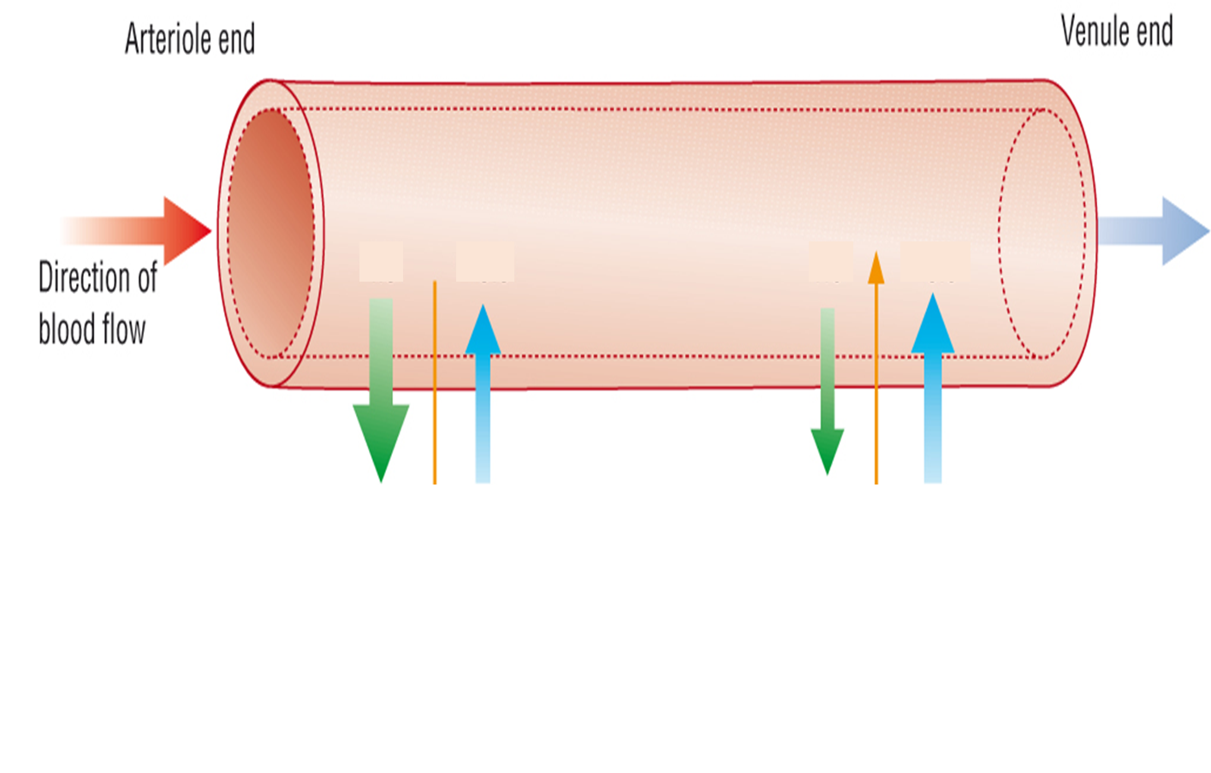
Annotate your diagram to explain how tissue fluid is formed. No notes!

Slide 3
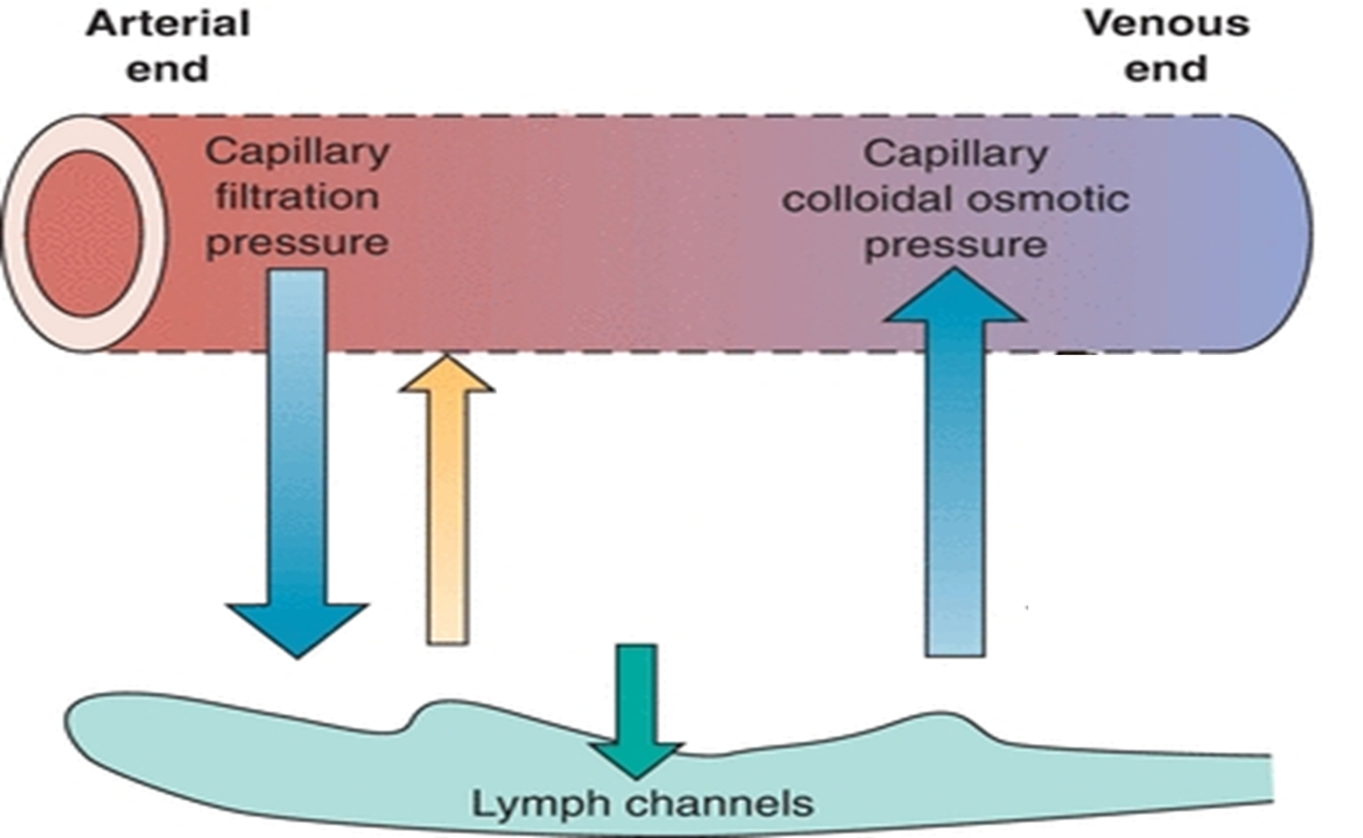
Here's how
4. As the blood moves through the capillaries towards the venous system, the hydrostatic pressure drops as fluid has moved out and the pulse surge is lost.
5. Large plasma proteins (like albumin) do not pass into the tissue fluid and remain in the capillaries. Creating a low water potential in the capillaries at the venule end
1. Blood arrives at the arteriole end under pressure from the surge of blood when the heart contracts
2. This hydrostatic pressure is higher than the oncotic pressure, so fluid is forces out of the capillaries to surround the cells
6. This creates a strong oncotic pressure (osmotic pressure), which is higher than the hydrostatic pressure, so water moves back into the capillaries via osmosis (with CO2, nitrogenous waste).
Hydrostatic pressure
Oncotic pressure
Oncotic pressure
3. This fluid is called tissue fluid. Diffusion of substances (Oxygen, glucose, fatty acids, salts) occurs from the blood to the cells via the tissue fluid.
7. By the time the blood returns to the veins 90% of the fluid is back in the blood containing waste products like CO₂.
The other 10% becomes lymph.

Slide 4
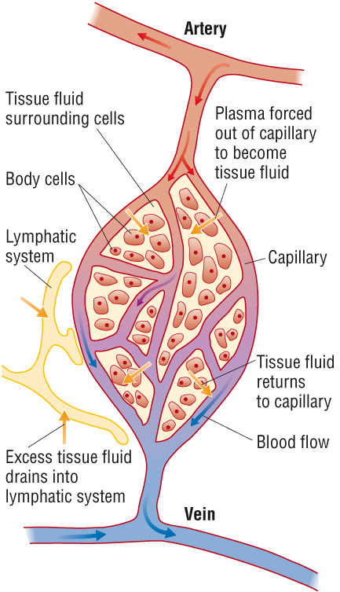
Return of tissue fluid to the circulatory system
1. Via capillaries due to hydrostatic pressure gradient and oncotic forces (90%)
2. Via lymphatic system (10%)

Slide 5


Slide 6
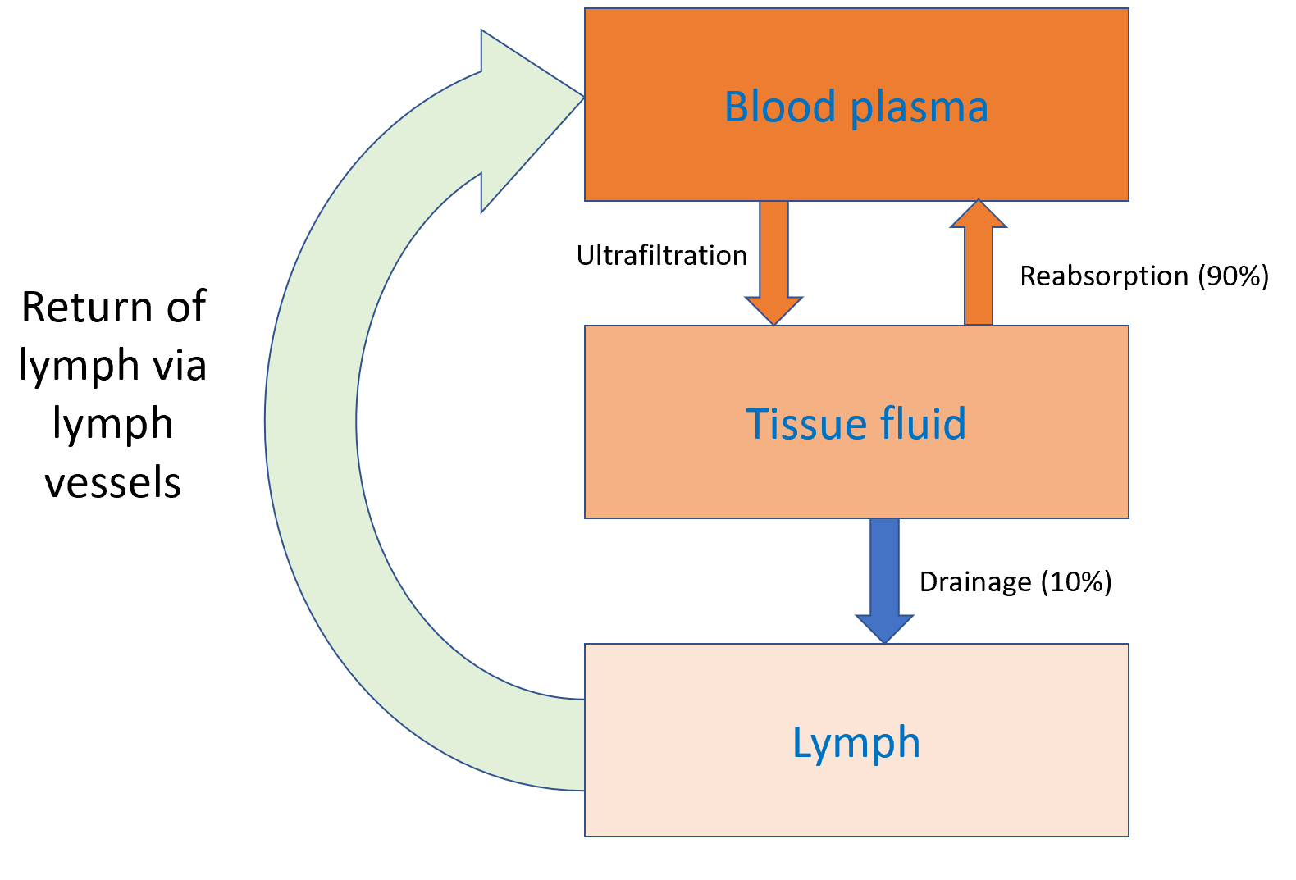

Lymph journey back into the circulatory system
Lymph contains less ………………….. , fewer …………….. and high CO₂ levels.
Lymph move through lymph ………………., which join to form larger lymph vessels
…………………. of body muscles moves the lymph through the vessels
The lymph vessels contain ……………. to prevent backwards flow
The lymph return to the blood through the subclavian vein located below the …………………
Lymph nodes
Located along the lymph ……………..
Lymphocytes (B/T) build up in the lymph nodes when required to produce ……………… or antitoxins, which are then passed into the ……….
Lymph nodes also intercept bacteria and other debris, which are digested by …………………. found in the nodes.
Enlarged lymph nodes are a sign the body is ……………. off an ……………….
oxygen
nutrients
capillaries
Contractions
valves
clavicle
vessels
antibodies
blood
phagocytes
fighting
infection
infection oxygen blood nutrients fighting capillaries phagocytes contraction antibodies valves vessels clavicle

Slide 7
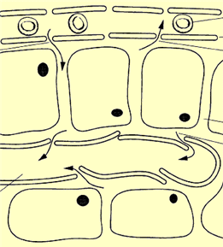

Match the descriptions in your table to a number on the diagram
1
High hydrostatic pressure forces plasma out of capillary through spaces
between endothelial cells
– this is now called tissue fluid
1
3
2
Exchange occurs between tissue fluid and cells:
- nutrients into cells
- waste products into tissue fluid
2
3
Tissue fluid is drawn back into the capillary by osmosis down a water potential gradient – because plasma proteins in the capillary cause a low water potential. The osmotic effect exerted by the proteins in the blood is referred to as oncotic pressure
4
6
5
4
Any remaining tissue fluid drains into lymph vessels and is returned to the circulation via the lymphatic system
5
Valves in the wall of the lymph vessel allow fluid to flow in but not out
6
Proteins from the tissue fluid and white blood cells enter lymph

Slide 8
Complete the following table comparing the composition of plasma, tissue fluid and lymph:
 | plasma | tissue fluid | lymph
pressure | high | low | low
red blood cells | many | none | none
white blood cells | many | some | some
glucose concentration | high | high | low
CO₂ concentration | low | low | high
protein concentration | high | low | low

Slide 9
Complete the following table comparing the composition of plasma, tissue fluid and lymph:
 | plasma | tissue fluid | lymph
pressure | high | low | low
red blood cells | many | none | none
white blood cells | many | very few | very few
glucose concentration | high | high | low
CO₂ concentration | low | High (venule end) | high
protein concentration | high | low | low

Slide 10
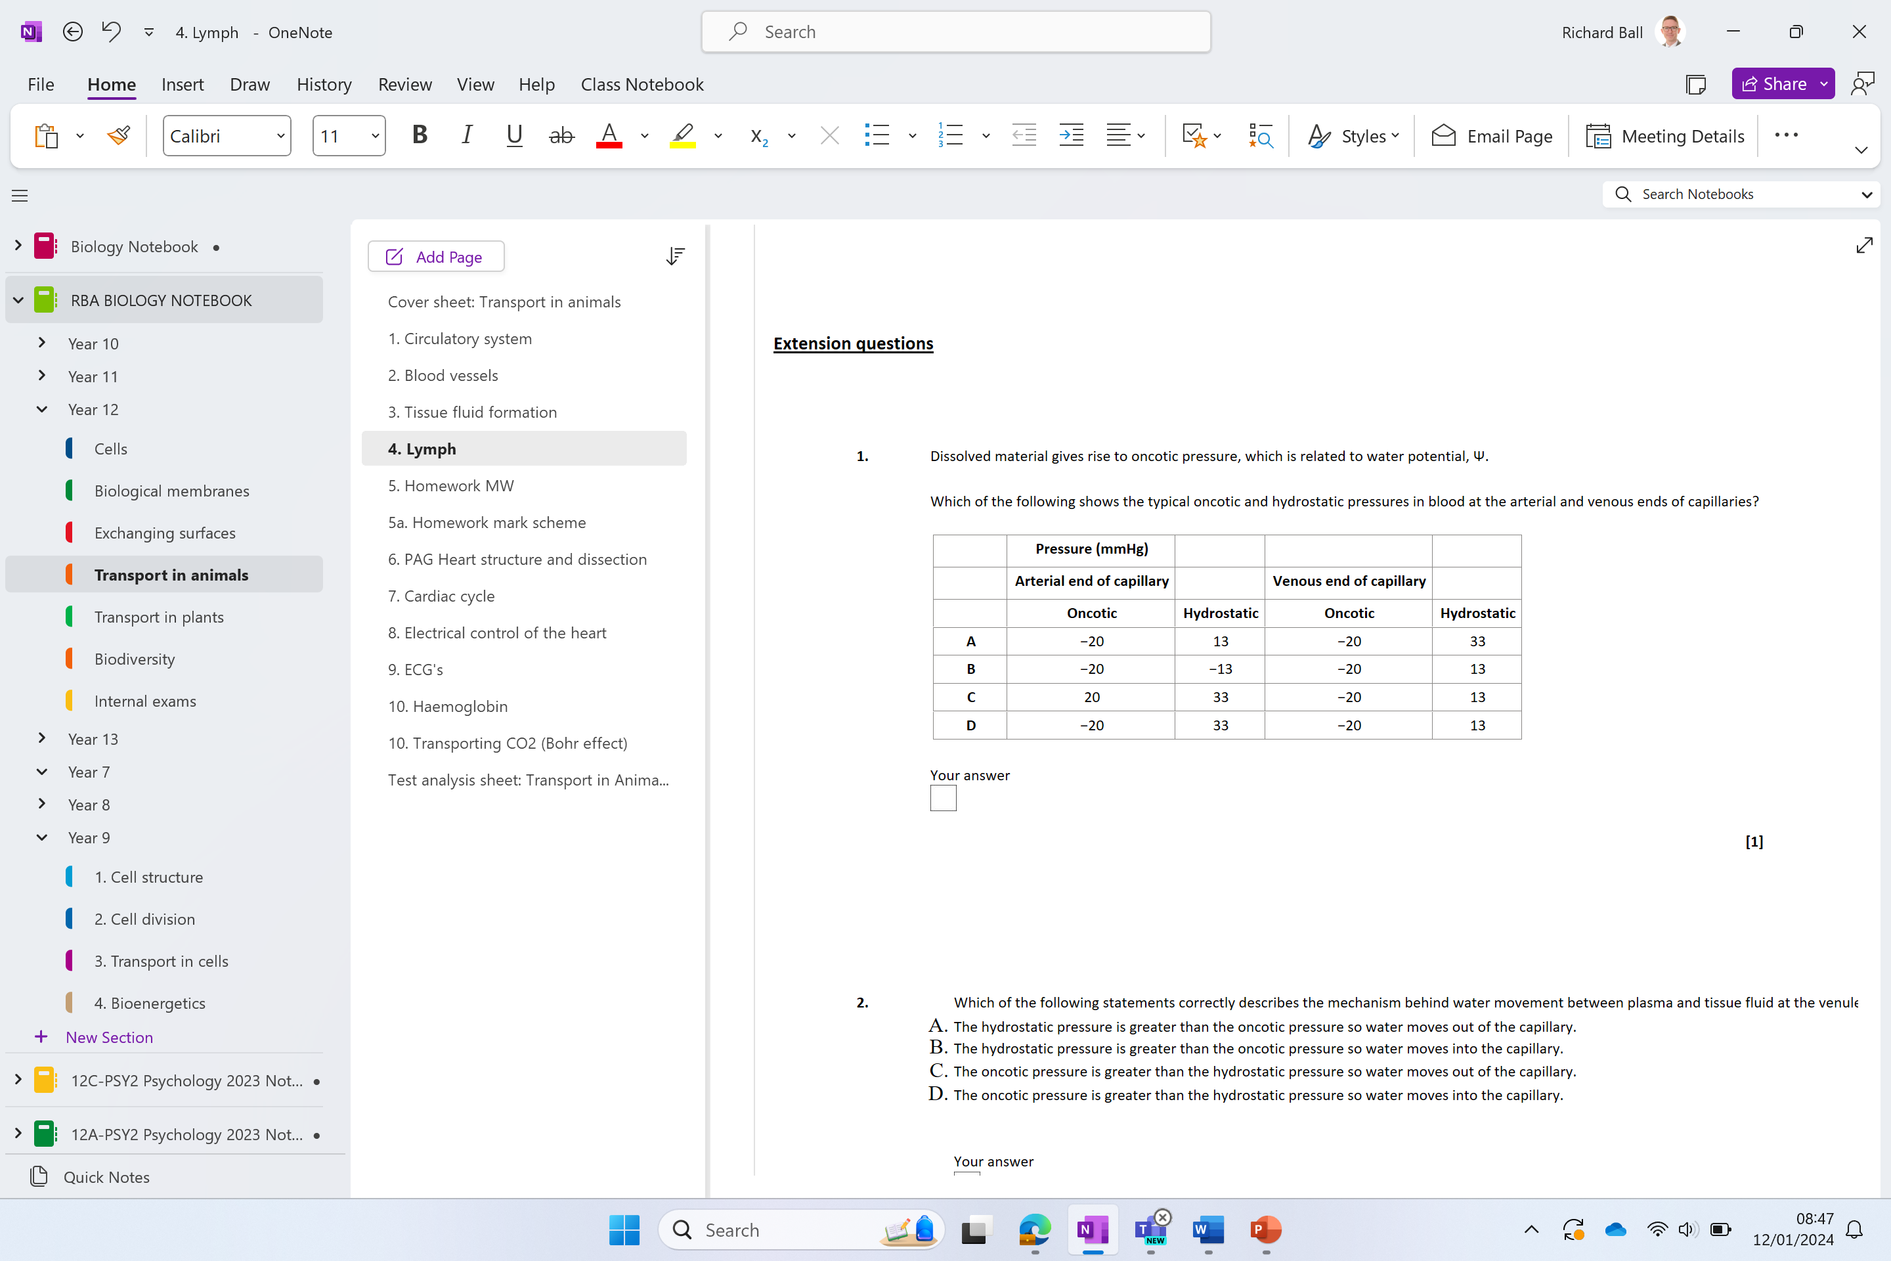

Slide 11
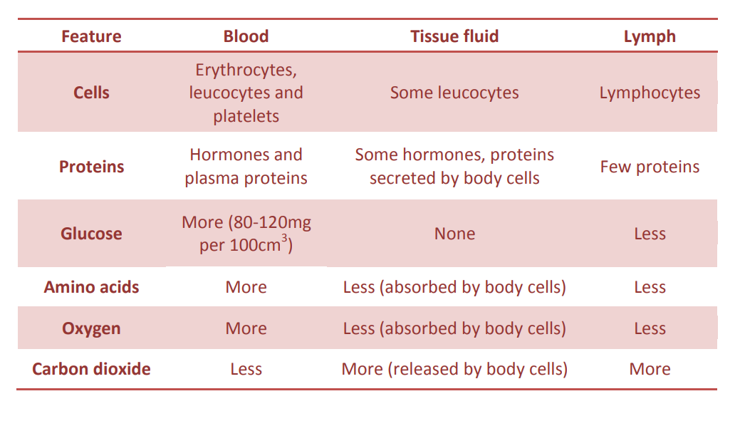
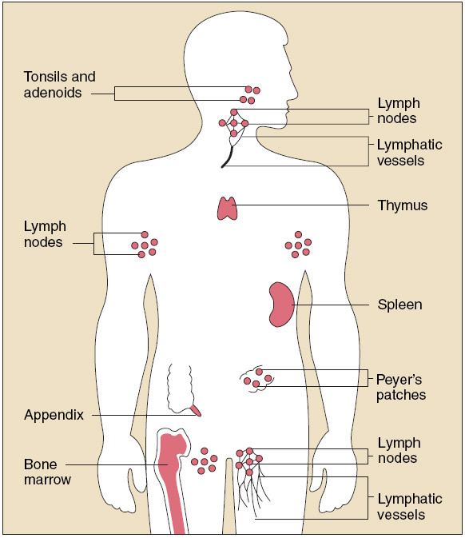

Slide 13
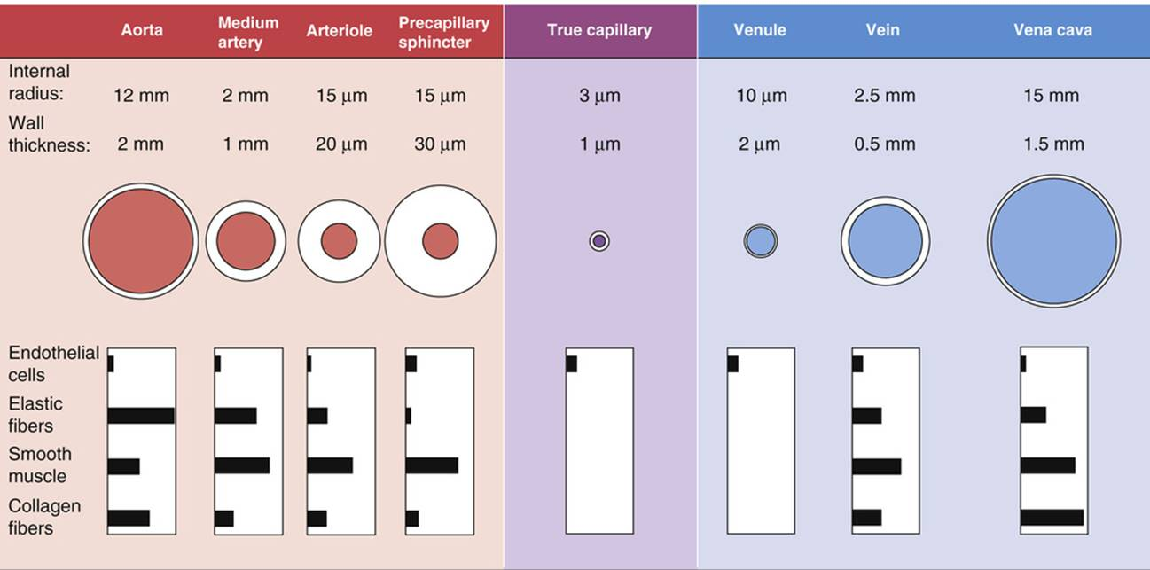

Slide 14
Long answer practice
Three 6 mark questions on:
•Tissue fluid
•Blood vessel structure
•The heart
BULLET POINT YOUR ANSWERS

Slide 15
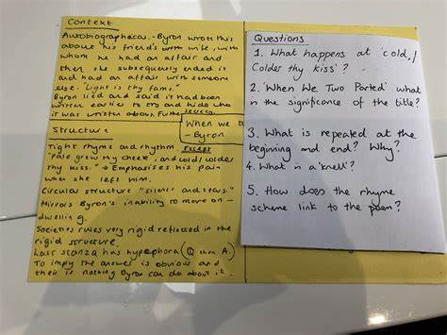

Slide 16
Quick check!
Describe how tissue fluid is formed and drained:
Blood enters the capillary from arterioles at high hydrostatic pressure, causing plasma to be forced out through the pores between the capillary endothelium cells.
The filtered tissue fluid contains small solutes such as glucose, amino acids and ions, but large plasma proteins and red blood cells remain in the capillary because they are too large to pass through the pores.
The plasma proteins create an oncotic pressure which is greater than the hydrostatic pressure causing a net movement of fluid into the capillary
The remaining tissue fluid enters lymph vessels through one-way valves and is removed from the tissue and returned to the blood

Slide 17
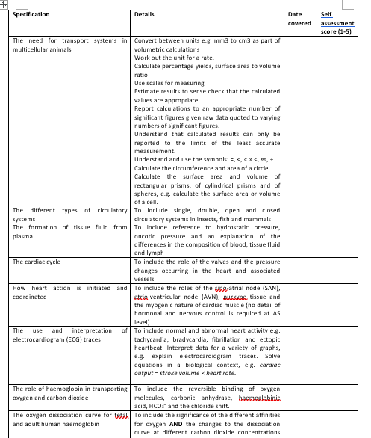
Learning Outcomes
Describe how tissue fluid is formed from plasma.

Slide 18
Quick quiz
Where would I find the tricuspid valve?
What bonds hold water molecules together?
Define mass flow
Name the 2 parts of the mammalian circulatory system
Which blood vessel delivers oxygenated blood to the body?
What tissue is found in the tunica externa?
Which vessel returns deoxygenated blood from the upper body to the heart?
Which blood vessels have valves?
Which blood vessels have the smallest lumen?
Why are there spaces between capillary endothelial cells?

