Slide 1

Topic 1: Development – How did you develop?
Edexcel GCSE 9-1 Psychology
Paper 1

Slide 2
Lesson 1
Full lesson covering content on Early Brain Development.
Covers tasks from AO1, AO2 and AO3

Slide 3
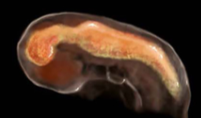


Hook – say what you see!!
Hook
TASK: Discuss what you think this image is. What brings you to this conclusion?
EXTEND: At what stage do you think the brain starts to develop in the fetus?
    A neural groove closes into a tube at around 3-4 weeks. The brain begins to develop at 5 weeks
Notes:
1.7.2013
Say what you see – what is it at what point do you thinkn the brain starts to develop in the fetus
1
‹#›

Slide 4





Topic 1: Developmental Psychology – How did you develop?
1.1.1 Early Brain Development
Do now Task–
Label the parts of the brain that you know
If you are not sure use the key words to help you
EXTEND:
Can you label any of the functions of the parts of the brain?
Knowledge: I am learning to understand how the brain develops during the early stages of life
I can explain how the brain develops in the womb
I can describe the functions of certain parts of the brain
I can apply knowledge of development to a scenario exam style question
Skills
Application to real life, critical thinking, analysis, evaluation, knowledge
Bigger Picture
At what age did you begin to develop your brain?
KEYWORDS: midbrain, forebrain, hindbrain, cerebellum, medulla oblongata, involuntary, neural connections, anterior, posterior

Slide 5
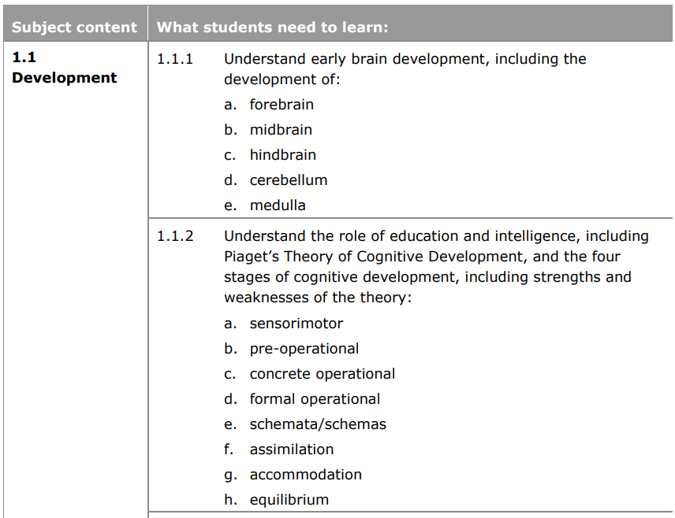
What are we learning?

Slide 6
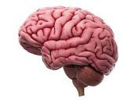




AO1 - The role of the brain
TASK: What is the role of the brain? Identify which of the following roles the brain is responsible for
regulates emotions
releases hormones
“The brain is part of the nervous system and processes information. It also controls the behaviour of an organism in response to their surroundings”
regulates emotions
releases hormones
memory
motor control
memory
motor control
sensory processing
facilitates exchange of oxygen and carbon dioxide
sensory processing
facilitates exchange of oxygen and carbon dioxide
produces gametes
produces gametes
maintaining homeostasis in the body
maintaining homeostasis in the body
Early Brain Development - Development, GCSE Psychology [AQA] - YouTube

Slide 7

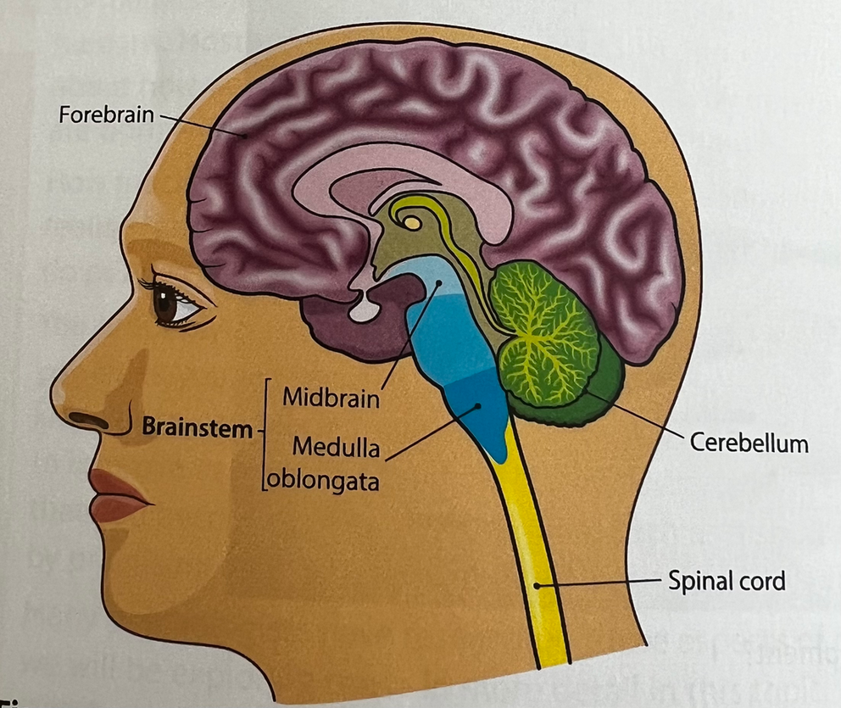

AO1 – Parts of the brain
TASK: Label the parts of the brain that you know
If you are not sure use the key words to help you
Forebrain
Midbrain
Brainstem
Hind brain
Spinal cord
Cerebellum
Medulla oblongata
EXTEND: Can you describe the function of the forebrain, midbrain and brainstem?

Slide 8
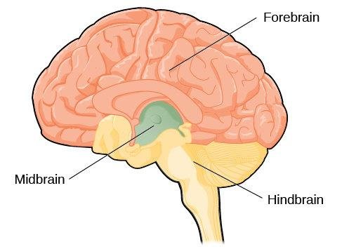

AO1 - The parts of the brain – self assess
The forebrain is located at the front of the brain and will develop responsibility for a range of processes, including higher order thinking and decision making
EXTEND: Can you describe the function of the forebrain, midbrain and brainstem?
The midbrain is more closely linked with sensory information, sleep and simple movement.
However, it does share some functions with the forebrain.
The brainstem is located at the very back of the brain and is directly connected to the spinal cord. Sometimes it is called the ‘reptilian’ part of the brain as it is the oldest part of the brain and controls most basic human functions, such as heart rate, coordination and facial expressions.

Slide 9

Developmental Psychology
TASK: What is development? Why do we study it in Psychology?
    Development determines everything we do, say our attitudes and beliefs throughout our lifetime
    As psychologists it allows us to determine how these abilities, skills, understanding and emotions emerge and develop in humans
    EXTEND AO2: Look at the following examples and discuss how you think the behaviours developed. Use the terms ‘nature’ and ‘nurture’ in your response
    Chloe is the fastest runner in Year 8
    If you show Abdullah the flag of any country he can name the country
    When Fatma was 2 she used to have tantrums but now she is 7 she doesn’t
    Harry is only 14 but has passed Grade 8 on the piano

Slide 10

AO2 – Application of knowledge - Nature vs Nurture
Nature
    Much of our development is triggered by biological changes
    Some skills and abilities may be natural and supported by our biology
    Chloe may have a natural pre-disposition for running i.e. her biological make-up means that she has the potential to be a fast runner
Nurture
    Learning and our environment also affects development
    Some skills and abilities are learned
    Chloe may be an excellent runner partly because she has natural ability but also because her parents took her to athletics clubs from a young age and encouraged her

Slide 11

AO1 – building neural connections
TASK: How many new neural connections do you predict a child to form every second between the ages of 0 – 3 years?
20-50 100-1000 300-500 700-1000
    A baby will develop between 700-1000 new neural connections every second from birth to the age of 3!
    These connections allow for very fast communication between many different parts of the brain
    The brain doubles in size over the first year and reaches 80% of it’s size by the age of 3
    EXTEND: With what we have learnt about internet addiction how do you think this information supports our understanding of addiction?

Slide 12
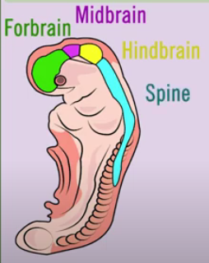

AO1 – Development of the brain
    EXTEND: Arrange the card sort to demonstrate the development of the following areas of the brain
    Forebrain, midbrain, hindbrain, cerebellum, medulla oblongata (medulla)
Early Brain Development - Development, GCSE Psychology [AQA] - YouTube

Slide 13
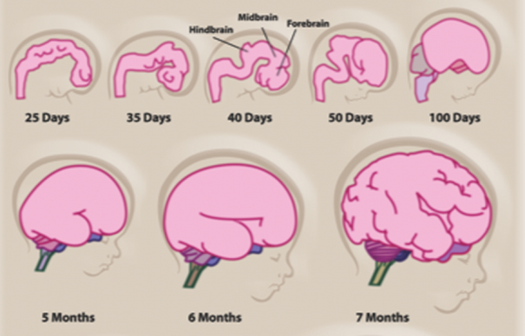
Development of the brain – self assess
3 - 4 weeks
A long tube develops in the brain, which is divided from the front into 3 sections. These are the forebrain, midbrain and hindbrain. The spinal cord develops below the hindbrain
The forebrain and hindbrain have each split into a further two cavities (giving 5 in total), the forebrain splits into an anterior and posterior section and the hindbrain splits in the middle. The midbrain does not divide
5 - 6 weeks
11 weeks
The cerebellum can be seen in the foetus. It controls physical skills which develop a lot over this time, it is also involved in responses such as fear and in functions such as processing sense information
20 weeks –
birth
The medulla oblongata is in the hindbrain in front of the cerebellum and controls involuntary responses, such as sneezing and breathing as well as heart rate and blood pressure

Slide 14
AO3 – How will we evolve in the future?
TASK: Discuss how you think our brain development will change in the future to adapt to society
    The Evolutionary Theory of Psychology claims that as humans we have evolved over millions of years. As technology and society changes some Scientists have predicted physiological changes such as shorter thumbs!!
    As humans we have a large brain that has survival value, this is why we have inherited genes that programme our bodies to grow such large brains in our early development
    We also rely on our parents for protection from danger and food, we have evolved to form attachments in our early years.
**This information is not required for the exam**

Slide 15
Plenary – Exam style question
Bethany is in the first month of pregnancy, known as the embryonic stage. She reads a magazine article that says a human brain will have already started to develop in this early stage of pregnancy.
Using your knowledge of early brain development, explain what development Bethany would expect to see in her baby. [2 marks]

Slide 16
Plenary – Self Assess
    The brain will already have developed a neural tube.
    This is divided into 3 distinct areas – the forebrain at the top, mid brain and hind brain at the bottom.

Slide 17
Extended curriculum
TASK: Answer the questions below to help you secure your knowledge of early brain development
    When is the neural tube developed?
    When is the spinal cord developed?
    When is the Hindbrain, midbrain and forebrain developed?
    When is the neural tube developed?
    When is the spinal cord developed?
    When is the Hindbrain, midbrain and forebrain developed?
    What is the difference between the forebrain, the midbrain and the hindbrain?
    What part of the brain is at the front?
    Which part of the brain is at the back?
    Which controls higher order processes?
    Which is known as the reptilian brain?
    Which controls sensory information and sleep?
    Which controls basic human functions?

