Slide 1
NEXT STEP
Watch first
The Calvin Cycle (youtube.com)

Slide 2
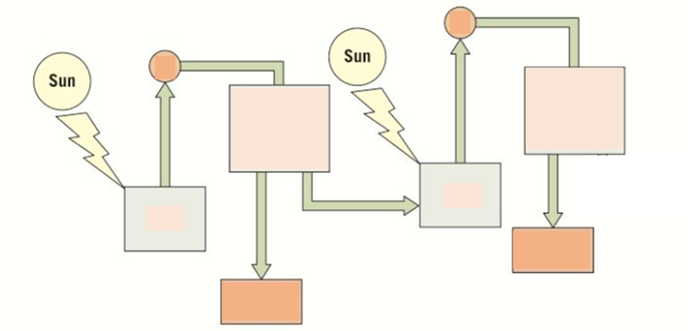
Knowledge retrieval task
Complete your diagram of PSII by filling in the gaps and by adding annotations explaining what happens at each stage

Slide 3
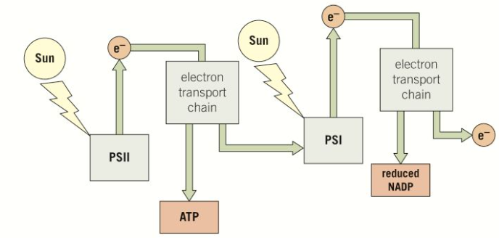
The photons from the sun excite electrons which are released from the reaction centre of PSII and are passed to an electron transport chain.
ATP is produced by the process of chemiosmosis
Excited electrons are released from the reaction centre at PSI.
These electrons are passed to another electron transport chain.
And again, ATP is produced by chemiosmosis.
How are electrons lost from PSI replaced?
These electrons are replaced by electrons that have travelled along the first electrons transport chain after being released from PSII
How are electrons lost from PSII replaced?
The electrons lost from the reaction centre PSII are replaced from water molecules broken down using energy from the sun during photolysis
chemiosmosis
The electrons leaving the electron transport chain following PSI are accepted, with a hydrogen ion by coenzyme NADP forming…….
Reduced NADP (or NADPH)
Reduced NADP provides the hydrogen (reducing power) in the production of glucose in the light-independent stage…
Notes:
Chemiosmosis is the movement of chemicals (protons) down their concentration gradient, the energy released from this can be used by ATP synthase to synthesise ATP
This excited electron is captured by an electron acceptor, transported via a chain of electron carriers known as an electron transport chain before being passed back to the chlorophyll molecule in photosystem I (hence: cyclic)
As electrons pass through the electron transport chain they provide energy to transport protons (H⁺) from the stroma to the thylakoid lumen via a proton pump
A build-up of protons in the thylakoid lumen can then be used to drive the synthesis of ATP from ADP and an inorganic phosphate group (P_{i}) by the process of chemiosmosis
The ATP then passes to the light-independent reactions

Slide 4
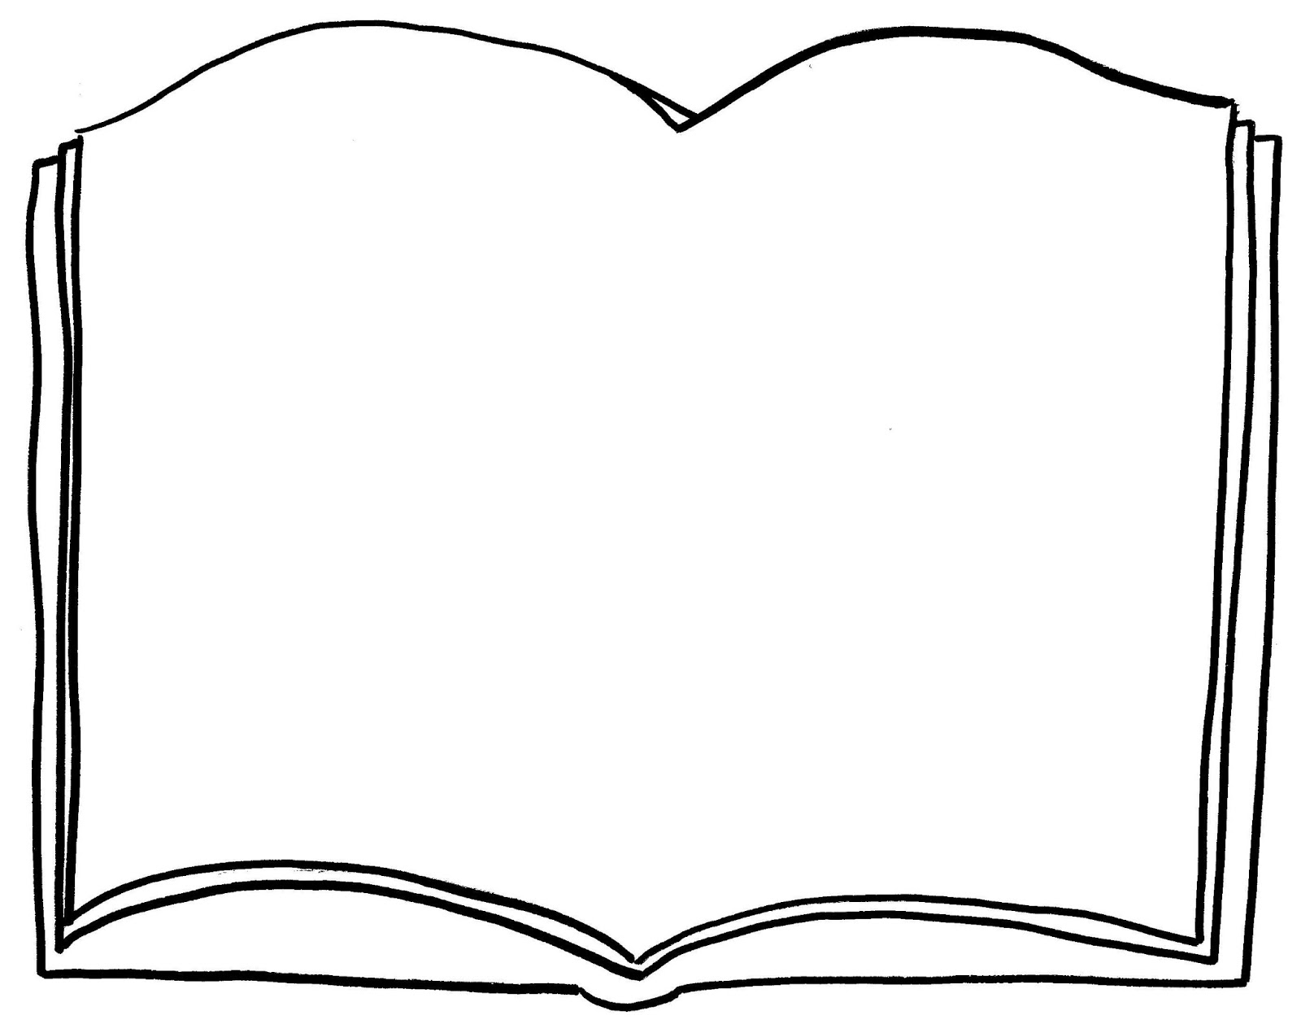
The light-dependent story...
1. P………….. creates O2 and H+ and e-
2. Light energy is captured by pigments in p……………….. and funnelled down to the reaction centre, containing chlorophyll a.
3. The electrons become e…………. enough to jump up an energy level and leave the chlorophyll.
3. The excited electrons are passed to an electron t………….. c………….
5. The electron is passed along the chain losing a little e……… on the way.
6. This energy is used to a………….. pump …… from the stroma into the t……………. space to create an electrochemical gradient.
7. Protons then d……………. down the gradient through the stalked particle causing a conformational change which allows ATP synthase to produce A……… (chemiosmosis).
8. At the end of the chain the electrons join with H+ to r……………… NADP
9. This is non-cyclic p…………………………..

Slide 5
The light dependent story...
1. Photolysis creates O₂ and H⁺ and e⁻
2. Light energy is captured by pigments in photosystem II and funnelled down to the reaction centre, containing chlorophyll a.
3. The electrons become excited enough to jump up an energy level and leave the chlorophyll.
3. The excited electrons are passed to an electron transport chain
5. The electron is passed along the chain losing a little energy on the way.
6. This energy is used to actively pump H+ from the stroma into the thylakoid space to create an electrochemical gradient.
7. Protons then diffuse down the gradient through membrane channels which allows ATP synthase to produce ATP (chemiosmosis).
8. At the end of the chain the electrons join with H⁺ to form reduced NADP
9. This is non-cyclic photophosphorylation

Slide 6
Light-independent reaction of photosynthesis (LIR)

Slide 7
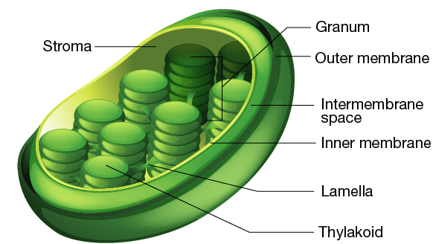
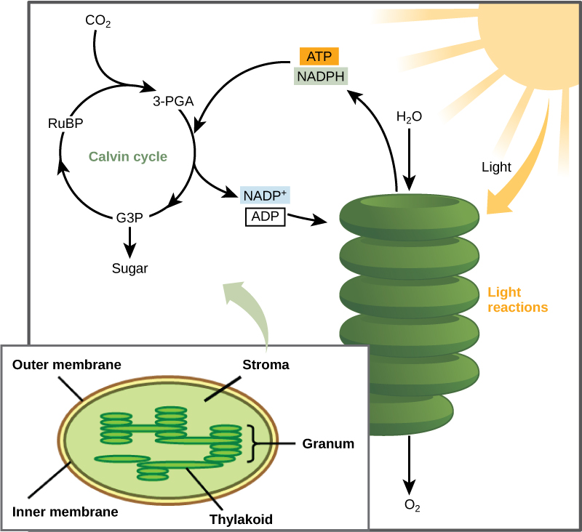
The light-independent stage of photosynthesis
Takes place in the stroma of chloroplasts and uses carbon dioxide as a raw material.
The products from the light-dependent stage – ATP and reduced NADP are also required.
Organic molecules (like glucose) are produced in a series of reactions known as the Calvin Cycle
The Calvin cycle can be summarised in three steps
CO₂ Fixation – carbon dioxide is fixed (incorporated into organic molecules) in step one
CO₂ Reduction – GP is reduced it TP by addition of hydrogen from reduced NADP using ATP
Regeneration – RuBP is regenerated from the recycled TP

Slide 8
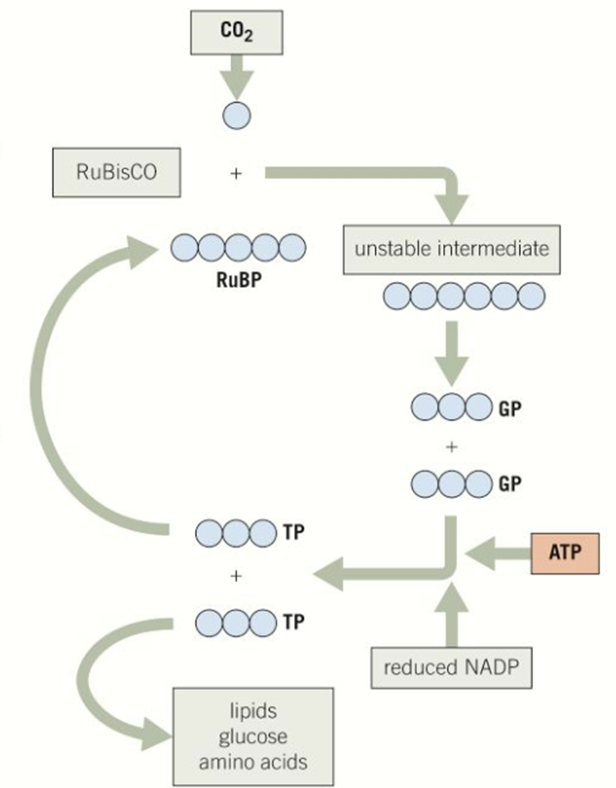
The Calvin cycle

Slide 9
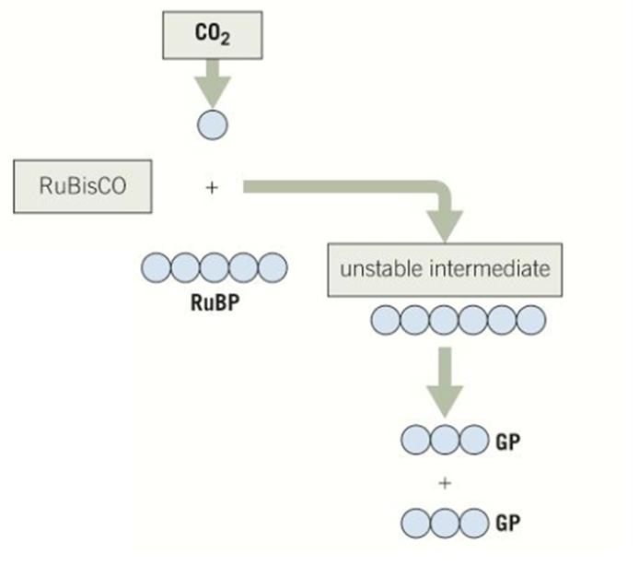
Step 1 – CO₂ Fixation
Carbon dioxide enters the intercellular space within the spongey mesophyll of the leaves via the stomata.
It diffuses into stroma of the chloroplasts.
CO₂ combines with five-carbon molecules called ribulose bisphosphate (RuBP).
The carbon is therefore fixed, meaning that it is incorporated into an organic molecule
The enzyme ribulose biphosphate carboxylase (RuBisCO) catalyses the reaction and results in an unstable six-carbon intermediate being produced
The unstable six-carbon compound immediately breaks down, forming two three-carbon glycerate 3-phosphate (GP) molecules.

Slide 10
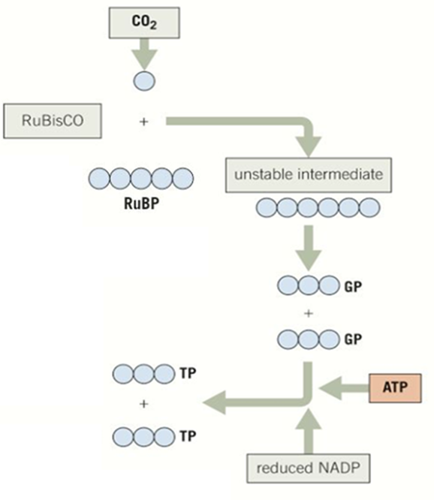
Step 2 – CO₂ Reduction
Producing carbohydrate
Each GP molecule is converted into two, three-carbon molecules called Triose phosphate (TP)
This uses a hydrogen atom from reduced NADP and ATP from the LDR
NADP+ and ADP return back to the thylakoid to be converted back into NADP and ATP by the LDR
RuBisCO enzyme is inhibited by oxygen, so a lot is needed to carry out photosynthesis.
It is likely the most abundant enzyme on planet Earth!

Slide 11
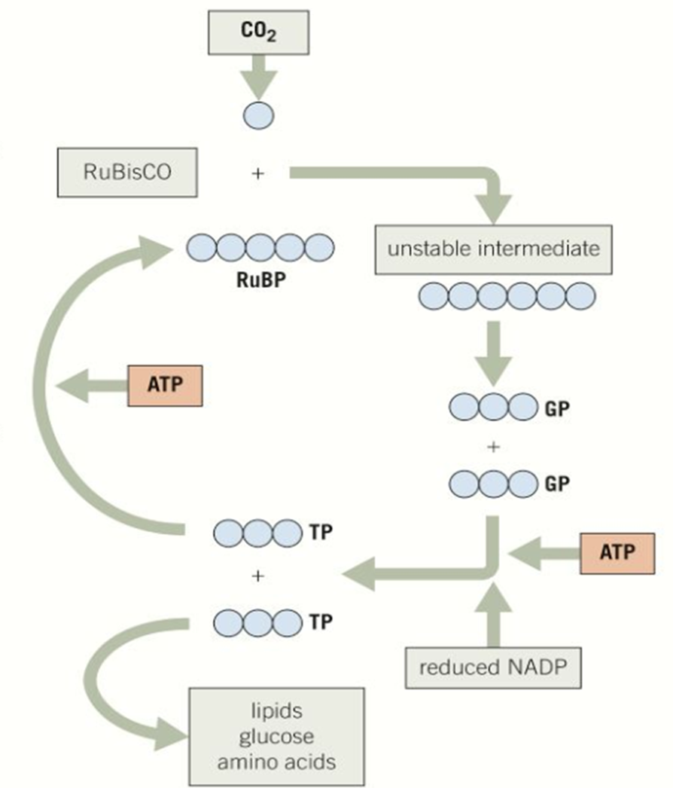
Step 3 – Regeneration of RuBP
Triose phosphate (TP) is a carbohydrate, a three-carbon sugar.
A small number of Triose phosphate (TP) molecules are used to generate glucose, lipids and amino acids.
The majority of TP is recycled using ATP to regenerate RuBP which combines with CO₂ and the Calvin cycle can continue.

Slide 12
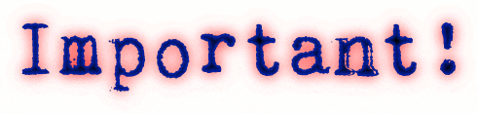

Slide 13
For one glucose molecule (C₆H₁₂O₆) how many carbon dioxide molecules need to enter the Calvin cycle?
6 to supply the 6 carbon atoms required in glucose
How many turns of the carbon cycle will this require?
6 full turns
How many Triose phosphate molecules will be produced in 6 full turns?
12 TP molecules
Two of the twelve TP molecules formed after 6 full turns of the Calvin cycle are used to produce glucose
What happens to the other ten?
They are recycled to regenerate RuBP
How many RuBP are produced from 10 TP molecules?
6 (five carbon RuBP)

Slide 14
Find the best video clip
The Calvin Cycle (youtube.com)
GP IS CALLED PG
TP is called 3GP

Slide 15
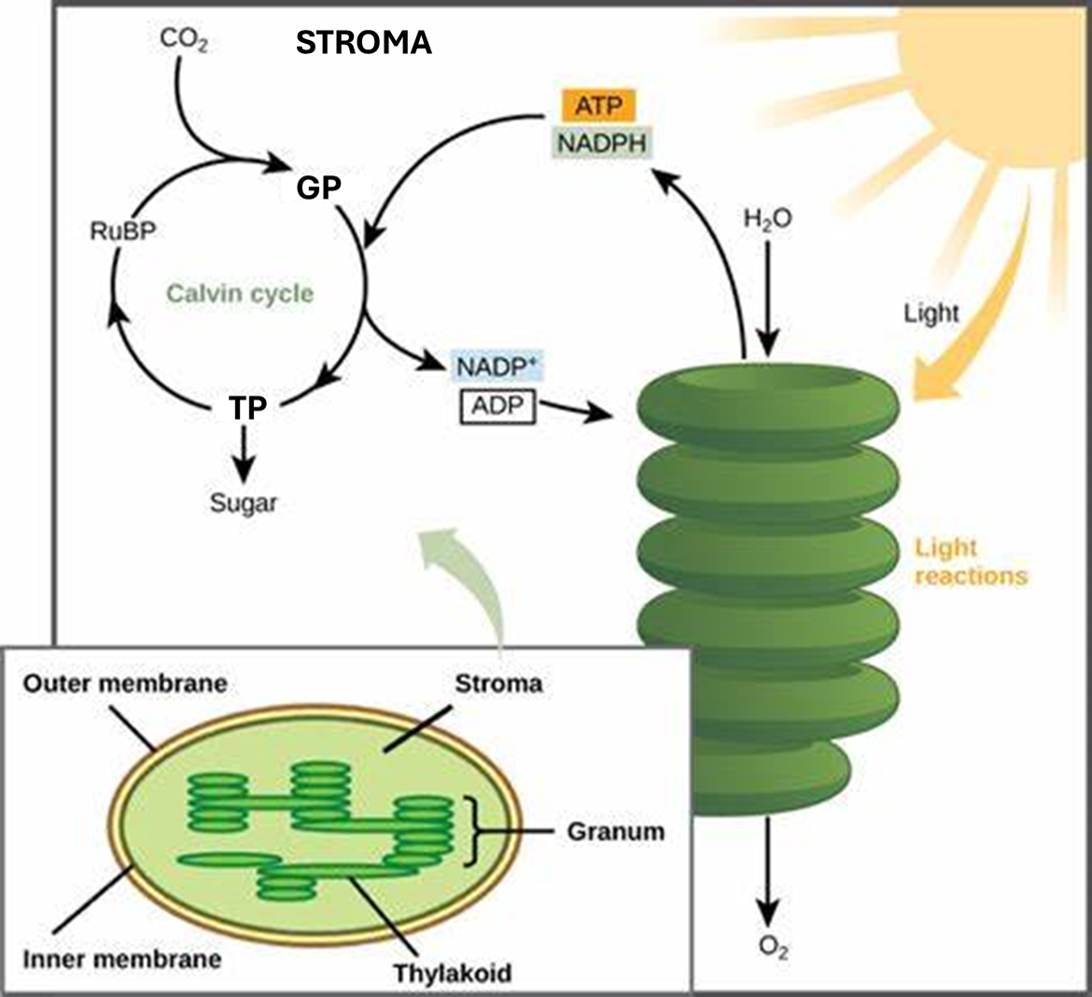

Slide 16
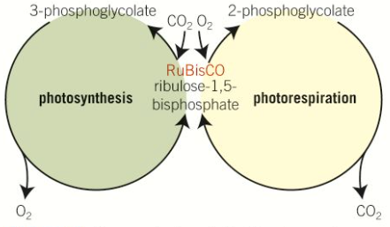
Photorespiration
2-Phosphoglycerate = toxic!
When stomata close to prevent water loss, CO₂ is also prevented from entering the leaves.
The plant will still be photosynthesising and so CO₂ levels begin to fall and oxygen levels increase.
Oxygen inhibits RuBisCO enzyme reducing the production of glycerate 3-phosphate (GP) and increasing the production of phosphoglycerate (produced when there is a lack of CO₂)
Phosphoglycerate is toxic two-carbon molecule – it must be broken down using ATP.
Approximately 25% of the products of the Calvin cycle are lost to photorespiration, reducing the efficiency of photosynthesis

Slide 17
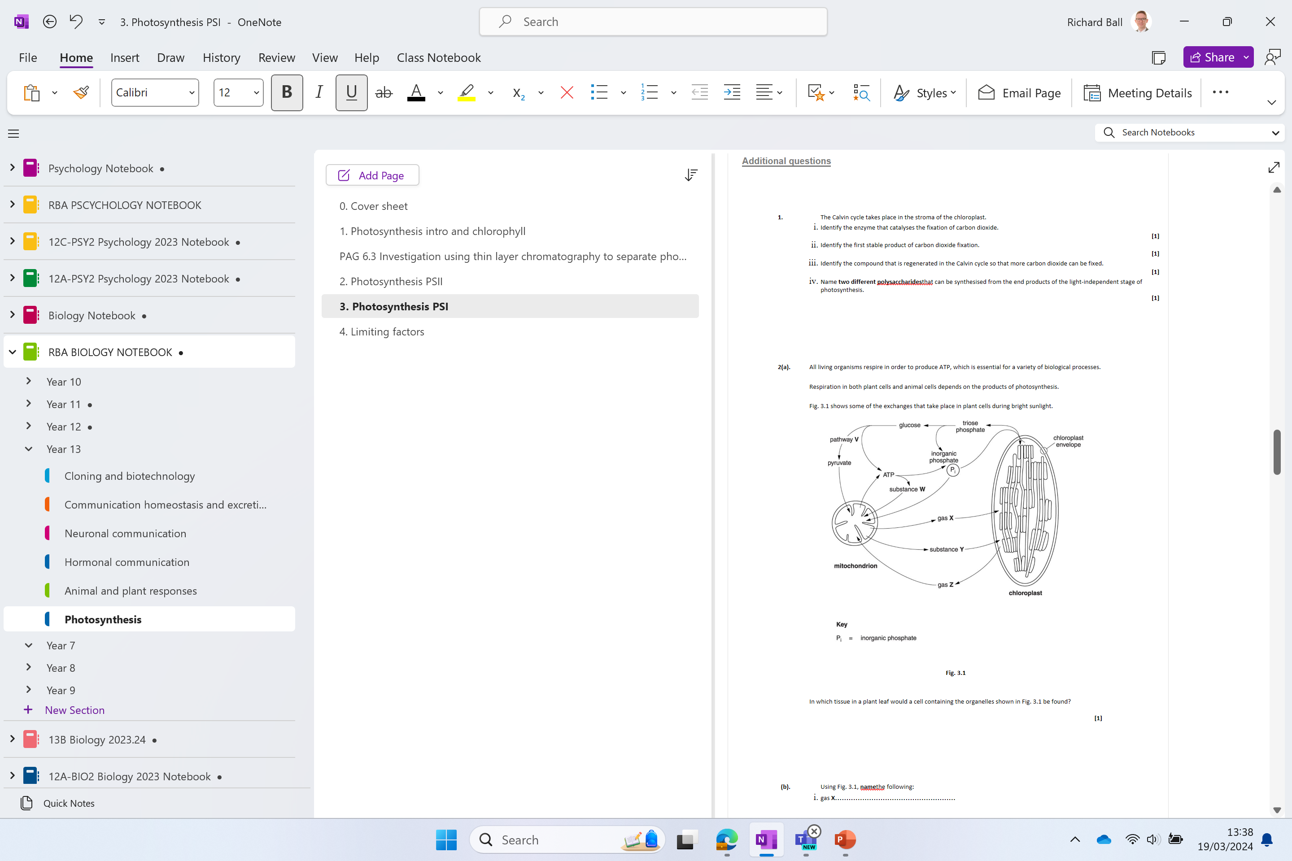
Additional questions

Slide 18
*(c) With reference to the structures in a chloroplast, explain how the energy from light is made available in ATP molecules for the synthesis of organic materials.
(6)
.................................................................................................................................................................................................................................................................................
.................................................................................................................................................................................................................................................................................
.................................................................................................................................................................................................................................................................................
.................................................................................................................................................................................................................................................................................
.................................................................................................................................................................................................................................................................................
CH: this is obviously a 6 mark question but there are 13 marking points available. How many of them can you get?

Slide 19
(QWC – Spelling of technical terms (shown in italics) must be correct and the answer must be organised in a logical sequence)
1. reference to {thylakoids / thylakoid (membranes)} ;
2. in {granum / grana} ;
3. (light energy) raises energy level of electrons / {chlorophyll / electrons}excited / eq ;
4. electrons released from {chlorophyll /photosystem / eq} / eq ;
5. reference to electron {carrier / eq} ;
6. reference to series of {redox / oxidation & reduction / eq} reactions ;
7. reference to energy level of electrons {falls /eq} ;
8. reference to {synthesise ATP from ADP +P /phosphorylate ADP} ;
9. reference to photophosphorylation ;
10. reference to ATP {synthetase / synthase /ase} ;
11. reference to {chemiosmosis / eq} ;
12. idea of electrons from {photolysis / eq} used to replace those lost ;
13. reference to involvement of {accessory pigments / named example} ;

Slide 20
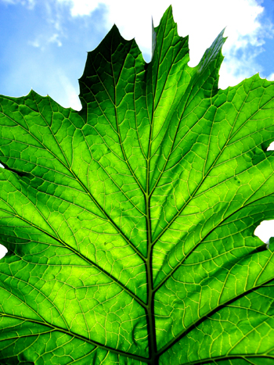
Photosynthesis: Light independent reactions
By the end of the lesson, we will have covered the following specification statements:
How the products of the LDR are used in the Calvin cycle (LIR) to produce TP, GP and RuBP using RuBisCo.
2. The use of TP by the plant.

Slide 21
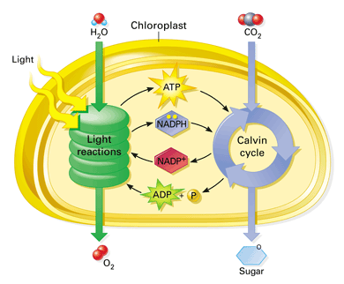
Light independent reaction
This is commonly known as the Calvin cycle.
It is the use of CO₂ in the production of carbohydrates, which are used to make new molecules. This is known as carbon fixation
Takes place in the stroma

Slide 22
What is available from the LDR to be used?
It uses the reduced NADP and ATP from the LDR.
What type of molecule is NADP?
It is a metabolic pathway- a series of small reactions each controlled by an individual enzyme.
Reduced NADP (a coenzyme) acts as a hydrogen carrier holding it loosely bonded so it can’t react with oxygen when moving it from water to the carbon dioxide.
You need:
Plain paper
Blue for molecule and carbon numbers
Red for ATP/Pi
Green for NADP
Black for molecule name

Slide 23
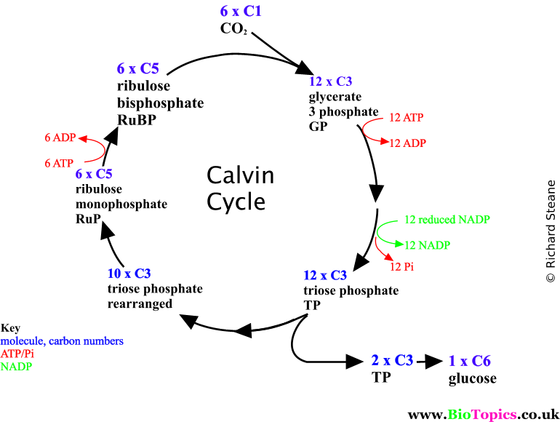
Draw this circle and see if you can fill in the gaps with the clues from the next slide

Slide 24
Carefully follow these steps:
Blue for molecule and carbon numbers
Red for ATP/Pi
Green for NADP
Black for molecule name
At the top of the page write out the photosynthesis equation.
Underneath write the carbon dioxide symbol, the number of molecules and the number of carbon atoms
At the bottom right corner write the remaining product.
Now let's fill in the rest of the cycle.
6 RuBP (ribulose bisphosphate, 5C compound) fixes 6CO₂ using RuBisCo (enzyme ribulose bisphosphate carboxylase).
Forms an unstable 6C compound which immediately separates into 2 x 3C compound glycate-3-phosphate – how many of these?
GP reduced into triose phosphate (3C compound) , how many of these? Using energy and donated hydrogen (where from?)
2 molecules of TP convert into 1 molecule of glucose.
The rest of the TP is rearranged into a more stable 5C compound, ribulose monophosphate, RuP
6 molecules of RuP regenerate 6 molecules RuBP using energy.
Now add all the correct carbon molecules and calculate the total amount of carbon at each stage. Does it all work?

Slide 27
1. Carbon fixation
3. Regeneration
2. Reduction

Slide 28
A* thinking...
Let's just talk about RuBisCO......
1. It's a fairly inefficient enzyme.
2. It's competitively inhibited by oxygen.
3. Therefore there must be lots of it.
4. It's thought to be the most abundant enzyme on the planet.
Consider this:
1. What happens to plants when the temperature is very high, and humidity is low?
2. How do plants overcome this?
3. How would this affect carbon dioxide and oxygen levels?
4. How does the plant overcome this?
5. The LIR used to known as the dark reaction, is this correct?
This topic is particularly suited to a "suggest" question. So.....
1. Suggest the possible benefit of cyclic photophosphorylation (4)
2. Suggest why the rate of oxygen production is only an estimate of the rate of photosynthesis (2)

Slide 29
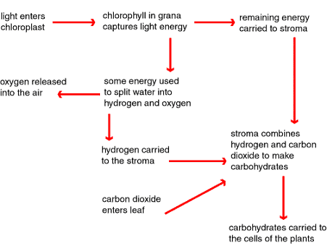
Summary of Photosynthesis

Slide 30
Photosynthesis poster
A summary of photosynthesis
The structure of the chloroplast and the role of each structure
The light dependent reaction including - cyclic and non cyclic photophosphorylation.
photolysis
  (CH)- chemiosmosis
The light independent reaction (can be in the form of an annotated diagram)

