Slide 1
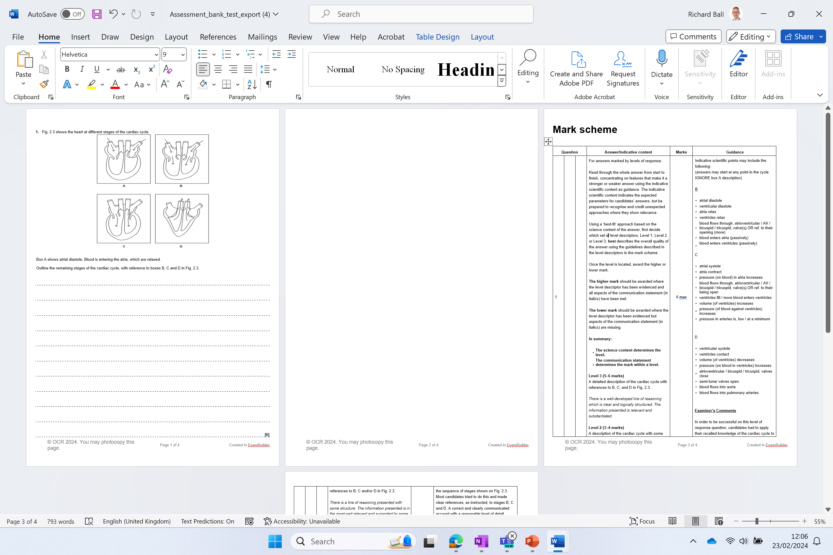
Independent exam question
You have 6 minutes
Start straight away
(6 marks)

Slide 2
B
• atrial diastole
• ventricular diastole
• atria relax
• ventricles relax
• blood flows through, atrioventricular / AV / bicuspid / tricuspid, valve(s) OR ref. to their opening (more)
• blood enters atria (passively)
• blood enters ventricles (passively)
C
• atrial systole
• atria contract
• pressure (on blood) in atria increases
• blood flows through, atrioventricular / AV / bicuspid / tricuspid, valve(s) OR ref. to their being open
• ventricles fill / more blood enters ventricles
• volume (of ventricles) increases
• pressure (of blood against ventricles) increases
• pressure in arteries is, low / at a minimum
D
• ventricular systole
• ventricles contact
• volume (of ventricles) decreases
• pressure (on blood in ventricles) increases
• atrioventricular / bicuspid / tricuspid, valves close
• semi-lunar valves open
• blood flows into aorta
• blood flows into pulmonary arteries

Slide 3
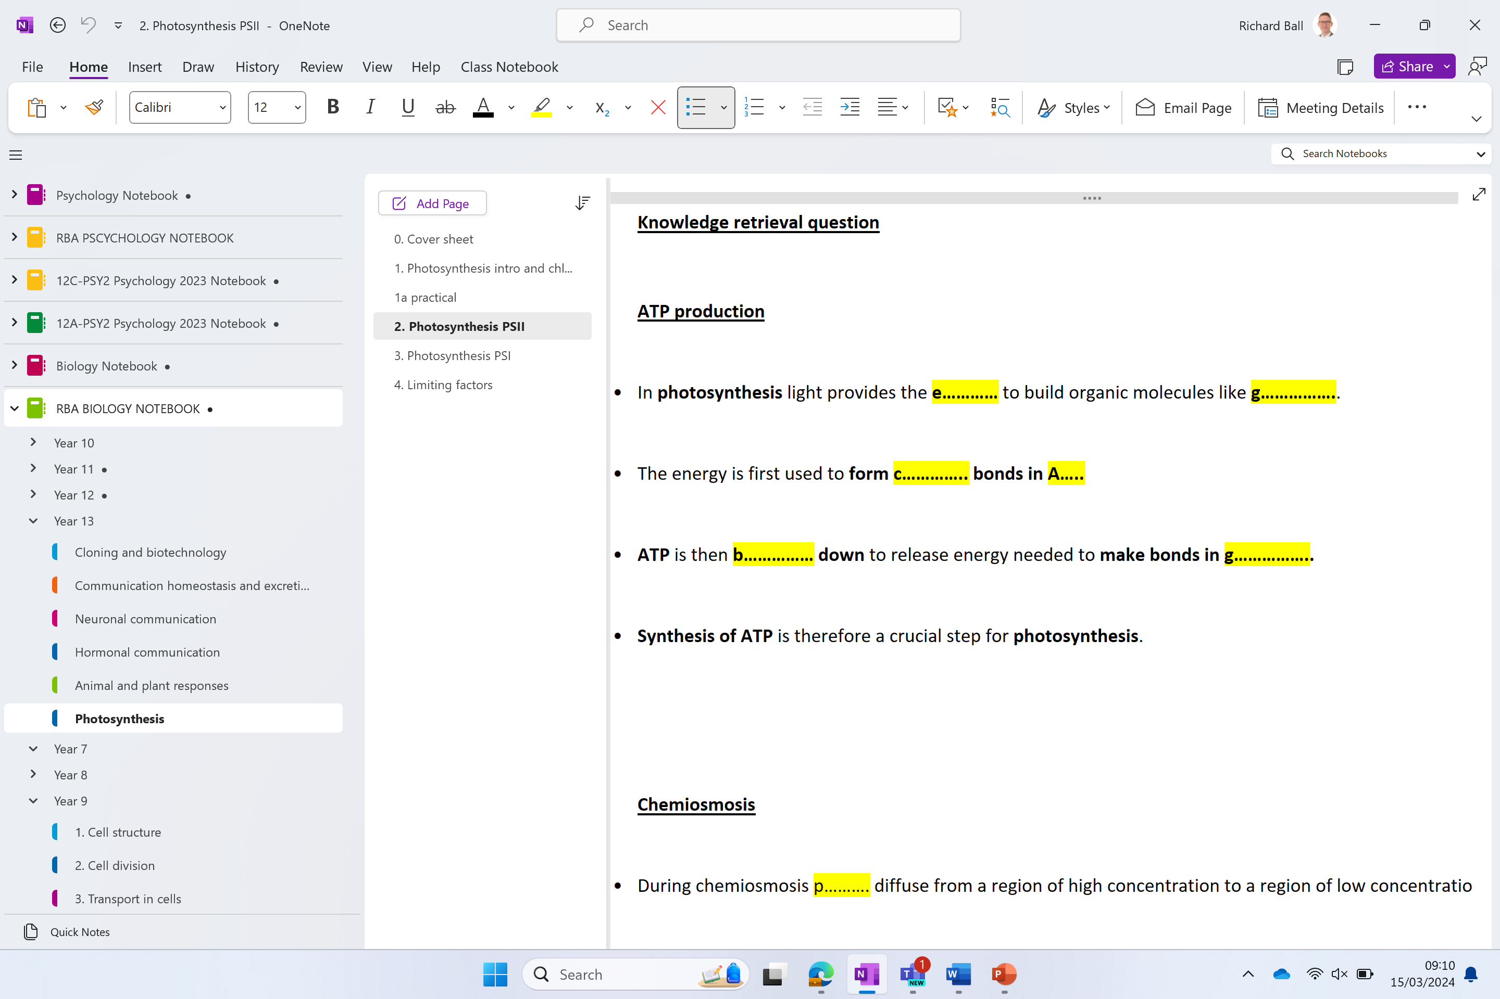

Slide 4
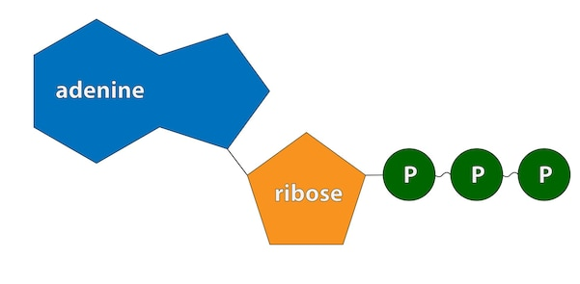
Knowledge retrieval question
ATP production
In photosynthesis light provides the e………… to build organic molecules like g……………..
The energy is first used to form c………….. bonds in A…..
ATP is then b…………… down to release energy needed to make bonds in g……………..
Synthesis of ATP is therefore a crucial step for photosynthesis.

Slide 5
Knowledge retrieval question
ATP production
In photosynthesis light provides the energy to build organic molecules like glucose.
The energy is first used to form chemical bonds in ATP
ATP is then broken down to release energy needed to make bonds in glucose.
Synthesis of ATP is therefore a crucial step for photosynthesis.
How is energy used to form ATP?
Chemiosmosis
Notes:
During respiration energy released from breaking down glucose + O2 is used to form ATP – oxidative phosphorylation

Slide 6
Key points
Photosynthesis uses photophosphorylation – not oxidative phosphorylation
Chemiosmosis occurs in both processes to produce ATP – it is the movement of ions across a semi-permeable membrane which is used to generate ATP using ATP synthase.
Notes:
phosphorylation is the attachment of a phosphate group to a molecule or an ion.
Photosynthesis uses light to do this
Respiration uses oxygen to do this:
Oxygen’s Role:Oxygen plays a critical role at the end of the electron transport chain.
It accepts electrons and combines with protons to form water.
Without oxygen, the electron transport chain stops, and ATP production via chemiosmosis ceases.

Slide 7
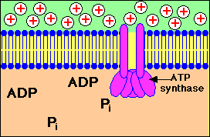
ATP production - Chemiosmosis
During chemiosmosis p………. diffuse from a region of high concentration to a region of low concentration.
This occurs across a p……….. P…………….. m…………….
The movement of protons flowing down their concentration gradient releases e………. that is used to connect Pi to A….. forming A….
This process relies on the creation of a proton gradient. The energy to do this comes from e………… electrons.

Slide 8
ATP production - Chemiosmosis
During chemiosmosis protons diffuse from a region of high concentration to a region of low concentration.
This occurs across a partially permeable membrane.
The movement of protons flowing down their concentration gradient releases energy that is used to connect Pi to ADP forming ATP.
This process relies on the creation of a proton gradient. The energy to do this comes from excited electrons.

Slide 9
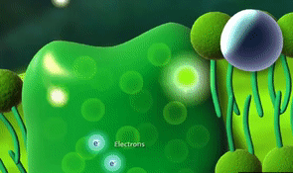
Excited electrons
During photosynthesis electrons are excited in pigment molecules (chlorophyll).
The excited electrons pass into an electron transport chain and are used to generate a proton gradient.
Notes:
Electrons are excited in respiration when chemical bonds are broken in respiratory substrates like glucose

Slide 10
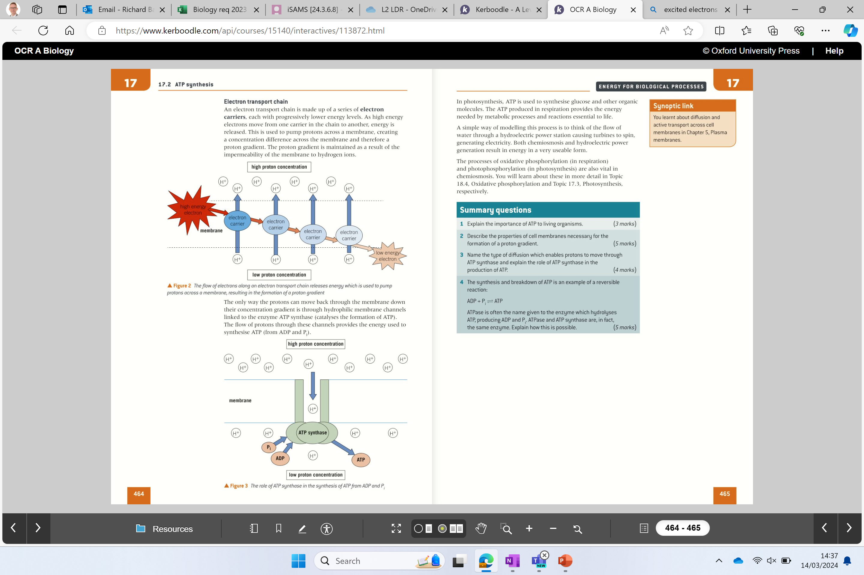
Electron transport chain
Explain to the person next to you
Notes:
Electrons are excited in respiration when chemical bonds are broken in respiratory substrates like glucose

Slide 11
Electron transport chain
The electron transport chain is made up of a series of electron carriers – each with progressively lower energy levels.
When electrons move from one carrier to another energy is released.
This energy is used to pump protons across a membrane creating a concentration difference across the membrane (a proton gradient).
The gradient is maintained as the membrane is impermeable to H+ ions (protons)
How is ATP produced using this H+ gradient?
Notes:
Electrons are excited in respiration when chemical bonds are broken in respiratory substrates like glucose

Slide 12
ATP synthase
Explain to the person next to you
Notes:
Electrons are excited in respiration when chemical bonds are broken in respiratory substrates like glucose

Slide 13
ATP synthase
The only way the ………….. can move back through the membrane is through hydrophilic membrane ……………..
These channels are linked to the enzyme …… …………….. (catalyses the formation of ATP).
The flow of protons through these channels provides the ………….. used to synthesis ATP (from ADP and Pi).
Notes:
Electrons are excited in respiration when chemical bonds are broken in respiratory substrates like glucose

Slide 14
ATP synthase
The only way the protons can move back through the membrane is through hydrophilic membrane channels.
These channels are linked to the enzyme ATP synthase (catalyses the formation of ATP).
The flow of protons through these channels provides the energy used to synthesis ATP (from ADP and Pi).
Notes:
Electrons are excited in respiration when chemical bonds are broken in respiratory substrates like glucose

Slide 15
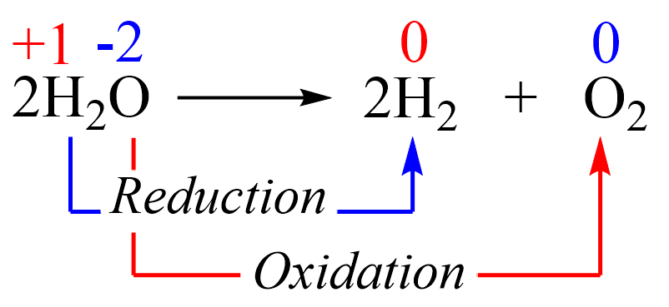
TRY THIS
Explain what has been oxidised and what has been reduced during this reaction.

Slide 16
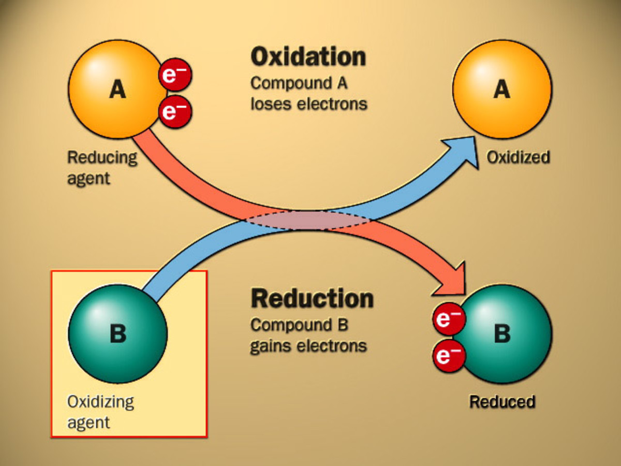

Slide 17
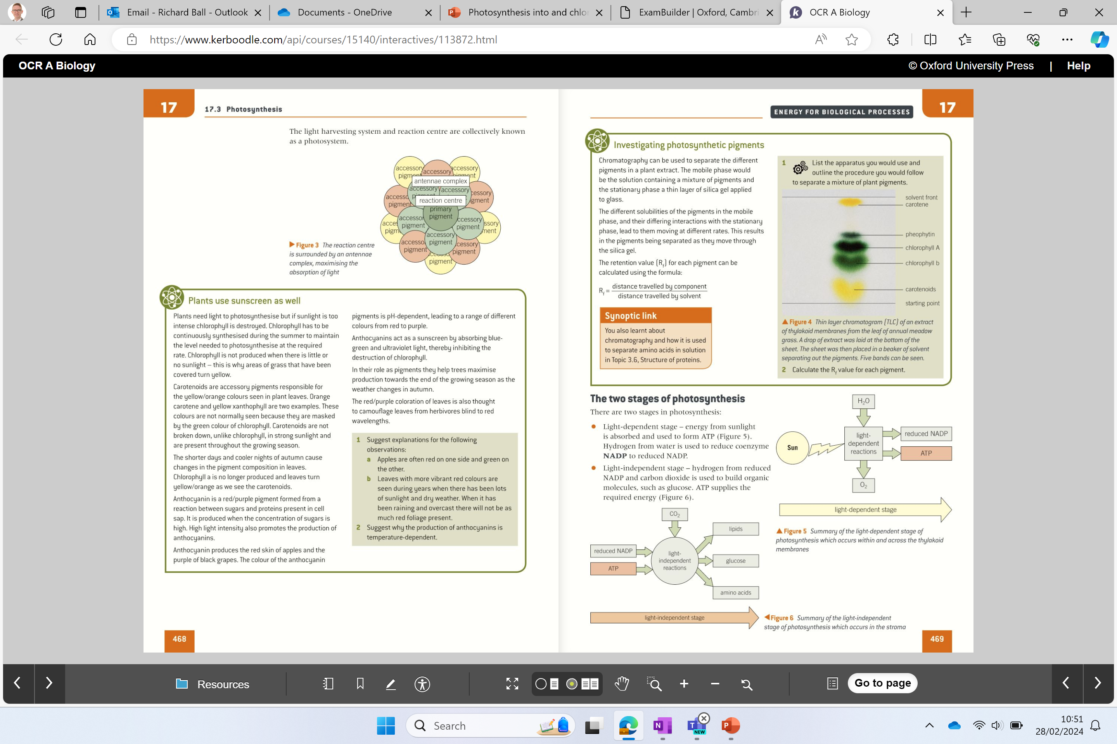
THE TWO STAGES OF PHOTOSYNTHESIS
Light dependent reaction
Light-independent reaction

Slide 18
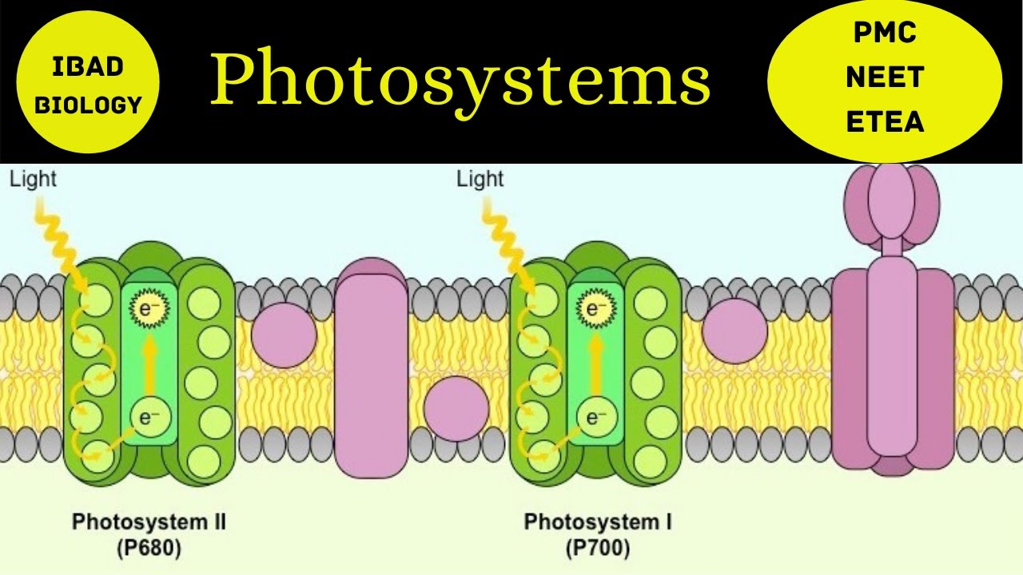
Two photosystems are involved in non-cyclic photophosphorylation
Photosystem II (PSII)
Followed by →
Photosystem I (PSI)
Photosystem II absorbs light at lower wavelengths of 680nm (P680)
Photosystem I absorbs light at higher wavelengths of 700nm (P700)
Notes:
NAMED AFTER THE ORDER THEY WERE DISCOVERED – NOT THE ORDER THEY PARTICIPATE

Slide 19
Light dependent stage:
Water is split by photolysis
ATP is produced by photophosphorylation
Reduced NADP is created by non-cyclic photophosphorylation

Slide 20
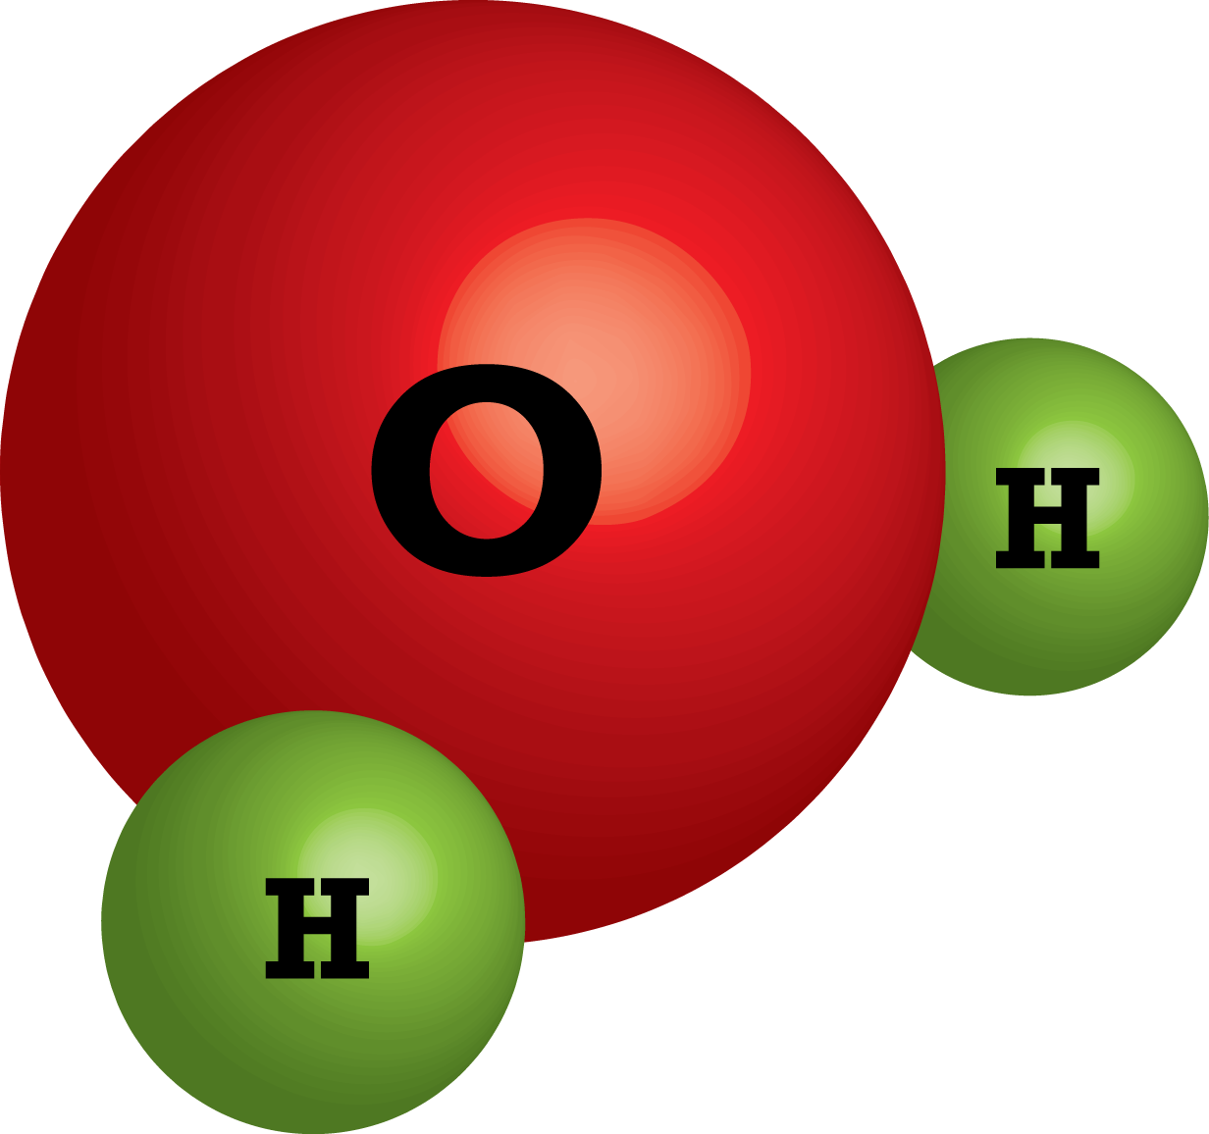
Photolysis
Part 1 – breaking down water
Using an enzyme and sunlight energy
O
e⁻
e⁻
H⁺
H⁺

Slide 21
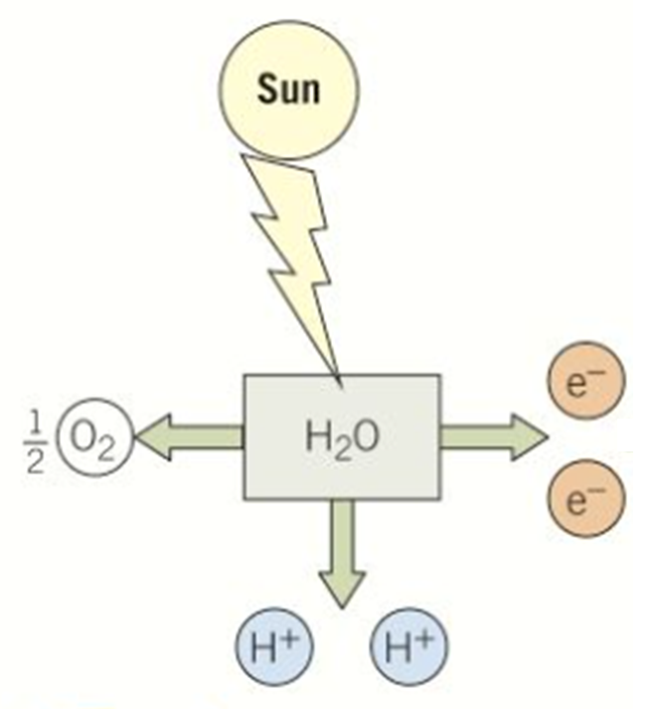
Photolysis
The oxygen-evolving complex (part of the PSII) is an enzyme that catalyses the breakdown of water using energy from the sun in a process called photolysis
Water molecules are split into hydrogen ions, electrons and oxygen molecules.
The photolysis reaction is summarised as:
H₂O → 2H⁺ + 2e⁻ + ½ O₂
*The oxygen-evolving complex, also known as the water-splitting complex, is a water-oxidizing enzyme
Notes:
Chemiosmosis is the movement of chemicals (protons) down their concentration gradient, the energy released from this can be used by ATP synthase to synthesise ATP

Slide 22
Putting products to use
Important in the photophosphorylation
H₂O → 2H⁺ + 2e⁻ + ½ O₂
Important in the photophosphorylation
Used in respiration by the plant

Slide 23
Light dependent stage:
Water is split by photolysis ✔
ATP is produced by photophosphorylation

Slide 24
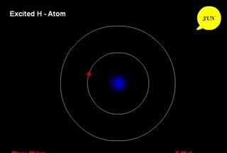
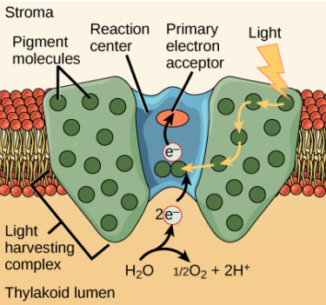
The light absorbed excites electrons at the reaction centre of the photosystems
Light dependent stage

Slide 25
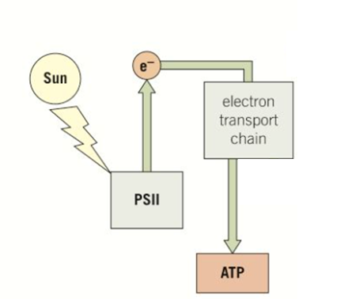
The excited electrons are released from the reaction centre of PSII and are passed to an electron transport chain.
ATP is produced by the process of chemiosmosis
How are electrons replaced lost form PSII?
The electrons lost from the reaction centre PSII are replaced from water molecules broken down using energy from the sun during photolysis
*this is why light is a factor affecting the rate of photosynthesis
Notes:
Chemiosmosis is the movement of chemicals (protons) down their concentration gradient, the energy released from this can be used by ATP synthase to synthesise ATP
This excited electron is captured by an electron acceptor, transported via a chain of electron carriers known as an electron transport chain before being passed back to the chlorophyll molecule in photosystem I (hence: cyclic)
As electrons pass through the electron transport chain they provide energy to transport protons (H⁺) from the stroma to the thylakoid lumen via a proton pump
A build-up of protons in the thylakoid lumen can then be used to drive the synthesis of ATP from ADP and an inorganic phosphate group (P_{i}) by the process of chemiosmosis

Slide 26
Recap more specifically now…
What am I used for?
Replace electrons lost from reaction centre at PSII
Excess oxygen diffuses out of the stomata!
H₂O → 2H⁺ + 2e⁻ + ½ O₂
What am I used for?
Protons used in photophosphorylation – forming ATP
What am I used for?
Used in respiration

Slide 27
Electron transport chain and ATP synthesis
Photosynthesis Intro and Light-Dependent Reactions - YouTube
Stop at “Hydroelectric damn” – 2.42

Slide 28
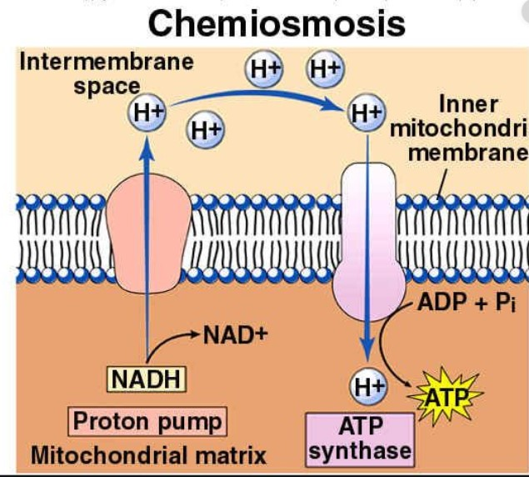
RECAP
Chemiosmosis is the movement of ions across a selectively permeable membrane, down their electrochemical gradient.
It is the process by which hydrogen ions (protons) diffuse to the other side of the biological membrane from high to low concentration.
The gradient energy synthesises adenosine triphosphate (ATP) in the cell
Notes:
Chemiosmosis is the movement of chemicals (protons) down their concentration gradient, the energy released from this can be used by ATP synthase to synthesise ATP
This excited electron is captured by an electron acceptor, transported via a chain of electron carriers known as an electron transport chain before being passed back to the chlorophyll molecule in photosystem I (hence: cyclic)
As electrons pass through the electron transport chain they provide energy to transport protons (H⁺) from the stroma to the thylakoid lumen via a proton pump
A build-up of protons in the thylakoid lumen can then be used to drive the synthesis of ATP from ADP and an inorganic phosphate group (P_{i}) by the process of chemiosmosis

Slide 29

1. What are the two stages of photosynthesis?
Light dependent and light independent
2. How many photosystems are involved in non-cyclic photophosphorylation?
Two PSII and PSI
3. What is the difference between PSII and PSI?
PSII absorb 680nm wavelength PSI absorb 700nm wavelength
4. What does the light absorbed at the reaction centres do and cause?
Excites electrons which are released from PSII and passed to an electron transport chain.
5. How is ATP produced?
Chemiosmosis
6. How are electrons from the reaction centre PSII replaced?
Photolysis

Slide 30
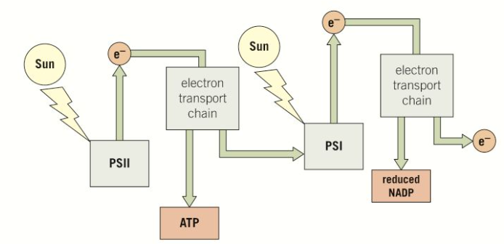
Let's keep going

Slide 31
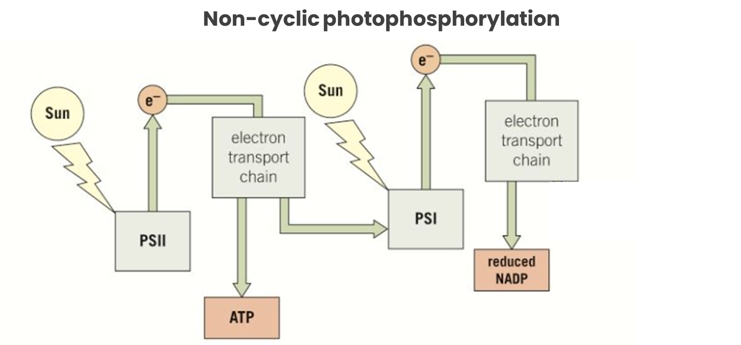
Excited electrons are released from the reaction centre at PSI.
These electrons are passed to another electron transport chain.
And again, ATP is produced by chemiosmosis.
These electrons are replaced by electrons that have travelled along the first electrons transport chain after being released from PSII
The electrons leaving the electron transport chain following PSI are accepted, with a hydrogen ion by coenzyme NADP forming…….
Reduced NADP (or NADPH)
Reduced NADP provides the hydrogen (reducing power) in the production of glucose in the light-independent stage……
Notes:
Chemiosmosis is the movement of chemicals (protons) down their concentration gradient, the energy released from this can be used by ATP synthase to synthesise ATP
This excited electron is captured by an electron acceptor, transported via a chain of electron carriers known as an electron transport chain before being passed back to the chlorophyll molecule in photosystem I (hence: cyclic)
As electrons pass through the electron transport chain they provide energy to transport protons (H⁺) from the stroma to the thylakoid lumen via a proton pump
A build-up of protons in the thylakoid lumen can then be used to drive the synthesis of ATP from ADP and an inorganic phosphate group (P_{i}) by the process of chemiosmosis

Slide 36
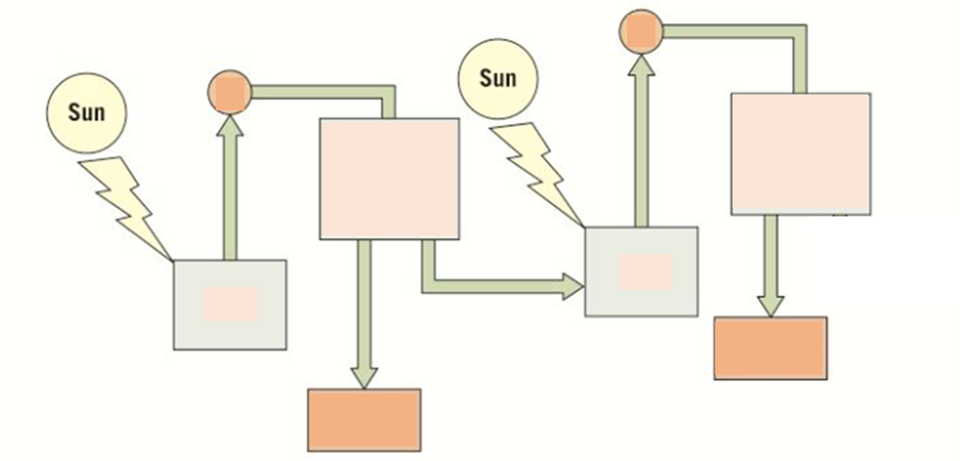
Knowledge retrieval task
Complete your diagram of PSII by filling in the gaps and by adding annotations explaining what happens at each stage

Slide 37
The energy from the sun is used to excite electrons in PSII
The excited electrons are released from the reaction centre of PSII and are passed to an electron transport chain.
ATP is produced by the process of chemiosmosis
The electrons lost from the reaction centre PSII are replaced from water molecules broken down using energy from the sun during photolysis
Notes:
Chemiosmosis is the movement of chemicals (protons) down their concentration gradient, the energy released from this can be used by ATP synthase to synthesise ATP
This excited electron is captured by an electron acceptor, transported via a chain of electron carriers known as an electron transport chain before being passed back to the chlorophyll molecule in photosystem I (hence: cyclic)
As electrons pass through the electron transport chain they provide energy to transport protons (H⁺) from the stroma to the thylakoid lumen via a proton pump
A build-up of protons in the thylakoid lumen can then be used to drive the synthesis of ATP from ADP and an inorganic phosphate group (P_{i}) by the process of chemiosmosis

Slide 38
Excited electrons are released from the reaction centre at PSI.
These electrons are passed to another electron transport chain.
And again, ATP is produced by chemiosmosis.
These electrons are replaced by electrons that have travelled along the first electrons transport chain after being released from PSII
The electrons leaving the electron transport chain following PSI are accepted, with a hydrogen ion by coenzyme NADP forming…….
Reduced NADP (or NADPH)
Reduced NADP provides the hydrogen (reducing power) in the production of glucose in the light-independent stage……
Notes:
Chemiosmosis is the movement of chemicals (protons) down their concentration gradient, the energy released from this can be used by ATP synthase to synthesise ATP
This excited electron is captured by an electron acceptor, transported via a chain of electron carriers known as an electron transport chain before being passed back to the chlorophyll molecule in photosystem I (hence: cyclic)
As electrons pass through the electron transport chain they provide energy to transport protons (H⁺) from the stroma to the thylakoid lumen via a proton pump
A build-up of protons in the thylakoid lumen can then be used to drive the synthesis of ATP from ADP and an inorganic phosphate group (P_{i}) by the process of chemiosmosis

Slide 39
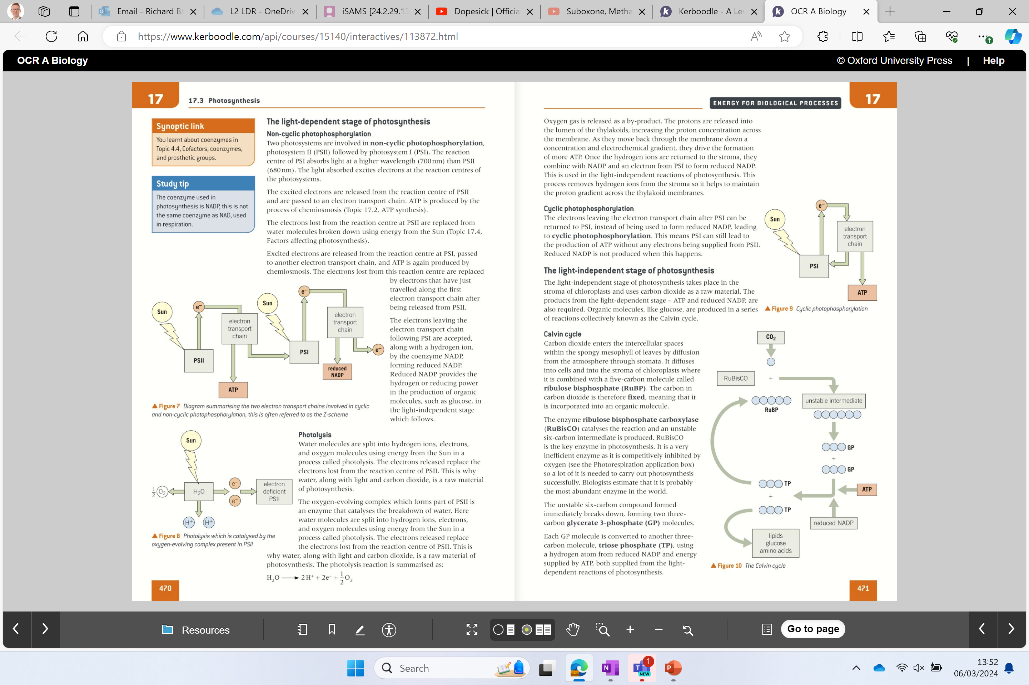
Cyclic photophosphorylation
Only involves PSI
The electrons leaving the electron chain after PSI can be returned to PSI, instead of being used to form reduced NADP.
This means PSI can continue to produce ATP without electrons from PSII
Reduced NADP is not formed during cyclic photophosphorylation
Cyclic photophosphorylation

Slide 40
Non-cyclic photophosphorylation
In non-cyclic photophosphorylation, we saw that electrons were released from PSII and passed to PSI, where they were used to generate ATP.
Finally, the electrons were given to NADP (plus H⁺) to make reduced NADP.
These electrons are not returned to PSII.
How does PSII replace lost electrons?
Photolysis

Slide 41
IMPORANT
In non-cyclic photophosphorylation electrons released from PSII and passed to PSI, where they were used to generate ATP. and given to NADP (plus H⁺) to make reduced NADP. Not recycled.
Cyclic photophosphorylation just involves PSI. Less ATP is made via cyclic photophosphorylation, but importantly the electrons aren’t given to NADP. Therefore, the process is cyclic – the electrons are recycled.
*Cyclic - occurring in cycles

Slide 42
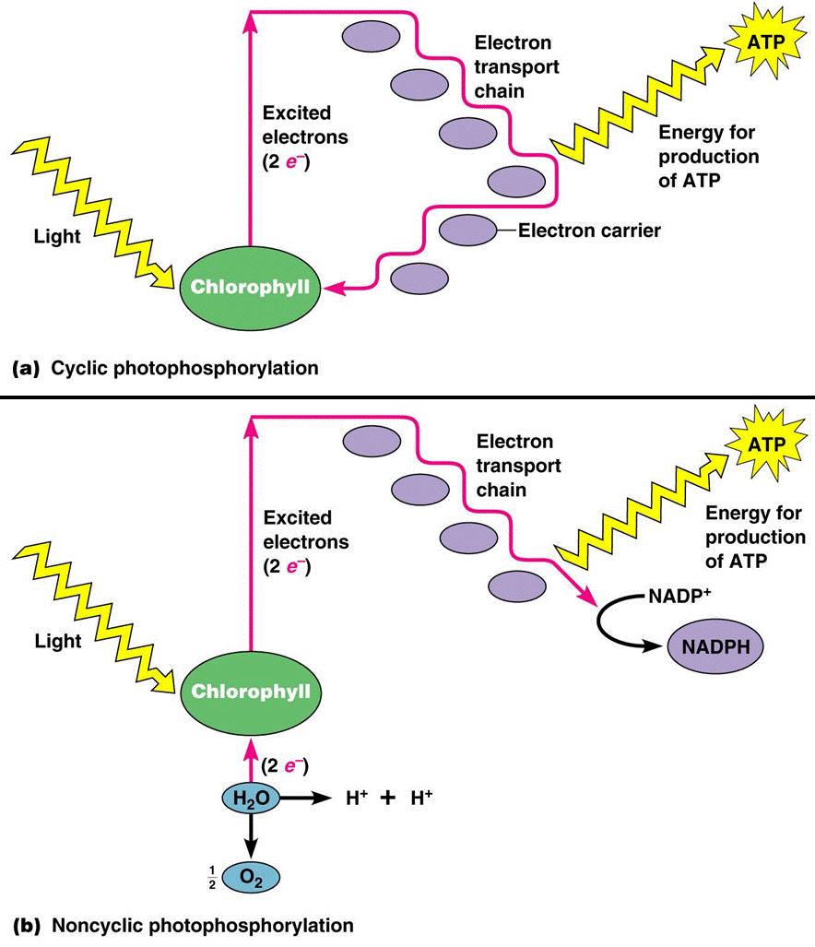

Slide 44
Light dependent stage:
Water is split by photolysis ✔
ATP is produced by photophosphorylation ✔
Reduced NADP is created by non-cyclic photophosphorylation ✔

Slide 45
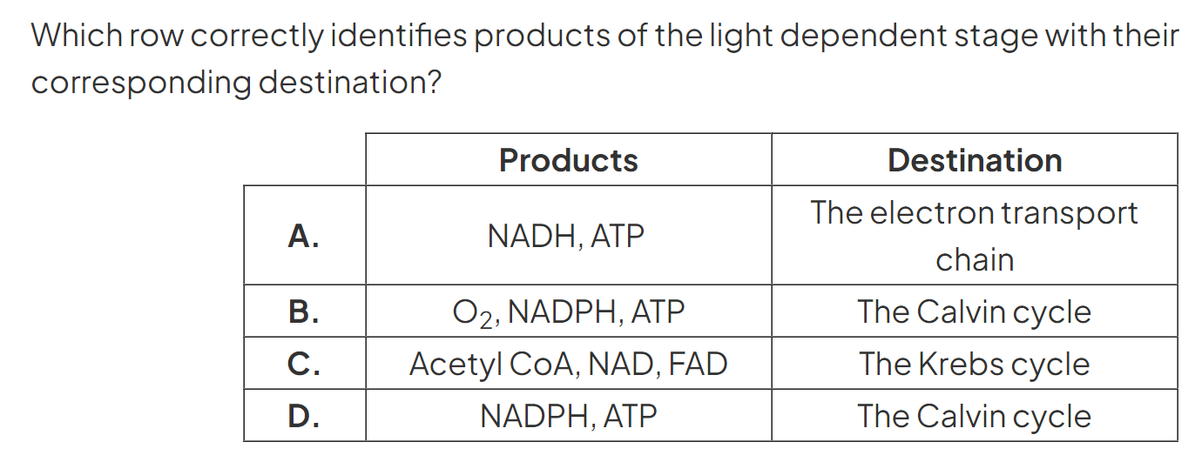
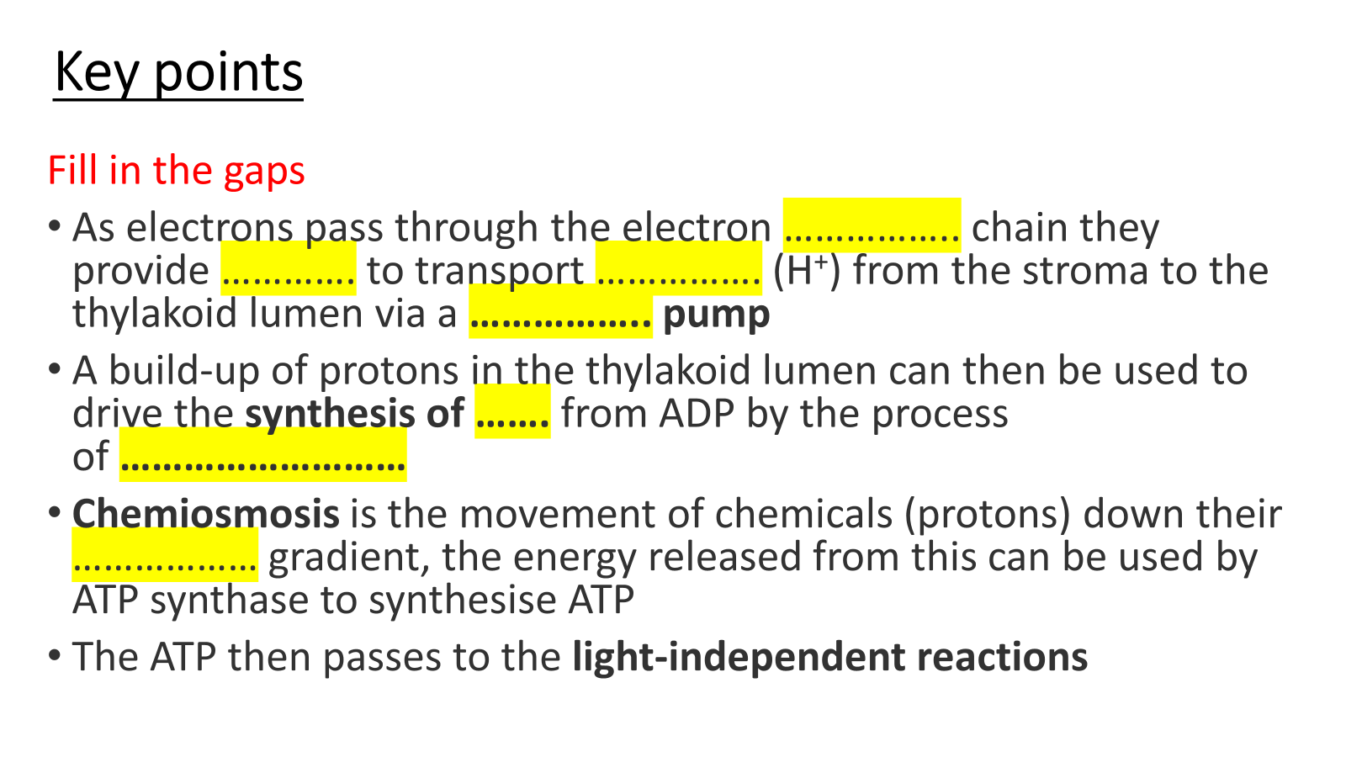
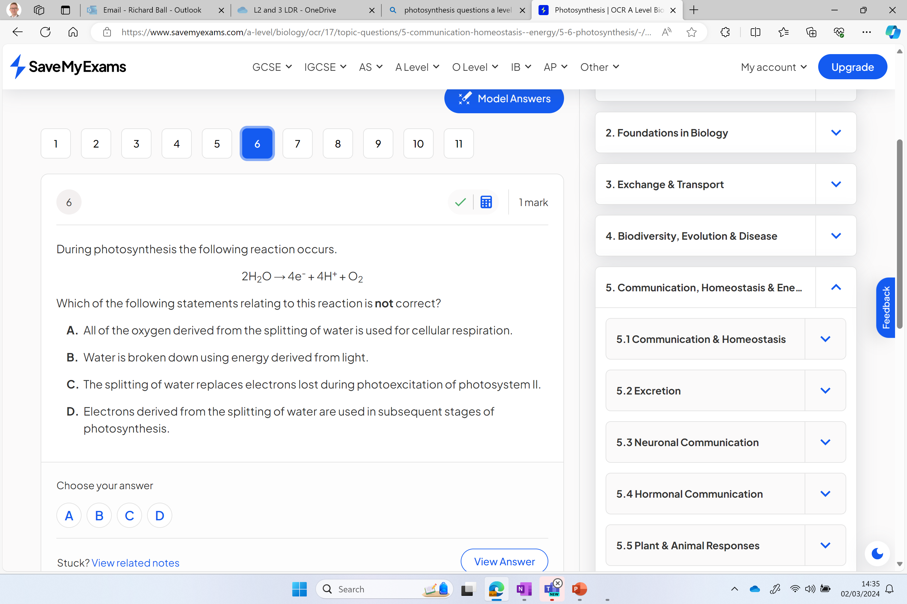
TRY THESE

Slide 46
Key points
Fill in the gaps
As electrons pass through the electron …………….. chain they provide …………. to transport ……………. (H⁺) from the stroma to the thylakoid lumen via a …………….. pump
A build-up of protons in the thylakoid lumen can then be used to drive the synthesis of ……. from ADP by the process of ………………………
Chemiosmosis is the movement of chemicals (protons) down their ……………… gradient, the energy released from this can be used by ATP synthase to synthesise ATP
The ATP then passes to the light-independent reactions

Slide 47
Key points
Fill in the gaps
As electrons pass through the electron transport chain they provide energy to transport protons (H⁺) from the stroma to the thylakoid lumen via a proton pump
A build-up of protons in the thylakoid lumen can then be used to drive the synthesis of ATP from ADP by the process of chemiosmosis
Chemiosmosis is the movement of chemicals (protons) down their concentration gradient, the energy released from this can be used by ATP synthase to synthesise ATP
The ATP then passes to the light-independent reactions

Slide 48
RECAP ALL
The Light Reactions of Photosynthesis - YouTube

Slide 49
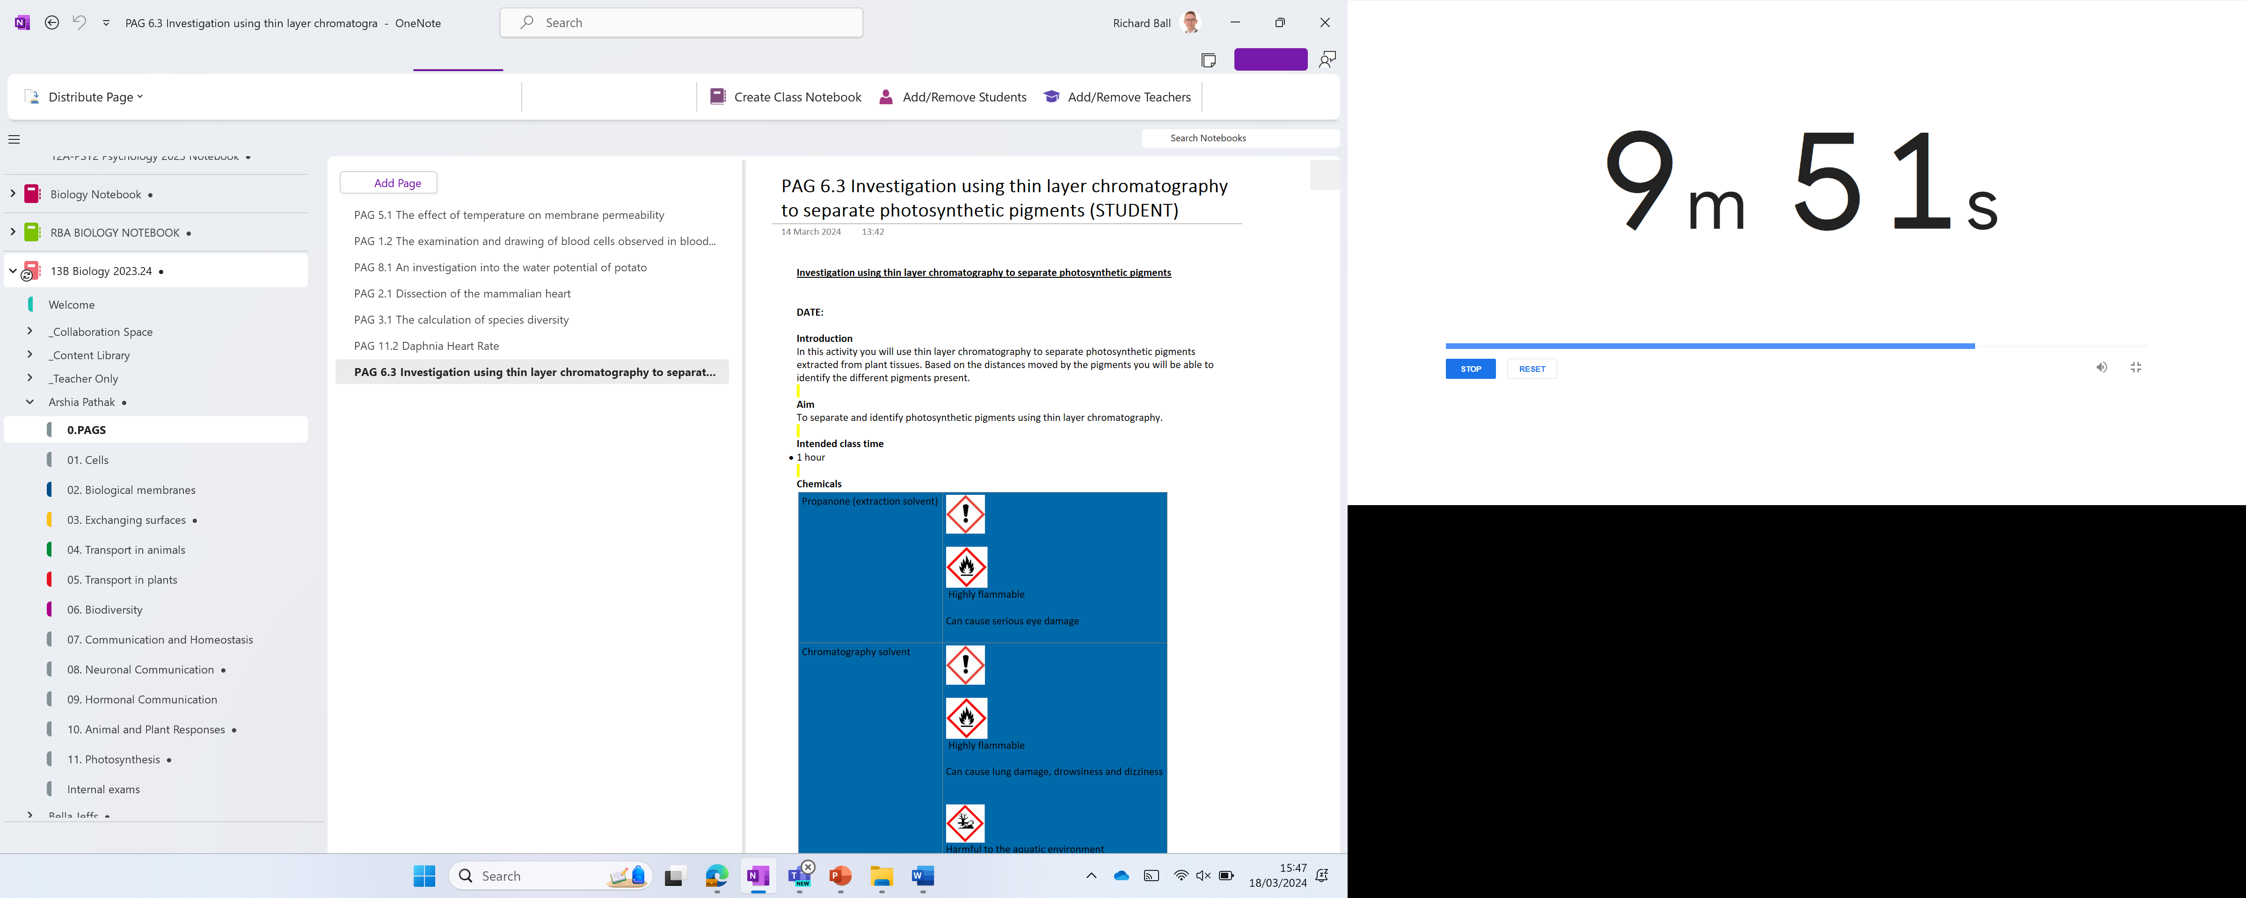

Slide 50
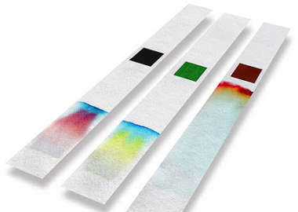
Photosynthesis PAG 6.3
Chromatography

Slide 51
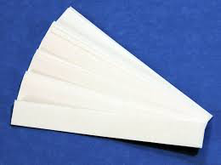
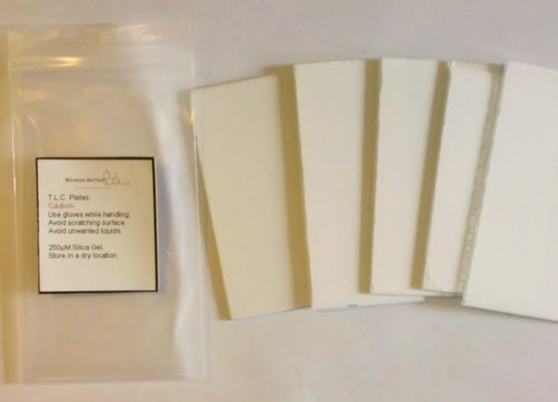
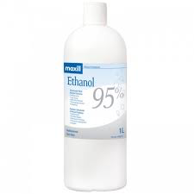
What is chromatography?
The aim of chromatography is to separate a mixture into its constituents: in this case biological molecules.
There are two key components to chromatography, known as the stationary phase and the mobile phase.
2
Mobile phase
1
Stationary phase
This is the solvent for the biological molecules. For polar molecules we use water and for non-polar molecule we use ethanol.
This is either the chromatography paper of a thin-layer chromatography (TLC) plate.
The mobile phase flows through and across the stationary phase, carrying biological molecules with it.
Diagram: chromatography paper
Diagram: TLC plate
The TLC plate is often a sheet of plastic, coated with a thin layer of silica gel or aluminum hydroxide. In each case, there are free –OH groups pointing outwards, in contact with the mobile phase.

Slide 52
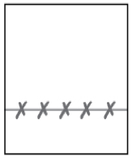
Practical
The diagrams over the next few slide show the protocol for paper chromatography, but it would be the same setup for thin lay chromatography.
Chromatography practical
1. Draw a pencil line across a strip of chromatography paper, about 1cm from the bottom – this is the baseline. You should also put a tiny dot (or cross) on the line to show you where to place your solution mixture.
NOTE: you should draw your link in pencil not ink as the ink would dissolve and the pigments in the ink will also separate.
Baseline

Slide 53
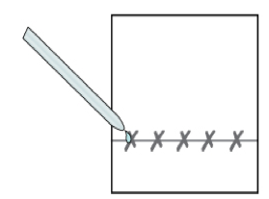
2. Using capillary tubing to put a spot of the test solution onto the pencil dot along the baseline – this the point of origin. Wait for the spot to dry before putting on the next spot!
NOTE: a spot is applied, allowed to dry, then another spot it applied on top of the first. This is done several times!

Slide 54
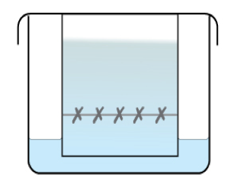
3. When it is completely dry, lower it into the solvent (e.g. water/ethanol). Ensure the level of the solvent at the start is below the baseline and then cover the beaker with a watch glass or glass plate.
Solvent front
Level of solvent

Slide 55
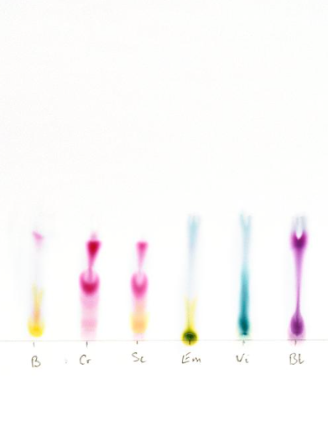
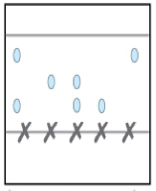
4. Let the apparatus ‘run’ until the solvent has reached a point just underneath the top of the paper/TLC plate. Then remove it from the solvent, and lay it on a white tile to dry.
Diagram: an example of the results from a chromatography experiment.

Slide 56
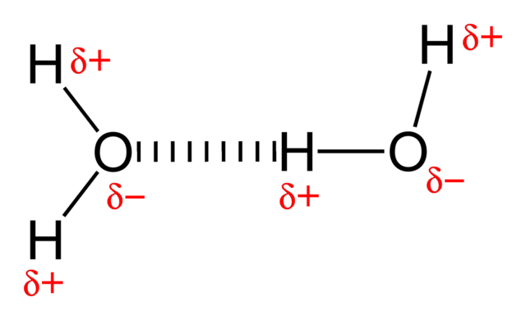
How does it work?
The speed at which molecules move along the paper or TLC plate depends on their solubility in the solvent, and their polarity. In the case of paper chromatography, it may also depend on their size.
Exposed –OH groups make the surface of the paper very polar and allow it to form hydrogen bonds with the molecules.
A highly polar solute will tend to stick to the surface and hence move slowly.
A non-polar solute will travel very quickly up the plate.
Notes:
If two molecules travel at exactly the same speed, it will be difficult to separate them. In this case you could try using a different solvent, or changing the pH.

Slide 57

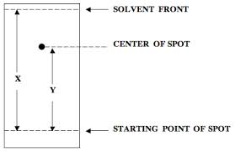
You can calculate the R_{f} value by looking the distance travelled by the spot and the solvent.
(Y)
(X)
You calculate the R_{f} value by measuring the distance from the pencil link to the centre of pigment (x), and the distance from the pencil link to the solvent front (y).
NOTE: if you repeat the investigation under the same conditions, each pigment will always have the same R_{f} value.
Notes:
LEARN

Slide 58
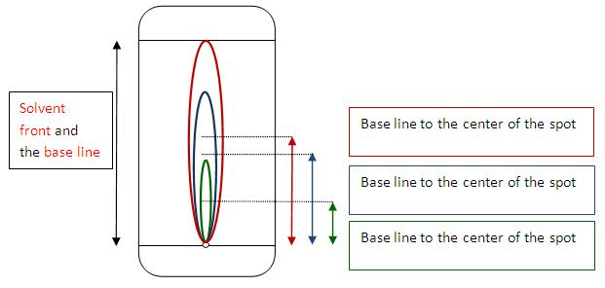

Slide 59
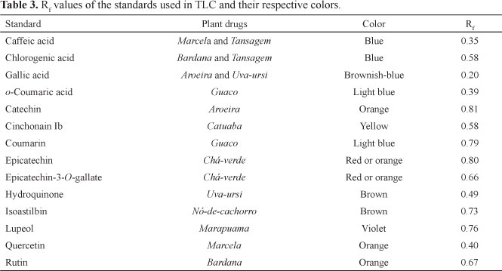
If you know the R_{f} values of particular pigments under certain conditions, it will allow you to identify them. Exactly the same is true of biological molecules.

Slide 60
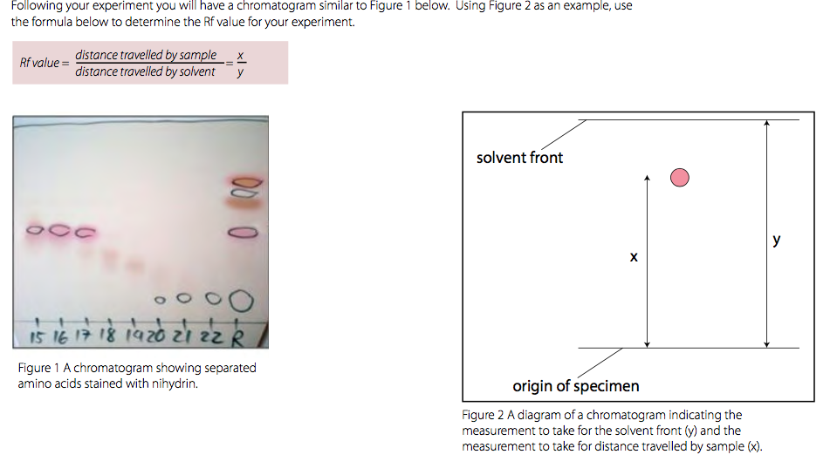

Slide 61
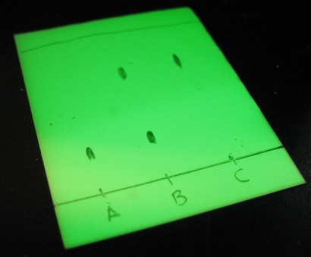
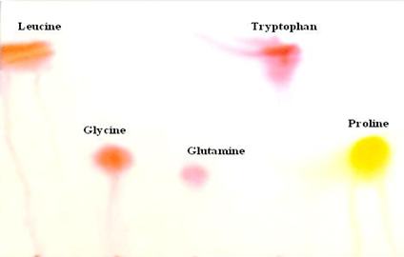
Sometimes with colourless molecules, you cannot see where they finish. Using thin-layer chromatography, there are solutions:
1. Ultraviolet light
2. Ninhydrin
Thin layer chromatography plates have chemical which fluoresces under UV light. If you look at the plate under UV light, most of it will glow, except those places where the spots have travelled to. They mask the plate from the UV light.
To see amino acids, allow the plate to dry, and then spray it with ninhydrin. This binds to the amino acids which are then visible as brown, yellow or purple spots.
3. Iodine
Allow the plate to dry, and place in an enclosed container with a few iodine crystals. The iodine forms a gas, which then binds to the molecules in each of the spots.

Slide 62
Practical Skills to be achieved
1.2.1 (b) Safely and correctly use a range of practical equipment and materials
1.2.1 (c) Follow written instructions
1.2.1 (d) Make and record observations / measurements
1.2.1 (e) Keep appropriate records of experimental activities
1.2.1 (f) Present information and data in a scientific way
1.2.1 (j) Use a wide range of experimental and practical instruments, equipment and techniques appropriate to the knowledge and understanding included in the specification.
1.2.2 (a) Use of appropriate apparatus to record a range of quantitative measurements (length)
1.2.2 (g) Separation of biological compounds using thin layer / paper chromatography

Slide 63

Safety
Label | Identity | Hazard information
Propanone (extraction solvent) | Propanone | Highly flammable. Can cause serious eye damage.
Chromatography solvent | 1 part propanone, 1 part ethoxy-ethane, 2 parts petroleum ether 80˚C. Pre-fill the chromatography tank in the fume hood to a depth of 0.5 cm. | Highly flammable. Can cause lung damage, drowsiness and dizziness. Harmful to the aquatic environment.
Chemicals

Slide 64
Extension Questions
Answers to extension questions
Why is a small spot of pigment needed on the TLC plate?
To minimise the spread, and potential overlap, of the different pigments and hence allow clear separation.
Why is propanone used as the extraction solvent?
All the pigments are soluble in propanone. An extraction solvent can only extract those compounds that it dissolves.
Why is the chromatogram run in the dark?
The pigments will fade in the light.
How could you find out whether the separated pigment spots you have observed on your chromatogram are single, pure pigments or a mixture of two or more?
Using a different chromatography solvent and/or a different stationary phase (e.g. paper instead of silica gel) could separate pigments which run together in this particular solvent and stationary phase. Two dimensional chromatography using a square of TLC film would be one solution.

Slide 65
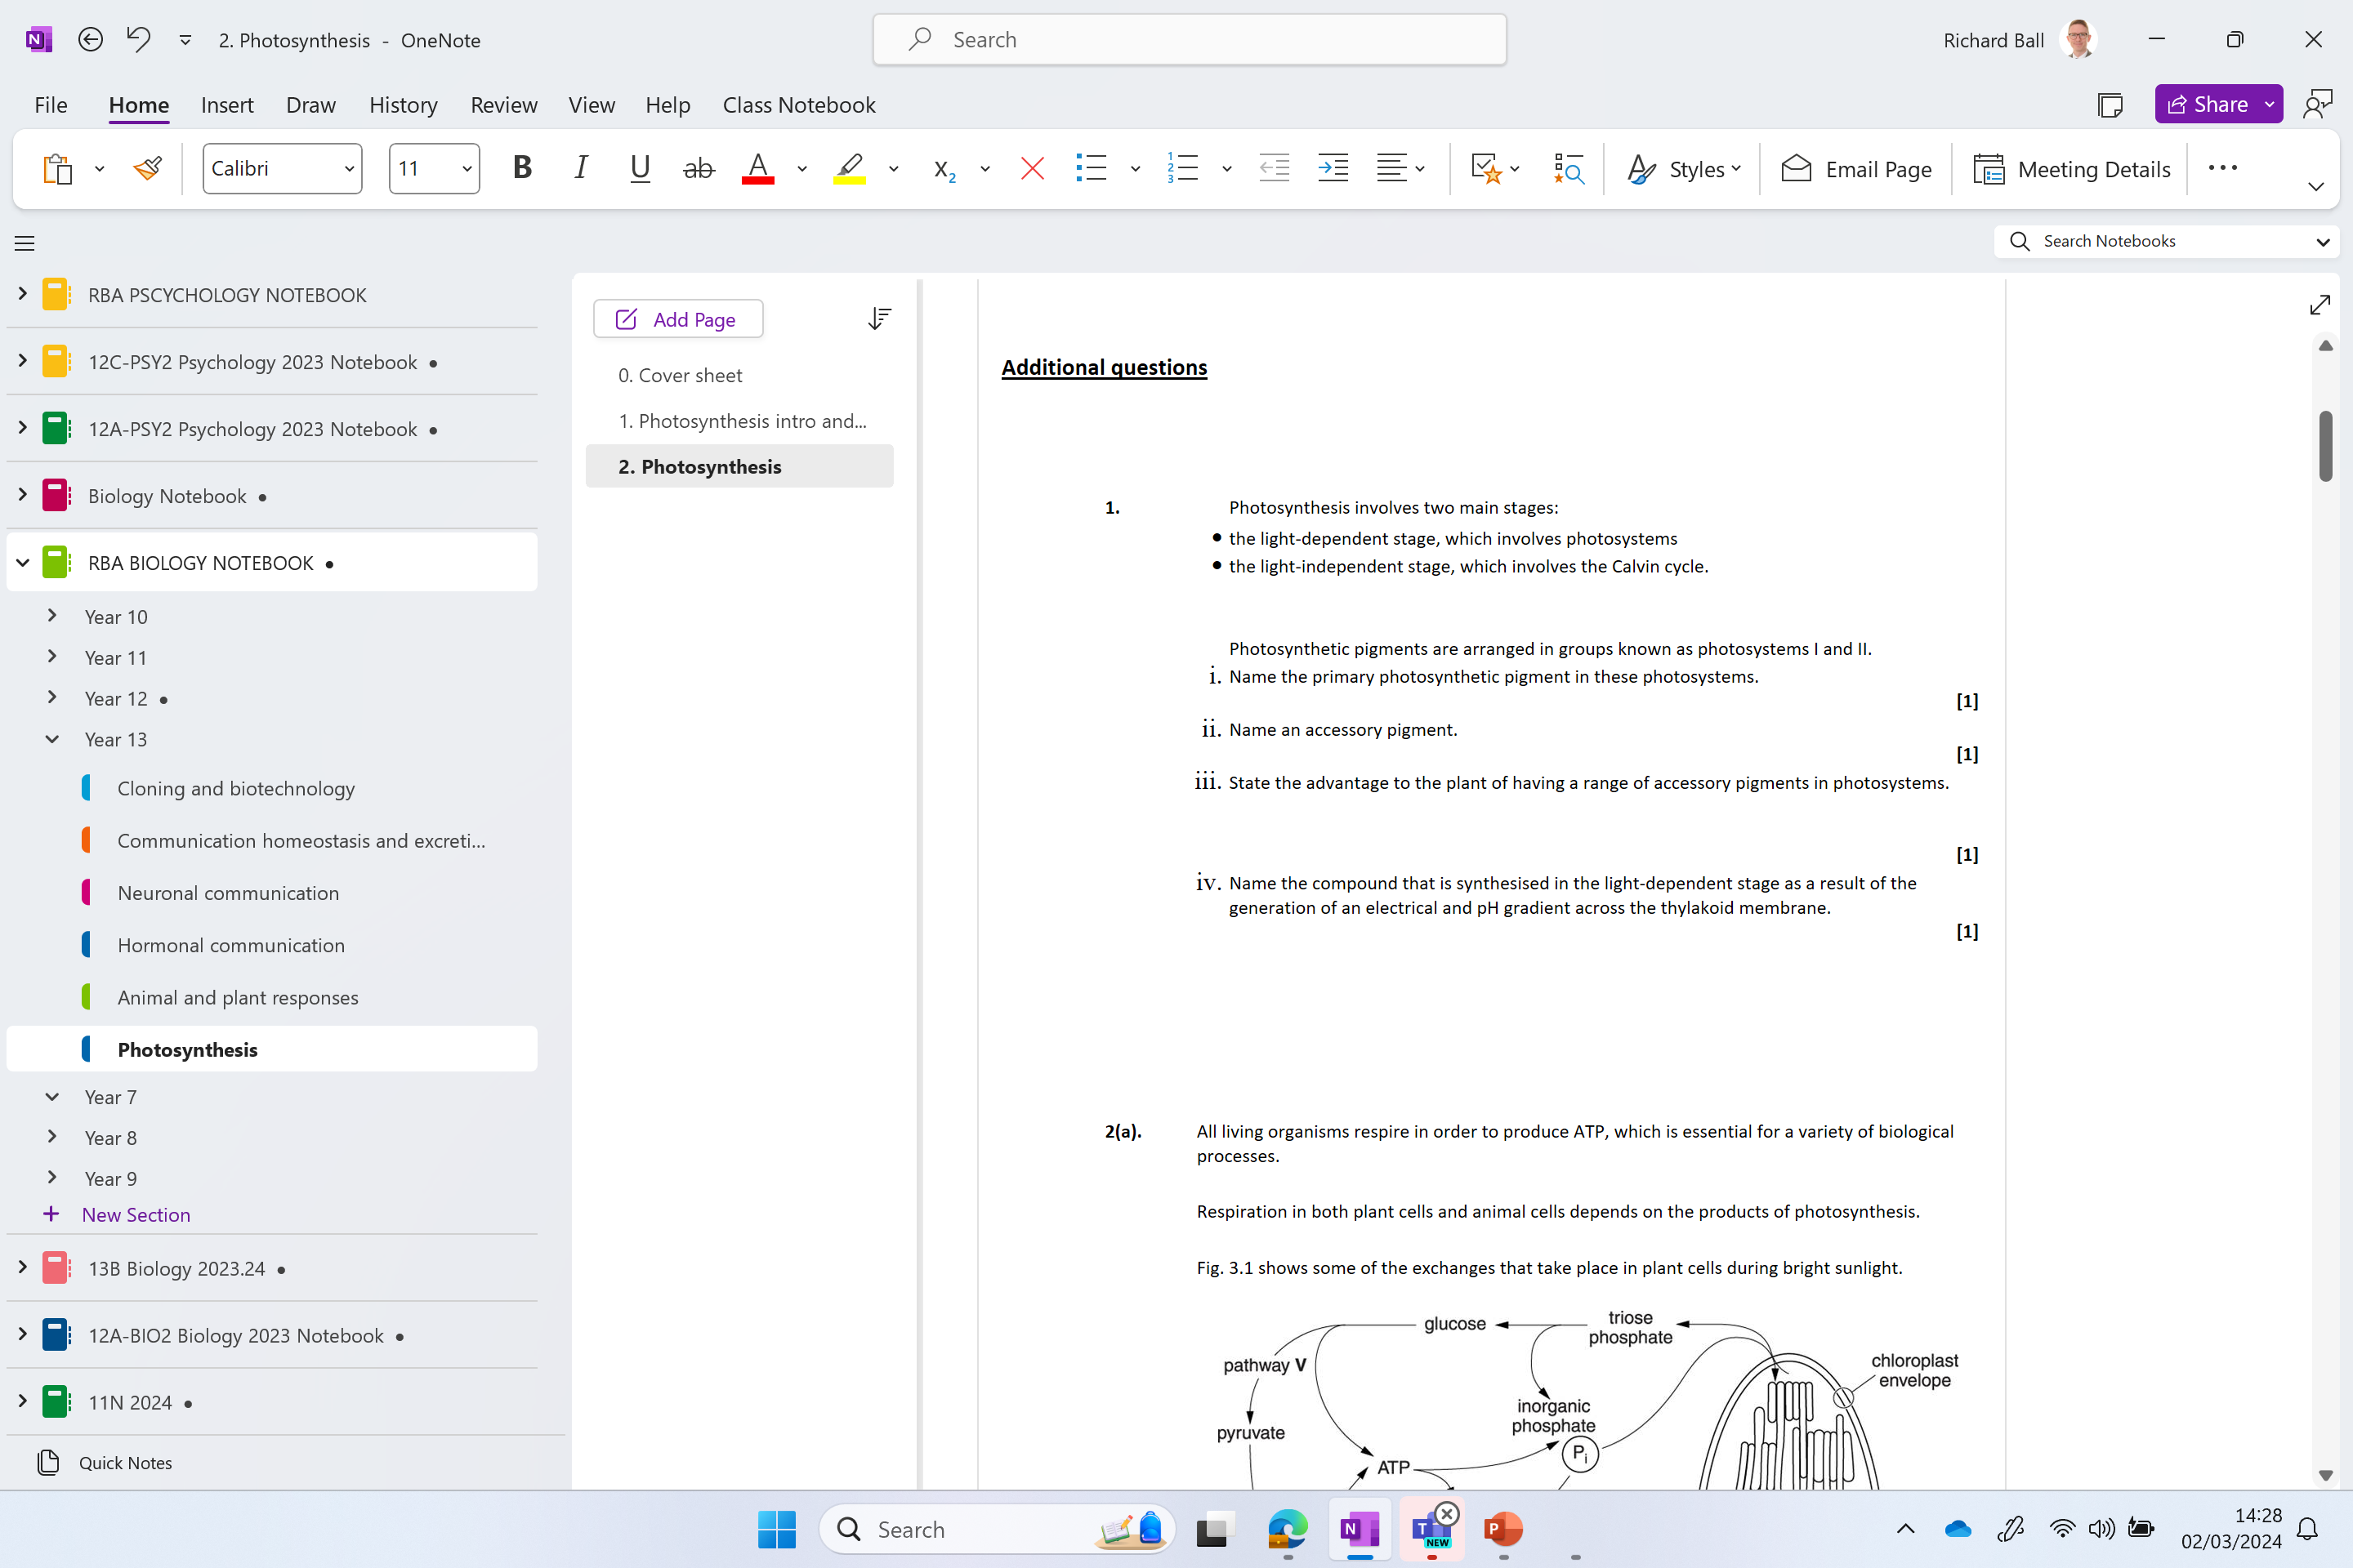
Additional questions

