Slide 1

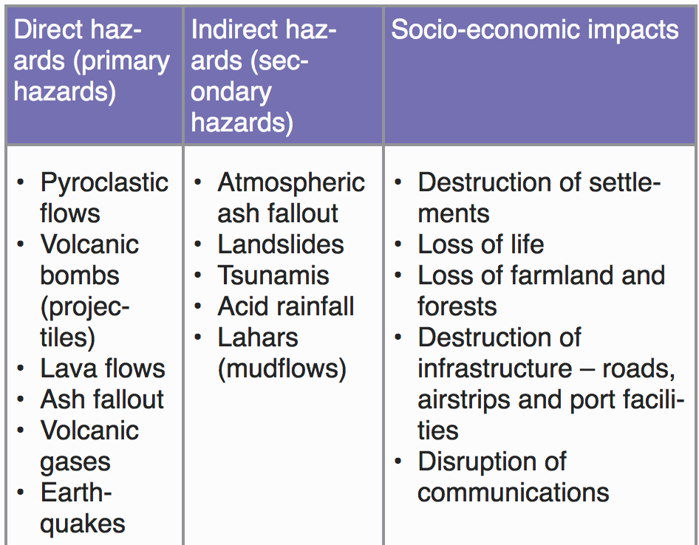
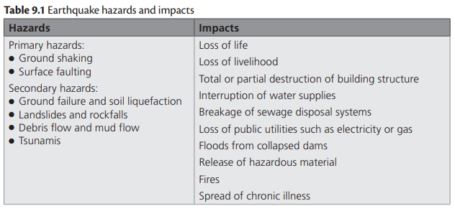
Secondary hazards of tectonic events

Slide 2
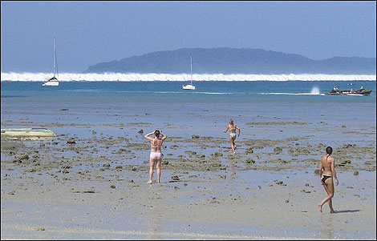
Secondary hazards of tectonic events
Learning Objectives
Identify what a tsunami is
Describe how they are caused
Explain the short term and long-term impacts of tsunamis
Discussion Questions:
What does the Japanese word “tsunami” mean?
How are tsunami’s caused? – Explain this fully.
Explain what happens as the tsunami waves ripple outwards.
What impacts do tsunamis create?
Do all earthquakes and volcanoes lead to tsunamis? Why or why not?
Give one example of how tsunami’s can be measured.

Slide 3

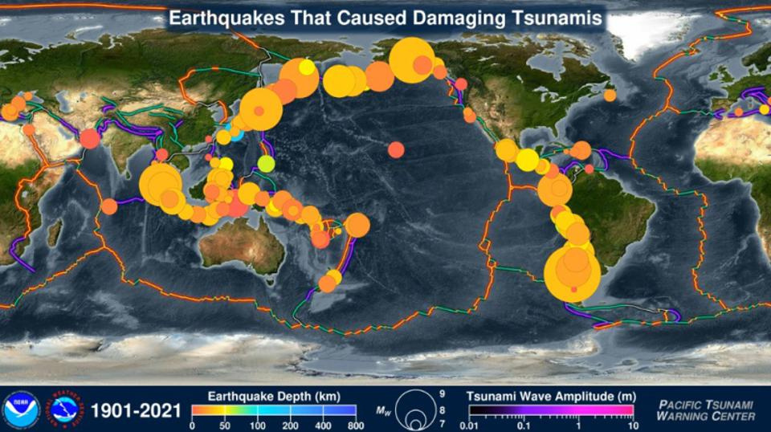
Tsunamis 101 - https://www.youtube.com/watch?v=_oPb_9gOdn4
What is a tsunami?
Complete some research into tsunami’s by clicking the link below: https://spaceplace.nasa.gov/tsunami/en/

Slide 4
Tsunami Footage
Tonga hit by Tsunami from nearby violent volcanic eruption
Why the Indian Ocean Tsunami Was So Deadly
Image of the Week - 2004 Indian Ocean Tsunami
Boxing day Tsunami 2004

Slide 5
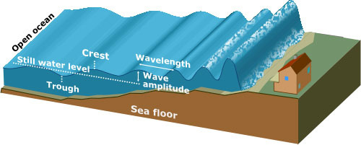
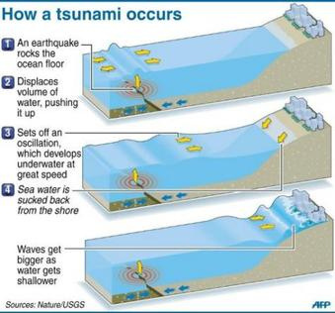
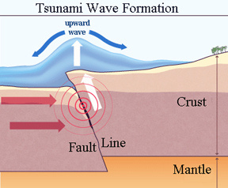
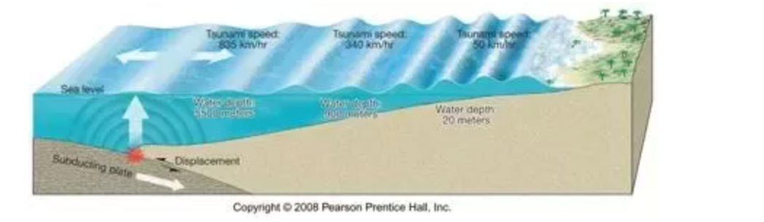
How are tsunamis caused?
8 Explain the formation of tsunami. Evaluate the extent to which the hazardous impacts of tsunami may be reduced. [20]
Study the diagrams below. Using them, can you write a paragraph describing & explaining the formation of a tsunami.

Slide 6
How are tsunamis formed:
Extension: Watch this excellent video about Tsunami’s
8 Explain the formation of tsunami. Evaluate the extent to which the hazardous impacts of tsunami may be reduced. [20]
Most tsunamis are caused by underwater earthquakes at destructive plate boundaries.
The same processes happen as with a normal earthquake. When the pressure releases and the plates slip, the plate movement displaces a lot of water, causing a series of waves to ripple outward from the epicentre (imagine throwing a large rock into a lake).
The waves can travel large distances at great speed, but are relatively small when in the open ocean. When the waves reach shallower water the following happens:
the shallow water slows the waves (friction)
the waves get closer together
the height of the waves can increase by several metres
Water retreating is a sign that a tsunami is approaching a coast. Shortly after this happens, the waves reach the shore.

Slide 7
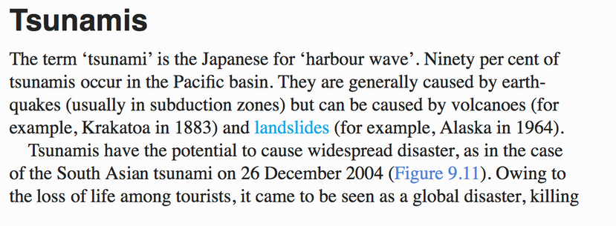
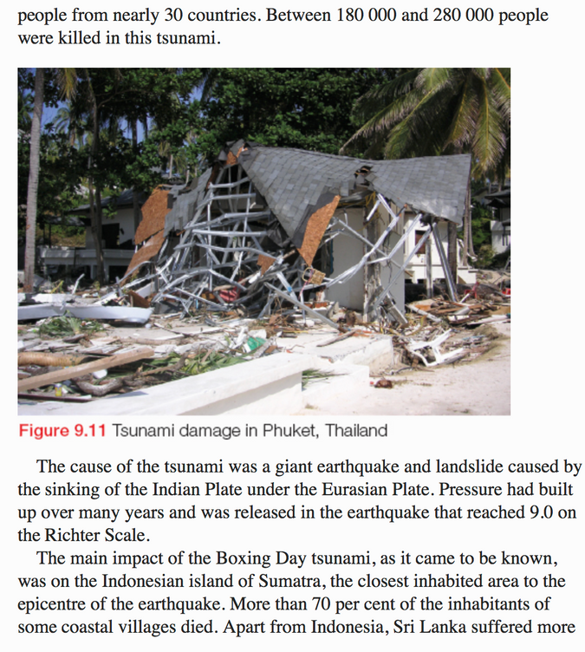
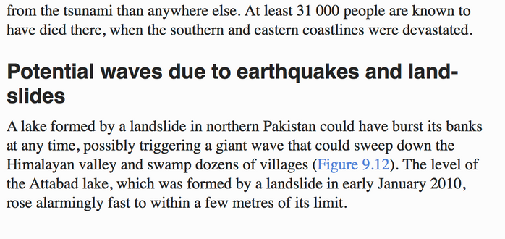
What are the impacts of tsunamis
The 2004 South-East Asia tsunami is a widely-used tsunami case study. The earthquake measured 9.1 on the Richter Scale & the impacts in the region were far-reaching and catastrophic. There is lots of information online relating to the causes, impacts, management/response.
Do some research to find some of the other impacts, evaluate the management strategies….

Slide 8
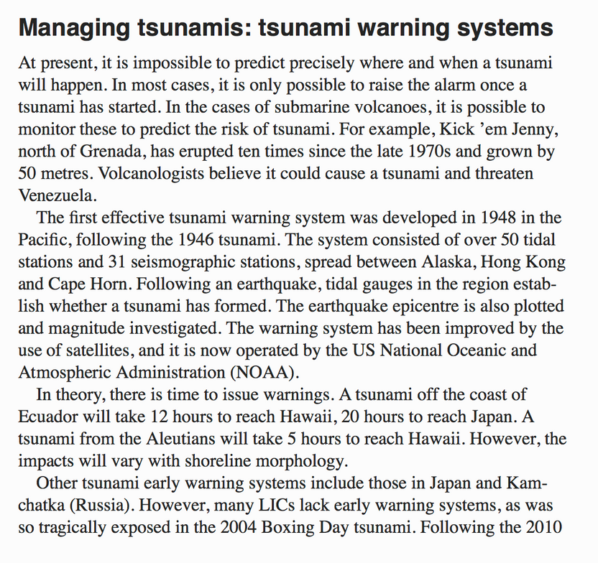
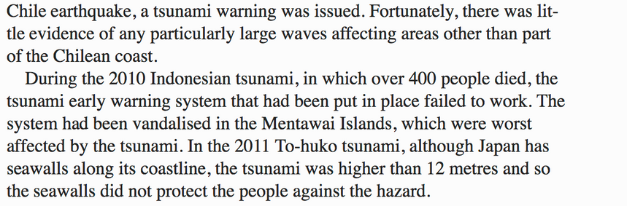
Managing tsunamis
Watch the following two short videos which relate the ways to protect against the dangers of tsunamis. The second video is based on Japan's plans to build a 2200km great wall. Then, read the textbook extract on the right. Consider the following:
Identify the ways in which tsunami’s can be managed
Outline the different warning systems that have been used
Assess the effectiveness of these systems
Potential 20 mark Exam Question:
To what extent is it possible to manage the impact of tsunamis?
8 Explain the formation of tsunami. Evaluate the extent to which the hazardous impacts of tsunami may be reduced. [20]
https://www.youtube.com/watch?v=4UKO-NIdlbE&feature=emb_logo
https://www.youtube.com/watch?v=s1uaB41bLRk&feature=emb_logo

Slide 9
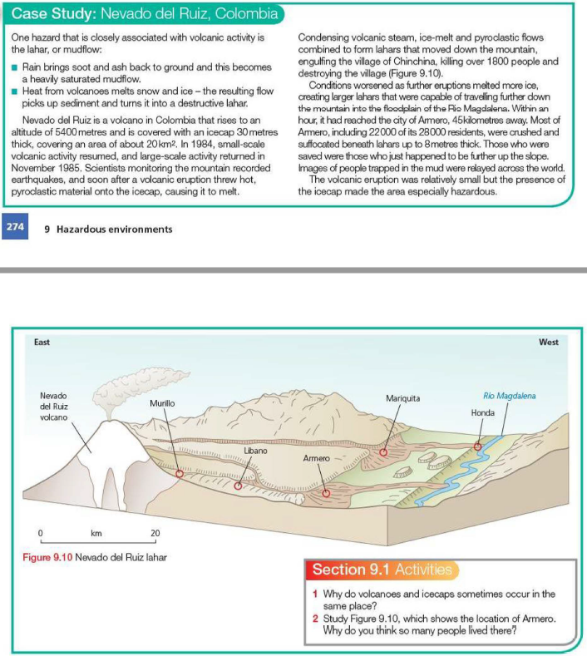
Secondary hazards of volcanic activity – Lahars/mudflows
Landslide from volcanic eruption – Mount Meager, Canada, 2010
Planetary cooling due to volcanic ash: Climate change – as the addition of dust to the atmosphere results in temporary cooling, e.g. Mount Pinatubo in the Philippines.
You can learn more here.

Slide 10
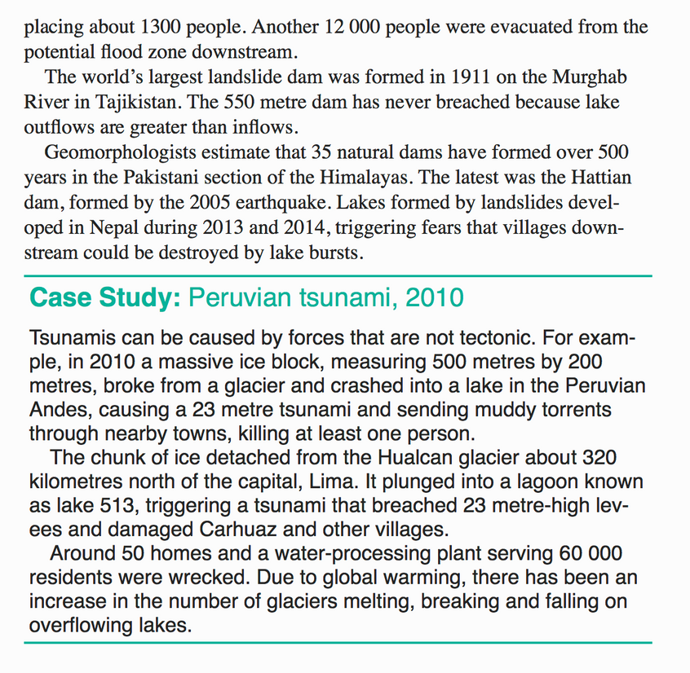
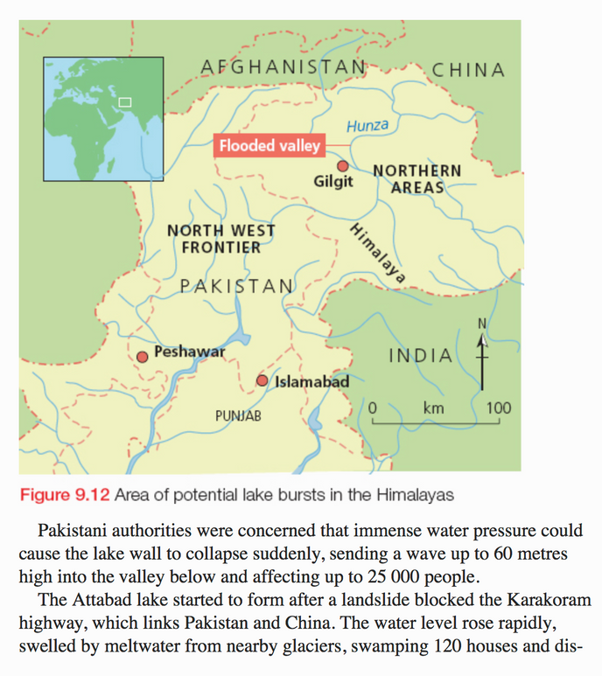
Potential tsunami waves due to non-tectonic events - landslides

