Slide 1
Watch each clip in order
(97) Our Forests | Timelapse in Google Earth - YouTube
Paraguay Deforestation: The Soy Invasion | Tropic of Capricorn | BBC Studios - Bing video
(97) Will Lemurs Lose Their Home Forever? | Indian Ocean with Simon Reeve | BBC Studios – YouTube

Slide 2
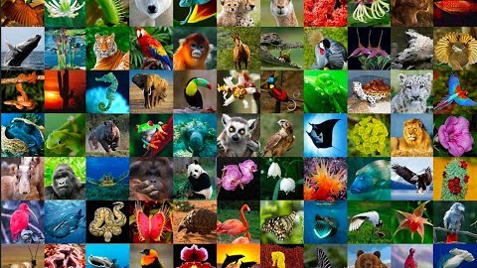
Conservation agreements
How do local and international agreements help to preserve biodiversity?

Slide 3
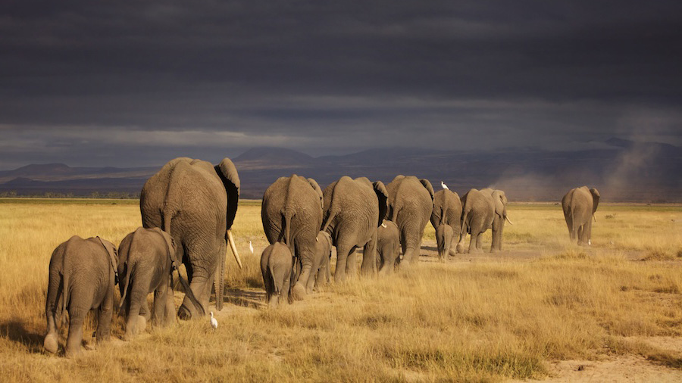
Animals do not respect boundaries
Cross-border protection should be offered to increase chances of survival
Why do these agreements need to be international?

Slide 4

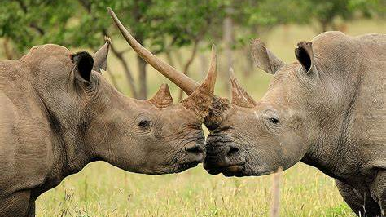
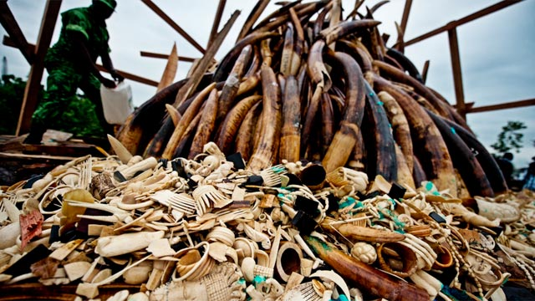
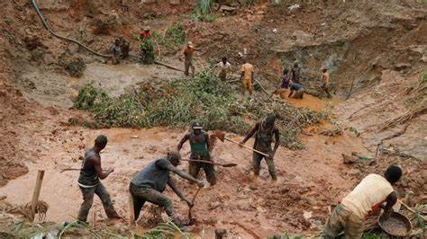
Why do local and international agreements help to preserve biodiversity?

Slide 5

Conservation agreements
These aim to protect and preserve habitats and individual species
Why do local and international agreements help to preserve biodiversity?
  Animals do not respect nations’ boundaries
  Landowners/countries have economic/cultural reasons for exploiting natural resources – leading to loss of biodiversity
  Financial incentives are often needed to replace the income exploiting a resource would provide
  Agreements between nations needed to manage endangered populations and help limit trade of controlled/protected species

Slide 6
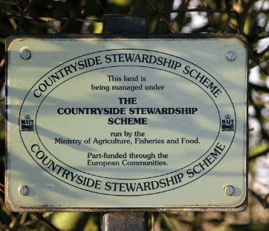

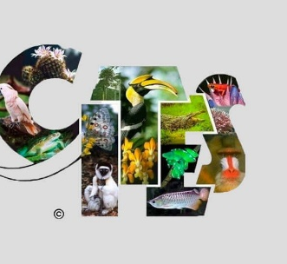
Task:
Go away into research groups and find the following information about the following conservation agreements
  Acronyms and what they stand for
  When formed and why
  Aims of convention/agreements made
  Any relevant additional information

Slide 7
Historic and/or current agreements include:
The Convention on International Trade in Endangered Species
The Rio Convention on Biological Diversity
Countryside Stewardship Scheme

Slide 8

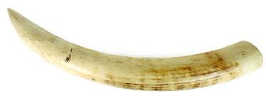
Convention on International Trade in Endangered Species (CITES)
Formed: 1963 – International agreement
Member countries agreed:
Not to kill endangered species
Limit trade by licensing
Illegal to trade products from endangered species
Raise awareness of threats to biodiversity

Slide 9

The Rio Convention on Biological Diversity (CBD)
Formed: 1992 - International agreement
Aims:
Develop international strategies on the conservation of biodiversity
Using plant and animal products in a sustainable way
International law – Biodiversity is everyone’s responsibility
Provide guidance to governments on how to conserve biodiversity

Slide 10
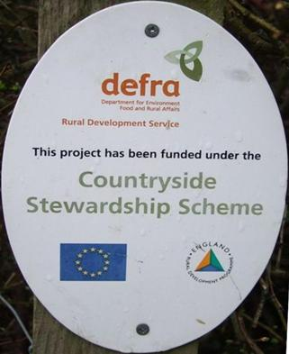
The Countryside Stewardship Scheme (CSS)
Formed: 1991 – Local agreement
Aims to:
Farmer are offered payments for conservation (improve hedgerows, grassy margins for wild flowers)
Conserve wildlife and biodiversity
Improve and extend wildlife habitats
Promote land management techniques to land owners

