Slide 1

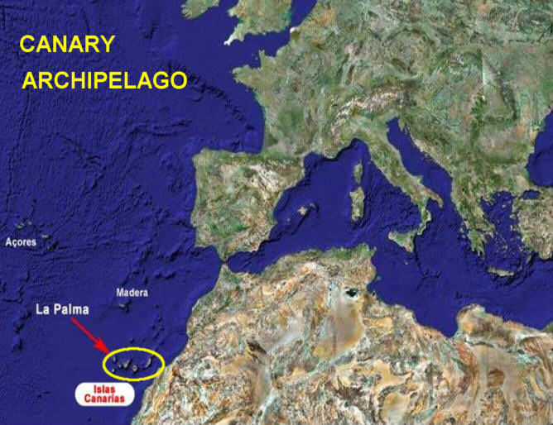
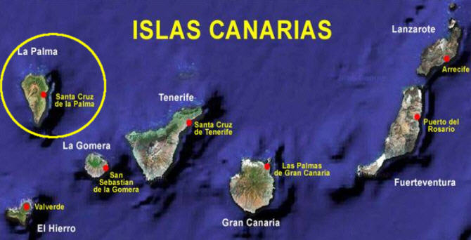
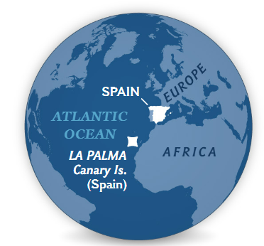
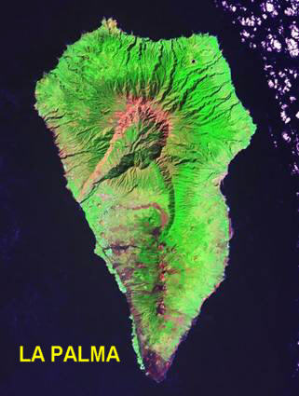
How to use an article/webpage to help your essay writing
Cumbre Vieja, La Palma, Canary Islands
Eruption started on September 19 2021 and lasted for 85/86 days
The Canary archipelago is located in the Atlantic Ocean, about 1300 km South from the mainland Spain and 115 km West from the African cost (Morocco). It includes 7 islands belonging to Spain, among which La Palma (in the North-West of the archipelago), Tenerife and Gran Canaria (central).
Let’s read the excellent National Geographic Article first - here

Slide 2
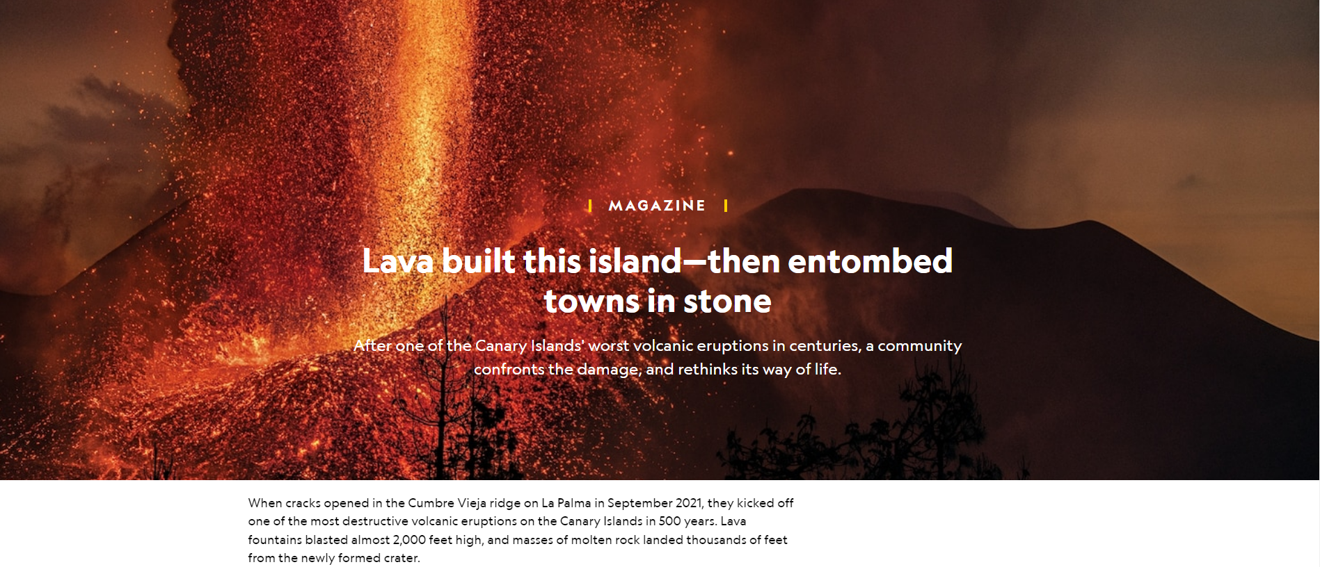
Good place specific info, and stats.
Volcanic Hazards
What is 2000 feet in metres?

Slide 3
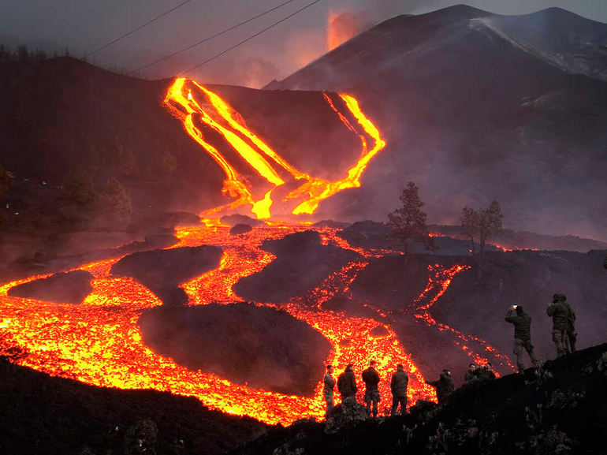
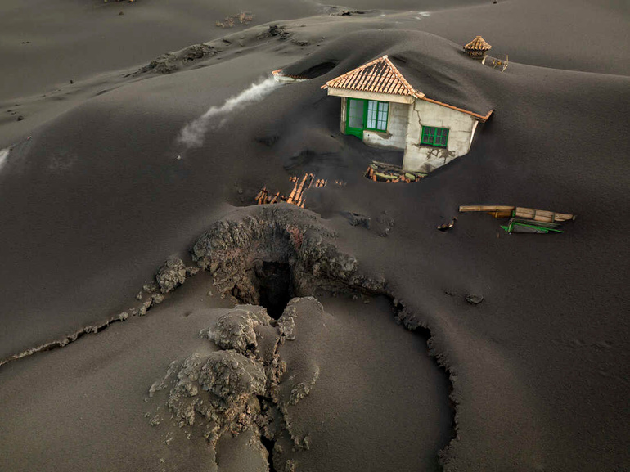
The air ahead shimmers with heat as I approach an entrance to the underworld. Wind roaring in my ears, I carefully follow the footprints of my guide, Octavio Fernández Lorenzo, across a blackened landscape on La Palma in the Spanish Canary Islands.
“This is almost as far as we can go,” he says suddenly, stopping a few yards from our target, the maw of a volcanic cave known as a lava tube. We continue a few more steps toward the entrance, where a private drone operator had recently registered temperatures of 338°F—hot enough to bake bread. Fernández Lorenzo, vice president of the Canary Federation of Speleology, has been keeping close watch on the slowly cooling cave; he hopes to eventually enter to gather clues about one of the archipelago’s most destructive volcanic eruptions in 500 years.
For nearly 86 days, starting September 19, 2021, molten rock coursed from cracks high on the island’s Cumbre Vieja ridge, inching downslope in incandescent rivulets that branched and rejoined like the strands of a braided stream. The volcano did not directly claim any lives. But the eruption gushed more than 261 million cubic yards of lava and built a cone of ash and rock over 650 feet tall, where we now stand. Just a year ago, this area of the island was a verdant pine forest with a scattering of homes. Now only the tallest parts—the upper branches of trees, the tip of a lamppost, the ridge of a roof—are visible above mounds of coarse black sand. Entranced by this dystopian scene, I barely register Fernández Lorenzo’s suggestion that we head uphill, his voice muffled behind a gas mask. But then his tone changes.
Blackened landscape – solidified magma from the lava flow turned to basalt rock, which is black in colour. Lot’s of potential negative impacts of this, environmentally and socio-economically. Also, good info on the nature of the eruption.
Lava tube - A lava tube, or pyroduct, is a natural conduit (passageway/tunnel) formed by flowing lava from a volcanic vent that moves beneath the hardened surface of a lava flow – Nature of the eruption.
Speleology is the study of caves. This person will collect samples of rock from the eruption and study/analyse them to help deepen understanding of volcananism in the region – management strategies/responses, being pro-active, help understand the nature of the eruption, the volcanic materials, could it help predict future eruptions??
Nature of eruption – extensive flow, braided channels. Built a cone of ash and rock 200 metres tall. Nearly 200 million cubic metres of lava Hawaiian eruption? Central activity, runny (low viscosity), basaltic lava travels down the side of a volcano in lava flows. Gases escape easily, non-explosive. Occasional pyroclastic activity but this is of less significance than the eruption. Learn more about this on L5, slides 5-9, to enable L4 access.
Impacts – no deaths (social). Destruction of pine forests (environmental – further impacts of this i.e. loss of biodiversity, impact on food chains etc.). Destruction of houses (social, socio-economic?). Destruction of infrastructure (economic, cost of rebuilding)

Slide 4
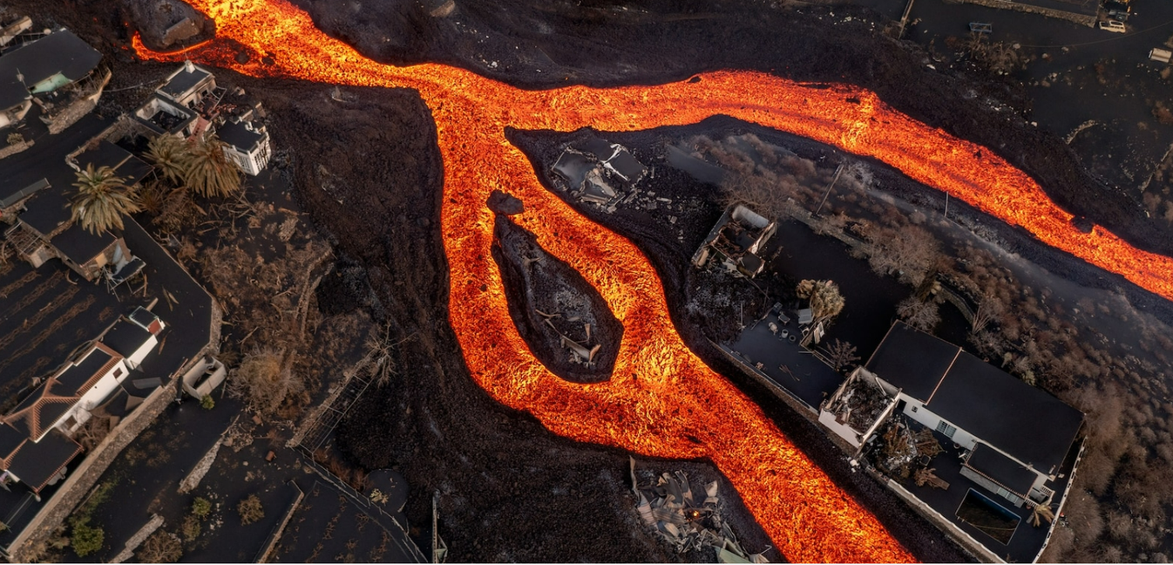
“Up, up, up, up,” he says, each word increasing in volume and urgency. “We’re going to burn.”
The wind had shifted in a gust from the valley below, potentially blasting us with scorching air. The ground crumbles and shifts beneath my feet as I struggle up the steep flank of the volcanic cone to find a safer perch for surveying the scene.
La Palma has a long history of eruptions, but its fiery fits usually aren’t considered dangerous. The chemistry of its lava makes it flow as sluggish rivers rather than explode in the dramatic blasts that devastate other parts of the world. The last eruption on the island was in 1971, when molten rock burst from a fissure in a sparsely populated region near the southern coast, providing a show of geologic pyrotechnics that caused comparatively little damage. Since then, though, the island’s population has grown; over 86,000 people now live on 273 square miles of land. When the volcano erupted last year, lava swallowed more than 2,800 buildings, 864 acres of farmland, and over 43 miles of road. Many difficult years of reconstruction lie ahead, hampered by lingering magmatic heat and an unclear economic future.
Nature of eruption – Low-viscosity lava & non-explosive eruption due to lava chemistry. Low silica content (SiO2). Low silica because…. Learn more about this on L5, slides 5-9, to enable L4 access.
For months the lava flowed downslope in rivers, overwhelming everything in its path. Homes, restaurants, shops, churches, agricultural fields, and schools once sat in the three and a half miles between the new volcano and the sea. Now they’re all entombed in stone.
Impacts. Social, economic and socio-economic. Can link with inflation and recession – potentially long term impacts?

Slide 5
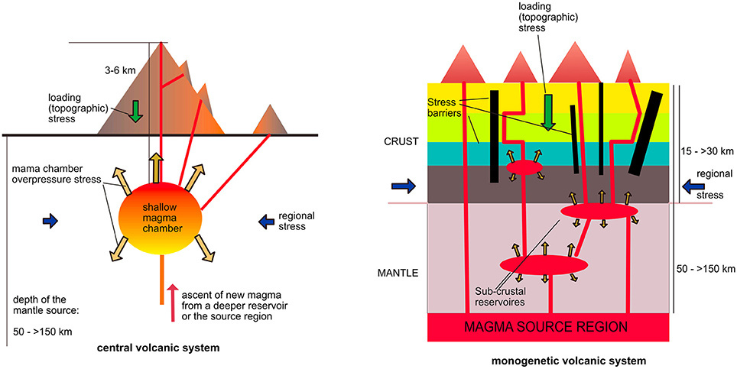
Around the world, about 60 million people live in the shadow of active volcanoes, so as the global population continues to grow, disasters like that seen in La Palma will become more common. Perhaps by better understanding what happened on this tiny island, its residents and those in similar communities can better prepare for future volcanic catastrophe.
“Volcanoes have built La Palma,” says Fernández Lorenzo. “We have to learn to live with them.”
Destructive as they may be, volcanoes are the lifeblood of the Canary Islands, a subtropical archipelago some 50 miles off the coast of Africa. Past eruptions sculpted the land into a spectacle of nature, from sweeping coastal cliffs and black-sand beaches to mountains packed with plants not found anywhere else.
Over the centuries, nutrient-rich lava flows have broken down into fertile soil. When Castilians conquered the islands in the 15th century, they ravaged the Indigenous population and converted the land into sugar plantations, which then gave way to other crops. Before the 2021 eruption, half of La Palma’s gross domestic product came from bananas grown for export.
Exactly what drives the Canaries’ volcanism is still debated, but much of the firepower likely comes from a plume of superheated rock rising from deep underground, known as a hot spot. As the African tectonic plate inches over this plume, new volcanoes—and baby islands—are born. La Palma is one of the youngest and most volcanically active islands in the Canaries. The northern volcanoes have fallen silent, though, and for the past 150,000 years, La Palma’s eruptions have struck exclusively in the hot, dry south, which is bisected by the Cumbre Vieja ridge.
Magma rises like a curtain under Cumbre Vieja, exploiting cracks or weaknesses to rush to the surface. No two eruptions follow the same path, a process known as monogenetic volcanism, which means scientists never know exactly where the next one will pop up.
Positive impacts of volcanic eruptions – create new land, new islands, incredible landscapes, can encourage/promote wildlife and biodiversity.
Volcanic materials bring nutrients from within the Earth and deposit them as ash and pyroclastic material. Lava flows break into fertile soil – positive impacts of this?
Volcanic activity has played a role in enabling banana exports to become 50% of La Palma’s GDP.
Causes of the eruption – still not fully understood. Most likely a hotspot. Great place-specific information here. Stationary magma plume, and slowly moving tectonic plate results in creation of volcanic island chains, with newer islands being created as older islands move away from the plume. Learn more on Lesson 1, slide 28.
A monogenetic volcanic field is a type of volcanic field consisting of a group of small monogenetic volcanoes, each of which erupts only once, as opposed to polygenetic volcanoes, which erupt repeatedly over a period of time.

Slide 6
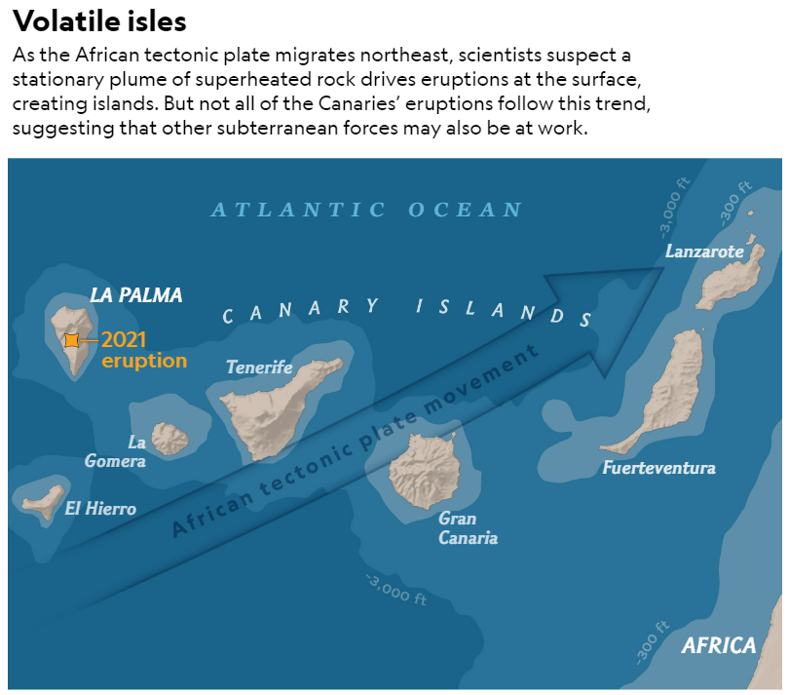
Causes of eruption

Slide 7
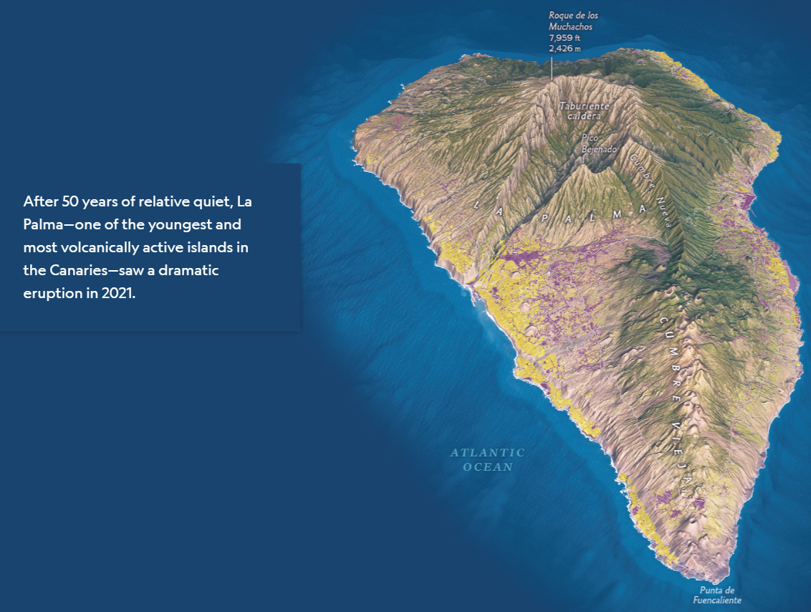
Living in the path of chaos

Slide 8
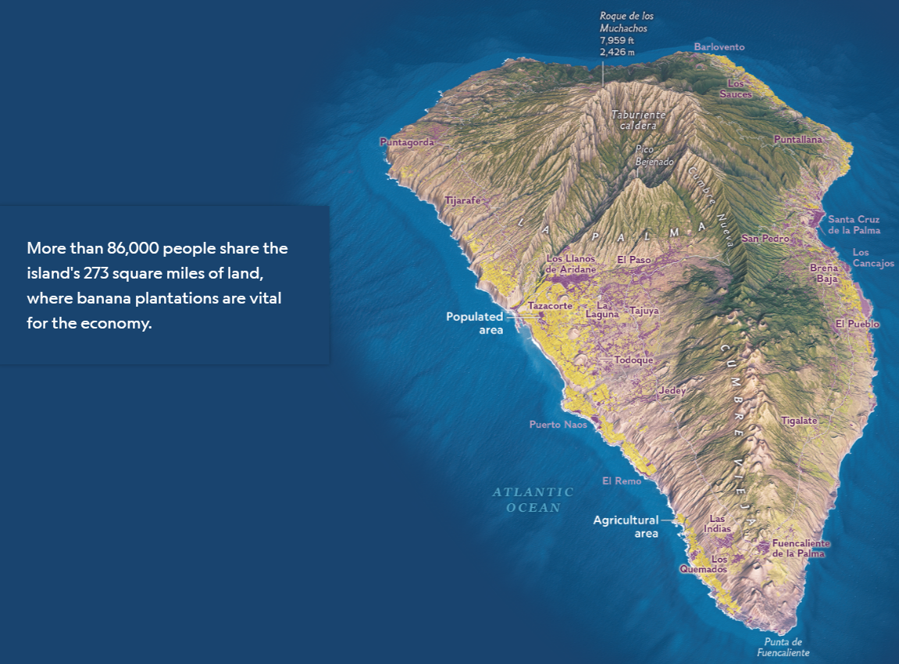
Living in the path of chaos
Can make note of the population distribution of the island, as well as describe it’s terrain/relief.

Slide 9
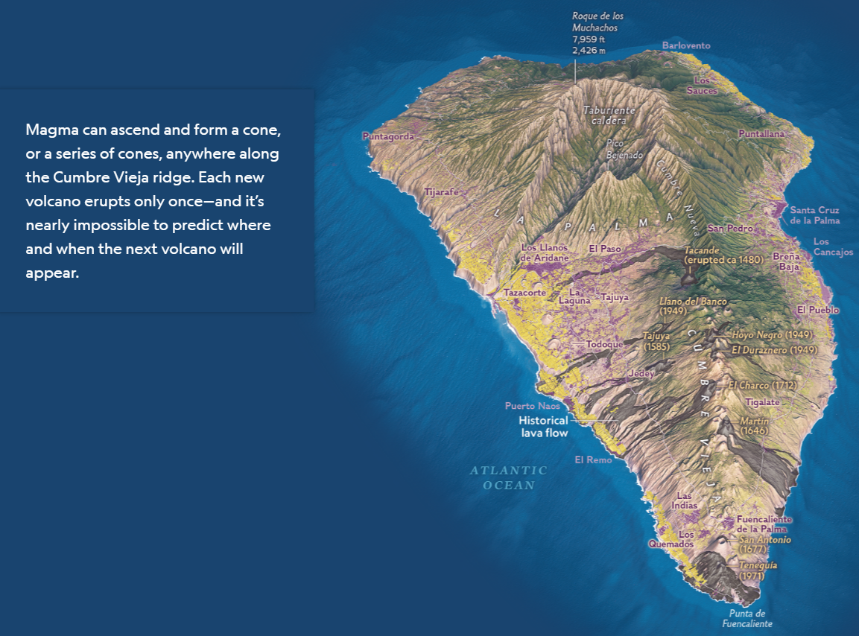
Living in the path of chaos
What are the patterns trends of historical eruptions and flows?
Nature of flows on La Palma
Difficulties in management

Slide 10
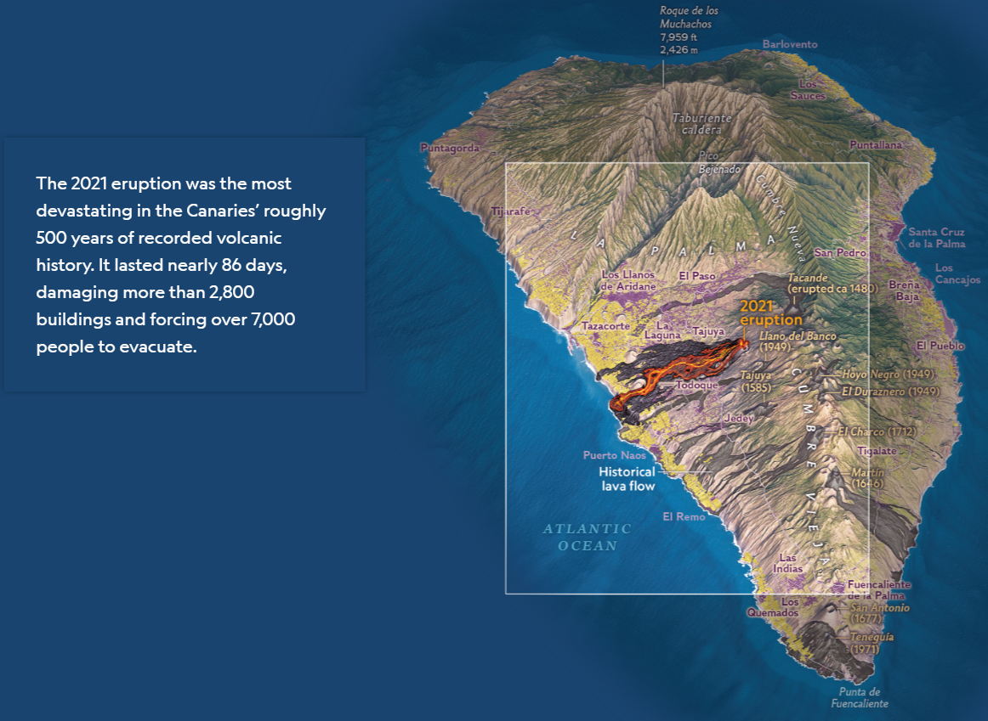
Living in the path of chaos
Nature and pattern of flow of 2021 eruption. Describe the flow/path of the lava flow? Name affected areas?
Impacts and responses (evacuation)

Slide 11
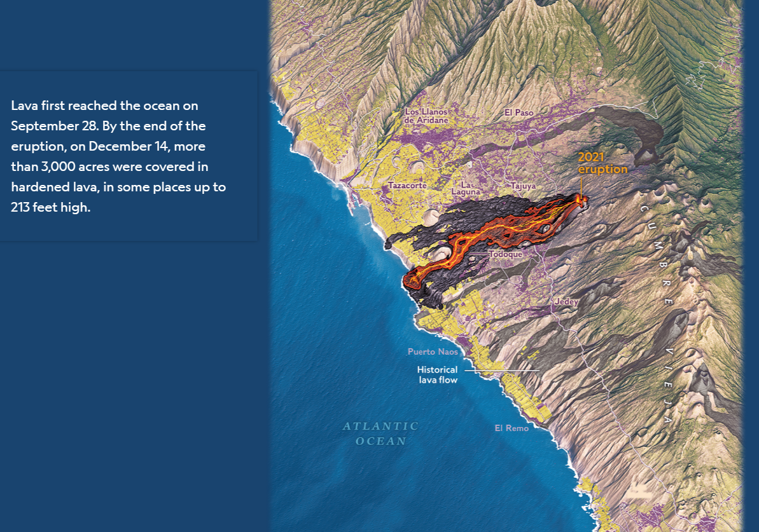
Living in the path of chaos
Nature and pattern of flow of 2021 eruption. Describe the flow/path of the lava flow? Name affected areas?
Impacts and responses (evacuation)

Slide 12
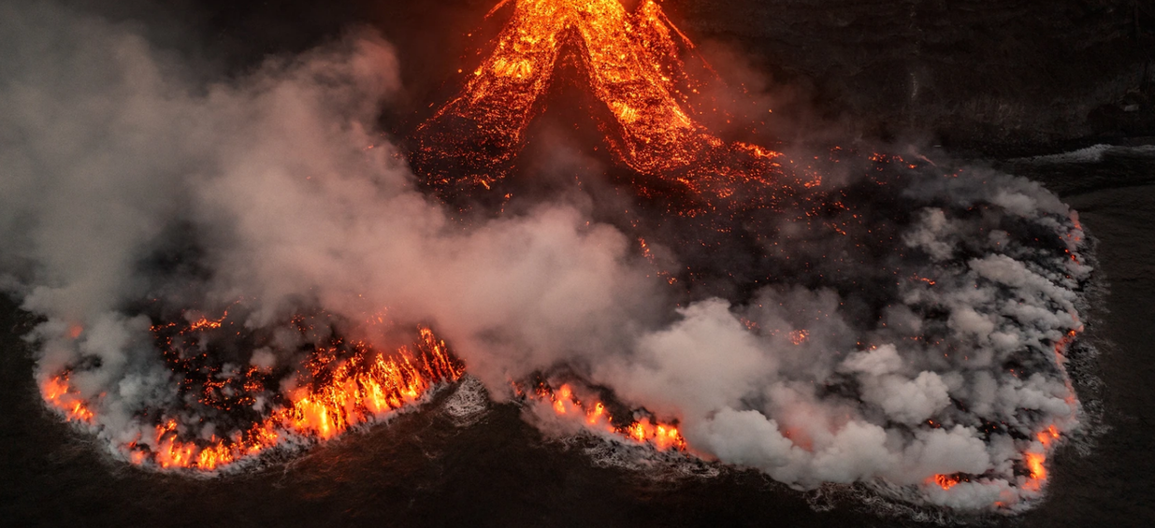
Magma rises like a curtain under Cumbre Vieja, exploiting cracks or weaknesses to rush to the surface. No two eruptions follow the same path, a process known as monogenetic volcanism, which means scientists never know exactly where the next one will pop up.
As the recent eruption showed, this is a huge challenge for protecting the thousands of people who live on the slopes of the ridge. And after five decades of volcanic slumber, many locals had never witnessed their island’s full geologic power. There also seems to have been a disconnect between the activity scientists observed at the volcano in the days leading up to the eruption and what the public understood would happen. The result was devastating.
“We didn’t know what was coming,” says Ana Jesica Acosta Cruz, a local shop owner and previous resident of Todoque, a town now entirely paved over in jet-black rock. “We didn’t know it was going to be this demon.”
Managing the volcano – due to the process of monogenetic volcanism = difficult/impossible to predict when/where next eruption will occur. Difficult to hazard map with the nature of this volcanism. Negatively affects their ability to manage eruptions. Can’t predict, so difficult to protect people living in proximity to Cumbre Vieja ridge.
People unaware of risk. Illustrates that perhaps education and awareness of volcano/volcanic hazards was limited amongst islanders. Is this a flaw in preparedness from authorities? Is this poor management? Or is it down to the monogenetic volcanism nature of the volcano? = EVALUATION of management!!
This indicates poor management. It seems scientists were aware of the potential of impending volcanic activity but communication from scientists to the public wasn’t effective, meaning locals were not aware of what would happen.
Environmental impacts – positive and negative
Incandescent streams of lava flow into the ocean, extending La Palma’s coastline. The eruption devastated marine ecosystems nearby, but new life has already begun to flourish atop the nutrient-rich underwater rocks.

Slide 13
The earthquake swarm that kicked up on September 11, 2021, was one clue to the potential for disaster. The ground also began to swell and shift—a sign of magma moving below. Authorities quickly activated the islands’ volcanic emergency plan, which brought together a scientific committee of eight organizations and universities to pore over data and figure out what might happen next.
The plan communicates increasing volcanic hazards using a four-color “traffic light”—green, yellow, orange, and red. On September 13, authorities set the level to yellow, which means that the public should pay attention to official communications because of an increased eruption risk.
The earthquakes, which numbered in the thousands, migrated northwest as they grew ever more shallow and intense. “On Thursday [September 16], we all were almost sure that there would be an eruption,” says Stavros Meletlidis, a volcanologist at the Spanish National Geographic Institute (IGN), the official body responsible for volcanic monitoring throughout the country.
The big question was when. A 2011 eruption on the neighboring island of El Hierro was preceded by months of earthquakes. Yet the situation in La Palma seemed to be progressing more rapidly. Still, the scientific committee couldn’t reach a consensus that a blast was imminent, IGN’s director, María José Blanco, said in later testimony to the regional parliament. Such a declaration would have required politicians to change the volcanic alert level to orange, kicking off evacuations. But those are complex and costly, and timing is everything: Ask people to leave too soon, they may return to their homes before the threat has lapsed. If they leave and nothing happens, they may not trust future warnings.
On the morning of September 19, authorities began evacuating several dozen people with reduced mobility, saying they were worried about damage from the earthquakes.
Then the volcano erupted. The alert level still sat at yellow.
Prediction & monitoring – earthquakes, swelling & shifting of ground.
Responses – island’s volcanic emergency plan activated quickly. Involved scientific analyses and discussions before making decisions.
Traffic light system used based on increasing volcanic hazards. Communicated to public so public can act accordingly and be aware of increased risk.
Prediction & monitoring – thousands of earthquakes, migrating northwest, becoming shallower and more intense. Excellent monitoring of volcano by authorities. Excellent local organisation named – great info for 20 marker. Three days before the eruption, they were sure an eruption would occur, but didn’t know exactly when.
Prediction – comparing with past eruptions on neighbouring volcanic island.
Management/response – excellent info here illustrating the flaws of the scientific committee. Failure to come to a consensus meaning important decisions were not taken and/or delayed. Did this influence the impacts?
This is excellent info on evaluation of management – reluctant to initiate evacuations too early due to complexity, cost and timing. Could upping the risk level to orange earlier have reduced the impacts? Remember, there were no casualties….
Despite the fact that they their monitoring of the volcano/volcanic activity being to an excellent standard, and that they were sure an eruption would occur… it was still a mere yellow level alert when the volcano erupted. Does this indicate poor management of event?

Slide 14
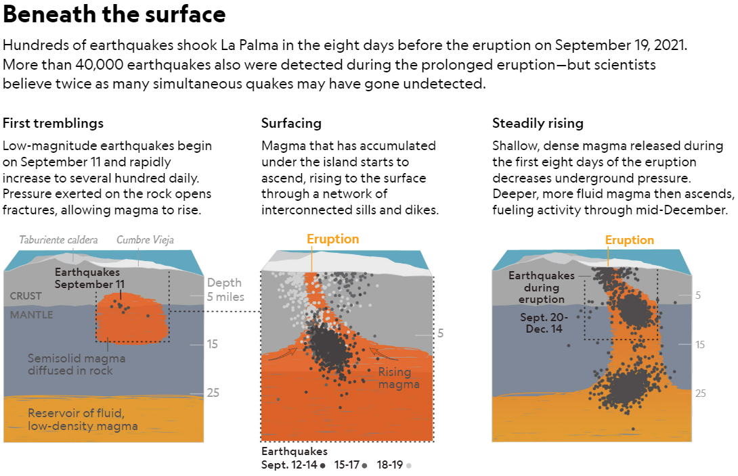
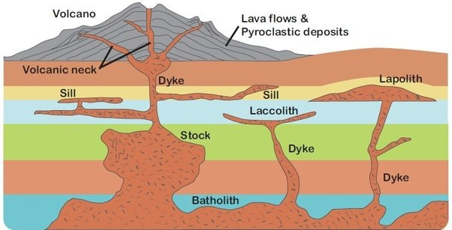
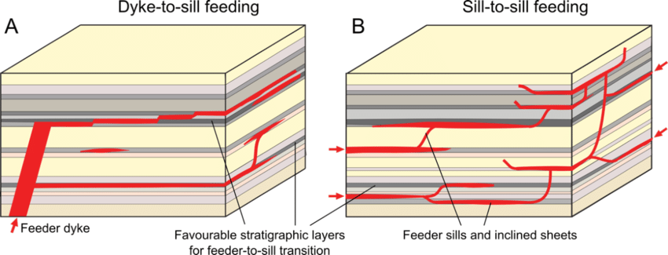
Prediction & monitoring – excellent information here describing/explaining the seismic activity leading up to the eruption.
Good info on the nature of the eruption too – low-density magma, rose to the surface through a network of interconnected sills and dykes.

Slide 15
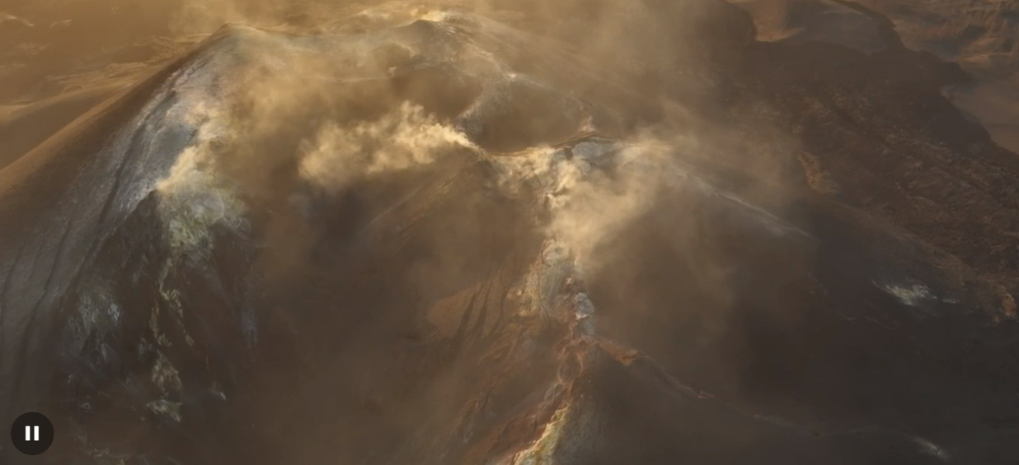
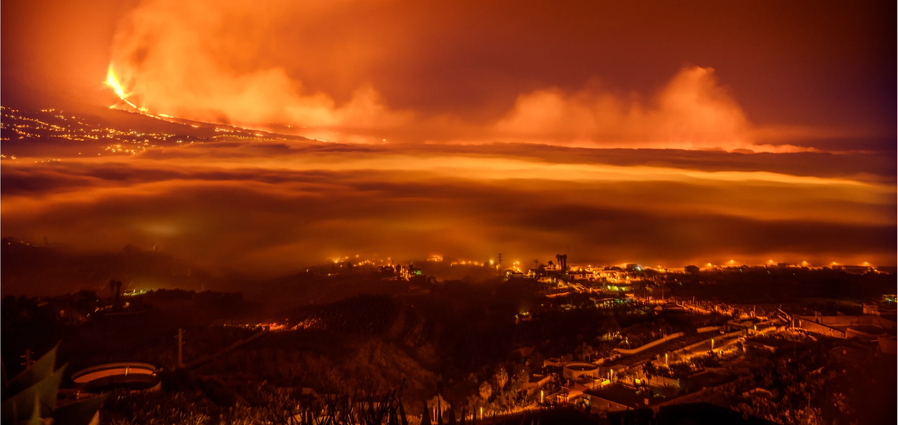
On a warm June day nine months later, I meet up with Sharon Backhouse, director of GeoTenerife, a U.K. company that has organized educational trips around the Canaries for nearly a decade. When she saw the disaster in progress on La Palma, she stayed to document the eruption and recovery efforts through local residents’ eyes in a project now known as #VolcanoStories.
Sounds of generators and jackhammers greet us as we approach the remains of a school, La Laguna’s Early Childhood and Primary Education Center. Its director, Mónica Viña, peers through a chain-link fence surrounding the property, now dwarfed by a wall of lava rock nearby. As Backhouse translates, Viña shows pictures on her phone and describes what the school used to look like. About 150 students ages three to 12 once gathered in this trio of flat-topped concrete buildings painted brilliant blue trimmed in white.
At first the lava flow bypassed the school, and Viña hoped the complex would be spared. But luck ran out on October 20. Viña pauses, fighting back tears. “We always thought it wouldn’t happen,” she says, her voice barely audible above the din of construction. “It’s very sad to see it like this.”
Months of sputtering from the volcano built up a cone that now stands more than 650 feet tall. Almost half a year after the eruption’s end, steam still rises from the peak—a sign of smoldering rock just beneath the surface.
Nice piece to include in an conclusion – what happens next? Is the island still a high risk zone?
Locals lived with the volcano’s fiery rampage for nearly three months. Its roar became La Palma’s soundtrack, punctuated by earthquakes and periodic blasts. At night the incandescent rock painted the skies an eerie red. Even for those whose homes were not in the path of destruction, the geologic cacophony was so overwhelming that many people took refuge in the nonactive north of the island.
Responses – voluntary evacuations from people who were not in the path of the lava flows.

Slide 16
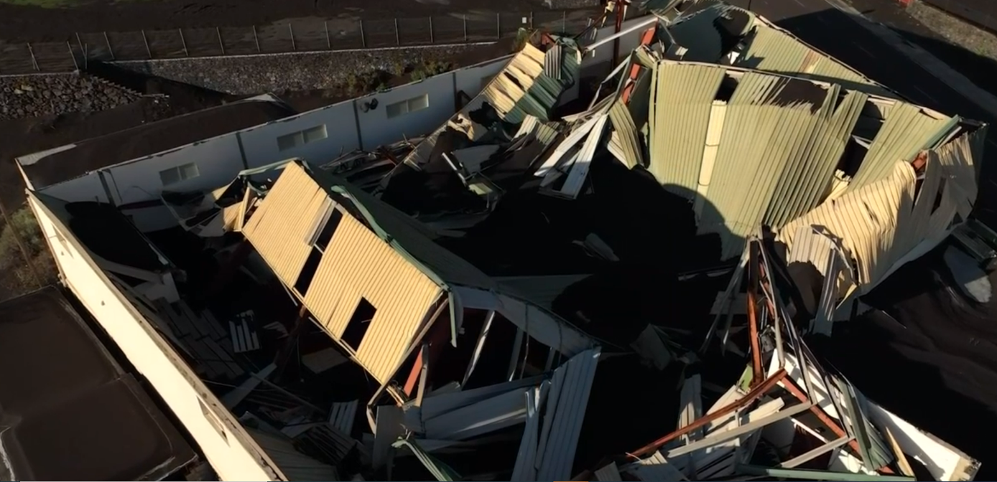
At first the lava flow bypassed the school, and Viña hoped the complex would be spared. But luck ran out on October 20. Viña pauses, fighting back tears. “We always thought it wouldn’t happen,” she says, her voice barely audible above the din of construction. “It’s very sad to see it like this.”
Just one building still stands. The fan of an air conditioner droops on its spindle as if it were made of putty. A lamppost is split down one side. We pass a hefty tree toppled on its side, its roots in a death grip around chunks of concrete ripped from the ground. For Viña, the chaos is a potent reminder of the value of education, especially when it comes to understanding local hazards.
“We knew what a lava flow was, but we didn’t know the impact it could have on the population,” Viña says. She plans to start bringing scientists into the school to talk with students about volcanic blasts. They should learn about the dangers, she says, “even if nothing happens.”
Almost a year later, many of La Palma’s families remain in temporary housing, waiting for promised funds from the Spanish government and decisions about how to rebuild. Some are struggling to prove ownership of their land after leaving behind legal documents in the rush to evacuate. Then there’s the debate over how to rebuild on such a dramatically altered landscape. Lava consumed entire neighborhoods, leaving the land—and the lives of those who called it home—forever changed.
Management - Lack of education, awareness and understanding of the nature of volcanic hazards and their potential impact.
Positive response, however, as they aim on addressing this issue by having scientists educate school students on volcanic hazards, potentially reducing impacts of future eruptions.
The eruption covered vast regions with molten rock and built up thick layers of ash. The tiny, sharp fragments of volcanic ash form heavy layers that can collapse rooftops, as seen here.
Impacts – medium/potentially long-term. Rebuilding process is slow due to lengthy decision-making process from Spanish govt. on how to rebuild. Temporary housing…. Legal issues involving ownership of land – social issues.

Slide 17
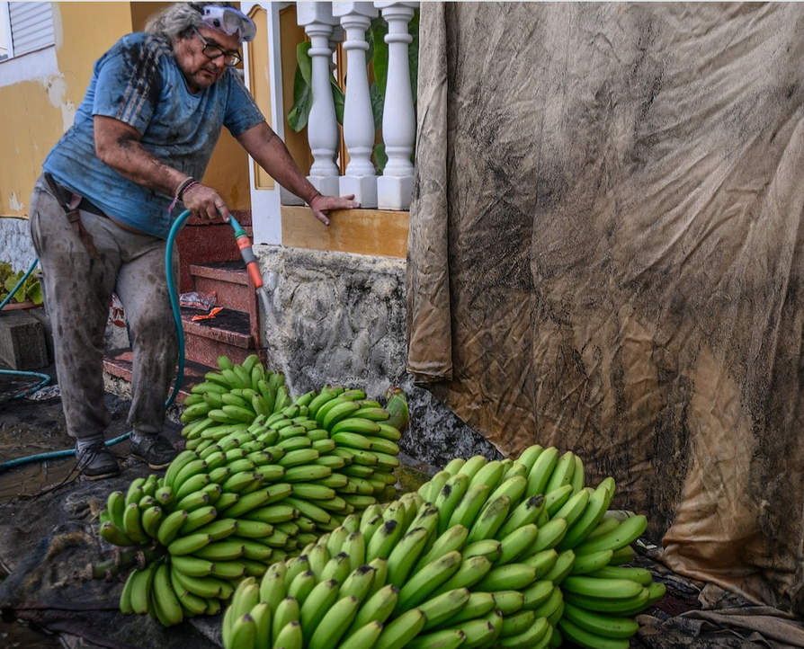
Some parts of the new lava flow will likely be preserved as a national park, to be a poignant reminder of the island’s volcanic underpinnings. Other parts will be reclaimed by agriculture and buildings as soon as the deep rock fully cools. But the challenges are steep. Much of the flow is what residents call malpais, or “bad land,” because it’s full of jagged rubble that shifts underfoot and can cut clothes and skin.
The eruption also landed a heavy blow to island agriculture, particularly the banana-growing industry, which is heavily subsidized by the Spanish government. The natural process that transforms fresh lava rock into fertile soil takes hundreds of years, and farming on top of the lava flow would require moving soil in from elsewhere on the island.
In addition, bananas need lots of water to grow. A series of pipes currently transports water from the island’s wet north to the patchwork of banana terraces across the hot, dry south. But with water at a premium and many plantations now buried under rock and ash, some people are questioning whether bananas are truly the best fit for La Palma.
Responses – creating National Park – positive social, economic and environmental impacts, excellent.
Reclamation of agriculture – nutrient-rich, fertile soils will enable farmers to recover, produce high yielding crops and earn income to aid recovery from eruption – positive socio-economic impacts.
Negative impact – bad land / malpais – land that was once productive, fertile and ideal for agriculture is now useless, lacking in fertility and unproductive for human use i.e. agriculture, building.
FYI: Negative impacts on agriculture industry – definitely worth digging deeper and getting some stats/data on this important impact.
The banana industry, which is crucial to the island’s economy, suffered from the eruption. Here farmer Santiago Alexis Hernández Rodríguez sprays fruit to remove ash that can damage banana skin. He says that many trees were buried in the eruption; others haven't been watered because of broken pipes.
This is very interesting, and links with another important geography topic – water, and water sustainability. This eruption is forcing La Palma’s residents and authorities to question banana production as their ‘go-to’ export for earning revenue. Big questions to be answered with regard to the island’s economic sustainability lie ahead. Responses & Impacts of the eruption.

Slide 18
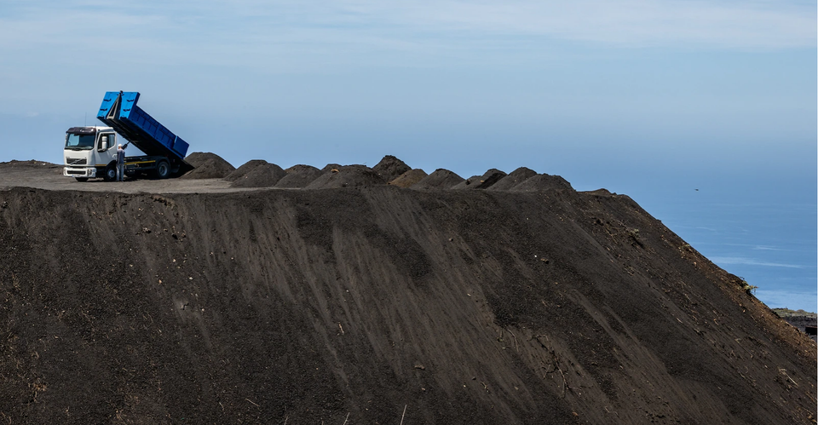
One such argument comes from Victoria Torres Pecis, the owner of La Palma’s oldest operating winery. Like her parents and grandparents before her, she’s spent her life caring for small plots of grapevines tucked across the island. Dried leaves cover the bottom of her van when I join her on a sunny afternoon to visit some of her vineyards in Fuencaliente, near La Palma’s southern tip. As we bump along the dirt road, she talks passionately about her efforts to work with the volcanic lands in their most natural form.
“We think we can change everything,” Torres Pecis says of efforts required to grow water-hungry crops. “We haven’t been paying enough attention to where we live.”
She slows the van, pointing to some of her plots. The plants look almost wild, nestled into steep slopes of black ash. The roots dig deep under the surface to tap into the more evolved, clay-rich soils. Unlike the banana farmers, she doesn’t irrigate, relying instead on natural rainfall and the sea of clouds that glides up the island’s steep slopes. The top layer of ash holds moisture from the air and retains heat that ripens the fruit. Only recently has an extended drought forced some vineyards to selectively water to make up for the loss of rainfall.
Torres Pecis has found that embracing the island’s complicated terrain can bear unexpected beauty: You can taste the difficulties the vines face. She offers me wine from three barrels made from the same variety of grapes. The first comes from vines grown in older, nutrient-rich soils in the wet northern regions, which produce a slightly sweet, simple taste. But the other two wines are made from grapes grown in the south’s more challenging conditions—in younger, drier soils or on windy slopes—which create surprising complexity and depth.
Winemaking isn’t an easy profession, and Torres Pecis acknowledges that bananas are an important part of La Palma’s history. But she argues that the island’s agricultural future should lie in a variety of crops better suited to the dry climes, such as figs or sweet potatoes. If there’s a positive from this event, she says, it’s that the eruption opened many people’s eyes to the forces that gave rise to La Palma’s picturesque cliffs and undulating land.
“You start to see volcanoes where you saw a mountain before,” Torres Pecis says.
Managing the volcano / living with the volcano in sustainable ways – is this economically, socially and environmentally sustainable?
Works with the volcanic landscape – the plants grow with no need for irrigation. Great description/explanation of how the grapevines grow and thrive in the volcanic landscape. Irrigation only required in times of drought. Positive impacts of eruption – ash holds moisture & retains heat, helping with agriculture, particularly vineyards.
Useful info here for other units – sustainable, innovative agricultural practices – we will be looking at agriculture in the ‘Production, Location & Change’ unit
Excellent info here relating to La Palma’s economic sustainability in light of La Palma’s eruption. Potential changes to production on the island to ensure economic sustainability.
While volcanic ash can be a nuisance or even a danger, it’s also a valuable resource. Adding ash to soil is beneficial for agriculture because it helps retain moisture and slowly releases nutrients. Scientists are also investigating using ash in cement to reduce the construction material’s carbon footprint.
Positive impacts of volcanic eruptions – use of ash in agriculture and construction industries. Economically and environmentally sustainable.

Slide 19
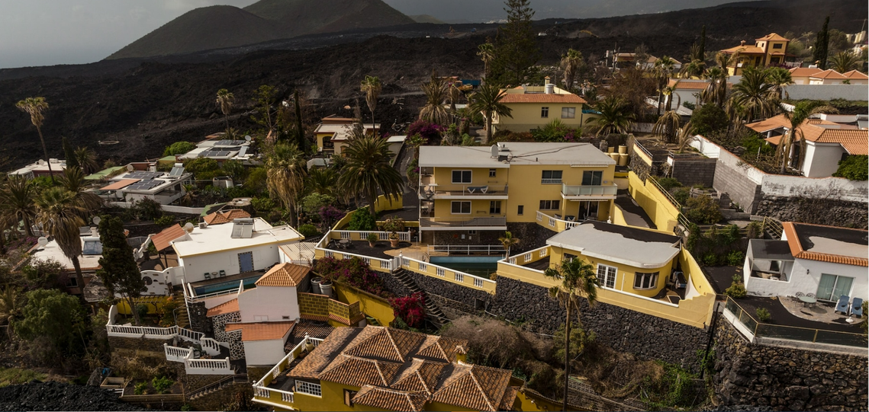
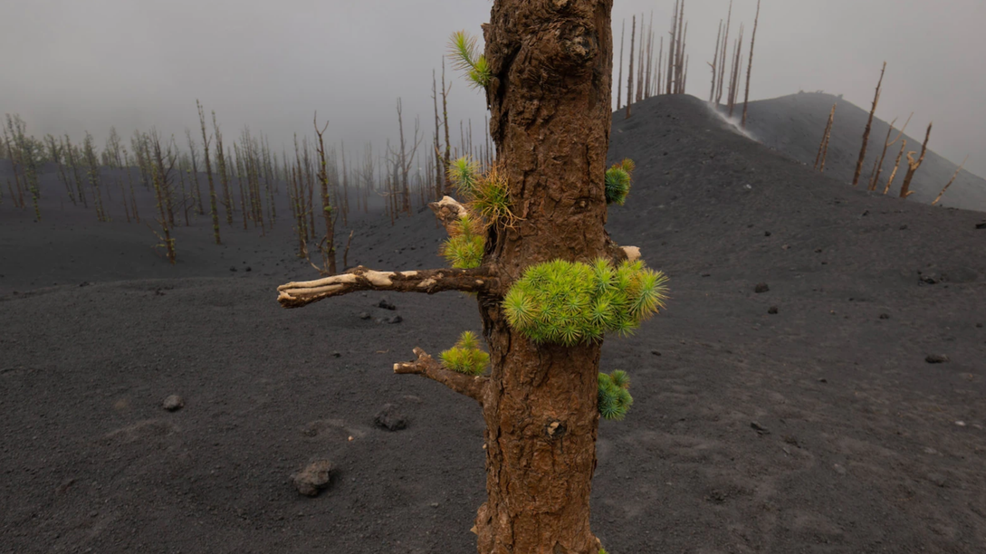
Despite the tragedy, many residents seem to have only strengthened their devotion to their home island. They proudly wear La Palma–shaped pendants and beaded bracelets colored in the yellow and blue of the Canary flag even as they embark on the difficult tasks of rebuilding. And rethinking agriculture is just one lesson being considered in the wake of the latest volcanic outburst.
Debate has also brewed over the volcanic traffic light that’s used to alert the community of potential hazards. After the 2011 eruption on El Hierro, authorities added an “orange” level to provide more nuance to warnings when an eruption seemed imminent. But in the hours leading up to La Palma’s recent blast, the orange alert wasn’t used, sowing confusion.
One possible explanation lies in the current emergency plan’s inflexibility, says Jose M. Marrero, an expert in volcanic hazard and risk assessment at Montserrat Volcano Observatory. Because the system directly links the alert levels to required emergency responses, certain scientific observations about volcanic activity trigger a domino effect ending in major steps, such as wide-scale evacuations. As a result, the onus of major policy decisions essentially rests on scientists alone, which could affect how they interpret the data, whether subconscious or not.
These lessons reach far beyond La Palma’s shores. But the urgency of finding solutions to the challenges is at its clearest in the Canary Islands.
Sitting at the Volcano Cafe in Santa Cruz, the bustling capital of nearby Tenerife island, volcanologist Meletlidis and I talk of the many challenges of living with slumbering volcanoes. As a constant stream of people and cars passes by, I wonder aloud about concerns for a future eruption here, the Canaries’ most populous island.
Meletlidis’s response is immediate, his voice low: “We think about it every day.”
Responses – they are evaluating the effectiveness of the traffic light hazard system. Current system is inflexible. Escalation of alert level automatically requires extra/elevated emergency responses, which triggers a domino effect ending in major steps such as wide-scale evacuation. This means major policy decisions, such as evacuations, essentially rests on scientists alone and not the island’s authorities. This may affect how the scientists interpret the data they have at their disposal, as they may be wary of triggering such major actions, which one could argue is not their area of expertise. Perhaps a more collaborative approach, where the scientific committee works in conjunction with local governmental and health authorities to decide on ‘next steps’ as data is interpreted could lead to a more streamlined, clear and effective volcanic eruption management approach on the island.
Reassuring to see that they are not taking the eruption lightly, and they are putting strategies and plans in place so that they can effectively manage future eruptions, with the aim of minimising their impacts.
Lava blanketed the surface in thick sheets in some areas, but it spared a few clusters of homes built on what are known as kipukas, a Hawaiian term for mounds of older lava rocks that survive within a sea of fresh flows.
Many of La Palma’s plants have adapted to the challenges of living on a volcanic island. Pinus canariensis, shown here, can withstand the searing heat of wildfires and perhaps even the volcanic gases that stripped the trees bare during the eruption. New sprouts of green are signs that the trees—like the people of La Palma—are fighting to rise again from the volcanic ashes.
Protection/preparedness = definitely worth learning more about kipukas! Great example of appropriate technology in managing hazards. Economically sustainable, soft engineering.

Slide 20
What else do we need / would like to know?
  Causes of eruption – We have loads in this article. Can review our learning on hotspots to add to what is here.
  Nature of eruption – We have loads in this article. Can study L5, slides 5-9, to enhance/deepen your understanding.
  Impacts – We have loads here, but I think this is the section we could be slightly lacking in. Need to think like geographers in order to expand on some of the impacts outlined in the article. Further research may be required to find data/stats on some of the effects e.g. what was the total economical cost of the eruption? Were flights disrupted? What was the impact on the tourism industry? Businesses closed? Homelessness? Should also research to find some stats on how the agriculture industry was affected. Should also research to find some stats on the growth of other industries like wineries and fig & sweet potato farming.
  Responses/management – We have loads in this article. Should research to learn more about kipukas as a protection/preparedness strategy.
Whenever I give you an article, website, resource, Geofile etc., thisis how you should be aiming to analyse it and use it to support your learning.
I give you these things because I know they are useful and valuable – use them!
Check out this article on the volcanic eruption too!

