Slide 1

Volcanoes and their resultant Hazards: Case Study Examples
Geography is the study of our planet, so everything we learn must be applied to real-life examples & case studies.
At A-Levels, there is no set number of case studies that you must learn. Instead, the expectation is that you bring your case study knowledge/real-life examples when answering questions.
In relation to volcanic eruptions, we need to know the following:
Background information – Where the case study is located/ what level of development is it/When the eruption happened etc.
Causes of the eruption – What type of plate boundary, type of eruption etc.
Nature of the eruption & hazards – this will link to the boundary type & type of eruption
Impacts of the eruption – primary & secondary, SEEP impacts, short/long term
Management of the event - What was in place prior to the eruption to reduce the impacts (prediction, preparation)? How did they respond to the eruption? Evaluate the effectiveness of these management strategies.
I recommend writing up 2 case studies for eruption – one in a HIC and one in an LIC. I also recommend learning an explosive & effusive eruption! Remember, all case studies must be within the last 25 years!
What case studies to use? Completely up to you!
Where to find them?
  Next slide has some links
  Revision folder
  There are endless case studies online you can research
Learning Objectives:
Compare and Contrast volcanic hazardous events.
Explain the impact resultant hazards had on the areas.
Assess which resultant hazards causes the most damage.
Exam Questions to think about….
‘The type of eruption is the most important factor influencing the hazards from volcanoes.’ With the aid of examples, how far do you agree? [20]
Assess the extent to which the types of volcanic eruptions and their products determine the hazardous impacts. [20]
With the aid of a case study of a hazardous environment, assess how prediction and preparedness can reduce the impacts of the hazard(s) on lives and property. [20]
Assess the extent to which prediction, hazard mapping and preparedness can reduce the impacts of volcanic eruptions on lives and property. [20]
‘Prediction is the most effective way of reducing the impacts of volcanic eruptions on lives and property.’ How far do you agree with this view? [20]
Compare the two case studies, Assess the claim that impacts of earthquakes are worse in LIC countries than HIC countries. [20]
‘Earthquakes are more difficult to predict, but easier to prepare for, than volcanic eruptions.’ How far do you agree with this view? [20]

Slide 2
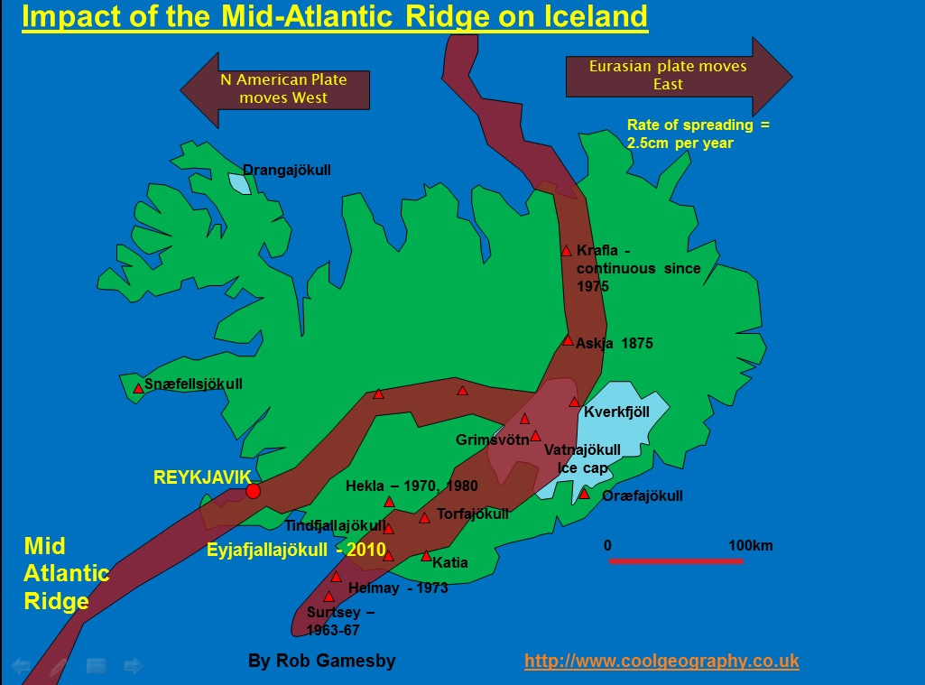
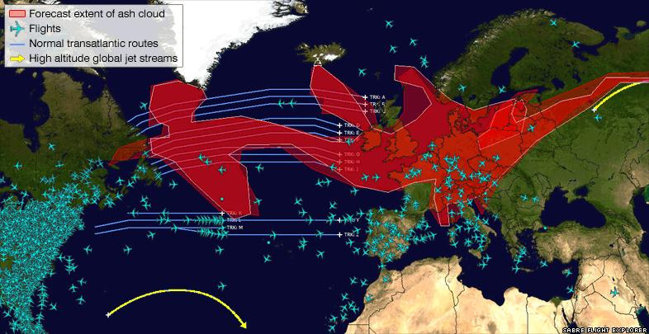
Geofile – Eyjafjallajökull, 2010 in lesson folder & HERE
Chaiten, Chile 2010
La Palma, 2021 & Nat Geo Article here
Extension – Check out the Geofile on ‘Geysers, fumaroles, hot springs, mud pots and solfataras’ in the 9.1 folder. These structures are known collectively as hydrothermal features.

