Slide 1
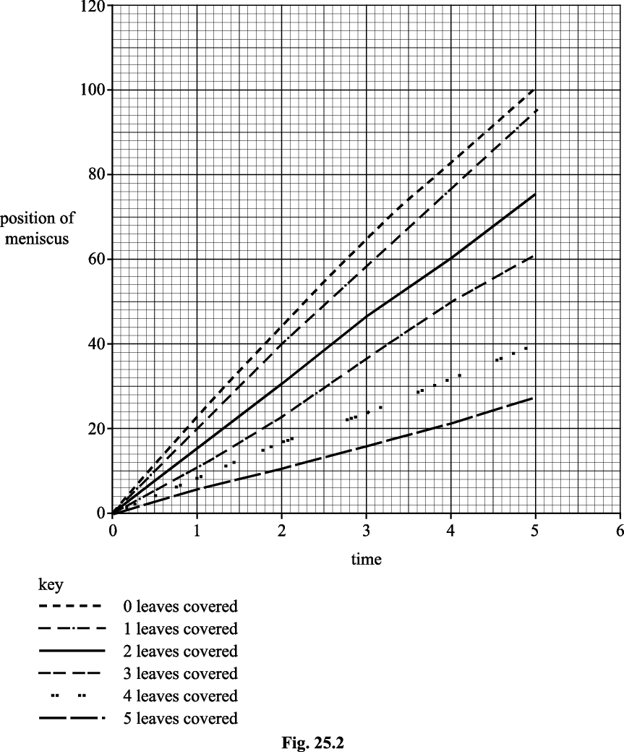
Knowledge retrieval questions
L7. Translocation
https://pollev.com/science1s478
Q1. A student used a potometer to investigate the role of stomata in transpiration. The student noted the position of the air-water meniscus each minute for five minutes.
The student then covered the underside of one of the leaves in petroleum jelly before repeating the measurements. This was continued until the undersides of all the leaves had been covered.
a) State two different types of information the student has missed from the graph (2 marks)
No units on axis / plotted points / title
b) Use the graph to calculate the minimum rate of transpiration mm min⁻¹ (2 mark)
5.25 mm min-1 (anything between 5-6 accepted)
c) Suggest how water is being lost from the cut stem when all the leaves have been treated with petroleum jelly (1 mark)
Evaporation from the upper surface of the leaf
d) Suggest two possible sources of error (2 mark)
not all lower leaf surface covered (1)
leaks in apparatus / seal not air tights (1)
shoot not cut under water (1)
error in reading position of meniscus (1)

Slide 2
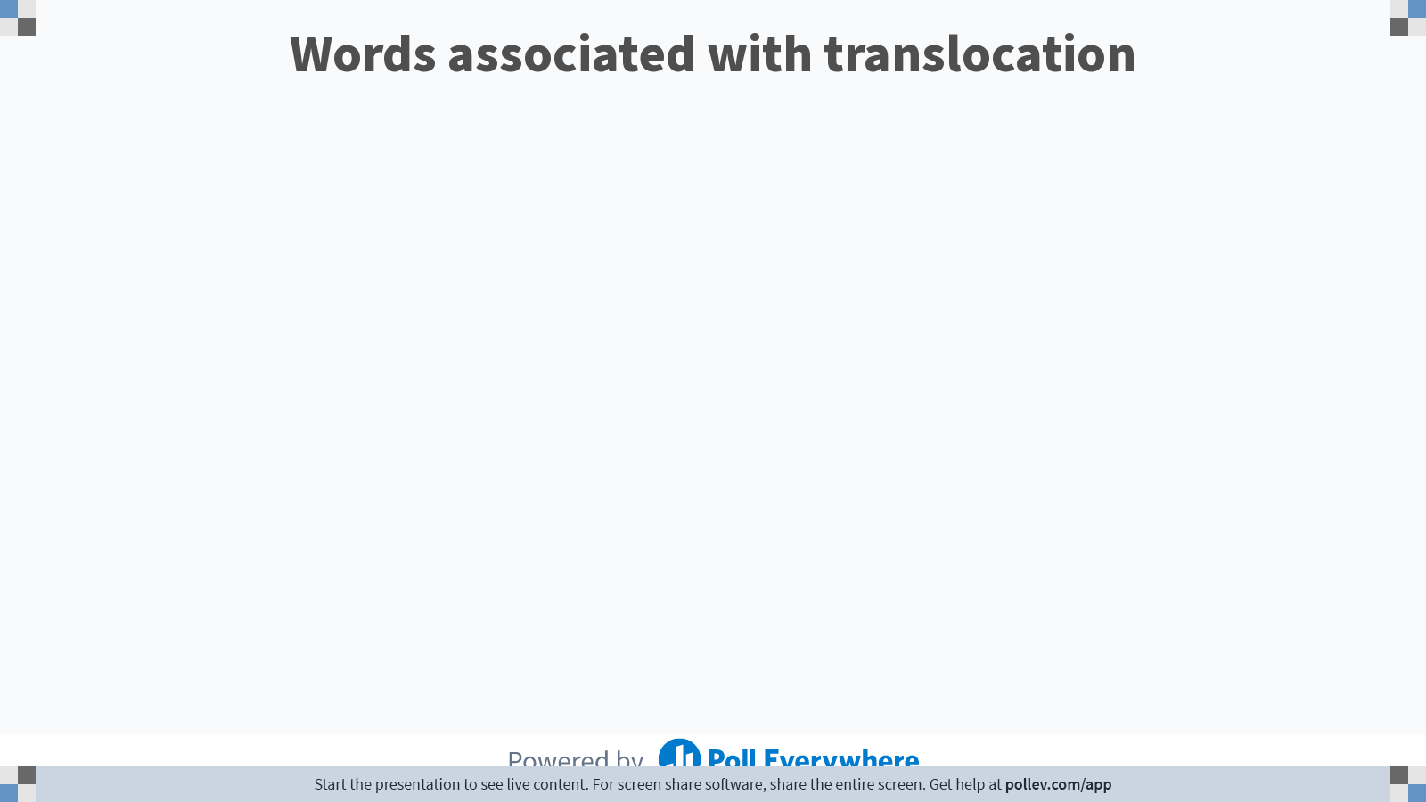
Notes:
Poll Title: Do not modify the notes in this section to avoid tampering with the Poll Everywhere activity.
More info at polleverywhere.com/support
Words associated with translocation
https://www.polleverywhere.com/free_text_polls/qSK3MXVIfdeiGREzScpYz

Slide 3
Move below questions to the end of the mesophyte / hydrophyte lesson next year
We taught this in a different order last year

Slide 4
Knowledge retrieval question
Q1. The water calthrop, Trapa natans, lives in lakes and other water bodies. Its leaves float on the surface of the water. Its stems trail just under the surface of the water.
State and explain three adaptations of plants like T. natans, which allow them to survive in water (3 marks)
air spaces in leaves / stems - allows leaves / stems to float, so they can access light, for photosynthesis (1)
stomata on upper leaf surface - to allow access to air, absorption of CO₂ (1)
stem has air spaces - oxygen can diffuse to roots, for aerobic respiration (1)
roots may be reduced / absent - not required to obtain water (1)
waxy surface / cuticle - so water does not block stomata (1)
Q2. Many plants are adapted to the availability of water in their environment; one group of these plants is the xerophytes. Which one of the following statements correctly describes a xerophyte? (1 mark)
A Smooth cordgrass grows in highly saline marine estuary environments.
B The water lily has aerenchyma tissue to allow the movement of gases to submerged roots.
C The poison tree has leafless branches covered in thorns to reduce water loss.
D Water lobelia completes its entire life cycle submerged in shallow ponds.

Slide 5
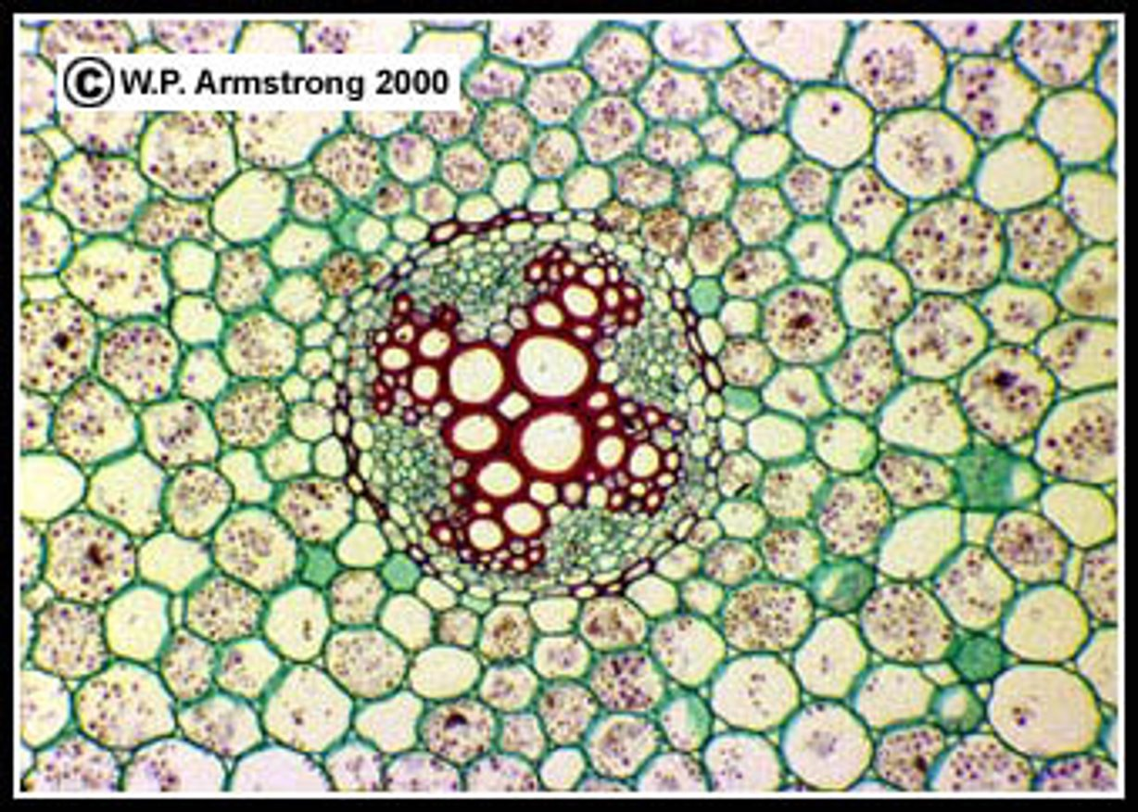
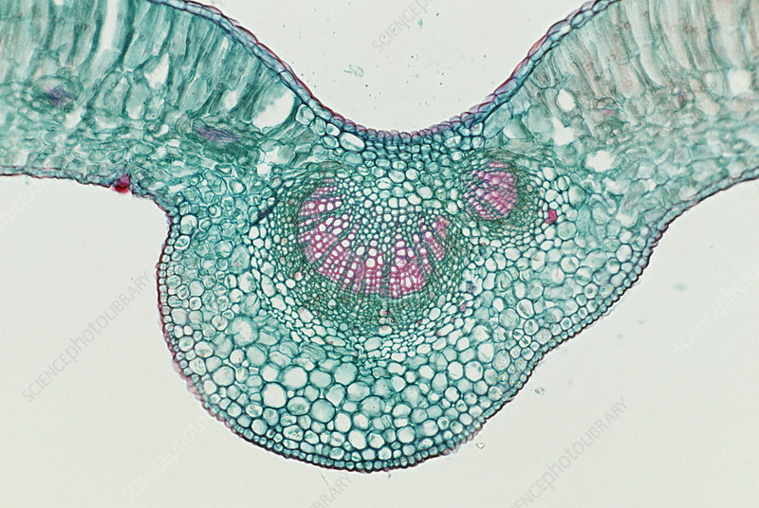
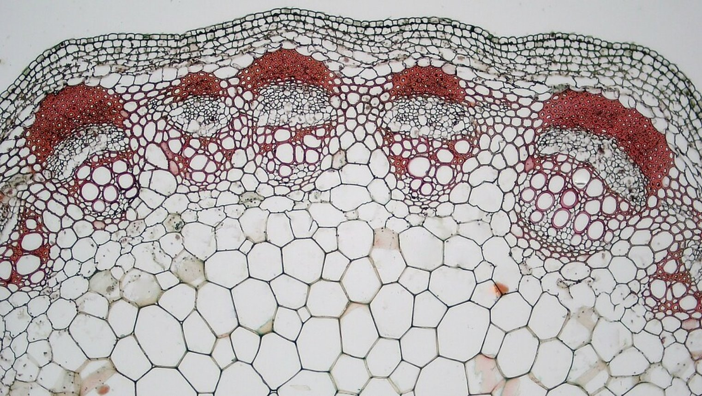
Place an X on the following diagrams to identify where the phloem tissue is.

Slide 6
Place an X on the following diagrams to identify where the phloem tissue is.
X
X
X

Slide 7
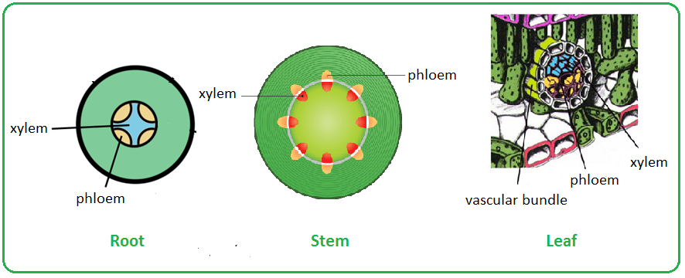

Slide 8
Define translocation

Slide 9
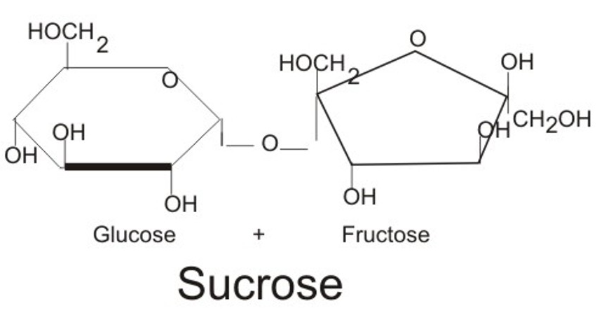
Translocation
The movement of dissolved substances within a plant, from the site of photosynthesis or uptake (source) to area of growth or storage (sink)
Why is sugar transported through plants in this form?
Sucrose contains more energy than a monosaccharide, so it is more energy efficient, both in transport and in storage.
It is more difficult to use for cellular respiration, so less likely to be used up when transporting
Notes:
What disaccharide am I below blue box?
Fructose is an isomer of glucose
While fructose and glucose have the same calorific value, the two sugars are metabolized differently in the body.
Fructose causes seven times as much cell damage as does glucose, because it binds to cellular proteins seven times faster; and it releases 100 times the number of oxygen radicals (such as hydrogen peroxide, which kills everything in sight).[
1] Fructose is a simple sugar commonly found in fruits and vegetables. Vast quantities are also manufactured in the lab.
Glucose, also known as grape or blood sugar, is present in all major carbohydrates like starch and table sugar. While both are a good source of energy, excess of glucose can be fatal to diabetic patients, and excess of fructose can lead to health problems like insulin resistance and liver disease.
Comparison chart Source of energy. Often added to food and drinks to improve taste. Source of energy. Fuels cellular respiration. Photosynthesis, the breakdown of glycogen. Vast quantities produced artificially in the lab by the food industry.
9

Slide 10
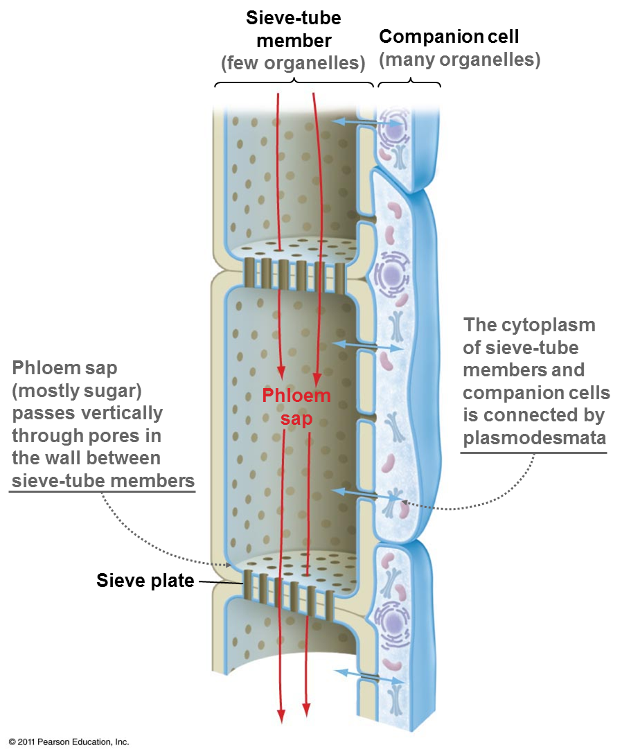
Assimilates of photosynthesis
The products of photosynthesis that are transported are known as assimilates.
Plants transport organic compounds in the ……………… from sources (the tissues that produce them) to ………….. (the tissues that need them).
Glucose and fructose are converted into …………… to be transported through the plant.
When it reaches the cells, it is then converted back into ……………. for respiration, or into ………….. for storage.

Slide 11
Assimilates of photosynthesis
The products of photosynthesis that are transported are known as assimilates.
Plants transport organic compounds in the phloem from sources (the tissues that produce them) to sinks (the tissues that need them).
Glucose and fructose are converted into sucrose to be transported through the plant.
When it reaches the cells, it is then converted back into glucose for respiration, or into starch for storage.

Slide 12
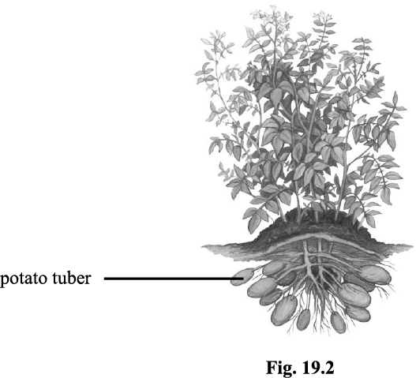
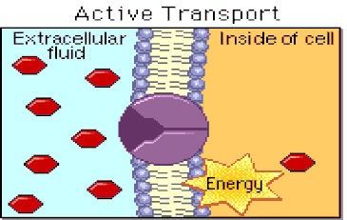
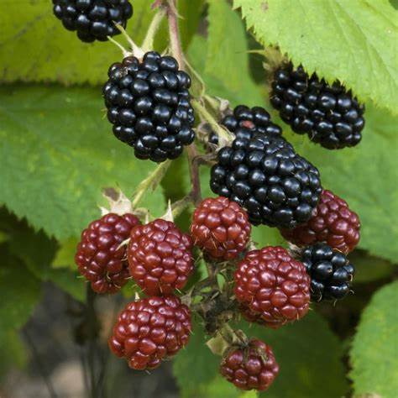
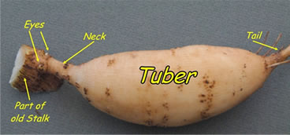
The main sources
The main sinks
Green leaves and stems
Storage organs like tubers and tap roots, that unload their stores at the beginning of a growth period
Stores within seeds for germination
Growing roots or areas actively absorbing minerals ions
Meristems that are actively dividing
Any part of the plant laying down food stores, such as seeds, fruits or storage organs.
*tubers are various types of modified plant structures that are enlarged to store the nutrients

Slide 13
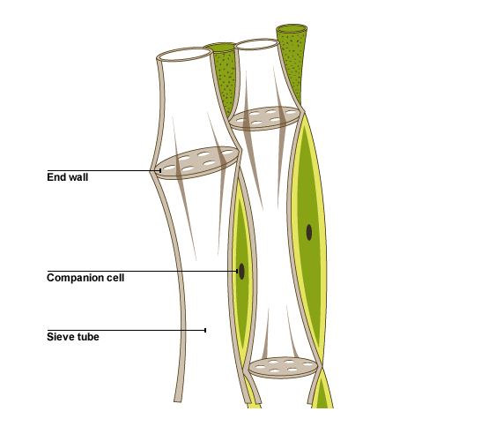
Annotate around your diagram using the notes from the following slides

Slide 14
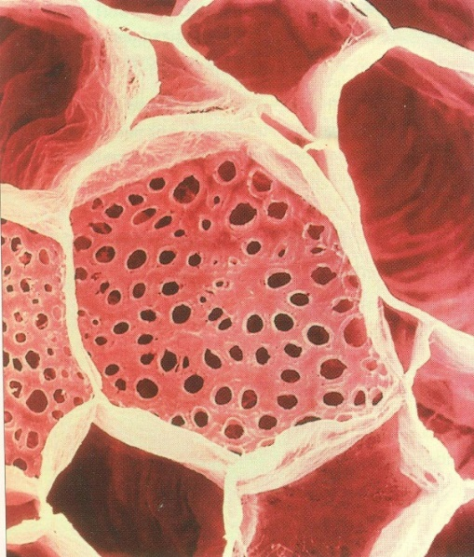
Sieve tube elements (phloem)
Phloem is a living tissue.
The sieve tube elements are the main cells making up the phloem.
These have sieve plates across the ends of the cells allowing transfer of large molecules between cells.
They have very few organelles to allow the maximum amount of space for assimilate transport.

Slide 15
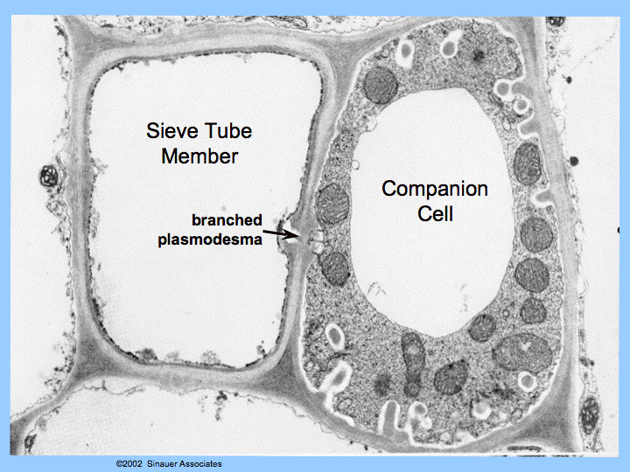
Companion cells
Companion cells are part of the phloem tissue.
They are positioned between sieve tube cells.
Companion cells have large nuclei and lots of mitochondria.
They actively load assimilates into sieve tubes using ATP.

Slide 16
Structure of phloem tissue - summary
Sieve tube elements – arranged one on top of each other in long columns, contain few organelles.
End walls – partially broken down to form sieve plates.
Companion cells – packed with mitochondria for active transport of assimilates

Slide 17
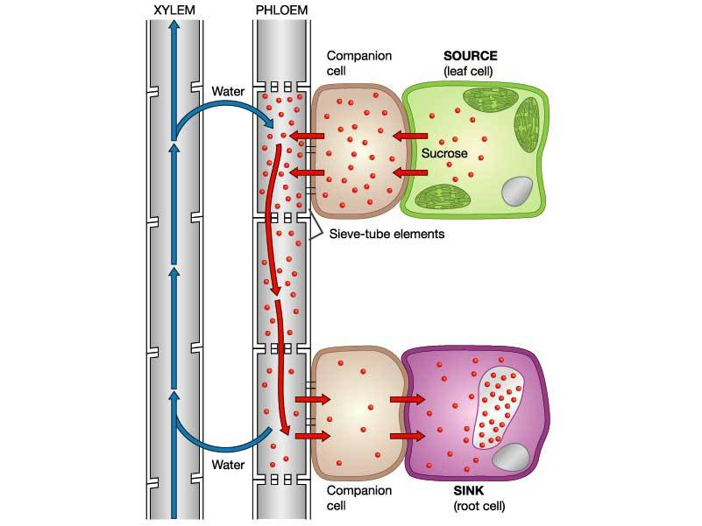
Translocation continued
Translocation is the mass flow of assimilate from source to sink.
The leaves (source) produce large amounts of glucose which is converted to sucrose for transport.
When it reaches the cells, it is converted back to glucose for respiration or to starch for storage or used to produce other compounds.

Slide 18
Key points
You will need to know about the process of active phloem loading via the apoplast route (through cell walls and inter-cell spaces).
* The symplast route (in some species) loads sucrose by diffusing it through the cytoplasm – this is a passive process. Not required for your A Level

Slide 19
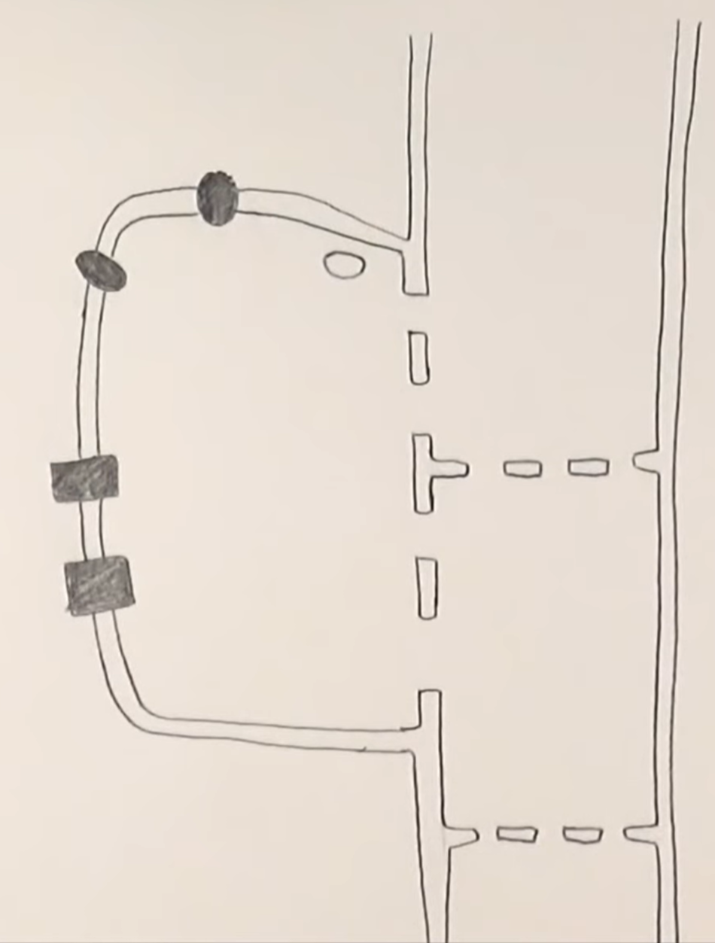
Lets start by labelling the structures you know
Notes:
Why is it important that the cells are living? Cells must be living to generate ATP, phloem loading is an active process.
What could the two proteins be in the cell membrane of the companion cell? Proton pump and co-transporter

Slide 20
Lets start by labelling the structures you know
Nucleus
Sieve tube (phloem)
Each cell is a sieve tube element
Proton pump
Co-transporters
Sieve plate
Plasmodesmata
Companion cell
Why is it important that the companion cells are living?
Notes:
Why is it important that the cells are living? Cells must be living to generate ATP, phloem loading is an active process.

Slide 21
Phloem loading via the apoplast pathway
The task
Sucrose needs to be transported into the companion cell from the source.
Sieve tube (phloem)
Sucrose
Proton pump
Nucleus
Co-transporters
Companion cell
Sieve plate
Notes:
Why is it important that the cells are living? Cells must be living to generate ATP, phloem loading is an active process.

Slide 22
Phloem loading via the apoplast pathway
The task
Sucrose needs to be transported into the companion cell from the source.
Then into the sieve tube (phloem)
Then transported around the plant to the sinks
Sieve tube (phloem)
Sucrose
Proton pump
Nucleus
Co-transporters
Companion cell
Sieve plate
Notes:
Why is it important that the cells are living? Cells must be living to generate ATP, phloem loading is an active process.

Slide 23
Phloem loading via the apoplast pathway
The task
Sucrose needs to be transported into the companion cell from the source.
Then into the sieve tube (phloem)
Then transported around the plant to the sinks
Sieve tube (phloem)
Sucrose
Proton pump
Nucleus
Co-transporters
Companion cell
Sieve plate
Notes:
Why is it important that the cells are living? Cells must be living to generate ATP, phloem loading is an active process.

Slide 24
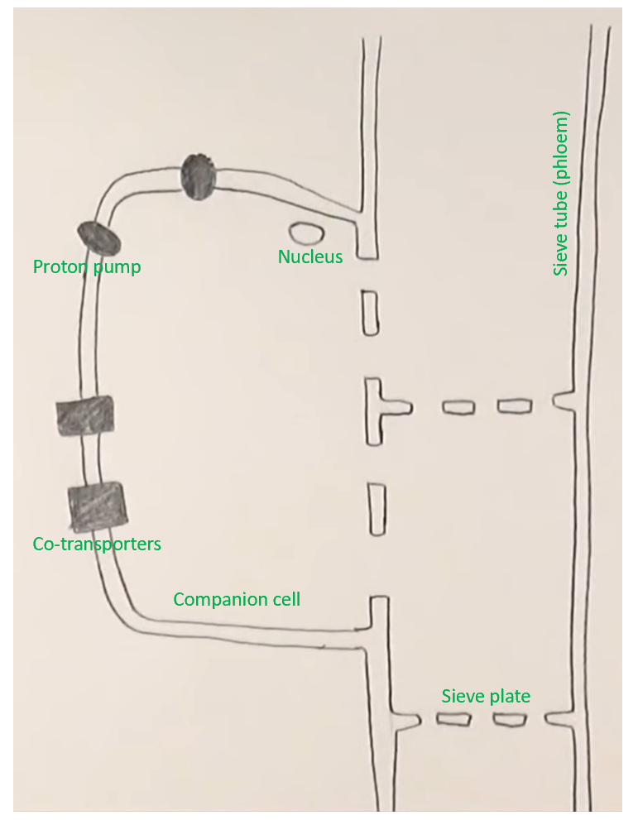
Phloem loading via the apoplast pathway
1. Hydrogen ions (protons) are actively pumped (using ATP) out of the companion cell into the surrounding area, increasing the proton concentration outside the cell.
H⁺
H⁺
H⁺
Notes:
Why is it important that the cells are living? Cells must be living to generate ATP, phloem loading is an active process.

Slide 25
Phloem loading via the apoplast pathway
1. Hydrogen ions (protons) are actively pumped (using ATP) out of the companion cell into the surrounding area, increasing the proton concentration outside the cell.
2. This creates a proton concentration gradient, so the protons will want to move back into the companion down the concentration gradient via the co-transporters
3. Co-transporters only work when protons and sucrose are transported together. This increases the sucrose concentration in the companion cell. Co-transporters facilitate diffusion of sucrose.
H⁺
H⁺
H⁺
Notes:
Why is it important that the cells are living? Cells must be living to generate ATP, phloem loading is an active process.

Slide 26
Phloem loading via the apoplast pathway
5. Diffusing sucrose molecules into the sieve tube lowers the water potential in the sieve tube elements.
6. This causes water molecules from the companion cells to move in via osmosis
7. This generates turgor pressure, which causes the mass flow of assimilates along the phloem to areas of lower pressure (sinks)
1. Hydrogen ions (protons) are actively pumped (using ATP) out of the companion cell into the surrounding area, increasing the proton concentration outside the cell.
Lower pressure
2. This creates a proton concentration gradient, so the protons will want to move back into the companion down the concentration gradient via the co-transporters
H⁺
H₂0
3. Co-transporters only work when protons and sucrose are transported together. This increases the sucrose concentration in the companion cell. Co-transporters facilitate diffusion of sucrose.
H⁺
H₂0
H⁺
4. The sucrose then diffuse through the plasmodesmata from the companion cell into the sieve tube (phloem) down the concentration gradient
Lower pressure
Notes:
Why is it important that the cells are living? Cells must be living to generate ATP, phloem loading is an active process.

Slide 27
Phloem loading via the apoplast pathway
5. Diffusing sucrose molecules into the sieve tube lowers the water potential in the sieve tube elements.
6. This causes water molecules from the companion cells to move in via osmosis
7. This generates turgor pressure, which causes the mass flow of assimilates along the phloem to areas of lower pressure (sinks)
1. Hydrogen ions (protons) are actively pumped (using ATP) out of the companion cell into the surrounding area, increasing the proton concentration outside the cell.
Lower pressure
2. This creates a proton concentration gradient, so the protons will want to move back into the companion down the concentration gradient via the co-transporters
H⁺
H₂0
3. Co-transporters only work when protons and sucrose are transported together. This increases the sucrose concentration in the companion cell. Co-transporters facilitate diffusion of sucrose.
H⁺
H₂0
H⁺
4. The sucrose then diffuse through the plasmodesmata from the companion cell into the sieve tube (phloem) down the concentration gradient
Lower pressure
Notes:
OVERALL THIS IS AN ACITVE PROCESS BECAUSE H+ ions are actively pumped out – the co-transporter facilitates the movement back in
Why is it important that the cells are living? Cells must be living to generate ATP, phloem loading is an active process.

Slide 28
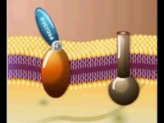

Slide 29
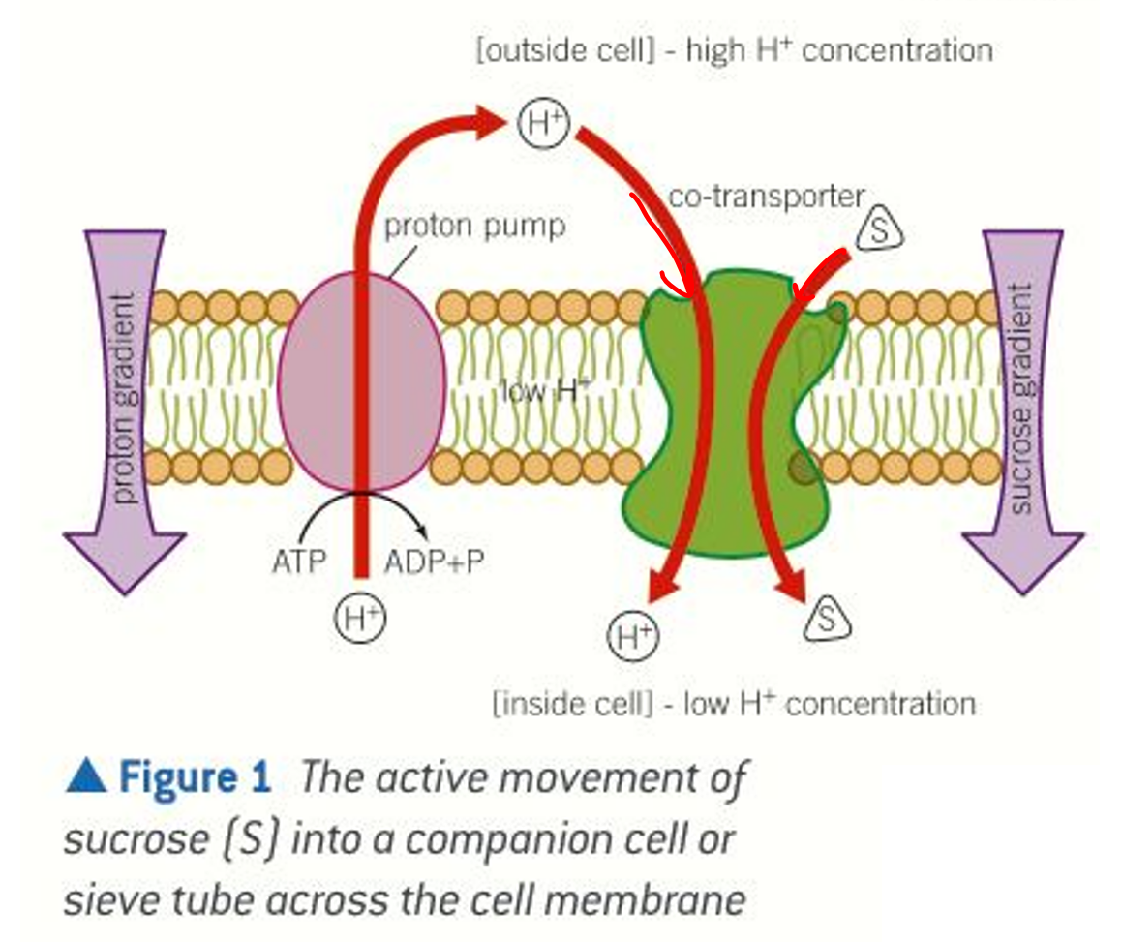

Slide 30
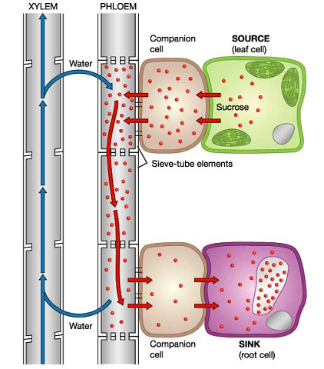
Phloem unloading
The sucrose is unloaded at any point where it is needed, there will be a diffusion gradient.
Here, sucrose diffuses from the sieve tube into the companion cell then into other cells by diffusion. Sucrose is constantly being used so a concentration gradient is always maintained.
The loss of sucrose from the sieve tubes, raises the water potential so water moves out, into the xylem (via bordered pits) and the companion cells, via osmosis.
This reduces the turgor pressure at the sink

Slide 31
Evidence for translocation
1. What happens to translocation if you poison the mitochondria?
If the mitochondria of the companion cells are poisoned, translocation stops as ATP cannot be produced to actively pump H+ ions out of the companion cells.
2. The flow of sugars in the phloem is about 10000 times faster than it would be by diffusion alone suggesting an active process is driving the mass flow.

Slide 32
Evidence question
The following statements summarise the results from experiments designed to discover more about the translocation of organic materials in the phloem.
A | Any increase in the sugar content of leaves is followed by a similar change in the sieve tube contents in the stem.
B | The rate of transport increases with increasing temperature, reaching a maximum at 25 °C before decreasing at higher temperatures.
C | Translocation stops when stems are treated with a substance that inhibits respiration.
D | Sugars can be transported both up and down the plant.
E | Aphids can be used to sample phloem sap.
F | Roots, young leaves and growing fruits will import sugars.
State all the letters that provide evidence for the following conclusions:
A) Translocation is an active process.
B) Sugars are translocated from source to sink.
Notes:
Invertase converts sucrose back into glucose and fructose

Slide 33
Evidence question
The following statements summarise the results from experiments designed to discover more about the translocation of organic materials in the phloem.
A | Any increase in the sugar content of leaves is followed by a similar change in the sieve tube contents in the stem.
B | The rate of transport increases with increasing temperature, reaching a maximum at 25 °C before decreasing at higher temperatures.
C | Translocation stops when stems are treated with a substance that inhibits respiration.
D | Sugars can be transported both up and down the plant.
E | Aphids can be used to sample phloem sap.
F | Roots, young leaves and growing fruits will import sugars.
State all the letters that provide evidence for the following conclusions:
A) Translocation is an active process.
B) Sugars are translocated from source to sink.
B C
A D F
Notes:
Invertase converts sucrose back into glucose and fructose

Slide 34
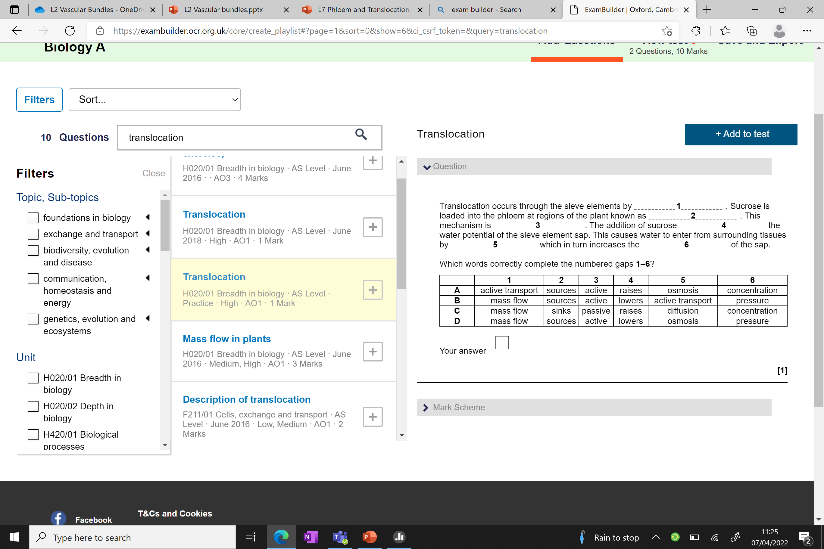

Slide 35
D

Slide 36

Translocation
Learning Objectives:
Describe what translocation is
Explain the process of translocation:
  loading
  Unloading
Explain the evidence for translocation

Slide 37

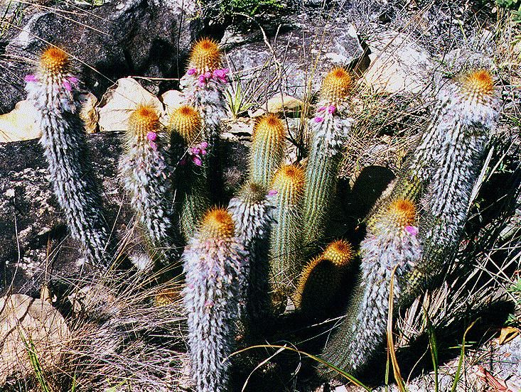
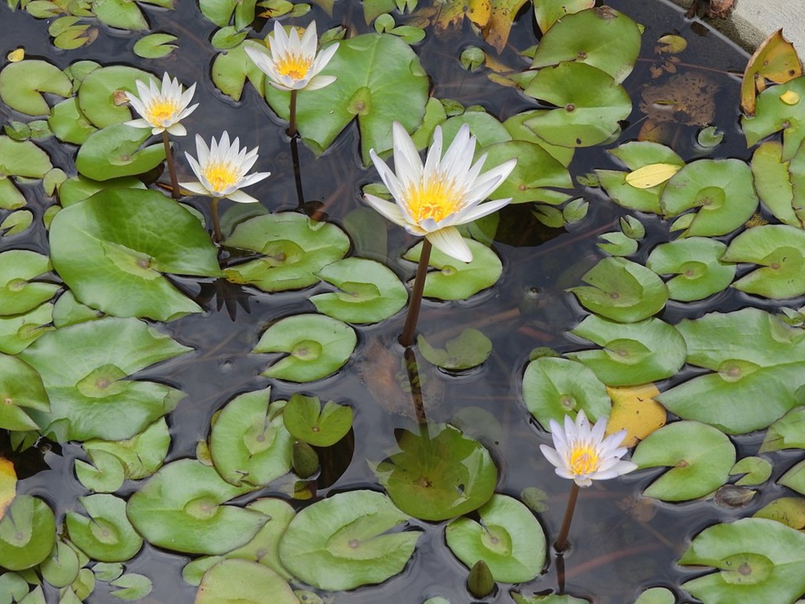
Upload work to Teams
Complete exam style questions in folder
Mini fact finding trip next lesson

