Slide 1
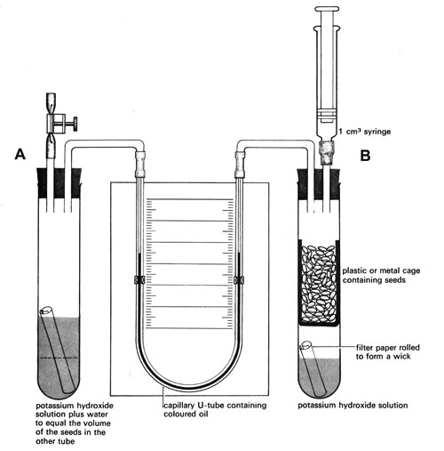
Measuring respiration
Learning outcomes:
Describe and explain how a respirometer can be used to measure the volumes of oxygen & carbon dioxide exchanged

Slide 2
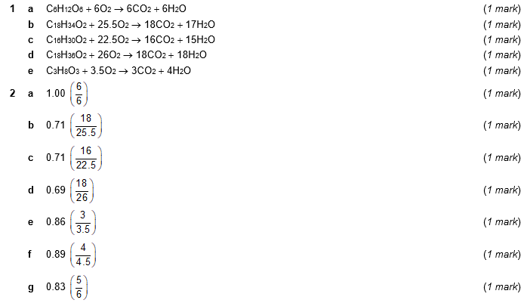

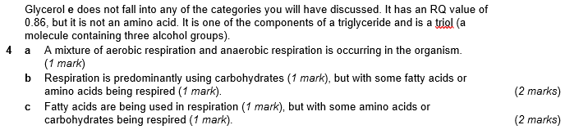
Home Learning: Check your answers

Slide 3
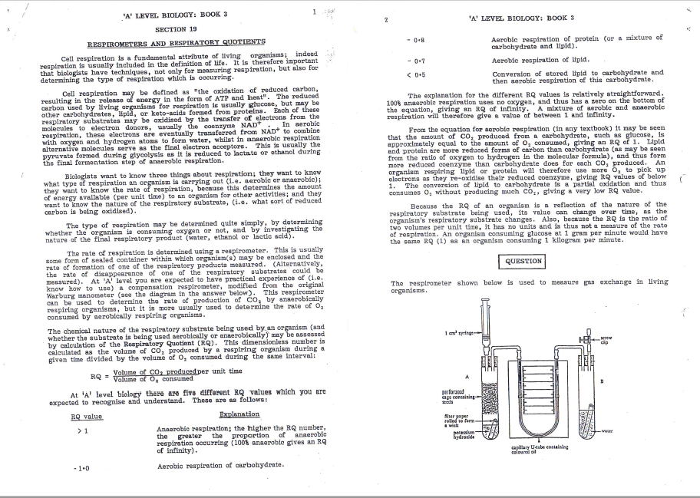
Read and Reduce
Read the passage about respiratory quotients.
Summarise the page in 5, short sentences.
Now select 5 words to summarise the page.

Slide 4
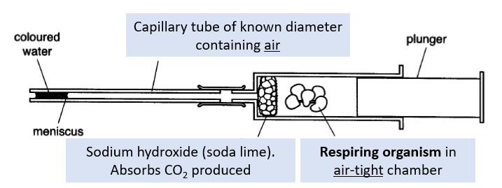
Respirometers:
Apparatus used to measure the rate of respiration by measuring the volumes of oxygen taken up/ carbon dioxide released
During aerobic respiration, the volume of air in the capillary tubing decreases causing the coloured liquid to move. This happens because oxygen is taken up from air without carbon dioxide being added back, as it is absorbed by the soda lime.

Slide 5
Calculating the volume of oxygen used:
The volume of oxygen taken up can be calculated from the distance moved by the meniscus:
volume of O₂ uptake = π x internal radius of tubing² x distance moved
Calculate the volume of oxygen taken up if the fluid moves 5mm in one minute
(internal diameter of the tubing = 2mm):
volume of O₂ uptake = π r² d
= 3.14 x (1mm²⁾ x 5mm
= 15.7mm³ /min

Slide 6
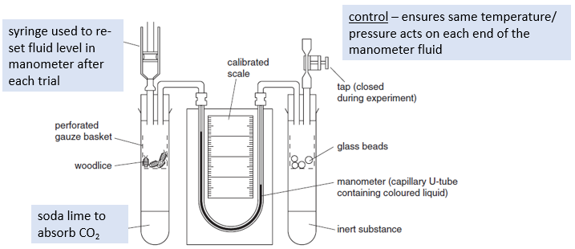
Using respirometers with manometers
Set up apparatus and allow to equilibrate (reach required temperature/ resting respiration rate etc)
Measure distance moved by fluid in set time.
Re-set fluid level using syringe.
Repeat 3-5 times and calculate mean.
Convert distance into volume of oxygen.
List some variables that must be controlled:
temperature, age/ mass/ number of organisms, volume of sodium hydroxide

Slide 7
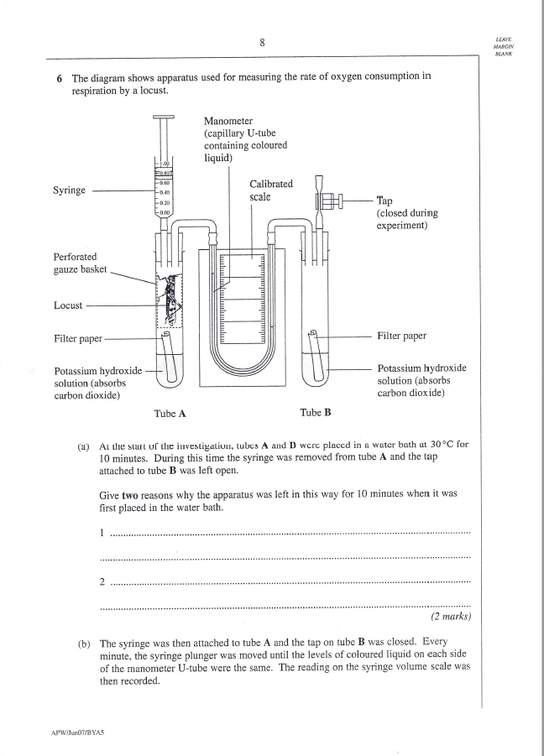
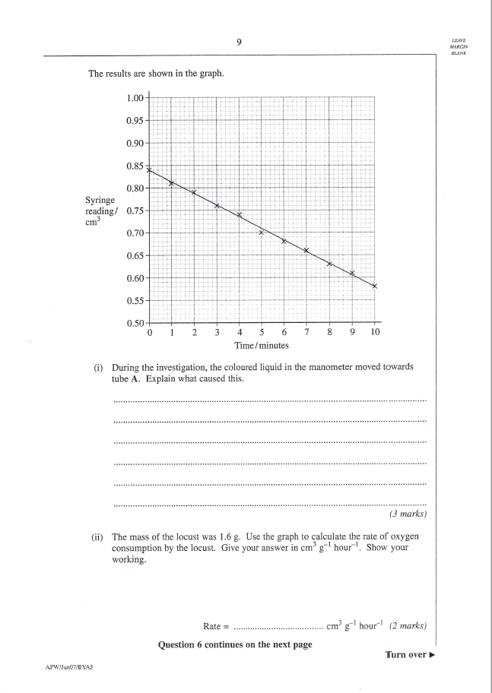
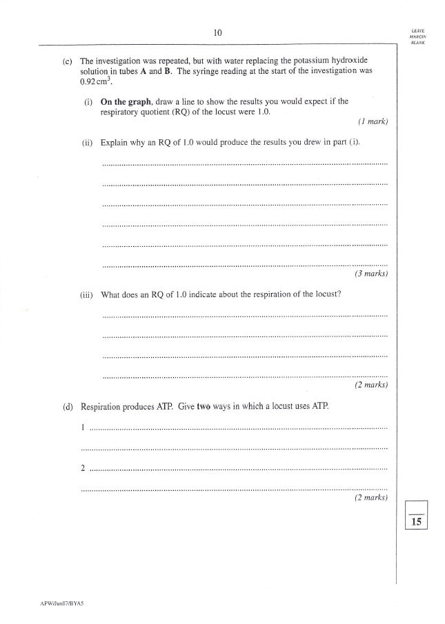
Now try the Practice Exam Question

Slide 8
