Slide 1
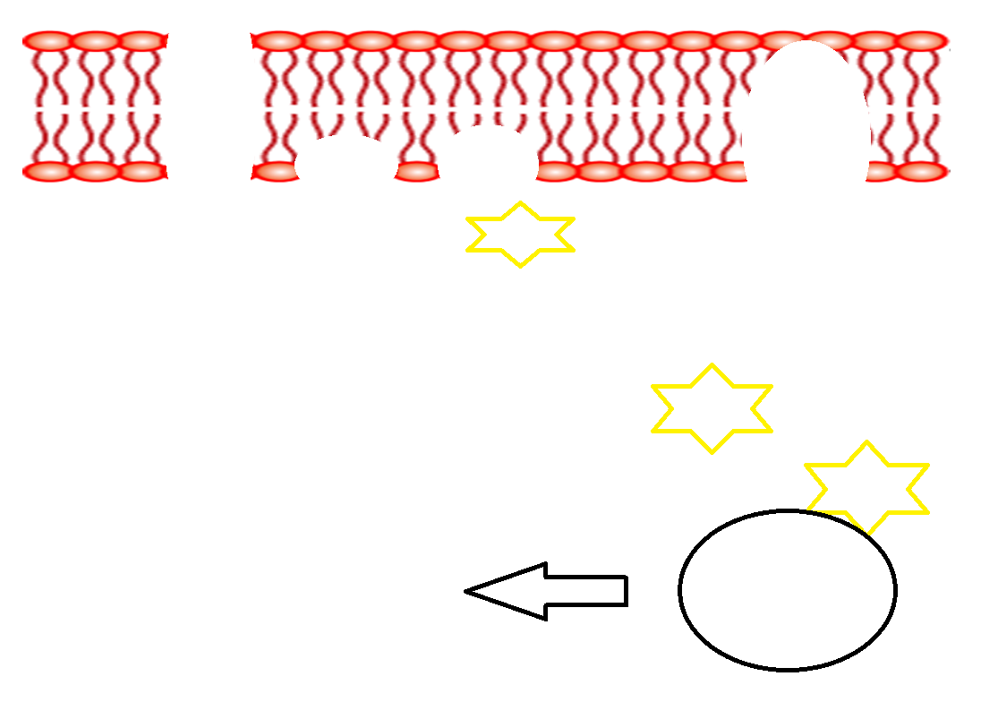
Action of Adrenaline - Complete the gaps using diagrams + annotations
Notes:
Glycogen phosphorylase is the additional enzyme​

Slide 2
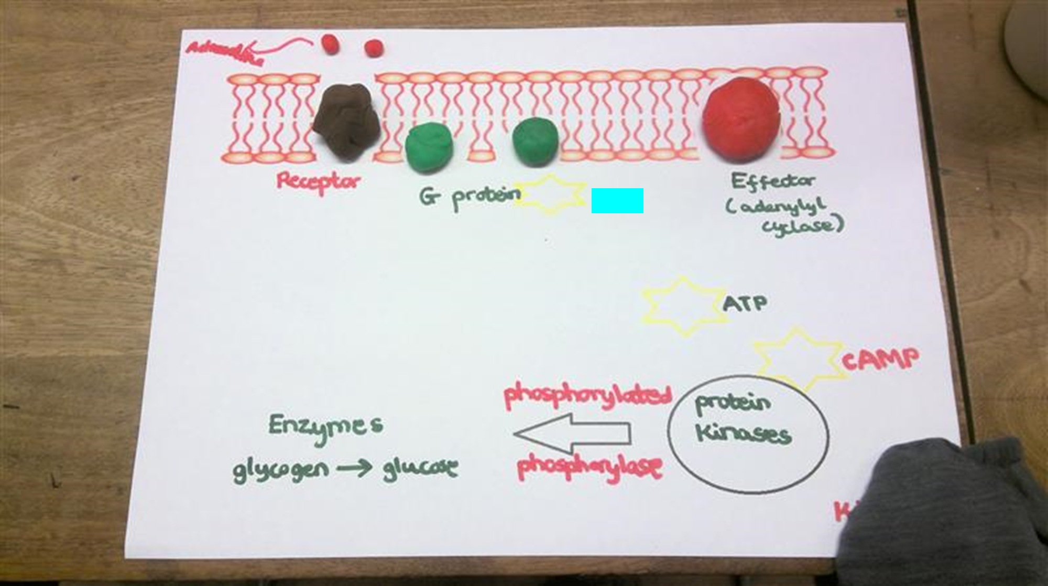
Notes:
Phosphorylate - to cause an organic molecule to combine with phosphoric acid
Protein kinases phosphorylate and activates other enzymes - Glycogen phosphorylase is the additional enzyme​
Glycogen phosphorylase is the additional enzyme​

Slide 3
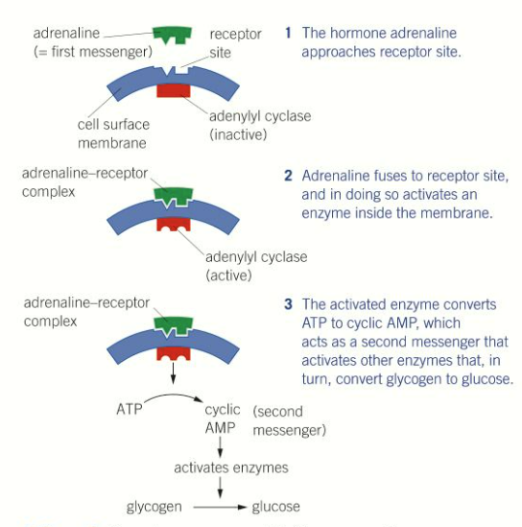
Action of adrenaline action
Adrenaline binds to receptors on the plasma membrane of target cells (e.g liver cells) which activates a G protein
The G protein activates enzyme adenylyl cyclase which converts ATP to cyclic AMP (cAMP).
cAMP is the secondary messenger which activates protein kinases
They then phosphorylate (add a phosphate) other enzymes to activate them to convert glycogen into glucose
Notes:
Phosphorylate - to cause an organic molecule to combine with phosphoric acid
Protein kinases phosphorylate and activates other enzymes - Glycogen phosphorylase is the additional enzyme​
Glycogen phosphorylase is the additional enzyme​

Slide 4
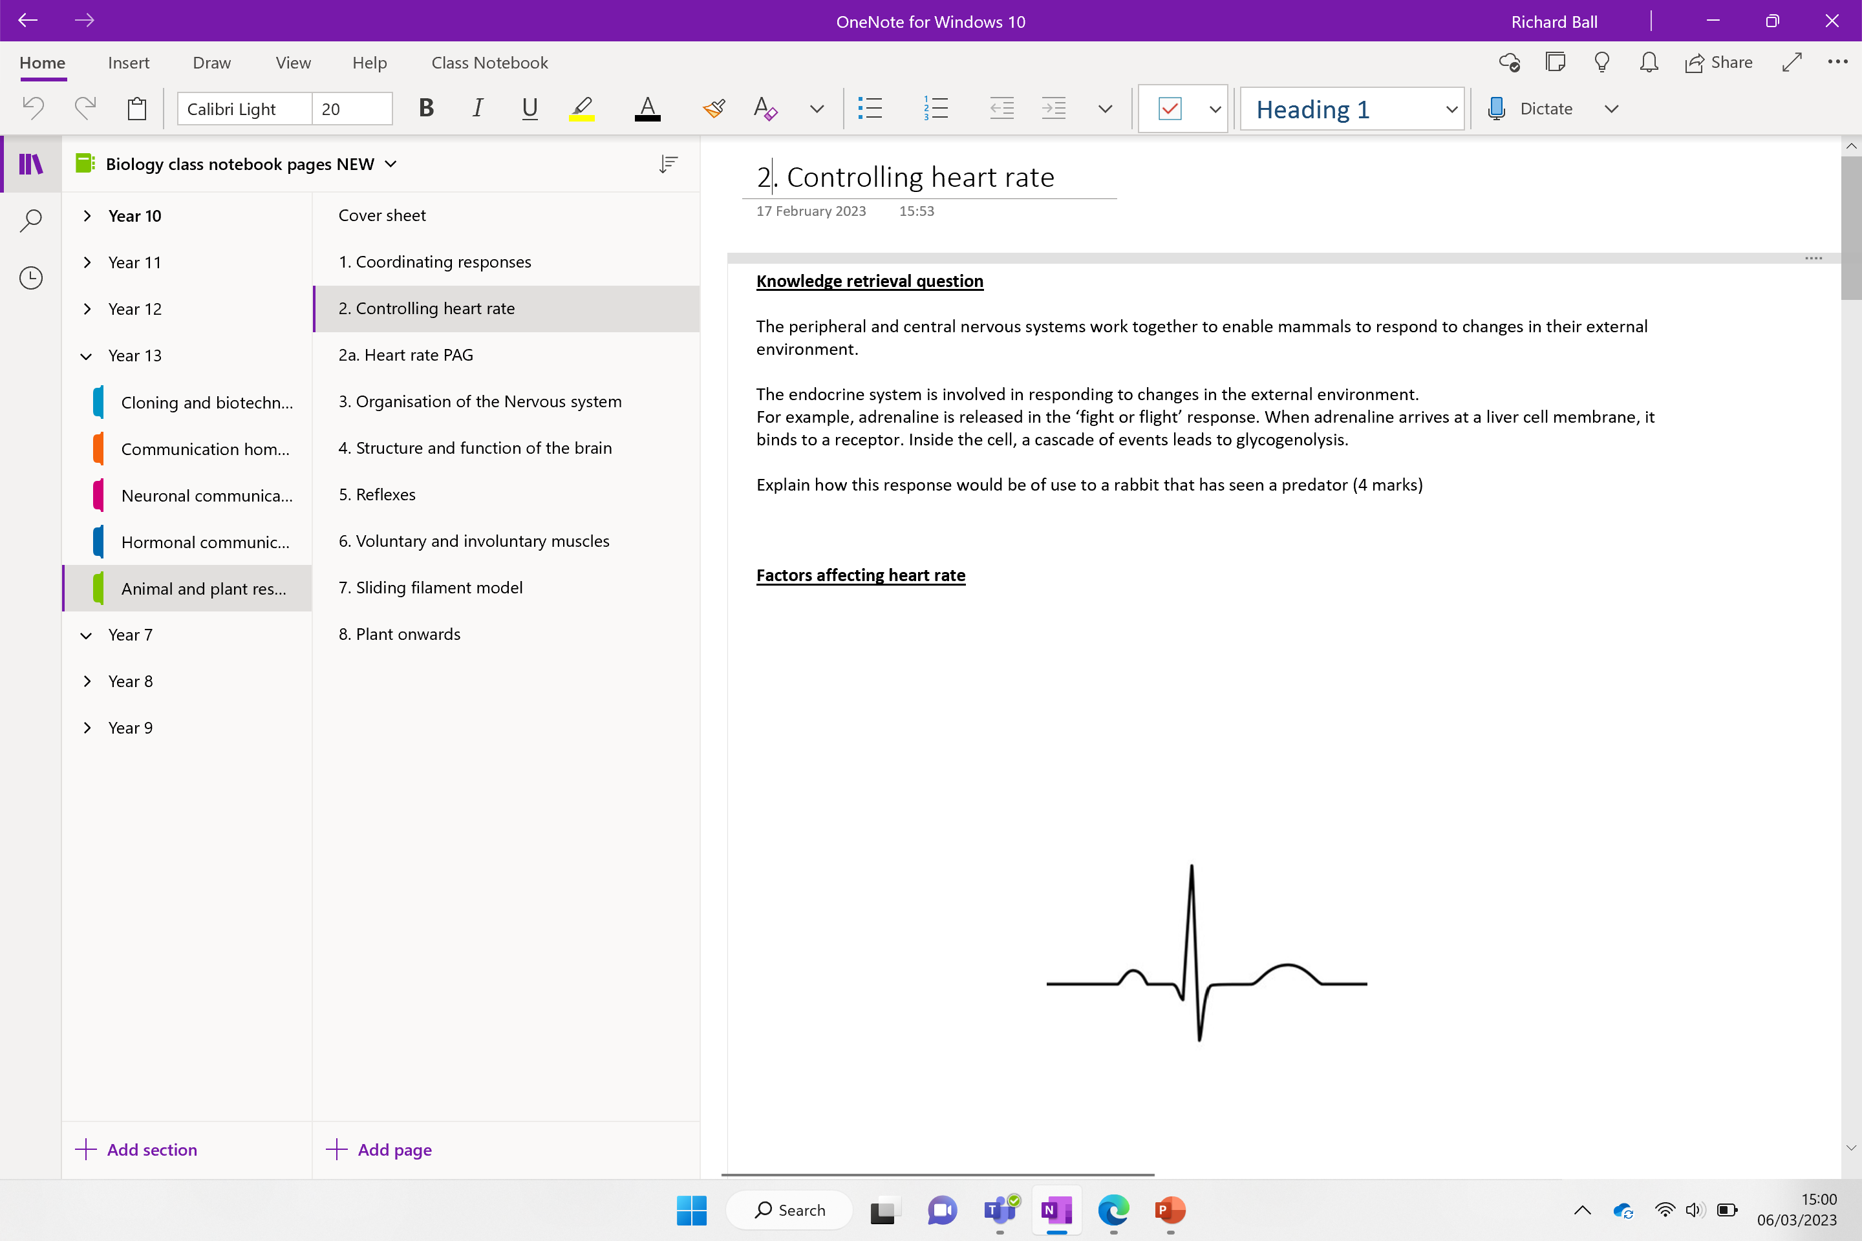

Slide 5
Knowledge retrieval question
The peripheral and central nervous systems work together to enable mammals to respond to changes in their external environment.
The endocrine system is involved in responding to changes in the external environment.
For example, adrenaline is released in the ‘fight or flight’ response. When adrenaline arrives at a liver cell membrane, it binds to a receptor. Inside the cell, a cascade of events leads to glycogenolysis.
Explain how this response would be of use to a rabbit that has seen a predator (4 marks)
Glycogen converted into glucose (in liver)
Glucose released into blood and carried to cells
(glucose needed for) respiration to release energy / make ATP;
for increased, breathing rate / heart rate / muscle contraction; (to run away or fight)

Slide 6
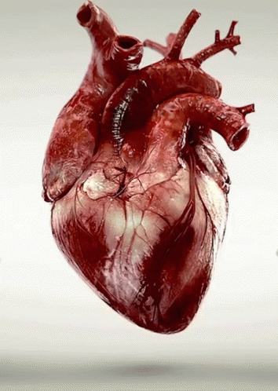
Make a list factors affecting heart rate

Slide 7
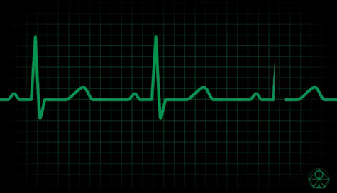
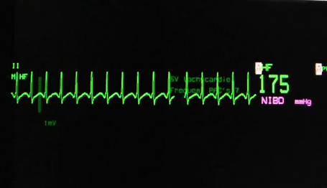
Factors affecting heart rate
Age
Fitness levels
Response to exercise
Response to changes in blood pressure
Response to changes in temperature
Response to change in pH
Response to build up of waste products
Response to presence of hormones

Slide 8
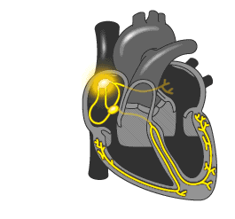
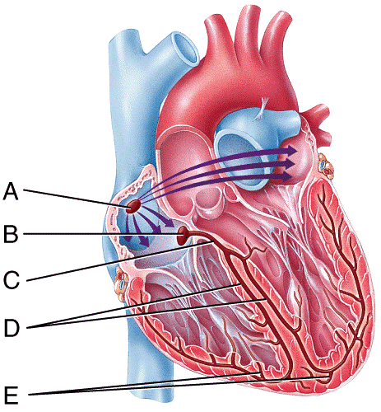
Task: Annotate your diagram to recap electrical control of the heart

Slide 9
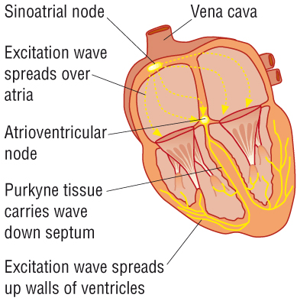
Cardiac muscle is myogenic, meaning it can contract and relax without receiving nerve signals. This pattern controls the heart rate.
A. Sino atrial node (SAN) is found in the wall of the right atrium and acts as a pacemaker. It sends regular waves of electrical activity (waves of excitation) over the atrial walls.
B. The wave of excitation is passed to the atrio-ventricular node (AVN).
A band of non-conducting tissue prevents this wave passing to the ventricles.
C. The delay, is in order to allow the atria to have emptied before passing into the bundle of His
D. The bundle of His carries the impulse along the Purkyne fibres (which is a bundle of conducting).
E. The Purkyne fibres are muscle fibres which branch upwards, causing the ventricular walls to simultaneously contract, from the bottom (apex) upwards, this allows for a more efficient emptying of the ventricles.
Notes:
How does the SA node create its own signal?
The main function of the SA node is to act as the normal pacemaker of the heart. It initiates an action potential that results in an electrical impulse traveling through the heart’s electrical conduction system to cause myocardial contraction. Unlike atrial and ventricular cells, pacemaker cells in the sinus node do not have a resting phase. Instead, these cells have pacemaker potential, in which they begin to depolarize automatically after an action potential ends.
Action potential : The cell creates a potential difference across the cell membrane that then allows Na and K ions to move through the protein channels creating and impulse .

Slide 10
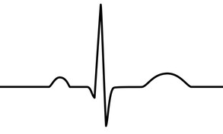
RECAP!
Annotate your diagram.
Include:
Letters for each section of the ECG
Atrial systole
Ventricular systole
Ventricular diastole
What causes the flat line between the first two sections
Why is atrial diastole not shown?

Slide 11
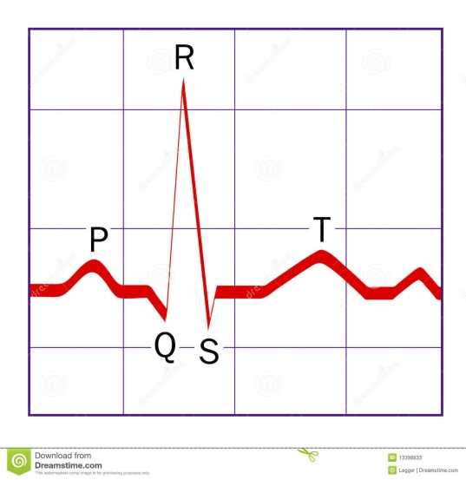
QRS complex – The signal enters the bundle of His and spreads throughout the ventricles walls via the conductive Purkyne fibres. This depolarises the fibres in the ventricle walls inducing ventricular systole. Atrial repolarisation is also occurring but hidden by QRS
P WAVE
The SA node produce the first electrical excitation in the right atrium.
The signal passes across both atria, causing the muscles cells to depolarise and contract.
Atrial systole
The signal passes out of the ventricles, the ventricular walls start to relax. This is called ventricular diastole.
This repolarisation of the ventricles is represented by the T-Wave on the ECG.
P-R segment – the flat line following the P wave. The signal pauses at the non-conductive tissue in the AV node

Slide 12
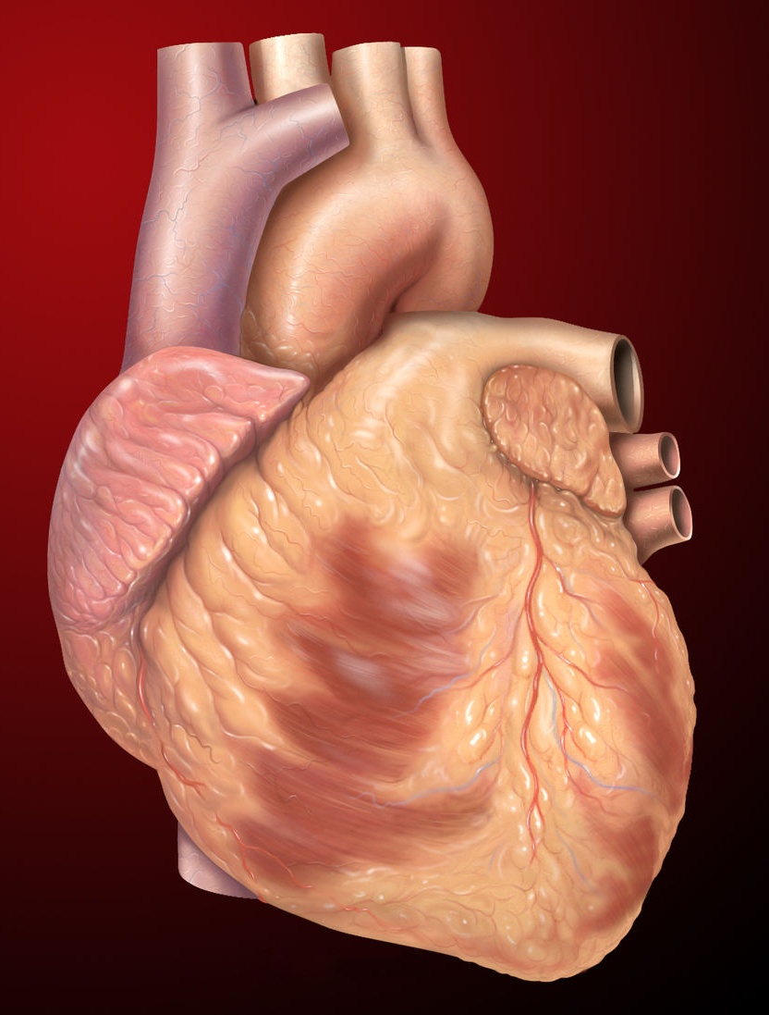
The activity of the body changes, so it is important that the frequency of the heartbeat changes according to these needs.

Slide 13
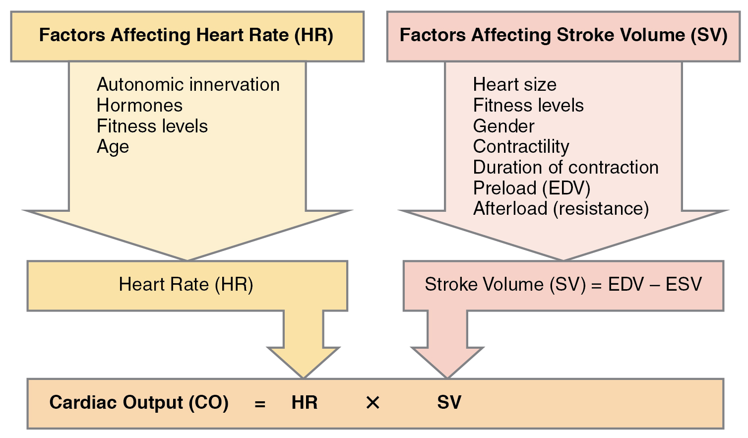
The circulatory system can adapt to meet the needs of the body by changing the heart rate or altering the stroke volume.
← HUH?
Notes:
High preload = higher stroke volume
The autonomic innervation of the heart refers to the network of nerves that are responsible for the functioning of the heart.

Slide 14
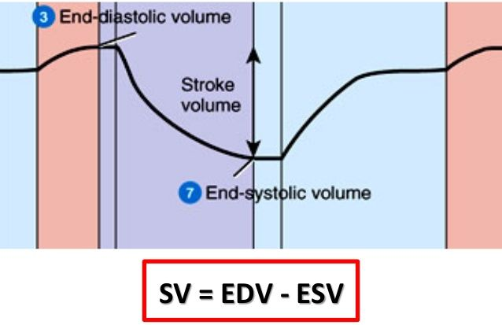
Calculating stoke volume
EDV – heart chamber relax and fill with blood
ESV – heart chamber contract pump blood

Slide 15
How do we change the frequency of the heartbeat?

Slide 16
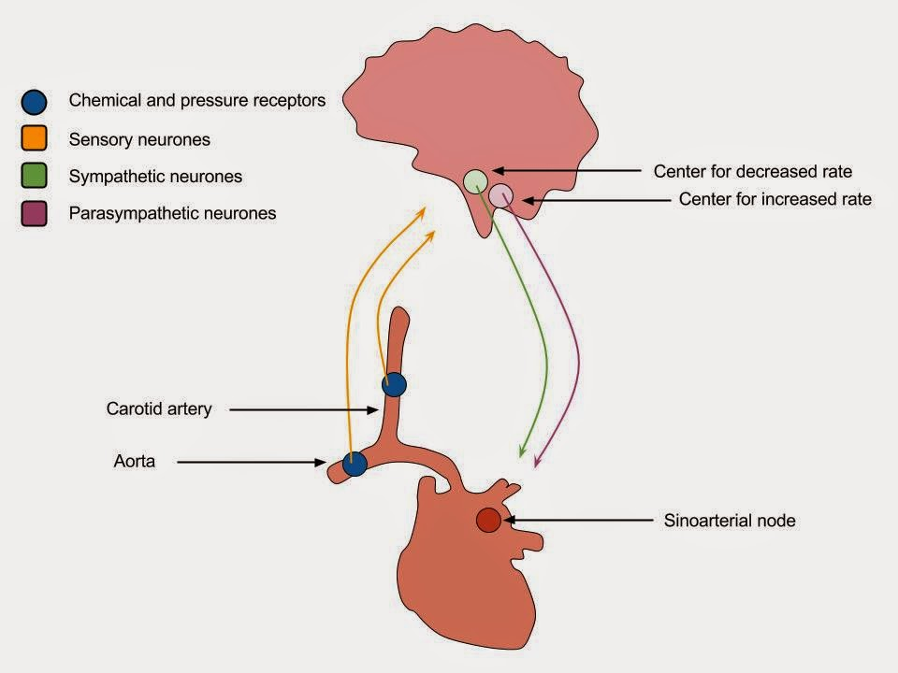
Medullar oblongata
The medullar oblongata (brain stem) is responsible for controlling heart rate.
It contains two centres linked to the sinoatrial node (SAN). These are:
Centre 1 - increases HR by sending impulses via the sympathetic nervous system (specifically the accelerator nerve)
Centre 2 – decreases HR by sending impulses via the parasympathetic nervous system (specifically the vagus nerve)

Slide 17
How is each centre stimulated?

Slide 18
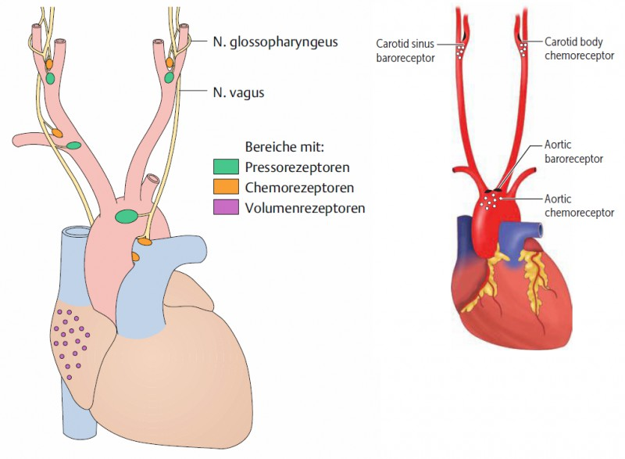
How is each centre stimulated?
What chemical / pressure changes might be detected?
What would the response be?

Slide 19
Receptors in blood vessels
Baroreceptors (pressure receptors)
Detect changes in blood pressure
(eg low blood pressure is detected and trigger an increase in HR to avoid fainting)
Receptors are present in the aorta, vena cava and carotid arteries.
These send signals via neurones to the medulla oblongata

Slide 20
Receptors in blood vessels
Chemoreceptors (chemical receptors)
Detect changes in levels of particular chemicals in the blood (e.g. CO₂ OR changes to pH)
Present in the aorta, carotid arteries and medulla.
These send signals via neurones to the medulla oblongata

Slide 21
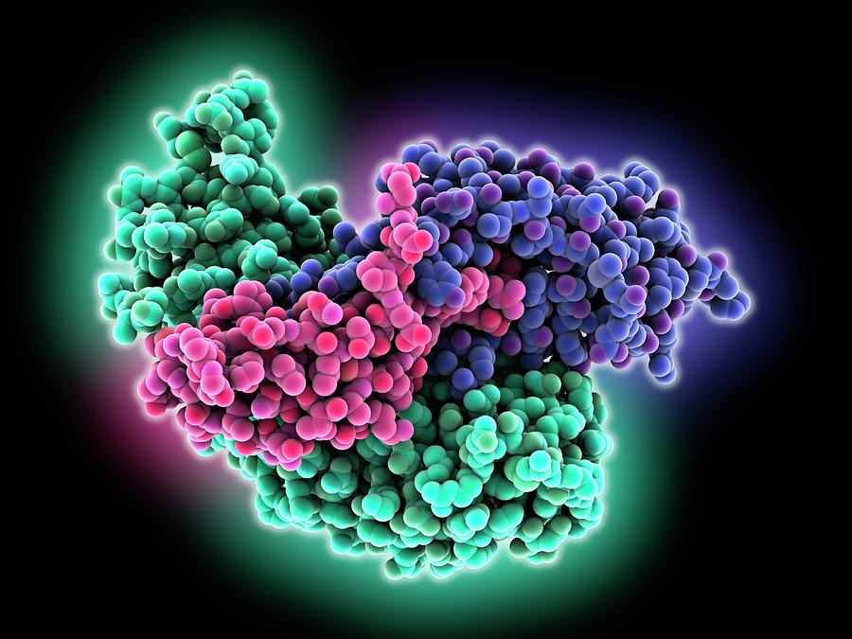
Hormonal control
Heart rate is also influenced by the presence of hormones.
Two stress hormones that are released that increase heart rate are:
Adrenaline
Noradrenaline
They increase heart rate by increasing the number of impulses produced by the SAN.
Both play an important role in the ‘fight or flight’ response.
Notes:
Both act on sodium ion channels (opening them) – depolarisation increase frequency of AP/impulse increasing heart rate

Slide 22
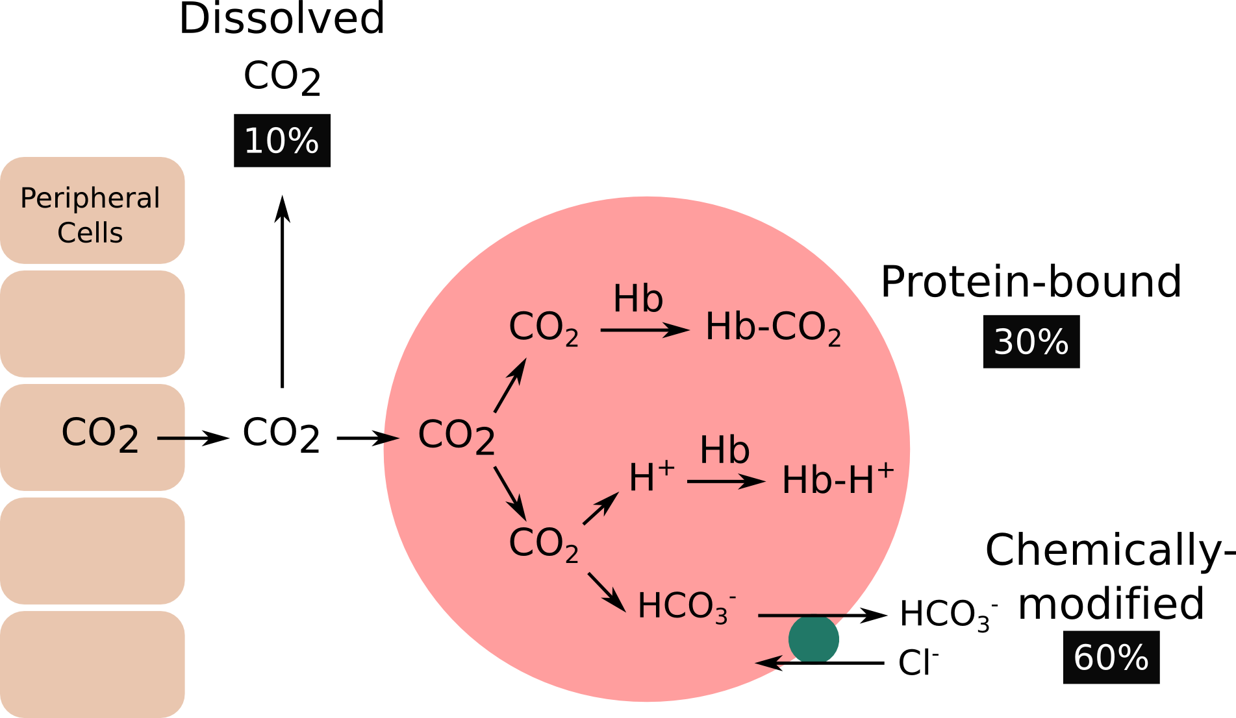
Chemoreceptors
RECAP!
Chemoreceptors are also sensitive to pH.
Explain how the pH of your blood changes in the presence of CO₂. How would this affect your heart rate. Include any equations to support your answer (4 marks).

Slide 23
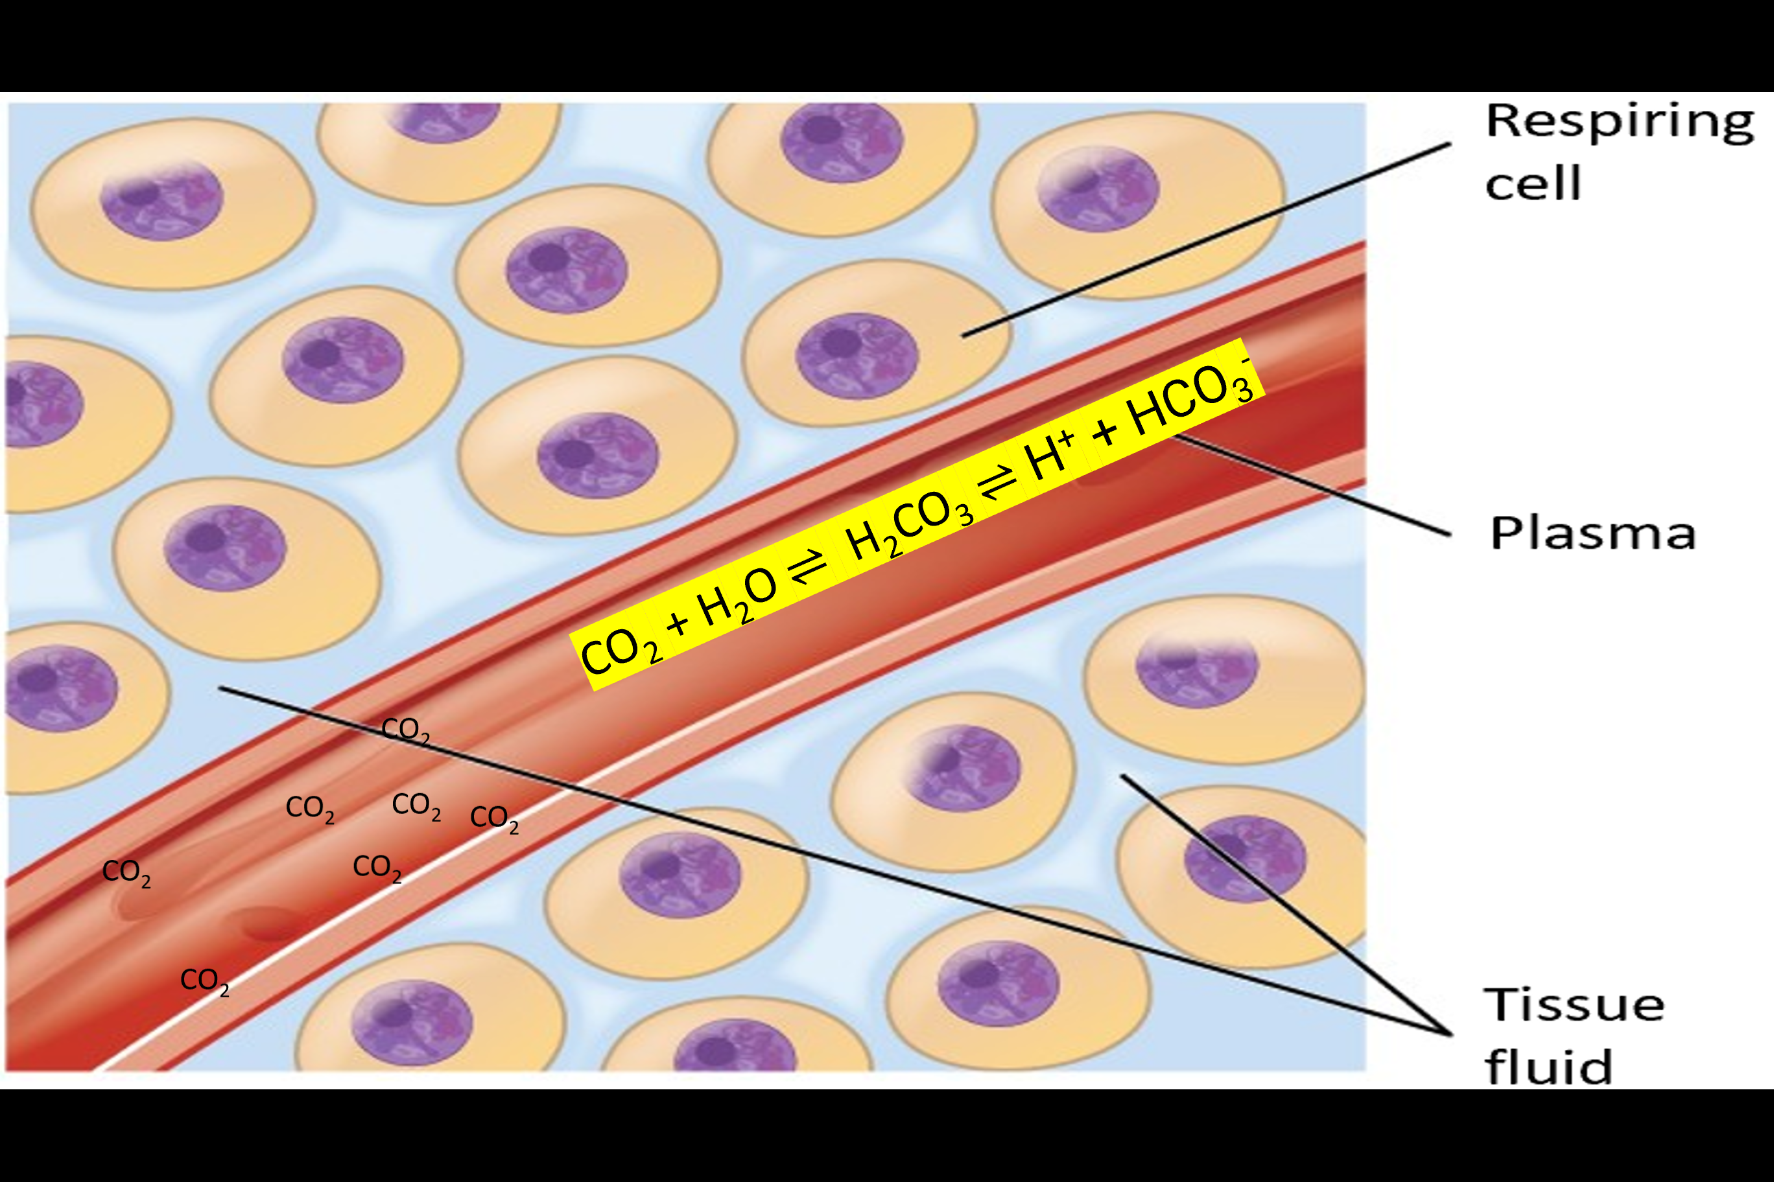
Explain how the pH of your blood changes in the presence of CO₂. How would this affect your heart rate. Include any equations to support your answer (4 marks).
pH of the blood decreases as carbonic acid is formed (when CO₂ + water react in RBC)
CO₂ + H₂O ⇌ H₂CO₃ ⇌ H⁺ + HCO₃- ​
This is drop in pH is detected by chemoreceptors
Negative feedback is sent to the medulla oblongata, which sends an impulse along the accelerator nerve to increase HR.

Slide 24
What happens when deoxygenated blood arrives at the lungs?

Slide 25
NL BELOW
Quick 10?

Slide 26
Place the following in order. The first has been done for you.
When carbon dioxide levels in the blood decrease
This reduces the frequency of nerve impulses being sent to the medulla oblongata.
In turn, this reduces the frequency of impulses being sent to the SAN via the sympathetic nervous system.
The chemoreceptors located in the carotid arteries and aorta detect the change in pH.
Thus, the heart rate decreases back to its normal levels

Slide 27
Place the following in order. The first has been done for you.
When carbon dioxide levels in the blood decrease
The chemoreceptors located in the carotid arteries and aorta detect the change in pH.
This reduces the frequency of nerve impulses being sent to the medulla oblongata.
In turn, this reduces the frequency of impulses being sent to the SAN via the sympathetic nervous system.
Thus, the heart rate decreases back to its normal levels

Slide 28
Baroreceptors
Complete the gaps for your notes on baroreceptors
Located in the ……….. and ……….. artery walls and detect changes in …………..
If pressure is too ………, impulses are sent to the medulla oblongata centre which decreases ………… rate.
The medulla oblongata sends …………. along the …………………….. neurones to the …….. which decrease the heart rate.
This ………….. blood pressure back to normal.

Slide 29
Baroreceptors
Complete the gaps for your notes on baroreceptors
Located in the aorta and carotid artery walls and detect changes in pressure.
If pressure is too high, impulses are sent to the medulla oblongata centre which decreases heart rate.
The medulla oblongata sends impulses along the parasympathetic neurones to the SAN which decrease the heart rate.
This reduces blood pressure back to normal.

Slide 30
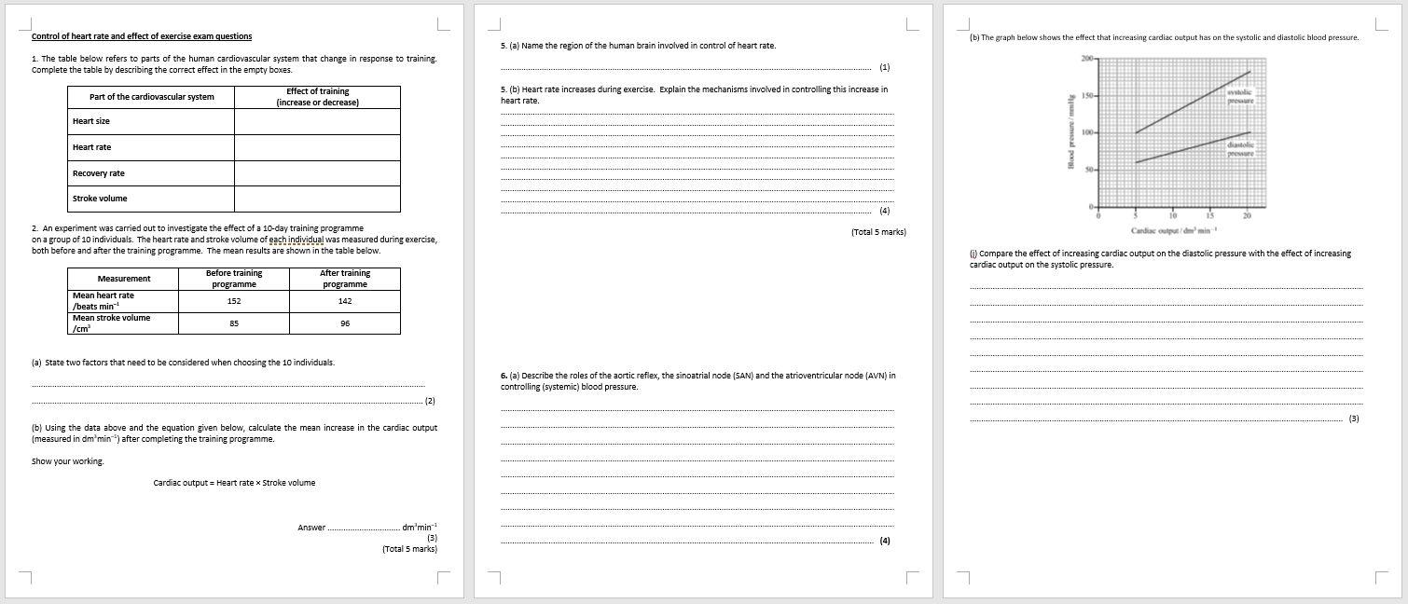
Now try these exam questions…

Slide 31
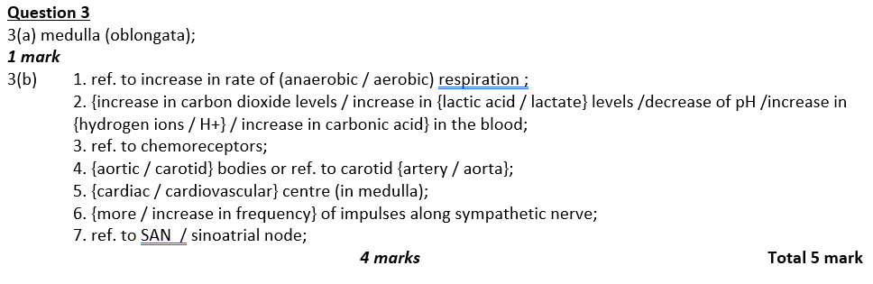
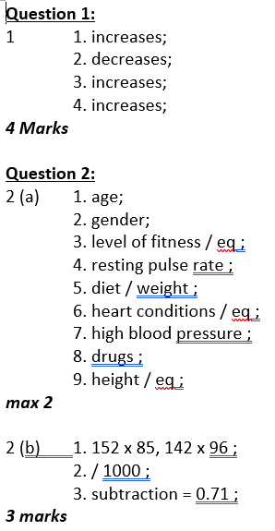
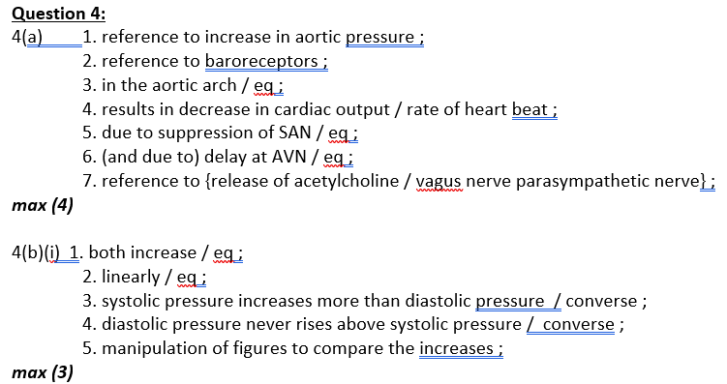

Slide 32
Review questions…
Name the region of the heart responsible for maintaining the resting heart rate at 60-80 beats per minute.
Which two types of receptor provide feedback to the cardiovascular centre in the brain and where are they located?
Outline the nervous mechanisms controlling heart rate.

Slide 33
Review question answers…
Sinoatrial node (SAN)
Chemoreceptors found in the carotid artery/aorta and brain and stretch receptors found in muscles/carotid sinus
Baroreceptors and chemoreceptors in the aorta, brain or carotid arteries send signals via sensory neurones to the medulla oblongata. An increase in impulses sent down the accelerator nerve increases the heart rate.

