Slide 1
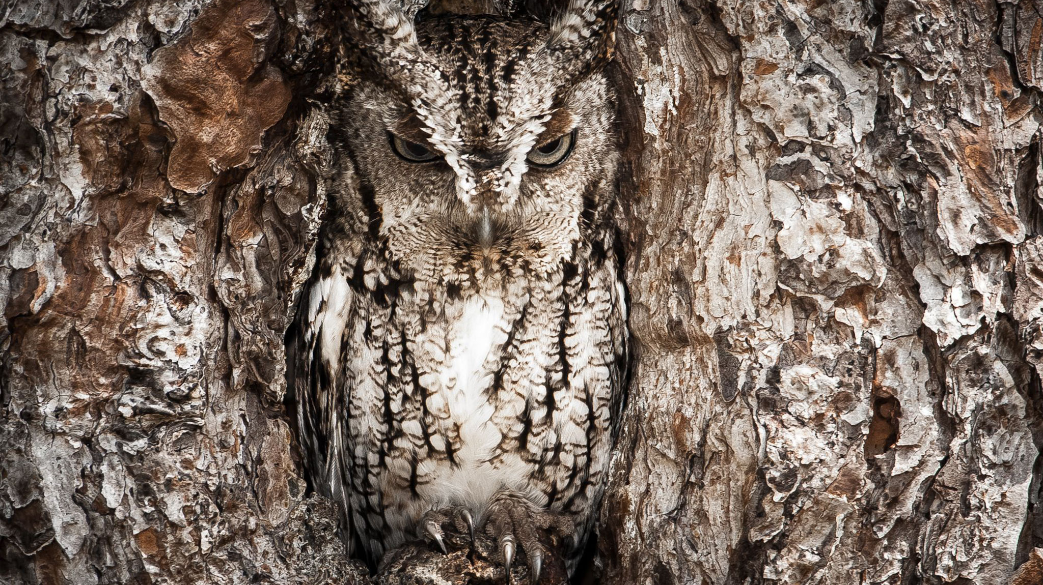
Adaptations
By the end of the lesson you should be able to:
Describe the different types of adaptations of organisms to their environment including: anatomical, physiological and behavioural adaptations
Explain why organisms from different taxonomic groups may show similar anatomical features, including the marsupial mole and placental mole.

Slide 2
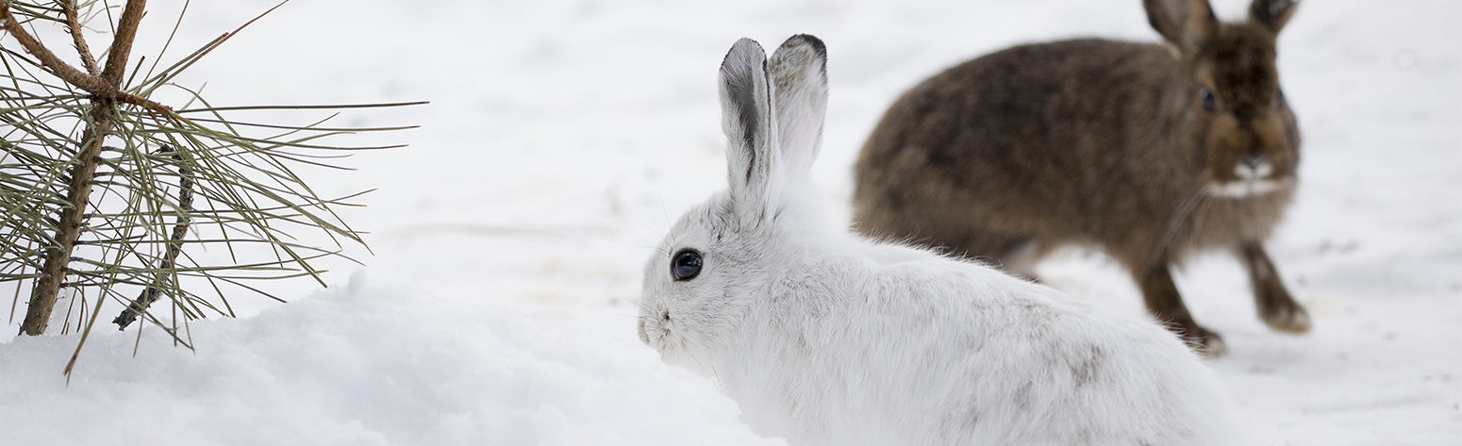
What are adaptations?
Adaptations are characteristics that increase an organism's chance of survival and reproduction in its environment.
Adaptations can be:
  Anatomical – physical features (internal and external)
  Behavioural – the way an organism acts
  Physiological – processes that take place inside an organism
Adaptations develop by evolution through means of natural selection.
Use your prior knowledge to explain this last statement

Slide 3
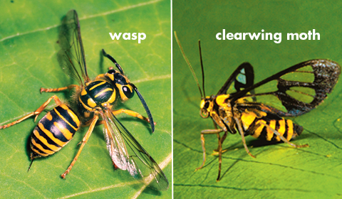
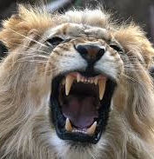
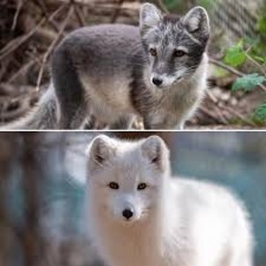
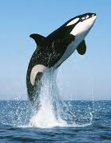
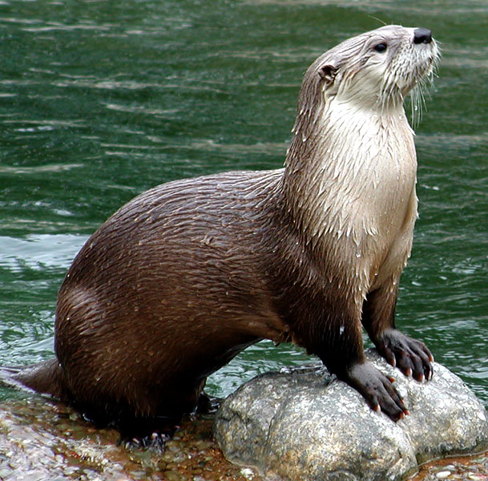
Can you identify some anatomical adaptations?
Notes:
e.g.
Thick layer of blubber
Streamlined
Colour change for season
Teeth suited to diet

Slide 4
Anatomical adaptations
Body covering (feathers, hair, scales, spines, shells)
Colour – camouflage
Teeth- adapted for the diet an organism has
Mimicry – copying another animal’s appearance to warn off predators
Examples:
Whales – thick blubber
Otters – streamlined
Snowshoe hare changes colour to remain camouflaged with the season

Slide 5
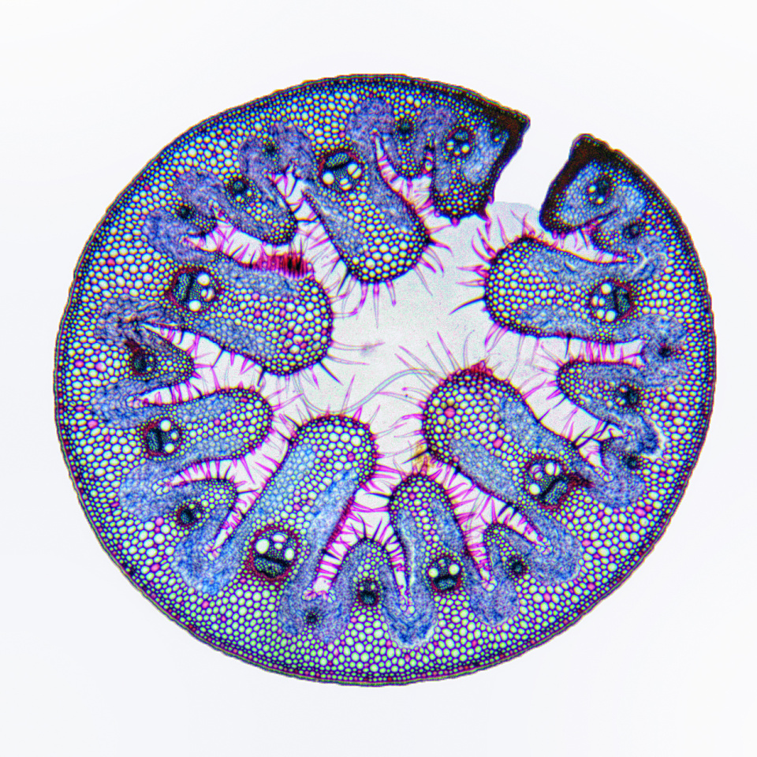
Topic Link: Transport in Plants
Marram grass is a xerophyte. How is adapted to minimise transpiration ?
Rolled leaves minimise surface area
Rolled leaves, sunken stomata and hairs trap moist air close to the leaf and reduce diffusion gradient
Thick waxy cuticle reduces evaporation

Slide 6
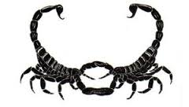
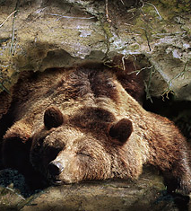
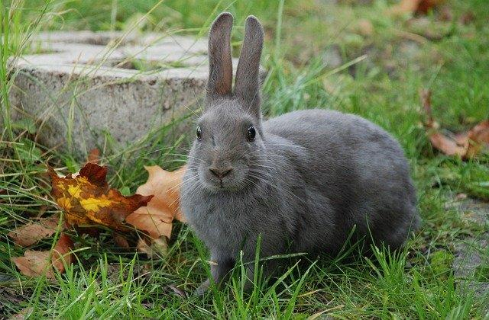
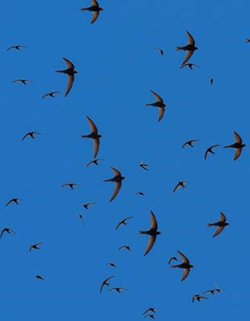
What behavioural adaptations can you identify?
Notes:
Possum playing dead
Scorpion mating dance
Rabbit frozen in fear
Hibernating bear
Swallows migrating south for winter

Slide 7
Behavioural adaptations
Survival eg. Possoms playing dead
Courtship e.g. scorpions dancing
Seasonal e.g. migration, hibernation
Behavioural adaptations can be:
Innate – inherited though genes e.g. spiders building webs
Learned behaviour - observing other animals e.g. sea otters using tools
Many behavioural adaptations are a combination of both.

Slide 8
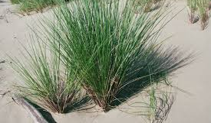
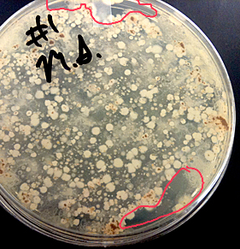
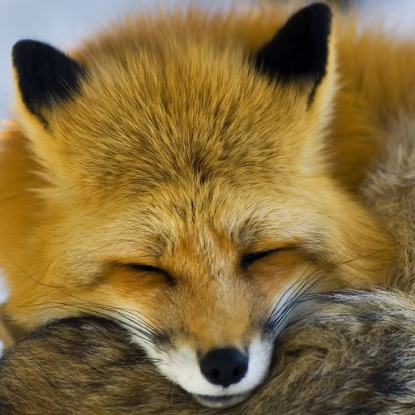
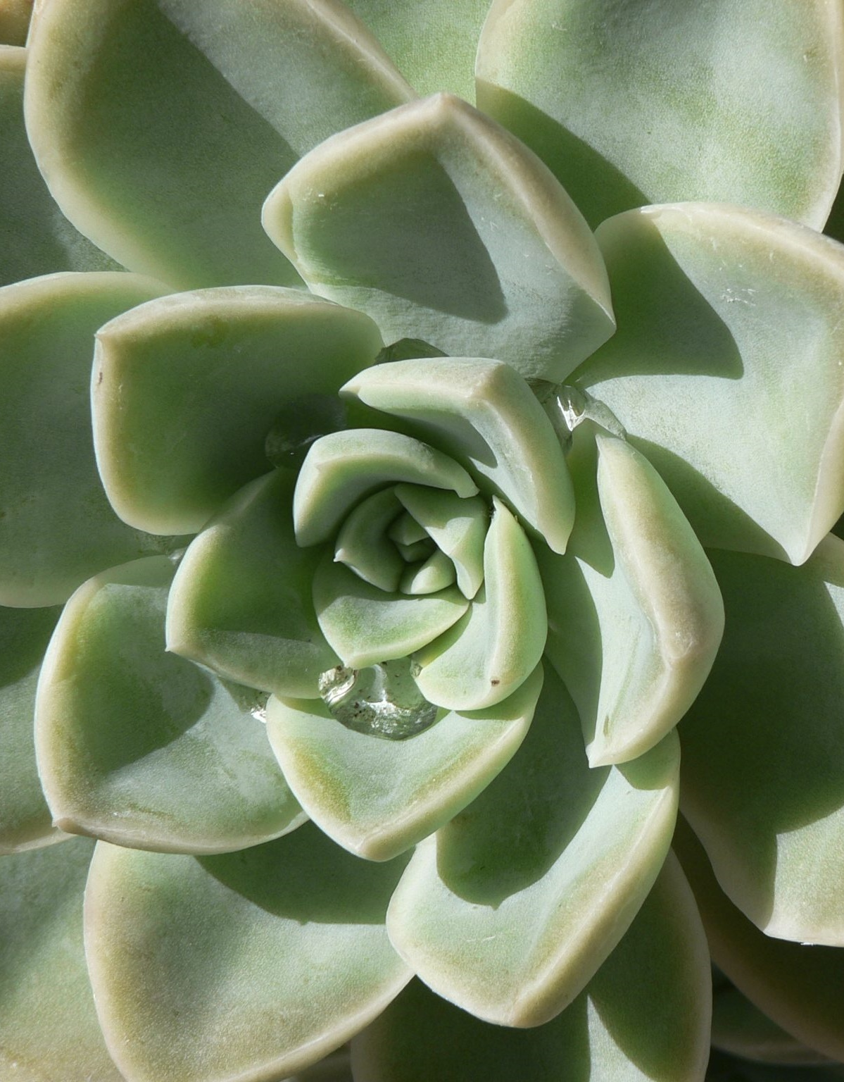
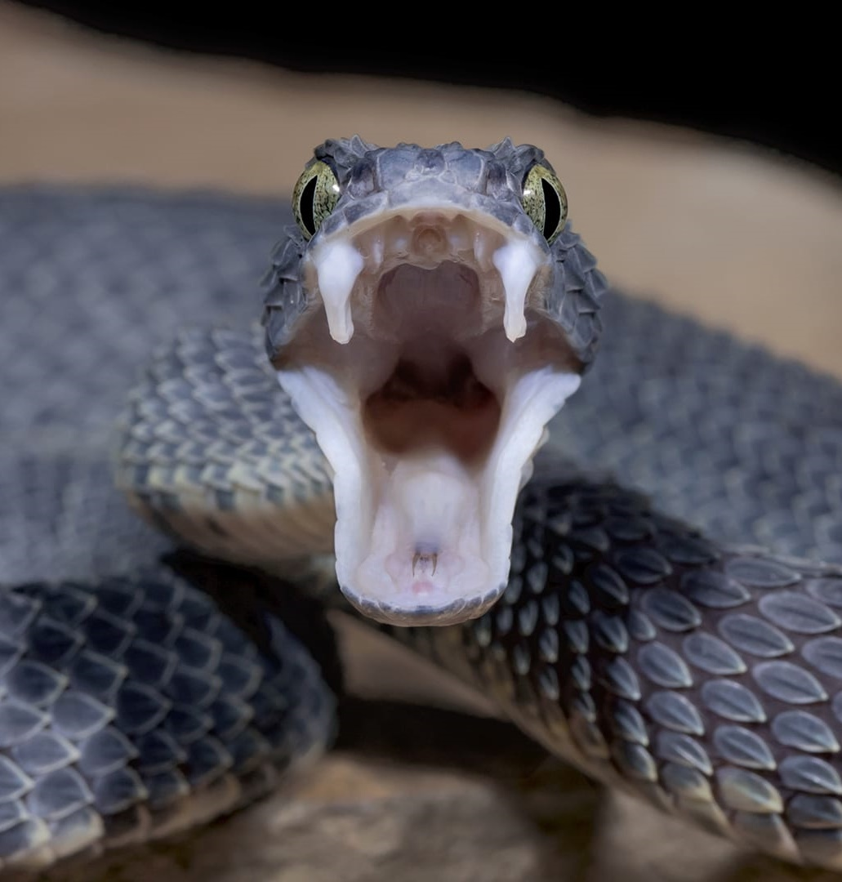
What physiological adaptations can you identify?
Notes:
Production of venom
Production of antibiotics
Storage of water
Maintenance of a constant body temperature

Slide 9
Physiological adaptations
Examples
Antibiotic production
Venom production
Cacti store water
Many adaptations fall into more than one category. For example:
  Hibernation is a behavioural adaptation that involves physiological changes such as a slow down in heart rate and breathing rate and lowering of body temperature.
  Peacock courtship behaviour requires the peacock to lift its huge, colourful tail which is an example of behavioural and anatomical adaptations.

Slide 10
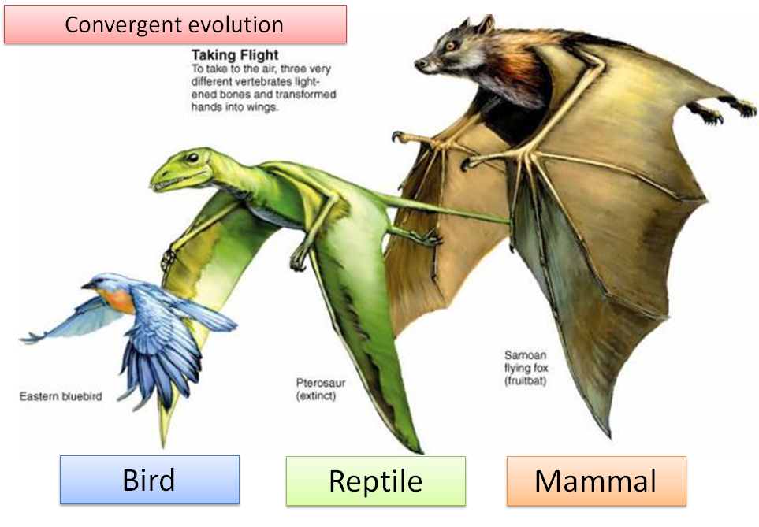
This takes place when unrelated species begin to share similar traits. These similar traits evolve because the organisms adapt to similar environments or experience similar selection pressures.
Convergent evolution results in analogous structures – structures which have adapted to perform the same role but have different genetic origins, e.g. wings on butterflies, birds and bats.

Slide 11
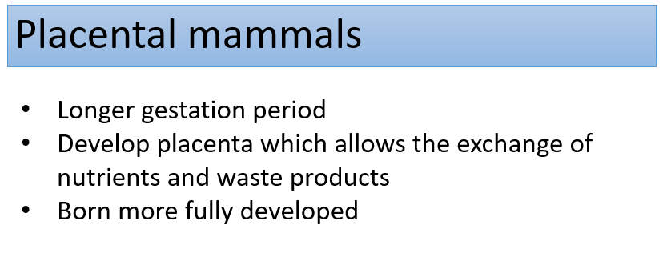
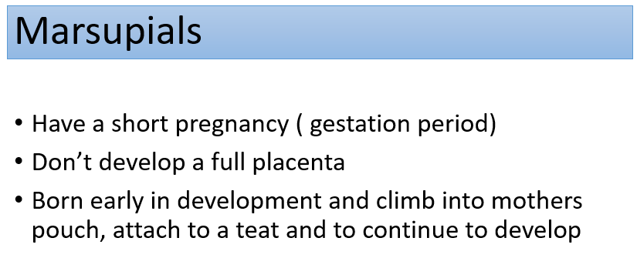
Example of convergent evolution:
Placental and Marsupial mammals
Marsupials and placental mammals separated from a common ancestor more than 100 million years ago

Slide 12
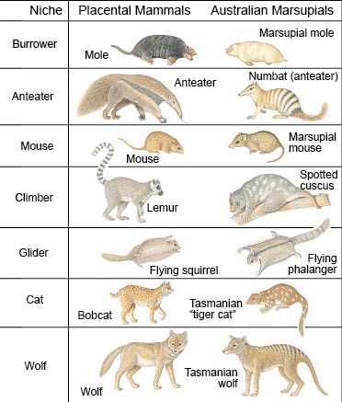
Convergent evolution
Marsupials in Australia and placental mammals in the North America have adapted to similar climates and food supplies
Species in each content strongly resemble each other because they have adapted to occupy similar niches.

Slide 13
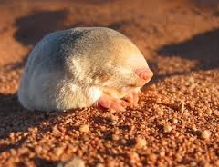
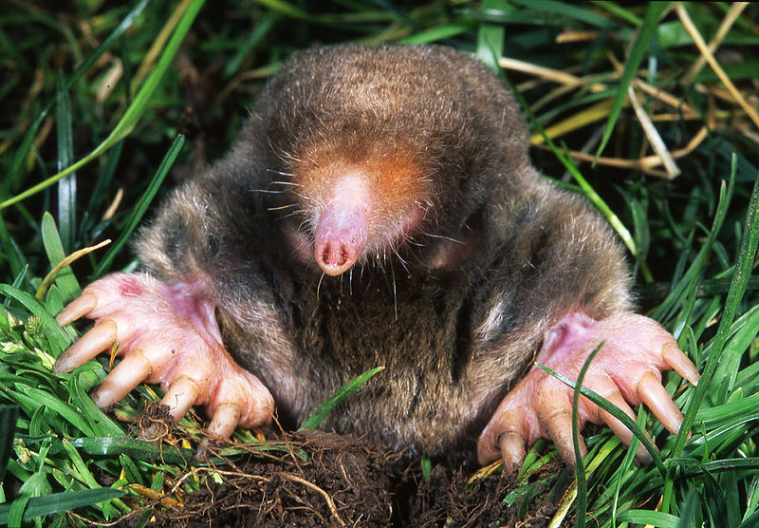
Example:
Marsupial and Placental Moles
Both types of mole burrow through soft soil to find worms and grubs.
They have a streamlined body shape and modified forelimbs for digging.
They have velvety fur which allows smooth movement through the soil
Both organisms have evolved in such a similar way but are thousands of miles apart on different continents.

Slide 14
Questions
1. Classify the following adaptations into anatomical, behavioural or physiological adaptations: Melanin production; camouflage; migration; sharp canine teeth; production of toxins; courtship dance
Anatomical – camouflage, sharp canine teeth (1) Physiological – melanin production, production of toxins (1) Behavioural – migration, courtship dance (1)
2. State the difference between analogous and homologous structures
Analogous structures have adapted to perform the same function but have a different origin whereas homologous structures appear superficially different but have the same underlying structure (1)
3. Which of the following is an example of convergent evolution? Explain your answer
  Insect wing and bird wing
  Bat wing and human arm
  Both have evolved to fly to escape predators/ catch food
4. State and explain how marsupial moles and placental moles provide evidence for convergent evolution
Both burrow through soft soil to find insects (1).
Both have a streamlined body shape, and modified forelimbs for digging (1).
Both have velvety fur which allows smooth movement through the soil (1).

