Slide 1

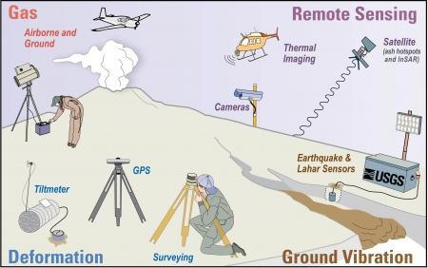
Predicting and Preparing for volcanoes
Learning Objectives
To outline the different ways in which people prepare for volcanoes.
Explain different prediction and preparation Methods
Assess the effectiveness of these methods.
Starter: Managing Volcanoes. Look at the pictures below and discuss what is being shown in regard to, volcano monitoring:

Slide 2

Syllabus Guide – What we must know!
9.1 Hazards resulting from tectonic processes
The global distribution of earthquakes and volcanoes related to plate tectonics.
Earthquakes and resultant hazards: shaking, landslides, soil liquefaction, and tsunami.
Volcanoes and resultant hazards: types of eruption and their products (nuées ardentes, lava flows, volcanic mudflows/lahars, volcanic landslides, pyroclastic flows, and ash fallout).
Primary and secondary impacts on lives and property.
Prediction, hazard mapping, preparedness and monitoring of earthquake and volcanic hazards and perception of risk.
Please refer to the course syllabus regularly – It guides you on exactly what is required from you in this course!

Slide 3
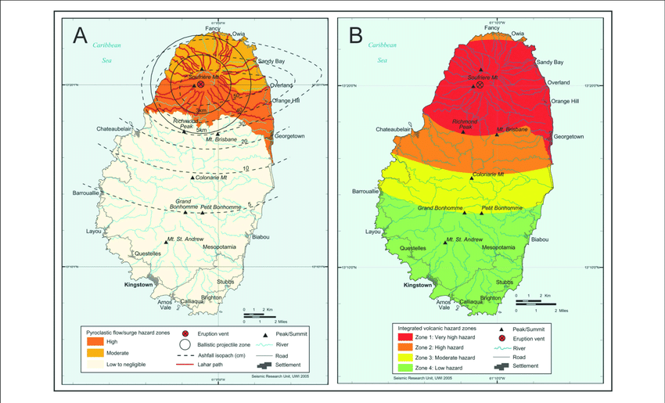
Predicting and Preparing for volcanoes
800 million people around the world live within 100km of active volcanoes around the world. As with earthquakes, we can reduce the impacts of volcanic activity through the following:
Prediction, preparedness and protection
Responding to volcanic events
What were the other potential strategies humans can implement to reduce the impact of hazards?
Cost/benefit, Insurance, Hazard Perception & Aid – Refer back to the first lesson!!!!
Use your textbook, slides 4-6 on this PowerPoint and any additional research (and resources in the revision folder!) required to build up your understanding of each of the above. Produce your work in any way you see fit.
Ensure you do the following:
Explain how the various methods used work & evaluate their effectiveness
Regularly refer to real-life examples of the methods being used in both HICs and LICs.
9 With the aid of a case study of a hazardous environment, assess how prediction and preparedness can reduce the impacts of the hazard(s) on lives and property. [20]
9 Assess the extent to which prediction, hazard mapping and preparedness can reduce the impacts of mass movements on lives and property. [20]
8 ‘Earthquakes are more difficult to predict, but easier to prepare for, than volcanic eruptions.’ How far do you agree with this view? [20]
8 ‘The type of eruption is the most important factor influencing the hazards from volcanoes.’ With the aid of examples, how far do you agree? [20]
8 ‘Prediction is the most effective way of reducing the impacts of volcanic eruptions on lives and property.’ How far do you agree with this view? [20]
9 Assess the extent to which the types of volcanic eruptions and their products determine the hazardous impacts. [20]

Slide 4
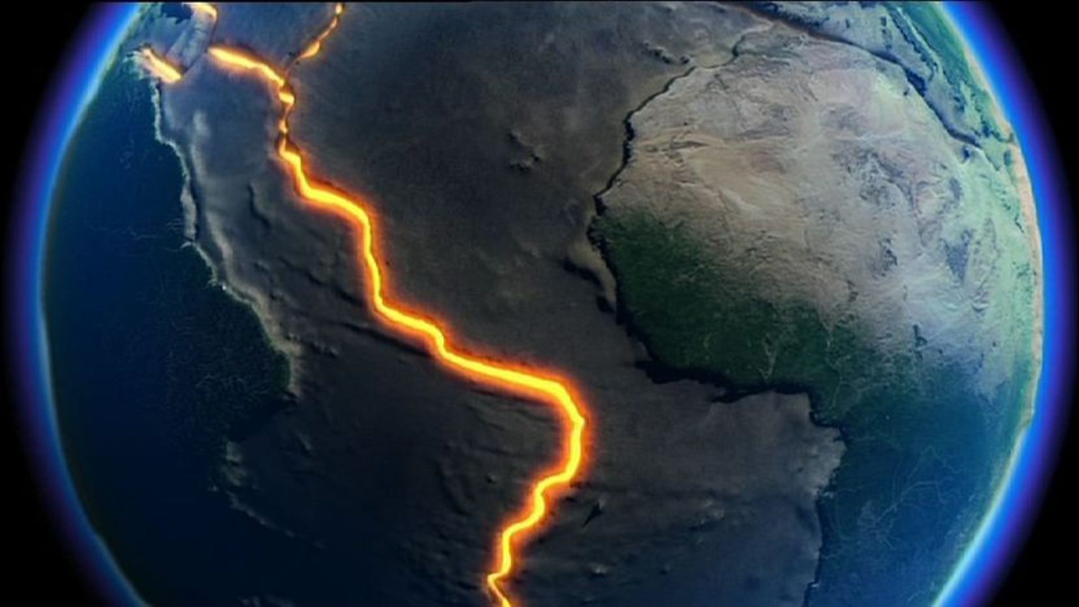
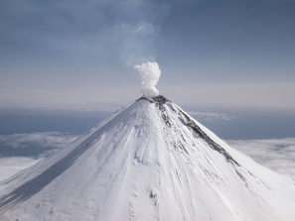
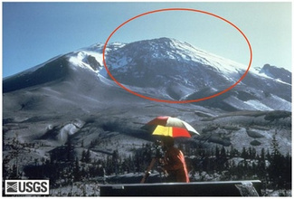
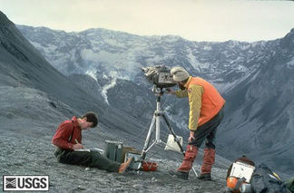
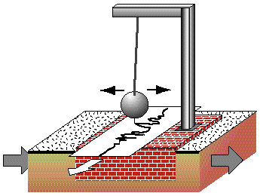
Predicting a Volcanic eruption
As a volcano becomes active, it gives off a number of warning signs. These warning signs are picked up by volcanologists (experts who study volcanoes) and the volcano is monitored. Read through some the information boxes and decide which are monitoring techniques and which are warning signs.
Gas samples may be taken and chemical sensors used to measure sulphur levels
Temperatures around the volcano rise as activity increases.
GPS or Tilt-meters – these measure changes in the slope or ‘tilt’ of the ground. Often, the sides of volcanoes bulge as magma builds up before an eruption. | Thermometers or infrared cameras
Seismograph | COSPEC – gas detector
GROUND DEFORMATION (bulges in the ground) helps us to identify that there is movement of magma. | Changing GAS LEVELS suggest there is something happening beneath the ground.
HYDROTHERMAL activity (changes in water temperature) give us clues of what is happening under the surface. | SEISMOLOGISTS measure any shaking of the ground, this can indicate magma movement.
When a volcano is close to erupting it starts to release gases.
Seismometers are used to detect earthquakes.
Thermal imaging techniques and satellite cameras can be used to detect heat around a volcano.
Hundreds of small earthquakes are caused as magma rises up through cracks in the Earth's crust.

Slide 5
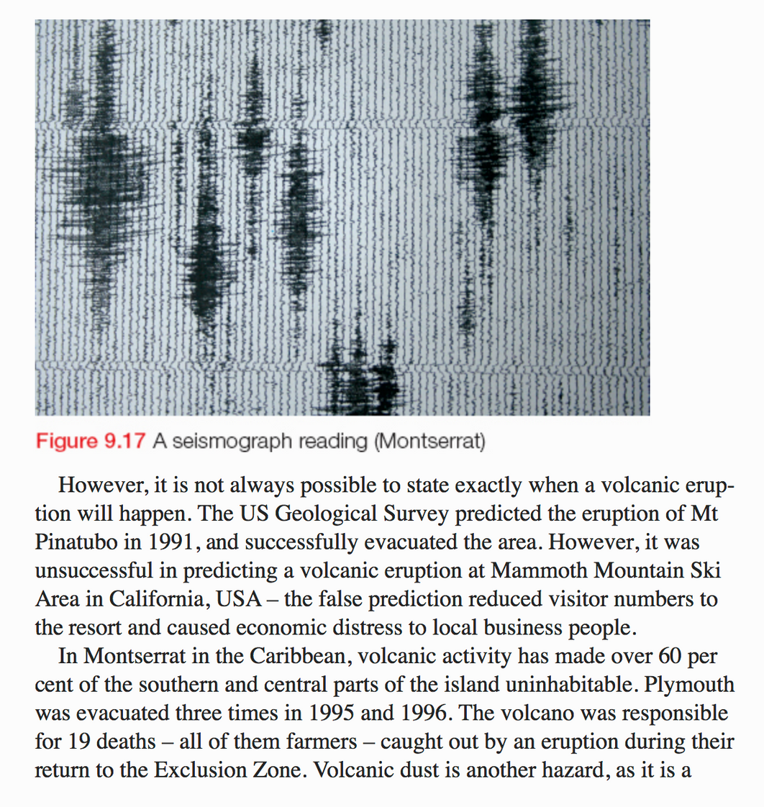
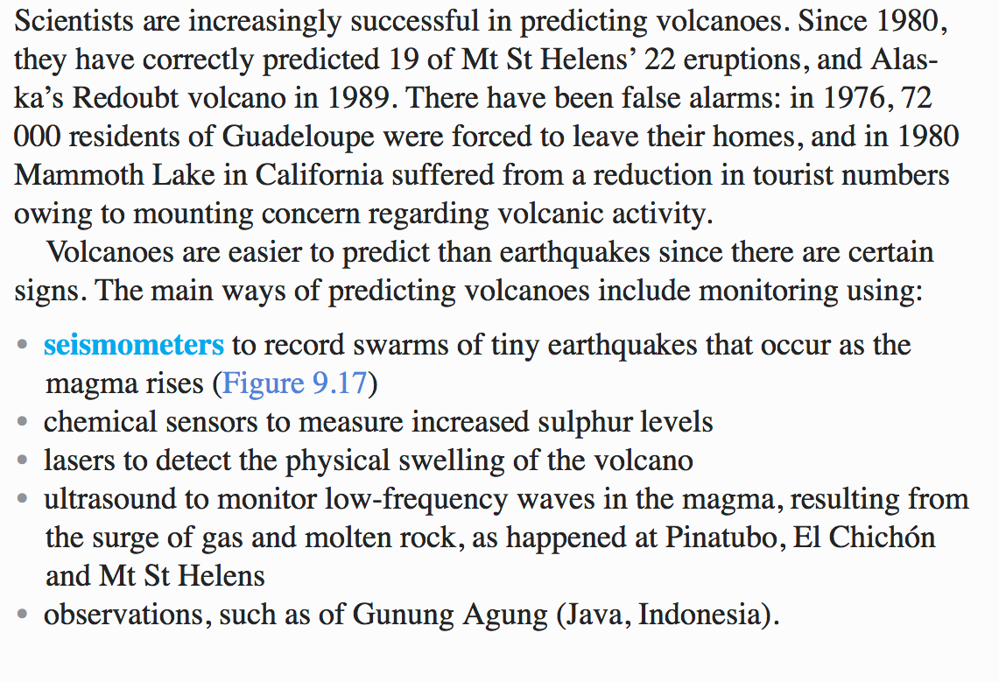
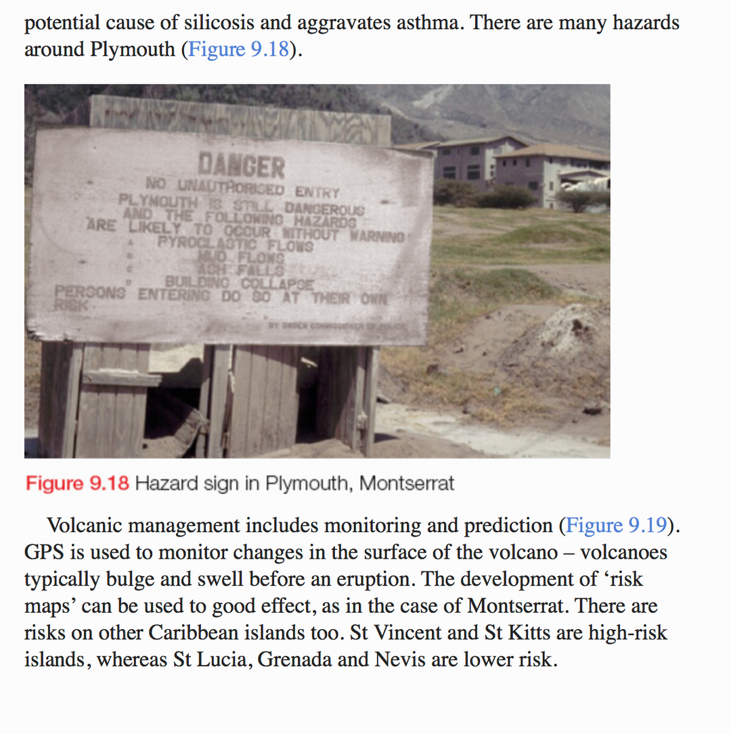
Predicting Volcanoes
Read the textbook extracts below and in your google slide, summarise the ways in which scientist predict volcanoes.
prediction – monitoring indications of imminent activity such as harmonic tremors, bulges in the cone, geochemical changes, gravitational changes, temperature changes, satellite monitoring.

Slide 6
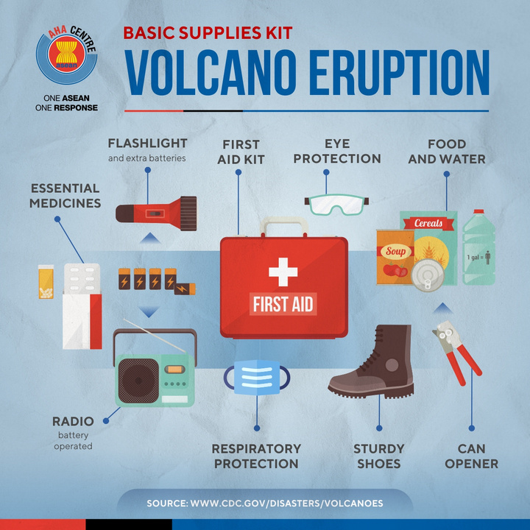
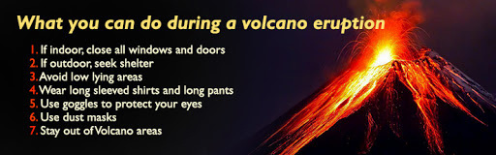
Protection
Pretend you live in a volcanic eruption zone. Think of some ways we can protect ourselves and our belongings from volcanic eruptions. Put your ideas into a mind-map.
Check out the link below for some ideas.
https://www.sciencefocus.com/planet-earth/the-thought-experiment-could-i-build-a-house-that-would-survive-a-volcanic-eruption/
Preparing for a Volcano
creating an exclusion zone around the volcano.
being ready and able to evacuate residents.
having an emergency supply of basic provisions, such as food.
Having well-trained emergency services available
funds need to be available to deal with the emergency and a good communication system needs to be in place.
Responding to volcanic activity - Lava Diversion
Watch the video below and make notes on how Mount Etna’s Lava was being Diverted
https://www.youtube.com/watch?v=SrqM-ygW2hw&feature=emb_logo
Reducing the impacts of natural hazards – BBC Bitesize
https://www.bbc.co.uk/bitesize/guides/zptn6yc/revision/1
Edexcel Resources
Prediction and Forecasting
Modifying Vulnerability
Other management strategies to reduce the impact? Hazard mapping (preparedness?) Cost/benefit, insurance. Independent research required ☺

Slide 7

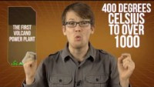
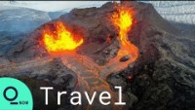
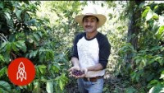
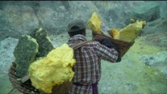
Do volcanoes bring opportunities?

Slide 8
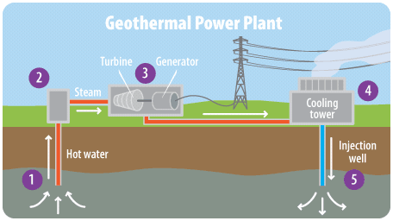
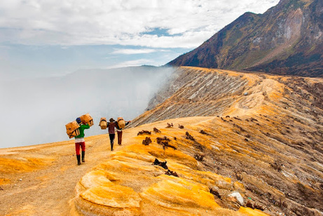
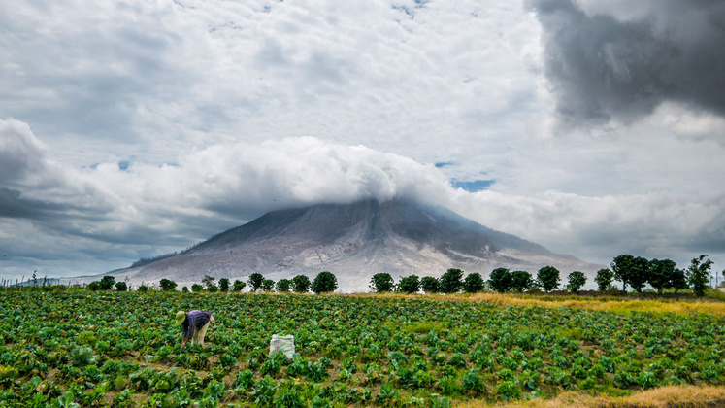
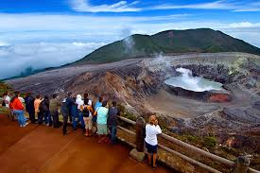
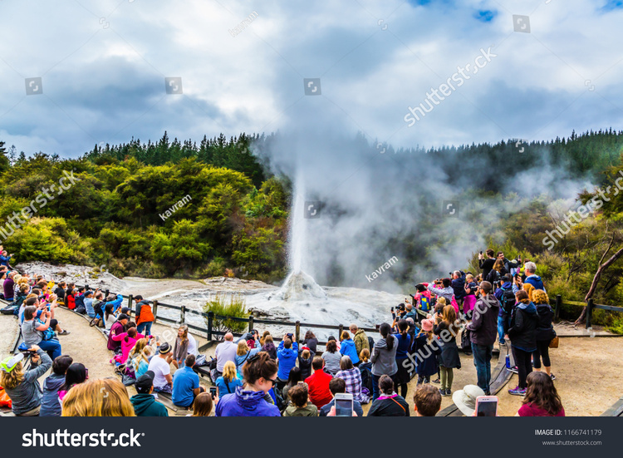
Do volcanoes bring opportunities?
Geothermal Energy – Volcanic heat can be converted to produce renewable electricity. 99% of Reykjavik’s (capital of Iceland) energy needs comes from geothermal energy!
Minerals – As magma cools, the process releases minerals. Minerals formed by volcanoes include gold, silver, copper, zinc, lead and sulphur.
Sulphur mining - although very dangerous to health, is very profitable for farmers in places like Java, Indonesia.
Fertile soils – The ash and dust released by volcanoes contains many useful minerals which help to make very fertile soil. Some of the best soil in the world for farming is near volcanoes. Many prosperous vineyards, farms and grain fields are located around volcanoes, from Italy to Indonesia!
Tourism – volcanoes themselves are awesome features and attract tourists from around the world. Other volcano features such as hot springs and geysers also attract tourists. This creates lots of employment in local areas (restaurants, souvenir shops etc.) and contributes to employment in fields such as tour operators, travel agents etc. These tourists also bring money into the economy and help cause the multiplier effect. Examples include New Zealand, Hawaii, Yellowstone National Park in California.

Slide 9

Do volcanoes bring opportunities?
https://www.youtube.com/watch?v=4ug_krIdYaA

Slide 10
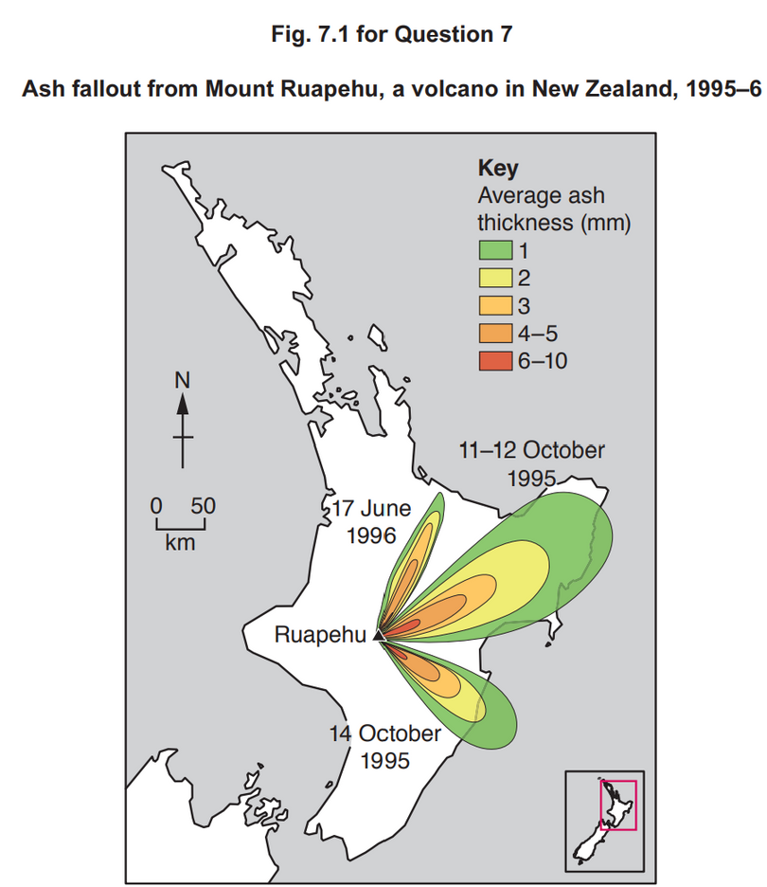
Hazardous environments If answering this option, answer Question 7 and either Question 8 or Question 9.
7 Fig. 7.1 shows ash fallout from Mount Ruapehu, a volcano in New Zealand, 1995–6.
Describe the pattern of ash fallout shown in Fig. 7.1. [4]
Suggest two reasons for the pattern you described in (a). [6]
7(a) Fig. 7.1 shows ash fallout from Mount Ruapehu, a volcano in New Zealand, 1995–6.
Describe the pattern of ash fallout shown in Fig. 7.1.
Candidates should interpret Fig. 7.1 to identify the pattern of ash fallout across the area.
Candidates may identify that:
• ash fallout is broadly westerly
• specific direction varies on different dates
• distance travelled also varies
• thickness of fallout decreases with distance
1 mark for each valid point. Allow one mark maximum for accurate use of data. 4
7(b) Suggest two reasons for the pattern you described in (a).
Candidates should focus on the pattern described. Reasons include:
• direction of winds may influence direction of ash travel
• strength of wind influences distance of travel
• amount of ash ejected influences thickness of deposits
• proximity to the vent influences thickness of fallout
• relief of the landscape, including the presence of valleys which may channel ash in clouds in particular directions
Award marks based on the quality of explanation and breadth of the response using the marking levels below.
Level 3 (5–6) Response applies knowledge and understanding of two reasons and explains their influence on the pattern. Response is well founded in detailed knowledge and strong conceptual understanding of the topic. Any examples used are appropriate and integrated effectively into the response.
Level 2 (3–4) Response discusses at least one reason, possibly in an unbalanced way, making some explanatory links to at least one element of the pattern. Response develops on a largely secure base of knowledge and understanding. Examples may lack detail or development.
Level 1 (1–2) Response consists of one or more descriptive statements with little or no explanation of the pattern. Knowledge is basic and understanding may be inaccurate. Examples are in name only or lacking entirely.
Level 0 (0) No creditable response. 6
Notes:
9696_s20_qp_33
10

