Slide 1
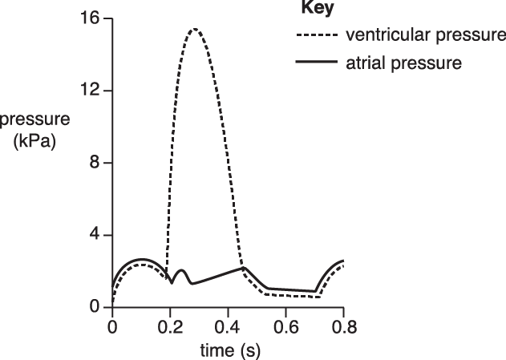
Knowledge retrieval question
Q1. Structurally, why is atrial systole pressure always lower than the ventricular systole pressure? (1 mark)
Thin walls of the atria are unable to produce high pressure when contracting.
Q2. Which of the following time periods, A to D, shows ventricular systole? (1 mark)
a. 0.0 to 0.1 s
b. 0.2 to 0.3 s
c. 0.2 to 0.5 s
0.6 to 0.8 s
Q3. Which of the following two time periods, A to D, shows atrial systole? (1 mark)
a. 0.0 to 0.1 s
b. 0.2 to 0.3 s
c. 0.0 to 0.2 s
d. 0.7 to 0.8 s

Slide 2
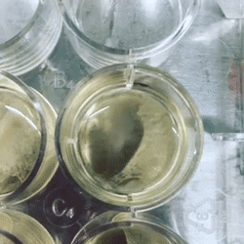
Heart muscle cells are myogenic

Slide 3
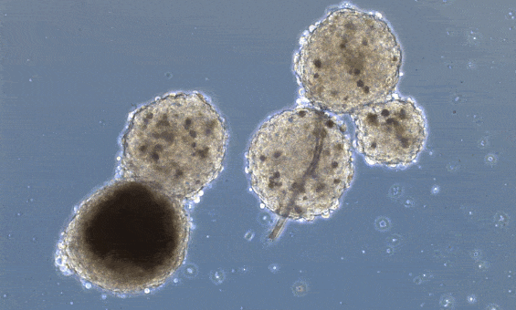
Heart muscle cells are myogenic
Myogenic means that a muscle is able to contract with no external stimulus, like a nerve signal
Take the heart for example, if you take cardiomyocytes (heart muscle cells) out of the body and keep them alive in a suitable medium, they will continue to contract.

Slide 4
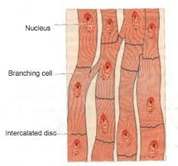
Cardiac muscle structure
Cardiac muscle consists of fibres that branch, producing cross-bridges that help to spread the wave of excitation across the heart.
They have lots of mitochondria to release energy for contraction and are separated by intercalated discs which helps to synchronise the contraction.
*Intercalated discs are unique structural formations found between the myocardial cells of the heart. They play vital roles in bonding cardiac muscle cells together and in transmitting signals between cells.

Slide 5
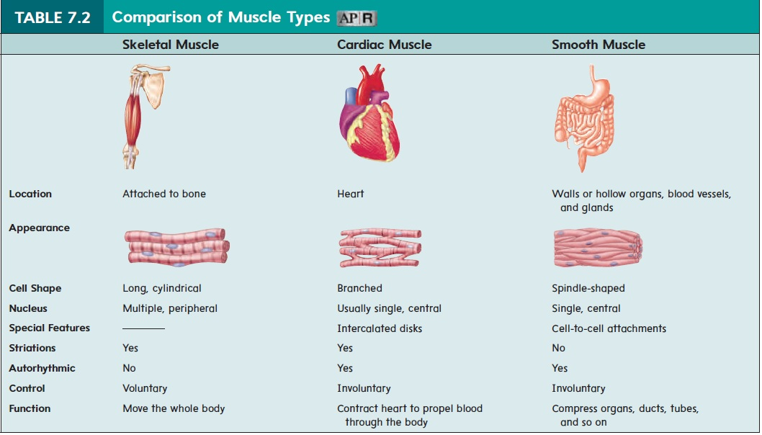

Slide 6
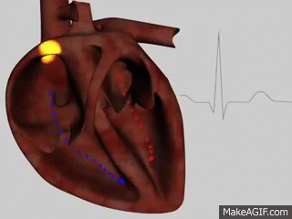

Slide 7
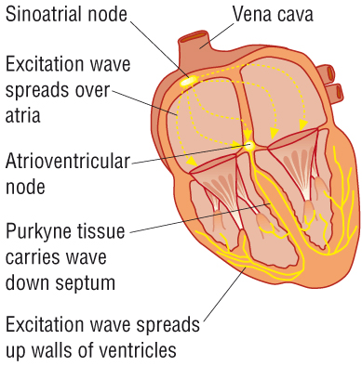

Slide 8
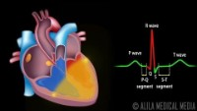

Slide 9
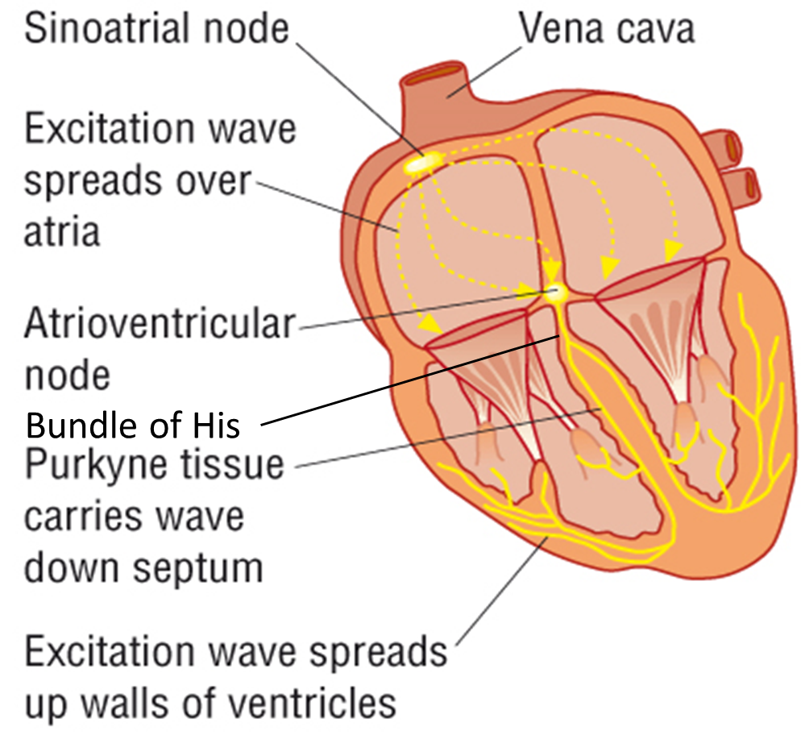
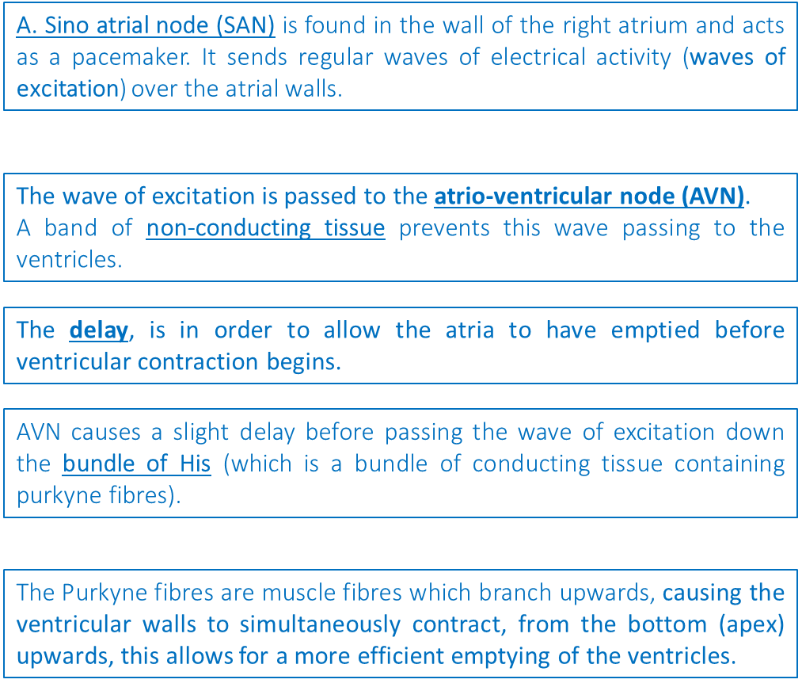
Cardiac muscle is myogenic, meaning it can contract and relax without receiving nerve signals. This pattern controls the heart rate.
Place the sequence of events in order
Notes:
How does the SA node create its own signal?
The main function of the SA node is to act as the normal pacemaker of the heart. It initiates an action potential that results in an electrical impulse traveling through the heart’s electrical conduction system to cause myocardial contraction. Unlike atrial and ventricular cells, pacemaker cells in the sinus node do not have a resting phase. Instead, these cells have pacemaker potential, in which they begin to depolarize automatically after an action potential ends.
Action potential : The cell creates a potential difference across the cell membrane that then allows Na and K ions to move through the protein channels creating and impulse .

Slide 10
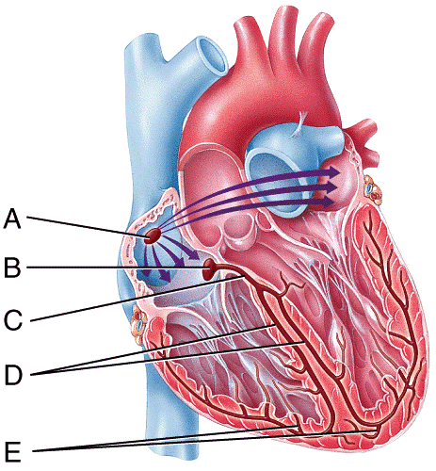
Cardiac muscle is myogenic, meaning it can contract and relax without receiving nerve signals. This pattern controls the heart rate.
A. Sino atrial node (SAN) is found in the wall of the right atrium and acts as a pacemaker. It sends regular waves of electrical activity (waves of excitation) over the atrial walls.
The wave of excitation is passed to the atrio-ventricular node (AVN).
A band of non-conducting tissue prevents this wave passing to the ventricles.
The delay, is in order to allow the atria to have emptied before ventricular contraction begins.
AVN causes a slight delay before passing the wave of excitation down the bundle of His (which is a bundle of conducting tissue containing purkyne fibres).
The Purkyne fibres are muscle fibres which branch upwards, causing the ventricular walls to simultaneously contract, from the bottom (apex) upwards, this allows for a more efficient emptying of the ventricles.
Notes:
How does the SA node create its own signal?
The main function of the SA node is to act as the normal pacemaker of the heart. It initiates an action potential that results in an electrical impulse traveling through the heart’s electrical conduction system to cause myocardial contraction. Unlike atrial and ventricular cells, pacemaker cells in the sinus node do not have a resting phase. Instead, these cells have pacemaker potential, in which they begin to depolarize automatically after an action potential ends.
Action potential : The cell creates a potential difference across the cell membrane that then allows Na and K ions to move through the protein channels creating and impulse .

Slide 11
Definitions and calculations
Heart rate:
Stroke volume:
Cardiac output:
Calculation:
Calculation:
Calculation:
What is the effect of exercise on cardiac output?

Slide 12
Definitions and calculations
Heart rate: number of heartbeats per minute
Stroke volume: volume of blood (cm³) pumped by heart in 1 beat
Cardiac output: stroke volume multiplied by the heart rate, gives the volume of blood (cm³) pumped by heart in 1 minute
Heart rate = beats per minute
Stroke Volume = blood ml OR cm³ per beat
Cardiac Output = Heart rate x stroke volume
What is the effect of exercise on cardiac output?

Slide 13
Typical Cardiac output and effects of exercise
 | Heart rate (beats/min) | Stroke Volume (cm³/beat) | Cardiac Output (cm³/min) (ml/beat)
At rest | 75 | 75
During exercise | 180 | 120
5,625
21,600
Cardiac Output = blood cm³ per beat ^{X} beats per minute = blood per minute

Slide 14
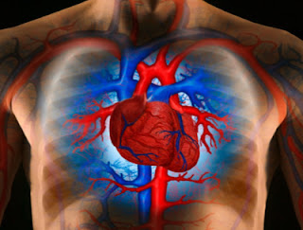
Comparing cardiac output

Slide 15
Calculating cardiac output at rest vs after exercise
Take your resting heart rate: ………..bpm
Use the average stroke volume for your age group at rest: 70 ml/b
Calculate cardiac output: ……...……ml/min
Take your heart rate after a brisk walk walk : ………..bpm
Use the average stroke volume for your age when walking fast: 100 ml/b
Calculate cardiac output: ……………ml/min
Brisk walk average 9000 – 15000 ml/min
Rest average 4500 – 5000 ml/min
Q1. Explain why there is an increase in cardiac output after jogging (3 marks)
Q2. Calculate the percentage increase in cardiac output (2 marks)
Q3. Why does cardiac output decrease with age? (2 marks)

Slide 16
EXAMPLE: What is the effect of exercise on cardiac output?
 | Heart rate (beats/min) | Stroke Volume (cm³/beat) (ml/beat) | Cardiac Output (cm³/min) (ml/beat)
At rest |  | 75
During exercise |  | 100
Q1. Explain why there is an increase in cardiac output after a brisk walk (3 marks) ​
Q2. Calculate the percentage increase in cardiac output (2 marks)​
Q3. Why does cardiac output decrease with age? (2 marks)

Slide 17
Q1. Explain why there is an increase in cardiac output during exercise (3 marks)
Higher demand for oxygenated blood
To the working muscles
To release energy via respiration
Q2. Calculate the percentage increase in cardiac output (2 marks)
Example
Cardiac output at rest: 4500ml/min
Cardiac output after exercise: 9500ml/min
(difference/initial) x 100
(5000/4500) x 100 = 111%
Q3. Why does cardiac output decrease with age? (2 marks)
Muscles degenerate with time
Heart becomes weaker / less efficient
Weaker contraction = lower stroke volume = lower cardiac output

Slide 18
Blood Pressure – key points
Measured in blood vessels (artery)
Determined by cardiac output and resistance to flow of blood in vessels
Resistance to flow affected by diameter of blood vessels
Narrower vessels (vasoconstriction)
Wider vessels (vasodilation)

Slide 19
Recording blood pressure
Systolic blood pressure:
  Maximum blood pressure
  Occurs when ventricles are contracting (at the end of the cardiac cycle)
Diastolic blood pressure:
  Minimum blood pressure
  Occurs when ventricles are relaxed and filled with blood (at the beginning of the cardiac cycle)
We record blood pressure as: Systolic BP/Diastolic BP
  e.g. 120/80 mm Hg

Slide 20
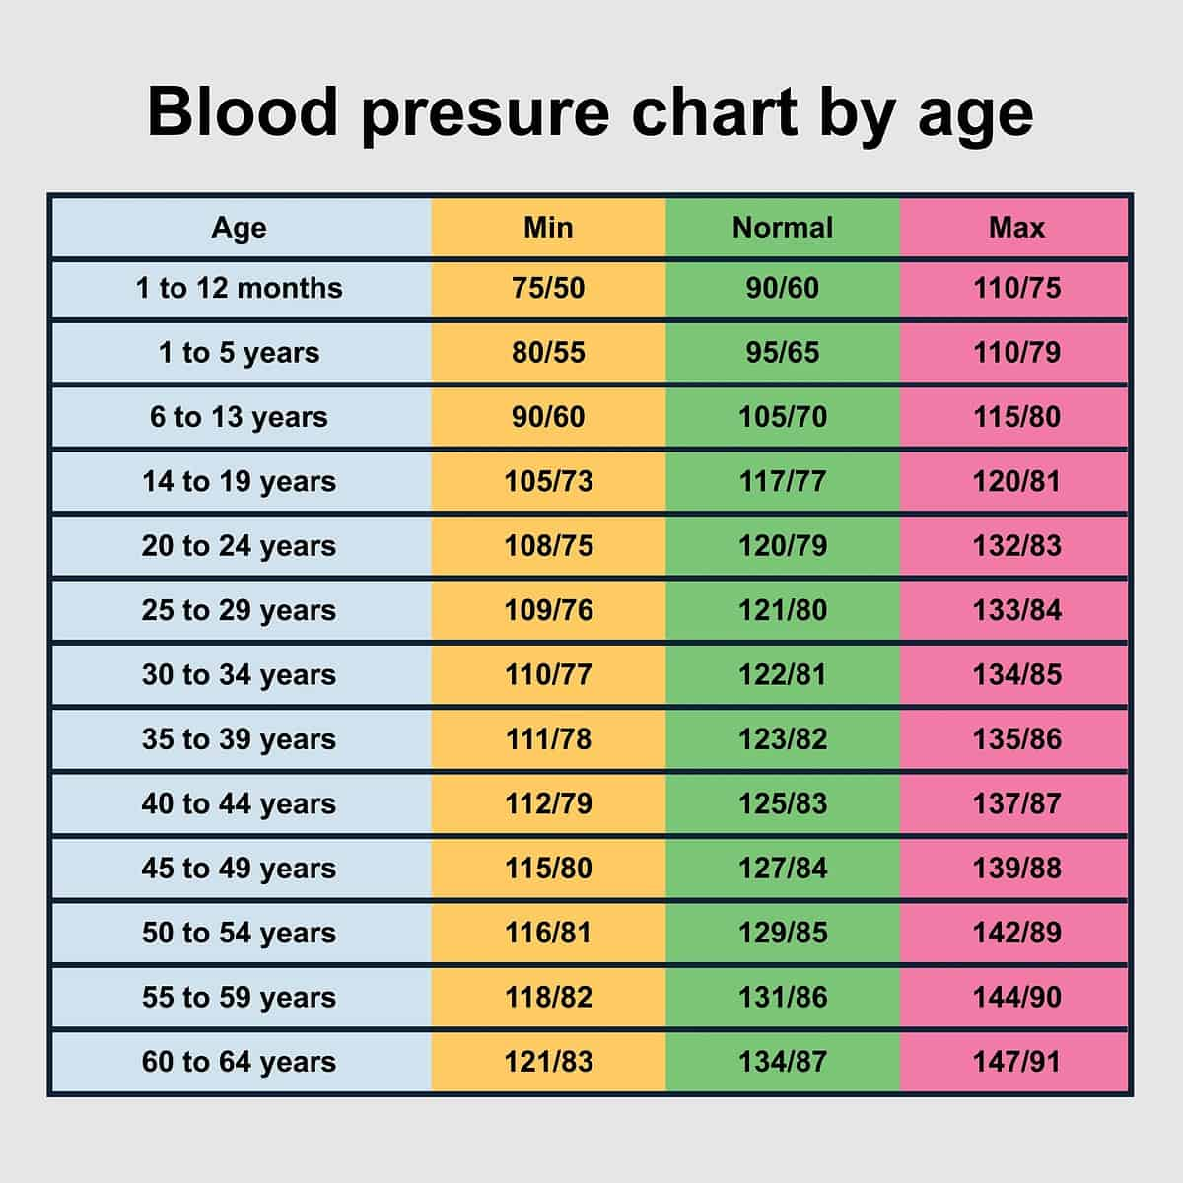
Blood pressure
Notes:
Low BP – causes diet / dehydration – dizzy , loss of focus

Slide 21

Factors affecting blood pressure
Discuss - fill in mind map with factor and reason why it affects BP
Cardiovascular centre
  Diameter of blood vessels controlled by stimulation of sympathetic and parasympathetic nerves
Smoking
  Nicotine causes vasoconstriction – stimulates the sympathetic nerves
  Build up of fatty deposits in vessels
Diet
  High fat diet leads to build up of fatty deposits in blood vessels
Adrenaline
  Causes selective vasoconstriction & vasodilation
Increase in blood viscosity
  Excess water loss (sweating/excessive urination)
Notes:
What are the Similarities Between Sympathetic and Parasympathetic Nervous System?
Both parts of the autonomic nervous system / involuntary responses
Sympathetic nervous system = fight-or-flight response
Parasympathetic nervous system = control the homeostasis of the body.

Slide 22
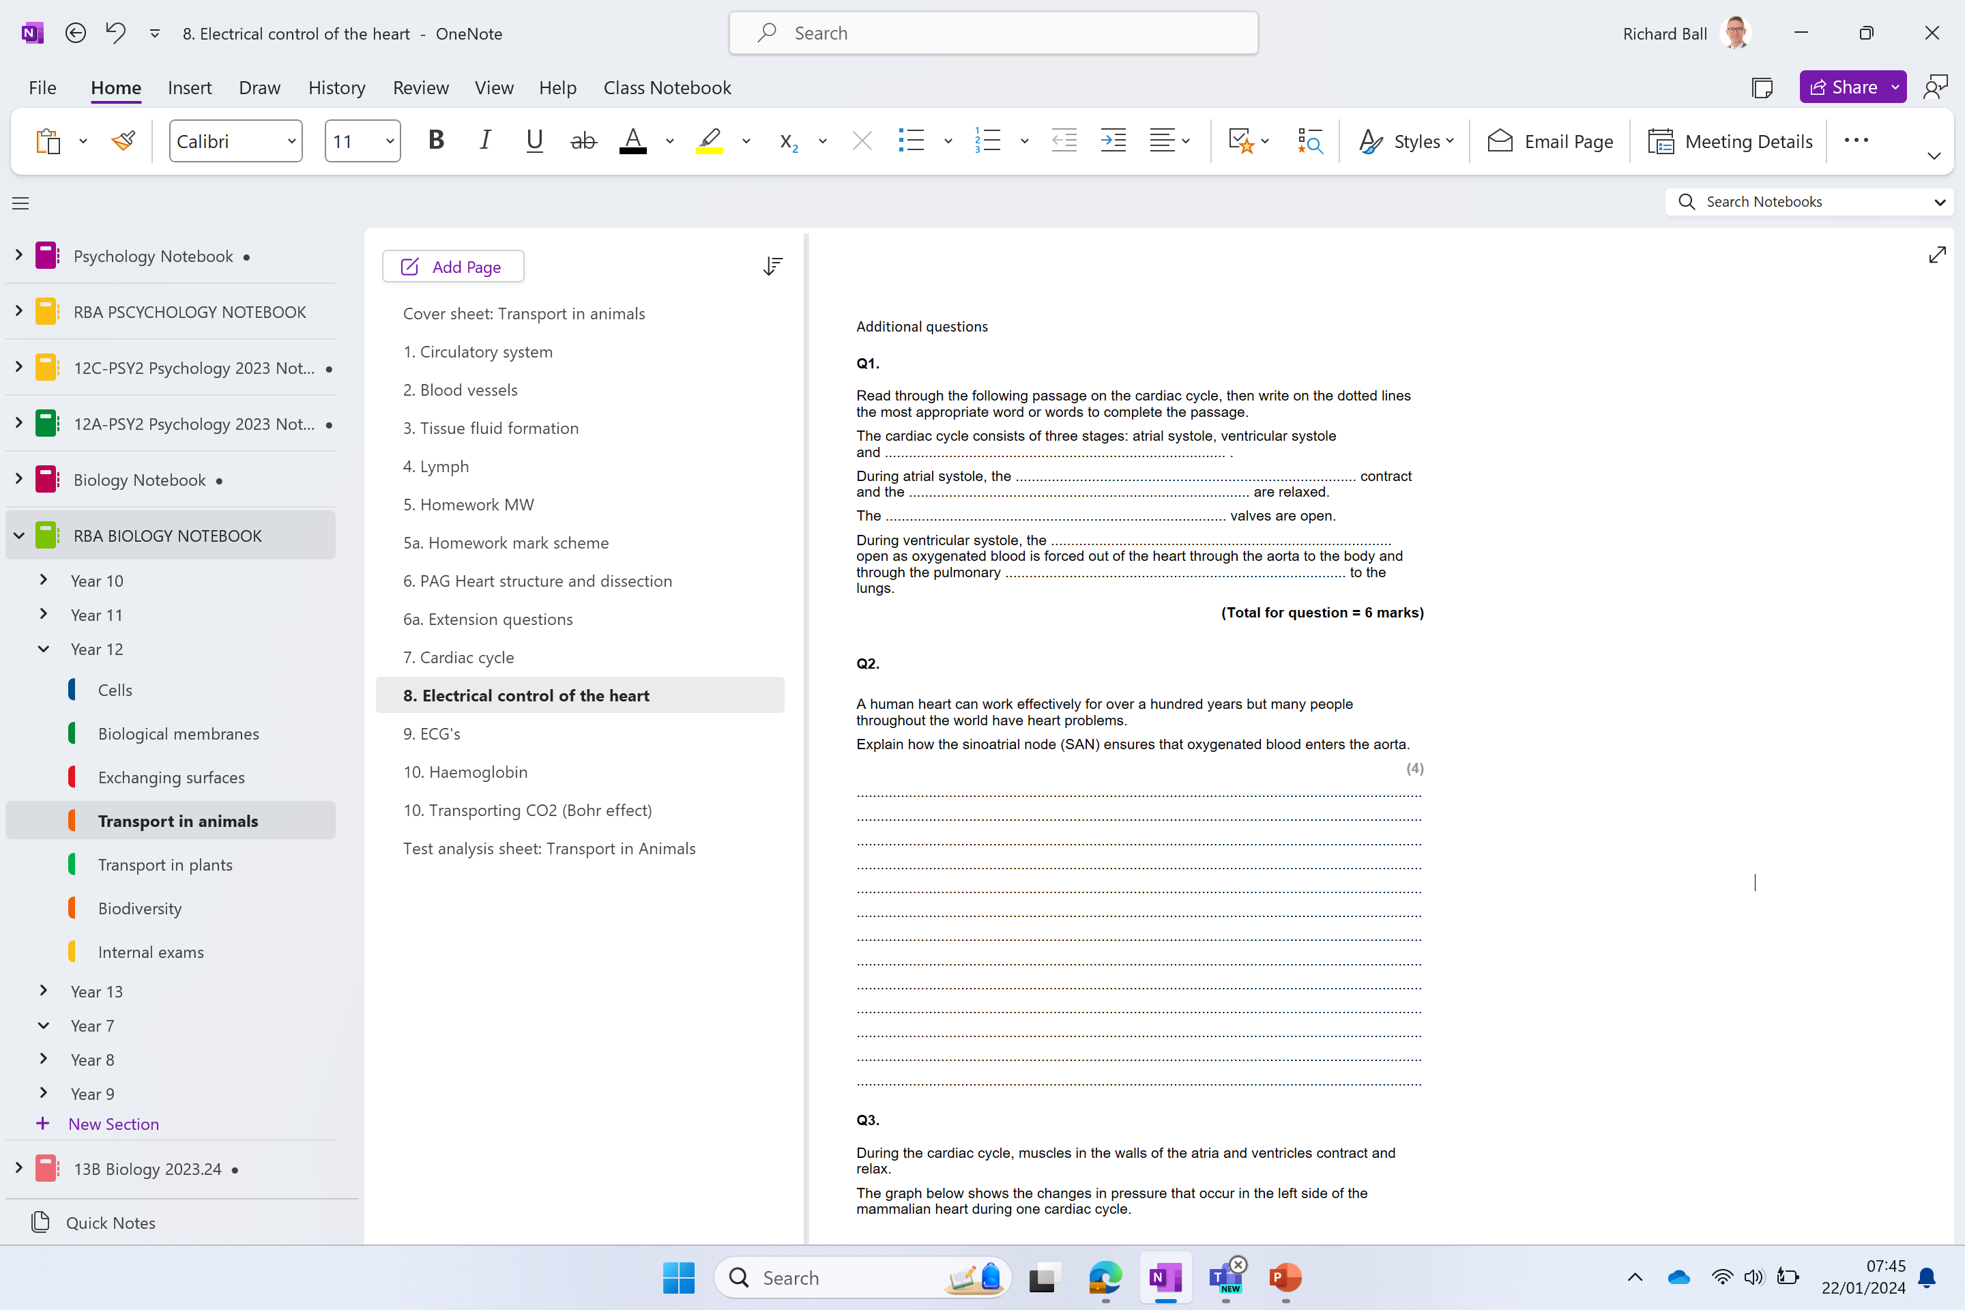
Additional questions

Slide 23
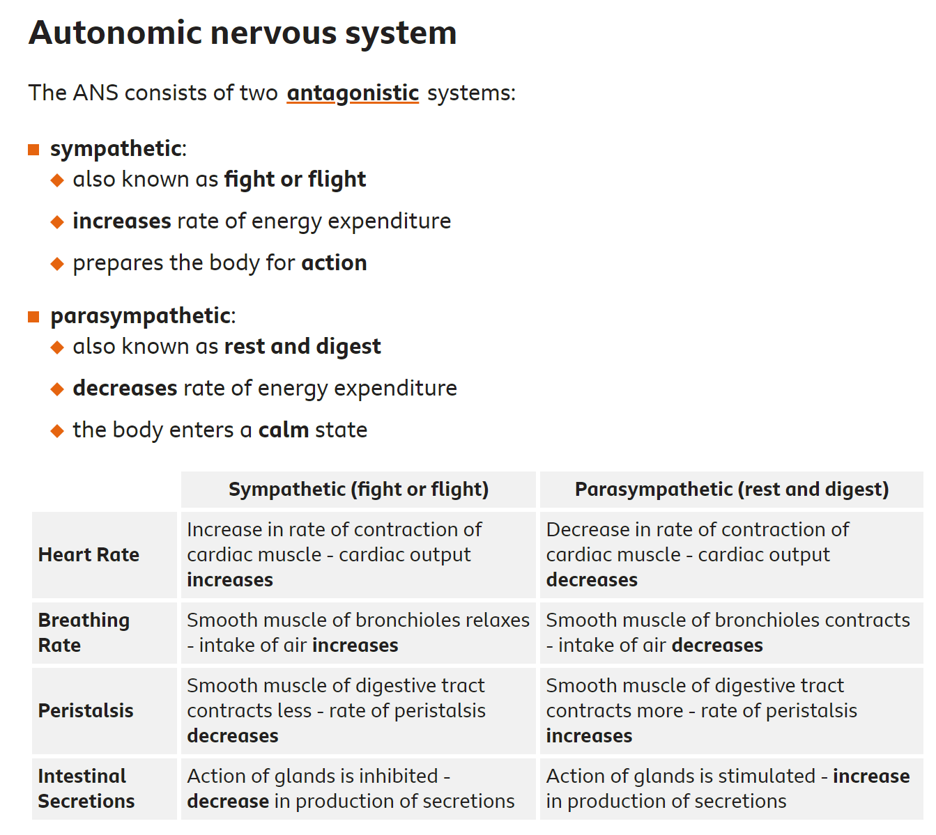

Slide 24
