Slide 1
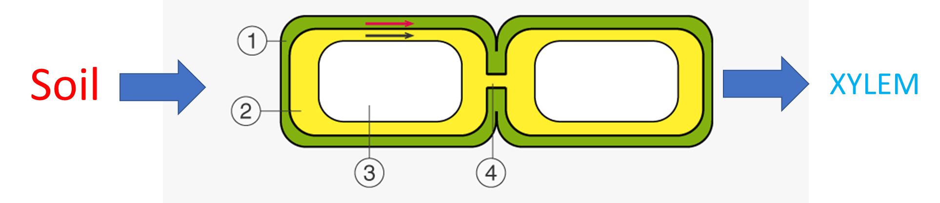
Knowledge retreival task
Q1. Annotate your diagrams to show how water moves through the roots to the xylem along both pathways. Include:
Symplast and apoplast pathways
Casparian strip
Pericycle, endodermis, plasmodesmata, plasma membrane and cell wall
On paper or device
Q2. Explain why the effects of cyanide, oxygen levels and respiratory substrates (glucose) on root pressure are taken as evidence that active transport is involved in the development of root pressure (4 marks).

Slide 2
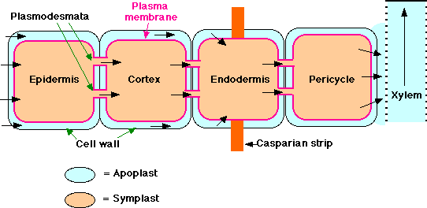
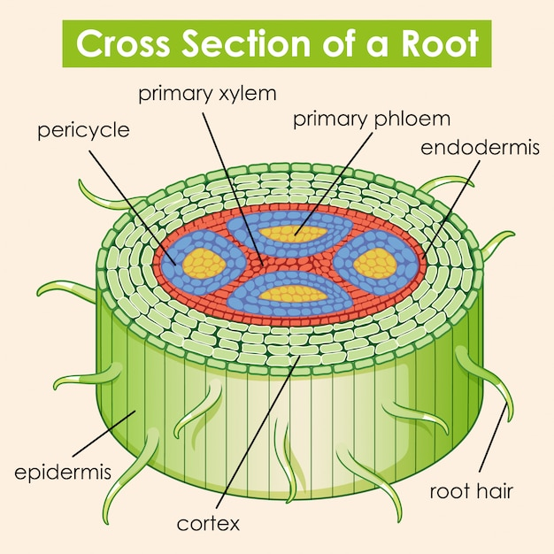

Slide 3
Knowledge retrieval question
science1s478's presentation | Poll Everywhere
1 mark for CWR
Explain why the effects of cyanide, oxygen levels and respiratory substrates (glucose) on root pressure are taken as evidence that active transport is involved in the development of root pressure (4 marks).
Active transport needs energy in the form of ATP
Cyanide poisons mitochondria where cellular respiration takes place, so cyanide prevents ATP formation
Oxygen and respiratory substrates are needed for cellular respiration and ATP production – (root pressure decreases without them = no active transport)
Factors which interfere with ATP production also interfere with development of root pressure
The development of root pressure is an active process requiring ATP.
WRITE IN FULL SENTENCED BULLET POINTS!
Notes:
Glucose is the main respiratory substrate for aerobic respiration in most cells
When the supply of glucose in a cell has been used up a cell may continue respiration using other substrates
These may be:
Other carbohydrates
Lipids
Proteins
Amino acids from proteins are only respired aerobically when all other substrates have been used up
This is because they often have essential functions elsewhere in the cell
Amino acids are required to make proteins which have structural (eg. in the cytoskeleton) and functional (eg. enzymatic) roles
When these different substrates are broken down in respiration, they release different amounts of energy

Slide 4
Water transport through a plant

Slide 5
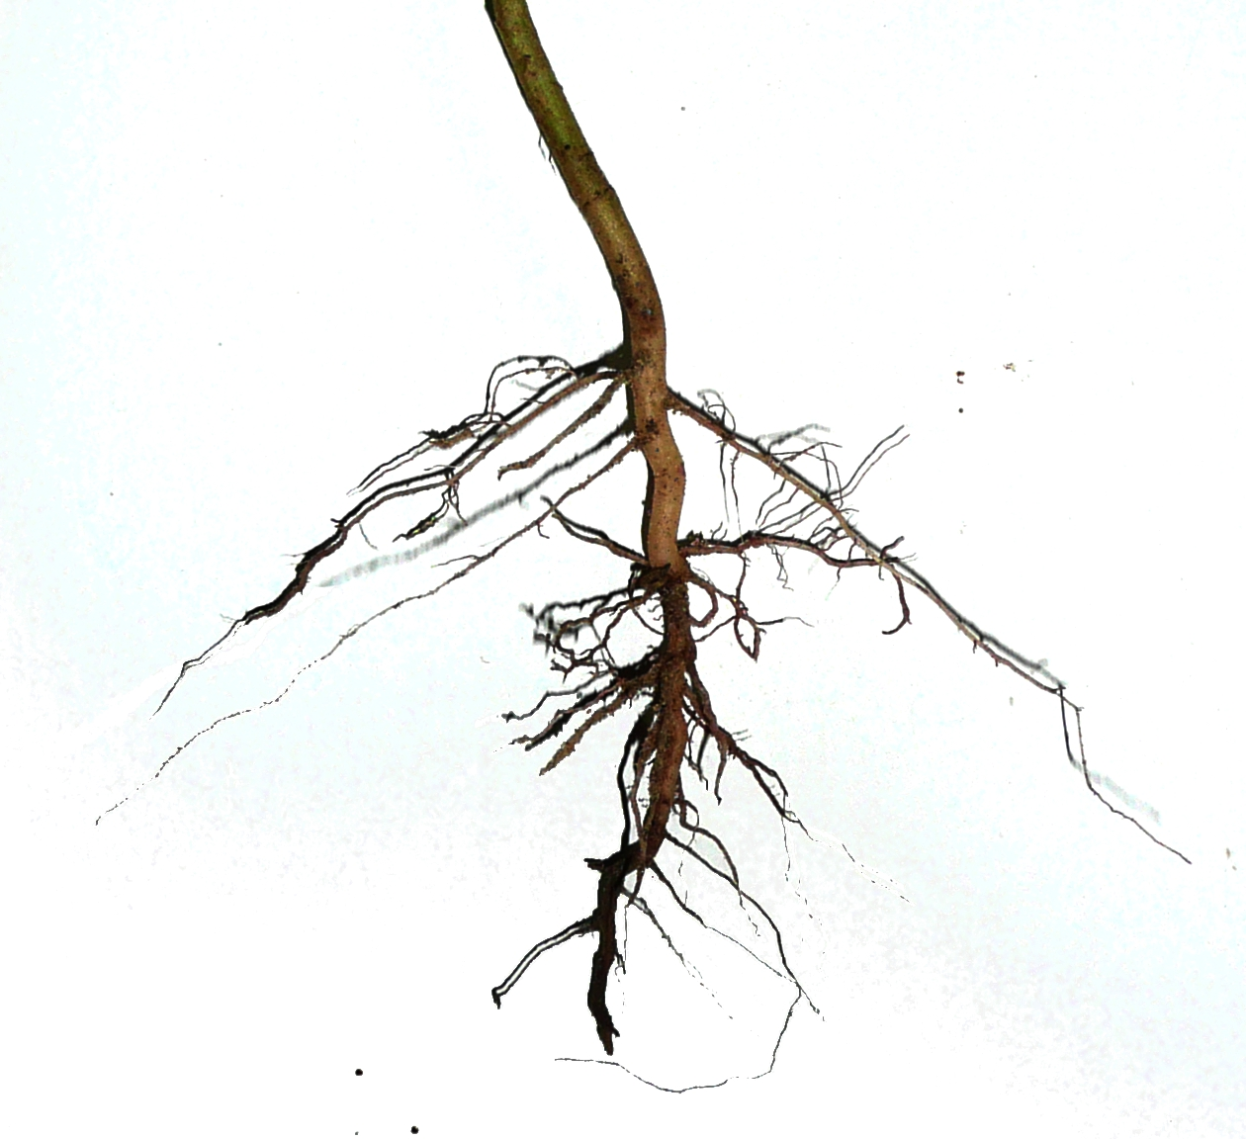
RECAP : Root Pressure
Active pumping of minerals into the xylem to enable movement of water by osmosis results in root pressure.
Root pressure gives water a ‘push’ up the xylem, but is not the major factor in moving water up through the stem to the leaves.

Slide 6

What is the inevitable consequence of opening the stomata to absorb CO₂ and release O₂ during gas exchange in plants?

Slide 7

science1s478's presentation | Poll Everywhere

Slide 8
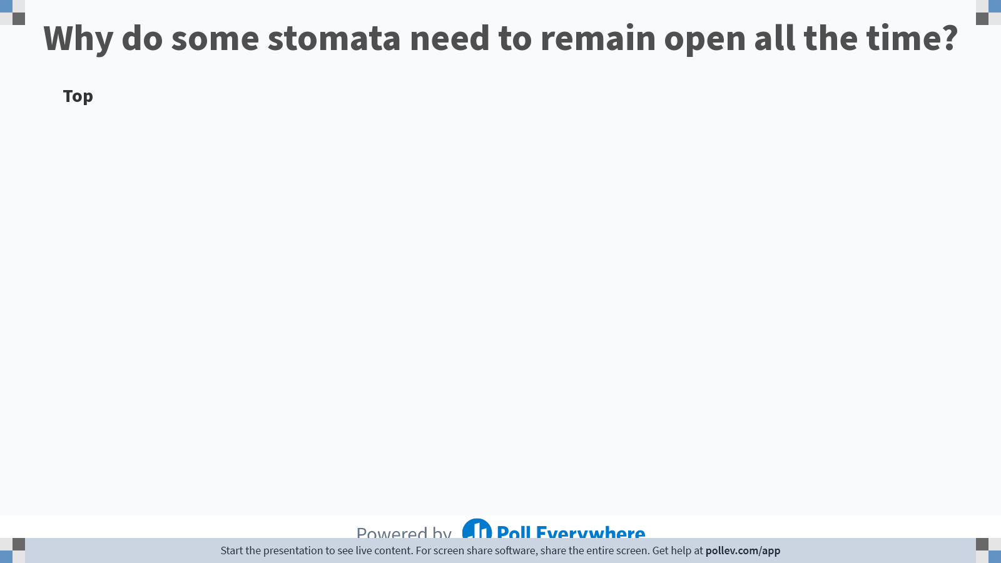
Notes:
Poll Title: Do not modify the notes in this section to avoid tampering with the Poll Everywhere activity.
More info at polleverywhere.com/support
Why do some stomata need to remain open all the time?
https://www.polleverywhere.com/discourses/sDW7Mf5FnkpH3013yFMlg

Slide 9
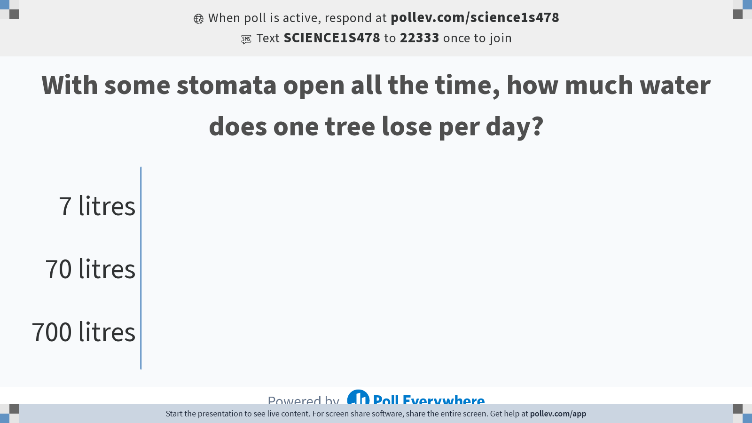
Notes:
Poll Title: Do not modify the notes in this section to avoid tampering with the Poll Everywhere activity.
More info at polleverywhere.com/support
With some stomata open all the time, how much water does one tree lose per day?
https://www.polleverywhere.com/multiple_choice_polls/9sRLGtSwoQXyPZD0lT5jU?state=opened&flow=Default&onscreen=persist

Slide 10

Notes:
One large tree loses 9 baths worth of water per day! 700litres

Slide 11
<1% of water taken in by a plant gets used during photosynthesis
5% for building new cells
The rest just evaporates away

Slide 12
How is water pull up through the plant?

Slide 13
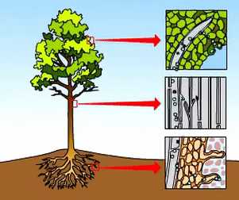
Water molecules are cohesive – form hydrogen bonds with each other
The evaporation of water from the stomata creates a tension force between the water molecules.
This creates a transpiration stream throughout the plant.
Notes:
Image pulling a rope

Slide 14
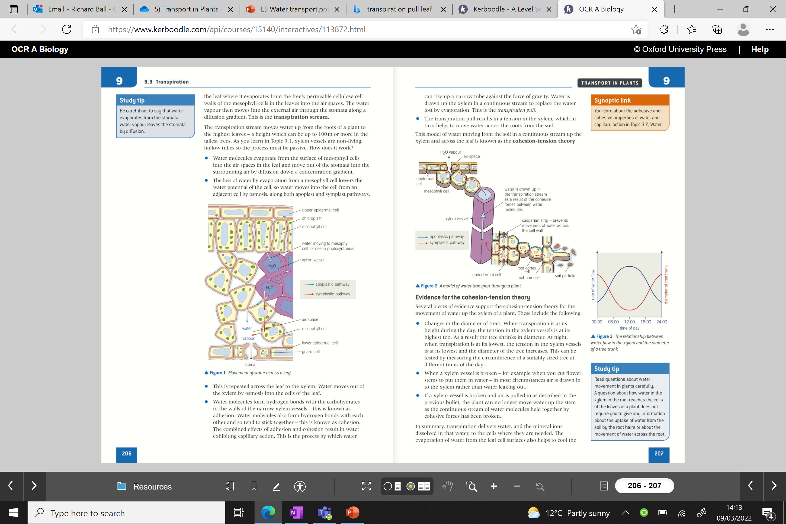
The Cohesion Tension theory

Slide 15
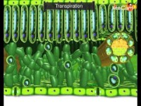

Slide 16
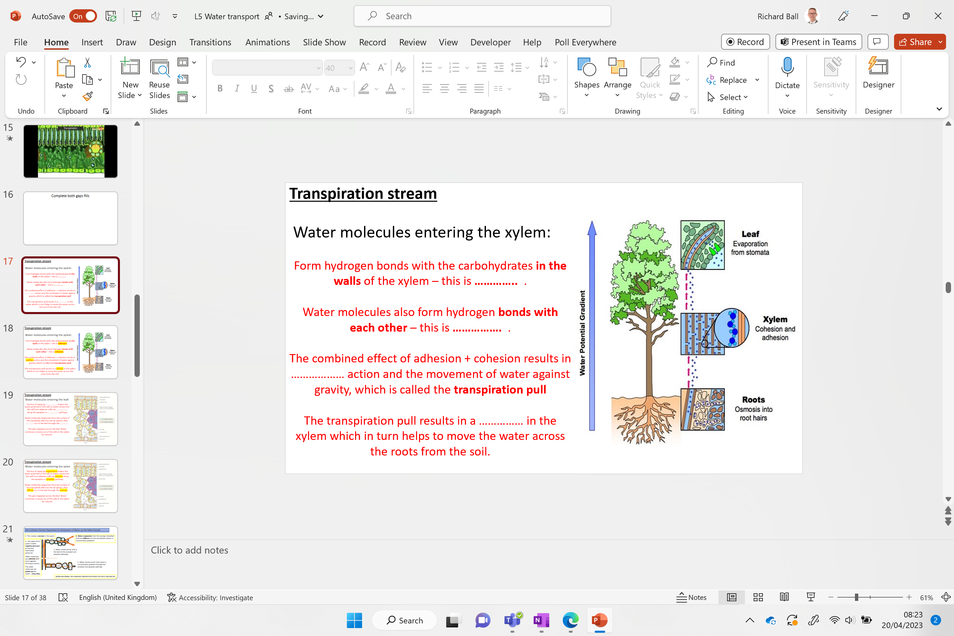
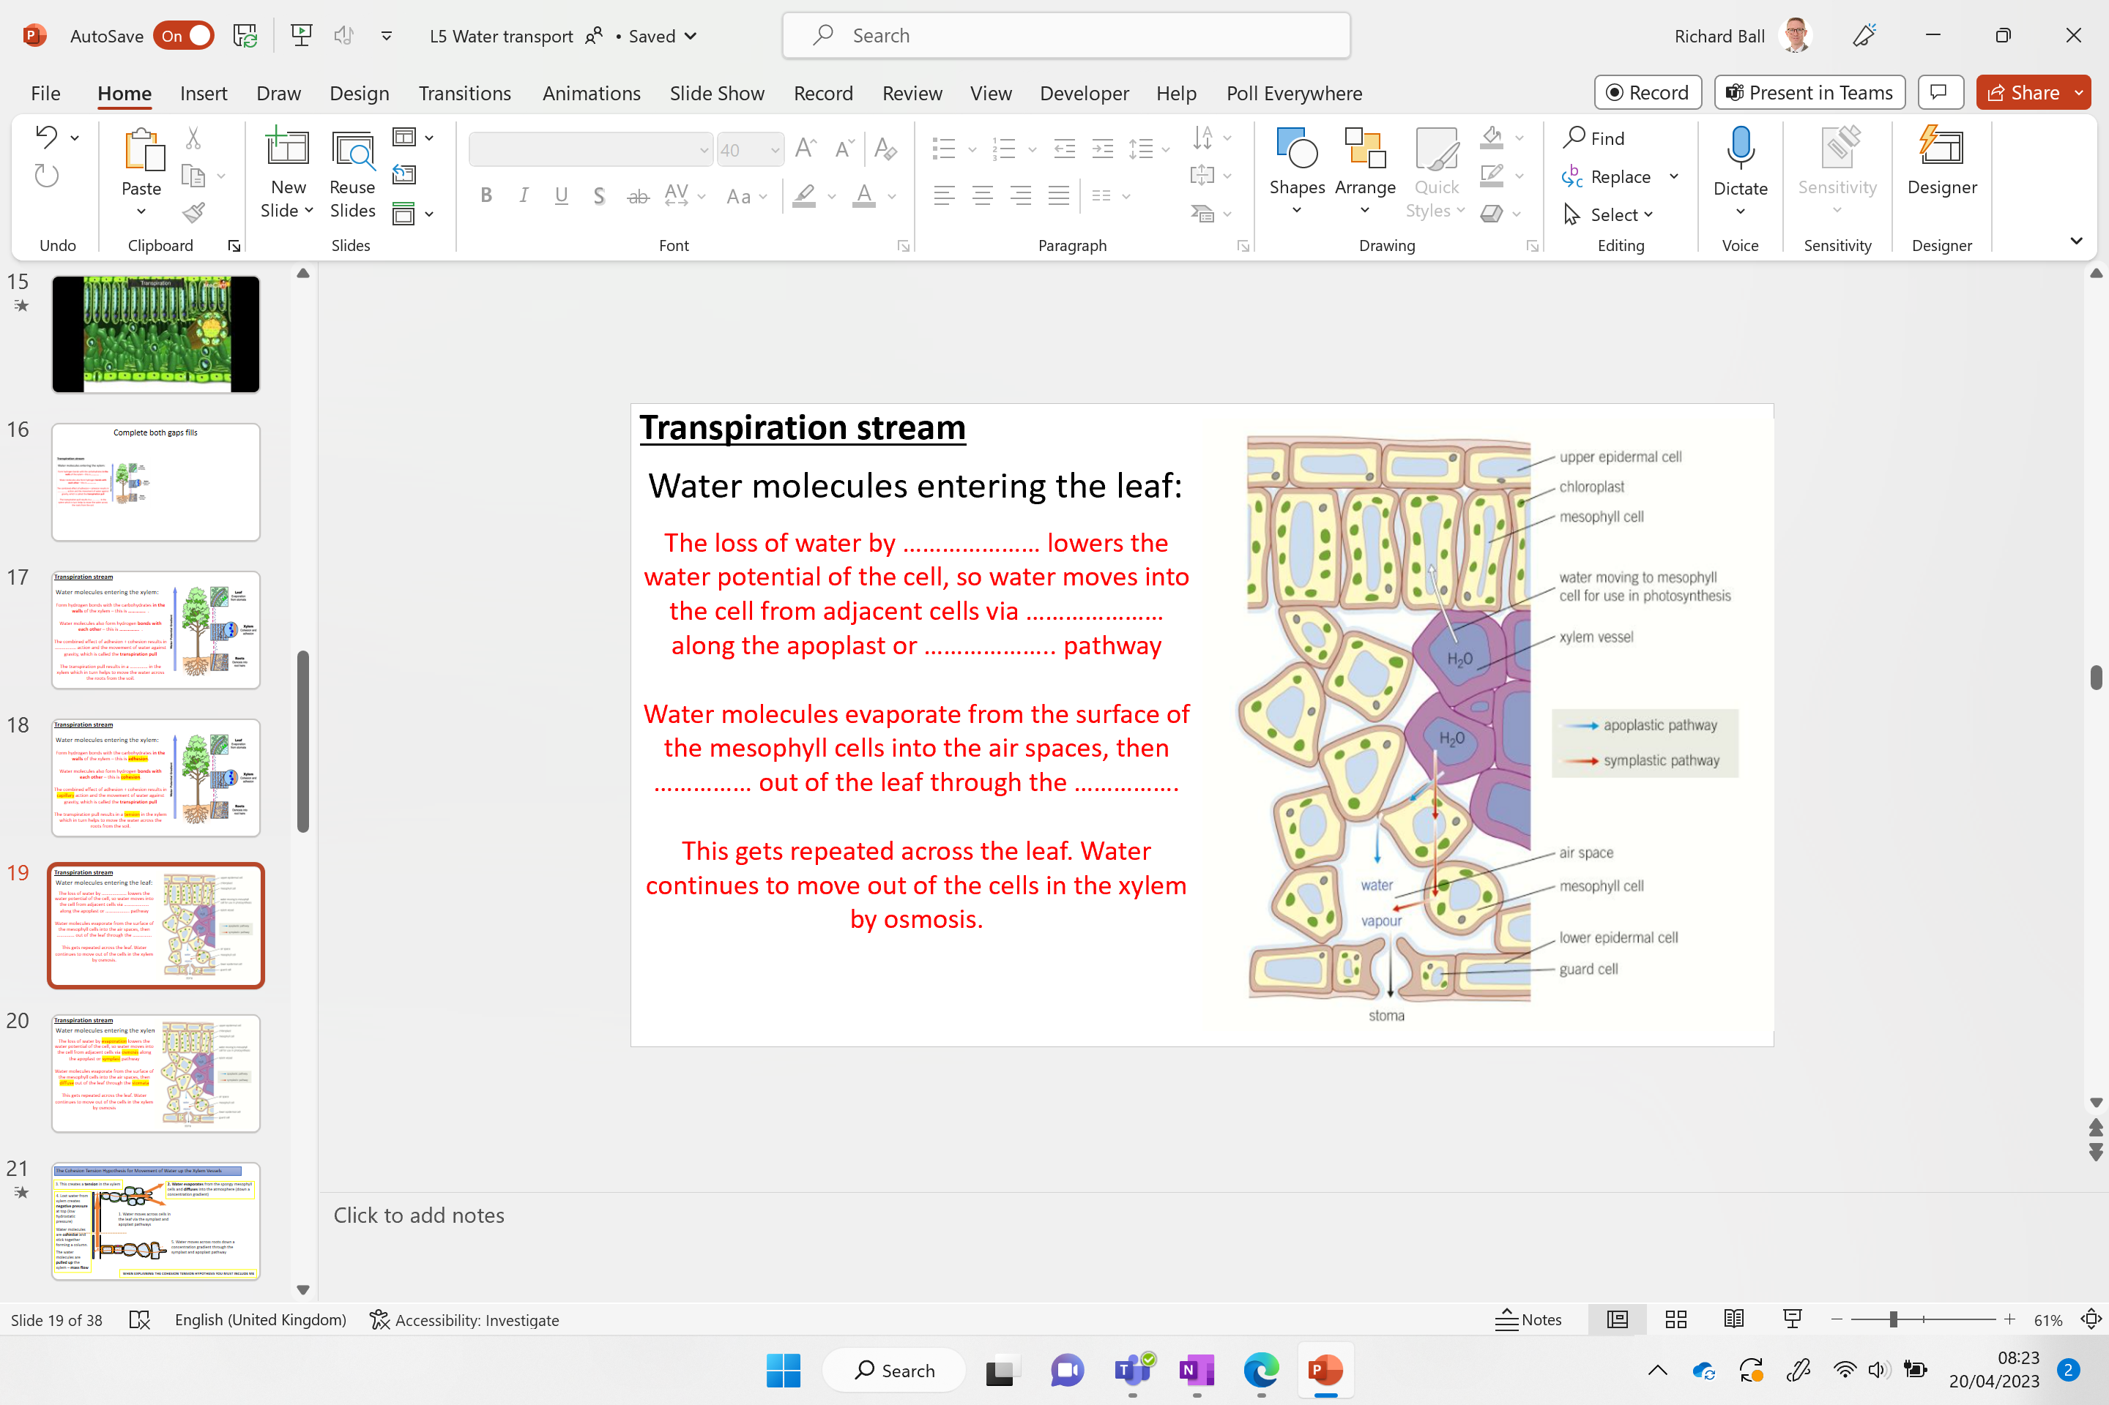
Complete both gaps fills

Slide 17
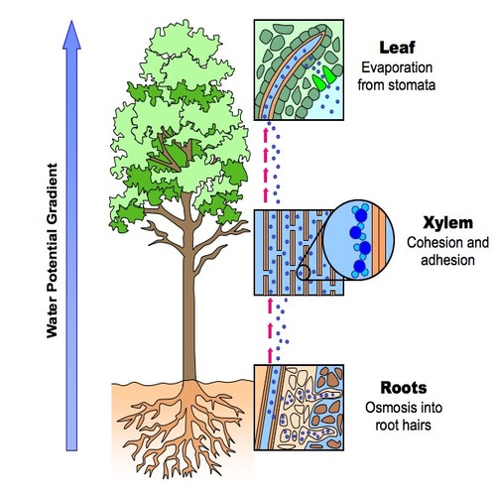
Transpiration stream
Water molecules entering the xylem:
Form hydrogen bonds with the carbohydrates in the walls of the xylem – this is ………….. .
Water molecules also form hydrogen bonds with each other – this is ……………. .
The combined effect of adhesion + cohesion results in ……………… action and the movement of water against gravity, which is called the transpiration pull
The transpiration pull results in a …………… in the xylem which in turn helps to move the water across the roots from the soil.

Slide 18
Transpiration stream
Water molecules entering the xylem:
Form hydrogen bonds with the carbohydrates in the walls of the xylem – this is adhesion.
Water molecules also form hydrogen bonds with each other – this is cohesion.
The combined effect of adhesion + cohesion results in capillary action and the movement of water against gravity, which is called the transpiration pull
The transpiration pull results in a tension in the xylem which in turn helps to move the water across the roots from the soil.

Slide 19
Transpiration stream
Water molecules entering the leaf:
The loss of water by ………………… lowers the water potential of the cell, so water moves into the cell from adjacent cells via ………………… along the apoplast or ……………….. pathway
Water molecules evaporate from the surface of the mesophyll cells into the air spaces, then …………… out of the leaf through the …………….
This gets repeated across the leaf. Water continues to move out of the cells in the xylem by osmosis.

Slide 20
Transpiration stream
Water molecules entering the xylem:
The loss of water by evaporation lowers the water potential of the cell, so water moves into the cell from adjacent cells via osmosis along the apoplast or symplast pathway
Water molecules evaporate from the surface of the mesophyll cells into the air spaces, then diffuse out of the leaf through the stomata
This gets repeated across the leaf. Water continues to move out of the cells in the xylem by osmosis

Slide 21

The Cohesion Tension Hypothesis for Movement of Water up the Xylem Vessels
3. This creates a tension in the xylem
2. Water evaporates from the spongy mesophyll cells via stoma and diffuses into the atmosphere (down a concentration gradient)
4. Lost water from xylem creates negative pressure at top (low hydrostatic pressure)
Water molecules are cohesive and stick together forming a column.
The water molecules are pulled up the xylem – mass flow
1. Water moves across cells in the leaf via the symplast and apoplast pathways
WHEN EXPLAINING THE COHESION TENSION THEORY YOU MUST INCLUDE ME

Slide 22
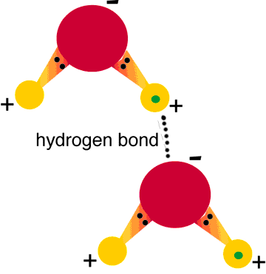
Cohesion – Tension theory (key points)
The sun provides the energy to ‘pull’ the water up by providing the energy for evaporation.
Water moves up the xylem by mass flow from the higher pressure in roots to the lower pressure in the leaves.
The column of water does not break because of the cohesive forces (hydrogen bonds) between individual water molecules.
Water also forms hydrogen bonds with carbohydrates in the walls of the xylem, known as adhesion (this is not why water is drawn up the stem)
The theoretical maximum height water can move this way is ~ 10m – the tallest trees are ~115 m

Slide 23
1. Transpiration happens as a consequence of the need for gas exchange.
2. There are cohesive forces between water molecules because they form hydrogen bonds with one another.
3. Water is drawn up the stem due to adhesive forces between water molecules
Which of the following statements about water transport in plants is/are correct?
Notes:
1 and 2 only

Slide 24
1. Transpiration happens as a consequence of the need for gas exchange.
2. There are cohesive forces between water molecules because they form hydrogen bonds with one another.
3. Water is drawn up the stem due to cohesive forces between water molecules
Which of the following statements about water transport in plants is/are correct?
Notes:
1 and 2 only

Slide 25
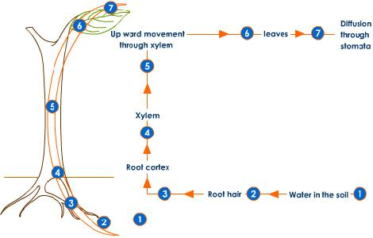
Water transport through a plant
Three routes to know:
  Root pressure (minor)
  Capillarity (minor)
  Cohesion tension theory (major)

Slide 26
science1s478's presentation | Poll Everywhere

Slide 27
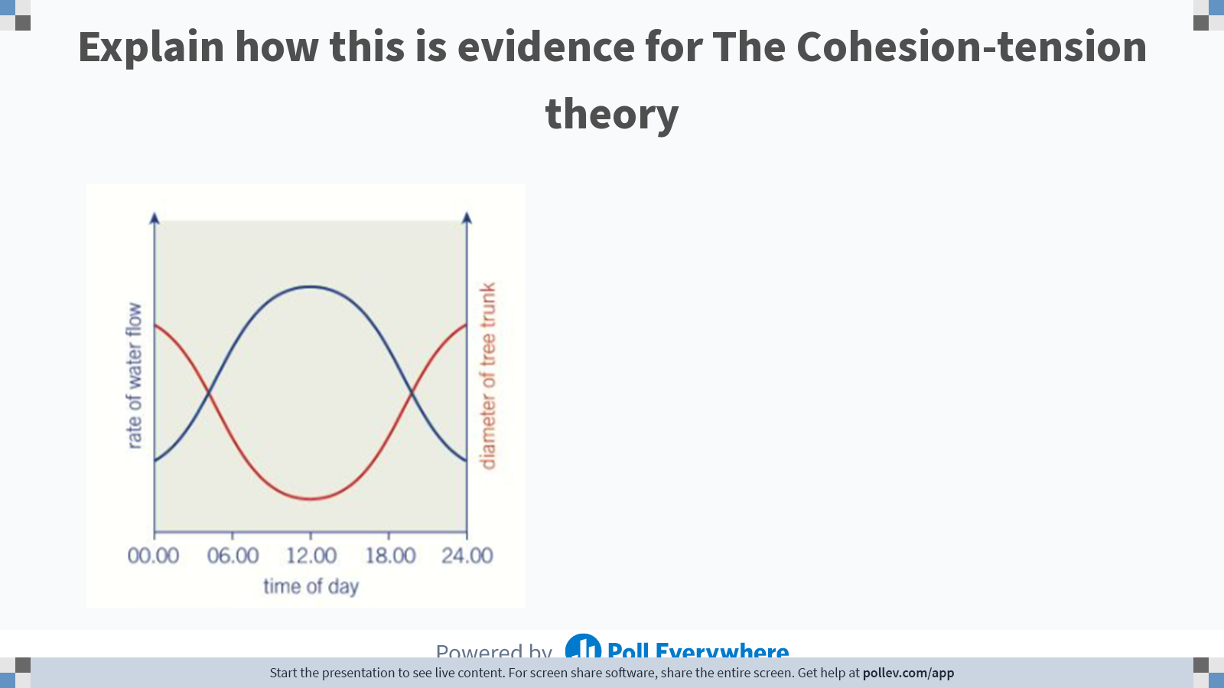
Notes:
Poll Title: Do not modify the notes in this section to avoid tampering with the Poll Everywhere activity.
More info at polleverywhere.com/support
Explain how this is evidence for The Cohesion-tension theory
https://www.polleverywhere.com/free_text_polls/V08mz1auoHKjrsDw52LTP

Slide 28
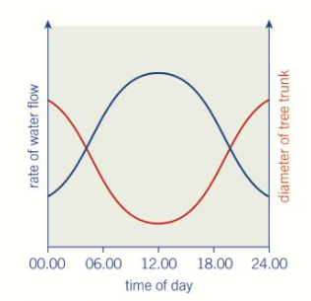
Evidence for cohesion-tension theory
During the day (transpiration rate high) the tension in the xylem vessels is at its highest.
This shrinks the diameter of the trunk.
At night when transpiration is at its lowest, the tension in vessels is also at its lowest.
The diameter of the tree increases.
This can be tested using a suitably sized tree at different times of the day.

Slide 29
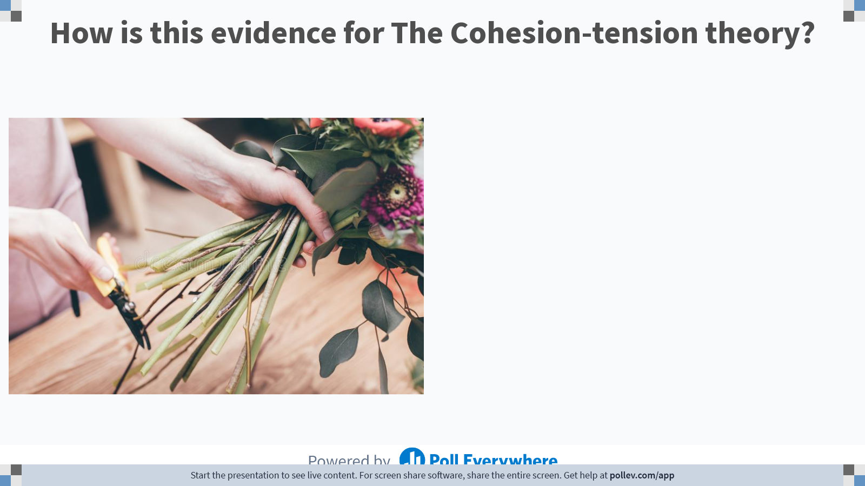
Notes:
Poll Title: Do not modify the notes in this section to avoid tampering with the Poll Everywhere activity.
More info at polleverywhere.com/support
How is this evidence for The Cohesion-tension theory?
https://www.polleverywhere.com/free_text_polls/8bvSwf8EsCfjiyDNpbzKj

Slide 30

Evidence for cohesion-tension theory
When cutting stems of flowers
Air gets drawn into the xylem
Rather than water leaking back out

Slide 31
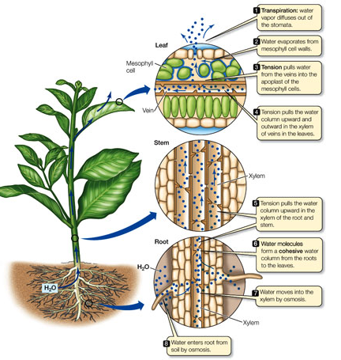
Evidence: to support cohesion-tension theory
Changes in diameter of tree trunks according to rate of transpiration. (high tension in xylem results in shrinking in diameter due to more negative pressure).
Water does not leak out of broken xylem, instead air enters and gets sucked upwards.
Broken xylem disrupts column of water, no more cohesion at point of break.
Transpiration: H₂O vapour diffuses out of the stomata
H₂O evaporates from the mesophyll cell walls
Tension pulls the H₂O from the veins into the apoplast of the mesophyll cells
Tension pulls the H₂O column out of xylem vessels into the leaves
Tension pulls the H₂O column upward in the xylem of root and stem
H₂O molecules form a cohesive column from the roots to the leaves
H₂O moves into the xylem by osmosis
H₂O enters root from soil by osmosis

Slide 32

Minute talk
Transpiration
ERM ERR

Slide 33

Water has a maximum height of 10m
What happens at 10m?
Some trees are 120m tall……
Notes:
Water boils in the vacuum at 10m

Slide 34
What are some of the anomalous properties of water?
Less dense as solid
Relatively high melting / boiling – hydrogen bonds
Surface tension
Notes:
Cohesion refers to the attraction of molecules for other molecules of the same kind, and water molecules have strong cohesive forces thanks to their ability to form hydrogen bonds with one another.

Slide 35

Notes:
Derek Muller – Veritasium

Slide 36
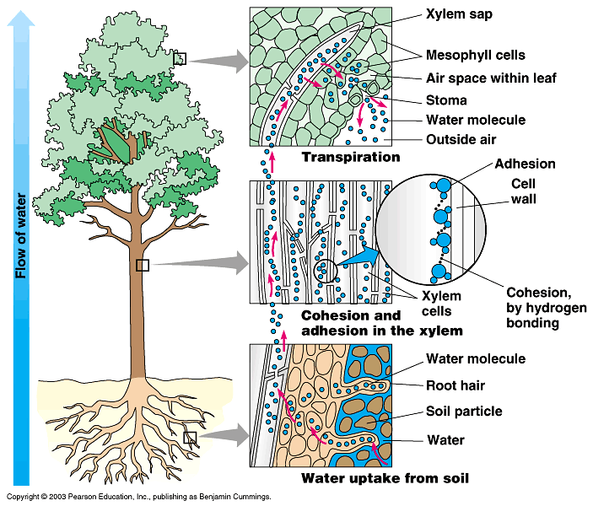

Slide 37
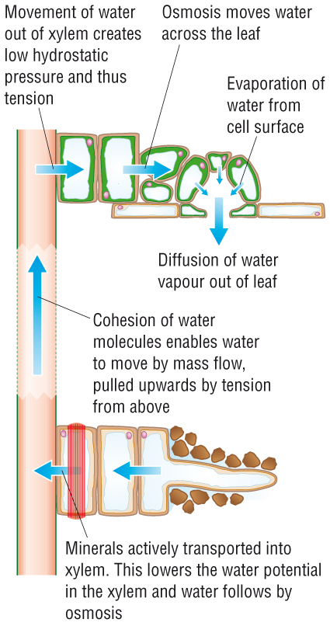
Summary: Movement of water: main force comes from the transpiration stream (transpiration pull, TP).
Across the leaf
Water evaporates (transpiration) from at top of plant
Water loss from leaf is replaced via the apoplast/symplast/vacuolar pathways…
With water moving down water potential gradient…
Lost water replaced with water from the xylem…
2. Up xylem
Lost water from xylem creates negative pressure at top…
Water moves from higher pressure at bottom of xylem to lower pressure at top of xylem…
And is pulled up under tension…
By mass flow
Water molecules form H-bonds between them, becoming cohesive (sticky)….
Thus water forms a continuous unbroken column from mesophyll down the xylem.
Adhesion of water molecules to xylem contributes to mass movement
High root pressure at bottom of xylem.
TP is a passive process (xylem dead cells) but the initial energy for evaporation comes from the Sun.

Slide 38
Additional questions

Slide 39
Define the water transport terms
KEY TERM: | MEANING:
Cortex
Parenchyma cell
Plasmodesmata
Middle Lamella
Cellulose
Lignin
Xylem
Sclerenchyma
Evaporation
Stomata
Cohesive
Apoplast pathway
Symplast pathway
Casparian strip

Slide 40
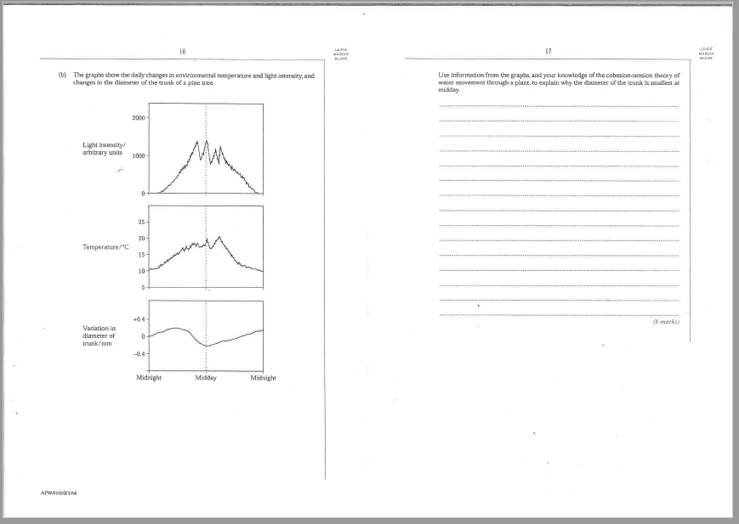
Now try this exam question

Slide 41
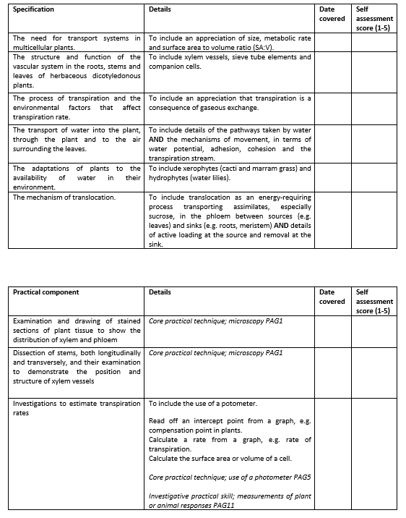
Learning Outcomes
Describe the role of xylem vessels in the movement of water through a plant
Explain why the properties of water allow this to occur
Compare the structures, position in the stem and function of sclerenchyma fibres (support) and xylem vessels (support and transport of water and mineral ions).

