Slide 1

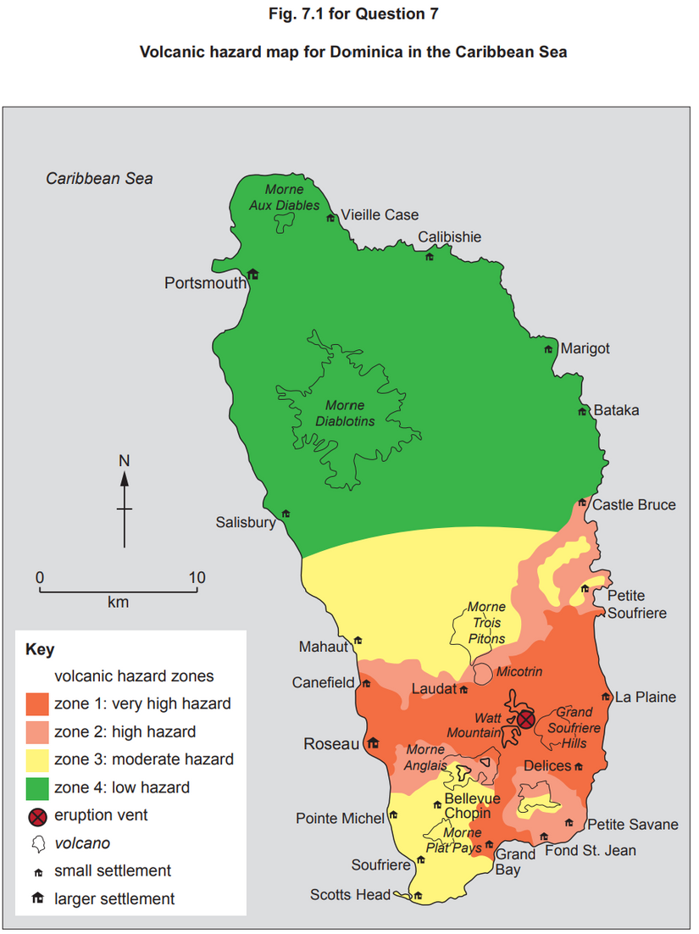
7 Fig. 7.1 shows a volcanic hazard map for Dominica in the Caribbean Sea.
Describe the pattern of volcanic hazard zones shown in Fig. 7.1. [4]
Suggest two reasons why some places have a very high hazard level. [6]
7(a) Fig. 7.1 shows a volcanic hazard map for Dominica in the Caribbean Sea. Describe the pattern of volcanic hazard zones shown in Fig. 7.1.
Candidates should interpret Fig. 7.1 to identify the pattern of hazards across the island. Candidates may identify that:
• highest levels of hazard are in the south and lowest in the north
• level of hazard decreases with distance from the vent
• however, it is uneven
• hazard level is still very high on the coast to the east and west, up to 12 km away, of the vent
• whereas level of hazard decreases quickly towards Morne Anglais to the south-west
• moderate hazard level up to 15 km away to the north-east towards Petite Soufriere
1 mark for each valid point. Map evidence required for maximum. 4
7(b) Suggest two reasons why some places have a very high hazard level.
Candidates may limit their answer to the information in (a) or may take a more generic view. Reasons include:
• proximity to a vent and to the eruptive products, especially gas, and projectiles such as volcanic bombs
• level of hazard depends on the type of eruptive product, as lava flows may be very predictable and slow moving if viscous…
• …whereas pyroclastic flows and surges are more hazardous and less predictable and may travel further
• steep gradient meaning high velocity movements of lava
• relief of the landscape, including the presence of valleys which may channel ejecta in particular directions
• direction and strength of prevailing winds may influence distance and direction of ash travel
Award marks based on the quality of explanation and breadth of the response using the marking levels below.
Level 3 (5–6) Response applies knowledge and understanding of two reasons and explains their influence on very high levels. Response is well founded in detailed knowledge and strong conceptual understanding of the topic. Any examples used are appropriate and integrated effectively into the response.
Level 2 (3–4) Response discusses at least one reason, possibly in an unbalanced way, making some explanatory links to very high levels. Response develops on a largely secure base of knowledge and understanding. Examples may lack detail or development.
Level 1 (1–2) Response consists of one or more descriptive statements with little or no explanation of very high levels. Knowledge is basic and understanding may be inaccurate. Examples are in name only or lacking entirely.
Level 0 (0) No creditable response. 6
Notes:
9696_s20_qp_31
1

Slide 2
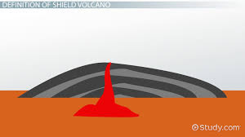
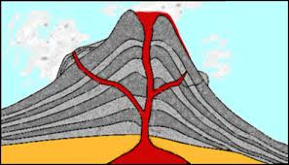
Volcanoes and their resultant hazards
Learning Objectives
Identify reasons why people might live near a volcano.
Describe how volcanic strength is measured and the risks volcanic hazards create
Explain the impacts associated with the risks of volcanoes.
Starter: Match the Labels to the correct Volcano
Composite
Shield
Hot runny lava
Thick viscous lava
Associated with destructive plate boundaries
Associated with constructive plate boundaries and hotspots
Made up of alternating bands of lava and ash
Layers of solidified lava
Explosive eruptions
Gentle eruptions
What other labels could we add to highlight the differences between the two volcanoes?

Slide 3

Volcanos 101 - https://www.youtube.com/watch?v=VNGUdObDoLk

Slide 4

Syllabus Guide – What we must know!
9.1 Hazards resulting from tectonic processes
The global distribution of earthquakes and volcanoes related to plate tectonics.
Earthquakes and resultant hazards: shaking, landslides, soil liquefaction, and tsunami.
Volcanoes and resultant hazards: types of eruption and their products (nuées ardentes, lava flows, volcanic mudflows/lahars, volcanic landslides, pyroclastic flows, and ash fallout).
Primary and secondary impacts on lives and property.
Prediction, hazard mapping, preparedness and monitoring of earthquake and volcanic hazards and perception of risk.
Please refer to the course syllabus regularly – It guides you on exactly what is required from you in this course!

Slide 5
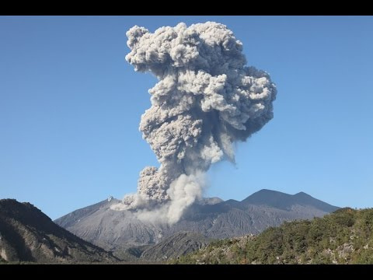
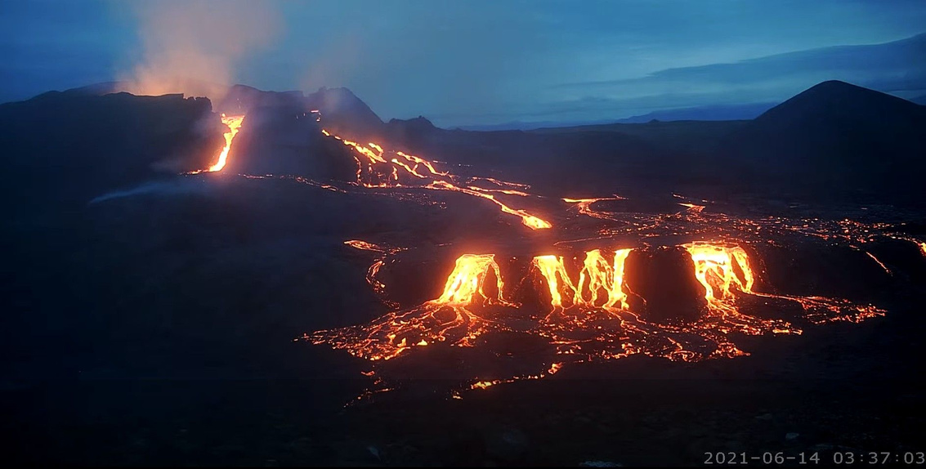
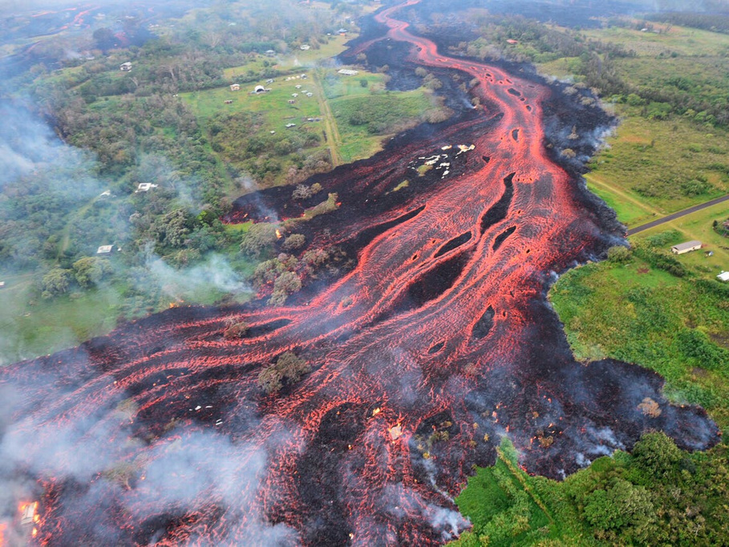
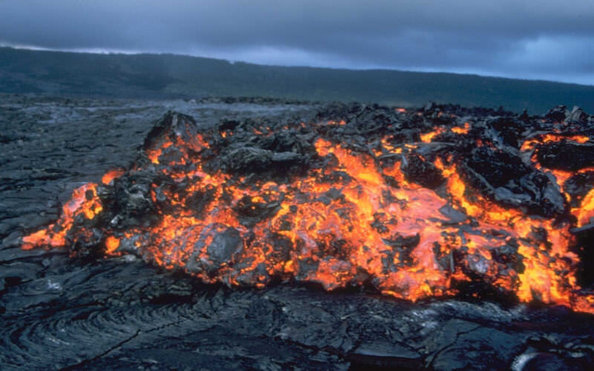
Different volcanoes & volcanic eruptions at different zones
VS
Fagradalsfjall volcano in Iceland, 2021
Sakurajima Volcanic Eruption, Japan - 2015
8 ‘The type of eruption is the most important factor influencing the hazards from volcanoes.’ With the aid of examples, how far do you agree? [20]
9 Assess the extent to which the types of volcanic eruptions and their products determine the hazardous impacts. [20]

Slide 6
Shield v Composite/strato-volcanoes &
Effusive v Explosive eruptions
TASK 1: Learn all about shield volcanoes, their characteristics & features by studying this webpage.
TASK 2: Learn all about composite/strato-volcanoes, their characteristics & features by studying this webpage.
Task 3: Take notes as you watch the video on effusive v explosive eruptions. It’s very good, A-Level standard material - https://www.youtube.com/watch?v=erThKrqID3Q

Slide 7
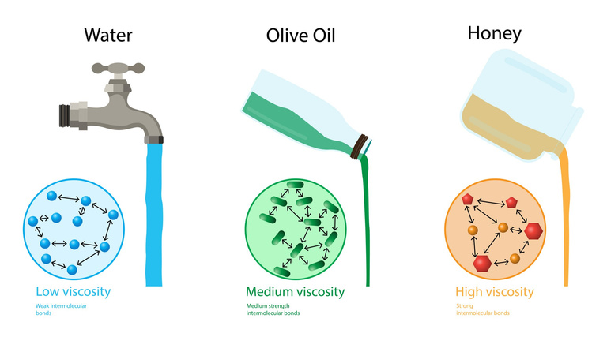
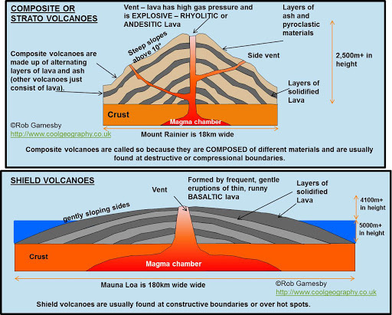
Different volcanoes & volcanic eruptions at different zones -
Subduction Zones (Destructive Boundaries) vs Mid-Ocean Ridges (Constructive Boundaries)
Why are there different eruption styles, and therefore, different volcano types, at different plate boundaries? What are these different volcano types
Different viscosities of magma/lava explain different eruption styles & different volcano types. i.e. explosive, thick lava at subduction zones leading to composite volcanoes & gentle, effusive eruptions with runny lava at divergent boundaries, leading to shield volcanoes.
But what explains the different viscosities?
The chemistry of the magma/lava controls viscosity. Lavas with more silica (SiO2) have higher viscosity because silica forms lots of chemical bonds, making the lava very stiff and very "sticky“ i.e. viscous. Sand is an example of a material with high levels of silica – that’s why sand sticks together when wet.
But what explains the difference in chemistry and silica levels?
Plate tectonics! Volcanoes that form along divergent plate boundaries (constructive) have very little silica because the lavas are derived from the mantle, where little silica is found. These lava’s are, therefore, less viscous, very fluid and runny in nature. Also, there are fewer gases here (again, because the lava is derived from the mantle), and whatever gases there are can escape easily through the runny magma before it reaches the surface so eruptions here are gentle and not explosive. The lava is called basaltic lava. Volcanoes & volcanic eruptions at hotspots mirror the above.
Volcanoes that form along convergent plate boundaries (subduction zones) have more silica because the lavas become contaminated with sediment during subduction and often with high-silica continental crust as the magma moves upward toward the surface. These lavas, therefore, become much more viscous, and are thicker and less fluid in nature. There are also more volatile gases here (e.g. O2 & CO2 from the subducted oceanic plate) & these gases cannot escape through the viscous magma, causing great pressure to build up, leading to explosive eruptions with ash clouds common. The lava is called rhyolithic or andesitic lava.
What is silica?
Silicon is a chemical element with the symbol Si and atomic number 14. Silicon makes up 27.7% of the Earth’s crust by mass and is the second most abundant element (oxygen is the first). It does not occur un-combined in nature but occurs chiefly as the oxide (silica) and as silicates.
An oxide is a chemical compound that contains at least one oxygen atom and one other element in its chemical formula. The oxide includes sand, quartz, rock crystal and flint.
Silicates are salts containing silicon (Si) and oxygen. There are many types of silicates, because the silicon-to-oxygen ratio can vary widely. The silicate form includes asbestos, granite, hornblende, feldspar, clay and mica.
Partial melting also affects magma/lava viscosity. Magma in the mantle is molten/semi-molten. Some minerals melt before others – this is called partial melting & it alters the composition of the magma produced. At subduction zones, the older and deeper slabs experience greater partial melting and this produces silica-rich magma. The process of partial melting isn’t as prevalent at constructive boundaries.
8 ‘The type of eruption is the most important factor influencing the hazards from volcanoes.’ With the aid of examples, how far do you agree? [20]

Slide 8
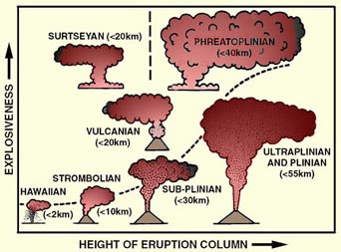
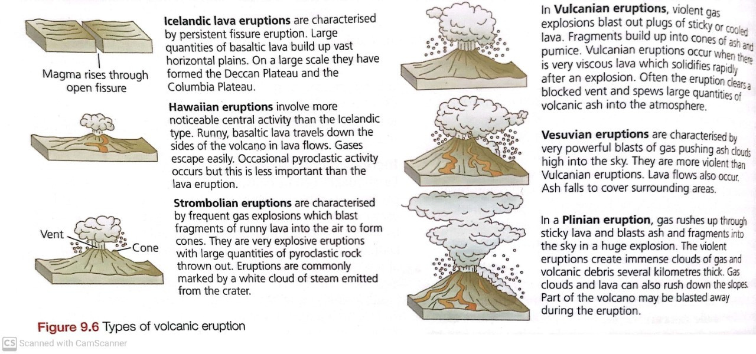
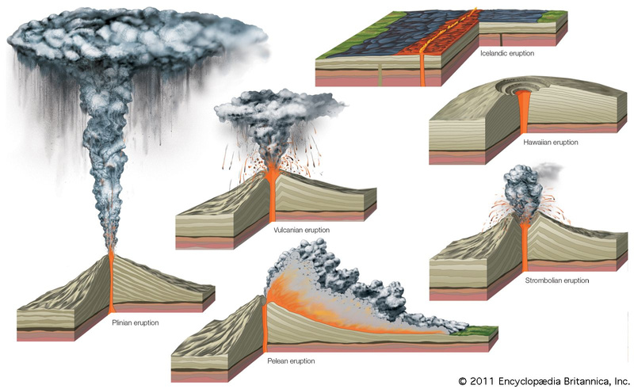
Types of volcanic eruption & their products
8 ‘The type of eruption is the most important factor influencing the hazards from volcanoes.’ With the aid of examples, how far do you agree? [20]
9 Assess the extent to which the types of volcanic eruptions and their products determine the hazardous impacts. [20]
TASK: Study the resources on this slide (including the links!) to build your knowledge on the various types of volcanic eruptions.
A-Level Geography - great webpage!
Britannica
This Wikipedia article also has excellent information.
Study this webpage related to eruption types. Then, click the bullet points to further your learning on each of the eruption types.

Slide 9
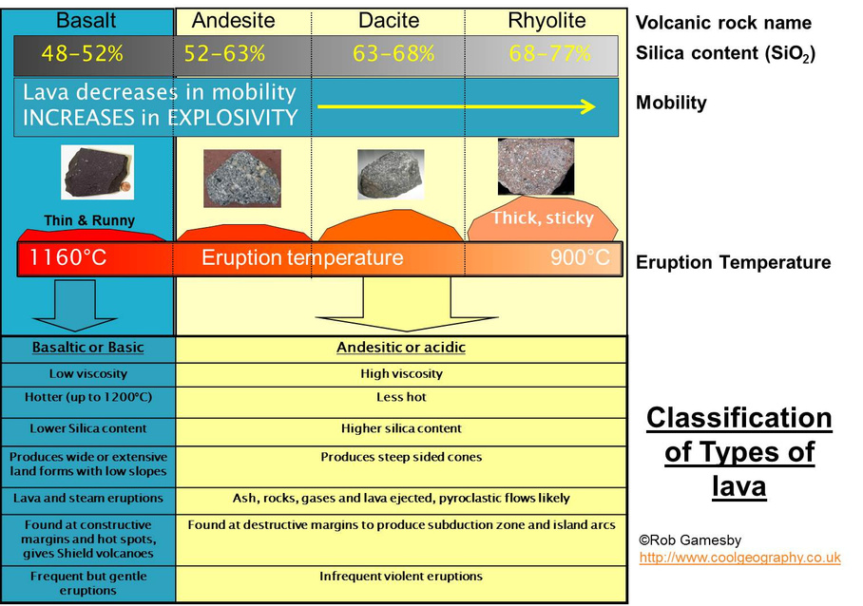
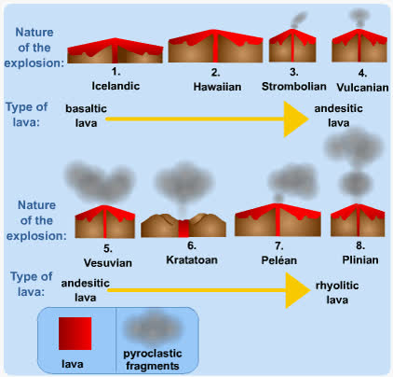
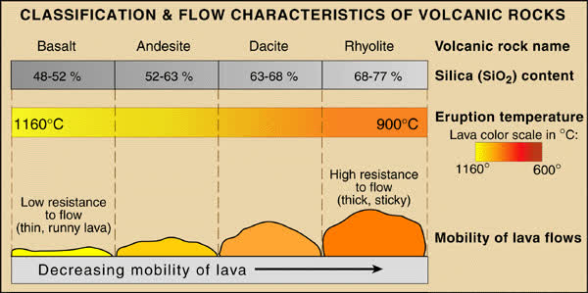
Different plate margins &different types of eruption = Different volcanic activity
Destructive margins – explosive activity, pyroclastic flows/nuées ardentes, ash fallout, acid viscous lava flows. Resultant landforms – dome volcanoes, composite cones, cinder cones.
Constructive margins – less explosive activity – fluid, basic, basalt lava flows, fire fountaining, lava bombs, e.g. Iceland. Resultant landforms: shield cones – low, gently sloping, wide cones, plateau basalts (Snake River Plateau, USA, Deccan Plateau, India)
Hot spots, e.g. Pacific plate. These are ‘mantle plumes’ of molten material from the mantle which are ejected on the surface far from a plate boundary, e.g. Hawaiian Islands. They tend to produce isolated activity and can occur on continents as well.

Slide 10
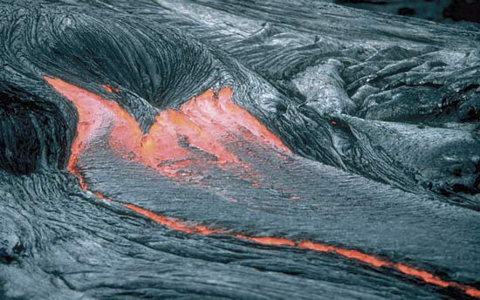
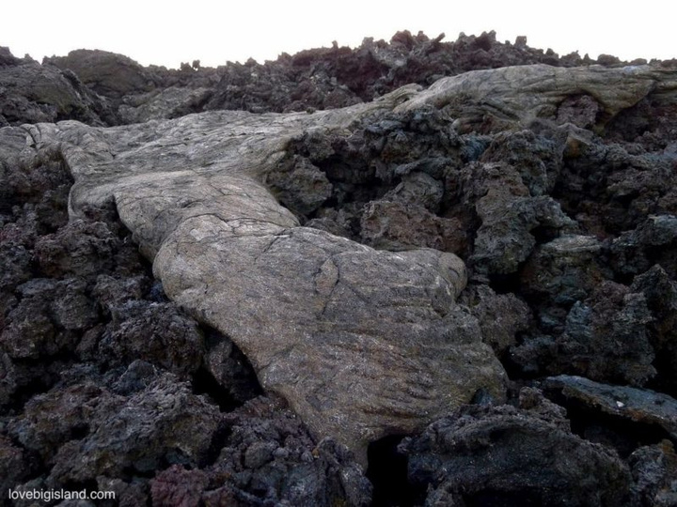
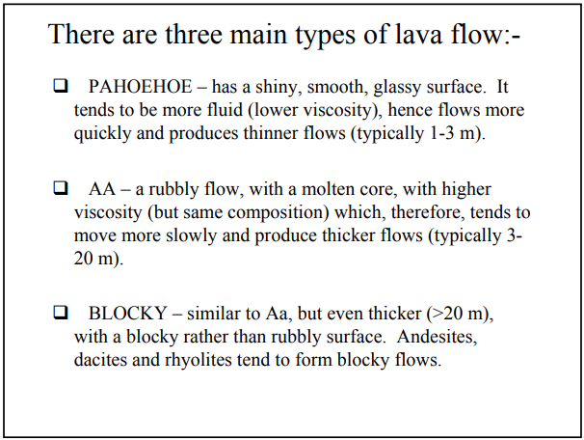
Types of volcanic eruption & their products
Types of lava flow – Aa v Pahoehoe
Lava flow ranges from being extremely thick and viscous, to highly fluid & runny. The amount of pyroclastic material also varies. The two types are:
Aa flow: This is a few metres thick, a mix of uneven shaped, sharp edged ash and cinder blocks. It is unstable.
Pahoehoe flow: Is fluid rather than viscous. Often the surface layer is static whilst flow continues beneath.
Pāhoehoe flows typically can change into ʻaʻā flows depending on the speed of the flow and the amount of gas present in the flowing lava, while the opposite (aʻā to pāhoehoe) is much rarer.
The most obvious difference between the two is that pāhoehoe flows are smooth, and aʻā are not. Furthermore, aʻā flows consist of only 1-2 large flow units, while pāhoehoe flows can consist of thousands of small flow units called toes. Lets watch this video.
https://www.lovebigisland.com/quick-and-remarkable-facts-about-hawaii/pahoehoe-and-aa/
https://www.differencebetween.com/difference-between-aa-and-vs-pahoehoe/
TASK: Make a quick table to compare/contrast aa flow and pahoehoe flow. Use the info on this slide and the 2 links above.
Ext: There is 1 characteristic of the flows that the links above have incorrect to me – what is it?
8 ‘The type of eruption is the most important factor influencing the hazards from volcanoes.’ With the aid of examples, how far do you agree? [20]
9 Assess the extent to which the types of volcanic eruptions and their products determine the hazardous impacts. [20]
Pahoehoe lava partially covers A’a lava in the Hawaii Volcanoes National Park.

Slide 11
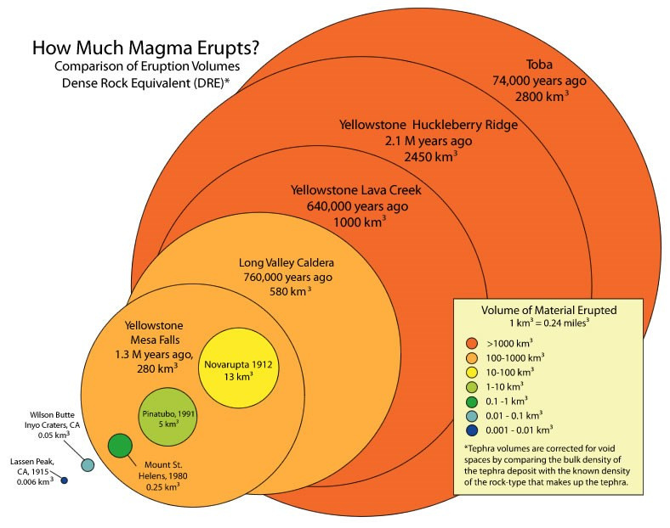
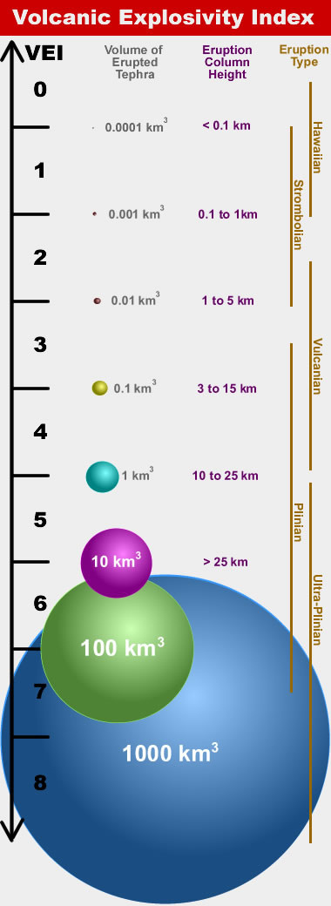
Volcanic Strength
The strength of a volcano is measured using the Volcano Explosive Index (VEI). This is based on the amount of material ejected in the explosion, the height of the cloud it creates, and the amount of damage caused. Any explosion above a level 5 is considered to be very large and violent. A VEI of 8 or above is usually caused by a super volcano.
Article - It's Official: Tonga's Volcano Was The Largest Explosive Eruption of The 21st Century. The Volcanic Explosivity Index (VEI) rating for the blast was set at 6, with one such eruption expected once every 50-100 years.
How a Supervolcano Ignited an Evolutionary Debate - Interesting 20 minute documentary on the Toba eruption 74,000 years ago

Slide 12
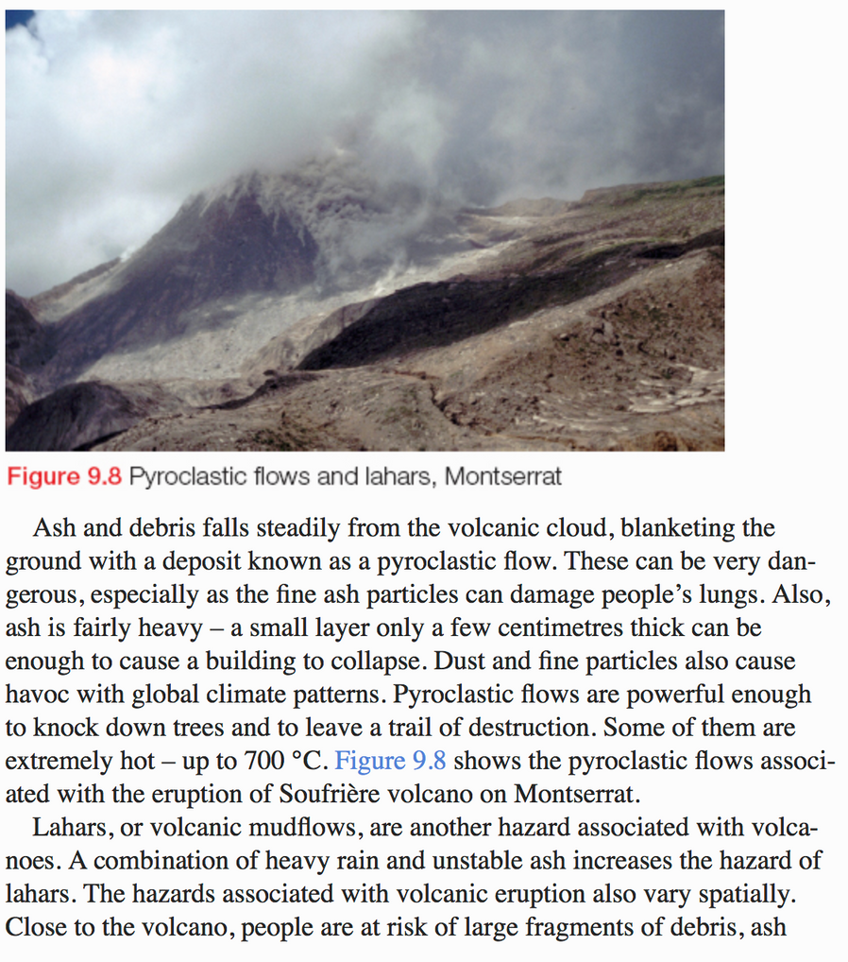
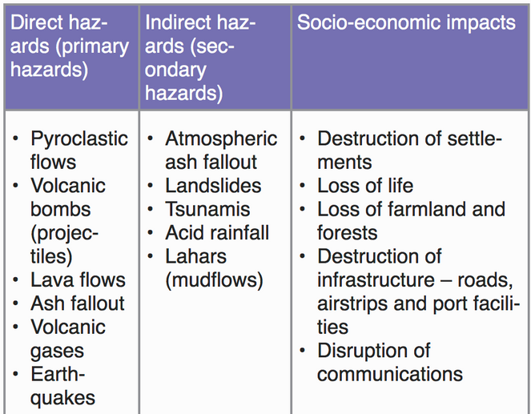
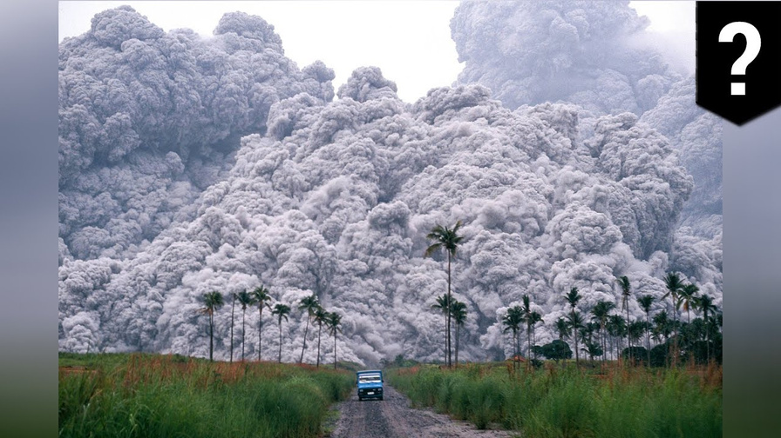
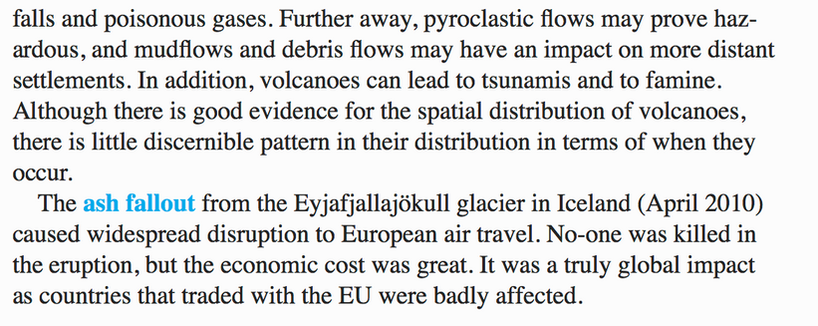
Volcanic Hazards
I recommend you check out the reading in the lesson folder first – it is very comprehensive. Take notes as you read.
TASK: What are the primary and secondary hazards of volcanic hazards?
Watch the video in the link below to learn about volcanic hazards.
https://www.youtube.com/watch?v=BCm6xTZj-vk
Geography Revision
Geography Revision A Level
TASK - Create a visual/table outlining the different volcanic hazards and impacts. The resources on this slide and the next slide will help you. It should include the following:
Describe the hazard and explain it.
Where does it occur? Type of volcano & type of eruption?
Impacts of the hazard – real-life examples? Facts/data?
Any further/secondary impacts? ‘This can/could/has le(a)d to…’
Pictures?
Ext: Factors affecting severity of volcanic damage? Compare HIC’s v LIC’s…
Factors affecting severity of volcanic impacts - here

Slide 13
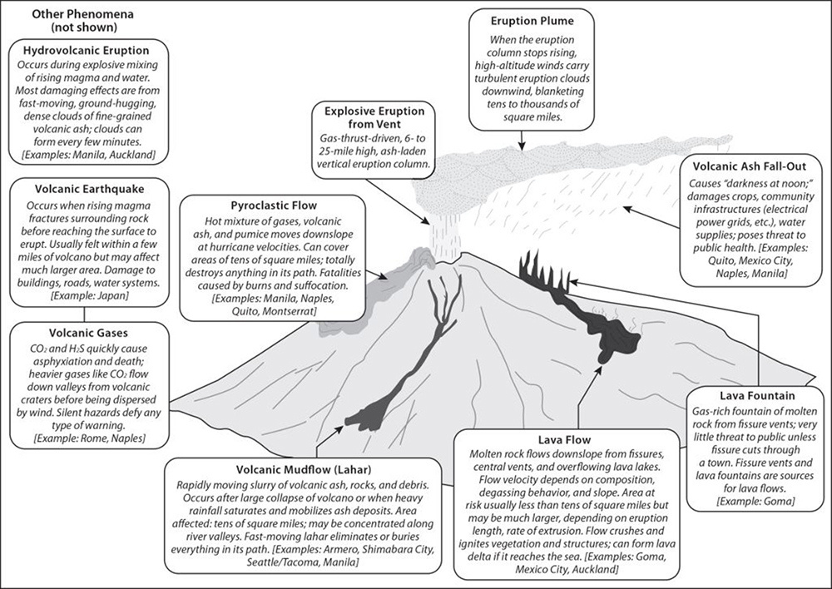
Volcanic Hazards
Mountains of Fire - Touring the world's most active volcanoes

Slide 14
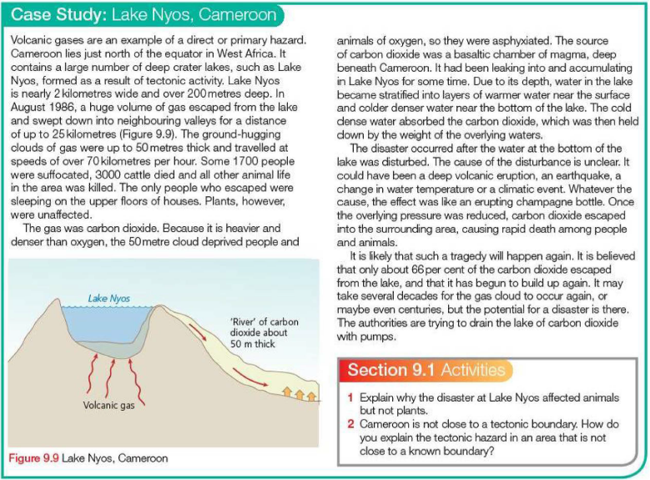
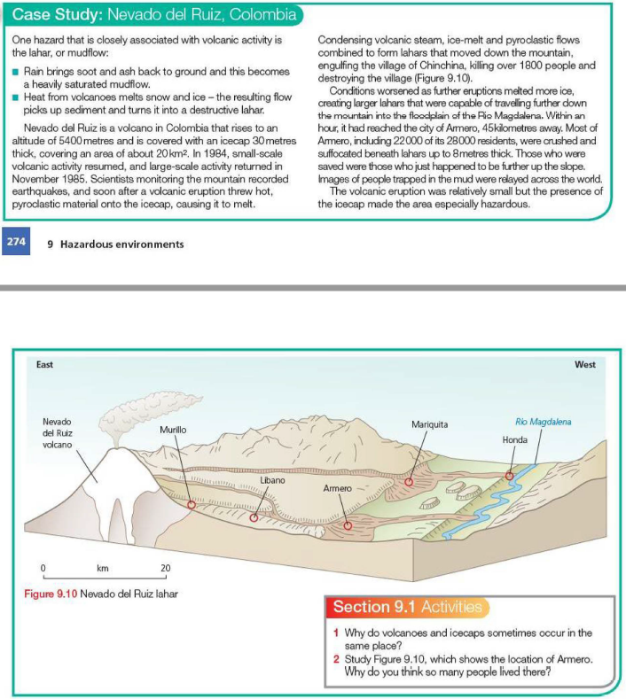
TASK: These are some mini-case studies focused on volcanic hazards. Very useful for 20 markers. You should study some of them!
Case Study: Volcanic Hazards – Volcanic Gases
Case Study: Secondary Hazards of Volcanic Events – Lahars & mudflows
Lake Nyos – a case study of gas poisoning
Case study: Chances Peak, Montserrat, 1995-97 - an LEDC - Lahars & Pyroclastic Flows
Case Study - Mount Nyiragongo - lava flows in 2002

Slide 15
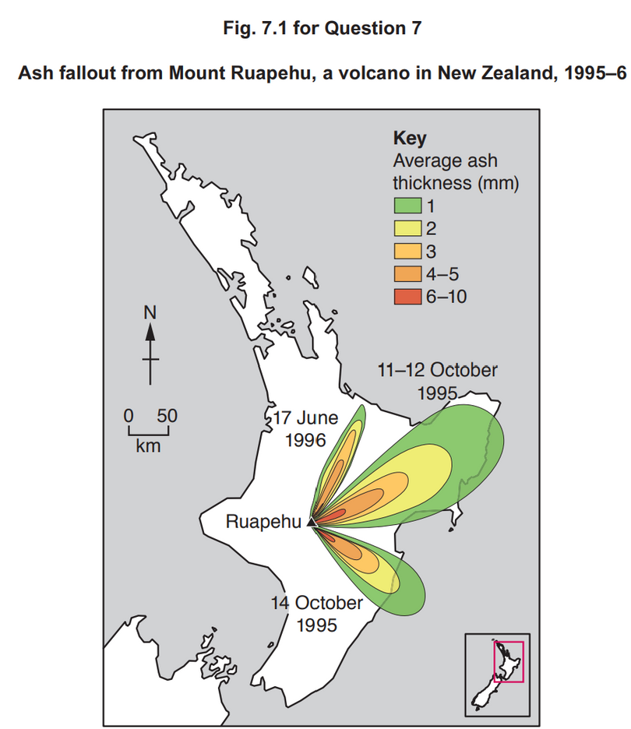
Hazardous environments If answering this option, answer Question 7 and either Question 8 or Question 9.
7 Fig. 7.1 shows ash fallout from Mount Ruapehu, a volcano in New Zealand, 1995–6.
Describe the pattern of ash fallout shown in Fig. 7.1. [4]
Suggest two reasons for the pattern you described in (a). [6]
7(a) Fig. 7.1 shows ash fallout from Mount Ruapehu, a volcano in New Zealand, 1995–6.
Describe the pattern of ash fallout shown in Fig. 7.1.
Candidates should interpret Fig. 7.1 to identify the pattern of ash fallout across the area.
Candidates may identify that:
• ash fallout is broadly westerly
• specific direction varies on different dates
• distance travelled also varies
• thickness of fallout decreases with distance
1 mark for each valid point. Allow one mark maximum for accurate use of data. 4
7(b) Suggest two reasons for the pattern you described in (a).
Candidates should focus on the pattern described. Reasons include:
• direction of winds may influence direction of ash travel
• strength of wind influences distance of travel
• amount of ash ejected influences thickness of deposits
• proximity to the vent influences thickness of fallout
• relief of the landscape, including the presence of valleys which may channel ash in clouds in particular directions
Award marks based on the quality of explanation and breadth of the response using the marking levels below.
Level 3 (5–6) Response applies knowledge and understanding of two reasons and explains their influence on the pattern. Response is well founded in detailed knowledge and strong conceptual understanding of the topic. Any examples used are appropriate and integrated effectively into the response.
Level 2 (3–4) Response discusses at least one reason, possibly in an unbalanced way, making some explanatory links to at least one element of the pattern. Response develops on a largely secure base of knowledge and understanding. Examples may lack detail or development.
Level 1 (1–2) Response consists of one or more descriptive statements with little or no explanation of the pattern. Knowledge is basic and understanding may be inaccurate. Examples are in name only or lacking entirely.
Level 0 (0) No creditable response. 6
Notes:
9696_s20_qp_33
15

Slide 16
Podcast - This Week in History: the eruption that changed the world
https://www.abc.net.au/radio/programs/nightlife/tambora/13835284

