Slide 1

Variation
By the end of the lesson you should be able to:
Describe the different types of variation, including intraspecific and interspecific variation
Explain the differences between continuous and discontinuous variation, using examples of a range of characteristics found in plants, animals and microorganisms
Suggest genetic and environmental causes of variation.

Slide 2


Slide 3
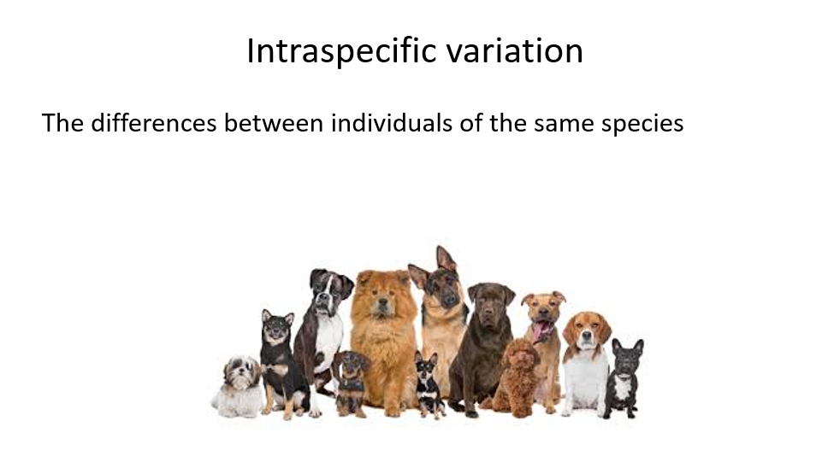
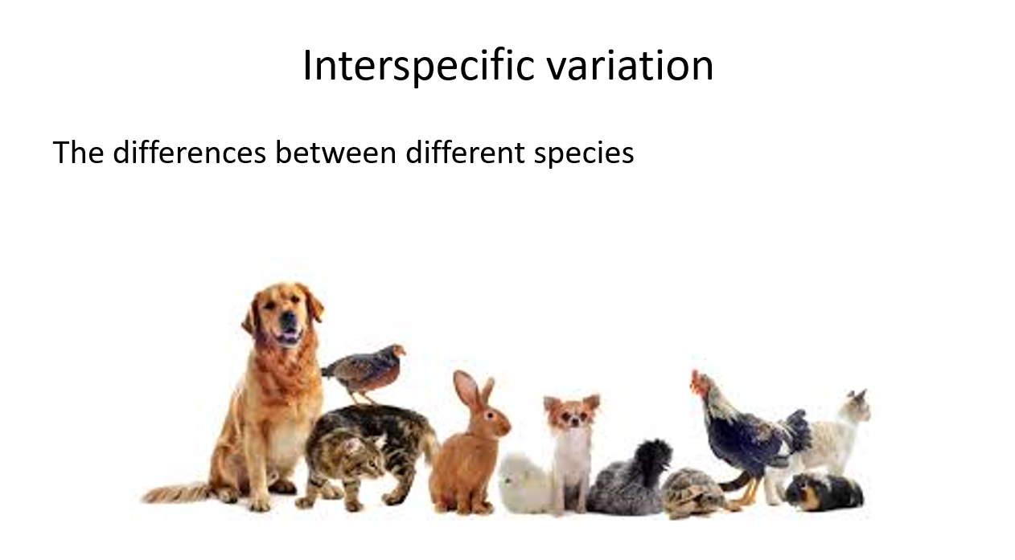
What is Variation?
Differences in characteristics between organisms

Slide 4
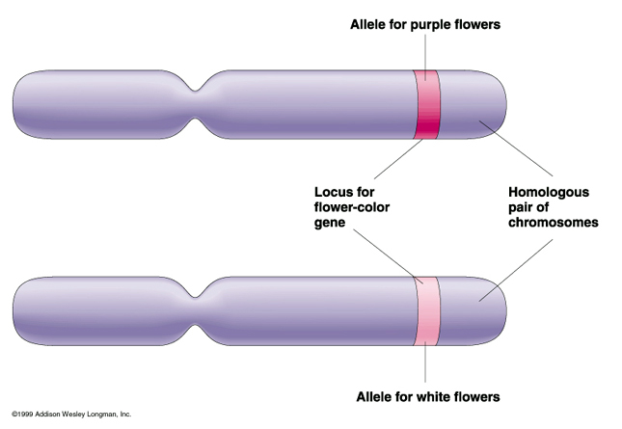
Causes of variation
Genetic causes
Environmental causes (e.g. climate, food, lifestyle)
Different species have different genes. Individuals of the same species have the same genes, but different versions of them called alleles.
The alleles an organism has make up its genotype.
The differences in genotype result in variation in phenotype (the characteristics displayed by an organism).

Slide 5
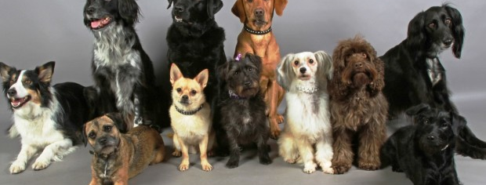
Why is a greater genetic diversity a good trait to have within a species?
Greater genetic diversity means that the species is more likely to be able to adapt to a changing environment i.e. it is more probable that an individual will possess a characteristic that suits it to a new environmental pressure.

Slide 6
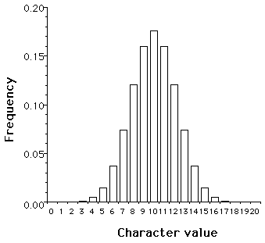
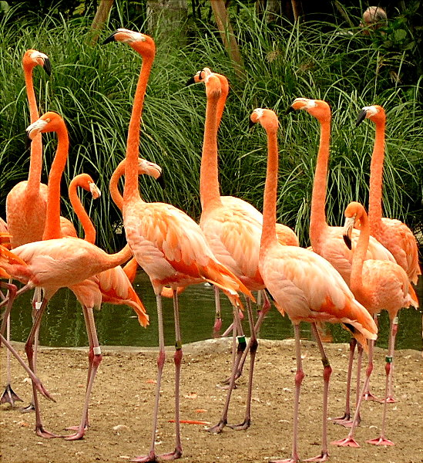
Continuous Variation
Continuous variation in the phenotype (characteristic) arises when a trait is polygenic i.e. the phenotype is determined by multiple alleles for many different genes at different loci.
The environment also has a significant effect on the majority of polygenic phenotypes.
The most common phenotype will be somewhere mid-way between the extremes of the ranges

Slide 7
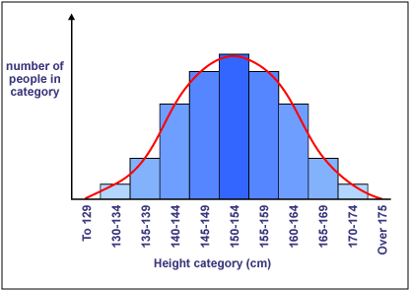
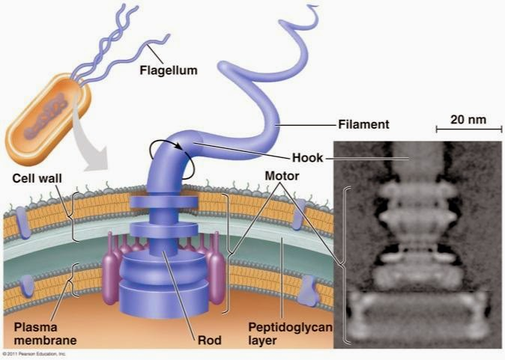
Variation influenced by the environment
Many characteristics show a gradation within a population, forming a continuum e.g. height or mass in humans:
N.B. Variation can (and is quite often) a result of both environmental and genetic factors. For example, flagella are instructed to grow by genes but some will only begin to grow in certain environments such as metal ions

Slide 8
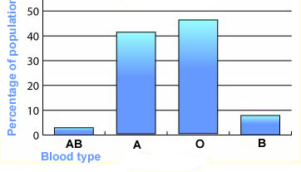

Discontinuous Variation
Some characteristics are determined by a single gene at a singe loci. These characteristics usually show discontinuous variation and are not usually influenced by the environment.
The phenotypes fall into discrete groups with no overlap
Discontinuous variation is usually caused by:
  Mutations. Changes in genes/chromosomes that MAY be inherited
  Meiosis. Creates new combinations of alleles
  Random fusion of gametes

Slide 9

Continuous or discontinuous?

Slide 10
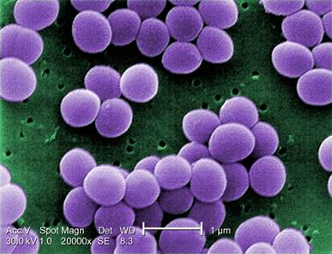
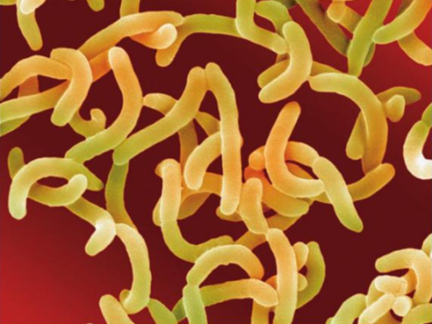
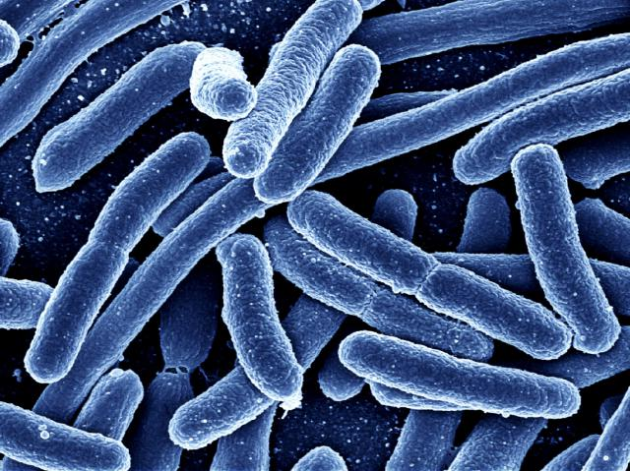
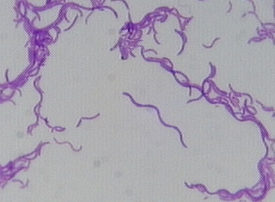
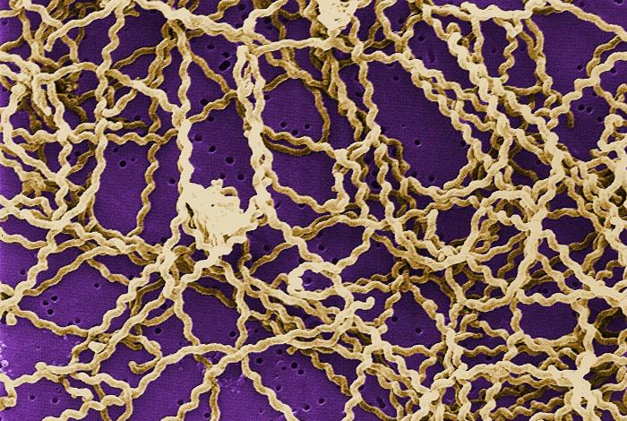
Continuous or discontinuous?
Bacteria can be classified by shape which include:
Cocci (spherical)
Vibrio (comma)
Bacilli (rod)
Spirilla (spiral)
Spirochaete (corkscrew)

Slide 11
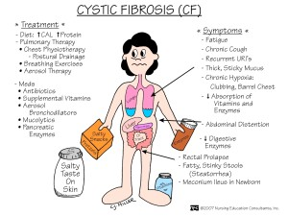
Continuous or discontinuous?
Cystic fibrosis is a disease characterised by the production of a thick and sticky mucus
It is caused by a mutation to a single gene which codes for a protein that regulates the movement of Cl⁻ in and out the cell

Slide 12

Continuous or discontinuous?
A person’s body mass is heavily influenced by environmental factors such as diet and exercise
Genetic factors can also influence weight. Genes such as the APOA2 gene have been shown to significantly increase weight gain, but only if the person has a diet high in saturated fats.

Slide 13
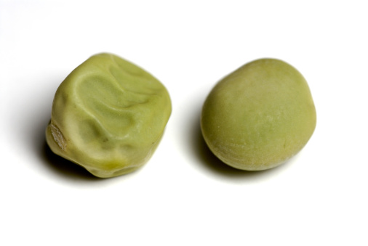
Continuous or discontinuous?
Sweet pea plants can produce either round or wrinkled peas (one of the characteristics studied by Mendel)

Slide 14
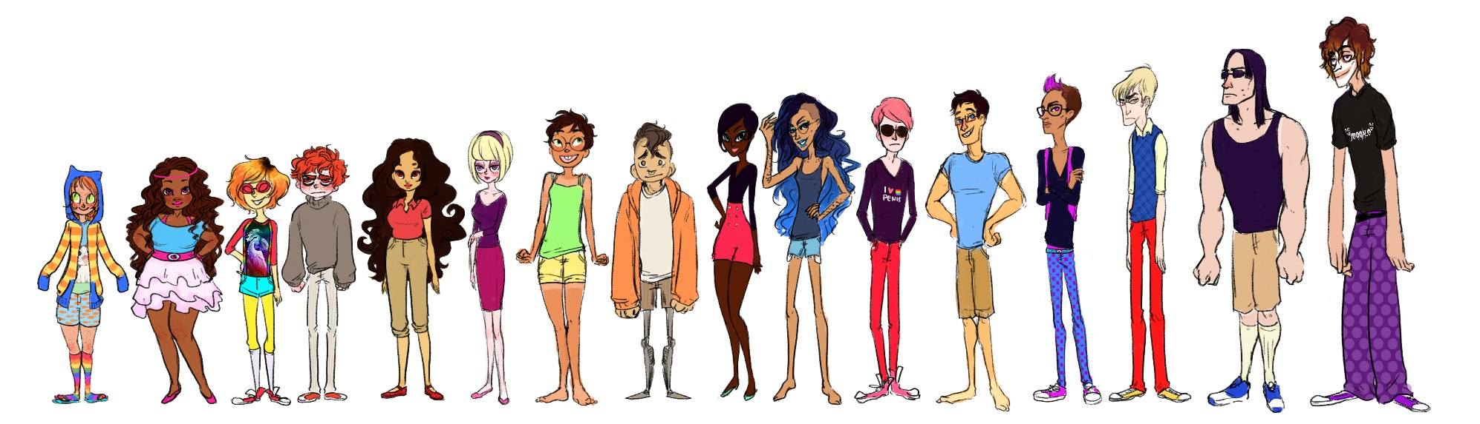
Continuous or discontinuous?
Height

Slide 15

Continuous or discontinuous
Some people can roll the sides of their tongue up and others cannot

Slide 16
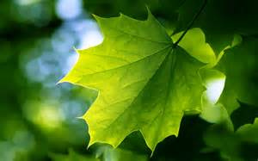
Continuous or discontinuous?
The surface area of leaves.

Slide 17
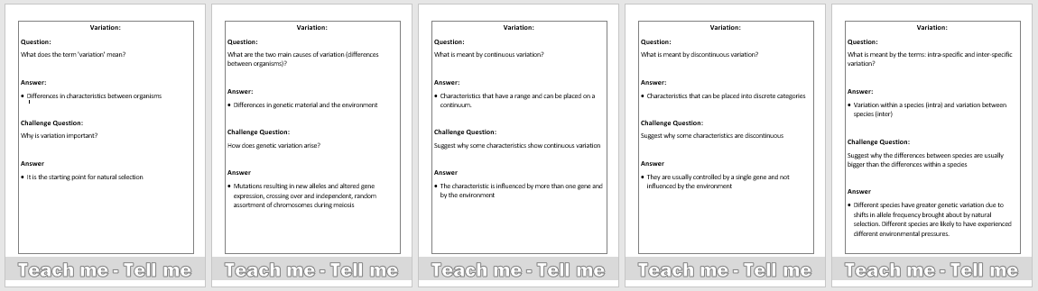
Test yourself

Slide 18
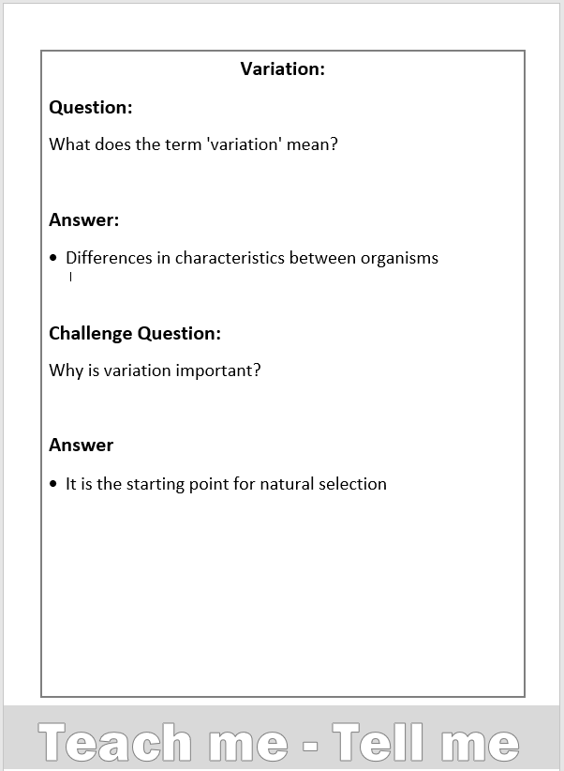

Slide 19
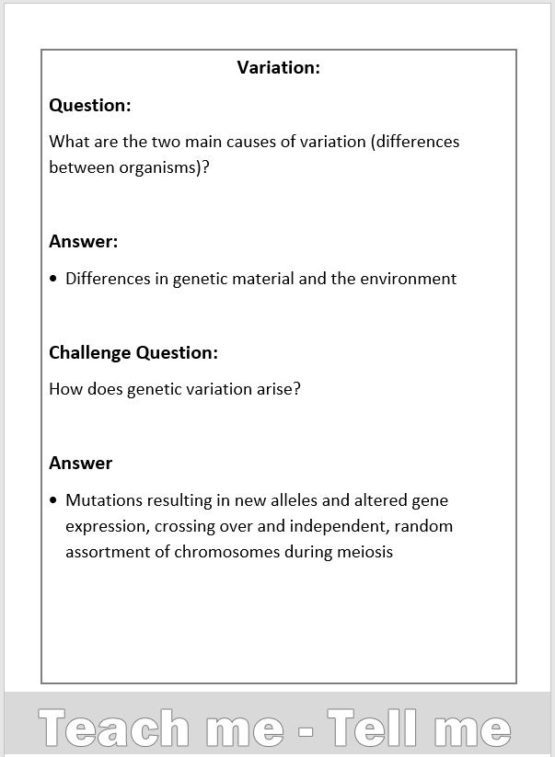

Slide 20
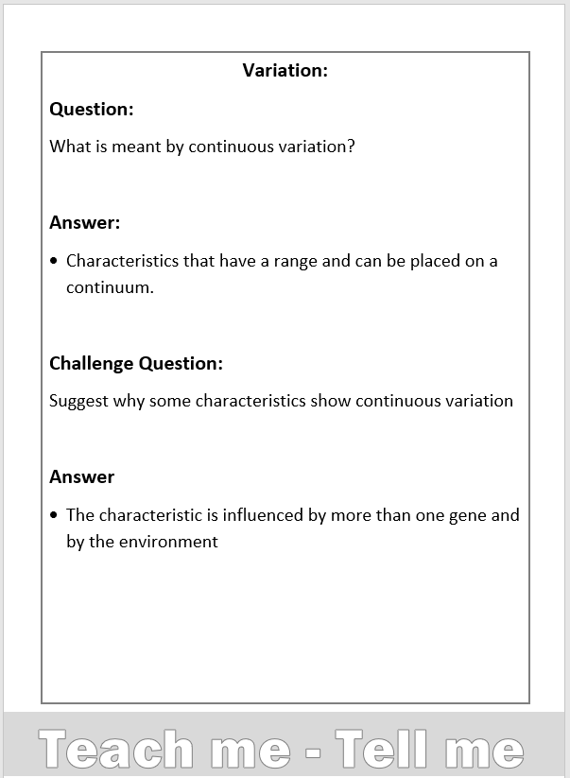

Slide 21
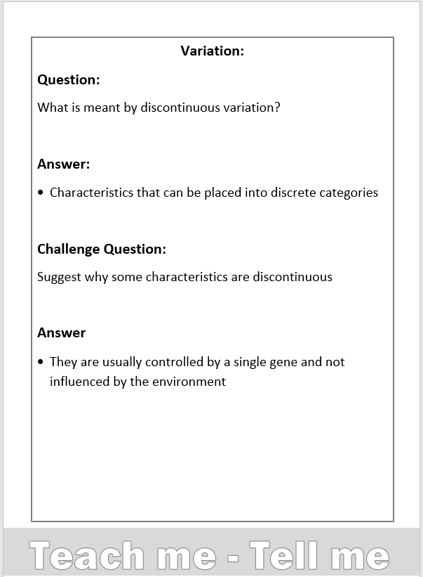

Slide 22
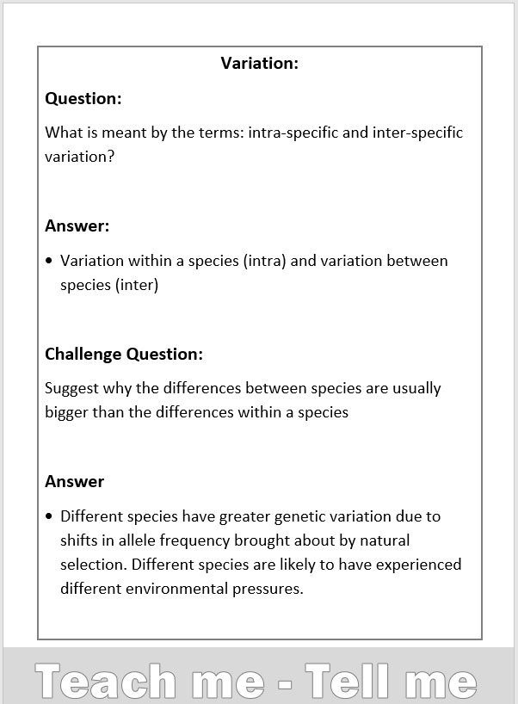

Slide 23
Create a mind map to show what you know about variation in organisms
Variation is the difference that exists between organisms.
Intraspecific variation is the variation within a species.
Discontinuous variation is when there are two or more distinct categories, and each individual falls into one of these categories. There are no intermediates:
Animals – sex (male or female), blood group
Plants – colour, seed shape/texture (wrinkled or smooth)
Microorganisms – antibiotic resistance, pigment production
Variation
Genetic factors.
Environmental factors.
Interspecific variation is the variation between different species.
Continuous variation is when the individuals in a population vary within a range, there is no distinct categories:
Animals – height, mass, milk yield
Plants – number of leaves, height, mass
Microorganisms – cell width, length of flagellum

