Slide 1
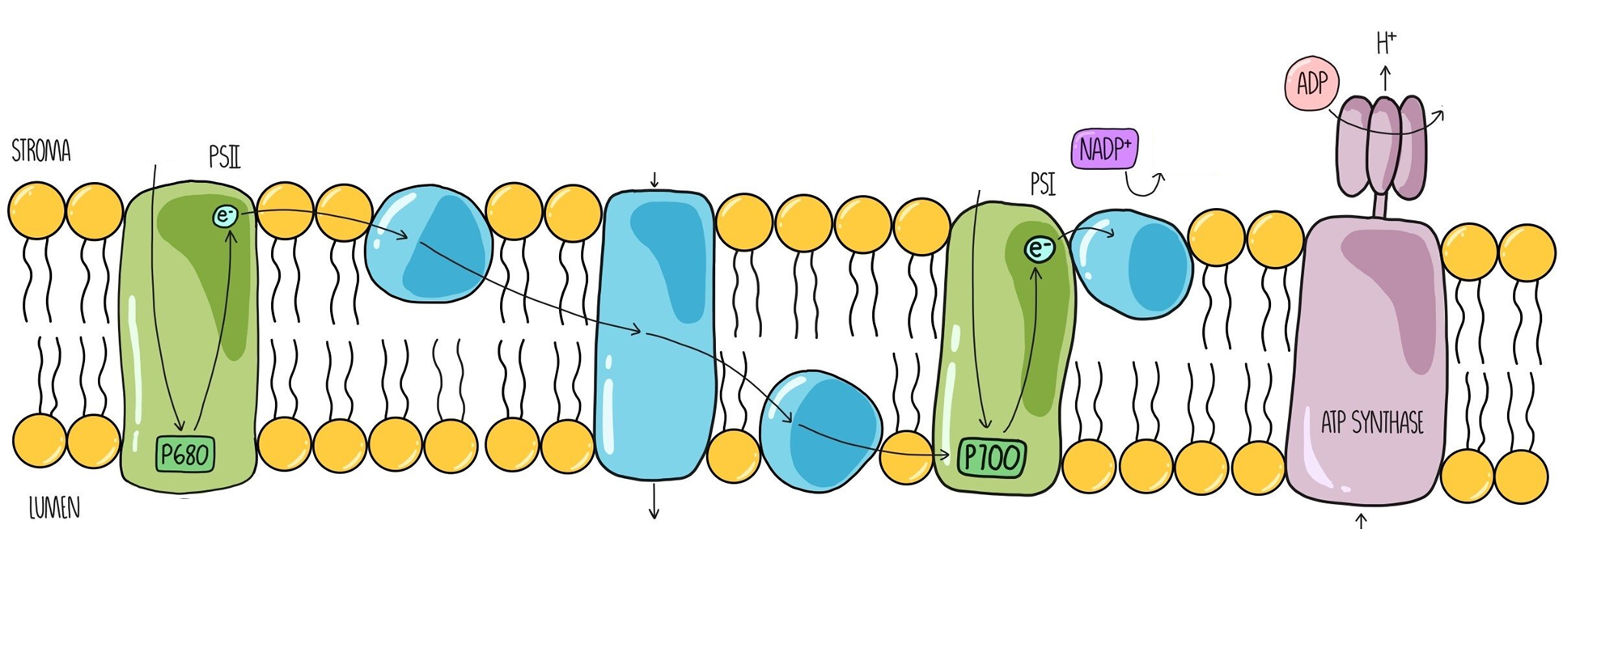

Slide 2
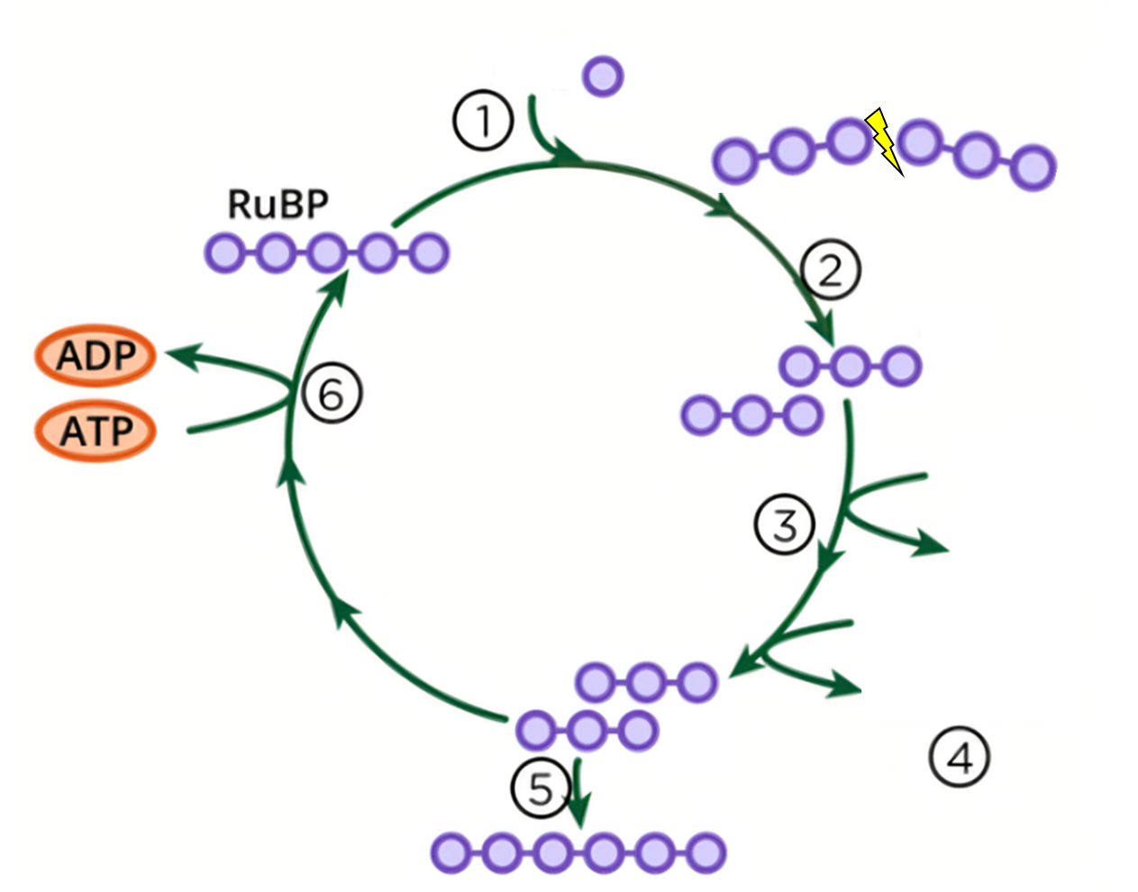

Slide 3
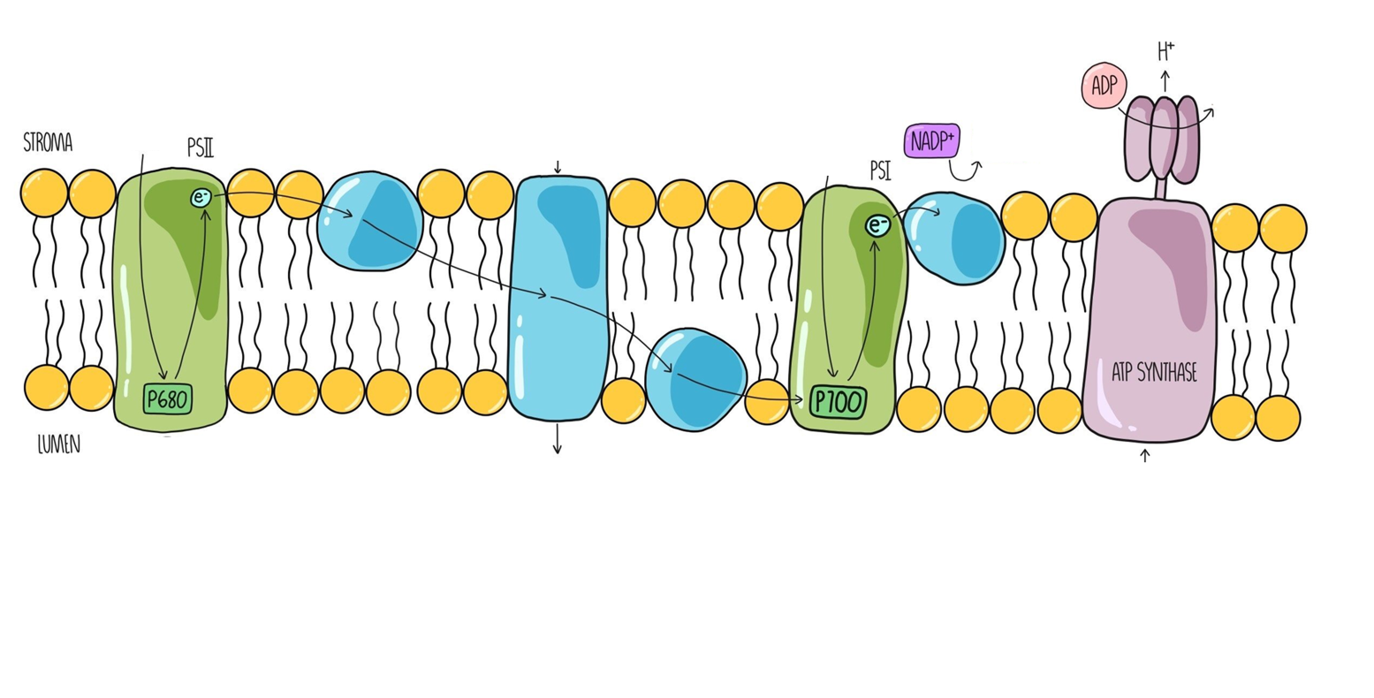
Knowledge retrieval task
Annotate both sides of your sheet to explain the light dependent and light independent stages of photosynthesis

Slide 4
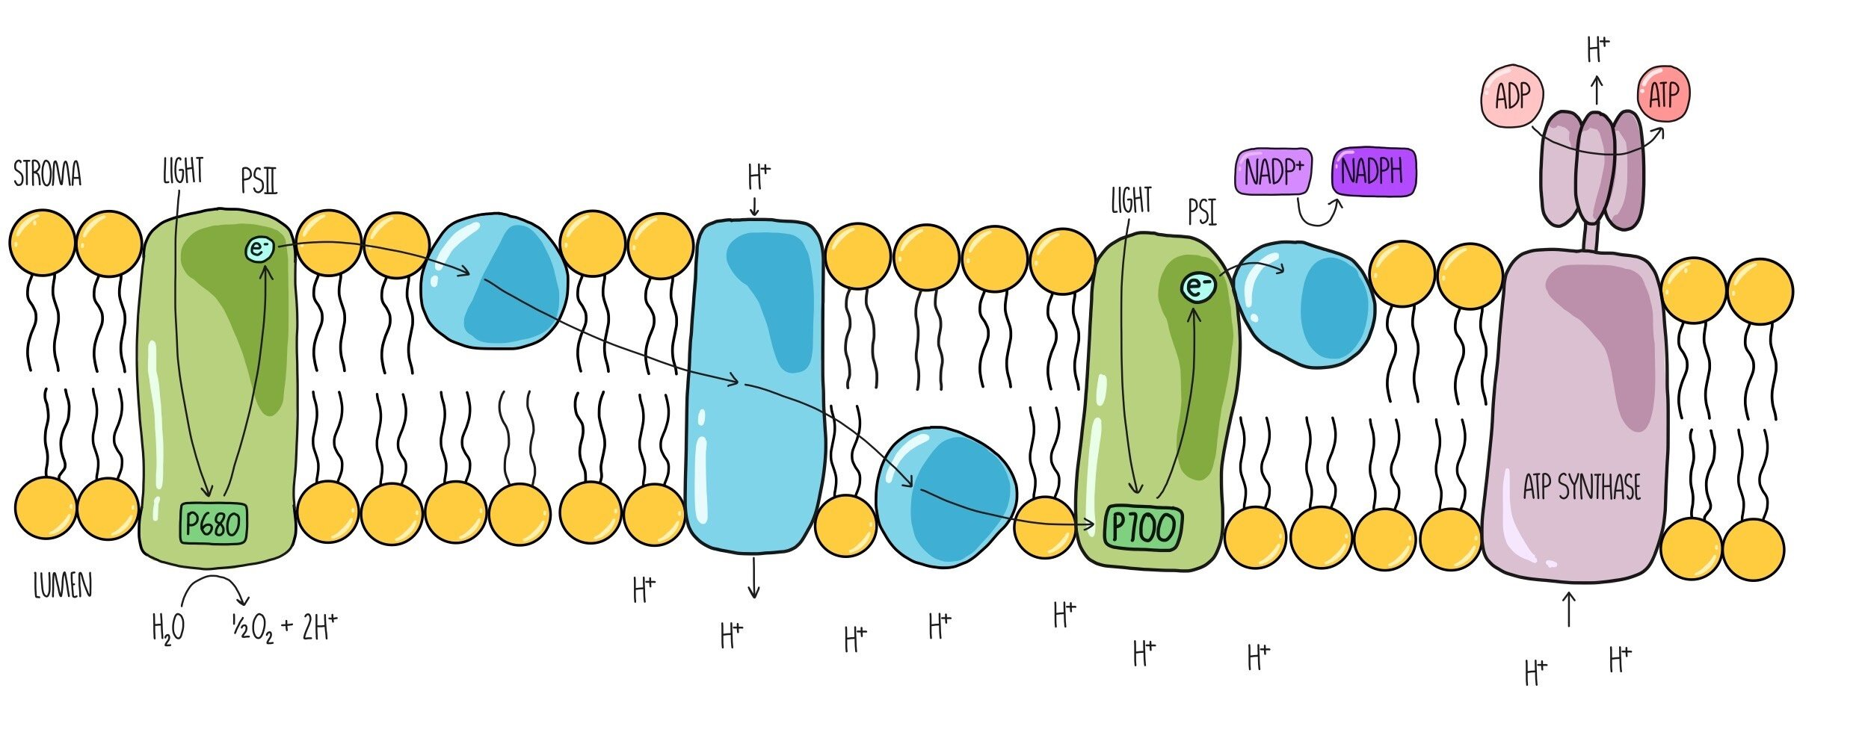
Thylakoid
Notes:
Go to whiteboard and complete the following

Slide 5
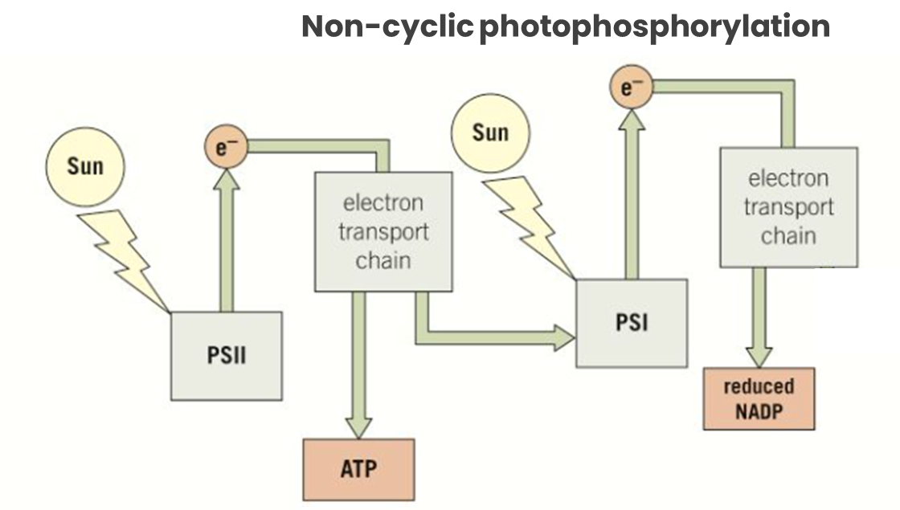
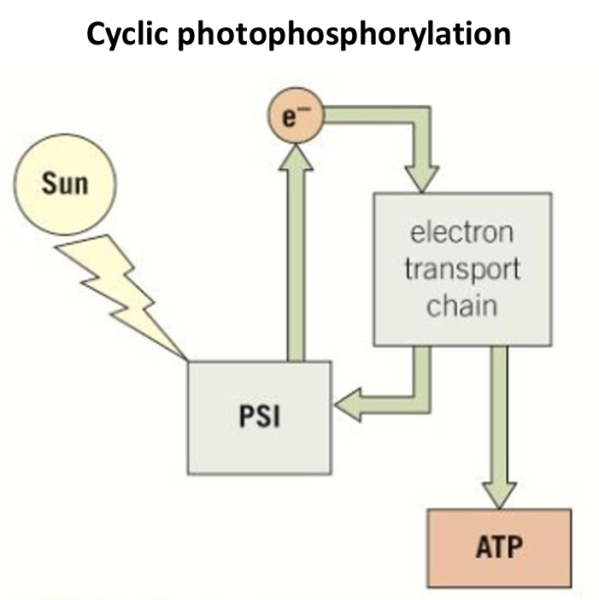
ONLY INVOLVES PSI

Slide 6
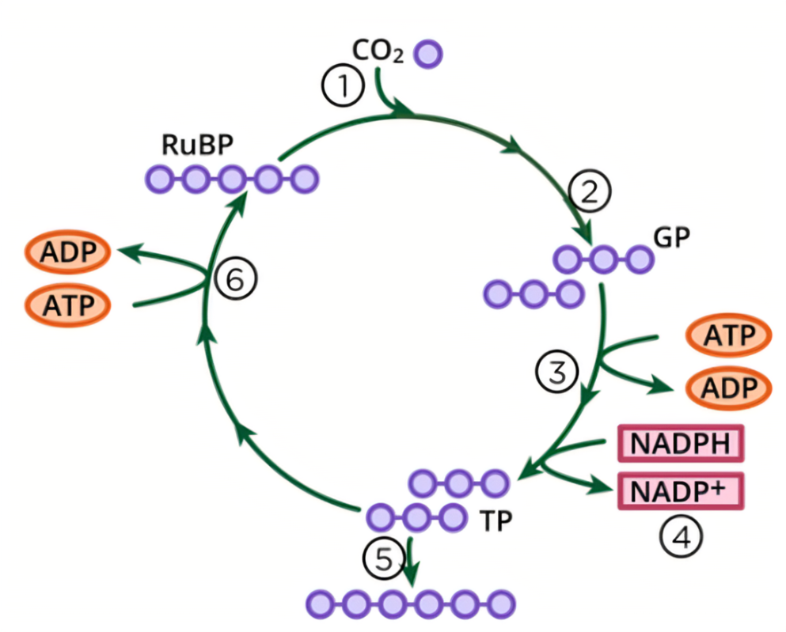
Calvin cycle
RuBisCO
enzyme
Unstable 6-carbon molecule
Notes:
Go to whiteboard and complete the following

Slide 7
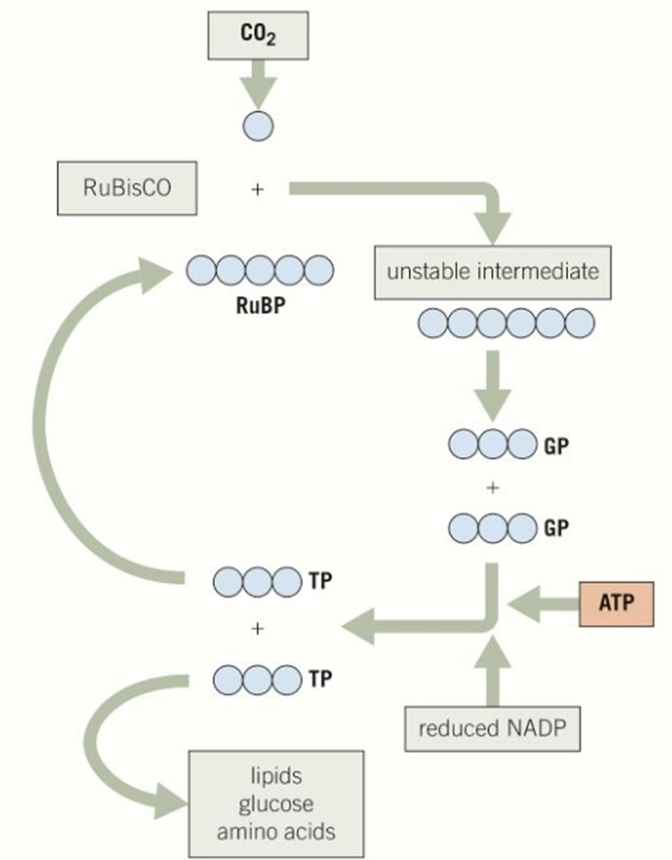

Slide 8
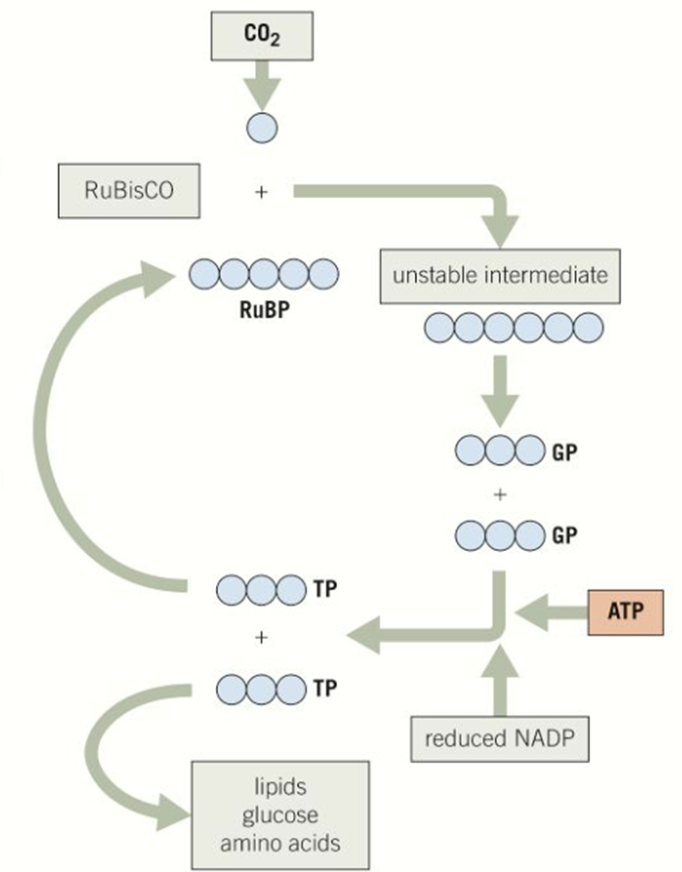
For one glucose molecule (C₆H₁₂O₆) how many carbon dioxide molecules need to enter the Calvin cycle?
6 to supply the 6 carbon atoms required in glucose
How many turns of the carbon cycle will this require?
6 full turns
How many Triose phosphate molecules will be produced in 6 full turns?
12 TP molecules
Two of the twelve TP molecules formed after 6 full turns of the Calvin cycle are used to produce glucose
What happens to the other ten?
They are recycled to regenerate RuBP
How many RuBP are produced from 10 TP molecules?
6 (five carbon RuBP)

Slide 9
Limiting factors in photosynthesis
Discuss limiting factors in photosynthesis with reference to light intensity, temperature and carbon dioxide concentration.
Describe how to investigate experimentally the factors that affect the rate of photosynthesis.
Describe the effect on the rate of photosynthesis, and on the levels of glycerate-3-phosphate, ribulose bisphosphate and triose phosphate, of changing light intensity, temperature and carbon dioxide concentration.

Slide 10
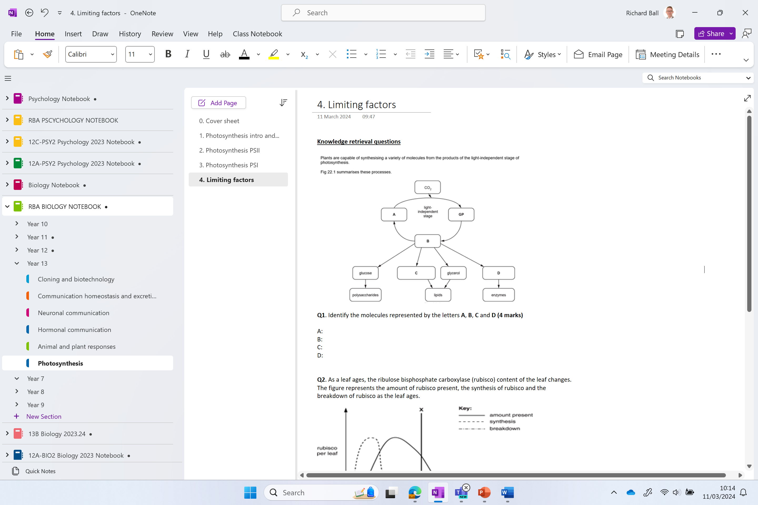

Slide 11
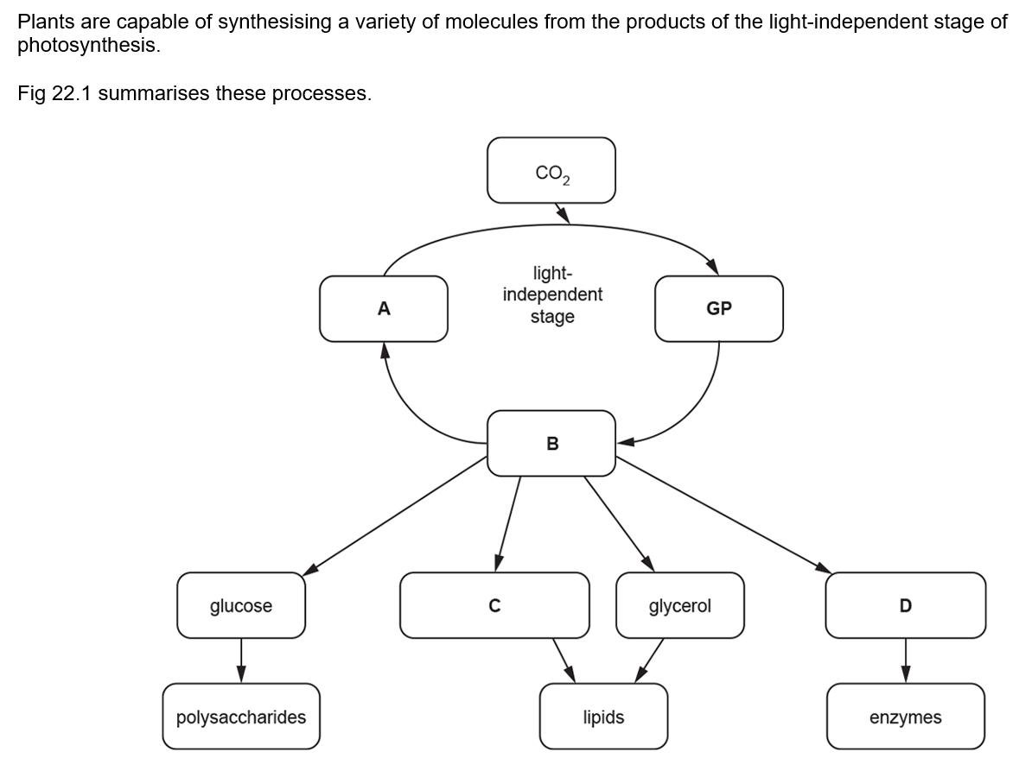
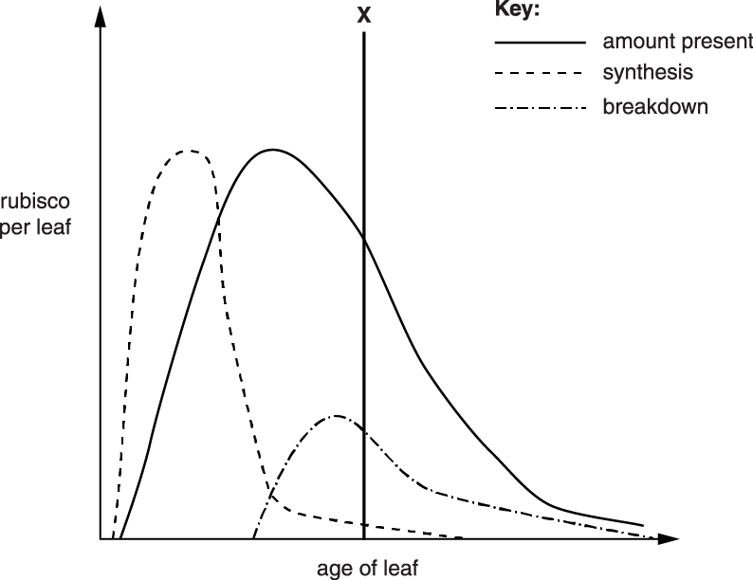
Knowledge retrieval questions
As a leaf ages, the ribulose bisphosphate carboxylase (rubisco) content of the leaf changes.
The figure represents the amount of rubisco present, the synthesis of rubisco and the breakdown of rubisco as the leaf ages.
Explain the effect that the levels of rubisco would have on the rate of photosynthesis as the age of the leaf increases beyond the line labelled X.
(5 marks)
1 rate of photosynthesis would decrease;
2 little rubisco being synthesised / more rubisco is being broken down than being synthesised;
3 less / no, enzyme / rubisco, available to fix CO₂
4 less / no, Calvin cycle / light independent stage, can take place;
5 rubisco becomes limiting (factor);
Q1. Identify the molecules represented by the letters A, B, C and D
A RuBP / ribulose bisphosphate ✓
B triose phosphate / TP ✓
C fatty acid(s) ✓
D amino acid(s) ✓

Slide 12
How does the structure of a chloroplast increase the rate of photosynthesis?
Where in a leaf are chloroplasts located?
Structure | Effect on Photosynthesis
Large surface area of thylakoids
Small space within the thylakoids
Fluid stroma (similar to the cytoplasm)
For the light absorption of photons. Membrane bound photosystems and high density of chlorophyll for light absorption
Accumulation of protons creating a concentration gradient
Provides optimum condition for enzymes (rubisco for carboxylation of RuBP)

Slide 13
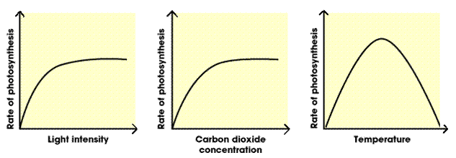
Using your knowledge of the Calvin cycle and light dependent reactions of photosynthesis, explain how an insufficient quantity of any one of three environmental factors limits the rate of photosynthesis a plant can achieve

Slide 14
Limiting factor | Explanation
Light intensity
CO2 concentration
Temperature
light provides the energy to excite electrons This energy is used to synthesise ATP and NADPH/H⁺, both are then used to reduce CO₂ to form glucose
CO₂ is the reactant from which sugars are formed,
lower CO₂ concentration means lower rate of reaction
The reactions of the Calvin cycle are catalysed by enzymes (RuBisCo), enzyme activity is dependent on temperature,the lower the temperature the lower the rate of reaction.
Too high and enzymes can denature

Slide 15
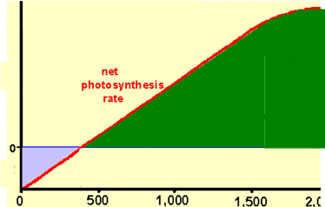
Y
CO₂ exchange
The graph shows the relationship between light intensity (x axis) and the net exchange of CO₂ with the environment (y axis)
Label the following points X,Y,Z on the graph, explaining your reasons for each choice.
Z
X
light intensity
 | point | explanation
X | max CO₂ release from plant
Y | max CO₂ uptake by plant
Z | compensation point (no net CO₂ exchange)
Light intensity = 0, so no photosynthesis, so no uptake of CO₂;
plant is respiring so producing CO₂;
= max CO₂ release since rate of respiration relatively constant
graph levels off so light intensity no longer limiting ,
max rate of photosynthesis achieved;
so uptake of CO₂ also at maximum;
rate of photosynthesis > rate of respiration
rate of photosynthesis = rate of respiration;
CO₂ taken up for photosynthesis is balanced by CO₂ released from respiration

Slide 16
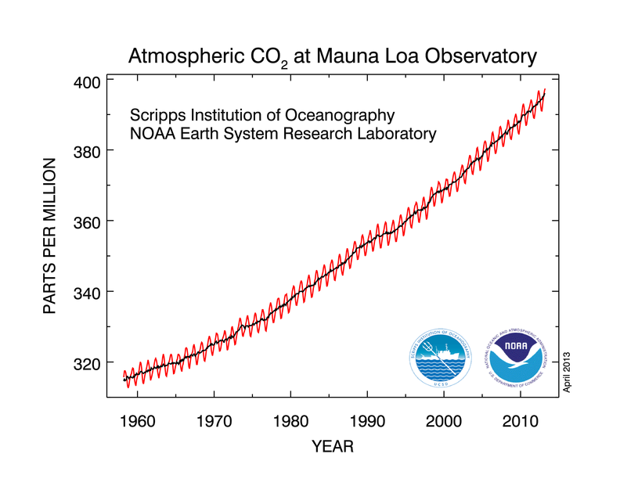
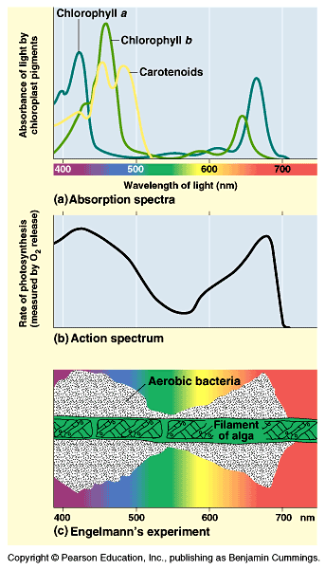
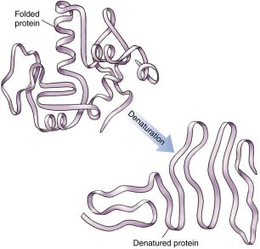
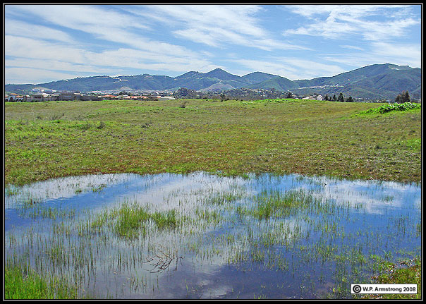
Limiting factors?
Optimum temperature of ~25 ºC:
Below 10 ºC enzymes in………….. (low k ………….. energy)
Above 45 ºC enzymes (e.g r ………….. and A…… synthase) will d …………..
At high temperature, stomata c ………….. to avoid loss of w………….., this means less CO₂ can enter the leaf.
Concentration of CO₂:
0.04% in atmosphere.
Higher % increases rate of photosynthesis but causes s………….. to close.
Water:
Not considered to be a l………….. f………….. even though it is a reactant.
If water potential is low enough to limit the rate the plant will already have c………….. s………….. and p………….. will have ceased.

Slide 17
Limiting factors?
Optimum temperature of ~25 ºC:
Below 10 ºC enzymes inactive (low kinetic energy)
Above 45 ºC enzymes (e.g rubisco and ATP synthase) will denature
At high temperature, stomata close to avoid loss of water, this means less CO₂ can enter the leaf.
Concentration of CO₂:
0.04% in atmosphere.
Higher % increases rate of photosynthesis but causes stomata to close.
Water:
Not considered to be a limiting factor even though it is a reactant.
If water potential is low enough to limit the rate the plant will already have closed stomata and photosynthesis will have ceased.

Slide 18
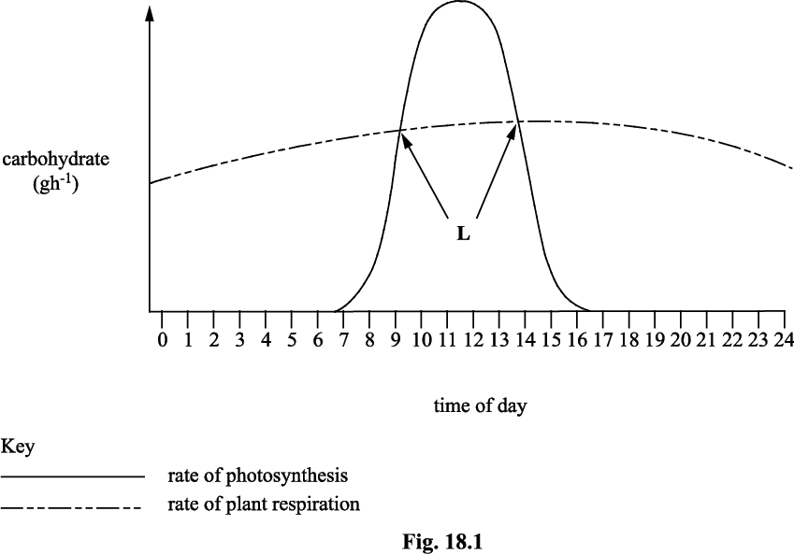
TRY THIS
Plants photosynthesise and respire. Fig. 18.1 shows the rate of production of carbohydrate in photosynthesis and the rate of use of carbohydrate by respiration.
Explain the shape of the curve for the rate of photosynthesis.
increased photosynthetic activity during daylight (1)
as light intensity increases there is increased activity of the light dependent reaction (1)
Explain the shape of the curve for the rate of plant respiration
daytime temperatures generally higher than night time (1)
rate of respiration increases with increased temperature as its enzymes are temperature-dependent (1)
What is happening at the points indicated by the letter L? [1]
compensation point(s) / carbohydrate produced by photosynthesis equal to carbohydrate used in respiration (1)

Slide 19
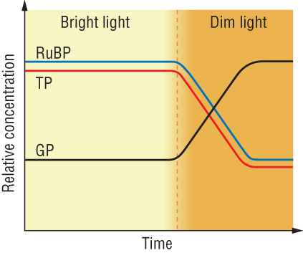
Explain the effect on relative concentrations of GP, TP and RuBP, when reducing light intensity
Less NADPH and ATP – no light energy for the LDR
Therefore, the conversion of GP into TP and RuBP is slow
So GP increases
[TP] and [RuBP] decreases.

Slide 20
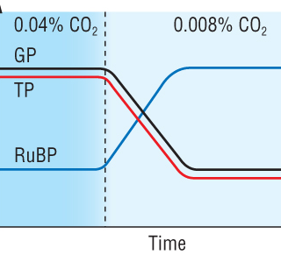
Explain the effect on relative concentrations of GP, TP, and RuBP when reducing carbon dioxide concentration
Low CO_{2(g)}.
Conversion of RuBP to GP is slow.
[RuBP] increases
[GP] and [TP] decreases

Slide 21
TRY THIS
Plants photosynthesise and respire. Fig. 18.1 shows the rate of production of carbohydrate in photosynthesis and the rate of use of carbohydrate by respiration.
Explain the shape of the curve for the rate of photosynthesis.
increased photosynthetic activity during daylight (1)
as light intensity increases there is increased activity of the light dependent reaction (1)
Explain the shape of the curve for the rate of plant respiration
daytime temperatures generally higher than night time (1)
rate of respiration increases with increased temperature as its enzymes are temperature-dependent (1)
What is happening at the points indicated by the letter L? [1]
compensation point(s) / carbohydrate produced by photosynthesis equal to carbohydrate used in respiration (1)

Slide 22
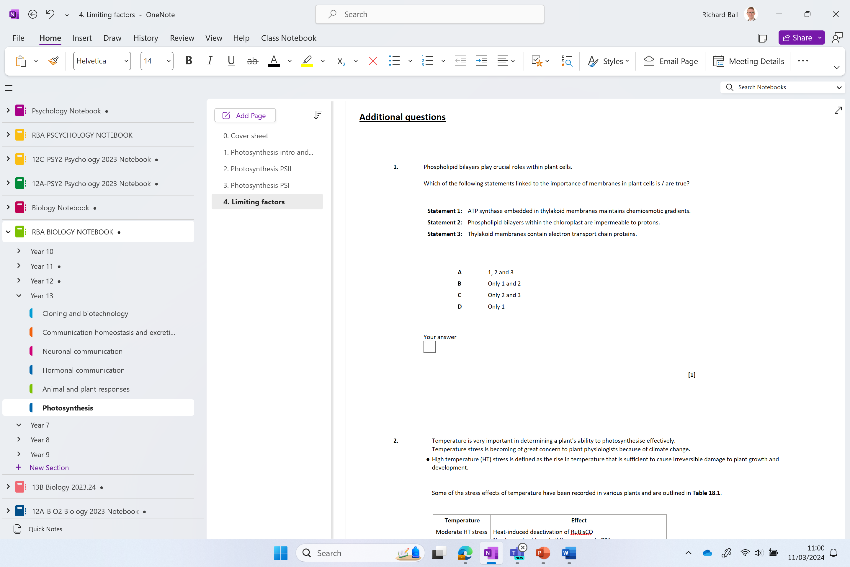
Additional questions

Slide 23


Slide 27
Describe how to investigate experimentally the factors that affect the rate of photosynthesis.
Describe the effect on the rate of photosynthesis, and on the levels of glycerate-3-phosphate, ribulose bisphosphate and triose phosphate, of changing light intensity, temperature and carbon dioxide concentration.
Design an experiment that will allow you to measure the rate of photosynthesis during different limiting factors. Remember to include:
Hypothesis
Scientific theory to support hypothesis
Controls
Safety/hazard information
Method
Table
Graph
You must include how this will affect the levels of GP RuBP and TP.

Slide 28
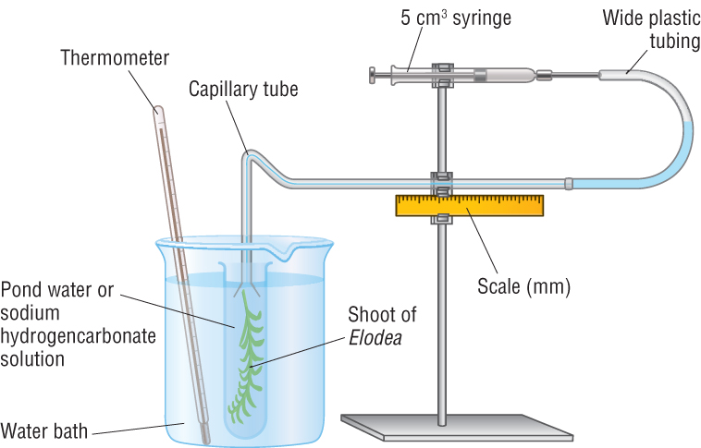
A photosynthometer – apparatus used to measure the rate of photosynthesis under various conditions

Slide 29
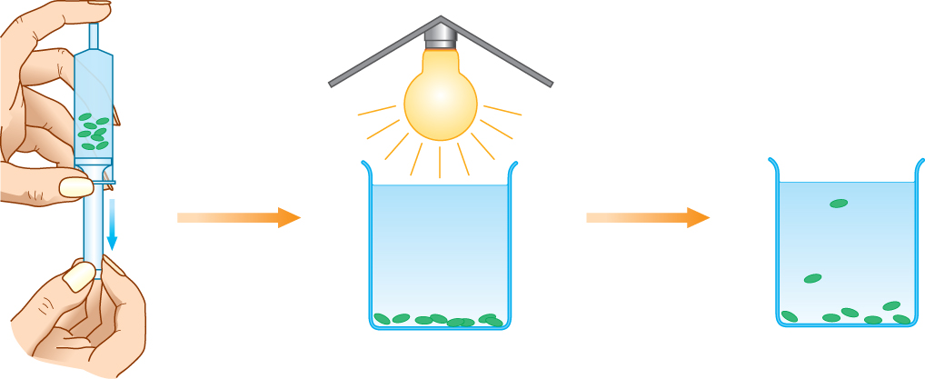
Using leaf discs to measure the rate of photosynthesis

Slide 30
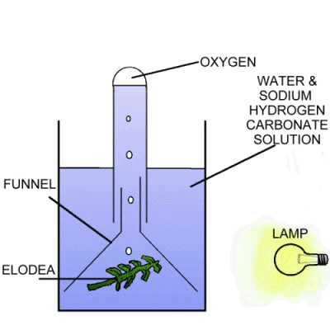

Slide 31
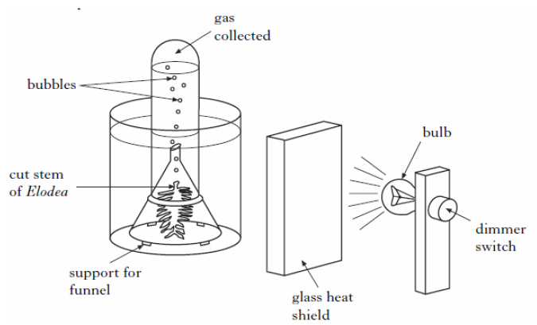

Slide 32
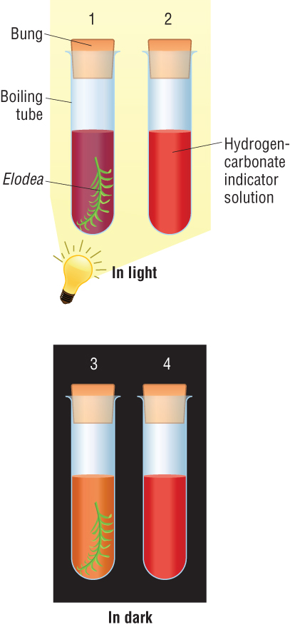
Using an indicator solution

