Slide 1

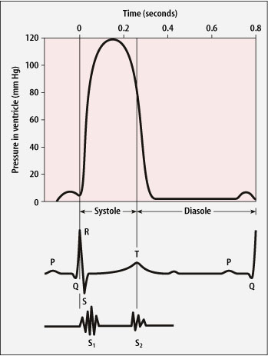
CAREFULL
GET STEPHOSCOPES
Heard through a stethoscope
Made by the blood pressure closing the heart valves
Described as ‘lub-dub’
First sound – when blood is forced against the atrio-ventricular valves as the ventricle contracts
Second sound – when a backflow of blood causes the semi-lunar valves to close in the aorta and pulmonary artery as the ventricles relax
Notes:
Sometime:
Third sound
The third heart sound is a low-pitched sound audible with the rapid rush of blood from the atrium into the ventricle as it starts relaxing. This may be a normal sound in some people but in people with heart conditions, S3 may indicate heart failure.
Fourth sound
The fourth is a low-intensity sound heard just before S1 in the cardiac cycle. The sudden slowing of blood flow by the ventricle as the atrium contracts causes this sound, which may be a sign of heart disease.

Slide 2
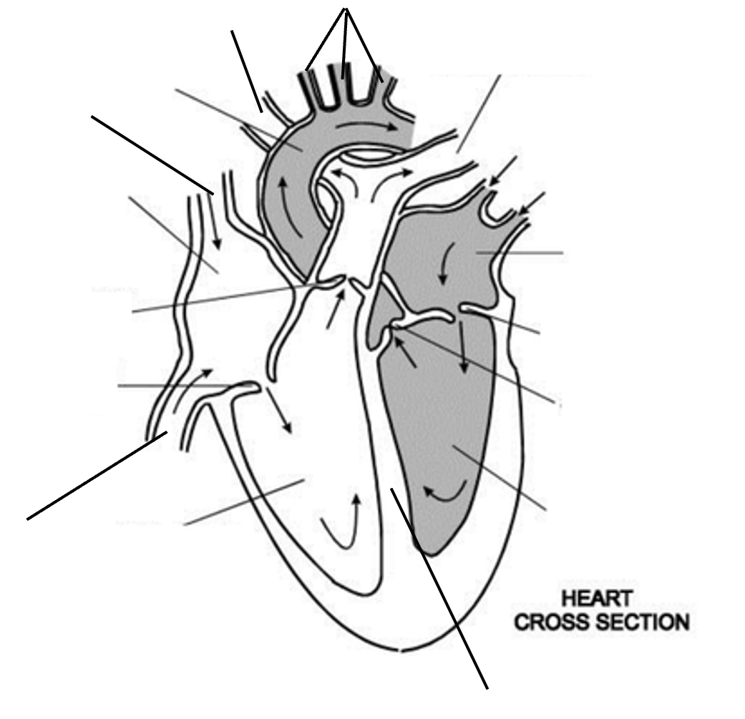
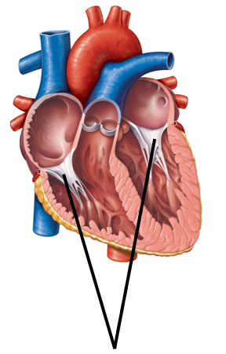
Knowledge retrieval question
Label the heart (17 marks)
Carotid arteries (blood to brain)
Right pulmonary artery
Left pulmonary artery
Aorta
Superior vena cava
Pulmonary
veins
Right atrium
Papillary muscles
Left atrium
Semilunar valves
Bicuspid or mitral valve
Left atrio-ventricular valve
Tricuspid valve
Right atrio-ventricular valve
Semilunar valves
Left ventricle
Inferior vena cava
right ventricle
Tendinous cords
Septum

Slide 3
Key points
Systole vs diastole what's the difference?
Contraction = systole
Relaxation = diastole

Slide 4


Slide 5

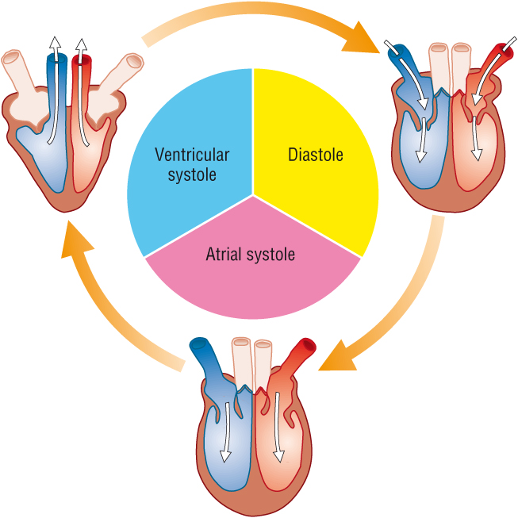
The Cardiac Cycle
1. All chambers are relaxed and blood flows into both atrium (diastole)
3. Closely followed by the contractions of the ventricles (ventricular systole)
2. The atria contract first (atria systole)
Notes:
Talk about pressure difference in atria compared to pulmonary vein / vena cava – allows blood to flow into atria at low pressure
When atria fill the AV open, and blood fills the ventricle
Atrial systole followed by ventricular systole

Slide 6
Task
Place the following sentences in order for the cardiac cycle

Slide 7
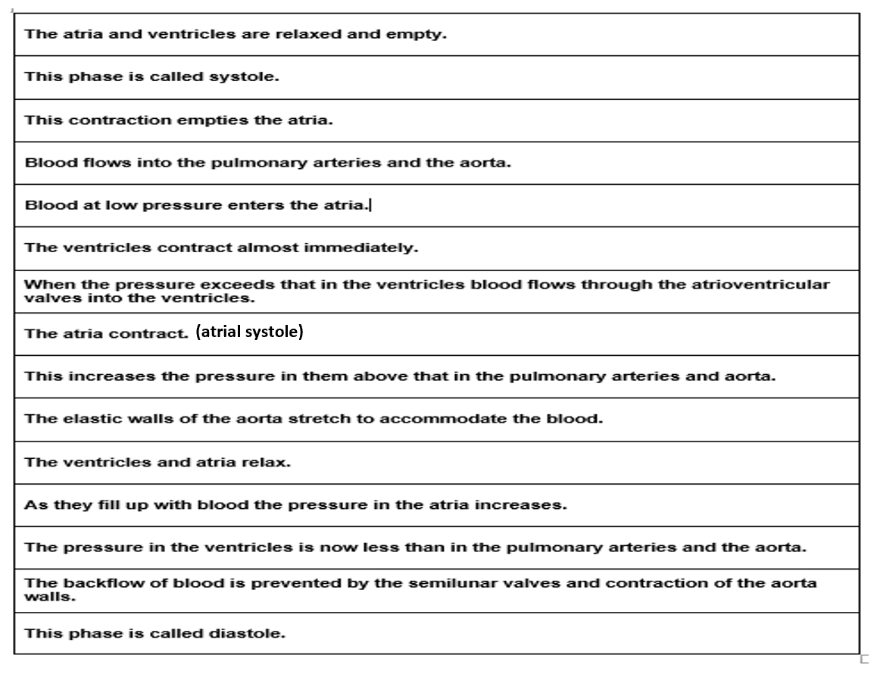
Arrange these sentences into the correct order on your page.
You can move the sentences around
The first two are in the correct order

Slide 8
The atria and ventricles are relaxed and empty.
This phase is called diastole.
Blood at low pressure enters the atria
As they fill up with blood the pressure in the atria increases.
When the pressure exceeds that in the ventricles blood flows through the atrioventricular valves into the ventricles.
The atria contract (atria systole)
This contraction empties the atria.
The ventricles contract almost immediately.
This phase is called systole.
This increases the pressure in them above that in the pulmonary arteries and aorta.
Blood flows into the pulmonary arteries and the aorta.
The elastic walls of the aorta stretch to accommodate the blood
The ventricles and atria relax.
The pressure in the ventricles is now less than in the pulmonary arteries and the aorta.
The backflow of blood is prevented by the semilunar valves and contraction of the aorta walls.

Slide 9
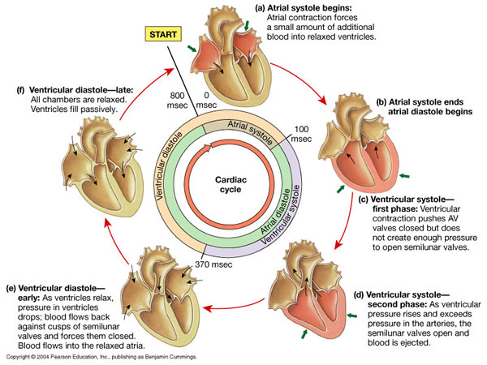
Contraction = systole
Relaxation = diastole
Ventricles relaxed; atria fill with blood, which increases the pressure. AV valves open, blood flows into ventricles. Atria contract, forcing remaining blood out.
Atria ready to be filled again with blood, due to higher pressure in vena cava and pulmonary vein. Cycle ready to start again.
Ventricles contract, atria relax. Pressure higher in ventricles than atria, forcing AV valves shut, preventing backflow
Ventricles and atria relax, increasing in volume, and lowering pressure in chambers. Higher pressure in pulmonary artery and aorta force SL valves shut, preventing backflow.
Ventricular pressure continues to increase, forcing open SL valves. Blood moves into pulmonary artery and aorta.

Slide 10
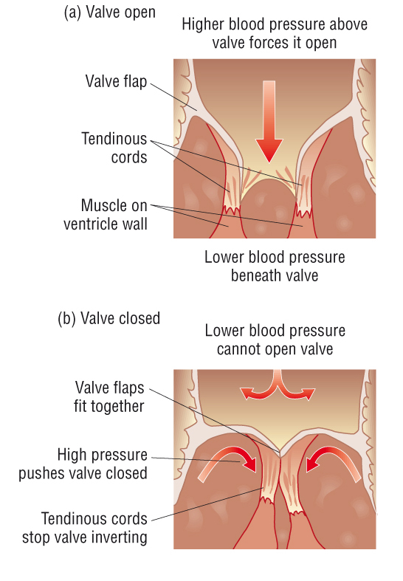
Valves
Cusp shaped, flexible, fibrous tissue.
Cusp shape has a concave and convex side.
String-like tendons attached to papillary muscles stop valves inverting.
(Pillar muscles)

Slide 11
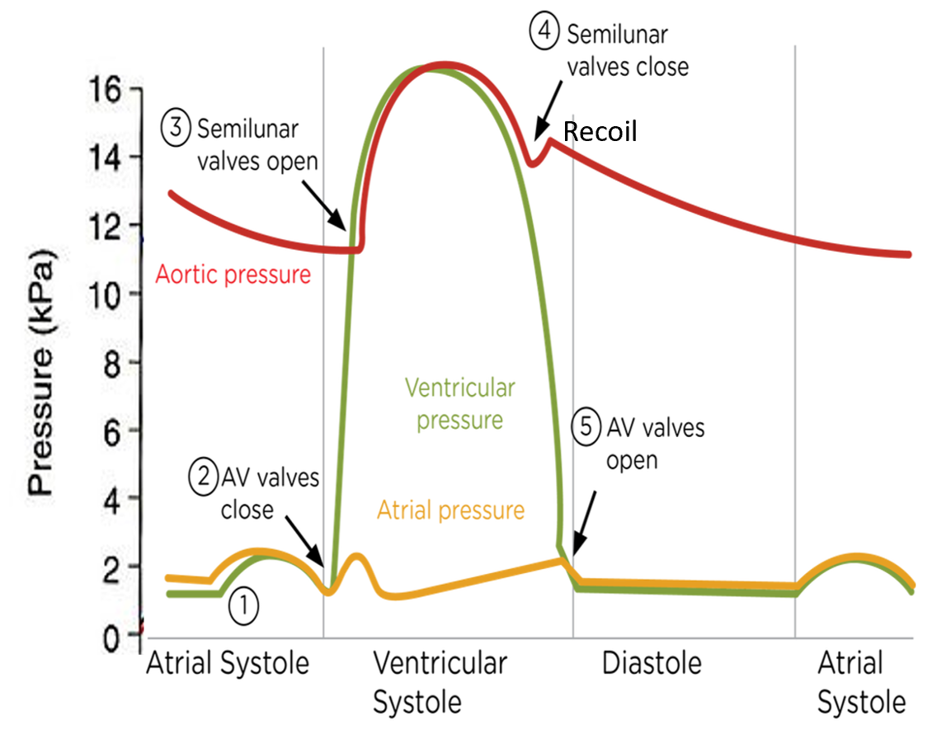
Make some bullet points with your partner to explain the following numbers. Give reference to the following pressures:
Atrial pressure
Aortic pressure
Ventricular pressure
Atrial pressure: Orange
Ventricular pressure: Green
Aortic pressure: Red

Slide 12
Atrial pressure
①
The atrium walls contract and the pressure rises and forces blood through the AV valve – this also increases the pressure in the ventricle slightly.
The pressure quickly falls in the atrium and the AV valve closes ② and the walls of the atrium relax.
The atria then fill with blood again, which gradually increases the pressure
The pressure however drops when the AV opens again and some blood moves into the ventricle
The yellow box is a slight rise in pressure in the atrium during ventricular systole
Atrial pressure: Orange
Ventricular pressure: Green
Aortic pressure: Red

Slide 13
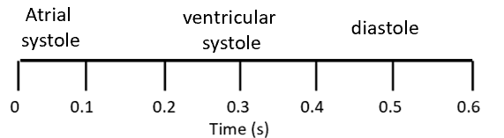
Ventricular pressure
Ventricular pressure rises slightly as blood is pumped from the atrium into the ventricle (1)
A large increase in pressure occurs when the ventricles contract (ventricular systole)
Atrial pressure: Orange
Ventricular pressure: Green
Aortic pressure: Red

Slide 14
Aortic pressure
Aortic pressure rises when ventricles contract as blood is forced into the aorta ③
It then gradually falls but never below 12kPa because of the elasticity of the its walls (elastin fibres), which create a recoil action.
This maintains blood supply to the tissue, the recoil produces a temporary rise in pressure at the start of the relaxation phase ④

Slide 15
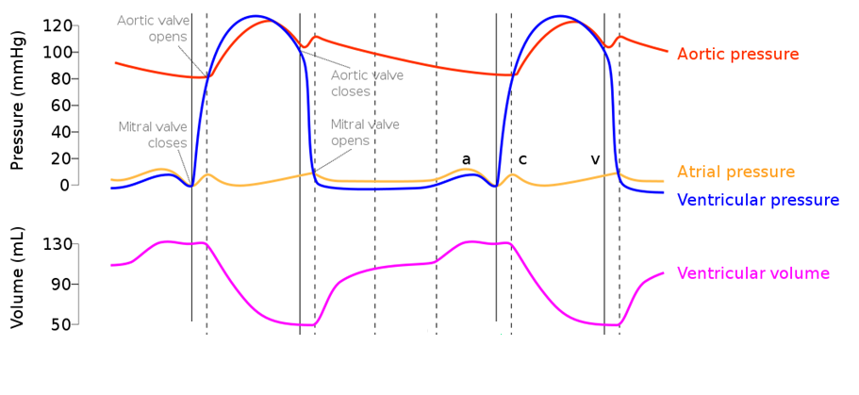
Volume of the ventricles
When pressure is high volume is low

Slide 16
Heart sound
Heard through a stethoscope
Made by the blood pressure closing the heart valves
Described as ‘lub-dub’
First sound – when blood is forced against the atrio-ventricular valves as the ventricle contracts
Second sound – when a backflow of blood causes the semi-lunar valves to close in the aorta and pulmonary artery as the ventricles relax
Notes:
Sometime:
Third sound
The third heart sound is a low-pitched sound audible with the rapid rush of blood from the atrium into the ventricle as it starts relaxing. This may be a normal sound in some people but in people with heart conditions, S3 may indicate heart failure.
Fourth sound
The fourth is a low-intensity sound heard just before S1 in the cardiac cycle. The sudden slowing of blood flow by the ventricle as the atrium contracts causes this sound, which may be a sign of heart disease.

Slide 17
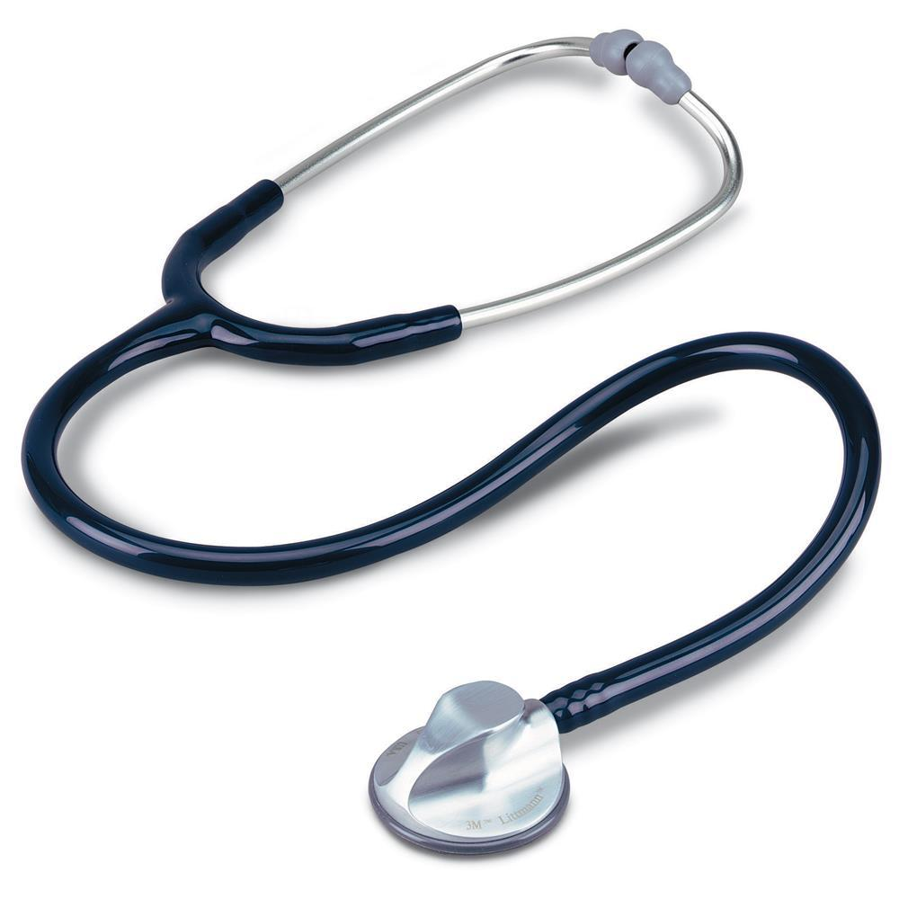
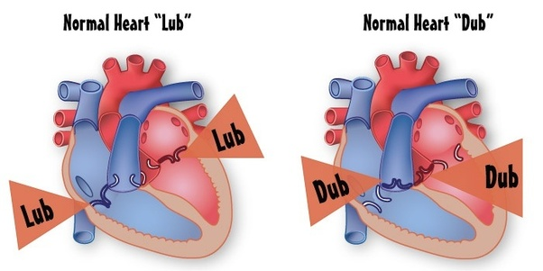
What is the cause for the sound the heart makes?

Slide 18
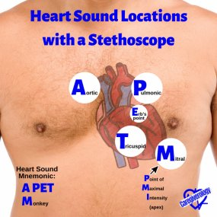

Slide 19
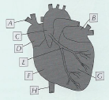
Questions:
What causes an increase in the pressure in the aorta?
2) What happens to the elastic fibres in the aorta/arteries as the pressure a) increases b) drops?
3) Explain why is the maximum pressure in the left ventricle is higher than that in the right ventricle? (16KPa v 4KPa)
4) Label the heart A-G.
Blood entering from the ventricles due to ventricular systole
The fibres stretch in response to the increase in pressure
then recoil as the pressure drops – both help maintain an even pressure
The walls of the left ventricle are thicker/ contain more muscle because the blood has to travel further (all around body compared to the lungs).
A: Superior vena cava
B: Left atrium
C: Aorta
D: Right atrium
E: Coronary artery
F: Right ventricle
H: Inferior vena cava

Slide 20
Heart sound
Heard through a stethoscope
Made by the blood pressure closing the heart valves
Described as ‘lub-dub’
First sound – when blood is forced against the atrio-ventricular valves as the ventricle contracts
Second sound – when a backflow of blood causes the semi-lunar valves to close in the aorta and pulmonary artery as the ventricles relax
Notes:
Sometime:
Third sound
The third heart sound is a low-pitched sound audible with the rapid rush of blood from the atrium into the ventricle as it starts relaxing. This may be a normal sound in some people but in people with heart conditions, S3 may indicate heart failure.
Fourth sound
The fourth is a low-intensity sound heard just before S1 in the cardiac cycle. The sudden slowing of blood flow by the ventricle as the atrium contracts causes this sound, which may be a sign of heart disease.

Slide 21
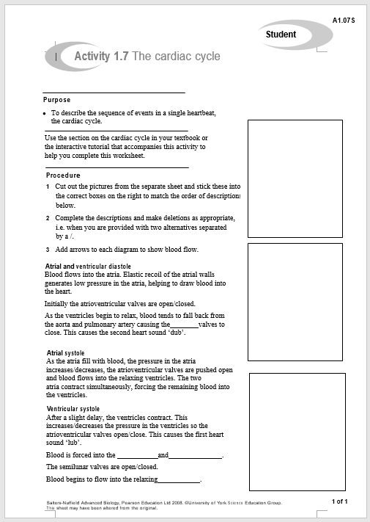

Slide 22
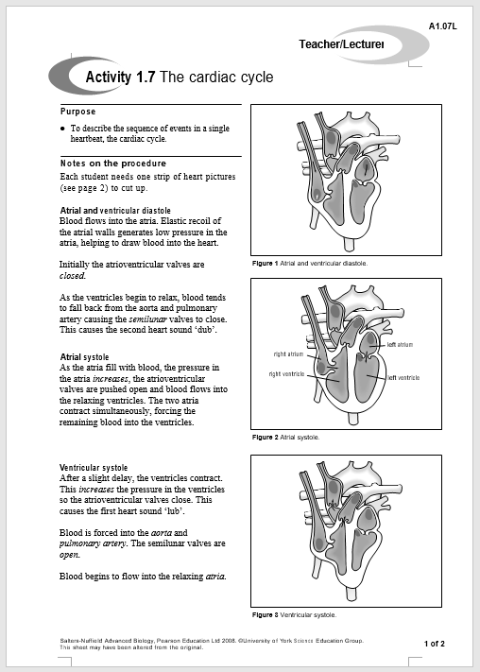

Slide 24
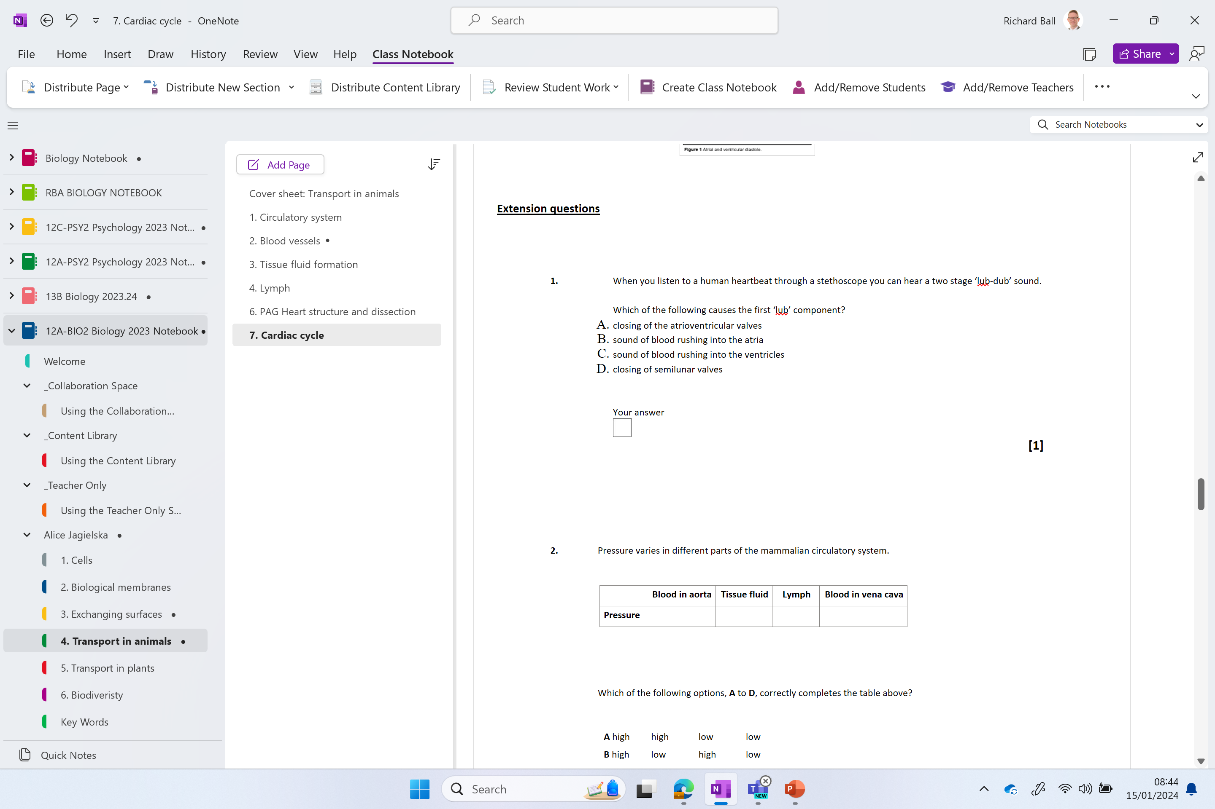
Extension questions

Slide 25
Long answer practice
Three 6 mark questions on:
•Tissue fluid formation
•Blood vessel structure
•Types of circulatory systems
BULLET POINT ALL ANSWERS

Slide 26
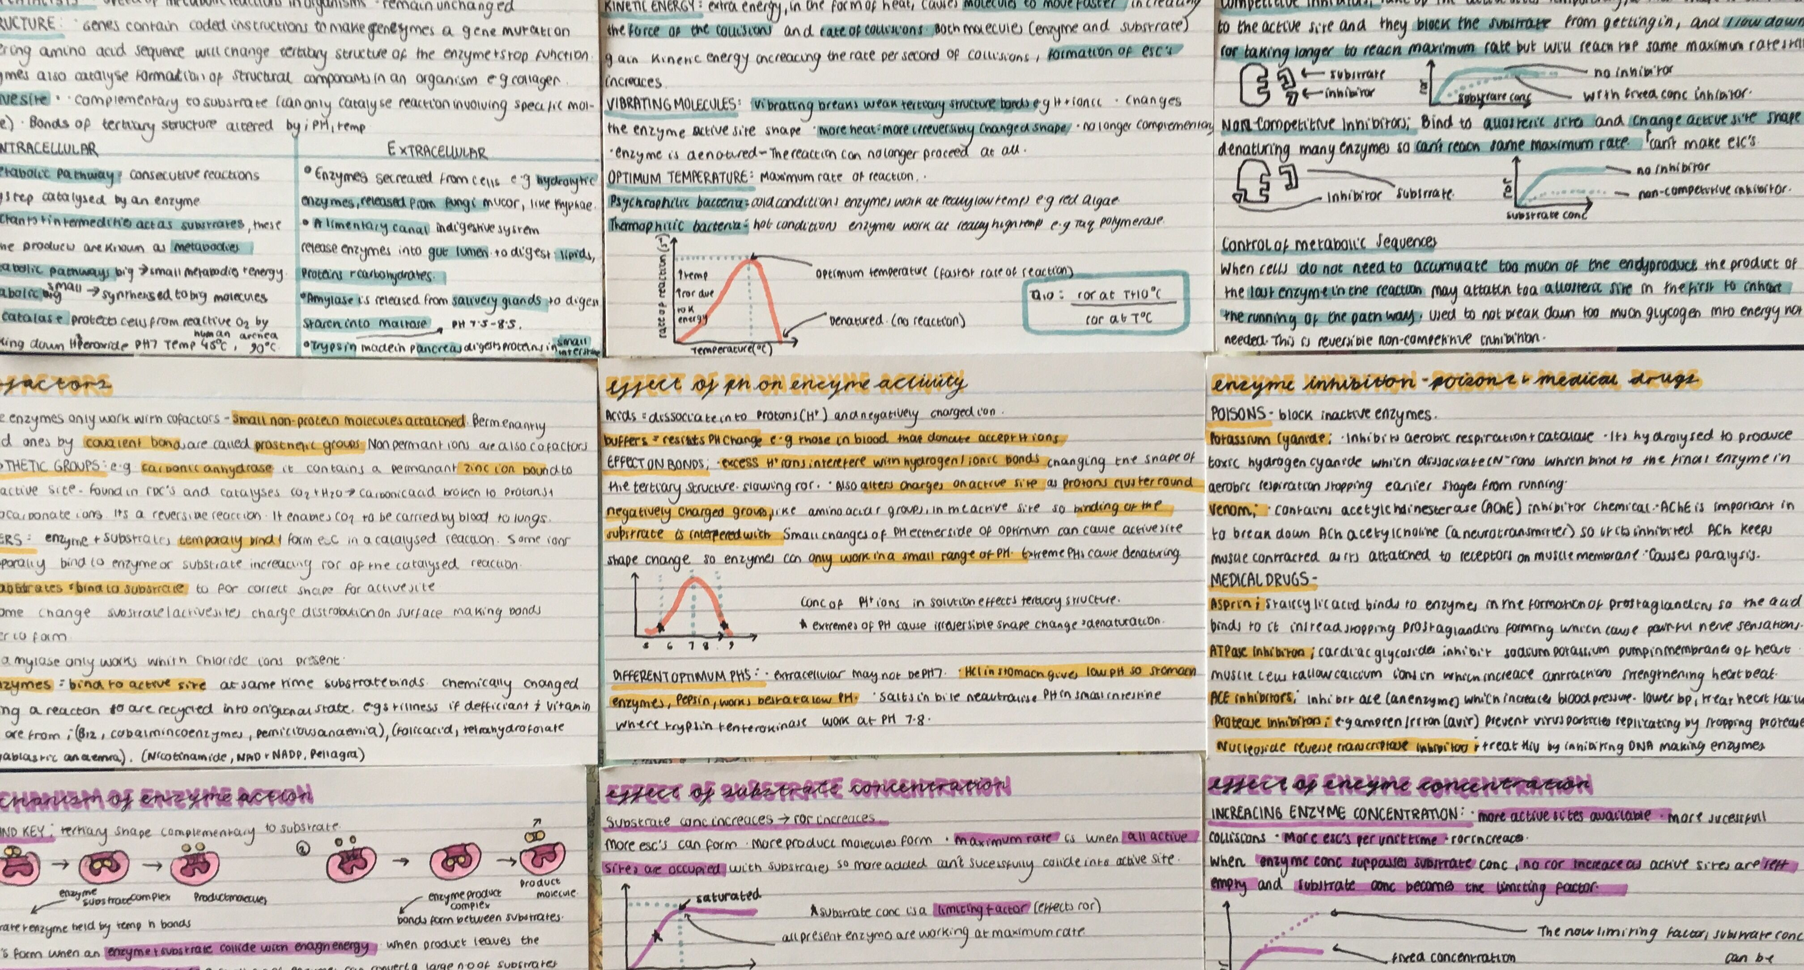
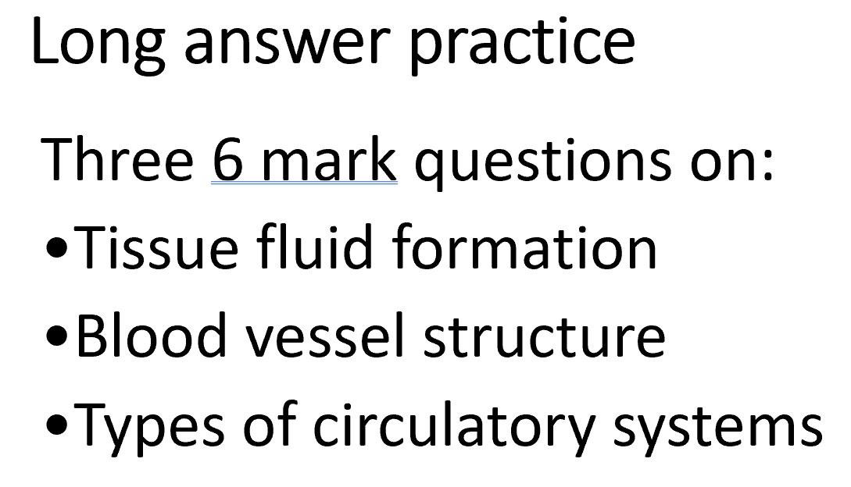
10 minutes and one piece of card to add as many notes as you like!!

Slide 27
Test response to marking
Q1.
Use the term “water” and not “fluid” when talking about the reabsorption into the capillaries via osmosis
Few mentioned the large proteins (albumin) in the blood that helps to maintain the low water potential
Q2.
Elastin – maintains an even pressure by stretching and recoiling
Smooth muscle – vasoconstrict to (change) the blood flow or pressure. Try to avoid using the word control
Don’t forget to mention the endothelium lay has a smooth surface to reduce friction
Q3.
The amphibian heart is not able to maintain a pressure difference between the pulmonary and systemic system with just the one ventricle.

Slide 28
KH below
The heart, blood vessels & cardiac cycle – in favourites
Exam style question in folder

