Slide 1
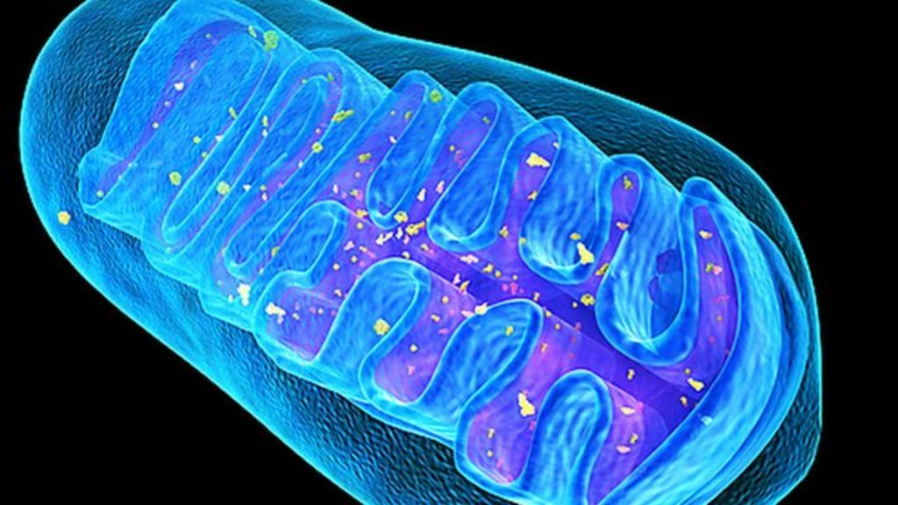
Krebs Cycle
By the end of the lesson you should be able to:
Explain the formation of citrate from acetate and oxaloacetate and the reconversion of citrate to oxaloacetate AND the importance of decarboxylation, dehydrogenation, the reduction of NAD and FAD, and substrate level phosphorylation.

Slide 2
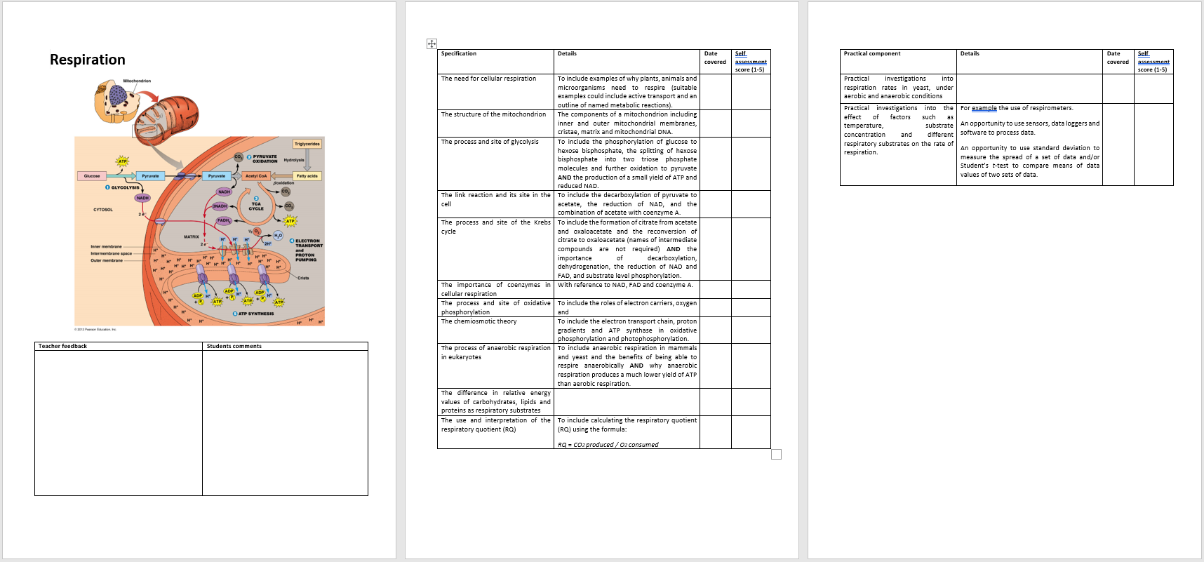

Slide 3
True or false?
True or false?
1 | The first stage of glycolysis involves the phosphorylation of glucose, which requires the input of energy from the cell | T
2 | For each molecule of glucose broken down in glycolysis, one NADH molecule is produced | F
3 | The dehydrogenase enzyme in glycolysis, oxidises the substrate and reduces the coenzyme NAD⁺ | T
4 | In substrate level phosphorylation, ADP combines with a phosphate from the substrate being respired | T
7 | Substrate level phosphorylation only occurs in the presence of oxygen | F
8 | ATP will only be made from NADH in the presence of oxygen | T

Slide 4
hexose bisphosphate (6C)
glucose (6C)
2 x ATP
pyruvate (3C)
2 x ATP
_ x NAD⁺
glucose (6C)
2 x ADP
2 x ADP
2 x NADH/H⁺
hexose bisphosphate (6C)
triose phosphate (3C)
_ x ATP
_ x ADP
2 x
triose phosphate (3C)
2 x
2 x
2 x NAD⁺
2 x NADH/H⁺
Arrange the boxes to show the process of glycolysis.
Insert the correct number of molecules where omitted
4 x ADP
4 x ATP
2 x
pyruvate (3C)

Slide 5
Overview
LISTEN
Aerobic Respiration: The Krebs Cycle
A series of oxidation-reduction reactions that take place in the mitochondrial matrix. The cycle occurs twice for every glucose.
CoA reused in next link reaction
1
CoA
Acetyl CoA from the link reaction combines with oxaloacetate to form citrate, catalysed by citrate synthase
Coenzyme A goes back to the link reaction to be used again.
Acetyl CoA (2C)
Oxaloacetate is regenerated for use in the next Krebs Cycle
6 – carbon compound (citrate)
Reduced
NAD
4 – carbon compound (oxaloacetate)
CO₂
2
NAD
The 6C citrate molecule is converted to a 5C molecule.
Decarboxylation occurs where carbon dioxide is removed
Dehydrogenation occurs, the removal of hydrogen
The hydrogen is used to produce reduced NAD from NAD
Reduced FAD
NAD
FAD
ATP
reduced
NAD
ADP + Pi
5 – carbon compound
Reduced
NAD
NAD
CO₂
Carbon dioxide is released as a waste product
3
The 5C molecule is converted to a 4C molecule (intermediate compounds are formed).
Decarboxylation and dehydrogenation occur, producing one molecule of reduced FAD and two of reduced NAD.
ATP is produced from a direct transfer of a phosphate group from an intermediate compound to ADP (substrate-level phosphorylation). Citrate has now been converted into oxaloacetate.
Substrate Level phosphorylation – when a phosphate group is directly transferred from one molecule to another.
3 Reduced NAD, 1 reduced FAD go to oxidative phosphorylationc
Notes:
Used as a consolidation teaching slide and Checkpoint 4 – I leave this information next to mini whiteboard and pen, they practise writing it from memory. These are printed out for the students as active revision cards, printed 2 to a page and back to back with do and review.

Slide 6
CoA Reused in next …….. …………
Aerobic Respiration – Stage 3 Krebs Cycle
A series of oxidation-reduction reactions that take place
In matrix of mitochondria. The cycle occurs twice for
every glucose.
Do!
CoA
1
…………… (2C)
……………. from the link reaction combines with …………….. to form citrate, catalysed by citrate synthase
Coenzyme A goes back to the …………… to be used again.
6 – carbon compound (citrate)
Reduced
NAD
4 – carbon compound (………………)
…
NAD
……………….
NAD
2
……
The 6C citrate molecule is converted to a 5C molecule.
…………….. occurs where carbon dioxide is removed
………….. occurs, the removal of hydrogen
The hydrogen is used to produce ……….. from NAD
ATP
reduced
NAD
ADP + Pi
5 – carbon compound
Reduced
NAD
……….. ……..is released as a waste product
NAD
…
………… is regenerated for use in the next Krebs Cycle
3
The 5C molecule is converted to a 4C molecule (intermediate compounds are formed).
Decarboxylation and dehydrogenation occur, producing one molecule of reduced …. and two of reduced ……..
…….. is produced from a direct transfer of a phosphate group from an intermediate compound to ADP (substrate-level phosphorylation). Citrate has now been converted into oxaloacetate.
Substrate Level phosphorylation – when a phosphate group is directly transferred from one molecule to another.
3 Reduced NAD, 1 reduced FAD go to ………… phosphorylation

Slide 7
White board fun
Where does respiration take place in prokaryotes?
Why?
Draw a circle in the middle of the mini-white board. (8cm across)
Rub out a finger width at 10 o’clock, 2 o’clock and 6 o’clock
Write in 6C, 5C and 4C in clockwise order.
Draw between 6 and 5.
  a decarboxylation
  a dehydrogenation causing reduction of NAD⁺
Between 5 and 4 draw
  decarboxylation,
  two dehydrogenations causing reduction of NAD⁺
  A substrate level phosphorylation
  a dehydrogenation causing reduction of FAD

Slide 8
CO NAD CO NAD ATP FAD NAD

Slide 9
How many ATP?
(per glucose)
This is hugely debated. You will see a range from 28-38 per molecule of glucose. Not all protons reach their destination (the membrane can be leaky). Some ATP is used directly for glycolysis. Some protons are used in other metabolic reactions.
Stage of respiration | Molecules produced | Net number of ATP molecule
Glycolysis | 2 ATP | 2
Glycolysis | 2 NADH | 2 x 2.5 = 5
Link reaction (x2) | 2 NADH | 2 x 2.5 = 5
Krebs cycle (x2) | 2 ATP | 2
Krebs cycle (x2) | 6 NADH | 6 x 2.5 = 15
Krebs cycle (x2) | 2 FADH₂ | 2 x 1.5 = 3
 |  | Total ATP = 32
1 NADH produces 2.5 ATP.

Slide 10
The Krebs Cycle and Oxidative Phosphorylation
Location of Krebs Cycle:
Location of Oxidative Phosphorylation:
State the products of the Krebs Cycle and where they go (x6);
Describe the main steps in the Krebs Cycle
Describe the Main Steps in Oxidative Phosphorylation
Define chemiosmosis

Slide 11
The Krebs Cycle and Oxidative Phosphorylation
Location of Krebs Cycle:
Matrix of mitochondria
Location of Oxidative Phosphorylation: Inner mitochondrial membrane/cristae
State the products of the Krebs Cycle and where they go (x6); Coenzyme A – reused in next link reaction; Oxaloacetate – regenerated for next Krebs cycle; carbon dioxide (x2) - released as waste; ATP – used for energy; reduced NAD (x3) to oxidative phosphorylation; reduced FAD to oxidative phosphorylation
Describe the main steps in the Krebs Cycle
1) Acetyl Co-A (from link) combines with oxaloacetate to form citrate
2) Decarboxylation occurs (carbon dioxide is removed), a 5C molecule is produced, then dehydrogenation occurs (hydrogen is removed), reduced NAD is produced
3) Decarboxylation occurs, a 4C compound – oxaloacetate is formed, dehydrogenation occur producing one molecule of reduced FAD and two of reduced NAD, an ATP is produced by direct transfer of a phosphate group.
Describe the Main Steps in Oxidative Phosphorylation
1) Hydrogen atoms are released from reduced NAD and reduced FAD. The H atoms split into protons and electrons.
2) The electrons pass down the electron transport chain, energy is transferred at each carrier (to the carrier).
3) Electron carriers use the energy to pump protons from the mitochondrial matrix into the intermembrane space, forming an electrochemical gradient (gradient of ions).
4) Protons move down the electrochemical gradient back into the matrix via ATP synthase, the movement drives the synthesis of ATP from ADP and Pi.
5) Finally the protons, electrons and oxygen combine.
Define chemiosmosis
The process of ATP production driven by the movement of hydrogen ions across a membrane

Slide 12
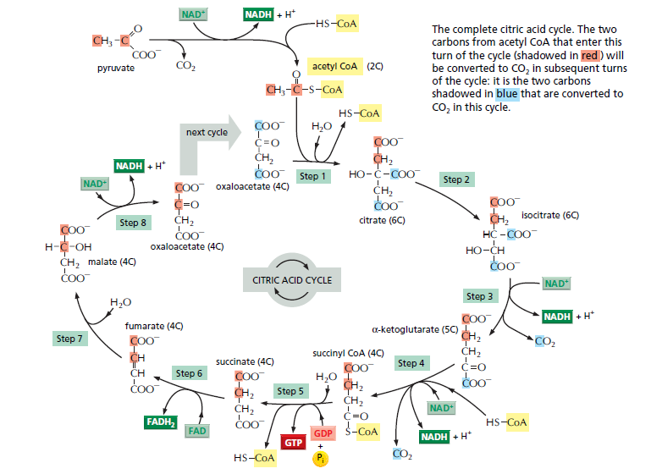
Krebs cycle

Slide 13
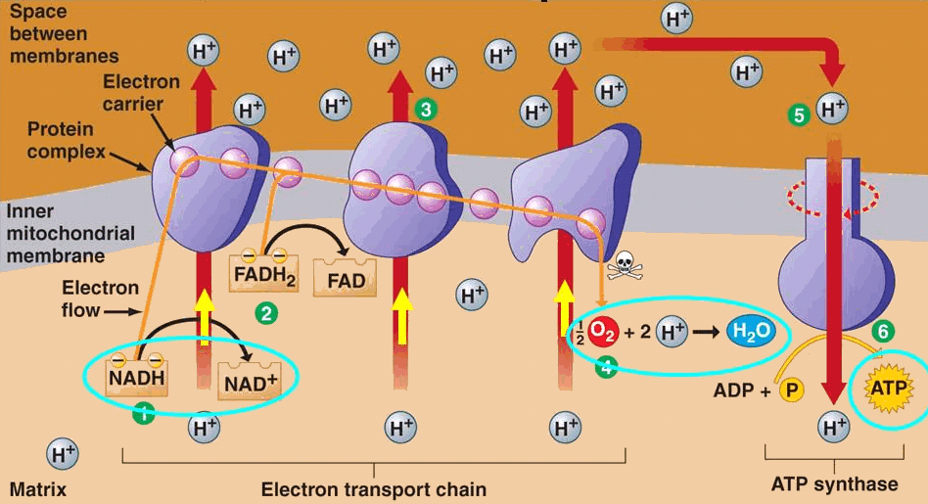
Questions:
Use the information in the diagrams to explain the following:
Why can the link reaction and Krebs cycle only take place if oxygen is present?
  Oxygen is the final electron acceptor in the ETC. Without it the ETC stops meaning coenzymes NADH/H⁺ and FADH₂ cannot become re-oxidised so reactions stop as the cell runs out of NAD⁺/ FAD
Why are ~2.5 ATP molecules produced when NAD is used as a coenzyme but only ~1.5 are produced when FAD is used?
  Electrons from FADH₂ are accepted further down the electron transport chain compared to NADH/H⁺ , meaning fewer H⁺ are pumped across the membrane per electron, so fewer ATP molecules can be made.

