Slide 1

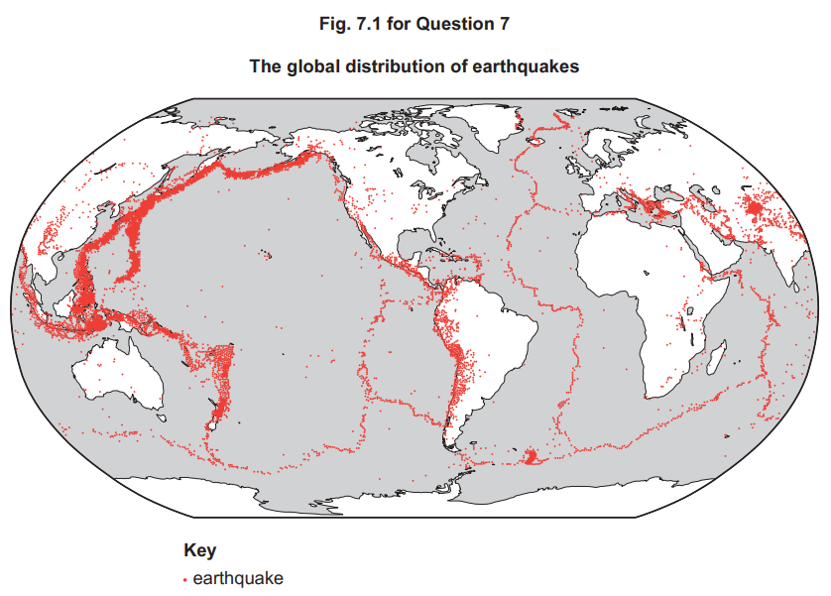
Earthquakes and Resultant Hazards – Case Studies
LO: To investigate the impacts of earthquakes on people and place.
Describe the causes of earthquakes with the use of specific examples.
Explain the impacts caused by these specific earthquakes.
Compare case study examples and assess whether level of development has an impact on the level of damage caused.
7 Fig. 7.1 shows the global distribution of earthquakes.
Describe the global distribution of earthquakes shown in Fig. 7.1. [4]
Explain why the depth of focus of earthquakes varies from place to place. [6]

Slide 2
7(a) Fig. 7.1 shows the global distribution of earthquakes.
Describe the global distribution of earthquakes shown in Fig. 7.1.
Candidates should interpret Fig. 7.1 to identify the distribution of earthquakes across the globe. Candidates may identify that:
• Earthquakes are mainly linear in their distribution/belts/chains/long and narrow
• Widely distributed across the globe
• There are clusters/concentrations
• Many are along the edges of continental landmasses, e.g. Pacific Ring of Fire
• Others are mid-oceanic, e.g. mid-Atlantic
• A few are in continental interiors, e.g. central/east Africa
• There are a few in isolated locations, e.g. Hawaii
1 mark for each relevant distribution point. Map evidence required for max. 4
7(b) Explain why the depth of focus of earthquakes varies from place to place.
Reasons include:
• Depends on type of plate boundary
• Destructive (convergent) tend to have a range of focus depth in the subduction zone
• Constructive (divergent) and conservative (transform) tend to produce shallow focus earthquakes as no subduction occurs
• Collision (convergent) tend to produce relatively shallow focus earthquakes as no subduction, but there is uplift/folding above
Award marks based on the quality of explanation and breadth of the response using the marking levels below.
Level 3 (5–6) Response applies knowledge and understanding of a range of plate boundaries to explain the variations in depth of focus. Response is well founded in detailed knowledge and strong conceptual understanding of the topic. Any examples used are appropriate and integrated effectively into the response.
Level 2 (3–4) Response explains at least two types of plate boundary to explain variations in depth of focus. Response develops on a largely secure base of knowledge and understanding. Examples may lack detail or development.
Level 1 (1–2) Response consists of one or more descriptive statements about earthquakes with little or no explanation of the reasons for their varying depth of focus. Knowledge is basic and understanding may be inaccurate. Examples are in name only or lacking entirely.
Level 0 (0) No creditable response. 6

Slide 3

Syllabus Guide – What we must know!
9.1 Hazards resulting from tectonic processes
The global distribution of earthquakes and volcanoes related to plate tectonics.
Earthquakes and resultant hazards: shaking, landslides, soil liquefaction, and tsunami.
Volcanoes and resultant hazards: types of eruption and their products (nuées ardentes, lava flows, volcanic mudflows/lahars, volcanic landslides, pyroclastic flows, and ash fallout).
Primary and secondary impacts on lives and property.
Prediction, hazard mapping, preparedness and monitoring of earthquake and volcanic hazards and perception of risk.
Please refer to the course syllabus regularly – It guides you on exactly what is required from you in this course!

Slide 4
Exam Questions to think about….
Compare the two case studies, Assess the claim that impacts of earthquakes are worse in LIC countries than HIC countries. [20]
‘Earthquakes are more difficult to predict, but easier to prepare for, than volcanic eruptions.’ How far do you agree with this view? [20]
Describe the hazards resulting from earthquakes. Assess the extent to which hazards resulting from earthquakes can be managed. [20]
With the aid of a case study of a hazardous environment, assess how prediction and preparedness can reduce the impacts of the hazard(s) on lives and property. [20]
‘Earthquakes are difficult to predict but their impacts can be reduced.’ How far do you agree with this view? [20]
‘The hazardous impact of earthquakes depends on the levels of preparedness and monitoring.’ How far do you agree with this view? [20]
Describe and explain the range of hazards caused by earthquakes. Assess the extent to which these hazards can be predicted. [20]
For any one hazardous environment, explain the management strategies that can be used to reduce the effects of the hazards. Assess the effectiveness of these management strategies. [20]
Explain the techniques used to monitor earthquakes and assess the extent to which prediction can reduce the hazardous impact of earthquakes. [20]
Earthquake Case Studies
Geography is the study of our planet, so everything we learn must be applied to real-life examples & case studies.
At A-Levels, there is no set number of case studies that you must learn like there is at GCSE. Instead, the expectation is that you bring your case study knowledge/real-life examples throughout when answering questions.
In relation to earthquakes, we need to know the following:
Background information – Where the case study is located/ what level of development the country is/When the earthquake happened etc.
Causes of the earthquake – Tectonic setting, what type of plate boundary, what magnitude, depth of focus etc.
Hazards – Primary & Secondary. Can you describe them?
Impacts of the earthquake – primary & secondary, SEEP impacts, short/long term
Management of the earthquake - What was in place prior to the earthquake to reduce the impacts (prediction, monitoring, preparation, protection, hazard mapping)? How did they respond to the earthquake and manage the event? Evaluate the effectiveness of these management strategies in reducing the impacts of the earthquake.
The syllabus recommends writing up 2 case studies – one in a HIC and one in an LIC. Remember, all case studies must be within the last 25 years!
What case studies to use? Completely up to you!
Where to find them?
Textbook
Revision folder
There are endless case studies online you can research!
IMPORTANT: Through the case studies, you should develop their awareness of secondary events, e.g. mass movements landslides and mudflows – link with 9.2. Soil liquefaction is a common secondary hazard and these mass movements can compound the effects of the tectonic hazard.

Slide 5
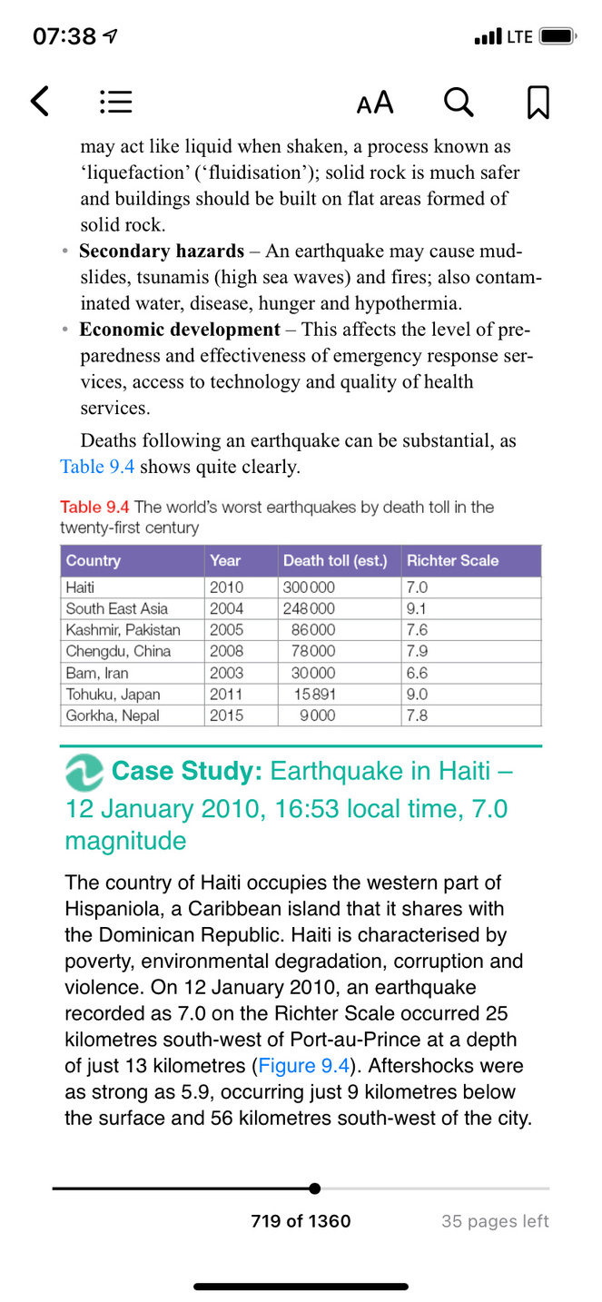
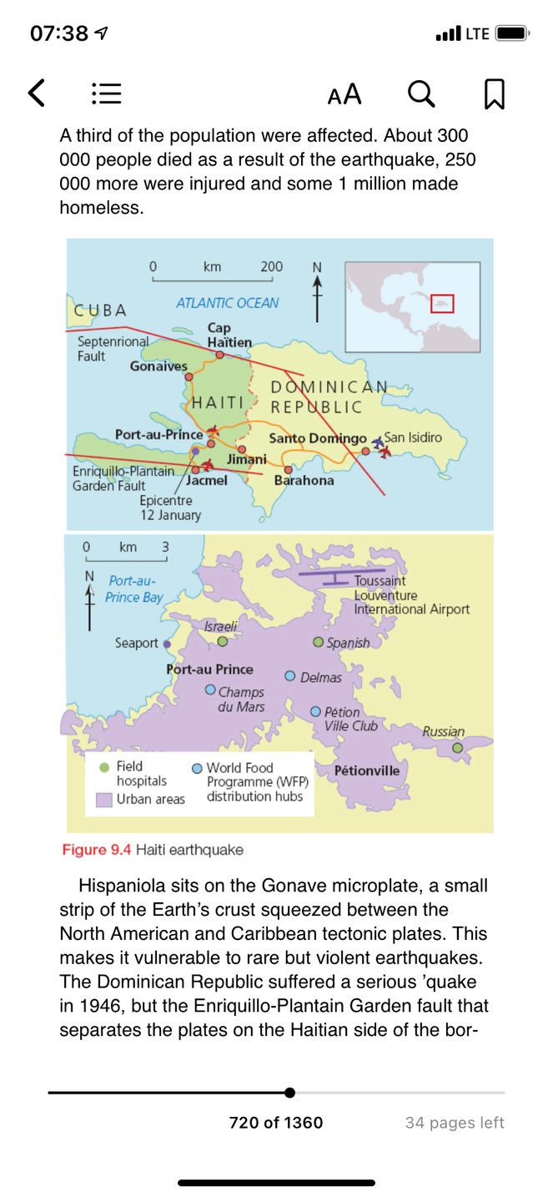
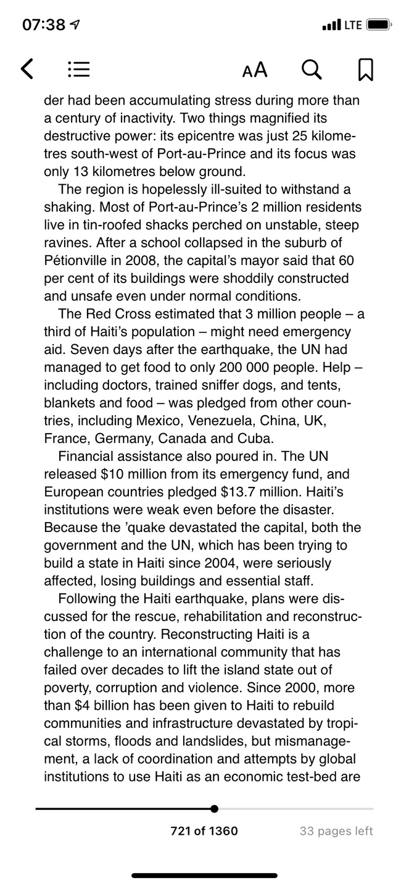
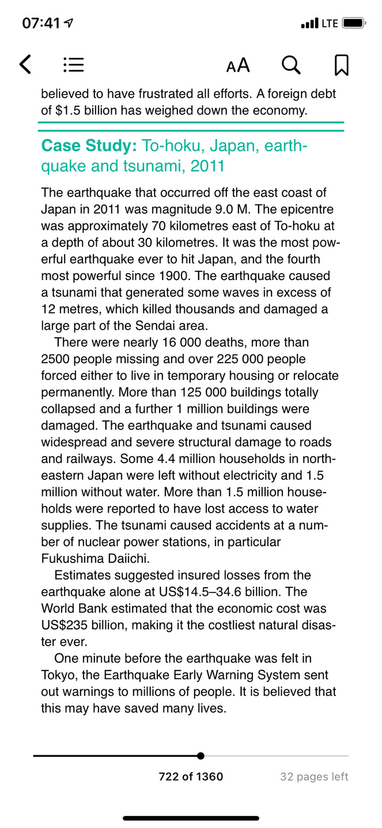
Case Study 1: Haiti – 12ᵗʰ Jan 2010 16:53 local time, 7.0 magnitude
Cool Geography
Physics & Maths Tutor
Handy Geography

Slide 6
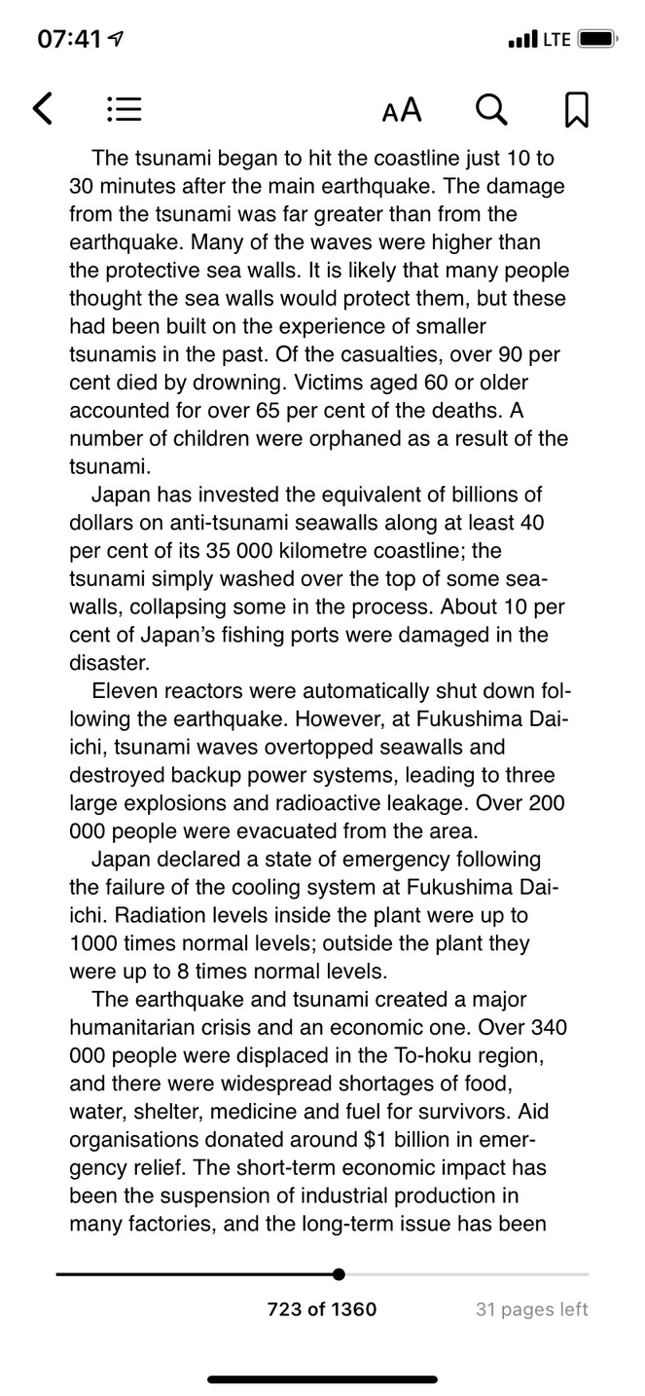
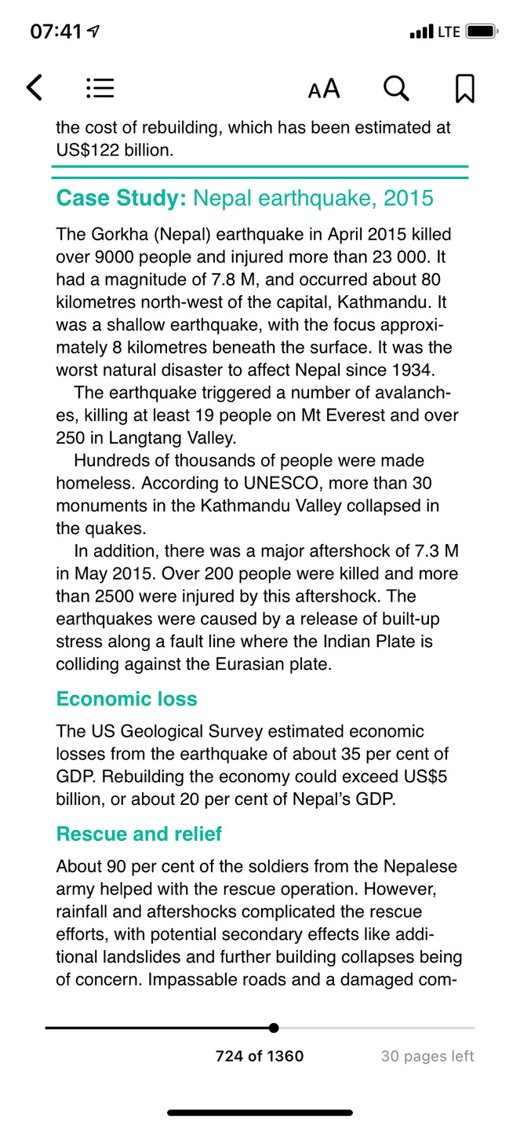
Case Study 2: To-hoku, Japan 2011
Cool Geography
Britannica
Physics & Maths Tutor
Internet Geography

Slide 7
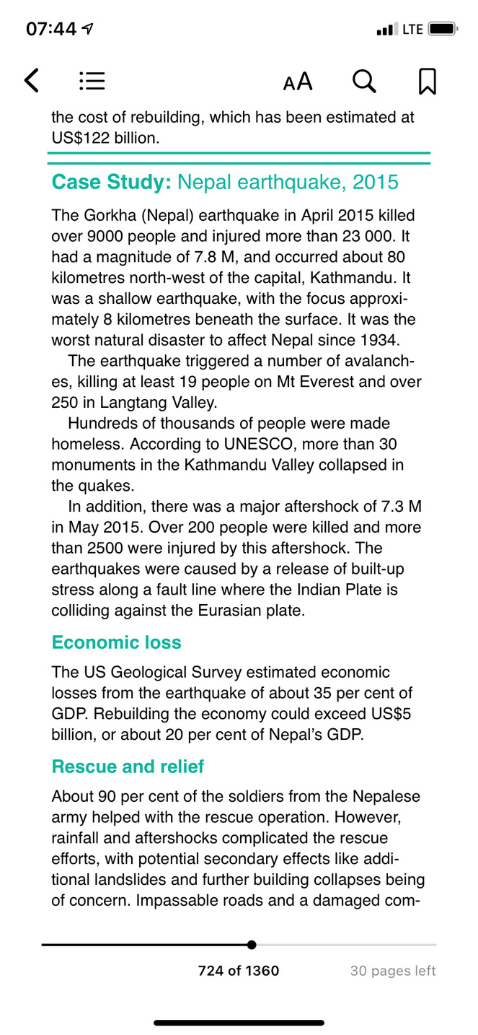
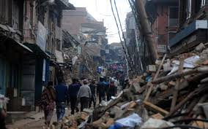
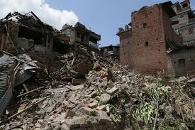
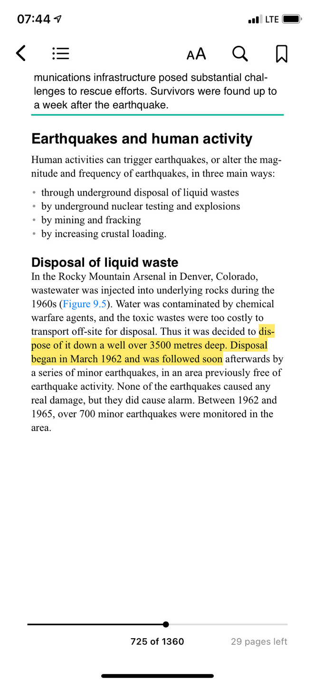
Extra Example Case Study 3: Nepal Earthquake 2015
Internet Geography
Cool Geography
BBC Bitesize
Physics & Maths Tutor

Slide 8
Case Study 4: Chiapas, Mexico Earthquake 2017
Geofile is in lesson folder
Case Study 5: Syria/Turkey Earthquake 2023. Most recent serious earthquake. Lots of info online regarding the impacts, management and responses.

Slide 9
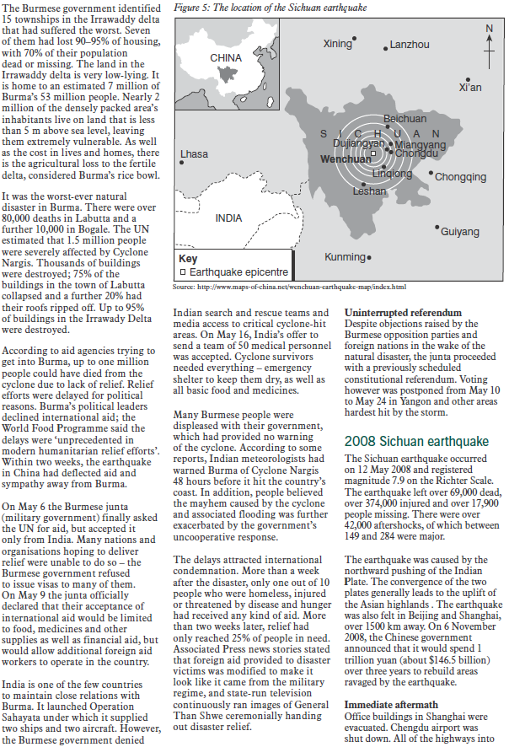
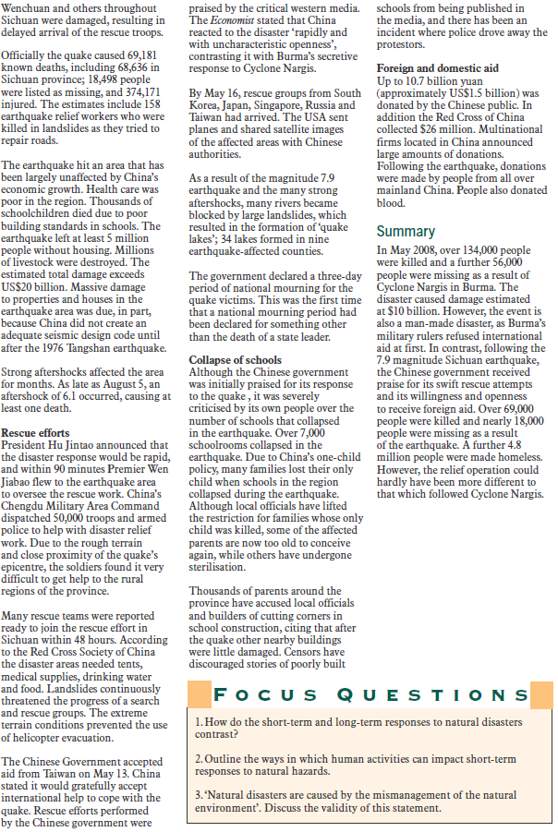
Case Study 6: Sichuan, China Earthquake 2008

Slide 10
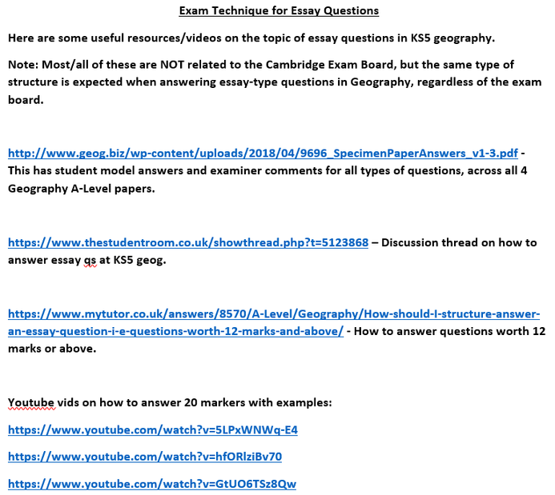
‘The hazardous impact of earthquakes depends on the levels of preparedness and monitoring.’ How far do you agree with this view? [20]
What will your 3/4 main body paragraphs be?
Approach 1
Main body paragraph 1:
Discuss an impact(s)
Discuss how this impact(s) can be/was monitored/prepared for.
Evaluate the effectiveness of the preparation/monitoring techniques.
Repeat for main body paragraphs 2/3/4
Approach 2
Main body paragraph 1:
Discuss a preparation/monitoring technique(s) & what impact(s) it can help reduce.
Evaluate how effective it is.
Repeat for main body paragraphs 2/3/4
Approach 3
Main body paragraph 1:
Discuss the range of impacts of earthquakes (either using a small number of case studies or a wide range of different examples) – Primary/secondary, LICs v HICs etc.
Main body paragraph 2:
Evaluate how earthquake preparation can reduce the hazardous impacts of earthquakes.
Main body paragraph 3:
Evaluate earthquake monitoring techniques and how these can reduce the hazardous impacts of earthquakes.
Check out these resources in the Revision folder if you need help/guidance on how to write/structure essay questions in Geography!
A ‘discussion’ is also needed whereby you show appreciation that because of the nature of seismic hazards, even with the best preparedness and monitoring techniques in place, there are other factors involved which mean the impacts can still be severe e.g. strength/magnitude… depth of focus, pop. density etc.
HICs v LICs should be evident in your argument.
Notes:
9696_s18_qp_31
10

Slide 11
8 ‘The hazardous impact of earthquakes depends on the levels of preparedness and monitoring.’ How far do you agree with this view?
Candidates are free to develop their own approach to the question and responses will vary depending on the examples chosen. Whichever approach is chosen, essays which discuss the hazardous impacts of earthquakes and consider the levels of preparedness and monitoring, supporting their answer with relevant examples, will be credited. There may be detailed consideration of a case study or a broadly conceived response, drawing on several examples to show the factors involved.
Impacts which may be discussed include:
Primary effects of earthquakes are immediate damage such as collapsing buildings, roads and bridges, which may kill many people. Secondary effects are after-effects of the earthquake, such as fires, tsunami, landslides, disease, soil liquefaction. All are notably negative impacts.
Some methods of monitoring may include:
• laser beams to detect plate movement
• seismometer to pick up vibrations that might suggest possible earthquake
• radon gas levels
Many techniques are not reliable and therefore planning and preparation are very important:
• people need to know what to do in an earthquake, earthquake drills
• emergency kits and first aid
• earthquake proof buildings, designed to absorb earthquake’s energy.
Award marks based on the quality of the response using the marking levels below.
Level 4 16–20 Response thoroughly discusses a range of impacts of earthquakes. Response makes clear links between the impacts and assesses whether impacts of earthquakes vary depending on preparedness and monitoring. An effective and sustained evaluation with a sound conclusion. Response is well founded in detailed exemplar knowledge and strong conceptual understanding of the topic.
Level 3 11–15 Response discusses one or more impacts of earthquakes and makes some links, but may be mostly about impacts with less discussion about the importance of preparedness and monitoring. Response is broadly evaluative in character, comprising some explanatory or narrative content and a conclusion. Response develops on a largely secure base of knowledge and understanding with the use of example(s).
Level 2 6–10 Response shows general knowledge and understanding of a limited range of impacts of earthquakes. Response is mainly descriptive or explanatory in approach and contains a brief or thinly supported evaluation of the levels of preparedness and monitoring. Responses without the use of example(s) to support the response will not get above the middle of Level 2 (8 marks).
Level 1 1–5 Response broadly discusses earthquakes, but without a focus on the question or a convincing conclusion. A descriptive response comprising a few simple points. Knowledge is basic and understanding may be poor and lack relevance to the question set.
Level 0 0 No creditable response. 20
‘The hazardous impact of earthquakes depends on the levels of preparedness and monitoring.’ How far do you agree with this view? [20]
Notes:
9696_s18_qp_31
11

