Slide 1
Retrieval Practice
Domesticated pigs are descended from Sus scrofa, sometimes called the ‘wild boar’.
  number the levels in the correct sequence and
  Complete the name column. [4]
ii) We now have DNA evidence of how organisms are related to each other. This evidence has helped biologists to construct a second classification viewpoint: the Domain system.
Explain what such developments show about the nature of scientific knowledge. [1]
It advances/ improves/ grows (Develop is in the question)
2. In 1990, Carl Woese suggested a new top level taxon to the current system of classification of living organisms, which he termed a domain. He used his results from studying RNA to organise organisms into three distinct groups. Name the cell component that appears in organisms of all three domains that Woese suggested.
Name the cell component that appears in organisms of all three domains that Woese suggested
One of the domains he suggested is called Eukarya. Name the other two domains. [2]
State two defining features of all members of the domain Eukarya [2]
Nucleus, DNA with histones, linear DNA, membrane bound organelles, 80s ribosomes
Sequence of levels | Level | Name
..................... | Order | Artiodactyla
..................... | Species | .....................
..................... | Family | Suidae
1 | Kingdom | .....................
..................... | Genus | .....................
..................... | Phylum | Chordata
..................... | Class | Mammalia
One mark for level numbers all correct.
Do not allow if scrofa is given with capital S
Do not allow if Sus is given with lower case s
47
scrofa
Animal(ia)
Sus
5
6
2
3
ribosome
(Eu)bacteria , Archaea (bacteria)

Slide 2
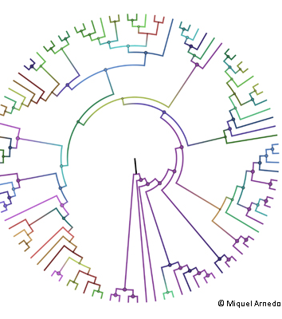
Phylogeny
By the end of the lesson you should be able to:
Explain the relationship between classification and phylogeny

Slide 3
Key Terms:
Phylogeny: the name given to the evolutionary relationships between organisms
Phylogenetics: the study of the evolutionary history of groups of organisms. It reveals which groups a particular organism is related to and how closely related

Slide 4

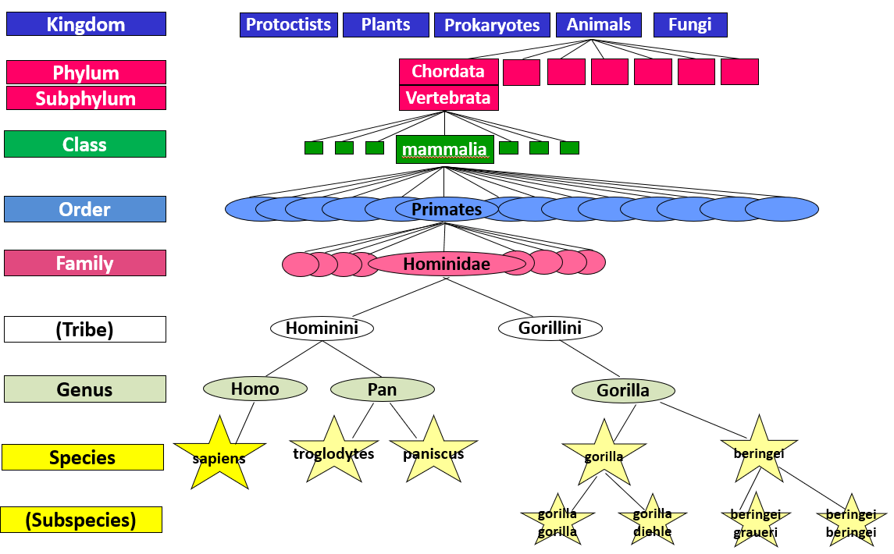
Using phylogenetics in classification
Classification can occur without any knowledge of phylogeny (as occurred in the past)
It is the objective of many scientists to develop a classification system that correctly takes into account the phylogeny of an organism
Chimpanzees and gorillas were once classified in (a now obsolete) family ‘Pongidae’. Evidence from phylogenetics showed that they belonged in the family ‘Hominidae’ (as shown in diagram)

Slide 5
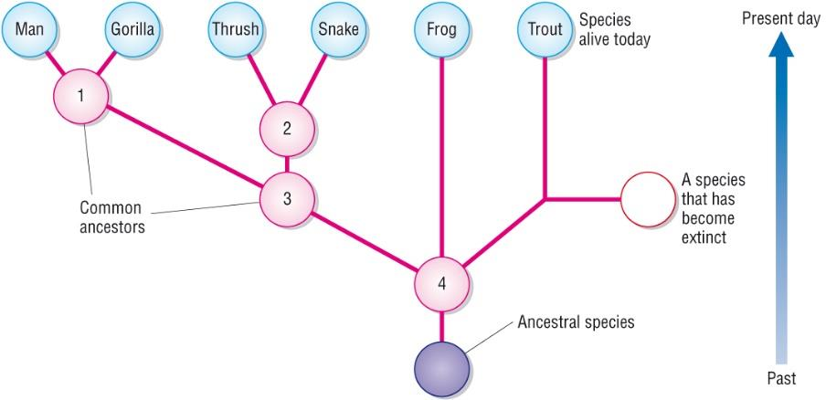
Phylogenetic Tree
All organisms have evolved from shared common ancestors.
Closely related species evolved from each other most recently

Slide 6
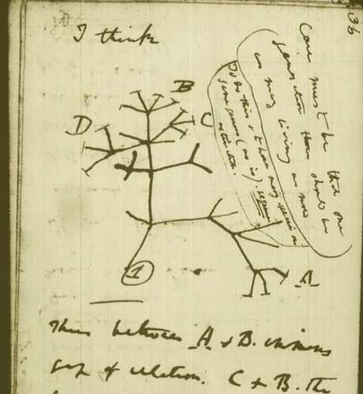
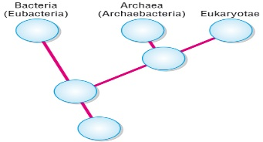

Common ancestors
Common ancestor (archaea & eukaryotes)
Common ancestor (bacteria, archaea & eukaryotes)

Slide 7
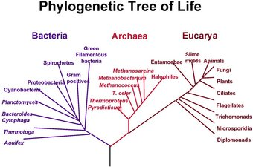
What is the significance of the junctions (where the branch of an organism meets the main trunk?

Slide 8

Advantages of Phylogenetic Classification
Phylogeny takes into account evolutionary relationships that might not be obvious by just looking at characteristics
It produces a continuous tree whereas classification requires discrete groups – scientists are forced to put organisms into a specific group even if they do not quite fit
It is not hierarchical therefore different groups on the tree are represented according to their evolutionary position – and can thus be compared

Slide 9
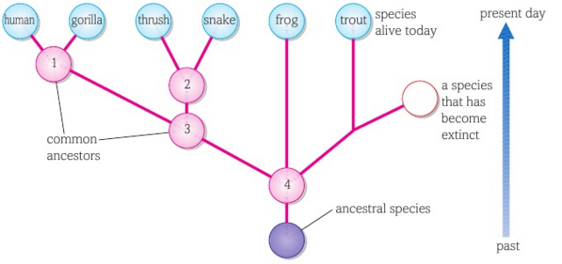
Question practice
Species 1 is a common ancestor of …
Species 2 is a common ancestor of …
Species 3 is a common ancestor of …
Species 4 is a common ancestor of …
A common ancestor of the trout and snake is …
A common ancestor of the thrush and gorilla is …
Humans and gorillas
Thrush and snake
Humans, gorillas, thrush and snakes
Humans, gorillas, thrush, snakes, frogs and trout
species 4
species 3

Slide 10
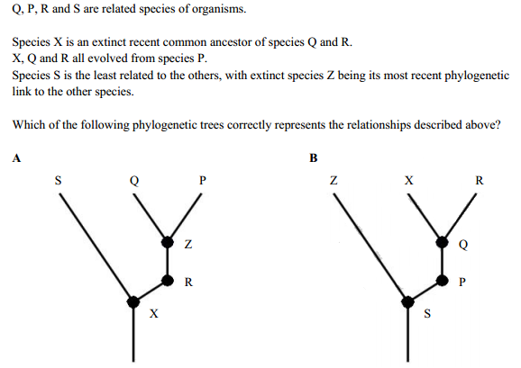
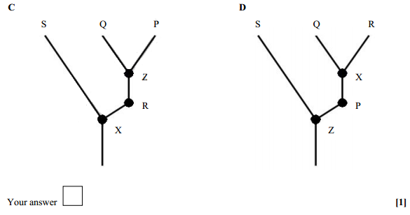
D

Slide 11
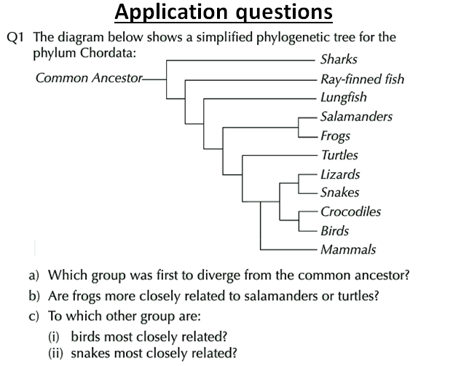
Sharks
Salamanders
Crocodiles
Lizards

Slide 12
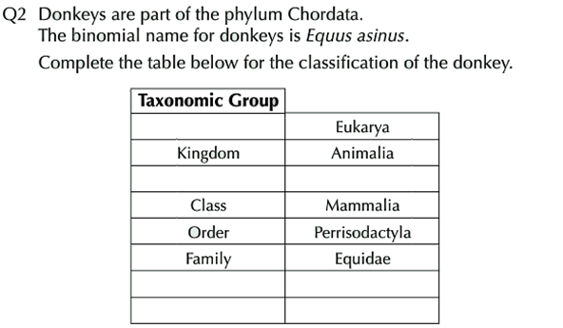
Domain
Phylum
Chordata
Genus
Equus
Species
asinus

