Slide 1

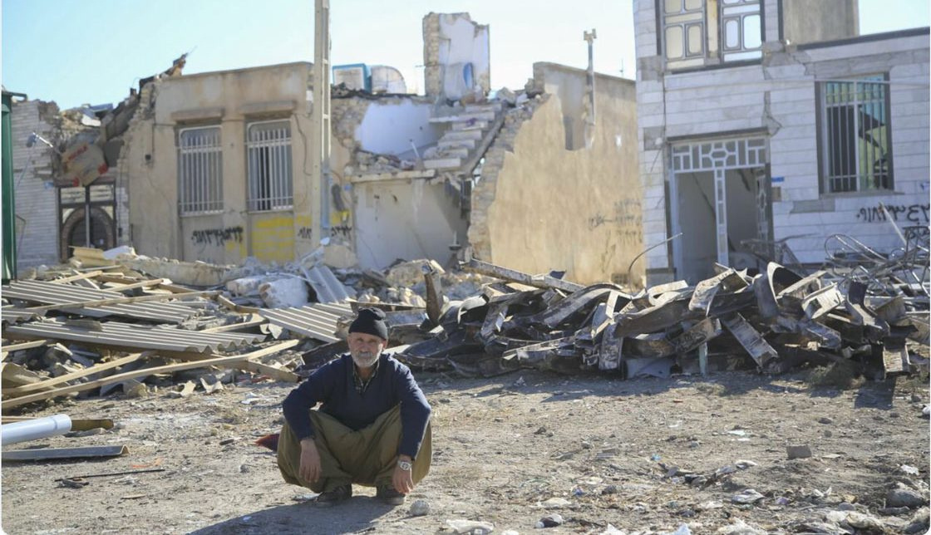
Living with Earthquakes
LO: To investigate how we can reduce the potential impacts of earthquakes
Describe different hazard prediction methods
Assess the importance of geophysical hazard adaptation in terms of increased government planning, land use zoning, and personal resilience, including increased preparedness, use of insurance and adoption of new technology.
Starter: Look at the image below & consider…
The town has just been devastated by an earthquake.
Imagine you are the man in the picture.
Could this fate have been avoided? Discuss….
Exam Questions to think about….
‘Earthquakes are more difficult to predict, but easier to prepare for, than volcanic eruptions.’ How far do you agree with this view? [20]
Describe the hazards resulting from earthquakes. Assess the extent to which hazards resulting from earthquakes can be managed. [20]
With the aid of a case study of a hazardous environment, assess how prediction and preparedness can reduce the impacts of the hazard(s) on lives and property. [20]
‘Earthquakes are difficult to predict but their impacts can be reduced.’ How far do you agree with this view? [20]
‘The hazardous impact of earthquakes depends on the levels of preparedness and monitoring.’ How far do you agree with this view? [20]
Describe and explain the range of hazards caused by earthquakes. Assess the extent to which these hazards can be predicted. [20]
For any one hazardous environment, explain the management strategies that can be used to reduce the effects of the hazards. Assess the effectiveness of these management strategies. [20]
Explain the techniques used to monitor earthquakes and assess the extent to which prediction can reduce the hazardous impact of earthquakes. [20]

Slide 2

Syllabus Guide – What we must know!
9.1 Hazards resulting from tectonic processes
The global distribution of earthquakes and volcanoes related to plate tectonics.
Earthquakes and resultant hazards: shaking, landslides, soil liquefaction, and tsunami.
Volcanoes and resultant hazards: types of eruption and their products (nuées ardentes, lava flows, volcanic mudflows/lahars, volcanic landslides, pyroclastic flows, and ash fallout).
Primary and secondary impacts on lives and property.
Prediction, hazard mapping, preparedness and monitoring of earthquake and volcanic hazards and perception of risk.
Please refer to the course syllabus regularly – It guides you on exactly what is required from you in this course!

Slide 3
The Perception of Risk
At an individual level, there are three important influences upon an individuals response to any hazardous event:
Experience – The more experience a person has of environmental hazards, the greater the adjustment to the hazard.
Material well-being/level of affluence – Those who are better off have more choices
Personality – is the person a leader or a follower, a risk-taker or risk-minimizer?
Ultimately there are three choices:
Do nothing and accept the hazards
Adjust to the situation of living in a hazardous environment
Leave the area.
It is the adjustment to the hazard that we are interested in. The level of adjustment will depend, in part, upon the risks caused by the hazard. This includes:
Identification of the hazards
Estimation of the risk (probability) of the environmental hazard
Evaluation of the cost (loss) caused by the environmental hazard.
IMPORTANT: This applies to all hazards – not just earthquakes!

Slide 4
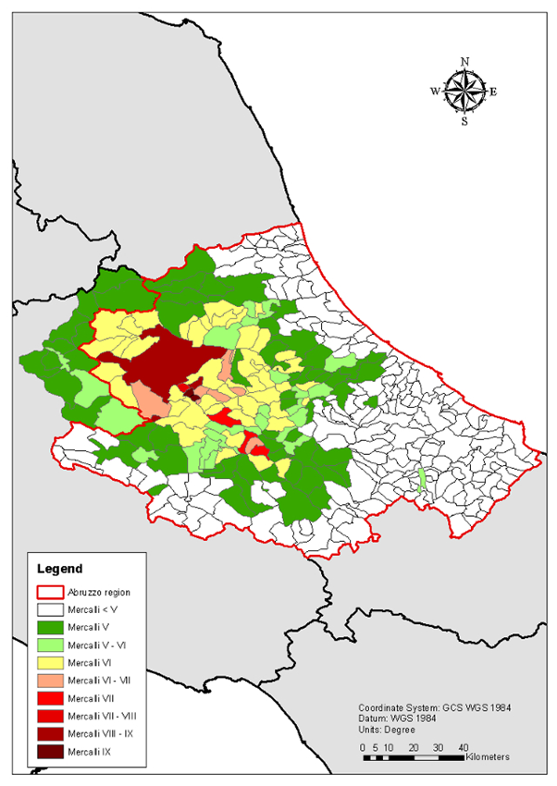
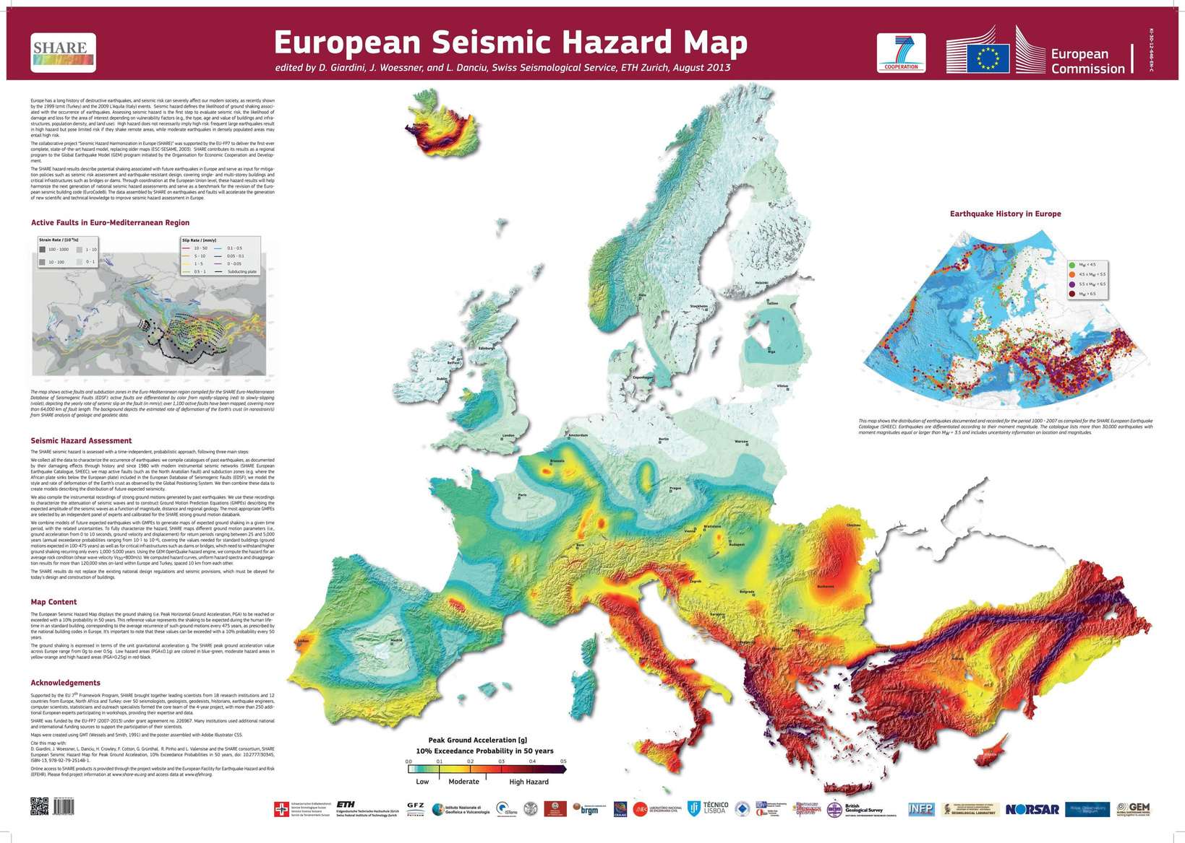
Hazard Risks Maps
Study the following gallery of different hazard risk maps and identify ways how each each map can be used to help authorities to prepare for the associated hazard

Slide 5
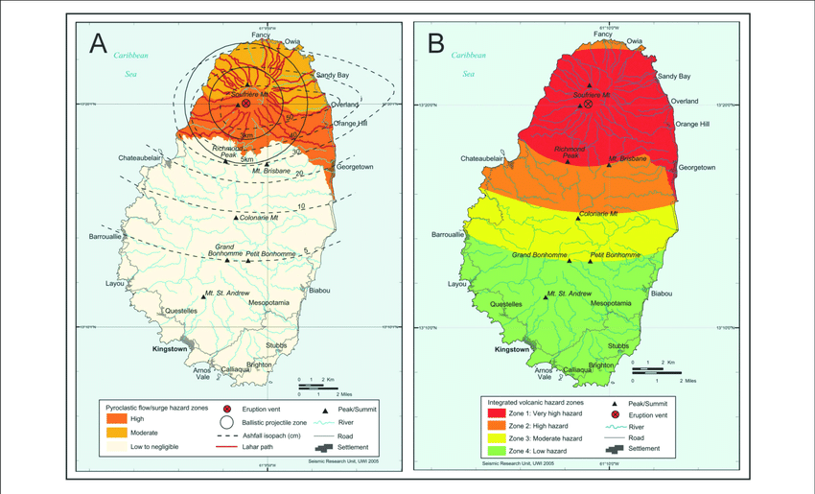
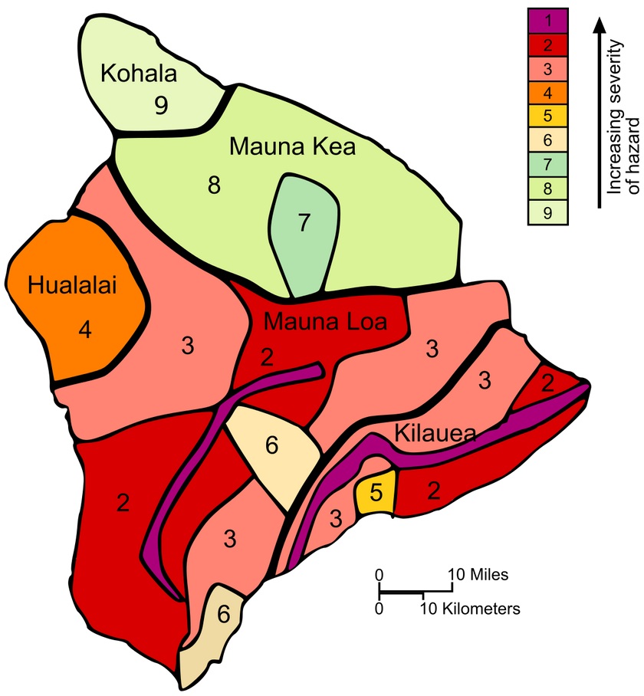
Hazard Risks Maps
Study the following gallery of different hazard risk maps and identify ways how each each map can be used to help authorities to prepare for the associated hazard

Slide 6
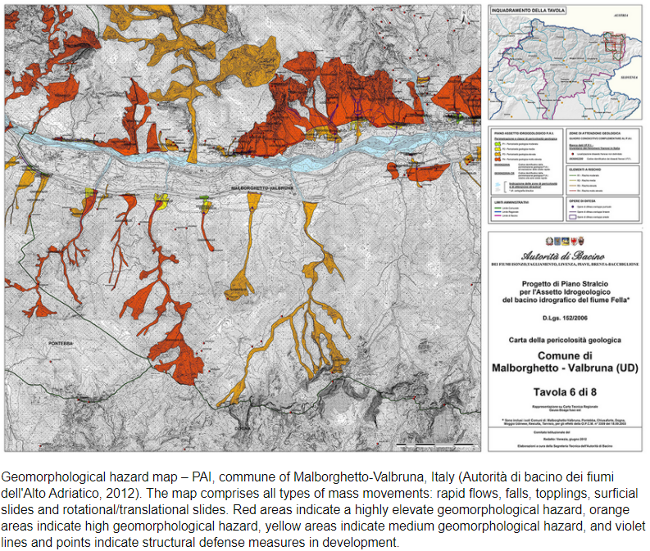
Hazard Risks Maps
Study the following gallery of different hazard risk maps and identify ways how each each map can be used to help authorities to prepare for the associated hazard

Slide 7
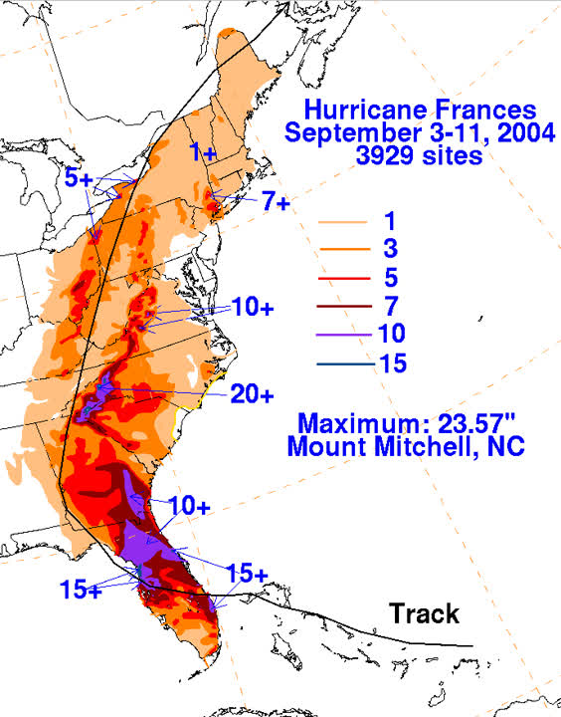
Hazard Risks Maps
Study the following gallery of different hazard risk maps and identify ways how each each map can be used to help authorities to prepare for the associated hazard

Slide 8
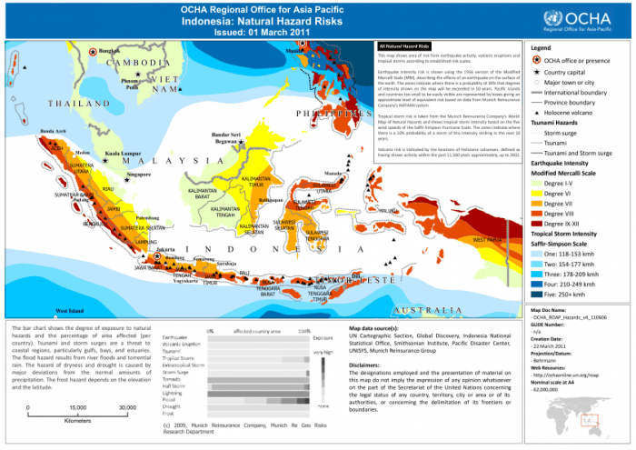
Hazard Risks Maps
Study the following gallery of different hazard risk maps and identify ways how each each map can be used to help authorities to prepare for the associated hazard

Slide 9
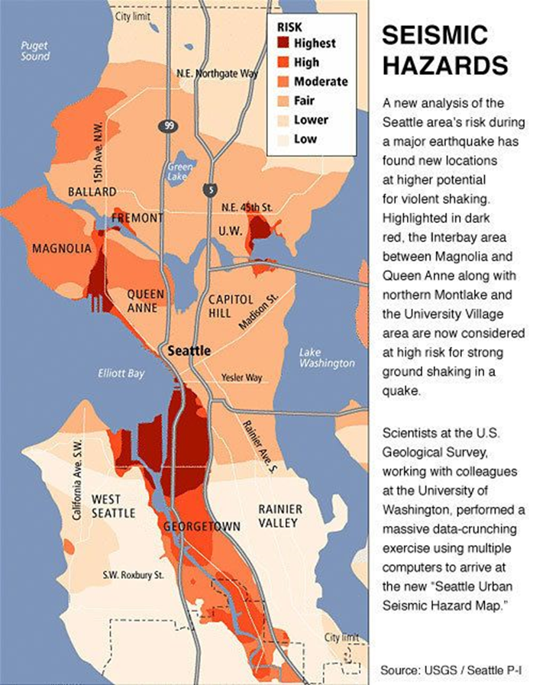
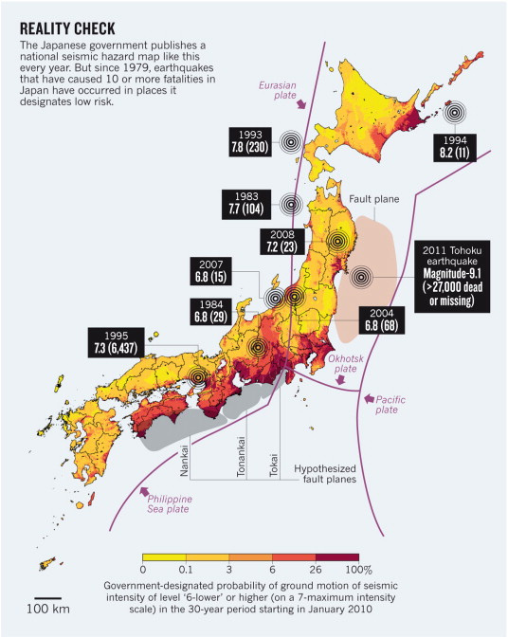
Hazard Risks Maps
Study the following gallery of different hazard risk maps and identify ways how each each map can be used to help authorities to prepare for the associated hazard.

Slide 10
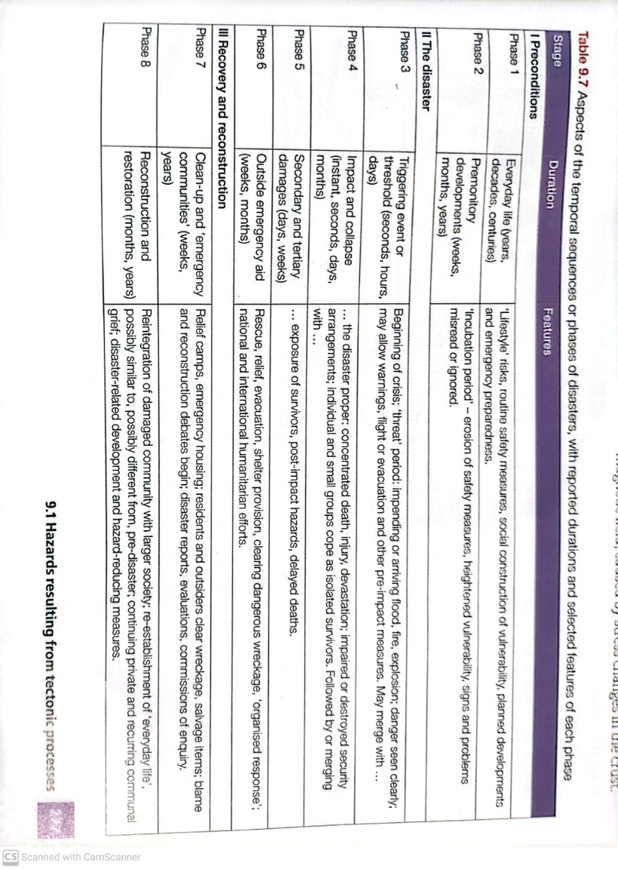
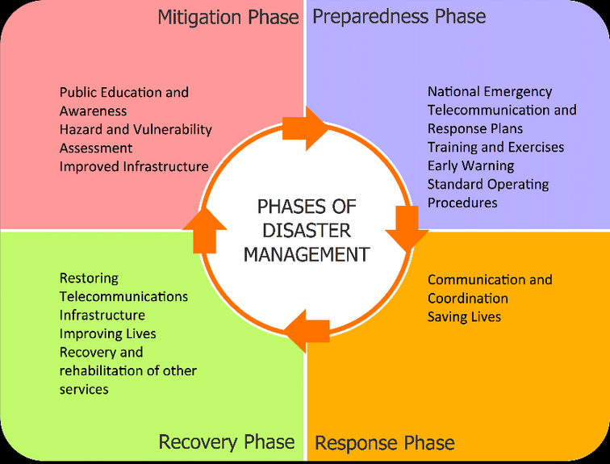
Hazard Mapping, Risk Assessment and Preparedness
Hazard mapping includes a body of theory that includes risk, prediction, prevention, event and recovery.
Vulnerability refers to the geographic conditions that increase the susceptibility of a community to a hazard or to the impacts of a hazard event. Examples?
Risk is the probability of a hazard event causing harmful consequences (Expected losses in terms of death, injuries, property damage, economy and environment).
A hazard is a threat/danger (whether natural or human) that has the potential to cause loss of life, injury, property damage, socio-economic disruption or environmental degradation.
In contrast, a disaster is a major hazard event that causes widespread disruption to a community or region, with a significant demographic, economic and/or environmental losses.
A number of stages can be observed in the build up to a disaster and in its aftermath (see table). Rehabilitation/recovery refers to people being able to make safe homes that the can live in again. This can be a very long, drawn out process, taking up to a decade or more for major construction projects (often dependent on level of development).
As well as dealing with the aftermath of a disaster, governments try to plan to reduce impacts of future events. This was seen after the South Asian tsunami of 2004. Before the event, a tsunami early warning system was not in place in the Indian Ocean. Following the event, as well as emergency rescue rehabilitation and reconstruction, governments and aid agencies in the region developed a system to reduce the impacts of future tsunamis. It is just part of the process needed to reduce the impact of hazards and to improve safety in the region.
Mitigate = make (something bad) less severe, serious, or painful.

Slide 11
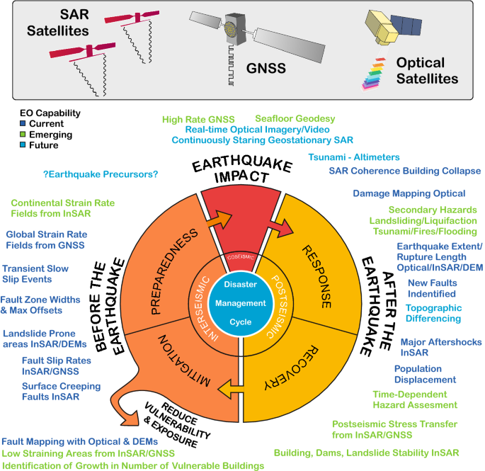
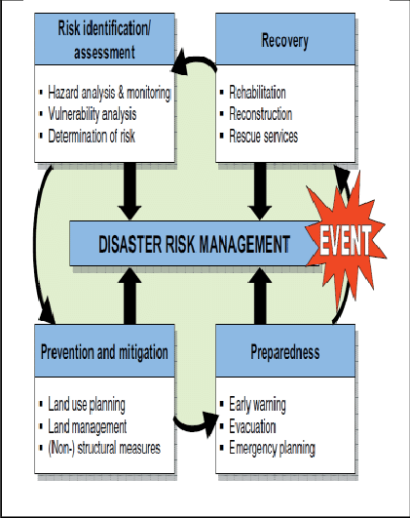
There is no way to accurately predict earthquakes, but there are many methods used to make estimates and to prepare. What are these methods?
seismic gap theory (forecasting)
monitoring of earthquake zones – use of instruments, seismograph, radon gas, geophysical changes (forecasting/prediction)
hazard mapping (forecasting/prediction/preparedness/protection)
community preparedness, e.g. Earthquake Awareness Day in Japan, emergency service teams etc. (preparedness)
hard engineering: earthquake proof building structures are an example of technological fix (protection)
In reality, do all of these fall into the category of earthquake preparedness?
Management of seismic hazards

Slide 12

Hazard Mapping, Risk Assessment and Preparedness – Earthquakes
People deal with earthquakes in a number of ways, which include:
Doing nothing and accepting the hazard.
Adjusting/adapting to the hazardous environment e.g. strengthening their home.
Leaving the area.
FYI – There is an abundance of information on these in the textbook (pg.276-282) and in the various resources in the Google Drive.
The remaining slides on this PowerPoint have a bunch of content/resources that may also be of use too.
As will additional independent research – websites, YouTube videos etc. ☺
How can we best prepare for/manage earthquakes?
Your task is to produce a comprehensive report for the GFDRR (Global Facility for Disaster Reduction and Recovery) in which you include the following:
Prediction, monitoring, hazard mapping & risk assessment – offer insights into the various methods we use around the world to predict earthquakes and assess their risk. Ensure you evaluate these predication methods – how do they work? Are they successful/reliable? Why/why not? Evaluate their effectiveness. Ensure you account for the different capabilities of HICs v LICs here and offer examples of how each can prepare for earthquakes.
Learning to live with earthquakes (protection & preparation) – offer insights into how we can prepare for earthquakes and learn to live with them. It is impossible to stop earthquakes from happening, so we must focus on attempting to minimize death/injury/damage in high risk areas using aseismic designs for structures. We can also have robust warning systems in place & ensure people are educated on what to do in the event of an earthquake. Discuss all of these, giving plenty of examples and images of aseismic structure designs, explaining how they work to reduce the impacts of earthquakes and evaluate how effective they are/have been. Ensure you account for the different capabilities of HICs v LICs here and offer examples of how each can prepare for earthquakes.
Responding to earthquakes – Evaluate how effective/efficient emergency procedures in the immediate aftermath of an earthquake can help reduce the impacts. Must also consider longer-term recovery and rehabilitation efforts and the impact these can have. Examples of varying success from different countries would really illustrate this point. The Geofile in the 9.1 sub-topic folder on Christchurch’s recovery following the 2010-2011 earthquake sequence, called ‘The Blueprint’ is an excellent case study on recovery from earthquake disasters.
Exam Questions to think about….
‘Earthquakes are more difficult to predict, but easier to prepare for, than volcanic eruptions.’ How far do you agree with this view? [20]
Describe the hazards resulting from earthquakes. Assess the extent to which hazards resulting from earthquakes can be managed. [20]
With the aid of a case study of a hazardous environment, assess how prediction and preparedness can reduce the impacts of the hazard(s) on lives and property. [20]
‘Earthquakes are difficult to predict but their impacts can be reduced.’ How far do you agree with this view? [20]
‘The hazardous impact of earthquakes depends on the levels of preparedness and monitoring.’ How far do you agree with this view? [20]
Describe and explain the range of hazards caused by earthquakes. Assess the extent to which these hazards can be predicted. [20]
For any one hazardous environment, explain the management strategies that can be used to reduce the effects of the hazards. Assess the effectiveness of these management strategies. [20]
Explain the techniques used to monitor earthquakes and assess the extent to which prediction can reduce the hazardous impact of earthquakes. [20]
Idea: Make your life easier by studying the case studies first & looking at the various prediction/forecasting/preparedness/protection strategies that have been used, and evaluate them? That way, you already have real-life examples, data, stats, facts etc. to go with the management strategies that you will be learning/writing about…

Slide 13
Predicting earthquakes…
There are a number of ways of predicting and monitoring earthquakes which involve the measurement of:
small-scale ground surface changes
small-scale uplift or subsidence
ground tilt
changes in rock stress
micro-earthquake activity (clusters of small quakes)
anomalies in the Earth's magnetic field
changes in radon gas concentration.
changes in electrical resistivity of rocks.
One particularly intensively studied site is Parkfield in California, on the San Andreas fault. Parkfield, with a population of fewer than 50 people, claims to be the earthquake capital of the world. It is heavily monitored by
instruments:
Strain meters measure deformation at a single point.
Two-colour laser geodimeters measure the slightest movement between tectonic plates.
Magnetometers detect alterations in the Earth's magnetic field, caused by stress changes in the crust.
Can you discuss each of these? Will likely require research! Can you evaluate their effectiveness using examples?
These are some methods of predicting earthquakes. Can you find real-life examples of them in use to use in 20 markers?

Slide 14
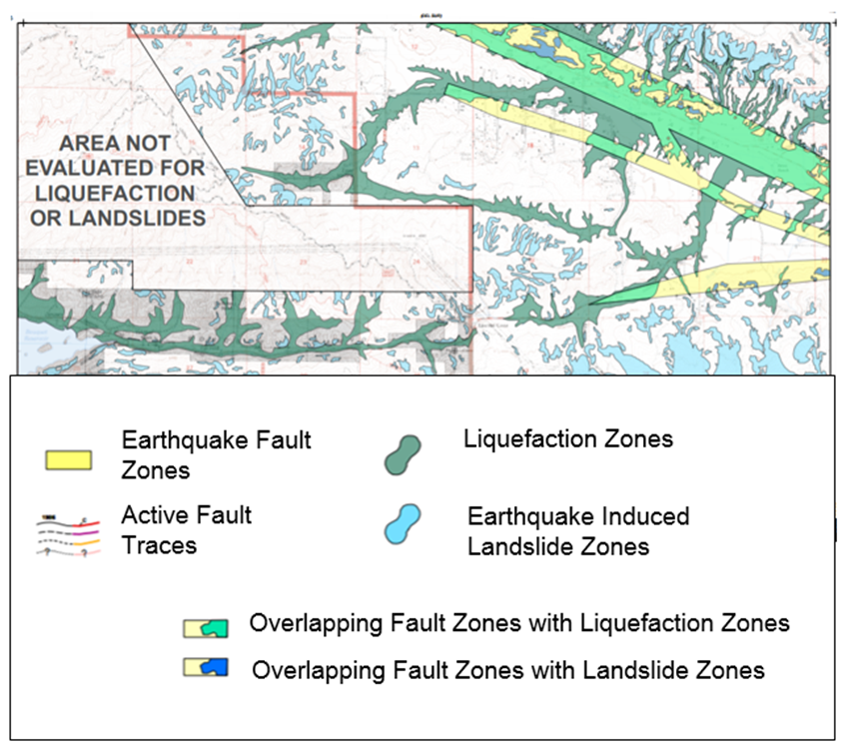
Increasing Preparedness
The ability of authorities to prepare for geophysical hazards closely depends on the resources available to them. Therefore developed countries are much better placed in terms of economic resources to build capacity for preparation. Less developed countries struggle with often more pressing challenges such as health care provision, poverty reduction and concerns relating to economic stability.
The more authorities can do to prepare for hazards the more resilient their population and economy will be. Preparation comes in many forms including technology approaches. Sound maps provide insight into how geosphysical hazards will impact the local geography. These maps alongside sophisticated computer modelling provided focused localized knowledge. With sophisticated use of GPS, satellite imagery, radar as well as seismic and geodetic instruments authorities are improving early warning systems. Local populations empowered with knowledge can take precaution to build resilience in their community and homes; retrofit houses and buildings and improve their insurance against financial losses. Local authorities develop sophisticated awareness campaigns to increase perception of risk and educate their communities on the actions required to save lives before, during and following a hazard.
Study the following graph of Sleepy Valley, in California, adapted from a map produced by the California Geological Survey. Such maps are available for many parts of California. Link: http://maps.conservation.ca.gov/cgs/informationwarehouse/
Suggest how maps such as this are useful to:
Households
Businesses and organizations

Slide 15
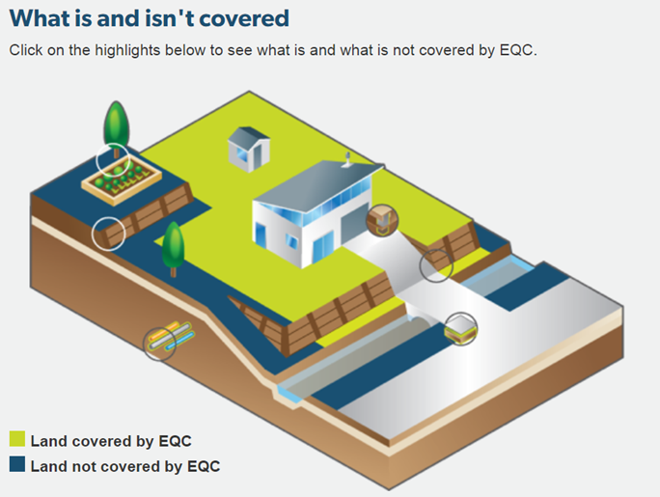
Preparing for earthquakes…
Simulating the Impacts of Earthquakes
Watch the two videos below and suggest ways the science, through technology, support local authorities in California
https://www.youtube.com/watch?v=m5xM-CTDLo0&feature=emb_logo
https://www.youtube.com/watch?v=blTx92TuWHA&feature=emb_logo
Hazard Mapping
Is it prediction or preparedness?
Land Use Zoning – see textbook
Earthquake Early Warning Systems
Watch the following video and make notes on Japan's Earthquake Early warning System
https://www.youtube.com/watch?v=cYNoNUAMlzg&feature=emb_logo
The Role of Insurance
Watch the following video introducing the California push to insure - https://www.youtube.com/watch?v=XmvP2aTZhEw&feature=emb_logo
Study the interactive house from the EQC website in New Zealand and identify what is and isn't covered by earthquake insurance.
The following video explains California's grant scheme to retrofit older homes
https://www.youtube.com/watch?v=gQAa0u7e20Q&feature=emb_logo

Slide 16
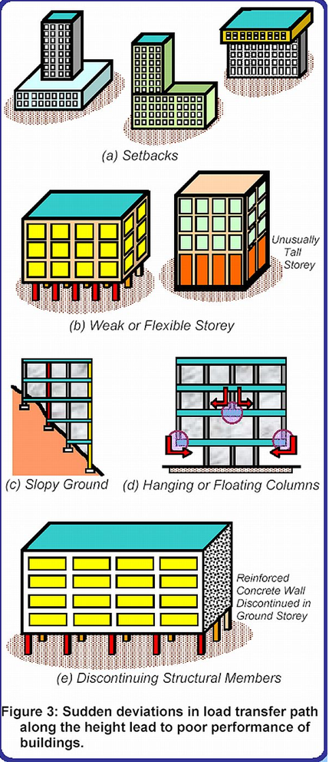
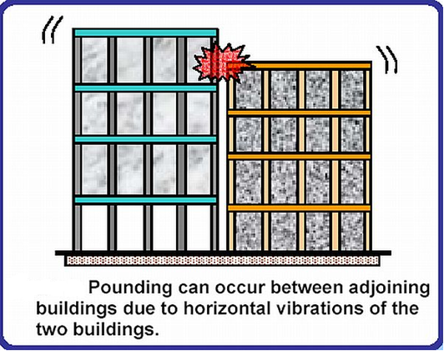
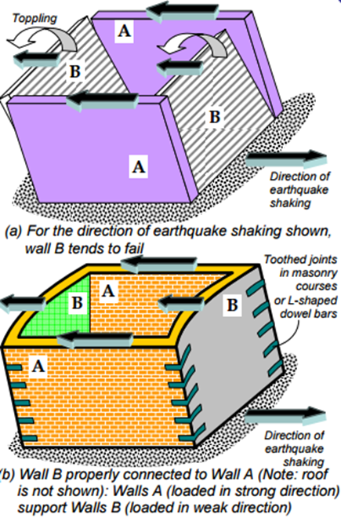
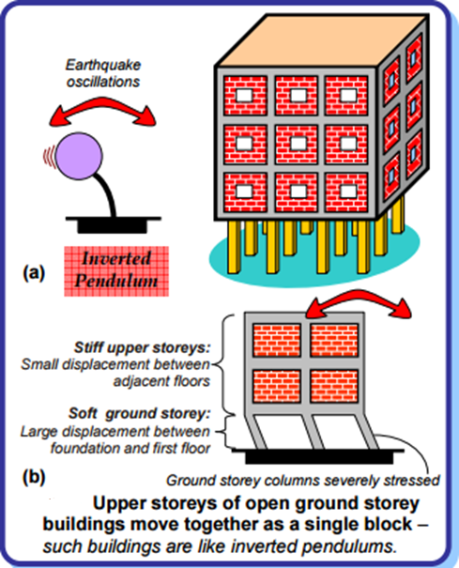
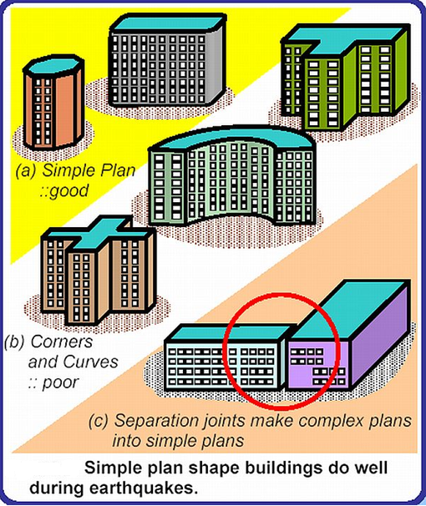
Preparing for earthquakes - Building Design (protection)
Study the images below and discuss how its design contributes to effective or less effective resistance to earthquakes. Add notes to your google slide.
Notes:
16

Slide 17
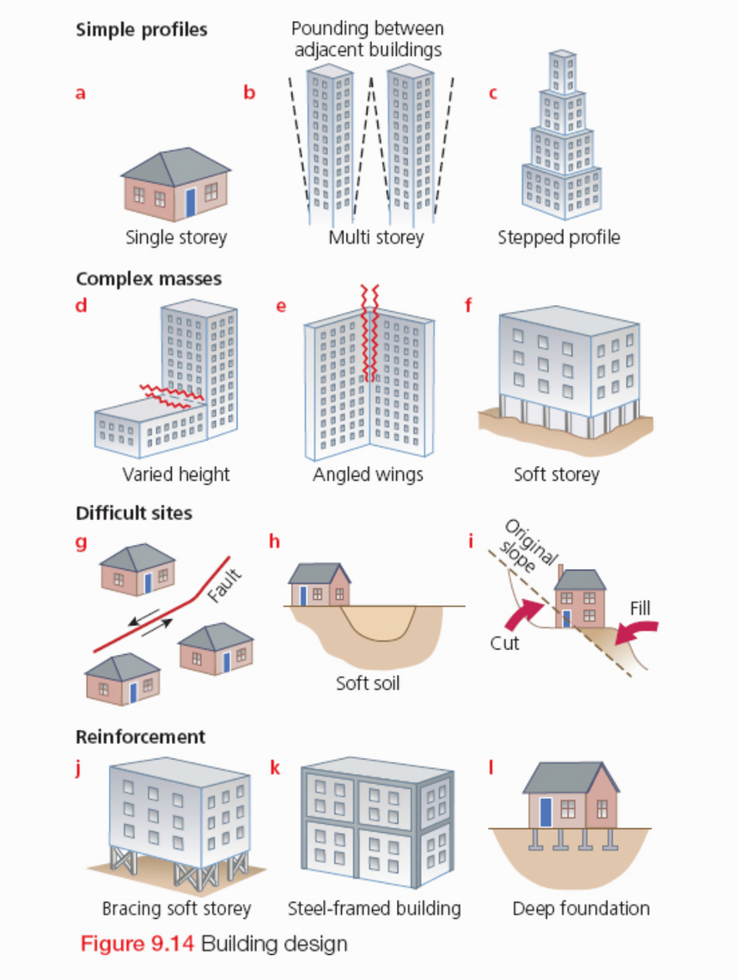
Preparing for earthquakes - Building Design (protection)
Increasingly as the availability of land is reduced, more and more people are living in seismic areas. This increases the potential impact of an earthquake. However, buildings can be designed to withstand the ground shaking that occurs in an earthquake.
Single-story buildings are more suitable that multi-story structures, because this reduces the number of people at risk and the treat of collapse over roads and evacuation routes.
Some tall buildings are built with a soft-story at the bottom such as a car park raised on pillars. This collapses in an earthquake, so that the upper floors sink down onto it and this cushions the impact.
Basement isolation – mounting the foundations of a building on rubber mounts that allow the ground to move under the building – is widely used. This isolates the buildings from the tremors.
Building Reinforcement strategies include building on foundations built deep into underlying bedrock, and the use of steel-constructed frames that can withstand shaking.
Land-use planning is another important way of reducing earthquake risk.

Slide 18
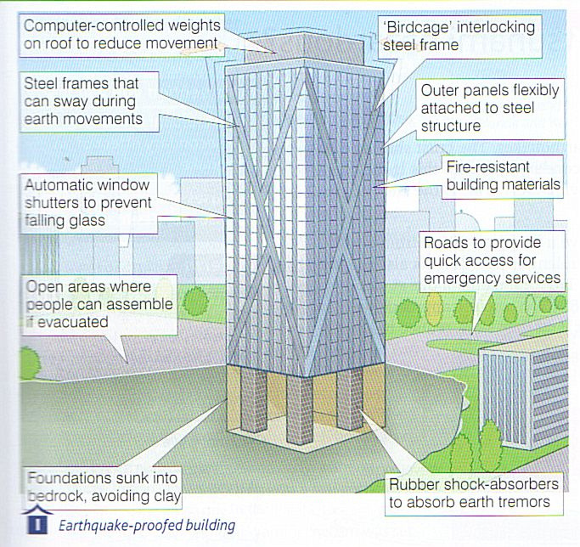
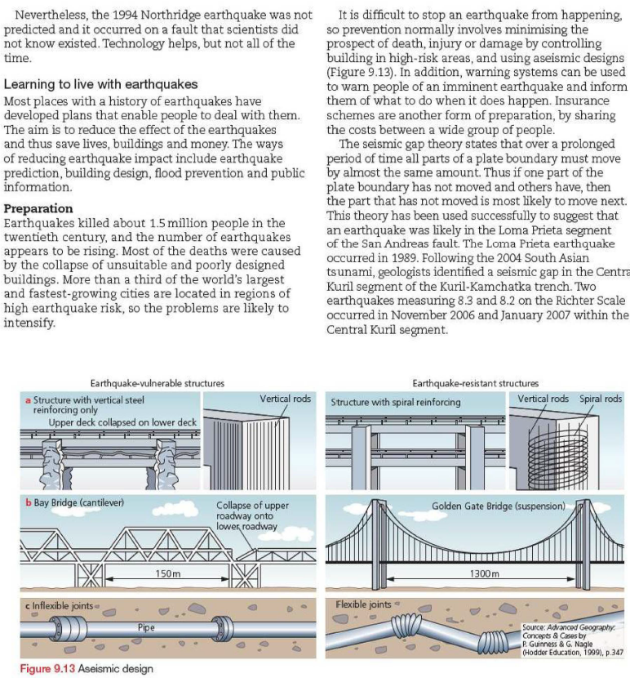
Preparing for earthquakes - Building Design (protection)
How to Retrofit a Home for an Earthquake - Video
The Future of Earthquake-Proof Buildings - Video
Stanford engineers build an earthquake-resistant house - Video
How we design our buildings to survive earthquakes - Video
Buildings Can Be Designed to Withstand Earthquakes – Very good, interactive, New York Times article. Make this one a priority!
How Earthquake-Proof Buildings Are Designed - Webpage
Outsmarting tremors with earthquake resilient building design - Article

Slide 19
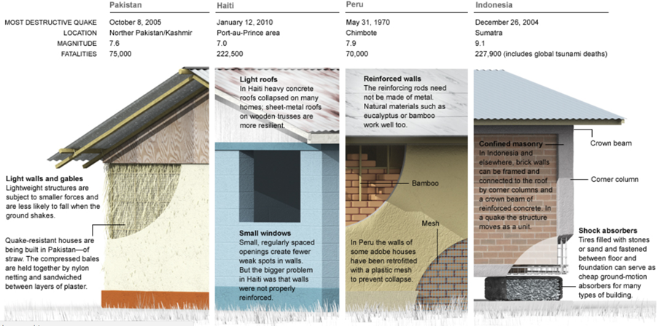
Preparing for earthquakes - Building design in LICs (protection)
Discuss the challenges of pre-event management in LICs
Study the following diagram of building design appropriate to LICs and add to your work

Slide 20
Preparing for earthquakes - Safe Houses (protection)
Read the Paragraph below and complete the following activities:
Describe measures put in place by LIC countries
Assess the effectiveness of these measures.
The earthquake in Haiti was a reminder that billions of people live in houses that cannot withstand shaking. Yet safer ones can be built cheaply – using straw, adobe and old tyres.
In wealthy cities in fault zones the added expense of making buildings earthquake resistant has become a fact of life. Concrete walls are often reinforced with steel and a few buildings even rest on elaborate shock absorbers. Strict building codes were credited with saving thousands of lives when a magnitude 8.8 E/q hit Chile in February 2010. But in LICs, like Haiti, conventional earthquake engineering is often unaffordable. However, cheap solutions do exist.
In Peru in 1970 an earthquake killed 70,000 people, many of whom died when their houses crumbled around them. Heavy brittle walls of traditional adobe-cheap, sun dried brick – cracked instantly when the ground started buckling. Subsequent shakes brought roofs thundering down. Existing adobe walls can be reinforced with a strong plastic mesh installed under plaster; in a quake these walls crack but do not collapse, allowing occupants to escape. Since 2007, 5000 houses in Peru have been strengthened with plastic mesh and other reinforcements, when an 8.8 magnitude earthquake struck in 2019 only 2 people were killed and 30 injured.
Other engineers are working on methods that use local materials. Researchers in India have successfully tested a concrete house reinforced with bamboo. A model house for Indonesia rests on ground motion dampers – old tyers filled with bags of sand. Such a house might be only a third as strong as one built on a more sophisticated shock absorber, but it would cost much less.
In Northern Pakistan, straw is available. Traditional houses are built of stone and mud, but straw is far more resilient and warmer in winter. However, cheap ideas aren’t always cheap enough

Slide 21
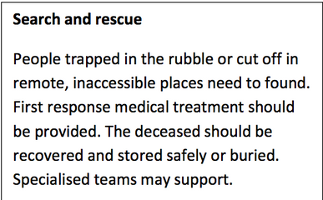
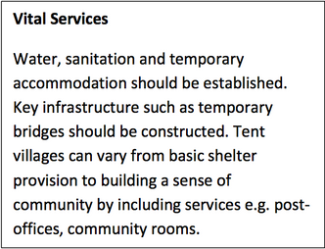
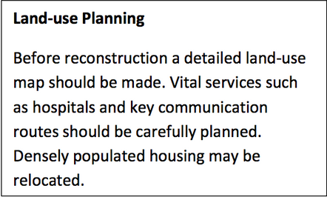
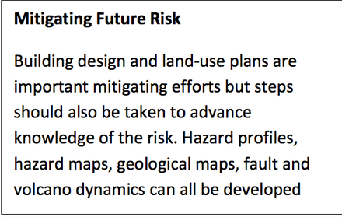
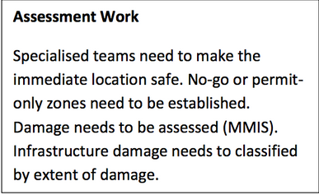
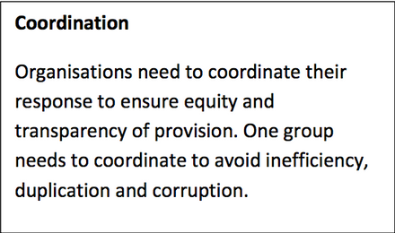
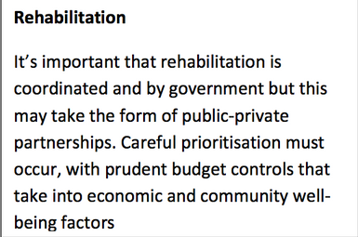
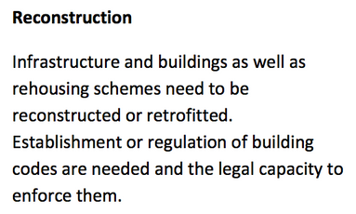
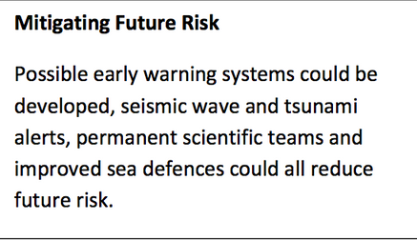
Post Event Management Strategies (response, recovery, mitigation)
Learning Objectives
Identify ways in which authorities can manage earthquake activity
To examine the importance of different post-event management strategies including rescue, rehabilitation, reconstruction
Assess the effectiveness of these strategies.
Starter: Card Sort – Post Event Management Strategies
Look at the cards below. Sort these cards into the correct timeframe i.e. in chronological order.
Extension – Consider what organisations/stakeholders may be involved at each stage.

Slide 22
Search and Rescue
Discuss as a class what factors might hinder the search and rescue. Then add to the spider diagram below
Secondary hazards, aftershocks, landslides, flooding, tsunamis, unsafe buidlings
Degree of hazard preparedness and community perception of risk
Scale of loss - mega-disasters understandably overwhelm communities
Spatial extent, remoteness, access
Factors that hinder search and rescue
Magnitude of the event
Timing of the event - night time events are far more challenging
Resilence and social conditions within the local community, this can be highly supportive or rapidly become unsafe
Government capacity, wealth, leadership, coordination, availability of trained people e.g. military
Relationship with neighbouring countries and international community

Slide 23
Search and Rescue
Watch the following Videos and make notes on
Challenges of search and Rescue
The Use of dogs
Use of communication technologies to enhance the search
https://www.youtube.com/watch?v=puW4DzndLtA&feature=emb_logo
https://www.youtube.com/watch?v=u-_qj3AYgmw&feature=emb_logo
Rehabilitation and Recovery of L'Aquila and Port au Prince
Watch the following video based on the recovery of L'Aquila and Port au Prince, following their earthquakes answer the questions on your google slides and then make notes on;
The extent of the recovery
Different challenges they face
https://www.youtube.com/watch?v=RjuE3984Wb8&feature=emb_logo
https://www.youtube.com/watch?v=Ypmh-p2T1zs&feature=emb_logo
https://www.youtube.com/watch?v=Y9k7k1wFMNA&feature=emb_logo
Providing Temporary Shelter
Study the following two videos, showing tent village life in Port au Prince, Haiti and L'Aquila, Italy.
Make notes on how they contrast in terms of:
Conditions/materials
Extent of government involvement
Role of community and community resilience
https://www.youtube.com/watch?v=GG_NFlz_8QA&feature=emb_logo
https://www.youtube.com/watch?v=dQa_KjiCFCU&feature=emb_logo
Complete the following table:
Drones and Mapping
Watch the two videos on use of drones in disaster regions and make notes of the usefulness of drones for:
Assessing needs
Mapping impacts
Measuring effects of recovery
https://www.youtube.com/watch?v=gSnFB9Q27Zw&feature=emb_logo
https://www.youtube.com/watch?v=Oou32o-jR0M&feature=emb_logo
Assessing Impact for recovery at Christchurch
The Geofile in the 9.1 sub-topic folder on Christchurch’s recovery following the 2010-2011 earthquake sequence, called ‘The Blueprint’ is an excellent case study on recovery from earthquake disasters.
Watch the following video showing the mapped impacts and recovery of Christchurch and make notes on the:
Impact on infrastructure
Impact on land and buildings
The role of SCIRT and the recovery plan
https://www.youtube.com/watch?v=D5RhI0ijjuk&feature=emb_logo
 | Port au Prince, Haiti | L’Aquila, Itlay
Conditions/ materials
Extent of government involvement
Role of community and community resilience

Slide 24
Other Resources
China - Hong Kong-Zhuhai Bridge (Instagram) & BBC News
Seismic Risk Management in Macedonia

