Slide 1
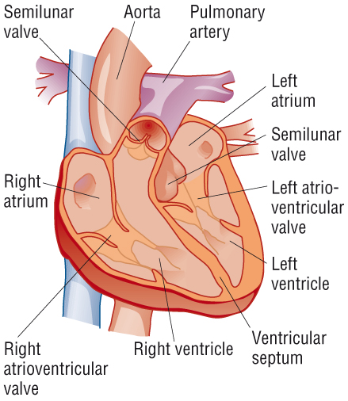
Knowledge retrieval question
Explain the differences in the thickness of the walls on the different sides of the heart in terms of their function (4 marks)
The walls of the left ventricle are thick and muscular. This allows for stronger contractions to create higher systemic pressure
To supply the whole body with oxygenated blood
The walls on the right side if the heart are thinner (less muscular) than the right side of the heart, lower diastolic pressure
Shorter distance to supply blood to the lungs, at a lower pressure to protect the capillaries.

Slide 2
PAG: Heart dissection 2.1
Open PAG 2.1 in 0.PAGS tab
Read through and complete “External structure task” before making incisions (TAKE PHOTOS) with lolly sticks!
Read through the method on your sheet carefully to complete the dissection (ask if you are unsure) (TAKE PHOTOS)
Part of the method includes taking a measurement of the left and right ventricle walls
Complete your scientific drawing
No sketching / no shading / labelled with straight lines / align your annotations – examples on next couple slides
Complete the extension questions

Slide 3
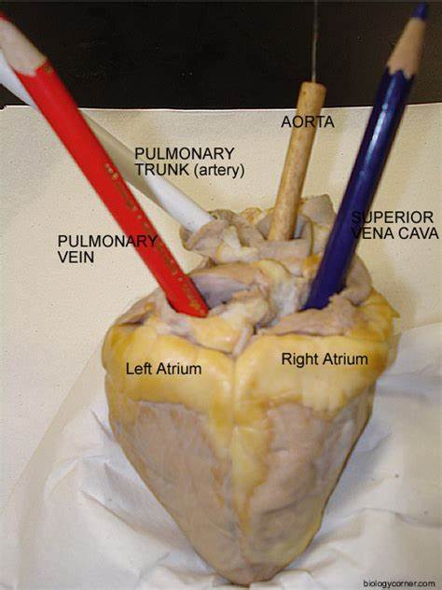

Slide 4
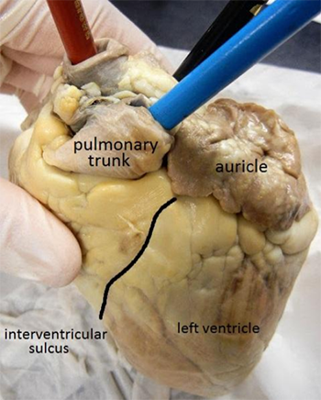
Pulmonary trunk – the beginning of the pulmonary artery that will eventually split into the right and left pulmonary arteries
Auricles – can be found at the top of each atria. They increase the capacity of the right and left atrium.
Interventricular sulcus – mark the separation between ventricles on the front and back surfaces of the heart.
Apex of the heart –the tip of the left ventricle

Slide 5
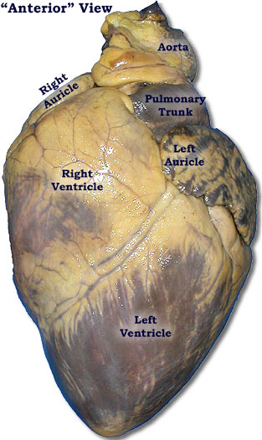
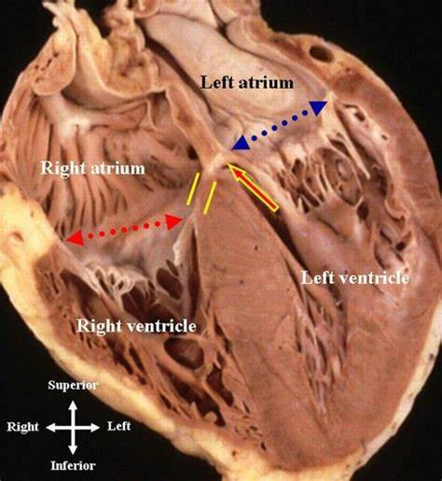
Dissection method
Spend some time examining the external surfaces of the heart and place your fingers inside the 4 chambers to feel the differences in the thicknesses of the walls. Do not make any cuts at this stage.
Identify the coronary artery on the external surface and locate where it comes from the aorta. If necessary, trim fat away using the scissors.
Use the information you have gained from steps 1 and 2 to position your heart on the dissecting board. Make sure you know which the left side of the heart is and which the right is.
Watch a demonstration from your teacher to show the location of the main cut and then use scissors to cut through the wall of the left atrium. Follow the cut down to the apex (bottom tip) of the left ventricle. Open up the left atrium and left ventricle to examine them.
Look for the tendinous cords (also called the heart strings) and how they are attached to the atrioventricular valve. The valve on this side has two flaps so is called the bicuspid valve.
It may be possible to see a different valve in the aorta. It is called the semi-lunar valve due to its half-moon shape.
Make a similar cut down the right side of the heart to open up the right atrium and ventricle. Spend some time examining the wall and internal structures.
Look for the atrioventricular valve on this side. It has three flaps so is called the tricuspid valve. Look for the semi-lunar valve.
Use a ruler to measure the thicknesses of the wall of the left and right atria and ventricles and record these values in a suitably designed table.
Produce a detailed scientific annotated drawing. Carefully arrange the dissected heart so that all the structures that you have identified can be easily seen. An annotated diagram should have detail about each structure added beside each label.

Slide 7
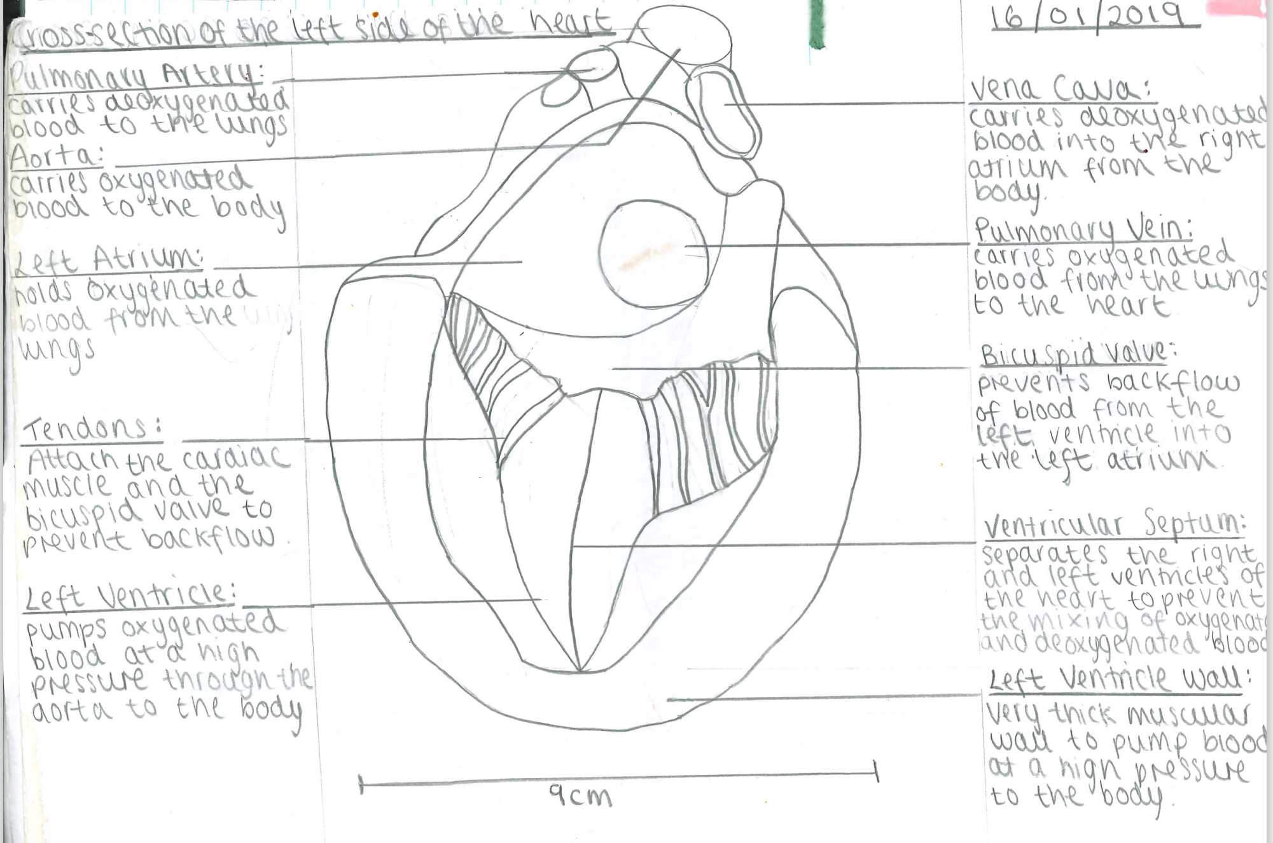
Posted on Teams

