Slide 1
Overview
Aerobic Respiration – Stage 1 Glycolysis
Glycolysis occurs in the cytosol. What's the difference between cytosol and cytoplasm?
Overall Summary: There are 4 stages in aerobic respiration
Glycolysis Link Reaction Krebs Cycle
Oxidative Phosphorylation
Stage 1 – Glycolysis Makes Pyruvate from Glucose
This occurs in the cytoplasm of cells.
Glycolysis does not need oxygen to take place. It is the first stage in both aerobic and anaerobic respiration.
Glycolysis consists of three stages, phosphorylation, lysis and oxidation.
NAD is a coenzyme that acts as a hydrogen acceptor
Phosphorylation
Glucose is phosphorylated, 2 phosphates are added from 2 molecules of ATP
The products are one molecule of hexose bisphosphate and 2 molecules of ADP
Glucose (6C)
2ATP
2Pi
2ADP
(There's an intermediary step here that adds 2 more phosphates forming biphosphoglyceric acid)
Hexose bisphosphate (6C)
Lysis
Then hexose bisphosphate is split into 2 molecules of triose phosphate
2 x triose phosphate (3C)
Oxidation
Triose phosphate is oxidised by losing hydrogen, the product is 2 molecules of pyruvate
NAD collects the hydrogen, forming 2 molecules of reduced NAD
4 ATP are produced in this stage, so overall there is a net gain of 2 ATP
Substrate level phosphorylation.
4ADP
+ 4Pi
2H
2 Reduced NAD used in oxidative phosphorylation
2NAD
4ATP
2 reduced
NAD (NADH)
2 x pyruvate (3C)
2 pyruvate molecules are actively transported into the matrix of the mitochondria for the link reaction

Slide 2
Overview
Aerobic Respiration – Stage 2 Link Reaction
Takes place in the mitochondrial matrix
Pyruvate (3C)
acetate (2C)
Acetyl CoA (2C)
Pyruvate is decarboxylated - one carbon atom is removed from pyruvate in the form of carbon dioxide.
NAD is reduced by collecting the hydrogen ions from pyruvate, forming acetate
Acetate is combined with coenzyme A (CoA) to form acetyl coenzyme A (acetyl CoA)
No ATP is produced in the link reaction
Carbon dioxide is released as a waste product
CO₂
NAD
reduced
NAD (NADH)
Coenzyme A (CoA)
2 Reduced NAD go to oxidative phosphorylation
The Link Reaction Occurs Twice For Every Glucose Molecule
As two pyruvate molecules are made for every glycose molecule during glycolysis, the link reaction (and also the Krebs cycle) happen twice for every glucose molecule.
Two molecules of acetyl coenzyme A go into the Krebs cycle
Two CO₂ molecules are released as a waste product of respiration.
Two molecules of reduced NAD are formed and go to the last stage – oxidative phosphorylation
Two molecules Acetyl CoA go into Krebs Cycle
Structure of Mitochondrion
Outer mitochondrial membrane
Mitochondrial DNA
Inner mitochondrial membrane
Fold - crista
Matrix

Slide 3
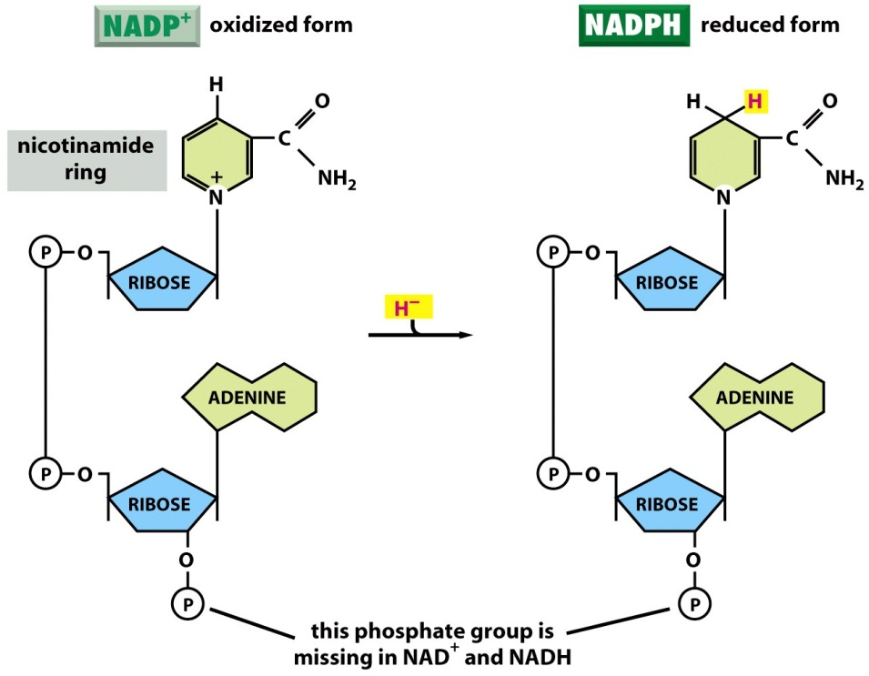
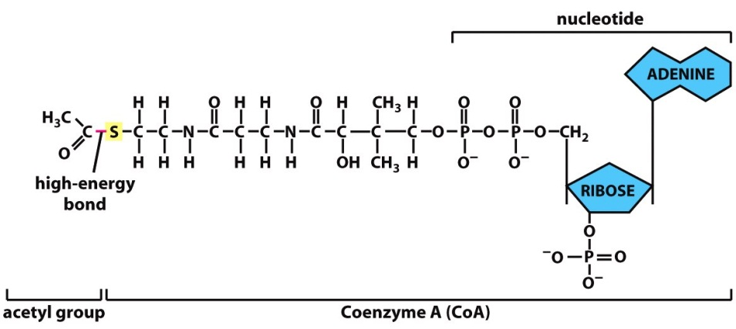
Why use coenzymes?
Help enzymes with their jobs.
Carry groups that need to be transferred.
Enzymes are not very good at catalysing oxidation and reduction reactions
Coenzymes are used as carriers of hydride ions to the site of later stages of respiration.

Slide 4
Glycolysis and the Link Reaction
Define coenzyme:
Describe the main steps in glycolysis
State the products of glycolysis and where they go
Describe the Main Steps in the Link reaction
Describe the processes of dehydrogenation and phosphorylation
Explain how NAD acts as a coenzyme in glycolysis

Slide 5
Glycolysis and the Link Reaction
Define coenzyme: Organic molecule that helps enzymes carry out their function. They may transfer atoms or groups from one reaction to another or form part of the active site of an enzyme.
Describe the main steps in glycolysis
1) Phosphorylation of glucose, 2Pis from ATP
2) Hexose bisphosphate is formed and 2 x ADP
3) Hexose bisphosphate splits into 2 x triose phosphate
4) Triose phosphate is oxidised (loses hydrogen)
5) Forming 2 x pyruvate
6) NAD collects the hydrogen forming reduced NAD
7) 4 x ATP produced
8) NET gain of 2 ATP (2 used, 4 produced)
State the products of glycolysis and where they go
2 x reduced NAD go to oxidative phosphorylation
2 x pyruvate go to link reaction in matrix of mitochondria
Describe the Main Steps in the Link reaction
Pyruvate is decarboxylated (C removed as carbon dioxide)
NAD is reduced – collects hydrogen from pyruvate
Acetate is formed
4) Acetate is combined with coenzyme A (CoA)
5) Acetyl coenzyme A is formed
Describe the processes of dehydrogenation and phosphorylation
Phosphorylation is the addition of a phosphate group to a molecule.
Dehydrogenation is the removal of a hydrogen atom.
Explain how NAD acts as a coenzyme in glycolysis
NAD gains hydrogen

Slide 6
Test your oxidation/ reduction knowledge
Oxidation
Reduction
Removal of electrons or hydrogen
Addition of electrons or hydrogen
1 – Match Up
2 – With a partner test the definitions without looking
Notes:
Checkpoint 2 question

Slide 7
Spot the mistakes!!
Describe glycolysis
Glucose is oxidised to produce hexose biphosphate, then phosphorylated to produce pyruvate.

Slide 8
Spot the mistakes!!
Describe glycolysis
Glucose is phosphorylated to produce hexose bisphosphate. This splits into two molecules of triose phosphate, which is then oxidised to produce pyruvate.

Slide 9
Spot the mistakes!!
State the products of glycolysis
During glycolysis there is a net gain of 4 ATP. In addition two molecules of pyruvate are produced and 2 NAD.

Slide 10
Spot the mistakes!!
State the products of glycolysis
During glycolysis there is a net gain of 2 ATP. In addition two molecules of pyruvate are produced and 2 Reduced NAD.

Slide 11
Spot the mistakes!!
Describe the link reaction
During the link reaction, pyruvate is decarboxylated, then hydrogen ions are released forming acetate. The hydrogen ions are picked up by NAD, forming reduced NAD. Acetate then combines with coenzyme A to form acetyl CoA

Slide 12
No mistakes on that one!
Describe the link reaction
During the link reaction, pyruvate is decarboxylated, then hydrogen ions are released forming acetate. The hydrogen ions are picked up by NAD, forming reduced NAD. Acetate then combines with coenzyme A to form acetyl CoA

Slide 13
Overview
Aerobic Respiration – Stage 1 Glycolysis
Overall Summary: There are 4 stages in aerobic respiration
Glycolysis Link Reaction Krebs Cycle
Oxidative Phosphorylation
Stage 1 – Glycolysis Makes Pyruvate from Glucose
This occurs in the cytoplasm of cells.
Glycolysis does not need oxygen to take place. It is the first stage in both aerobic and anaerobic respiration.
Glycolysis consists of three stages, phosphorylation, lysis and oxidation.
NAD is a coenzyme that acts as a hydrogen acceptor
Phosphorylation
Glucose is phosphorylated, 2 phosphates are added from 2 molecules of ATP
The products are one molecule of hexose bisphosphate and 2 molecules of ADP
Glucose (6C)
2ATP
2Pi
2ADP
Hexose bisphosphate (6C)
Lysis
Then hexose bisphosphate is split into 2 molecules of triose phosphate
2 x triose phosphate (3C)
Oxidation
Triose phosphate is oxidised by losing hydrogen, the product is 2 molecules of pyruvate
NAD collects the hydrogen, forming 2 molecules of reduced NAD
4 ATP are produced in this stage, so overall there is a net gain of 2 ATP
Substrate level phosphorylation.
4ADP
+ 4Pi
2H
2 Reduced NAD used in oxidative phosphorylation
2NAD
4ATP
2 reduced
NAD (NADH)
2 x pyruvate (3C)
2 pyruvate molecules are actively transported into the matrix of the mitochondria for the link reaction

Slide 14
Overview
Aerobic Respiration – Stage 1 Glycolysis
Overall Summary: There are 4 stages in aerobic respiration
Glycolysis …… Reaction …………………………
Oxidative Phosphorylation
Stage 1 – Glycolysis Makes Pyruvate from Glucose
This occurs in the ……………….. of cells.
Glycolysis does not need ……………. to take place. It is the first stage in both aerobic and anaerobic respiration.
Glycolysis consists of three stages, phosphorylation, lysis and …………………….
NAD is a coenzyme that acts as a hydrogen acceptor
Phosphorylation
Glucose is phosphorylated, 2 phosphates are added from 2 molecules of …………
The products are one molecule of ………… bisphosphate and 2 molecules of ADP
Glucose (6C)
2ATP
2Pi
2ADP
Hexose bisphosphate (6C)
Lysis
Then hexose bisphosphate is split into 2 molecules of ……………………………..
2 x triose phosphate (3C)
Oxidation
Triose phosphate is oxidised by losing hydrogen, the product is 2 molecules of ………………..
NAD collects the …………………, forming 2 molecules of ……………. NAD
4 ATP are produced in this stage, so overall there is a net gain of 2 ATP
Substrate level phosphorylation.
4ADP
+ 4Pi
2H
2 Reduced NAD used in oxidative phosphorylation
2NAD
4ATP
2 reduced
NAD (NADH)
2 x ……………………. (3C)
2 pyruvate molecules are ……………….. transported into the ………….. of the mitochondria for the link reaction

Slide 15
Overview
Aerobic Respiration – Stage 2 Link Reaction
Pyruvate (3C)
acetyl (2C)
Acetyl CoA (2C)
Pyruvate is decarboxylated - one carbon atom is removed from pyruvate in the form of carbon dioxide.
NAD is reduced by collecting the hydride ions from pyruvate, forming acetate
Acetyl is combined with coenzyme A (CoA) to form acetyl coenzyme A (acetyl CoA)
No ATP is produced in the link reaction
Carbon dioxide is released as a waste product
CO₂
NAD
reduced
NAD (NADH)
Coenzyme A (CoA)
2 Reduced NAD go to oxidative phosphorylation
The Link Reaction Occurs Twice For Every Glucose Molecule
As two pyruvate molecules are made for every glycose molecule during glycolysis, the link reaction (and also the Krebs cycle) happen twice for every glucose molecule.
Two molecules of acetyl coenzyme A go into the Krebs cycle
Two CO₂ molecules are released as a waste product of respiration.
Two molecules of reduced NAD are formed and go to the last stage – oxidative phosphorylation
Two molecules Acetyl CoA go into Krebs Cycle
Structure of Mitochondrion
Outer mitochondrial membrane
Mitochondrial DNA
Inner mitochondrial membrane
Fold - crista
Matrix

Slide 16
Overview
Aerobic Respiration – Stage 2 Link Reaction
Pyruvate (3C)
acetate (2C)
Acetyl CoA (2C)
Pyruvate is ……………….. - one carbon atom is removed from pyruvate in the form of carbon dioxide.
NAD is ……………….. by collecting the hydrogen ions from pyruvate, forming acetate
Acetate is ………………. with coenzyme A (CoA) to form acetyl coenzyme A (acetyl CoA)
No …………… is produced in the link reaction
Carbon dioxide is released as a waste product
CO₂
NAD
reduced
NAD (NADH)
Coenzyme A (CoA)
2 Reduced NAD go to oxidative phosphorylation
The Link Reaction Occurs Twice For Every Glucose Molecule
As two pyruvate molecules are made for every glycose molecule during ………………, the link reaction (and also the Krebs cycle) happen ………. for every glucose molecule.
Two molecules of acetyl coenzyme A go into the Krebs cycle
Two ………. molecules are released as a waste product of respiration.
Two molecules of reduced NAD are formed and go to the last stage – oxidative phosphorylation
Two molecules Acetyl CoA go into Krebs Cycle
Structure of Mitochondrion
………. mitochondrial membrane
Mitochondrial DNA
Inner mitochondrial ……………..
cristae
……………

Slide 17
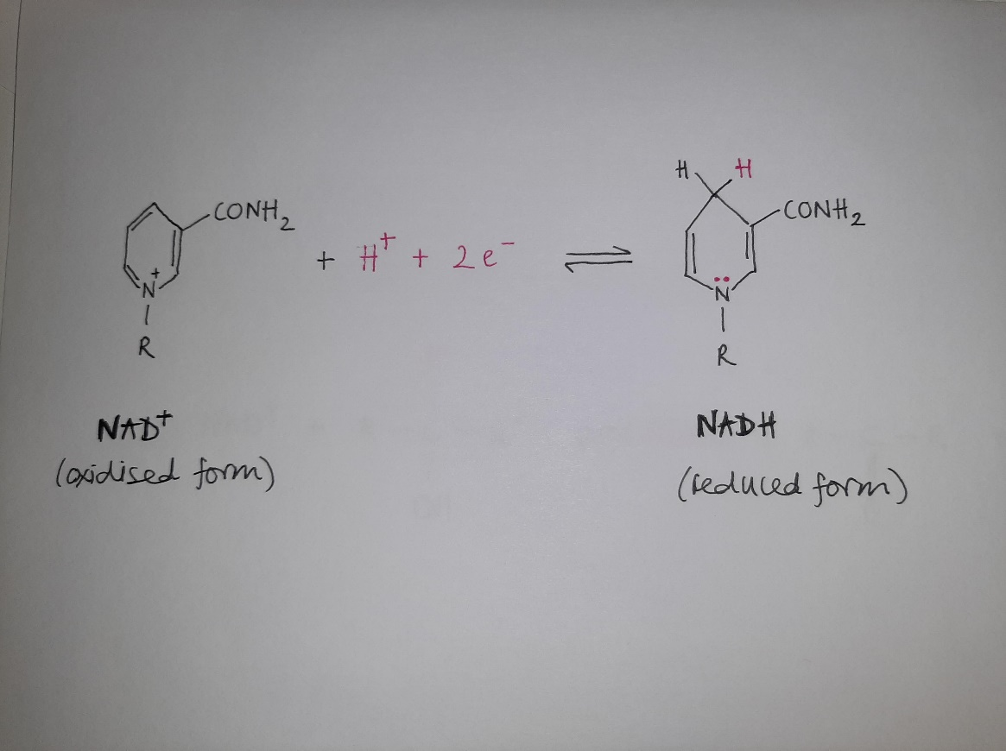
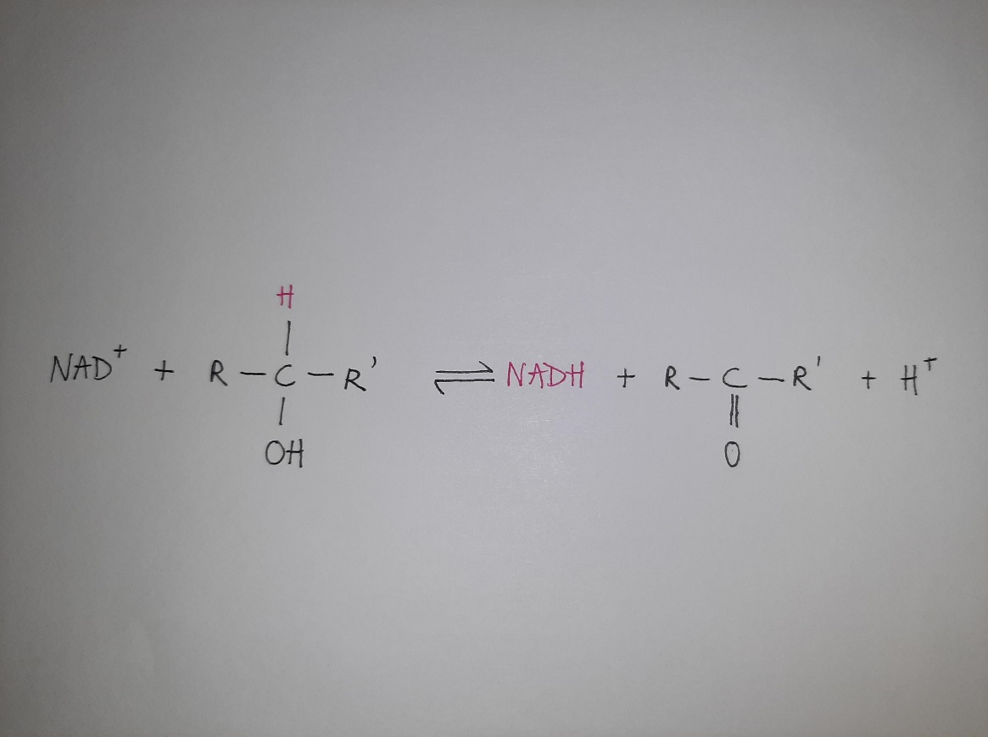
A closer look at NAD

