Slide 1
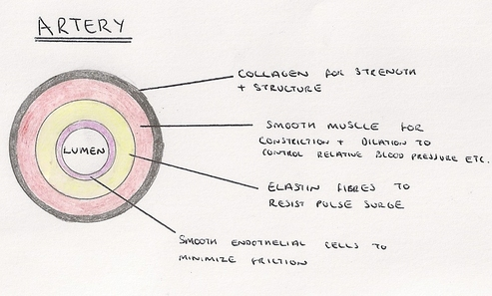
Knowledge retrieval questions
Q1. Draw a labelled diagram to show the structure of an artery (does not need to be 3D) (3 marks)
Q2. Explain how the structure of an artery relates to its function (3 marks)​
Q3. Give three differences between the structure of a vein and the structure of a capillary (3 marks)
1. thick wall drawn ;
2. {two / three / four} layers indicated ;
Max two from the following correctly labelled:
3. lumen ;
4. endothelium / epithelium / endothelial layer / epithelial
layer / tunica intima} ;
5. smooth muscle / elastic fibres / elastin / tunica media
6. tunica externa / collagen (tough outer layer)
thick wall to withstand blood under high pressure
reference to narrow lumen to maintain high pressure
reference to presence of elastic fibres to allow vessel to stretch / recoil (maintain pressure)
reference to (smooth) muscle contracts to squeeze blood along
smooth lining reduces friction
(walls of) veins more than one layer of cells / capillaries one layer (endothelium)
(walls of) veins contain connective tissue / (smooth) muscle collagen / elastic tissue / capillaries do not
veins have valves in them / capillaries do not
veins do not have pores (fenestrations) but capillaries do (for exchanging substances)
veins have wide lumen / capillaries have narrow lumen

Slide 2
Capillaries & Tissue Fluid
Wednesday, 23 July 2025

Slide 3
Transport in the blood
oxygen
carbon
Transport …………….. to the respiring cells and transport …………….. …………… away
Transport food molecules from the ……………. ……………………..
Transport …………………….. waste products to the ………………….. organs
Transport ……………..….. (chemical messages)
Transport ………………. to damaged areas
Transport cells and antibodies involved in the ………………. response.
dioxide
small
intestine
nitrogenous
excretory
hormones
platelets
immune

Slide 4
Key points
Blood is the main transport fluid in the body, but this is only part of the story
Tissue fluid is the other main player in the transfer of substances from the blood to the cells.
A third liquid called lymph is also part of the circulatory system

Slide 5
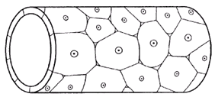
Capillaries & Tissue fluid
Match the structure with the function
Capillaries have an arteriole end and a venous end
structural feature | function
smooth endothelial surface
reduces resistance to blood flow
single layer of endothelium
short diffusion distance
small diameter (7mm)
slows flow rate of blood
short diffusion distance
gaps between endothelial cells (fenestrated)
allows plasma to pass out of capillaries

Slide 6
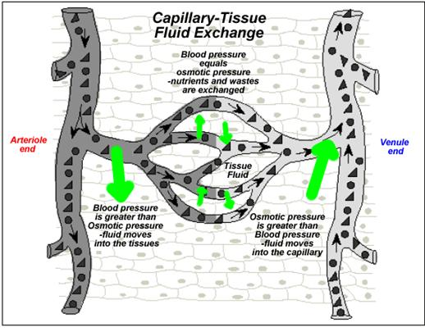
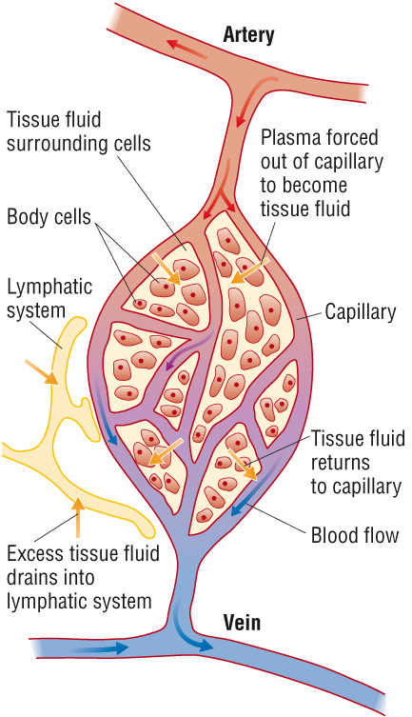
Tissue fluid is a watery fluid containing glucose, amino acids, fatty acids, salts, O₂ and CO₂
Tissue fluid is the medium by which substances are transferred between cells and blood. It is formed from blood plasma.
SO WHERE DOES IT COME FROM?

Slide 7

DO NOT FORGET
TISSUE FLUID IS NOT BLOOD!!
BLOOD DOES NOT LEAVE THE CAPILLARY!!

Slide 8

What does the term ultrafiltration mean and where have you heard it before?
In the kidneys - the glomerulus filtrate is formed from the substances in the blood
In the capillaries - tissue fluid is formed from the plasma in the blood

Slide 9
The next slides shows what happens here

Slide 10
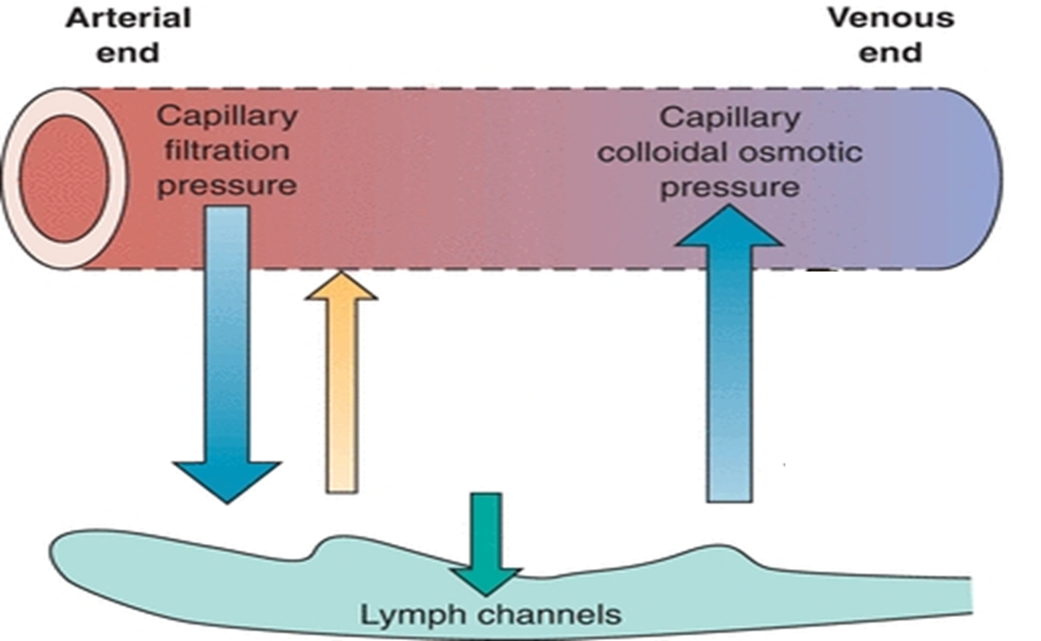

Slide 11
Here's how
4. As the blood moves through the capillaries towards the venous system, the hydrostatic pressure drops as fluid has moved out and the pulse surge is lost.
5. Large plasma proteins (like albumin) do not pass into the tissue fluid and remain in the capillaries. Creating a low water potential in the capillaries at the venule end
1. Blood arrives at the arteriole end under pressure from the surge of blood when the heart contracts
2. This hydrostatic pressure is higher than the oncotic pressure, so fluid is forces out of the capillaries to surround the cells
6. This creates a strong oncotic pressure (osmotic pressure), which is higher than the hydrostatic pressure, so water moves back into the capillaries via osmosis (with CO2, nitrogenous waste).
Hydrostatic pressure
Oncotic pressure
Oncotic pressure
3. This fluid is called tissue fluid. Diffusion of substances (Oxygen, glucose, fatty acids, salts) occurs from the blood to the cells via the tissue fluid.
7. By the time the blood returns to the veins 90% of the fluid is back in the blood containing waste products like CO₂.
The other 10% becomes lymph.

Slide 12
Recap question
Q1. Compare the structure of the aorta to the vena cava. Make reference to their function in your answer (4 marks)
Aorta – higher levels of elastic fibre than vein that can stretch and recoil to maintain blood pressure
Vena cava – Higher level of smooth muscle to contract and relax when controlling the volume of blood flowing through them
Aorta and Vena cava – both have collagen to withstand pressure from outside and within
Aorta and Vena cava – Low levels of endothelial tissue. No diffusion across surface. Endothelial tissue also help reduce friction.
Aorta– thicker wall and smaller lumen – maintain and withstand high pressure

Slide 13
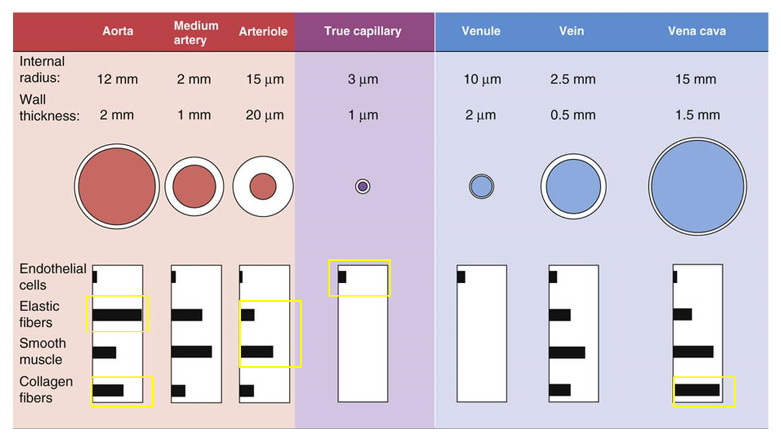
Endothelium - Thin inner layer for diffusion (capillaries), very smooth to prevent friction.
Elastin fibres - Helps to maintain blood pressure by stretching and springing back.
Smooth muscle layer - Can contract and relax to control volume of blood flow passing through them
Collagen fibres - tough outer layer which resists pressure changes from outside and within.

Slide 14

science1s478's presentation | Poll Everywhere

Slide 15
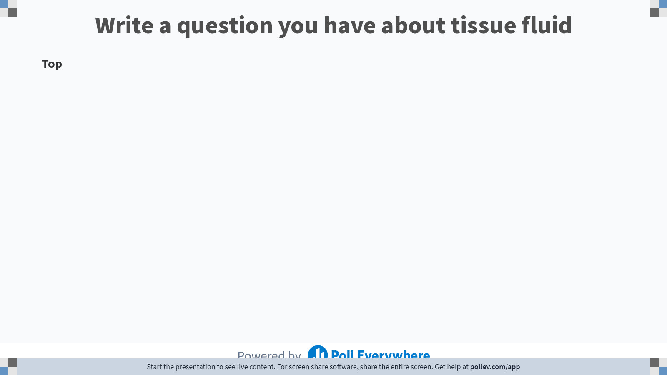
Notes:
Poll Title: Do not modify the notes in this section to avoid tampering with the Poll Everywhere activity.
More info at polleverywhere.com/support
Write a question you have about tissue fluid
https://www.polleverywhere.com/discourses/OUtuadZhahzCZ6DW3NxoZ

Slide 16
Key points for tissue formation
Hydrostatic pressure in blood vessels is the pressure of the blood against the walls of the vessel (pushing force)
Oncotic pressure the tendency of water to move into the blood via osmosis as a result of the plasma proteins (pulling force)
(Large) Plasma proteins (particularly albumin) give the capillaries a low water potential compared to the surrounding tissue fluid. As a result, water moves into the capillaries via osmosis

Slide 17
Exchange of substances
Can be found in tissue fluid
Oxygen
Glucose
CO₂
Amino acids
Water
Substances that remain in the blood
Large proteins (albumin)
Red blood cells
Most white blood cells

Slide 18
Summary – flow chart
Blood plasma
Ultrafiltration
Reabsorption (90%)
Return of lymph via lymph vessels
Tissue fluid
Drainage (10%)
Lymph
Notes:
a colourless fluid containing white blood cells, which bathes the tissues and drains through the lymphatic system into the bloodstream.
Lymph nodes contain a high concentration of WBC and swell when fighting infection

Slide 19
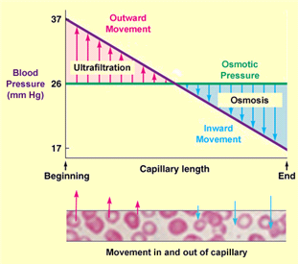

Slide 20
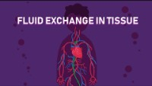

Slide 21

Further reading
Difference Between Hydrostatic and Oncotic Pressure | Definition, Mechanism, Function (pediaa.com)
Link found on Teams

Slide 22
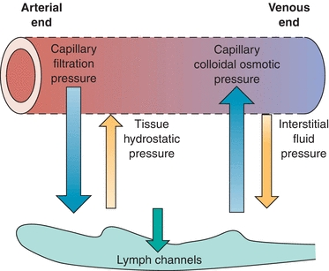
Summary
Hydrostatic pressure decreased as you move from the from the arteriole end to the venule end of the capillary
Oncotic pressure is created due to the large proteins that remain in the capillaries.
This creates a water potential gradient which increases towards the venous end
Once the hydrostatic pressure reduces, water (an waste products) move back into the capillary via osmosis
At the arteriole end, there is a net movement of fluid out of the capillary (see diagram)
Only small molecules are forced out, not large proteins and cells.
At the venule end there is a net movement of fluid into the capillary
Carrying waste products of respiration (CO₂, water)

Slide 23
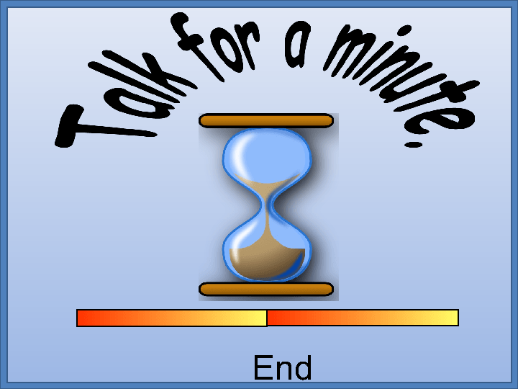

Slide 24
3.Large proteins…
1. H>O Pressure…
4. O>H
2. TF containing…
5. Osmosis
6. Lymph

Slide 25
Additional questions

Slide 26
Test next lesson
Three 6 mark questions on:
Tissue fluid
Blood vessel structure
The heart

Slide 27
Kh – saved in favourites – “tissue fluid”
Or eliminator – possibly better Friday after lymph

Slide 28


Slide 29
Task 1:
Complete your heart PAG write up including:
Scientific diagram, labelled and annotated
Appropriate table to compare thickness of right/left ventricle walls
Answer all extension questions
Task 2:
Go back through your notes on hydrostatic/oncotic pressure and answer the additional questions at the bottom of the page.
We will recap this towards the end of the lesson.
Complete Additional Questions at the end of lesson 1 and 2

Slide 30

EVERYONE HAS A BUZZER!

Slide 31
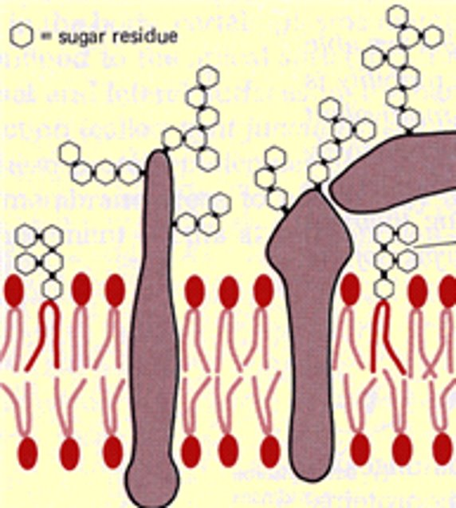
Glycolipid / glycoprotein

Slide 32
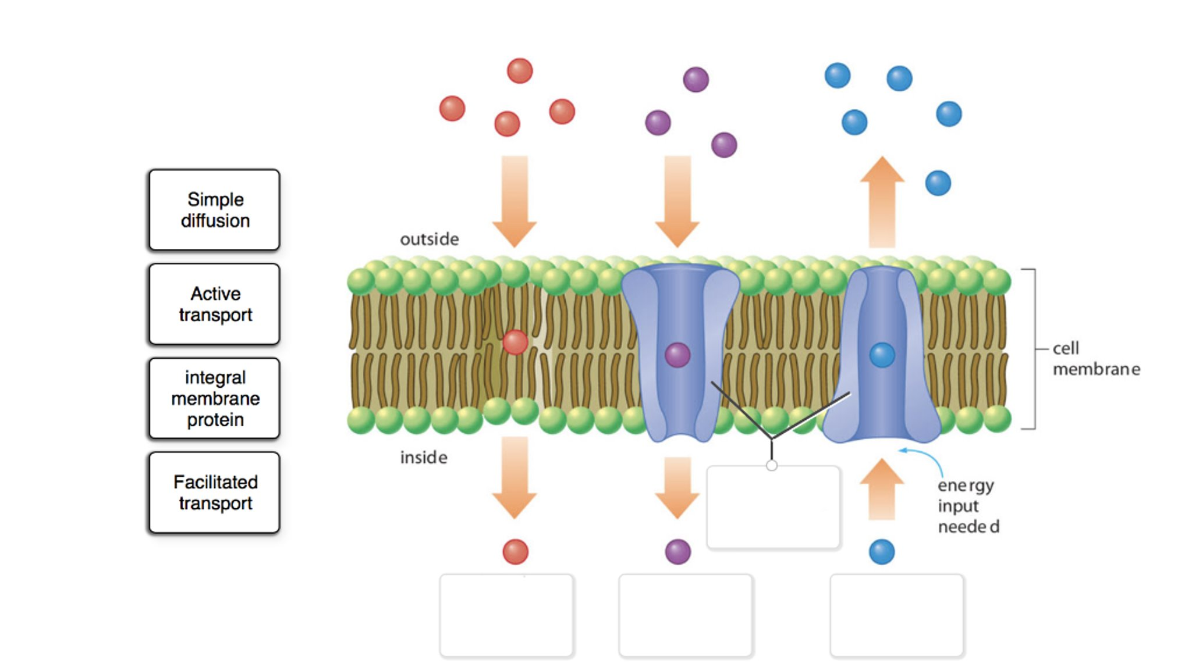
Facilitated diffusion

Slide 33
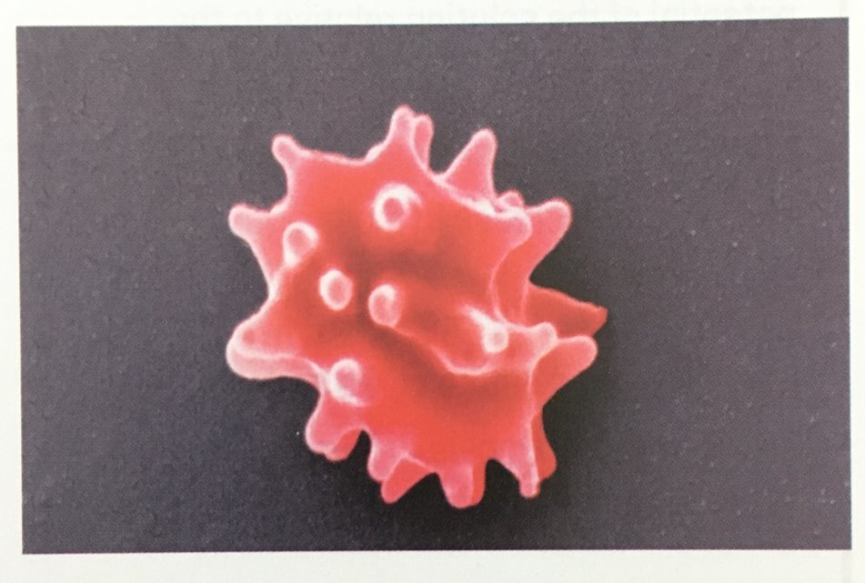
Crenated

Slide 34
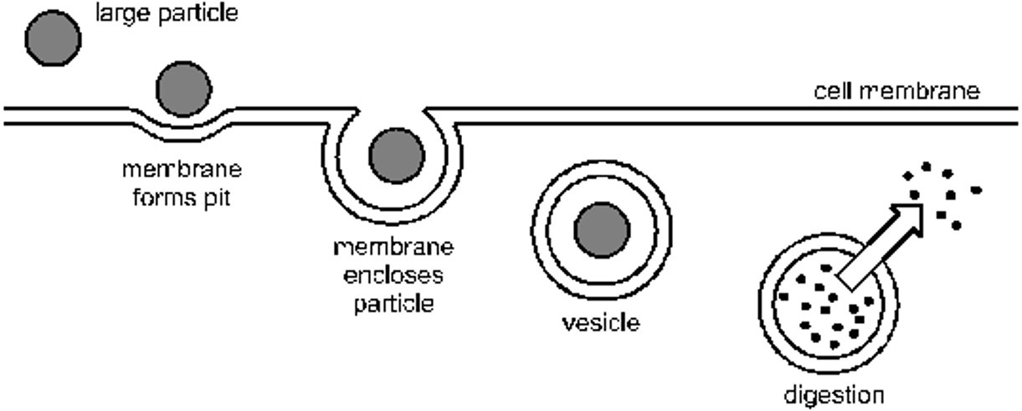
Endocytosis

Slide 35
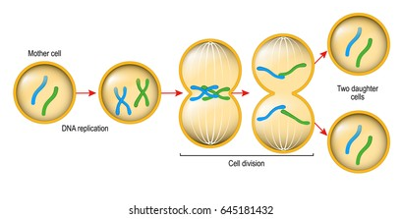
Mitosis

Slide 36
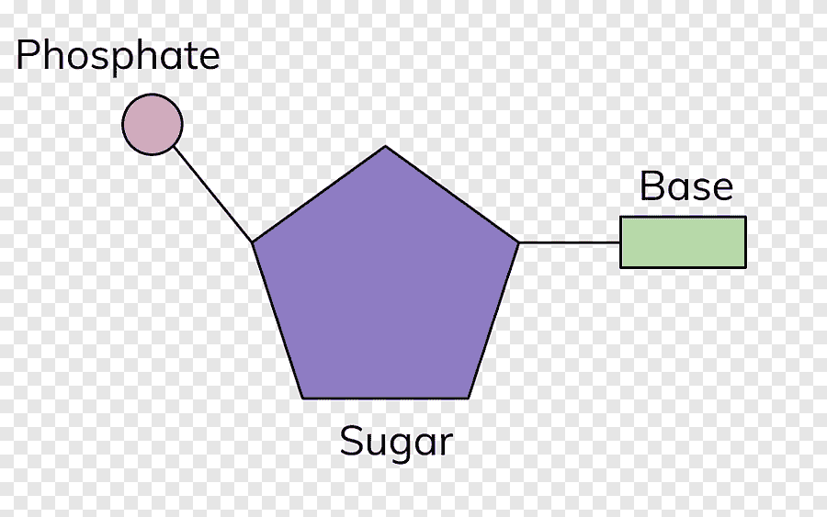
Nucleotide

Slide 37
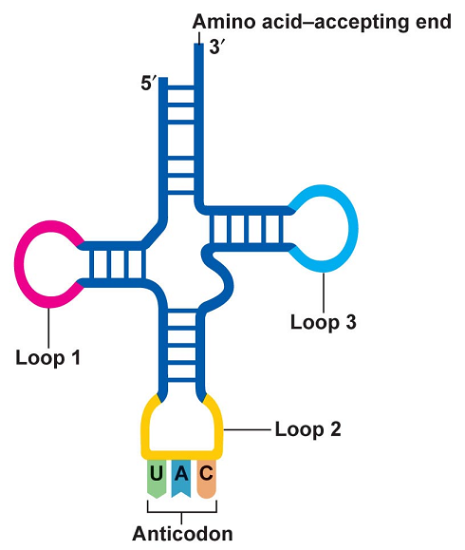
tRNA

Slide 38
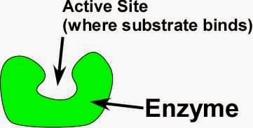
Active site

Slide 39
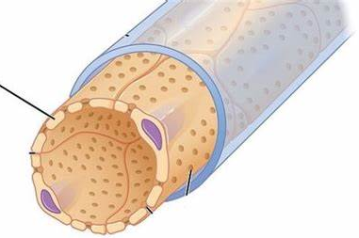
Endothelium

Slide 40
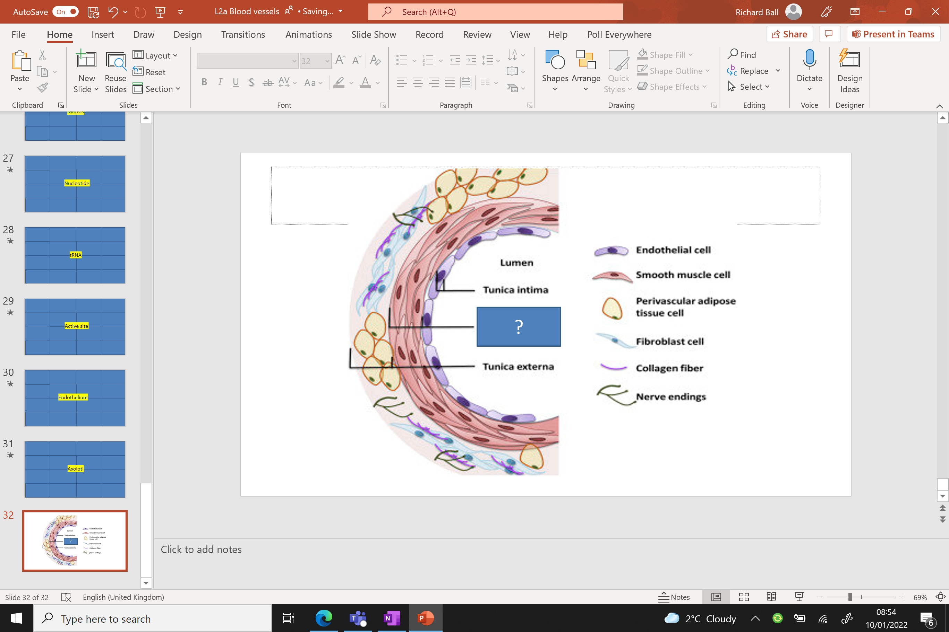
Tunica media

