Slide 1
Gas exchange – test feedback
Add corrections in different colour
Upload photo of test
Complete test analysis

Slide 2

Notes:
EVERYONE HAS A BUZZER!
just guess – can be frozen out

Slide 3
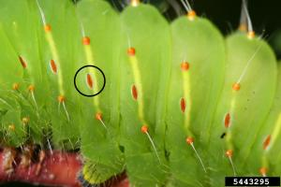
Spiracle

Slide 4
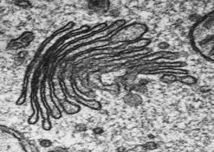
Golgi apparatus

Slide 5
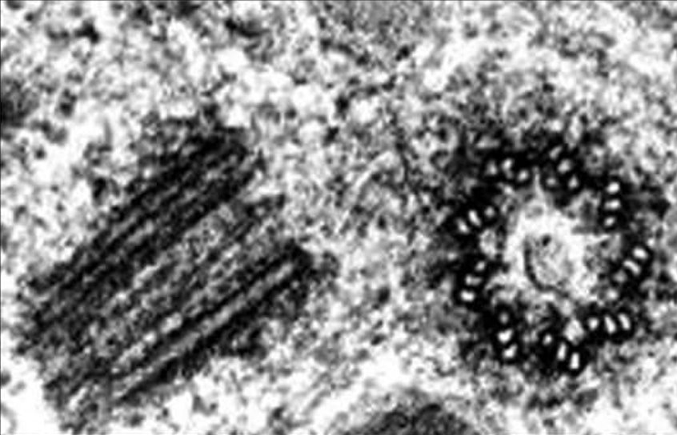
Centrioles

Slide 6
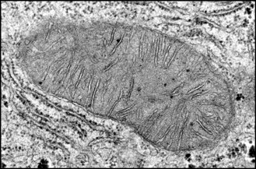
Mitochondria

Slide 7
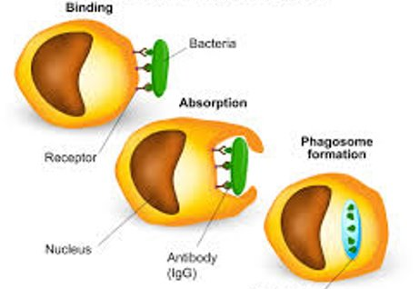
Phagocytosis / phagocyte

Slide 8
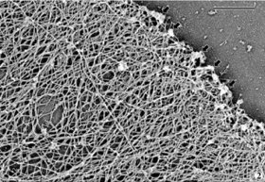
Cytoskeleton

Slide 9
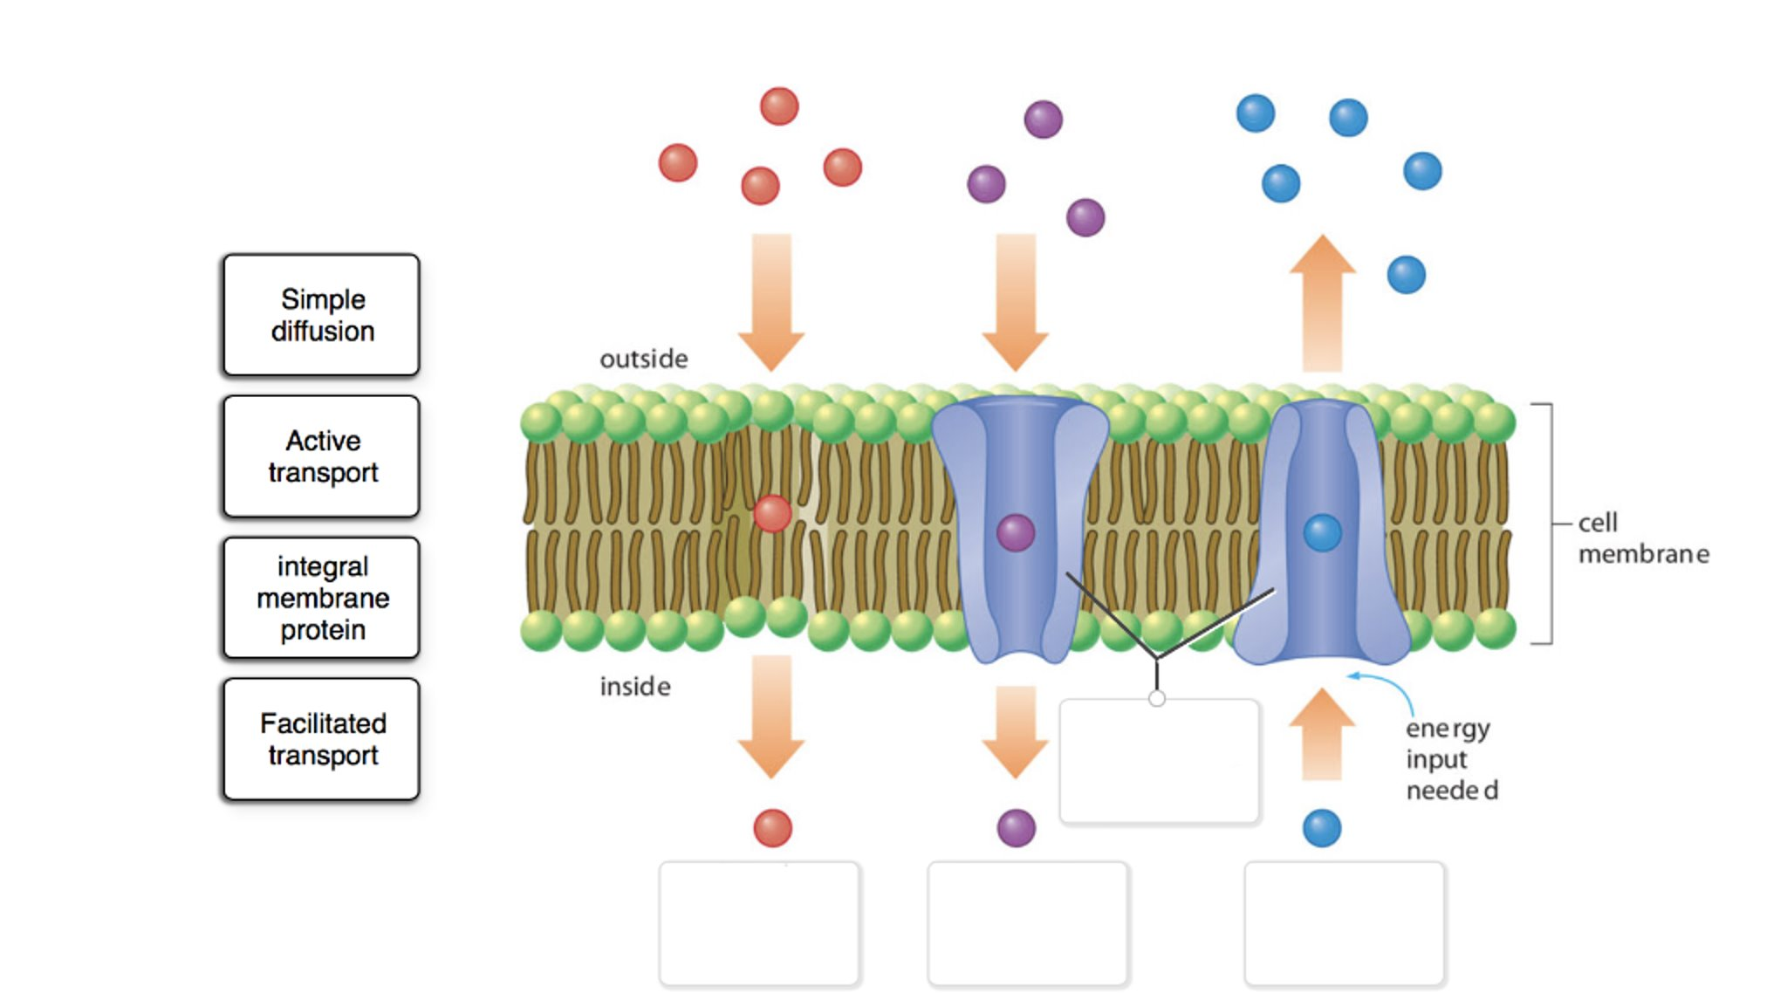
Active transport

Slide 10
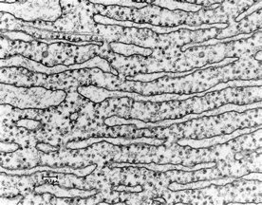
Rough endoplasmic reticulum

Slide 11
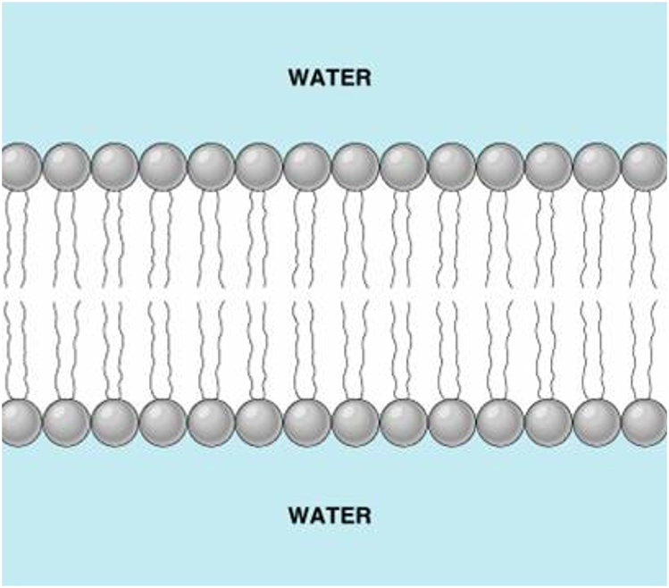
Phospholipid bilayer

Slide 12
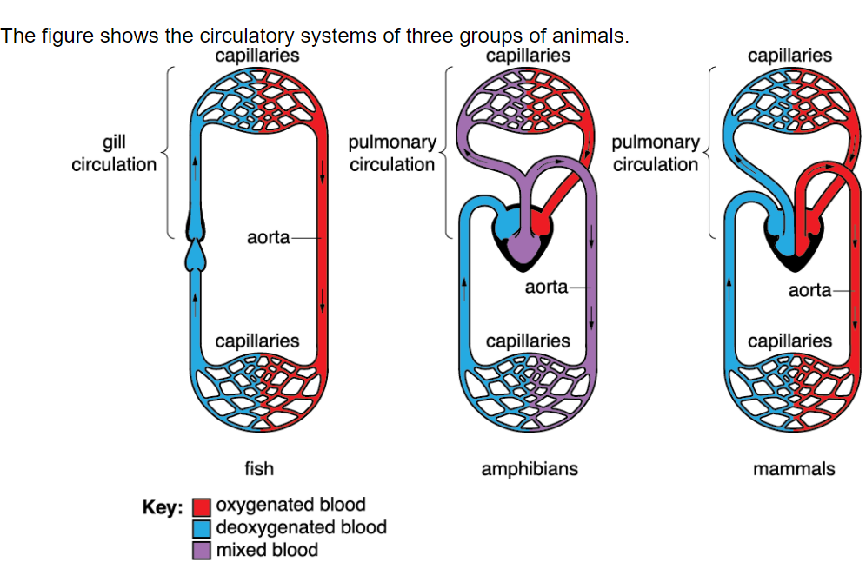
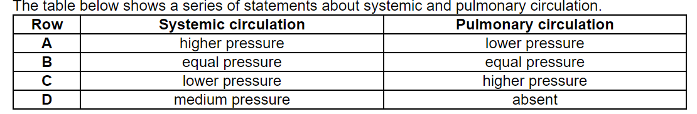
Knowledge retrieval questions Blood vessels L2
Q1. What type of circulatory system is shown in all three animals (1 marks)
Q2. How does the circulatory system of a fish compare to that of a mammal? (2 marks)​
Q3. Which of the rows, A to D, correctly describes a closed, double circulatory system? (1 marks)
Q4. The aquatic crustacean Daphnia magna has a heart that pumps a blood-like liquid called haemolymph around the body cavity. Which of the statements, A to D, describes the circulatory system of Daphnia magna? (1 marks)
Closed circulatory system / blood remains in system
(explanation also accepted …. oxy vs deoxy etc)
the fish has a single circulation
the mammal has a double circulation
A | single closed
B | single open
C | double open
D | double closed

Slide 13
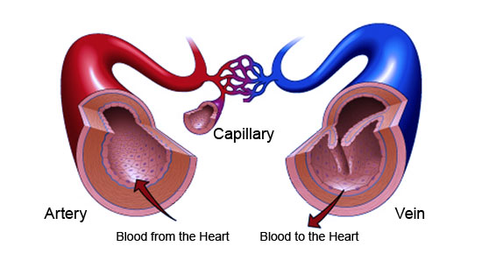
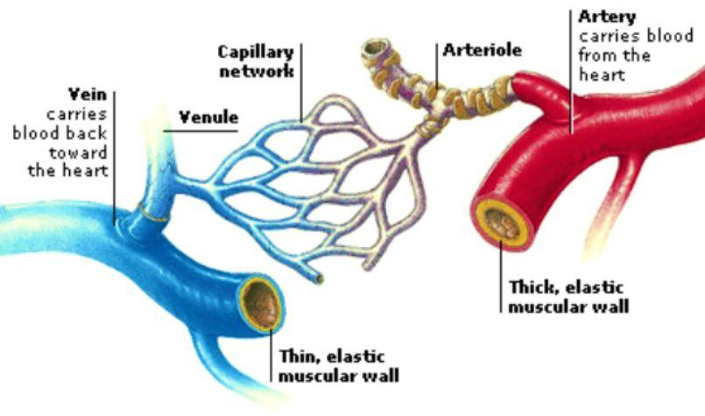
Arteries, arterioles, veins, venules and capillaries

Slide 14
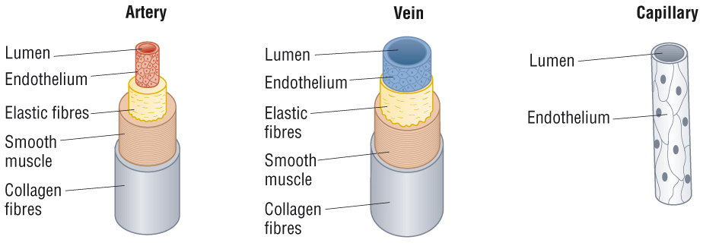
1. Lumen. Centre hollow cavity of blood vessel through which blood flows.
2. Endothelium. Thin inner layer for diffusion (capillaries), very smooth to prevent friction.
3. Elastic layer (contain elastin fibres) Helps to maintain blood pressure by stretching and springing back.
5. Tough outer layer, made of collagen fibres, which resists pressure changes from outside and within.
4. Smooth muscle layer. Can contract and relax to control volume of blood flow passing through them

Slide 15
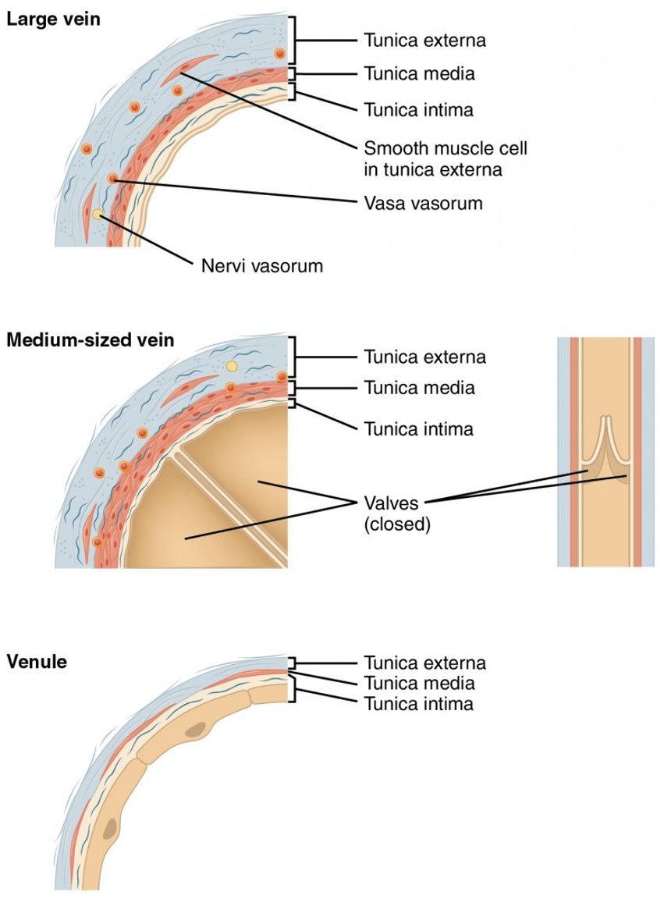

Slide 16
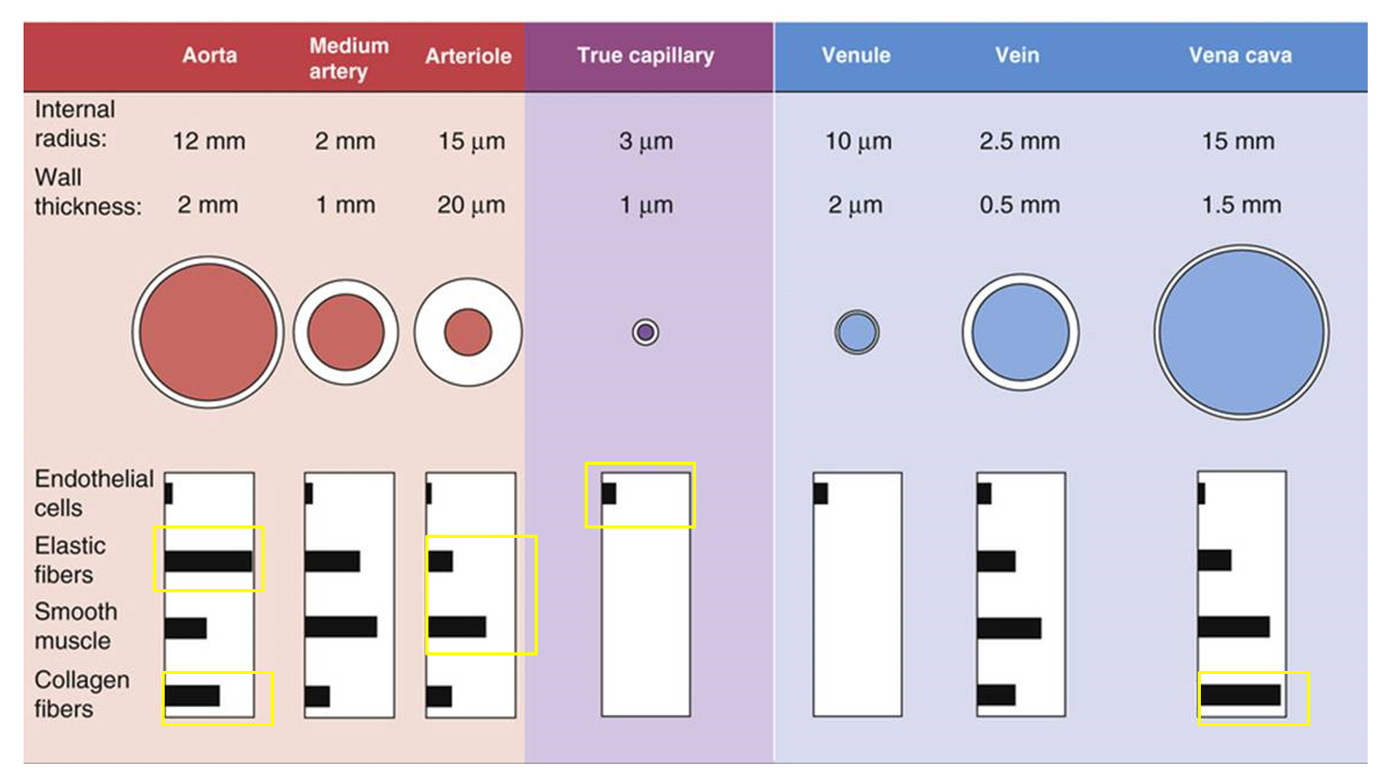
Endothelium - Thin inner layer for diffusion (capillaries), very smooth to prevent friction.
Elastin fibres - Helps to maintain blood pressure by stretching and springing back.
Smooth muscle layer - Can contract and relax to control volume of blood flow passing through them
Collagen fibres - tough outer layer which resists pressure changes from outside and within.

Slide 17
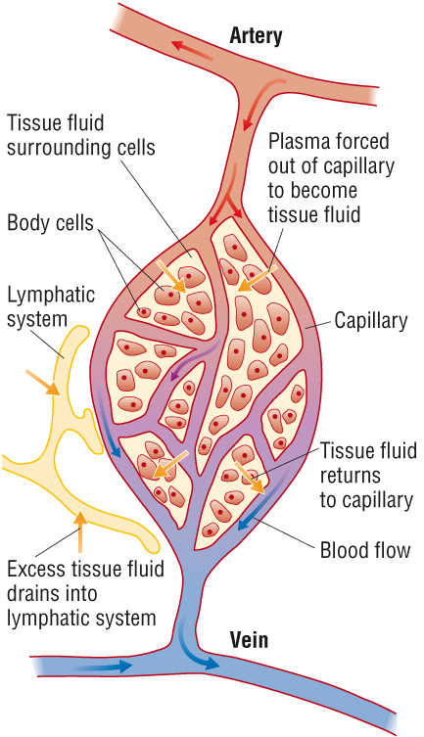
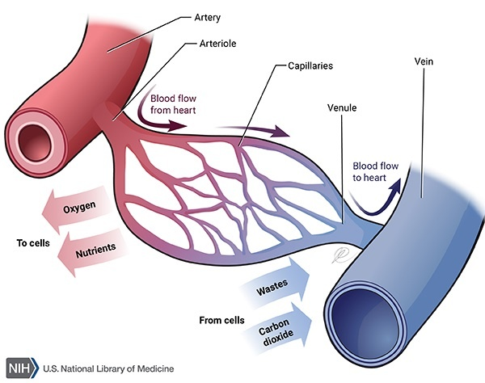
Arterioles and venules
*Lymphatic system function, like the venous system, is to return fluid from the tissues to the central circulation – more next lesson

Slide 18
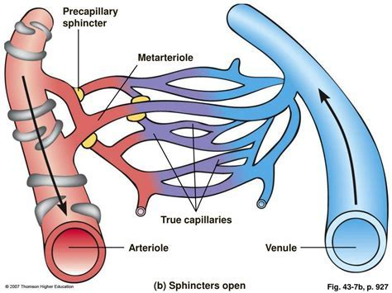
Precapillary sphincter is used to narrow or widen the arterioles by contacting or relaxing.

Slide 19
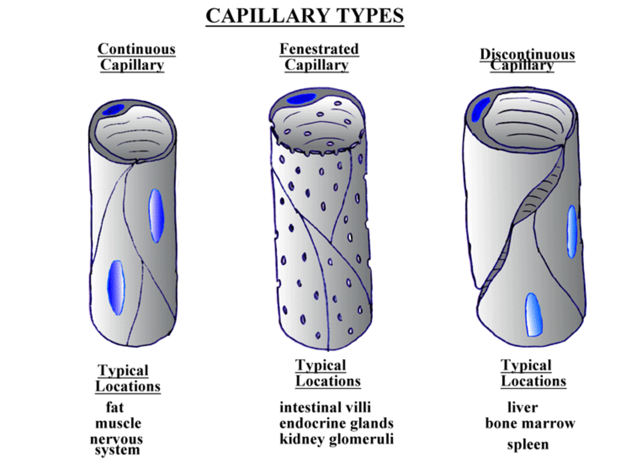

Slide 20
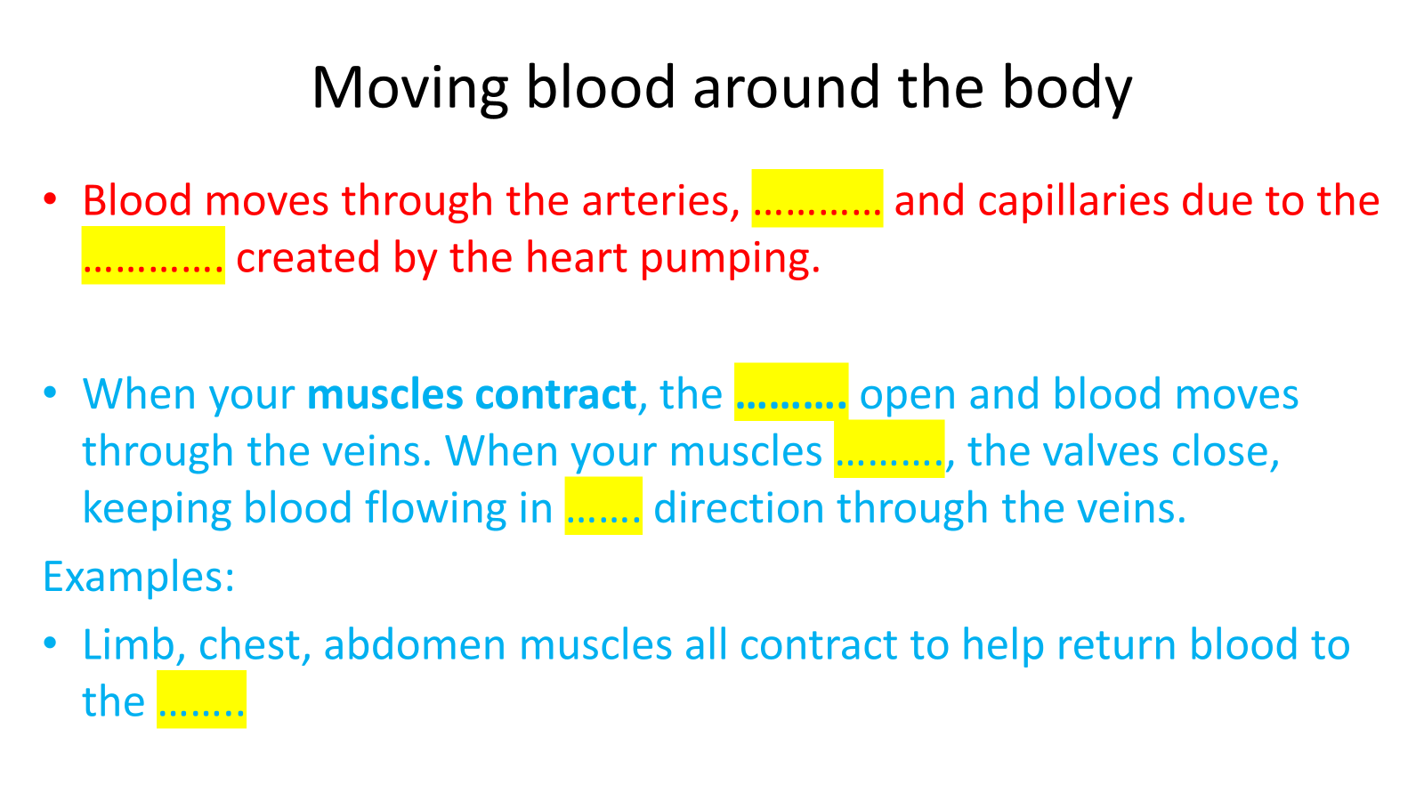
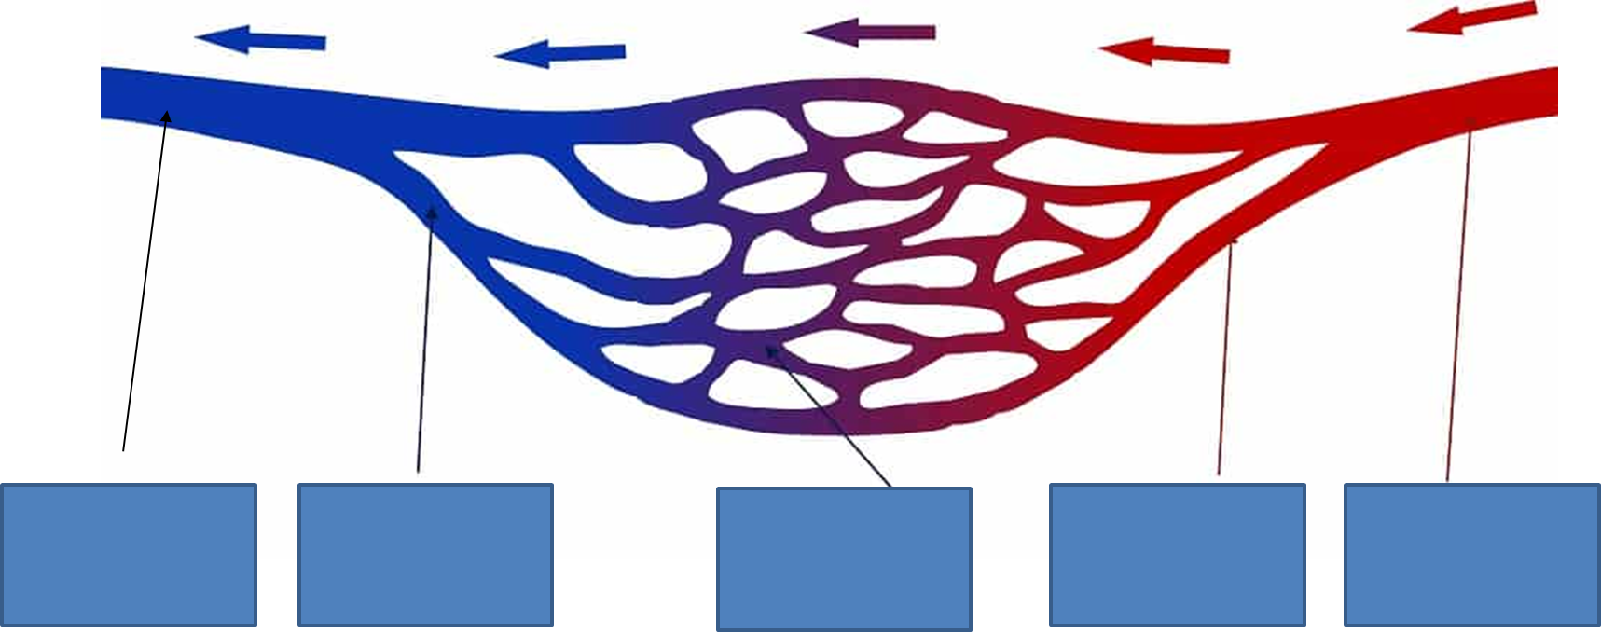
Label the diagram and complete the gap fill

Slide 21
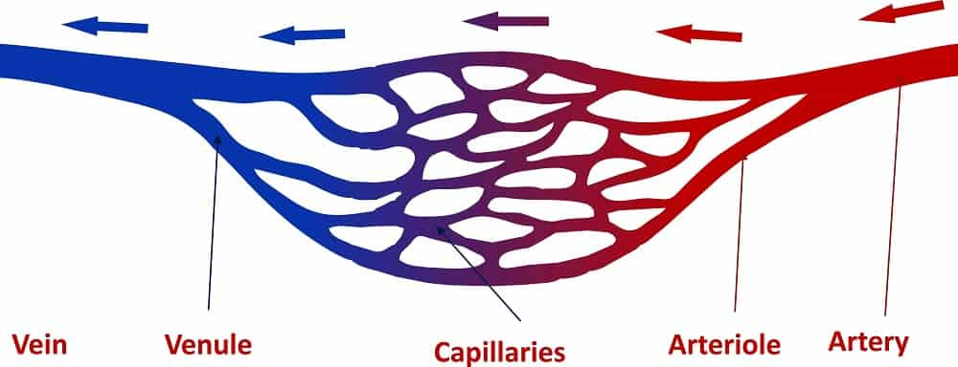
How does blood return to the heart?

Slide 22
How does blood return to the heart?

Slide 23
Moving blood around the body
Blood moves through the arteries, ………… and capillaries due to the …………. created by the heart pumping.
When your muscles contract, the ………. open and blood moves through the veins. When your muscles ………., the valves close, keeping blood flowing in ……. direction through the veins.
Examples:
Limb, chest, abdomen muscles all contract to help return blood to the ……..

Slide 24
Moving blood around the body
Blood moves through the arteries, arterioles and capillaries due to the pressure created by the heart pumping.
When your muscles contract, the valves open and blood moves through the veins. When your muscles relax, the valves close, keeping blood flowing in one direction through the veins.
Examples:
Limb, chest, abdomen muscles all contract to help return blood to the heart

Slide 25
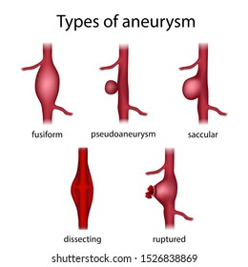
Aneurysm
A bulge or a weakness in a blood vessel (most commonly the aorta)
High blood pressure has been the best predictor in recent years.
Scientist have recently discovered that an increase in collagen in the aorta could also lead to an aneurysm.
Usual ratio of collagen:elastin in the aorta is 1.85:1
During large aneurysms its been found to be 7.91:1

Slide 26
EXAM TIPS
Questions on vessels always come up
These are usually comparative, make sure you are using words such as larger, smaller etc.
Elastin fibres STRETCH and RECOIL to maintain blood pressure
Smooth muscle fibres CONTRACT and RELAX to control volume of blood passing through them.
We will try some example questions after complete your comparison table

Slide 27
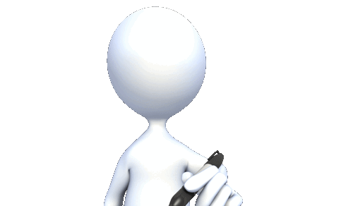
Move around the different stations in the room and to gather the information in the table
Vessel | Diagram (use internet) | Lumen size (Large or small) | Tissues present (smooth, elastic, collagen) | Direction of blood Tw | Pressure (High / low) | Valves present (yes / no)
Artery
Arteriole
Vein
Venule
Capillary
Complete the exam style questions when you are done!

Slide 28
The graph below shows the change in blood pressure as blood circulates around the body.
A
B
C
D
E
1. Identify the 5 types of blood vessel labelled A – E.
2. Explain why it is important the pressure drops as blood flows through vessel B.
lower pressure prevents capillaries from being damaged/ bursting
lower pressure slows the flow rate in the capillaries, allowing time for exchange
3. Explain why the pressure is at its lowest through vessel E.
The surge from the heart pumping is lost through the narrow capillaries
4. Which vessel holds the greatest volume of blood.
Vein (up to 60% of the body's blood)

Slide 29
The graph below shows the change in blood pressure as blood circulates around the body.
Using information from the graph:
1 a) Describe the function of arteries
to carry blood away from the heart to the organs under high pressure
1 b) Explain how the structural features of arteries allow them to carry out this function
elastic tissue (contains elastin fibres) allows arteries to stretch when the heart expels blood, and to recoil to maintain blood pressure when the heart is relaxing

Slide 30
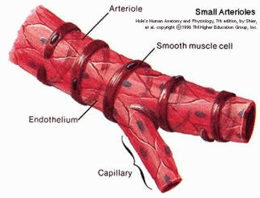
Describe the function of arterioles
To adjust flow rate & pressure of blood entering capillaries
Complete the table below describing the structural features of an arteriole
structural feature | present in arterioles | explain the function of the feature, or why it is not necessary
endothelium |  | smooth lining reduces friction
smooth muscle |  | vasoconstriction allows pressure and flow rate of blood into capillaries to be adjusted
elastic tissue |  | blood pressure needs to be reduced, so elastic stretch and recoil not needed
Explain the evidence from the graph that suggests arterioles contain little or no elastic tissue (3 marks)
The graph shows a decrease in blood pressure from 11kPa to 5.5kPa as blood moves through the arterioles
Elastic tissue can stretch and recoil to maintain blood pressure. Arterioles need to reduce blood pressure so contain more smooth muscle for vasoconstriction.

Slide 31
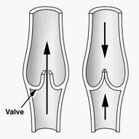
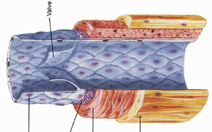
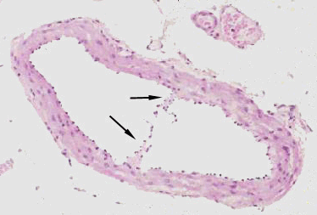
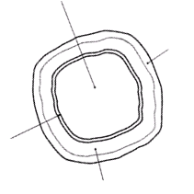
Veins carry blood from organs back to the heart under very low pressure
- so do not need thick walls of muscle and elastic tissue
Large veins contain valves to prevent backflow and ensure blood only moves in one
direction
-In the limbs, contraction of limb muscles helps move blood through veins
narrow lumen
Veins consist of the same 3 layers as arteries:
3
3
1
2
1
1
2
3
2
1 – tunica intima – single layer of flattened squamous endothelium cells
smooth lining reduces friction (which would slow down blood flow)
2– tunica media – thin wall of muscle and elastic tissue
much thinner than artery with less elastic tissue (blood pressure is lower and will not cause bursting. No recoil is needed.)
3 – tunica externa – fairly thick layer of collagen
no elastic tissue

Slide 32
The graph below shows the rate of blood flow in different blood vessels.
It also shows the total cross-sectional area of these blood vessels.
4. The rate of blood flow decreases from the aorta to the capillaries.
Use information from the graph to explain why.
large increase in total cross-sectional area (volume increases, so pressure decreases)
vessel diameters decrease, so resistance to the flow of blood increases
the further blood travels, the more it slows due to friction from blood vessel walls

Slide 33
Food for thought!
Why do people eat placentas? - BBC News

