Slide 1
BASIS OF COMPARISON | SIEVE TUBES | COMPANION CELLS
Description | Sieve Tubes are a series of cells placed end to end to form a continuous tube. | Companion cells are specialized parenchyma cell, located in the phloem of flowering plants and closely associated in development and function with sieve tube elements.
Nature Of Cells | They are usually living cells with an elongated structure. | They are living and elongated in structure with thin walls.
Mitochondria & Other Organelles | They contain fewer mitochondria. | They contain a large number of mitochondria and ribosomes as they are very metabolically active.
Function | They are responsible for the transport of food throughout the plant body. | They are responsible for regulating the activity of the sieve element.
Prominence Of Nucleus | No nucleus | Companion cells have a prominent elongated nucleus, which is retained throughout the life of the cell.
Metabolic Activity | They show low rate of metabolic activity. | They show high rate of metabolic activity.
Transverse Wall | The transverse wall of sieve tubes contains pores. | The transverse wall of companion cells does not contain pores.

Slide 2
REQ Microscopes for root vs stem vascular bundle observations
Dicot – roots , stem , leaves

Slide 3
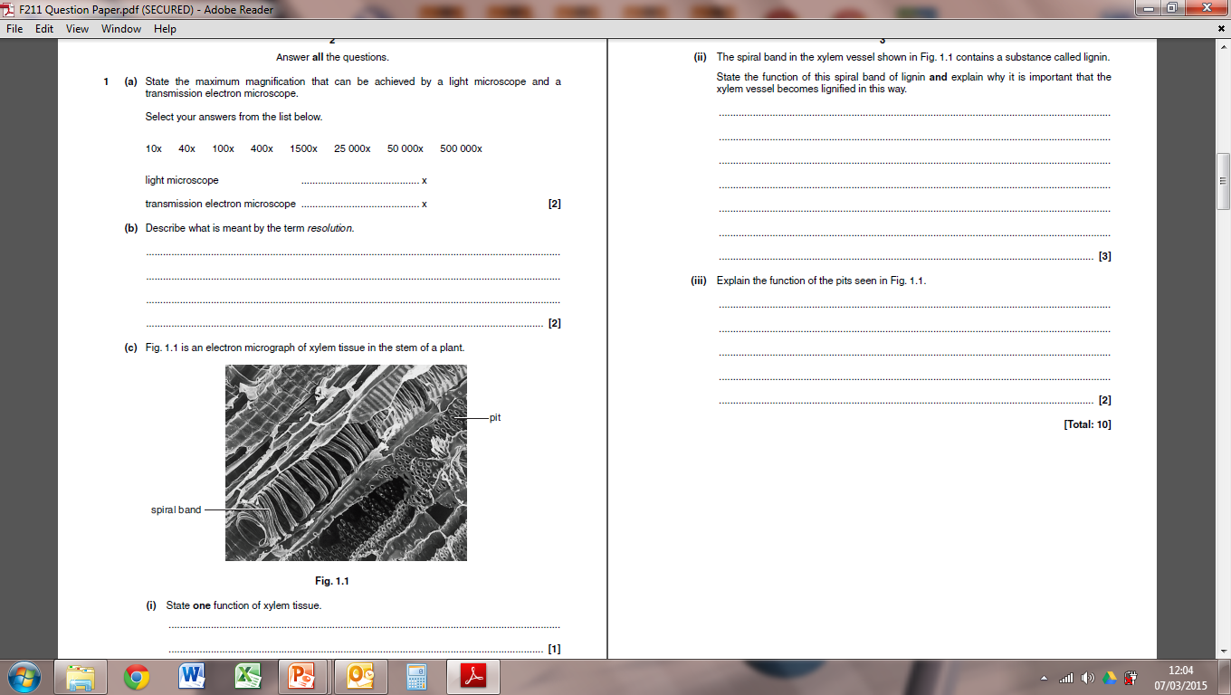
Lignin strengthens the xylem wall / prevents the collapse of the xylem (2 marks)
Waterproofing the wall / reduces water loss through the wall (2 marks)
Spiral pattern provides flexibility / prevents the stem from braking in the wind (2 marks)
1500x
500 000x
The ability to see two objects close together
In detail
They act as the channels for the transport of
water and minerals between adjacent cells.
Transport water up the plant
Transport mineral ions up the plant
Support the structure of the plant

Slide 4
https://pollev.com/science1s478

Slide 5
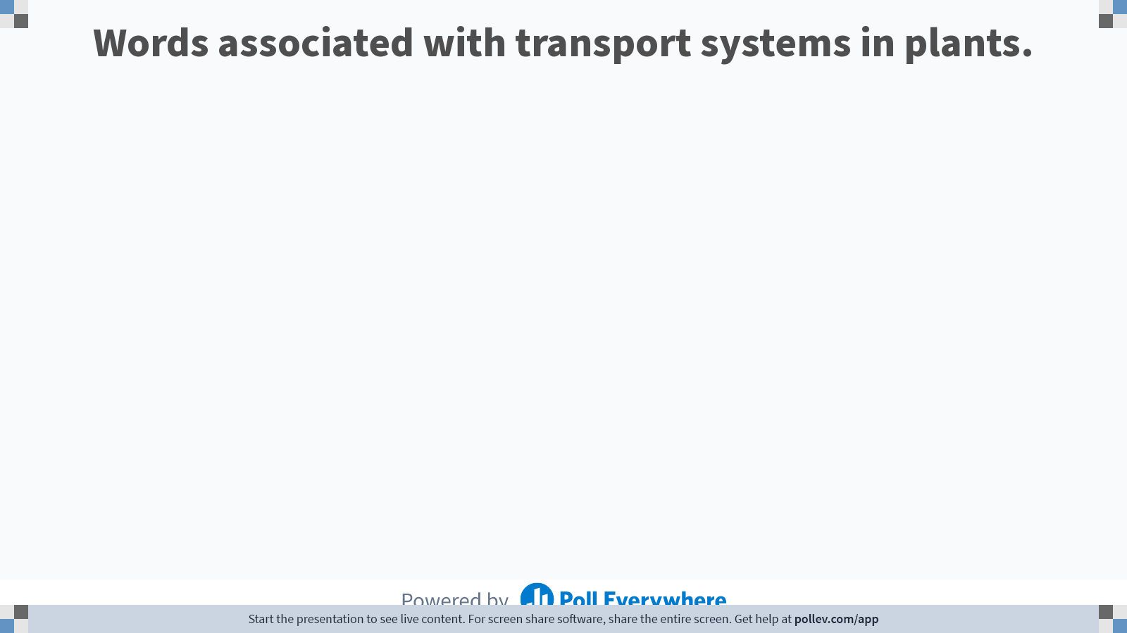
Notes:
Poll Title: Do not modify the notes in this section to avoid tampering with the Poll Everywhere activity.
More info at polleverywhere.com/support
Words associated with transport systems in plants.
https://www.polleverywhere.com/free_text_polls/ePIGrY4znNNMwxBMJr64a

Slide 6
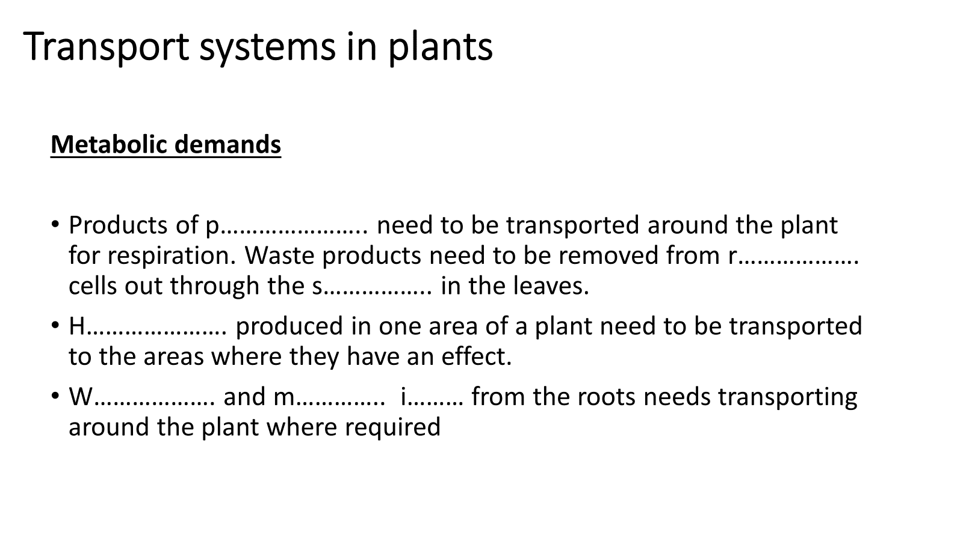
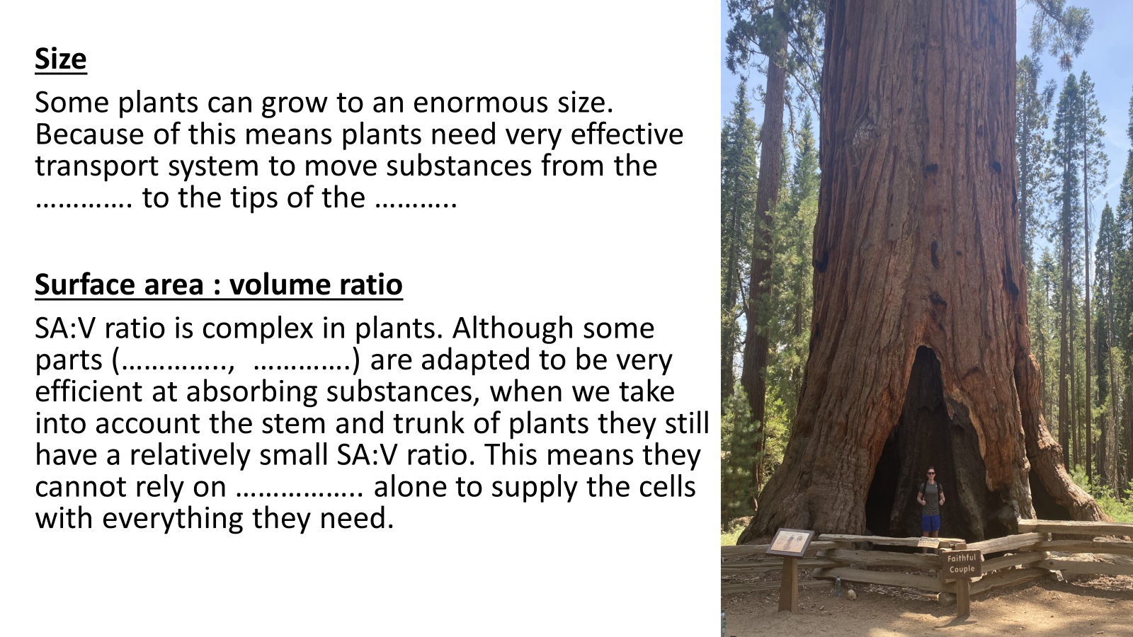
Quick recap!
Gap fill
Quick recap!
Gap fill

Slide 7
Transport system in plants
Metabolic demands
Products of photosynthesis need to be transported around the plant for respiration. Waste products need to be removed from respiring cells out through the stomata In the leaves.
Hormones produced in one area of a plant need to be transported to the areas where they have an effect.
Water and mineral ions from the roots needs transporting around the plant where required

Slide 8
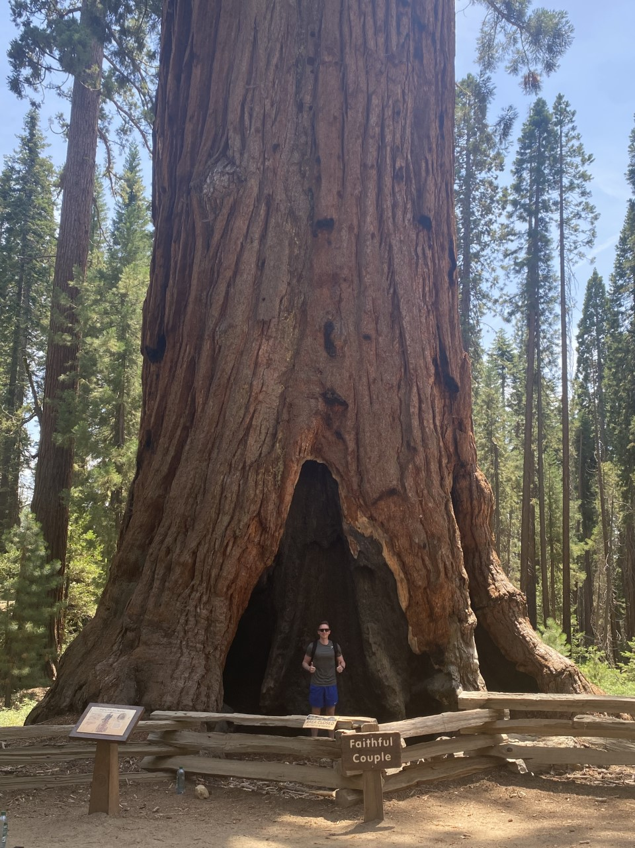
Size
Some plants can grow to an enormous size. Because of this it means plants need very effective transport system to move substances from the roots to the tips of the leaves.
Surface area : volume ratio
SA:V ratio is complex in plants. Although some parts (roots, leaves) are adapted to be very efficient at absorbing substances, when we take into account the stem and trunk of plants they still have a relatively small SA:V ratio. This means they cannot rely on diffusion alone to supply the cells with everything they need.

Slide 9
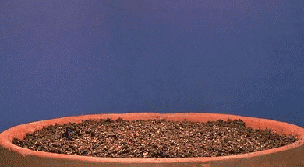
Monocot vs Dicot
Discuss the differences with your partner

Slide 10
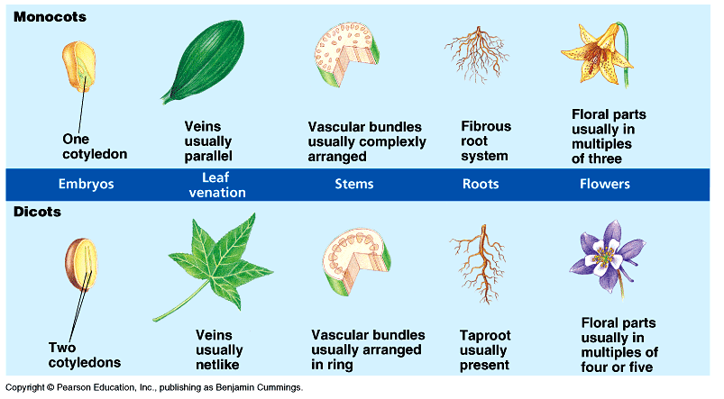
Notes:
Dicots make seeds that contain two cotyledons
The cotyledon forms the first leaves when the plant germinates
Cotyledon - an embryonic leaf in seed-bearing plants, one or more of which are the first leaves to appear from a germinating seed.

Slide 11
Dicotyledonous plants (dicots)
Make seeds that contain two cotyledons
The cotyledon forms the first leaves when the plant germinates
Types of dicots
Herbaceous dicots, with soft tissue and short life cycles (leaves, stems die at end of growing season)
Woody dicots, with hard lignified tissues and long life cycles.
We are looking at herbaceous dicots in this unit!

Slide 12
Vascular system in dicotyledonous plants
Dicotyledonous plants (dicots) have a series of transport vessels running through the stem, roots and leaves called the vascular system.
In herbaceous dicots this consists of two vessels:
Xylem
Phloem
The pattern of these vascular bundles differs from the root, stem and leaves……

Slide 13
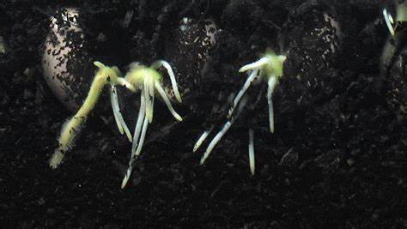

Slide 14

https://pollev.com/science1s478
Notes:
Vascular bundle found in the middle to help the plant withstand the tugging strains as the stem and leaves are blown in the wind.

Slide 15
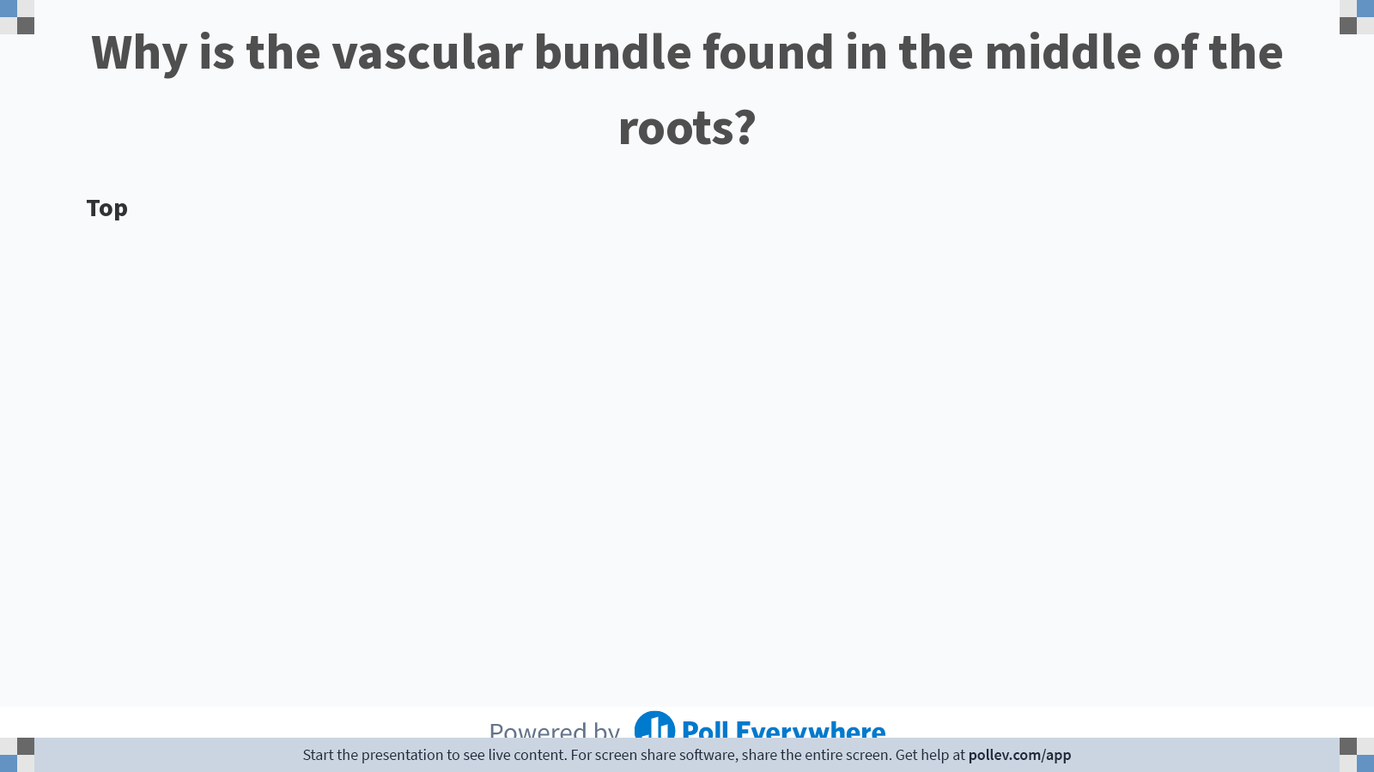
Notes:
Poll Title: Do not modify the notes in this section to avoid tampering with the Poll Everywhere activity.
More info at polleverywhere.com/support
Why is the vascular bundle found in the middle of the roots?
https://www.polleverywhere.com/discourses/odLdZRkWMzvKrt0FV2H5M

Slide 16
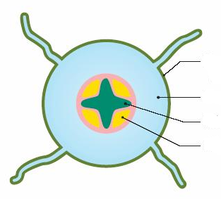
The roots
Vascular bundle found in the middle to help the plant withstand the tugging strains as the stem and leaves are blown in the wind.
Cross shape helps with strength
Notes:
Vascular bundle found in the middle to help the plant withstand the tugging strains as the stem and leaves are blown in the wind.

Slide 17
The roots
Endodermis
Epidermis
Vascular bundle found in the middle to help the plant withstand the tugging strains as the stem and leaves are blown in the wind.
Exodermis
Cortex – filled with parenchyma cells (packing/supporting tissue)
Xylem
Vascular bundle in the roots
Phloem
Cross shape helps with strength

Slide 18
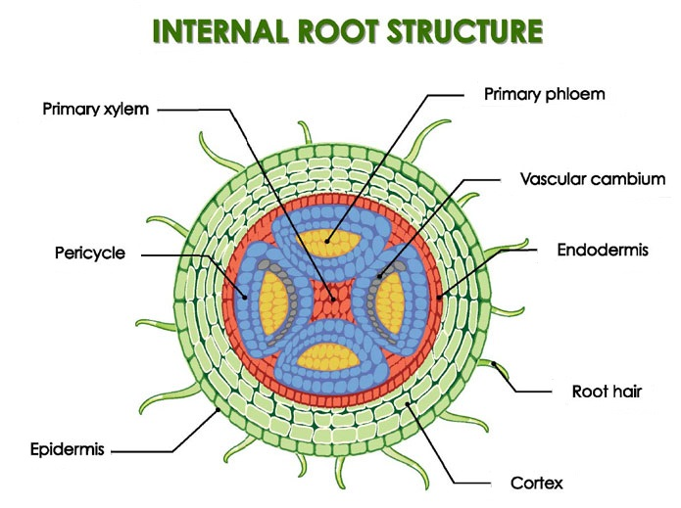
Pericycle
A thin layer of plant tissue between the endodermis and the phloem.
Cambium
A tissue layer that contains meristems (undifferentiated cells)
Notes:
Pericycle contains parenchyma tissue

Slide 19
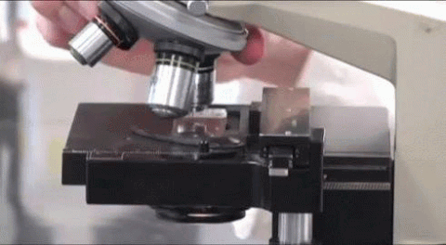
LETS TAKE A LOOK

Slide 20
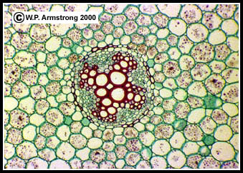
Under the microscope
C
A:
B:
C:
D:
Xylem
B
Phloem
A
D
Cortex/ parenchyma
Endodermis

Slide 21
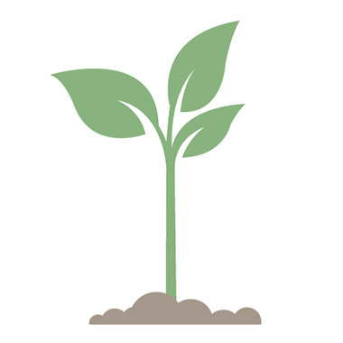

Slide 22
https://pollev.com/science1s478
Notes:
Vascular bundle found in the middle to help the plant withstand the tugging strains as the stem and leaves are blown in the wind.

Slide 23
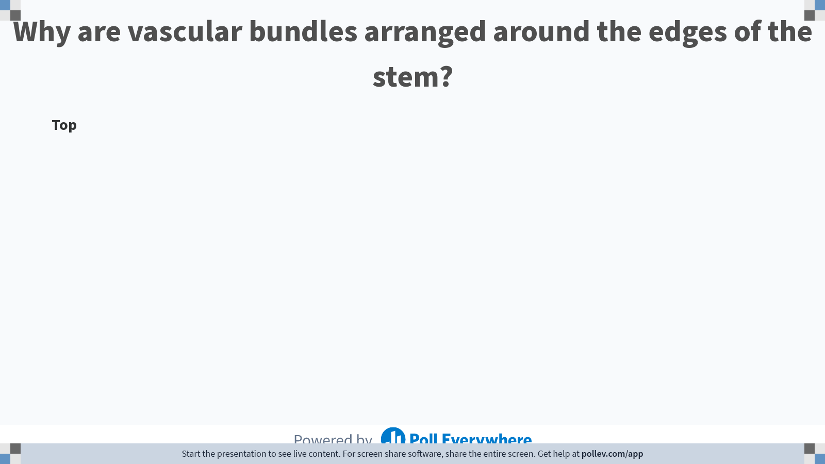
Notes:
Poll Title: Do not modify the notes in this section to avoid tampering with the Poll Everywhere activity.
More info at polleverywhere.com/support
Why are vascular bundles arranged around the edges of the stem?
https://www.polleverywhere.com/discourses/ZWv1Sr1O5WiferQ1DpUft

Slide 24
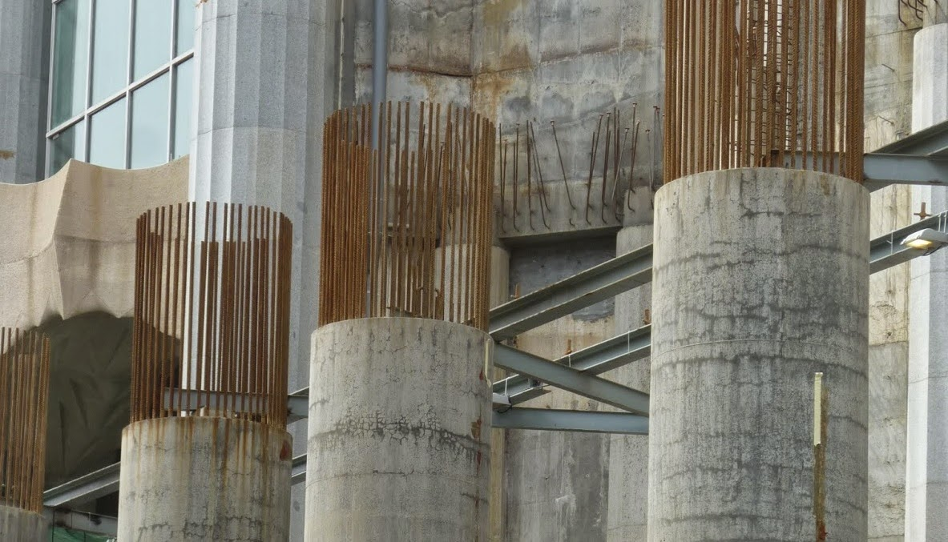
We design structures based on nature all the time!

Slide 25
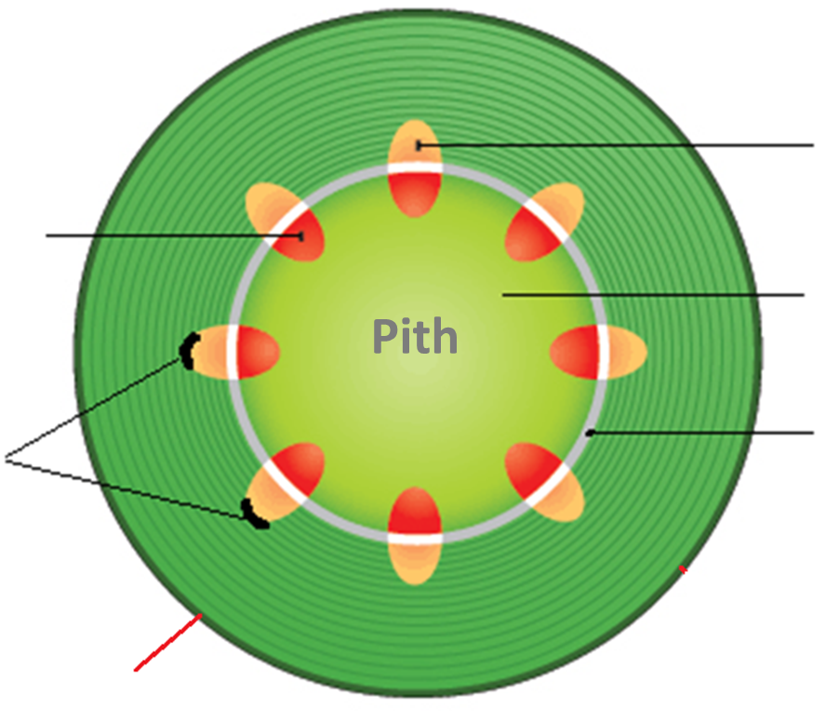
The stem
Vascular bundles arrange around the edge to give the stem structure and support

Slide 26

The stem
Vascular bundles arrange around the edge to give the stem structure and support
Phloem (outer edge)
Xylem (inner edge)
Parenchyma
Called the Pith (central packing tissue)
Sclerenchyma fibres
Fibrous cap on the outside of the vascular bundles
Contain lignin (impermeable)
Provides structure/support to the stem
Pith
Z
Cambium central line
(meristem cells)
Responsible for secondary growth
Epidermis (inside)
Exodermis (outside)
contain high cellulose levels
For structure and support
Meristem tissue
Notes:
Having the stronger xylem vessels in the centre provides strength to the stem and acts like an internal ‘scaffolding’ to support the stem and prevent it from breaking in the wind.

Slide 27
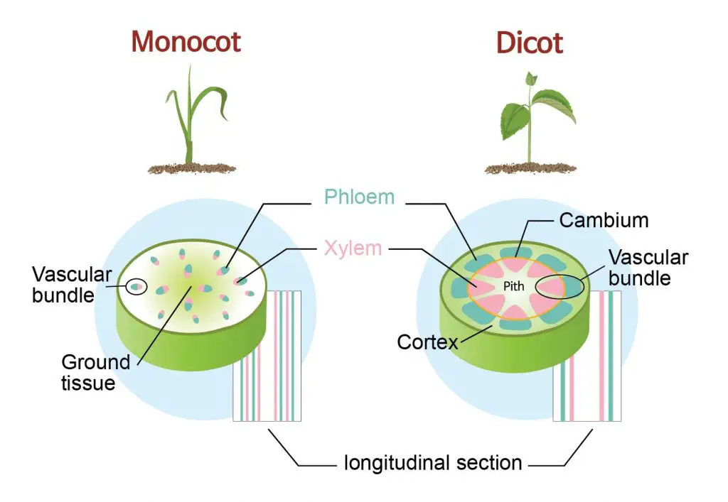

Slide 28
LETS TAKE A LOOK

Slide 29
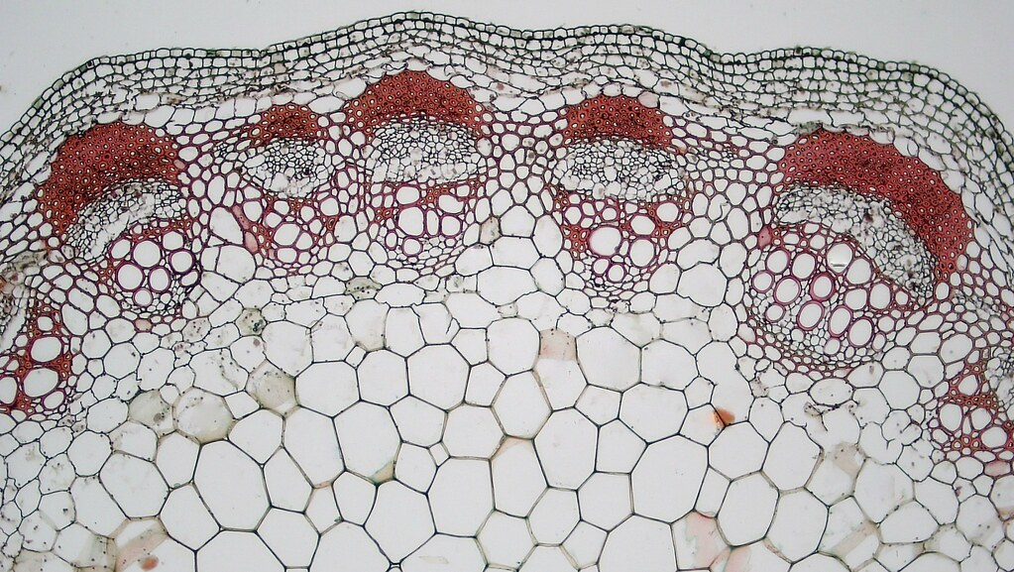
Stem under the microscope

Slide 30
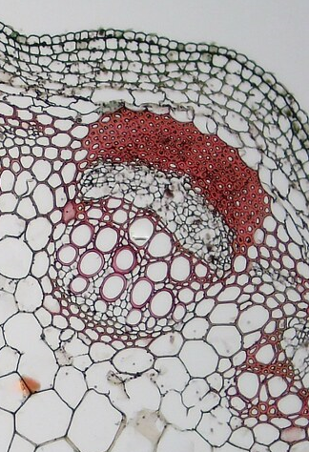
Label the image
F
A:
B:
C:
D:
E:
F:
A
C
B
D
E

Slide 31
F
A:
B:
C:
D:
E:
F:
Sclerenchyma fibres
A
Phloem
C
B
Cambium
D
Xylem
Cortex
E
Exodermis / epidermis

Slide 32
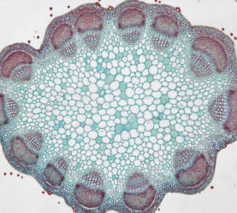
Vascular bundle
(dicot stem)
Use the prepared cross section slides to locate xylem, phloem, sclerenchyma and parenchyma.
Sclerenchyma
Phloem
Cambium (meristem)
Vascular bundle
Xylem
Pith (parenchyma)
Cortex (parenchyma)
Epidermis
Notes:
32

Slide 33
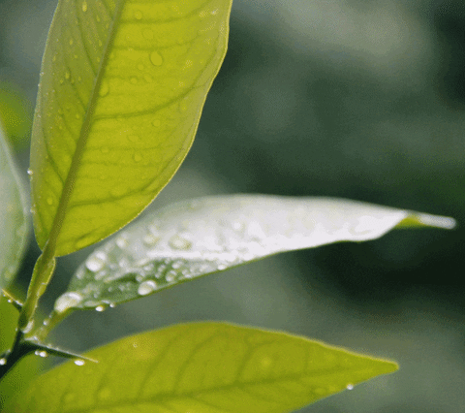

Slide 34
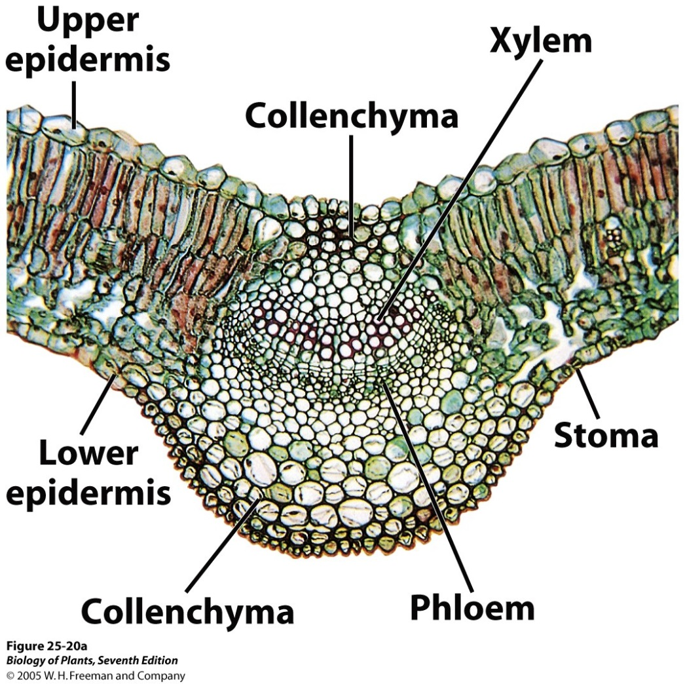
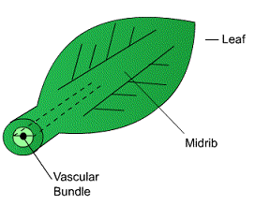
The xylem and phloem in the leaf
The vascular bundles form the midrib and veins of a leaf.
Within each vein, the xylem is located on top of the phloem.
Palisade mesophyll
Midrib
Collenchyma tissue – Also provide structural support / manufacture starch

Slide 35
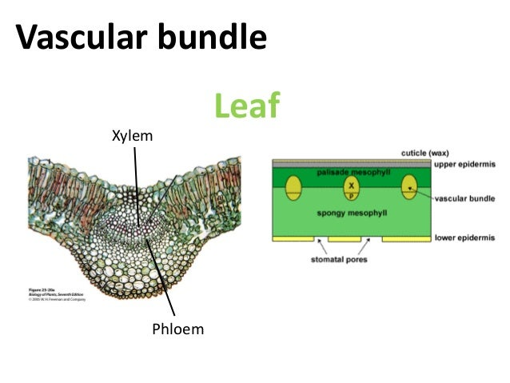

Slide 36
LETS TAKE A LOOK

Slide 37
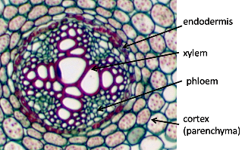
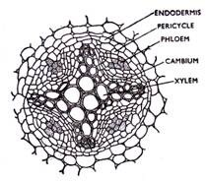
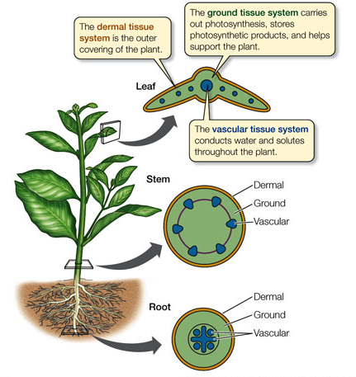
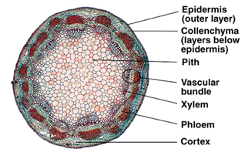
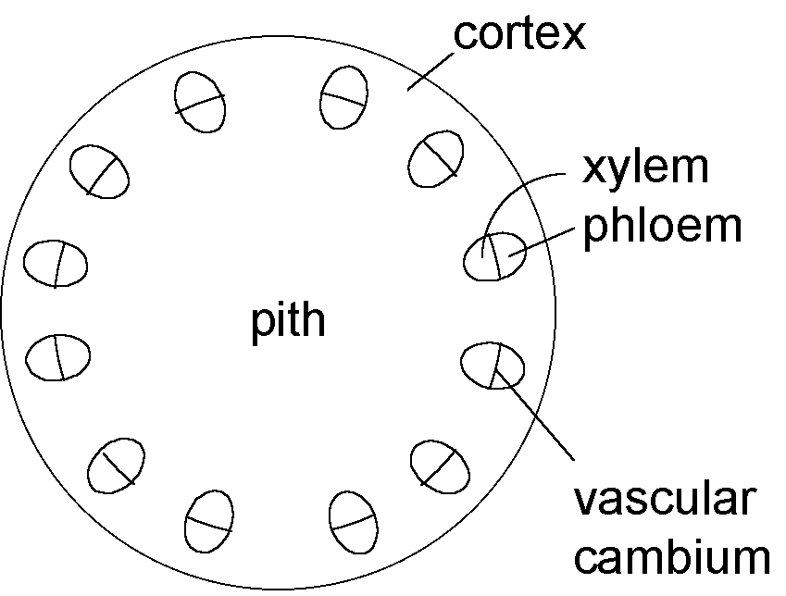

Summary

Slide 38
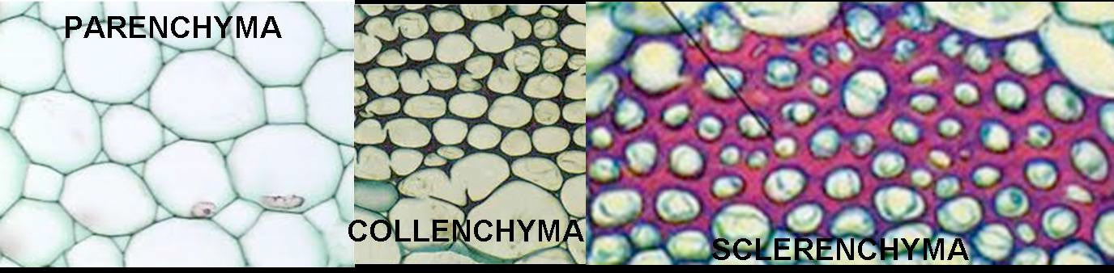
Tissues in plants
Parenchyma
Support/packing tissue, most typical type of plant cell
Collenchyma
Support, primarily around fast growing parts of the plant (leaves)
Sclerenchyma
Support, has a secondary lignified wall for additional support

Slide 39
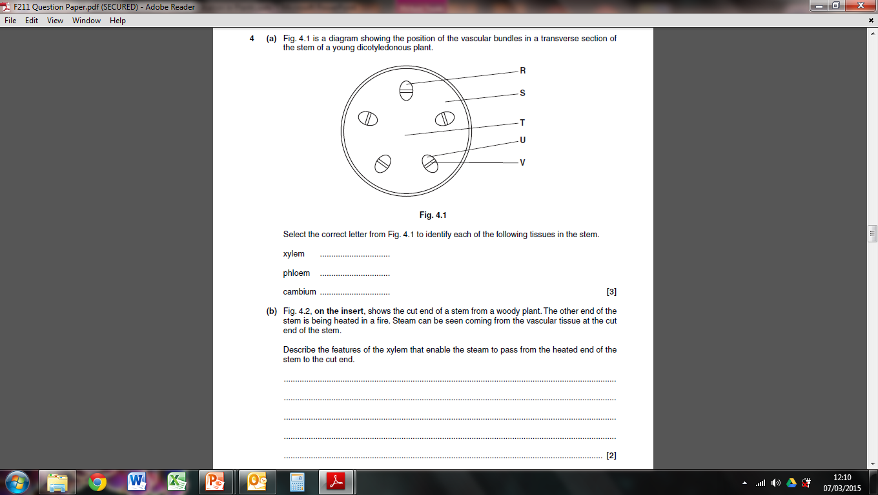
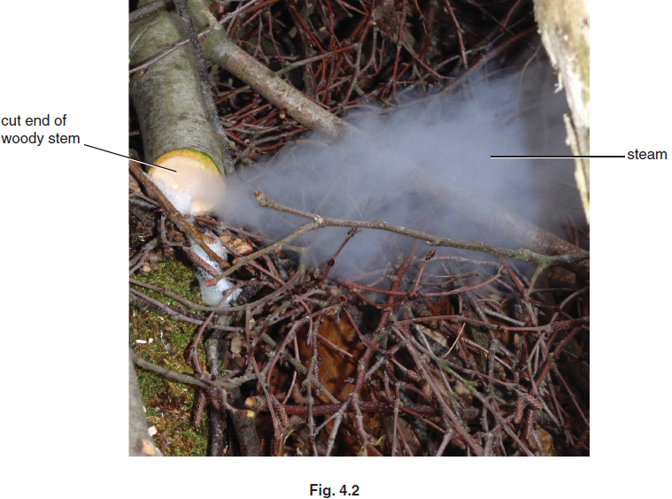
TRY THESE

Slide 40
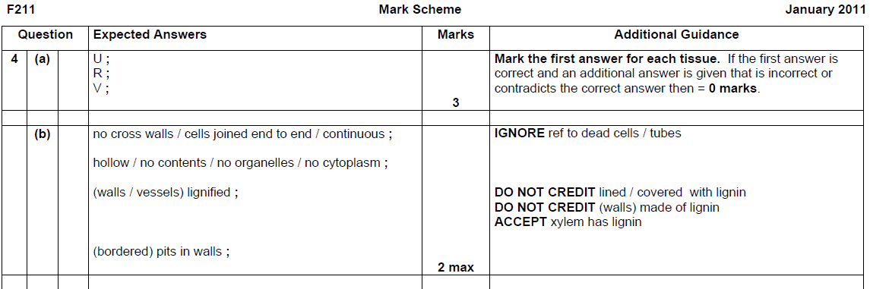
Mark Scheme (2)

Slide 41
Summary
Xylem | Phloem
Vascular bundle (containing xylem and phloem) in the centre of the root. This arrangement provides strength to withstand pulling forces to which the root is exposed
In the root, xylem is found in centre (cross shaped) | In the root, phloem is found between the arms of the cross of the xylem
Around the vascular bundle is the pericycle, a series of meristem cells, which can divide for growth of the root.
Vascular bundles are located on the outer edges in a circular arrangement. This arrangement provides strength and flexibility to withstand bending forces.
In stem, xylem is found in the inner section of vascular bundle | In stem, phloem is found in the outer section of vascular bundle
Between xylem and phloem is the cambium, a layer of meristem cells which can divide for growth of new xylem and phloem
Vascular bundles in midrib and veins of leaf
Xylem on top | Phloem on bottom

Slide 42
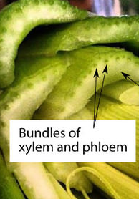
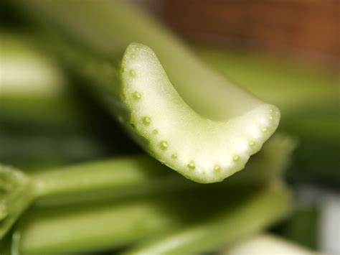
Open the PAG worksheet in the PAG folder

Slide 43
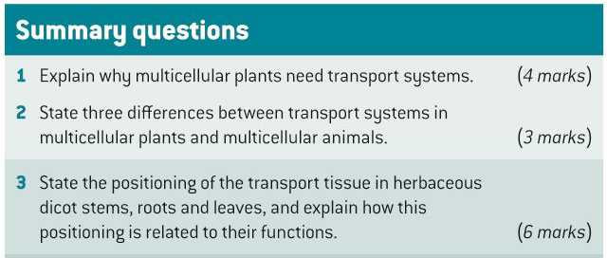
Review Questions
Answer the summary questions
Then answer the past exam question on the sheet

Slide 44
Answers
1
Too big for diffusion as SA : V ratio too small for diffusion to be effective means of transport (1);
transport system required for transporting glucose for respiration (1);
waste product removal (1);
water and mineral ions from roots to all the cells (1);
hormones made in one part of a plant to the areas where they have an effect (1).
2
In plants no heart to act as central pump, whereas many multicellular animals have heart (1);
in plants one type of vessel is made of dead cells – all animal vessels made of living tissue (1);
in plants there are two different transport systems carrying different materials – animals have different types of vessels but the same transport medium in both (1).

Slide 45
Answers
3
Stem – vascular bundles around outside (1); helps give strength and support to structure (1);
Roots – vascular bundles in centre (1); to help give strength against tugging forces when plant blown by wind (1);
Leaves – large central vein containing vascular tissue (1) gives supports to broad structure of leaf (1).

Slide 46
Key words / definitions (match them to the word on sheet)
contains parenchyma tissue, for packing (filling) of the root
fibrous caps on the outer layer of the vascular bundles, containing lignin
contains meristem tissue for secondary growth
contains parenchyma tissue, for packing (filling) of the stem
tissue containing cellulose for structure/support
cavities in the lignified cell walls of xylem, which act as a channel for water and mineral ions into the adjacent cells.

Slide 47
Key words / definitions
Cortex – contains parenchyma tissue, for packing (filling) of the root
Pith – contains parenchyma tissue, for packing (filling) of the stem
Cambium – contains meristem tissue for secondary growth
Collenchyma – tissue containing cellulose for structure/support
Sclerenchyma – fibrous caps on the outer layer of the vascular bundles, containing lignin
Pits - cavities in the lignified cell walls of xylem, which act as a channel for water and mineral ions into the adjacent cells.

