Slide 1
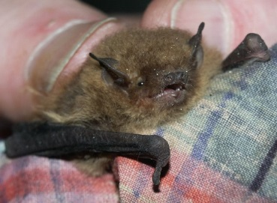
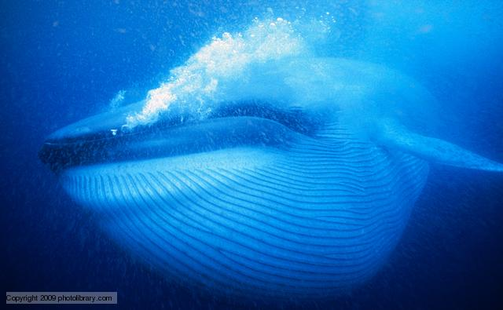
Temperature control
The physiological and behavioural responses involved in temperature control in ectotherms and endotherms.
To include: endotherms – peripheral temperature receptors, the role of the hypothalamus and effectors in skin and muscles; behavioural responses; ectotherms – behavioural responses.
Scientifically speaking, how is a microbat different from a blue whale? How is this related to the topic about temperature changes?
Bats have a larger SA:V ratio, struggle to maintain body temperature and, as a result, have a much higher metabolism. Why?
1 cm
5 m
Pipistrellus pipistrellus (Pipistrellus pygmaeus)
40 m
Balaenoptera musculus

Slide 2


Slide 3
Knowledge retrieval task
Q1. Homeostasis has been defined as ‘the maintenance of a constant or stable internal environment’.
Explain why the word ‘stable’ is more appropriate than the word ‘constant’ in a definition of homeostasis (2 marks)
not constant because - idea that internal conditions, fluctuate / AW;
stable because - idea of set, limits / points;
Q2. Asexual reproduction and the ability to produce natural reproductive clones is common in plants but rare in animals.
Explain why plants are more able to form natural reproductive clones than animals (2 marks)
(most) plant cells retain ability to differentiate / totipotent;
plants have, meristems / meristematic tissue;
(most) animal cells are, differentiated / not totipotent
idea that plant cells can de-differentiate and then differentiate into a different cell type;
Notes:
Beta cells secrete insulin

Slide 4
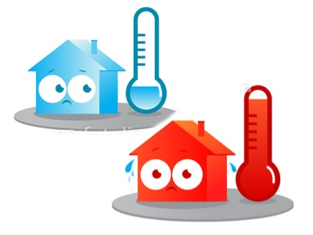
How does the body respond to changes in temperature?

Slide 5
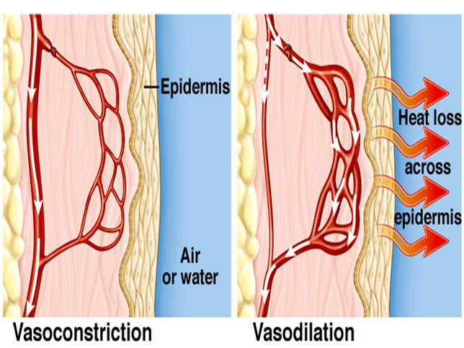
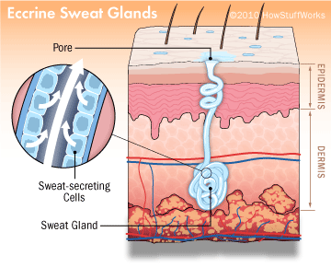
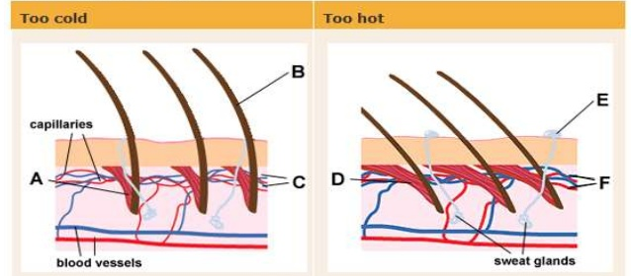
Thermoregulation

Slide 6
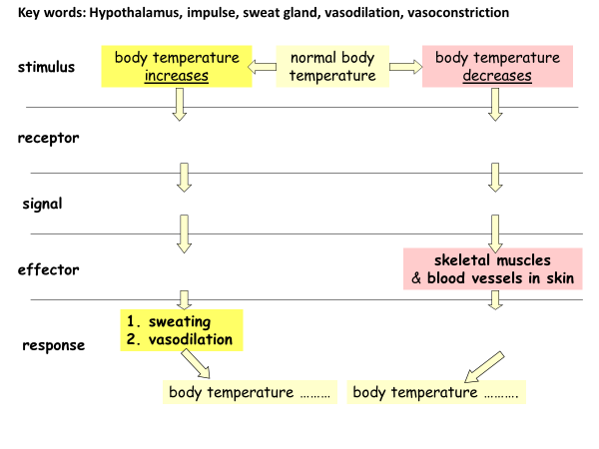
Thermoregulation – maintaining a stable body temperature
Complete the table below to describe the response of our bodies to a rise or fall in temperature, and explain how each response works:
condition | response | explanation
too hot (increased body temperature) | sweating | evaporation of sweat removes heat
 | vasodilation | blood flows close to surface of skin and loses heat
too cold (decreased body temperature) | shivering | muscle contraction generates heat
 | vasoconstriction | blood diverted away from the surface of the skin, and so loses less heat

Slide 7
Thermoregulation – maintaining a stable body temperature
Complete the table below to describe the response of our bodies to a rise or fall in temperature, and explain how each response works:
condition | response | explanation
too hot (increased body temperature) | sweating | evaporation of sweat removes heat
 | vasodilation | blood flows close to surface of skin and loses heat
too cold (decreased body temperature) | shivering | muscle contraction generates heat
 | vasoconstriction | blood diverted away from the surface of the skin, and so loses less heat

Slide 8
Key words: Hypothalamus, impulse, sweat gland, vasodilation, vasoconstriction
body temperature increases
normal body temperature
body temperature decreases
stimulus
receptor
signal
skeletal muscles
& blood vessels in skin
effector
sweating
vasodilation
response
body temperature ………
body temperature ……….

Slide 9
Key words: Hypothalamus, impulse, sweat gland, vasodilation, vasoconstriction
body temperature increases
normal body temperature
body temperature decreases
stimulus
receptor
receptors in skin and brain (hypothalamus)
receptors in skin and brain (hypothalamus)
signal
nerve impulse
nerve impulse
sweat glands
& blood vessels in skin
skeletal muscles
& blood vessels in skin
effector
sweating
vasodilation
shivering
vasoconstriction
response
body temperature falls
body temperature rises

Slide 10
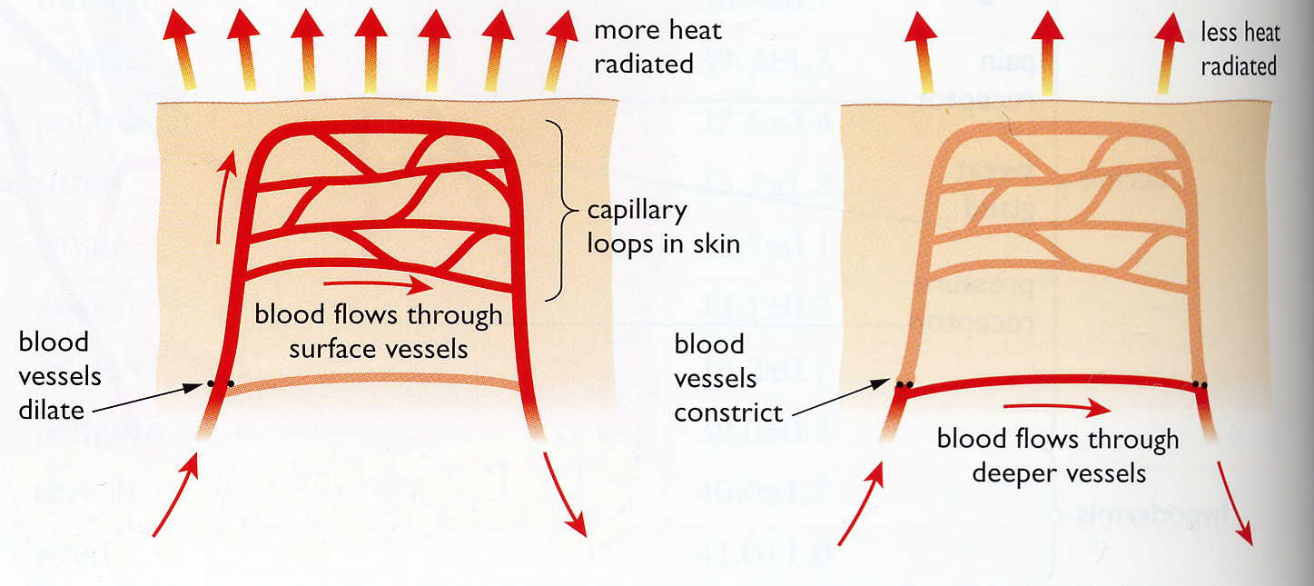
warm blood loses
heat by radiation
less blood flows close to the surface of the skin
arterioles (blood vessels)
Near the surface of the skin dilate
vasoconstriction
vasodilation
so less heat is
lost by radiation
more blood flows close to the surface of the skin
arterioles (blood vessels)
near the surface of the skin constrict
Place the boxes into the correct sequence to explain the processes of vasodilation and vasoconstriction:

Slide 11
vasodilation
vasoconstriction
arterioles (blood vessels)
near the surface of the skin dilate
arterioles (blood vessels)
near the surface of the skin constrict
more blood flows close to the surface of the skin
less blood flows close to the surface of the skin
so less heat is
lost by radiation
warm blood loses
heat by radiation

Slide 12
Problems associated with movement of temperature away from the optimum include….
Optimum to excessively hot
…………… energy increases
Substrate molecules move …………
Higher ……………. frequency
Higher rate of …………….. collisions
Kinetic energy of enzyme increases
KE greater than bonds keeping tertiary and secondary structure in place
Bonds break (H-bond, ionic, hydrophobic, hydrophilic)
Tertiary structure ……………
…………… site changes shape
Substrates no longer have ……………………… shape
Enzyme …………… and no longer catalyse chemical reaction
Optimum to excessively cold
Kinetic energy decreases
Substrate molecules move ………….
Lower collision ……………..
Lower rate of successful collisions
Kinetic energy of ………… decreases
Rate of ………………. reactions decrease

Slide 13
Problems associated with movement of temperature away from the optimum include….
Optimum to excessively hot
Kinetic energy increases
Substrate molecules move faster
Higher collision frequency
Higher rate of successful collisions
Kinetic energy of enzyme increases
KE greater than bonds keeping tertiary and secondary structure in place
Bonds break (H-bond, ionic, hydrophobic, hydrophilic)
Tertiary structure changes
Active site changes shape
Substrates no longer have complementary shape
Enzyme denatured and no longer catalyse chemical reaction
Optimum to excessively cold
Kinetic energy decreases
Substrate molecules move slower
Lower collision frequency
Lower rate of successful collisions
Kinetic energy of enzyme decreases
Rate of chemical reactions decrease

Slide 14
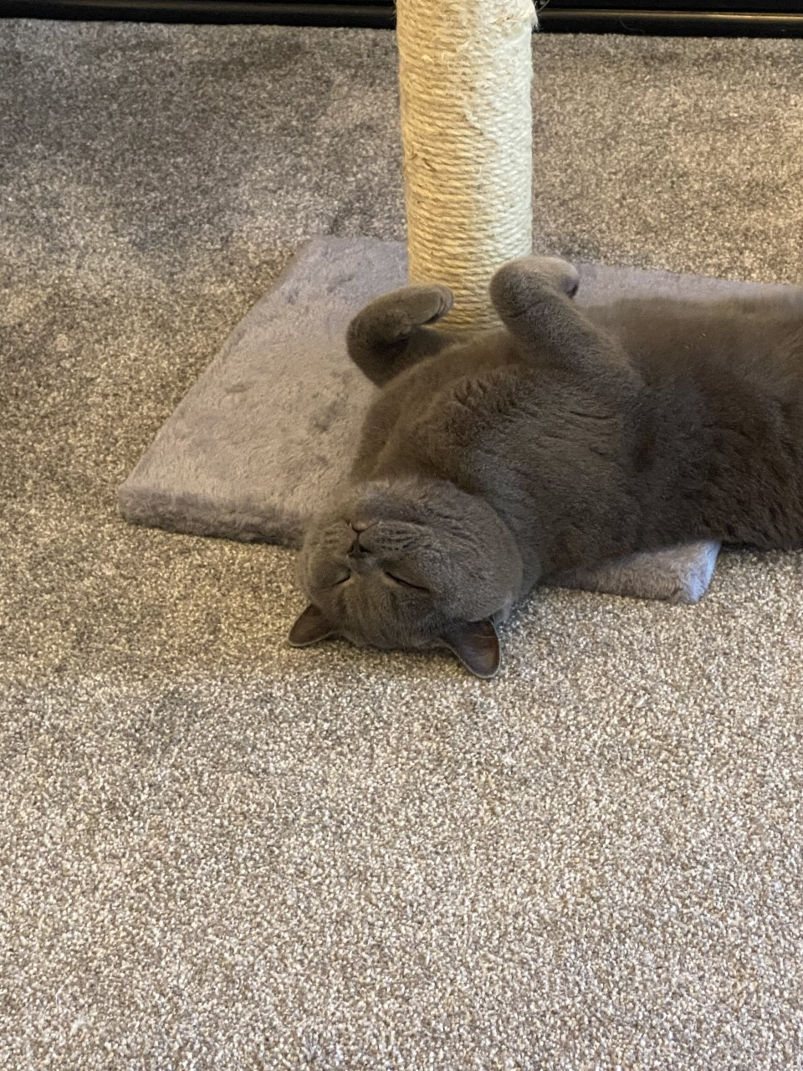
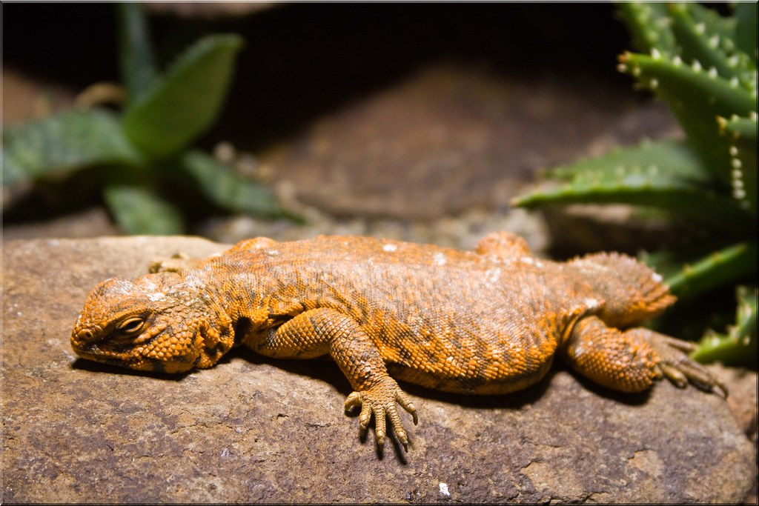
How does each animal maintain its body temperature?
Which is more advantageous in the wild?
Hint: food
Notes:
Ecto – less food required / but also less mobile in cold weather so susceptible to predators

Slide 15
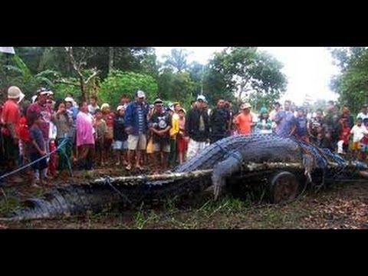
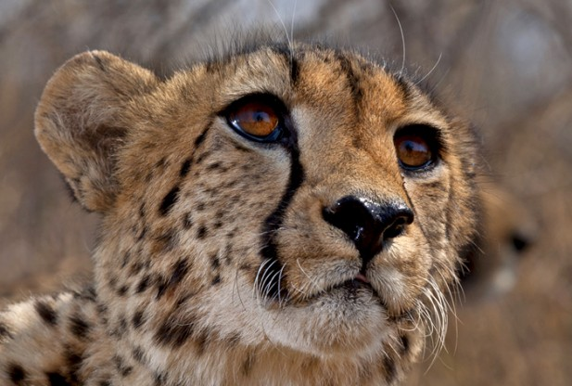
Ectotherms (cold-blooded animal): any animal whose regulation of body temperature depends on external sources, such as sunlight or a heated rock surface.
Endotherm - an organism which uses heat from metabolic reactions to maintain body temperature
Ectotherms do not require as much food as warm-blooded animals (endotherms) of the same size.

Slide 16
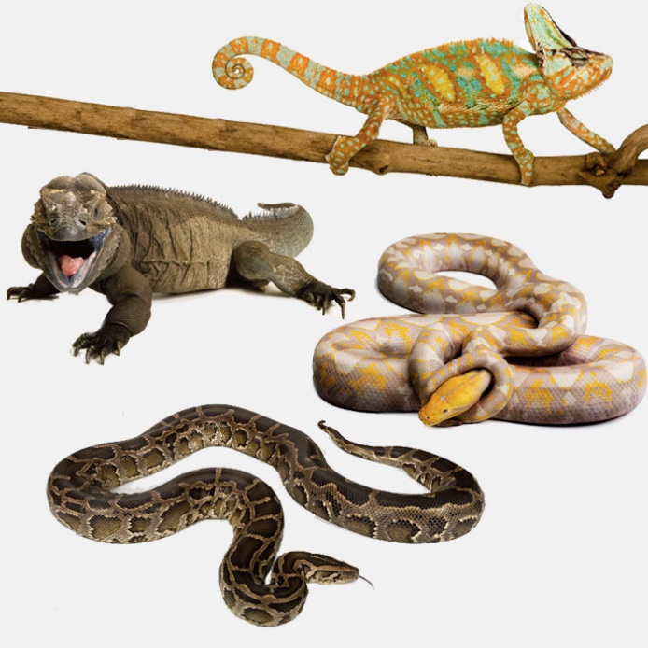
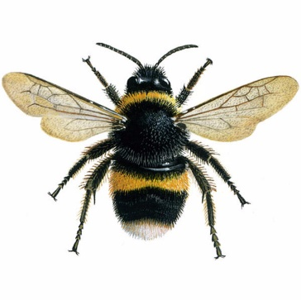
Temperature control in ectotherms
How do they warm up?
Absorb heat from their surroundings
Move into sunny area
Expose a larger surface area to the sun (lay on front or expand structural feature)
Increase rate of muscle contraction (bees)
How do they cool down?
Move out of the sun
Move underground
Reduce body surface exposed to the sun
Advantages of being an ectotherm include:
Do not use up energy to stay warm
Less food/biological molecules used in respiration
More food/biological molecules can be converted to growth
Can go longer periods of time without food
Disadvantages
1. Less active in cooler temperature and thus more at risk from predators (less energy available to escape)

Slide 17
Temperature control in Endotherms (behavioural responses also exist)
Too hot | Too cold
Sweat glands secrete more fluid, which uses heat from body to evaporate | Sweat glands secrete less fluid, less evaporation, less heat loss
Hairs/feathers lay flat to reduce insulation | Hairs/feathers stand to trap air, increasing insulation
Vasodilation of arterioles, precapillary sphincter muscles relax, blood directed to skin surface, more heat radiated away from body | Vasoconstriction of arterioles, precapillary sphincter muscles contract, blood diverted from skin surface, less heat radiated away from body
Animals pant, increasing evaporation of water from airways/lungs, use heat to evaporate | Less panting, less heat loss
Less respiration takes place, less heat released | Increased respiration in liver cells, more energy from biomolecules converted to heat
Skeletal muscle contraction reduces, less heat released | Skeletal muscle spontaneously contract, more heat released
Dilation of blood vessels to direct blood flow to extremities with larger SA:V | Constriction of blood vessels to direct blood flow away from extremities with larger SA:V

Slide 18
Advantages
Body temperature maintained at constant level despite external temperature
Can remain active even when external temperature is low (good for hunting)
Can inhabit colder climates
Disadvantages
Significant amount of energy used to maintain body temperature
Higher intake of food needed
Lower proportion of energy used for growth
Can over heat in hot weather

Slide 19
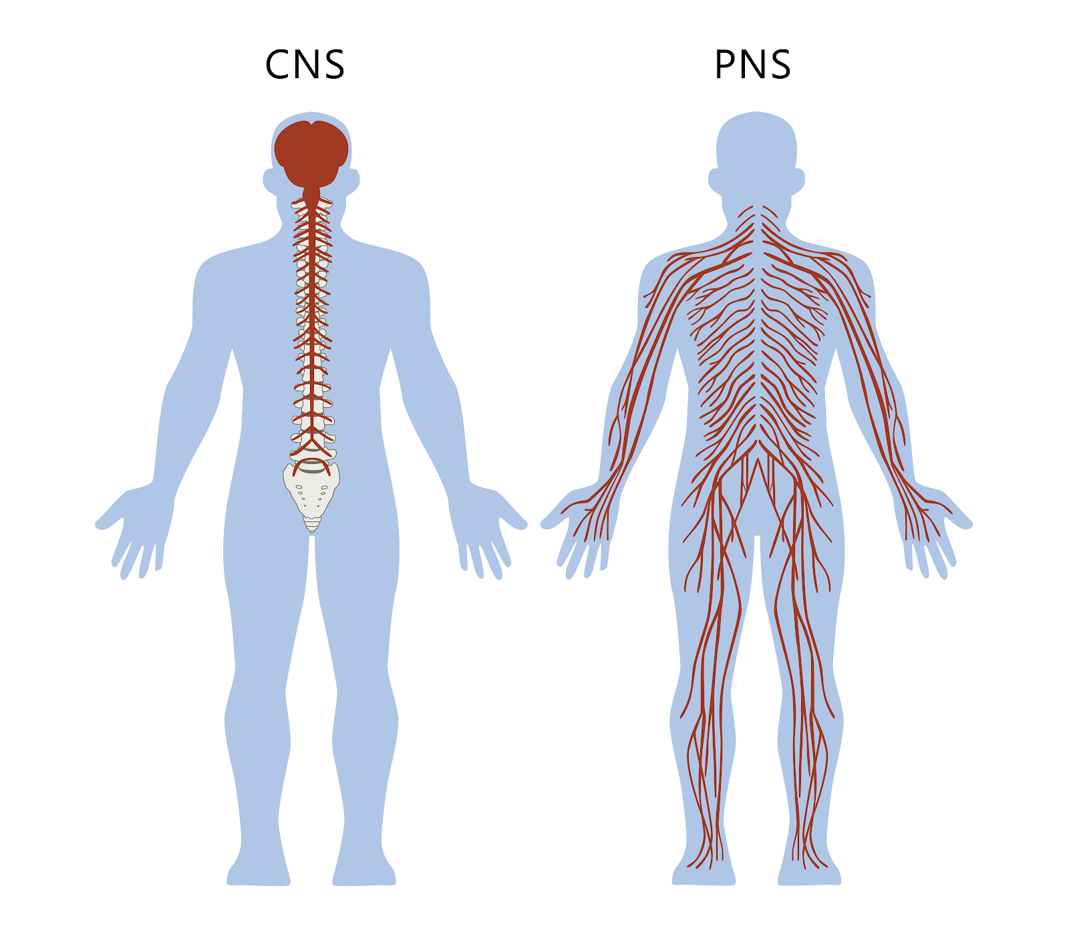

Slide 20
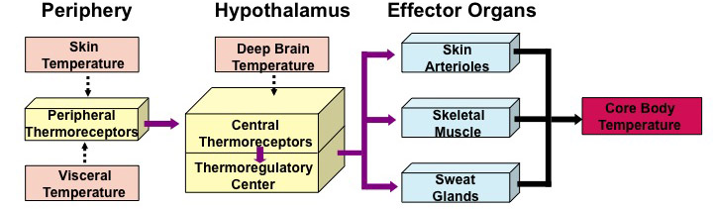
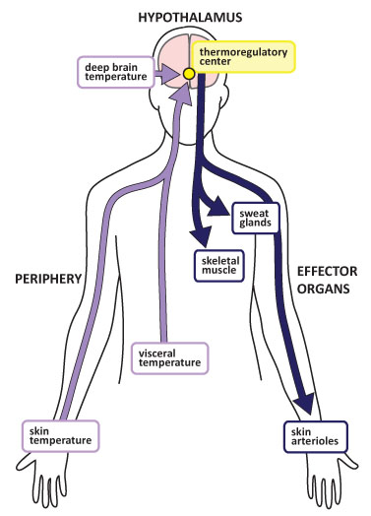
Internal temperature receptors
The hypothalamus contains its own thermoreceptors
These detect temperature changes in the blood
Neuronal system transmits rapid response
Hormonal system transmits longer lasting responses
Peripheral temperature receptors
Found in the skin
Detect changes to the surface temperature
The combination of the two allows the body to respond to very efficiently to any temperature change

Slide 21
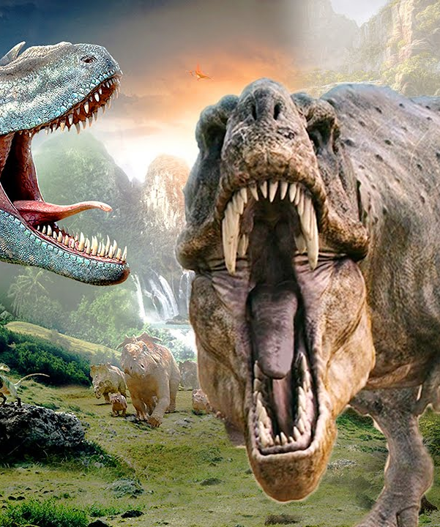
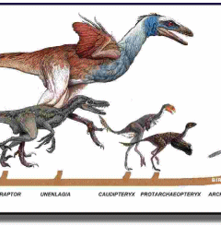
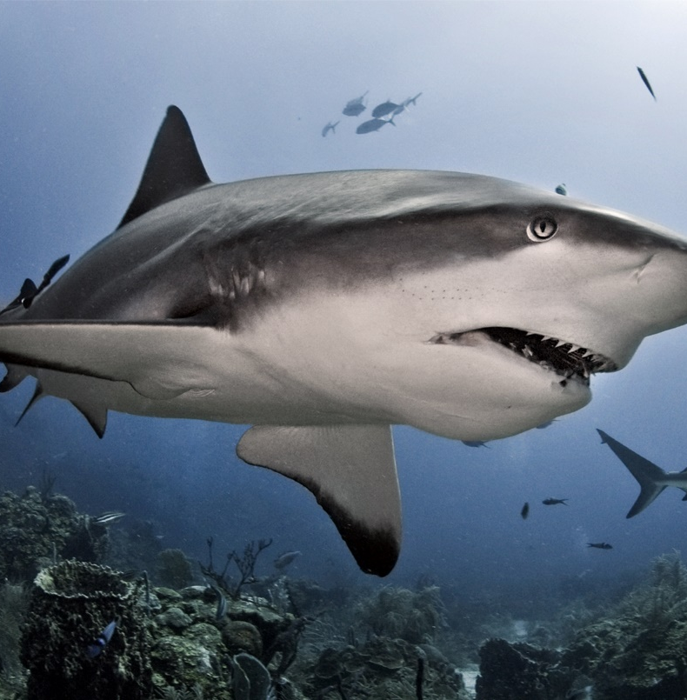
TASK: Mesothermic or Gigantothermic
Like mammals, mesotherms generate enough heat to keep their blood warmer than their environment, but like modern reptiles, they do not shiver to maintain a constant body temperature.
What were dinosaurs?
Notes:
Mesotherms exists sharks / turtles – they use internal metabolism to generate heat – but are unable to shiver or alter metabolic rate when cold
What were dinosaurs?
Palaeologists studied the speed at which bones grew – like tree rings – compared these to warm and cold blooded bone densities today
Found mesotherms were

Slide 22
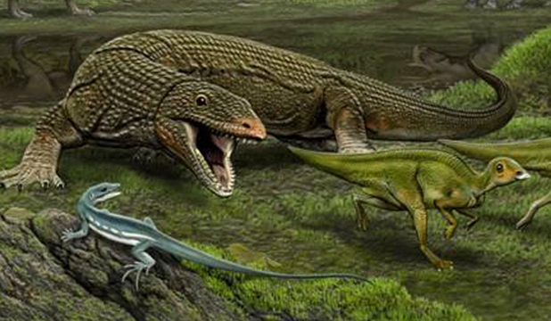
Why could dinosaurs preserve their body temperature better than lizards?

Slide 23
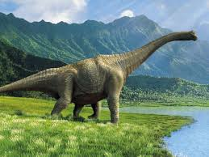
The larger the organism, the…
Reduced rate of transfer of substances out of organism (better at maintaining heat).
Even if considered cold blooded, might still be able to stay warm, due to large volume (gigantotherm)

Slide 24
PAG 11.2 – next lesson
Daphnia spp. are small ectothermic animals.
If an aspect of the medium surrounding them changes it can result in a rapid physiological response.
You will design an experiment to allow the temperature of the medium to be altered, and the effect on heart rate to be observed.

Slide 25
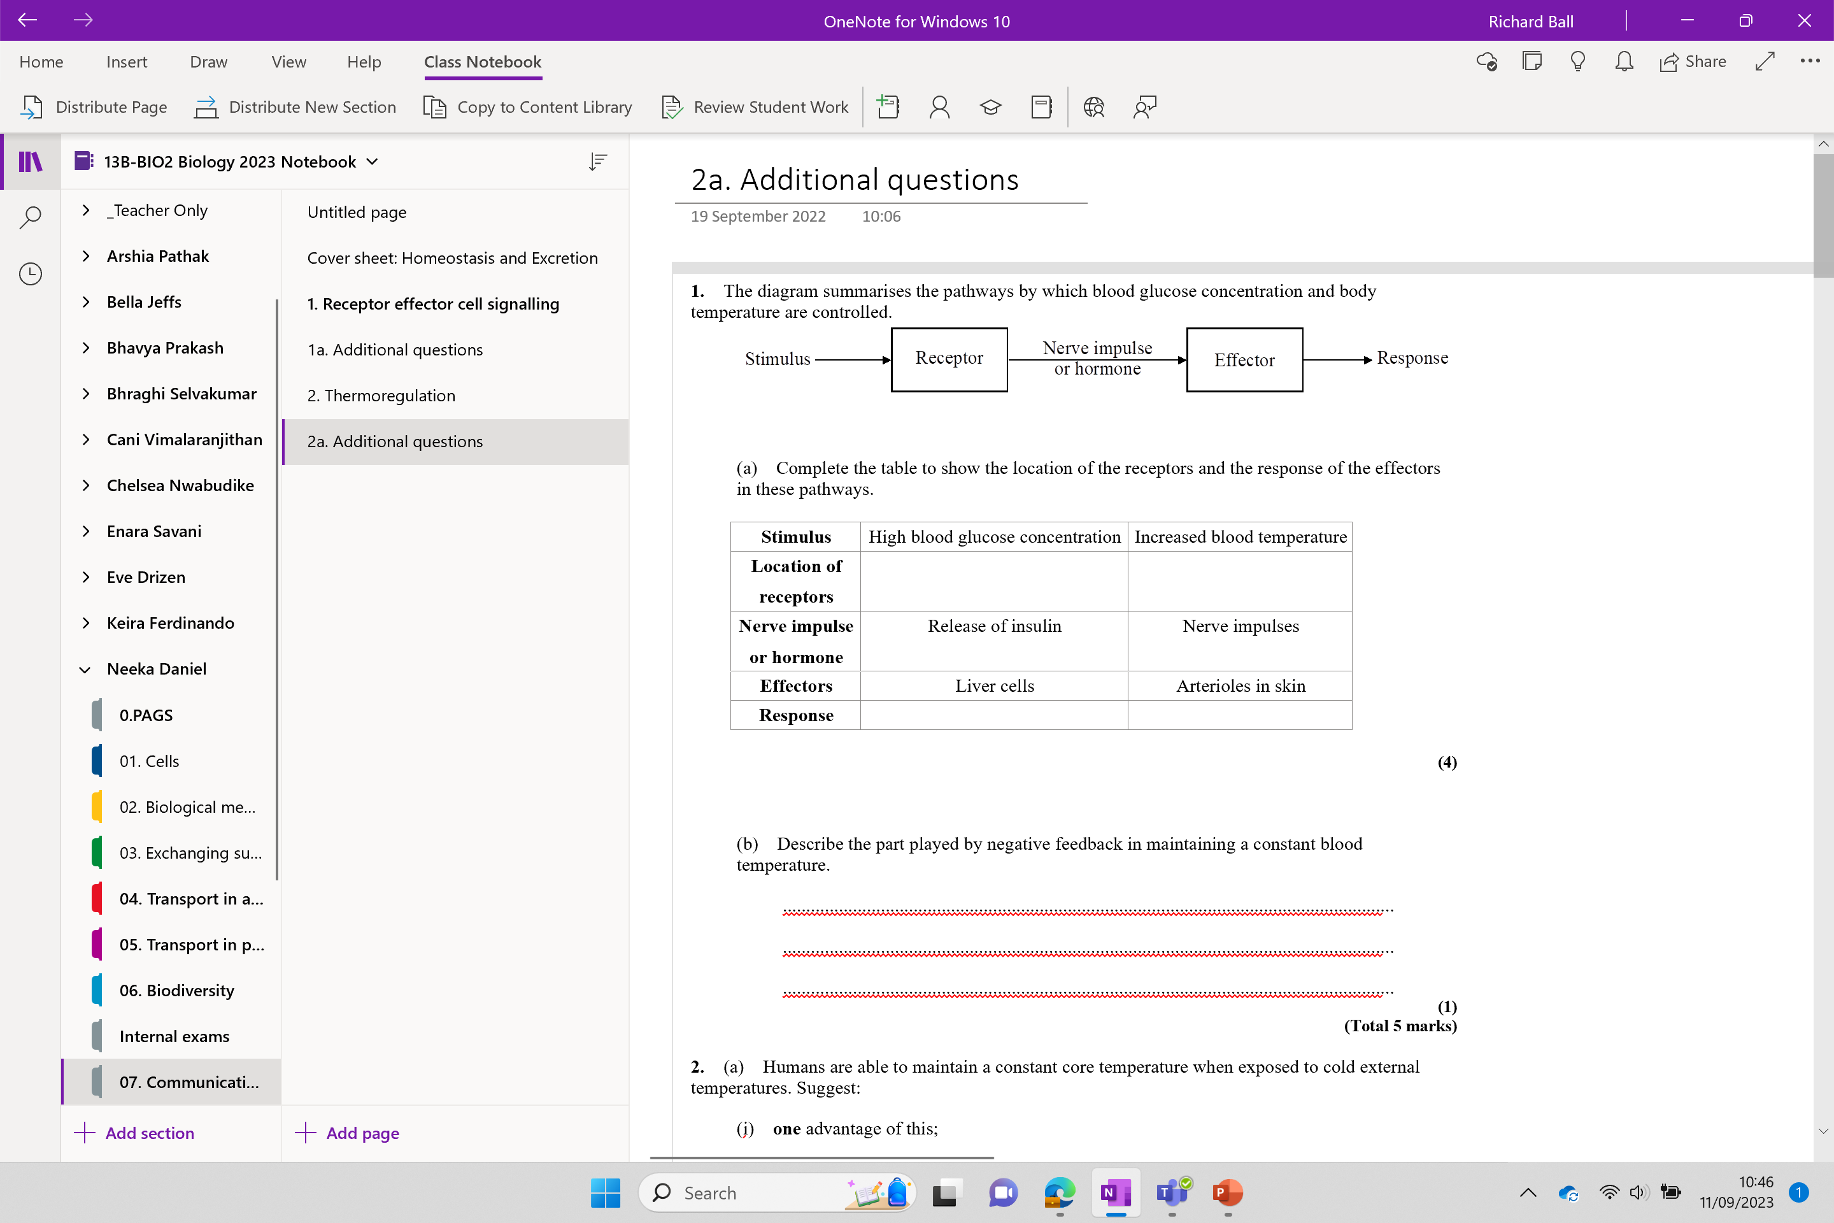
Additional questions

Slide 26
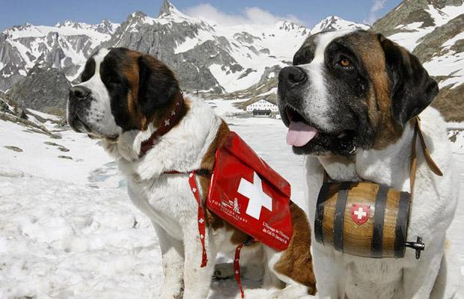
Question
Should mountain rescue dogs carry brandy?
  In early part of the twentieth century St Bernard dogs were used for mountain rescues.
  Traditionally they carried a small container of brandy for the lost or injured climber to drink.
  Alcohol causes vasodilation.

