Slide 1
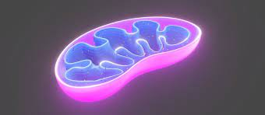
L2 Oxidative phosphorylation

Slide 2
The Synthesis of ATP.
Methods of generating ATP include:
Substrate level phosphorylation
Oxidative phosphorylation
Photophosphorylation

Slide 3
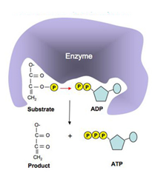
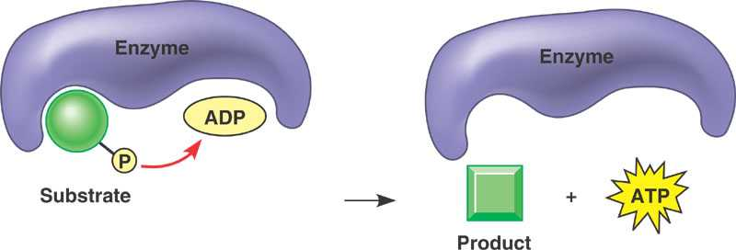
Substrate level phosphorylation
Substrate-level phosphorylation occurs when a phosphate group is transferred from a substrate molecule to ADP via an enzyme to make ATP.
Notes:
PEP (Phosphoenolpyruvate) transfers phosphate to ADP, products are pyruvate and ATP

Slide 4
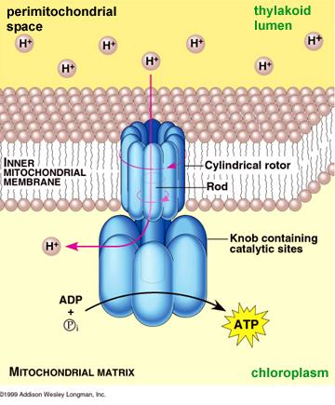
Oxidative Phosphorylation
ATP is synthesised by ATP synthase, located in both the inner membrane of mitochondria and the thylakoid membrane of chloroplasts:
ATP synthase (sometimes called a stalked particle) is a complex, trans-membrane protein – it contains:
- a channel allowing H⁺ ions to pass through the membrane
- the catalytic site where ADP is combined with Pi
The energy needed to synthesise ATP is provided by high energy electrons either:
removed from glucose in respiration, or
(2) excited by sunlight energy in photosynthesis

Slide 5

A closer look at ATP Synthase:

Slide 6
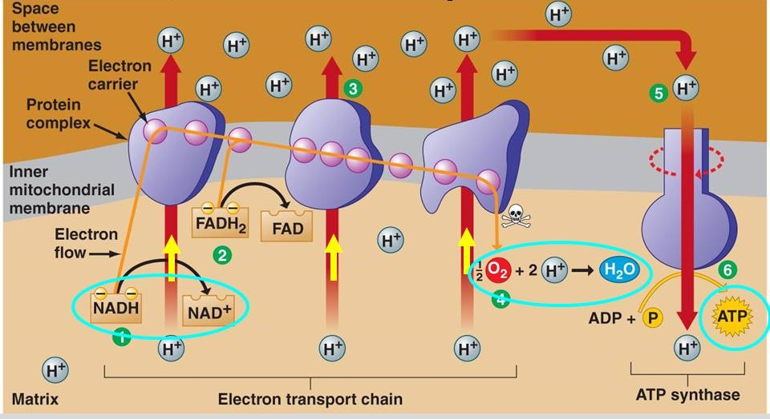
Chemiosmosis
ATP synthesis using energy from diffusion of H⁺ ions
proton gradient
high [H⁺]
1. Electrons are transferred to the electron transport chain – a series of carriers and proteins in the inner mitochondrial or thylakoid membrane
2. Energy lost from the electrons as they pass down the electron transport chain energy is used to pump protons (H⁺ ions) across the membrane, setting up a proton gradient
3. Protons (H⁺ ions) diffuse through the channel inside ATP synthase, providing the energy to combine ADP + P_{i}
low [H⁺]

Slide 7
A closer look at the ETC:
https://www.youtube.com/watch?v=xbJ0nbzt5Kw

Slide 8
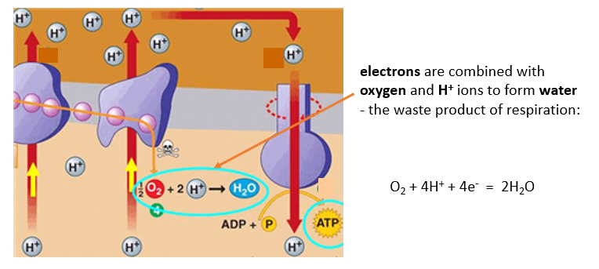
The synthesis of ATP during photosynthesis in chloroplasts is called photophosphorylation because it requires energy from sunlight
(phosphorylation = adding a phosphate to a molecule (ADP))
synthesis of ATP during aerobic respiration in mitochondria is called oxidative phosphorylation because it requires oxygen to accept the electrons after they have passed down the chain

Slide 9
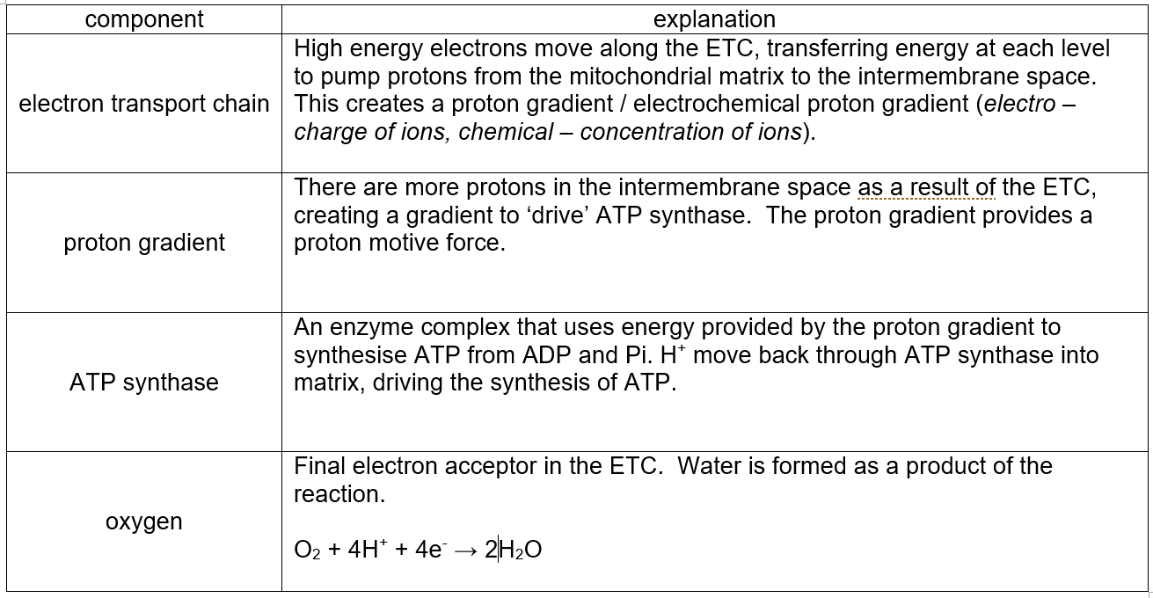
Now answer question 6 on your worksheet:
ADP + Pi = ATP

Slide 10
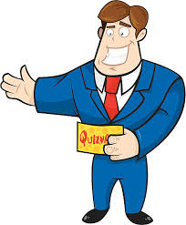
Welcome to….
BIOLOGY
QUIZ NIGHT
Round 1 is a game I like to call “TAKE a STEP BACK”

Slide 11
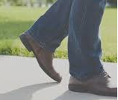
Take a step back
The definition to a key term will appear on the board. Can you take a step back and work out the key term that has been defined?
1st team to buzz in with the correct answer gets 2 TEAM POINTS!

Slide 12
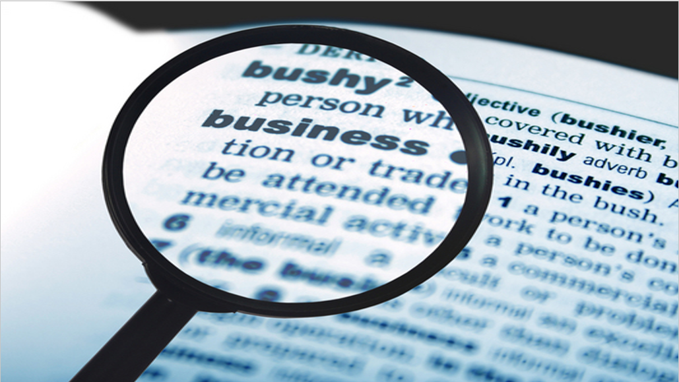
?
“Small, organic non-protein molecules that bind temporarily to the active site of the enzyme molecules, either just before or at the same time as the substrate binds”

Slide 13
Coenzymes

Slide 14
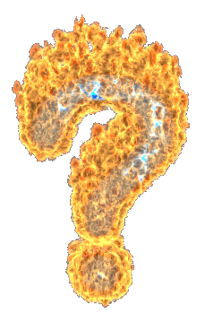
COENZYMES
in respiration

Slide 15
Welcome back to….
BIOLOGY
QUIZ NIGHT
So round 2 is called
“CRACK THE CODE”
This will help us to find out the name of one of the coenzymes

Slide 16
CRACK THE CODE
This competition has two parts and therefore there is the opportunity to win 2 TEAM POINTS
1. A statement will appear on the board that has a number as the answer. That number corresponds to the position of that letter in the alphabet! (e.g. 5 = E)
Simply, buzz in when you know the letter of the alphabet and if you’re right, you will get one TEAM POINT!
2. If you were the student who got the letter correct, you will then have a chance to earn a second TEAM POINT. A definition of the word beginning with the letter will appear. You then have just 10 seconds to state the key term

Slide 17
N
CRACK THE CODE
Day of the menstrual cycle when ovulation normally occurs
Vitamin B₃

Slide 18
A
CRACK THE CODE
Number of chains in a polypeptide that doesn’t have a quaternary structure
Nitrogenous base that pairs with uracil

Slide 19
D
CRACK THE CODE
Number of chambers in the human heart
Two lots of the monomer that make up both DNA and RNA

Slide 20
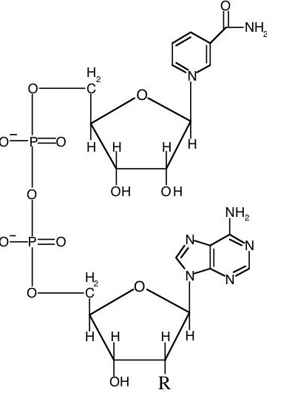
Introducing……
NAD
Nicotinamide adenine dinucleotide is a coenzyme found in all living cells.
The main function is the transfer of electrons.

Slide 21
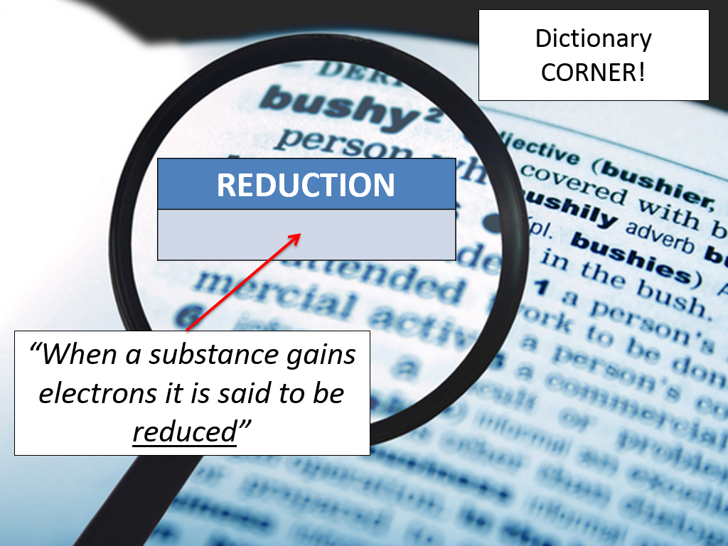
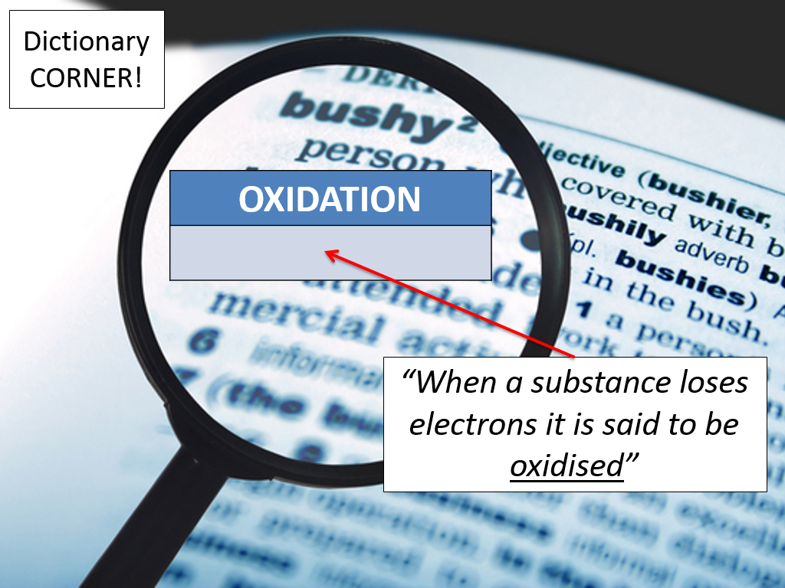
R
e
d
o
x
reactions
in terms of electrons

Slide 22
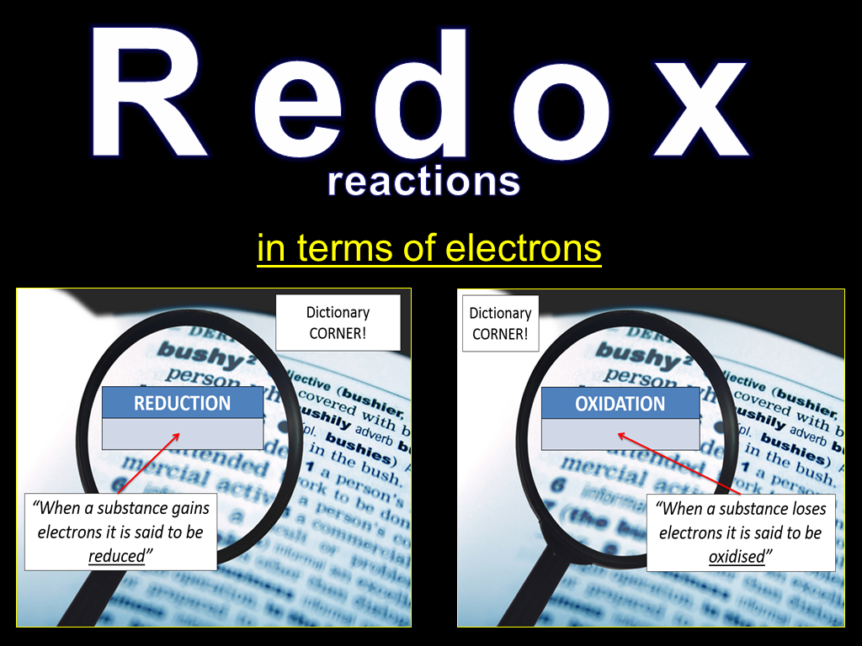
Getting this right!
Hydrogen atoms consist of protons and electrons.
So when a coenzyme such as NAD accepts hydrogen atoms, it is reduced. NAD can accept two hydrogen atoms.
When they coenzymes release these hydrogen atoms, they are oxidised.

Slide 23
COENZYMES
in respiration
N
D
Coenzyme A
FAD
Flavine adenine dinucleotide
A
Nicotinamide adenine dinucleotide

