Slide 1
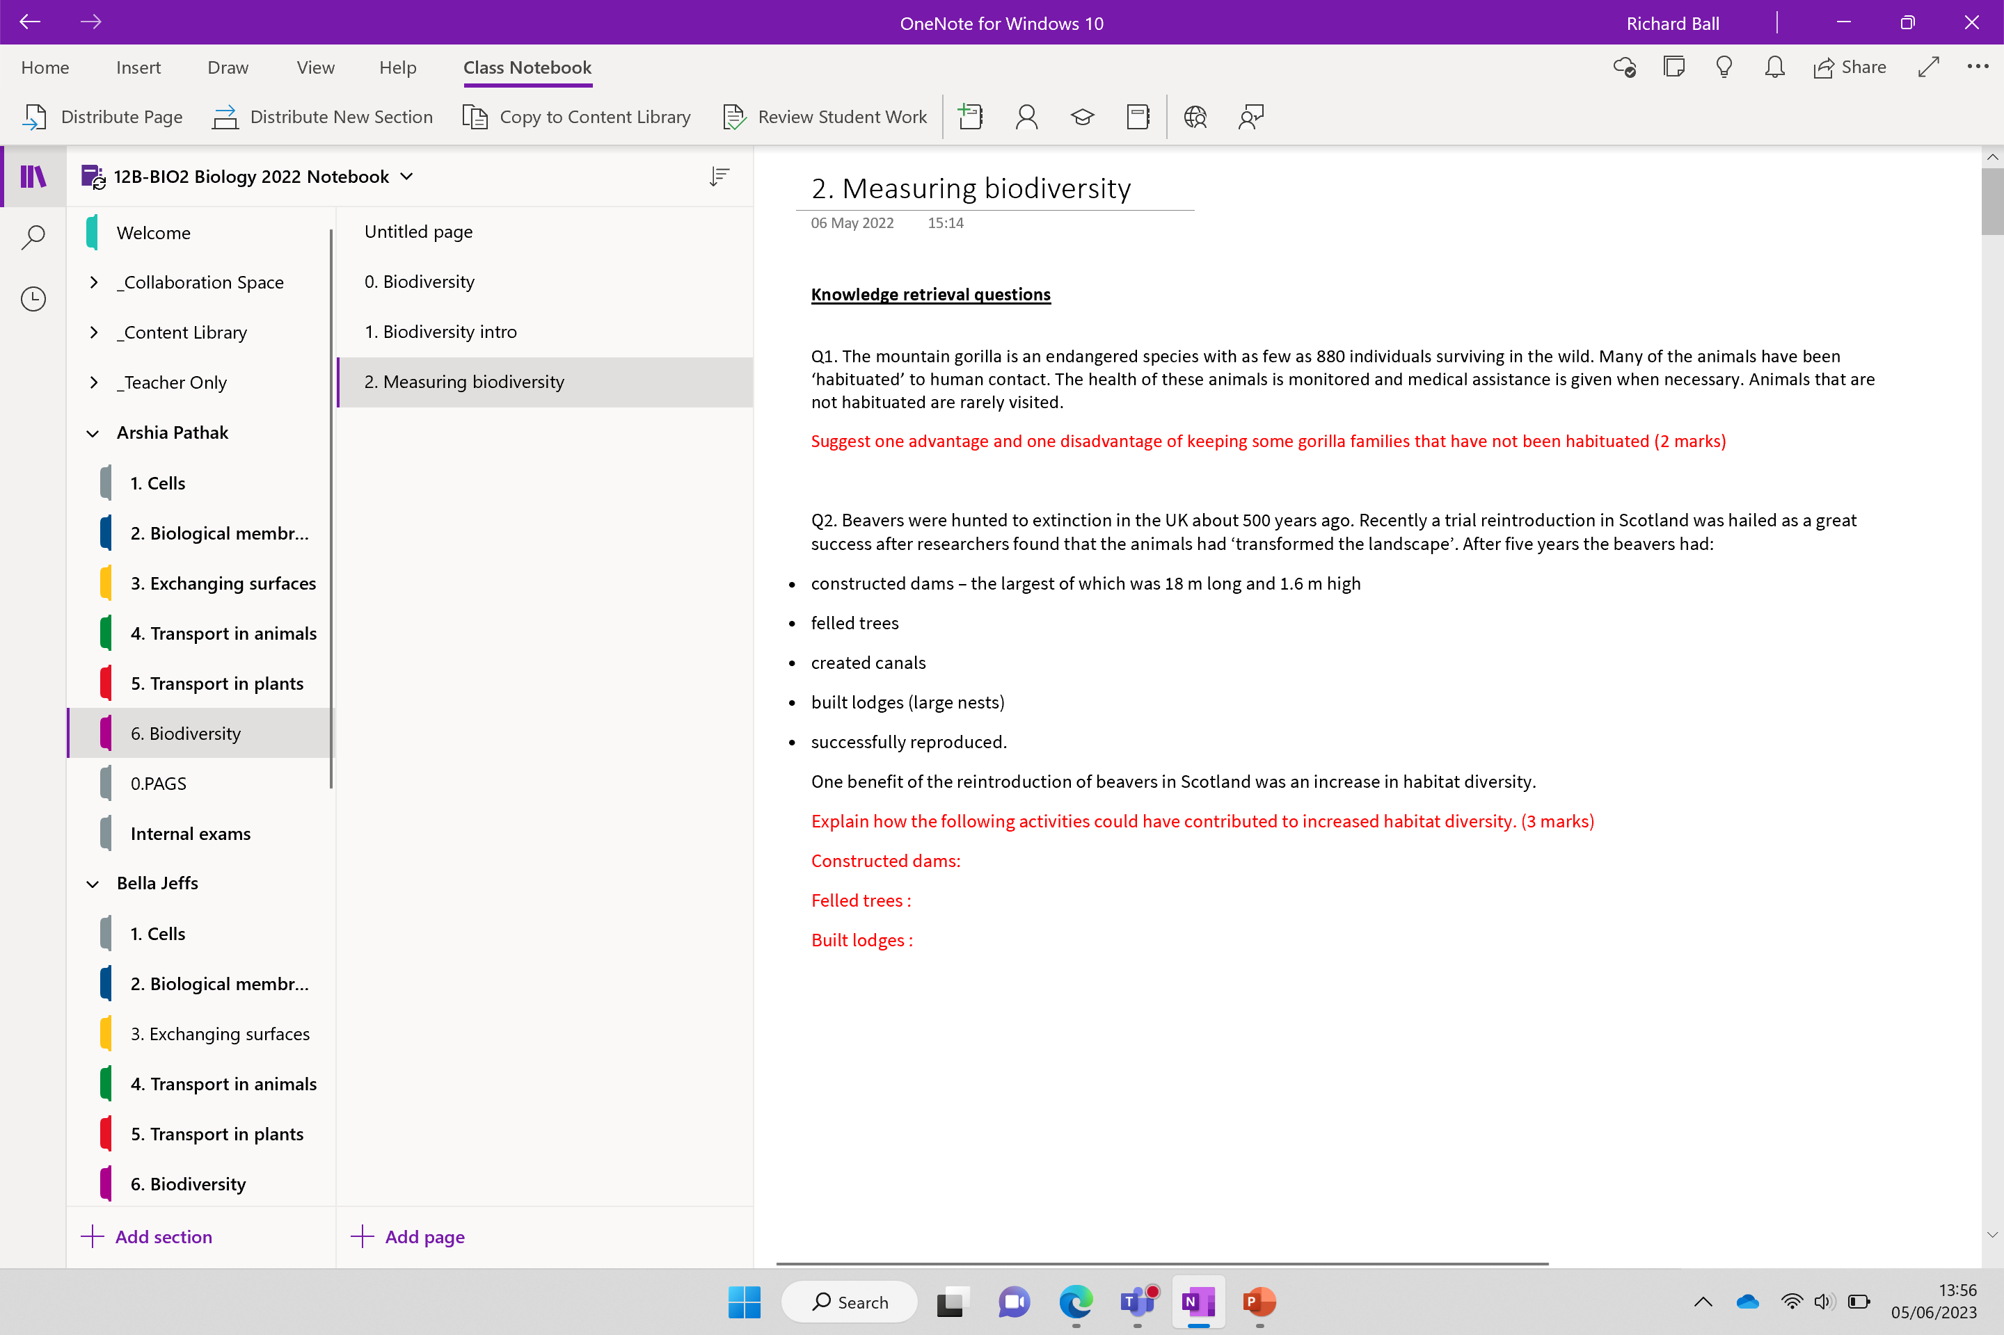

Slide 2
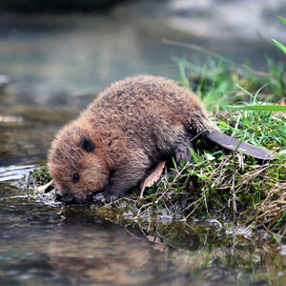
Knowledge retrieval questions
Q1. The mountain gorilla is an endangered species with as few as 880 individuals surviving in the wild. Many of the animals have been ‘habituated’ to human contact. The health of these animals is monitored and medical assistance is given when necessary. Animals that are not habituated are rarely visited.
Suggest one advantage and one disadvantage of keeping some gorilla families that have not been habituated (2 marks)
Pro: exhibit natural behaviour / less likely to catch disease from humans
Con: poaching more likely / could be wiped out by disease / more difficult to count
Q2. Beavers were hunted to extinction in the UK about 500 years ago. Recently a trial reintroduction in Scotland was hailed as a great success after researchers found that the animals had ‘transformed the landscape’. After five years the beavers had:
constructed dams – the largest of which was 18 m long and 1.6 m high
felled trees
created canals
built lodges (large nests)
successfully reproduced.
One benefit of the reintroduction of beavers in Scotland was an increase in habitat diversity.
Explain how the following activities could have contributed to increased habitat diversity. (3 marks)
Constructed dams:
Felled trees :
Built lodges :
flooded areas upstream / reduced flow rate downstream creating still, slow moving water for aquatic species
opens up tree canopy allowing light to ground level
creates sheltered habitat for insect species

Slide 3
Sampling is useful because……
Helps us to estimate numbers of organisms in an area and build up an accurate picture of that area’s biodiversity
Allows us to see how human activities effect biodiversity

Slide 4
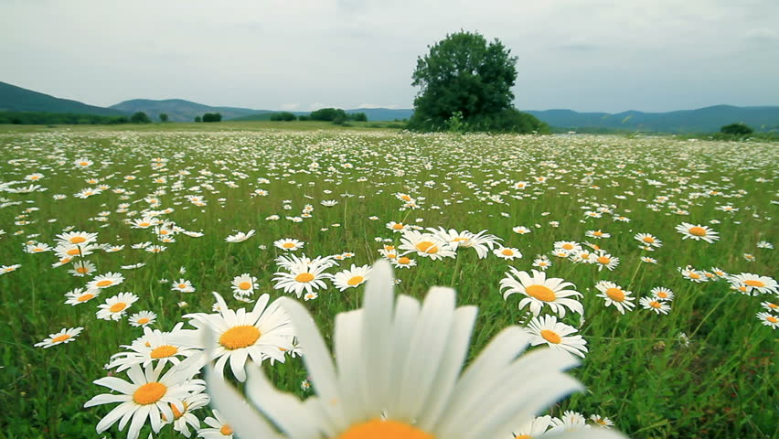
How would you estimate the number of daisies in the field?

Slide 5
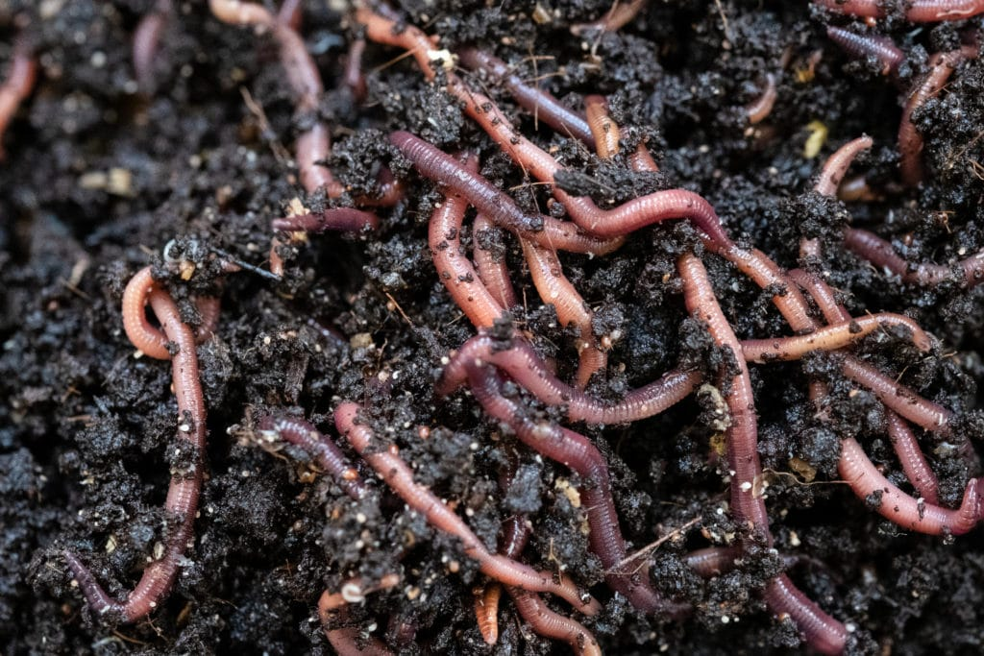
Can you use the same method to estimate the population of worms?

Slide 6
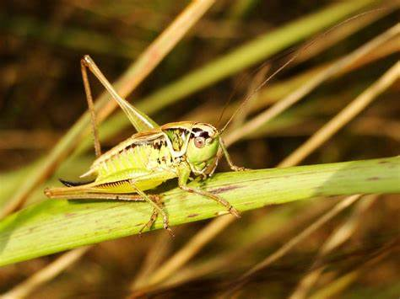
Can you use the same method to estimate the population of crickets?

Slide 7
What do you think the following sampling techniques are used for?
Pooter
Pitfall traps
Kick sampling
Sweep nets
Tree beatings
Pointed quadrat

Slide 8
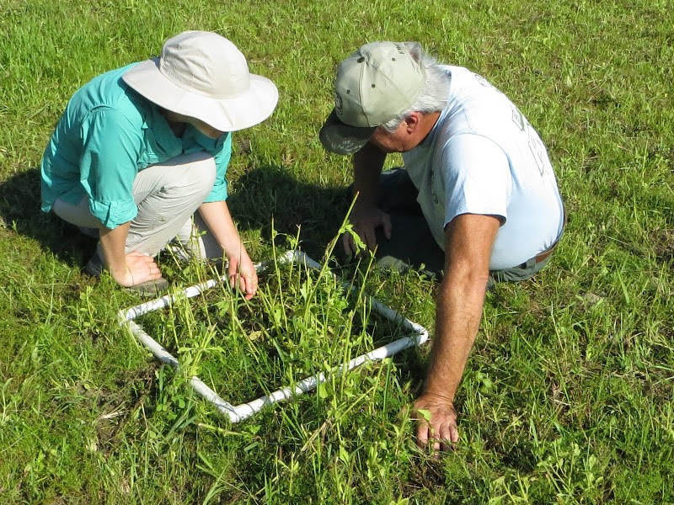
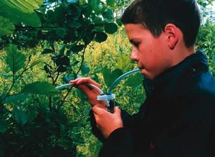
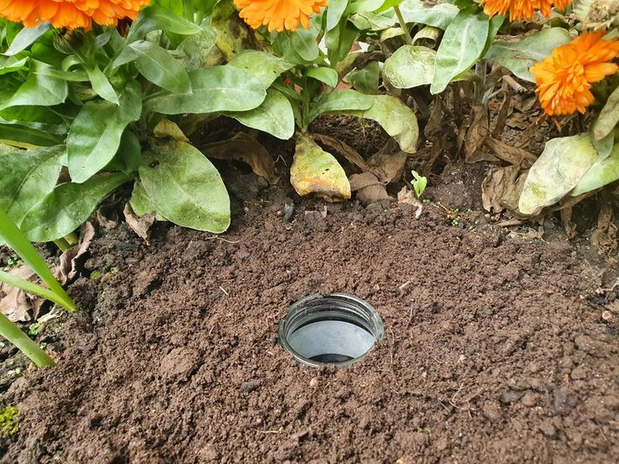
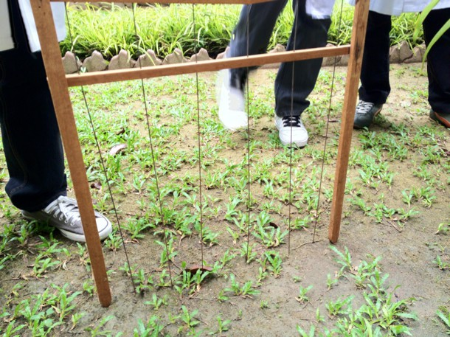
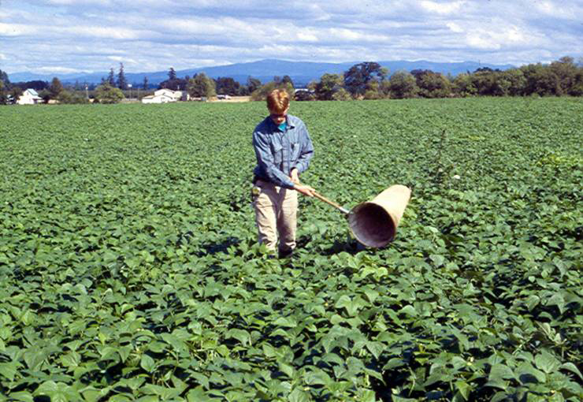
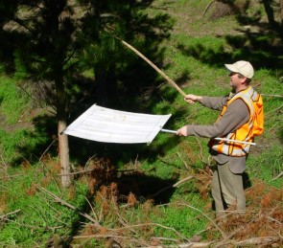
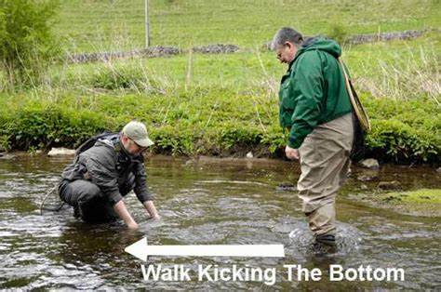
Pooter
Quadrats
Pitfall traps
Kick sampling
Pointed quadrats
Beating tray
Sweep nets
Sampling techniques
Notes:
Pitfall traps
Sweep nets
Pooter
Quadrats / transects
Kick sampling
Tree beatings

Slide 9
What sampling method should be used?
The equipment and methods used will entirely depend upon what is being measured.
Look at the examples on the next few slides to get some ideas

Slide 10

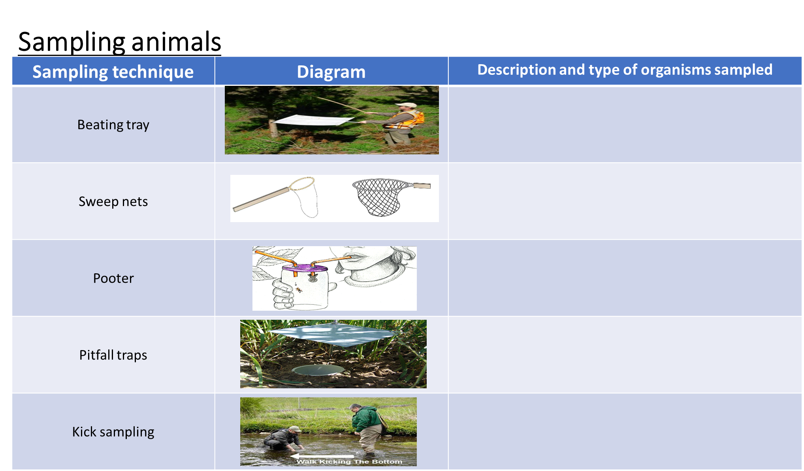
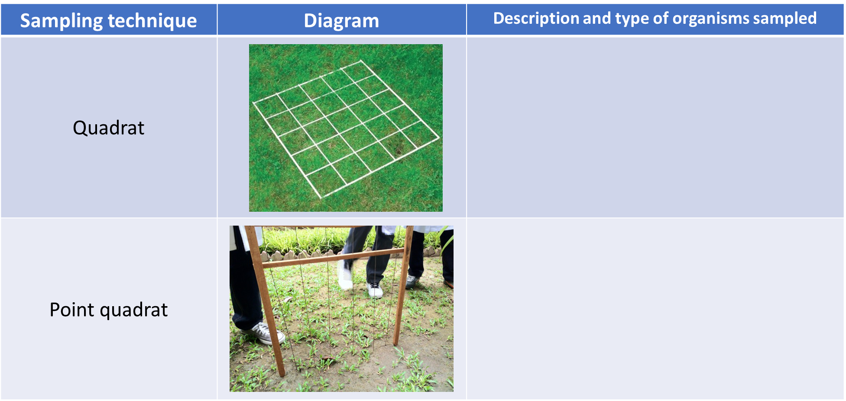
Task: complete the following two tables for animal and plant sampling

Slide 11
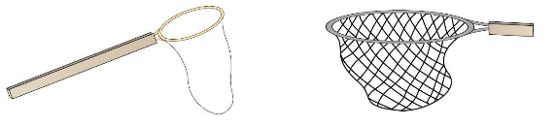
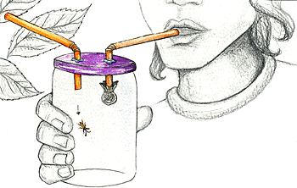
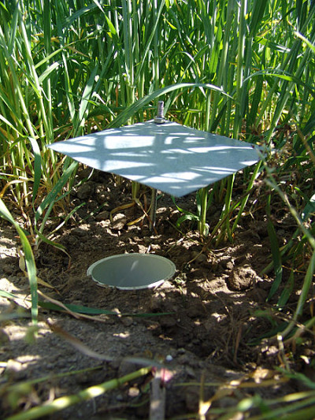
Sampling animals (biotic factors)
Sampling technique | Diagram | Description and type of organisms sampled
Beating tray
Sweep nets
Pooter
Pitfall traps
Kick sampling
A pooter is a small jar used for collecting insects. It has two tubes - one goes into your mouth so you can apply suction, and the other goes over the insect so that it is sucked into the jar. A fine mesh over the end of the first tube stops you swallowing the insect.

Slide 12
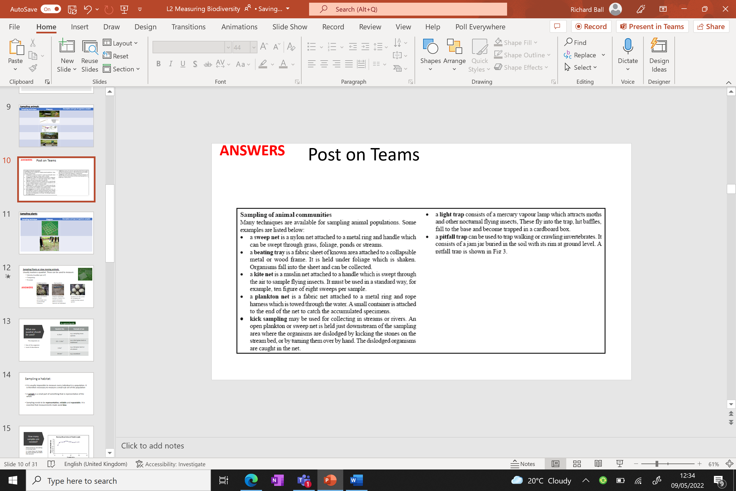
ANSWERS – post on teams

Slide 13
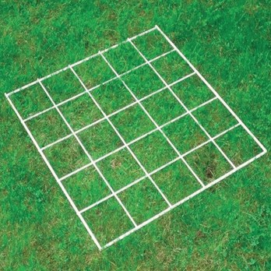
Sampling plants
Sampling technique | Diagram | Description and type of organisms sampled
Quadrat
Point quadrat
A quadrat is a frame, traditionally square, used in ecology, biology to isolate a standard unit of area for study of the distribution of an item over a large area.
A point quadrat is a frame shaped like a T. The bar of the T has ten holes in it, and to sample vegetation a long pin much like a knitting needle is stuck through each hole. The different plants that the pin ‘hits’ as it is pushed towards the ground are identified and counted.

Slide 14
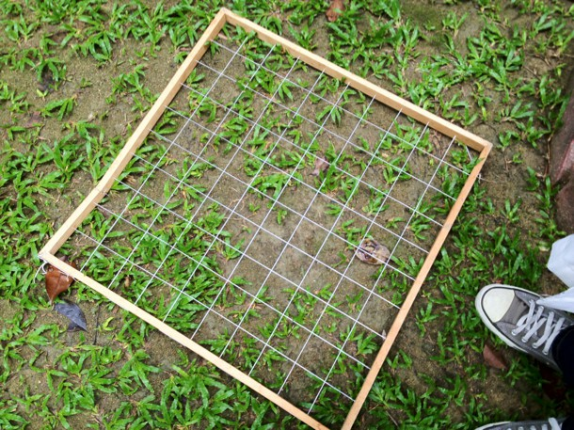
Frequency or % cover
Percentage cover and frequency, when used together, give a good picture of the distribution of a species

Slide 15
Limitations
Quadrats and transects can only be used for ……. moving or …………….. species (eg. plants or snails)
Some species can be counted to find their abundance but others that are very ………. or in high numbers require abundance to be calculated using ………………. cover or ……………….. techniques.
The frequency technique shows how common a species is but it does not give information on the estimated …………. of individuals or the size of the ………………...

Slide 16
Limitations
Quadrats and transects can only be used for slow moving or immobile species (eg. plants or snails)
Some species can be counted to find their abundance but others that are very small or in high numbers require abundance to be calculated using percentage cover or frequency techniques.
The frequency technique shows how common a species is but it does not give information on the estimated number of individuals or the size of the population.

Slide 18
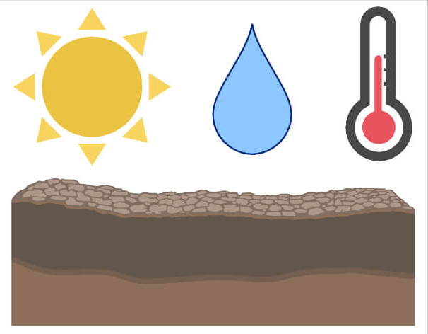
How do we sample these?

Slide 19
Sampling abiotic factors:
Complete as many gaps as you can
Abiotic factor | Sensor used | Example unit
 | anemometer | m s⁻¹
Light intensity
Humidity |  | Mg dm⁻³
Acidity or alkalinity of soil
 |  | ºC
 | Dissolved oxygen probe | Mg dm⁻³
Wind speed
Light meter
lx
Humidity sensor
pH probe
pH
Temperature
Temperature probe
Oxygen content in water

Slide 20
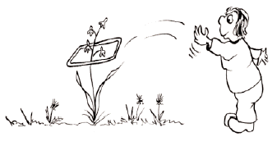
Why cant I sample like this?
What are the limitations?

Slide 21
Avoiding bias
Throwing quadrats is NOT a random method because there is an unavoidable bias in selecting where to throw it.
There is also a limit to the area that can be reached (how far can you throw a quadrat?!)

Slide 22
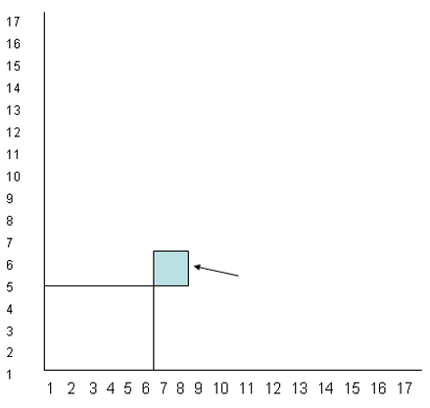
Random sampling
The area under study should be mapped and grid references established
A random number generator button on a calculator, or a random number table should be used to generate co-ordinates.
The bottom left hand corner of the quadrat should be placed at the appropriate co-ordinate
How was this quadrat position selected?
Write a short bullet pointed method

Slide 23
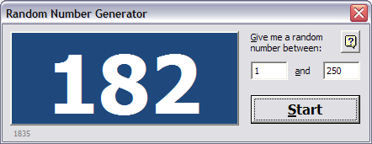
Random sampling
Advantage
Disadvantage
Objective (unbiased)
May not cover all areas equally
Species with low presence may be missed

Slide 24

How do you know where to collect samples / take measurements?
A sampling strategy must be used.
Sampling strategies can be broadly divided into two groups:
  Random
  Non-random
    Stratified
    Systematic
    Opportunistic

Slide 25
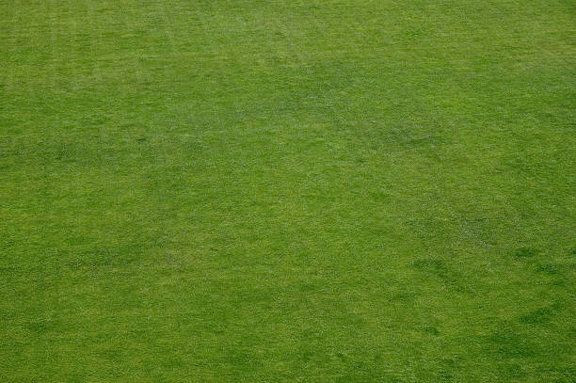
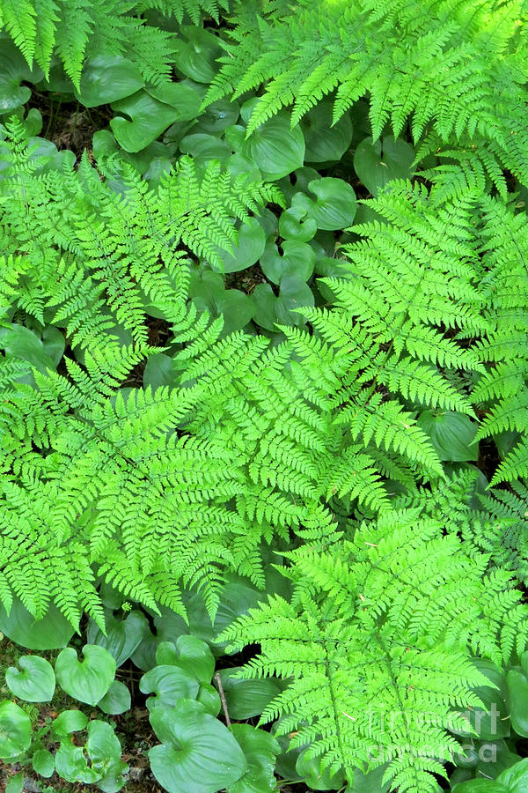
What problem does random sampling present?
One of the problems with random sampling is that it may not cover all areas of a habitat equally.
A random selection of samples may not show, for example, any bracken within a grassland habitat, which would not be representative if there was an area where bracken was growing!

Slide 26
Non-random sampling
This alternative sampling method is not completely random.
The three categories are:
Stratified
Systematic
Opportunistic

Slide 27
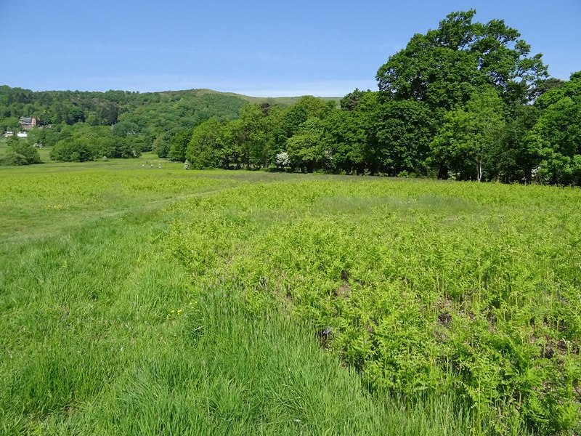
Stratified Sampling
Stratified sampling can be used where a distinct area within a habitat can be identified.
e.g. areas of bracken within a grassland.

Slide 28

How many samples would you need to take in each zone?

Slide 29
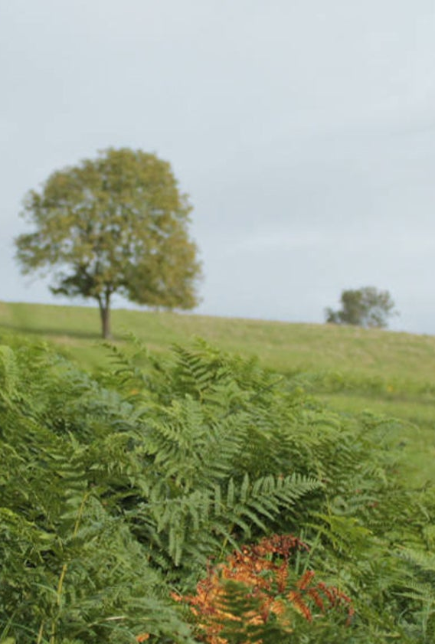

Stratified sampling
Example: A grassland area is 200m² overall and the bracken patch occupies 50m².
If I take 12 quadrat samples across the whole grassland, how many need to be taken from the area of bracken?
The bracken accounts for 25% of the grassland area
If 12 samples needed to be taken, then 3 of those samples (25%) would need to be taken in the bracken patch.
There is a standard formula for calculating the number of samples to be placed in each unit/ area.
(50 x 12)
200
= 3

Slide 30
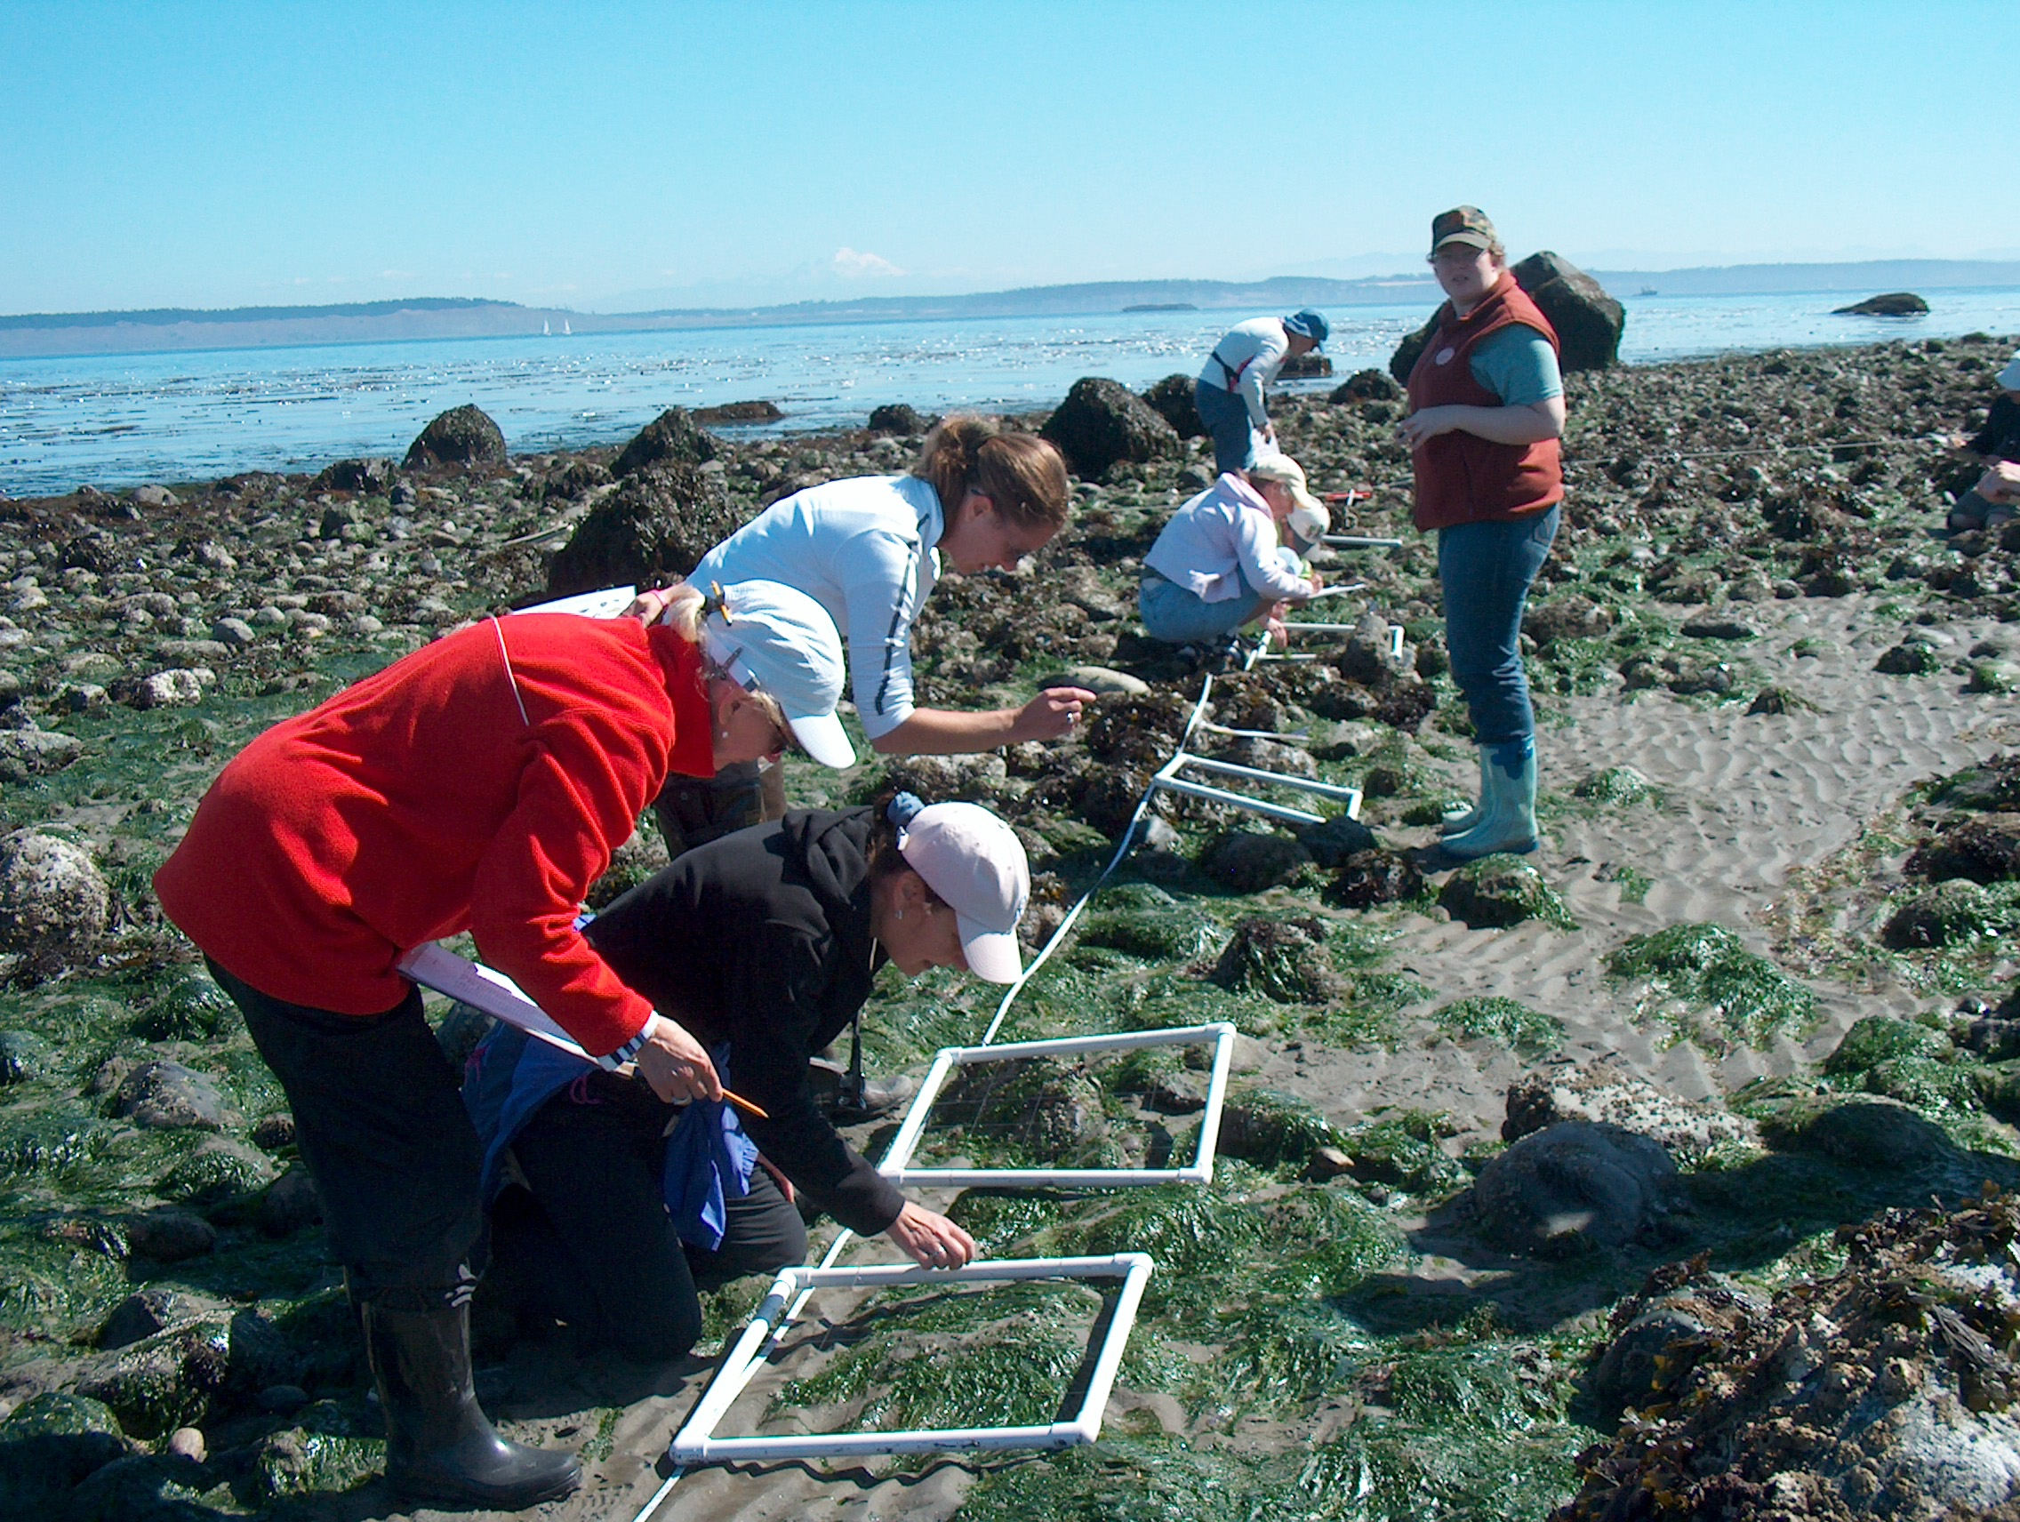
Systematic Sampling
Samples are taken at fixed intervals along a transect.
The transect is set up across an environmental gradient.
e.g change to light intensity moving from grassland to woodland (Biological gradient)

Slide 31
Identify the biological gradient in these examples:
Example | What is the biological gradient?
Changes in plants as you move from grassland to woodland | Light intensity as you move from grassland into woodland
Effect of pollution, radiating from a particular source, on species composition | Concentration of the pollutant
Changes in abundance of different species up a rocky shore | Height above sea level
Density of plantain as you move away from a path | How compacted/ trampled the soil is
Changes to percentage cover of grass as you move away from a tree | Moisture content of the soil / light intensity

Slide 32
Identify the biological gradient in these examples:
Example | What is the biological gradient?
Changes in plants as you move from grassland to woodland | Light intensity as you move from grassland into woodland
Effect of pollution, radiating from a particular source, on species composition | Concentration of the pollutant
Changes in abundance of different species up a rocky shore | Height above sea level
Density of plantain as you move away from a path | How compacted/ trampled the soil is
Changes to percentage cover of grass as you move away from a tree | Moisture content of the soil / light intensity

Slide 33
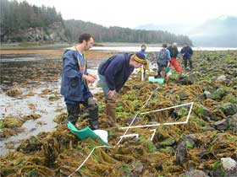
Types of Transect
Line transect
This is a line placed at 90◦ to the environmental gradient. Either all species touching the line are recorded (continuous sampling) or species are counted at fixed intervals (no quadrats used!)
Belt transect
Two parallel transects are is set up and quadrats placed along it at equal intervals
Advantage
Useful when habitat shows a clear gradient in environmental factors
Disadvantage
Only species on the line/belt are recorded leading to an underestimate

Slide 34
Opportunistic – weakest form of sampling
Researcher takes samples based on prior knowledge or during the process of collecting data
May sample an area that they know contains a particular species.
Advantages
Easier and faster than random sampling
Disadvantage
Data may be biased
Overestimate of biodiversity

Slide 35
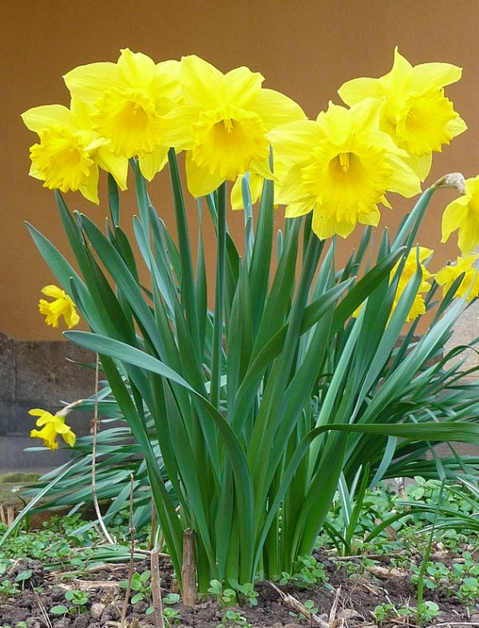




Why could counting butterflies be a problem?
Solution?
Capture & mark. Then release, recapture to avoid overestimate

Slide 36
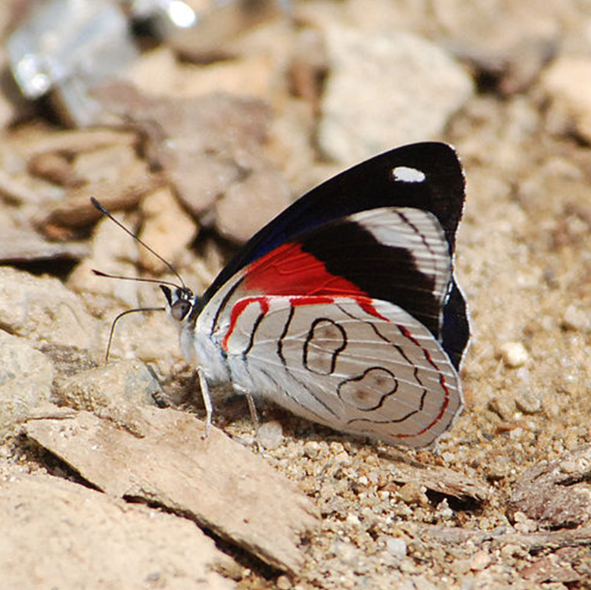
Capture and mark
1. Capture as many animals as you can in a defined period of time.
2. Count them and mark them in a way that causes no harm
3. Release them to mix in the population.

Slide 37
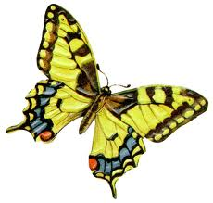

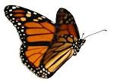
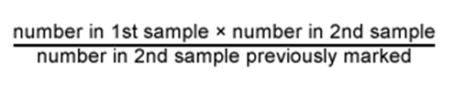
Recapture
4. After a few weeks / days capture the same species over the same time period.
5. Count how many are marked and how many are not marked.
Population size
=

Slide 38
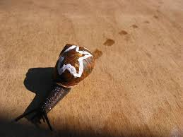
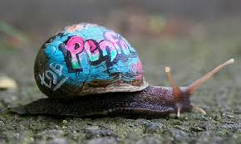
Limitations
Assumptions need to be made:
  No death, immigration or emigration
  Identical sampling methods
  marking does not affect the survival rate of the animals
EXT. what would be an appropriate way to mark a snail?
Notes:
Emigration is the act of leaving a place of residence with the intent to settle elsewhere (to permanently leave a country).
Conversely, immigration describes the movement of people into one country from another (to permanently move to a country).

Slide 39
Estimating population size
Population size
=
If 10 animals were marked and released, then two days later 20 animals were trapped and of these, 5 were found to be marked. Estimate the population size.
10 x 20 = 40
5

Slide 40
Additional questions

Slide 41
AMERSHAM PAG

