Slide 1

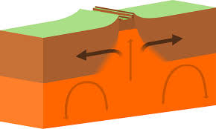
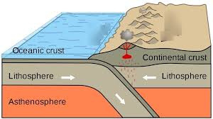
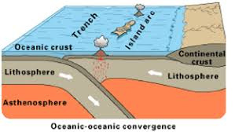
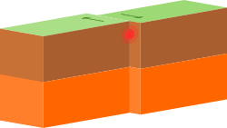
Earthquakes and Resultant Hazards
LO: To investigate the causes and impacts of earthquakes and their resultant hazards
Describe the causes of earthquakes and how they are measured
Explain the resultant hazards of earthquakes along with the factors affecting the impact
Evaluate the extent to which earthquakes are caused by a variety of factors
Starter: Recap from previous lesson. Look at the diagrams and give the name of the boundary, discuss what processes take place at each boundary & what features are created at each one, and an example of the plates involved & features created.
Name: What happens: Features: | Name: What happens: Features:
Name: What happens: Features: | Name: What happens: Features:
Extension – What plate boundary is missing here? Can you repeat the task for this missing boundary?

Slide 2
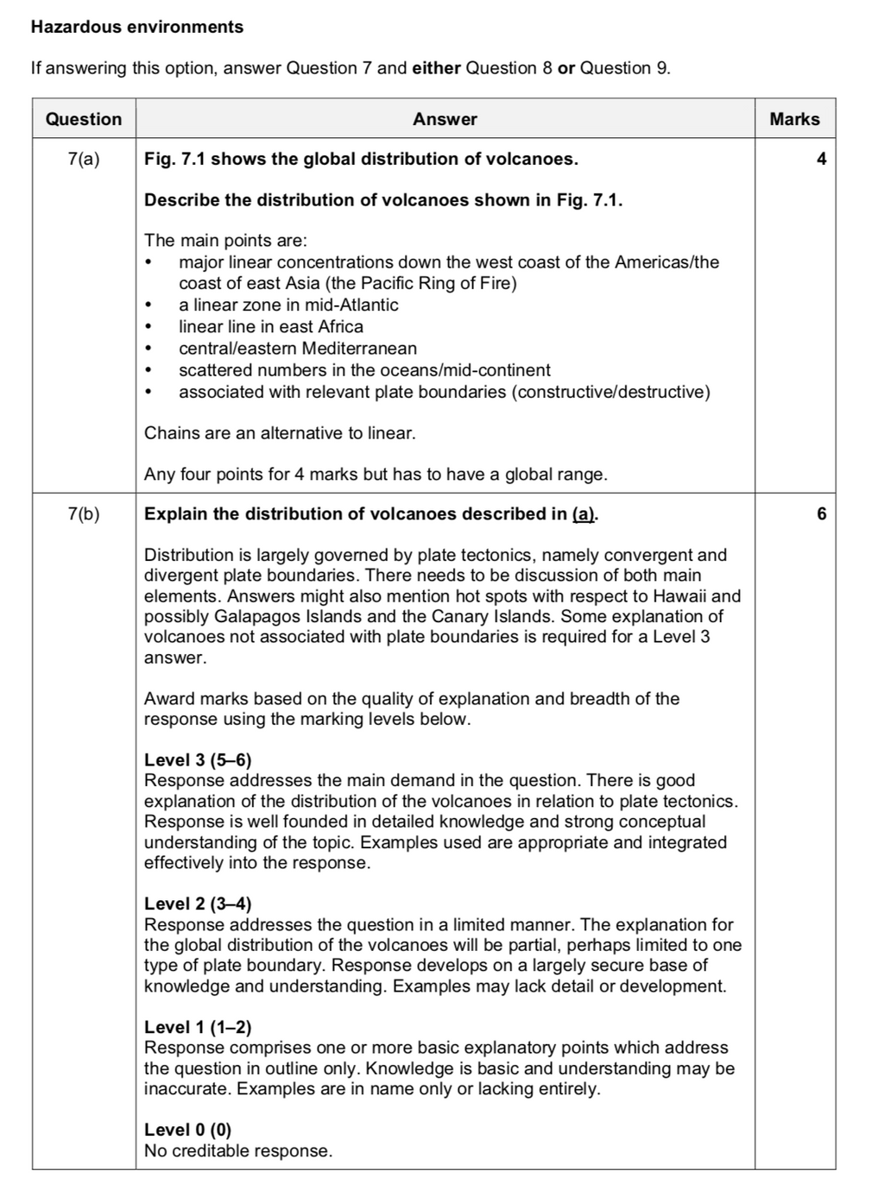
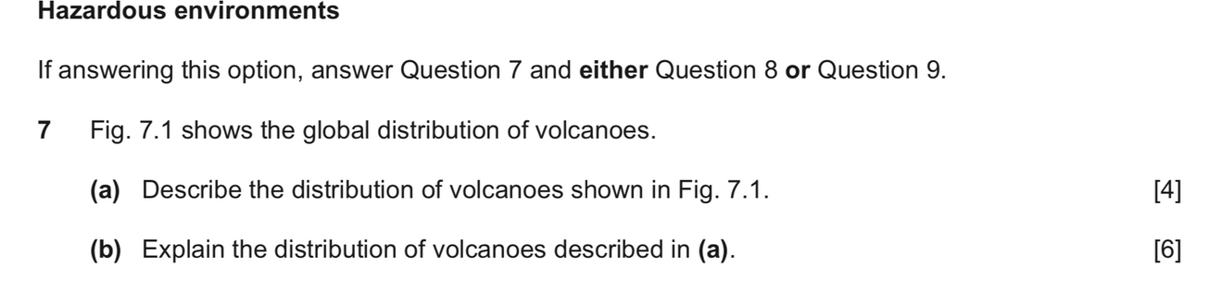
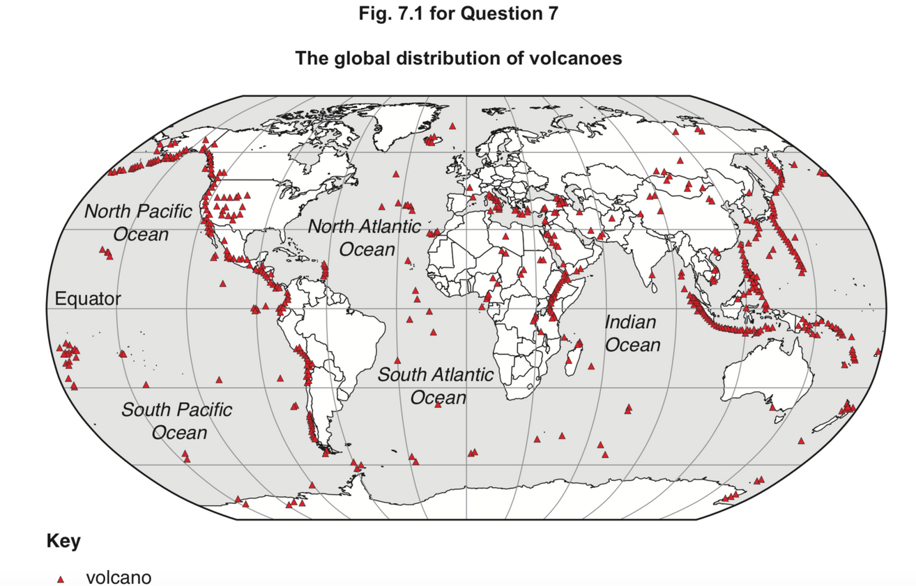
Exam Practice

Slide 3
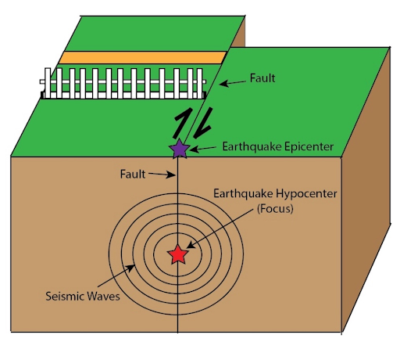
Title – Earthquakes & resultant hazards
LO: To investigate the causes and impacts of earthquakes and their resultant hazards
Describe the causes of earthquakes and how they are measured
Explain the resultant hazards of earthquakes along with the factors affecting the impact
Evaluate the extent to which earthquakes are caused by a variety of factors
An earthquake is the shaking of the surface of the Earth resulting from a sudden release of energy in the Earth's lithosphere that creates seismic waves. The point of energy release is called the focus - a series of vibrations or seismic (shock waves) originate from the focus. The vast majority of earthquakes are caused by strains in rock masses in earth’s crust due to tectonic plate movement. However, there are other causes including volcanism, deep mining and reservoir induction.
TASK: Explain in detail - What is an earthquake?
Epicentre: Marks the point of the earthquake on the surface of the earth immediately above the focus of the earthquake.
Seismic waves are able to travel along the surface of the earth and also through the body of the earth.
Learn more here!
Foreshocks – happen before a large earthquake
Aftershocks – occur after the main earthquake has taken place & can be particularly devastating – why?

Slide 4

Syllabus Guide – What we must know!
9.1 Hazards resulting from tectonic processes
The global distribution of earthquakes and volcanoes related to plate tectonics.
Earthquakes and resultant hazards: shaking, landslides, soil liquefaction, and tsunami.
Volcanoes and resultant hazards: types of eruption and their products (nuées ardentes, lava flows, volcanic mudflows/lahars, volcanic landslides, pyroclastic flows, and ash fallout).
Primary and secondary impacts on lives and property.
Prediction, hazard mapping, preparedness and monitoring of earthquake and volcanic hazards and
perception of risk.
Please refer to the course syllabus regularly – It guides you on exactly what is required from you in this course!

Slide 5
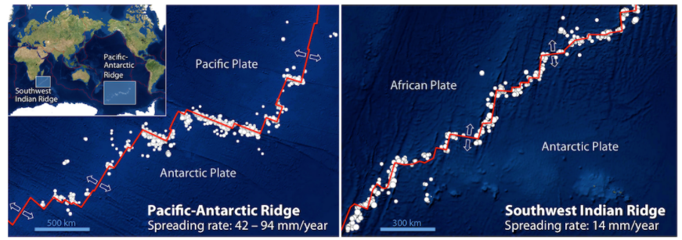
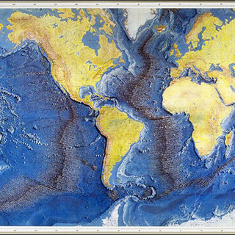
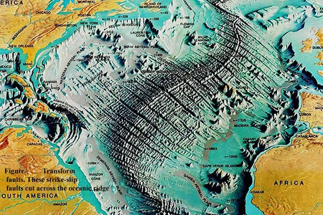
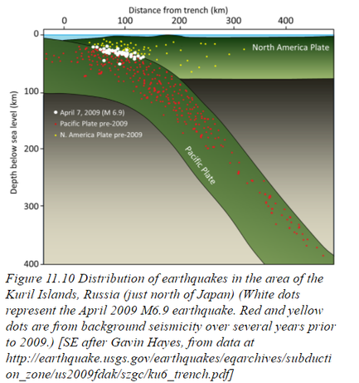
Earthquakes & plate boundaries
Divergent Plate Boundaries
At mid-ocean ridges & rift valleys earthquakes are quite shallow (usually less than 30 kilometres), infrequent & small – why?
Because the crust here is very weak and thin (this is because of crust spreading – the crust is not very thick because it is relatively new and it is weak because the rocks here are very hot (heated rock is more elastic, less rigid, therefore friction will be lower).
The lithosphere (upper mantle & crust) is weak at these boundaries so strain cannot build up enough to cause large earthquakes.
A feature of mid-ocean ridges are transform faults (perpendicular to the spreading ridge). Most of the earthquakes are located along these transform faults, rather than along the spreading segments (because here the rocks are cooler and stronger (see image below), although there are clusters of earthquakes at some of the ridge-transform boundaries.
Some earthquakes do occur on spreading ridges, but they tend to be small and infrequent because of the relatively high rock temperatures in the areas where spreading is taking place.
Convergent Plate Boundaries (Subduction Zones)
Subduction zones create some of the deepest earthquakes recorded – from 700 kilometres below ground.
When the oceanic crust descends, it takes time to warm up.
As the slab descends, it distorts (deforms/warps) because of the heat & because of the intense friction with the opposing plate. This builds up pressure and increases stress on the rocks. The rocks deform and eventually snap/jerk – this snap/jerk results in the release of stored energy i.e. the earthquake.
The size of the earthquake is dependent of the thickness of the descending slab & the rate of movement. Faster descending & thicker slab = bigger quake.
Subduction is relatively fast so by the time the slab cracks & the main quake occurs, it can have slid several hundred kilometres into the mantle (study image below).
In areas with earthquake activity, what is the relationship between chances of an earthquake and increasing time since the last earthquake?
The chances of an earthquake increase with time since the last earthquake!
Plates move at a rate of between 1.5cm – 7.5cm per year. However, a large earthquake can involve a movement of a few metres or more, which would occur every couple of hundred of years or so.
The longer the period of time since the last earthquake = More likelihood of increased strength of next earthquake.
Bands of earthquakes are wider along subduction zones because they take place throughout the subducting slab that extends beneath the opposing plate.
Earthquakes tend to get deeper with distance from ocean trench.
Transform Plate Boundaries
Like at divergent plate boundaries earthquakes are quite shallow (usually less than 30 kilometres) because below those depths, rock is too hot and weak.
However, like at convergent boundaries earthquakes can be very powerful because of friction and stress/pressure build up between opposing plates.
Convergent Plate Boundaries (collision zones)
Where continents collide, earthquakes are scattered over a much wider area compared to earthquakes along mid-ocean ridges, transform margins, or subduction zones. Most of the earthquakes are the result of tectonic squeezing caused by the convergence. Many others are related to transform faults on either side of the main fault line.
This is tough material! Check out this webpage to dig deeper and consolidate learning ☺

Slide 6
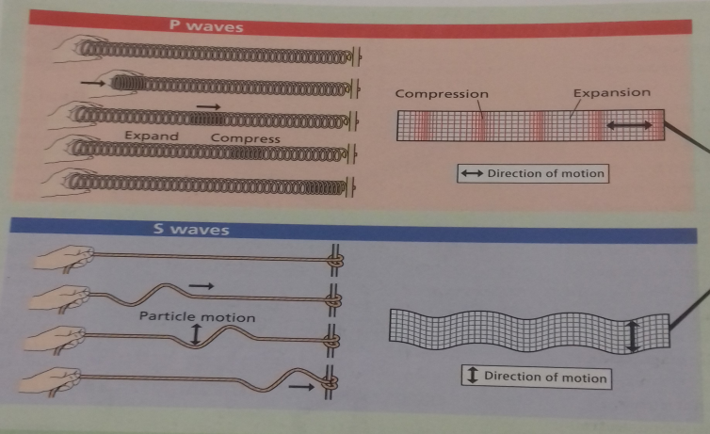
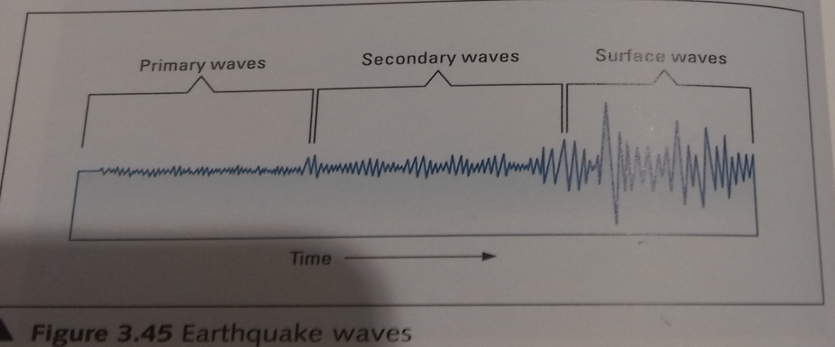

Earthquake waves – body waves
Following an earthquake, two types of body waves (waves within the earths interior) occur.
Primary Waves: The first are P-waves (also called compression waves – they work like the compression of the coils of a spring). These travel fastest & are first to be registered on a seismograph. These are longitudinal waves and cause the rocks to vibrate forwards and backwards in the direction of wave movement. P-waves travel by compression and expansion, and are able to pass through rocks, gases and liquids.
Secondary Waves: S-waves (also called shear waves – they work like the flick of a rope). These are slower moving waves that travel in a side-to-side motion through solid rock (they cannot travel through liquids or gases as liquids/solids have no rigidity (have no elastic properties). As they travel through the rock they cause the material to vibrate at right angles to the wave. Called transverse waves.
All crystal clear?!
10/10 explanation video on seismic waves - refer to it often!!
Seismographs readings as the 1999 Turkish earthquake struck.
https://www.youtube.com/watch?v=KZaI4MEWdc4 – Extension - watch this video for a model of how P & S waves work!

Slide 7
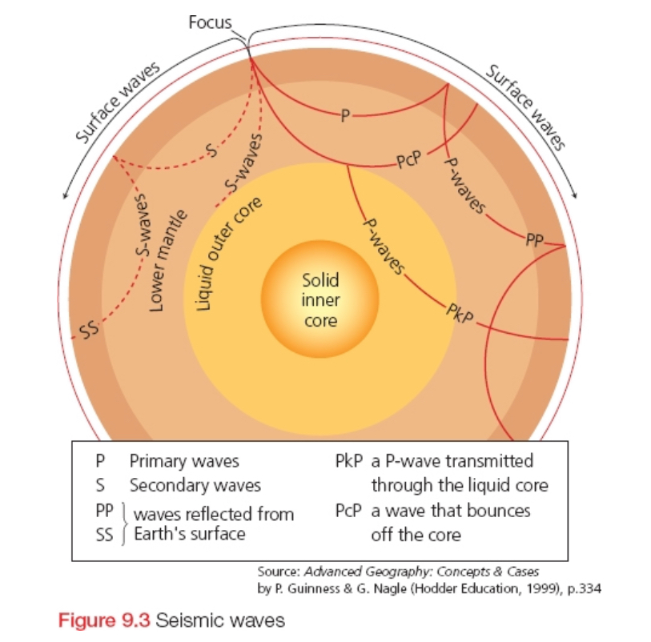
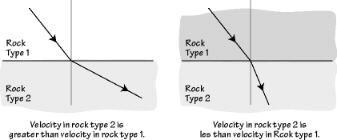
How were seismic waves used to help us figure out the composition/structure of Earth???
Reflection v Refraction?
Do waves move through liquid/solids/gases at the same speed? Why/Why not?
In the diagram on the right, why are the waves moving in curved lines, not straight lines?
Why do the S-waves stop when reaching the outer core?
Mohorovicic Discontinuity? The ‘Moho’?
Moho suggested a change in density from 2.9g/cm3 to 3.3g/cm3 marks the boundary between Earth’s crust and the mantle below. This boundary is known as the Mohorovicic Discontinuity or The ‘Moho’.
Later, geologists found a ‘shadow zone’ within the Earth where they could not detect S waves.
The explanation was that the S waves had passed from a solid to a liquid, thus S waves would stop and P waves would be refracted – this marks the boundary between the mantle and the liquid outer core. Here, at 2900 kilometres, there was a change in density from 5.5g/cm3 to a density of 10g/cm3.
The inner core is made of very dense solid material & density here can reach 13.6g/cm3.
The waves are refracted as they travel through the Earth due to a change in density of the medium. This causes the waves to travel in curved paths.
https://youtu.be/UNZ171fDja4 - Refraction of seismic waves
https://youtu.be/yAQSucmHrAk - The Moho Discontinuity

Slide 8
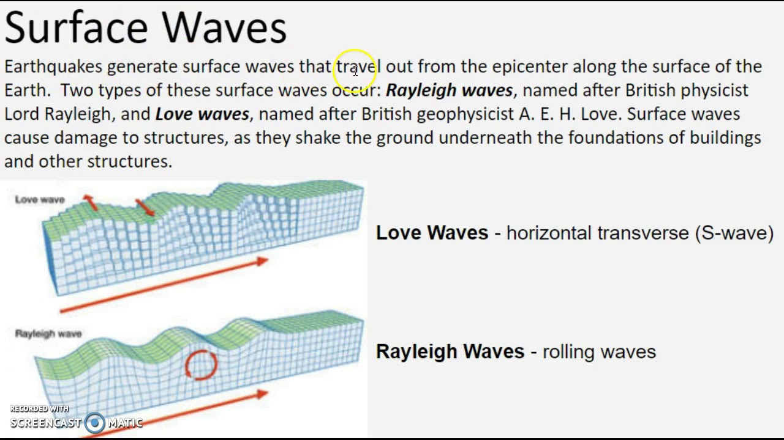
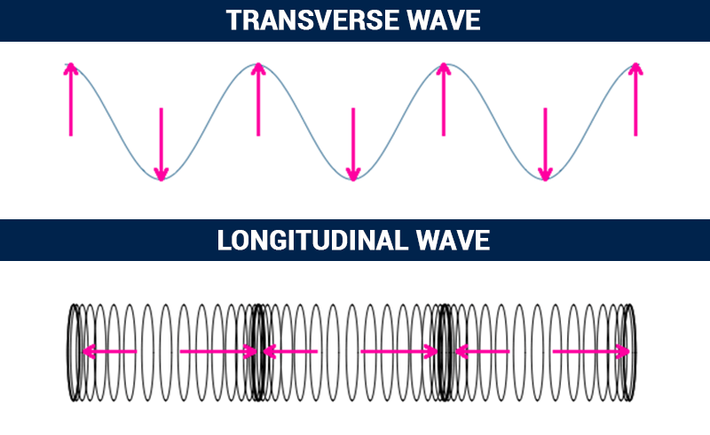
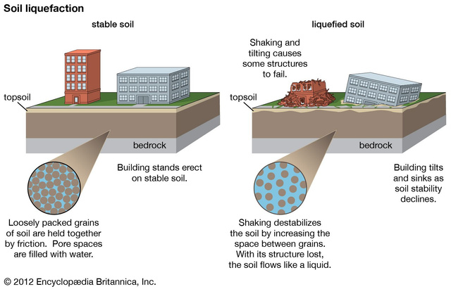
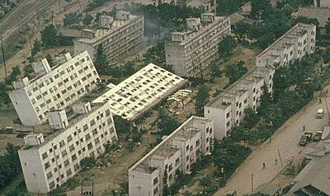
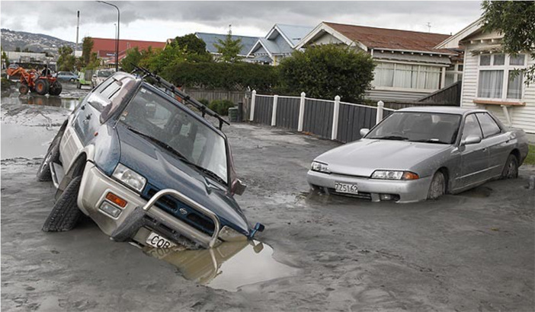
Earthquake waves - Surface Waves
When P & S waves reach Earth’s surface, some of them become surface waves. TASK: Use this slide to learn about surface waves.
Surface Waves are the slowest of the three waves and arrive shortly after the other two. They differ from P and S waves in that they only travel close to, and along the surface, causing anything on it to move in an up-and-down (called Rayleigh waves, like waves in an ocean) and side-to-side (called Love waves) motion. Both are longitudinal and transverse (Transverse waves cause the medium to move perpendicular to the direction of the wave. Longitudinal waves cause the medium to move parallel to the direction of the wave). These produce a shearing motion, causing much of the surface damage seen when earthquakes occur.
The nature of rock & sediment below the surface influences the pattern of shocks & vibrations during an earthquake. Unconsolidated sediments such as sand shake in a less predictable way than solid rock. Hence, the damage is far greater to the foundations of buildings.
P-waves from earthquakes can cause liquefaction. Liquefaction takes place when loosely packed, water-logged sediments at or near the ground surface lose their strength in response to strong ground shaking.
Check out some videos on all types of wave here.

Slide 9
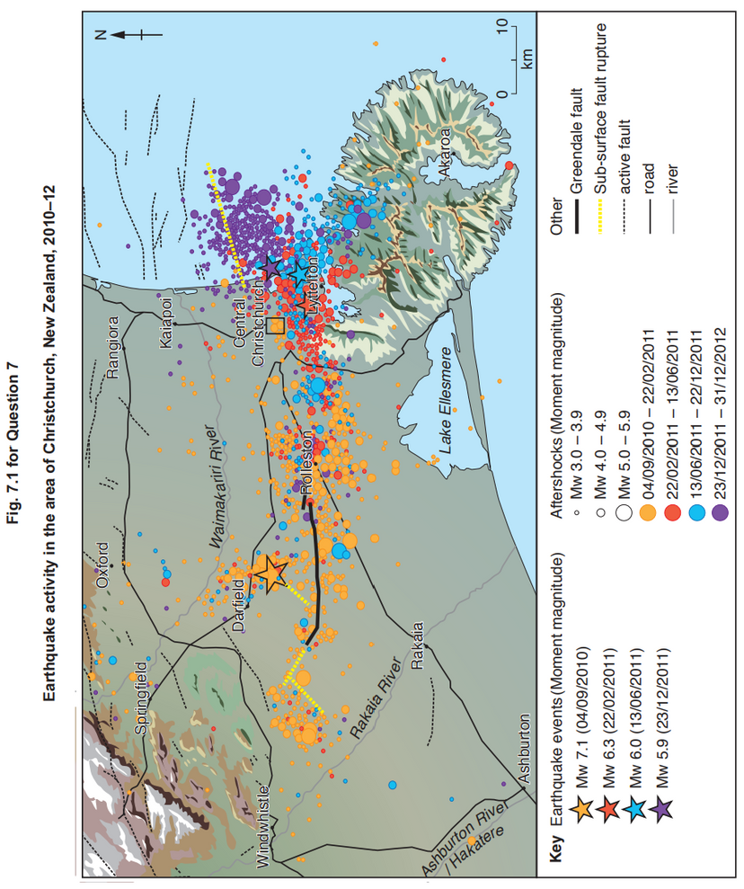
Hazardous environments If answering this option, answer Question 7 and either Question 8 or Question 9.
7 Fig. 7.1 shows earthquake activity in the area of Christchurch, New Zealand, 2010–12.
Describe the pattern of earthquake activity shown in Fig. 7.1. [4]
Suggest reasons for the great amount of earthquake activity in the area shown in Fig. 7.1. [6]
7(a) Fig. 7.1 shows earthquake activity in the area of Christchurch, New Zealand, 2010–12.
Describe the pattern of earthquake activity shown in Fig. 7.1.
Candidates should interpret Fig. 7.1 to describe the main pattern of earthquake activity.
Candidates may identify:
• most intense earthquake in the west
• the Mw earthquakes of 6.3, 6.0 and 5.9 concentrated just to the east of Christchurch
• aftershocks on 04/09/2010 in a line west of Christchurch clearly related to the 04/09/2010 earthquake probably associated with the Greendale fault
• other aftershocks concentrated to the south and east of Christchurch
• isolated aftershocks of low magnitude more widely scattered
• age pattern is acceptable
1 mark for each clear and unambiguous point including use of data. 4
7(b) Suggest reasons for the great amount of earthquake activity in the area shown in Fig. 7.1.
Candidates should refer to the information provided in Fig. 7.1 in suggesting reasons. No knowledge of New Zealand or Christchurch is expected but generic points might be valid. However, the bulk of the answer should relate to detail provided in Fig. 7.1 such as movement along the major fault lines such as the Greendale fault. Offshoots from this major fault (sub-surface fault rupture) are also relevant.
Suggestions may include:
• the Greendale fault
• several active faults are present
• sub-surface fault rupture offshore to the north-east
This information needs to be used in combination with an understanding of the causes of earthquakes.
Award marks based on the quality of explanation and breadth of the response using the marking levels below.
Level 3 (5–6) Response clearly uses the information in Fig. 7.1 to suggest reasons for the earthquake activity. Response is well founded in detailed knowledge and strong conceptual understanding of the topic. Examples used are appropriate and integrated effectively into the response.
Level 2 (3–4) Response offers some suggestions to account for the earthquake activity but with limited use of Fig. 7.1. Response develops on a largely secure base of knowledge and understanding. Examples may lack detail or development.
Level 1 (1–2) Response suggests some reasons for the earthquake activity but explanation is insecure. Knowledge is basic and understanding may be inaccurate. Examples are in name only or lacking entirely.
Level 0 (0) No creditable response. 6
Notes:
9696_s19_qp_31
9

Slide 10
Hazardous environments If answering this option, answer Question 7 and either Question 8 or Question 9.
7 Fig. 7.1 shows earthquake activity in the area of Christchurch, New Zealand, 2010–12.
Describe the pattern of earthquake activity shown in Fig. 7.1. [4]
Suggest reasons for the great amount of earthquake activity in the area shown in Fig. 7.1. [6]
7(b) Suggest reasons for the great amount of earthquake activity in the area shown in Fig. 7.1. (6)
Candidates should refer to the information provided in Fig. 7.1 in suggesting reasons. No knowledge of New Zealand or Christchurch is expected but generic points might be valid. However, the bulk of the answer should relate to detail provided in Fig. 7.1 such as movement along the major fault lines such as the Greendale fault. Offshoots from this major fault (sub-surface fault rupture) are also relevant.
Suggestions may include:
• the Greendale fault
• several active faults are present
• sub-surface fault rupture offshore to the north-east
This information needs to be used in combination with an understanding of the causes of earthquakes.
Award marks based on the quality of explanation and breadth of the response using the marking levels below.
Level 3 (5–6) Response clearly uses the information in Fig. 7.1 to suggest reasons for the earthquake activity. Response is well founded in detailed knowledge and strong conceptual understanding of the topic. Examples used are appropriate and integrated effectively into the response.
Level 2 (3–4) Response offers some suggestions to account for the earthquake activity but with limited use of Fig. 7.1. Response develops on a largely secure base of knowledge and understanding. Examples may lack detail or development.
Level 1 (1–2) Response suggests some reasons for the earthquake activity but explanation is insecure. Knowledge is basic and understanding may be inaccurate. Examples are in name only or lacking entirely.
Level 0 (0) No creditable response. 6
Model Answer!
The Greendale fault, measuring approx. 20km in length is a contributing factor for the great amount of earthquake activity in the area. A 7.1 Mw earthquake struck a few kilometres north of this fault on 4th Sept 2010, and this was followed by tens/hundreds of smaller earthquakes in the areas around the fault line (particularly to the west and east/south-east) in the 5 month period which followed. These were likely the aftershocks from the main quake, as the sub-surface rocks try to ‘settle’ into their positions but often become locked/jammed as they do so.
Another reason for the high amount of earthquake activity is the presence of sub-surface fault ruptures. A sub-surface fault rupture extends for approx. 15km just offshore of N.Z. to the north east of Christchurch. To the north of this are several active fault lines. All of this means seismic activity is likely in this region. A 6.3Mw earthquake struck south of this this rupture, and just south of the city of Christchurch in Feb 2011, and was succeeded by two more, slightly less powerful, earthquakes measuring 6.0Mw & 5.9Mw later on that year. As the epicentre of each of these earthquakes progressively moved closer to the sub-surface fault rupture, this indicates that movement of plate/rock at the fault rupture was responsible for this earthquake activity. This area is located at a subduction zone, which are associated with wide-bands of earthquake activity, as rocks/plate becomes stuck as it sinks into the mantle, often many kilometres away from the point of subduction; the earthquake activity in the image illustrates this. The zones immediately surrounding the three main quakes which struck Christchurch in 2011 experienced hundreds of smaller earthquakes measuring under 5.9Mw in the months following the main quakes, which are likely either foreshocks or aftershocks as rocks jostle for position beneath the surface.
Notes:
9696_s19_qp_31
10

Slide 11
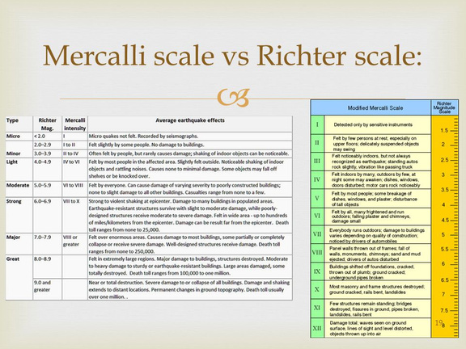
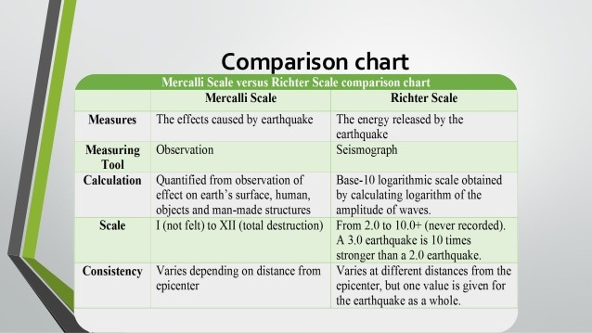
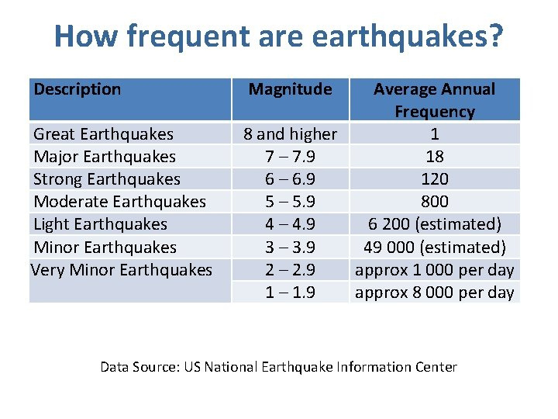
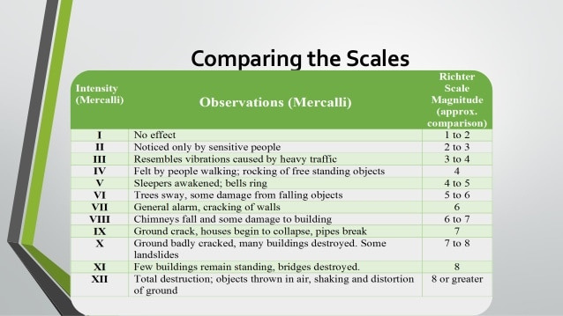
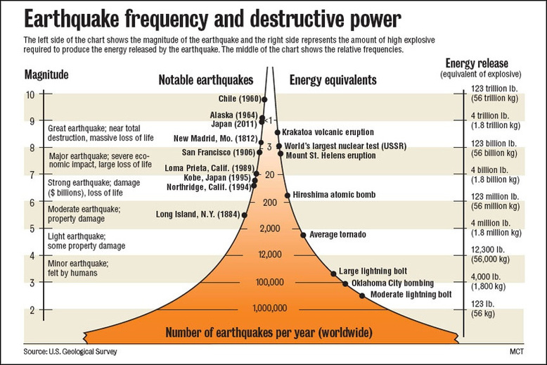
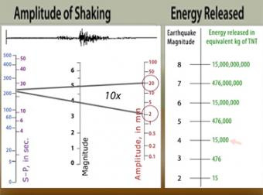
How are earthquakes measured?
TASK:
Research the Richter Scale (magnitude) and the Moment Magnitude and Mercalli (intensity) Scales.
Produce a table/visual which compares and contrasts both scales.
Make sure you address the following:
Who created them?
How they work – how do they measure earthquakes & what tool is used for measurement?
How is the earthquakes strength/magnitude calculated?
What is the scale used?
Advantages and limitations of each?
Which scale is most used today & why?

Slide 12
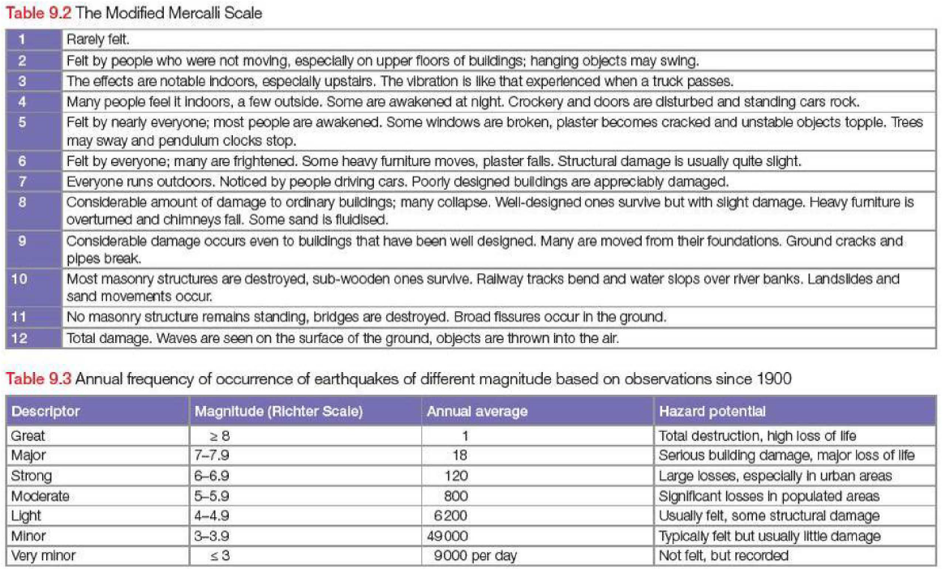

Slide 13

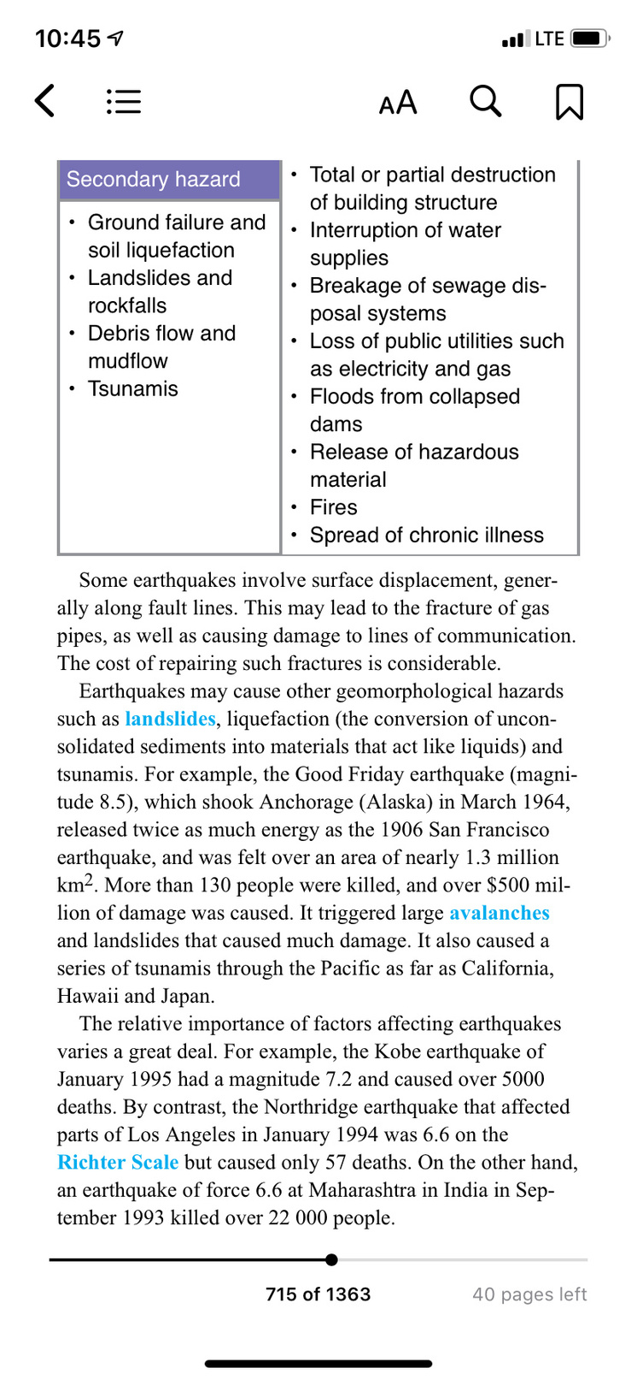
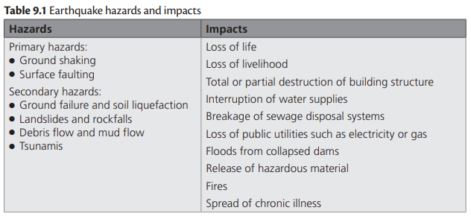
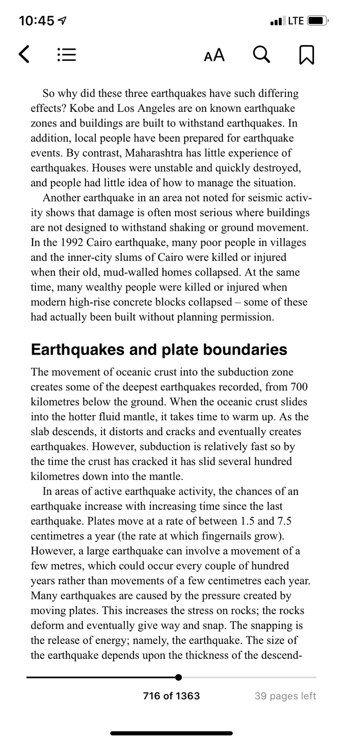
Resultant hazards & impacts of earthquakes?
Many impacts are caused as a result of earthquakes. Most problems are associated with damage to buildings, structures and transport systems. The collapse of building structures is the direct cause of injuries and deaths, but it also reduces the effect of the emergency services. In some cases, more damage is caused by the aftershocks of earthquakes that follow the main event. Why?
Aftershocks are more subdued but longer lasting and more frequent than the main tremor. Buildings only partly damaged by earthquakes may be completely damaged in the aftershocks.
What are the primary hazards and secondary hazards of earthquakes? Can you list 8 impacts?
TASK – Read the textbook extract & complete the following tasks:
Make your own table illustrating the primary & secondary hazards of earthquakes.
Make a table illustrating the effects/impacts of earthquakes. Can you categorise into SEE? Primary/secondary? Short-term/long-term?
Using examples and data, explain how/why some earthquakes have greater impacts than others despite potentially having lower magnitudes.
PPQ - Describe the hazards resulting from earthquakes. Assess the extent to which hazards resulting from earthquakes can be managed. [20]
We will be doing earthquake case studies soon. As per the above question, you need to know and describe the various hazards which result from earthquakes. Remember this when you are learning/writing/research your earthquake case study. Choose earthquakes that have had many hazards associated with them e.g. tsunamis, landslides, soil liquefaction etc. to make your life easier.

Slide 14
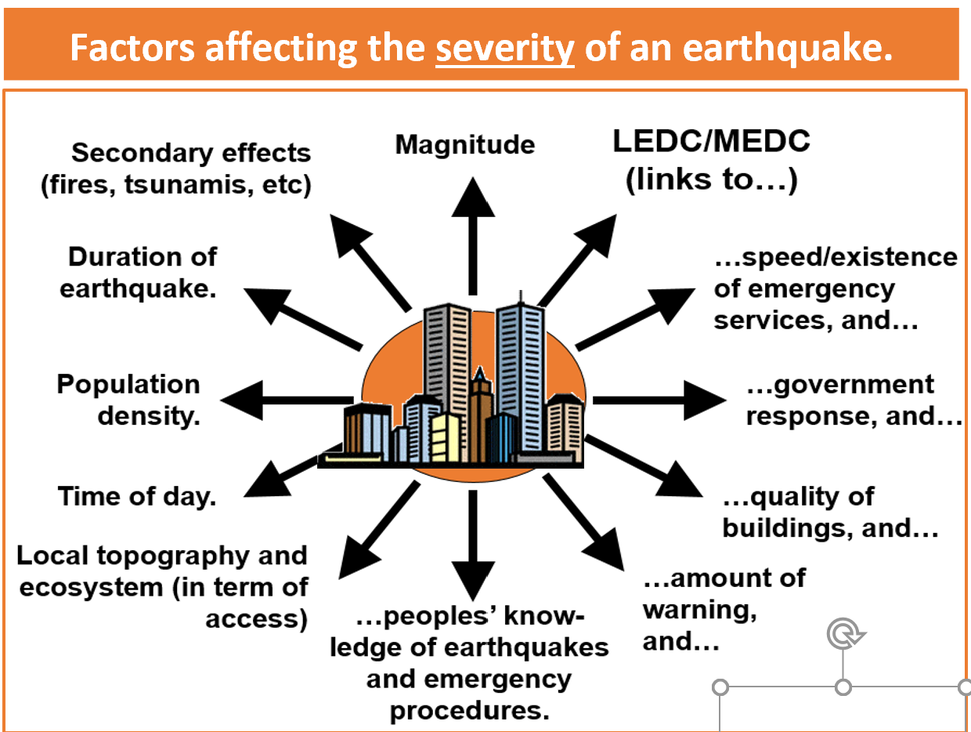
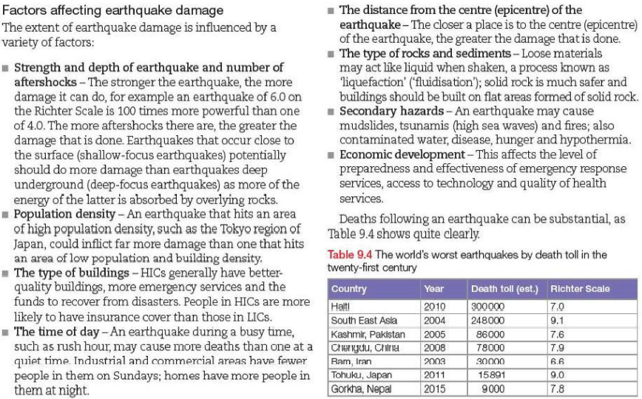
Reminder - Factors affecting earthquake damage

Slide 15
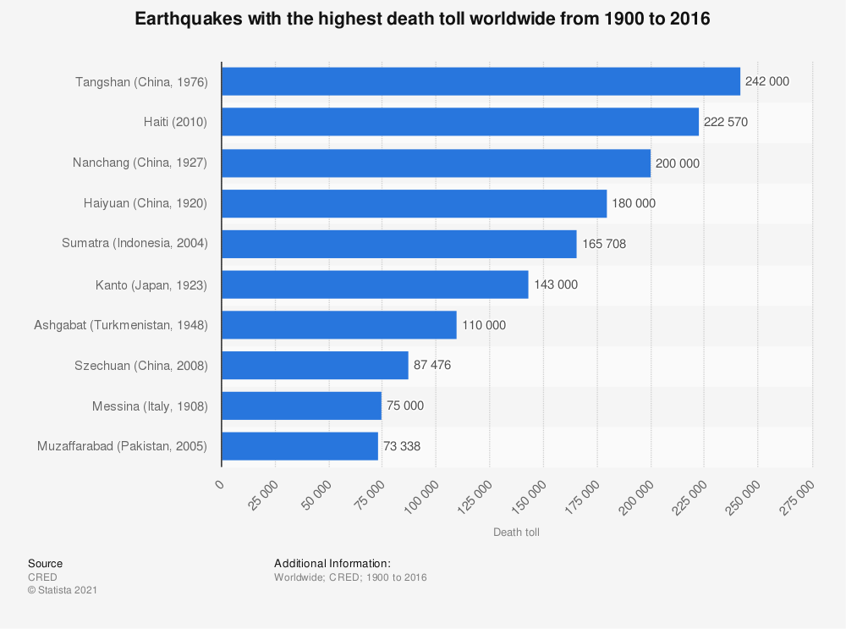
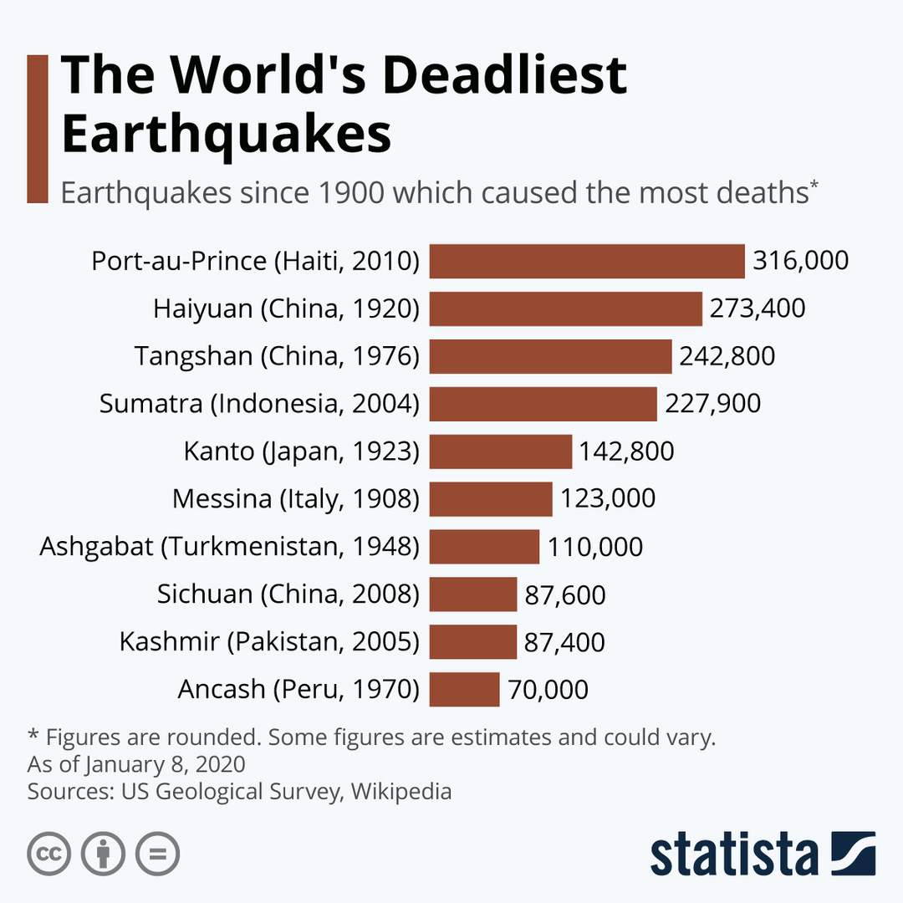
Reminder - Factors affecting earthquake damage
What are the world's costliest earthquakes?
Critical Thinking: Why are there discrepancies between these two graphs?

Slide 16
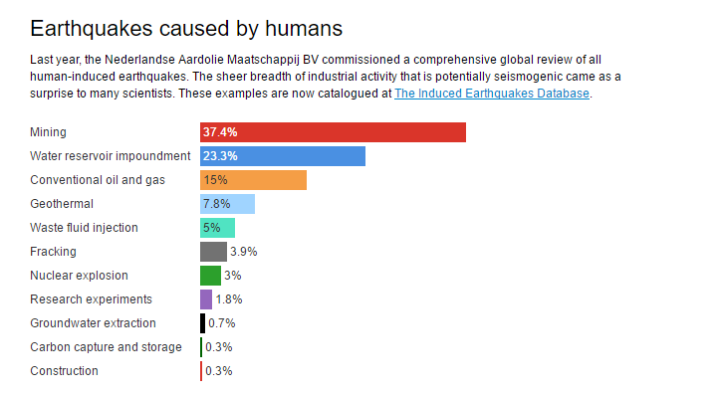
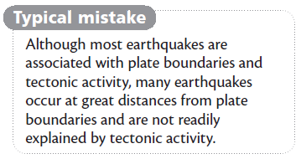
Can human activity trigger earthquakes?
Check out this video & read the article. Human activities can trigger earthquakes, or alter the magnitude and frequency of earthquakes in multiple ways:
Underground disposal of liquid wastes
Underground nuclear testing & explosions
Mining & fracking
Increased crustal loading
TASK:
Create a visual/mind-map to describe/explain how each of the above can cause earthquakes. Ensure you refer to real-life examples in each case (slides 17-20 have further info on each).
Global Earthquakes caused by Human Activity in 2017

Slide 17
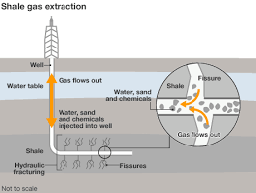
Can human activity trigger earthquakes?
What is Fracking?
“The process of injecting liquid at high pressure into subterranean rocks, boreholes, etc. so as to force open existing fissures and extract oil or gas”.
Watch the video on the link below and answer the following questions
https://www.youtube.com/watch?v=Uti2niW2BRA&t=228s
What is Fracking and how does it work?
What opportunities can fracking bring?
What are the dangers of Fracking?
Watch the video on the link below and answer the two questions
How can Fracking cause earthquakes?
What is the evidence for this?
https://www.youtube.com/watch?v=RVp3z7itKKo

Slide 18
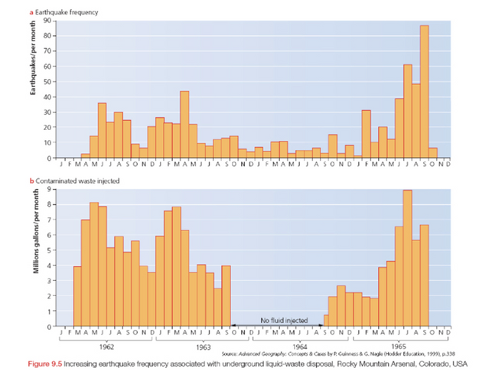
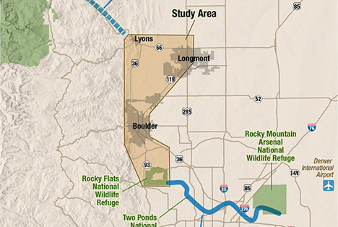
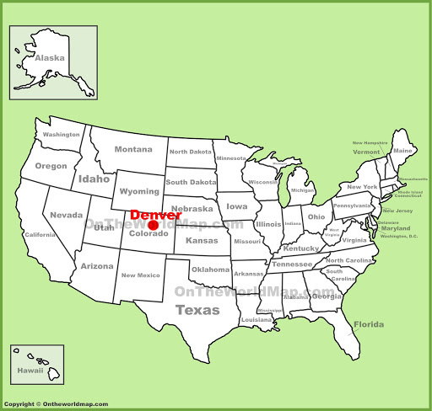
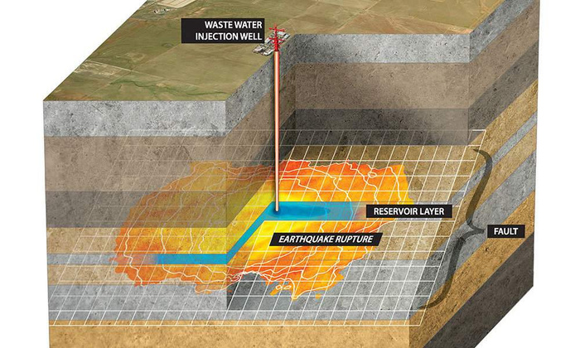
Can human activity trigger earthquakes?
Disposal of liquid waste
Look at the tables & image below:
Describe the relationship between earthquake activity and disposal of waste liquid.
Disposal of Liquid Waste – Rocky Mountains
Read the information below and;
Explain the link between disposal of liquid waste and earthquakes
Extension: To what extent do you agree with this statement
”The Disposal of liquid waste does not pose a major threat to surrounding areas”
In the Rocky Mountain Arsenal in Denver Colorado, wastewater was injected into underlying rocks during the 1960’s. Water was contaminated by chemical warfare agents, and the toxic wastes were too costly to transport off-site for disposal. Thus it was decided to dispose of it down a well over 3500m deep. Disposal began in March 1962 and was followed soon afterwards by a series of minor earthquakes, in an area previously free of E/q activity. None of the earthquakes caused any real damage, but they did cause alarm. Between 1962 and 1965 over 700 minor earthquakes were monitored in the area.
The injection of the liquid waste into the bedrock lubricated and reactivated a series of deep undergroung faults that had been inactive for a long time. The more waste-water was put down the well, the larger the number of minor earthquakes. When the link was established, disposal stopped. In 1966, the well was filled in and the number if minor earthquake events detected in the area fell sharply.

Slide 19
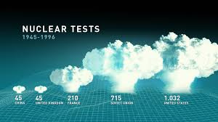
Can human activity trigger earthquakes?
Underground Nuclear testing
Watch the video below
What do you think is happening to cause the explosions?
What impacts could this have on the place and local community?
https://www.youtube.com/watch?v=HCPhJpUrvak
Read the paragraph below and give examples of how nuclear testing can cause earthquakes.
Nuclear testing is conducted to document function, yield and effects of nuclear weapons during their development. Underground nuclear testing has triggered earthquakes in a number of places. In 1968, testing of a series of 1200 tonne bombs in Nevada set off over 30 minor earthquakes in the area over the following 3 days. Since 1966, the Polynesian island of Moruroa has been the site of over 80 underground nuclear explosion tests by France. More than 120000 people live on the island. In 1966, a 120,000 tonne nuclear device was detonated, producing radioactive fallout that was measured over 3000 km downwind.

Slide 20
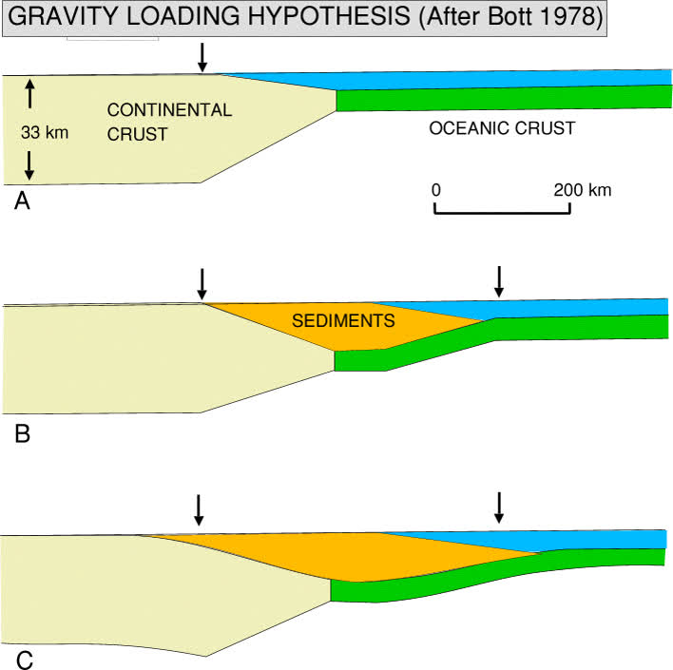
Can human activity trigger earthquakes?
Increased Crustal Loading
Read the text below and;
Identify what increased crustal loading is.
Explain how it can cause earthquakes
Extension: Assess the impact of these earthquakes.
Crustal Loading. The adding of weight by sedimentation from erosion or orogenic processes, or loading, causes crustal depression and subsidence. Sediments accumulate at the lowest elevation possible, in accommodation spaces. The rate and magnitude of sedimentation controls the rate at which subsidence occurs.
Earthquakes can be caused by adding increased loads on previously stable land surfaces. For example, the weight of water behind large reservoirs can trigger earthquakes. In 1935, the Colorado River was dammed by the Hoover Dam to form Lake Mead. As the lake filled, over a period of ten years, and the underlying rocks adjusted to the new increased load of over 40km3 of water, long-dormant faults in the area were reactivated, causing over 6000 minor earthquakes. Over 10,000 events were recorded up to 1973, about 10% of which were string enough to be felt by residents. None caused damage.

Slide 21
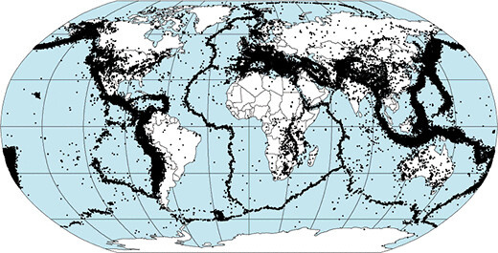
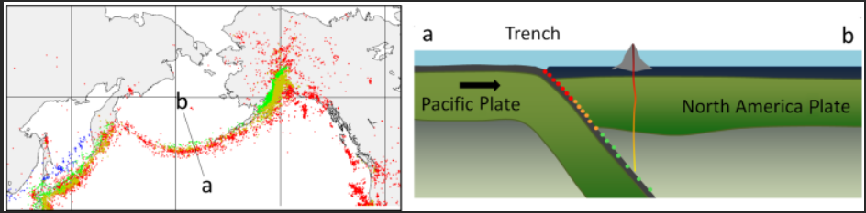
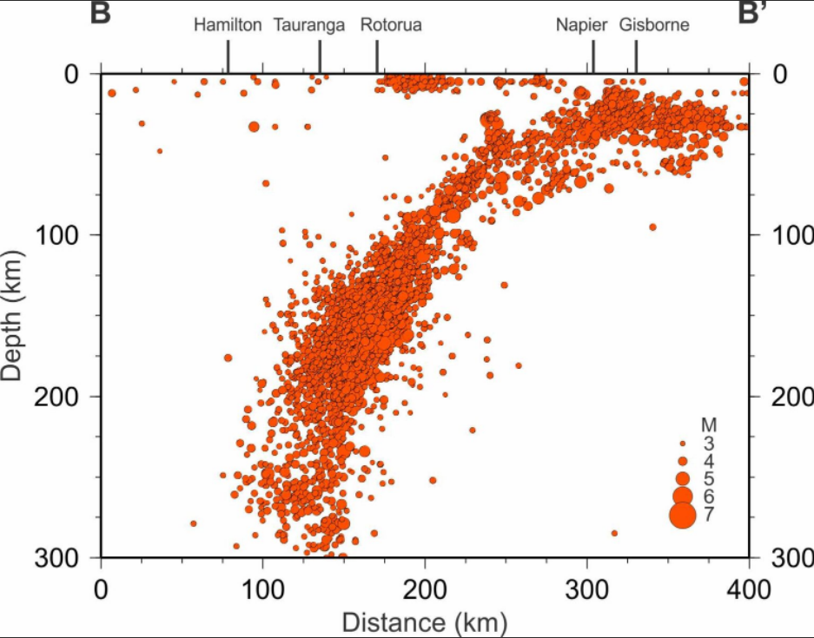
Why do earthquakes & their effects extend beyond the immediate plate boundary?
The vast majority of earthquakes occur in zones that we now recognize as the boundaries between tectonic plates. These are locations where slabs of the lithosphere (the crust and top hard part of the mantle) are bumping, grinding, and sliding past each other.
But not all these zones are the same. Some zones are thin/narrow lines and some zones are thick/wide black smudges on the map.
This is where the DEPTH of the earthquake comes into play. Scientists group earthquakes into the following depths:
Shallow earthquakes are between 0 and 70 km deep;
Intermediate earthquakes are 70 – 300 km deep;
Deep earthquakes are 300 – 700 km deep.
If we look at the thin zones we notice that all the earthquakes are shallow.
If we look at the wide zones we see that the earthquakes are shallow on one side (red in image above), intermediate depth in the middle (yellow/orange) and deep (green) on the other side. This zoning phenomenon is now commonly known as the Benioff Zone. The Benioff Zone of earthquakes is caused by the subduction of one tectonic plate under another. The earthquakes at the surface boundary between the two plates are shallow. The subducted plate is forced down deeper, and further away from the plate boundary, causing intermediate earthquakes and as it is forced into the mantle it continues to produce earthquakes (deep earthquakes) until the plate finally is reabsorbed into the mantle at a depth of around 700 km or so.
The earthquake data acts as a ‘sonogram’ of what is happening at the plate boundary. If we plot the data on a graph showing earthquake depth against distance we almost can see the shape of the plate being forced down into the mantle. Where the earthquakes stop at depth is where the plate becomes so soft that no sudden movements (ie rocks grinding) can be detected. Here the plate is being reabsorbed into the mantle.

Slide 22
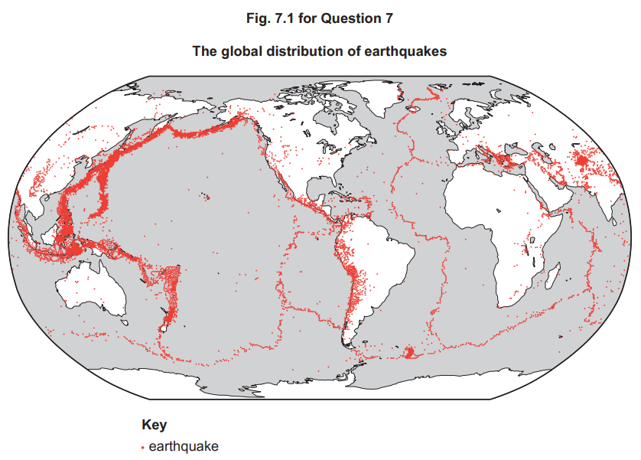
Hazardous environments If answering this option, answer Question 7 and either Question 8 or Question 9.
7 Fig. 7.1 shows the global distribution of earthquakes.
Describe the global distribution of earthquakes shown in Fig. 7.1. [4]
Explain why the depth of focus of earthquakes varies from place to place. [6]
7(a) Fig. 7.1 shows the global distribution of earthquakes.
Describe the global distribution of earthquakes shown in Fig. 7.1.
Candidates should interpret Fig. 7.1 to identify the distribution of earthquakes across the globe. Candidates may identify that:
• Earthquakes are mainly linear in their distribution/belts/chains/long and narrow
• Widely distributed across the globe
• There are clusters/concentrations
• Many are along the edges of continental landmasses, e.g. Pacific Ring of Fire
• Others are mid-oceanic, e.g. mid-Atlantic
• A few are in continental interiors, e.g. central/east Africa
• There are a few in isolated locations, e.g. Hawaii
1 mark for each relevant distribution point. Map evidence required for max. 4
7(b) Explain why the depth of focus of earthquakes varies from place to place.
Reasons include:
• Depends on type of plate boundary
• Destructive (convergent) tend to have a range of focus depth in the subduction zone
• Constructive (divergent) and conservative (transform) tend to produce shallow focus earthquakes as no subduction occurs
• Collision (convergent) tend to produce relatively shallow focus earthquakes as no subduction, but there is uplift/folding above
Award marks based on the quality of explanation and breadth of the response using the marking levels below.
Level 3 (5–6) Response applies knowledge and understanding of a range of plate boundaries to explain the variations in depth of focus. Response is well founded in detailed knowledge and strong conceptual understanding of the topic. Any examples used are appropriate and integrated effectively into the response.
Level 2 (3–4) Response explains at least two types of plate boundary to explain variations in depth of focus. Response develops on a largely secure base of knowledge and understanding. Examples may lack detail or development.
Level 1 (1–2) Response consists of one or more descriptive statements about earthquakes with little or no explanation of the reasons for their varying depth of focus. Knowledge is basic and understanding may be inaccurate. Examples are in name only or lacking entirely.
Level 0 (0) No creditable response. 6
Notes:
9696_s21_qp_33
22

