Slide 1
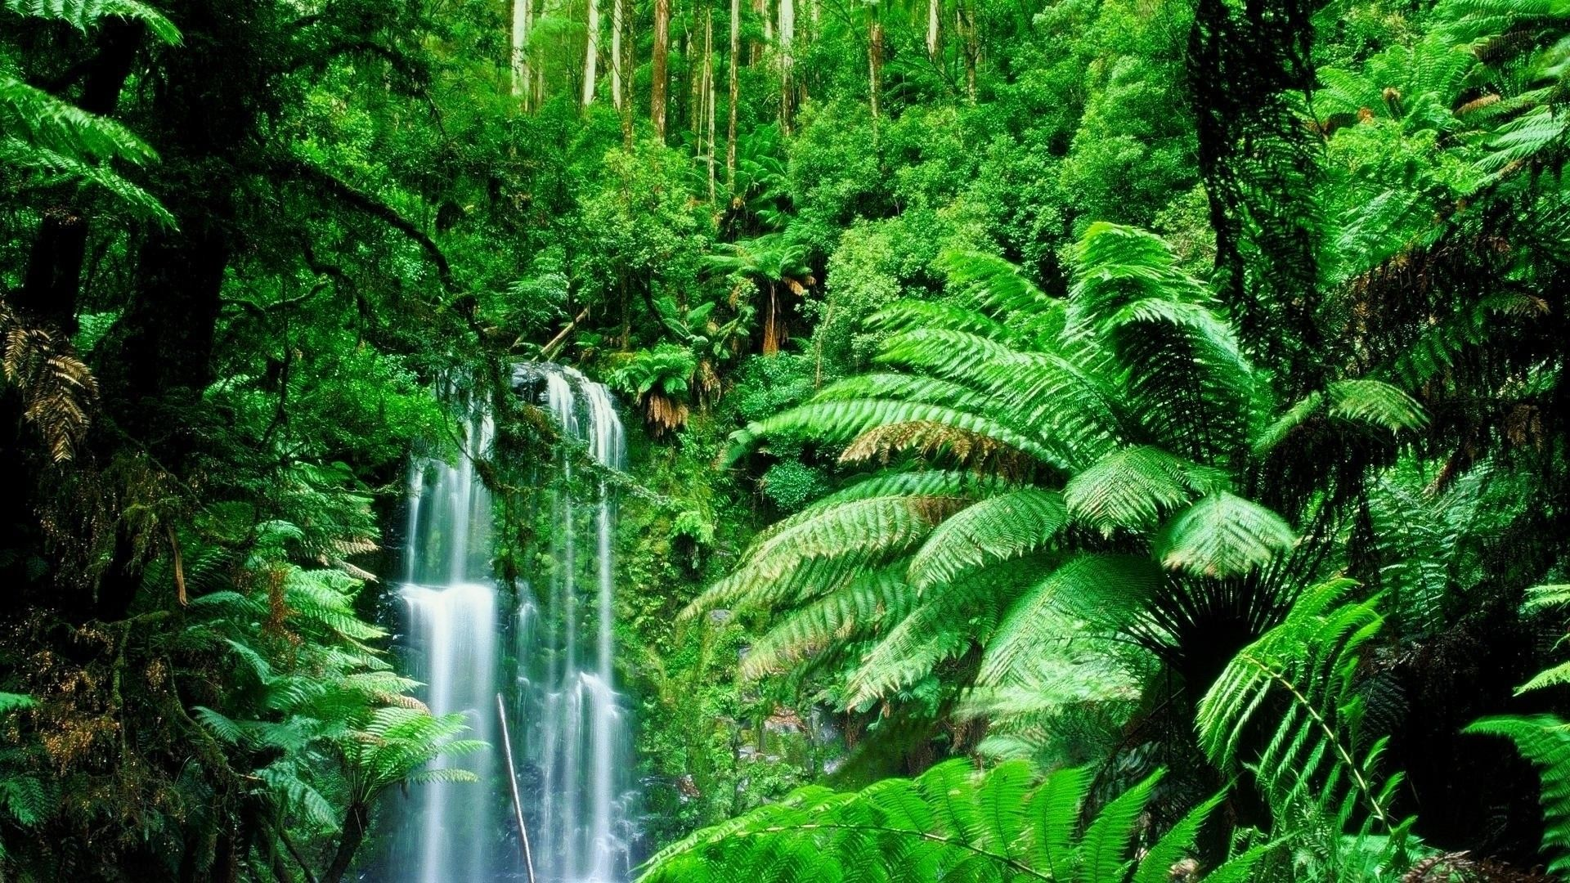
Classification systems
By the end of the lesson you will be able to:
Describe the evidence that has led to new classification systems, such as the three domains of life, which clarifies relationships, including the more recent use of similarities in biological molecules and other genetic evidence

Slide 2

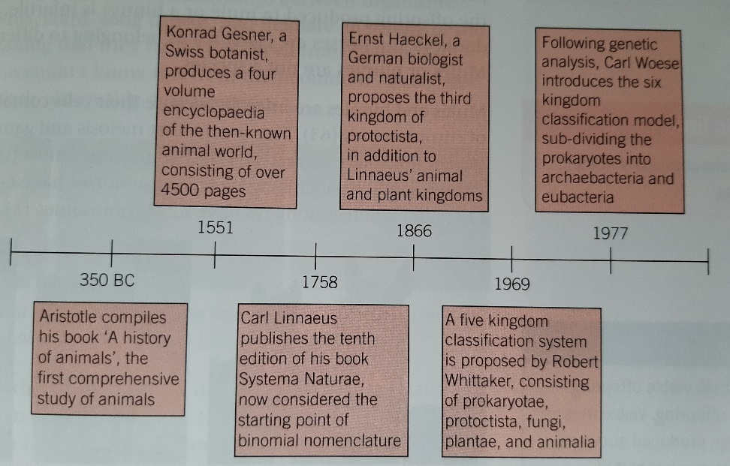
Development of Classification Systems
As Scientists learn more about organisms, classification systems change. Early classification systems were based on observable features.
Through the study of genetics, DNA and other biological molecules, scientists are now able to study evolutionary relationships between organisms

Slide 3

The Evolution of Classification Systems
Evidence to support the classification of organisms
We now have the capability to compare the molecules of organisms as well as their external features and functions, in order to confirm our classification of them. Since it is the DNA which ultimately dictates an organism’s features, by encoding proteins, we can analyse both of these types of molecules to provide evidence of relationships between organisms.
How would you expect the DNA of two closely related organisms to compare to each other and to a more distant relative?
Taxonomists will also use embryonic evidence and fossil evidence
Notes:
(Closely related organisms will have more DNA base sequences in common. When one sp gives rise to another, the new sp’s DNA will be very similar to the old sp at first, but over time, thanks to MUTATIONS, the two sps’ DNA base sequence will show more and more differences.)

Slide 4
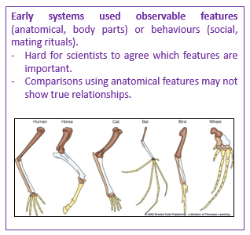
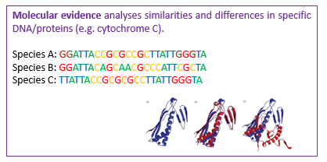
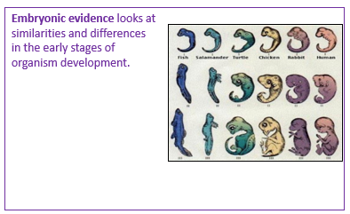
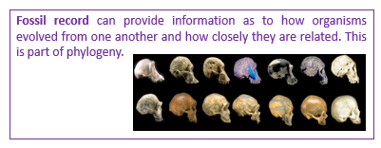

Slide 5
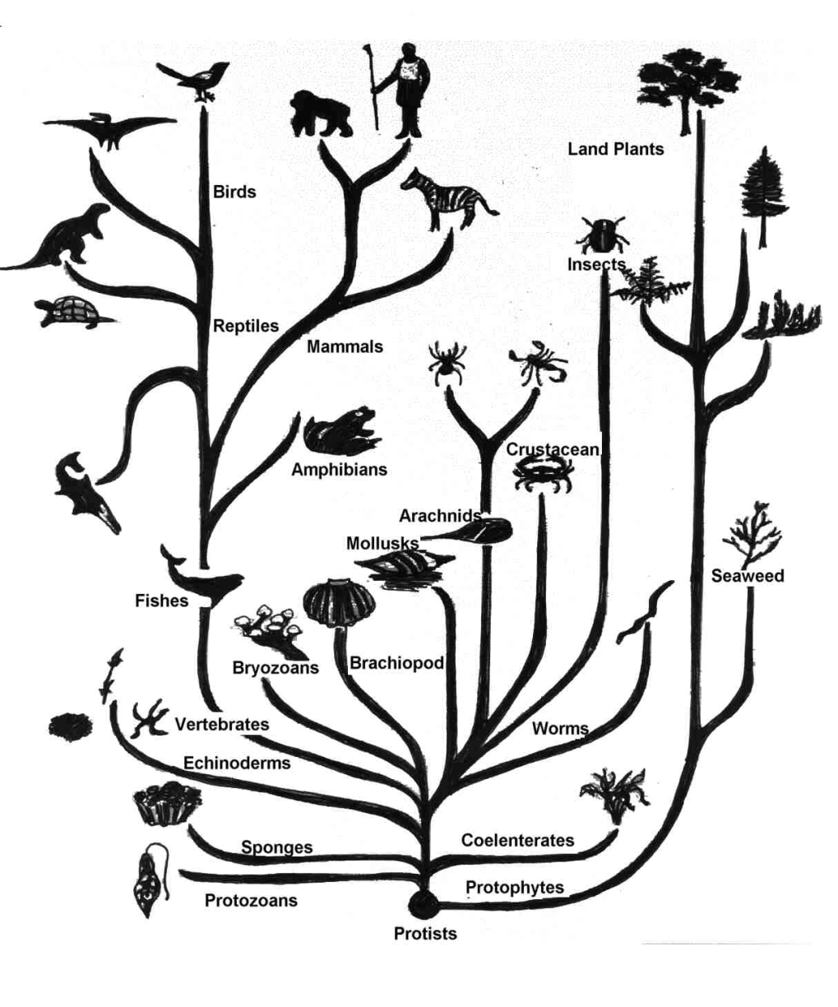
Comparison of DNA base sequences
When one species evolves from another, the DNA will be very similar.
Mutations will change the base sequence of new species.
Closely related species = similar DNA sequences

Slide 6

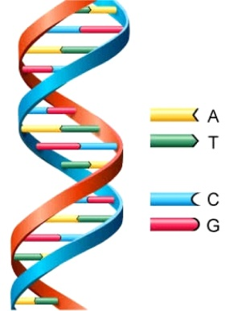

Using DNA sequences
Changes in DNA are caused by mutations.
The more differences there are the less closely related two species are as they will have evolved separately for a longer period of time.
Quick Question:
Which of two of these 3 species are most closely related?

Slide 7
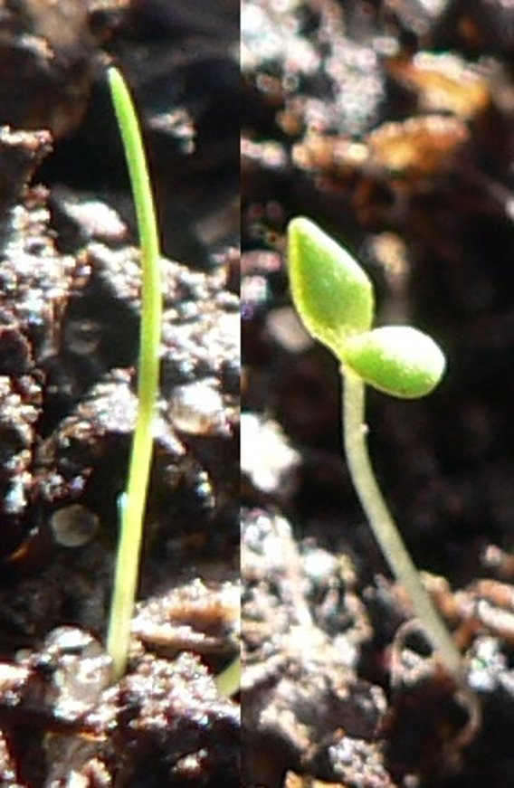

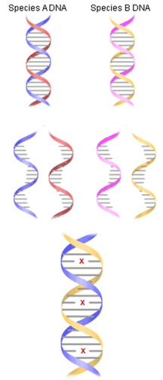
DNA Hybridisation
This has been used recently to classify plants rather than counting the number of leaves
Put these statements into the correct order:
1. Therefore the more closely related the species
2. On cooling, the strands combine with others that have a complementary base sequence.
3. DNA from 2 species is extracted, purified & cut into small pieces
4. The higher the temperature needed to break the new strands apart = more H bonds
5. DNA is heated to about 90°C to break the H bonds
3, 5, 2, 4, 1

Slide 8
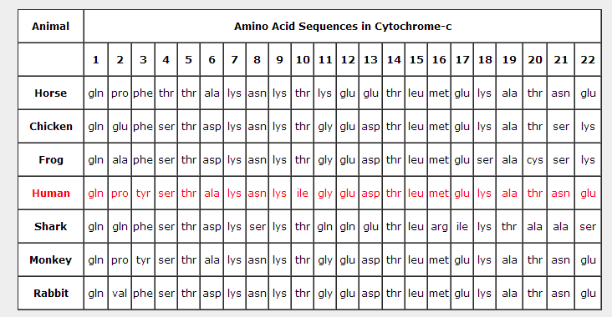
Using Amino Acid sequences
Cytochrome C is a protein used for respiration. It is not identical in all species. We can compare the sequence of the amino acid sequence in the cytochrome C protein to find how closely related organisms are.
Similar sequence = closely related
The more differences found = less closely related species.

Slide 9
Q. Which are the most and least closely related organisms to humans in the table below?
Horse = 17 similarities / 5 differences
Chicken = 16 similarities / 6differences
Frog =14 similarities/ 8 differences
Shark = 8 similarities/ 14 differences
Monkey = 21 similarities/ 1 difference
Rabbit = 18 similarities/ 4 differences

Slide 10
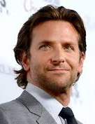
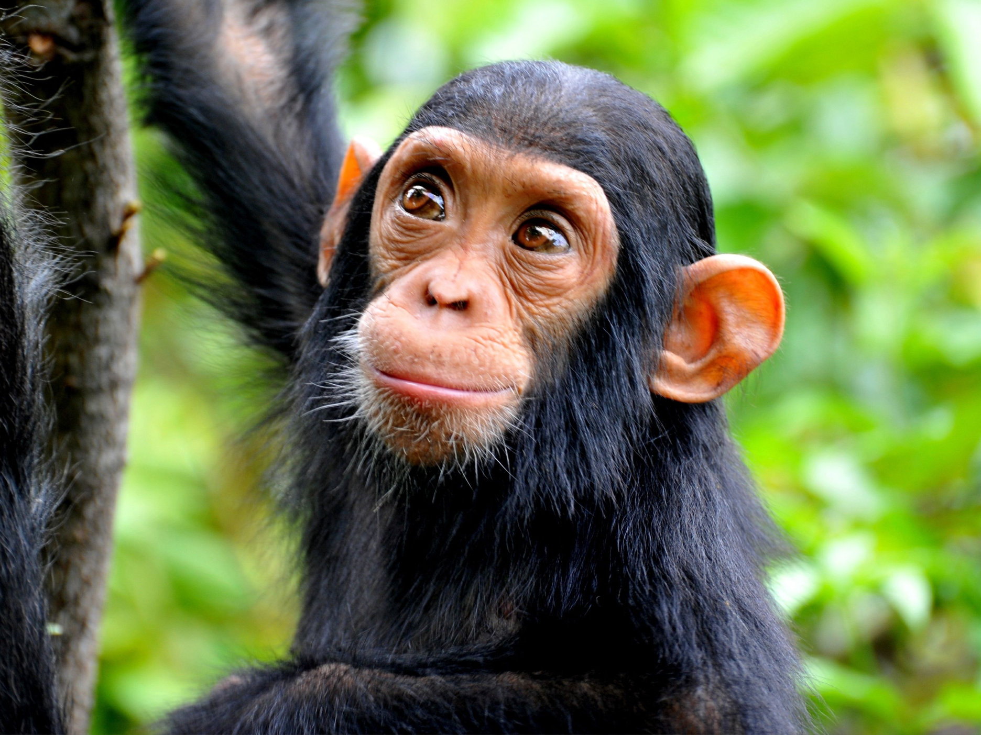
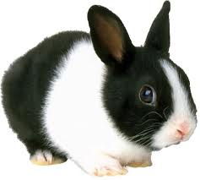
Immunological Comparison of Proteins
A* challenge
How closely related is Bradley Cooper to a chimpanzee?
You will need a handy rabbit to check this!
Read the card sort and put it into the correct order.
Albumin is a protein formed in the liver involved in maintaining and transporting substances in the blood.
card sort kept in yr 12 tray

Slide 11
Immunological Comparison of Proteins
Serum albumin from Sp. A injected into Sp. B
Sp. B produces antibodies specific to all the antigen sites on Sp. A albumin
Serum is extracted from Sp. B; containing antibodies specific to antigens on Sp. A’s albumin.
Serum from Sp. B is mixed with blood from a third species, Sp. C
Antibodies respond to antigens on albumin of Sp. C - Response is the formation of a precipitate
More similar antigens, more precipitate formed and more closely related the species
Sp. A
Sp. B
Sp. C

Slide 12
Application question
Below shows the amino acid sequence of the same protein for 4 different species. a)Which 2 are the most closely related ? b)Which 2 are the least closely related?
Species 1
Species 2
Species 3
Species 4
Phe
arg
glu
met
ser
ala
Phe
arg
val
val
ser
ala
Phe
val
glu
ser
val
ala
Phe
arg
glu
val
ser
ala

Slide 13
Comparing similarities and differences
 | Species 1 | Species 2 | Species 3 | Species 4
Species 1 |  | 2 | 3 | 1
Species 2 | 4 |  | 4 | 1
Species 3 | 3 | 2 |  | 3
Species 4 | 5 | 5 | 3
differences
similarities

Slide 14
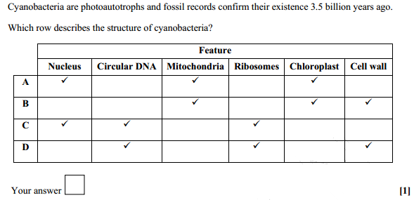
Exam question
D

Slide 15
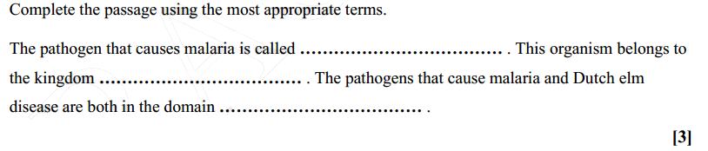
Exam question
Plasmodium
Protoctista
Eukarya

Slide 16
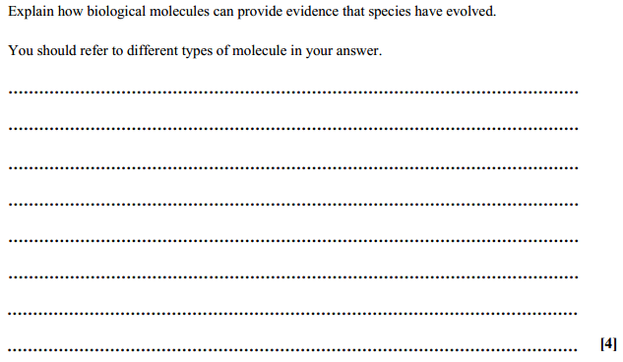
Exam question
biological molecule
nucleic acid / (nuclear) DNA / mtDNA / RNA ✓
idea that in samples from two species sequence similarity in any of the above can imply an evolutionary relationship , difference / divergence in sequence implies evolutionary distance ✓
biological molecule
proteins / polypeptides / cytochrome C / haemoglobin
idea that in the same protein from two species , amino acid
/ primary sequence similarity implies evolutionary
relationship , difference / divergence in sequence implies
evolutionary distance ✓

