Slide 1
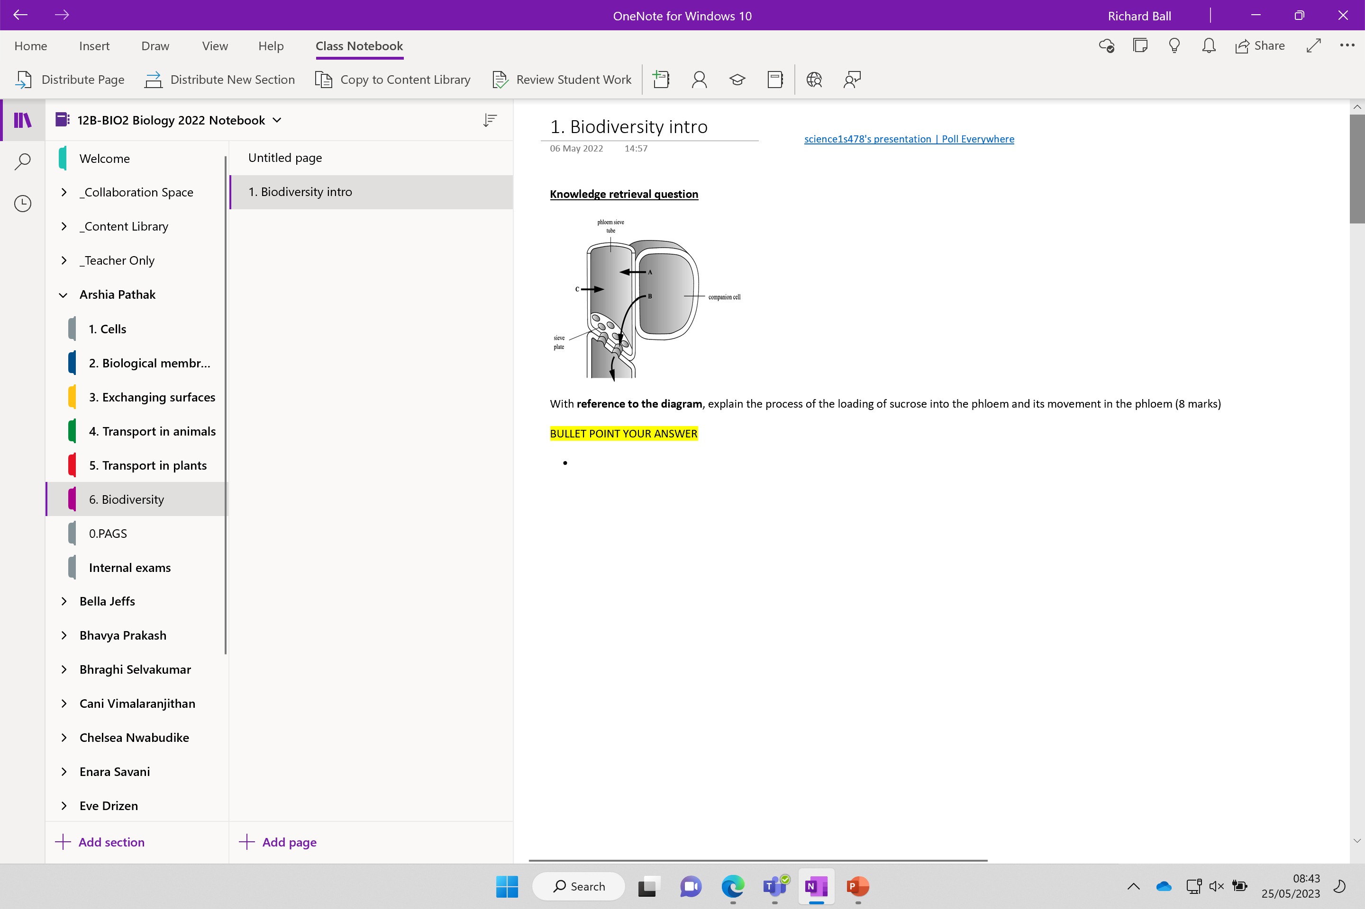

Slide 2
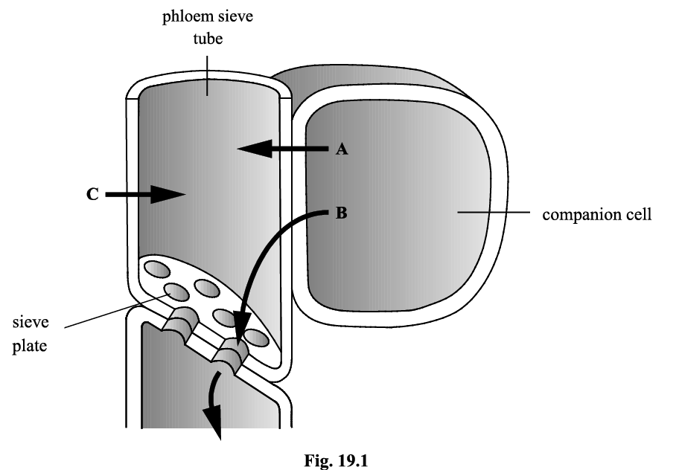
Knowledge retrieval question
With reference to the diagram, explain the process of the loading of sucrose into the phloem and its movement in the phloem (8 marks)
H+ / proton actively pumped out of companion cells through proton pumps
sucrose pumped into companion cell
by active transport
H+ / proton, co-transport of sucrose into companion cell
B / sucrose diffuses into phloem sieve tube lowering water potential in sieve tube
A / water, enters sieve tube from companion cell via osmosis
C / water, enters sieve tube from xylem via pits
increased pressure forces flow of sap down phloem
through the pores in the sieve plates to the sinks (meristems, growing fruit, storage organs).
NO NOTES
BULLET POINT!!

Slide 3
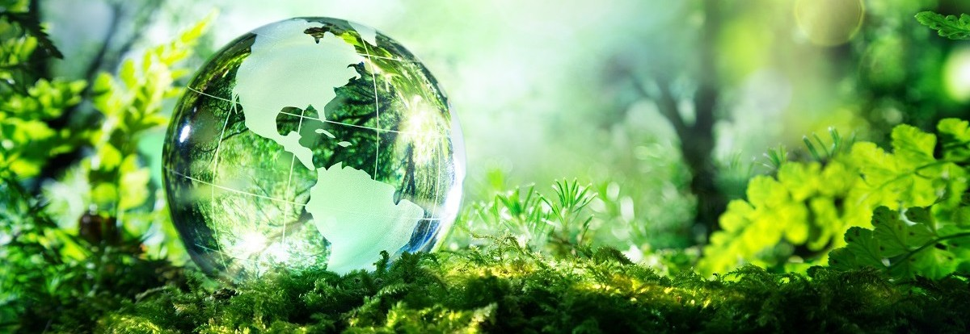
Biodiversity

Slide 4
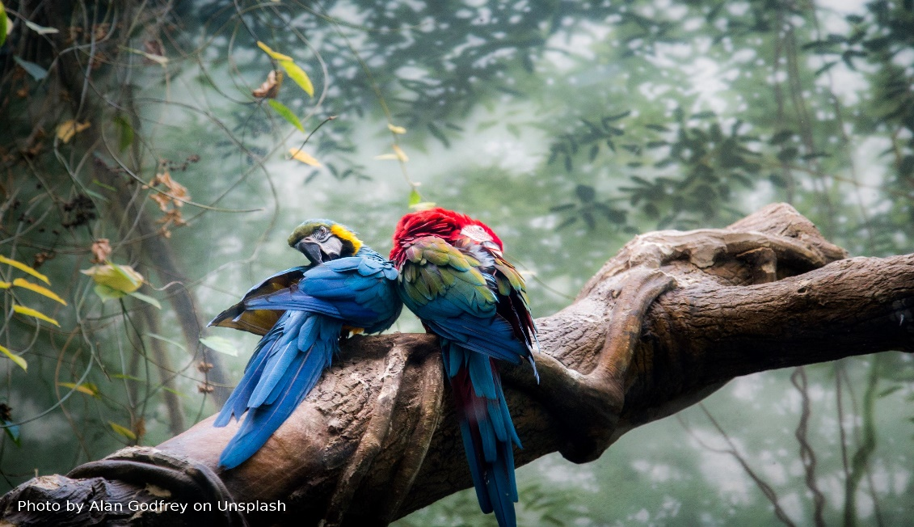
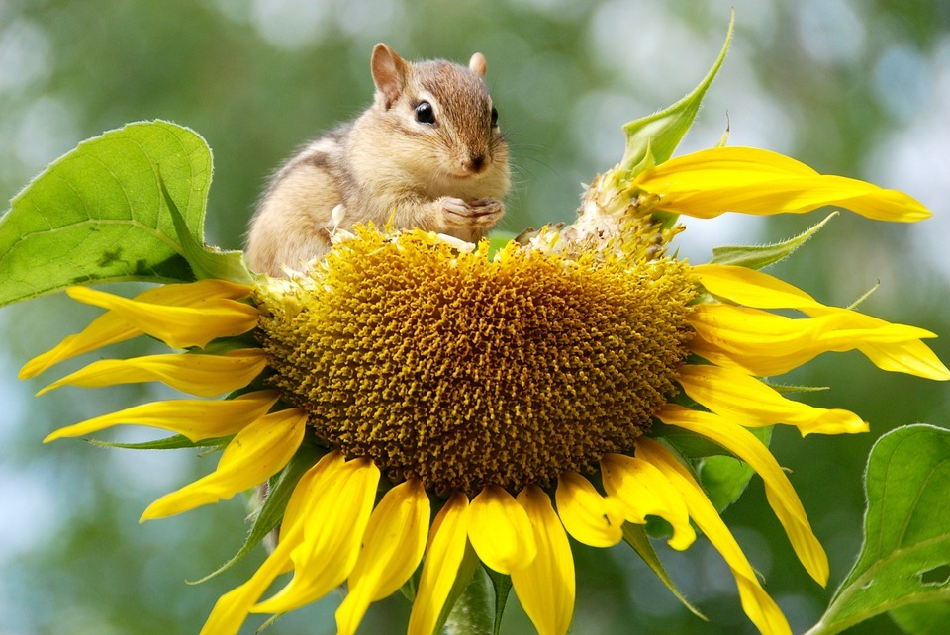
Bio
diversity
Why is it important?
Bio: Biological organisms within an area like:
Plants
Animals
Fungi
Diversity: The variety of living organisms within an area

Slide 5
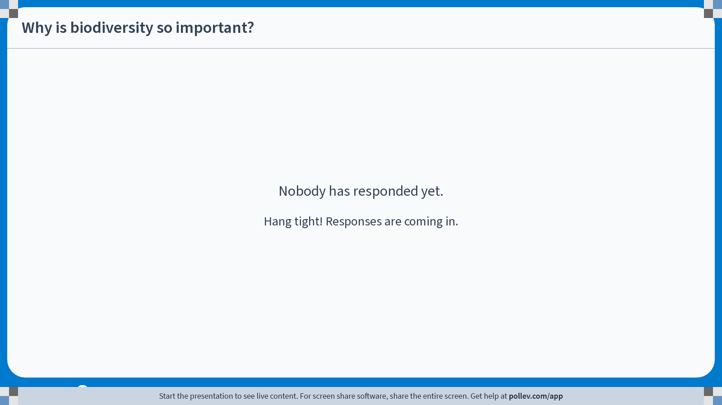
Notes:
Poll Title: Do not modify the notes in this section to avoid tampering with the Poll Everywhere activity.
More info at polleverywhere.com/support
Why is biodiversity so important?
https://www.polleverywhere.com/discourses/SNfscTsp5og8r72HRs2EH

Slide 6
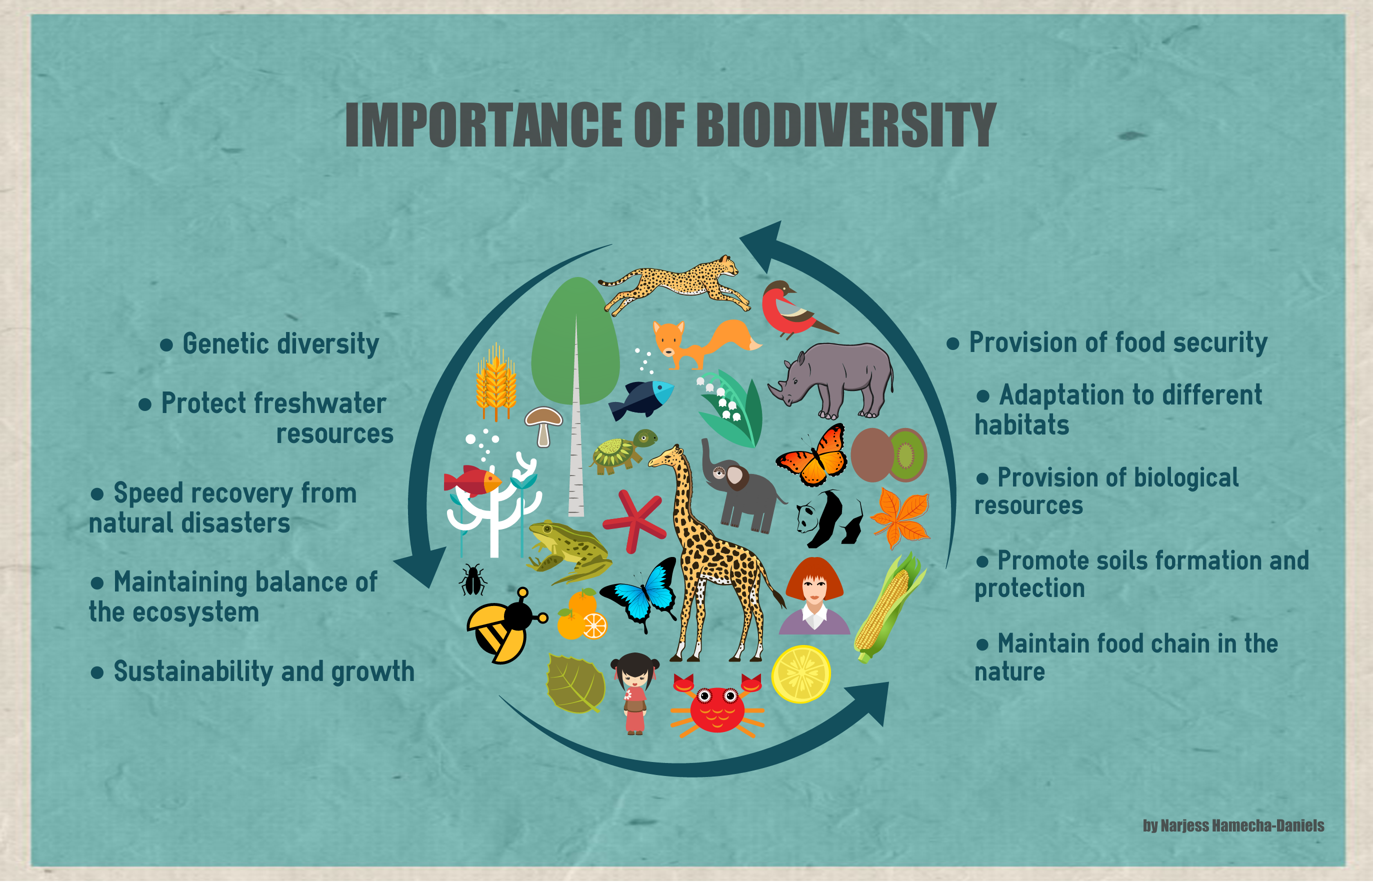

Slide 7
Importance of biodiversity
Many species form interdependent relationships with each other.
Make as many links between each word/s below to show how each relies on the other:
Animals use trees as habitats
Fertile soil
Trees/plants
Trees need fertile soil to grow
Animals
Fungi/microorganisms help decompose dead plants and animals, returning nutrients to the soil
Fungi/microorganisms
Animals eat plants

Slide 8
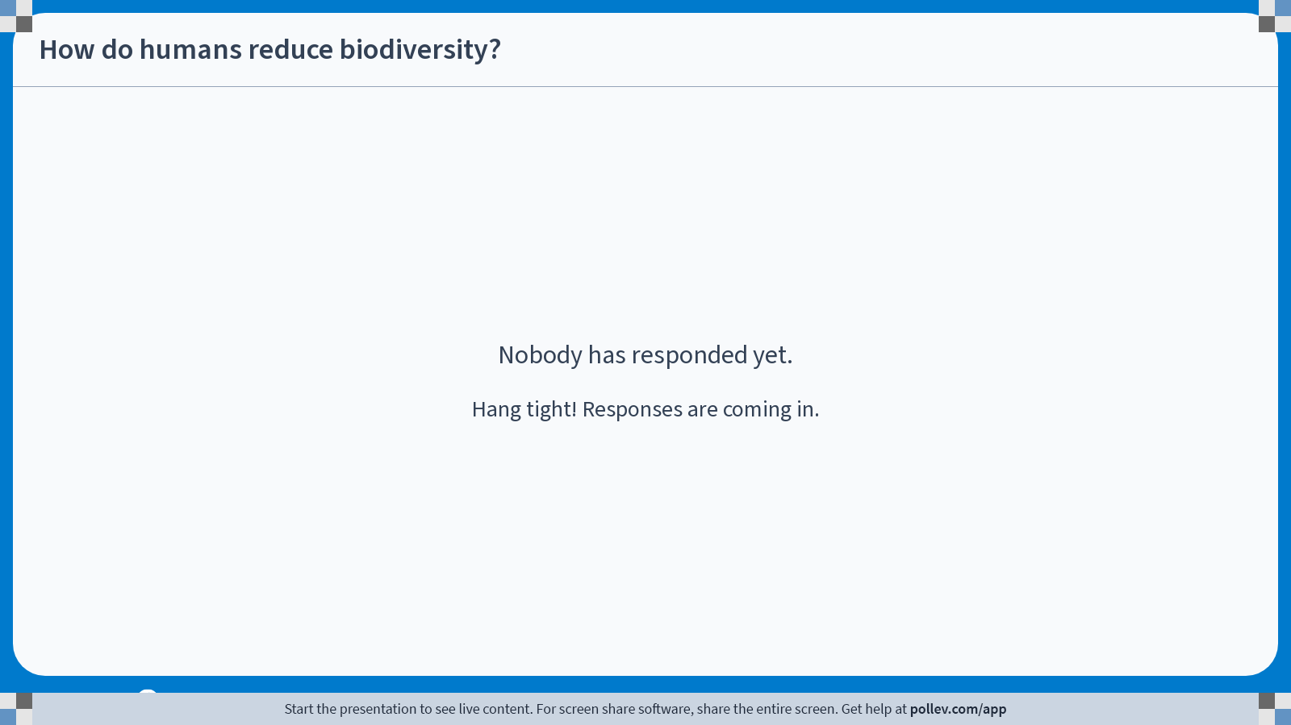
Notes:
Poll Title: Do not modify the notes in this section to avoid tampering with the Poll Everywhere activity.
More info at polleverywhere.com/support
How do humans reduce biodiversity?
https://www.polleverywhere.com/free_text_polls/L9pNDNxiEF9G7C96WiqUN

Slide 9
For each of the following come up with a solution already in place.
Reducing biodiversity
Cause
Poaching
Deforestation /Housing
Agriculture
Solution
Laws against poaching / breeding programmes for endangered species
Protected habitats, laws against deforestation
Alternative sources of food production

Slide 10
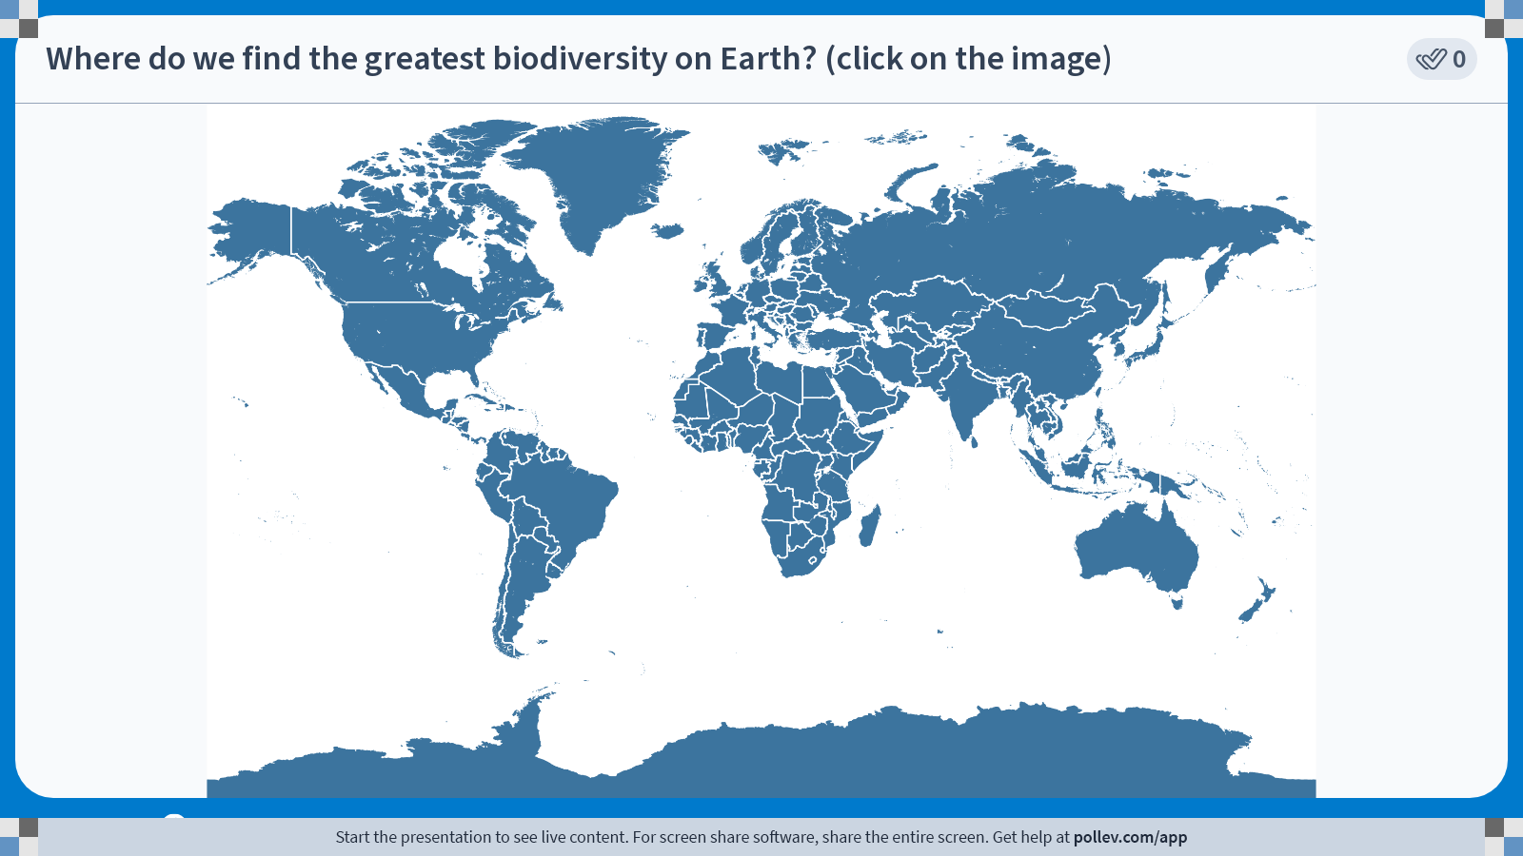
Notes:
Poll Title: Do not modify the notes in this section to avoid tampering with the Poll Everywhere activity.
More info at polleverywhere.com/support
Where do we find the greatest biodiversity on Earth? (click on the image)
https://www.polleverywhere.com/clickable_images/95yu0SLuCRor6dsUyznaO

Slide 11
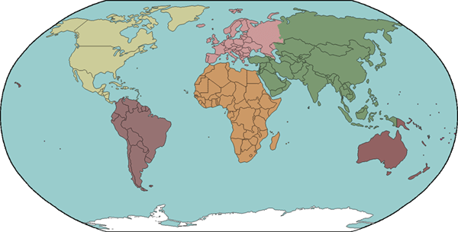
Diversity and climate
Least diversity
Cold all year round
3,000 plant species
Warm summer, cold winter
Most diversity
40,000 plant species
Warm all year round
Warm summer, cold winter
Least diversity
Cold all year round
Notes:
Tropical, moist regions that are warm all year round have the most biodiversity
Temperate climate has les biodiversity
Very cold areas such as the arctic or very dry areas e.g. deserts have least biodiversity
Generally the closer a region is to the equator, the greater the biodiversity,
Over 40000 plant species in amazon, less than 3000 live in northern Canada

Slide 12

Measuring biodiversity
Why is it important to measure biodiversity?
It is important to measure biodiversity to inform us of any changes caused by humans, disease or climate change.
For example before any major project (e.g building a motorway) an EIA will assess the impact on biodiversity at different levels:
Habitat biodiversity
Species biodiversity
Genetic biodiversity
If the impact is deemed to be to great, the project will not be approved!
*EIA – Environment impact assessment

Slide 13
Lets go through each in detail
Habitat biodiversity
Species biodiversity
Genetic biodiversity

Slide 14
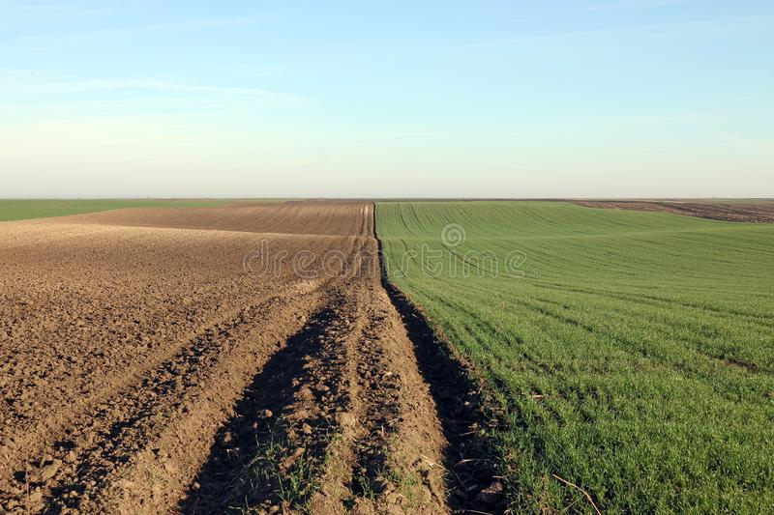
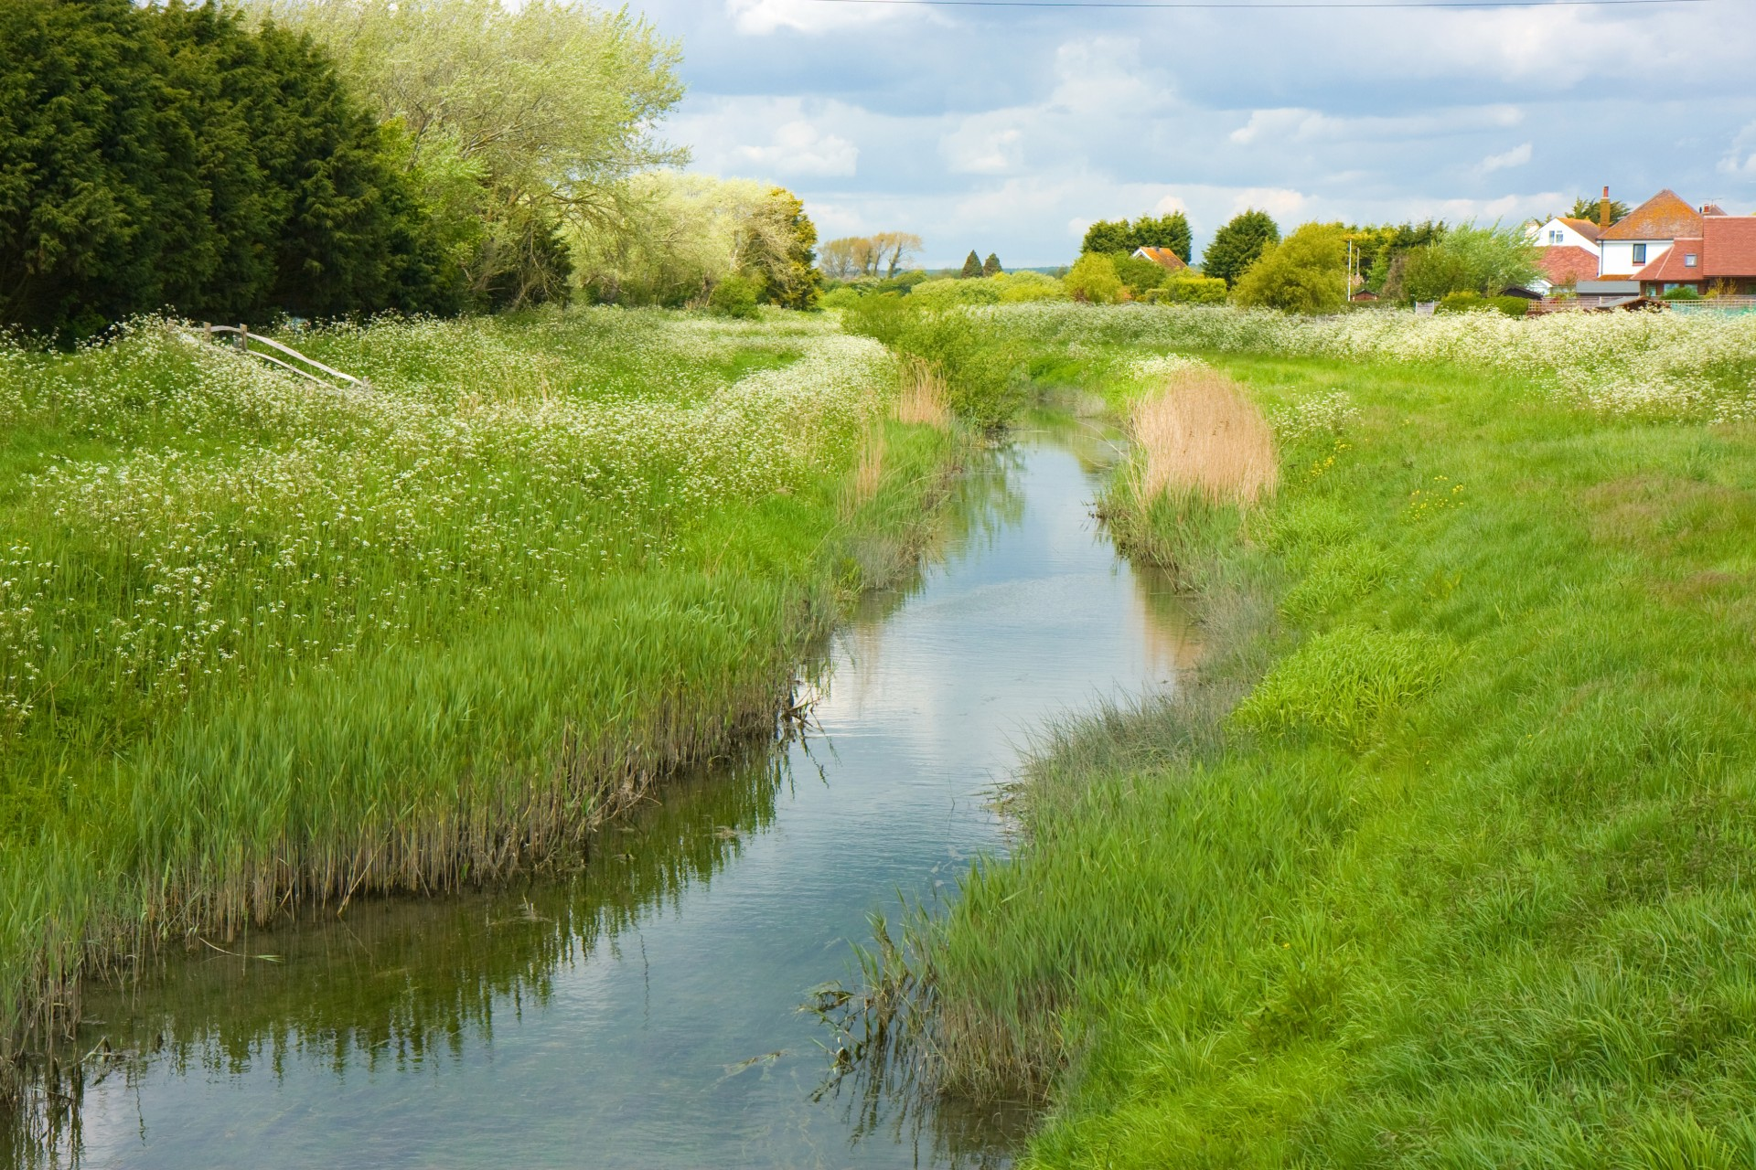
Both images are from the countryside.
Which of the following has a greater habitat biodiversity?

Slide 15
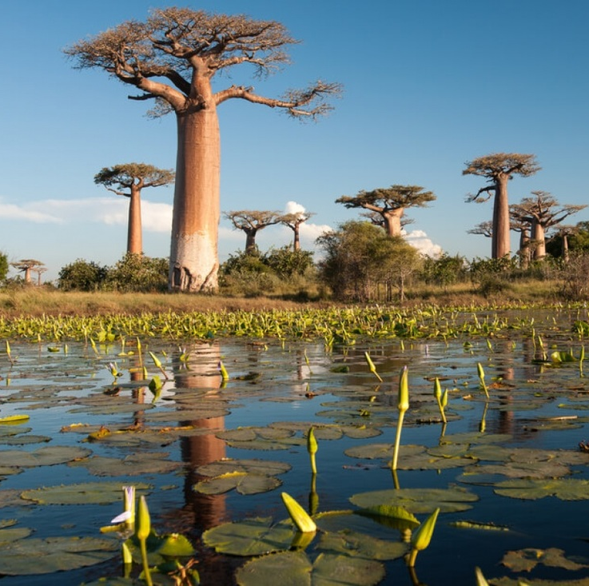
Habitat biodiversity
The number of different habitats found within an area
Each habitat can support a number of different species, so the greater the habitat biodiversity, the greater the species diversity

Slide 16
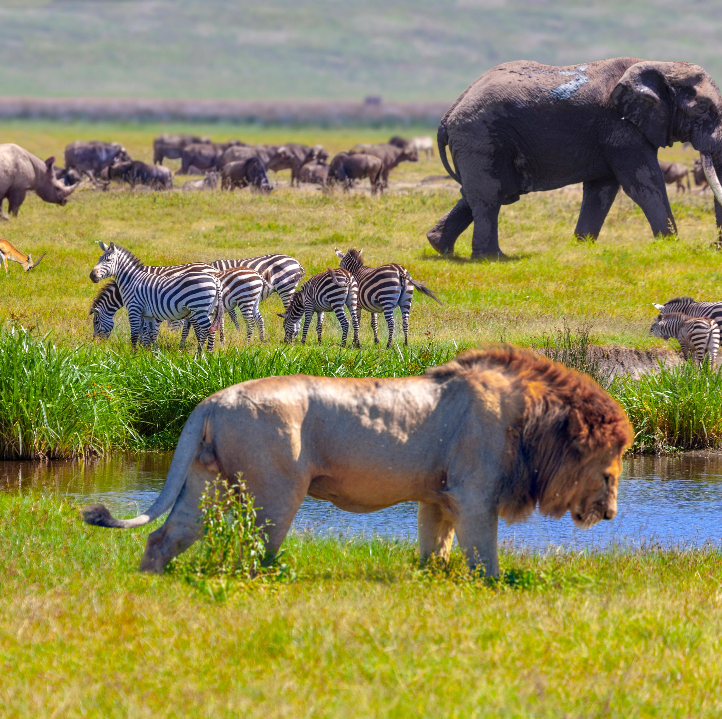
Species biodiversity
Two different components:
Species richness – the number of different species living in a particular area
Species evenness – a comparison of the number of individuals of each species within a community

Slide 17
Species biodiversity
Two different components:
Species richness –
Species evenness –

Slide 18
Question
Why isn’t species richness a good isolated
method for measuring species diversity?
(3 marks)

Slide 19
Why isn’t species richness a good isolated
method for measuring species diversity? (3 marks)
Species richness does not take into account dominant species or abundance of species.
If the species richness of two areas is similar
it is useful to know what the species evenness is to gauge biodiversity

Slide 20
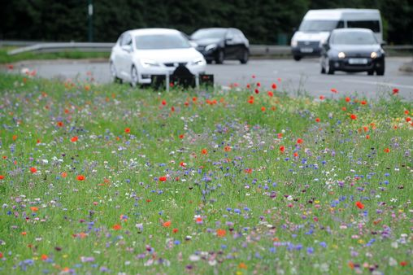

Slide 21


Slide 22
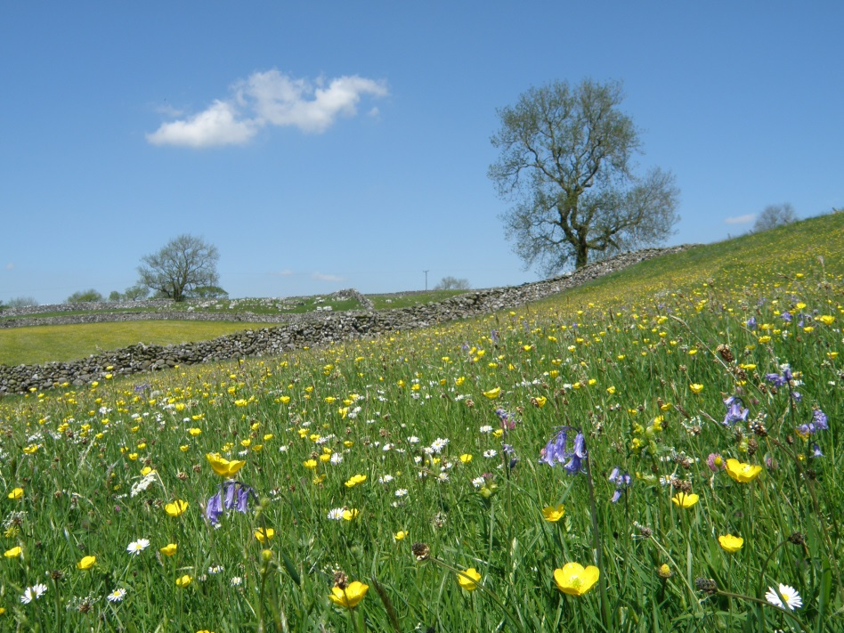
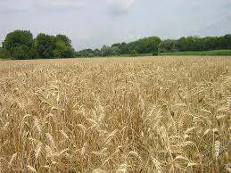
Compare the habitat and species biodiversity in the two pictures below
Wild grass meadow
monoculture wheat field
Wild grass meadow | Monoculture wheat field

Slide 23
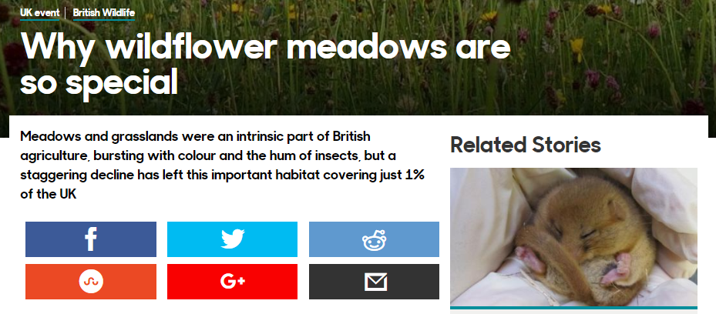
Wild grass meadow | Monoculture wheat field
Large number of different plant species – high species richness. Likely to also attract more animals. | One species – low species richness
Even distribution of species – high species evenness | One dominant species – low species evenness
Variety of plants, tree and wall increase habitat diversity | Only one habitat (wheat) – low habitat biodiversity
Species richness
Species evenness
http://www.bbc.co.uk/earth/story/20150702-why-meadows-are-worth-saving
Habitat diversity

Slide 27
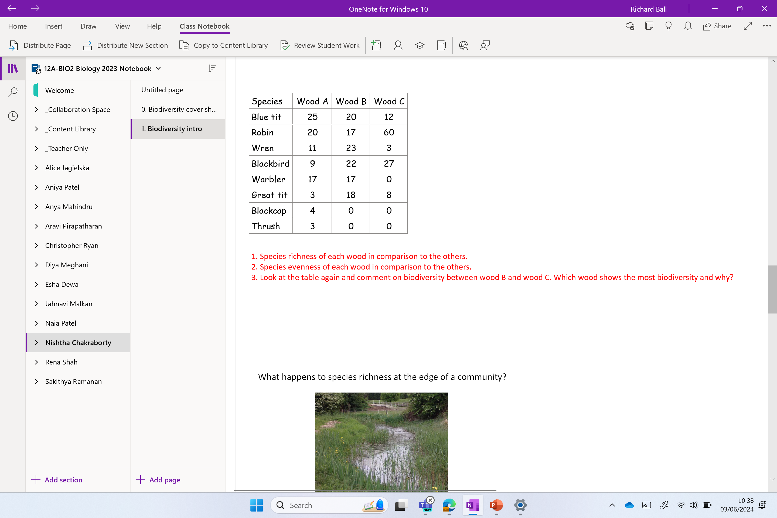

Slide 28
Look at the table and comment on:
1. Species richness of each wood in comparison to the others.
2. Species evenness of each wood in comparison to the others.
3. Look at the table again and comment on biodiversity between wood B and wood C. Which wood shows the most biodiversity and why?
Species | Wood A | Wood B | Wood C
Blue tit | 25 | 20 | 12
Robin | 20 | 17 | 60
Wren | 11 | 23 | 3
Blackbird | 9 | 22 | 27
Warbler | 17 | 17 | 0
Great tit | 3 | 18 | 8
Blackcap | 4 | 0 | 0
Thrush | 3 | 0 | 0

Slide 29
1. Species richness of each wood in comparison to the others.
2. Species evenness of each wood in comparison to the others.
3. Look at the table again and comment on biodiversity between wood B and wood C. Which wood shows the most biodiversity and why?
Species richness – wood A is more diverse (has a higher species richness) than the others because it has more species of bird present.
Species evenness – wood B shows the greatest species evenness because the numbers of the species present are the most similar. It has a high species evenness, no single species dominates.
Wood B shows the most biodiversity as it has higher species richness and higher species evenness. Wood C is dominated by the Robin.

Slide 30
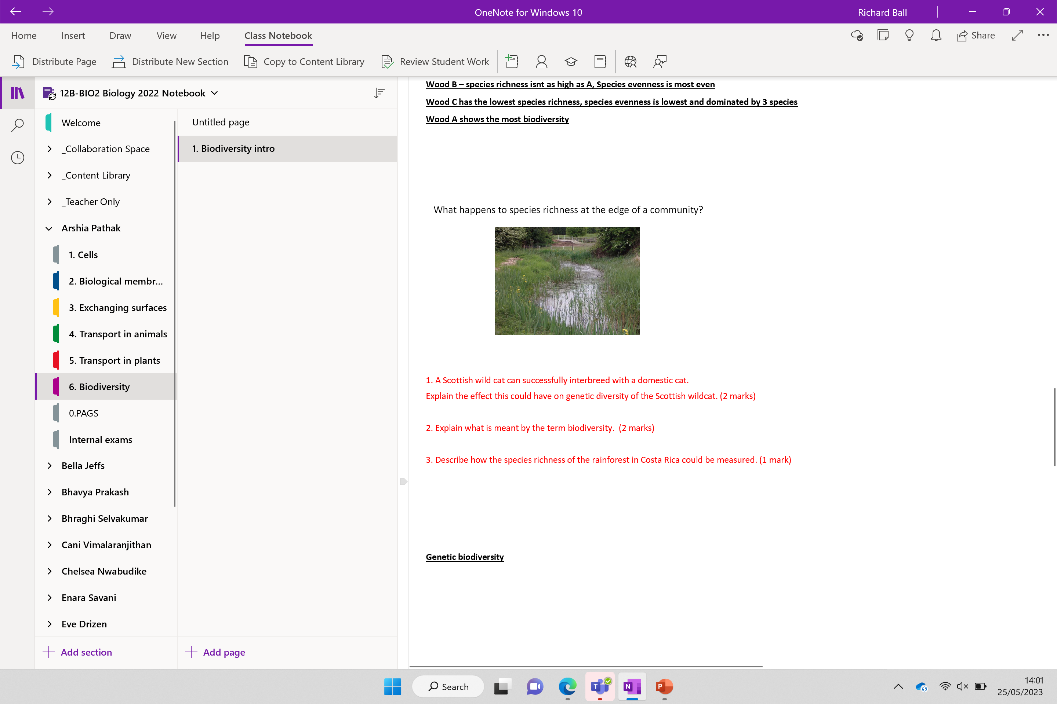
NL below
Place in starter

Slide 31

Why did the war reduce biodiversity in the UK?

Slide 32
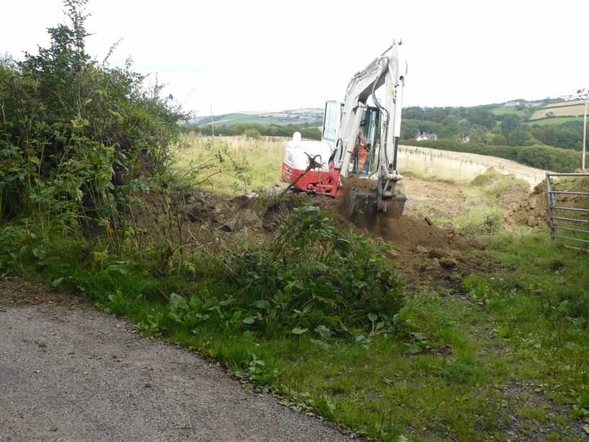
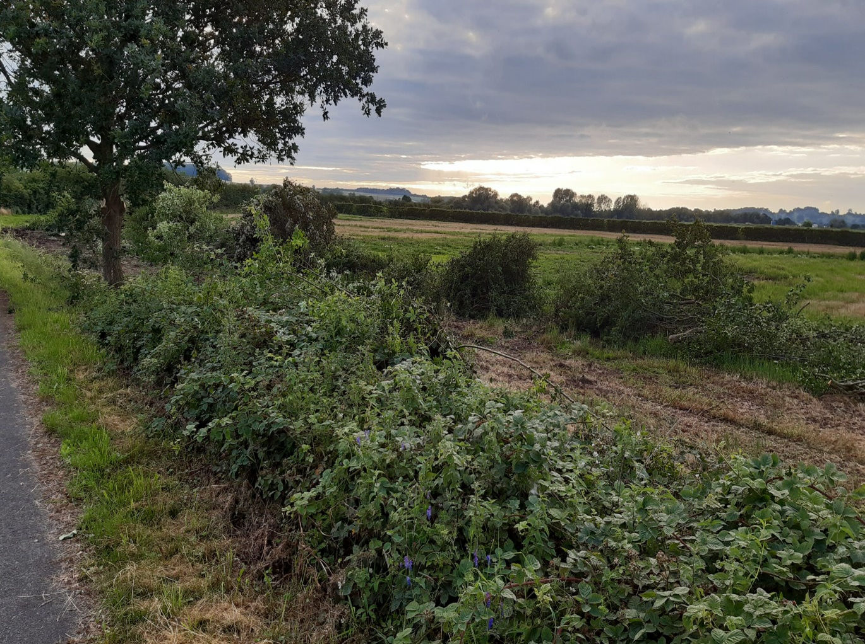
Large-scale hedgerow removal took place after the Second World War. In 1947, the Agriculture Act was passed.
Notes:
Hedgerows were removed to maximise space to grow food after the war 50% of the UK’s hedgerows were lost after WW2 – it is not illegal to remove hedgerows without permission

Slide 33
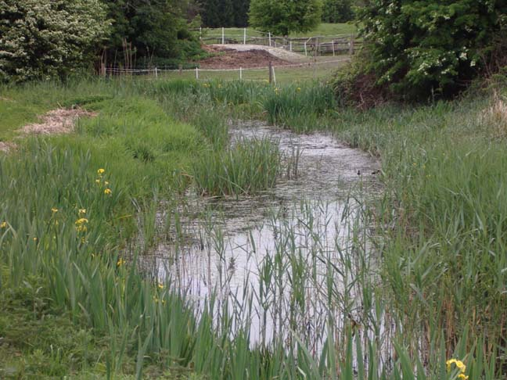
What happens to species richness at the edge of a community?
It tends to increase as the 2 habitats overlap – this is called the edge effect

Slide 34
Species Richness and Evenness
A Scottish wild cat can successfully interbreed with a domestic cat.
  Explain the effect this could have on genetic diversity of the Scottish wildcat.
  2 marks
2. Explain what is meant by the term biodiversity. 2 marks
3. Describe how the species richness of the rainforest in Costa Rica could be measured.
1 mark

Slide 35
Answers
A Scottish wild cat can successfully interbreed with a domestic cat.
Explain the effect this could have on genetic diversity of the Scottish wildcat.
2 marks
2. Explain what is meant by the term biodiversity. 2 marks
3. Describe how the species richness of the rainforest in Costa Rica could be measured.
1 mark
1.
Increases genetic diversity/size of gene pool.
Because of introduction of {new/different} combinations of alleles
2.
Number of different species.
Genetic variety within a species within an area
3.
Idea of counting number of species within a given area and then scale up the estimate

Slide 36
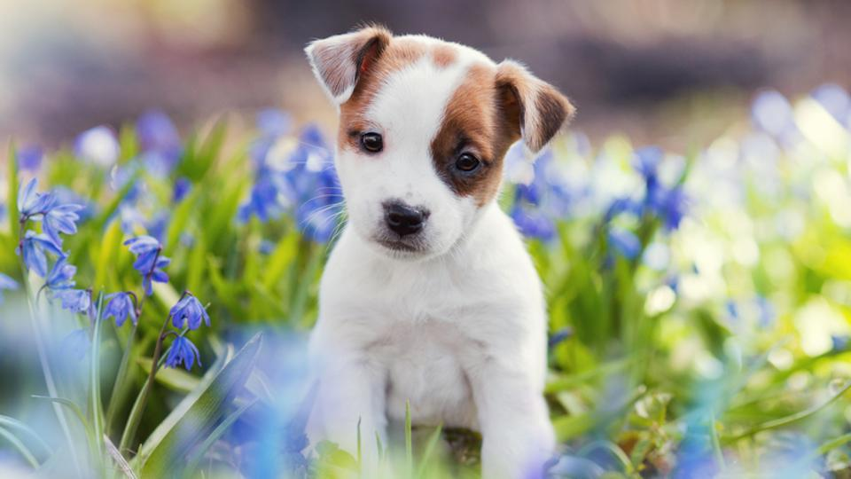
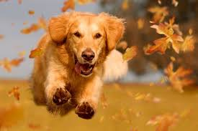

Genetic biodiversity:
The variety of genes that make up a species
Phenotypes are different due to different allele combinations.
e.g. all dogs are the same species but the different allele combinations create individual breeds.
Why is genetic biodiversity important?
Greater genetic biodiversity allows for
better adaptations to a changing environment
increases the chances of individuals being resistant to disease.
We will look at calculating this later!

Slide 37
How do you work out species richness?
How do you work out species evenness?
If two communities have the same number of species how do you work out which is more biodiverse?
What is the edge effect?
Which types of communities usually have a greater biodiversity?
  a. How is this usually worked out?
Add up how many different species there are.​
Work out the range of species number.​
See which has the highest species evenness​
Where the boundary between two communities has higher biodiversity.​
Older communities ​
a. Using species richness and species evenness.​

Slide 38
Key terms loop task
- ANSWER - DEFINITION - ANSWER – DEFINITION - ANSWER – DEFINITION - ANSWER – DEFINITION ANSWER - DEFINITION - ANSWER – DEFINITION - ANSWER – DEFINITION - ANSWER - DEFINITION - ANSWER – DEFINITION - ANSWER - DEFINITION - ANSWER – DEFINITION - ANSWER - DEFINITION -
Place the matching definition and key term next to each other.
If you do it correctly then you will form a complete loop.
Notes:
USE AS STARTER TO NEXT LESSON IF OUT OF TIME

Slide 39
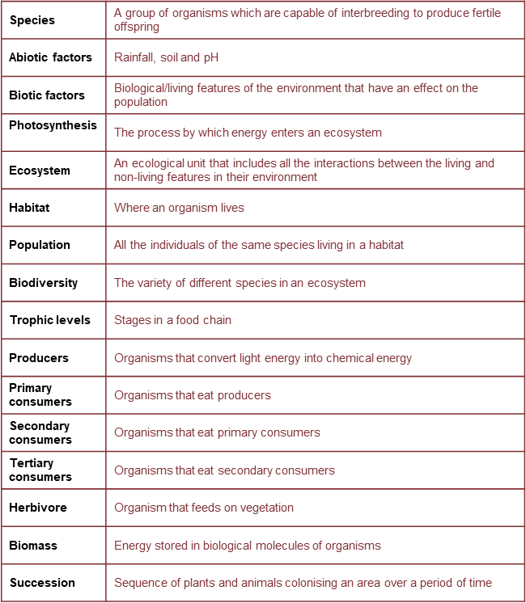
Check your answers

Slide 40
REMINDER: Amersham meeting today
13:30 Lab 3

Slide 41


Slide 42
Tb.

Slide 43
Taboo.a
Biodiversity edition

Slide 44
Ready

Slide 45
Biodiversity

Slide 46
Population

Slide 47
Evenness

Slide 48
Mesophytes

Slide 49
biotic

Slide 50
Species

Slide 51
Richness

Slide 52
Producer

Slide 53
Community

Slide 54
Genetic

Slide 55
Habitat

Slide 56
Omnivore

Slide 57
Mesophytes

Slide 58
Quadrat

Slide 59
species

Slide 60
Biome

Slide 61
Fungi

Slide 62
Biomass

Slide 63
Abiotic

Slide 64
Ecosystem

Slide 65
Xerophytes

Slide 66
Trophic level

Slide 67
Transect

Slide 68
Tertiary consumer

Slide 69
Extremophile

