Slide 1
(a) (i) the contribution of both environmental and genetic factors to phenotypic variation
Keywords: variation
Lesson objectives:
Define keywords for genetics
Explain how genes and the environment affect different organisms
Link to 4.2.2
Types of variation
Notes:
Include examples of genetic and environmental contributions (diet in animals and etiolation and chlorosis in plants)

Slide 2
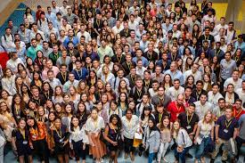
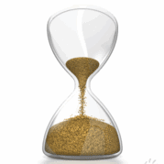
There are now over 8 billion people in the world, what makes us different?
Talk for 1 minute
Notes:
Talk in pairs, one talks the other notes down any key terms mentioned on a ‘show me’ board

Slide 3
Keywords you should have used…
Variation
DNA
Genes
Alleles
Proteins
Amino acids
Base sequence
Environment

Slide 4
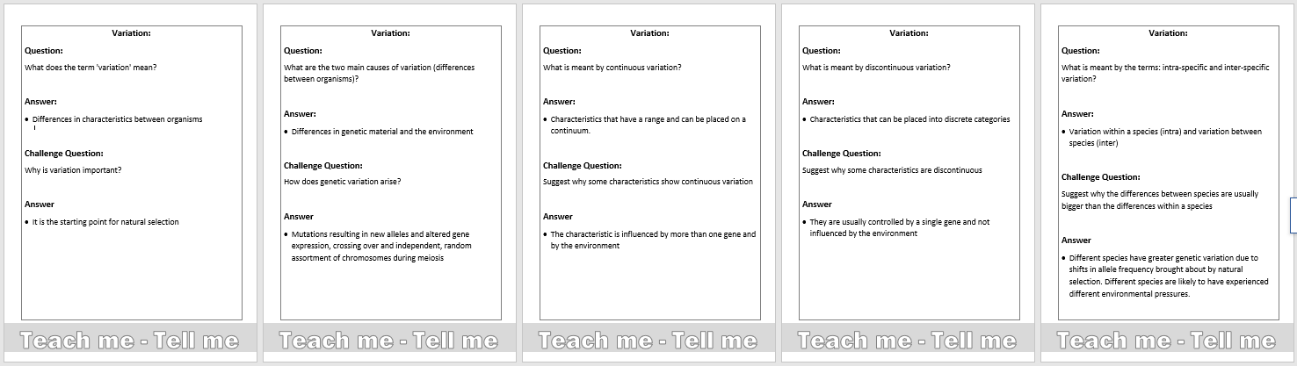
What do you remember about variation?

Slide 5
Quick 10 revision
1. What term describes the characteristics displayed by an organism?
2. Define allele
3. What are differences within a species?
4. How is an organism described if it has both a recessive and dominant allele?
5. What are all the alleles an organism contains?
6. Which two factors contribute to the way you look?
7. Which type of variation is controlled by multiple alleles?
8. Which term describes the bulging of the plasma membrane?
9. What type of variation is hitch hiker's thumb?
10. In which stage of meiosis do chromatids move towards the poles?
1. phenotype
2. type of gene.
3. variation.
4. heterozygous
5. genotype
6. genes, environment
7. polygenic/continuous
8. blebbing
9. discontinuous/monogenic
10. Anaphase II

Slide 6
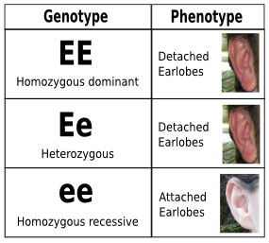
Genotype- the genetic make-up – the alleles an organism has
Phenotype- the observable characteristics

Slide 7
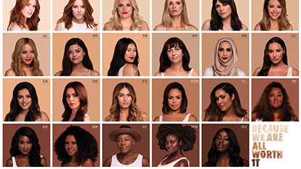
Continuous variation
POLYGENIC (controlled by many genes) e.g. skin colour

Slide 8
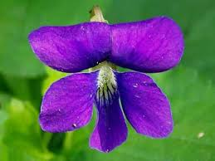
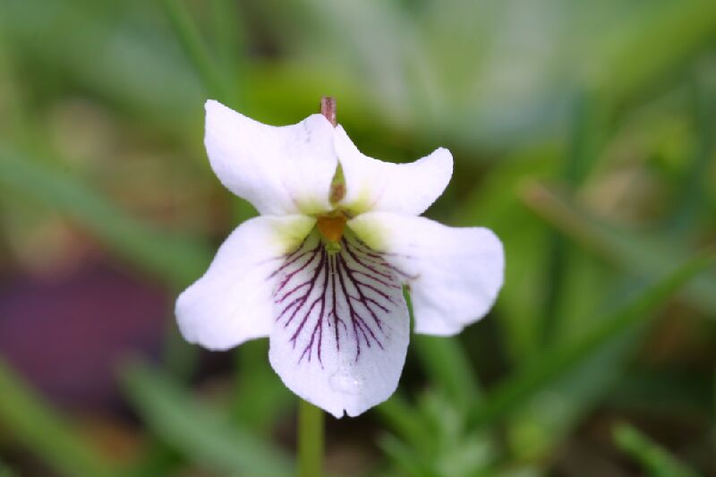

Discontinuous variation
MONOGENIC (controlled by one gene) e.g. the colour of violet flowers

Slide 9

Environment
Phenotypic variation can be affected by the environment:
Diet
Climate
Lifestyle
Light
Nutrients

Slide 10
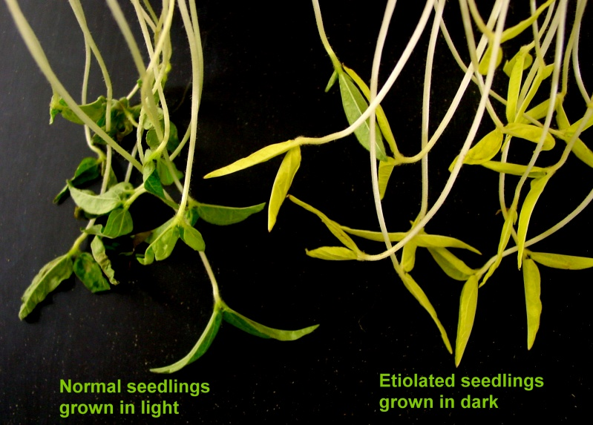
Etiolation
Plants grow abnormally long and spindly – due to not enough light

Slide 11
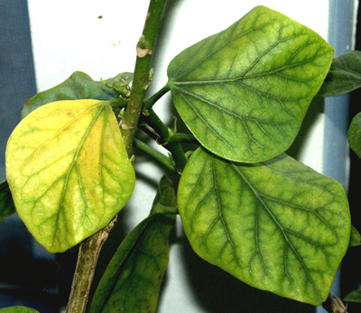
Chlorosis
Plants do not produce enough chlorophyll.
Due to a lack of magnesium ( Iron can also cause this)

Slide 12
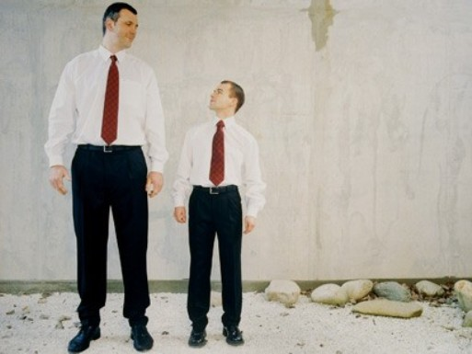
Genes and the environment
Height- you might have the genes to be 6’2 but whether or not you reach that height depends on your diet.

Slide 13
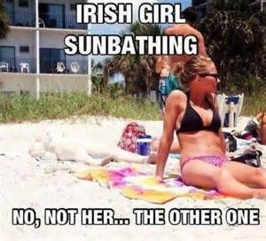
Genes and the environment
Melanin production is partially controlled by genes but also the amount of sunlight that a person is exposed to.

Slide 14
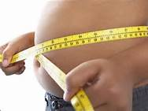
Debate
Obesity – environment or genes?

Slide 15
Obesity
Environment: Availability of food
Humans stop eating when dopamine levels reach a certain level
Genes : people with one particular allele have 30% fewer dopamine receptors - overeat
Next:
Complete the practice exam questions on your worksheet

Slide 16
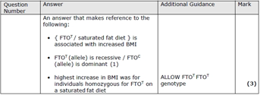


Slide 17
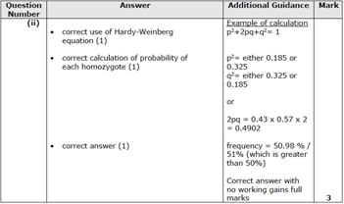

Slide 18
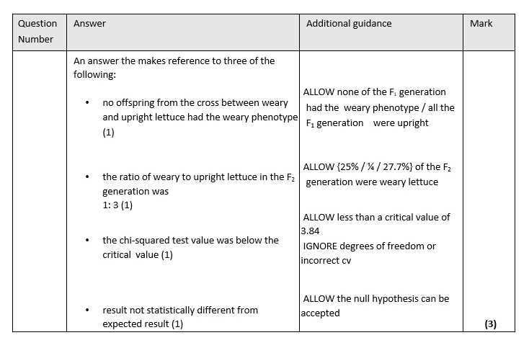

Slide 19
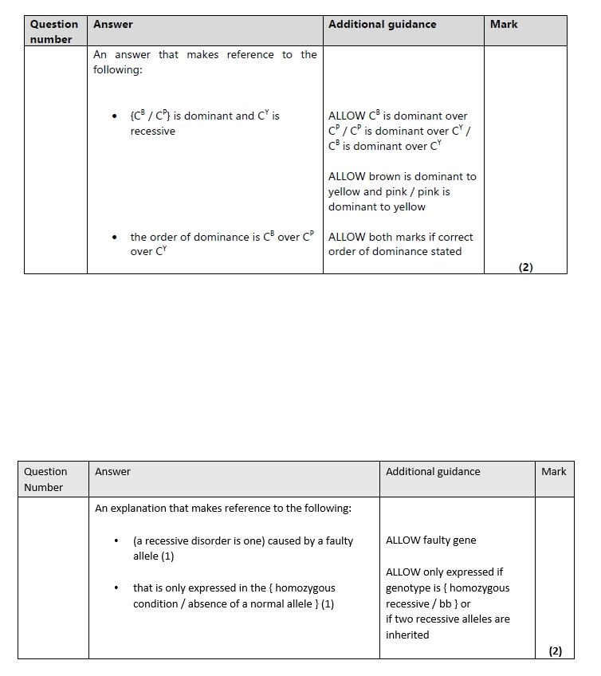

Slide 20
(a) (ii) how sexual reproduction can lead to genetic variation within a species
Keywords: gamete, haploid, diploid
Revision lesson objectives:
State 3 ways how meiosis creates genetic variation
Describe the stages of meiosis
Notes:
Meiosis and the random fusion of gametes at fertilisation

Slide 21
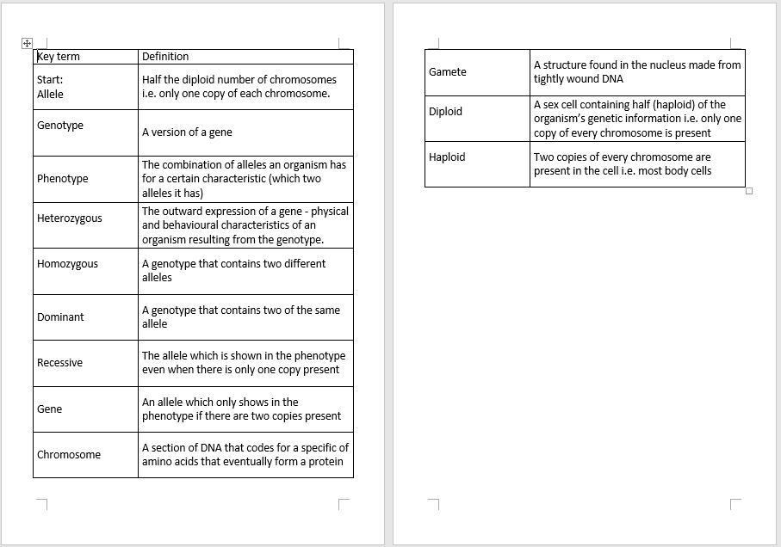
Key term definitions race

Slide 22
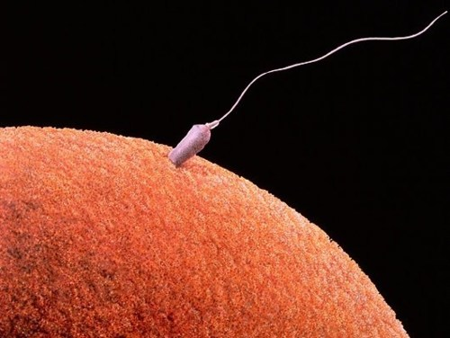
Can you talk about this image for more than 60 seconds?
Notes:
Same partners as before, swap the roles of speaker and recorder

Slide 23
Words I expect you to have used…
Spec link 2.1.6
Egg
Sperm
Fertilisation
Gamete
Haploid
Chromosomes
Genetic
Genes
How many chromosomes are in a human diploid cell?
How many are in a haploid cell?

Slide 24
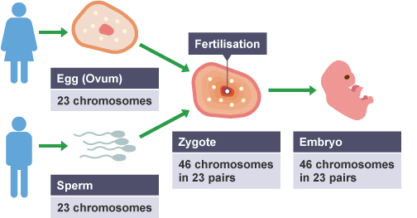
Gametes
(how many chromosomes at each stage?)
Spec link 2.1.6

Slide 25
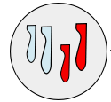
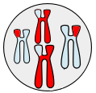


The process of Meiosis
Spec link 2.1.6
Which are haploid? Which are diploid?

Slide 26
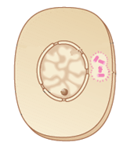
Interphase -
DNA duplicates during S phase
Spec link 2.1.6

Slide 27
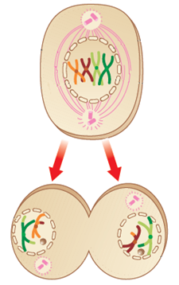

Meiosis I (first division)
Spec link 2.1.6
Use your mwb to draw out the stages
Each chromosome is made up of 2 sister chromatids
Genetic recombination takes place
At random -Chromosomes cross over
and swap blocks of genes
Chiasmata
Homologous chromosomes segregate into 2 nuclei.
Nuclear envelope forming
Prophase 1, metaphase 1, anaphase 1, telophase 1

Slide 28
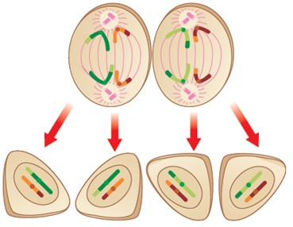
Meiosis II (Second division)
Spec link 2.1.6
Use your mwb to draw out the stages
Daughter chromosomes separate
Independent assortment:
4 haploid gametes formed
Prophase 2, metaphase 2, anaphase 2, telophase 2

Slide 29
How does sexual reproduction lead to variation within genotypes?
Spec link 2.1.6
Crossing over
Independent assortment
Random fertilisation

Slide 30
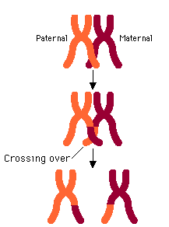
Creating genetic variation
Spec link 2.1.6
Crossing over
Chromatids twist around each other and swap.
Contain the same genes but different alleles.

Slide 31
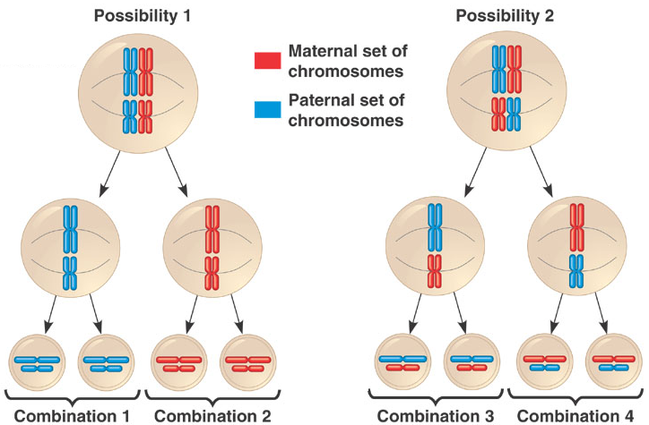
Creating genetic variation
Spec link 2.1.6
2. Independent random assortment of chromosomes
Of chromosomes (meiosis I)
Of chromatids (meiosis II)
There are 8.5million combinations.

Slide 32
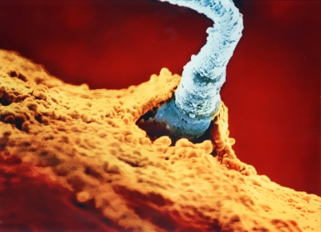
Creating genetic variation
Spec link 2.1.6
3. Random fertilisation
Any sperm can fertilise any egg.
Each individual is unlike any to have existed before or any that will exist again.

Slide 33
Summary
Why is it essential that gametes are haploid?
Describe 3 ways that genetic variation is achieved

