Slide 1
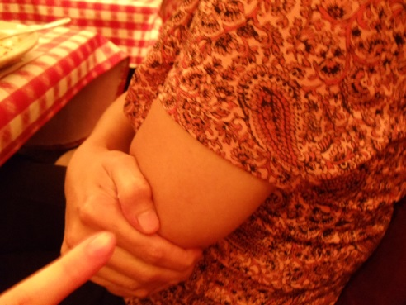
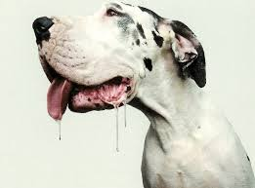
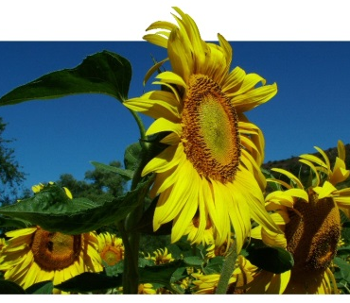
Communication and homeostasis
Outline the need for communication systems within multicellular organisms, with reference to the need to respond to changes in the internal and external environment and to coordinate the activities of different organs.
State that cells need to communicate with each other by a process called cell signalling, including adjacent and distance cells.
State that neuronal (nervous system) and hormonal (endocrine system) are examples of cell signalling.
Task - In pairs, discuss why organisms need to respond to their environment and how they respond to different stimuli.
e.g. Organisms need to respond to the environment because...
Organisms respond to light by…

Slide 2
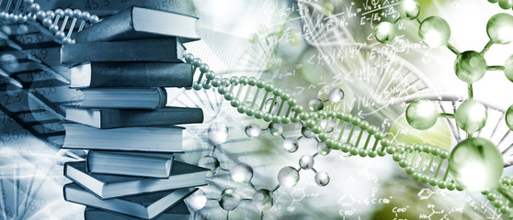
Welcome to year 13 biology!
Click the link on posts for your starter activity!
Notes:
POST ON TEAMS

Slide 3
Send biodiversity unit test score

Slide 4
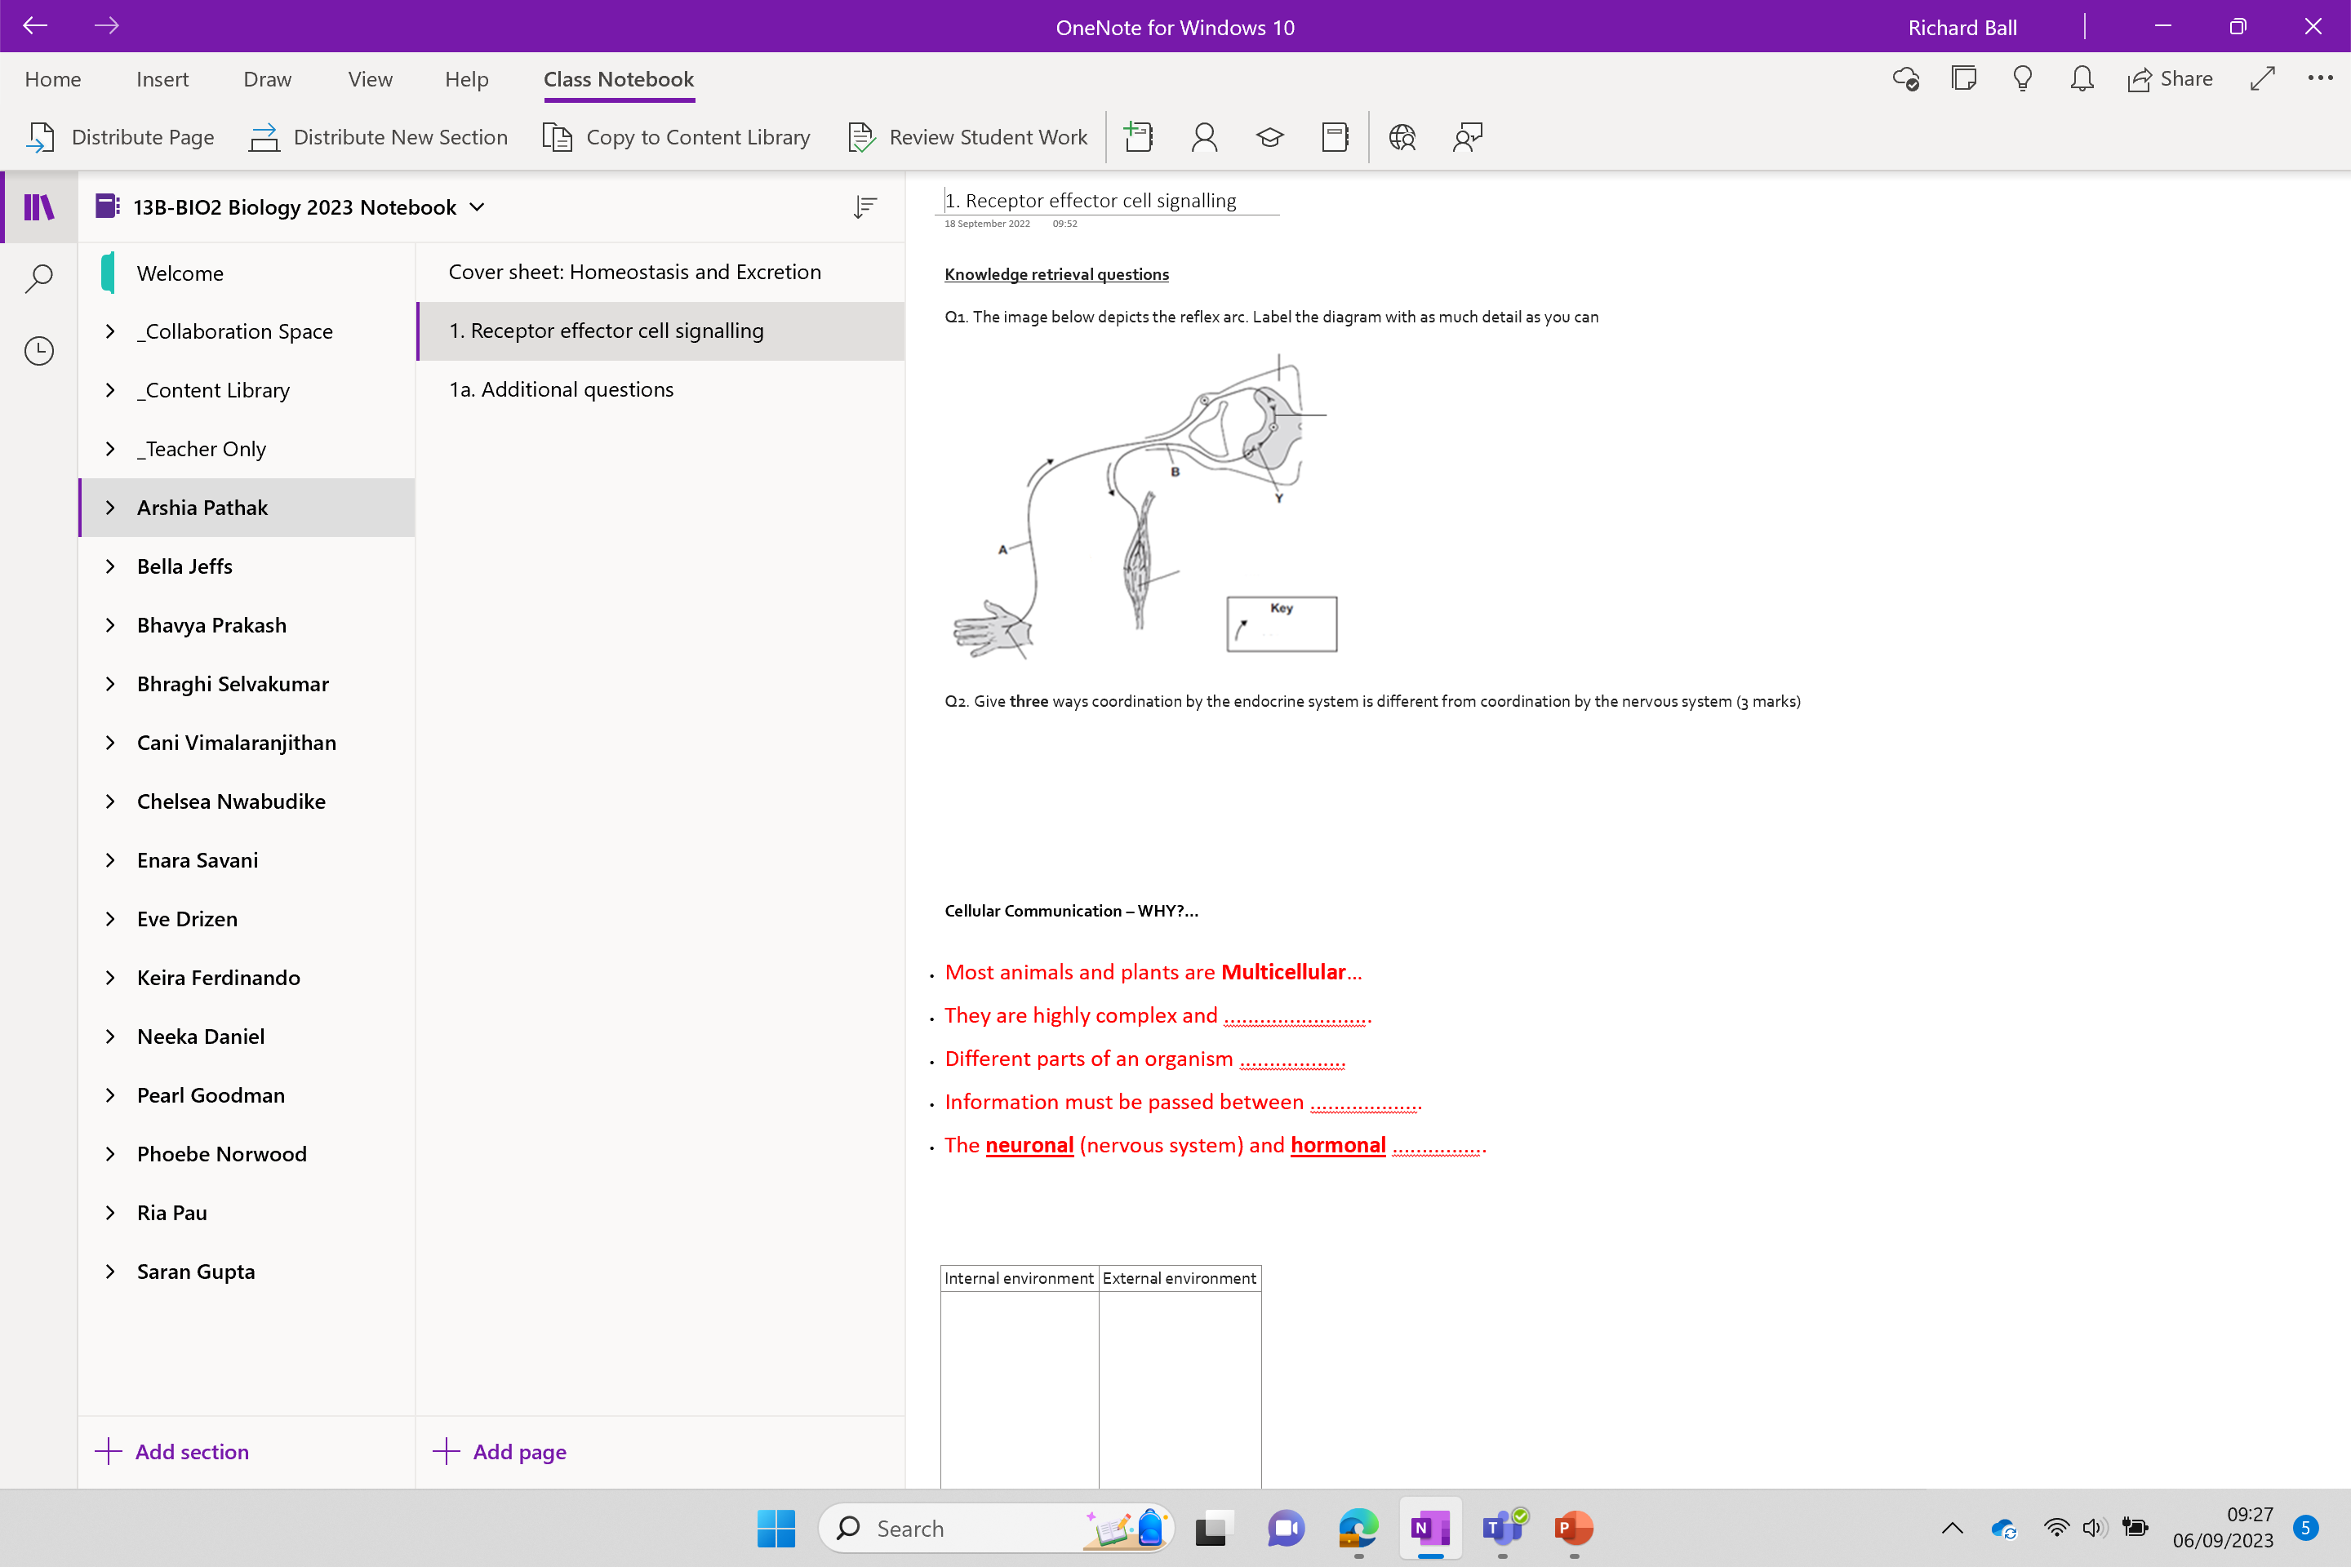

Slide 5
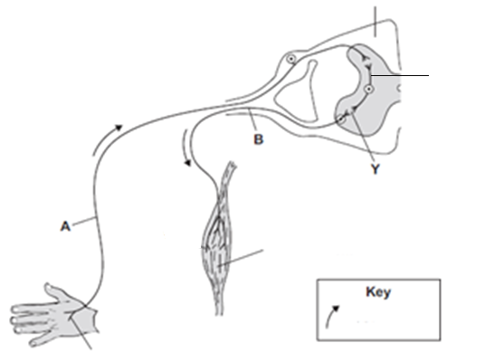
Knowledge retrieval questions
Q1. The image below depicts the reflex arc. Label the diagram with as much detail as you can
Q2. Give three ways coordination by the endocrine system is different from coordination by the nervous system (3 marks)
Spinal cord (CNS)
Relay neurone
Motor neurone
Synapse
Sensory neurone
Muscle / effector
Direction of impulse
Receptors in the skin

Slide 6
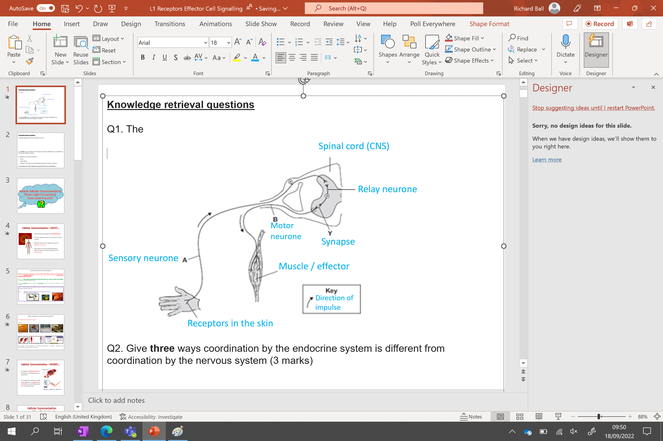
Knowledge retrieval questions
Label the diagram with as much detail as you can
Give three ways coordination by the endocrine system is different from coordination by the nervous system (3 marks)
coordination by endocrine system is:
Slower
longer-lasting
(chemical / hormone) via blood instead of electrical / impulse / neurones
allow converse points if clearly indicating nervous co-ordination answers must be comparative

Slide 7
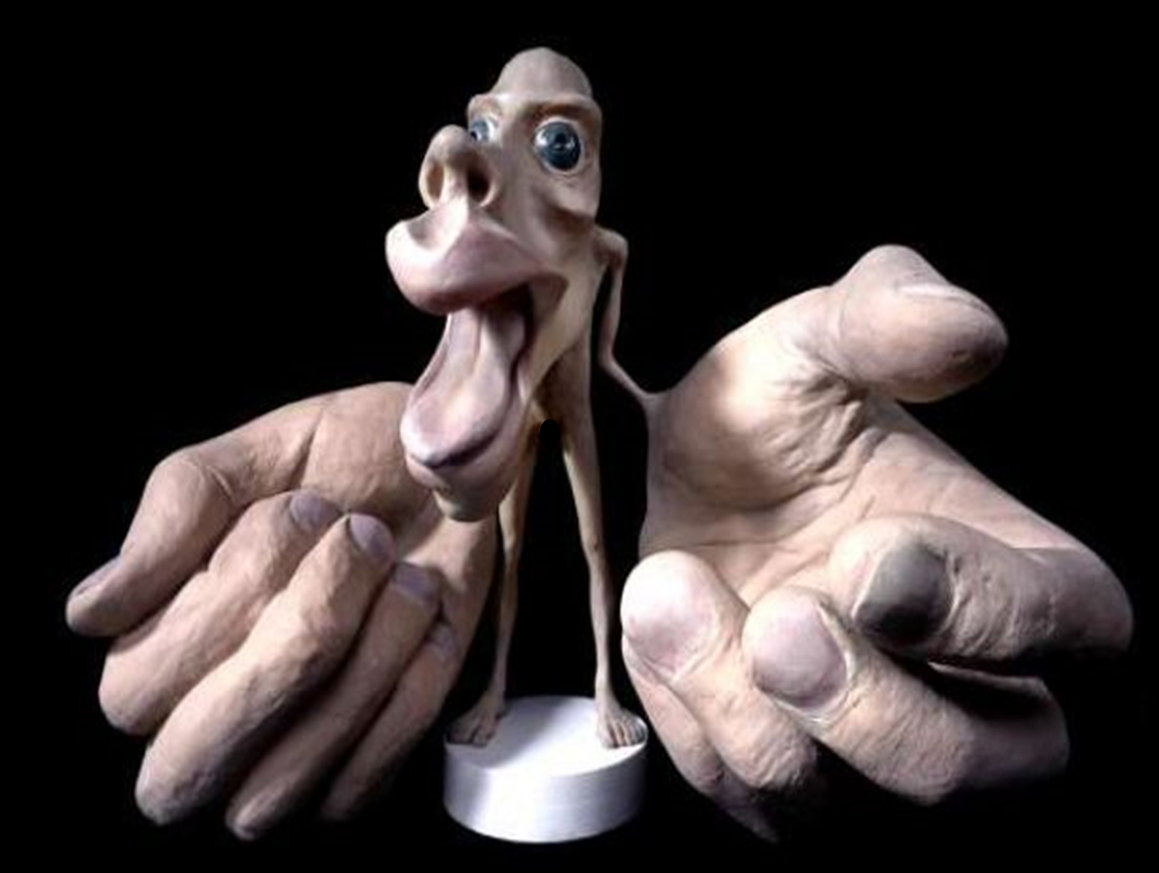

Slide 8

What is Cellular Communication?
Which systems do we use for this?

Slide 9
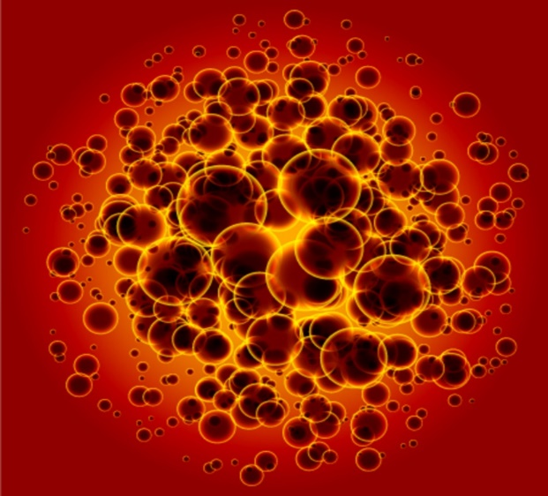
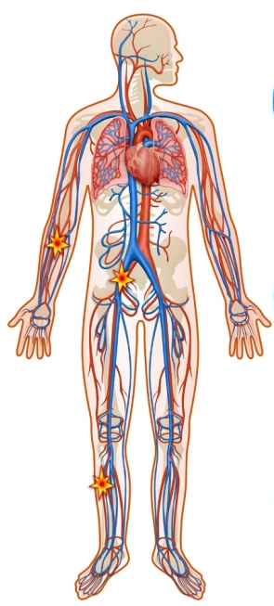
Some
Cellular Communication – WHY?...
Most animals and plants are Multicellular…
They are highly complex and made of million of cells
Different parts of an organism perform different functions.
Information must be passed between different parts so their activities can be coordinated!
The neuronal (nervous system) and hormonal (endocrine system) are examples of cell signalling.

Slide 10




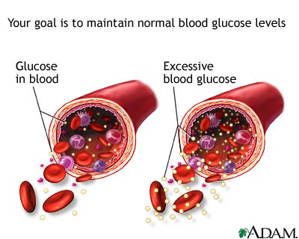
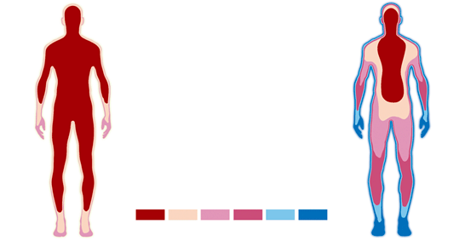
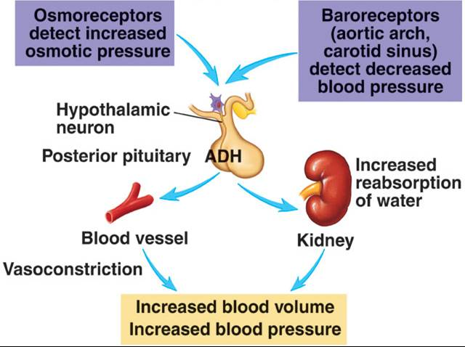
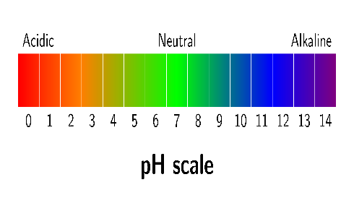
Why respond to the environment?
Increases chances of survival
In your table list as many internal and external changes the body must respond to
External
Internal
Any change in the external or internal environment is called a stimulus (e.g. temperature, light intensity, pressure)
Sudden loud sounds
External
Temperature
Humidity
Light intensity
Blood glucose
Internal temperature
Blood glucose
Waste potential

Slide 11
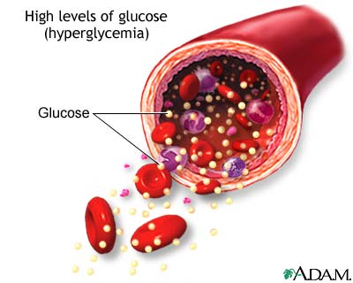
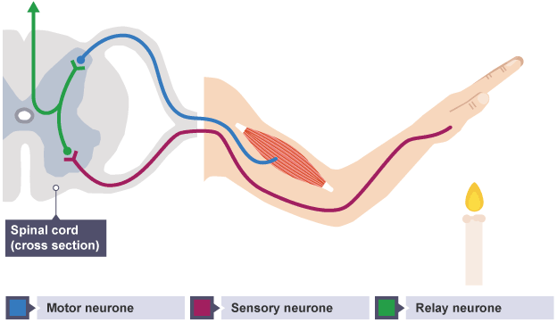
all
Cellular Communication – When...
To regulate substance levels in the body e.g. blood glucose in mammals.
To change the activity of a part of an organism in response to a stimulus e.g. touching a hot flame

Slide 12
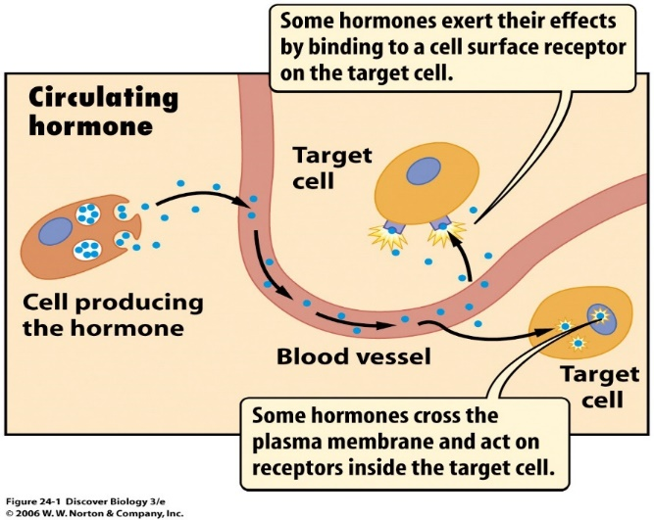
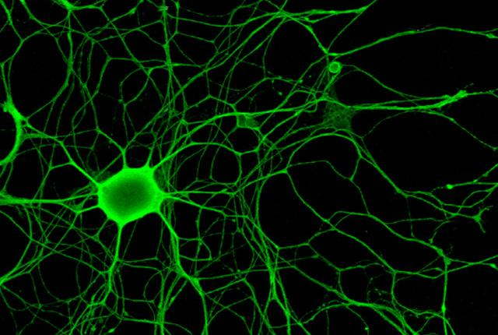
all
Cellular Communication
(Signalling)– How?...
QUESTIONS!
1) Hormones - In plants and animals help to transfer chemical information from one part of the organism to another via the blood. An endocrine organ releases the hormone & is detected by specific target cells. (Longer-term response)
2) Nerves - In many animals, nerves transport information in the form of electrical impulses via a network of neurones. (Rapid responses)
Both these methods of passing information from 1 cell to another are known as Cell Signalling.

Slide 13
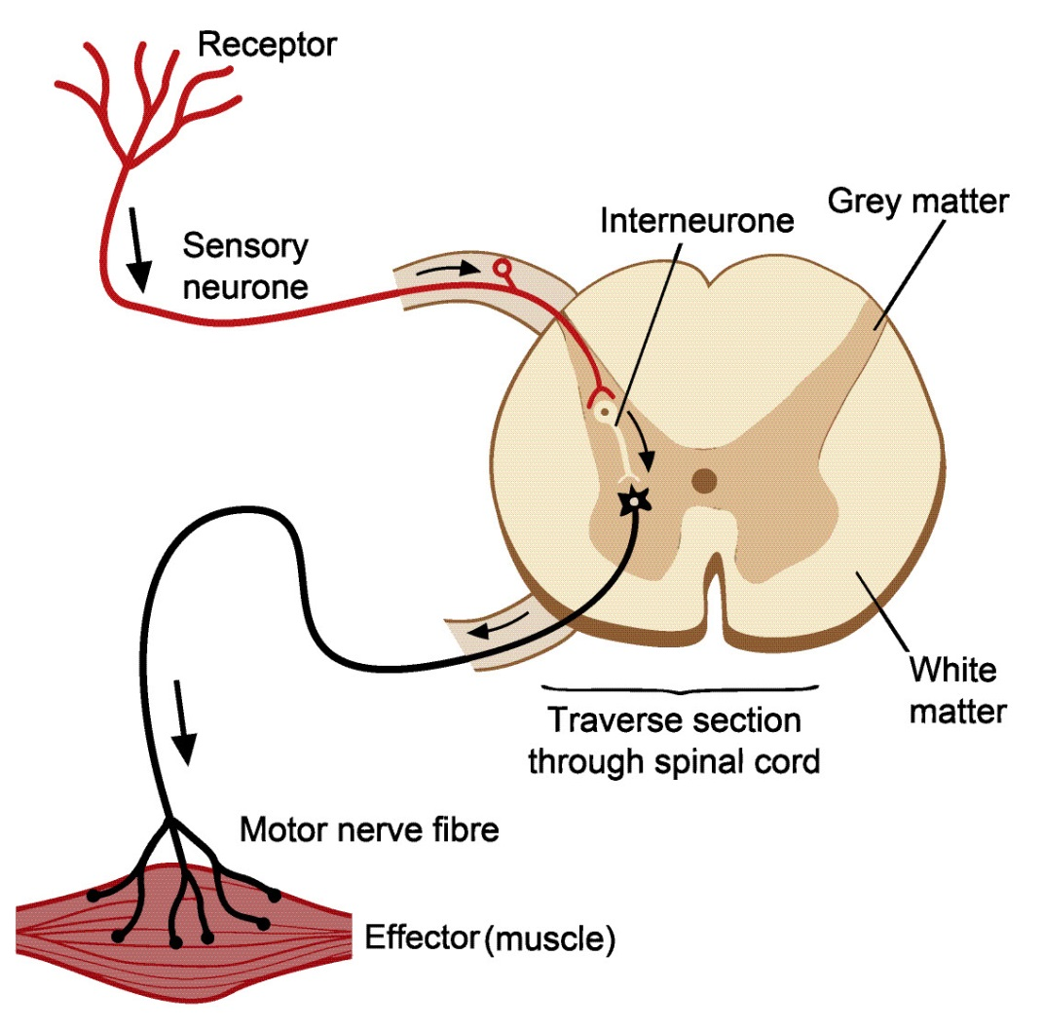
All
Receptors and effectors
Receptors:
Detect specific stimuli.
Only detect one stimuli each.
e.g. pressure receptors, photoreceptors, thermoreceptors
Receptors can be proteins or cells
Effectors:
Bring about a response to a stimuli.
e.g. muscle cells contract, cells in pancreas secrete hormones
From what we know so far..
Why are receptors and effectors important?
They allow ………………………….. between different parts of the organism.
Allows the different ……………. to coordinate their activities, so they work effectively.
Allows ……… responses, ……… responses, ………. term and ……….. term responses.
Notes:
Protein receptor – glycoprotein on plasma membrane
Cell receptors – like retina cells (photoreceptors back of eye)

Slide 14
Receptors and effectors
Receptors:
Detect specific stimuli.
Only detect one stimuli each.
e.g. pressure receptors, photoreceptors, thermoreceptors
Receptors can be proteins, cells
Effectors:
Bring about a response to a stimuli.
e.g. muscle cells contract, cells in pancreas secrete hormones
Why are receptors and effectors important?
They allow communication between different parts of the organism.
Allows the different organs to coordinate their activities, so they work effectively.
Allows rapid responses, specific responses, short term and long term responses.

Slide 15
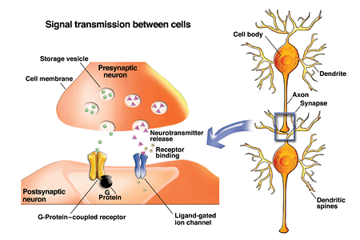
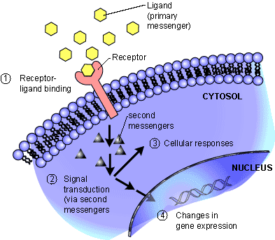
GOT
Cell signalling - summary
Cells communicate with effectors via nervous system and/or with the hormonal system.
One cell releases a chemical which is detected by another cell.
Neuronal system is interconnected network of neurones that signal to each other across synapse junctions.
Hormonal system uses the blood to transport its signals (hormones), which is recognised by specific target cells.

Slide 16
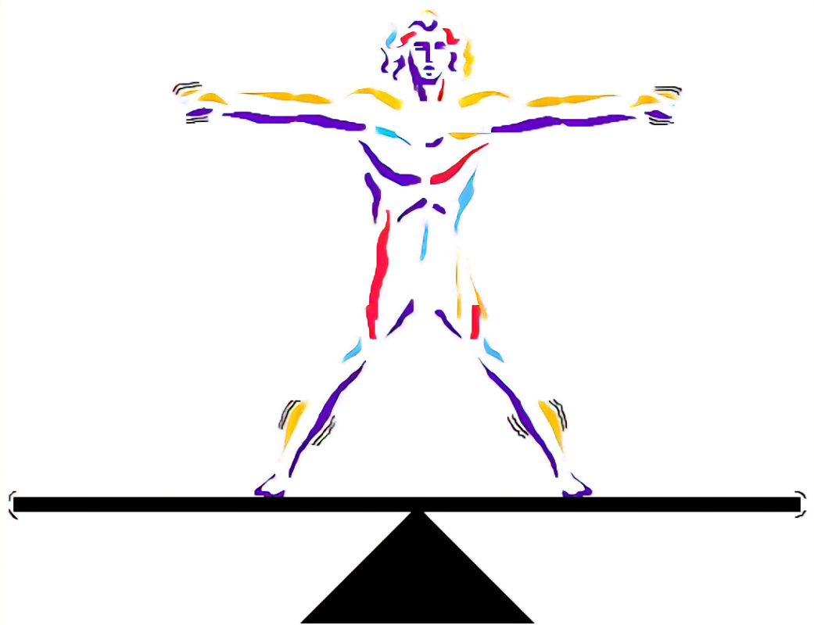
Link everything, we have spoken about to homeostasis

Slide 17
Homeostasis
Understand the principles of homeostasis, including the differences between receptors and effectors, and the differences between negative feedback and positive feedback.
Write definitions for the following key words:
Homeostasis
Maintenance of a constant internal environment, despite changes to internal and external factors
Positive feedback
A mechanism which increases a change, taking a system further away from the optimum
Negative feedback
A mechanism which acts to decrease (or reverse) a change, taking a system further back towards the optimum
Sensory receptors
Cells or parts of cells (dendrites) which respond to stimuli
Effector
A cell, tissue or organ which brings about a response

Slide 18
Homeostasis
Complex animals (e.g. humans) need to maintain certain features of their internal environment within defined limits.
Complete the table below:
internal factor | reason for control
maintain rate of enzyme reactions –
(prevent denaturing/ control a reaction rate )
Maintain plasma membrane
temperature
blood [glucose]
maintain water potential of blood ;
provide sufficient glucose for cell respiration
blood water potential
prevent dehydration of body cells
blood pressure
provide sufficient O₂ + glucose for cell respiration;
(maintain consciousness)

Slide 19
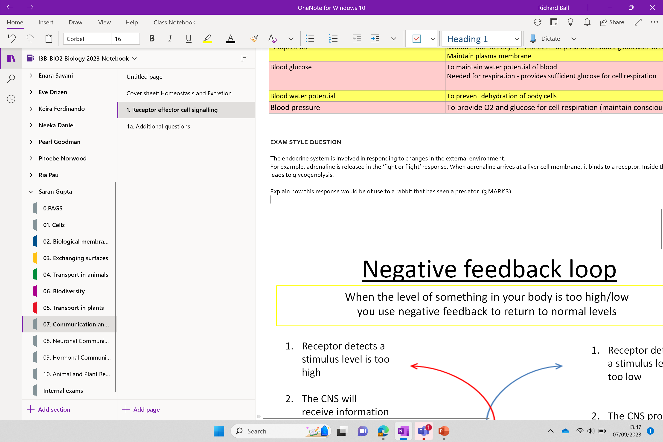
STARTER QUESTION

Slide 20
EXAM STYLE QUESTION
The endocrine system is involved in responding to changes in the external environment.
For example, adrenaline is released in the ‘fight or flight’ response.
When adrenaline arrives at a liver cell membrane, it binds to a receptor. Inside the cell, a cascade of events leads to glycogenolysis.
Explain how this response would be of use to a rabbit that has seen a predator. (3 MARKS)
glycogen converted into glucose (in liver) and then glucose released into blood; (carried / available) to cells;
(glucose needed for) respiration / glycolysis; to release energy / make ATP;
for increased, breathing rate / heart rate /muscle contraction;

Slide 21
Key terms
Glycogenolysis
process by which glycogen, the primary carbohydrate stored in the liver and muscle cells of animals, is broken down into glucose
Glycogenesis
the process by which glucose is converted into glycogen and stored in the liver and muscle cells
Lysis = Breakdown
Genesis = The creation of

Slide 22
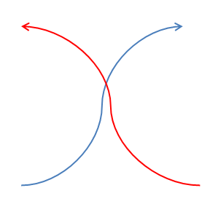
Negative feedback loop
When the level of something in your body is too high/low you use negative feedback to return to normal levels
Receptor detects a stimulus level is too high
The CNS will receive information and produce response
Effector produces response and levels return towards the optimum
Receptor detects a stimulus level is too low
The CNS produces a response
Effector produces a response and levels return towards the optimum again
THIS MIGHT CAUSE THE OPPOSITE
PROBLEM SO THE NEGATIVE FEEDBACK LOOP STARTS AGAIN

Slide 23
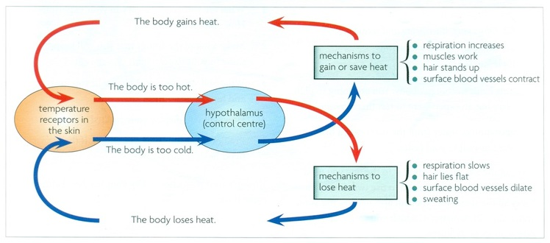
Specific example

Slide 24
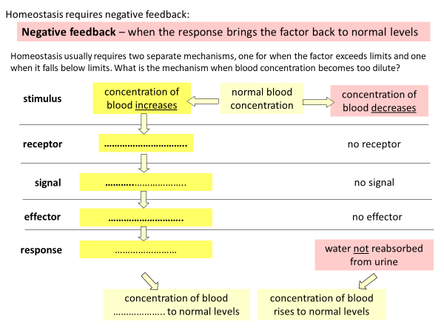
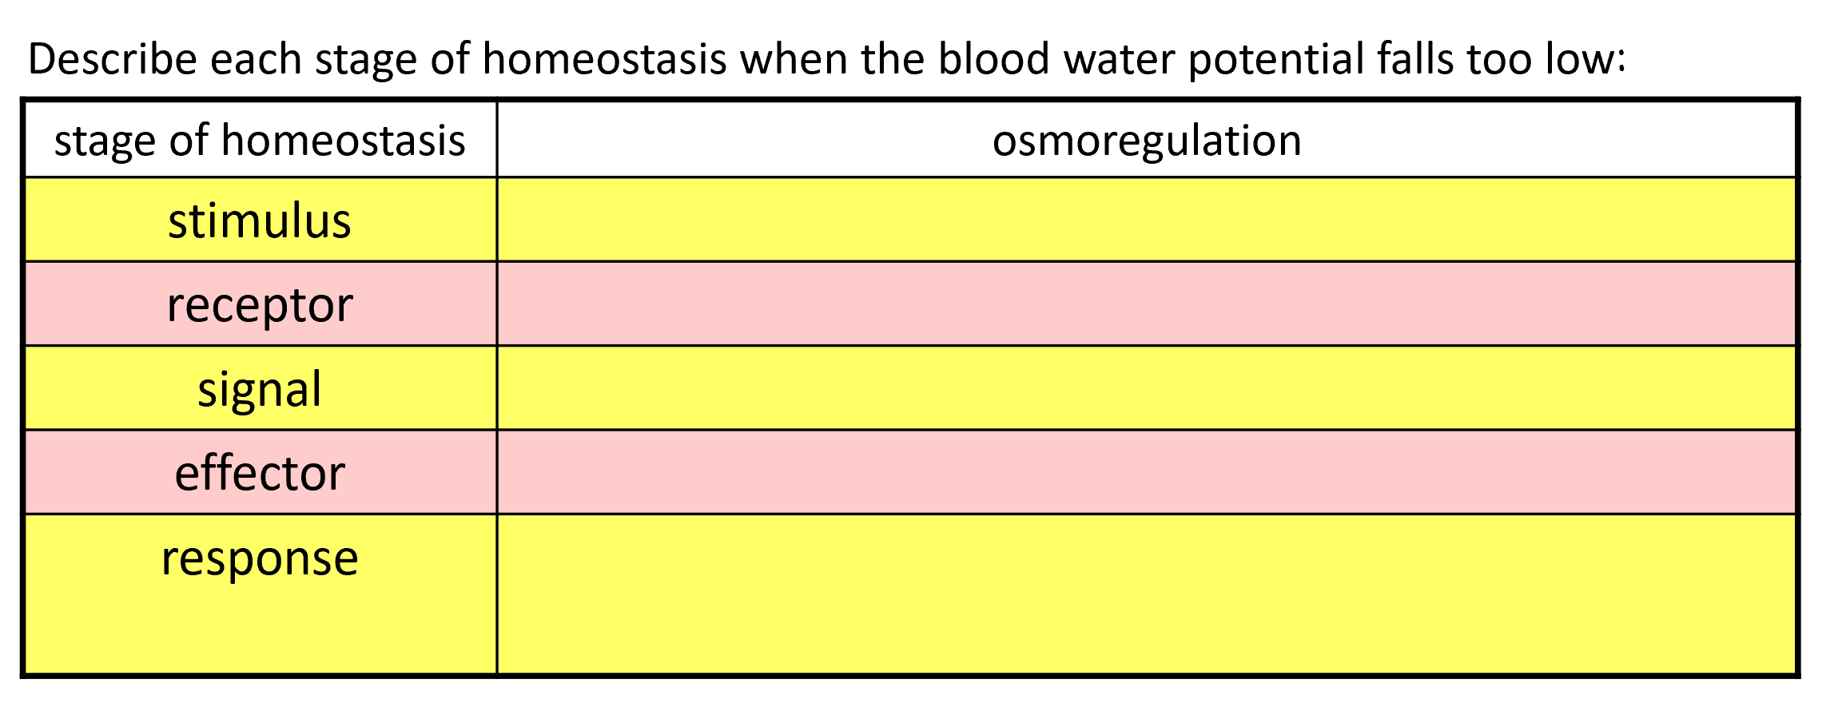
Task
Fill in the missing words and the table for how the negative feedback keeps water levels constant the blood

Slide 25
Homeostasis requires negative feedback:
Negative feedback – when the response brings the factor back to normal levels
Homeostasis usually requires two separate mechanisms, one for when the factor exceeds limits and one when it falls below limits. What is the mechanism when blood concentration becomes too dilute?
concentration of blood increases
normal blood concentration
concentration of blood decreases
stimulus
receptor
Os………………….
no receptor
signal
……….. released into blood
no signal
effector
………….. duct cells / aqua………
no effector
response
more ………. …………….. from ……………..
water not reabsorbed
from urine
………………. of blood falls to normal levels
concentration of blood rises to normal levels

Slide 26
Homeostasis requires negative feedback:
Negative feedback – when the response brings the factor back to normal levels
Homeostasis usually requires two separate mechanisms, one for when the factor exceeds limits and one when it falls below limits. What is the mechanism when blood concentration becomes too dilute?
concentration of blood increases
normal blood concentration
concentration of blood decreases
stimulus
receptor
Osmoreceptors
no receptor
signal
ADH released into blood
no signal
effector
collecting duct cells / aquaporins
no effector
response
more water reabsorbed from urine
water not reabsorbed
from urine
concentration of blood falls to normal levels
concentration of blood rises to normal levels

Slide 27
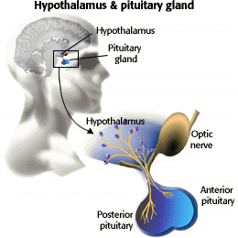
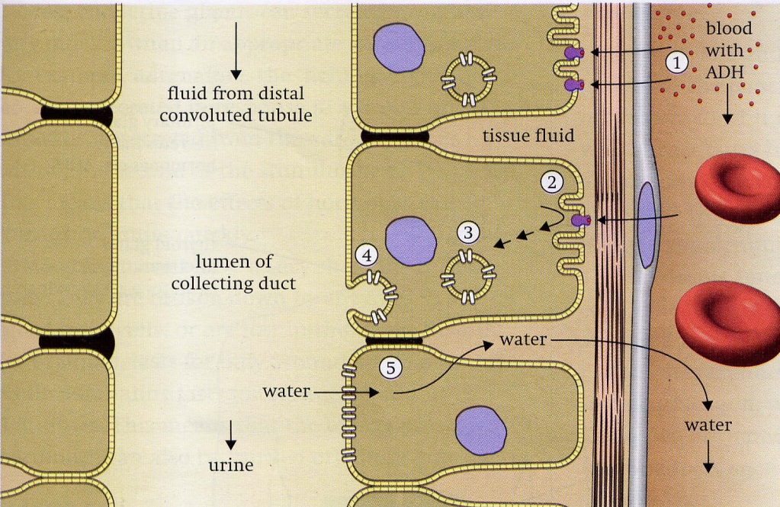
http://highered.mcgraw-hill.com/sites/0072495855/student_view0/chapter20/animation__hormonal_communication.html
ADH
ADH
water
water
Describe each stage of homeostasis when the blood water potential falls too low:
stage of homeostasis | osmoregulation
stimulus
receptor
signal
effector
response
increased solute concentration of blood
osmoreceptors in the hypothalamus
ADH (hormone) released by posterior pituitary
collecting duct cells (in the kidney nephron)
aquaporins (water channels) insert in membrane; increasing water reabsorption from filtrate back to blood

Slide 28
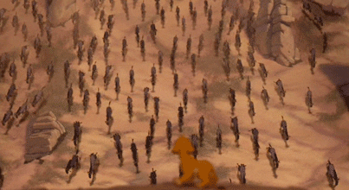
What is positive feedback?
More and more of the desired product is produced until we reach the desired outcome
Notes:
The process of labor and childbirth is perhaps the most-cited example of positive feedback. In childbirth, when the fetus’s head presses up against the cervix, it stimulates nerves that tell the brain to stimulate the pituitary gland, which then produces oxytocin. Oxytocin causes the uterus to contract. This moves the fetus even closer to the cervix, which causes more oxytocin to be produced until childbirth occurs and the baby leaves the womb.
Only the child being born with stop the feedback loop

Slide 29
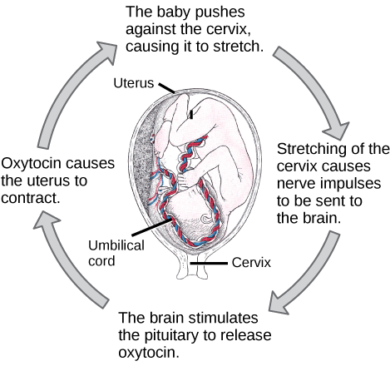
Positive feedback
Less common
Destabilises the system
Can be beneficial, depending on the circumstances

Slide 30
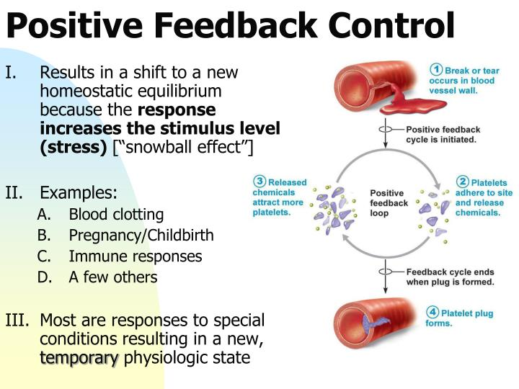

Slide 31
Summary
Negative feedback is about balance
Positive feedback is about reaching a finite/ final outcome

Slide 32
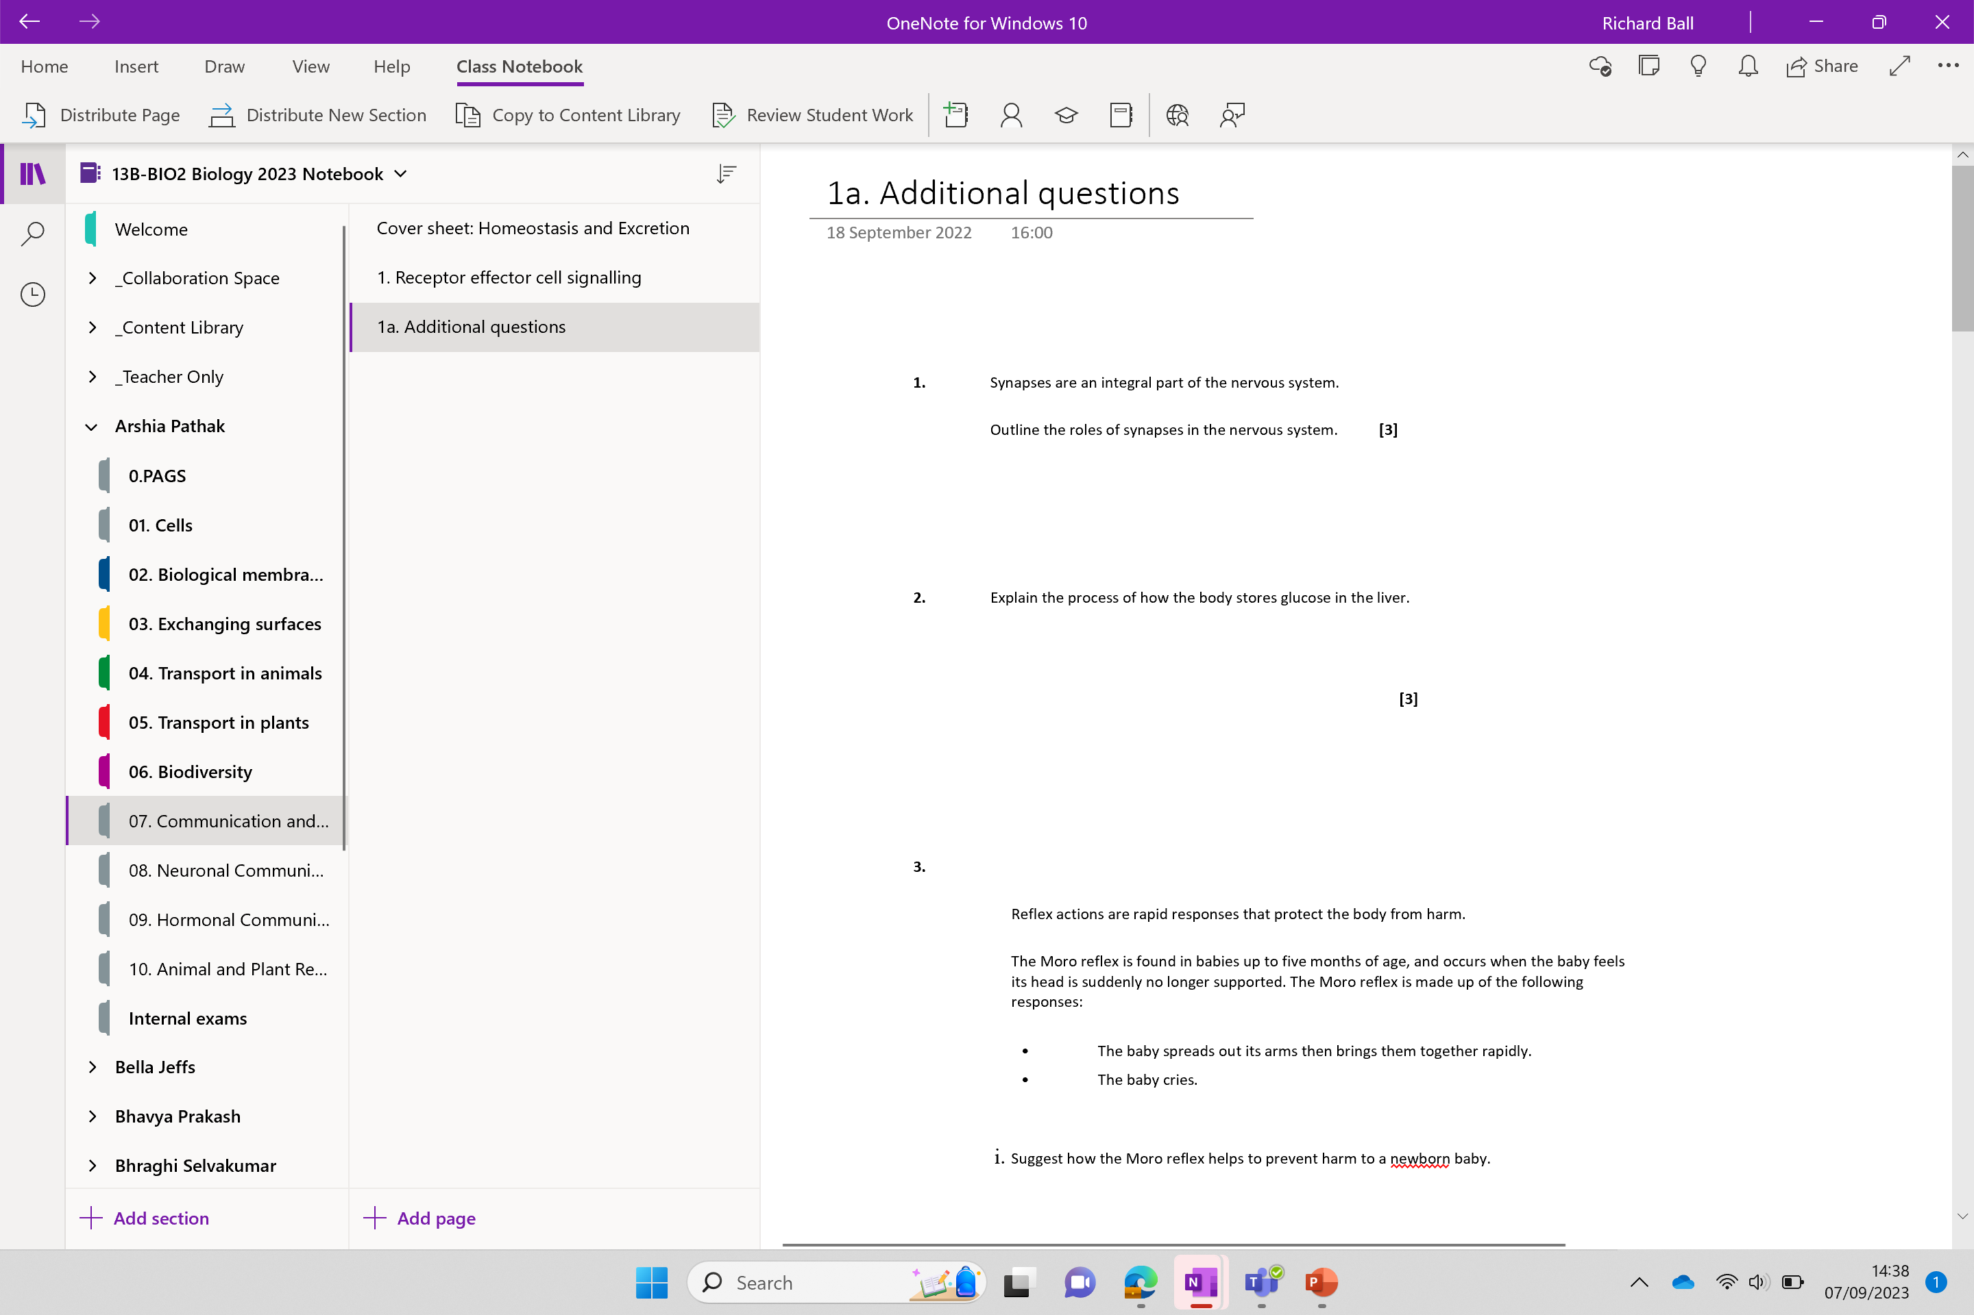
Additional questions

Slide 33
Tb

