Slide 1

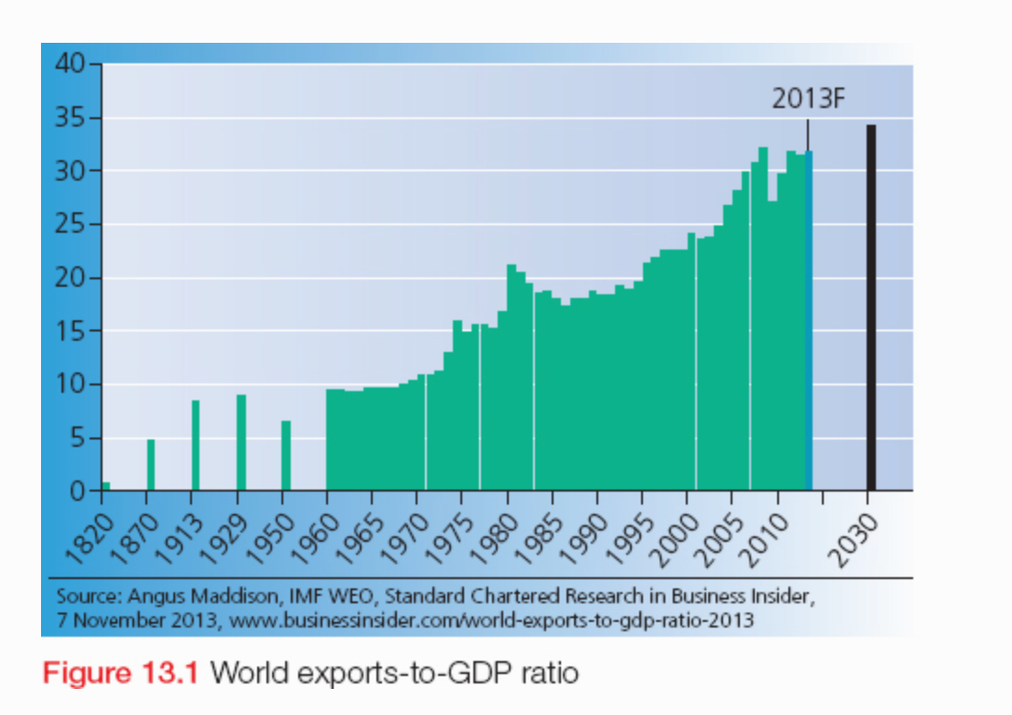
Global Interdependence: Trade flows, trading Patterns and inequalities
Starter: Look at the graph below. Identify and describe the trends in global exports.
Learning Objectives:
Define Key terms related to trade.
Describe the global patterns of trade
Explain reasons for inequalities of trade.
Extension Question: Why does trade occur?
Trade results from the uneven distribution of resources around the earths surface. Even the countries with an abundance of resources and wide industrial base cannot always produce all of the goods and services that their populations desire, so they buy (import) goods and services from other countries if they can afford them. Additionally, countries seek to trade their goods/services to generate revenue, which can be used to improve the country in various ways.
Fact: Trade is the most vital element in the growth of the global economy, accounting for over 30% of GDP – about 3 times its share in 1960.

Slide 2
Key Word Match up: Match the key words to their correct meaning
When the value of a countries imports exceeds the value of its exports. A country can make up the difference by using it’s savings or borrowing, but such a situation cannot continue indefinitely.
Trade
Imports
Goods and services sold to other countries.
Exports
The exportation of services which include, travel and tourism, business etc.
Balance of trade
When the value of a countries exports exceeds the value of its imports. This will contribute to the GDP of a nation.
Trade deficit
The difference between the value of a countries imports and exports
Trade surplus
The physical exportation of goods that can be seen e.g. raw materials or manufactured goods.
Visible trade
The exchange of goods and services for money.
Invisible trade
Goods and services purchased from other countries.

Slide 3
Key Word Match up: Match the key words to their correct meaning
Trade
The exchange of goods and services for money.
Goods and services purchased from other countries.
Imports
Goods and services sold to other countries.
Exports
The difference between the value of a countries imports and exports.
Balance of trade
When the value of a countries imports exceeds the value of its exports. A country can make up the difference by using it’s savings or borrowing, but such a situation cannot continue indefinitely.
Trade deficit
Trade surplus
When the value of a countries exports exceeds the value of its imports. This will contribute to the GDP of a nation.
Visible trade
The physical exportation of goods that can be seen e.g. raw materials or manufactured goods.
Invisible trade
The exportation of services which include, travel and tourism, business etc.

Slide 4

A history of Global Trade
Learning Objectives:
Define Key terms related to trade.
Describe the global patterns of trade
Explain reasons for inequalities of trade.
The origin and continuing basis of global interdependence is trade.
When did the global trading system develop?
It developed at the time of the European colonial expansion.
Why? What emerged from this in terms of trade?
A ‘colonial division of labour’ emerged – LIC’s exported cheap primary products, agriculture and minerals. Europe & North America exported manufactured goods. This remained the general pattern of world trade until the post-WWII period, when a more complex pattern of international trade emerged. This was one of the several factors which caused the development gap we see today between nations of the world.
Learn about the history of global trade in this article.
Ext: Check out these videos outlining the history of global trade & explaining global trade.

Slide 5
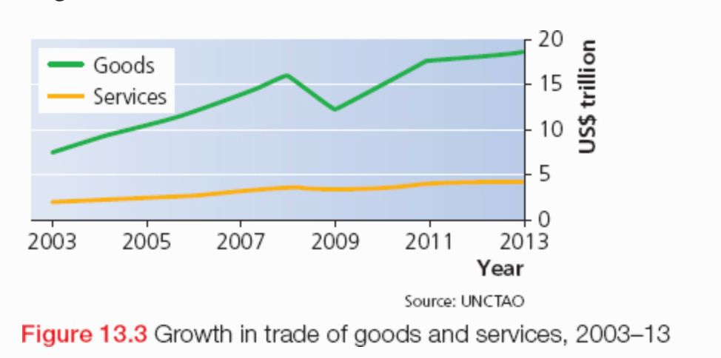
The value of global trade in goods (visible trade) increased from less than $8 trillion in 2003 to more than $18.5 trillion in 2013.
Trade in services (invisible trade) also increased significantly from about $2 trillion in 2003 to $4.7 trillion in 2013.
Throughout the period in question, the value of world trade in services (invisible trade) was roughly a quarter that of global trade in goods (visible trade).
The severe dip in 2008-09 indicates the strong effect of the global financial crisis had on world trade. The dip in trade in services was of a much lower magnitude.
Growth of Trade between 2003 - 2013
Look at the graph which outlines the growth of visible and invisible trade
Identify the pattern of the growth of trade
Compare the differences between the growth of visible and invisible trade
Explain the anomaly to the trend evidenced in the year 2008.

Slide 6
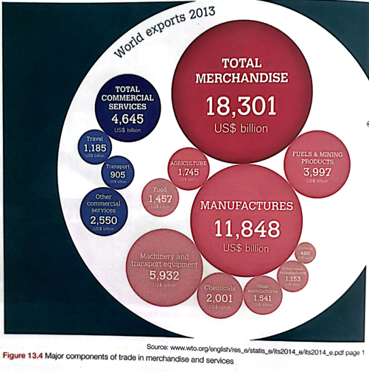
Major components of trade in goods (merchandise) and services
TASK: Describe the graph
Of all world exports, goods/merchandise is of much higher value/more dominant than services accounting for …%... Over 4/5’s.
With merchandise, manufactured goods are the dominant component, followed by fuel and mining products, then agriculture.
In the manufactured goods component, machinery & transport equipment is by far the most important element.
Coinciding with the rise of global tourism since the 1950’s, travel is the major element in the services component, closely followed by transport.
Thinking question: What kinds of things do you think fall in the ‘other commercial services’ component?

Slide 7
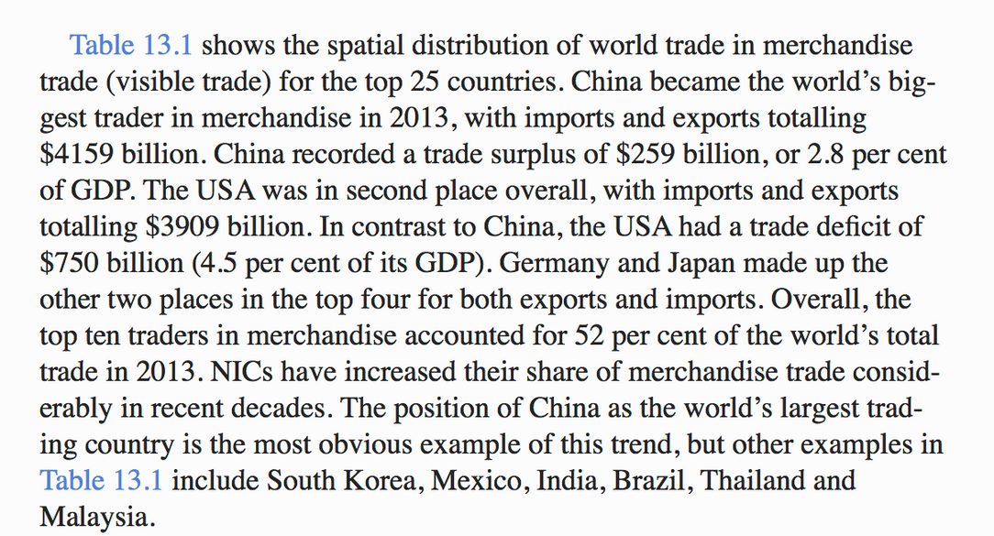
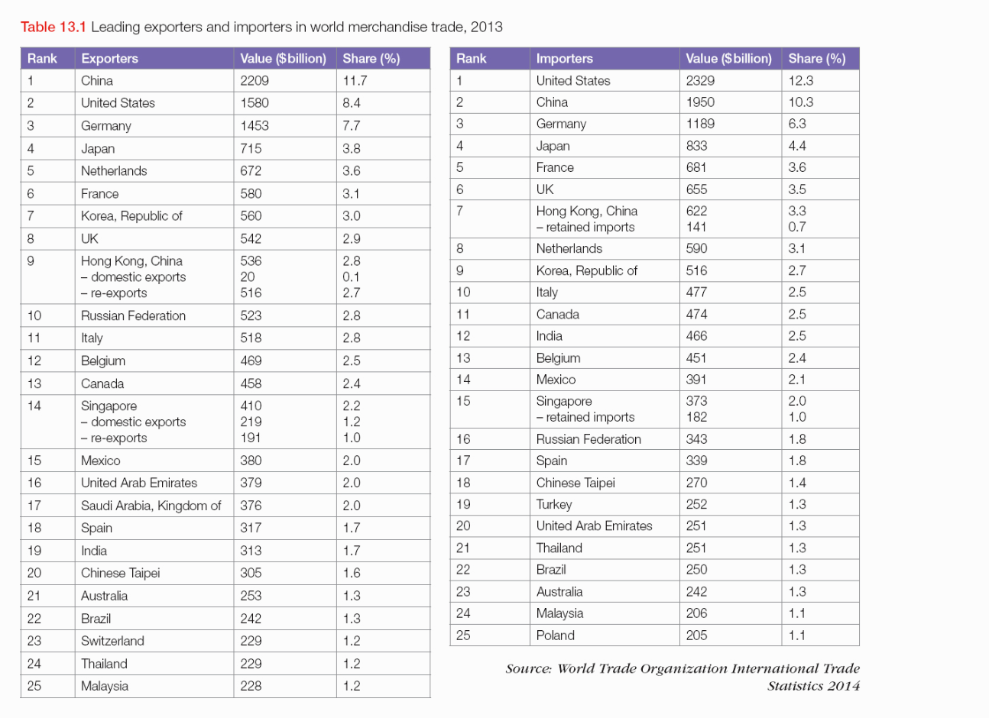
Spatial Distribution of Merchandise (visible) Trade
TASK: Look at the table below and describe the spatial distribution of merchandise trade (visible trade).
The trading positions of affluent countries with relatively small populations such as the Netherlands, Belgium and Switzerland, is also worthy of note.
The least developed countries share of total global merchandise exports totalled only 1.1%, compared to 75.5% of the G20 (group of 20 largest economies).
Retained imports : Some countries discriminate retained imports of goods which refer to those imported goods which are retained for use in the country rather than being re-exported to other places.
Re-exportation, also called entrepot trade, is a form of international trade in which a country exports goods which it previously imported without altering them.
This table is a little out-dated (2013). Check out these links which offer excellent interactive visuals on world trade data: here & here & here & here

Slide 8
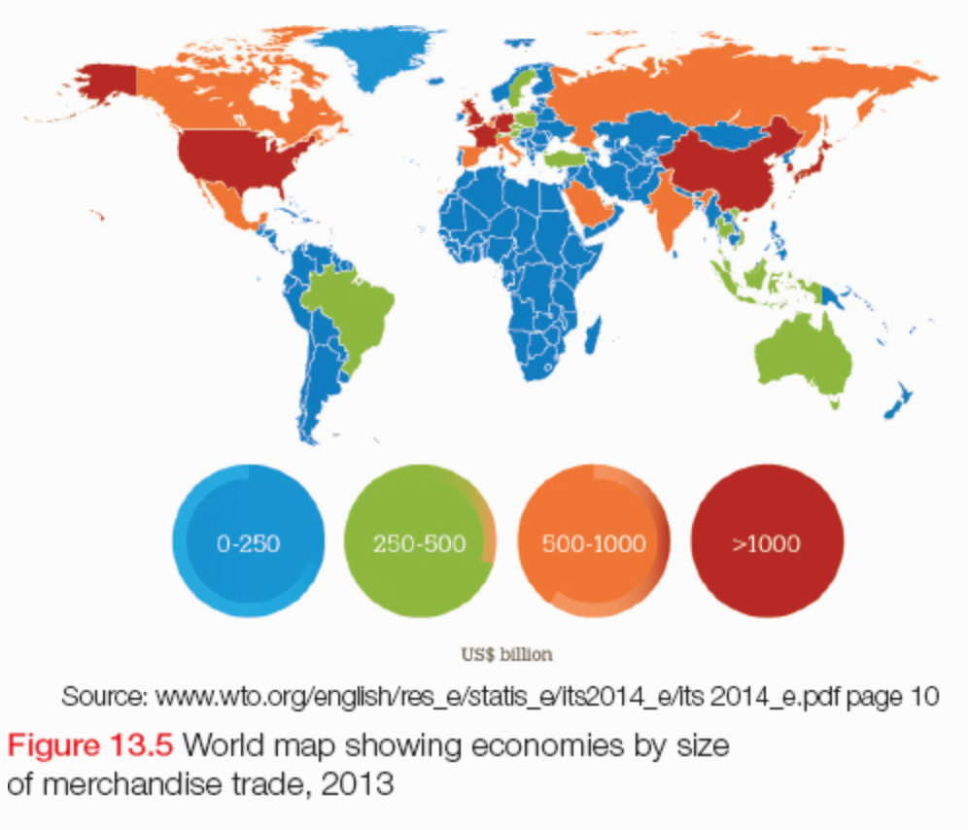
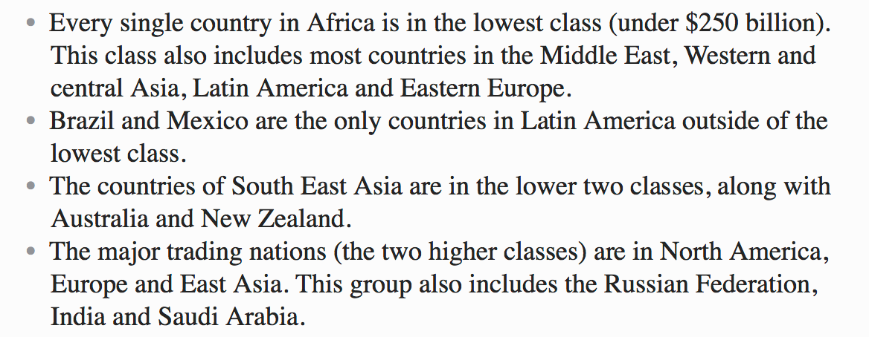
Spatial Distribution of Merchandise (visible) Trade
The figure shows economies of individual countries by size of their merchandise trade in 2013.
There are clear spatial patterns; can you identify/describe them?

Slide 9
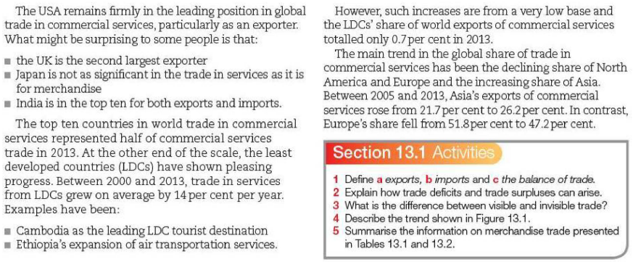
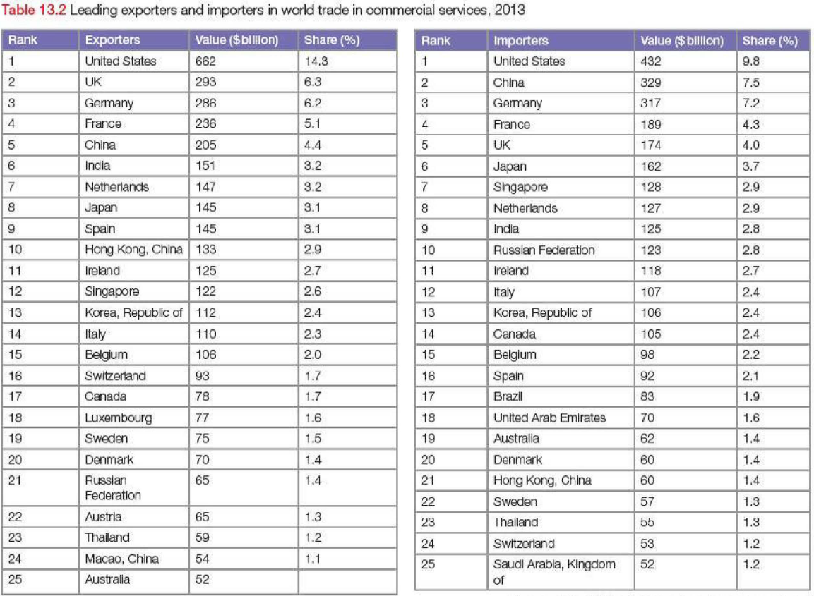
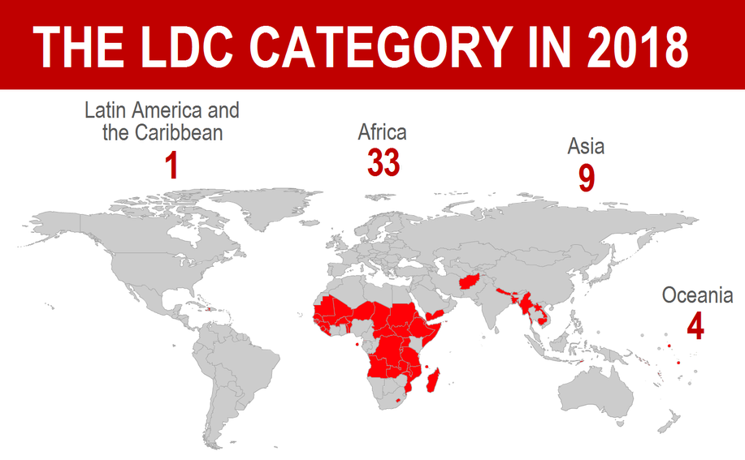
Spatial Distribution of Commercial (invisible) Trade
TASK 1: Look at the table and describe the spatial distribution of invisible trade.
TASK 2: Can you describe & explain some the trends from the extract e.g. why is Japan not as significant in the trade of services as it is for merchandise?
LDCs: The least developed countries are a list of developing countries that, according to the United Nations, exhibit the lowest indicators of socioeconomic development, with the lowest Human Development Index ratings of all countries in the world. Learn more by accessing this website & video.

Slide 10
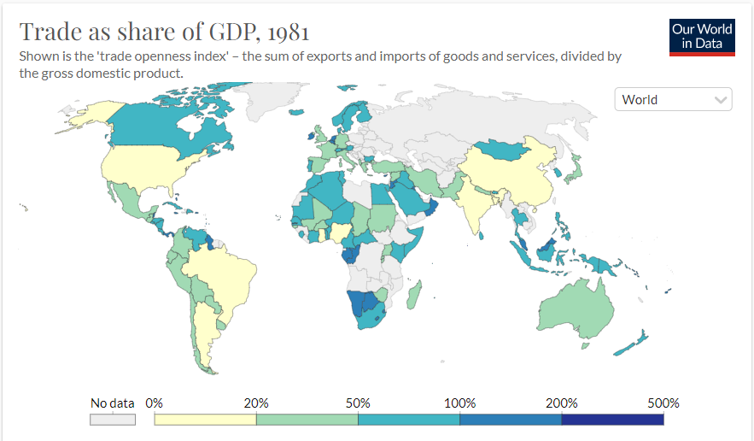
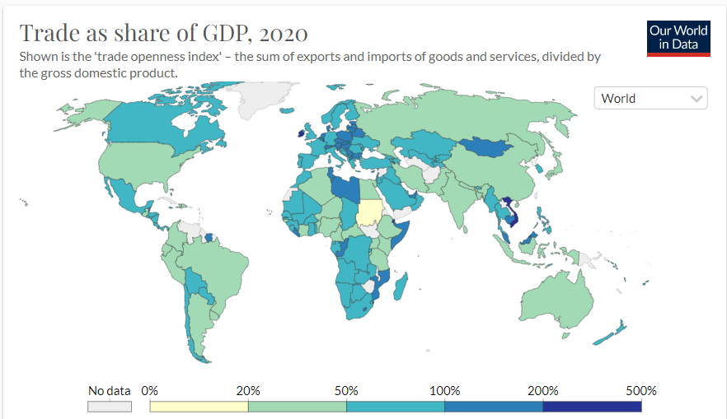
Trade – GDP ratio
The trade-to-GDP ratio is an indicator of the relative importance of international trade in the economy of a country. It is calculated by dividing the aggregate value of imports and exports over a period by the gross domestic product for the same period. Although called a ratio, it is usually expressed as a percentage. It is used as a measure of the openness of a country to international trade, and so may also be called the trade openness ratio. It may be seen as an indicator of the degree of globalisation of an economy.
Other factors aside, the trade-to-GDP ratio tends to be low in countries with large economies and large populations such as Japan and the United States, and to have a higher value in small economies (why?).
While countries with large populations benefit from exporting, they have a lesser need to export to gain sale volume due to having a large domestic market. For example, German car companies would have a lot of trouble being efficient if they couldn’t sell their cars abroad as the German market is relatively small. In contrast, while US car manufacturers certainly can benefit from exporting cars to help in gaining the same efficiencies, the US population is four times larger than Germany’s, and therefore the need to export to get enough sales volume is lessened. Countries of larger sizes also have increased costs when exporting e.g. transport costs. In a small country like Austria, every part of the country is close to a border. Thus the distances involved in goods leaving the country is a lot lower than would be typical for a large country like Canada or the US.
Singapore has the highest trade-to-GDP ratio of any country; between 2008 and 2011 it averaged about 400%.
Worldwide trade-to-GDP ratio rose from just over 20% in 1995 to about 30% in 2014.

Slide 11
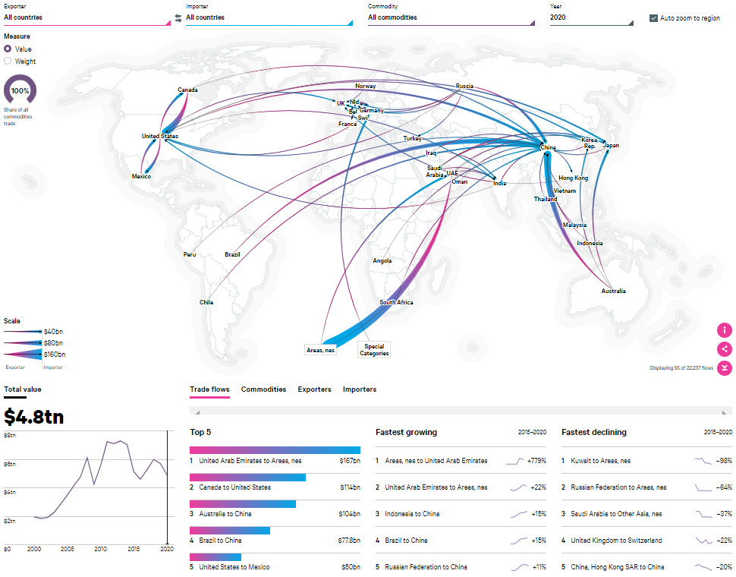
Awesome Interactive Global Trade Map

Slide 12
Check out the Geofile in the lesson folder
Geofile - How does global trade function

