Slide 1


Deserts 101
Feel free to bullet point / take note of important info while you watch.
https://www.youtube.com/watch?v=n4crvs-KTBw

Slide 2
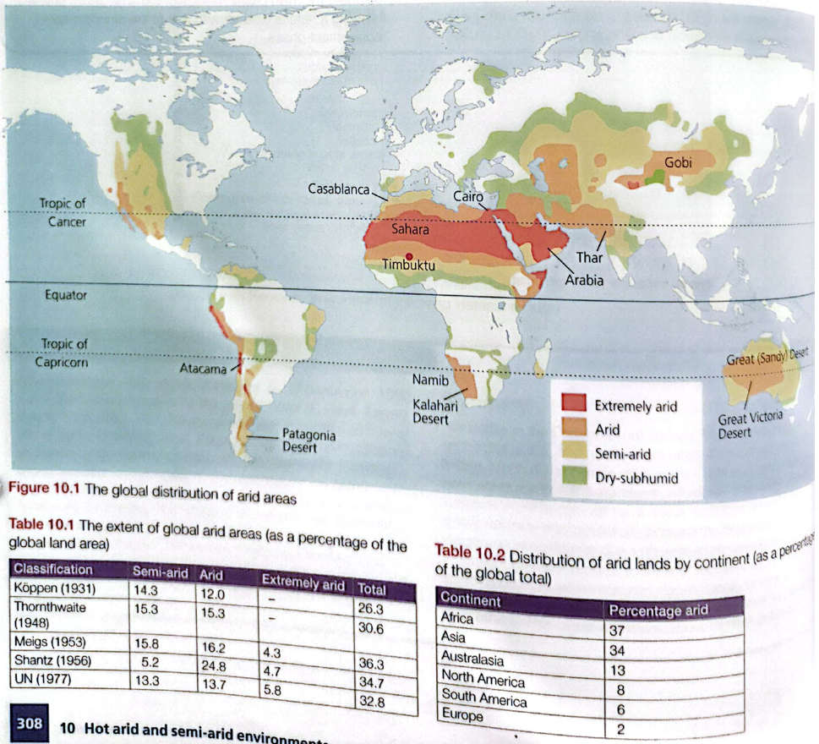
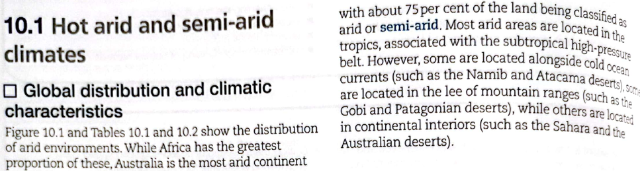
Unit 10 – Hot arid and semi-arid environments
TASK: Study the map & Table 10.2. Describe the global distribution of arid areas. Aim for 4-6 points.
TASK: Can you add to your answer from reading the textbook extract?
TASK: Can you bullet point 4 ways (or types of locations) deserts are formed/found, from the extract above?
Sub-tropical high pressure belt (Hadley Cell)
Lee of mountain ranges (rain shadow effect)
Continental interiors
Cold ocean currents

Slide 3
Intro Video – Where are deserts found and why?
Feel free to bullet point / take note of important info while you watch AND it’s important that you refer back to this video as needed in future.
https://www.youtube.com/watch?v=XARurOygog8

Slide 4
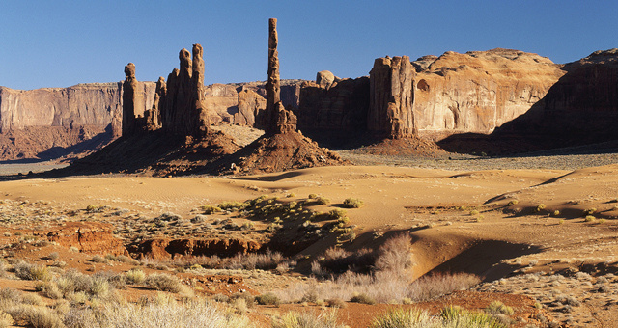
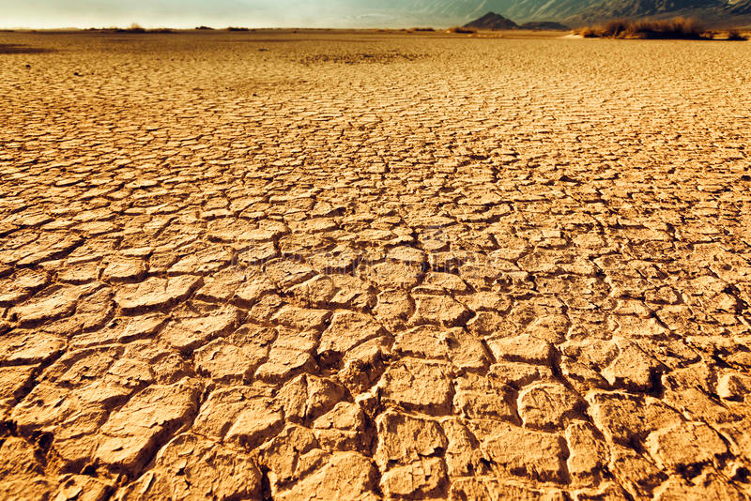
What is ‘aridity’ & how is it classified?
TASK: What words/terms come to mind when you hear the word ‘arid’? Aim for 3 words.
Dry
Inhospitable
Barren
Un-vegetated
Lack of water
Most modern definitions of aridity are based on the concept of ‘water balance’. What is water balance?
Water balance is the relationship that exists between inputs in the form of precipitation (P) and the losses arising from evaporation & transpiration (evapotranspiration) (E).
What is ‘potential evapotranspiration’ (PE) and how is it different to ‘evapotranspiration’? This revision of Y12…
The distinction between E and PE lies in the concept of moisture availability. Potential evapotranspiration is the water loss that would occur if there was an unlimited supply of water for use by vegetation & evaporation. An area can have a low rate of E (evapotranspiration) but a very high PE (potential evapotranspiration). How?
For example: Egypt’s E (evapotranspiration) is low, less than 250mm. This is because Egypt receives less than 250mm of rain annually. However, given Egypt’s high temperatures, if rainfall were as high as 2000mm, there would be sufficient heat to evaporate all of that water. Hence, the PE rate in Egypt is 2000mm.
Ext: Learn this, and then test yourself by explaining PE without looking at this slide and see how you get on. Another good idea is to practice by explaining it out loud.
3 classifications of aridity are explained in the textbook:
Meigs’ (1953)
Grove (1977)
‘Number 3’ (Not given a title in the book!)
Study all 3, and explain them in your own words – hanrdwritten!! (they are on the next slide).

Slide 5
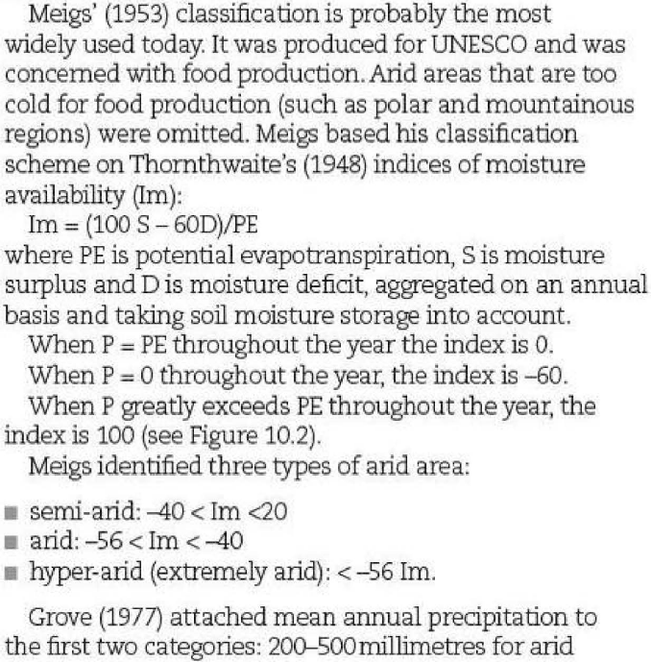
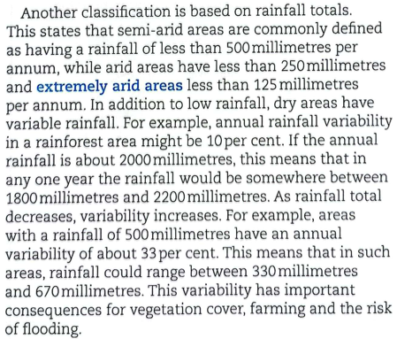
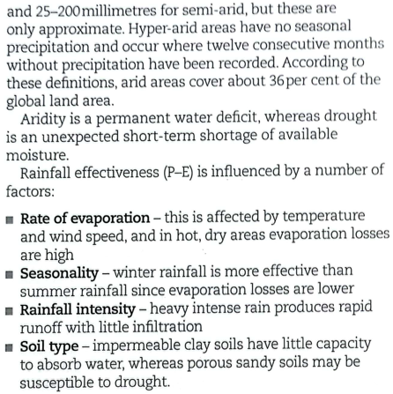
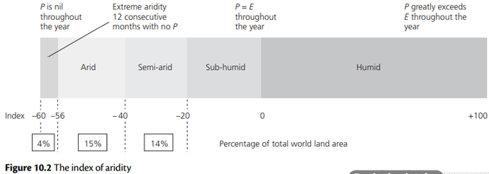
What is ‘aridity’ & how is it classified?
Cambridge summary:
The traditional definition of arid and semi-arid areas:
arid: less than 250 mm per annum (year)
semi-arid: 250–500 mm per annum (year).
Definitions now use P:PET ratios (Precipitation:Potential EvapoTranspiration) and the aridity index:
arid: 0.03–0.2 mm P:PET ratio
semi-arid: 0.2–0.5 mm P:PET ratio.
In semi-arid areas rainfall may vary up to 40% above or below the mean.
Aridity index:
–100 (areas with no precipitation)
0 (areas where P=PET)
+100 (areas where P>PET).
Arid areas are between –40 and –100 and semi-arid areas are between –20 and –40.
P = Precipitation
PE = Potential evapotranspiration
Task: Briefly explain the term ‘rainfall effectiveness’. Research if needed.
Ext: This is an excellent resource on effective rainfall & its significance.

Slide 6
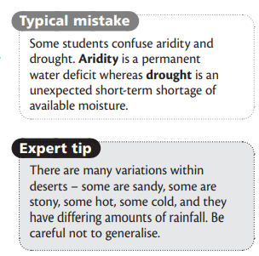
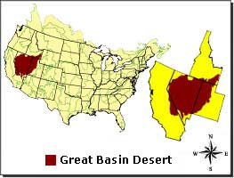
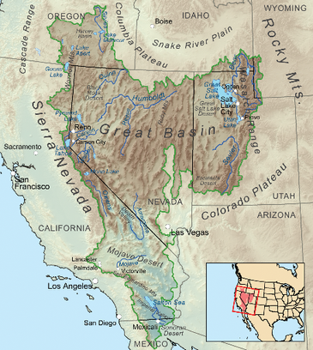
Other important info on aridity – study & learn!!
Why are all 3 areas (arid, semi-arid and hyper-arid) considered part of the ‘arid zone’?
The division between the three is arbitrary and varies depending on the classification used.
Annual precipitation is highly variable and in any one year could be extremely low e.g. in any given year, a semi-arid region could receive as little precipitation as a hyper-arid zone.
These areas share the same processes and landforms.
In the 20ᵗʰ century, climate change and human activities have caused some arid areas to expand into semi-arid areas, and also the expansion of semi-arid areas e.g. The Sahel in Africa.
Semi-arid areas are often termed ‘deserts’ by their inhabitants.
Other important points:
There are other factors that influence arid areas.
There are hot deserts (tropical and subtropical) and cold deserts (high latitude and high altitude).
Coastal deserts, such as the Atacama and the Namib have very different temperature and humidity characteristics than deserts in continental interiors, such as the central areas of the Sahara.
There are also mountain basin deserts, such as south-west USA (Basin and range topography is characterized by alternating parallel mountain ranges and valleys). Learn about the Great Basin Desert in the USA here. Again, desert characteristics here will differ.

Slide 7
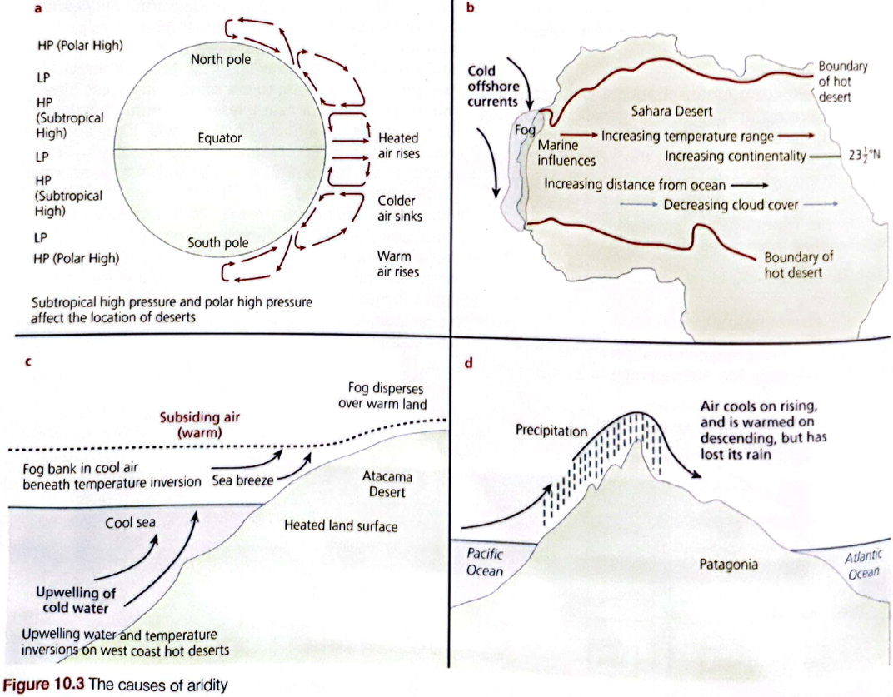
What are the causes of aridity?
20 markers
‘Pressure systems are the most important cause of aridity.’ To what extent do you agree with this statement? [20]
Assess the extent to which the global distribution of hot arid environments is the result of pressure and wind systems. [20]
Evaluate the role of pressure and wind systems in the global distribution of hot arid and semi-arid environments. [20]
With the aid of examples, assess the extent to which ocean currents are the cause of aridity. [20]
TASK: Open the ‘Causes of aridity’ worksheet in the lesson folder.
Study the 4 diagrams. Just from studying the diagrams, attempt to explain all 4 in the boxes provided.
Then, try to explain how human activities can lead to aridity in the 5ᵗʰ box.
Now, read the textbook explanations on the next slide. Add to/adjust/edit/re-do your explanations based if needed.
Ext: Re-watch the video from slide 3. Can you add to/improve your notes?

Slide 8
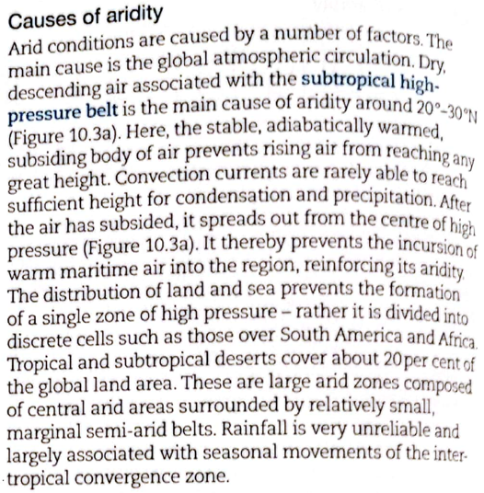
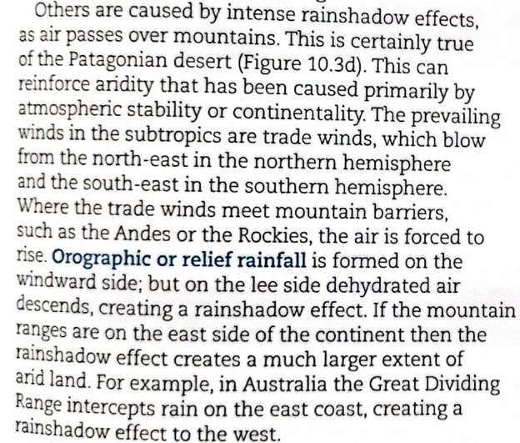
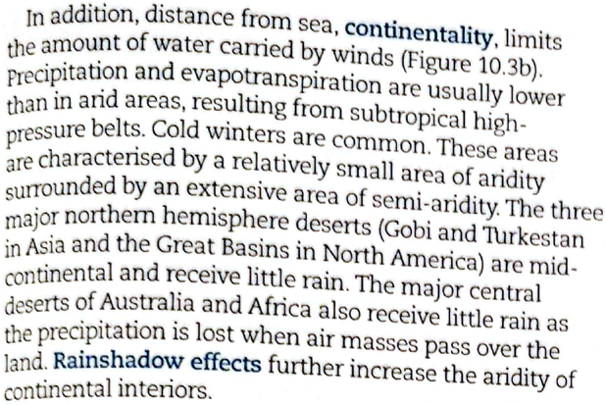
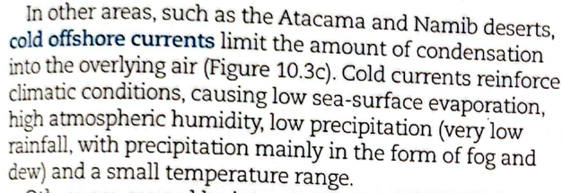
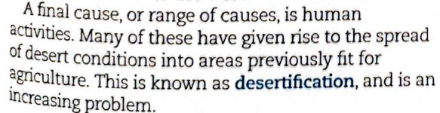
What are the causes of aridity?
Sub-tropical high pressure systems (Global atmospheric circulation & The Hadley Cell)
Rainshadow Effects
Distance from sea/continentality
Descending limb of Hadley cell and related winds which control latitudinal distribution, e.g. Sahara
Rain shadow areas, relate to continental interiors and high mountains, e.g. Andes, Patagonia, Rockies, North America
Human activities
Cold offshore ocean currents
Desertification will be a big part of our studies for this unit! Can learn about it here

Slide 9
Geofile – Causes of aridity in lesson folder!
Study this, and add to your work even further!

Slide 10
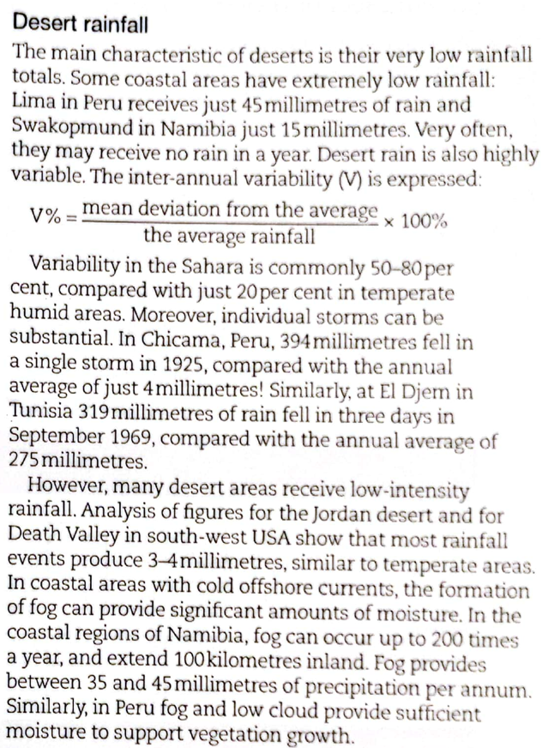
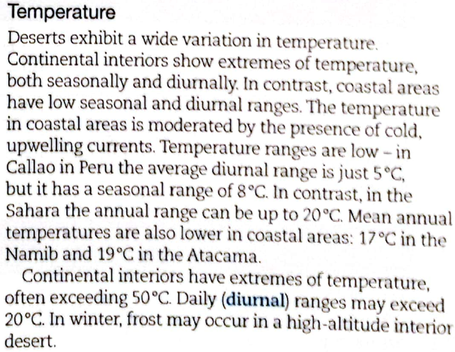
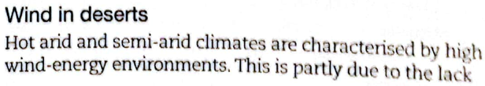

What are the key features of hot arid and semi-arid environments?
What key ‘climatic features’ must we consider when looking at arid environments?
Desert rainfall
Temperature
Wind
It is these 3 features which account for the landforms and landscapes we see in arid areas. We will be studying these later. There are other climatic features of arid environments, many of which are linked to the 3 above:
excessive heat
inadequate, variable precipitation
high diurnal range
lack of seasonality (VARIES…)
rainfall and temperature are the primary factors, but other factors have an influence
rainfall intensity is also relevant
humidity is generally low in arid zones
scarcity of vegetation helps make arid regions very windy
Use the ‘Features of Aridity’ worksheet I created, or make your own notes to discuss all 3.
The resources on this slide will help with this task.
MUSR READ Further Reading - Study this webpage which has information on the characteristics of arid and semi-arid environments.
To what extent is the lack of precipitation the only climatic feature of arid environments? [20]

Slide 11
What are the key features of hot arid and semi-arid environments?
11 To what extent is the lack of precipitation the only climatic feature of arid environments?
Candidates are free to develop their own approach to the question and responses will vary depending on the examples chosen. Whichever approach is chosen, essays which discuss a range of climatic features of aridity, and approach the extent to which a lack of precipitation is the only climatic feature of arid environments and support their argument with relevant examples will be credited. There may be detailed consideration of one or more examples or a case study, or a broadly conceived response, drawing on several examples to show the factors involved.
The focus of the discussion should be on the extent to which the lack of precipitation is the only climatic feature of arid climates. Candidates may discuss the following features of arid climates:
• excessive heat and inadequate, variable precipitation
• high diurnal range
• lack of seasonality
• rainfall and temperature are the primary factors, but other factors have an influence
• rainfall intensity is also relevant
• humidity is generally low in arid zones
• scarcity of vegetation reduces air movements, so arid regions are windy
• geographical features such as coastal deserts
Award marks based on the quality of the response using the marking levels below.
Level 4 16–20 Response thoroughly discusses the climatic features of arid environments and provides a thorough assessment of the relative importance of the lack of precipitation as the main climatic feature. An effective and sustained evaluation with a sound conclusion. Response is well founded in detailed exemplar knowledge and strong conceptual understanding of the topic.
Level 3 11–15 Response discusses the climatic features of arid environments and makes a sound assessment of the relative importance of the lack of precipitation as the main climatic feature. Response is broadly evaluative in character, comprising some explanatory or narrative content and a conclusion. Response develops on a largely secure base of knowledge and understanding with the use of example(s).
Level 2 6–10 Response shows general knowledge and understanding of the climatic features of arid environments. Response is mainly descriptive or explanatory in approach and contains a brief or thinly supported evaluation. Responses without the use of example(s) to support the response will not get above the middle of Level 2 (8 marks).
Level 1 1–5 Response broadly discusses the climatic features of arid environments without a clear focus on the question. A descriptive response comprising a few simple points. Knowledge is basic and understanding may be poor and lack relevance to the question set.
Level 0 0 No creditable response
TASK: All of you work together to write an essay plan for this 20 marker using the writing frame I created.
Ensure you thoroughly use all the information on the previous slide INCLUDING the further reading webpage.
Ensure you are including all the important content in the mark scheme on the right.
Another important consideration: The climatic features of arid environments VARY OVER SPACE!! I.E. The climatic features of a hyper arid environment will be different to an arid environment, which will be different to a semi-arid environment. You should be illustrating your awareness of these differences in your essay/essay plan, as it’s excellent evaluation.
You must work together to research examples & statistics to back up the points you are making in your plan and include these in your plan e.g. For lack of seasonality – prove that it is a climatic feature of arid environments by finding a real example of a hot desert which has a lack of seasonality (i.e. low temperature range all year round and similar precipitation levels on a monthly basis). Then, include these figures/data for this desert. Follow this kind of process for all the points you make!
There are 4 of you working on this – your plan must be detailed & thorough, like the one’s I’ve made for you previously.

Slide 12
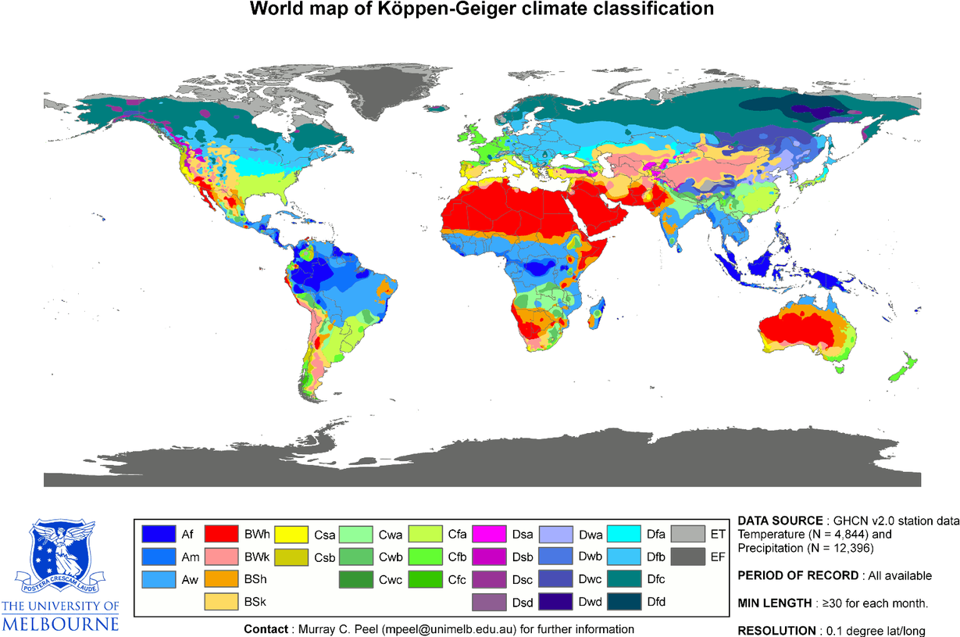
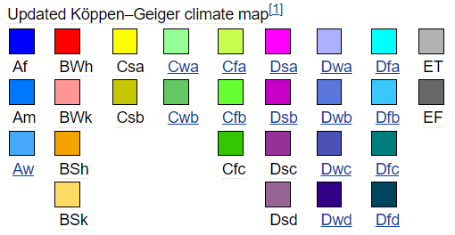
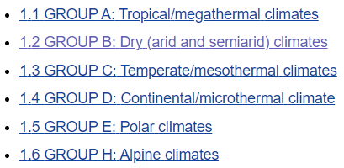
What are the classifications of desert climates?
Hot desert climates (BWh)
Semi-arid outer tropical climate (BSh)
Semi-arid: Poleward of hot deserts (BSk)
These are the different climate groupings. We are concerned with group B for this unit. Even though ‘BWk’ is in our grouping, it doesn’t concern us. Why?
What are those letters in brackets?
The Köppen climate classification is one of the most widely used climate classification systems. It was first published by Crimea German climatologist Wladimir Köppen in 1884, with several later modifications by Köppen himself, notably in 1918 and 1936. Later, German climatologist Rudolf Geiger collaborated with Köppen on changes to the classification system, which is thus sometimes referred to as the Köppen–Geiger climate classification system.
The system is based on the concept that native vegetation is the best expression of climate. Thus, climate zone boundaries have been selected with vegetation distribution in mind. It combines average annual and monthly temperatures and precipitation, and the seasonality of precipitation. Extend your learning by accessing this link and this video.

Slide 13
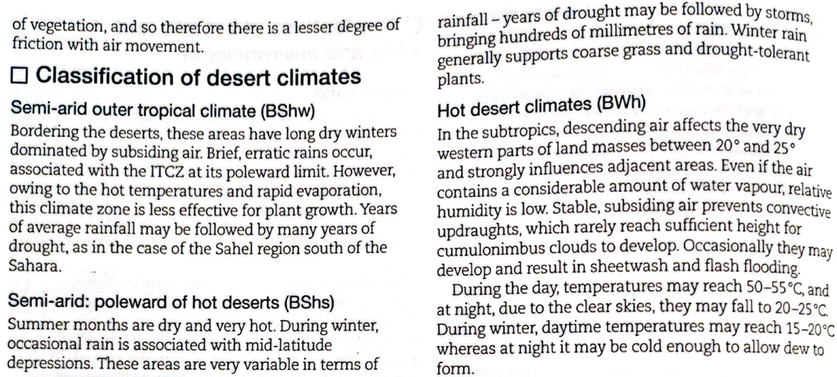

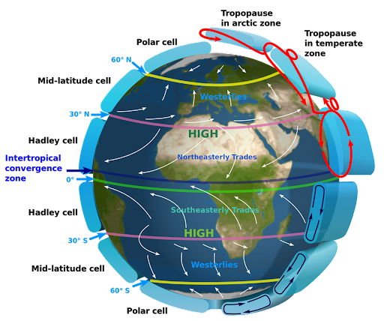
What are the classifications of hot desert climates?
Semi-arid outer tropical climate (BSh)
Semi-arid: Poleward of hot deserts (BSk)
Hot desert climates (BWh)
BSh
BSk
You learned about the ITCZ last year. What do you remember?
Check out this link for a brief overview, and this link for comprehensive information & this video too! Or, see the ‘Atmospheric Transfers’ lesson from Year 12.
TASK: Use the textbook extracts on this slide to take notes on the 3 types of hot desert climates.

Slide 14
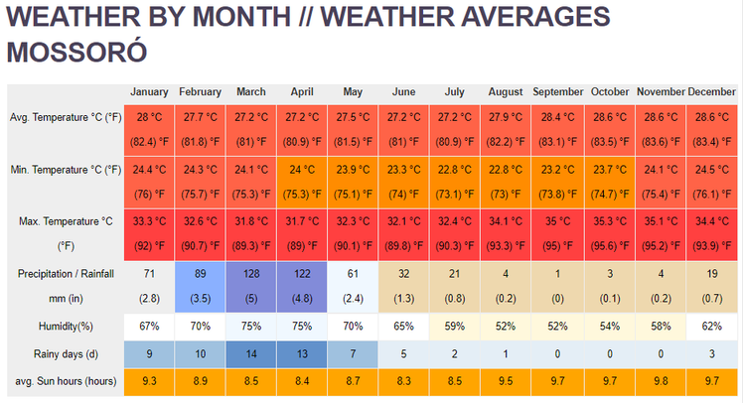
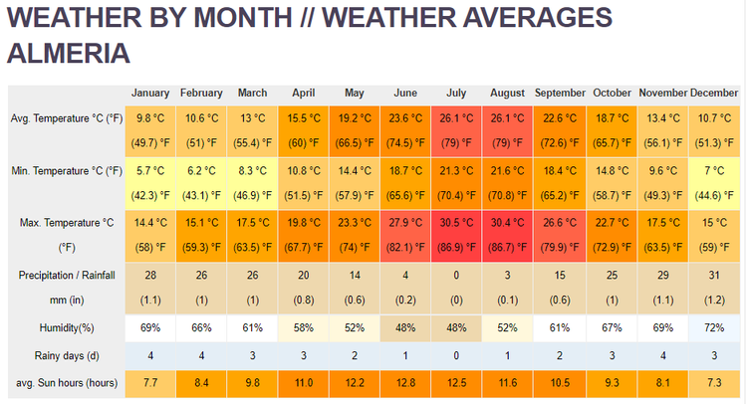
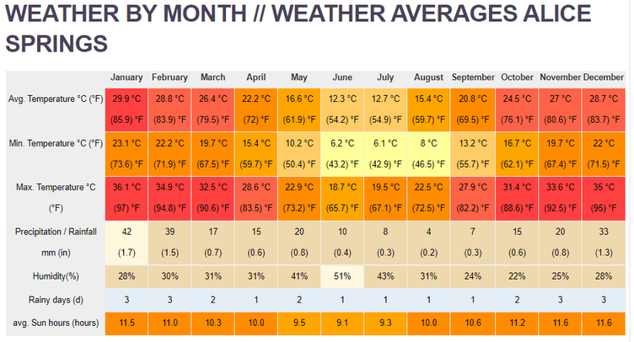
What are the classifications of hot desert climates?
Semi-arid: Poleward of hot deserts (BSk)
Hot desert climates (BWh)
Semi-arid outer tropical climate (BSh)
TASK: Study the climate data on the left. Which ones apply to each classification on the left?
Ext Task: Compare the climate data for the 3 areas.
Ext Task: Suggest reasons for the differences you have identified.
IMPORTANT: The climate of any single place is influenced by many local factors also (microclimates). So, these various ‘zones’ are not always set in stone e.g. Some parts of the Mediterranean have a BSh (semi-arid outer tropical) climate as opposed to their usual BSk).

Slide 15
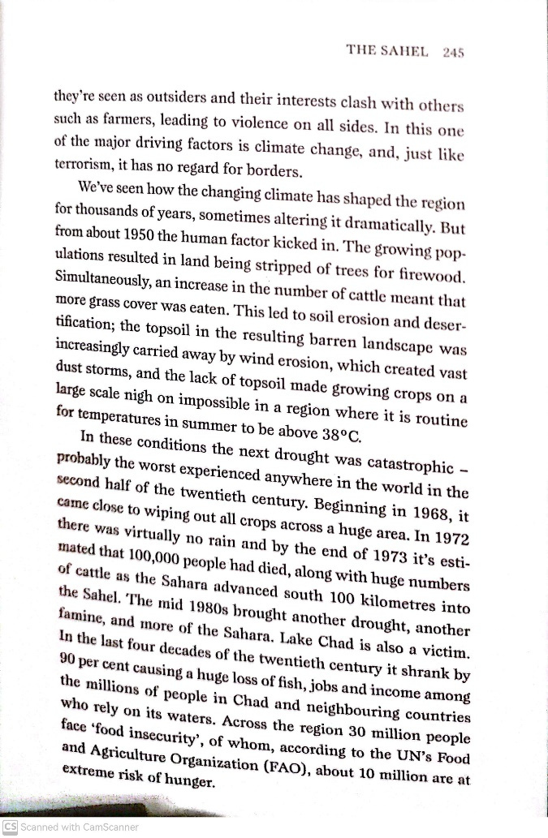
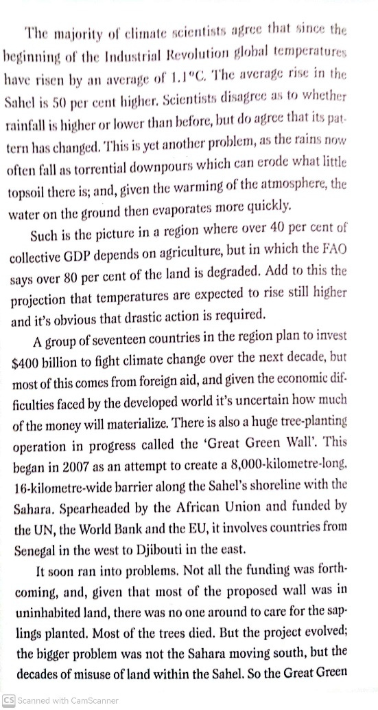
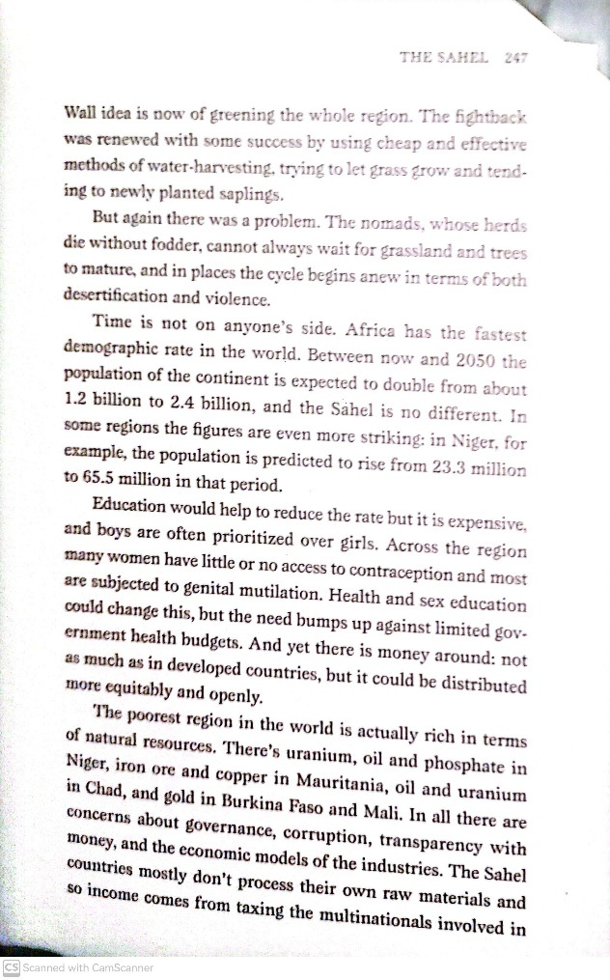
Extract from ‘The Power of Geography’ Book – Desertification in the Sahara (The Sahel)
So many links in this extract to what we have been studying in geography for the past 2 years!
I have recommend you to read this book before – it’s a must read for geographers!

Slide 16
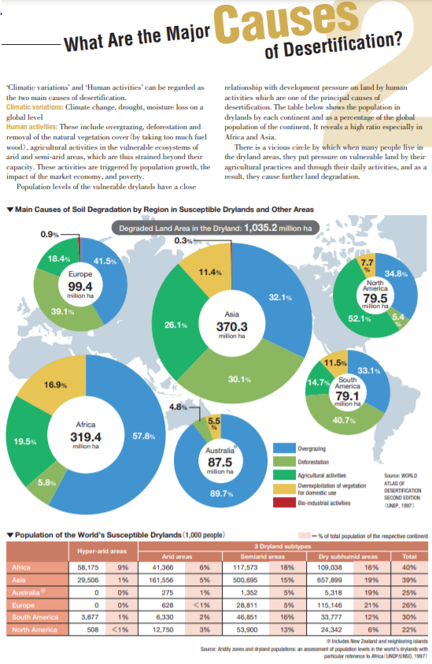
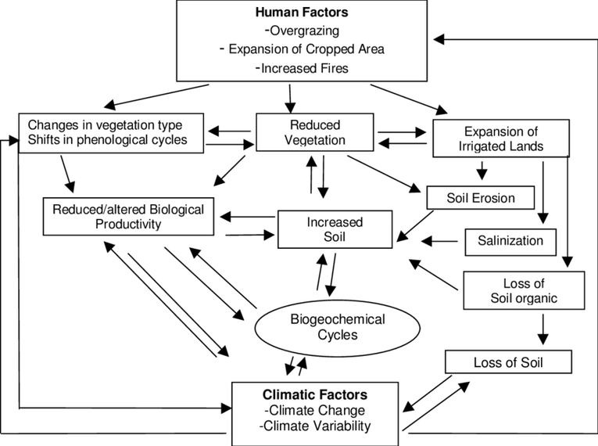
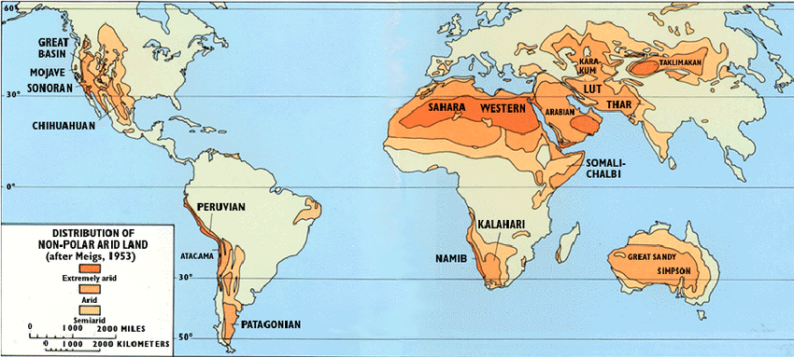
More resources!
Characteristics of hot deserts
Introduction to Hot Desert Environments & Their Margins (Not a fully comprehensive video as it doesn't fully explain where deserts are found and why they are found where they are)

Slide 17
Task for reminder of lesson – Geofile in lesson folder – causes of aridity
TASK: Study the Geofile, and then answer the questions at the end in detail. For Q3, you can draw your own very rough world map using the one below as a guide.

