Slide 1

Production, Location & Change
From Cambridge…
This topic considers agricultural systems and how agricultural change is managed. It also considers manufacturing and how the change in this industry is managed.

Slide 2
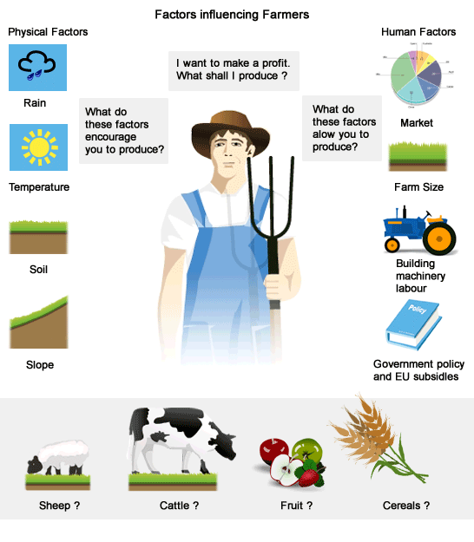
Title: Factors affecting agricultural land-use and practices
What is agriculture?
Agriculture is the practice of farming.
What are the different types of agriculture?
The main types are commercial/subsistence, arable/pastoral/mixed, and intensive/extensive.
TASK: Imagine you are a farmer. What factors will influence the land-use and practices on your farm? Create a list of at least 6 factors.
How can you categorise these factors?
A wide range of factors combine to influence agricultural land use and practices on farms. These can be placed under the general headings of physical or human (economic, political and social/cultural) factors.
TASK: Go through the textbook extracts in the lesson folder & familiarise yourself on the various factors which affect agricultural land use and practices. 2 lessons.
Feel free to use the template I created in the lesson folder (called ‘Factors – Worksheet), or take your own notes. Finished? Complete the 4 extension questions at the end of the worksheet.
‘Physical factors affect agricultural land use and practices on farms more than economic factors.’ How far do you agree? [20]

Slide 3
Title: Factors affecting agricultural land-use and practices
There are some geofiles in this lesson folder linked to this topic:
Geofile - Managing future global food supplies.
Geofile - The Geopolitics of Food.
Geofile - The Globalisation of Food Production.
To extend your learning, check them out & see what content you can extract that may be useful to your studies.
20 marker
‘Physical factors affect agricultural land use and practices on farms more than economic factors.’ How far do you agree? [20]

