Slide 1
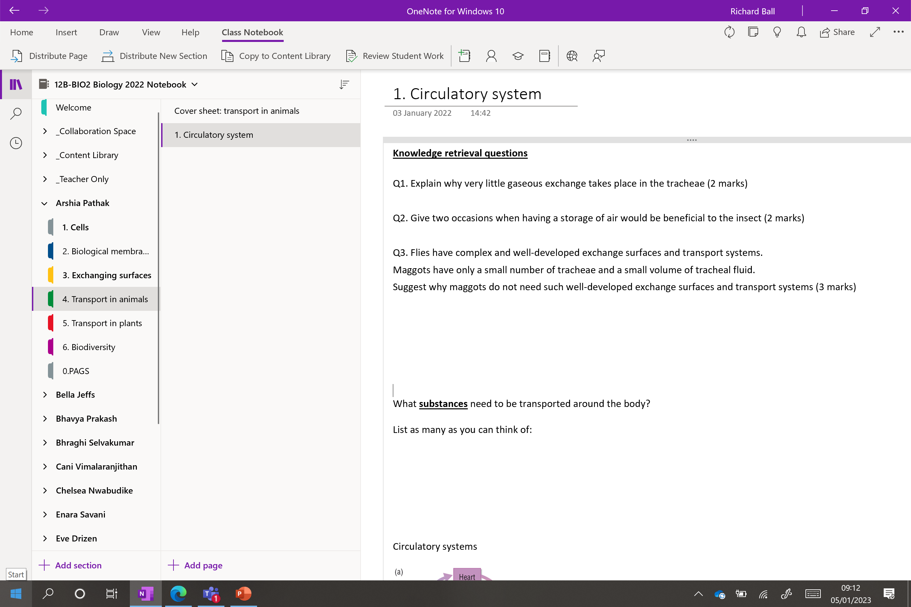

Slide 2
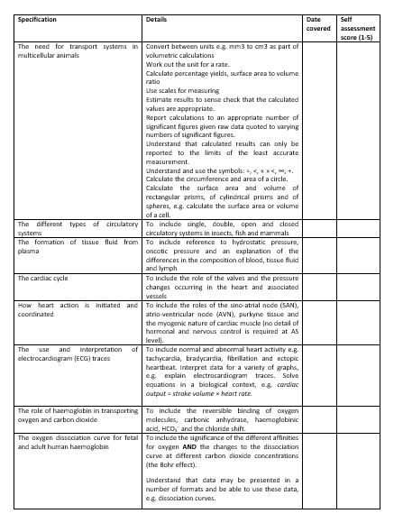
Learning Outcomes
Explain the need for transport systems in multicellular animals in terms of size, level of activity and surface area to volume ratio.
Explain the meaning of the terms ‘single circulatory system’ and ‘double circulatory system’ with reference to the circulatory systems of fish and mammals.
Explain the meaning of the terms ‘closed circulatory system’ and ‘open circulatory system’, with reference to the circulatory systems of fish and insects.

Slide 3
What substances need to be transported around the body?
3 or less – you need to think much harder
4 – ok
5 – good work
6 – excellent
7 or more – you are a biological super star!!
Write them down - 2 minutes. Go!
O_{2(g)}
C₆H₁₂O_{6(aq)}
H₂O_{(l)}
CO_{2(g)}
Urea
Waste products
Hormones
ATP
Antibodies
Antitoxins
HCO₃⁻_{(aq)} (carbonic acid - buffer)

Slide 4
Remind the person next to you!
Why do multicellular organisms need a transport system?
They have a low surface area to volume ratio
Diffusion distance is too great
They are very metabolically active, they need to supply reactants for respiration and remove waste products
They need a good supply of nutrients
Do all organisms have the same circulatory systems?

Slide 5
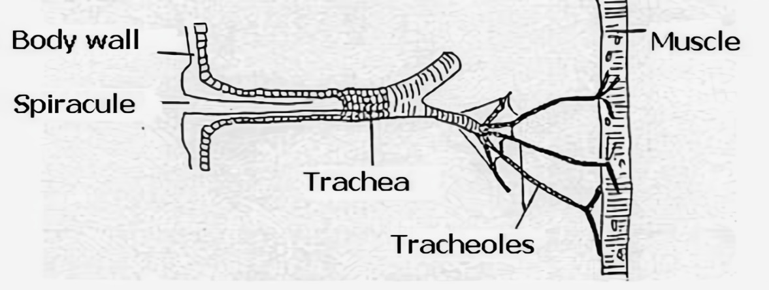
Knowledge retrieval questions Transport in animals
Q1. Explain why very little gaseous exchange takes place in the tracheae (2 marks)
Q2. Give two occasions when having a storage of air would be beneficial to the insect (2 marks)​
(tracheae) Lined with chitin
Chitin is impermeable to gases
The air sacs are also used when the insect has a high energy demand (flying).
Keeping its spiracles closed in a dry environment and use the oxygen it has stored inside. Reduce water loss.​
Q3. Flies have complex and well-developed exchange surfaces and transport systems.
Maggots have only a small number of tracheae and a small volume of tracheal fluid.
Suggest why maggots do not need such well-developed exchange surfaces and transport systems (3 marks)
maggots are smaller so have greater surface area to volume ratio (than adult flies)
There is a shorter diffusion distance
maggots are less active so lower metabolic demand for O₂
no (hard) exoskeleton so can absorb oxygen by diffusion through, skin / cuticle

Slide 6
Circulatory systems
Closed
Double
Single
Open

Slide 7
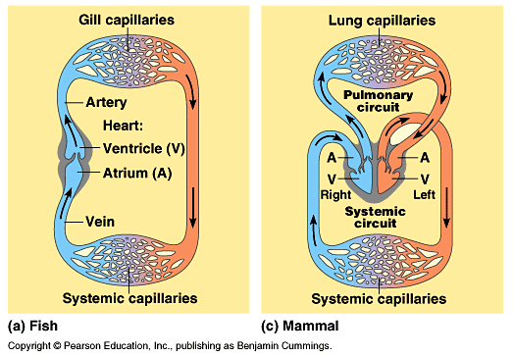
Notes:
Systemic – Left – High
Pulmonary – Right – Low
HINT COLOURS

Slide 8
What's the difference?
Pulmonary system
Systemic system
Notes:
Systemic – Left – High
Pulmonary – Right – Low
HINT COLOURS

Slide 9
Notes:
Systemic – Left – High
Pulmonary – Right – Low
HINT COLOURS

Slide 10
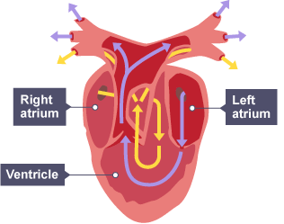
Notes:
Systemic – Left – High
Pulmonary – Right – Low
HINT COLOURS

Slide 11
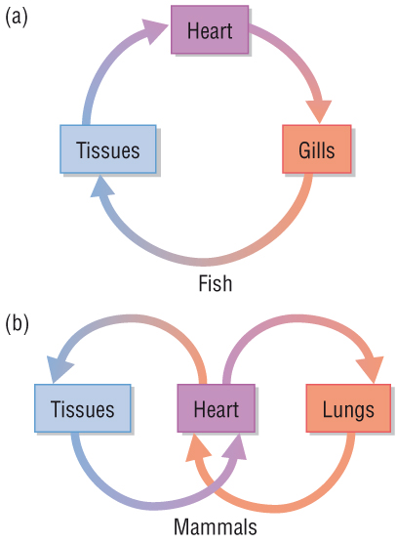
(a) Single circulation and (b) double circulation
Different organisms can have different circulatory systems:
(a) In a single system, blood can only pass through the heart once for each complete circuit of the body.
e.g. fish
(b) In a double system, the blood passes through the heart twice for each complete circuit of the body.
e.g. mammals

Slide 12
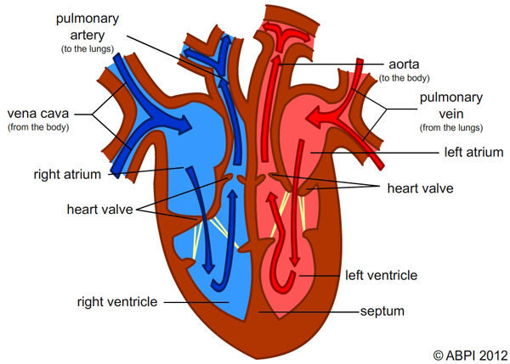
Double circulation
Why is the human heart considered a double pump?
Mammalian heart is divided down the middle (two hearts in one).
Right side = pumps deoxygenated blood to the lungs to receive oxygen (pulmonary system).
Left side = pumps oxygenated blood to the rest of the body (systemic system).

Slide 13
DISCUSS
What type of blood pressure (High or low) do we have on the left side of the heart, explain why?
Why is it important to have low blood pressure on the right side of the heart?
Why have mammals evolved to have a double circulatory system?
Hint: Where is blood going?
Notes:
Systemic – Left – High
Pulmonary – Right - Low

Slide 14
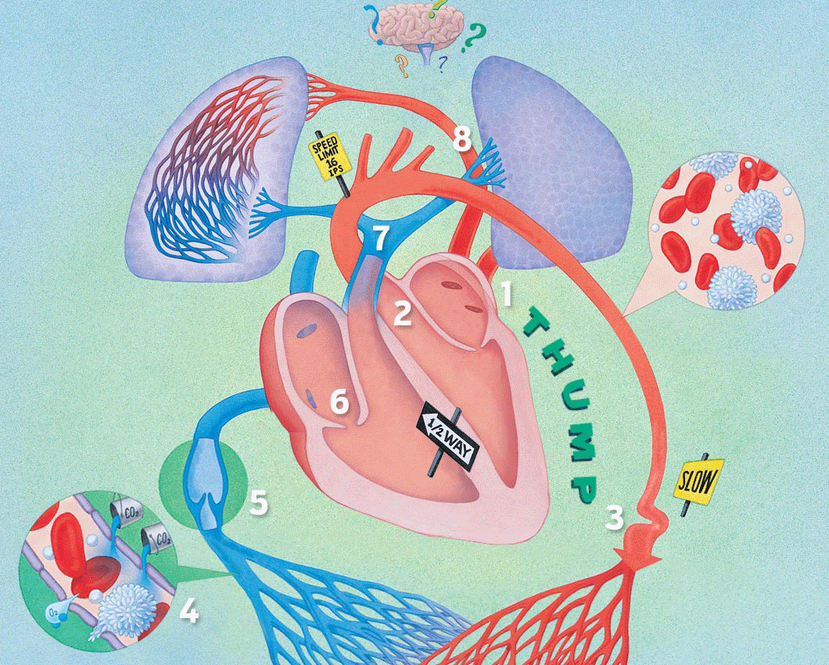

Slide 15
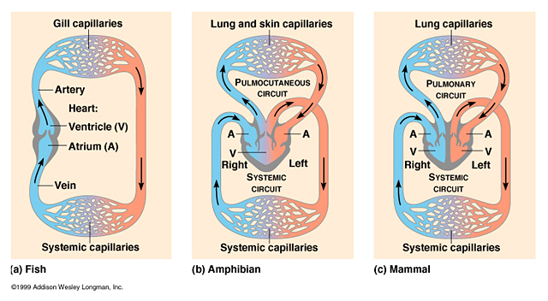
What is the advantage of having a double circulatory system?
Blood pressure must not be too high for the blood entering the lungs, otherwise it can …………... capillaries. However, blood needs to be pumped at high enough ………….. to get to all parts of the body, especially for a highly ………………….. active organism such as a mammal. A …………. circulatory system means pulmonary pressure can be low, whilst separate …………… pressure can be high, in order to pump blood at higher pressure around the body to the ………….. cells.

Slide 16
What is the advantage of having a double circulatory system?
Blood pressure must not be too high for the blood entering the lungs, otherwise it can damage capillaries. However, blood needs to be pumped at high enough pressure to get to all parts of the body, especially for a highly metabolically active organism such as a mammal. A double circulatory system means pulmonary pressure can be low, whilst separate systemic pressure can be high, in order to pump blood at higher pressure around the body to the respiring cells.

Slide 17
Closed circulatory system

Slide 18
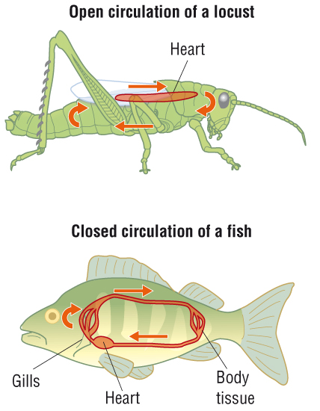
Blood is enclosed inside blood vessels
O_{2(g)} diffuses into blood from gills
O_{2(g)} and glucose can diffuse from blood into cells via the tissue fluid. But the blood remains in the vessels.
Heart pumps blood into arteries, veins and then to the capillaries

Slide 19
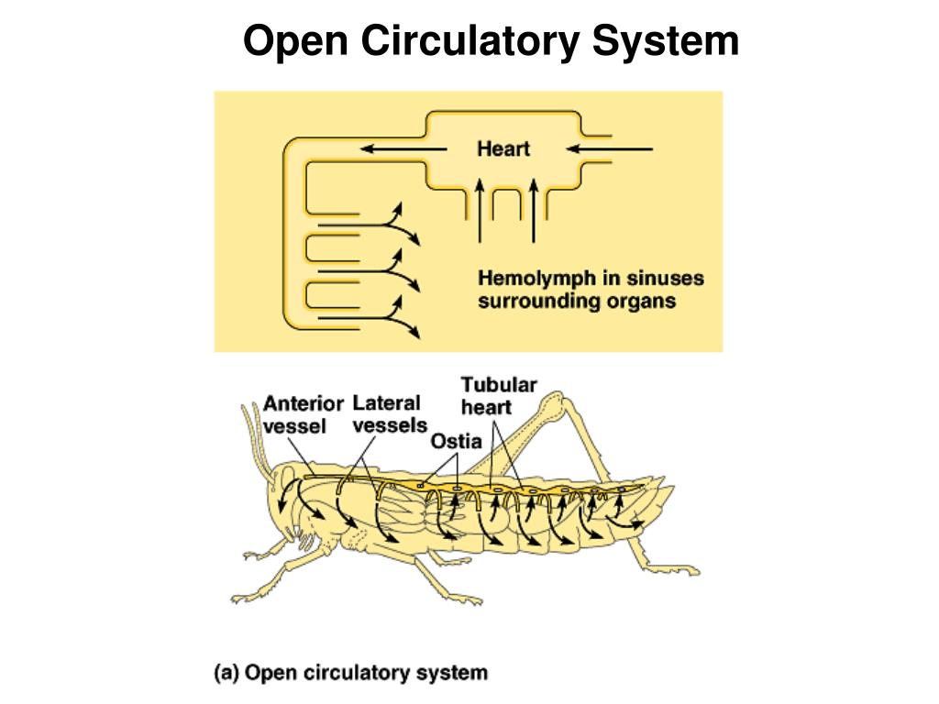

Slide 20
Types of circulatory systems
*Haemolymph – “insect blood” (only transports food, nitrogenous waste and immune cells
*Sinus – hollow cavity
Blood flows freely through the body cavity.
Body movement can help move blood around

Slide 21
How does it work?
The heart is segmented, contracting in a wave, starting at the back.
Blood flows around insect’s organs and back to heart via valves.
Blood pumped into a single main artery, which opens up into body cavity.
The open system supplies cells with nutrients and transports substances. But not oxygen! This is by done by the tracheal system.

Slide 22
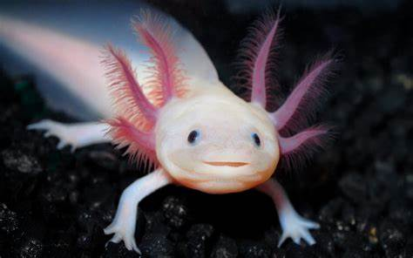

Slide 23
Amphibians
Have a three-chamber heart
Mixing of oxygenated and deoxygenated blood is kept to a minimum due to the timing of contractions
Able to compensate for lack of efficiency by diffusing oxygen through their moist skin

Slide 24
Names of some of the main blood vessels of the mammalian circulation
vessel | name
A
B
C
D
E
F
G
Name the two large arrows!
B
A
C: H........ A...........
D: H…….. V…………
E: H…….. P……….. V…….
F: R……… a………….
G: R……… v………….
D
C
E
G
F

Slide 25
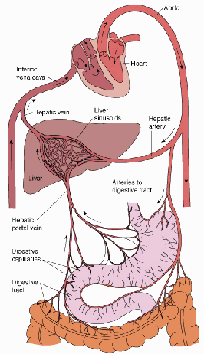
Names of some of the main blood vessels of the mammalian circulation
vessel | name
A | vena cava
B | aorta
C | hepatic artery
D | Hepatic vein
E | hepatic portal vein
F | renal artery
G | renal vein
Name the two large arrows!
hepatic artery
carries blood from
the aorta to the liver
Pulmonary artery
Pulmonary vein
B
A
C: H........ A...........
D: H…….. V…………
E: H…….. P……….. V…….
F: R……… a………….
G: R……… v………….
hepatic vein carries
blood from the liver
to the vena cava
D
C
E
hepatic portal vein
carries blood containing
digested food from the
intestines to the liver
G
F

Slide 26
Names of some of the main blood vessels of the mammalian circulation
vessel | name
A | vena cava
B | aorta
C | hepatic artery
D | Hepatic vein
E | hepatic portal vein
F | renal artery
G | renal vein
Name the two large arrows!
hepatic artery
carries blood from
the aorta to the liver
Pulmonary artery
Pulmonary vein
B
A
C: H........ A...........
D: H…….. V…………
E: H…….. P……….. V…….
F: R……… a………….
G: R……… v………….
hepatic vein carries
blood from the liver
to the vena cava
D
C
E
hepatic portal vein
carries blood containing
digested food from the
intestines to the liver
G
F

Slide 27
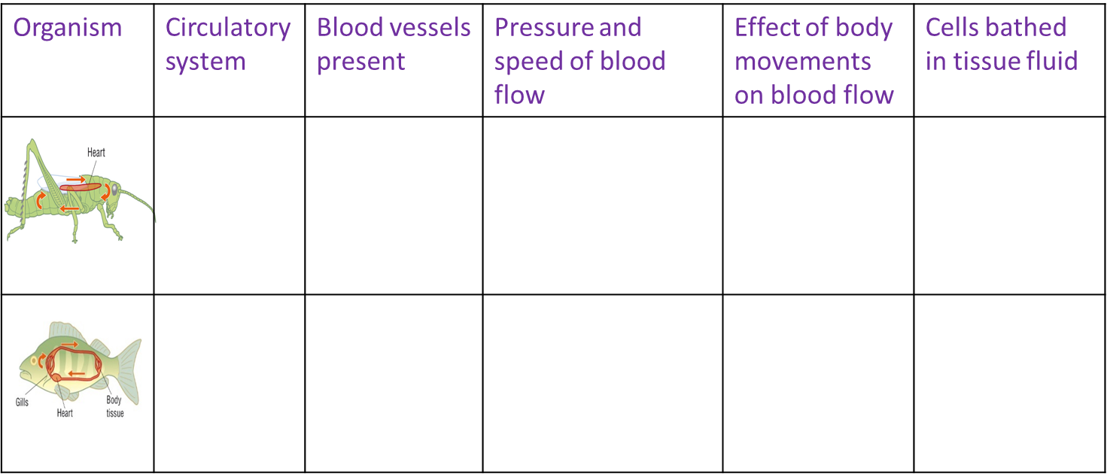
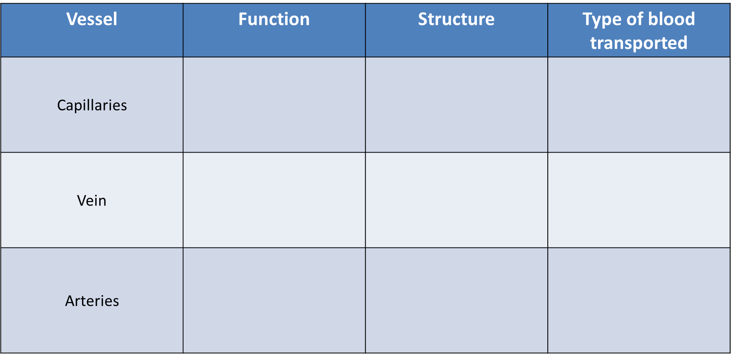

Slide 28
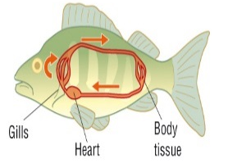
Organism | Circulatory system | Blood vessels present | Pressure and speed of blood flow | Effect of body movements on blood flow | Cells bathed in tissue fluid
 | Open | One main artery which opens in body cavity | Lower pressure ‘blood’ flow slow | Transport of blood can be affected by body movements | No
 | Closed | Many arteries, veins and capillaries | Higher pressure Blood flow fast | Transport of blood independent of body movements | Yes

Slide 29
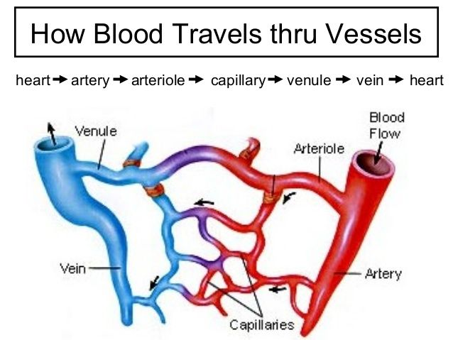
Use the table to compare and contrast the structure and function of the different types of blood vessels (arteries, arterioles, capillaries, venules, veins)
Information to include:
Direction of blood flow
Whether blood carried is oxygenated or deoxygenated
Pressure differences between the vessels
Structural differences
Function of each vessel
RECAP TASK!
NEXT LESSON WE LOOK AT THE VESSELS IN MORE DETAIL

Slide 30
Vessel | Function | Structure | Type of blood transported
Capillaries
Vein
Arteries

Slide 31
Vessel | Function | Structure | Type of blood transported
Capillaries | To supply tissues with components of, and carried by, the blood, and also to remove waste from the surrounding cells - as opposed to simply moving the blood around the body, in the case of other blood vessels. The exchange of oxygen, carbon dioxide, water, salts, etc., between the blood and the surrounding body tissues. | Tiny (extremely narrow) blood vessels. Capillary walls are only one cell thick, which permits exchanges of material between the contents of the capillary and the surrounding tissue. | Both
Vein | Transport blood towards the heart | Have relatively wide lumens Have valves throughout the main veins of the body. These are to prevent blood flowing in the wrong direction, as this could (in theory) return waste materials to the tissues. | Carry de-oxygenated blood *except - pulmonary vein
Arteries | Arteries carry the blood away from the heart to respiring tissues at high pressure | Have relatively narrow lumens Transports blood under higher pressure than veins Do not have valves - except for the semi-lunar valves of the pulmonary artery and the aorta | Oxygenated *exception – pulmonary artery

Slide 32
This is the answer, what is the question?
Because blood is enclosed inside blood vessels
Why is a mammals circulatory system described as being closed?
This is the answer, what is the question?
Mammals
Name a group of animals that has a double circulatory system.

Slide 33
This is the answer, what is the question?
Multicellular organisms are relatively big, with a low surface area/volume ratio. They are also very active and so need a constant, rapid supply of glucose and oxygen.
Give two reasons why multicellular organisms need transport systems.
This is the answer, what is the question?
Because blood only passes through the heart once for a complete circuit of the body
Why is a fish’s circulatory system described as being single?

Slide 34
This is the answer, what is the question?
Because the blood is not enclosed inside blood vessels all of the time. Instead it flows freely through the body cavity.
Explain why the insect circulatory system is described as an open circulatory system.
This is the answer, what is the question?
The heart is divided down the middle, with the right side of the heart pumping blood to the lungs to pick up oxygen and the left side of the heart pumping blood to the rest of the body.
Briefly describe how the double circulatory system works.

Slide 35

EVERYONE HAS A BUZZER!

Slide 36
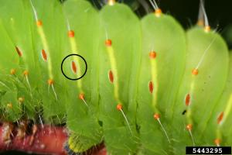
Spiracle

Slide 37
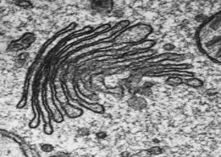
Golgi apparatus

Slide 38
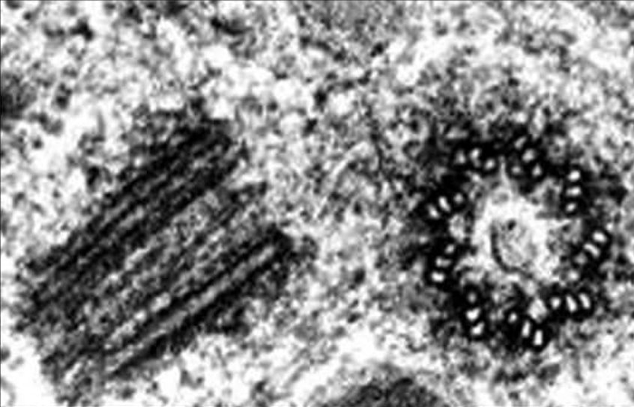
Centrioles

Slide 39
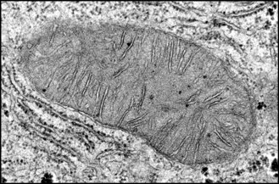
Mitochondria

Slide 40
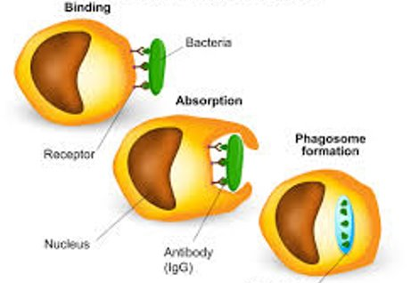
Phagocytosis / phagocyte

Slide 41
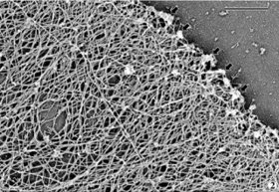
Cytoskeleton

Slide 42
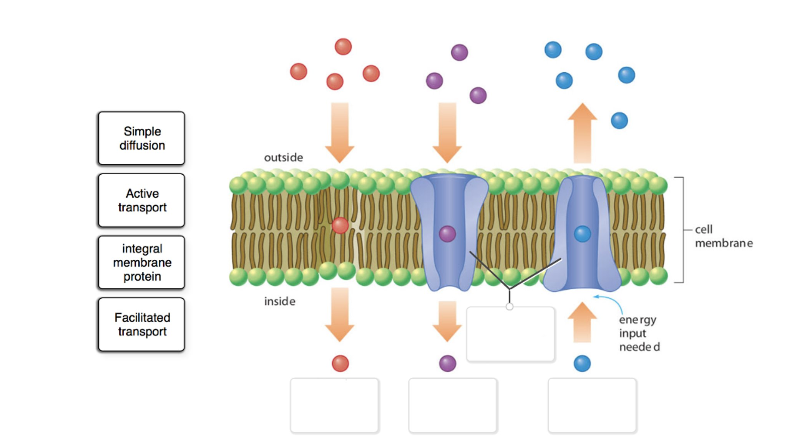
Active transport

Slide 43
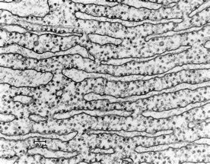
Rough endoplasmic reticulum

Slide 44
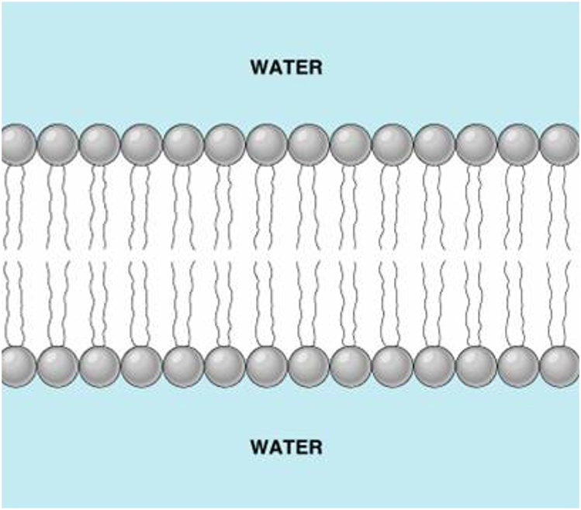
Phospholipid bilayer

Slide 45
Additional questions

