Slide 1
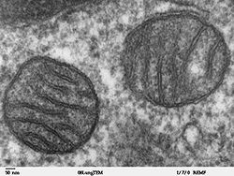
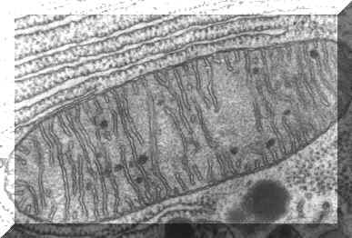
Name the organelle

Slide 2
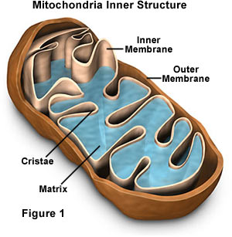
Now draw a diagram and label it
Inter membrane
space

Slide 3
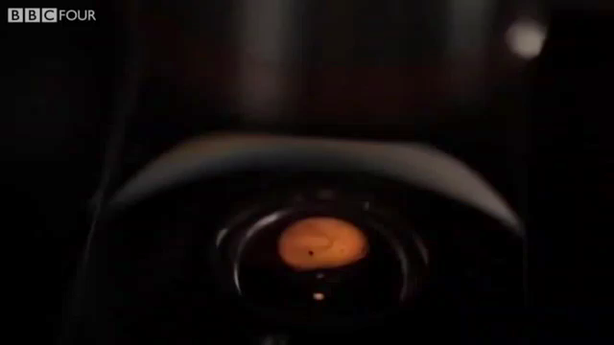

Slide 4
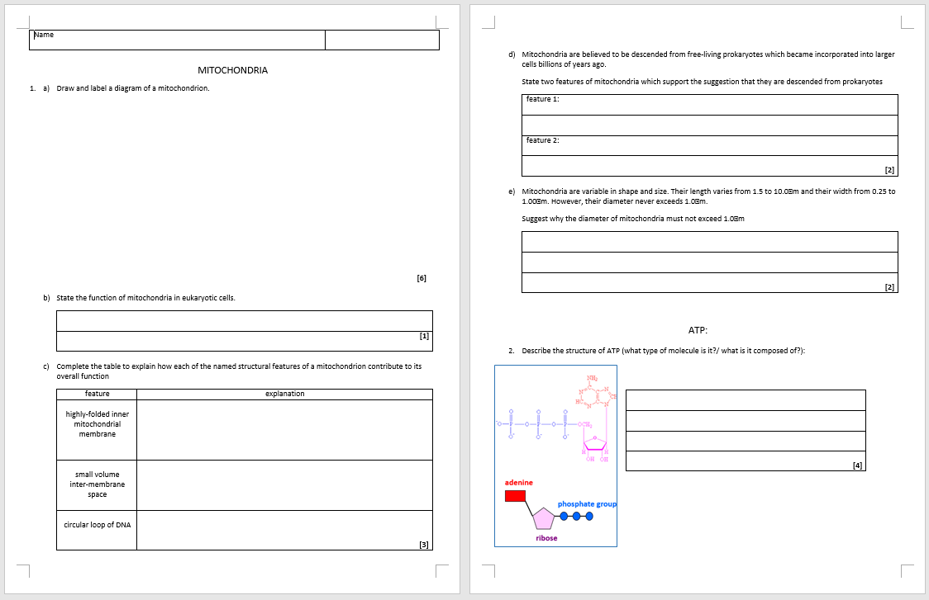
Now complete questions 1b to 1e on the worksheet

Slide 5
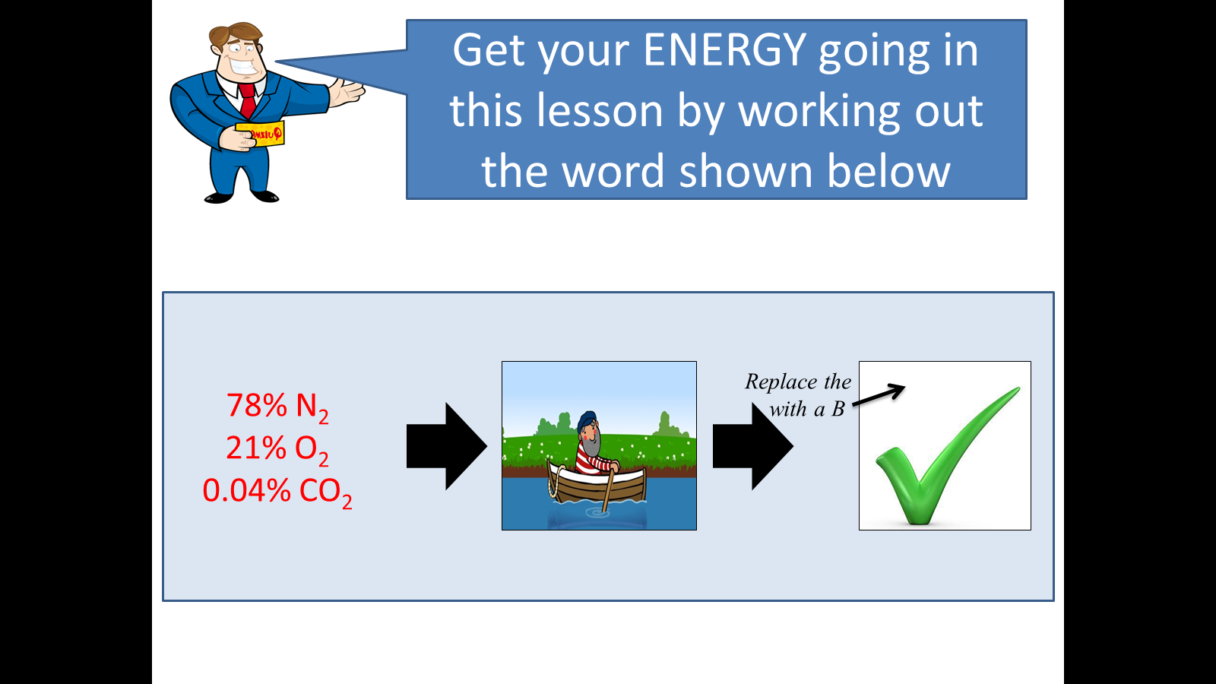
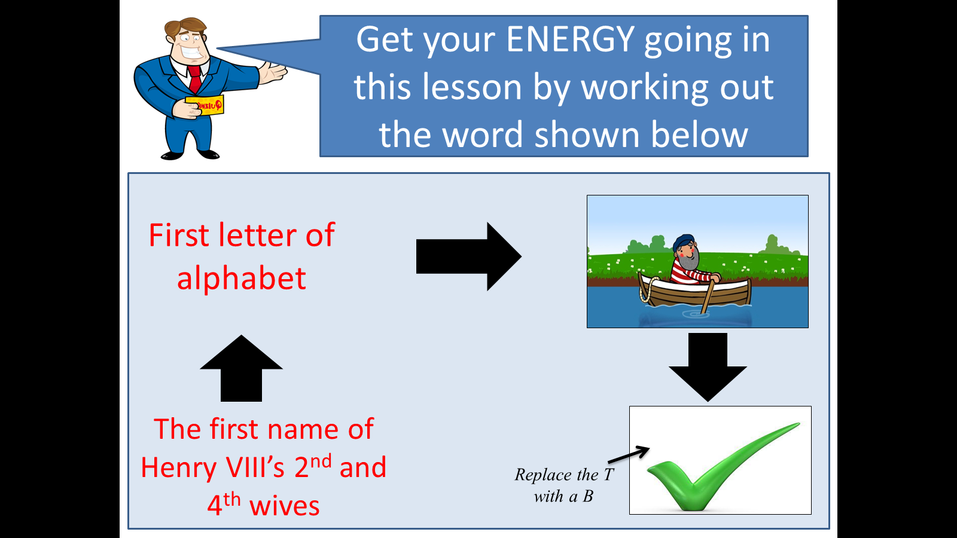
1. Get your ENERGY going in this lesson by working out the two words shown below
2. Write a detailed definition for the process that connects both these words

Slide 6
Self-Assess:
Respiration is the metabolic process that occurs in the living cells of all organisms and releases the energy stored in organic molecules such as glucose.
At A-level, we need to know that this released energy is used to synthesise ATP

Slide 7
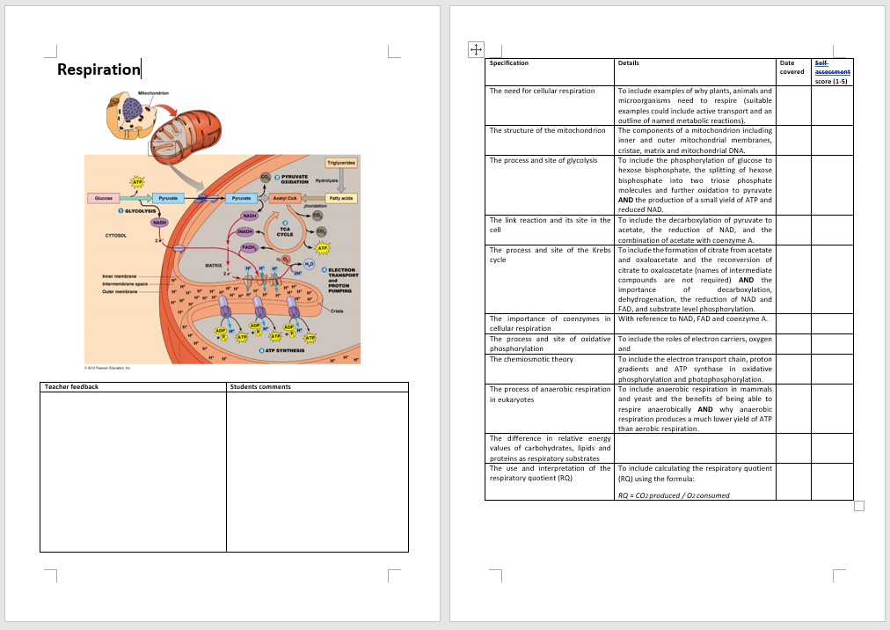
Respiration

Slide 8
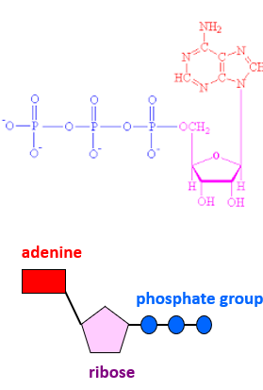
ATP
Describe the structure of ATP (what type of molecule is it?/ what is it composed of?):
ATP = adenosine tri-phosphate
It is a nucleotide made up of:
the nitrogenous base adenine
the pentose sugar ribose
3 phosphates
Extra info:
Adenosine is a nucleoside. It is a purine bonded to a ribose.
Adenine is a nucleotide.

Slide 9
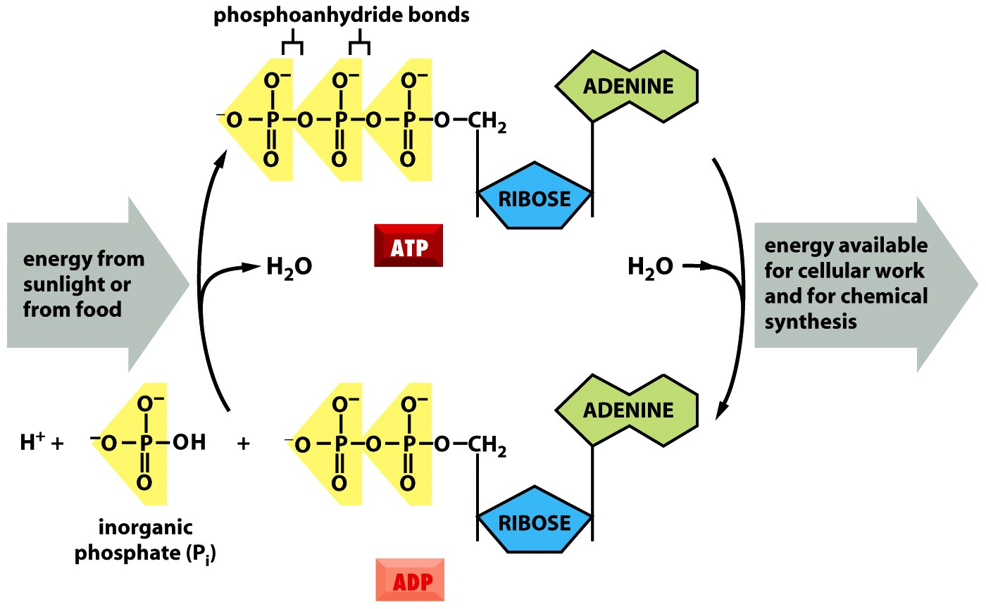
ATP is synthesised by adding a phosphate group (P_{i} = inorganic phosphate) to ADP
This reaction is thermodynamically unfavourable (requires energy), so ATP is synthesised using the energy released from respiration or that absorbed from sunlight by plants
The third/terminal phosphate bond is a high energy bond
This ‘captured’ energy is released when ATP is hydrolysed to ADP and Pi
Breaking of this bond can be coupled to other energy-requiring processes in the cell

Slide 10

ATP: The universal energy currency of cells
- Found in almost all living cells
- Synthesised where energy is captured (sunlight)/ released (respiration)
- A small molecule that can easily be moved around the cell
- Hydrolysed to release energy where it is needed
- Hydrolysed to release small quantities of energy (enough to be useful but not to cause cellular damage – hydrolysis of ATP releases 30.6kJmol⁻¹)
I went shopping ...

Slide 11
Cellular processes that require energy:
synthesis of macromolecules (proteins, carbohydrates, nucleic acids, fats)
growth/ cell division
active transport
generation of nerve impulses/ muscle contraction

