Slide 1
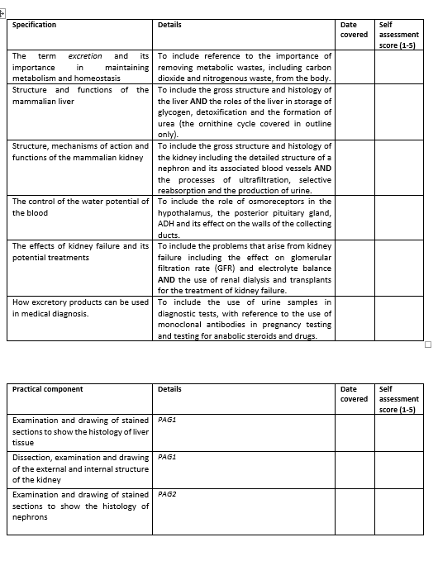
Learning Outcomes
The effects of kidney failure and its potential treatments.

Slide 2
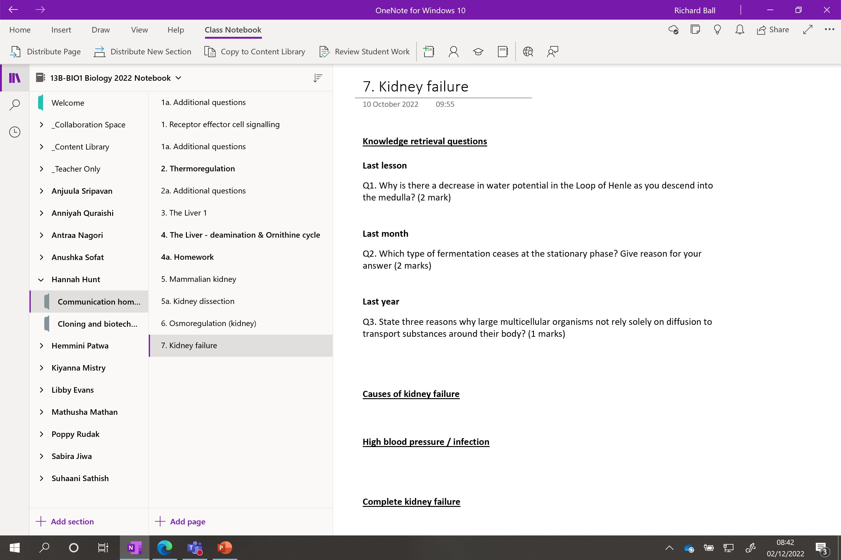

Slide 3
Kidney Failure

Slide 4
Knowledge retrieval questions
Last lesson
Q1. Why is there a decrease in water potential in the Loop of Henle as you descend into the medulla? (2 mark)
Descending limb is permeable to water
Water removed from descending limb via osmosis
Last month
Q2. Which type of fermentation ceases at the stationary phase? Give reason for your answer (2 marks)
Batch
Process is stopped before death phase and harvested
Last year
Q3. State three reasons why large multicellular organisms cannot rely solely on diffusion to transport substances around their body? (3 marks)
Multicellular organisms have many layers of cells so there is a large diffusion distance. ​
Large multicellular organisms have a small surface area to volume ratio ​
Cells in the centre of the organism would not receive any materials or receive them too slowly to meet demand​
Some large organisms have a high metabolic rate – diffusion insufficient to meet demand

Slide 5
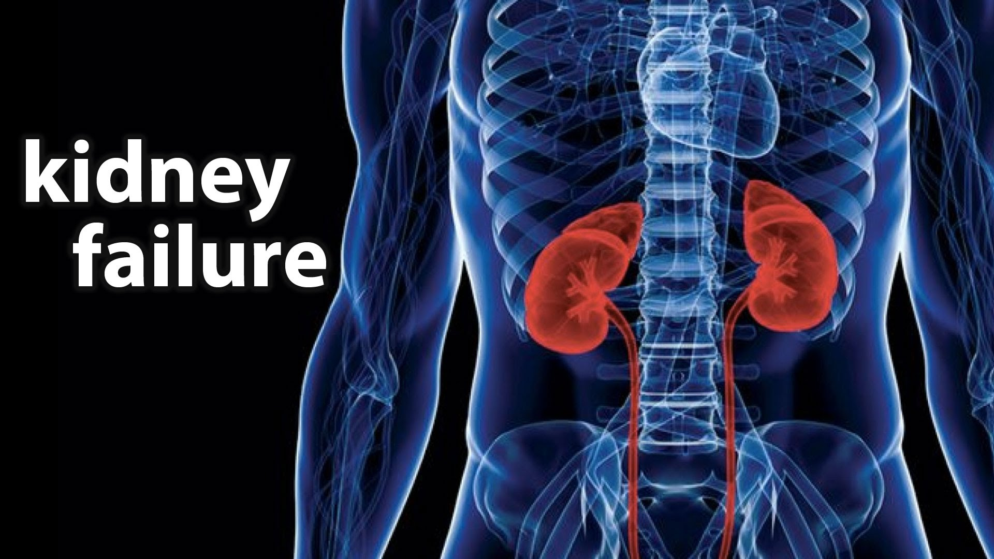

Slide 6
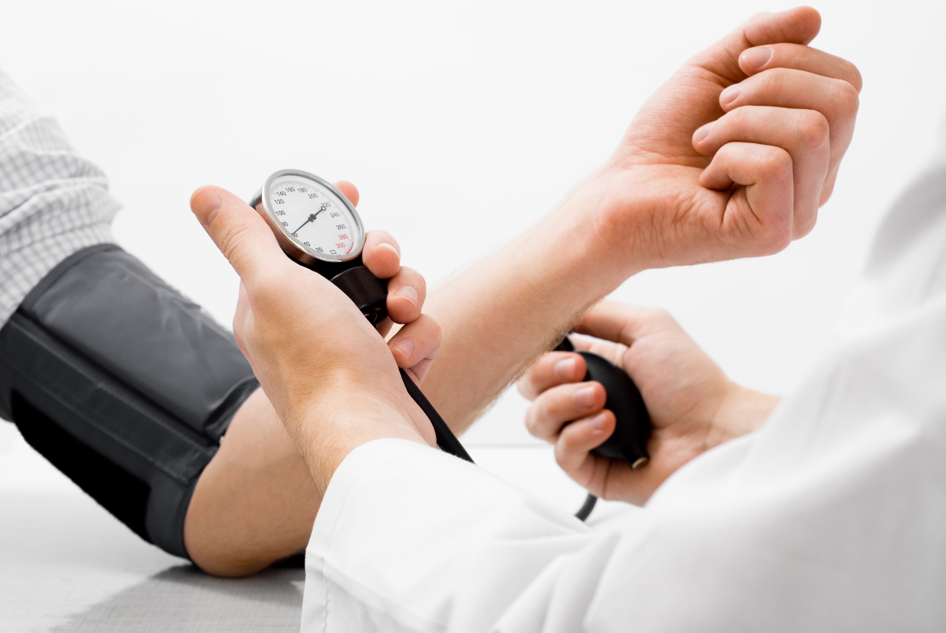
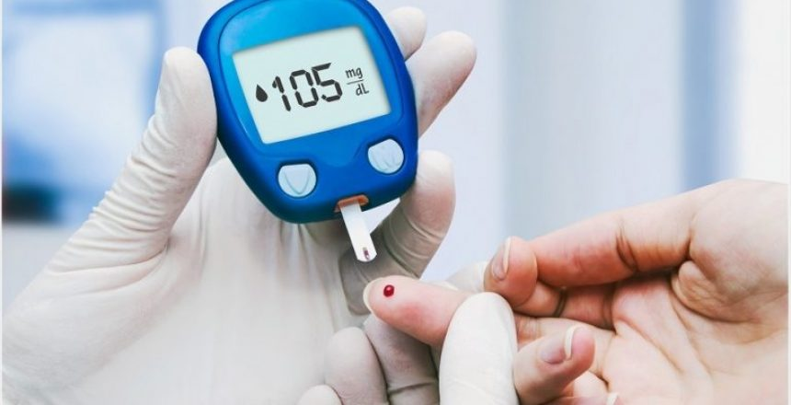
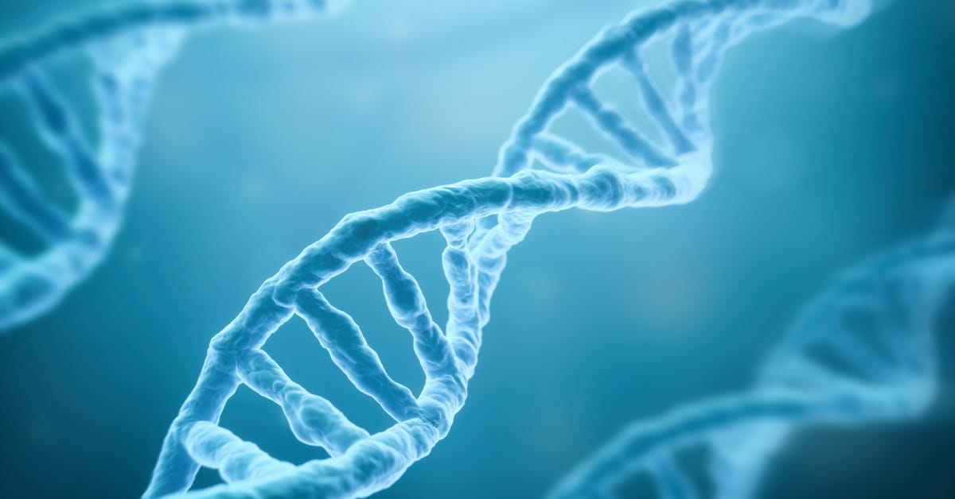
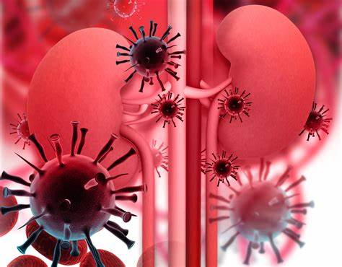

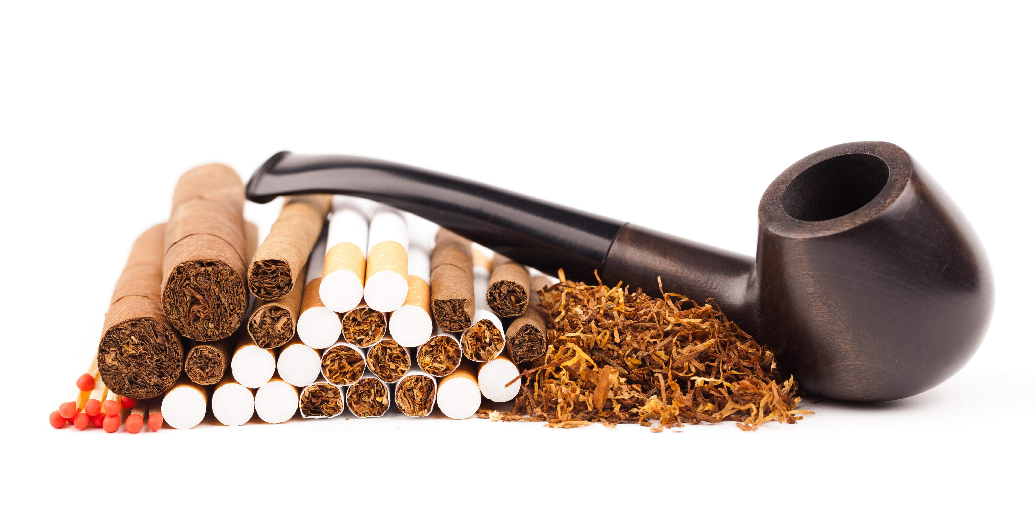
Causes of kidney failure
Use the images to make your list
Notes:
Diet. A high protein, high salt diet makes kidney stones more likely. Men tend to have a greater intake of both.
Dehydration. Men tend to drink less water than the recommended daily intake — about 64 ounces a day.

Slide 7
Causes of kidney failure
High blood pressure – damages the basement membrane of the Bowmans capsule
Infection – podocytes and tubules become damaged
Genetic conditions – eg polycystic kidney disease (healthy tissue replaced with cysts)
Diabetes (type 1 and 2) - linked to high BP
Tobacco - linked to high BP
Gender – men at higher risk (diet, hydration)

Slide 8
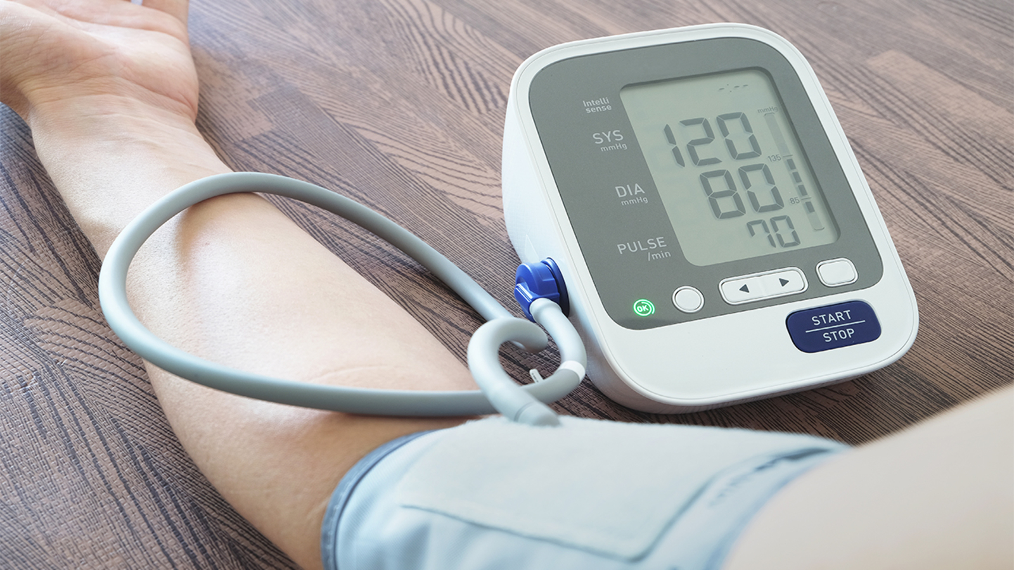
Sphygmomanometer
Contracts and pushes out blood
SYS
DIA
Meaning?
relaxes and fills with blood
LETS CHECK YOURS!!
Notes:
Sphygmomanometer - svig mo ma nometer
The systolic blood pressure (the number on top) is the pressure produced when the heart contracts and pushes out blood
The diastolic blood pressure (the number on the bottom) is the pressure when the heart relaxes and fills with blood between heartbeats

Slide 9
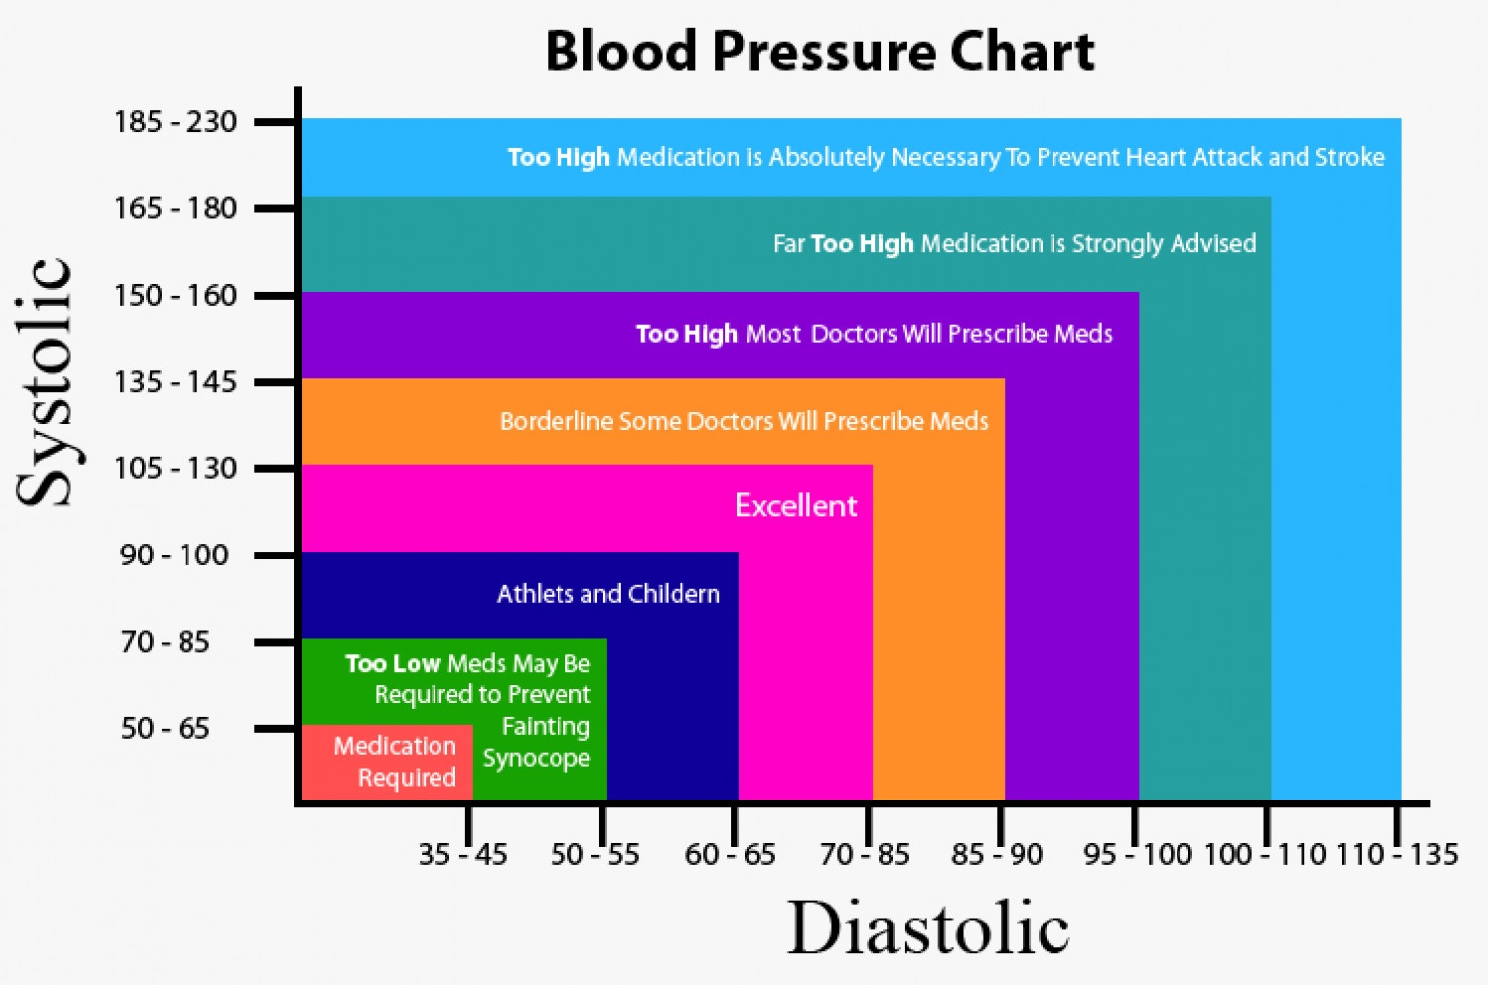
Notes:
Athletes tend to have lower BP due to a very efficient cardiovascular system – stronger more efficient pumps means they can pump more blood at lower pressure.

Slide 10
High blood pressure (hypertension) or infection
Can cause:
Protein in the urine – basement membrane or podocytes in the BC are damaged. Unable to filter out large plasma proteins from the urine.
Blood in the urine – Another symptom that the filtration system is no longer working.
Notes:
High bp when blood is consistently pushing against the artery walls with too much force
Renal hypertension causes the above

Slide 11
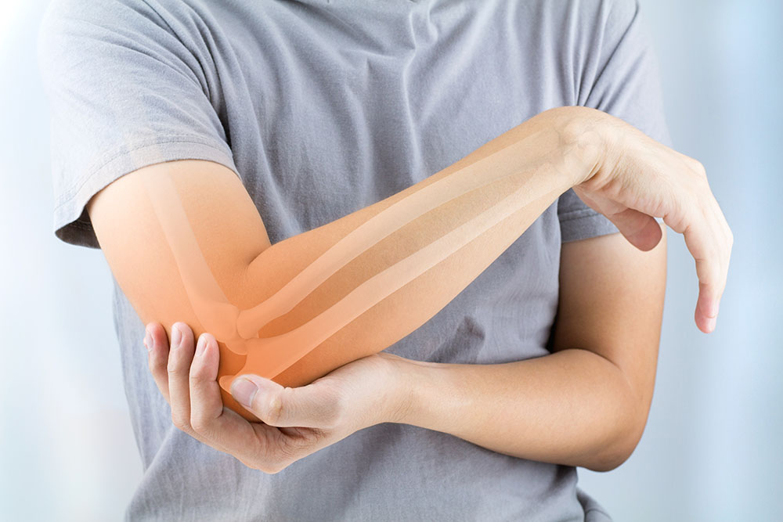
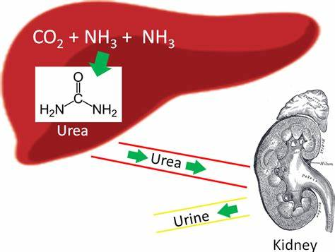

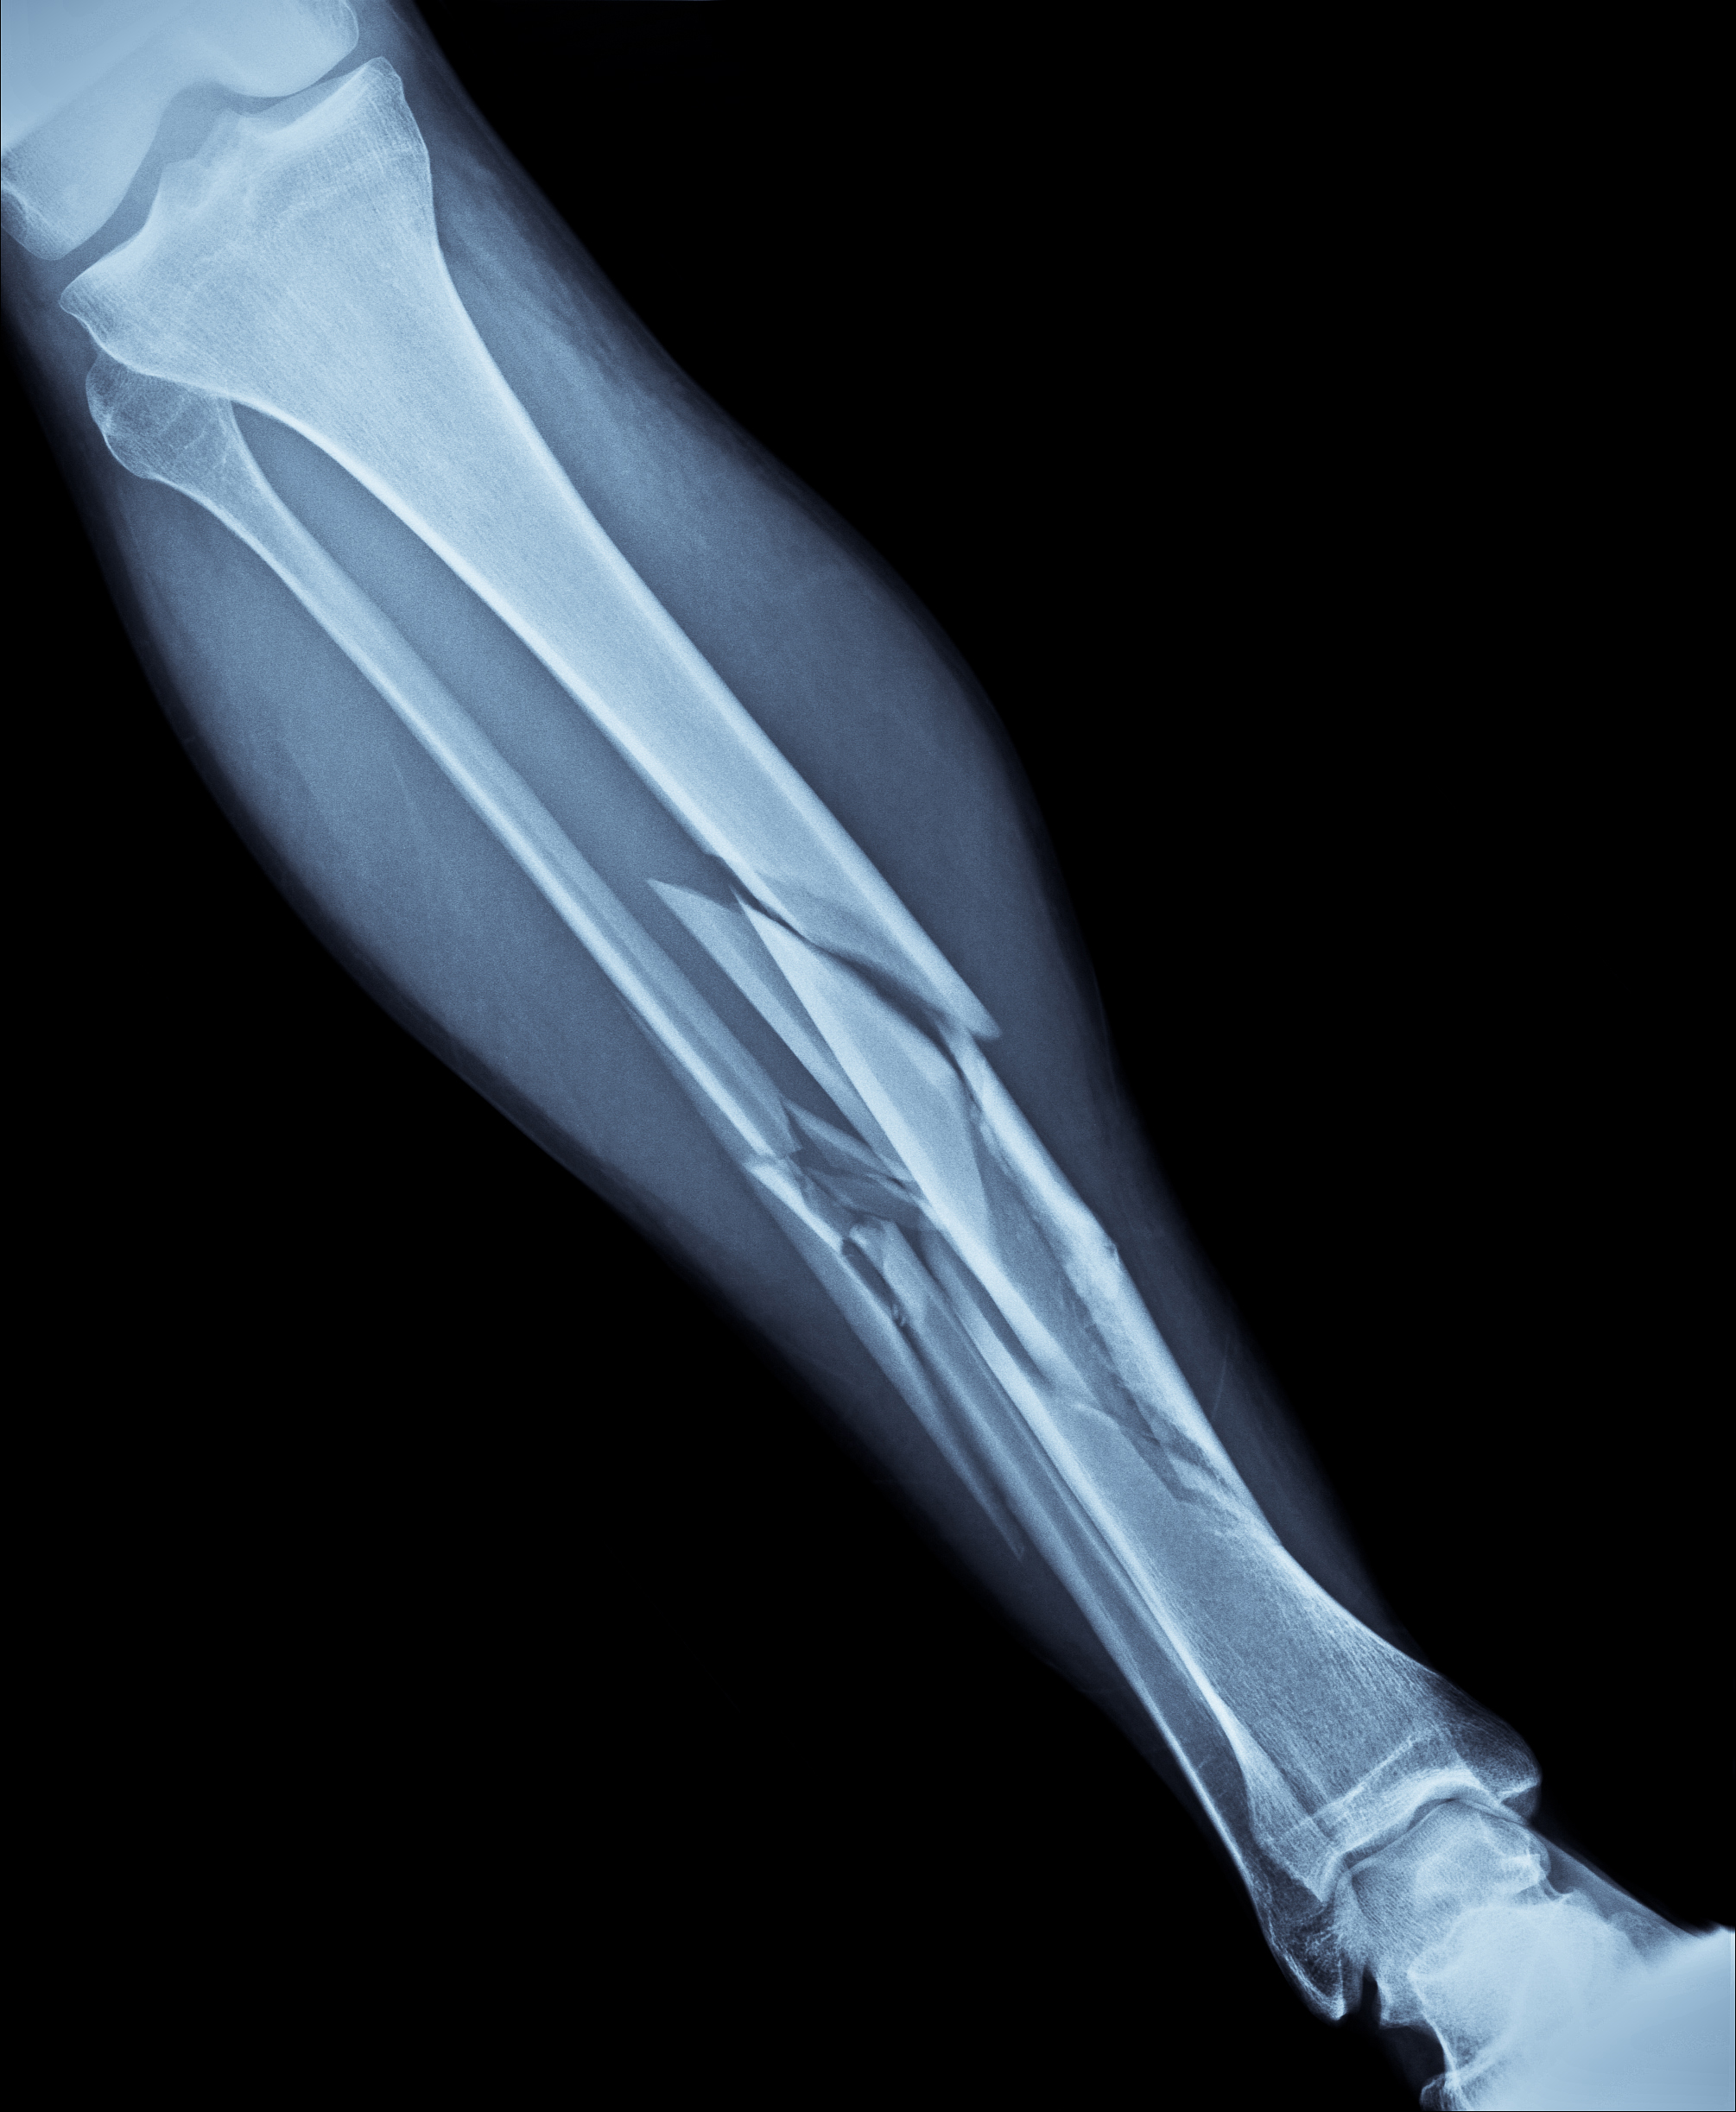
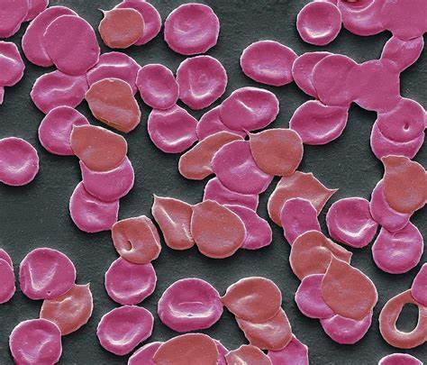
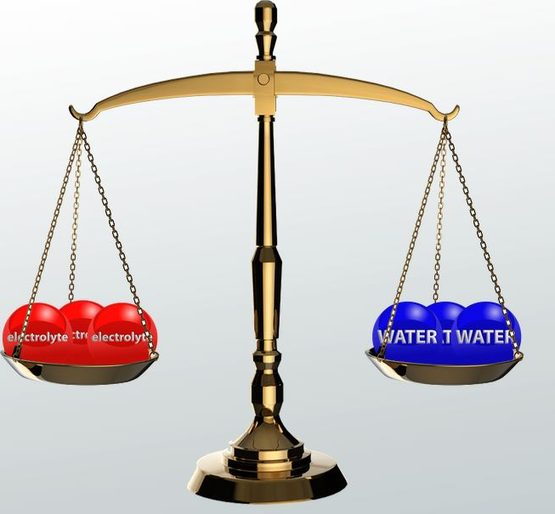
Complete kidney failure
What will happen in the body?
Loss of electrolyte balance
Build up of toxic urea
High blood pressure
Weakened bones
Pain and stiffness in joints
Anaemia
Notes:
EPO hormones produced by the kidney – instructs to bone marrow to produce RBC’s – common hormone injected by athletes that cheat!
Bones weaken due a reduction in calcium in the blood – some sort of association with phosphorus

Slide 12
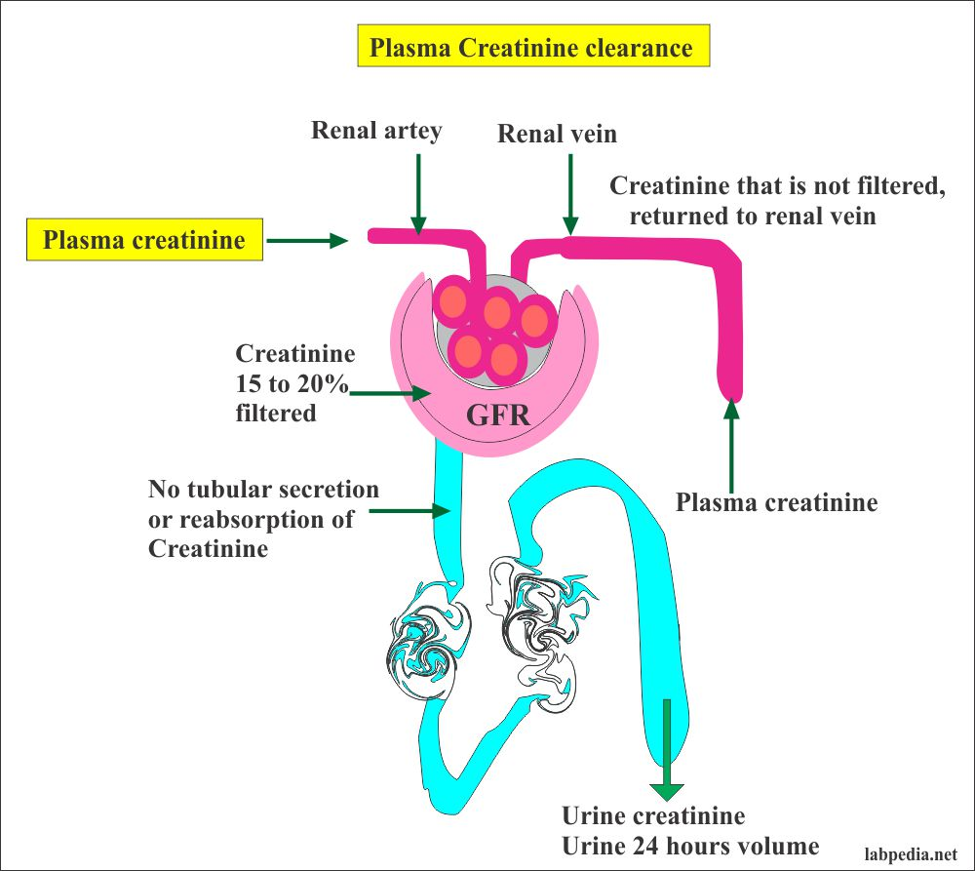

Slide 13
Glomerulus filtrate rate
Creatine is an amino acid found mainly in the muscles.
The breakdown of creatine produces creatinine
This gets filtered in the kidneys and can be used to determine your glomerulus filtrate rate (GFR)
Notes:
15 – 20% usually filtered anything higher could indicate a problem
Healthy kidneys remove creatinine from the blood at the same rate that your body makes it. So, if a blood test for creatinine shows higher than normal levels, it could mean that you have a kidney problem

Slide 14
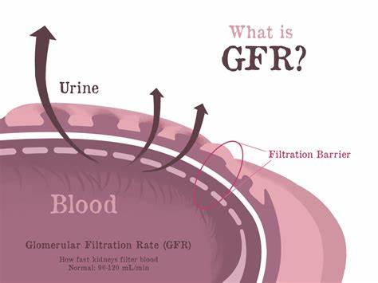
Glomerular filtrate rate (GFR)
The rate in which blood is filtered in the BC in the nephrons.
Can be used to indicate kidney failure/disease.
High creatinine in the blood is an indication that the kidney is not functioning correctly.
Units are cm³/min

Slide 15
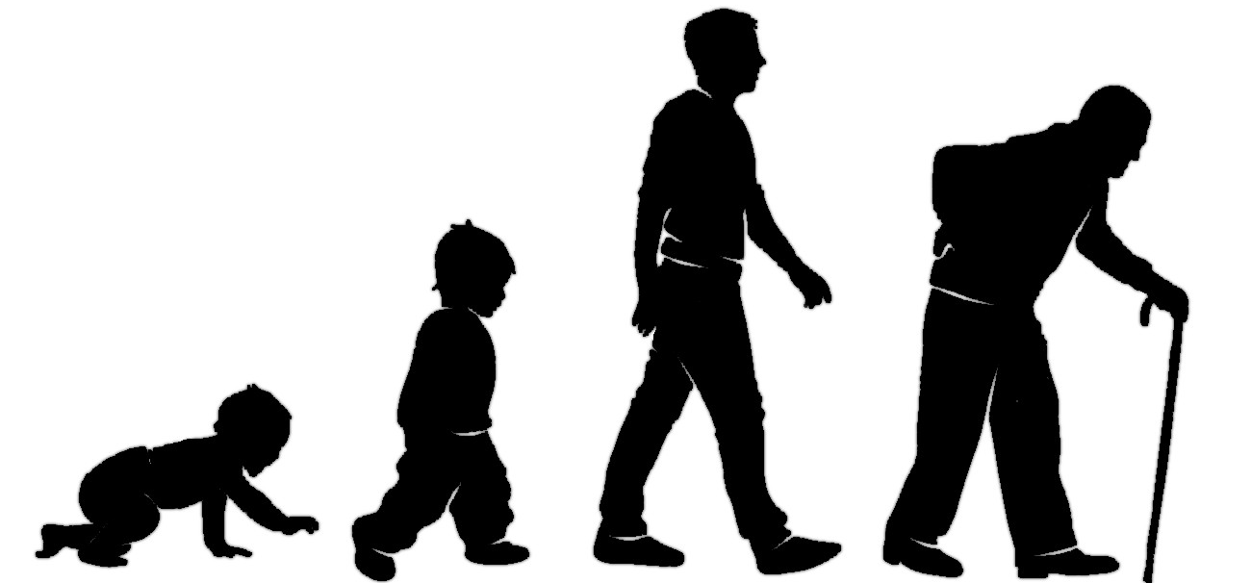
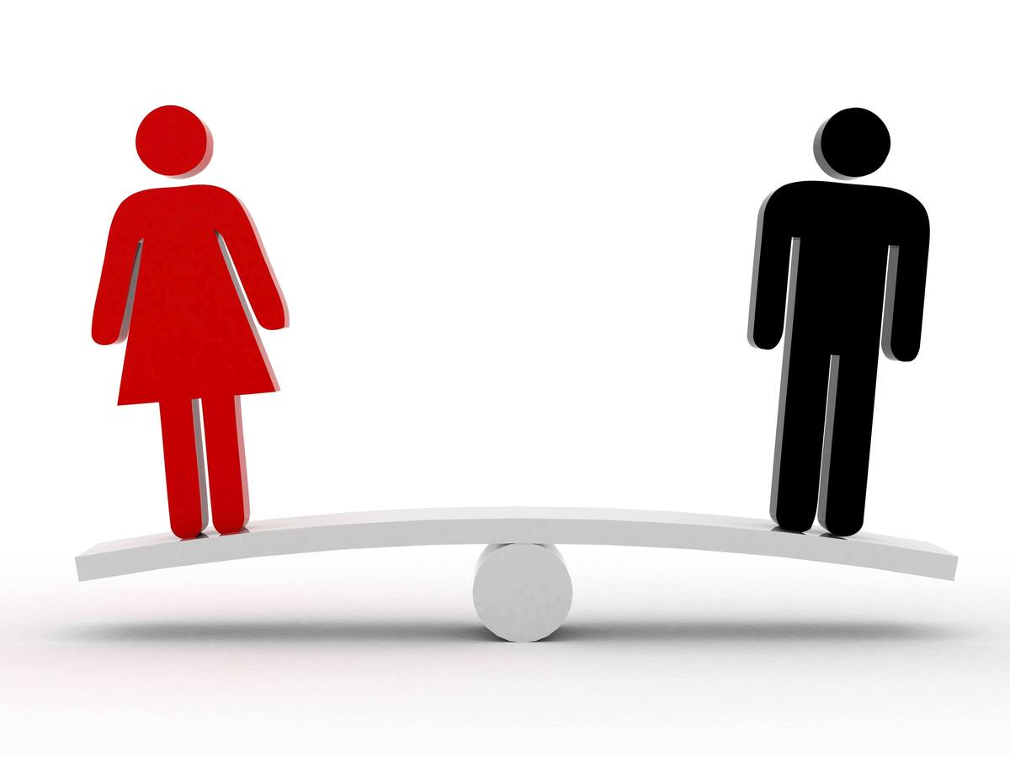


GFR considerations
GFR data must be carefully analysed. Use the image to explain why.
GFR will naturally decrease with age
Men and women have different muscle mass – so different levels of creatinine
Diet can effect the levels of creatinine
Exercise effects the amount of muscles mass – resulting in changes to creatinine

Slide 16
Notes:
Athletes tend to have lower BP due to a very efficient cardiovascular system – stronger more efficient pumps means they can pump more blood at lower pressure.

Slide 17
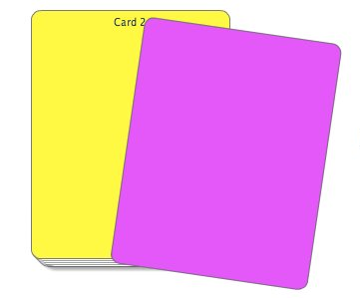
1.
2.
3.
4.
5.
6.
7.
8.
9.
10.
1.
2.
3.
4.
5.
6.
7.
8.
9.
10.
Write 1-10 on your card
Notes:
Recap agency theory

Slide 18
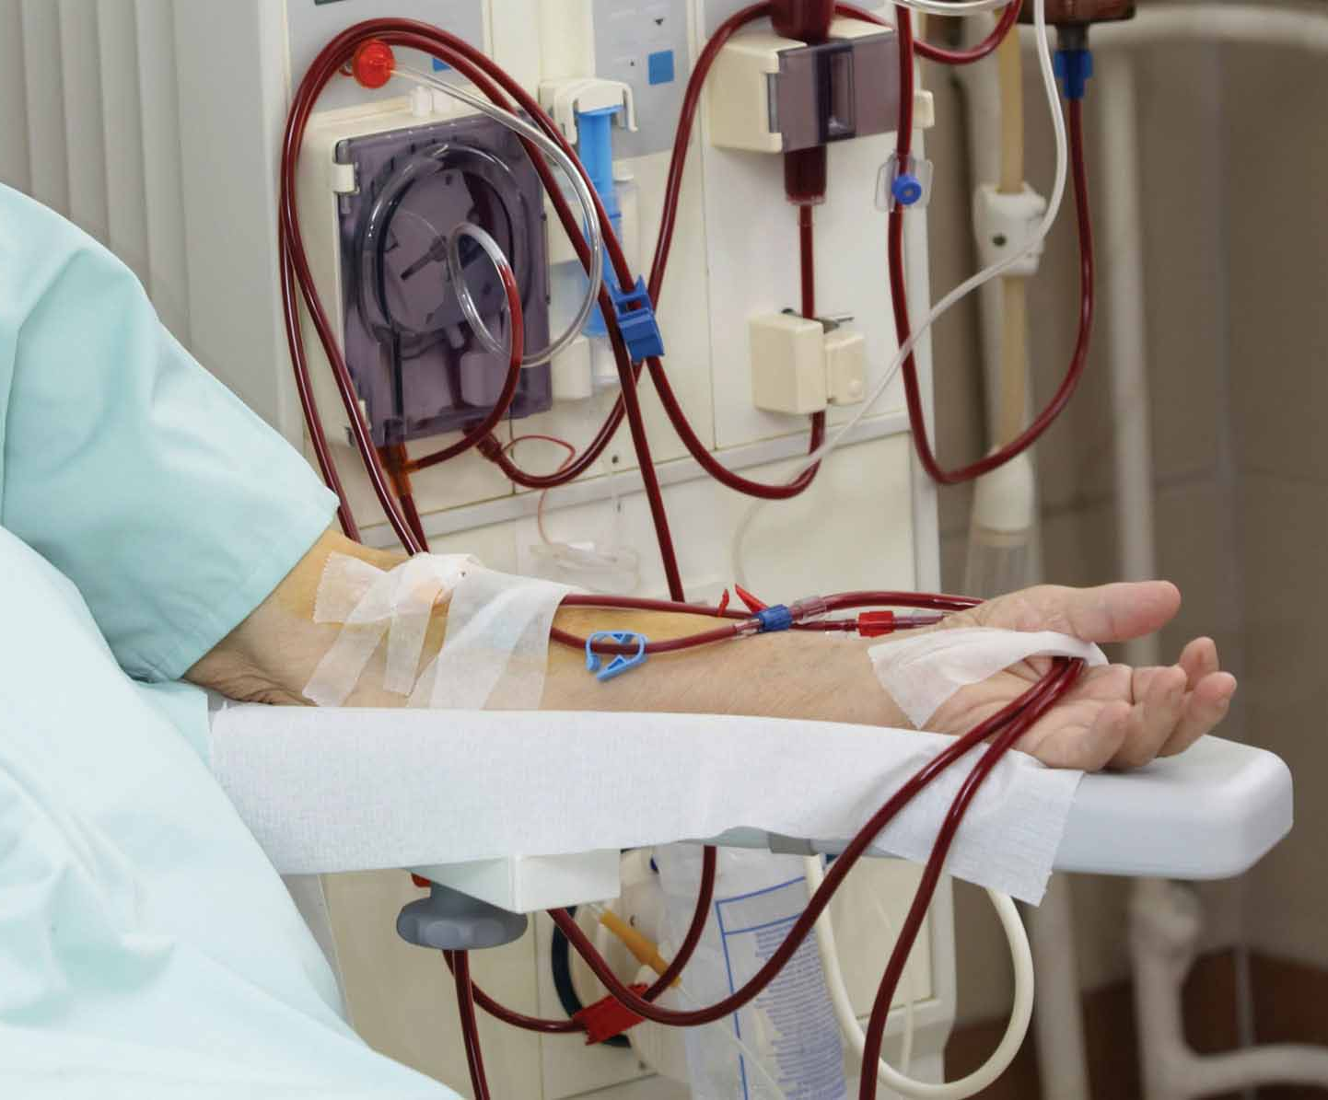
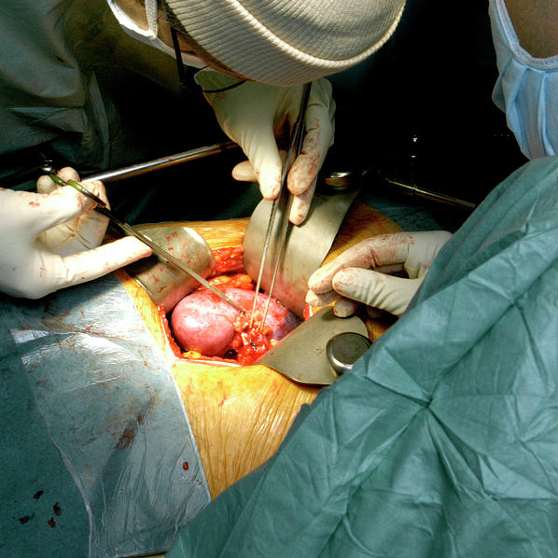
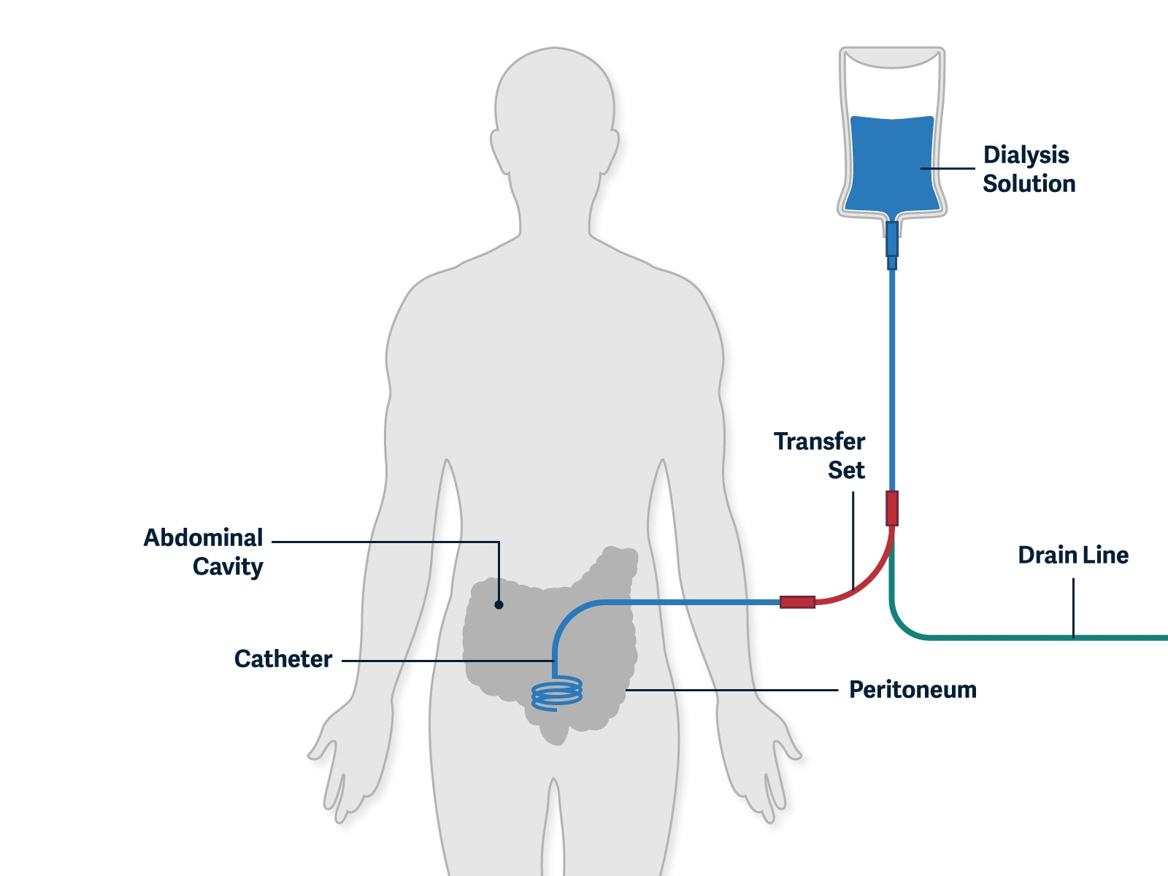
Treating kidney failure
Hemodialysis
Peritoneal
Transplant
Research 5-10 mins go!
Method / pros / cons

Slide 19
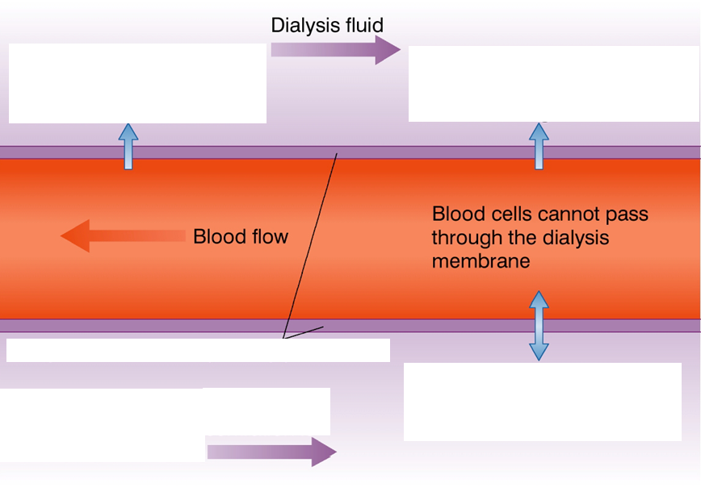
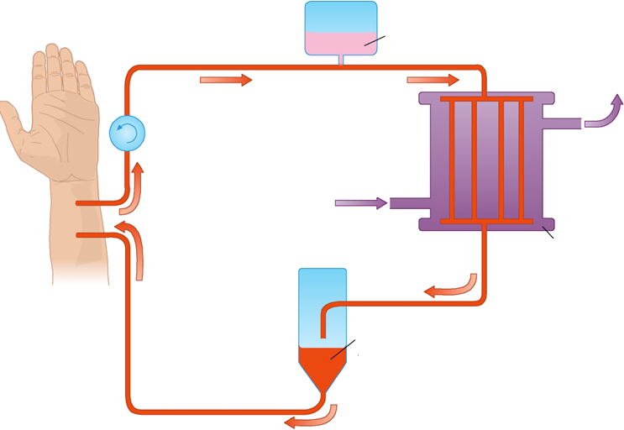
Dialysis - Haemodialysis
Requires dialysis machine
The machine mimics the membrane in the BC
Requires several hours / several times a week attached to the machine

Slide 20
Arterial blood leaves the arm
Blood is thinned to prevent clotting
Dialysis machine (see next slide)
Clean blood returns through a vein in the body
Clean blood flows through bubble trap to prevent any bubbles flowing into body

Slide 22
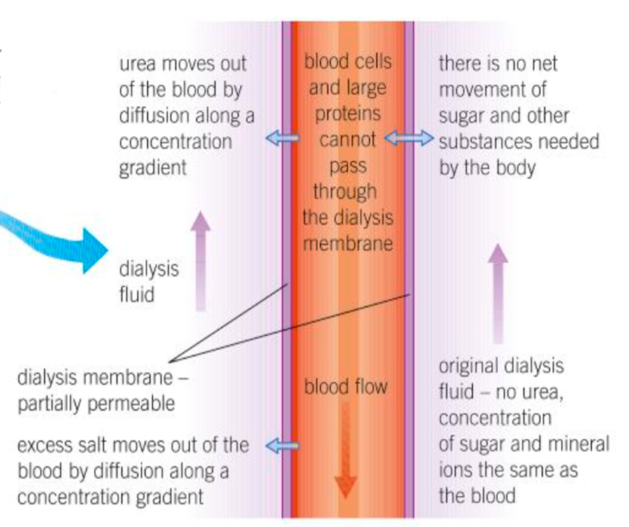

Dialysis fluid contains no urea
It contains the correct concentration of:
Mineral ions (electrolytes)
Plasma
Glucose
How do maintain the concentration gradient with the blood?
The dialysis fluid must flow in the opposite direction to the blood (counter current exchange system)

Slide 23
Dialysis – Peritoneal
Takes place …………. the body
Uses the natural ……………… lining of the abdomen (peritoneum)
Can be completed at …………..
Patient can ……… around while it takes place
The dialysis fluid is pumped into the abdomen ………… fluid (via catheter).
Urea, ions, glucose and plasma then pass from the blood capillaries into the fluid, until the correct ………………. are reached.
After several ………. the fluid is drained off and discarded.

Slide 24
Dialysis – Peritoneal
Takes place inside the body
Uses the natural membrane lining of the abdomen (peritoneum)
Can be completed at home.
Patient can move around while it takes place
The dialysis fluid is pumped into the abdomen tissue fluid (via catheter).
Urea, ions, glucose and plasma then pass from the blood capillaries into the fluid, until the correct concentrations are reached.
After several hours the fluid is drained off and discarded.

Slide 25
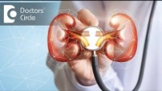

Slide 26
Transplant
Long term solution to kidney failure/disease
Last 8-10 years
Long waiting lists
Risk of rejection
Why?
Antigens on the donor organ do not match, triggering an immune response.
Notes:
10 year – consistent low grade inflammation

Slide 27

Reducing risk of rejection (transplant)
Find organ with similar antigens – same blood group
To reduce the chances of rejection
Prevent an immune response
Immunosuppressant drugs can be taken to reduce the immune response to the new organ
Why could this be an issue?
Reduces the patients response to infectious disease

Slide 29
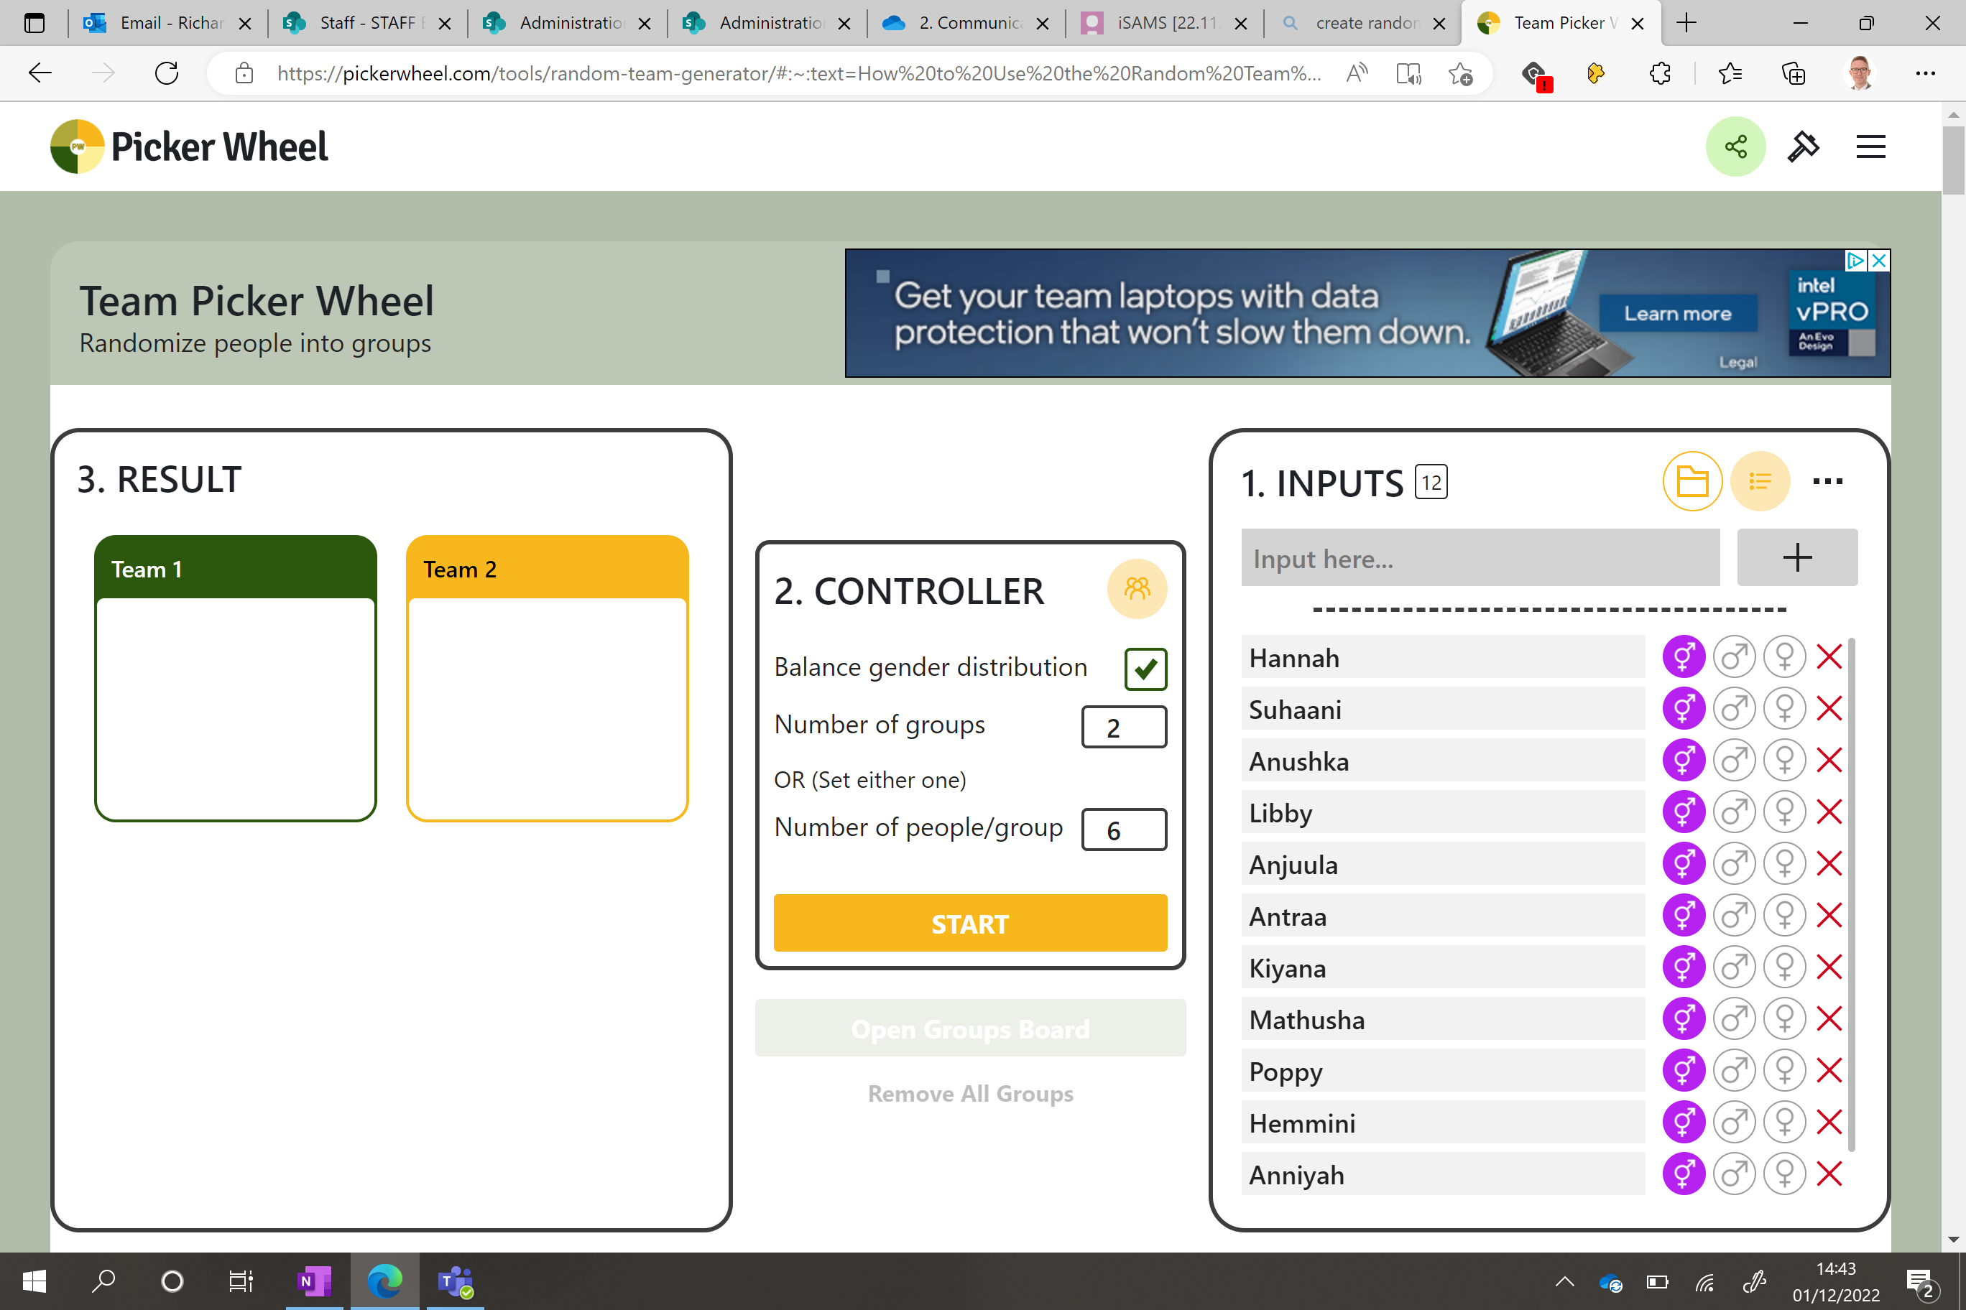

Slide 30
Tb.

Slide 31
The future of transplants
BBC iPlayer - Click - Organ Scanning and Crypto Scandal

Slide 32
Homework table below for couple lessons time

Slide 33
Advantages and Disadvantages of Dialysis & transplant
 | Advantages | Disadvantages
Haemodialysis
Peritoneal Dialysis
Kidney transplant

Slide 34
Exam style question
Evaluate the advantages and disadvantages of treating organ failure by kidney dialysis or transplant (4 marks)
Advantages KT - patients can lead a more normal life without constantly having to think about what they are eating and drinking KT - cheaper for NHS KD - available to everyone KD - no immune suppressants (make immune system weaker) needed | Disadvantages KT - must take immunosuppressants KT - there is a shortage of organ donors KT - Kidney only lasts 8-9 years KT - risks (infection, etc) KD - must limit salt intake between dialysis sessions KD - expensive KD - has to be regular and has impacts on patient's lifestyle

Slide 35
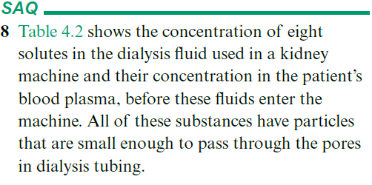
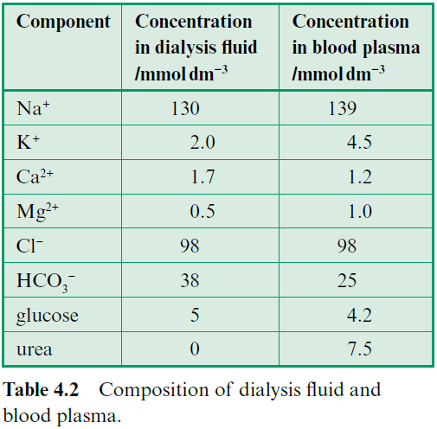
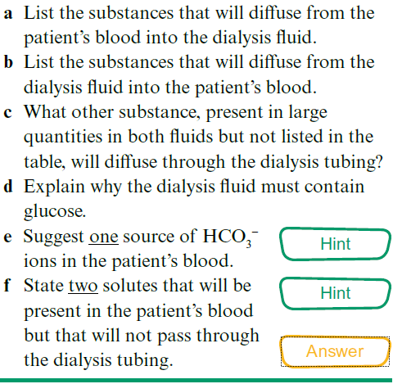
Question

Slide 36
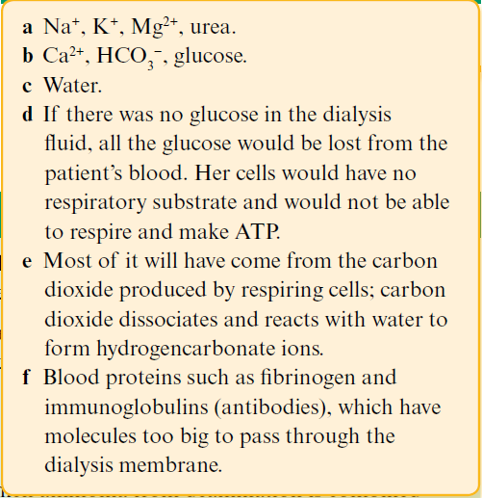
Answers

Slide 37
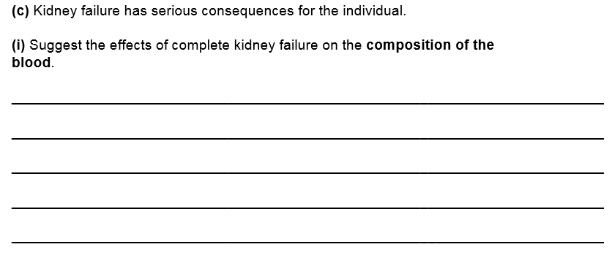
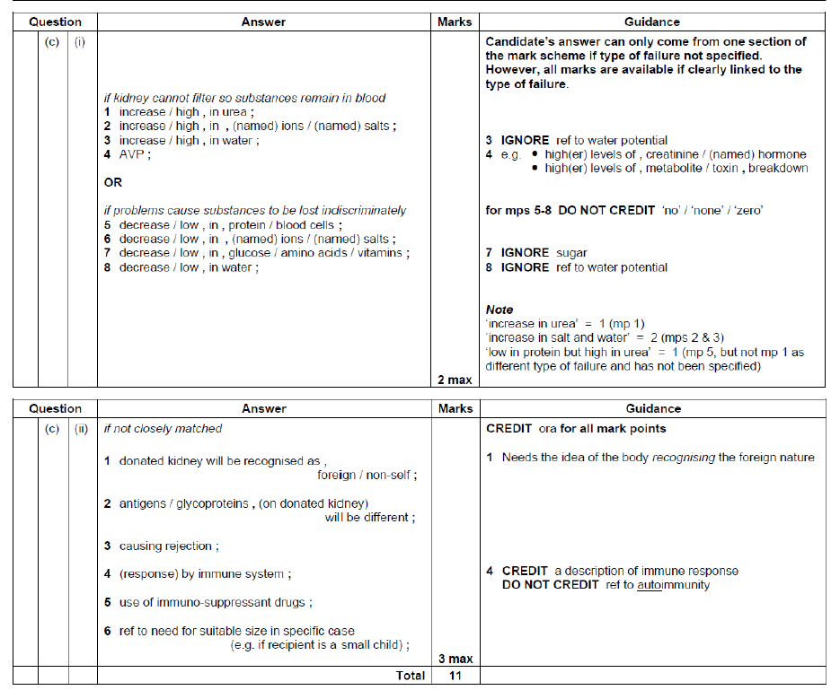
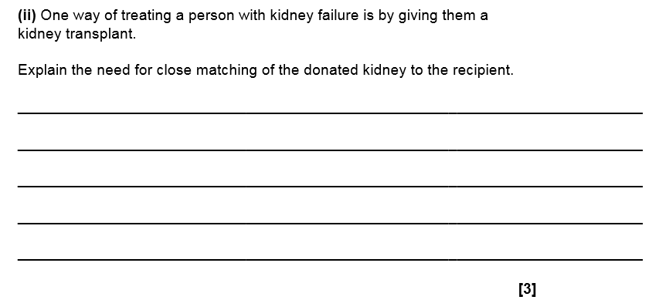

Slide 38
Learning Outcomes
The effects of kidney failure and its potential treatments.

