Slide 1


Cambridge IGCSE Computer Science 0478/0984 - Revision Notes
Chapter 8 - Programming with Python and Pseudocode
This study guide has been expertly compiled and edited by successful former teachers of Computer Science and highly experienced examiners and is suitable for students who are taking 0478 (9-1) IGCSE, the 0984 (A*-G) IGCSE, and the 2210 O Level for examination in 2023 onwards. It could be used as lesson starters, or supplied to students for independent use.
For more help, please visit www.exampaperspractice.co.uk

Slide 2


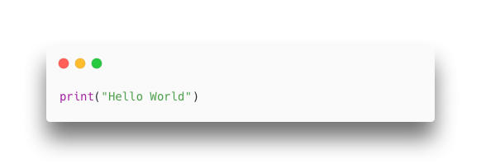

CHAPTER 8
PROGRAMMING
IGCSE Computer Science
For more help, please visit www.exampaperspractice.co.uk

Slide 3
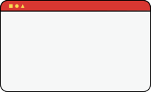
Chapter Outline
8.2.1 One-dimensional Arrays
8.1.1 Variables and Constants
8.1.2 Basic Data Types
8.1.3 Input and Output
8.1.4 Programming Fundamentals
8.1.5 Nested Statements
8.1.6 Procedures, Functions and Parameters
8.1.7 Library Routines
8.1.8 Creating a Maintainable Program
8.2.2 Two-dimensional Arrays
8.3.1 Reading from a file
8.3.2 Writing to a file
For more help, please visit www.exampaperspractice.co.uk

Slide 4

Chapter Outline
8.2.1 One-dimensional Arrays
8.1.1 Variables and Constants
8.1.2 Basic Data Types
8.1.3 Input and Output
8.1.4 Programming Fundamentals
8.1.5 Nested Statements
8.1.6 Procedures, Functions and Parameters
8.1.7 Library Routines
8.1.8 Creating a Maintainable Program
8.2.2 Two-dimensional Arrays
8.3.1 Reading from a file
8.3.2 Writing to a file
For more help, please visit www.exampaperspractice.co.uk

Slide 5


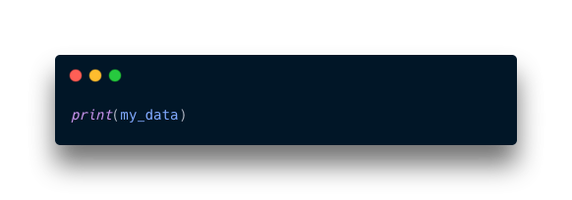
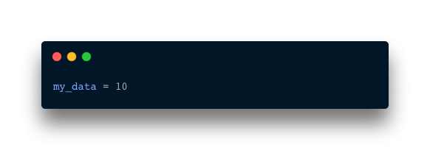
Variables and Constants
Definition:
A variable in programming is a named storage location in memory that holds data, and its value can be changed during program execution.
10
Variable is created
refer to the data stored in the memory by name
Computer memory
For more help, please visit www.exampaperspractice.co.uk

Slide 6
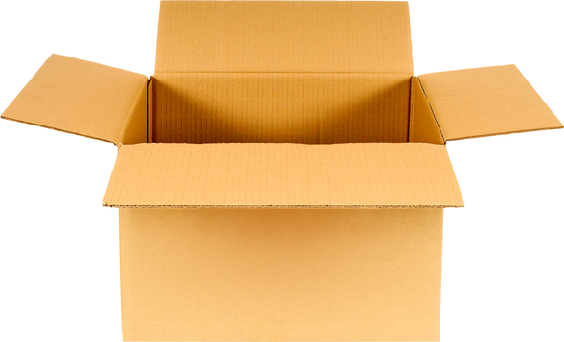
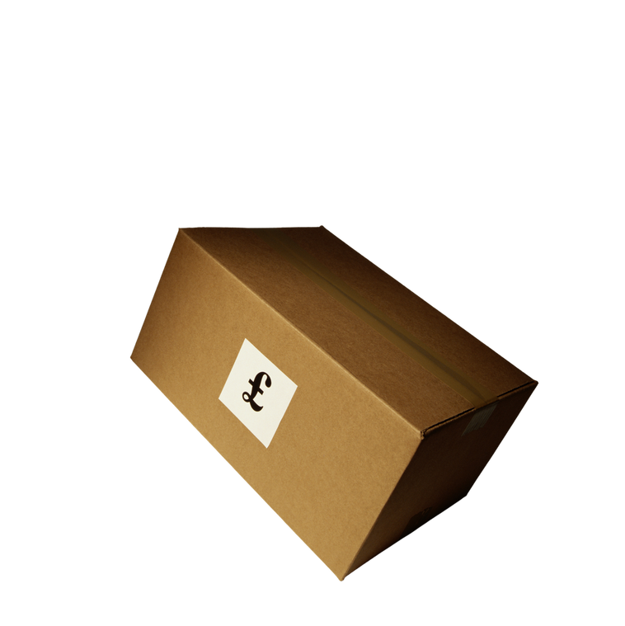
Variables VS Constants
A variable in programming is a named storage location in memory that can hold data whose value can change during program execution.
Variables
Eg. High score of a game
A constant in programming is a named value that cannot be changed once it has been assigned a value.
Constant
Eg. Number of days in a week
For more help, please visit www.exampaperspractice.co.uk

Slide 7
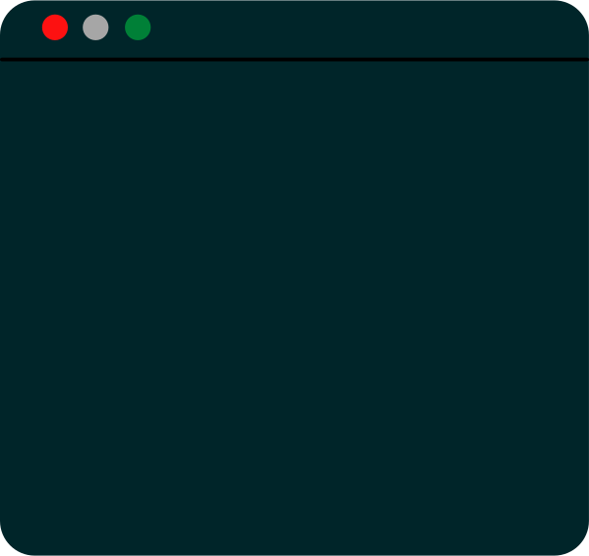

Pseudocode
Variables and Constants
DECLARE FirstVar : INTEGER DECLARE SecondVar : INTEGER
Variables
CONSTANT FirstConst <- 500 CONSTANT SecondConst <- 100
Constant
For more help, please visit www.exampaperspractice.co.uk

Slide 8
Python Code
Variables and Constants
.py
total_price_var = 0
ticket_price_const = 25
number_of_tickets = input("Enter number of ticket")
total_price_var = number_of_tickets * ticket_price_const
Constant
Variables
*Python does not require any separate declarations and does not differentiate between constants and variables
For more help, please visit www.exampaperspractice.co.uk

Slide 9
Chapter Outline
8.2.1 One-dimensional Arrays
8.1.1 Variables and Constants
8.1.2 Basic Data Types
8.1.3 Input and Output
8.1.4 Programming Fundamentals
8.1.5 Nested Statements
8.1.6 Procedures, Functions and Parameters
8.1.7 Library Routines
8.1.8 Creating a Maintainable Program
8.2.2 Two-dimensional Arrays
8.3.1 Reading from a file
8.3.2 Writing to a file
For more help, please visit www.exampaperspractice.co.uk

Slide 10


Basic Data
Types
Different types of data are formally categorized within a computer system to enable effective processing and storage so that
"a" in ascii
Data can be stored in an appropriate way
1100001
97 in denary
Giving data a "TYPE" helps the computer to differentiate the data
For more help, please visit www.exampaperspractice.co.uk

Slide 11

Basic Data
Types
In order for a computer system to process and store data effectively, different kinds of data are formally given different TYPES, so that:
numbers with mathematical
operators
Eg. 3 + 5 = 8
Data can be manipulated effectively
characters with concatenation
Eg. "a" + "b"= "ab"
For more help, please visit www.exampaperspractice.co.uk

Slide 12

Basic Data
Types
In order for a computer system to process and store data effectively, different kinds of data are formally given different TYPES, so that:
Auto validation
For more help, please visit www.exampaperspractice.co.uk

Slide 13





5 Basic Data Types
Integer
Real/Float
Char
String
Boolean
A char (character) is a data type in programming that represents a single character, such as a letter, digit, or symbol, typically enclosed in single quotes.
An integer is a data type in programming that represents whole numbers without any fractional component.
A float (floating-point number) is a data type in programming that represents numbers with a fractional component.
A string is a data type in programming that represents a sequence of characters, typically used for storing and manipulating text.
A boolean is a data type in programming that represents a value of true or false, used for logical operations and conditions.
For more help, please visit www.exampaperspractice.co.uk

Slide 14
Examples
Integer
Real/Float
Char
String
Boolean
TRUE
FALSE
25
25.0
'c'
"ccc"
""
For more help, please visit www.exampaperspractice.co.uk

Slide 15





Test your understanding!
Integer
Char
String
Boolean
Real/Float
25
25.0
'c'
"ccc"
TRUE
For more help, please visit www.exampaperspractice.co.uk

Slide 16
What data type is:
"Football"
Integer
Real
Char
String
Boolean
25
25.0
'c'
"ccc"
TRUE
For more help, please visit www.exampaperspractice.co.uk

Slide 17
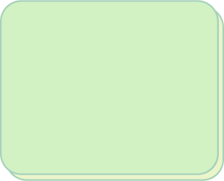
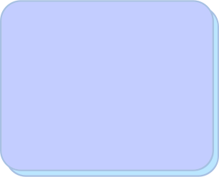


What data type is:
"Football"
Integer
Real
Char
String
Boolean
25
25.0
'c'
"ccc"
TRUE
For more help, please visit www.exampaperspractice.co.uk

Slide 18
What data type is:
35.2
Integer
Real
Char
String
Boolean
25
25.0
'c'
"ccc"
TRUE
For more help, please visit www.exampaperspractice.co.uk

Slide 19
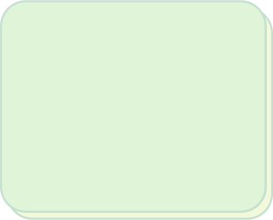



What data type is:
35.2
Integer
Real
Char
String
Boolean
25
25.0
'c'
"ccc"
TRUE
For more help, please visit www.exampaperspractice.co.uk

Slide 20
What data type is:
int(10.52)
Integer
Real
Char
String
Boolean
25
25.0
'c'
"ccc"
TRUE
For more help, please visit www.exampaperspractice.co.uk

Slide 21
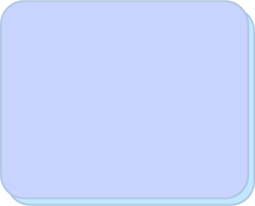



What data type is:
int(10.52)
Integer
Real
Char
String
Boolean
25
25.0
'c'
"ccc"
TRUE
For more help, please visit www.exampaperspractice.co.uk

Slide 22
Chapter Outline
8.2.1 One-dimensional Arrays
8.1.1 Variables and Constants
8.1.2 Basic Data Types
8.1.3 Input and Output
8.1.4 Programming Fundamentals
8.1.5 Nested Statements
8.1.6 Procedures, Functions and Parameters
8.1.7 Library Routines
8.1.8 Creating a Maintainable Program
8.2.2 Two-dimensional Arrays
8.3.1 Reading from a file
8.3.2 Writing to a file
For more help, please visit www.exampaperspractice.co.uk

Slide 23


Input and Output
Main function
Take input from a keyboard and output to a screen
Output
Input
For more help, please visit www.exampaperspractice.co.uk

Slide 24
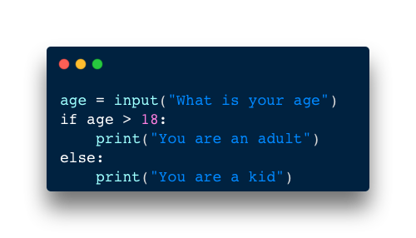
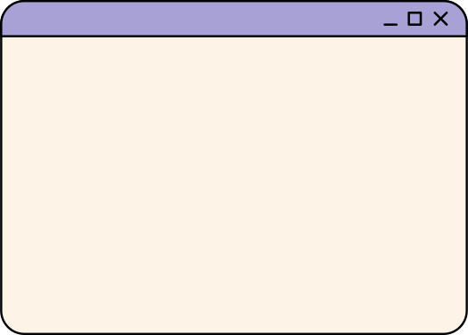
Input
Pseudocode
Python Code
INPUT Age
IF Age > 18
THEN
OUTPUT "You are an adult"
ELSE
OUTPUT "You are a kid"
ENDIF
For more help, please visit www.exampaperspractice.co.uk

Slide 25

Input
Each input needs to be accompanied by a prompt
PROMPT
PROMPT
Pseudocode
Python Code
OUTPUT "What is your age"
INPUT Age
IF Age > 18
THEN
OUTPUT "You are an adult"
ELSE
OUTPUT "You are a kid"
ENDIF
For more help, please visit www.exampaperspractice.co.uk

Slide 26
Input and Output
Input can also be in the form of file (excel, image). See Chapter 8.3
Output
Input
For more help, please visit www.exampaperspractice.co.uk

Slide 27

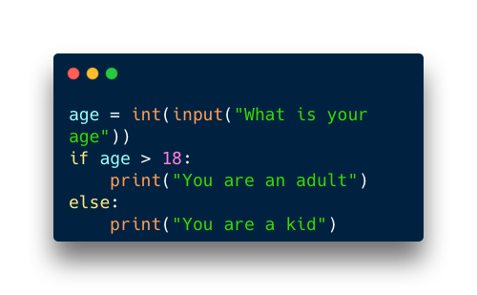
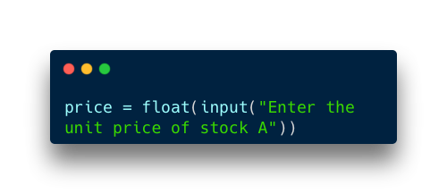
Input
By default, all inputs are treated as strings, so if the input needs to be an integer or real number, commands like int() or float() in languages such as Python are used to convert the data type accordingly.
For more help, please visit www.exampaperspractice.co.uk

Slide 28
Output
For a program to be effective, each output must be accompanied by a descriptive message that clarifies the result being presented to the user.
Pseudocode
Python Code
INPUT Age
IF Age > 18
THEN
OUTPUT "You are an adult"
ELSE
OUTPUT "You are a kid"
ENDIF
Output
For more help, please visit www.exampaperspractice.co.uk

Slide 29

PROGRAMMING TIME
For more help, please visit www.exampaperspractice.co.uk

Slide 30
TASK
SPECIFICATION
So far we have learned the following topics:
    Variables and Constant
    Basic Data Type
    Input and Output
    Let's put everything that we have learned into practice.
For more help, please visit www.exampaperspractice.co.uk

Slide 31

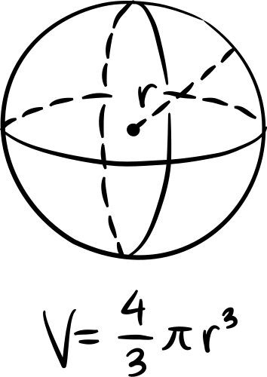
TASK 1
VOLUME OF A SPHERE
To calculate the volume of a sphere, we can use the formula:
Your task is to create a program that asks the user for the radius of a sphere, and then calculate its volume. The program must output a message showing the result calculated.
TIPS:
You need to create a constant called PI that has the value of 3.142. You can perform multiplication in python using the * symbol. A fraction can be created using the division / symbol (eg. 4/3).
For more help, please visit www.exampaperspractice.co.uk

Slide 32
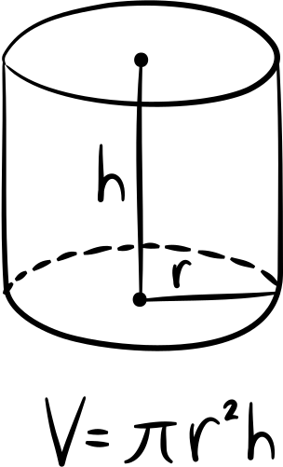
TASK 2
VOLUME OF A CYLINDER
To calculate the volume of a cylinder, we can use the formula:
Your task is to create a program that asks the user for the radius and height of a cylinder, and then calculate its volume. The program must output a message showing the result calculated.
TIPS:
You need to create a constant called PI that has the value of 3.142. You can perform multiplication in python using the * symbol.
For more help, please visit www.exampaperspractice.co.uk

Slide 33
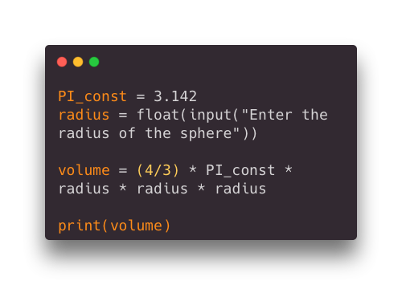
ANSWER (TASK 1)
For more help, please visit www.exampaperspractice.co.uk

Slide 34
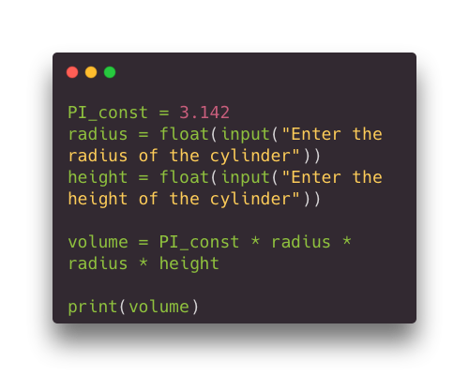
ANSWER (TASK 2)
For more help, please visit www.exampaperspractice.co.uk

Slide 35
Chapter Outline
8.2.1 One-dimensional Arrays
8.1.1 Variables and Constants
8.1.2 Basic Data Types
8.1.3 Input and Output
8.1.4 Programming Fundamentals
8.1.5 Nested Statements
8.1.6 Procedures, Functions and Parameters
8.1.7 Library Routines
8.1.8 Creating a Maintainable Program
8.2.2 Two-dimensional Arrays
8.3.1 Reading from a file
8.3.2 Writing to a file
For more help, please visit www.exampaperspractice.co.uk

Slide 36



Sub Chapter Outline
8.1.4.1
Sequencing
8.1.4.2
Selection
8.1.4 Programming Fundamentals
8.1.4.3
Iteration
8.1.4.4
Totalling and Counting
8.1.4.5
String handling
8.1.4.6
Arithmetic, Logical and Boolean Operators
For more help, please visit www.exampaperspractice.co.uk

Slide 37

Sequencing
The sequence of steps in an algorithm is crucial. Incorrect ordering can result in inaccurate outcomes or unnecessary additional steps for completing the task.
Step 1: Ask for a radius
Step 2:Using the radius,calculate the volume
For more help, please visit www.exampaperspractice.co.uk

Slide 38

Sequencing
The sequence of steps in an algorithm is crucial. Incorrect ordering can result in inaccurate outcomes or unnecessary additional steps for completing the task.
Eg. The process of frying an egg
Step 1: Heat up the pan
Step 2: Pour in oil
Step 3: Crack the egg and add the egg into the pan
Step 4: Eat
For more help, please visit www.exampaperspractice.co.uk

Slide 39

Sequencing
You can't do this...
Eg. The process of frying an egg
Step 1: Crack the egg and add the egg into the pan
Step 2: Heat up the pan
Step 3: Pour in oil
Step 4: Eat
For more help, please visit www.exampaperspractice.co.uk

Slide 40
Sequencing
The sequence of steps in an algorithm is crucial. Incorrect ordering can result in inaccurate outcomes or unnecessary additional steps for completing the task.
Step 1: Ask for radius
Step 2: Ask for height
Step 3:Using the radius and height,calculate the volume
For more help, please visit www.exampaperspractice.co.uk

Slide 41
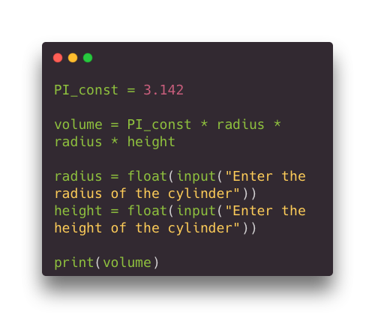

Sequencing
Human would recognise that this is wrong, but
THE COMPUTER WOULD JUST DO AS IT IS TOLD
Step 1:Using the radius and height,calculate the volume
Step 2: Ask for radius
Step 3: Ask for height
For more help, please visit www.exampaperspractice.co.uk

Slide 42

Sub Chapter Outline
8.1.4.1
Sequencing
8.1.4.2
Selection
8.1.4 Programming Fundamentals
8.1.4.3
Iteration
8.1.4.4
Totalling and Counting
8.1.4.5
String handling
8.1.4.6
Arithmetic, Logical and Boolean Operators
For more help, please visit www.exampaperspractice.co.uk

Slide 43



Selection
Another fundamental concept in programming involves the ability of code to make decisions or pose questions, particularly when there are multiple potential options available.
Yes
Show football videos
Do you like football?
Show other videos
No
For more help, please visit www.exampaperspractice.co.uk

Slide 44
Selection
Selection can be written in programs by using either an
IF statement ...
Pseudocode
Python Code
INPUT Age
IF Age > 18
THEN
OUTPUT "You are an adult"
ELSE
OUTPUT "You are a kid"
ENDIF
If statement
For more help, please visit www.exampaperspractice.co.uk

Slide 45
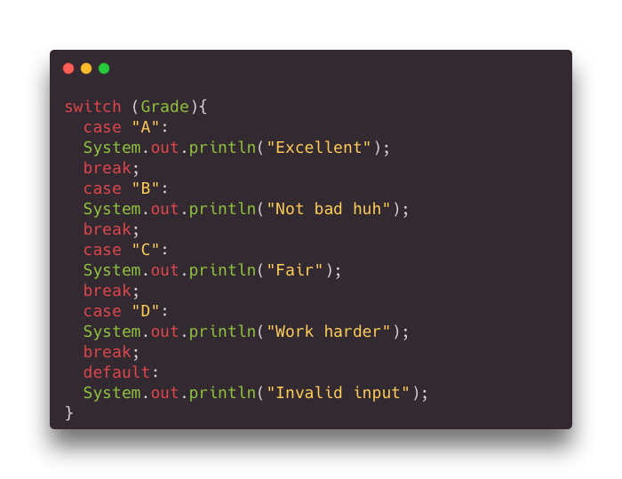
Selection
or a CASE statement.
Java Code
Pseudocode
INPUT Grade
CASE OF Grade
A : OUTPUT "Excellent"
B : OUTPUT "Not bad huh"
C : OUTPUT "Fair"
D : OUTPUT "Work harder"
OTHERWISE : OUTPUT "Invalid input"
ENDCASE
For more help, please visit www.exampaperspractice.co.uk

Slide 46
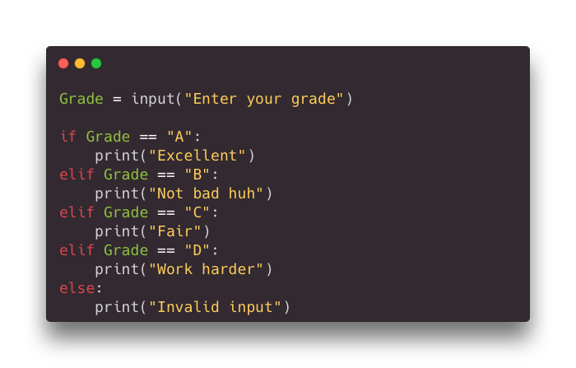
Selection
Python does not have a CASE statement. Alternatively, the statement "elif" (stands for else-if) is used.
Pseudocode
Python Code
INPUT Grade
CASE OF Grade
A : OUTPUT "Excellent"
B : OUTPUT "Not bad huh"
C : OUTPUT "Fair"
D : OUTPUT "Work harder"
OTHERWISE : OUTPUT "Invalid input"
ENDCASE
For more help, please visit www.exampaperspractice.co.uk

Slide 47
PROGRAMMING TIME - SELECTION
For more help, please visit www.exampaperspractice.co.uk

Slide 48
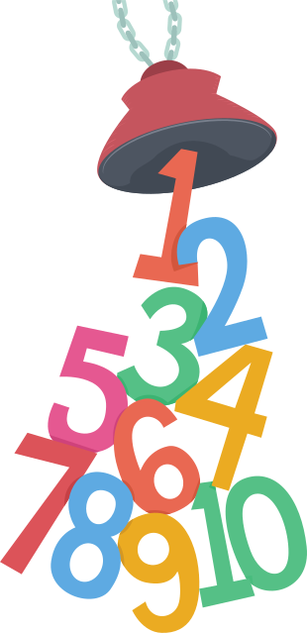
TASK 1 - ODD OR EVEN
Ask the user for a number. Determine if the number entered is an odd number or an even number. Print out the result.
Tips:
When we divide a number by 2, an odd number will have a remainder of 1 and an even number will have a remainder of 0.
You can check the remainder of a number by using the "%" symbol. Eg.
5%2 will give you 1.
For more help, please visit www.exampaperspractice.co.uk

Slide 49
TASK 2 - VOWEL OR CONSONANT
Ask the user for a character. Determine if the character entered is a vowel (a, e, i, o, u). If so, print out the vowel character. Otherwise, print "this character is a consonant".
Tips:
A simple if-else statement is not enough!
For more help, please visit www.exampaperspractice.co.uk

Slide 50
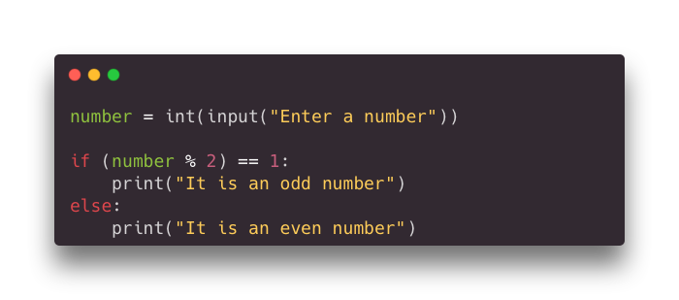
ANSWER (TASK 1)
For more help, please visit www.exampaperspractice.co.uk

Slide 51
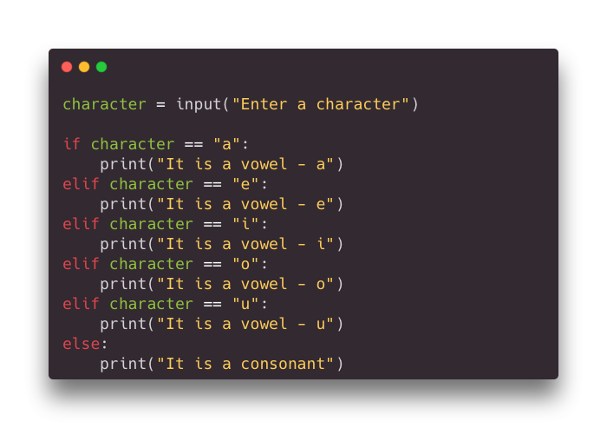
ANSWER (TASK 2)
For more help, please visit www.exampaperspractice.co.uk

Slide 52


Sub Chapter Outline
8.1.4.1
Sequencing
8.1.4.2
Selection
8.1.4 Programming Fundamentals
8.1.4.3
Iteration
8.1.4.4
Totalling and Counting
8.1.4.5
String handling
8.1.4.6
Arithmetic, Logical and Boolean Operators
For more help, please visit www.exampaperspractice.co.uk

Slide 53
Iteration
Iteration in an algorithm occurs when specific instructions dictate that a step or set of steps must be repeated until a condition is satisfied or a termination command is given.
Eg. The algorithm for frying 5 eggs
Step 1: Heat up the pan
Step 2: Pour in oil
Step 3: Crack the egg and add the egg into the pan
Step 4:Put the fried egg on a plate
REPEAT Step 3 and 4 until for 5 times.
For more help, please visit www.exampaperspractice.co.uk

Slide 54


Iteration
Another word for iteration is loop. There are 3 different types of loop in iterative programming.
Count-controlled loop
Pre-condition
loop
Post-condition
loop
For a set number of iterations
Always has at least one iteration
May have no iterations
For more help, please visit www.exampaperspractice.co.uk

Slide 55
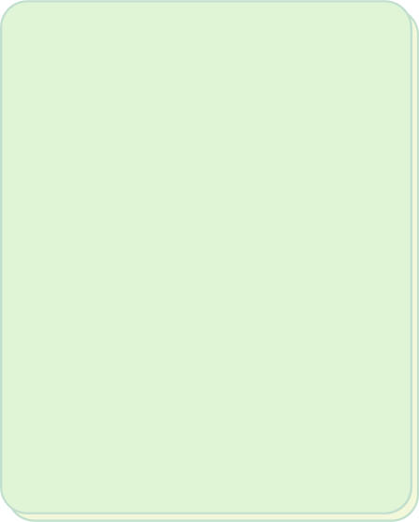

Iteration
Another word for iteration is loop. There are 3 different types of loop in iterative programming.
Count-controlled loop
Pre-condition
loop
Post-condition
loop
For a set number of iterations
Always has at least one iteration
May have no iterations
For more help, please visit www.exampaperspractice.co.uk

Slide 56

Count-controlled loop
IN A FOR LOOP, THE NUMBER OF ITERATIONS IS PREDETERMINED, AND A COUNTER KEEPS TRACK OF HOW MANY TIMES THE LOOP HAS EXECUTED.
FOR Counter <- 1 TO 10
OUTPUT Counter
NEXT Counter
Pseudocode that output value from 1 to 10
For more help, please visit www.exampaperspractice.co.uk

Slide 57
PSEUDOCODE
SYNTAX BREAKDOWN
Initial value of the Counter variable
FOR Counter <- 1 TO 10
OUTPUT Counter
NEXT Counter
When the Counter variable reaches this value, the loop will terminate
Increment the existing Counter value by 1
(eg. 3 -> 4,
7 -> 8
, etc)
For more help, please visit www.exampaperspractice.co.uk

Slide 58
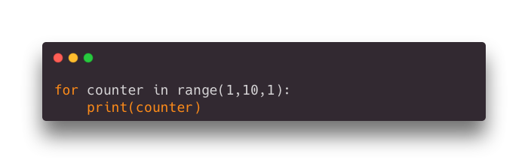
PYTHON CODE
SYNTAX BREAKDOWN
Variable that is used as a counter
range function
Steps incremented to the counter variable at each iteration
Notes: You don't have to specify step if the value is 1.
for keyword
Starting value of the counter variable
When the counter variable reaches this value, the loop will end
For more help, please visit www.exampaperspractice.co.uk

Slide 59
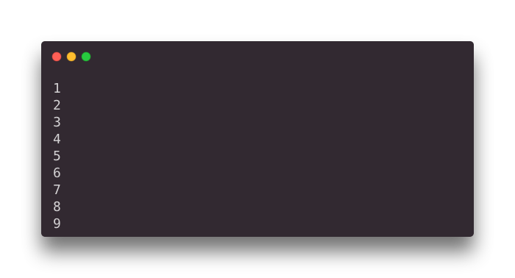

PYTHON CODE
OUTPUT
RUN THIS CODE
Notes: "10" is not printed as the loop has already terminated.
For more help, please visit www.exampaperspractice.co.uk

Slide 60
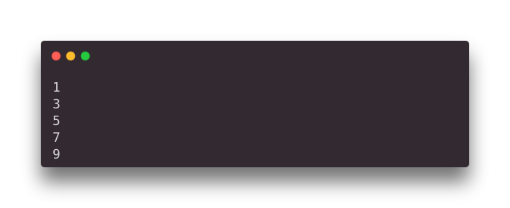
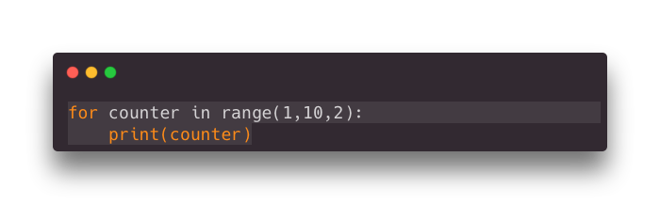
PYTHON CODE
OUTPUT
RUN THIS CODE
step = 2
For more help, please visit www.exampaperspractice.co.uk

Slide 61
Count-controlled loop
Comparing pseudocode with Python code
FOR Counter <- 1 TO 10
OUTPUT Counter
NEXT
For more help, please visit www.exampaperspractice.co.uk

Slide 62
Iteration
Another word for iteration is loop. There are 3 different types of loop in iterative programming.
Count-controlled loop
Pre-condition
loop
Post-condition
loop
For a set number of iterations
Always has at least one iteration
May have no iterations
For more help, please visit www.exampaperspractice.co.uk

Slide 63
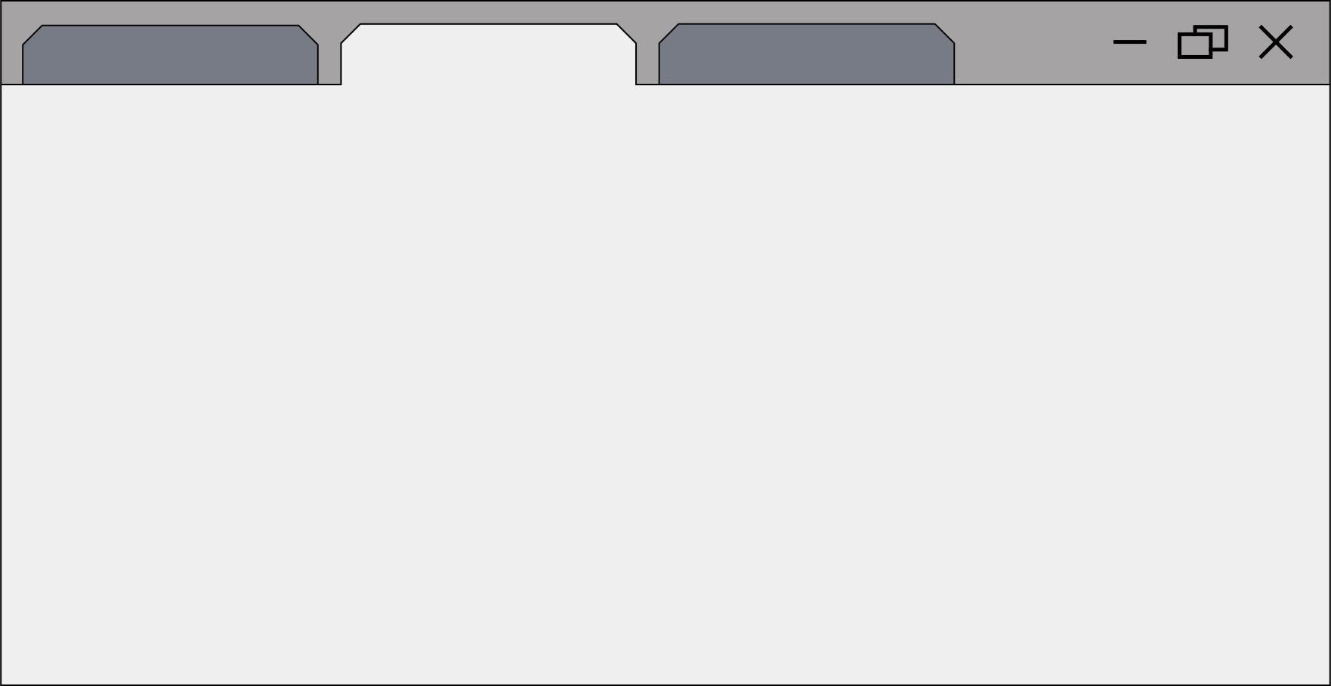
Pre-condition
loop
A while loop executes its operations only when a specified condition is true.
Total ← 0
OUTPUT "Enter value for mark, -1 to finish "
INPUT Mark
WHILE Mark <> -1 DO
Total ← Total + Mark
OUTPUT "Enter value for mark, -1 to finish"
INPUT Mark
ENDWHILE
For more help, please visit www.exampaperspractice.co.uk

Slide 64

Pre-condition
loop (Pseudocode)
This is where a condition must be true before the loop or operation takes place.
Condition that must be met before the indented codes can be run
SYNTAX BREAKDOWN
Total ← 0
OUTPUT "Enter value for mark, -1 to finish "
INPUT Mark
WHILE Mark <> -1 DO
Total ← Total + Mark
OUTPUT "Enter value for mark, -1 to finish"
INPUT Mark
ENDWHILE
indented codes
For more help, please visit www.exampaperspractice.co.uk

Slide 65
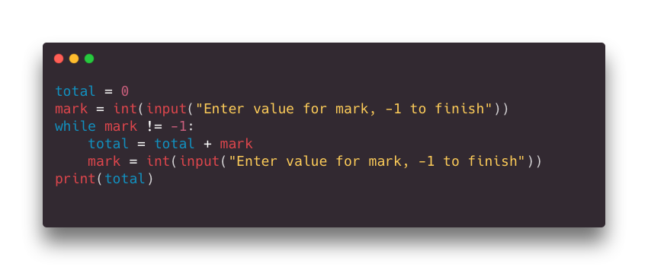

Pre-condition
loop (Python Code)
Condition that must be met for indented chunk of code to run
SYNTAX BREAKDOWN
The above program will keep adding what the user enters until user keys in the value "-1". The total will be printed.
For more help, please visit www.exampaperspractice.co.uk

Slide 66
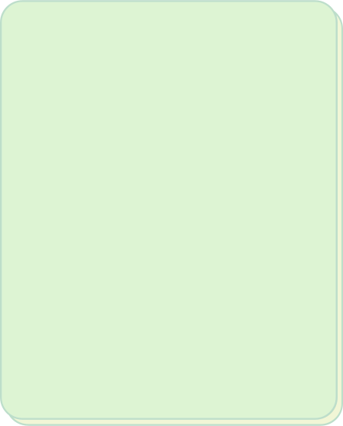

Iteration
Another word for iteration is loop. There are 3 different types of loop in iterative programming.
Count-controlled loop
Pre-condition
loop
Post-condition
loop
For a set number of iterations
Always has at least one iteration
May have no iterations
For more help, please visit www.exampaperspractice.co.uk

Slide 67
Post-condition
loop
A repeat-until loop in pseudocode executes its operations repeatedly until a specified condition becomes true after each iteration.
Total ← 0
Mark ← 0
REPEAT
Total ← Total + Mark
OUTPUT "Enter value for mark, -1 to finish "
INPUT Mark
UNTIL Mark = -1
For more help, please visit www.exampaperspractice.co.uk

Slide 68
Post-condition
loop (Pseudocode)
This is where a condition must be true after the loop or operation takes place.
SYNTAX BREAKDOWN
Total ← 0
Mark ← 0
REPEAT
Total ← Total + Mark
OUTPUT "Enter value for mark, -1 to finish "
INPUT Mark
UNTIL Mark = -1
Indented code. It will run at least once.
Condition that must be met for the indented codes to repeat
For more help, please visit www.exampaperspractice.co.uk

Slide 69
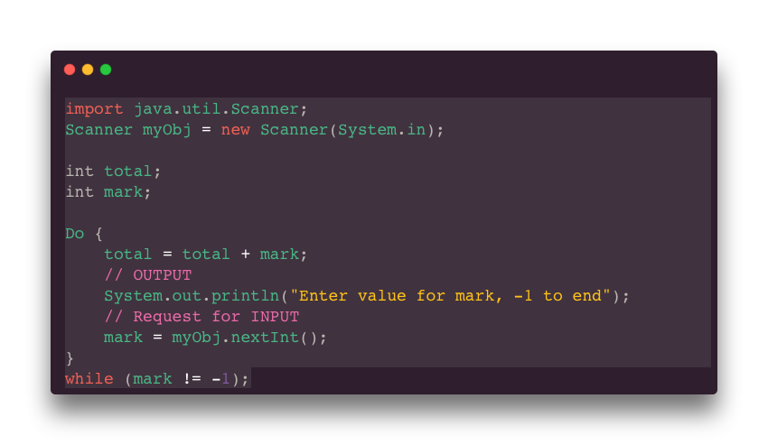

This is where a condition must be true after the loop or operation takes place.
Post-condition
loop (Java Code)
SYNTAX BREAKDOWN
*DO ... WHILE loop in Java
Indented code. It will run at least once.
*Python only supports pre-condition and count-controlled loop
Condition that must be met for the indented codes to repeat
For more help, please visit www.exampaperspractice.co.uk

Slide 70

PROGRAMMING
TIME
ITERATION
For more help, please visit www.exampaperspractice.co.uk

Slide 71
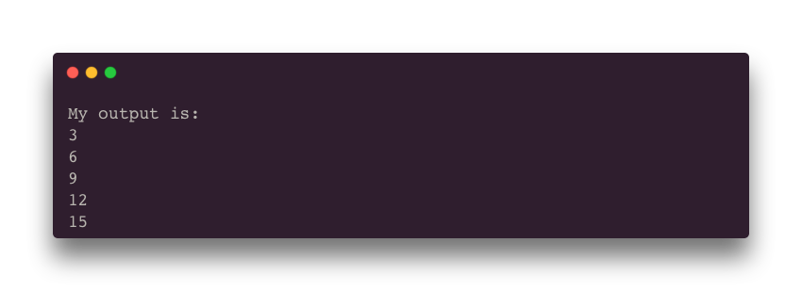
TASK 1 - MULTIPLES OF 3
Use a FOR loop (count-controlled) to output the first 5 multiples of 3. Your program should output the following:
For more help, please visit www.exampaperspractice.co.uk

Slide 72
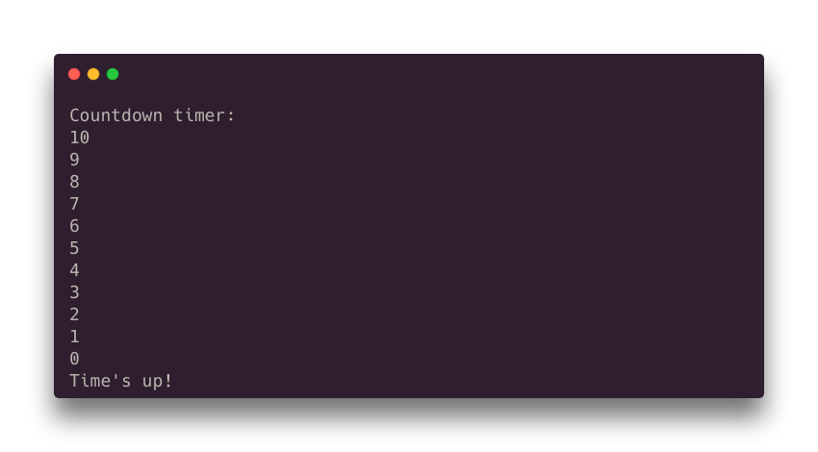
TASK 2-
COUNTDOWN
Use a FOR loop (count-controlled) to output a countdown from 10 to 0. Your program should output as the diagram below:
For more help, please visit www.exampaperspractice.co.uk

Slide 73
TASK 3-
COUNTDOWN (WHILE LOOP)
Use a WHILE loop (count-controlled) to output a countdown from 10 to 0. Your program should output as the diagram below:
For more help, please visit www.exampaperspractice.co.uk

Slide 74
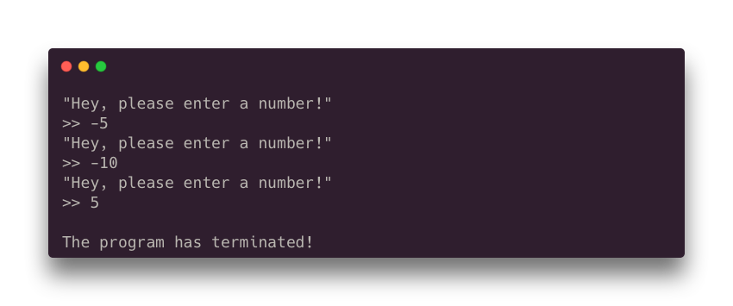
TASK 4-
I WANT POSITIVE NUMBER
Write a program that asks user to input numbers REPEATEDLY until the user keys in a positive number.
Your program would work like this:
For more help, please visit www.exampaperspractice.co.uk

Slide 75
TASK 5-
SUM TO N
Write a program that asks user to input numbers REPEATEDLY until the user keys in a positive number (from Task 4). Using the positive number (N), calculate the sum from 0 up to N.
Eg. If the user enters the value "5", your program should output the value 15 (5 + 4 + 3 + 2 + 1 + 0 = 15).
Test case:
INPUT = 3, OUTPUT = 6
INPUT = 10, OUTPUT = 55
INPUT = 100, OUTPUT = 5050
For more help, please visit www.exampaperspractice.co.uk

Slide 76
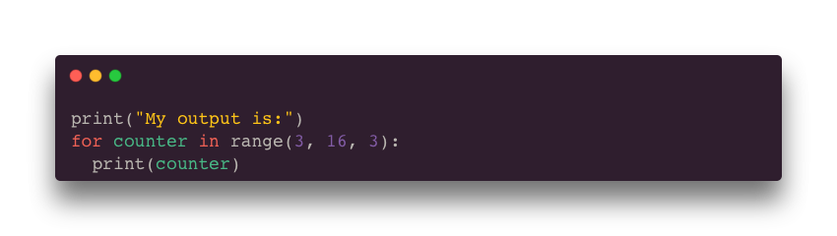
ANSWER - TASK 1
For more help, please visit www.exampaperspractice.co.uk

Slide 77
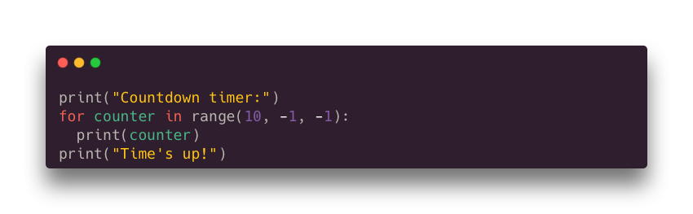
ANSWER - TASK 2
For more help, please visit www.exampaperspractice.co.uk

Slide 78
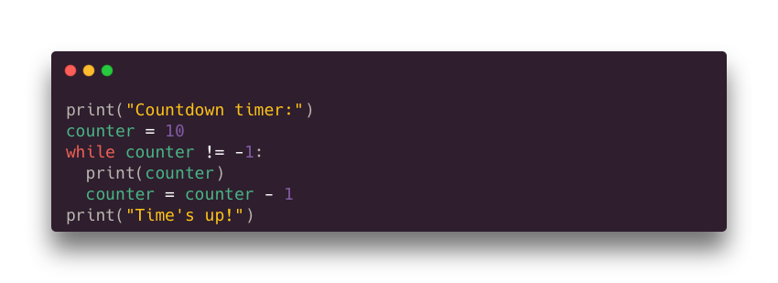
ANSWER - TASK 3
For more help, please visit www.exampaperspractice.co.uk

Slide 79
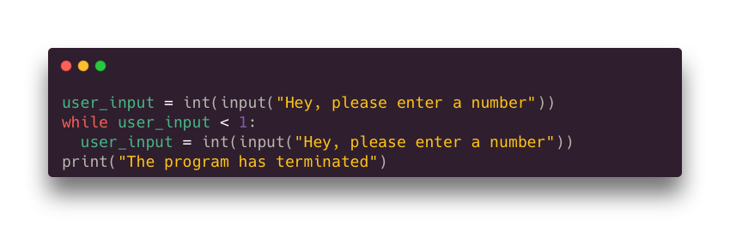
ANSWER - TASK 4
For more help, please visit www.exampaperspractice.co.uk

Slide 80
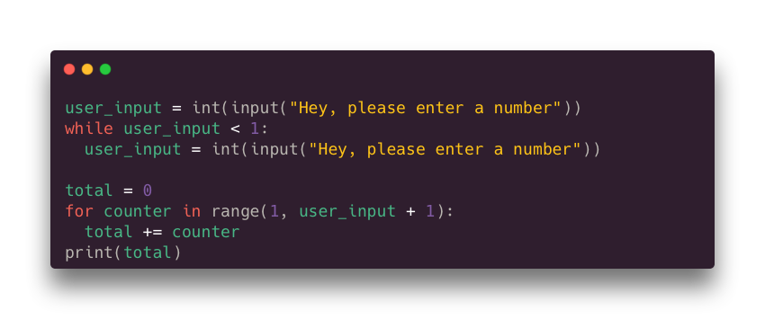
ANSWER - TASK 5
For more help, please visit www.exampaperspractice.co.uk

Slide 81

Sub Chapter Outline
8.1.4.1
Sequencing
8.1.4.2
Selection
8.1.4 Programming Fundamentals
8.1.4.3
Iteration
8.1.4.4
Totalling and Counting
8.1.4.5
String handling
8.1.4.6
Arithmetic, Logical and Boolean Operators
For more help, please visit www.exampaperspractice.co.uk

Slide 82
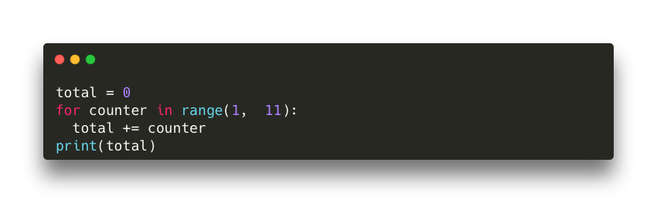
Totalling
In programming, totaling refers to the process of adding a number to an existing stored number, typically stored in two separate variables.
Eg. Python code to "Total" up the sum from 0 to 10 (0 + 1 + 2 ... 10).
For more help, please visit www.exampaperspractice.co.uk

Slide 83
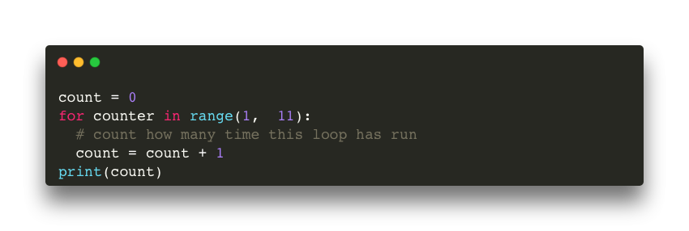
Counting
Counting keeps a check on how many iterations a program has performed in a loop.
For more help, please visit www.exampaperspractice.co.uk

Slide 84
Sub Chapter Outline
8.1.4.1
Sequencing
8.1.4.2
Selection
8.1.4 Programming Fundamentals
8.1.4.3
Iteration
8.1.4.4
Totalling and Counting
8.1.4.5
String handling
8.1.4.6
Arithmetic, Logical and Boolean Operators
For more help, please visit www.exampaperspractice.co.uk

Slide 85


"abcdefghijk"
lower
upper
length
substring
For more help, please visit www.exampaperspractice.co.uk

Slide 86

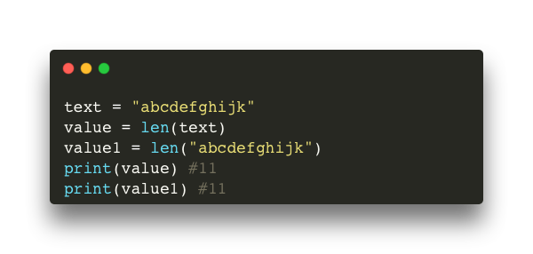
"abcdefghijk"
Find the number of characters in a string.
Pseudocode
Python code
length
value ← LENGTH("abcdefghijk")
OUTPUT value
#The value "11" will be output.
*Both text in quote and a variable in data type string can be used.
For more help, please visit www.exampaperspractice.co.uk

Slide 87
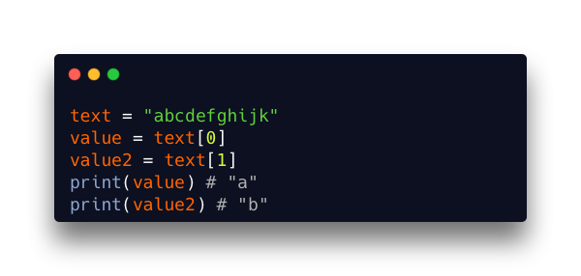
"abcdefghijk"
Extracting part of a string
0
1
2
3
4
5
6
7
8
9
10
a
b
c
d
e
f
g
h
I
j
k
substring
(one character)
*In Python, index starts at 0.
For more help, please visit www.exampaperspractice.co.uk

Slide 88
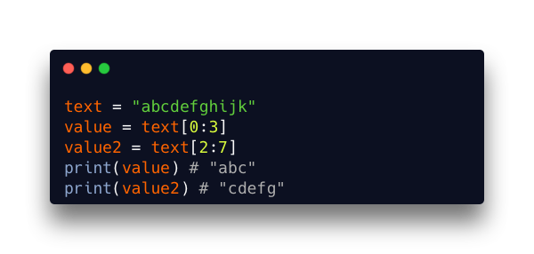
"abcdefghijk"
Extracting part of a string
0
1
2
3
4
5
6
7
8
9
10
a
b
c
d
e
f
g
h
I
j
k
substring
(range of characters)
*In Python, index starts at 0.
*syntax variable[x:y], x is the starting position and y is the ending
For more help, please visit www.exampaperspractice.co.uk

Slide 89
"abcdefghijk"
Extracting part of a string
1
2
3
4
5
6
7
8
9
10
11
a
b
c
d
e
f
g
h
I
j
k
substring
(range of characters)
*In Pseudocode, index starts at 1.
text <- "abcdefghijk"
shorten_text <- SUBSTRING(text, 1, 3)
OUTPUT shorten_text # "abc"
For more help, please visit www.exampaperspractice.co.uk

Slide 90
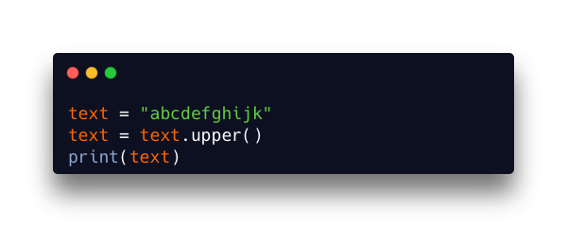
"abcdefghijk"
Convert all the letters in a string to uppercase
upper
text <- "abcdefghijk"
upper_text <- UCASE(text)
OUTPUT upper_text
# "ABCDEFGHIJK"
# "ABCDEFGHIJK"
For more help, please visit www.exampaperspractice.co.uk

Slide 91
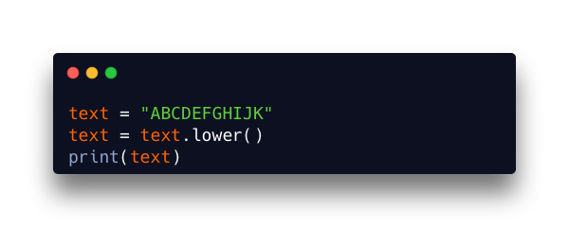
"abcdefghijk"
Convert all the letters in a string to lowercase
lower
text <- "ABCDEFGHIJK"
lower_text <- LCASE(text)
OUTPUT lower_text
# "abcdefghijk"
# "abcdefghijk"
For more help, please visit www.exampaperspractice.co.uk

Slide 92
Sub Chapter Outline
8.1.4.1
Sequencing
8.1.4.2
Selection
8.1.4 Programming Fundamentals
8.1.4.3
Iteration
8.1.4.4
Totalling and Counting
8.1.4.5
String handling
8.1.4.6
Arithmetic, Logical and Boolean Operators
For more help, please visit www.exampaperspractice.co.uk

Slide 93
Arithmetic Operators
Action
Pseudocode
Python
Add
+
+
Subtract
-
-
Multiply
*
*
Divide
/
/
Raise to the power of
^
**
Remainder division
MOD
%
Integer
division
DIV
//
For more help, please visit www.exampaperspractice.co.uk

Slide 94

Arithmetic Operators
Quick try out (on Python):
    Find the value of 352 + 102 + 21
    Find 2 to the power of 11
    Find the remainder when 1980 is divided by 7
    Try to add two characters/strings and see what you observed
For more help, please visit www.exampaperspractice.co.uk

Slide 95
Logical Operators
Operator
Pseudocode
Python
More than
>
>
Less than
<
<
Equal
=
==
Greater than or equal to
>=
>=
Less than or equal to
<=
<=
Not Equal
<>
!=
For more help, please visit www.exampaperspractice.co.uk

Slide 96
Boolean
Operator
Operator
Description
Pseudocode
Python
AND
Both True
AND
and
OR
Either True
OR
or
NOT
Not True
NOT
not
For more help, please visit www.exampaperspractice.co.uk

Slide 97
PROGRAMMING
TIME
OPERATORS
For more help, please visit www.exampaperspractice.co.uk

Slide 98
TASK 1 - USING OPERATORS
Takes 2 numbers as inputs from the user (N1 and N2):
Compare N1 and N2:
    Output with a suitable message if both numbers are not equal
    Output with a suitable message identifying which number is larger
    Output with a suitable message identifying which number is smaller
    Output with a suitable message if both numbers are equal
For more help, please visit www.exampaperspractice.co.uk

Slide 99
TASK 1B - USING OPERATORS
[Continued] Take in a 3th number (N3).
    Output with a suitable message if all three numbers are not equal
    Output with a suitable message if all numbers are equal.
For more help, please visit www.exampaperspractice.co.uk

Slide 100
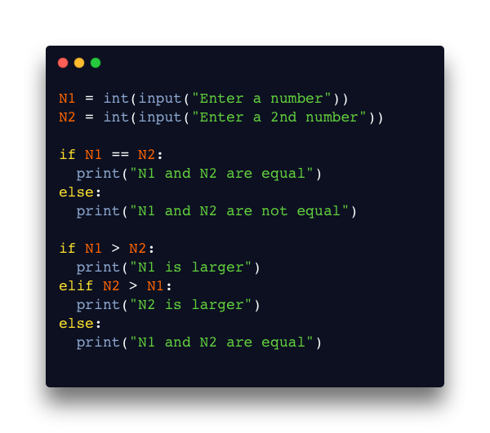
ANSWER - TASK 1
For more help, please visit www.exampaperspractice.co.uk

Slide 101

ANSWER - TASK 1B
For more help, please visit www.exampaperspractice.co.uk

Slide 102
Sub Chapter Outline
8.1.4.1
Sequencing
8.1.4.2
Selection
8.1.4 Programming Fundamentals
8.1.4.3
Iteration
8.1.4.4
Totalling and Counting
8.1.4.5
String handling
8.1.4.6
Arithmetic, Logical and Boolean Operators
For more help, please visit www.exampaperspractice.co.uk

Slide 103
Chapter Outline
8.2.1 One-dimensional Arrays
8.1.1 Variables and Constants
8.1.2 Basic Data Types
8.1.3 Input and Output
8.1.4 Programming Fundamentals
8.1.5 Nested Statements
8.1.6 Procedures, Functions and Parameters
8.1.7 Library Routines
8.1.8 Creating a Maintainable Program
8.2.2 Two-dimensional Arrays
8.3.1 Reading from a file
8.3.2 Writing to a file
For more help, please visit www.exampaperspractice.co.uk

Slide 104



Sometimes, it is necessary to execute one IF statement, followed by another, and then followed by another. This is when nested selection is needed.
Nested Selection
Nested IF-statement
Normal IF-statement
For more help, please visit www.exampaperspractice.co.uk

Slide 105

Nested Selection
SYNTAX BREAKDOWN
Nested IF-statement
An IF statement within an IF statement
An IF statement
For more help, please visit www.exampaperspractice.co.uk

Slide 106
Nested Selection
SYNTAX BREAKDOWN
What does the code below do?
Check if number input is more than 50.
If so, check again if it is more than 75.
For more help, please visit www.exampaperspractice.co.uk

Slide 107



In the same way as a selection can be nested, a loop can be nested inside another loop.
Nested Iteration
Normal Loop
Nested Loop
For more help, please visit www.exampaperspractice.co.uk

Slide 108
Nested Iteration
STEP-BY-STEP
Output
>> "Counter = 1"
>> "Counter = 2"
>>
Program ended as the loop ends when counter = 3. Easy!!
Normal Loop
For more help, please visit www.exampaperspractice.co.uk

Slide 109

Nested Iteration
STEP-BY-STEP
Code
for counter in range(1,3):
print("Counter = " + str(counter))
for another_counter in range(1,3):
print("Another counter = " + str(another_counter))
Output
>>
For more help, please visit www.exampaperspractice.co.uk

Slide 110
Nested Iteration
STEP-BY-STEP
Code
for counter in range(1,3):
print("Counter = " + str(counter))
for another_counter in range(1,3):
print("Another counter = " + str(another_counter))
Output
>> Counter = 1
For more help, please visit www.exampaperspractice.co.uk

Slide 111
Nested Iteration
STEP-BY-STEP
Code
for counter in range(1,3):
print("Counter = " + str(counter))
for another_counter in range(1,3):
print("Another counter = " + str(another_counter))
Output
>> Counter = 1
For more help, please visit www.exampaperspractice.co.uk

Slide 112
Nested Iteration
STEP-BY-STEP
Code
for counter in range(1,3):
print("Counter = " + str(counter))
for another_counter in range(1,3):
print("Another counter = " + str(another_counter))
Output
>> Counter = 1
>> Another counter = 1
For more help, please visit www.exampaperspractice.co.uk

Slide 113
Nested Iteration
STEP-BY-STEP
Code
for counter in range(1,3):
print("Counter = " + str(counter))
for another_counter in range(1,3):
print("Another counter = " + str(another_counter))
*return to inner loop
Output
>> Counter = 1
>> Another counter = 1
For more help, please visit www.exampaperspractice.co.uk

Slide 114
Nested Iteration
STEP-BY-STEP
Code
for counter in range(1,3):
print("Counter = " + str(counter))
for another_counter in range(1,3):
print("Another counter = " + str(another_counter))
Output
>> Counter = 1
>> Another counter = 1
>> Another counter = 2
For more help, please visit www.exampaperspractice.co.uk

Slide 115
Nested Iteration
STEP-BY-STEP
Code
for counter in range(1,3):
print("Counter = " + str(counter))
for another_counter in range(1,3):
print("Another counter = " + str(another_counter))
*inner loop ended, return to outerloop
Output
>> Counter = 1
>> Another counter = 1
>> Another counter = 2
For more help, please visit www.exampaperspractice.co.uk

Slide 116
Nested Iteration
STEP-BY-STEP
Code
for counter in range(1,3):
print("Counter = " + str(counter))
for another_counter in range(1,3):
print("Another counter = " + str(another_counter))
Output
>> Counter = 1
>> Another counter = 1
>> Another counter = 2
>> Counter = 2
For more help, please visit www.exampaperspractice.co.uk

Slide 117
Nested Iteration
STEP-BY-STEP
Code
for counter in range(1,3):
print("Counter = " + str(counter))
for another_counter in range(1,3):
print("Another counter = " + str(another_counter))
Output
>> Counter = 1
>> Another counter = 1
>> Another counter = 2
>> Counter = 2
For more help, please visit www.exampaperspractice.co.uk

Slide 118
Nested Iteration
STEP-BY-STEP
Code
for counter in range(1,3):
print("Counter = " + str(counter))
for another_counter in range(1,3):
print("Another counter = " + str(another_counter))
Output
>> Counter = 1
>> Another counter = 1
>> Another counter = 2
>> Counter = 2
>> Another counter = 1
For more help, please visit www.exampaperspractice.co.uk

Slide 119
Nested Iteration
STEP-BY-STEP
Code
for counter in range(1,3):
print("Counter = " + str(counter))
for another_counter in range(1,3):
print("Another counter = " + str(another_counter))
Output
>> Counter = 1
>> Another counter = 1
>> Another counter = 2
>> Counter = 2
>> Another counter = 1
For more help, please visit www.exampaperspractice.co.uk

Slide 120
Nested Iteration
STEP-BY-STEP
Code
for counter in range(1,3):
print("Counter = " + str(counter))
for another_counter in range(1,3):
print("Another counter = " + str(another_counter))
Output
>> Counter = 1
>> Another counter = 1
>> Another counter = 2
>> Counter = 2
>> Another counter = 1
>> Another counter = 2
For more help, please visit www.exampaperspractice.co.uk

Slide 121

Nested Iteration
STEP-BY-STEP
Code
for counter in range(1,3):
print("Counter = " + str(counter))
for another_counter in range(1,3):
print("Another counter = " + str(another_counter))
*outer loop ends, program ends, final output
Output
>> Counter = 1
>> Another counter = 1
>> Another counter = 2
>> Counter = 2
>> Another counter = 1
>> Another counter = 2
For more help, please visit www.exampaperspractice.co.uk

Slide 122
PROGRAMMING
TIME
NESTED
STATEMENTS
For more help, please visit www.exampaperspractice.co.uk

Slide 123

TASK 1 - MULTIPLICATION TABLE
Write a nested for loop program to print multiplication table in Python. Your program should produce the following output.
(Tips: Not an easy problem).
For more help, please visit www.exampaperspractice.co.uk

Slide 124

TASK 2 - STARS
Use a nested loop to print the following pattern in Python.
Tips: Harder to do than Task 1.
For more help, please visit www.exampaperspractice.co.uk

Slide 125

ANSWER - TASK 1
For more help, please visit www.exampaperspractice.co.uk

Slide 126

ANSWER - TASK 2
For more help, please visit www.exampaperspractice.co.uk

Slide 127
Chapter Outline
8.2.1 One-dimensional Arrays
8.1.1 Variables and Constants
8.1.2 Basic Data Types
8.1.3 Input and Output
8.1.4 Programming Fundamentals
8.1.5 Nested Statements
8.1.6 Procedures, Functions and Parameters
8.1.7 Library Routines
8.1.8 Creating a Maintainable Program
8.2.2 Two-dimensional Arrays
8.3.1 Reading from a file
8.3.2 Writing to a file
For more help, please visit www.exampaperspractice.co.uk

Slide 128
Subroutine
When writing algorithms, there are often recurring tasks that use the same sets of statements. To avoid repetition and writing new code each time they're needed, many programming languages utilize subroutines, also known as named procedures or functions. These are defined once and can be invoked multiple times throughout a program.
For more help, please visit www.exampaperspractice.co.uk

Slide 129


Subroutine
For example, let's say you have a program that would do the following operations to an input number:
- Add 5
- Multiply by 3
- Divide by 2
- Add 100
- Minus 20
- Then, print the total.
You program might look like this.
For more help, please visit www.exampaperspractice.co.uk

Slide 130

Subroutine
For example, let's say you have a program that would do the following operations to two input number:
- Add 5
- Multiply by 3
- Divide by 2
- Add 100
- Minus 20
- Then, print the total.
You program might look like this.
For more help, please visit www.exampaperspractice.co.uk

Slide 131
SIMILAR!
SIMILAR!
For more help, please visit www.exampaperspractice.co.uk

Slide 132
We can group this chunk of code together and make a procedure/function
For more help, please visit www.exampaperspractice.co.uk

Slide 133

We can group this chunk of code together and make a procedure/function
For more help, please visit www.exampaperspractice.co.uk

Slide 134
And use the function like
this
For more help, please visit www.exampaperspractice.co.uk

Slide 135
SYNTAX BREAKDOWN
function name,
used to call the function
parameter, the value which we insert into the function
def keyword
For more help, please visit www.exampaperspractice.co.uk

Slide 136
Procedure vs Function
A subroutine that will not return a value
A subroutine that will return a value
For more help, please visit www.exampaperspractice.co.uk

Slide 137



Procedure vs Function
does not
return a value
return a value
number is returned here
For more help, please visit www.exampaperspractice.co.uk

Slide 138


Parameter vs No Parameters
parameter
For more help, please visit www.exampaperspractice.co.uk

Slide 139

Global and local variables
For more help, please visit www.exampaperspractice.co.uk

Slide 140

Global and local variables
local variable, only can be used within the function
Can be used here because they are global variables
global variable,can be used anywhere
cannot be used here
For more help, please visit www.exampaperspractice.co.uk

Slide 141
PROGRAMMING
TIME
FUNCTIONS
For more help, please visit www.exampaperspractice.co.uk

Slide 142
TASK 1 - STARS
Write a function that can print one line of stars (*********).
In your codes, call the function 5 times to print 5 lines of stars. Your program should output the following:
For more help, please visit www.exampaperspractice.co.uk

Slide 143


TASK 1B - STARS EXTENDED
Create a function that takes in a "number" parameter. Using the number(N) parameter, print N lines of stars. For instance:
user input = 6
user input = 3
For more help, please visit www.exampaperspractice.co.uk

Slide 144
TASK 2 - FAHRENHEIT TO CELCIUS
The formula to convert Fahrenheit to Celsius is
Celsius = (Fahrenheit - 32) * (5/9)
Write a function that converts Fahrenheit to Celsius.
Your function will need to take in a value as parameter and return the result.
Then, use the function to calculate two input values from the user.
For more help, please visit www.exampaperspractice.co.uk

Slide 145

ANSWER - TASK 1
For more help, please visit www.exampaperspractice.co.uk

Slide 146

ANSWER - TASK 1B
For more help, please visit www.exampaperspractice.co.uk

Slide 147

ANSWER - TASK 2
For more help, please visit www.exampaperspractice.co.uk

Slide 148
Chapter Outline
8.2.1 One-dimensional Arrays
8.1.1 Variables and Constants
8.1.2 Basic Data Types
8.1.3 Input and Output
8.1.4 Programming Fundamentals
8.1.5 Nested Statements
8.1.6 Procedures, Functions and Parameters
8.1.7 Library Routines
8.1.8 Creating a Maintainable Program
8.2.2 Two-dimensional Arrays
8.3.1 Reading from a file
8.3.2 Writing to a file
For more help, please visit www.exampaperspractice.co.uk

Slide 149


Library Routine
A "physical" library contains books
For more help, please visit www.exampaperspractice.co.uk

Slide 150

Library Routine
The library of a programming language contains pre-written code blocks called library routines or functions, which can be easily called and reused multiple times.
For more help, please visit www.exampaperspractice.co.uk

Slide 151
Library Routine
They are pre-programmed routines that can be called upon as needed, without requiring additional programming, and are designed to address common challenges encountered in software development.
For more help, please visit www.exampaperspractice.co.uk

Slide 152
Library Routine
Some common libraries that we use in this subjects:
Returns the remainder of a division operation.
Returns the integer part of a division operation.
MOD
DIV
Function that rounds a number to the nearest integer.
Generates a random number within a specified range.
ROUND
RANDOM
For more help, please visit www.exampaperspractice.co.uk

Slide 153
Library Routine
CODE
Pseudocode
Try it out in
Python
MOD
MOD(10,3)
Value = 10%3
DIV
DIV(10,3)
Value = 10//3
ROUND
ROUND(6.933,2)
Value = round(6.97354, 2)
from random import random
Value = random()
RANDOM
RANDOM()
For more help, please visit www.exampaperspractice.co.uk

Slide 154
Chapter Outline
8.2.1 One-dimensional Arrays
8.1.1 Variables and Constants
8.1.2 Basic Data Types
8.1.3 Input and Output
8.1.4 Programming Fundamentals
8.1.5 Nested Statements
8.1.6 Procedures, Functions and Parameters
8.1.7 Library Routines
8.1.8 Creating a Maintainable Program
8.2.2 Two-dimensional Arrays
8.3.1 Reading from a file
8.3.2 Writing to a file
For more help, please visit www.exampaperspractice.co.uk

Slide 155

Maintainable
Program
After writing a program, there may come a time when another programmer needs to maintain or update it. They might only have the source code as documentation, and even the original programmer might forget the details of how certain tasks were implemented when revisiting the program after several years.
For more help, please visit www.exampaperspractice.co.uk

Slide 156


Maintainable
Program
3 ways to write a maintainable program
    Always use meaningful identifier names for variables, constant, arrays, procedures, functions.
Instead of:
Do this:
For more help, please visit www.exampaperspractice.co.uk

Slide 157

Maintainable
Program
3 ways to write a maintainable program
2. Program should be divided into modules using procedures and functions whenever possible
Instead of:
Do this:
For more help, please visit www.exampaperspractice.co.uk

Slide 158

Maintainable
Program
3 ways to write a maintainable program
3. Be fully commented using your programming language’s commenting feature.
*comments will not be run by computer, only as indicators to programmers
Instead of:
Do this:
For more help, please visit www.exampaperspractice.co.uk

Slide 159

Maintainable
Program
Fun fact: A book has been written to"teach" programmers how to write maintainable code.
464 pages!!!
For more help, please visit www.exampaperspractice.co.uk

Slide 160
Chapter Outline
8.2.1 One-dimensional Arrays
8.1.1 Variables and Constants
8.1.2 Basic Data Types
8.1.3 Input and Output
8.1.4 Programming Fundamentals
8.1.5 Nested Statements
8.1.6 Procedures, Functions and Parameters
8.1.7 Library Routines
8.1.8 Creating a Maintainable Program
8.2.2 Two-dimensional Arrays
8.3.1 Reading from a file
8.3.2 Writing to a file
For more help, please visit www.exampaperspractice.co.uk

Slide 161

One-dimensional array
RECAP
Variables are memory locations that can store a piece of data.
10
Variable is created
refer to the data stored in the memory by name
Computer memory
For more help, please visit www.exampaperspractice.co.uk

Slide 162

One-dimensional array
ARRAY
An array consists of consecutive memory locations that store data of the same data type.
2
3
4
Variable is created
refer to the
GROUP OF data stored in the memory by name
Computer memory
For more help, please visit www.exampaperspractice.co.uk

Slide 163
One-dimensional array
ARRAY
Each location can still store 1 data, but locations can be grouped together.
2
3
4
Variable is created
refer to the
GROUP OF data stored in the memory by name
Computer memory
For more help, please visit www.exampaperspractice.co.uk

Slide 164
One-dimensional array
ARRAY
0
1
2
Index
2
3
4
Data
Most programming languages automatically set the first index of an array to ZERO.
For more help, please visit www.exampaperspractice.co.uk

Slide 165
One-dimensional array
ARRAY
0
1
2
Index
2
3
4
Data
To retrieve an element of an array, we would just do:
ARRAYNAME[index]
For more help, please visit www.exampaperspractice.co.uk

Slide 166
One-dimensional array
ARRAY
Declare an array in Pseudocode
0
1
2
DECLARE MyList:ARRAY[0:2] OF INTEGER
For more help, please visit www.exampaperspractice.co.uk

Slide 167
One-dimensional array
ARRAY
Each position in the array can be populated in an array by defining the value at each index position
0
1
2
MyList[2] = 20
20
For more help, please visit www.exampaperspractice.co.uk

Slide 168

One-dimensional array
ARRAY
In Python, arrays are created using the LIST functionality.
0
1
2
20
For more help, please visit www.exampaperspractice.co.uk

Slide 169
Chapter Outline
8.2.1 One-dimensional Arrays
8.1.1 Variables and Constants
8.1.2 Basic Data Types
8.1.3 Input and Output
8.1.4 Programming Fundamentals
8.1.5 Nested Statements
8.1.6 Procedures, Functions and Parameters
8.1.7 Library Routines
8.1.8 Creating a Maintainable Program
8.2.2 Two-dimensional Arrays
8.3.1 Reading from a file
8.3.2 Writing to a file
For more help, please visit www.exampaperspractice.co.uk

Slide 170
Two-dimensional array
A two-dimensional array has multiple columns and multiple rows of data, all with the same data type.Very much like an excel file.
Index
0
1
2
2
3
4
0
5
6
7
1
8
9
10
2
For more help, please visit www.exampaperspractice.co.uk

Slide 171
Two-dimensional array
Example usage:
A world map in a simple 2D game.
Index
0
1
2
T
T
G
G - ground
T - tree
Z - zombies
H - humans
0
Z
G
G
1
H
G
G
2
For more help, please visit www.exampaperspractice.co.uk

Slide 172
Two-dimensional array
Example usage:
Students mark in different subjects
Physics
Chemistry
Biology
Index
0
1
2
76
65
67
StudentA
0
32
90
75
StudentB
1
66
77
31
StudentC
2
For more help, please visit www.exampaperspractice.co.uk

Slide 173
Two-dimensional array
PSEUDOCODE
Index
0
1
DECLARE MyList:ARRAY[0:2,0:1] OF INTEGER
0
1
2
TYPE
ROW
COLUMN
For more help, please visit www.exampaperspractice.co.uk

Slide 174
Two-dimensional array
PSEUDOCODE
Index
0
1
MYLIST[2,1] <- 10
0
1
2
10
For more help, please visit www.exampaperspractice.co.uk

Slide 175
Two-dimensional array
PSEUDOCODE
Index
0
1
OUTPUT MYLIST[0,0]
#30 will be OUTPUT
0
30
1
2
10
For more help, please visit www.exampaperspractice.co.uk

Slide 176

Two-dimensional array
PYTHON
Index
0
1
0
30
20
1
15
5
2
0
10
A two-dimensional array in Python is basically a list inside a list!
For more help, please visit www.exampaperspractice.co.uk

Slide 177

Two-dimensional array
PYTHON
In Python, you can loop through a list like this.
For more help, please visit www.exampaperspractice.co.uk

Slide 178


Two-dimensional array
STEP-BY-STEP
Loop through a list of list in python
Code
big_list = [["a", "b"], ["c", "d"]]
for small_list in big_list:
for character in small_list:
print(character)
>>
For more help, please visit www.exampaperspractice.co.uk

Slide 179
Two-dimensional array
STEP-BY-STEP
Loop through a list of list in python
Code
big_list = [["a", "b"], ["c", "d"]]
for small_list in big_list:
for character in small_list:
print(character)
>>
For more help, please visit www.exampaperspractice.co.uk

Slide 180
Two-dimensional array
STEP-BY-STEP
Loop through a list of list in python
Code
big_list = [["a", "b"], ["c", "d"]]
for small_list in big_list:
for character in small_list:
print(character)
>>
For more help, please visit www.exampaperspractice.co.uk

Slide 181
Two-dimensional array
STEP-BY-STEP
Loop through a list of list in python
Code
big_list = [["a", "b"], ["c", "d"]]
for small_list in big_list:
for character in small_list:
print(character)
>> a
>>
For more help, please visit www.exampaperspractice.co.uk

Slide 182
Two-dimensional array
STEP-BY-STEP
Loop through a list of list in python
Code
big_list = [["a", "b"], ["c", "d"]]
for small_list in big_list:
for character in small_list:
print(character)
>> a
>>
For more help, please visit www.exampaperspractice.co.uk

Slide 183
Two-dimensional array
STEP-BY-STEP
Loop through a list of list in python
Code
big_list = [["a", "b"], ["c", "d"]]
for small_list in big_list:
for character in small_list:
print(character)
>> a
>> b
For more help, please visit www.exampaperspractice.co.uk

Slide 184
Two-dimensional array
STEP-BY-STEP
Loop through a list of list in python
Code
big_list = [["a", "b"], ["c", "d"]]
for small_list in big_list:
for character in small_list:
print(character)
>> a
>> b
For more help, please visit www.exampaperspractice.co.uk

Slide 185
Two-dimensional array
STEP-BY-STEP
Loop through a list of list in python
Code
big_list = [["a", "b"], ["c", "d"]]
for small_list in big_list:
for character in small_list:
print(character)
>> a
>> b
For more help, please visit www.exampaperspractice.co.uk

Slide 186
Two-dimensional array
STEP-BY-STEP
Loop through a list of list in python
Code
big_list = [["a", "b"], ["c", "d"]]
for small_list in big_list:
for character in small_list:
print(character)
>> a
>> b
>> c
For more help, please visit www.exampaperspractice.co.uk

Slide 187
Two-dimensional array
STEP-BY-STEP
Loop through a list of list in python
Code
big_list = [["a", "b"], ["c", "d"]]
for small_list in big_list:
for character in small_list:
print(character)
>> a
>> b
>> c
For more help, please visit www.exampaperspractice.co.uk

Slide 188
Two-dimensional array
STEP-BY-STEP
Loop through a list of list in python
Code
big_list = [["a", "b"], ["c", "d"]]
for small_list in big_list:
for character in small_list:
print(character)
>> a
>> b
>> c
>> d
For more help, please visit www.exampaperspractice.co.uk

Slide 189
PROGRAMMING
TIME
ARRAYS
For more help, please visit www.exampaperspractice.co.uk

Slide 190

TASK 1 - SQUARE
Turn every item in the following list into squares. You can print out your result.
For more help, please visit www.exampaperspractice.co.uk

Slide 191
TASK 1 - EXAM MARKS
Create a list of list in python to represent the data. Then, find out:
    Find out the top marks for Physics, Chemistry and Biology.
    The student with the highest average mark
    Tips: The index and subject/name column is for illustration only, you do not need to include them in your list. Your list should be a 3x3 two dimensional list.
Physics
Chemistry
Biology
Index
0
1
2
StudentA
0
76
65
67
StudentB
1
32
90
75
StudentC
2
66
77
31
For more help, please visit www.exampaperspractice.co.uk

Slide 192

ANSWER - TASK 1
For more help, please visit www.exampaperspractice.co.uk

Slide 193

ANSWER TASK 2
For more help, please visit www.exampaperspractice.co.uk

Slide 194
Chapter Outline
8.2.1 One-dimensional Arrays
8.1.1 Variables and Constants
8.1.2 Basic Data Types
8.1.3 Input and Output
8.1.4 Programming Fundamentals
8.1.5 Nested Statements
8.1.6 Procedures, Functions and Parameters
8.1.7 Library Routines
8.1.8 Creating a Maintainable Program
8.2.2 Two-dimensional Arrays
8.3.1 Reading from a file
8.3.2 Writing to a file
For more help, please visit www.exampaperspractice.co.uk

Slide 195
Reading and writing
We have seen programming involves the input of a lot of data.
Pseudocode
Python Code
INPUT Age
IF Age > 18
THEN
OUTPUT "You are an adult"
ELSE
OUTPUT "You are a kid"
ENDIF
For more help, please visit www.exampaperspractice.co.uk

Slide 196

Reading and writing
Input can also be in the form of file.
For more help, please visit www.exampaperspractice.co.uk

Slide 197
Reading and writing
Files can be read and written to.
For more help, please visit www.exampaperspractice.co.uk

Slide 198




Reading from a file
Read mode
Output:
For more help, please visit www.exampaperspractice.co.uk

Slide 199
Chapter Outline
8.2.1 One-dimensional Arrays
8.1.1 Variables and Constants
8.1.2 Basic Data Types
8.1.3 Input and Output
8.1.4 Programming Fundamentals
8.1.5 Nested Statements
8.1.6 Procedures, Functions and Parameters
8.1.7 Library Routines
8.1.8 Creating a Maintainable Program
8.2.2 Two-dimensional Arrays
8.3.1 Reading from a file
8.3.2 Writing to a file
For more help, please visit www.exampaperspractice.co.uk

Slide 200

Writing to a file
Create a file if it does not exist
Write mode
Write each string in the content into the newly created txt file +
a new line
For more help, please visit www.exampaperspractice.co.uk

Slide 201

Writing to a file
Output
Code
For more help, please visit www.exampaperspractice.co.uk

