Slide 1


Cambridge IGCSE Computer Science 0478/0984 - Revision Notes
Chapter 10 - Logic Gates
This study guide has been expertly compiled and edited by successful former teachers of Computer Science and highly experienced examiners and is suitable for students who are taking 0478 (9-1) IGCSE, the 0984 (A*-G) IGCSE, and the 2210 O Level for examination in 2023 onwards. It could be used as lesson starters, or supplied to students for independent use.
For more help, please visit www.exampaperspractice.co.uk

Slide 2







IGCSE Computer Science
Logic Gates and circuits
For more help, please visit www.exampaperspractice.co.uk

Slide 3

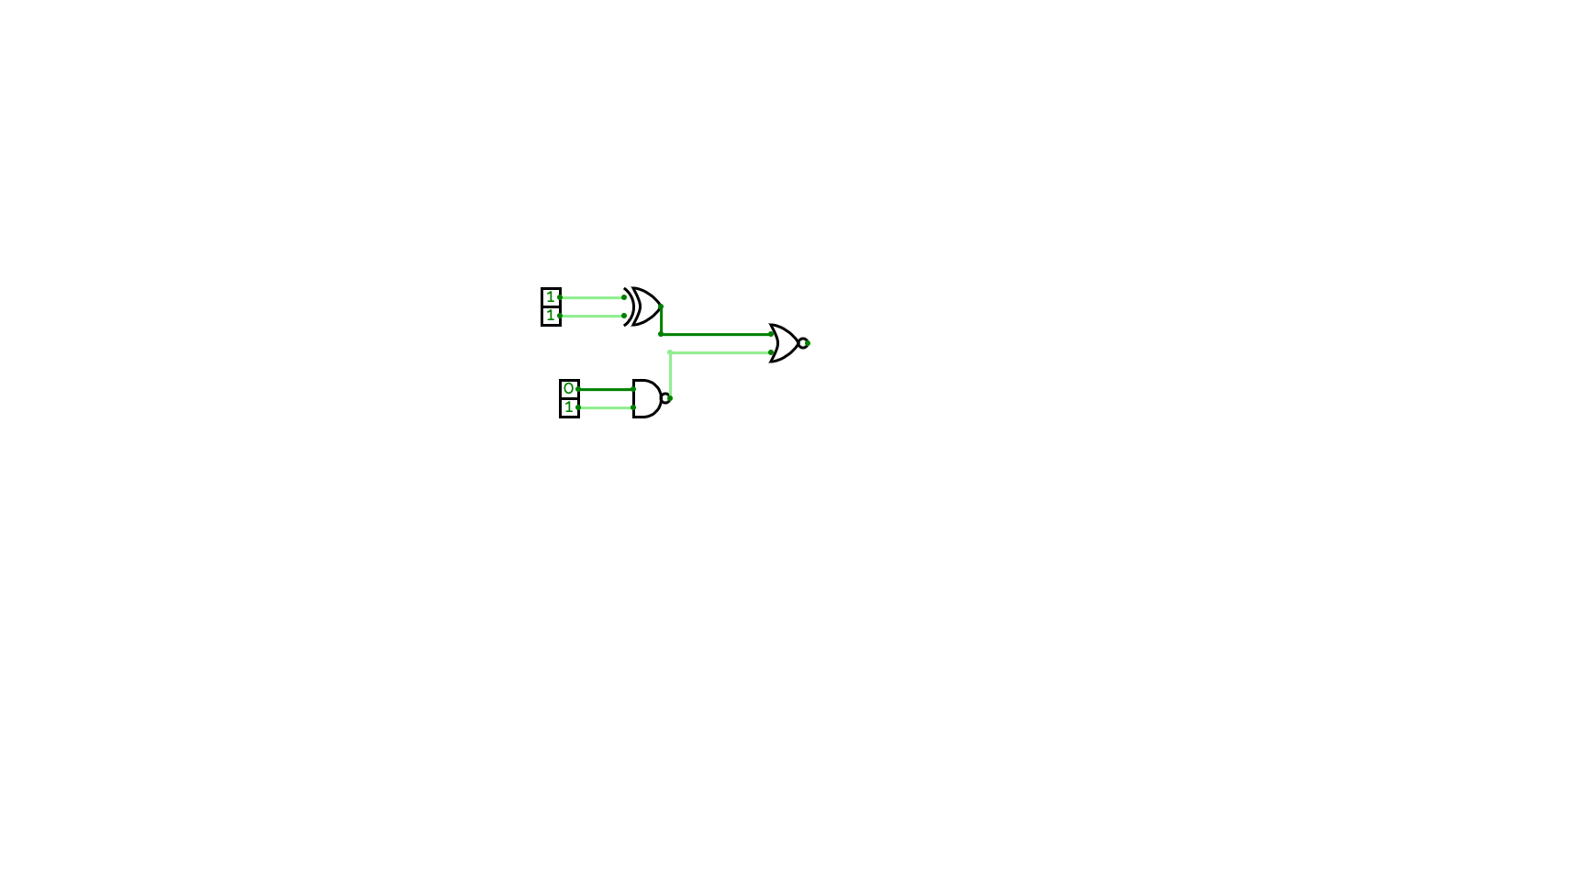

Logic Gates
Circuit
Logic gates are the basic components that make up a circuit.
These circuits are used in almost every computer system.
For more help, please visit www.exampaperspractice.co.uk

Slide 4
HOW DOES A LOGIC GATE WORK?
Apply a Boolean operation
0
The gates receives binary input
0
Output a binary result
0 , 1
1
For more help, please visit www.exampaperspractice.co.uk

Slide 5

Understanding Boolean Operations
Boolean values - A value that is either TRUE or FALSE
Boolean values
Binary value
Synonyms
True
1
On, Yes, Positive
False
0
Off, No, Negative
For more help, please visit www.exampaperspractice.co.uk

Slide 6
Understanding Boolean Operations
Logical Operators
Logical
Operator
Boolean
Operator
Examples
A AND B
A . B
AND
.
A OR B
A + B
OR
+
_
NOT A
A
NOT
_
For more help, please visit www.exampaperspractice.co.uk

Slide 7

Understanding Boolean Operations - Worked Example
Boolean values
Binary value
Synonyms
True
1
On, Yes, Positive
False
0
Off, No, Negative
You have decided that you will treat yourself a good meal if you have money. You also decide to do so even when you don’t have money if you are having a really bad day.
Express this using Boolean operators.
Logical
Operator
Boolean
Operator
Examples
AND
.
A AND B
A . B
OR
+
A OR B
A + B
_
NOT A
A
NOT
_
For more help, please visit www.exampaperspractice.co.uk

Slide 8
Understanding Boolean Operations - Worked Example
Expressing conditions as boolean values
You have money
TRUE
You have decided that you will treat yourself a good meal if you have money. You also decide to do so even when you don’t have money if you are having a really bad day.
Express this using Boolean operators.
You do not have money
FALSE
You have a bad day
TRUE
You do not have a bad day
FALSE
For more help, please visit www.exampaperspractice.co.uk

Slide 9



Understanding Boolean Operations - Worked Example
Logical expression
Buy yourself a good meal =
(You have money) OR (NOT (You have money)) AND (Have a bad day)
For more help, please visit www.exampaperspractice.co.uk

Slide 10

TRY IT YOURSELF
Write a logical expression like the example above for this given scenario.
There are two methods of getting to your basketball practice on time. You can get the bus but only if you wake up before 7.00am. If you wake up after this time, you will need to ask your parents to take you in the car. If you wake up before 7.00am but your parents offer to take you, then you will always say yes as it is easier.
For more help, please visit www.exampaperspractice.co.uk

Slide 11

TRY IT YOURSELF
Logical expression
Attend basketball on time
= (Wake up before 7am) OR (NOT Wake up before 7am AND Parent offer to take you)
For more help, please visit www.exampaperspractice.co.uk

Slide 12
TYPES OF logic gates
NOT Gate
XOR Gate
Different gates come with different logic rules
AND Gate
NAND Gate
OR Gate
NOR Gate
For more help, please visit www.exampaperspractice.co.uk

Slide 13
Not gate
1
0
0
1
The NOT gate takes a single input and produces the opposite of that input in a single output
For more help, please visit www.exampaperspractice.co.uk

Slide 14
Not gate
LOGIC NOTATION
A
X
X = NOT A
Truth Table
INPUT
OUTPUT
Boolean algebra
A
X
0
1
X = A
1
0
For more help, please visit www.exampaperspractice.co.uk

Slide 15
AND Gate
1
0
0
The AND date takes the inputs A and B and produces the output, X. If both inputs are 1, then the output will be 1, but otherwise the output will be 0.
For more help, please visit www.exampaperspractice.co.uk

Slide 16

AND gate
A
X
LOGIC NOTATION
B
X = A AND B
Truth Table
INPUT
OUTPUT
A
B
X
Boolean algebra
0
0
0
0
1
0
X = A . B
1
0
0
1
1
1
For more help, please visit www.exampaperspractice.co.uk

Slide 17

OR Gate
1
1
0
The OR gate takes two inputs, A and B, and produces output X. If either or both inputs is 1, the output will be 1.
For more help, please visit www.exampaperspractice.co.uk

Slide 18
OR gate
A
X
LOGIC NOTATION
B
X = A OR B
Truth Table
INPUT
OUTPUT
A
B
X
Boolean algebra
0
0
0
0
1
1
X = A + B
1
0
1
1
1
1
For more help, please visit www.exampaperspractice.co.uk

Slide 19

NAND Gate
1
1
0
NOT Gate
AND Gate
NAND (NOT + AND). It will only give an output of 0 if both inputs are 1.
For more help, please visit www.exampaperspractice.co.uk

Slide 20

NAND gate
A
X
LOGIC NOTATION
B
Truth Table
Negation of
AND
INPUT
AND
NAND
A
B
X
X
Boolean algebra
0
0
0
1
0
1
0
1
1
0
0
1
1
1
1
0
For more help, please visit www.exampaperspractice.co.uk

Slide 21
NAND gate
A
X
LOGIC NOTATION
B
X = A NAND B
Truth Table
INPUT
OUTPUT
A
B
X
Boolean algebra
0
0
1
0
1
1
X = A . B
1
0
1
1
1
0
For more help, please visit www.exampaperspractice.co.uk

Slide 22

NOR Gate
1
0
1
Not Gate
OR Gate
NOR (NOT + OR). Produces an output if both inputs A and B are 0.
For more help, please visit www.exampaperspractice.co.uk

Slide 23
NOR gate
A
X
LOGIC NOTATION
B
Truth Table
Negation of
OR
INPUT
OR
NOR
A
B
X
X
Boolean algebra
0
0
0
1
0
1
1
0
1
0
1
0
1
1
1
0
For more help, please visit www.exampaperspractice.co.uk

Slide 24
NOR gate
A
X
LOGIC NOTATION
B
X = A NOR B
Truth Table
INPUT
OUTPUT
A
B
X
Boolean algebra
0
0
1
0
1
0
X = A + B
1
0
0
1
1
0
For more help, please visit www.exampaperspractice.co.uk

Slide 25

XOR Gate
1
1
0
XOR (Exclusive OR). The output X is 1 when either (but not both) of the A or B inputs is 1.
For more help, please visit www.exampaperspractice.co.uk

Slide 26


gate
A
X
LOGIC NOTATION
B
X = A XOR B
Truth Table
INPUT
OUTPUT
A
B
X
Boolean algebra
0
0
0
0
1
1
X = A B
1
0
1
1
1
0
For more help, please visit www.exampaperspractice.co.uk

Slide 27
Combining logic gates
A
P
X
B
OR Gate
NOT Gate
Basic logic gates can be combined together in a certain way to get different outputs.
The combination of two or more logic gates forms a logic circuit.
For more help, please visit www.exampaperspractice.co.uk

Slide 28

Combining logic gates
Intermediate Output
Intermediate Output
INPUT
OR
OUTPUT
A
A
B
P
X
P
X
0
0
0
1
B
0
1
1
0
1
0
1
0
OR Gate
NOT Gate
1
1
1
0
For more help, please visit www.exampaperspractice.co.uk

Slide 29




logic gates (> 2 inputs)
A
B
P
X
Q
C
A logic circuit with three inputs is known as a two-level logic circuit.
For more help, please visit www.exampaperspractice.co.uk

Slide 30







The more inputs in the logic circuits, the more possible combinations there are.
INPUT
A
A
B
2 INPUTs
P
X
0
0
B
= 2
2
0
1
x4
OR Gate
NOT Gate
1
0
1
1
INPUT
A
A
B
C
0
0
0
3 INPUTs
B
0
0
1
P
3
X
0
1
0
= 2
0
1
1
x8
Q
1
0
0
C
1
0
1
1
1
0
1
1
1
For more help, please visit www.exampaperspractice.co.uk

Slide 31






logic gates (> 2 inputs)
INPUT
Intermediate Output
OUTPUT
A
Intermediate Output
A
B
C
P
Q
B
0
0
0
0
P
0
0
1
0
X
0
1
0
1
0
1
1
1
Q
1
0
0
1
C
1
0
1
1
Intermediate Output
1
1
0
1
1
1
1
1
Solve the intermediate output first
For more help, please visit www.exampaperspractice.co.uk

Slide 32
logic gates (> 2 inputs)
INPUT
Intermediate Output
OUTPUT
A
Intermediate Output
A
B
C
P
Q
B
0
0
0
0
1
P
0
0
1
0
0
X
0
1
0
1
1
0
1
1
1
0
Q
1
0
0
1
1
C
1
0
1
1
0
Intermediate Output
1
1
0
1
1
1
1
1
1
0
Solve the intermediate output first
For more help, please visit www.exampaperspractice.co.uk

Slide 33
logic gates (> 2 inputs)
INPUT
Intermediate Output
OUTPUT
A
Intermediate Output
A
B
C
P
Q
X
B
0
0
0
0
1
0
P
0
0
1
0
0
0
X
0
1
0
1
1
1
0
1
1
1
0
0
Q
1
0
0
1
1
1
C
1
0
1
1
0
0
Intermediate Output
1
1
0
1
1
1
1
1
1
1
0
0
The intermediate outputs will serve as the inputs for the logic gate.
For more help, please visit www.exampaperspractice.co.uk

Slide 34

From a circuit, build a Truth Table
From a circuit, build a logical expression
From a problem statement, draw a logic gate
(PYQ)
From a truth table, build a logical expression and a circuit
From a logical expression, build a circuit
For more help, please visit www.exampaperspractice.co.uk

Slide 35


From a circuit, build a Truth Table
For more help, please visit www.exampaperspractice.co.uk

Slide 36


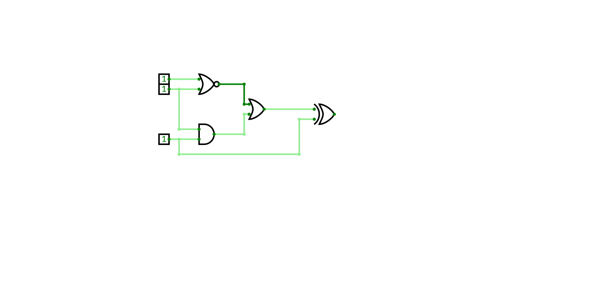

Worked Example 1
Build a Truth Table for the following circuit:
A
B
X
C
For more help, please visit www.exampaperspractice.co.uk

Slide 37
Worked Example 1
Steps:
    Identify all the possible combinations of input
    Work out the solution for intermediate output (layer by layer)
    Using the intermediate outputs, construct the final output
For more help, please visit www.exampaperspractice.co.uk

Slide 38


Worked Example 1
Step 1:
Identify all the possible combinations of input (we have 3 inputs)
INPUT
A
B
C
0
0
0
0
0
1
0
1
0
0
1
1
1
0
0
1
0
1
1
1
0
1
1
1
For more help, please visit www.exampaperspractice.co.uk

Slide 39

Worked Example 1
Step 2:
Identify the intermediate outputs. Solve them one by one.
P
R
Q
For more help, please visit www.exampaperspractice.co.uk

Slide 40

Worked Example 1
Step 2:
Identify the intermediate outputs. Solve them one by one (P).
INPUT
Intermediate Output
A
B
C
P
A
0
0
0
1
B
0
0
1
1
0
1
0
0
0
1
1
0
NOR Gate
(OR + NOT)
1
0
0
0
1
0
1
0
1
1
0
0
1
1
1
0
For more help, please visit www.exampaperspractice.co.uk

Slide 41
Worked Example 1
Step 2:
Identify the intermediate outputs. Solve them one by one (Q).
INPUT
Intermediate Output
A
B
C
P
Q
B
0
0
0
1
0
0
0
1
1
0
0
1
0
0
0
C
0
1
1
0
1
1
0
0
0
0
AND Gate
1
0
1
0
0
1
1
0
0
0
1
1
1
0
1
For more help, please visit www.exampaperspractice.co.uk

Slide 42

Worked Example 1
Step 2:
Identify the intermediate outputs. Solve them one by one (R).
INPUT
Intermediate Output
OUTPUT
A
B
C
P
Q
R
P
0
0
0
1
0
1
R
0
0
1
1
0
1
Q
0
1
0
0
0
0
0
1
1
0
1
1
1
0
0
0
0
0
OR Gate
1
0
1
0
0
0
1
1
0
0
0
0
1
1
1
0
1
1
For more help, please visit www.exampaperspractice.co.uk

Slide 43
Worked Example 1
Step 3:
Using the intermediate outputs, construct the final output (C XOR R).
A
P
B
R
X
Q
C
For more help, please visit www.exampaperspractice.co.uk

Slide 44
Worked Example 1
Step 3:
Using the intermediate outputs, construct the final output (C XOR R).
INPUT
Intermediate Output
OUTPUT
A
B
C
P
Q
R
X
R
0
0
0
1
0
1
1
0
0
1
1
0
1
0
C
0
1
0
0
0
0
0
0
1
1
0
1
1
0
1
0
0
0
0
0
0
XOR Gate
1
0
1
0
0
0
1
1
1
0
0
0
0
0
1
1
1
0
1
1
0
For more help, please visit www.exampaperspractice.co.uk

Slide 45
From a circuit, build a logical expression
For more help, please visit www.exampaperspractice.co.uk

Slide 46
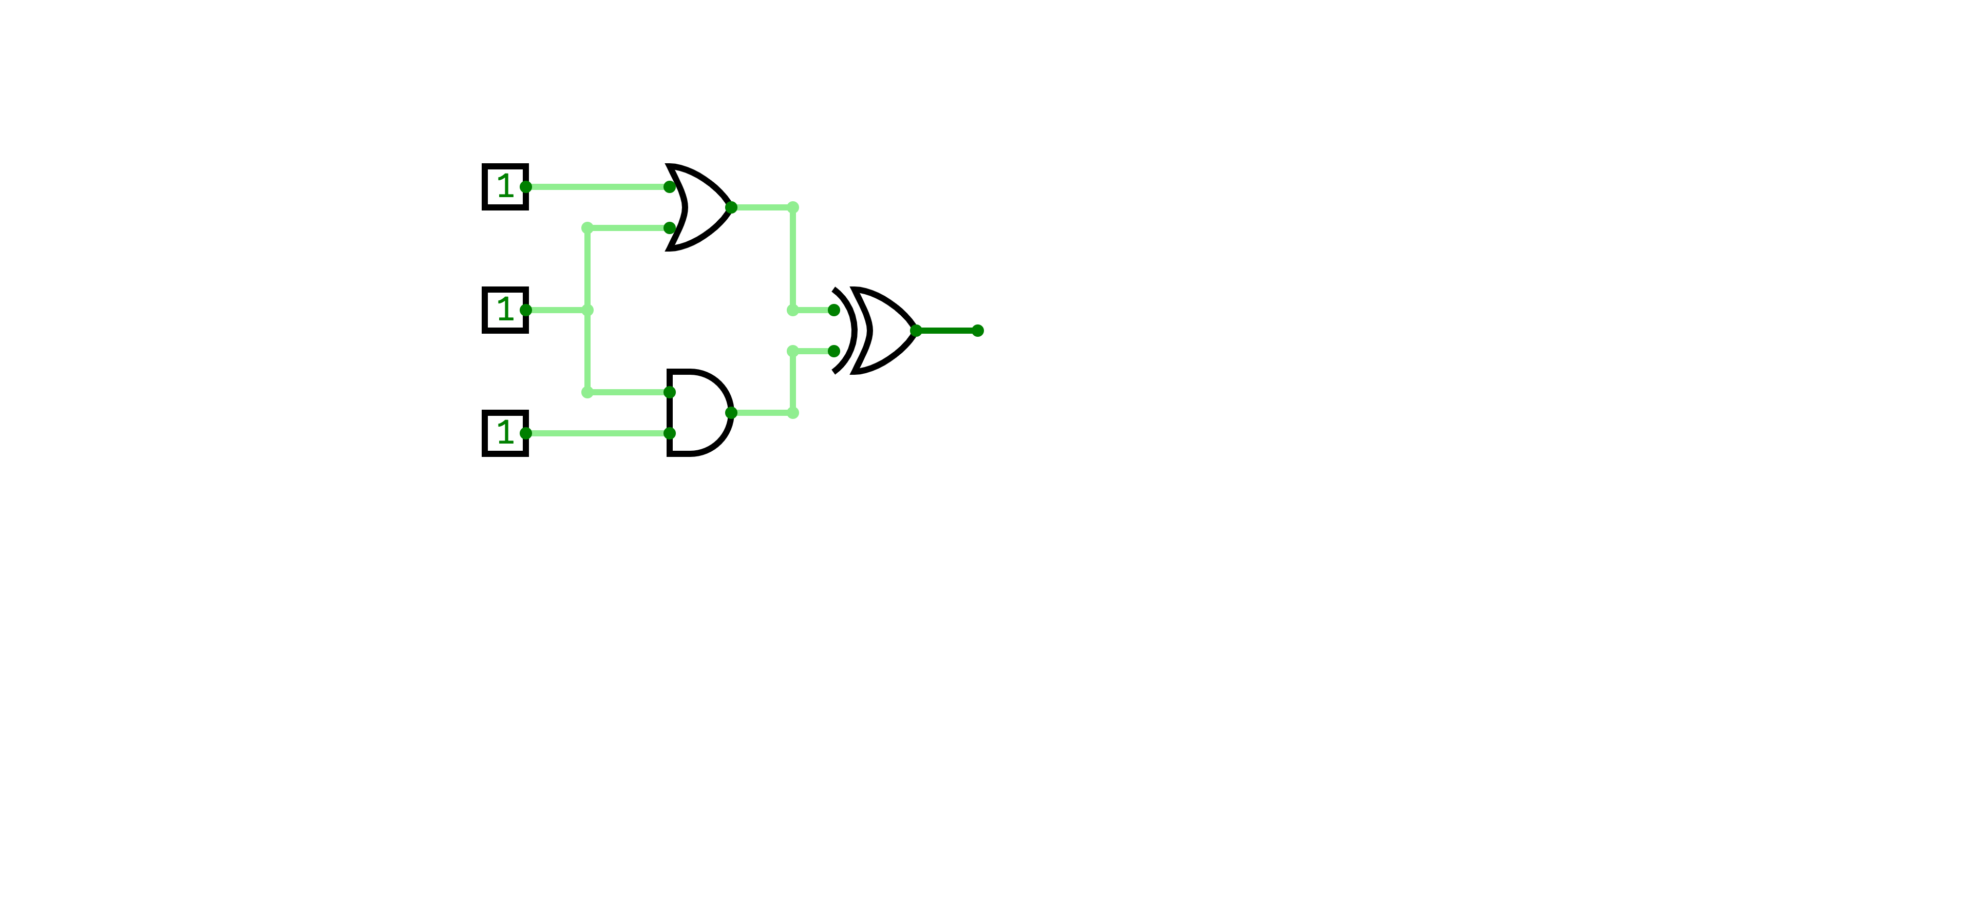
Worked Example 2
Build a logical expression from the following circuit:
A
B
C
For more help, please visit www.exampaperspractice.co.uk

Slide 47

Worked Example 2
Look at the gates connected to A, B and C.
Gate 1
A
Gate 3
B
C
Gate 2
For more help, please visit www.exampaperspractice.co.uk

Slide 48


Worked Example 2
Then, form an expression with gate 1 and gate 2 (first layer)
Gate 1
A
Gate 1 = A OR B
Gate 3
B
Gate 2 = B AND C
C
Gate 2
For more help, please visit www.exampaperspractice.co.uk

Slide 49
Worked Example 2
Then, form an expression with gate 3.
A
Gate 1
Gate 1 = A OR B
Gate 2 = B AND C
Gate 3
B
Gate 3 = Gate 1 XOR Gate 2
Substitution
C
Gate 2
Gate 3 = (A OR B) XOR (B AND C)
For more help, please visit www.exampaperspractice.co.uk

Slide 50
From a logical expression, build a circuit
For more help, please visit www.exampaperspractice.co.uk

Slide 51
Worked Example 3
A logic circuit can be represented by the following logic expression:
(A NAND C) XOR (NOT B OR C)
Produce a logic circuit and a truth table from the above statement.
For more help, please visit www.exampaperspractice.co.uk

Slide 52

Worked Example 3
(A NAND C) XOR (NOT B OR C)
To solve this problem, we need to break down the statement into smaller pieces.
Part 1: (A NAND C)
Part 2: (NOT B OR C)
Part 3: (Part 1) XOR (Part 2)
Let's build the circuit piece by piece
For more help, please visit www.exampaperspractice.co.uk

Slide 53
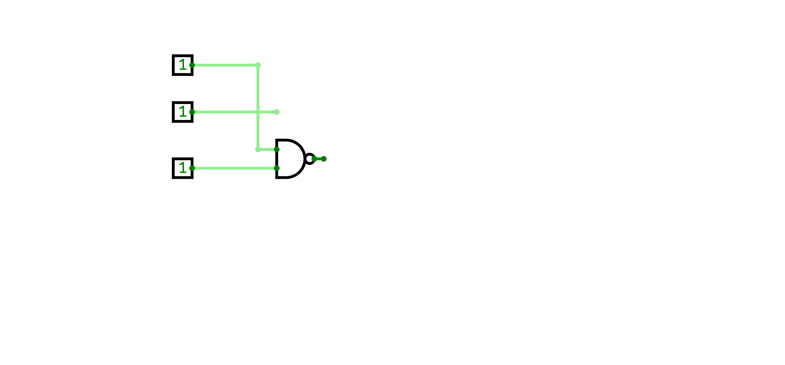
Worked Example 3
(A NAND C) XOR (NOT B OR C)
Part 1: (A NAND C)
A
B
C
For more help, please visit www.exampaperspractice.co.uk

Slide 54
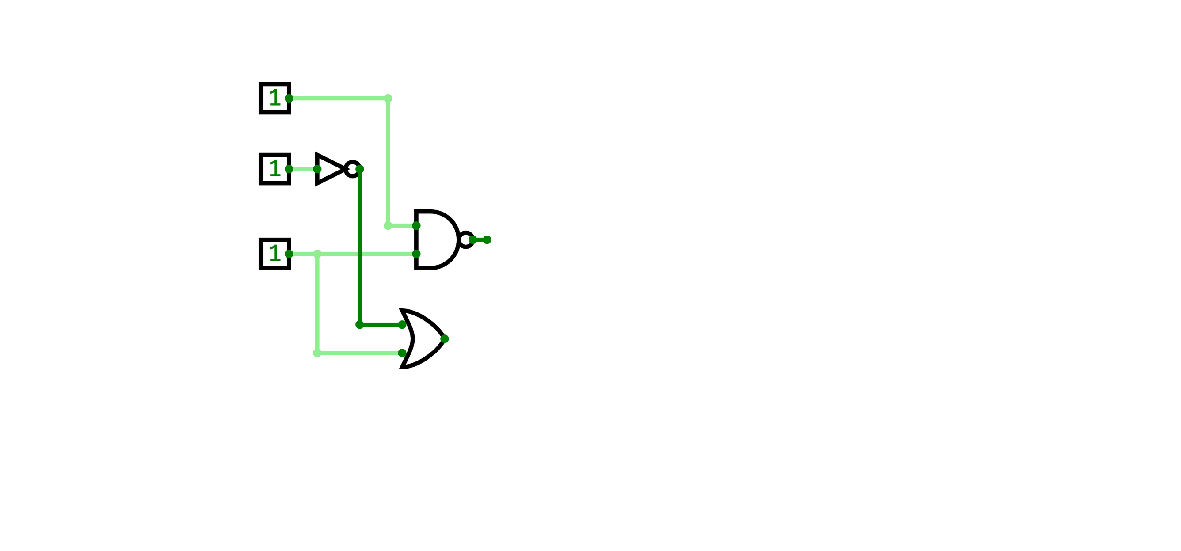
Worked Example 3
(A NAND C) XOR (NOT B OR C)
Part 2: (NOT B OR C)
A
B
C
For more help, please visit www.exampaperspractice.co.uk

Slide 55
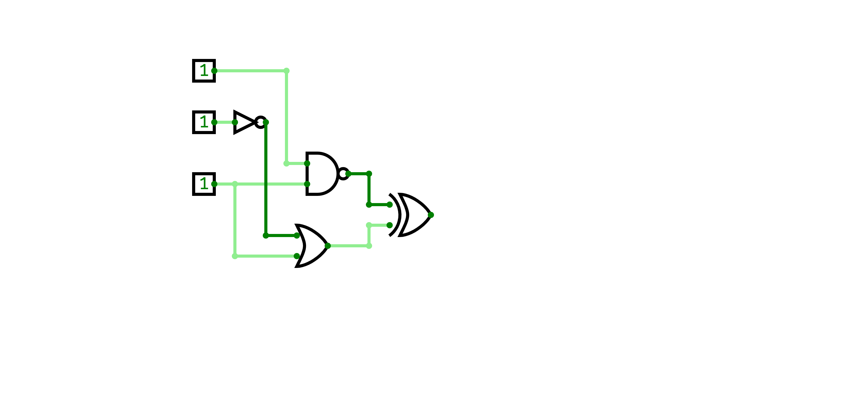

Worked Example 3
(A NAND C) XOR (NOT B OR C)
Part 3: (Part 1) XOR (Part 2)
A
Gate 1
B
C
Gate 2
For more help, please visit www.exampaperspractice.co.uk

Slide 56

Worked Example 3
(A NAND C) XOR (NOT B OR C)
Now, let's build a truth table from this circuit (same techniques from Worked Example 1)
A
B
C
For more help, please visit www.exampaperspractice.co.uk

Slide 57
Worked Example 3
(A NAND C) XOR (NOT B OR C)
Steps:
    Identify all the possible combinations of input
    Work out the solution for intermediate output (layer by layer)
    Using the intermediate outputs, construct the final output
A
B
C
For more help, please visit www.exampaperspractice.co.uk

Slide 58
Worked Example 3
Steps:
    Identify all the possible combinations of input (3 inputs)
INPUT
A
B
C
0
0
0
0
0
1
0
1
0
0
1
1
1
0
0
1
0
1
1
1
0
1
1
1
For more help, please visit www.exampaperspractice.co.uk

Slide 59

Worked Example 3
Step 2: Work out the solution for intermediate output (layer by layer)
A
P
B
Q
C
R
For more help, please visit www.exampaperspractice.co.uk

Slide 60
Worked Example 3
Step 2: Work out the solution for intermediate output (layer by layer)
- P
INPUT
A
B
C
P
0
0
0
1
P
0
0
1
1
B
0
1
0
0
0
1
1
0
1
0
0
1
P = NOT B
1
0
1
1
1
1
0
0
1
1
1
0
For more help, please visit www.exampaperspractice.co.uk

Slide 61

Worked Example 3
Step 2: Work out the solution for intermediate output (layer by layer)
- Q
INPUT
A
B
C
P
Q
A
0
0
0
1
1
0
0
1
1
1
Q
0
1
0
0
1
0
1
1
0
1
C
1
0
0
1
1
1
0
1
1
0
Q = A NAND C
1
1
0
0
1
1
1
1
0
0
For more help, please visit www.exampaperspractice.co.uk

Slide 62
Worked Example 3
Step 2: Work out the solution for intermediate output (layer by layer)
- R
INPUT
A
B
C
P
Q
R
0
0
0
1
1
1
0
0
1
1
1
1
R
P
0
1
0
0
1
0
0
1
1
0
1
1
C
1
0
0
1
1
1
R = P OR C
1
0
1
1
0
1
1
1
0
0
1
0
1
1
1
0
0
1
For more help, please visit www.exampaperspractice.co.uk

Slide 63
Worked Example 3
Step 3: Using the intermediate outputs, construct the final output
INPUT
A
B
C
P
Q
R
X
Q
0
0
0
1
1
1
0
0
0
1
1
1
1
0
0
1
0
0
1
0
1
0
1
1
0
1
1
0
X
R
1
0
0
1
1
1
0
1
0
1
1
0
1
1
X = Q XOR R
1
1
0
0
1
0
1
1
1
1
0
0
1
1
For more help, please visit www.exampaperspractice.co.uk

Slide 64
Worked Example 3
A logic circuit can be represented by the following logic expression:
(A NAND C) XOR (NOT B OR C)
Produce a logic circuit and a truth table from the above statement.
A
INPUT
A
B
C
P
Q
R
X
P
B
0
0
0
1
1
1
0
0
0
1
1
1
1
0
Q
0
1
0
0
1
0
1
0
1
1
0
1
1
0
C
1
0
0
1
1
1
0
1
0
1
1
0
1
1
R
1
1
0
0
1
0
1
1
1
1
0
0
1
1
Truth Table
Logic Circuit
For more help, please visit www.exampaperspractice.co.uk

Slide 65
Worked Example 3
Please refer to the Past Year Paper Slides for more practices.
For more help, please visit www.exampaperspractice.co.uk

Slide 66
From a truth table, build a logical expression and a circuit
For more help, please visit www.exampaperspractice.co.uk

Slide 67


Worked Example 4
Look at the truth tables below, produce a
logic expression and the corresponding logic circuit.
INPUT
OUTPUT
A
B
X
0
0
0
0
1
0
1
0
1
1
1
0
For more help, please visit www.exampaperspractice.co.uk

Slide 68

Worked Example 4
To produce the logical expression,
look at only the row where the output value is 1
Formula:
    Combine each input with an AND statement
    if the input value is zero, negate it using NOT gate
INPUT
OUTPUT
A
B
X
0
0
0
0
1
0
1
0
1
1
1
0
For more help, please visit www.exampaperspractice.co.uk

Slide 69

Worked Example 4
To produce the logical expression,
look at only the row where the output value is 1
INPUT
OUTPUT
Logical Expression
A
B
X
Negate B (which is 0)
0
0
0
A AND (NOT B)
0
1
0
Combine each input
1
0
1
1
1
0
For more help, please visit www.exampaperspractice.co.uk

Slide 70
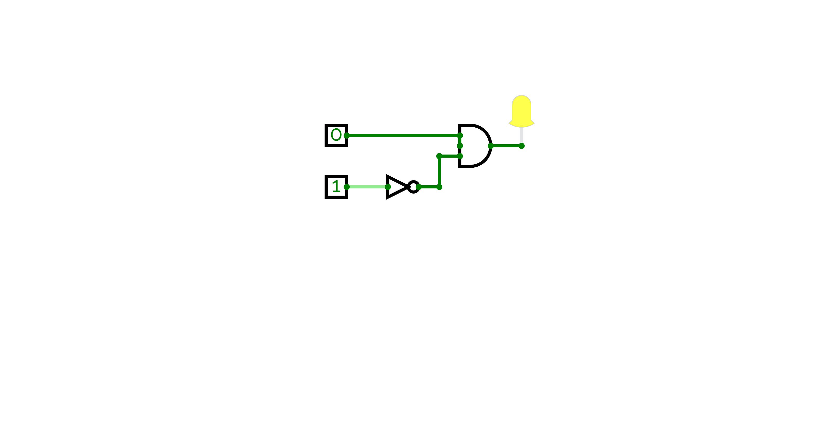
Worked Example 4
Based on the logical expression, create a circuit.
A AND (NOT B)
A
B
For more help, please visit www.exampaperspractice.co.uk

Slide 71
Worked Example 5
Look at the truth tables below, produce a
logic expression and the corresponding logic circuit.
INPUT
OUTPUT
A
B
X
0
0
0
0
1
1
1
0
0
1
1
1
For more help, please visit www.exampaperspractice.co.uk

Slide 72
Worked Example 5
To produce the logical expression,
look at only the row where the output value is 1
Formula:
    Combine each input with an AND statement
    if the input value is zero, negate it using NOT gate
INPUT
OUTPUT
A
B
X
0
0
0
0
1
1
1
0
0
1
1
1
For more help, please visit www.exampaperspractice.co.uk

Slide 73
Worked Example 5
To produce the logical expression,
look at only the row where the output value is 1
INPUT
OUTPUT
Logical Expression:
1st row: (NOT A) AND B
2nd row: A AND B
Concatenate these statements with OR
A
B
X
0
0
0
0
1
1
1
0
0
1
1
1
For more help, please visit www.exampaperspractice.co.uk

Slide 74

Worked Example 5
To produce the logical expression,
look at only the row where the output value is 1
INPUT
OUTPUT
A
B
X
Logical Expression:
((NOT A) AND B) OR (A AND B)
0
0
0
0
1
1
1
0
0
1
1
1
For more help, please visit www.exampaperspractice.co.uk

Slide 75
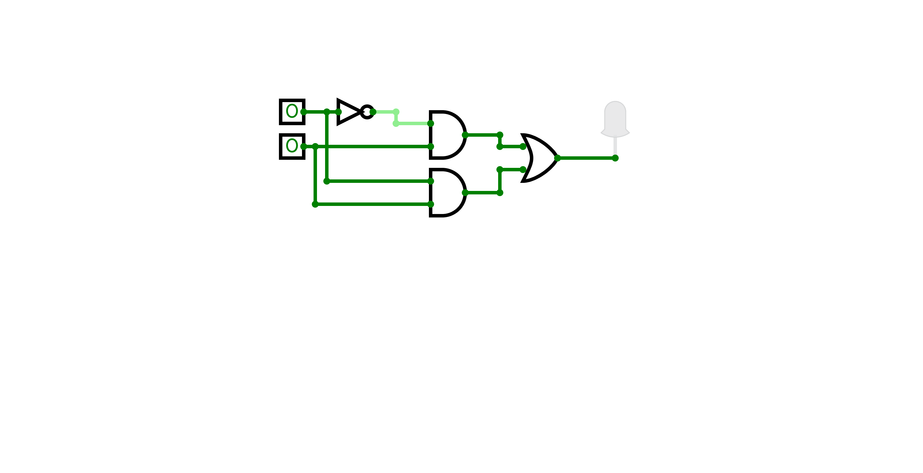
Worked Example 5
Logical Expression:
((NOT A) AND B) OR (A AND B)
A
B
For more help, please visit www.exampaperspractice.co.uk

Slide 76

Worked Example 6
Which logical expression is represented by the following truth table?
INPUT
OUTPUT
A
B
C
X
0
0
0
0
0
0
1
0
0
1
0
0
0
1
1
1
1
0
0
0
1
0
1
1
1
1
0
1
1
1
1
1
For more help, please visit www.exampaperspractice.co.uk

Slide 77
Worked Example 6
Which logical expression is represented by the following truth table?
INPUT
OUTPUT
A
B
C
X
Formula:
    Look at only the row where the output value is 1
    For each row, combine each input with an AND statement. If the input value is zero, negate it using NOT gate.
    Combine statement in each row with an OR statement.
0
0
0
0
0
0
1
0
0
1
0
0
0
1
1
1
1
0
0
0
1
0
1
1
1
1
0
1
1
1
1
1
For more help, please visit www.exampaperspractice.co.uk

Slide 78



Worked Example 6
Which logical expression is represented by the following truth table?
INPUT
OUTPUT
A
B
C
X
0
0
0
0
0
0
1
0
1st row: (NOT A) AND B AND C
2nd row: A AND NOT B AND C
3rd row: A AND B AND NOT C
4th row: A AND B AND C
0
1
0
0
0
1
1
1
1
0
0
0
1
0
1
1
1
1
0
1
1
1
1
1
((NOT A) AND B AND C) OR
(A AND NOT B AND C) OR
(A AND B AND NOT C) OR
(A AND B AND C)
For more help, please visit www.exampaperspractice.co.uk

Slide 79
Worked Example 6
SHOW THAT:
((NOT A) AND B AND C) OR
(A AND NOT B AND C) OR
(A AND B AND NOT C) OR
(A AND B AND C)
IS EQUAL TO:
(B AND C) OR
(A AND C) OR
(A AND B)
We can show the equivalence of boolean operations using a truth table!
For more help, please visit www.exampaperspractice.co.uk

Slide 80

Worked Example 6
(B AND C) OR
(A AND C) OR
(A AND B)
A
B
C
B AND C
A AND C
A AND B
0
0
0
0
0
0
0
0
0
1
0
0
0
0
0
1
0
0
0
0
0
0
1
1
1
0
0
1
1
0
0
0
0
0
0
1
0
1
0
1
0
1
1
1
0
0
0
1
1
1
1
1
1
1
1
1
For more help, please visit www.exampaperspractice.co.uk

Slide 81



Worked Example 6
INPUT
OUTPUT
A
B
C
X
0
0
0
0
0
0
1
0
SHOW THAT:
1
0
0
0
((NOT A) AND B AND C) OR
(A AND NOT B AND C) OR
(A AND B AND NOT C) OR
(A AND B AND C)
0
1
1
1
1
0
0
0
1
0
1
1
1
1
0
1
1
1
1
1
EQUAL
A
B
C
B AND C
A AND C
A AND B
OUTPUT
IS EQUAL TO:
0
0
0
0
0
0
0
(B AND C) OR
(A AND C) OR
(A AND B)
0
0
1
0
0
0
0
0
1
0
0
0
0
0
0
1
1
1
0
0
1
1
0
0
0
0
0
0
1
0
1
0
1
0
1
1
1
0
0
0
1
1
1
1
1
1
1
1
1
For more help, please visit www.exampaperspractice.co.uk

Slide 82
From a problem statement, draw a logic gate
(PYQ)
For more help, please visit www.exampaperspractice.co.uk

Slide 83
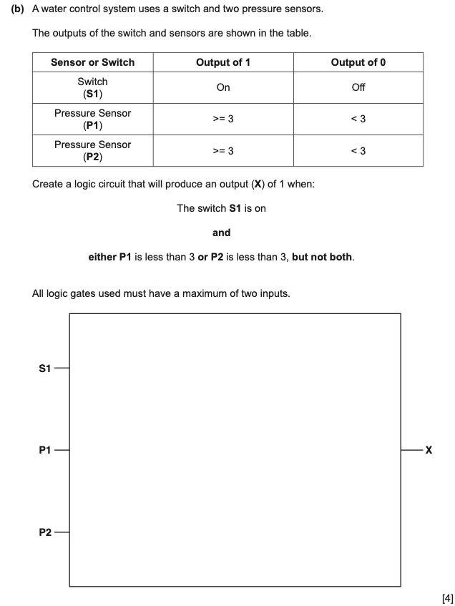
PAST YEAR QUESTION
For more help, please visit www.exampaperspractice.co.uk

Slide 84

STEP BY STEP PROBLEM SOLVING
    Understand the problem
In this problem, we have 3 different types of input,
a. Switch
b. Pressure sensor (P1)
c. Pressure sensor (P2)
Each input can be either true (1) or false (0), refer to table.
For more help, please visit www.exampaperspractice.co.uk

Slide 85


STEP BY STEP PROBLEM SOLVING
2. Simplifying the problem statement
S1 AND (NOT P1 XOR NOT P2)
For more help, please visit www.exampaperspractice.co.uk

Slide 86
STEP BY STEP PROBLEM SOLVING
Analysing the simplified problem statement:
S1 AND (NOT P1 XOR NOT P2)
For more help, please visit www.exampaperspractice.co.uk

Slide 87

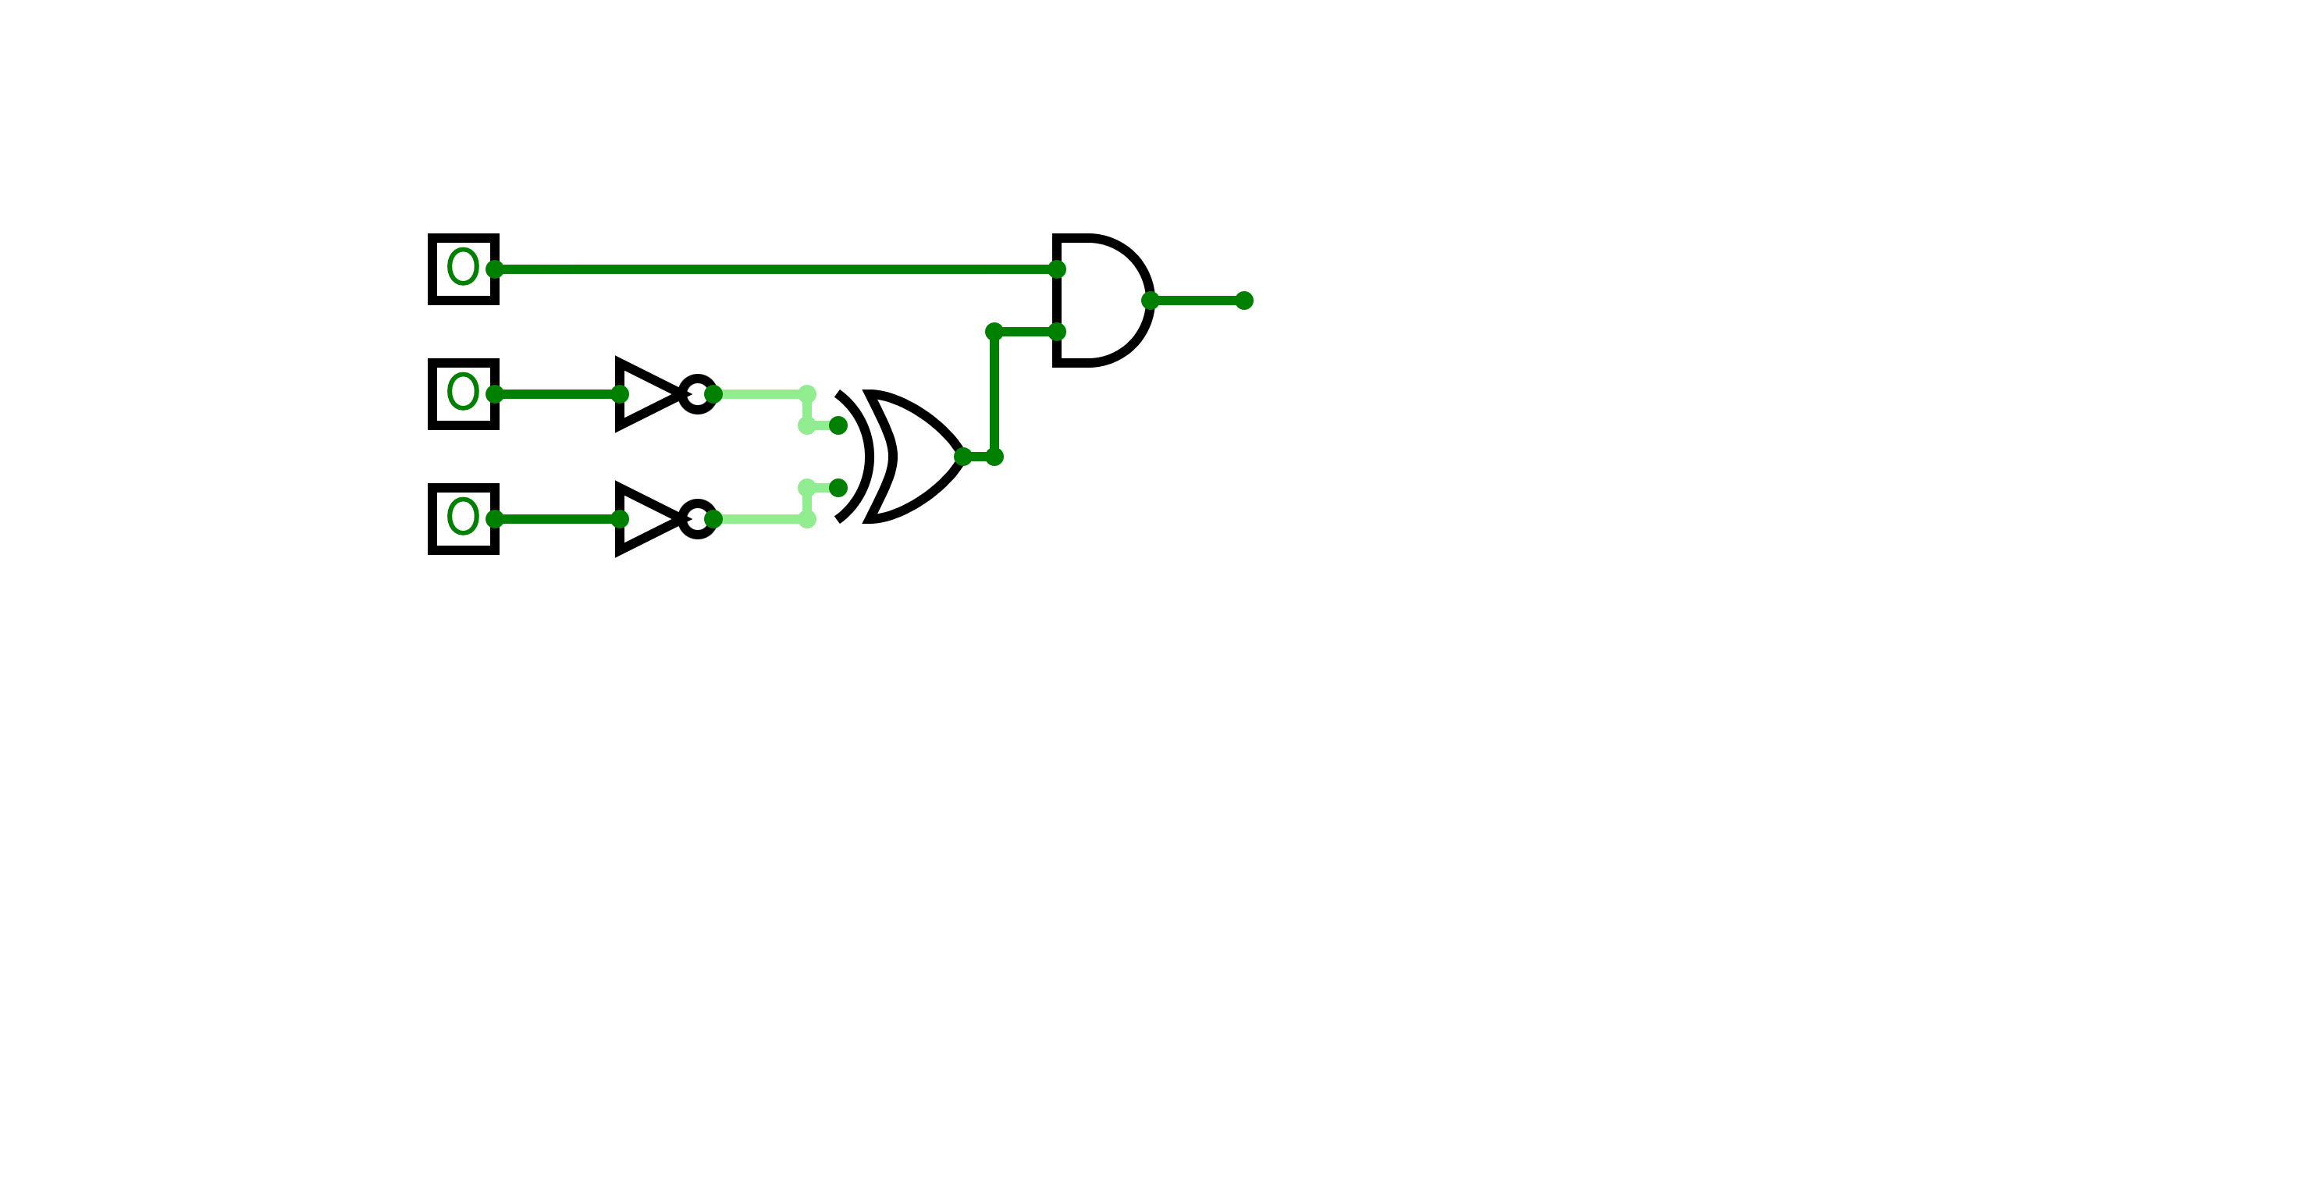
STEP BY STEP PROBLEM SOLVING
3. Draw the logic circuit based on the simplified problem statement.
S1 AND (NOT P1 XOR NOT P2)
S1
X
P1
P2
For more help, please visit www.exampaperspractice.co.uk

Slide 88
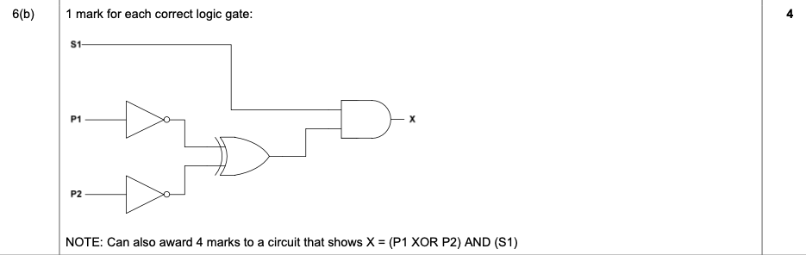
PAST YEAR QUESTION
For more help, please visit www.exampaperspractice.co.uk

