Slide 1


Cambridge IGCSE Computer Science 0478/0984 - Revision Notes
Chapter 5 - Internet and the World Wide Web
This study guide has been expertly compiled and edited by successful former teachers of Computer Science and highly experienced examiners and is suitable for students who are taking 0478 (9-1) IGCSE, the 0984 (A*-G) IGCSE, and the 2210 O Level for examination in 2023 onwards. It could be used as lesson starters, or supplied to students for independent use.
For more help, please visit www.exampaperspractice.co.uk

Slide 2

The Internet &
The World Wide Web
For more help, please visit www.exampaperspractice.co.uk

Slide 3

Differences?
The Internet &
The World Wide Web
For more help, please visit www.exampaperspractice.co.uk

Slide 4


Internet
The World Wide Web is part of the Internet
WWW
For more help, please visit www.exampaperspractice.co.uk

Slide 5

Internet
    The internet is a global network of interconnected networks, existing as a conceptual entity rather than something physical.
    It operates through a physical infrastructure comprising computers, devices, hardware, servers, and service providers, enabling connections between networks and devices worldwide.
For more help, please visit www.exampaperspractice.co.uk

Slide 6

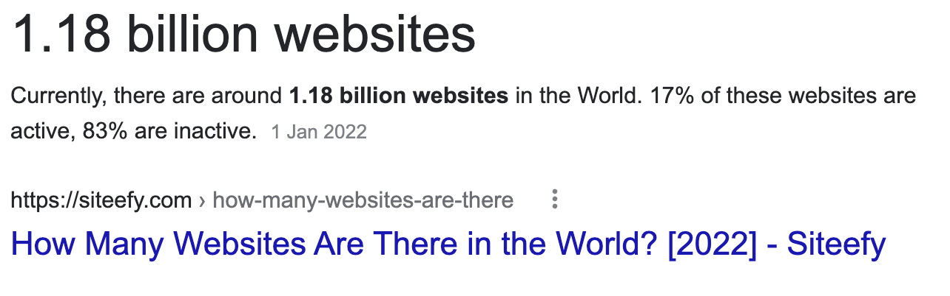
WWW explanation
The World Wide Web (WWW) is a segment of the internet accessible to users through web browser software. It encompasses a vast collection of web pages hosted on web servers.
For more help, please visit www.exampaperspractice.co.uk

Slide 7
WWW explanation
    The World Wide Web (WWW) is a segment of the internet accessible to users through web browser software. It encompasses a vast collection of web pages hosted on web servers.
    Uniform resource locators (URLs) are used to specifiy the location of web pages.
For more help, please visit www.exampaperspractice.co.uk

Slide 8
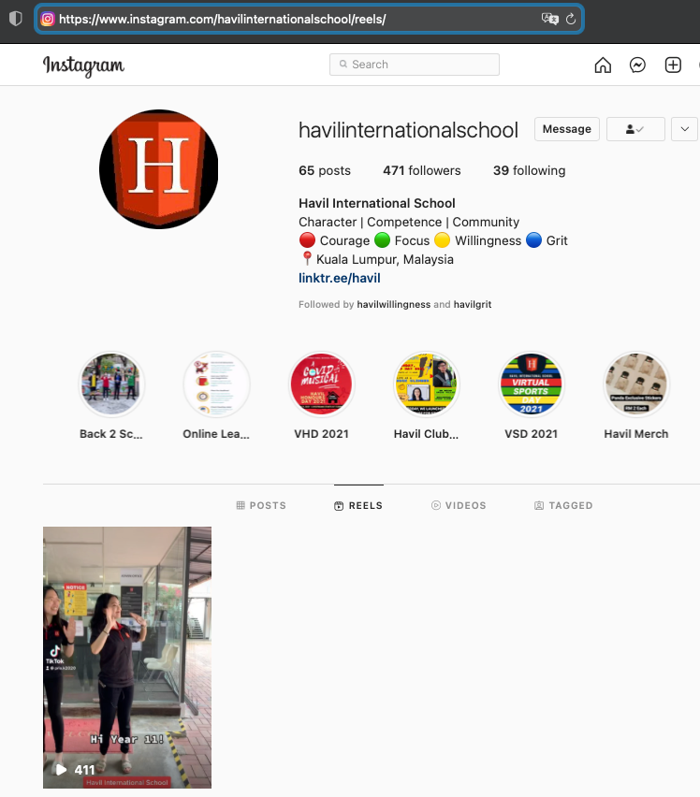
What components can you observe from the URL? Why do you think they are needed? (3 mins)
For more help, please visit www.exampaperspractice.co.uk

Slide 9

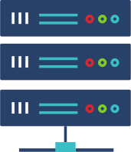



    URL stands for Uniform resource locators.
    URLs are text addresses used to access websites.
    URLs are basically just IP addresses.
What is a URL?
URL
????
Server
For more help, please visit www.exampaperspractice.co.uk

Slide 10
Format of a URL
For more help, please visit www.exampaperspractice.co.uk

Slide 11




Format of a URL
Protocol
Domain
Host
Domain
Name
Domain
Type
File name
Path
For more help, please visit www.exampaperspractice.co.uk

Slide 12
Hypertext Transfer Protocol
For more help, please visit www.exampaperspractice.co.uk

Slide 13
= Hypertext Transfer Protocol
    Data packets are transmitted across the internet using various protocols, which are sets of rules governing communication. The specific protocol used for transferring web pages is called Hypertext Transfer Protocol (HTTP).
    These protocols are essential because they ensure that data sent over the web, which can include private and sensitive information, is transmitted securely and reliably.
For more help, please visit www.exampaperspractice.co.uk

Slide 14
= HyperText Transfer Protocol
SECURE
    Secure Socket Layer (SSL) and Transport Layer Security (TLS) ensure secure connections between devices during data transfer:
      They establish a secure connection between two devices engaged in data transfer.
      Data packets are encrypted before transmission across the network and decrypted only upon reaching their intended destination.
For more help, please visit www.exampaperspractice.co.uk

Slide 15
Web Browser
For more help, please visit www.exampaperspractice.co.uk

Slide 16


Web browsers are software applications that enable users to access and view web pages on their device screens.
Retrieve HTML
Display
For more help, please visit www.exampaperspractice.co.uk

Slide 17

Features of a web browser
HINT:BAN CAR
For more help, please visit www.exampaperspractice.co.uk

Slide 18
Features of a web browser
    Bookmarks and favourites
    Allow multiple browsing tabs
    Navigation tools (back button, forward button and home button)
    Cookies (stores personal preferences or your activity)
    Address bar (where users type in the URL)
    Record user history
For more help, please visit www.exampaperspractice.co.uk

Slide 19
Locating and Viewing a Web Page
For more help, please visit www.exampaperspractice.co.uk

Slide 20
HTML
    HTML (HyperText Markup Language) is a language used to structure and display content on web browsers.
    Websites are primarily written in HTML and hosted on web servers, each with its own unique IP address.
For more help, please visit www.exampaperspractice.co.uk

Slide 21
Domain Name Server
    DNS (Domain Name System) is a system that translates domain names given in URLs into corresponding IP addresses:
      It serves to find IP addresses associated with domain names provided in URLs.
      DNS servers maintain databases of URLs along with their corresponding IP addresses.
      URLs and DNS alleviate the need for users to memorize IP addresses, simplifying access to websites and other resources on the internet.
DNS Server
128.17.134.25
https://drive.google.com/drive/u/2/my-drive
For more help, please visit www.exampaperspractice.co.uk

Slide 22

Flow to retrieve a web page
Using the IP address, the computer establishes communication with the website server, and then proceeds to download the required web pages.
The user enters the URL of a website into the address bar of the web browser.
The browser requests the DNS server for the IP address of the website.
The DNS server sends the IP address back to the user's computer.
HTML files are transmitted from the website server to the computer.
The browser interprets the HTML, which organizes the content, and then displays the information on the user's computer screen.
For more help, please visit www.exampaperspractice.co.uk

Slide 23





Flow to retrieve a web page
https://drive.google.com/
128.17.134.25
128.17.134.25
HTML
<h1> .... </h1>
For more help, please visit www.exampaperspractice.co.uk

Slide 24

Cookies
For more help, please visit www.exampaperspractice.co.uk

Slide 25
Cookies
    Cookies are small files or snippets of code stored on a user's computer. They are sent by a web server to a browser on the user's computer.
    Some usages of cookies:
      Hold user's preference
      Customise the web page for each individual user
      Store login details
      Store items in online shopping cart
For more help, please visit www.exampaperspractice.co.uk

Slide 26
Cookies
Session Cookies
Persistent Cookies
For more help, please visit www.exampaperspractice.co.uk

Slide 27
Session Cookies
    Temporary cookies, also known as session cookies, are deleted when the web browser is closed:
      They store information about your browsing session on a specific website.
      These cookies cease to exist on the user's computer once the browser is closed or the website session ends.
      For example, websites like Shopee maintain session cookies so users do not need to log in again when navigating between pages during a single browsing session.
For more help, please visit www.exampaperspractice.co.uk

Slide 28
Persistent Cookies
    Persistent cookies have expiration dates and are stored on a user's computer (hard drive) until they expire or are manually deleted by the user:
      They enable websites to remember users across visits.
      These cookies persist even after the browser is closed or the web session ends.
      Examples include remembering login details, saving items in a virtual shopping cart between visits, and storing preferences for online transactions (e.g., "Remember this card").
For more help, please visit www.exampaperspractice.co.uk

Slide 29
Flow of how cookies are used
When user revisits website, web server requests cookies file
Browser sends cookies file to Web Server to automatically enter details
Web Server sends cookies file to user's browser
Encrypted data is stored on browser or the user's HDD/SSD
Data are encrypted
For more help, please visit www.exampaperspractice.co.uk

Slide 30


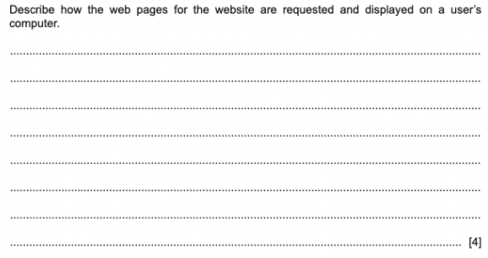
EXAM QUESTION
For more help, please visit www.exampaperspractice.co.uk

Slide 31
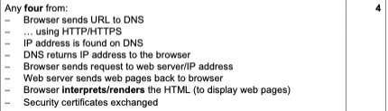
EXAM QUESTION
For more help, please visit www.exampaperspractice.co.uk

Slide 32
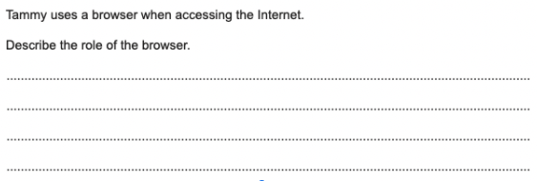
EXAM QUESTION
For more help, please visit www.exampaperspractice.co.uk

Slide 33
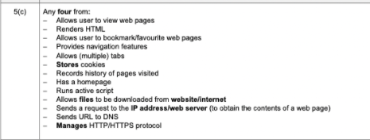
EXAM QUESTION
For more help, please visit www.exampaperspractice.co.uk

Slide 34



Digital
Currency
For more help, please visit www.exampaperspractice.co.uk

Slide 35
Definition
The currency that exists in electronic form only, with no physical counterpart, is known as digital currency or cryptocurrency.
For more help, please visit www.exampaperspractice.co.uk

Slide 36



Examples of digital currency
It is a method of payment, but rather than exchanging physical coins and bank notes, the payment is made electronically.
For more help, please visit www.exampaperspractice.co.uk

Slide 37


Central Banking System
Person A
Person B
Imagine Person A wants to transfer money to Person B ...
For more help, please visit www.exampaperspractice.co.uk

Slide 38

Central Banking System
Person A
Person B
A central bank is needed to act as the "middleman"
For more help, please visit www.exampaperspractice.co.uk

Slide 39
Problems with centralisation
- Confidentiality (Control of governments and central authorities)
- Security
For more help, please visit www.exampaperspractice.co.uk

Slide 40



Decentralisation - Cryptocurrency
Ethereum
RMXXX
Tether
RMXXX
Litecoin
RMXXX
Bitcoin
RMXXX
For more help, please visit www.exampaperspractice.co.uk

Slide 41
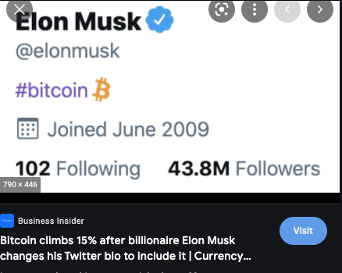
For more help, please visit www.exampaperspractice.co.uk

Slide 42
CRYPTOCURRENCY MINING
Miners use the computing power of their personal computers to process transactions on a blockchain network. As a reward for their efforts, miners receive a portion of the transaction fees associated with each payment processed.
For more help, please visit www.exampaperspractice.co.uk

Slide 43
Decentralisation - Cryptocurrency
    Traditional digital currencies are regulated by central banks and governments, with transactions and exchange rates determined by these entities. In contrast, cryptocurrencies operate independently of state control, with rules set by the cryptocurrency community.
    Cryptocurrencies function within a blockchain network, which enhances security through decentralized validation mechanisms.
For more help, please visit www.exampaperspractice.co.uk

Slide 44
Blockchain
A technology that sits behind all cryptocurrency transactions. It makes all sorts of cryptocurrency safe to use.
For more help, please visit www.exampaperspractice.co.uk

Slide 45
Blockchaining - How cryptocurrency work?
    Blockchain is a decentralized database where transactions from network participants are recorded.
    It comprises interconnected computers that are not linked to a central server.
    In this network, all transaction data is stored on every computer participating in the blockchain.
For more help, please visit www.exampaperspractice.co.uk

Slide 46


Blockchaining - A chain of blocks
For more help, please visit www.exampaperspractice.co.uk

Slide 47
Blockchaining - A chain of blocks
    When a new transaction takes place, a new block is created
    Blockchains = A collections of all transactions
For more help, please visit www.exampaperspractice.co.uk

Slide 48
What's inside one block?
Data = Sender, Recipient,
Amount of Coins
Hash Value, generated by an algorithm (acts as a unique identifier). Includes a timestamp.
Previous Hash Value - Points back to a previous block in the chain
For more help, please visit www.exampaperspractice.co.uk

Slide 49
Blockchaining - A chain of blocks
Hash: A4BF
Previous Hash: 0000
For more help, please visit www.exampaperspractice.co.uk

Slide 50
Blockchaining - A chain of blocks
Hash: A4BF
Previous Hash: 0000
Hash: 6AB1
Previous Hash: A4BF
Hash: 34EE
Previous Hash: 6AB1
For more help, please visit www.exampaperspractice.co.uk

Slide 51
Blockchaining - A chain of blocks
Hash: A4BF
Previous Hash: 0000
Hash: 6AB1
Previous Hash: A4BF
Hash: 34EE
Previous Hash: 6AB1
Hash: FF12
Previous Hash: 34EE
Let's say a new transaction is created!
For more help, please visit www.exampaperspractice.co.uk

Slide 52
Blockchaining - A chain of blocks
Hash: A4BF
Previous Hash: 0000
Hash: 6AB1
Previous Hash: A4BF
Hash: 34EE
Previous Hash: 6AB1
Hash: FF12
Previous Hash: 34EE
THERE ARE 3 REASONS WHY TRANSACTIONS CANNOT BE MODIFIED EASILY - MAKE THE SYSTEM SECURE
For more help, please visit www.exampaperspractice.co.uk

Slide 53
FIRST REASON: THE PREVIOUS HASH ATTRIBUTE IN THE BLOCK
Hash: A4BF
Previous Hash: 0000
Hash: 4ERD
Previous Hash: A4BF
Hash: 34EE
Previous Hash: 6AB1
Hash: FF12
Previous Hash: 34EE
Let's change the transaction in this block. Oops, what's the consequence of this?
For more help, please visit www.exampaperspractice.co.uk

Slide 54
Blockchaining - A chain of blocks
Hash: A4BF
Previous Hash: 0000
Hash: 4ERD
Previous Hash: A4BF
Hash: 34EE
Previous Hash: 6AB1
Hash: FF12
Previous Hash: 34EE
Lost connection. Block 3 and 4 will become invalid. Transaction fails.Blockchain prevents tampering (by hackers).
For more help, please visit www.exampaperspractice.co.uk

Slide 55
SECOND REASON: PROOF OF WORK MAKE THE CREATION OF BLOCK SLOWER
Hash: A4BF
Previous Hash: 0000
Hash: 4ERD
Previous Hash: A4BF
Hash: 34EE
Previous Hash: 6AB1
Hash: FF12
Previous Hash: 34EE
Hackers will find it hard to re-create block 3 and 4, due to proof-of-work, which makes sure it takes 10 minutes to add a block to the chain.
For more help, please visit www.exampaperspractice.co.uk

Slide 56

THIRD REASON: The exact blockchain is stored in all the computers in the networks.
Hash: A4BF
Previous Hash: 0000
Hash: 6AB1
Previous Hash: A4BF
Hash: 34EE
Previous Hash: 6AB1
Hash: A4BF
Previous Hash: 0000
Hash: 6AB1
Previous Hash: A4BF
Hash: 34EE
Previous Hash: 6AB1
Hash: A4BF
Previous Hash: 0000
Hash: 6AB1
Previous Hash: A4BF
Hash: 34EE
Previous Hash: 6AB1
Hash: A4BF
Previous Hash: 0000
Hash: 6AB1
Previous Hash: A4BF
Hash: 34EE
Previous Hash: 6AB1
For more help, please visit www.exampaperspractice.co.uk

Slide 57
When a new transaction is added, a block will added to each node.
Hash: A4BF
Previous Hash: 0000
Hash: 6AB1
Previous Hash: A4BF
Hash: 34EE
Previous Hash: 6AB1
Hash: 34EE
Previous Hash: 6AB1
Hash: A4BF
Previous Hash: 0000
Hash: 6AB1
Previous Hash: A4BF
Hash: 34EE
Previous Hash: 6AB1
Hash: 34EE
Previous Hash: 6AB1
Hash: A4BF
Previous Hash: 0000
Hash: 6AB1
Previous Hash: A4BF
Hash: 34EE
Previous Hash: 6AB1
Hash: 34EE
Previous Hash: 6AB1
Hash: A4BF
Previous Hash: 0000
Hash: 6AB1
Previous Hash: A4BF
Hash: 34EE
Previous Hash: 6AB1
Hash: 34EE
Previous Hash: 6AB1
For more help, please visit www.exampaperspractice.co.uk

Slide 58

All nodes within this network creates a consensus. Majority wins. This means that hacker will have to tamper a block in more than half of the nodes, which is impossible.
Hash: A4BF
Previous Hash: 0000
Hash: 6AB1
Previous Hash: A4BF
Hash: 34EE
Previous Hash: 6AB1
Hash: 34EE
Previous Hash: 6AB1
Hash: A4BF
Previous Hash: 0000
Hash: 6AB1
Previous Hash: A4BF
Hash: 34EE
Previous Hash: 6AB1
Hash: 34EE
Previous Hash: 6AB1
Hash: A4BF
Previous Hash: 0000
Hash: 6AB1
Previous Hash: A4BF
Hash: 34EE
Previous Hash: 6AB1
Hash: 34EE
Previous Hash: 6AB1
Hash: A4BF
Previous Hash: 0000
Hash: 6AB1
Previous Hash: A4BF
Hash: 34EE
Previous Hash: 6AB1
Hash: 34EE
Previous Hash: 6AB1
I Hack This!
For more help, please visit www.exampaperspractice.co.uk

Slide 59
All nodes within this network creates a consensus. Majority wins. This means that hacker will have to tamper a block in more than half of the nodes, which is impossible.
Hash: A4BF
Previous Hash: 0000
Hash: 6AB1
Previous Hash: A4BF
Hash: 34EE
Previous Hash: 6AB1
Hash: 34EE
Previous Hash: 6AB1
Hash: A4BF
Previous Hash: 0000
Hash: 6AB1
Previous Hash: A4BF
Hash: 34EE
Previous Hash: 6AB1
Hash: 34EE
Previous Hash: 6AB1
Hash: A4BF
Previous Hash: 0000
Hash: 6AB1
Previous Hash: A4BF
Hash: 34EE
Previous Hash: 6AB1
Hash: 34EE
Previous Hash: 6AB1
Hash: A4BF
Previous Hash: 0000
Hash: 6AB1
Previous Hash: A4BF
Hash: 34EE
Previous Hash: 6AB1
Hash: 34EE
Previous Hash: 6AB1
Failed!
For more help, please visit www.exampaperspractice.co.uk

Slide 60




Cyber Security
For more help, please visit www.exampaperspractice.co.uk

Slide 61
Cyber Security
Threat
For more help, please visit www.exampaperspractice.co.uk

Slide 62



Cyber Security
Threats
Solutions/Prevention
For more help, please visit www.exampaperspractice.co.uk

Slide 63
Cyber Security
Threats
Solutions/Prevention
For more help, please visit www.exampaperspractice.co.uk

Slide 64
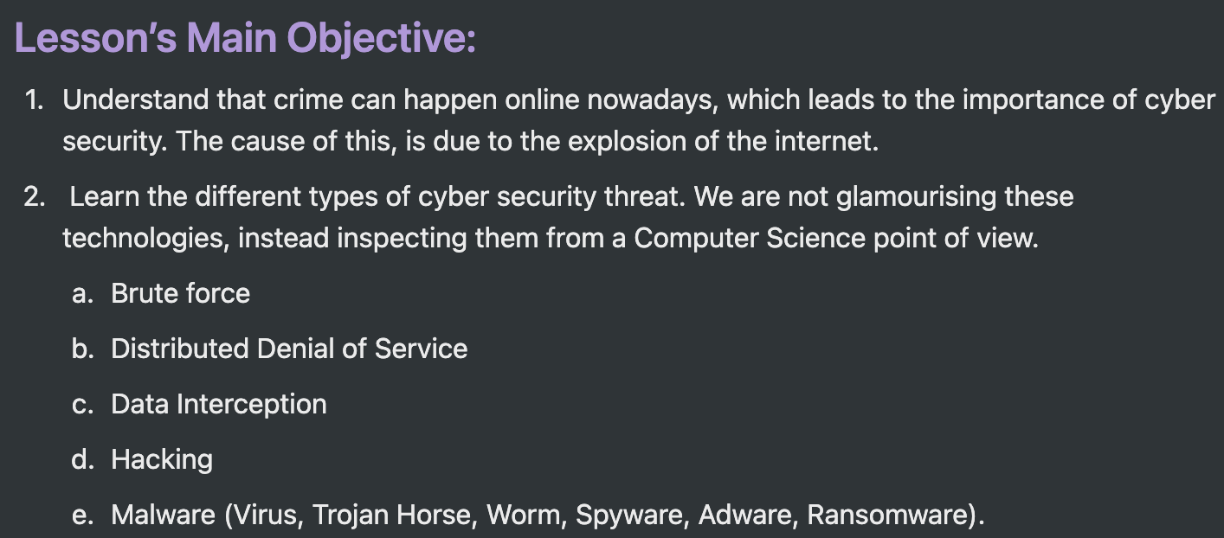
For more help, please visit www.exampaperspractice.co.uk

Slide 65


Cyber
Security
Brute-Force Attack
B
D
DDOS Attack
Data Interception
Threat
D
H
Hacking
M
Malware
P
Phishing
Social Engineering
P
Pharming
S
For more help, please visit www.exampaperspractice.co.uk

Slide 66

Cyber
Security
Brute-Force Attack
B
D
DDOS Attack
Data Interception
Threat
D
H
Hacking
M
Malware
P
Phishing
Social Engineering
P
Pharming
S
For more help, please visit www.exampaperspractice.co.uk

Slide 67





Brute-Force Attack
B
Activity: Can you guess my number?
For more help, please visit www.exampaperspractice.co.uk

Slide 68

Brute-Force Attack
B
    Cybercriminals use a 'trial and error' approach to crack passwords by testing all possible combinations of letters, numbers, and symbols.
    Starting with commonly used passwords can expedite the process of cracking a password.
    Longer passwords with a variety of characters are more difficult to crack due to increased complexity and the larger number of possible combinations.
For more help, please visit www.exampaperspractice.co.uk

Slide 69
Cyber
Security
Brute-Force Attack
B
D
DDOS Attack
Data Interception
Threat
D
H
Hacking
M
Malware
P
Phishing
Social Engineering
P
Pharming
S
For more help, please visit www.exampaperspractice.co.uk

Slide 70

Distributed Denial of Service (DDOS)
D
    A denial of service (DoS) attack aims to disrupt users' access to a network, particularly an internet server. The attacker can prevent users from:
      Accessing their emails
      Accessing websites/web pages
      Accessing online services such as banking
For more help, please visit www.exampaperspractice.co.uk

Slide 71
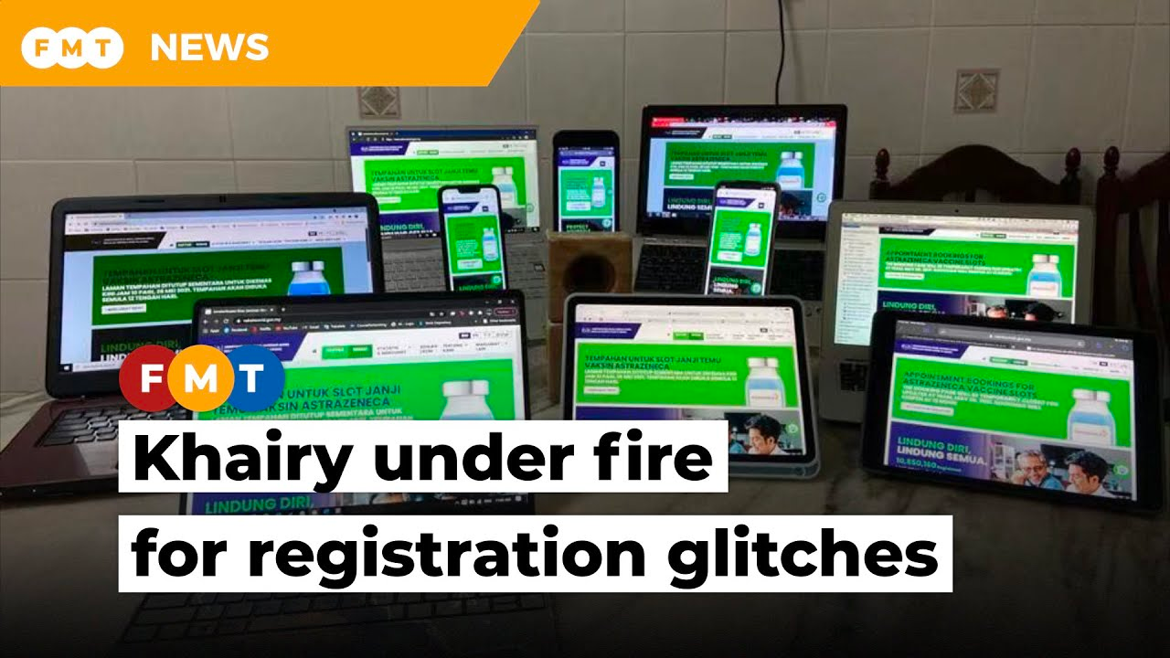
If too many people accessing a website at the same time, the server will go down ...
For more help, please visit www.exampaperspractice.co.uk

Slide 72





Distributed Denial of Service (DDOS)
D
How does it attack?
When a user enters a website's URL in their browser, a request is sent to the web server hosting that website.
For more help, please visit www.exampaperspractice.co.uk

Slide 73

Distributed Denial of Service (DDOS)
D
How does it attack?
When a user enters a website's URL in their browser, a request is sent to the web server hosting that website.
The server can only handle a finite number of requests. (say: 1 million) at a time
Patient ..
For more help, please visit www.exampaperspractice.co.uk

Slide 74

Distributed Denial of Service (DDOS)
D
How does it attack?
A criminal can use software to force thousands of innocent computers worldwide to send viewing requests to a web server.
x100000
For more help, please visit www.exampaperspractice.co.uk

Slide 75


Distributed Denial of Service (DDOS)
D
Distributed = Many computers
Denial of Service = Deny user from using a service
How does it attack?
A criminal can use software to force thousands of innocent computers worldwide to send viewing requests to a web server.
The server becomes overloaded and may be unable to fulfill legitimate user requests. This can slow down the website or cause it to go offline entirely.
Sorry can't do it!
x100000
For more help, please visit www.exampaperspractice.co.uk

Slide 76

Distributed Denial of Service (DDOS)
D
Signs to detect a DDOS attack
Slow network performance (opening files or accessing certain websites)
Inability to access certain websites
Large amounts of spam email reaching the user’s email account.
For more help, please visit www.exampaperspractice.co.uk

Slide 77

Cyber
Security
Brute-Force Attack
B
D
DDOS Attack
Data Interception
Threat
D
H
Hacking
M
Malware
P
Phishing
Social Engineering
P
Pharming
S
For more help, please visit www.exampaperspractice.co.uk

Slide 78
Data Interception
D
    Data interception involves stealing data by accessing wired or wireless communication links, typically with the aim of compromising privacy or obtaining confidential information.
    This can be achieved using a packet sniffer, a tool that examines data packets transmitted over a network and sends intercepted data to the hacker.
For more help, please visit www.exampaperspractice.co.uk

Slide 79

Data Interception
D
To tackle data interception
Encryption of data.
Eg. Wired Equivalency privacy (WEP)
It is crucial to avoid using Wi-Fi (wireless) connectivity in public places like airports because data transmitted over unencrypted connections can be intercepted by anyone within range.
For more help, please visit www.exampaperspractice.co.uk

Slide 80

Cyber
Security
Brute-Force Attack
B
D
DDOS Attack
Data Interception
Threat
D
H
Hacking
M
Malware
P
Phishing
Social Engineering
P
Pharming
S
For more help, please visit www.exampaperspractice.co.uk

Slide 81
Hacking
H
    Hacking is the act of gaining illegal access to a computer system without the user's permission.
    Data can be deleted, passed on, changed or corrupted.
    Can encryption stops hacking?
For more help, please visit www.exampaperspractice.co.uk

Slide 82
Hacking
H
    Hacking is the act of gaining illegal access to a computer system without the user's permission.
    Data can be deleted, passed on, changed or corrupted.
    Encryption does not stop hacking, it just make the data meaningless.
    Solution: Firewall, strong passwords.
For more help, please visit www.exampaperspractice.co.uk

Slide 83



Hacking
H
Black-hat hacker
White-hat hacker
A hacker who attempts to gain unauthorized access to a computer system is known as an "unauthorized intruder."
A hacker who identifies security vulnerabilities in a system and advises network owners on how to address them.
For more help, please visit www.exampaperspractice.co.uk

Slide 84
Cyber
Security
Brute-Force Attack
B
D
DDOS Attack
Data Interception
Threat
D
H
Hacking
M
Malware
P
Phishing
Social Engineering
P
Pharming
S
For more help, please visit www.exampaperspractice.co.uk

Slide 85

Malware = Malicious Code Software
M
Malware refers to software designed and coded to inflict damage or steal data from a computer or system.
There are several types of malware:
Trojan Horse
Virus
Worm
Spyware
Adware
Ransomware
For more help, please visit www.exampaperspractice.co.uk

Slide 86

Virus
V
    Viruses are self-replicating programs or code that aim to delete, corrupt files, or disrupt computer operations.
    They require an active host program or an already infected operating system to execute and cause harm.
    Viruses are often distributed through email attachments, infected websites, or bundled with downloaded software.
Trojan Horse
Virus
Worm
Spyware
Adware
Ransomware
For more help, please visit www.exampaperspractice.co.uk

Slide 87
Trojan Horse
T
    A Trojan horse is a type of malware disguised within seemingly harmless software code. It replaces or hides within legitimate software to carry out harmful actions on the user's computer system.
      Trojans require user execution to activate and are often disguised as email attachments or downloads from infected websites.
      Once installed, Trojan horses provide cybercriminals with access to personal information such as IP addresses, passwords, and other sensitive data.
      They are commonly used to install spyware and ransomware on users' computers, further compromising security and privacy.
Trojan Horse
Virus
Worm
Spyware
Adware
Ransomware
For more help, please visit www.exampaperspractice.co.uk

Slide 88

Worm
W
    A worm is a type of standalone malware that can self-replicate without needing an active host program to initiate damage.
      Unlike viruses, worms replicate independently until they consume the computer's resources, potentially causing system failure and crashes.
      Worms are particularly troublesome because they can spread across networks without any action from end-users, unlike viruses that require user initiation.
Trojan Horse
Virus
Worm
Spyware
Adware
Ransomware
For more help, please visit www.exampaperspractice.co.uk

Slide 89
Spyware
S
    Spyware is software designed to collect information by monitoring a user's activities on their computer.
      It gathers sensitive information such as bank account numbers, passwords, and credit/debit card details, which are then sent back to the cybercriminal who deployed the spyware.
      Similar to cookies, spyware operates stealthily to gather data without the user's knowledge.
      Anti-spyware software can detect and remove spyware from a computer system to enhance security and privacy.
Trojan Horse
Virus
Worm
Spyware
Adware
Ransomware
For more help, please visit www.exampaperspractice.co.uk

Slide 90
Adware
A
    Adware is software designed to inundate end-users with unwanted advertisements.
      It may redirect a user's browser to websites containing promotional advertising.
      Adware can generate pop-up ads that appear unexpectedly while browsing.
      It may also insert advertisements into the browser's toolbar or redirect search requests to promotional sites.
Trojan Horse
Virus
Worm
Spyware
Adware
Ransomware
For more help, please visit www.exampaperspractice.co.uk

Slide 91

Ransomware
R
    Ransomware is malicious software that encrypts data on a user's computer, effectively holding it hostage.
      Cybercriminals demand ransom payments before providing the decryption key needed to unlock the encrypted data.
      Once the ransom is paid, the cybercriminal may send the decryption key to the user, allowing them to regain access to their data.
Trojan Horse
Virus
Worm
Spyware
Adware
Ransomware
For more help, please visit www.exampaperspractice.co.uk

Slide 92

Flashcard
THE DIFFERENCE
BETWEEN VIRUS
AND WORMS
For more help, please visit www.exampaperspractice.co.uk

Slide 93

VIRUS NEEDS AND ACTIVE HOST, WORMS DO NOT.
For more help, please visit www.exampaperspractice.co.uk

Slide 94
Flashcard
HOW IS VIRUS
SENT TO A USER
For more help, please visit www.exampaperspractice.co.uk

Slide 95
VIA EMAIL ATTACHMENTS, INFECTED SOFTWARE/ WEBSITE
For more help, please visit www.exampaperspractice.co.uk

Slide 96
Flashcard
Once installed on the user’s computer, I will give cyber criminals access to personal information on your computers, such as IP addresses, passwords and other personal data. Spyware and ransomware are often installed on a user’s computer via ME.
WHO AM I?
For more help, please visit www.exampaperspractice.co.uk

Slide 97
TROJAN HORSE
For more help, please visit www.exampaperspractice.co.uk

Slide 98
Flashcard
Encryption can stop hacking. What's your view on it?
For more help, please visit www.exampaperspractice.co.uk

Slide 99
Encryption does not stop hacking, it just make the data meaningless.
For more help, please visit www.exampaperspractice.co.uk

Slide 100
Cyber
Security
Brute-Force Attack
B
D
DDOS Attack
Data Interception
Threat
D
H
Hacking
M
Malware
P
Phishing
Social Engineering
P
Pharming
S
For more help, please visit www.exampaperspractice.co.uk

Slide 101

Phishing
P
    Sending out emails that appear legitimate to trick recipients into divulging personal details by clicking on links or attachments that lead to fake websites.
For more help, please visit www.exampaperspractice.co.uk

Slide 102
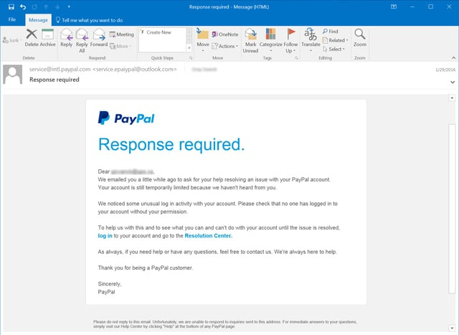
Phishing
P
    Sending out emails that appear legitimate to trick recipients into divulging personal details by clicking on links or attachments that lead to fake websites.
For more help, please visit www.exampaperspractice.co.uk

Slide 103
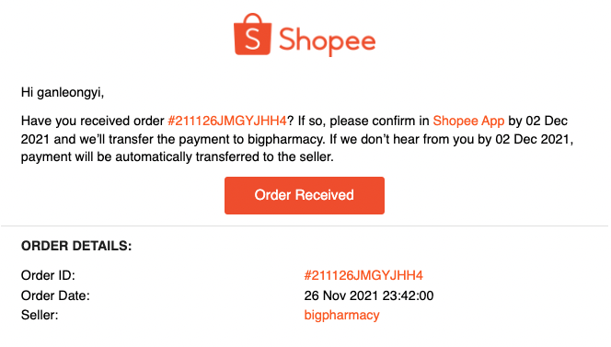
Phishing - Legit Emails
P
For more help, please visit www.exampaperspractice.co.uk

Slide 104
Phishing
P
Ways to prevent phishing
Be aware of fake emails (eg. Dear (Your name) and not Dear Customer)
Look out for http(s) in the address bar
Be very wary of pop-ups and use the browser to block them
For more help, please visit www.exampaperspractice.co.uk

Slide 105


Cyber
Security
Brute-Force Attack
B
D
DDOS Attack
Data Interception
Threat
D
H
Hacking
M
Malware
P
Phishing
Social Engineering
P
Pharming
S
For more help, please visit www.exampaperspractice.co.uk

Slide 106

Pharming
P
    Pharming involves redirecting users from a legitimate website to a fake one in a way that may go unnoticed, typically by manipulating the DNS server.
      Users may be prompted to enter login details on the fake site, which are then collected by criminals for use on the genuine site.
      Pharming attacks occur when web servers are compromised, and malicious code is inserted to alter website traffic and redirect visitors by changing the IP address.
For more help, please visit www.exampaperspractice.co.uk

Slide 107
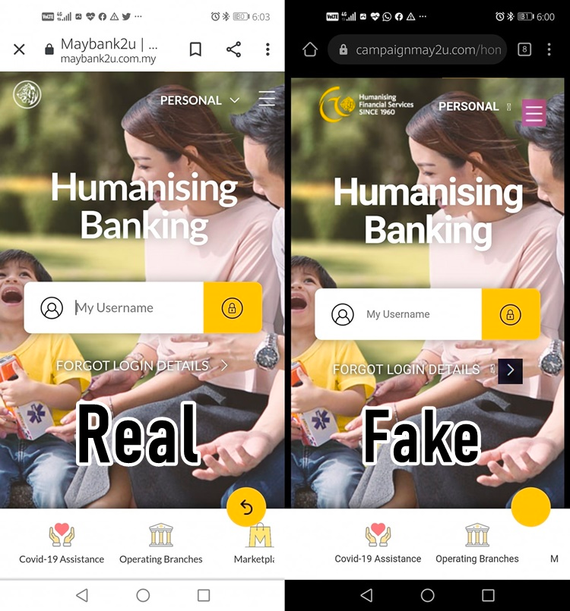

Examples:
For more help, please visit www.exampaperspractice.co.uk

Slide 108
Cyber
Security
Brute-Force Attack
B
D
DDOS Attack
Data Interception
Threat
D
H
Hacking
M
Malware
P
Phishing
Social Engineering
P
Pharming
S
For more help, please visit www.exampaperspractice.co.uk

Slide 109

Social Engineering
S
    This form of cybercrime manipulates users into acting against their normal behavior. Here are five common types of threats:
      Instant messaging: Includes malicious links embedded in messages.
      Scareware: False alerts claiming a computer is infected with a virus.
      Email: Deceptive emails that appear genuine.
      Baiting: Leaving infected USB drives in places where they can be found.
      Phone calls: Conning users into downloading harmful software.
    All these methods effectively introduce malware. Social engineering exploits human emotions like fear, curiosity, empathy, and trust to deceive individuals.
For more help, please visit www.exampaperspractice.co.uk

Slide 110
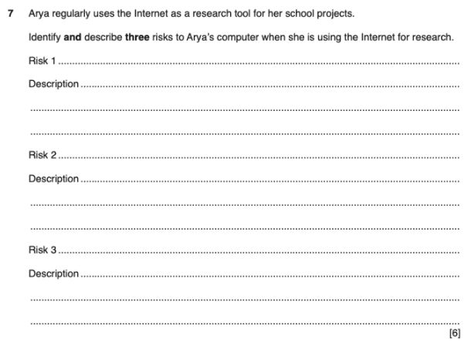
EXAM QUESTION
For more help, please visit www.exampaperspractice.co.uk

Slide 111
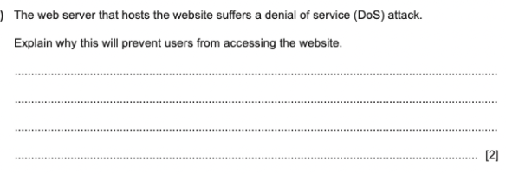
EXAM QUESTION
For more help, please visit www.exampaperspractice.co.uk

Slide 112
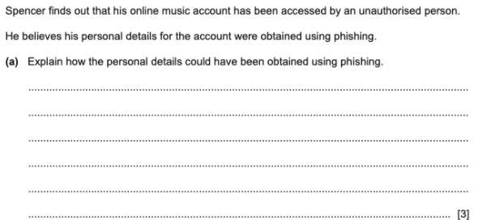
EXAM QUESTION
For more help, please visit www.exampaperspractice.co.uk

Slide 113
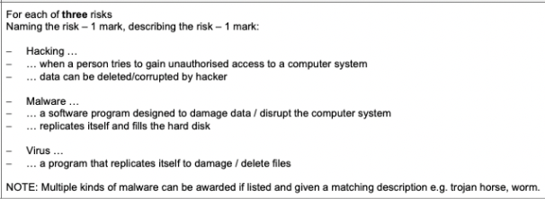
EXAM QUESTION
For more help, please visit www.exampaperspractice.co.uk

Slide 114

EXAM QUESTION
For more help, please visit www.exampaperspractice.co.uk

Slide 115

EXAM QUESTION
For more help, please visit www.exampaperspractice.co.uk

Slide 116
Cyber Security
Solutions and Prevention
For more help, please visit www.exampaperspractice.co.uk

Slide 117
Cyber Security
Threats
Solutions/Prevention
For more help, please visit www.exampaperspractice.co.uk

Slide 118



Cyber
Security
A
Access Level
A
Anti-Malware
Authentication
Automating Software Updates
A
A
Solution and Prevention
Spelling and Tone in communications
S
F
Firewalls
Privacy
Setting
P
Proxy Server
P
Secure Socket
Layer
S
For more help, please visit www.exampaperspractice.co.uk

Slide 119

Cyber
Security
A
Access Level
A
Anti-Malware
Authentication
Automating Software Updates
A
A
Solution and Prevention
Spelling and Tone in communications
S
F
Firewalls
Privacy
Setting
P
Proxy Server
P
Secure Socket
Layer
S
For more help, please visit www.exampaperspractice.co.uk

Slide 120

A
Access Level
    This method of protection is crucial in organizations with numerous users accessing a network, such as the Computer Lab.
      Users are assigned varying levels of access based on their roles, enabling control over their behavior while using the networked computers.
      Access levels are particularly significant when working with databases, determining permissions for reading, writing, and deleting data.
For more help, please visit www.exampaperspractice.co.uk

Slide 121
Cyber
Security
A
Access Level
A
Anti-Malware
Authentication
Automating Software Updates
A
A
Solution and Prevention
Spelling and Tone in communications
S
F
Firewalls
Privacy
Setting
P
Proxy Server
P
Secure Socket
Layer
S
For more help, please visit www.exampaperspractice.co.uk

Slide 122


A
Anti-malware
    The dangers posed by malicious software include:
      Theft of company data.
      Corruption of data, making it unreadable.
    Therefore, it is essential for a network to have anti-malware and antivirus applications installed to protect all devices, similar to how vaccines protect against COVID-19.
Types of Anti-malware
Anti Virus
Anti Spyware
For more help, please visit www.exampaperspractice.co.uk

Slide 123

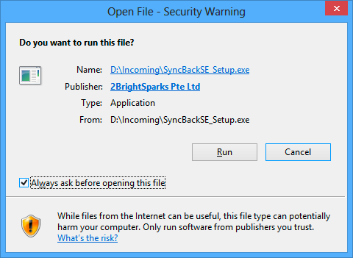

A
Anti virus
    Anti-virus software are constantly scanning documents, files and also incoming data from the internet.
Anti Virus
Anti Spyware
For more help, please visit www.exampaperspractice.co.uk

Slide 124
A
Anti virus
    Anti-virus software continually scans documents, files, and incoming internet data.
      It detects suspicious activity and files before they are accessed or stored, warning users against opening them.
      If a harmful file is detected, the anti-virus quarantines it to isolate it from the network, preventing further installation or spreading to other areas of the network or hard drive.
      Upon user command, the software can then remove and delete the identified malware or virus.
Anti Virus
Anti Spyware
For more help, please visit www.exampaperspractice.co.uk

Slide 125


A
Anti spyware
    Spyware functions by clandestinely collecting information through monitoring a user’s computer activities.
      It identifies spyware by detecting common characteristics typically associated with such malicious software, thereby flagging potential security risks.
      The software examines file structures known to be linked with spyware, enabling its identification and removal.
Anti Virus
Anti Spyware
For more help, please visit www.exampaperspractice.co.uk

Slide 126
Cyber
Security
A
Access Level
A
Anti-Malware
Authentication
Automating Software Updates
A
A
Solution and Prevention
Spelling and Tone in communications
S
F
Firewalls
Privacy
Setting
P
Proxy Server
P
Secure Socket
Layer
S
For more help, please visit www.exampaperspractice.co.uk

Slide 127

Authentication
A
    Authentication refers to the ability of a user to prove who they are.
Password and user names
Biometrics
Authentication
Two-step verification
Credit Card & Hotel Card
For more help, please visit www.exampaperspractice.co.uk

Slide 128

Password and user names
P
    Examples of where password is used:
      websites
      mobile phones, etc
    Password should be strong enough to stop criminals from guessing them.
Password and user names
For more help, please visit www.exampaperspractice.co.uk

Slide 129
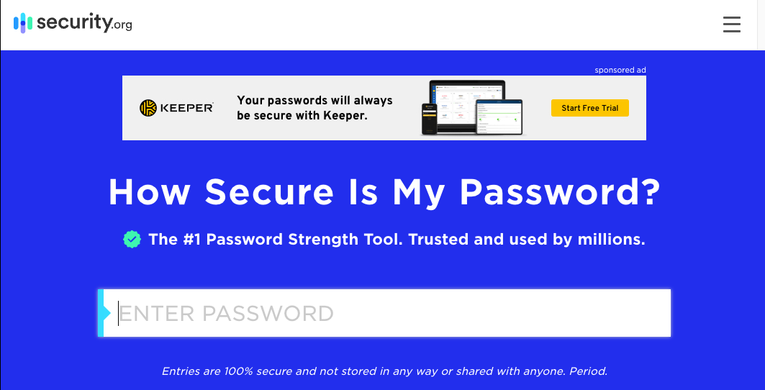
Let's try this out
Password and user names
For more help, please visit www.exampaperspractice.co.uk

Slide 130

Tips for a stronger password
T
    Combine different types of characters (lowercase, uppercase, special characters).
    Avoid predictable patterns in passwords (e.g., don't use sequential or repetitive patterns).
    Use random patterns for stronger passwords (e.g., "Hp3oe7Ls*(!kajmc").
    Use unique passwords for each account and avoid using the same password across multiple accounts.
Password and user names
For more help, please visit www.exampaperspractice.co.uk

Slide 131

Biometric Authentication
B
    Biometrics relies on certain unique characteristics of human beings:
Biometric Authentication
For more help, please visit www.exampaperspractice.co.uk

Slide 132
Biometric Authentication
B
    Biometrics relies on certain unique characteristics of human beings:
      Fingerprint scans (compare image stored versus image scanned; fingerprints are unique)
      Face recognition
      Voice recognition
Biometric Authentication
For more help, please visit www.exampaperspractice.co.uk

Slide 133
Two-step verification
T
    Requires two methods of authentication to verify who a user is.
    Example: Online shopping
      Step 1: Enter user name and password
      Step 2: Enter PIN that is sent back to her either in an email or as a text message to her mobile phone
Two-step
verification
For more help, please visit www.exampaperspractice.co.uk

Slide 134

Credit Card & Hotel Card
C
    A hotel card typically features a magnetic stripe on its back, which stores personal information for identification and access purposes.
    A credit card or smart card utilizes a chip that stores extensive information such as PIN numbers. This chip is read when inserted into an Electronic Funds Transfer Point of Sale (EFTPOS) terminal.
Credit Card & Hotel Card
For more help, please visit www.exampaperspractice.co.uk

Slide 135

Cyber
Security
A
Access Level
A
Anti-Malware
Authentication
Automating Software Updates
A
A
Solution and Prevention
Spelling and Tone in communications
S
F
Firewalls
Privacy
Setting
P
Proxy Server
P
Secure Socket
Layer
S
For more help, please visit www.exampaperspractice.co.uk

Slide 136

Automating Software Updates
A
    Why?
For more help, please visit www.exampaperspractice.co.uk

Slide 137
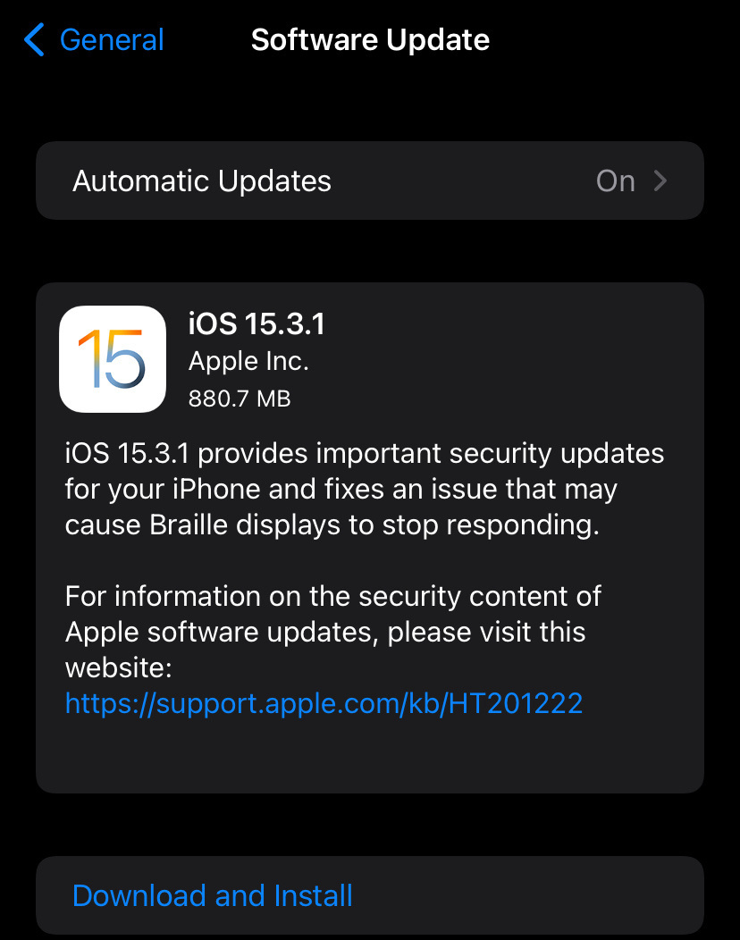
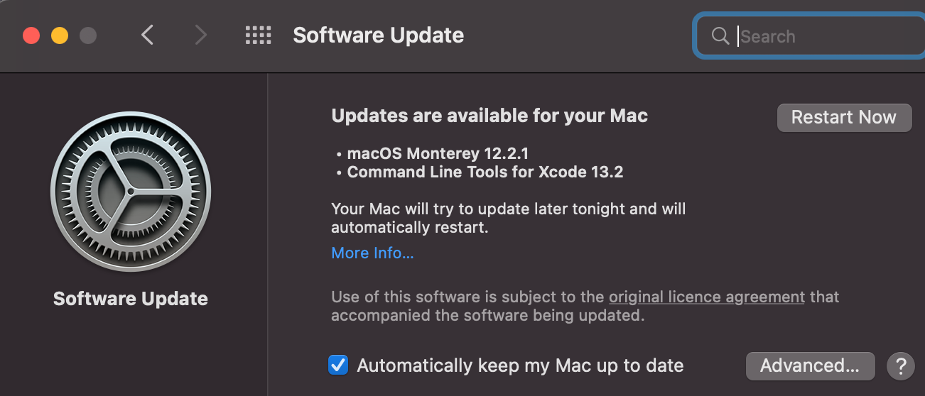
Automating Software Updates
A
For more help, please visit www.exampaperspractice.co.uk

Slide 138

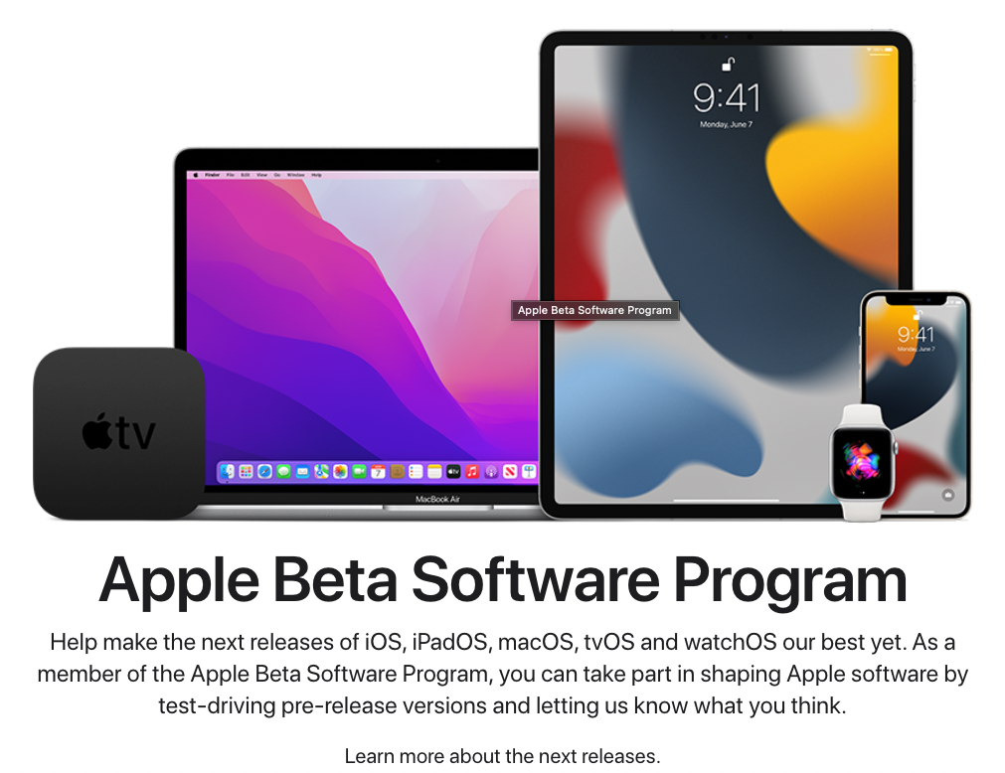
Automating Software Updates
A
    This ensures that essential applications like operating systems, antivirus software, and other commonly used programs are always running the latest versions.
      Continuously evolving threats necessitate constant updates, and antivirus companies strive to stay abreast of new attack methods.
For more help, please visit www.exampaperspractice.co.uk

Slide 139
Cyber
Security
A
Access Level
A
Anti-Malware
Authentication
Automating Software Updates
A
A
Solution and Prevention
Spelling and Tone in communications
S
F
Firewalls
Privacy
Setting
P
Proxy Server
P
Secure Socket
Layer
S
For more help, please visit www.exampaperspractice.co.uk

Slide 140
Spelling and Tone in communications
S
    Threat relating to emails?
For more help, please visit www.exampaperspractice.co.uk

Slide 141
Spelling and Tone in communications
S
    Phishing emails are a threat to security. Sending out legitimate-looking emails designed to trick the recipients into giving their personal details to the sender of the email.
    What can we do?
For more help, please visit www.exampaperspractice.co.uk

Slide 142

Spelling and Tone in communications
S
    Phishing emails are a threat to security. Sending out legitimate-looking emails designed to trick the recipients into giving their personal details to the sender of the email.
    Check
      If there is spellinnngngs errors in the email
      The tone used in the email message
www.gougle.com
www.amozon.com
For more help, please visit www.exampaperspractice.co.uk

Slide 143
Cyber
Security
A
Access Level
A
Anti-Malware
Authentication
Automating Software Updates
A
A
Solution and Prevention
Spelling and Tone in communications
S
F
Firewalls
Privacy
Setting
P
Proxy Server
P
Secure Socket
Layer
S
For more help, please visit www.exampaperspractice.co.uk

Slide 144

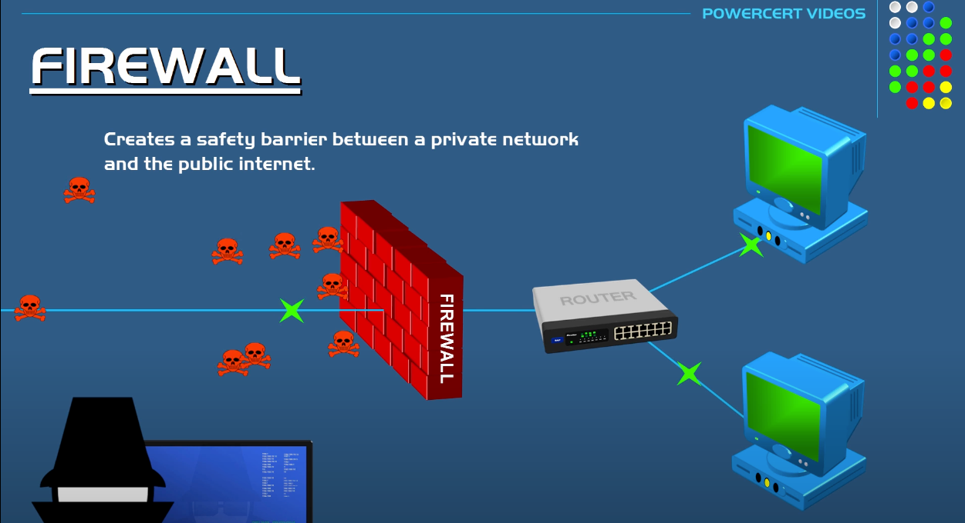
Firewall
F
    A firewall can exist as either software or hardware. Positioned between a user's computer and an external network like the internet, it regulates the flow of information entering and leaving the computer.
For more help, please visit www.exampaperspractice.co.uk

Slide 145
Firewall
F
    A firewall, whether software or hardware, acts as a barrier between a user's computer and an external network like the internet. It filters information going in and out of the computer to safeguard against hacking, malware (viruses and spyware), phishing, and pharming attacks.
    Key tasks of a firewall include:
      Monitoring the traffic between the user's computer or internal network and the public network.
      Evaluating incoming and outgoing data against predefined criteria. If the data fails to meet these criteria, the firewall blocks it.
      Setting criteria to restrict access to undesirable sites or maintaining a list of undesirable IP addresses.
      Firewalls can be implemented as software installed on a computer or integrated into the operating system in some cases.
For more help, please visit www.exampaperspractice.co.uk

Slide 146
Cyber
Security
A
Access Level
A
Anti-Malware
Authentication
Automating Software Updates
A
A
Solution and Prevention
Spelling and Tone in communications
S
F
Firewalls
Privacy
Setting
P
Proxy Server
P
Secure Socket
Layer
S
For more help, please visit www.exampaperspractice.co.uk

Slide 147

Privacy Setting
P
    Privacy settings encompass controls found on web browsers, social networks, and other websites aimed at restricting access to and visibility of a user’s personal profile. Examples include:
      "Do not track" setting: Requests that websites and advertisers refrain from tracking user activity.
      Allowing payment methods to be saved for convenience, reducing the need to enter sensitive information repeatedly.
      Safer browsing options to protect against malicious websites and threats.
      Apps that manage location sharing, allowing users to control who can access their location information.
For more help, please visit www.exampaperspractice.co.uk

Slide 148

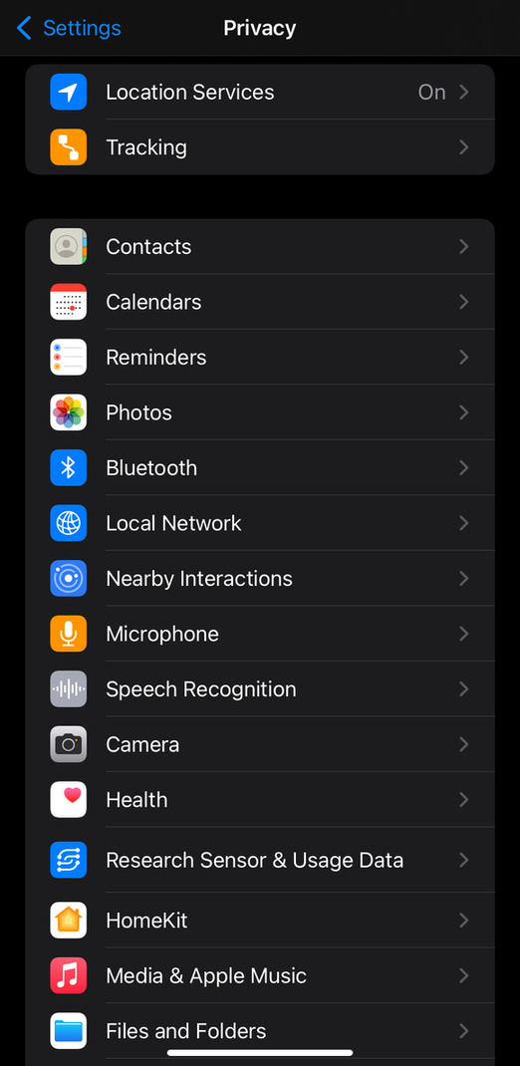
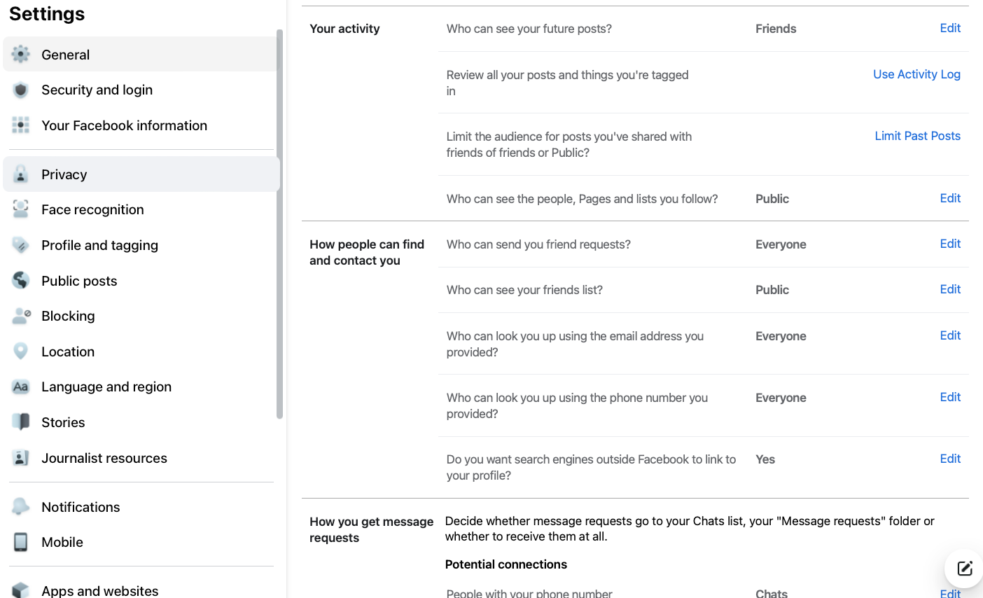
Privacy Setting - Phone and
P
For more help, please visit www.exampaperspractice.co.uk

Slide 149
Cyber
Security
A
Access Level
A
Anti-Malware
Authentication
Automating Software Updates
A
A
Solution and Prevention
Spelling and Tone in communications
S
F
Firewalls
Privacy
Setting
P
Proxy Server
P
Secure Socket
Layer
S
For more help, please visit www.exampaperspractice.co.uk

Slide 150

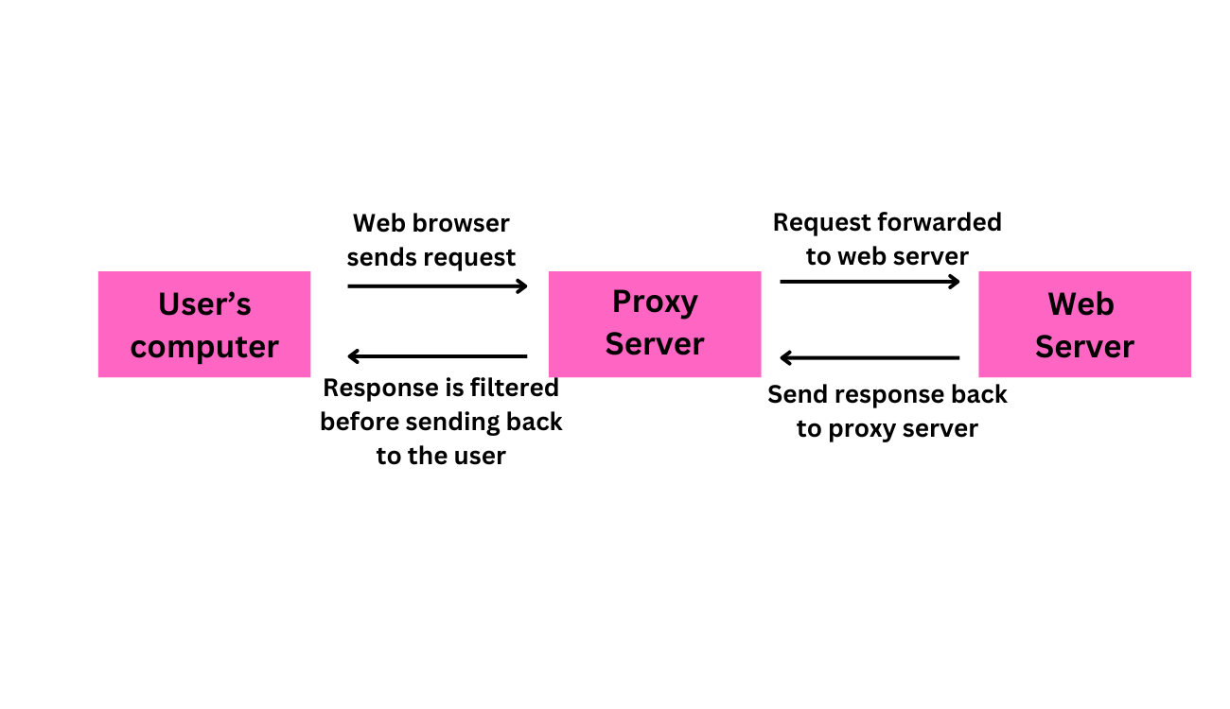
Proxy Server
P
    Proxy servers act as an intermediate between a user and a web server.
    Benefits?
For more help, please visit www.exampaperspractice.co.uk

Slide 151
Proxy Server
P
    Proxy servers act as an intermediate between a user and a web server.
    Benefits:
      Allows internet traffic to be filtered; it is possible to block access to a website if necessary - Parental Control
For more help, please visit www.exampaperspractice.co.uk

Slide 152
Proxy Server
P
    Proxy servers act as an intermediate between a user and a web server.
    Benefits:
      Allows internet traffic to be filtered; it is possible to block access to a website if necessary - Parental Control
      Keeps users’ IP addresses secret which improves security (middleman concept)
      Can you relate to one threat that we learned?
For more help, please visit www.exampaperspractice.co.uk

Slide 153
Proxy Server
P
    Proxy servers act as an intermediate between a user and a web server.
    Benefits:
      Allows internet traffic to be filtered; it is possible to block access to a website if necessary - Parental Control
      Keeps users’ IP addresses secret which improves security (middleman concept)
      If an attack is launched, it hits the proxy server instead – this helps to prevent hacking, DDoS, and so on.
For more help, please visit www.exampaperspractice.co.uk

Slide 154

Proxy Server
P
    Proxy servers act as an intermediate between a user and a web server.
    Benefits:
      Allows internet traffic to be filtered; it is possible to block access to a website if necessary - Parental Control
      Keeps users’ IP addresses secret which improves security (middleman concept)
      If an attack is launched, it hits the proxy server instead – this helps to prevent hacking, DoS, and so on
      Act as a firewall
For more help, please visit www.exampaperspractice.co.uk

Slide 155
Cyber
Security
A
Access Level
A
Anti-Malware
Authentication
Automating Software Updates
A
A
Solution and Prevention
Spelling and Tone in communications
S
F
Firewalls
Privacy
Setting
P
Proxy Server
P
Secure Socket
Layer
S
For more help, please visit www.exampaperspractice.co.uk

Slide 156

S
Secure socket layer
    SSL (Secure Sockets Layer) is a protocol commonly used on websites, especially those handling financial transactions.
      SSL encrypts the connection between a user's computer and the website, ensuring that sensitive data such as credit card numbers, login details, and passwords are securely transmitted.
For more help, please visit www.exampaperspractice.co.uk

Slide 157

Secure Socket Layer Handshake
S
A connection that is created between a web browser and a web server
For more help, please visit www.exampaperspractice.co.uk

Slide 158


Secure Socket Layer - flow
S
The user's browser sends a request to connect securely with the required website that is protected by SSL.
The browser then requests that the web server identifies itself through SSL.
The web server responds by sending a copy of its SSL certificate to the user's browser.
Certificate
An SSL certificate is a type of digital certificate used to authenticate a website and facilitate an encrypted connection.
For more help, please visit www.exampaperspractice.co.uk

Slide 159
Secure Socket Layer Handshake
S
The user's browser sends a request to connect securely with the required website that is protected by SSL.
The browser then requests that the web server identifies itself through SSL.
The web server responds by sending a copy of its SSL certificate to the user's browser.
If the browser successfully authenticates the certificate, it sends a message back to the web server to initiate communication.
For more help, please visit www.exampaperspractice.co.uk

Slide 160
Secure Socket Layer Handshake
S
The user’s browser sends a message so that it can connect with the required website which is secured by SSL
The browser then requests that the web server identifies itself
The web server responds by sending a copy of its SSL certificate to the user’s browser
Once this message is received, the web server acknowledges the web browser, and the SSL-encrypted two-way data transfer begins.
If the browser successfully authenticates the certificate, it sends a message back to the web server to initiate communication.
For more help, please visit www.exampaperspractice.co.uk

Slide 161


How do we know if a website is using SSL?
S
A user will know if SSL is being applied when they see "https" in the URL or a small padlock icon in the status bar at the top of the screen.
For more help, please visit www.exampaperspractice.co.uk

Slide 162

How do we know if a website is using SSL?
S
Examples of where SSL (or its modern counterpart, TLS) will be used include:
  Online banking and all online financial transactions
  Online shopping and e-commerce websites
  Sending and receiving emails (secure email protocols)
  Instant messaging applications
  Transport Layer Security (TLS) is a more advanced and secure version of SSL. It is a protocol that enhances the security and privacy of data exchanged between devices and users over a network.
For more help, please visit www.exampaperspractice.co.uk

Slide 163

Transport Layer Security (TLS)
T
Transport Layer Security (TLS) is a more advanced and secure protocol than SSL. It ensures the security and privacy of data exchanged between devices and users when communicating over a network.
For more help, please visit www.exampaperspractice.co.uk

Slide 164
Cyber
Security
A
Access Level
A
Anti-Malware
Authentication
Automating Software Updates
A
A
Solution and Prevention
Spelling and Tone in communications
S
F
Firewalls
Privacy
Setting
P
Proxy Server
P
Secure Socket
Layer
S
For more help, please visit www.exampaperspractice.co.uk

Slide 165
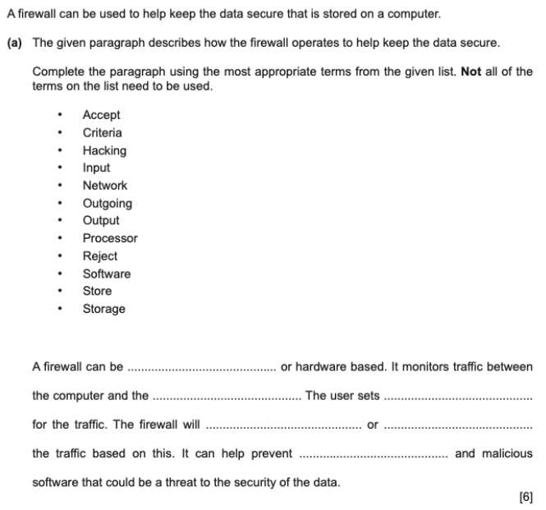
EXAM QUESTION
For more help, please visit www.exampaperspractice.co.uk

Slide 166
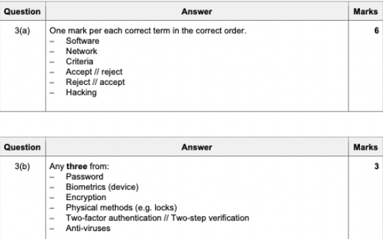
EXAM QUESTION
For more help, please visit www.exampaperspractice.co.uk

Slide 167
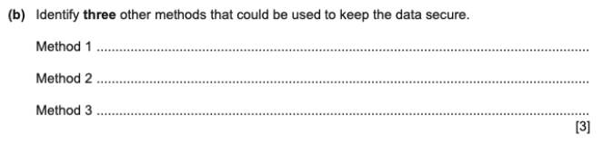
EXAM QUESTION
For more help, please visit www.exampaperspractice.co.uk

Slide 168
EXAM QUESTION
For more help, please visit www.exampaperspractice.co.uk

Slide 169
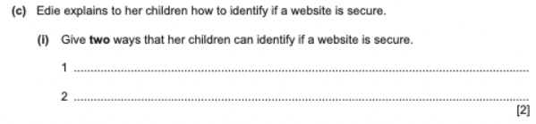
EXAM QUESTION
For more help, please visit www.exampaperspractice.co.uk

Slide 170

EXAM QUESTION
For more help, please visit www.exampaperspractice.co.uk

Slide 171
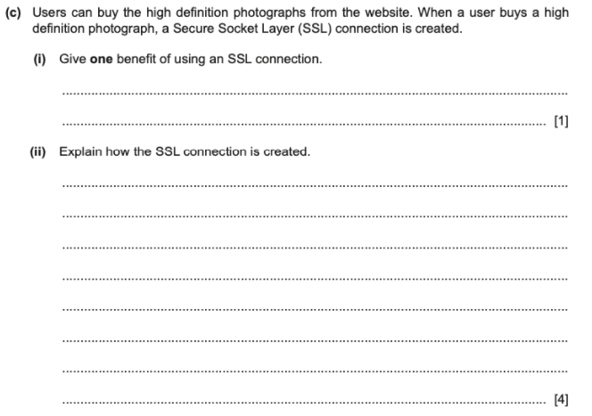
EXAM QUESTION
For more help, please visit www.exampaperspractice.co.uk

Slide 172
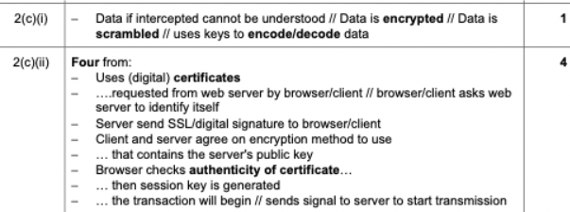
EXAM QUESTION
For more help, please visit www.exampaperspractice.co.uk

Slide 173
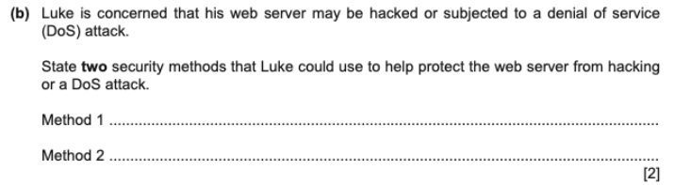
EXAM QUESTION
For more help, please visit www.exampaperspractice.co.uk

Slide 174
EXAM QUESTION
For more help, please visit www.exampaperspractice.co.uk

Slide 175
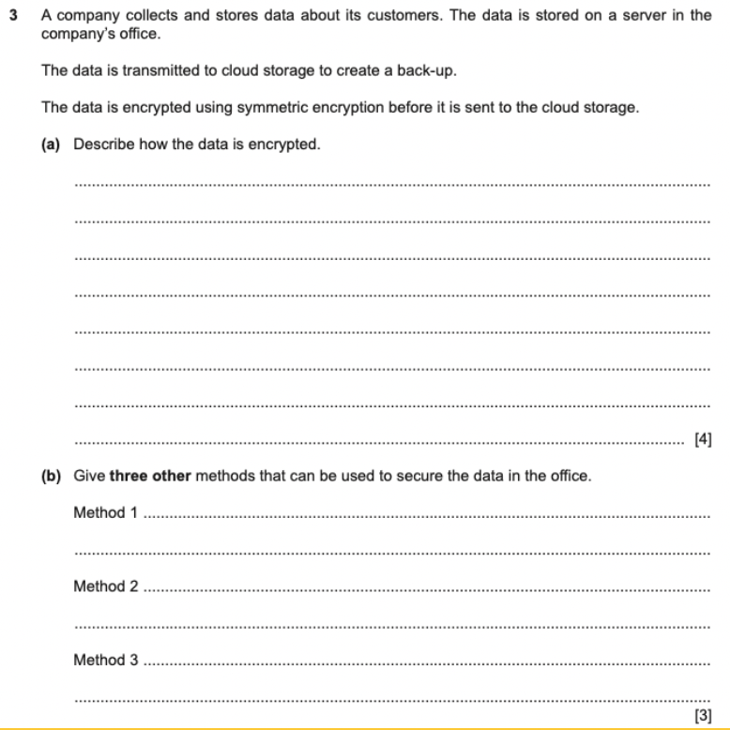
EXAM QUESTION
For more help, please visit www.exampaperspractice.co.uk

Slide 176
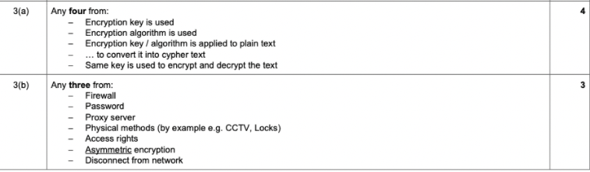
EXAM QUESTION
For more help, please visit www.exampaperspractice.co.uk

