Slide 1


Cambridge IGCSE Computer Science 0478/0984 - Revision Notes
Chapter 3 - Hardware
This study guide has been expertly compiled and edited by successful former teachers of Computer Science and highly experienced examiners and is suitable for students who are taking 0478 (9-1) IGCSE, the 0984 (A*-G) IGCSE, and the 2210 O Level for examination in 2023 onwards. It could be used as lesson starters, or supplied to students for independent use.
For more help, please visit www.exampaperspractice.co.uk

Slide 2

IGCSE Computer Science
What is a CPU?
Chapter 3: Hardware
For more help, please visit www.exampaperspractice.co.uk

Slide 3
IGCSE Computer Science
What is a CPU?
3.1 CENTRAL UNIT PROCESSING (CPU)
For more help, please visit www.exampaperspractice.co.uk

Slide 4
THE CENTRAL PROCESSING UNIT (CPU)
    The CPU serves as the core component in contemporary computer setups, typically integrated into a single microchip, and bears the primary duty of executing instructions and handling data within computer applications.
For more help, please visit www.exampaperspractice.co.uk

Slide 5
INTRODUCING THE VON NEWMANN ARCHITECTURE
    Early computers needed continuous human input during operation due to the inability to store programs or data.
    In the mid-1940s, John von Neumann pioneered the concept of the 'stored program computer’.
    This concept introduced several key features:
      Central Processing Unit (CPU) or processor.
      Direct memory access by the CPU.
      Capability of computer memories to store both programs and data.
      Execution of stored programs composed of sequential instructions.
See the Von Neumann Architecture!
For more help, please visit www.exampaperspractice.co.uk

Slide 6


VON NEUMANN ARCHITECTURE
CONTROL BUS
DATA BUS
Central Processing Unit (CPU)
ADDRESS BUS
MAR
CU
PC
MDR
CIR
ALU
ACC
Input
Output
Memory Unit (RAM)
keyboards, touch screens and microphones
printers, monitors and loudspeakers
For more help, please visit www.exampaperspractice.co.uk

Slide 7
VON NEUMANN ARCHITECTURE
CONTROL BUS
DATA BUS
Central Processing Unit (CPU)
ADDRESS BUS
Input
Output
keyboards, touch screens and microphones
printers, monitors and loudspeakers
For more help, please visit www.exampaperspractice.co.uk

Slide 8
VON NEUMANN ARCHITECTURE
CONTROL BUS
DATA BUS
Central Processing Unit (CPU)
ADDRESS BUS
ALU
Input
Output
keyboards, touch screens and microphones
printers, monitors and loudspeakers
For more help, please visit www.exampaperspractice.co.uk

Slide 9


Input 1
Input 2
ARITHMETIC & LOGIC UNIT
(ALU)
1
Enables processor to carry out mathematical operations on data (adding, subtracting, multiplying and dividing)
2
Enables logical operations to be carried out
ALU
3
A computer can have multiple ALUs to perform specific tasks. Multiplication and division are executed through a series of additions, subtractions, and left or right logical shifts.
Output
For more help, please visit www.exampaperspractice.co.uk

Slide 10
VON NEUMANN ARCHITECTURE
CONTROL BUS
DATA BUS
Central Processing Unit (CPU)
ADDRESS BUS
ALU
Input
Output
Memory Unit (RAM)
keyboards, touch screens and microphones
printers, monitors and loudspeakers
For more help, please visit www.exampaperspractice.co.uk

Slide 11

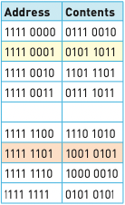
RANDOM ACCESS MEMORY
MEMORY UNIT
1
The CPU's memory unit (RAM) holds the instructions and processes that the computer frequently uses while handling data.
2
The CPU temporarily transfers data and programs from the hard disk drive into RAM.
3
Read and write operations performed using RAM are significantly faster than those to a hard disk drive.
4
RAM is a type of volatile memory, meaning it loses its contents when the computer is turned off.
For more help, please visit www.exampaperspractice.co.uk

Slide 12
VON NEUMANN ARCHITECTURE
CONTROL BUS
DATA BUS
Central Processing Unit (CPU)
ADDRESS BUS
MAR
PC
MDR
CIR
ALU
ACC
Input
Output
Memory Unit (RAM)
keyboards, touch screens and microphones
printers, monitors and loudspeakers
For more help, please visit www.exampaperspractice.co.uk

Slide 13
One of the most fundamental components of the von Neumann architecture.
REGISTERS
There are 5 of them (Special purpose registers)
FUNCTIONS
1
The CIR holds the instruction currently being executed by the CPU.
Current Instruction Register
CIR
2
The ACC is a register that stores intermediate arithmetic and logic results during processing.
Accumulator
ACC
3
The MAR contains the address in memory where the CPU either reads data from or writes data to.
Memory Address Register
MAR
4
The MDR holds the data being transferred to or from the memory location specified by the MAR.
Memory Data (Buffer) Register
MDR
5
The PC keeps track of the address of the next instruction to be executed in the program sequence.
Program Counter
PC
For more help, please visit www.exampaperspractice.co.uk

Slide 14
VON NEUMANN ARCHITECTURE
CONTROL BUS
DATA BUS
Central Processing Unit (CPU)
ADDRESS BUS
MAR
CU
PC
MDR
CIR
ALU
ACC
Input
Output
Memory Unit (RAM)
keyboards, touch screens and microphones
printers, monitors and loudspeakers
For more help, please visit www.exampaperspractice.co.uk

Slide 15

CONTROL UNIT
Coordinator
1
Fetches an instruction from memory, with its location address stored in the program counter.
2
The instruction is then processed through the Fetch-Decode-Execute sequence.
The Control Unit (CU) ensures that all these components adhere to the instructions it has processed from the input.
3
During this process, signals are sent via the control bus to instruct other components in the computer on their actions.
For more help, please visit www.exampaperspractice.co.uk

Slide 16
VON NEUMANN ARCHITECTURE
CONTROL BUS
DATA BUS
Central Processing Unit (CPU)
ADDRESS BUS
MAR
CU
PC
MDR
CIR
ALU
ACC
Input
Output
Memory Unit (RAM)
For more help, please visit www.exampaperspractice.co.uk

Slide 17
SYSTEM BUSES
*width of the address bus and data bus is important. The wider the bus, the larger the word length that can be transported.
Several buses, otherwise known as connections, carry data around a computer.
It carries the address of memory locations and input/output ports, specifying where data should be read from or written to.
1
Address Bus
It transmits data between the CPU, memory, and input/output devices, allowing information to be transferred within the computer system.
2
Data Bus
It carries control signals generated by the CPU to manage and coordinate activities among various hardware components, ensuring they operate synchronously and in accordance with instructions.
3
Control Bus
For more help, please visit www.exampaperspractice.co.uk

Slide 18
VON NEUMANN ARCHITECTURE
CONTROL BUS
DATA BUS
Central Processing Unit (CPU)
ADDRESS BUS
MAR
CU
PC
MDR
CIR
ALU
ACC
Input
Output
Memory Unit (RAM)
For more help, please visit www.exampaperspractice.co.uk

Slide 19

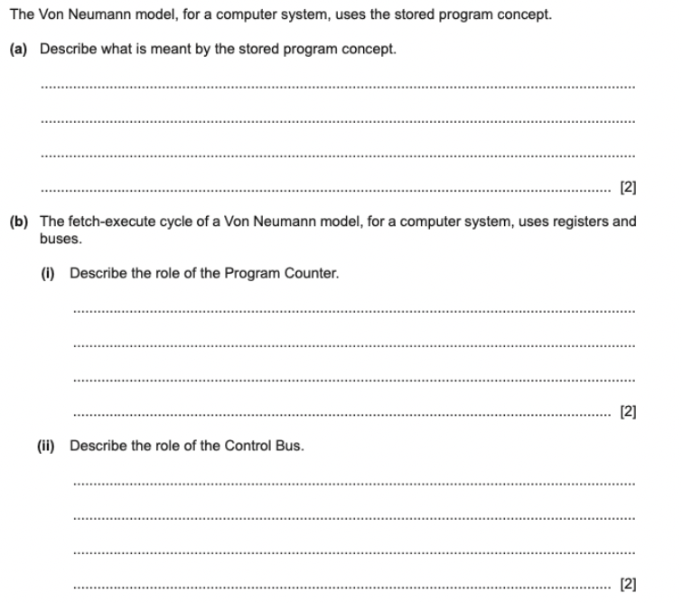

PAST YEAR QUESTION
For more help, please visit www.exampaperspractice.co.uk

Slide 20
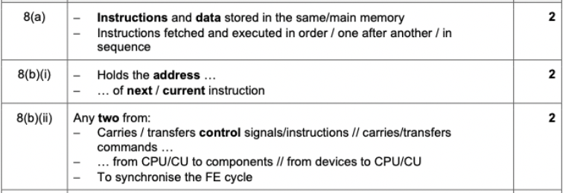
PAST YEAR QUESTION
For more help, please visit www.exampaperspractice.co.uk

Slide 21
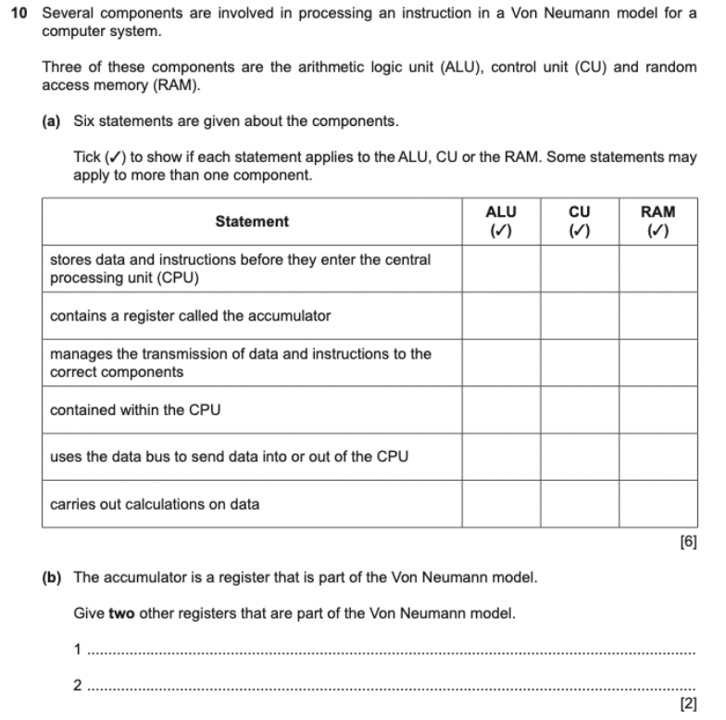
PAST YEAR QUESTION
For more help, please visit www.exampaperspractice.co.uk

Slide 22
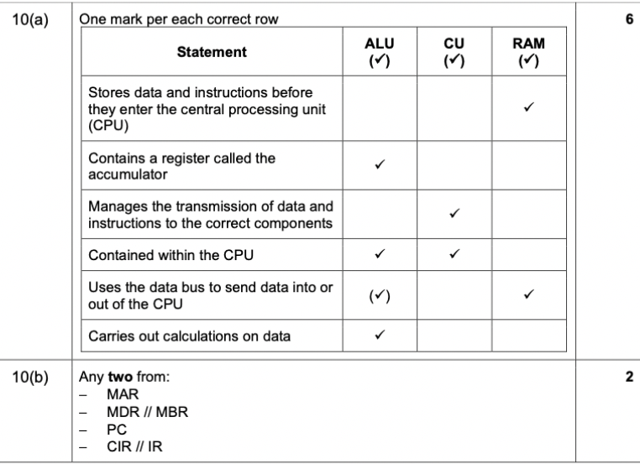
PAST YEAR QUESTION
For more help, please visit www.exampaperspractice.co.uk

Slide 23

CPU (2)
YEAR 10 COMPUTER SCIENCE
FETCH-DECODE-EXECUTE CYCLE
For more help, please visit www.exampaperspractice.co.uk

Slide 24
VON NEUMANN ARCHITECTURE RECAP
CONTROL BUS
DATA BUS
Central Processing Unit (CPU)
ADDRESS BUS
MAR
CU
PC
MDR
CIR
ALU
ACC
Input
Output
Memory Unit (RAM)
For more help, please visit www.exampaperspractice.co.uk

Slide 25
Fetch-Decode-Execute Cycle
    Modern computers utilizing the Von Neumann Architecture employ the fetch-decode-execute cycle to process data efficiently, ensuring sequential logic and fulfilling user requirements, typically completing within milliseconds using all CPU components.
For more help, please visit www.exampaperspractice.co.uk

Slide 26



Fetch-Decode-Execute Cycle
Data and instructions can be stored in the MDR. During the Fetch-Decode-Execute cycle, the next instruction is retrieved from the memory address stored in the MAR and placed into the MDR. The content of the MDR is then transferred to the Current Instruction Register (CIR). Subsequently, the PC is incremented by 1 to prepare for the processing of the next instruction.
The CPU transmits the decoded instruction as a series of control signals to the relevant components within the computer system, enabling each instruction to be executed in its logical sequence.
The instruction is then decoded in preparation for interpretation in the subsequent part of the cycle.
For more help, please visit www.exampaperspractice.co.uk

Slide 27
Z = X + Y
Memory
0
8
0
9
Control bus
Control Unit
2
10
Program Counter
3
11
0
12
Current Instruction Register
...
Accumulator
0
13
Memory Address Register
0
99
ALU
Memory Data Register
0
100
Load 10
101
Add 11
102
Store 12
103
For more help, please visit www.exampaperspractice.co.uk

Slide 28

Z = X + Y
Memory
0
8
0
9
Control bus
Control Unit
2
10
Program Counter
3
11
0
12
Current Instruction Register
...
Accumulator
0
13
All of these (value and address) will be stored using machine code (0 and 1)
Memory Address Register
0
99
ALU
Memory Data Register
0
100
Load 10
101
Add 11
102
Store 12
103
For more help, please visit www.exampaperspractice.co.uk

Slide 29
Fetch-Decode-Execute Step by Step
1. The program counter holds the memory address of the next instruction to be executed, and this address is then copied into the memory address register.
2. The program counter is incremented by one, updating its value to reflect the memory address of the next instruction to be executed.
3. The control unit (CU) sends a request to the RAM for the instruction, retrieving the address of the instruction from the MAR via the address bus.
4. The data stored in the RAM at the specified address is transferred via the data bus to the memory data register (MDR).
5. When the instruction reaches the MDR, it is then copied into the current instruction register (CIR).
6. The instruction in the CIR is decoded using the arithmetic logic unit (ALU) and subsequently executed. The outcome of this operation is stored in the accumulator.
For more help, please visit www.exampaperspractice.co.uk

Slide 30
1. The program counter holds the memory address of the next instruction to be executed, and this address is then copied into the memory address register.
Memory
0
8
0
9
Control bus
Control Unit
2
10
Program Counter
3
11
0
12
Current Instruction Register
...
Accumulator
0
13
Memory Address Register
0
99
ALU
Memory Data Register
0
100
Load 10
101
Add 11
102
Store 12
103
For more help, please visit www.exampaperspractice.co.uk

Slide 31
1. The program counter holds the memory address of the next instruction to be executed, and this address is then copied into the memory address register.
Memory
0
8
0
9
Control bus
Control Unit
2
10
Program Counter
101
3
11
0
12
Current Instruction Register
...
Accumulator
0
13
Memory Address Register
101
0
99
ALU
Memory Data Register
0
100
Load 10
101
Add 11
102
Store 12
103
For more help, please visit www.exampaperspractice.co.uk

Slide 32
2. The program counter is incremented by one, updating its value to reflect the memory address of the next instruction to be executed.
Memory
0
8
0
9
Control bus
Control Unit
2
10
Program Counter
102
3
11
0
12
Current Instruction Register
...
Accumulator
0
13
Memory Address Register
101
0
99
ALU
Memory Data Register
0
100
Load 10
101
Add 11
102
Store 12
103
For more help, please visit www.exampaperspractice.co.uk

Slide 33
3. The control unit (CU) sends a request to the RAM for the instruction, retrieving the address of the instruction from the MAR via the address bus.
Memory
0
8
0
9
Control bus
Control Unit
Address bus
2
10
Program Counter
102
3
11
0
12
Current Instruction Register
...
Accumulator
0
13
Memory Address Register
101
0
99
ALU
Memory Data Register
0
100
Load 10
101
Add 11
102
Store 12
103
For more help, please visit www.exampaperspractice.co.uk

Slide 34
4. The data stored in the RAM at the specified address is transferred via the data bus to the memory data register (MDR).
Memory
0
8
0
9
Control bus
Control Unit
Address bus
2
10
Program Counter
102
3
11
0
12
Current Instruction Register
...
Accumulator
0
13
Memory Address Register
101
0
99
ALU
Memory Data Register
0
100
Load 10
Load 10
101
Add 11
102
Store 12
103
For more help, please visit www.exampaperspractice.co.uk

Slide 35
5. When the instruction reaches the MDR, it is then copied into the current instruction register (CIR).
Memory
0
8
0
9
Control bus
Control Unit
Address bus
2
10
Program Counter
102
3
11
0
12
Current Instruction Register
...
Accumulator
Load 10
0
13
Memory Address Register
101
0
99
ALU
Memory Data Register
0
100
Load 10
Load 10
101
Add 11
102
Store 12
103
For more help, please visit www.exampaperspractice.co.uk

Slide 36
6. The instruction in the CIR is decoded using the arithmetic logic unit (ALU) and subsequently executed. The outcome of this operation is stored in the accumulator.
Memory
0
8
0
9
Control bus
Control Unit
Address bus
2
10
Program Counter
Load 10
102
3
11
0
12
Current Instruction Register
...
Accumulator
Load 10
0
13
Memory Address Register
101
0
99
ALU
Memory Data Register
0
100
Load 10
Load 10
101
Add 11
102
Store 12
103
For more help, please visit www.exampaperspractice.co.uk

Slide 37
6. The instruction in the CIR is decoded using the arithmetic logic unit (ALU) and subsequently executed. The outcome of this operation is stored in the accumulator.
Memory
0
8
0
9
Control bus
Control Unit
Address bus
2
10
Program Counter
Load 10
102
3
11
0
12
Current Instruction Register
...
Accumulator
Load 10
0
13
Memory Address Register
10
0
99
ALU
Memory Data Register
0
100
2
Load 10
101
Add 11
102
Store 12
103
For more help, please visit www.exampaperspractice.co.uk

Slide 38
6. The instruction in the CIR is decoded using the arithmetic logic unit (ALU) and subsequently executed. The outcome of this operation is stored in the accumulator.
Memory
0
8
0
9
Control bus
Control Unit
Address bus
2
10
Program Counter
Load 10
102
3
11
0
12
Current Instruction Register
...
Accumulator
Load 10
0
13
2
Memory Address Register
10
0
99
ALU
Memory Data Register
0
100
2
Load 10
101
Add 11
102
Store 12
103
For more help, please visit www.exampaperspractice.co.uk

Slide 39
FIRST INSTRUCTION DONE!
For more help, please visit www.exampaperspractice.co.uk

Slide 40
1. The program counter holds the memory address of the next instruction to be executed, and this address is then copied into the memory address register.
Memory
0
8
0
9
Control bus
Control Unit
Address bus
2
10
Program Counter
Load 10
102
3
11
0
12
Current Instruction Register
...
Accumulator
Load 10
0
13
2
Memory Address Register
102
0
99
ALU
Memory Data Register
0
100
2
Load 10
101
Add 11
102
Store 12
103
For more help, please visit www.exampaperspractice.co.uk

Slide 41
2. The program counter is incremented by one, updating its value to reflect the memory address of the next instruction to be executed.
Memory
0
8
0
9
Control bus
Control Unit
Address bus
2
10
Program Counter
Load 10
103
3
11
0
12
Current Instruction Register
...
Accumulator
Load 10
0
13
2
Memory Address Register
102
0
99
ALU
Memory Data Register
0
100
2
Load 10
101
Add 11
102
Store 12
103
For more help, please visit www.exampaperspractice.co.uk

Slide 42
3. The control unit (CU) sends a request to the RAM for the instruction, retrieving the address of the instruction from the MAR via the address bus.
Memory
0
8
0
9
Control bus
Control Unit
Address bus
2
10
Program Counter
Load 10
103
3
11
0
12
Current Instruction Register
...
Accumulator
Load 10
0
13
2
Memory Address Register
102
0
99
ALU
Memory Data Register
0
100
2
Load 10
101
Add 11
102
Store 12
103
For more help, please visit www.exampaperspractice.co.uk

Slide 43
4. The data stored in the RAM at the specified address is transferred via the data bus to the memory data register (MDR).
Memory
0
8
0
9
Control bus
Control Unit
Address bus
2
10
Program Counter
Load 10
103
3
11
0
12
Current Instruction Register
...
Accumulator
Load 10
0
13
2
Memory Address Register
102
0
99
ALU
Memory Data Register
0
100
Add 11
Load 10
101
Add 11
102
Store 12
103
For more help, please visit www.exampaperspractice.co.uk

Slide 44
5. When the instruction reaches the MDR, it is then copied into the current instruction register (CIR).
Memory
0
8
0
9
Control bus
Control Unit
Address bus
2
10
Program Counter
Load 10
103
3
11
0
12
Current Instruction Register
...
Accumulator
Add 11
0
13
2
Memory Address Register
102
0
99
ALU
Memory Data Register
0
100
Add 11
Load 10
101
Add 11
102
Store 12
103
For more help, please visit www.exampaperspractice.co.uk

Slide 45
6. The instruction in the CIR is decoded using the arithmetic logic unit (ALU) and subsequently executed. The outcome of this operation is stored in the accumulator.
Memory
0
8
0
9
Control bus
Control Unit
Address bus
2
10
Program Counter
Add 11
103
3
11
0
12
Current Instruction Register
...
Accumulator
Add 11
0
13
2
Memory Address Register
102
0
99
ALU
Memory Data Register
0
100
Add 11
Load 10
101
Add 11
102
Store 12
103
For more help, please visit www.exampaperspractice.co.uk

Slide 46
6. The instruction in the CIR is decoded using the arithmetic logic unit (ALU) and subsequently executed. The outcome of this operation is stored in the accumulator.
Memory
0
8
0
9
Control bus
Control Unit
Address bus
2
10
Program Counter
Add 11
103
3
11
0
12
Current Instruction Register
...
Accumulator
Add 11
0
13
2
Memory Address Register
11
0
99
ALU
Memory Data Register
0
100
2 + 3
3
Load 10
101
Add 11
102
Store 12
103
For more help, please visit www.exampaperspractice.co.uk

Slide 47
6. The instruction in the CIR is decoded using the arithmetic logic unit (ALU) and subsequently executed. The outcome of this operation is stored in the accumulator.
Memory
0
8
0
9
Control bus
Control Unit
Address bus
2
10
Program Counter
Add 11
102
3
11
0
12
Current Instruction Register
...
Accumulator
Add 11
0
13
5
Memory Address Register
11
0
99
ALU
Memory Data Register
0
100
2 + 3
3
Load 10
101
Add 11
102
Store 12
103
For more help, please visit www.exampaperspractice.co.uk

Slide 48
2ND INSTRUCTION DONE!
For more help, please visit www.exampaperspractice.co.uk

Slide 49
1. The program counter holds the memory address of the next instruction to be executed, and this address is then copied into the memory address register.
Memory
0
8
0
9
Control bus
Control Unit
Address bus
2
10
Program Counter
Add 11
103
3
11
0
12
Current Instruction Register
...
Accumulator
Add 11
0
13
5
Memory Address Register
103
0
99
ALU
Memory Data Register
0
100
2 + 3
3
Load 10
101
Add 11
102
Store 12
103
For more help, please visit www.exampaperspractice.co.uk

Slide 50
2. The program counter is incremented by one, updating its value to reflect the memory address of the next instruction to be executed.
Memory
0
8
0
9
Control bus
Control Unit
Address bus
2
10
Program Counter
Add 11
104
3
11
0
12
Current Instruction Register
...
Accumulator
Add 11
0
13
5
Memory Address Register
102
0
99
ALU
Memory Data Register
0
100
2 + 3
3
Load 10
101
Add 11
102
Store 12
103
For more help, please visit www.exampaperspractice.co.uk

Slide 51
3. The control unit (CU) sends a request to the RAM for the instruction, retrieving the address of the instruction from the MAR via the address bus.
Memory
0
8
0
9
Control bus
Control Unit
Address bus
2
10
Program Counter
Add 11
104
3
11
0
12
Current Instruction Register
...
Accumulator
Add 11
0
13
5
Memory Address Register
103
0
99
ALU
Memory Data Register
0
100
2 + 3
3
Load 10
101
Add 11
102
Store 12
103
For more help, please visit www.exampaperspractice.co.uk

Slide 52
4. The data stored in the RAM at the specified address is transferred via the data bus to the memory data register (MDR).
Memory
0
8
0
9
Control bus
Control Unit
Address bus
2
10
Program Counter
Add 11
104
3
11
0
12
Current Instruction Register
...
Accumulator
Add 11
0
13
5
Memory Address Register
103
0
99
ALU
Memory Data Register
0
100
2 + 3
Store 12
Load 10
101
Add 11
102
Store 12
103
For more help, please visit www.exampaperspractice.co.uk

Slide 53
5. When the instruction reaches the MDR, it is then copied into the current instruction register (CIR).
Memory
0
8
0
9
Control bus
Control Unit
Address bus
2
10
Program Counter
Add 11
104
3
11
0
12
Current Instruction Register
Store 12
...
Accumulator
0
13
5
Memory Address Register
103
0
99
ALU
Memory Data Register
0
100
2 + 3
Store 12
Load 10
101
Add 11
102
Store 12
103
For more help, please visit www.exampaperspractice.co.uk

Slide 54
6. The instruction in the CIR is decoded using the arithmetic logic unit (ALU) and subsequently executed. The outcome of this operation is stored in the accumulator.
Memory
0
8
0
9
Control bus
Control Unit
Address bus
2
10
Program Counter
Store 12
104
3
11
0
12
Current Instruction Register
Store 12
...
Accumulator
0
13
5
Memory Address Register
103
0
99
ALU
Memory Data Register
0
100
2 + 3
Store 12
Load 10
101
Add 11
102
Store 12
103
For more help, please visit www.exampaperspractice.co.uk

Slide 55
6. The instruction in the CIR is decoded using the arithmetic logic unit (ALU) and subsequently executed. The outcome of this operation is stored in the accumulator.
Memory
0
8
0
9
Control bus
Control Unit
Address bus
2
10
Program Counter
Store 12
104
3
11
5
12
Current Instruction Register
Store 12
...
Accumulator
0
13
5
Memory Address Register
103
0
99
ALU
Memory Data Register
0
100
2 + 3
Store 12
Load 10
101
Add 11
102
Store 12
103
For more help, please visit www.exampaperspractice.co.uk

Slide 56
3RD INSTRUCTION DONE!
FINISH Z = X + Y
For more help, please visit www.exampaperspractice.co.uk

Slide 57
Clock Speed, Cache Memory and Cores
    Other components make up part of the CPU and can make a significant difference to the overall operating speed of a computer .
    While the CPU processes instructions and data extremely quickly, other factors can affect a computer's performance.
For more help, please visit www.exampaperspractice.co.uk

Slide 58
1. Clock Speed
    Clock speed is a crucial metric for CPU performance, denoting the frequency of electrical pulses generated by the CPU's internal clock per second, measured in hertz, with modern speeds often in gigahertz (GHz). Increasing clock speed enhances computer processing speed (e.g., 3.5GHz equates to 3.5 billion cycles per second).
    Overclocking involves surpassing the CPU's designed clock speed, which can lead to issues such as asynchronous operations where instructions fail to complete before the next is executed, causing frequent crashes and instability. Additionally, overclocking can result in significant CPU overheating, further compromising reliability and performance.
For more help, please visit www.exampaperspractice.co.uk

Slide 59
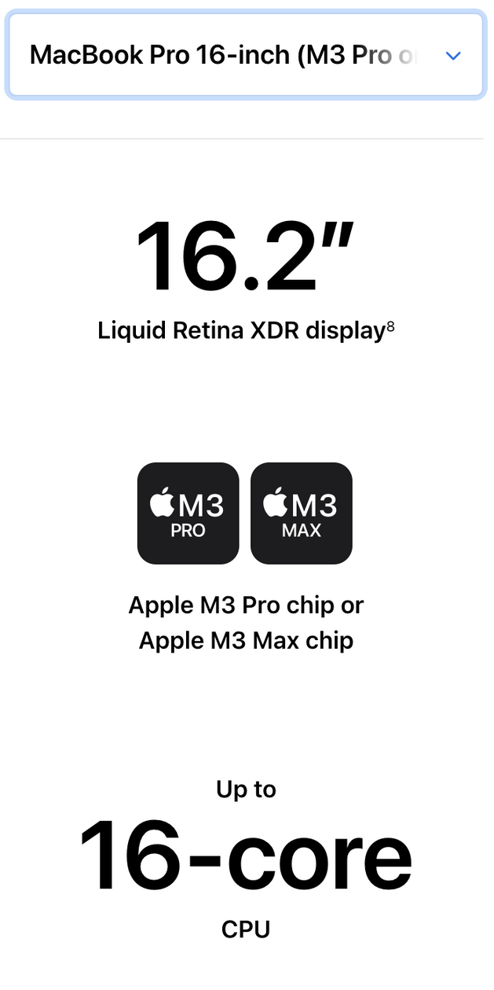
Cores
    Employing multiple cores can enhance computer performance.
    Each core includes an ALU, a control unit, and registers.
    Computers often feature dual-core (two cores) or quad-core (four cores) CPUs.
    This approach mitigates the necessity for constantly raising clock speeds.
For more help, please visit www.exampaperspractice.co.uk

Slide 60
One Core
Central Processing Unit (CPU)
MAR
CU
PC
MDR
CIR
ALU
ACC
For more help, please visit www.exampaperspractice.co.uk

Slide 61
Dual Core
Central Processing Unit (CPU)
Central Processing Unit (CPU)
MAR
MAR
CU
CU
PC
PC
MDR
MDR
CIR
CIR
ALU
ACC
ALU
ACC
However, doubling the number of cores doesn’t necessarily double the computer’s performance since we have to take into account the need for the CPU to communicate with each core; this will reduce overall performance.
For more help, please visit www.exampaperspractice.co.uk

Slide 62
Multi Core - 8 cores
Central Processing Unit (CPU)
Central Processing Unit (CPU)
Central Processing Unit (CPU)
MAR
CU
MAR
CU
MAR
CU
PC
PC
PC
MDR
MDR
MDR
ALU
CIR
CIR
CIR
ACC
ALU
ACC
ALU
ACC
Central Processing Unit (CPU)
Central Processing Unit (CPU)
Central Processing Unit (CPU)
MAR
CU
MAR
CU
MAR
CU
PC
PC
PC
MDR
MDR
MDR
ALU
CIR
CIR
CIR
ACC
ALU
ACC
ALU
ACC
Central Processing Unit (CPU)
Central Processing Unit (CPU)
CU
MAR
CU
MAR
PC
PC
MDR
MDR
CIR
CIR
ALU
ACC
ALU
ACC
For more help, please visit www.exampaperspractice.co.uk

Slide 63
Cache
    Cache memories play a crucial role in enhancing CPU performance.
    Unlike RAM, cache memory resides within the CPU, offering significantly faster data access times.
    It stores frequently used instructions and data, prioritizing quick retrieval to boost CPU efficiency.
    When the CPU needs to access memory, it first checks the cache; if the data isn't found there, it proceeds to main memory (RAM). Larger cache sizes correlate with improved CPU performance.
For more help, please visit www.exampaperspractice.co.uk

Slide 64

Memory
0
8
0
9
Control bus
Control Unit
Address bus
2
10
Program Counter
Store 12
103
3
11
5
12
Current Instruction Register
Store 12
...
Accumulator
0
13
5
Memory Address Register
102
0
99
ALU
Memory Data Register
0
100
2 + 3
Store 12
Load 10
101
Add 11
102
Cache
Store 12
103
For more help, please visit www.exampaperspractice.co.uk

Slide 65
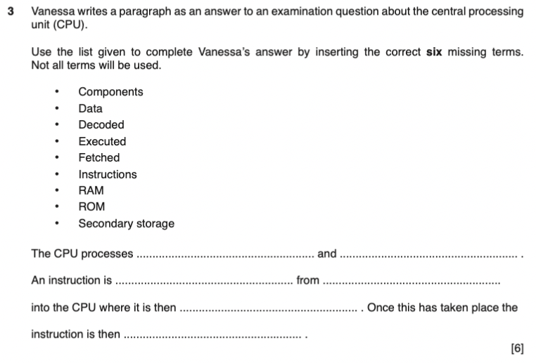
PAST YEAR QUESTION
For more help, please visit www.exampaperspractice.co.uk

Slide 66
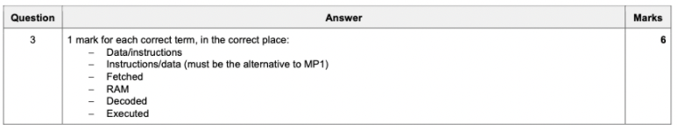
PAST YEAR QUESTION
For more help, please visit www.exampaperspractice.co.uk

Slide 67

0100 01101011
INSTRUCTION SET AND EMBEDDED SYSTEMS
For more help, please visit www.exampaperspractice.co.uk

Slide 68
Instruction Set
    Processor manufacturers have established a standard set of instructions to optimize CPU efficiency, encompassing all commands that a CPU can process.
    These instructions, known as operations, represent the fundamental commands that computers execute.
    They facilitate seamless operation of the control unit and arithmetic logic unit, ensuring efficient performance of their respective tasks.
For more help, please visit www.exampaperspractice.co.uk

Slide 69
Instruction Set
Operations are made up of opcodes and operands.
Load
Add
Store
10
11
12
For more help, please visit www.exampaperspractice.co.uk

Slide 70
Fetch-Decode-Execute Recap
Memory
0
8
0
9
Control bus
Control Unit
2
10
Program Counter
100
3
11
0
12
Current Instruction Register
...
Accumulator
0
13
Memory Address Register
100
0
99
ALU
Memory Data Register
0
100
Load 10
101
Add 11
102
Store 12
103
For more help, please visit www.exampaperspractice.co.uk

Slide 71
Instruction Set
Operations are made up of opcodes and operands.
Opcode:
- Operational Code
- Gives the CPU a precise job job that is required to happen
Load
Add
Store
10
11
12
The opcode are stored on a computer's hard disk and would usually be copied into the main memory RAM when the computer is powered on. The most regularly used opcodes would then be moved from the RAM to the cache memory.
For more help, please visit www.exampaperspractice.co.uk

Slide 72
Instruction Set
Operations are made up of opcodes and operands.
Load
Add
Store
10
11
12
An operand is the data that is required for the specific job as detailed by the opcode. The operand may be a piece of data itself, or it may be an address location within the main RAM or register.
For more help, please visit www.exampaperspractice.co.uk

Slide 73
Instruction Set
    Example : X86 Instruction Set
      1503
      Used by Intel Pentium and AMD Athlon CPU
    Instruction Set is not programming code. Instruction sets are the low-level language instructions that instruct the CPU how to carry out an operation
      Example:
        Python Code -> Instruction Set -> Computer
For more help, please visit www.exampaperspractice.co.uk

Slide 74
EMBEDDED SYSTEMS
For more help, please visit www.exampaperspractice.co.uk

Slide 75
Processors and Computer System
    Traditionally, desktop and laptop computers are categorized as general-purpose computers, designed to perform a broad spectrum of activities.
Discussion: Where could we find a processor, besides a computer or a laptop?
For more help, please visit www.exampaperspractice.co.uk

Slide 76
Embedded System
    An embedded system is a type of computer system designed to perform specific tasks efficiently.
    It integrates a small, built-in computer within a device, combining dedicated hardware and software tailored to execute a predefined set of functions.
    These systems typically focus on performing a single, specialized task as needed.
For more help, please visit www.exampaperspractice.co.uk

Slide 77
General Idea of an Embedded System
User Interface
Sensors, actuators
Analogue or digital input
Some form of Output
Software and hardware on an embedded system
For more help, please visit www.exampaperspractice.co.uk

Slide 78
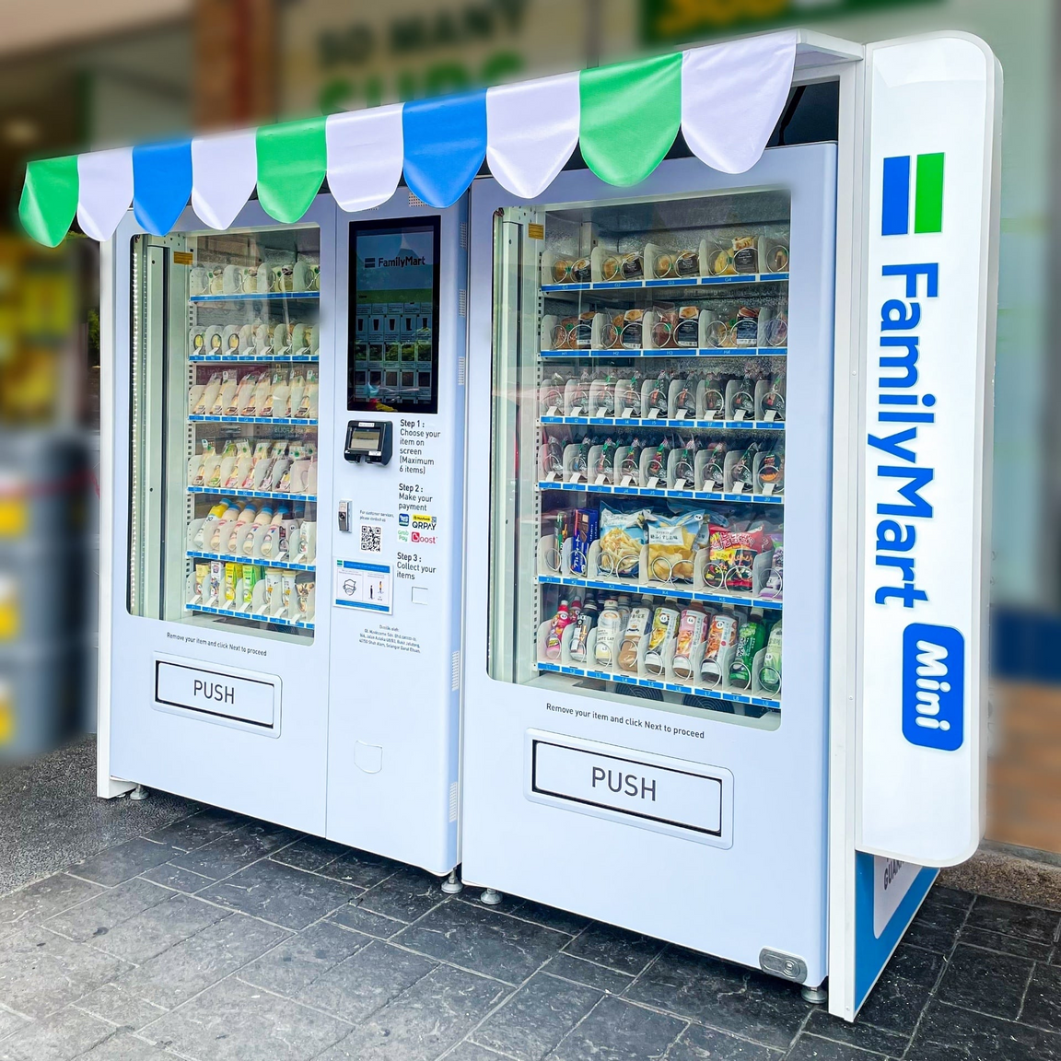
Vending Machine
Inputs to this system originate from various sources such as the keypad (for item selection) and sensors. These sensors are employed to monitor activities such as counting coins inserted by the customer, measuring internal temperature, and utilizing a tilt sensor for security monitoring.
The outputs of this system include:
- Signals to activate the cooling system if the temperature exceeds a set threshold.
- Display of item descriptions and any change due on an LCD display panel.
- Transmission of data back to the vending machine company, enabling remote monitoring of sales activity and facilitating instructions for machine refills without physical visits to each machine.
For more help, please visit www.exampaperspractice.co.uk

Slide 79

Lighting System
An embedded system can automatically control the lighting using a number of inputs (such as light sensors) and key data stored in memory
In an office environment, knowing the time of day or day of the week is crucial because the system can conserve energy by switching to low lighting levels when the office is unoccupied.
Certain lighting systems utilize Bluetooth-enabled light bulbs, enabling the embedded system to independently control each bulb. Many of these bulbs utilize LEDs and are available in multiple colors, offering the ability to adjust the lighting to create different moods.
For more help, please visit www.exampaperspractice.co.uk

Slide 80
Embedded System
    Embedded systems are typically low-power devices; for instance,
      Calculators rely on batteries.
    Depending on the device, embedded systems can be either programmable or non-programmable.
      Non-programmable devices generally require replacement for software upgrades.
      Programmable devices support upgrades through two methods: connecting to a computer for software downloads (e.g., updating GPS maps) or automatic updates via Wi-Fi, satellite, or cellular networks (e.g., updating engine management systems in modern cars).
For more help, please visit www.exampaperspractice.co.uk

Slide 81
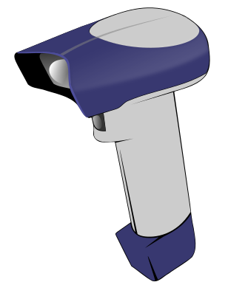



Input Devices
For more help, please visit www.exampaperspractice.co.uk

Slide 82
VON NEUMANN ARCHITECTURE RECAP
CONTROL BUS
DATA BUS
Central Processing Unit (CPU)
ADDRESS BUS
MAR
CU
PC
MDR
CIR
ALU
ACC
Input
Output
Memory Unit (RAM)
For more help, please visit www.exampaperspractice.co.uk

Slide 83

VON NEUMANN ARCHITECTURE RECAP
CONTROL BUS
DATA BUS
Central Processing Unit (CPU)
ADDRESS BUS
Our Focus this week!
MAR
CU
PC
MDR
CIR
ALU
ACC
Input
Output
Memory Unit (RAM)
For more help, please visit www.exampaperspractice.co.uk

Slide 84

Keyboards
What it has
It has a selection of keys that all perform different tasks.
Entering and typing letters and numbers. Used to given data and instruction to the computer.
What it does
Connected to the computer using either a universal serial bus port or wirelessly using a Bluetooth connection.
How to use
For more help, please visit www.exampaperspractice.co.uk

Slide 85
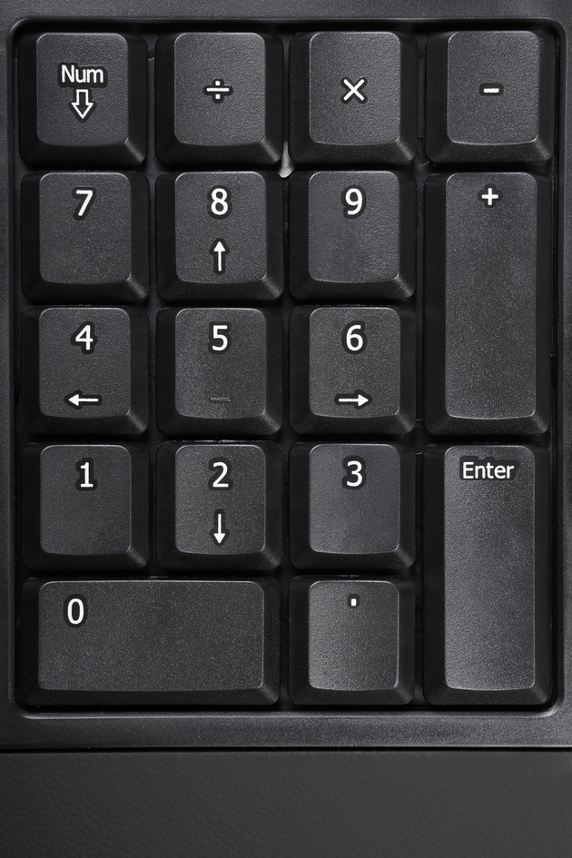

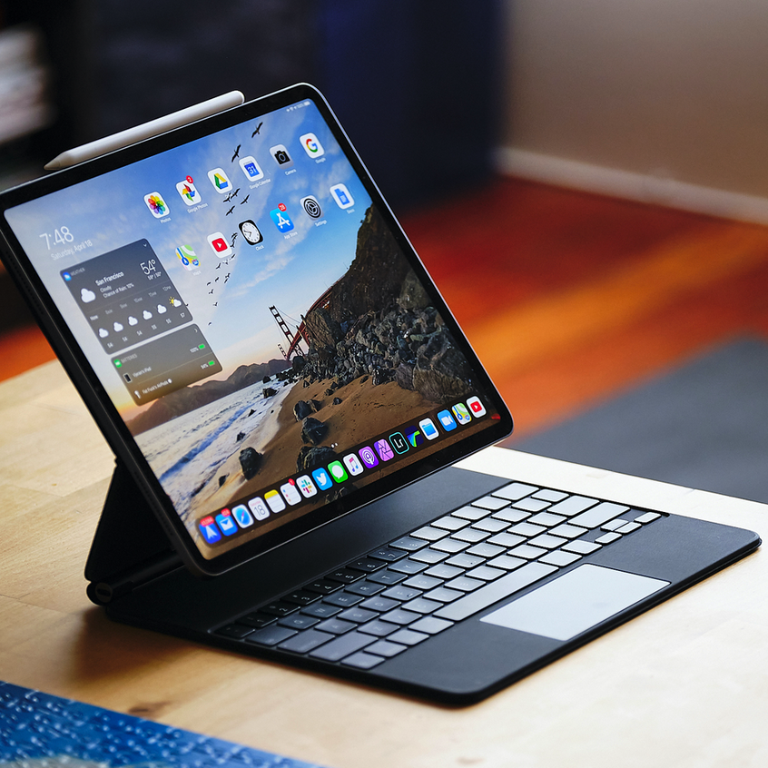
Other types of keyboards
For more help, please visit www.exampaperspractice.co.uk

Slide 86
How does it work?
Central Processing Unit (CPU)
CU
MAR
PC
MDR
01101000
CIR
ALU
ACC
Input
Memory Unit (RAM)
For more help, please visit www.exampaperspractice.co.uk

Slide 87

Optical Mouse
What it has
It has a left and right button, and a jog wheel in between button for easy scrolling
What it does
It is used as a pointing device
How to use
Connected to the computer using a USB port or a Bluetooth connection
For more help, please visit www.exampaperspractice.co.uk

Slide 88
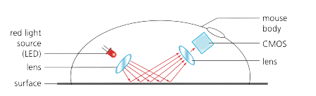
How does it work?
    In a mouse, a red LED located at the base emits red light, which reflects off the surface and is detected by a complementary metal oxide semiconductor (CMOS).
    The CMOS converts the reflected light into electrical pulses, which are then transmitted to a digital signal processor (DSP).
    Using the changing patterns in the images captured as the mouse moves, the DSP calculates the mouse's coordinates.
    These coordinates are then used by the computer to position the on-screen cursor accordingly.
For more help, please visit www.exampaperspractice.co.uk

Slide 89

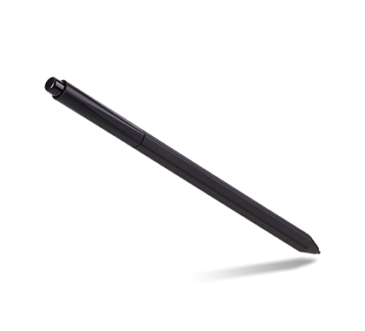

Other types of pointing device
Touch pad
Stylus
Gaming Controller
For more help, please visit www.exampaperspractice.co.uk

Slide 90
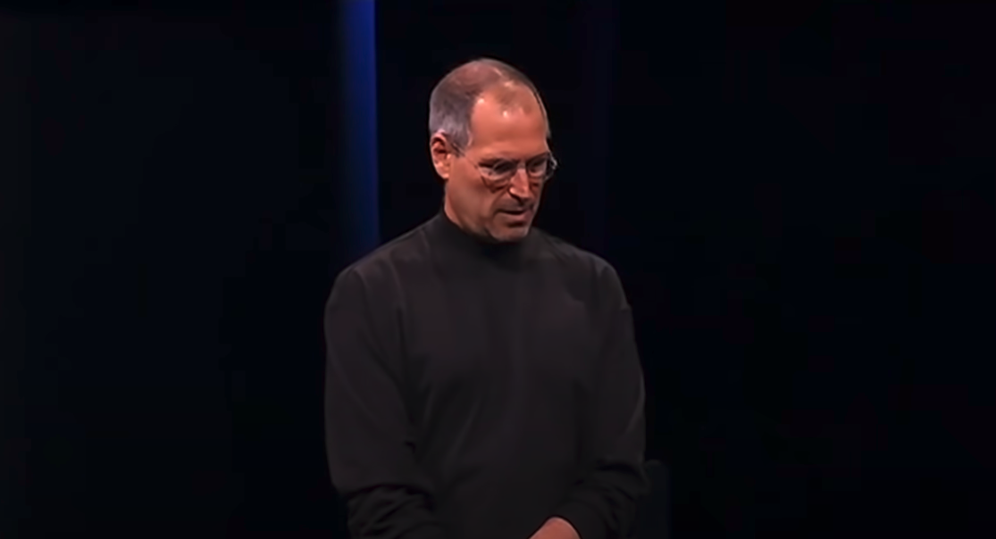
Before proceeding to the next hardware, let's revisit this epic presentation!
For more help, please visit www.exampaperspractice.co.uk

Slide 91

Touch Screens
What it has
A touch screen is made of glass and reacts to a finger press.
What it does
They allow the user to carry out the same functions as they would with a pointing device, such as mouse.
3 types of touch screens
    Capacitive touch screens
    Resistive touch screens
    Infrared touch screens
For more help, please visit www.exampaperspractice.co.uk

Slide 92
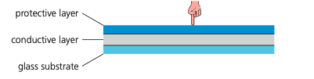
Capacitive touch screens
Advantage
Better image clarity than resistive screens,
Multitouch
    Capacitive touch screens consist of a protective glass layer, a transparent conductive electrode layer, and a glass substrate.
    When bare fingers touch the screen, which is a conductor of electricity, it alters the electrostatic field of the conductive layer.
    The embedded microcontroller can detect and measure these changes, allowing it to pinpoint the coordinates of the touch point on the screen.
Disadvantage
More expensive to manufacture
For more help, please visit www.exampaperspractice.co.uk

Slide 93
Resistive touch screens
    The term "resistive" in resistive touch screens refers to the resistance generated by the pressure applied on the screen by the user.
    When pressure is applied, it causes a change in resistance or an increase in voltage across the screen's layers.
    These layers detect the voltage change and calculate the coordinates where the pressure occurred.
    This allows the processor to respond accordingly by displaying the item or responding to the user's touch input.
Advantage
Can be used in bare fingers, stylus and gloved hand
Disadvantage
Low touch sensitivity, No multitouch
For more help, please visit www.exampaperspractice.co.uk

Slide 94
Infrared touch screens
    Infrared touch screens emit a continuous grid of infrared lights beneath the top surface layer.
    When a touch occurs on the screen, it interrupts this light grid, causing a disturbance.
    The processor detects and locates this disturbance, translating it into coordinates that correspond to the touch location on the screen.
Advantage
Very sensible
Disadvantage
Susceptible to false touch
For more help, please visit www.exampaperspractice.co.uk

Slide 95
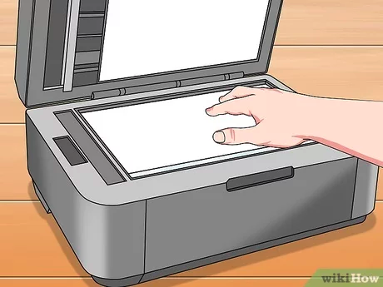
Scanner
What it has
Scanner are used to convert text or images on paper into digital information.
    A paper document is placed on the scanner and a beam of light is shone onto the paper.
    This light reflects onto a sensor, which determines the colour of the text or image on the paper.
    The information is used by the computer, as an input, to create a digital copy of the document
What it does
For more help, please visit www.exampaperspractice.co.uk

Slide 96
Optical character recognition
Computers equipped with optical character recognition (OCR) software can convert scanned text from documents into editable text file formats. This allows scanned images to be imported into a word processor for editing and manipulation.
If the original document was a photograph or image, then the If the original document was a photograph or image, the scanned result typically becomes an image file format such as JPEG. image forms an image file such as JPEG.
For more help, please visit www.exampaperspractice.co.uk

Slide 97
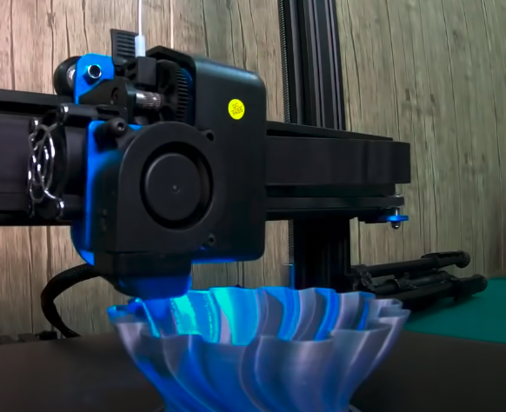
3D Scanner
Scanners can also operate in three dimensions, utilizing reflected laser light to construct a 3D model of a scanned object. These images can subsequently be employed with a 3D printer to produce a physical model.
For more help, please visit www.exampaperspractice.co.uk

Slide 98
Application of 2D and 3D Scanner
2D scanners employed at airports read passports using OCR technology to generate digital images of passport pages. This technology allows these digital images to be manipulated in various ways. For instance, OCR software can analyze the images, extract the text, and automatically populate the correct fields in an existing database.
Computed tomography (CT) scanners are utilized to generate a 3D image of a solid object using tomography technology. This process involves creating an image of the solid object by capturing a series of very thin 'slices'. Each of these 2D slices contributes to forming a comprehensive representation of the 3D solid object.
For more help, please visit www.exampaperspractice.co.uk

Slide 99
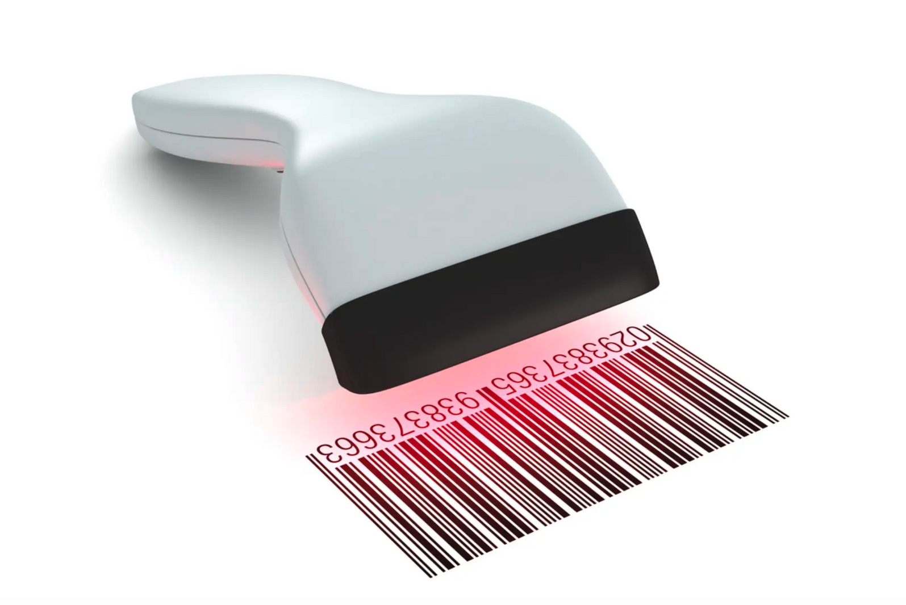
Barcode Reader
What it has
The Barcode uses infra-red light to read the bars in the code.
What it does
It accesses information about a product within the store.
For more help, please visit www.exampaperspractice.co.uk

Slide 100
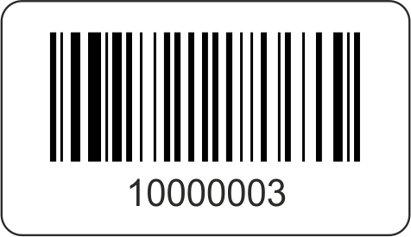
The Barcode
    Barcodes contain information such as product identification numbers, country of origin, and manufacturer details, but they do not store product prices, which are maintained in a database.
    When a purchase is made, the computer scans the barcode information and matches it with the database to verify the current price of the product.
For more help, please visit www.exampaperspractice.co.uk

Slide 101
How does the Barcode Reader work?
    The Barcode uses infra-red light to read the bars in the code.
    The light is reflected back to the device and is converted into digital data.
For more help, please visit www.exampaperspractice.co.uk

Slide 102

Quick Response Scanner
What it has
Consists of a block of small squares (light and dark) known as pixels
What it does
It allows characters, digits and also internet addresses to be encoded.
QR readers eliminate the need for users to remember long telephone numbers and website addresses by swiftly converting QR codes into the associated information.
Benefits
For more help, please visit www.exampaperspractice.co.uk

Slide 103




QR Code
Barcode
They can hold much more information
More than one QR format is available
QR codes are easier to read; they do not require expensive laser or LED technology.
QR codes can be used to transmit malicious code if they are tampered with or generated by malicious actors.
Encrypting QR codes enhances their security compared to traditional barcodes.
For more help, please visit www.exampaperspractice.co.uk

Slide 104
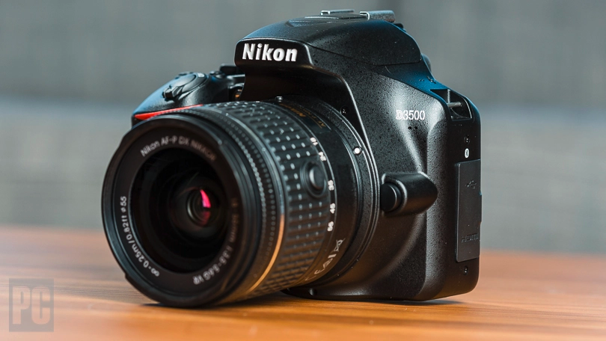
Digital Camera (Webcam)
What it does
When a camera captures consecutive digital images at a high frame rate, these images can be displayed on a computer screen as a live video feed of the view in front of its lens.
For more help, please visit www.exampaperspractice.co.uk

Slide 105


How does it work?
The image is captured as light passes through the lens onto a light-sensitive cell composed of millions of tiny sensors acting as photodiodes, such as charge-coupled devices (CCD), which convert light into electricity.
Each of these sensors is commonly referred to as a pixel (short for picture element), as they are the small components that collectively form the image.
The image is converted into small electric charges, which are then processed through an analog-to-digital converter (ADC) to create a digital image array.
For more help, please visit www.exampaperspractice.co.uk

Slide 106

Microphones
Cameras can either be built into the computer or connected as external devices via the USB port or through Bluetooth connectivity.
Description
It converts analog sound signals into digital information, commonly used with webcams for video conferencing. The digital signals are transmitted to another computer user and can be heard as audio.
What it does
For more help, please visit www.exampaperspractice.co.uk

Slide 107

1000 0001
1100 0101
0100 1001
Digital information
Hut
For more help, please visit www.exampaperspractice.co.uk

Slide 108
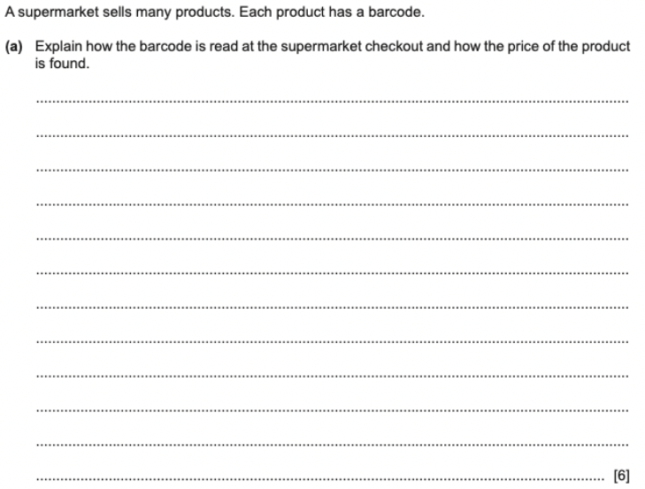
PAST YEAR QUESTION
For more help, please visit www.exampaperspractice.co.uk

Slide 109
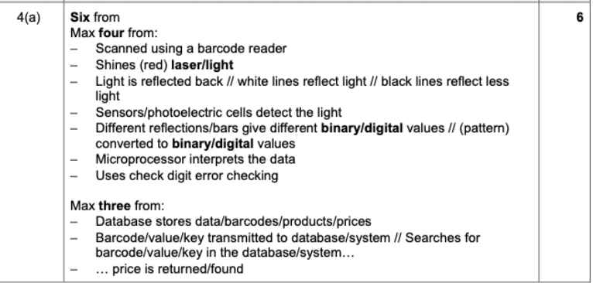
PAST YEAR QUESTION
For more help, please visit www.exampaperspractice.co.uk

Slide 110
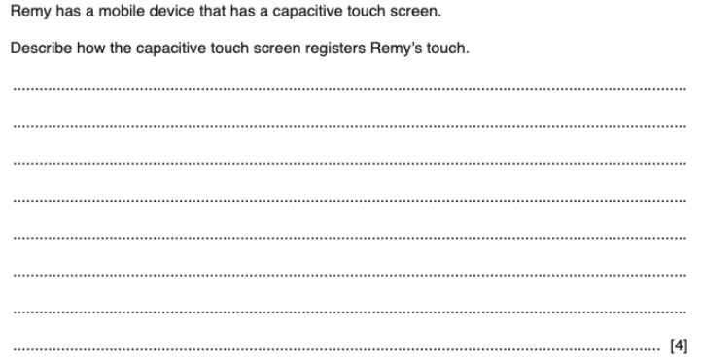
PAST YEAR QUESTION
For more help, please visit www.exampaperspractice.co.uk

Slide 111
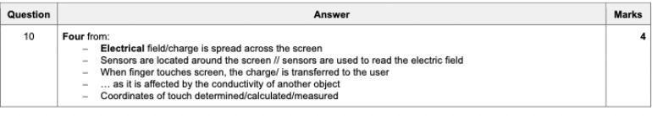
PAST YEAR QUESTION
For more help, please visit www.exampaperspractice.co.uk

Slide 112
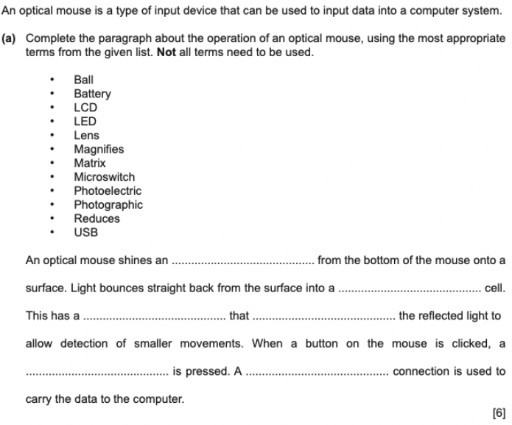
PAST YEAR QUESTION
For more help, please visit www.exampaperspractice.co.uk

Slide 113
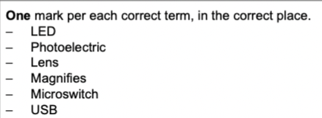
PAST YEAR QUESTION
For more help, please visit www.exampaperspractice.co.uk

Slide 114



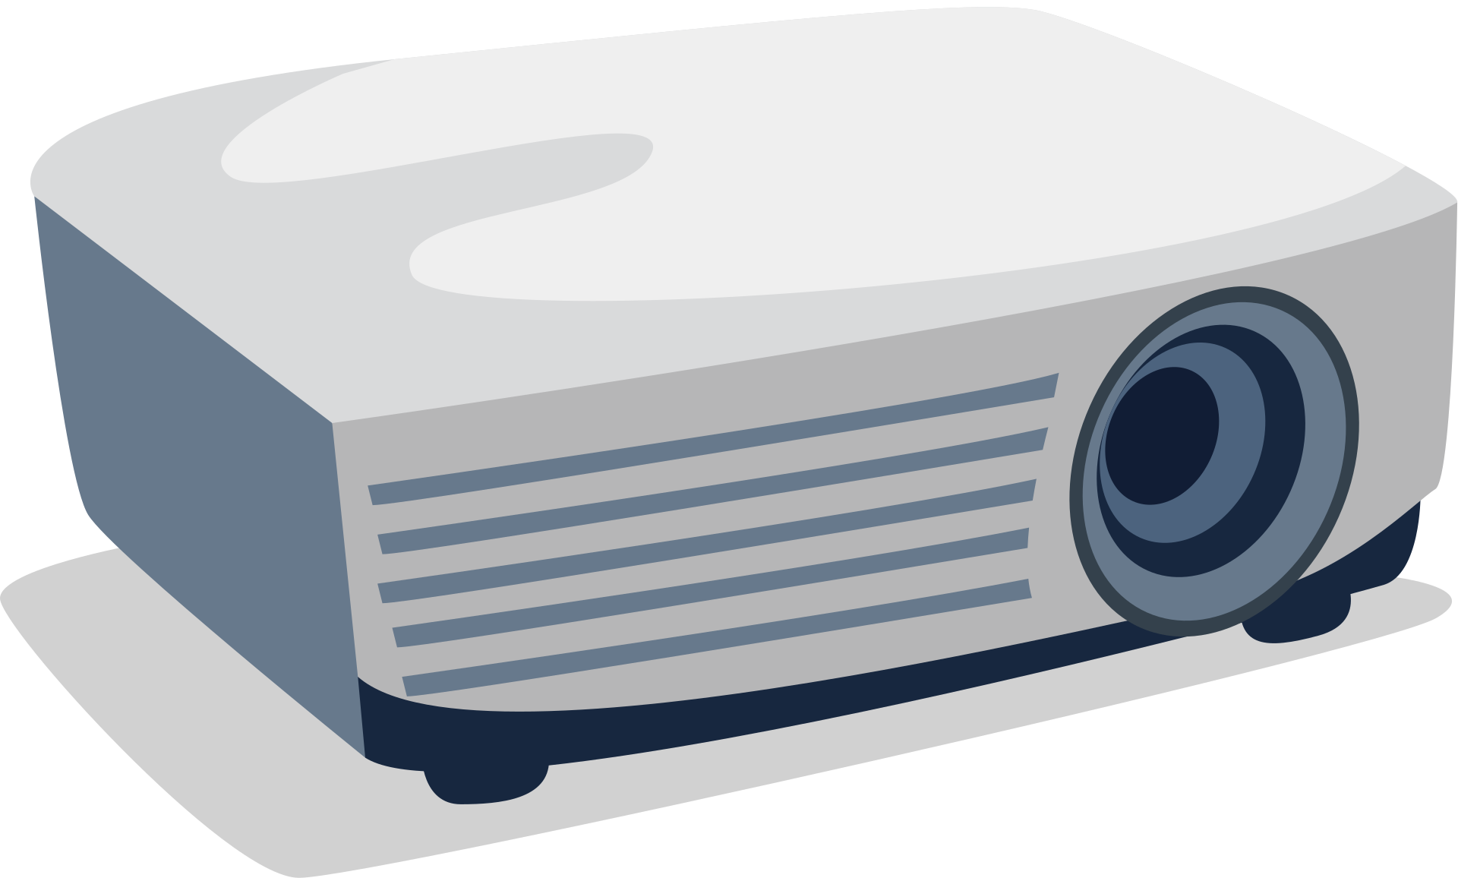
Output Devices
For more help, please visit www.exampaperspractice.co.uk

Slide 115
VON NEUMANN ARCHITECTURE RECAP
CONTROL BUS
DATA BUS
Central Processing Unit (CPU)
ADDRESS BUS
MAR
CU
PC
MDR
CIR
ALU
ACC
Input
Output
Memory Unit (RAM)
For more help, please visit www.exampaperspractice.co.uk

Slide 116
VON NEUMANN ARCHITECTURE RECAP
CONTROL BUS
DATA BUS
Central Processing Unit (CPU)
ADDRESS BUS
Our Focus this week!
MAR
CU
PC
MDR
CIR
ALU
ACC
Input
Output
Memory Unit (RAM)
For more help, please visit www.exampaperspractice.co.uk

Slide 117
Output Devices
    Output devices are hardware components that a computer uses to show or convey processed data.
    Input devices, which send instructions to the computer, are linked to output devices, enabling users to see or hear the results of those instructions.
    The choice of an output device is based on the most effective method for utilizing the processed data.
For more help, please visit www.exampaperspractice.co.uk

Slide 118
Output Devices
    Monitor
    Touch Screens
    Projector
      DLP Projector
      LCD Projector
    Printer
      Laser Printer
      Inkjet Printer
      3D Printer
    Speaker
    Actuator
For more help, please visit www.exampaperspractice.co.uk

Slide 119
Output Devices
    Monitor
    Touch Screens
    Projector
      DLP Projector
      LCD Projector
    Printer
      Laser Printer
      Inkjet Printer
      3D Printer
    Speaker
    Actuator
For more help, please visit www.exampaperspractice.co.uk

Slide 120

Monitor
    Monitors can display varying numbers of pixels depending on their quality; higher pixel counts result in better picture quality.
    Larger monitors typically command higher prices.
    Modern monitors connect to computers using a High-Definition Multimedia Interface (HDMI) connector, which enables the transmission of high-definition images and sound through a single cable.
    HDMI has become a standard connection port for audio/visual devices in computers.
Size in inch
For more help, please visit www.exampaperspractice.co.uk

Slide 121

Monitor - LED vs LCD
LCD - Liquid Crystal Display
LED - Liquid Emitting Diode
- Made up of tiny liquid crystals.
- Array of pixels affected by changes in applied electric fields.
- LCD screens are back-lit using LED technology since they do not emit light themselves.
- Made up of tiny light-emitting diodes (LEDs).
- Each LED emits red, blue, or green light.
- Varying the electric current to each LED controls its brightness, enabling a wide range of colors to be produced.
For more help, please visit www.exampaperspractice.co.uk

Slide 122
Monitor - OLED
OLED - Organic Liquid Emitting Diode
- Utilizes organic materials composed of carbon compounds to form flexible semiconductors.
- OLED technology enables screens to be exceptionally thin and flexible, allowing them to be bent into various shapes.
For more help, please visit www.exampaperspractice.co.uk

Slide 123
Some benefits of OLED
  Flexibility: OLED screens can be made flexible and even rollable, allowing for innovative form factors and applications.
  Improved Contrast: OLEDs offer superior contrast ratios compared to LED and LCD screens, resulting in deeper blacks and more vibrant colours.
  Energy Efficiency: OLEDs do not require a backlight like LCDs do, leading to potentially lower power consumption, especially when displaying darker content.
  Faster Response Time: OLEDs typically have faster response times than LCDs, making them better suited for fast-moving content such as gaming and sports.
  Wide Viewing Angles: OLED displays maintain consistent colours and brightness from almost any angle, whereas LCDs may suffer from colour shifting and brightness loss when viewed off-centre.
For more help, please visit www.exampaperspractice.co.uk

Slide 124
Output Devices
    Monitor
    Touch Screens
    Projector
      DLP Projector
      LCD Projector
    Printer
      Laser Printer
      Inkjet Printer
      3D Printer
    Speaker
    Actuator
For more help, please visit www.exampaperspractice.co.uk

Slide 125

Touch Screen
    A touch screen functions as both an input and an output device.
    Touch screens are commonly found on smartphones and tablets.
    When a user makes a selection by tapping the screen, it responds by displaying a new screen.
For more help, please visit www.exampaperspractice.co.uk

Slide 126
Output Devices
    Monitor
    Touch Screens
    Projector
      DLP Projector
      LCD Projector
    Printer
      Laser Printer
      Inkjet Printer
      3D Printer
    Speaker
    Actuator
For more help, please visit www.exampaperspractice.co.uk

Slide 127

Digital Lightning Processing (DLP) Projector
    A digital light processing (DLP) projector is a device that links to a computer and monitor to project the computer's video output onto a wall or whiteboard, allowing for a significantly larger display.
    These projectors are commonly used in school classrooms and home cinemas for showing videos or presentations.
    They connect to a computer using an HDMI connector.
    DLP projectors can be quite large and utilize powerful bulbs to project the image.
For more help, please visit www.exampaperspractice.co.uk

Slide 128

Liquid Crystal Display (LCD) Projector
    An LCD projector operates similarly to a DLP projector.
    The main distinction is that it uses red, green, and blue lights which pass through three prisms and are then combined through a second prism to create the image.
    LCD projectors typically produce more vibrant images compared to DLP projectors, but they are generally larger and heavier.
For more help, please visit www.exampaperspractice.co.uk

Slide 129
DLP Projector vs LCD Projector
- Higher reliability/longevity
- Quieter than LCD
- High contrast ratio
- Less efficient in their use of energy (generate more heat
- Better colour saturation
- Poorer longevity
- More efficient in their use of energy
For more help, please visit www.exampaperspractice.co.uk

Slide 130
Output Devices
    Monitor
    Touch Screens
    Projector
      DLP Projector
      LCD Projector
    Printer
      Laser Printer
      Inkjet Printer
      3D Printer
    Speaker
    Actuator
For more help, please visit www.exampaperspractice.co.uk

Slide 131

Laser Printer
    A laser printer generates printed output by using heat to transfer powdered toner onto paper.
    It can connect to a computer via a universal serial bus (USB) interface or wirelessly over a network. Laser printers are known for their fast printing speeds and high-quality results.
    The combination of excellent print quality and low noise levels makes them a popular choice in workplaces.
For more help, please visit www.exampaperspractice.co.uk

Slide 132

Inkjet Printer
    Inkjet printers are the most affordable type of printer.
    They function by spraying ink directly onto paper, which is heated by the printer. The ink flows from a cartridge through tiny holes, leaving the ink slightly wet when the paper exits the printer.
    Inkjet printers can produce both black-and-white and color output, making them popular for home use and photo printing.
    They connect to a computer via a universal serial bus (USB) interface or wirelessly over a network.
For more help, please visit www.exampaperspractice.co.uk

Slide 133
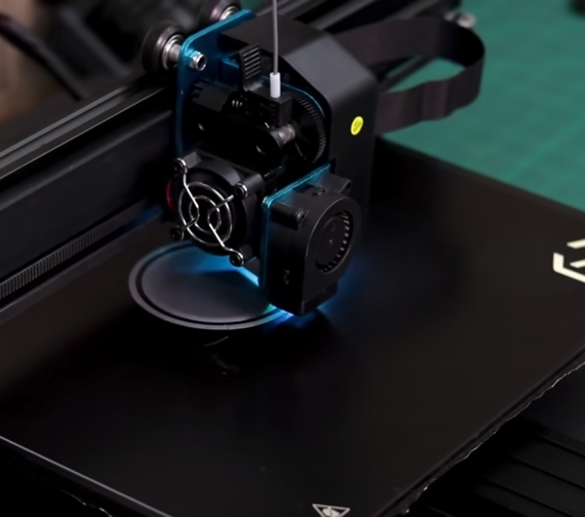
3D printer
    Three-dimensional (3D) printers are output devices that create physical objects instead of printing on paper.
    These printers typically use heated liquids like plastic or metal, chosen based on the item being produced.
    Guided by computer instructions, the liquid forms a surface and then solidifies. The printer builds the shape by layering this material.
    Designers primarily use 3D printers to create prototypes, and they have been utilized in car manufacturing for many years.
For more help, please visit www.exampaperspractice.co.uk

Slide 134
Output Devices
    Monitor
    Touch Screens
    Projector
      DLP Projector
      LCD Projector
    Printer
      Laser Printer
      Inkjet Printer
      3D Printer
    Speaker
    Actuator
For more help, please visit www.exampaperspractice.co.uk

Slide 135

Speaker
    Speakers are essential for delivering music, sound effects, and audio from videos, contributing to a high-quality multimedia experience.
    The quality of the sound produced depends on the type of speakers used. Built-in computer speakers typically offer lower sound quality, while external powered speakers, which connect to a computer’s sound card through an audio port, provide superior sound.
    The sound card, an internal component of the computer, manages the input and output of audio signals, supporting various multimedia applications.
For more help, please visit www.exampaperspractice.co.uk

Slide 136
Output Devices
    Monitor
    Touch Screens
    Projector
      DLP Projector
      LCD Projector
    Printer
      Laser Printer
      Inkjet Printer
      3D Printer
    Speaker
    Actuator
For more help, please visit www.exampaperspractice.co.uk

Slide 137

Actuator
    An actuator is a mechanical motor that performs a specific action in response to instructions from a computer or control system.
    For instance, in a digital camera, an actuator integrated into the lens moves it in and out to adjust the zoom level according to commands.
    Actuators vary in size and complexity; they can be small, like those in cameras, or large, such as those used in computer-controlled drills.
    They are crucial components that enable precise and automated movements in various mechanical systems.
For more help, please visit www.exampaperspractice.co.uk

Slide 138
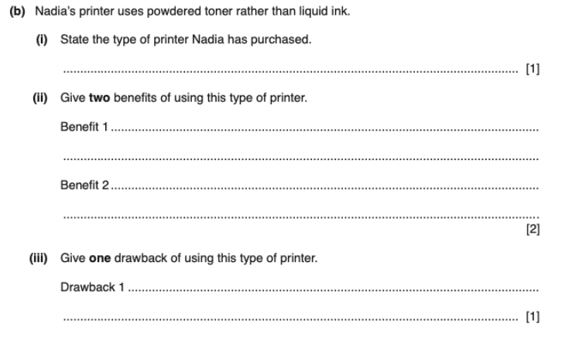
PAST YEAR QUESTION
For more help, please visit www.exampaperspractice.co.uk

Slide 139
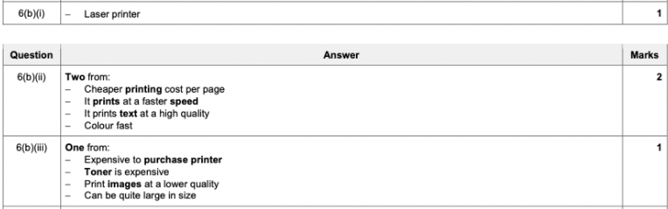
PAST YEAR QUESTION
For more help, please visit www.exampaperspractice.co.uk

Slide 140
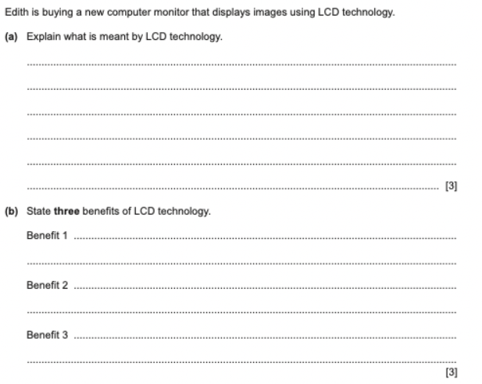
PAST YEAR QUESTION
For more help, please visit www.exampaperspractice.co.uk

Slide 141
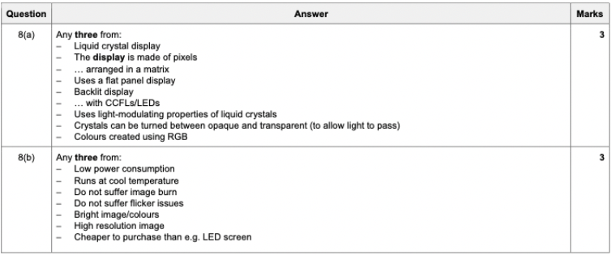
PAST YEAR QUESTION
For more help, please visit www.exampaperspractice.co.uk

Slide 142


Sensor
For more help, please visit www.exampaperspractice.co.uk

Slide 143
VON NEUMANN ARCHITECTURE
CONTROL BUS
DATA BUS
Central Processing Unit (CPU)
ADDRESS BUS
MAR
CU
PC
MDR
CIR
ALU
ACC
Input
Output
Memory Unit (RAM)
For more help, please visit www.exampaperspractice.co.uk

Slide 144
VON NEUMANN ARCHITECTURE
CONTROL BUS
DATA BUS
Central Processing Unit (CPU)
ADDRESS BUS
MAR
CU
PC
MDR
CIR
ALU
ACC
Sensor (Automatic Input)
Output
Memory Unit (RAM)
For more help, please visit www.exampaperspractice.co.uk

Slide 145





Function of a sensor
Read and measure physical properties from their surrounding.
For more help, please visit www.exampaperspractice.co.uk

Slide 146
Function of a sensor
Read and measure physical properties from their surrounding.
Acidity
Level
Temperature
Pressure
Length
For more help, please visit www.exampaperspractice.co.uk

Slide 147
Analogue to Digital Converter (ADC)
Reason ADC is needed
Computer cannot make sense of physical quantities (pH, celcius, etc)
Function of an ADC
Convert physical quantities to a digital format. It convert physical values (analogue data) into digital data.
Extra: Digital to Analogue Converter (DAC)
For more help, please visit www.exampaperspractice.co.uk

Slide 148
Feedback
Sensor readings can prompt a microprocessor to adjust a valve or motor, thereby affecting subsequent sensor readings. This creates a feedback loop where the microprocessor continuously modifies outputs to align the system with desired parameters, directly impacting subsequent inputs.
For more help, please visit www.exampaperspractice.co.uk

Slide 149

Feedback
Input
Ouput:
Release cold air
40 celcius
00101000
ADC
Microprocessor
Sensor
For more help, please visit www.exampaperspractice.co.uk

Slide 150
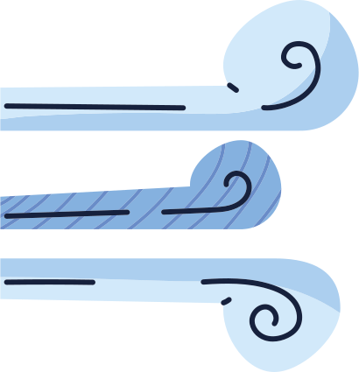
This will run constantly!
Input
Ouput:
Release cold air
ADC
Microprocessor
Sensor
For more help, please visit www.exampaperspractice.co.uk

Slide 151

Brainstorming
What are the types of sensors available?
For more help, please visit www.exampaperspractice.co.uk

Slide 152
Brainstorming
What are the applications of these sensors?
For more help, please visit www.exampaperspractice.co.uk

Slide 153


Common Sensors
SENSOR
TEMPERATURE
MOISTURE
Measures the temperature of the surrounding environment by sending signals.
Measures water levels, such as in soil.
FUNCTION
• control of a central heating system
• control/monitor a chemical process
• control/monitor temperature in a greenhouse
    control/monitor moisture levels in soil in a greenhouse
    monitor the moisture levels in a food processing factory
APPLICATION
For more help, please visit www.exampaperspractice.co.uk

Slide 154


Common Sensors
SENSOR
HUMIDITY
LIGHT
This measures the amount of water vapor in, for example, a sample of air, which is different from measuring temperature.
These devices utilize photoelectric cells that generate an electric current output based on the brightness of the light.
FUNCTION
    monitor humidity levels in a factory manufacturing microchips
    monitor/control humidity levels in the air in a greenhouse
    switching street lights on or off depending on light levels
    switch on car headlights automatically when it gets dark
APPLICATION
For more help, please visit www.exampaperspractice.co.uk

Slide 155

Common Sensors
SENSOR
INFRARED
PRESSURE
Detects infrared radiation emitted by objects to determine their presence or proximity.
Measures the force exerted by a fluid (gas or liquid) on its surface.
FUNCTION
    turn on car windscreen wipers automatically when it detects rain on the windscreen
    security alarm system (intruder breaks the infra- red beam)
• weighing of lorries at a weighing station
• measure the gas pressure in a nuclear reactor
APPLICATION
For more help, please visit www.exampaperspractice.co.uk

Slide 156


Common Sensors
SENSOR
SOUND
GAS
Detects sound waves and converts them into electrical signals.
Detects the presence and concentration of gases in the environment.
FUNCTION
• pick up the noise of footsteps in a security system
• detect the sound of liquids dripping at a faulty
pipe joint
    monitor oxygen and carbon dioxide levels in a greenhouse
APPLICATION
For more help, please visit www.exampaperspractice.co.uk

Slide 157


Common Sensors
SENSOR
PH
MAGNETIC FIELD
Measures the acidity or alkalinity of a solution.
Detects and measures the strength and direction of magnetic fields.
FUNCTION
• monitor/control acidity levels in the soil in a greenhouse
• control acidity levels in a chemical process
    Detect magnetic field changes (for example, in mobile phones and CD players)
APPLICATION
For more help, please visit www.exampaperspractice.co.uk

Slide 158

Common Sensors
SENSOR
ACCELEROMETER
PROXIMITY
Measures acceleration forces, enabling orientation and movement detection.
Detects the presence or absence of nearby objects without physical contact.
FUNCTION
    Used in cars to measure rapid deceleration and apply air bags in a crash
    Used by mobile phones to change between portrait and landscape mode
• Detect when a face is close to a mobile phone screen and switches off screen when held to the ear
APPLICATION
For more help, please visit www.exampaperspractice.co.uk

Slide 159


Common Sensors
SENSOR
FLOW
LEVEL
Determines the level or amount of a substance, typically liquid, in a container or reservoir.
Measures the rate of fluid flow through a pipe or channel.
FUNCTION
• Used in respiratory devices and inhalers in hospitals
• Measure gas flows in pipes (for example, natural gas)
    Monitor levels in a petrol tank in a car
    Leak detection in refrigerant (air conditioning)
APPLICATION
For more help, please visit www.exampaperspractice.co.uk

Slide 160



SENSORS ARE USED IN BOTH MONITORING AND CONTROL APPLICATIONS.
Controlling Application
Monitoring Application
1. Control of Street Lighting
2. Anti-lock braking system
3. Control Heating Systems
4. Chemical Process Control
5. Greenhouse Environmental Control
1. Security System
2. Monitoring of patients in a hospital
For more help, please visit www.exampaperspractice.co.uk
For more help, please visit www.exampaperspractice.co.uk

Slide 161
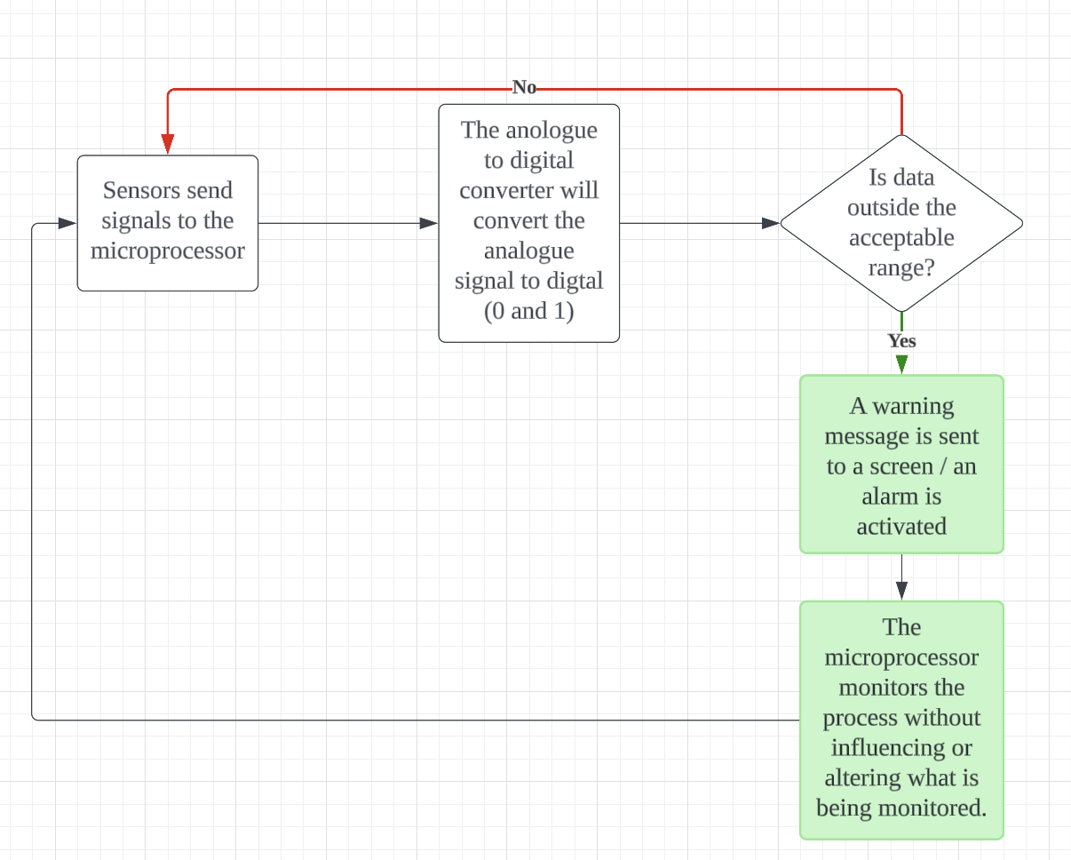
FLOWCHART OF HOW A MONITORING APPLICATION WORK:
For more help, please visit www.exampaperspractice.co.uk

Slide 162


Monitoring system (1) - Security System
1. The infrared sensor detects the movement of an intruder in the building.
2. The acoustic sensor picks up sounds such as footsteps or breaking glass.
3. The pressure sensor senses the weight of an intruder entering through a door or window.
4. Sensor data in analogue form is passed through an ADC to convert it into digital data.
5. The computer or microprocessor samples the digital data from these sensors at a specified frequency.
6. The sampled data is compared with stored values by the computer or microprocessor.
7. If any incoming data values fall outside the acceptable range, the computer sends a signal:
    Activating a siren to sound the alarm.
    Starting flashing lights.
    8. A DAC is utilized to convert digital signals back into analogue values if necessary for operating devices.
    9. The alarm continues to sound/lights continue to flash until the system is reset with a password.
For more help, please visit www.exampaperspractice.co.uk

Slide 163

Monitoring system (2) - Monitoring of patients in a hospital
1. Sensors are attached to the patient to measure parameters such as temperature, heart rate, and breathing rate.
2. These sensors transmit data constantly to a computer system.
3. Sensor data in analogue form is converted to digital data using an ADC.
4. The computer samples the data at frequent intervals.
5. The acceptable range of values for each parameter is programmed into the computer.
6. The computer or microprocessor compares the incoming data with the programmed values.
7. If any incoming data values fall outside the acceptable range, the computer sends a signal:
    Triggering an alarm.
    8. If sensor data is within range, the values are displayed graphically on a screen and/or as a digital readout.
    9. Monitoring continues until the sensors are disconnected from the patient.
For more help, please visit www.exampaperspractice.co.uk

Slide 164
MONITORING
APPLICATION
- JUST SEND WARNING
For more help, please visit www.exampaperspractice.co.uk

Slide 165
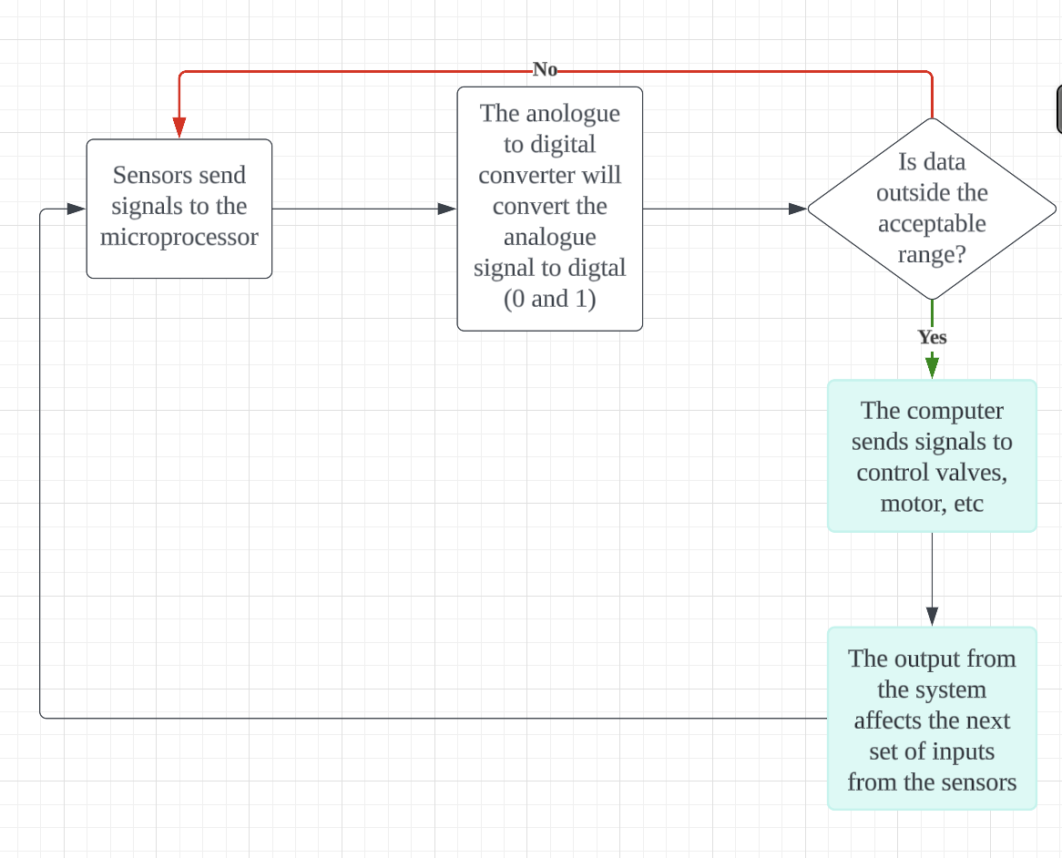
CONTROLLINGAPPLICATION
- DO SOMETHING
For more help, please visit www.exampaperspractice.co.uk

Slide 166

Controlling system (1) - Control of Street Lighting
1. The light sensor sends data to the ADC interface, which converts the data into digital form and forwards it to the microprocessor.
2. The microprocessor samples the data at regular intervals, such as every minute or every five minutes.
3. If the data from the sensor is less than the value stored in memory:
    The microprocessor sends a signal to the streetlamp.
    The streetlamp is switched on.
    The lamp remains on for 30 minutes before the sensor readings are sampled again.
    4. If the data from the sensor is greater than or equal to the value stored in memory:
    The microprocessor sends a signal to the streetlamp.
    The streetlamp is switched off.
    The lamp remains off for 30 minutes before the sensor readings are sampled again.
For more help, please visit www.exampaperspractice.co.uk

Slide 167

Controlling system (2) - Anti-lock braking (ABS) systems
Anti-lock braking systems (ABS) on cars utilize magnetic field sensors to prevent wheel lock-up during sharp braking. Here’s how it works:
1. If one of the car wheels rotates too slowly (indicating potential lock-up), a magnetic field sensor sends data to a microprocessor.
2. The microprocessor compares the rotation speed of the affected wheel with the other three wheels.
3. If the other wheels are rotating faster, the microprocessor sends a signal to the braking system.
4. The braking pressure to the affected wheel is reduced.
5. This action increases the wheel’s rotational speed to match the others.
6. The microprocessor continuously checks the rotational speeds using magnetic field sensors several times per second.
7. The braking pressure to all wheels is adjusted dynamically to prevent any wheel from locking up under heavy braking.
For more help, please visit www.exampaperspractice.co.uk

Slide 168
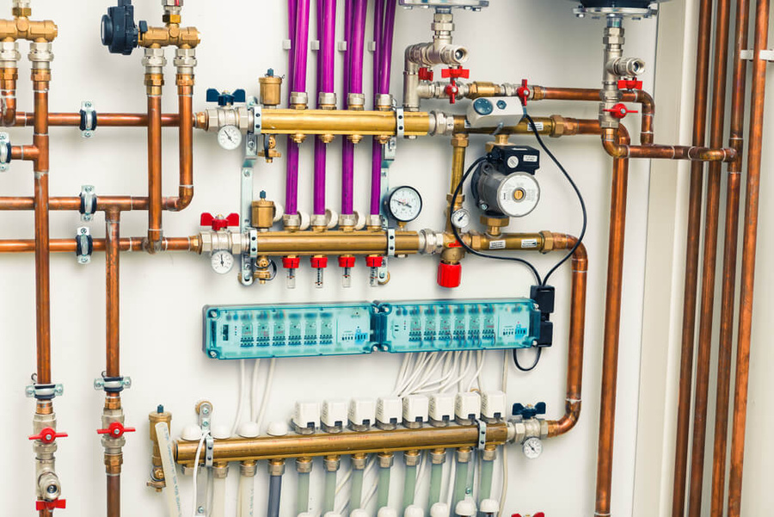
Controlling system (3) - Central Heating Systems
1. The required temperature is entered and stored in the microprocessor memory as the pre-set value.
2. The temperature sensor continually sends data readings to the microprocessor.
3. The sensor data is first passed through an ADC to convert the analogue data into digital format.
4. The digital data is then sent to the microprocessor.
5. The microprocessor compares the received data with the pre-set value.
6. If the temperature reading is greater than or equal to the pre-set value, no action is taken.
7. If the temperature reading is less than the pre-set value, a signal is sent:
    Via a DAC to open the gas valve to the heater.
    Via a DAC to activate the water pump.
    8. This process continues until the central heating system is turned off.
For more help, please visit www.exampaperspractice.co.uk

Slide 169
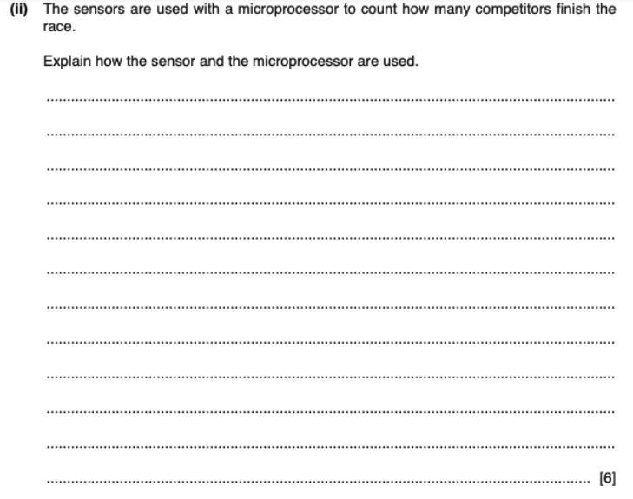
EXAM QUESTION
For more help, please visit www.exampaperspractice.co.uk

Slide 170

EXAM QUESTION
For more help, please visit www.exampaperspractice.co.uk

Slide 171
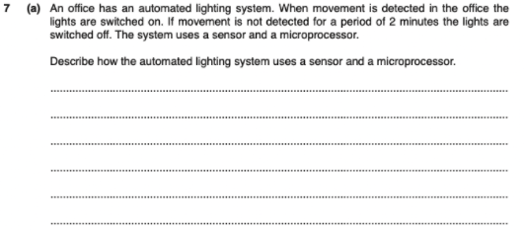
EXAM QUESTION
For more help, please visit www.exampaperspractice.co.uk

Slide 172
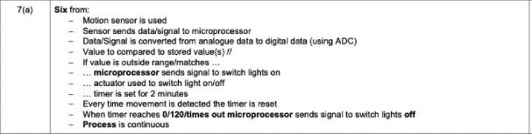
EXAM QUESTION
For more help, please visit www.exampaperspractice.co.uk

Slide 173






....01010100101011010101010010101001010.
YEAR 10 CS
Data
Storage
For more help, please visit www.exampaperspractice.co.uk

Slide 174
VON NEUMANN ARCHITECTURE
CONTROL BUS
DATA BUS
Central Processing Unit (CPU)
ADDRESS BUS
MAR
CU
PC
MDR
CIR
ALU
ACC
Input
Output
Memory Unit (RAM)
For more help, please visit www.exampaperspractice.co.uk

Slide 175
VON NEUMANN ARCHITECTURE
CONTROL BUS
Central Processing Unit (CPU)
DATA BUS
ADDRESS BUS
MAR
CU
PC
MDR
CIR
ALU
ACC
Input
Output
Memory Unit (RAM)
Load executable code when needed
Secondary Storage
(HDD, SSD, Removable Disk, CD)
For more help, please visit www.exampaperspractice.co.uk

Slide 176
VON NEUMANN ARCHITECTURE
CONTROL BUS
Central Processing Unit (CPU)
DATA BUS
ADDRESS BUS
MAR
CU
PC
OUR FOCUS THIS WEEK!!!
MDR
CIR
ALU
ACC
Input
Output
Memory Unit (RAM) / ROM
Load executable code when needed
Secondary Storage
(HDD, SSD, Removable Disk, CD)
For more help, please visit www.exampaperspractice.co.uk

Slide 177
VON NEUMANN ARCHITECTURE
CONTROL BUS
DATA BUS
ADDRESS BUS
Primary memory refers to the computer's main storage area that directly interacts with the CPU, holding data and instructions temporarily during processing.
Input
Output
Memory Unit (RAM) / ROM
Load executable code when needed
Secondary Storage
(HDD, SSD, Removable Disk, CD)
Secondary storage refers to non-volatile storage devices like hard drives and SSDs used for long-term data storage and retrieval, independent of the CPU's immediate operations.
For more help, please visit www.exampaperspractice.co.uk

Slide 178
VON NEUMANN ARCHITECTURE
CONTROL BUS
DATA BUS
ADDRESS BUS
Primary memory refers to the computer's main storage area that directly interacts with the CPU, holding data and instructions temporarily during processing.
Input
Output
Memory Unit (RAM) / ROM
Load executable code when needed
Secondary Storage
(HDD, SSD, Removable Disk, CD)
Secondary storage refers to non-volatile storage devices like hard drives and SSDs used for long-term data storage and retrieval, independent of the CPU's immediate operations.
For more help, please visit www.exampaperspractice.co.uk

Slide 179

Memory Unit (RAM) / ROM
Secondary Storage
(HDD, SSD, Removable Disk, CD)
Primary Memory
Secondary Storage
Store data that is key to running the computer (program executable code, bootup code)
Store applications, data and files
Directly addressable by the CPU
(High retrieval speed)
Compare
and
Contrast
Not directly addressable by the CPU
(Low retrieval speed)
RAM is volatile
ROM is non-volatile
All secondary storage devices
are non-volatile
Can be external or internal to the computer
Built internally into the computer
Example: HDD, SSD, DVD, memory stick,
Blu-ray disc
Example: RAM, ROM and cache memory
For more help, please visit www.exampaperspractice.co.uk

Slide 180
Memory Unit (RAM) / ROM
Secondary Storage
(HDD, SSD, Removable Disk, CD)
Primary Memory
Secondary Storage
Store data that is key to running the computer (program executable code, bootup code)
Store applications, data and files
Directly addressable by the CPU
(High retrieval speed)
Compare
and
Contrast
Not directly addressable by the CPU
(Low retrieval speed)
RAM is volatile
ROM is non volatile
All secondary storage devices
are non volatile
Can be external or internal to the computer
Built internally into the computer
Example: HDD, SSD, DVD, memory stick,
Blu-ray disc
Example: RAM, ROM and cache memory
For more help, please visit www.exampaperspractice.co.uk

Slide 181
Memory Unit (RAM) / ROM
Secondary Storage
(HDD, SSD, Removable Disk, CD)
Primary Memory
Secondary Storage
Store data that is key to running the computer (program executable code, bootup code)
Store applications, data and files
Directly addressable by the CPU
(High retrieval speed)
Compare
and
Contrast
Not directly addressable by the CPU
(Low retrieval speed)
RAM is volatile
ROM is non volatile
All secondary storage devices
are non volatile
Can be external or internal to the computer
Built internally into the computer
Example: HDD, SSD, DVD, memory stick,
Blu-ray disc
Example: RAM, ROM and cache memory
For more help, please visit www.exampaperspractice.co.uk

Slide 182
Memory Unit (RAM) / ROM
Secondary Storage
(HDD, SSD, Removable Disk, CD)
Primary Memory
Secondary Storage
Store data that is key to running the computer (program executable code, bootup code)
Store applications, data and files
Directly addressable by the CPU
(High retrieval speed)
Compare
and
Contrast
Not directly addressable by the CPU
(Low retrieval speed)
RAM is volatile
ROM is non volatile
All secondary storage devices
are non volatile
Can be external or internal to the computer
Built internally into the computer
Example: HDD, SSD, DVD, memory stick,
Blu-ray disc
Example: RAM, ROM and cache memory
For more help, please visit www.exampaperspractice.co.uk

Slide 183
Memory Unit (RAM) / ROM
Secondary Storage
(HDD, SSD, Removable Disk, CD)
Primary Memory
Secondary Storage
Store data that is key to running the computer (program executable code, bootup code)
Store applications, data and files
Directly addressable by the CPU
(High retrieval speed)
Compare
and
Contrast
Not directly addressable by the CPU
(Low retrieval speed)
RAM is volatile
ROM is non volatile
All secondary storage devices
are non volatile
Can be external or internal to the computer
Built internally into the computer
Example: HDD, SSD, DVD, memory stick,
Blu-ray disc
Example: RAM, ROM and cache memory
For more help, please visit www.exampaperspractice.co.uk

Slide 184
VON NEUMANN ARCHITECTURE
CONTROL BUS
DATA BUS
ADDRESS BUS
Primary memory refers to the computer's main storage area that directly interacts with the CPU, holding data and instructions temporarily during processing.
Input
Output
Memory Unit (RAM) / ROM
Load executable code when needed
Secondary Storage
(HDD, SSD, Removable Disk, CD)
Secondary storage refers to non-volatile storage devices like hard drives and SSDs used for long-term data storage and retrieval, independent of the CPU's immediate operations.
For more help, please visit www.exampaperspractice.co.uk

Slide 185




1.
FULL TERM
RANDOM ACCESS MEMORY
RAM
MEANING
2.
Memory
In RAM, any memory location can be accessed directly, regardless of the sequence or order in which other memory locations were accessed previously.
8
0
0
9
2
10
3.
3
11
APPLICATION
When an application or program is executed, data is fetched from secondary storage and temporarily stored in RAM for processing.
0
12
0
13
For more help, please visit www.exampaperspractice.co.uk

Slide 186
Features of RAM
Memory
0
8
0
9
    RAM can be both written to and read from, allowing data to be altered by either the user or the computer.
    It is used to temporarily store data, files, parts of applications, or parts of the operating system currently in use.
    RAM is volatile, meaning its contents are lost when the computer is powered off.
    The size of RAM directly affects the speed of the computer; larger RAM sizes result in faster operation.
2
10
3
11
0
12
0
13
For more help, please visit www.exampaperspractice.co.uk

Slide 187
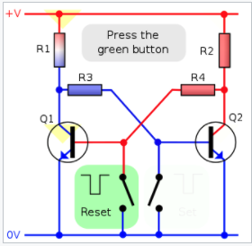

Common types of RAM
Used in memory cache
Dynamic RAM (DRAM)
Static RAM (SRAM)
Comprises numerous chips. Each chip contains millions of transistors (acting as switches) and capacitors (which store bits of information).
Make use of flip flops which hold each bit of memory
There are 2 types of RAM technologies
The capacitor requires periodic refreshing (recharging every 15 microseconds) to retain its value; otherwise, it would lose its data.
Doesn’t need to be constantly refreshed
Advantages:
    Much less expensive than SRAM
    Consume less power than SRAM
    Higher memory capacity than SRAM
Advantages:
    Faster data access
For more help, please visit www.exampaperspractice.co.uk

Slide 188
Common types of RAM
Used in memory cache
Dynamic RAM (DRAM)
Static RAM (SRAM)
Comprises numerous chips. Each chip contains millions of transistors (acting as switches) and capacitors (which store bits of information).
Make use of flip flops which hold each bit of memory
There are 2 types of RAM technologies
The capacitor requires periodic refreshing (recharging every 15 microseconds) to retain its value; otherwise, it would lose its data.
Doesn’t need to be constantly refreshed
Advantages:
    Much less expensive than SRAM
    Consume less power than SRAM
    Higher memory capacity than SRAM
Advantages:
    Faster data access
For more help, please visit www.exampaperspractice.co.uk

Slide 189
Common types of RAM
Used in memory cache
Dynamic RAM (DRAM)
Static RAM (SRAM)
Comprises numerous chips. Each chip contains millions of transistors (acting as switches) and capacitors (which store bits of information).
Make use of flip flops which hold each bit of memory
There are 2 types of RAM technologies
The capacitor requires periodic refreshing (recharging every 15 microseconds) to retain its value; otherwise, it would lose its data.
Doesn’t need to be constantly refreshed
Advantages:
    Much less expensive than SRAM
    Consume less power than SRAM
    Higher memory capacity than SRAM
Advantages:
    Faster data access
For more help, please visit www.exampaperspractice.co.uk

Slide 190
VON NEUMANN ARCHITECTURE
CONTROL BUS
Central Processing Unit (CPU)
DATA BUS
ADDRESS BUS
MAR
CU
PC
SRAM
MDR
CIR
ALU
ACC
Input
DRAM
Output
Load executable code when needed
Secondary Storage
(HDD, SSD, Removable Disk, CD)
For more help, please visit www.exampaperspractice.co.uk

Slide 191
1.
FULL TERM
Read-only MEMORY
ROM
MEANING
2.
it cannot be changed or written to.
3.
FEATURES
The contents can only be read
They are non-volatile (the contents are not lost after powering off the computer)
They are frequently used to store data needed by the computer during initial power-up. These are referred to as start-up instructions.
They are permanent memories
For more help, please visit www.exampaperspractice.co.uk

Slide 192
RAM
ROM
Temperory memory device
Permanent memory device
Volatile memory
Non-volatile memory
Compare and Contrast
Can be written to and read from
Data stored cannot be altered
Used to store data, files, programs, part of OS currently in use
Used to store BIOS and other data needed at start up
For more help, please visit www.exampaperspractice.co.uk

Slide 193
RAM
ROM
Temperory memory device
Permanent memory device
Volatile memory
Non-volatile memory
Compare and Contrast
Can be written to and read from
Data stored cannot be altered
Used to store data, files, programs, part of OS currently in use
Used to store BIOS and other data needed at start up
For more help, please visit www.exampaperspractice.co.uk

Slide 194
RAM
ROM
Temperory memory device
Permanent memory device
Volatile memory
Non-volatile memory
Compare and Contrast
Can be written to and read from
Data stored cannot be altered
Used to store data, files, programs, part of OS currently in use
Used to store BIOS and other data needed at start up
For more help, please visit www.exampaperspractice.co.uk

Slide 195
RAM
ROM
Temperory memory device
Permanent memory device
Volatile memory
Non-volatile memory
Compare and Contrast
Can be written to and read from
Data stored cannot be altered
Used to store data, files, programs, part of OS currently in use
Used to store BIOS and other data needed at start up
For more help, please visit www.exampaperspractice.co.uk

Slide 196
VON NEUMANN ARCHITECTURE
CONTROL BUS
DATA BUS
ADDRESS BUS
Primary Memory: Internal devices used to store data that the computer can access directly
Input
Output
Memory Unit (RAM) / ROM
Load executable code when needed
Secondary Storage
(HDD, SSD, Optical Disk)
Secondary Storage:
Allow users to store applications, data and files.
Non-volatile.
Slower access time by the CPU
For more help, please visit www.exampaperspractice.co.uk

Slide 197
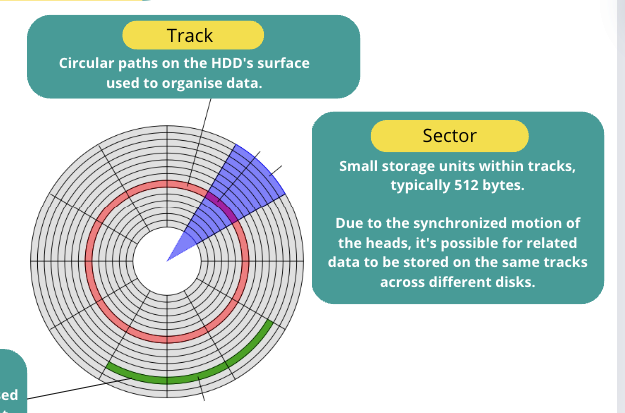
1.
FULL TERM
HDD
Hard Disk Drives
COMPONENTS
Used to store data. Data is stored in a digital format on the magnetic surfaces of the disks. The platters can spin about 7000 times a second.
Composed of electromagnets, they read data from or write data to the platters. Multiple read-write heads can access all surfaces for data storage, operating at a speed of 50 times per second.
A sector on a given track will contain a fixed number of bytes.
PLATTER
ELECTROMAGNET HEADS
TRACK AND SECTOR
For more help, please visit www.exampaperspractice.co.uk

Slide 198
WHY IS HDD SLOW?
Unfortunately, hard disk drives have very slow data access when compared to, for example, RAM. Many applications require the read-write heads to constantly look for the correct blocks of data; this means a large number of head movements. The effects of latency then become very significant. Latency is defined as the time it takes for a specific block of data on a data track to rotate around to the read-write head.
For more help, please visit www.exampaperspractice.co.uk

Slide 199
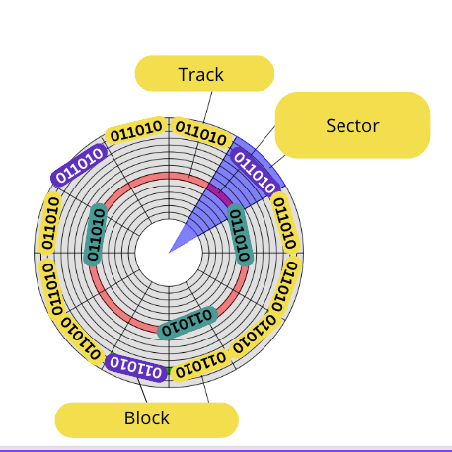
FRAGMENTATION OF HDD
When a file or data is stored on a HDD, the required number of sectors needed to store the data will be allocated. However, the sectors allocated may not be adjacent to each
other. Through time, the HDD will undergo numerous deletions and editing which leads to sectors becoming increasingly fragmented resulting in a gradual deterioration of the HDD performance (in other words, it takes longer and longer to access data). Defragmentation software can improve on this situation by ‘tidying up’ the disk sectors.
For more help, please visit www.exampaperspractice.co.uk

Slide 200
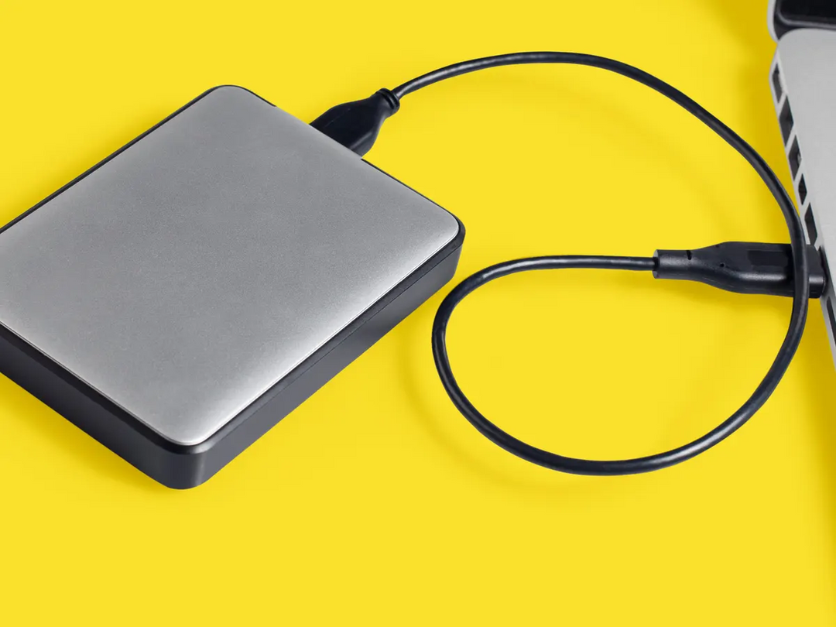
REMOVABLE HDD
Removable hard disk drives are essentially HDDs external to the computer that can be connected to the computer using one of the USB ports. In this way, they can be used as a back-up device or another way of transferring files between computers.
For more help, please visit www.exampaperspractice.co.uk

Slide 201
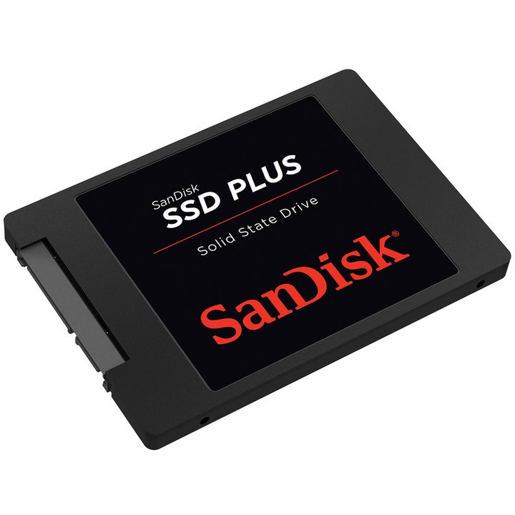
1.
FULL TERM
SSD
Solid State Drive
2.
ALSO KNOWN AS
Flash Storage
3.
DESCRIPTION
They have no moving part and all data is retrieved at the same rate
For more help, please visit www.exampaperspractice.co.uk

Slide 202
HOW DOES SSD STORE DATA
    Data is stored as 0s and 1s in millions of microscopic transistors. It stores information by controlling the movement of electrons using logic gates (NAND and NOR).
    Electric current reaches the control gates and flows through to the floating gates for storage.
    A dielectric coating separates the two transistors, allowing the floating gate transistor to retain its charge, making the memory non-volatile.
For more help, please visit www.exampaperspractice.co.uk

Slide 203
ADVANTAGES OF SSD OVER HDD
As they have no moving parts, SSD is :
    Lighter (LET)
    More Reliable (ME)
    Thinner (TAKE)
    Faster in data access (FRIED)
    Cooler (CHICKEN)
DISADVANTAGES OF SSD OVER HDD
    Poor longevity - is still not used in all servers
*memory sticks/flash memories use solid state technology
For more help, please visit www.exampaperspractice.co.uk

Slide 204


Optical Media
Blu-ray
CD
DVD
red laser
blue laser
red laser
For more help, please visit www.exampaperspractice.co.uk

Slide 205

CD and DVD
laser
binary = 0
binary = 1
land
pit
    Similar to an HDD, a CD/DVD is segmented into sectors for direct data access.
    The data is stored in 'pits' and 'lands' along a spiral track.
    A red laser is utilized to read and write the data.
    As the disk spins, the optical head moves to where the laser beam contacts the disk surface, following the spiral track from the center outward.
For more help, please visit www.exampaperspractice.co.uk

Slide 206
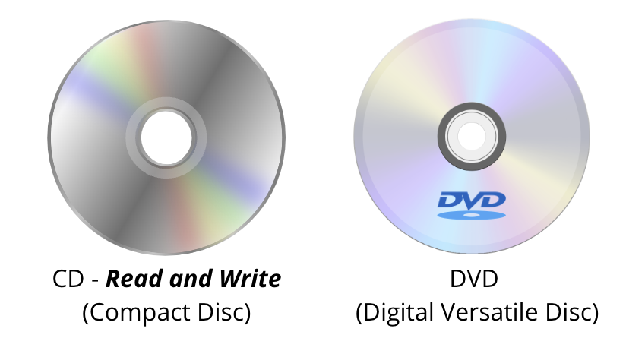
Difference between CD and DVD
    DVDs have more storage capacity than CDs.
    DVDs can also be dual-layered, with reading and writing of the second layer accomplished by a red laser focusing at a slightly different depth compared to the first layer.
    Even single-layer DVDs offer more storage than CDs due to the smaller 'pit' size and narrower track width.
For more help, please visit www.exampaperspractice.co.uk

Slide 207
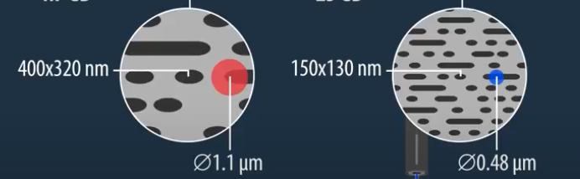
Blu-Ray
disk
    A blue laser, rather than a red one, is used for read and write operations due to its shorter wavelength of 405 nanometers (compared to the red laser's 650-780 nanometers).
    The shorter wavelength increases the medium's storage capacity. Blu-ray discs also feature a secure encryption system to prevent piracy and copyright infringement.
    The data transfer rate for a DVD is 10 Mbps, while for a Blu-ray disc it is 36 Mbps, allowing 25 GiB of data to be transferred in 1.5 hours. Blu-ray discs are available in both single and double layers.
For more help, please visit www.exampaperspractice.co.uk

Slide 208
DISK SIZE CAPACITY
Blu-ray
CD
DVD
27 GB (Single Layer)
50 GB (Dual Layer)
700MB
4.7 GB
For more help, please visit www.exampaperspractice.co.uk

Slide 209



Virtual
Memory
Part of the memory in HDD or SSD when we need more memory - RAM
When do we need virtual memory
When applications exhaust available memory by surpassing the capacity of RAM due to concurrent operation, it often leads to system crashes. This issue can be mitigated by utilizing additional storage on the hard disk drive or SSD as virtual memory when more memory is required.
For more help, please visit www.exampaperspractice.co.uk

Slide 210
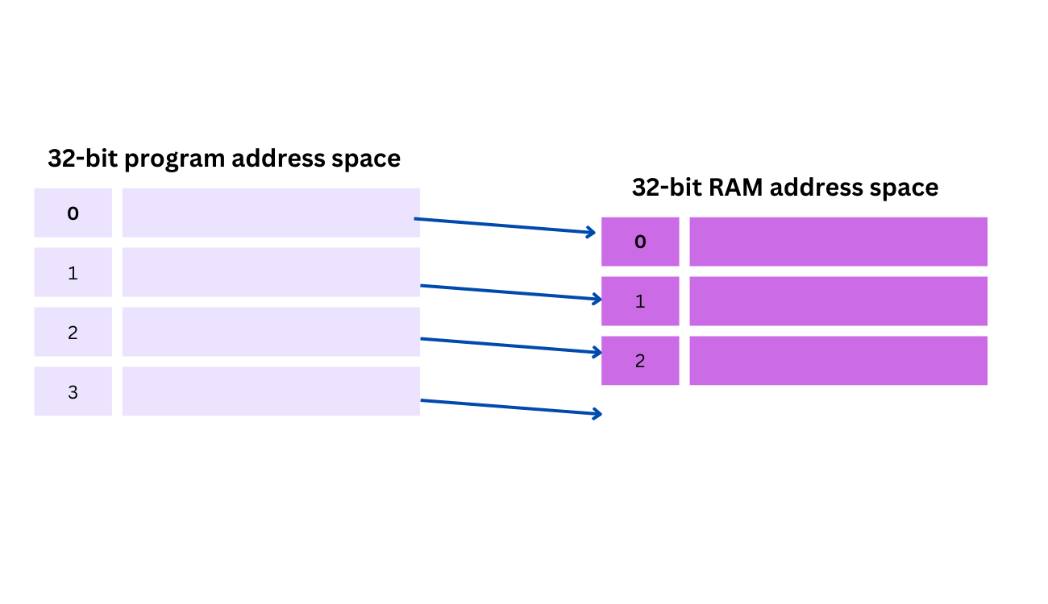
an example showing the importance of virtual memory
Imagine we want to run 4 instructions, but we only have 3 available slot in the ram ... (sad)
For more help, please visit www.exampaperspractice.co.uk

Slide 211
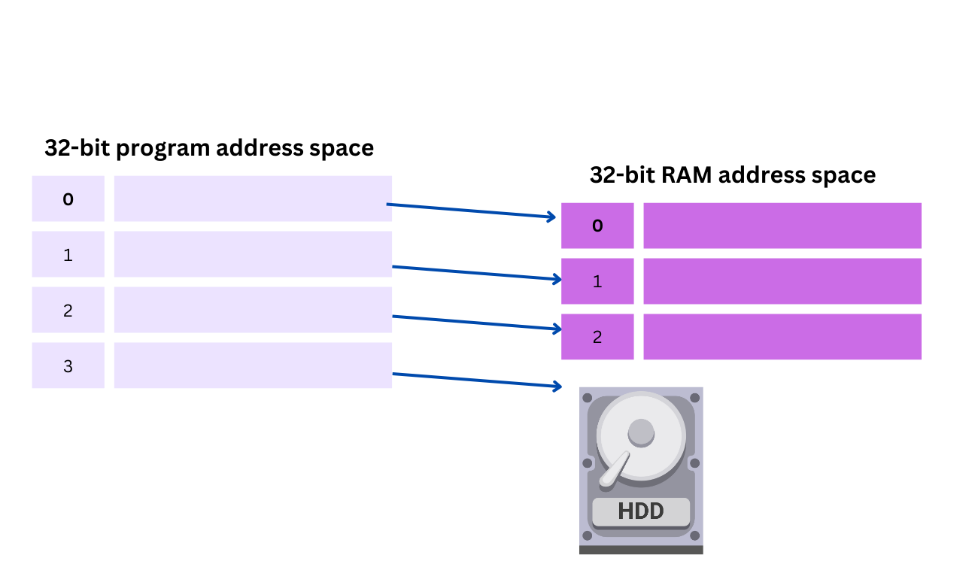
an example showing the importance of virtual memory
To solve this problem, we store the extra instruction into the hdd/ssd temperorily (waiting state)
For more help, please visit www.exampaperspractice.co.uk

Slide 212
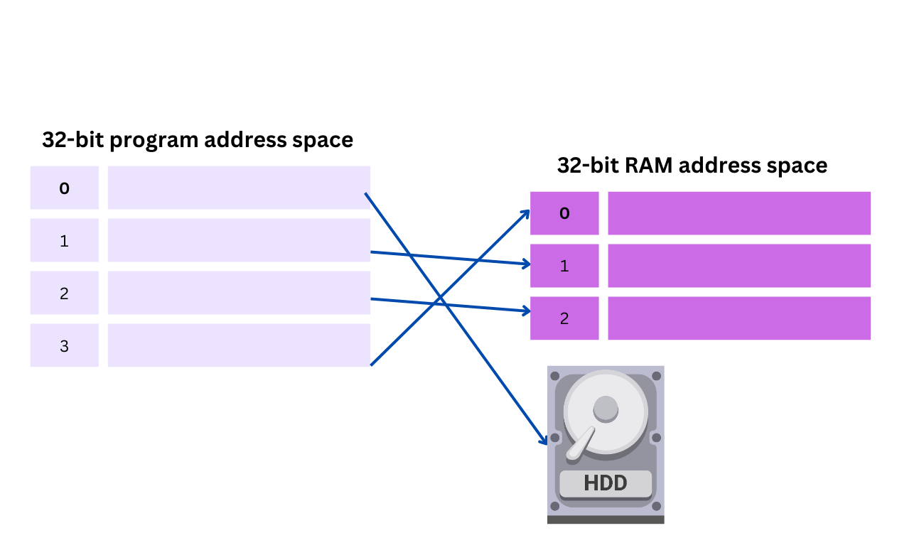
an example showing the importance of virtual memory
Virtual memory now moves the oldest data out of RAM into the HDD/SSD to allow program 3 to gain access to RAM. The 32-bit ‘map’ is now updated to reflect this new situation
For more help, please visit www.exampaperspractice.co.uk

Slide 213
Virtual Memory
    These conditions persist until the competing programs no longer overburden the RAM. Virtual memory creates the perception of limitless memory availability; even when RAM is full, data can be transferred to and from HDD/SSD to maintain the illusion of available memory.
    Operating systems employ paging in memory management to store and retrieve data between HDD/SSD and RAM. However, accessing data in virtual memory is slower. As previously discussed, larger RAM sizes facilitate faster CPU operations. This underscores the advantage of maximizing RAM capacity.
For more help, please visit www.exampaperspractice.co.uk

Slide 214
Disk Threshing
  Virtual memory using a HDD can lead to disk thrashing.
  Disk thrashing occurs as more data is swapped between main memory and virtual memory on the HDD.
  This frequent swapping causes high rates of HDD read/write head movements.
  If data swapping exceeds actual processing time, overall computer speed decreases significantly.
  A thrash point may be reached where system performance halts due to excessive data movement.
  Intensive head movements during thrashing can accelerate HDD wear and potential failure.
  Ways to reduce thrashing include increasing RAM, minimizing concurrent programs, or reducing swap file size.
  Alternatively, using a SSD instead of a HDD can mitigate thrashing due to faster access times.
For more help, please visit www.exampaperspractice.co.uk

Slide 215

Cloud Storage
A method of data storage where data is stored on remote servers.
Instead of saving data on a local hard disk or other storage device, a user can save their data ‘in the cloud’.
For more help, please visit www.exampaperspractice.co.uk

Slide 216

Advantages
Disadvantages
Client files stored in the cloud can be accessed globally from any internet-connected device, enabling convenient and flexible retrieval and usage across different locations.
Customers or clients with slow or unreliable internet connections may encounter difficulties accessing or downloading their data or files.
Customers or clients do not need to carry an external storage device or use the same computer consistently to store and access information.
Costs can be high if large storage capacity is required
The cloud offers remote data backup, providing significant benefits in mitigating data loss and enhancing disaster recovery capabilities.
There is always a risk of potential failure for cloud storage companies, which could result in the loss of all backed-up data.
For more help, please visit www.exampaperspractice.co.uk

Slide 217

EXAM QUESTION
For more help, please visit www.exampaperspractice.co.uk

Slide 218

EXAM QUESTION
For more help, please visit www.exampaperspractice.co.uk

Slide 219

EXAM QUESTION
For more help, please visit www.exampaperspractice.co.uk

Slide 220

EXAM QUESTION
For more help, please visit www.exampaperspractice.co.uk

Slide 221

EXAM QUESTION
For more help, please visit www.exampaperspractice.co.uk

Slide 222

EXAM QUESTION
For more help, please visit www.exampaperspractice.co.uk

Slide 223

EXAM QUESTION
For more help, please visit www.exampaperspractice.co.uk

Slide 224

EXAM QUESTION
For more help, please visit www.exampaperspractice.co.uk

Slide 225

EXAM QUESTION
For more help, please visit www.exampaperspractice.co.uk

Slide 226
EXAM QUESTION
For more help, please visit www.exampaperspractice.co.uk

Slide 227

EXAM QUESTION
For more help, please visit www.exampaperspractice.co.uk

Slide 228

EXAM QUESTION
For more help, please visit www.exampaperspractice.co.uk

Slide 229

NETWORK HARDWARE
IGCSE COMPUTER SCIENCE
For more help, please visit www.exampaperspractice.co.uk

Slide 230


NETWORK INTERFACE CARD (NIC)
Needed to allow a device to connect to a network (such as the internet)
WIRELESS NETWORK INTERFACE CARD (NIC)
They use wireless connectivity utilising an antenna to communicate with networks via microwaves
For more help, please visit www.exampaperspractice.co.uk

Slide 231


INTERNET PROTOCOL (IP) ADDRESS
For more help, please visit www.exampaperspractice.co.uk

Slide 232
WHEN A ROUTER CONNECTS TO THE INTERNET IT IS GIVEN A UNIQUE PUBLIC IP ADDRESS
254.26.38.77
254.25.28.77
254.16.48.102
For more help, please visit www.exampaperspractice.co.uk

Slide 233

WHEN A DEVICE CONNECTS TO A PRIVATE NETWORK, A ROUTER ASSIGNS A PRIVATE IP ADDRESS TO IT. THIS IP ADDRESS IS UNIQUE WITHIN THAT SPECIFIC NETWORK BUT COULD POTENTIALLY BE THE SAME AS AN IP ADDRESS ON A DIFFERENT NETWORK.
254.25.28.6
254.25.28.12
254.25.28.13
254.25.28.1
SUPPLIED BY ISP
For more help, please visit www.exampaperspractice.co.uk

Slide 234
IP ADDRESS FORMAT - IPV4
DD.DD.DD.DD
    EACH DIGIT RANGE FROM 0-255
    EACH DIGIT = 8 BITS
    EACH DIGIT IS SEPARATED BY DOT
    4.3 BILLIONS COMBINATION
EG
252.25.28.77
CAN BE REPRESENTED IN HEXA TOO..
For more help, please visit www.exampaperspractice.co.uk

Slide 235
IP ADDRESS FORMAT - IPV6
HHHH:HHHH:HHHH:HHHH:HHHH:HHHH:HHHH:HHHH
    EACH DIGIT RANGE FROM 0-65536 / 0000 - FFFF (HEXA)
    EACH DIGIT = 16 BITS
    EACH DIGIT IS SEPARATED BY COLON
    COMBINATIONS? 65535 POWER OF 8 (DON'T COUNT)
EG
A8FB:7A88:FFF0:0FFF:3D21:2085:66FB:F0FA
For more help, please visit www.exampaperspractice.co.uk

Slide 236

WHY IS IPV6 NEEDED?
For more help, please visit www.exampaperspractice.co.uk

Slide 237
SOME POSSIBLE ANSWERS
    REMOVES THE RISK OF IP ADDRESS COLLISIONS
    HAS BUILT-IN AUTHENTICATION CHECKS (STORES ADDITIONAL VALUE IN THE HEADER USING THE PAYLOAD)
    IPV6 HAS BEEN DESIGNED TO ALLOW THE INTERNET TO GROW IN TERMS OF THE NUMBER OF HOSTS AND POTENTIAL INCREASE IN THE AMOUNT OF DATA TRAFFIC
EG
For more help, please visit www.exampaperspractice.co.uk

Slide 238
Static IP Address
STATIC IP ADDRESSES ARE PERMANENTLY ASSIGNED TO A DEVICE BY THE INTERNET SERVICE PROVIDER (ISP), AND THEY DO NOT CHANGE EACH TIME THE DEVICE CONNECTS TO THE INTERNET.
Static vs Dynamic IP Address
USED BY
1.REMOTE SERVERS WHICH ARE HOSTING A WEBSITE
2. AN ONLINE DATABASE
ADVANTAGE:
ALLOW FOR FASTER UPLOAD AND DOWNLOAD SPEEDS
For more help, please visit www.exampaperspractice.co.uk

Slide 239
Static IP Address
Dynamic IP Address
STATIC IP ADDRESSES ARE PERMANENTLY ASSIGNED TO A DEVICE BY THE INTERNET SERVICE PROVIDER (ISP); THEY DON’T CHANGE EACH TIME A DEVICE LOGS ONTO THE INTERNET.
DYNAMIC IP ADDRESSES ARE ASSIGNED BY THE ISP EACH TIME A DEVICE LOGS ONTO THE INTERNET. THESE ADDRESSES ARE NOT PERMANENT AND CAN CHANGE WITH EACH CONNECTION SESSION.
Static vs Dynamic IP Address
USED BY
1.REMOTE SERVERS WHICH ARE HOSTING A WEBSITE
2. AN ONLINE DATABASE
DYNAMIC HOST CONFIGURATION PROTOCOL (DHCP) I USED BY THE ISP TO AUTOMATICALLY ASSIGN AN IP ADDRESS TO A DEVICE
ADVANTAGE:
ALLOW FOR FASTER UPLOAD AND DOWNLOAD SPEEDS
ADVANTAGE:
GREATER PRIVACY SINCE THEY CHANGE EACH TIME
A USER LOGS ON
For more help, please visit www.exampaperspractice.co.uk

Slide 240
THEN, HOW TO UNIQUELY IDENTIFY A DEVICE ON A LAN?
For more help, please visit www.exampaperspractice.co.uk

Slide 241
Media Access Control (MAC) Address
Function
Uniquely identify a computer on a Local Area Network (LAN)
Format
NN - NN - NN - DD - DD - DD
Manufacturer Code
Serial Number
Each digit is represented in Hexadecimal
If the NIC card is replaced, the MAC address will also change
Eg. 00 - 1C - B3 - 4F - 25 - FF
For more help, please visit www.exampaperspractice.co.uk

Slide 242
Universally Administered
MAC Address (UAA)
Locally Administered
MAC Address (LAA)
    Most common type of MAC address
    Set by manufacturer at the factory
    Rare for a user to change this address
    Useful when a user or organisation wishes to change their MAC adderss
    Cause big problem if changed address isn't unique
    Useful when certain software used on mainframe systems need all the MAC addresses of devices to fall into a strict format.
Types of MAC address
For more help, please visit www.exampaperspractice.co.uk

Slide 243
ROUTER
FUNCTION 1: ENABLE DATA PACKETS TO BE ROUTED BETWEEN DIFFERENT NETWORKS
254.26.38.77
254.25.28.77
254.16.48.102
For more help, please visit www.exampaperspractice.co.uk

Slide 244
ROUTER
FUNCTION 2: TAKES DATA TRANSMITTED IN ONE FORMAT FROM A NETWORK (WHICH IS USING A PARTICULAR PROTOCOL) AND CONVERTS THE DATA TO A PROTOCOL AND FORMAT UNDERSTOOD BY ANOTHER NETWORK, THEREBY ALLOWING THEM TO COMMUNICATE.
254.26.38.77
254.25.28.77
For more help, please visit www.exampaperspractice.co.uk

Slide 245
ROUTER
SINCE EVERY COMPUTER ON THE SAME NETWORK HAS THE SAME PART OF AN INTERNET PROTOCOL (IP) ADDRESS, THE ROUTER IS ABLE TO SEND THE DATA PACKET TO THE APPROPRIATE SWITCH, AND THE DATA WILL THEN BE DELIVERED TO THE CORRECT DEVICE USING THE
MAC DESTINATION ADDRESS
00 - 1C - B3 - 4F - 25 - FF
DESTINATION: 254.25.28.77
00 - 1C - B3 - 4F - 26 - FF
254.25.28.77
For more help, please visit www.exampaperspractice.co.uk

Slide 246

EXAM QUESTION
For more help, please visit www.exampaperspractice.co.uk

Slide 247

EXAM QUESTION
For more help, please visit www.exampaperspractice.co.uk

Slide 248

EXAM QUESTION
For more help, please visit www.exampaperspractice.co.uk

Slide 249

EXAM QUESTION
For more help, please visit www.exampaperspractice.co.uk

