Slide 1


Cambridge IGCSE Computer Science 0478/0984 - Revision Notes
Chapter 9 - Databases
This study guide has been expertly compiled and edited by successful former teachers of Computer Science and highly experienced examiners and is suitable for students who are taking 0478 (9-1) IGCSE, the 0984 (A*-G) IGCSE, and the 2210 O Level for examination in 2023 onwards. It could be used as lesson starters, or supplied to students for independent use.
For more help, please visit www.exampaperspractice.co.uk

Slide 2




IGCSE Computer Science Chapter 9
DATABASES
START
For more help, please visit www.exampaperspractice.co.uk

Slide 3
Students Info
A database is an organised collection of data. In a database, you can organise data in a
table format.
ID
Name
Age
House
For more help, please visit www.exampaperspractice.co.uk

Slide 4
BRAINSTORM
What are some usages of databases?
For more help, please visit www.exampaperspractice.co.uk

Slide 5
USAGE
Student and examination records at schools
ID
Name
Age
House
1
A
10
Blue
2
B
11
Red
3
C
10
Red
For more help, please visit www.exampaperspractice.co.uk

Slide 6
USAGE
Patient records at hospitals
ID
Name
Disease
1
A
Diabetes
2
B
Headache
3
C
Stroke
For more help, please visit www.exampaperspractice.co.uk

Slide 7
USAGE
Customer records at banks
ID
Name
Saving($)
1
A
300
2
B
500
3
C
1000
For more help, please visit www.exampaperspractice.co.uk

Slide 8
OthER USAGES
    Booking and reservation records at railways and airports
    Employee records at offices
For more help, please visit www.exampaperspractice.co.uk

Slide 9

CHAPTER OUTLINE
9.1
9.2
9.3
9.4
Important terms related to databases
Types of databases
Creating a database
Using query
For more help, please visit www.exampaperspractice.co.uk

Slide 10

CHAPTER OUTLINE
9.1
9.2
9.3
9.4
Important terms related to databases
Types of databases
Creating a database
Using query
For more help, please visit www.exampaperspractice.co.uk

Slide 11

Important terms
related to database
Table
Student Data
F
ID
First
Name
Last
Name
Age
House
R
001
Jay
Chou
11
Yellow
In a database, data is entered in a tabular format organised as rows and columns.
Q
002
Jane
Watson
10
Red
003
Will
Smith
13
Blue
D
004
Max
Verst
12
Green
005
Anna
Maria
11
Yellow
For more help, please visit www.exampaperspractice.co.uk

Slide 12

Important terms
related to database
AGE field
T
Student Data
Field
ID
First
Name
Last
Name
Age
House
001
Jay
Chou
11
Yellow
R
002
Jane
Watson
10
Red
A field is a column in a database. It is also a title given to a piece of data.
Q
003
Will
Smith
13
Blue
D
004
Max
Verst
12
Green
005
Anna
Maria
11
Yellow
For more help, please visit www.exampaperspractice.co.uk

Slide 13
Important terms
related to database
A record about Jane Watson
T
Student Data
F
ID
First
Name
Last
Name
Age
House
001
Jay
Chou
Record
11
Yellow
002
Jane
Watson
10
Red
Q
A record is a row in a database table. A collection of fields in the table for a specific person.
003
Will
Smith
13
Blue
D
004
Max
Verst
12
Green
005
Anna
Maria
11
Yellow
For more help, please visit www.exampaperspractice.co.uk

Slide 14

Important terms
related to database
Student Data
T
ID
First
Name
Last
Name
Age
House
F
001
Jay
Chou
11
Yellow
002
Jane
Watson
10
Red
R
003
Will
Smith
13
Blue
Query
004
Max
Verst
12
Green
005
Anna
Maria
11
Yellow
D
A query allows the user to find full records or records with specific fields in a database using certain criteria.
For more help, please visit www.exampaperspractice.co.uk

Slide 15

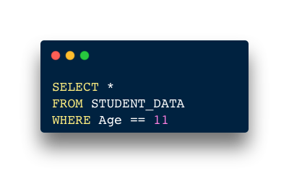
Student Data
ID
First
Name
Last
Name
Age
House
Query: Can you show me only the records of students who are 11 years old.
001
Jay
Chou
11
Yellow
002
Jane
Watson
10
Red
003
Will
Smith
13
Blue
Structured Query Language (Learn in C9.4)
004
Max
Verst
12
Green
005
Anna
Maria
11
Yellow
ID
First
Name
Last
Name
Age
House
001
Jay
Chou
11
Yellow
005
Anna
Maria
11
Yellow
For more help, please visit www.exampaperspractice.co.uk

Slide 16

Important terms
related to database
A data type helps computer to identify similar data for the purpose of sorting, searching and calculation.
T
F
TEXT/ALPHANUMERIC
Numeric
Char
INTEGER
R
ID
First
Name
Last
Name
Age
House
Q
001
Jay
Chou
11
Y
002
Jane
Watson
10
R
Data Type
003
Will
Smith
13
B
004
Max
Verst
12
G
005
Anna
Maria
11
Y
For more help, please visit www.exampaperspractice.co.uk

Slide 17
Important terms
related to database
T
F
Syllabus Data Type
Description
Microsoft Access data type
Text/Alphanumeric
A number of characters
Short/Long Text
R
Character
A single character
Short text with field size 1
Q
Boolean
Yes or No, True or False
Yes/No
Integer
Whole Number
Number formatted as fixed with zero decimal places
Data Type
Real
A decimal number
Number formatted as decimal
Date/Time
Date/Time
Date/Time
For more help, please visit www.exampaperspractice.co.uk

Slide 18
CHAPTER OUTLINE
9.1
9.2
9.3
9.4
Important terms related to databases
Types of databases
Creating a database
Using query
For more help, please visit www.exampaperspractice.co.uk

Slide 19



DATABASE MANAGEMENT SYSTEM (DBMS)
An interface which acts as an interface between the user and the database
Microsoft Access
Oracle Database
For more help, please visit www.exampaperspractice.co.uk

Slide 20


TWO TYPES OF DATABASES
FLAT-FILE DATABASE
    Store only a single table of data
    The database is not related to any other table or database.
    Disadvantages:
      Data duplication
        A process of creating an exact copy of data
      Data redundancy
        The storing of the same data in multiple locations
      Input errors
Student Data
ID
First
Name
Last
Name
Age
House
001
Jay
Chou
11
Yellow
002
Jane
Watson
10
Red
003
Will
Smith
13
Blue
004
Max
Verst
12
Green
005
Anna
Maria
11
Yellow
For more help, please visit www.exampaperspractice.co.uk

Slide 21

TWO TYPES OF DATABASES
RELATIONAL DATABASE
    A database that has multiple tables
    When the table are linked, the user can work on complex data structures having multiple tables
    A relational database does not allow data duplication. It is more efficient and consistent than a flat-file database
For more help, please visit www.exampaperspractice.co.uk

Slide 22
RELATIONAL DATABASE
Database that can have more than 1 table. Instead of placing all the fields into one table, fields are categorized into their types (student information & student result). It makes the database more organized.
Student Data
Student Result
ID
First
Name
Last
Name
Age
House
ID
Math
HIS
ENG
SCIENCE
001
Jay
Chou
11
Yellow
001
88
75
65
44
002
Jane
Watson
10
Red
002
45
38
70
55
003
Will
Smith
13
Blue
003
45
66
69
13
004
Max
Verst
12
Green
004
77
90
56
42
005
Anna
Maria
11
Yellow
005
67
48
43
54
For more help, please visit www.exampaperspractice.co.uk

Slide 23
PRIMARY KEY
In both tables, student ID will be unique for each record. It thus defines the record of each student. This specific field is defined as the primary key for that table.
Student Data
Student Result
ID
First
Name
Last
Name
Age
House
ID
Math
HIS
ENG
SCIENCE
001
Jay
Chou
11
Yellow
001
88
75
65
44
002
Jane
Watson
10
Red
002
45
38
70
55
003
Will
Smith
13
Blue
003
45
66
69
13
004
Max
Verst
12
Green
004
77
90
56
42
005
Anna
Maria
11
Yellow
005
67
48
43
54
A primary key is a unique field that allows the user to identify a record. Every record in the primary key field must be unique.
For more help, please visit www.exampaperspractice.co.uk

Slide 24
CHAPTER OUTLINE
9.1
9.2
9.3
9.4
Important terms related to databases
Types of databases
Creating a database
Using query
For more help, please visit www.exampaperspractice.co.uk

Slide 25
THE FOLLOWING TUTORIALS ARE MADE USING MICROSOFT ACCESS
For more help, please visit www.exampaperspractice.co.uk

Slide 26
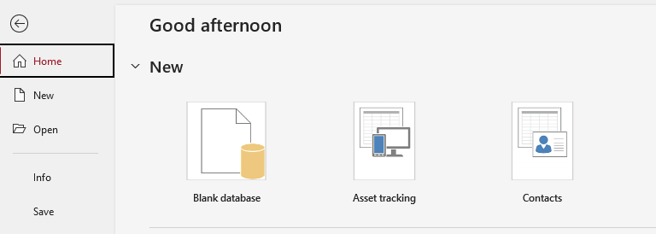
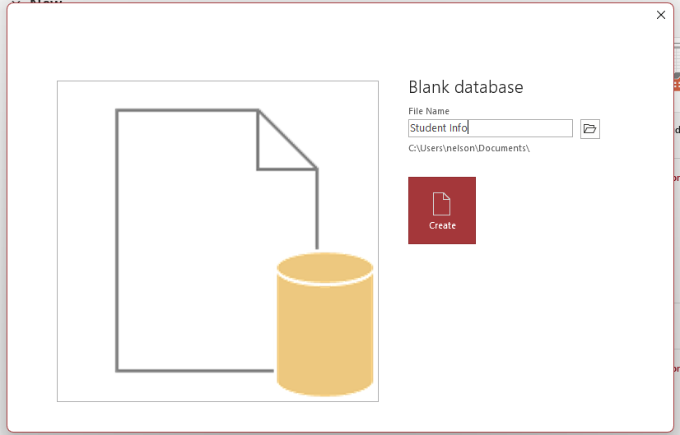

Step 1: Create a blank database and name it
For more help, please visit www.exampaperspractice.co.uk

Slide 27
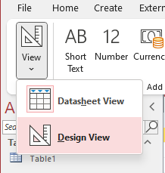
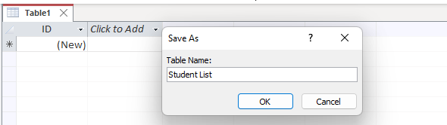
Step 2: Select Design View and you will be prompted to create a table.
For more help, please visit www.exampaperspractice.co.uk

Slide 28
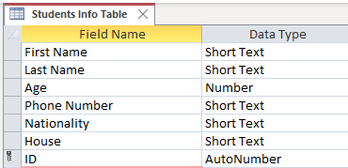
Step 3: Create field in your table and assign each field a datatype.
*Phone Number is given a short text data type as phone number can contain symbol (eg. +).
For more help, please visit www.exampaperspractice.co.uk

Slide 29
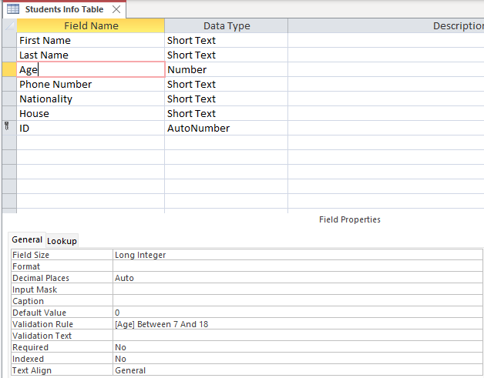
Step 4: Add validation to your fields - Age.
Restrict age to be between 7 to 18.
For more help, please visit www.exampaperspractice.co.uk

Slide 30
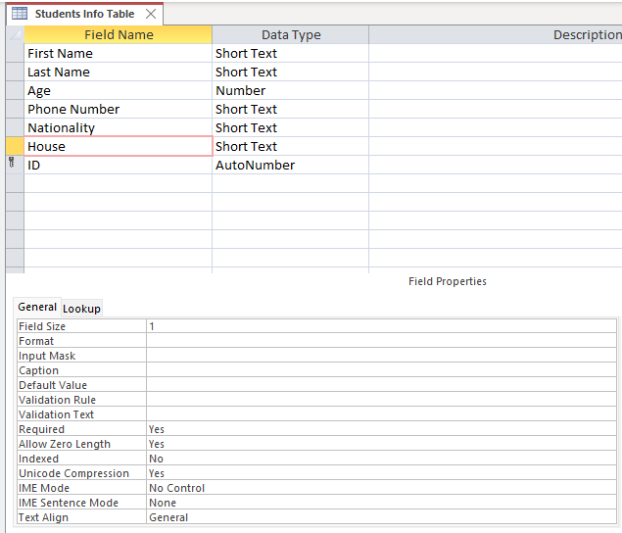
Step 4: Add validation to your fields - House.
Restrict House to contain only one character.
For more help, please visit www.exampaperspractice.co.uk

Slide 31
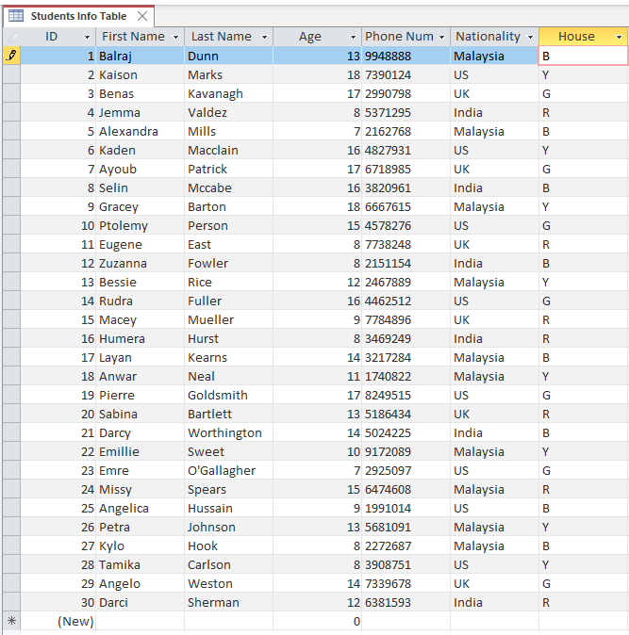
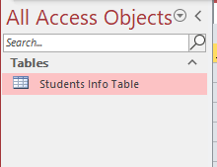
Step 5: Select table and enter data into it.
For more help, please visit www.exampaperspractice.co.uk

Slide 32
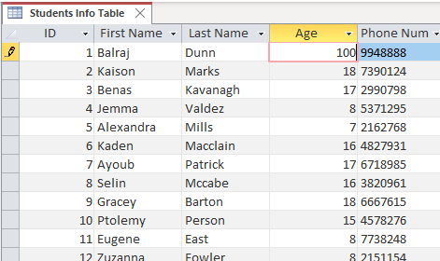
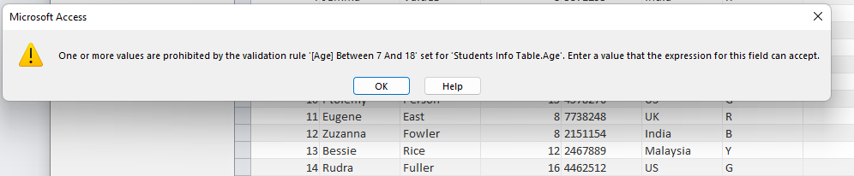
Testing out validation
Try to enter a value >18 into the Age field.
For more help, please visit www.exampaperspractice.co.uk

Slide 33
CHAPTER OUTLINE
9.1
9.2
9.3
9.4
Important terms related to databases
Types of databases
Creating a database
Using query
For more help, please visit www.exampaperspractice.co.uk

Slide 34

Queries are used for working with data in a database. You can search data by certain criteria such as "searching the records in which students are aged 11 or older".
Queries
Student Data
ID
First
Name
Last
Name
Age
House
Query: Can you show me only the records of students who are 11 years old.
001
Jay
Chou
11
Yellow
002
Jane
Watson
10
Red
003
Will
Smith
13
Blue
Structured Query Language
004
Max
Verst
12
Green
005
Anna
Maria
11
Yellow
ID
First
Name
Last
Name
Age
House
001
Jay
Chou
11
Yellow
005
Anna
Maria
11
Yellow
For more help, please visit www.exampaperspractice.co.uk

Slide 35


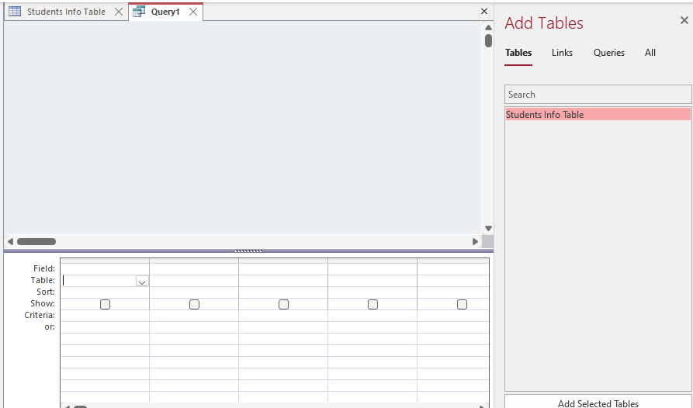
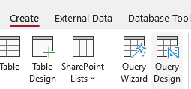

Method 1: Using Query-by
Step 2: Select the table in which you want to query on
Step 1: Select Query Design
For more help, please visit www.exampaperspractice.co.uk

Slide 36

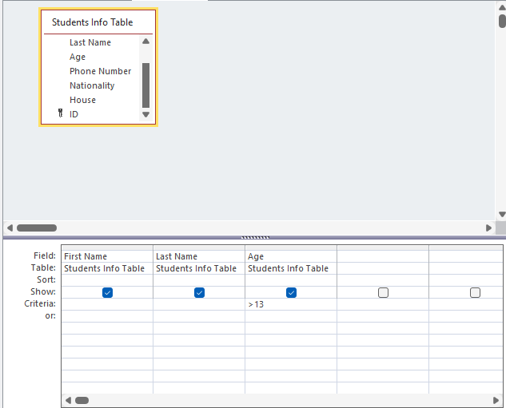
Method 1: Using Query-by
Step 3: Select fields that we want to view. Also select field that we want to set criteria on.
Only show > 13
For more help, please visit www.exampaperspractice.co.uk

Slide 37


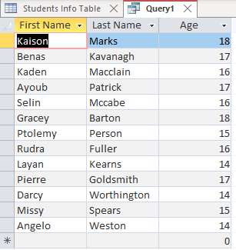
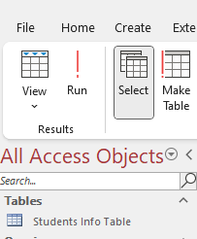
Method 1: Using Query-by
Step 4: Click Run
Step 5: Result!
For more help, please visit www.exampaperspractice.co.uk

Slide 38

Method 2: SQL
(Structured Query Language)
SQL is mainly used for relational databases. It contains statements which are used to retrieve or modify data from the database.
For more help, please visit www.exampaperspractice.co.uk

Slide 39


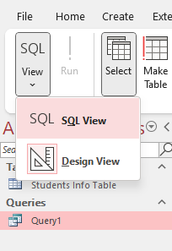
Using SQL in Microsoft Access
Step 2: Select SQL View
Step 1: Select Query Design
For more help, please visit www.exampaperspractice.co.uk

Slide 40

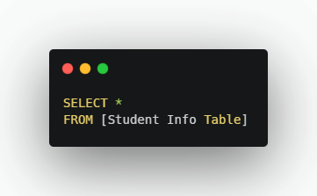
Using the * for the field name
This will retrieve all fields of a table
All the fields
SELECT [field(s)]
FROM [Table]
For more help, please visit www.exampaperspractice.co.uk

Slide 41
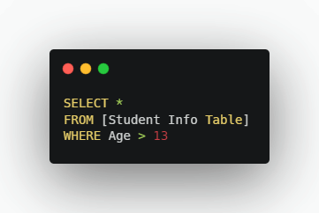
Used to specify a condition. You will get only records for which the condition is true.
Where clause
For more help, please visit www.exampaperspractice.co.uk

Slide 42
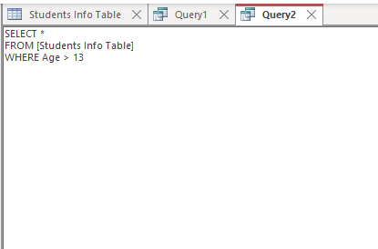
Let's type in the SQL code into Microsoft Access
Microsoft Access
For more help, please visit www.exampaperspractice.co.uk

Slide 43
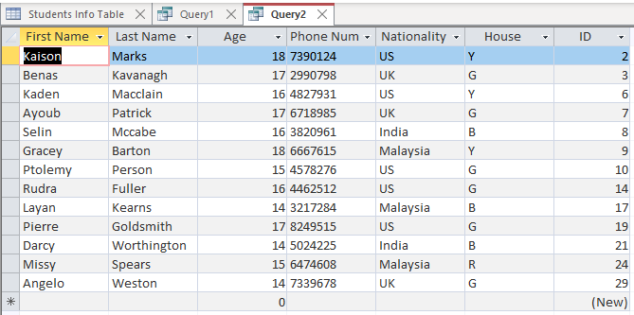
Result - only records which have age > 13 are selected
Microsoft Access
For more help, please visit www.exampaperspractice.co.uk

Slide 44
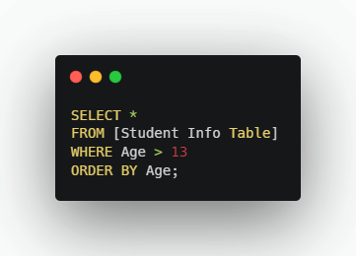
Used along with the SELECT statement to retrieve information in ascending order.
ORDER BY CLAUSE
For more help, please visit www.exampaperspractice.co.uk

Slide 45
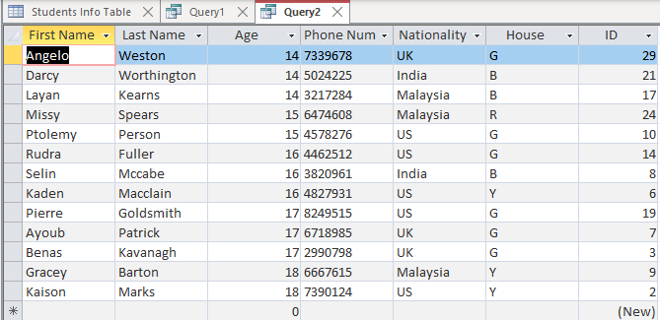
ORDER BY CLAUSE
A TABLE SHOWN THAT IS ORDERED BY AGE.
For more help, please visit www.exampaperspractice.co.uk

Slide 46
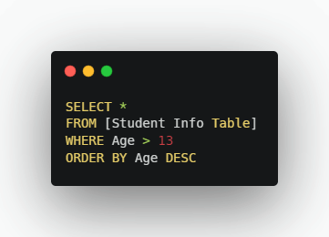

If information needs to be arranged in descending order, the DESC is used along with the Order By clause.
ORDER BY CLAUSE
For more help, please visit www.exampaperspractice.co.uk

Slide 47
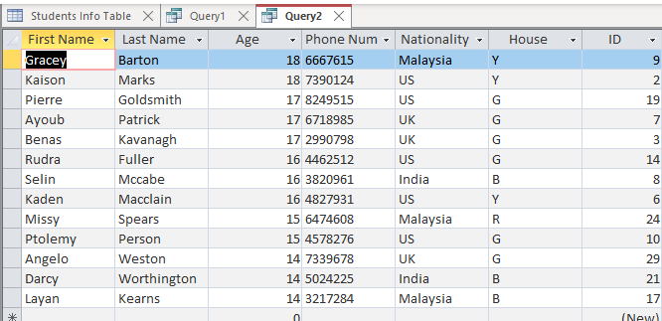
ORDER BY CLAUSE
RESULT WITH DESCENDING ORDER.
For more help, please visit www.exampaperspractice.co.uk

Slide 48
Aggregate functions are used to perform mathematical operations - counting and addition, respectively on the data values of a given field.
FUNCTIONS
COUNT FUNCTION
SUM FUNCTION
For more help, please visit www.exampaperspractice.co.uk

Slide 49
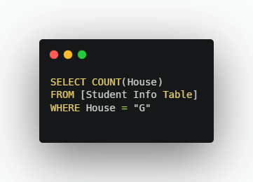
It is used for counting the number of rows in a field. You can add a condition using WHERE clause.
COUNT FUNCTION
It calculate the number of records which matches House = "G"
For more help, please visit www.exampaperspractice.co.uk

Slide 50
COUNT FUNCTION
Illustration
Student Info Table
ID
First
Name
Last
Name
Age
House
Query: Can you COUNT for me how many of these students are from the Green ('G') House?
001
Jay
Chou
11
G
002
Jane
Watson
10
R
003
Will
Smith
13
B
Structured Query Language
004
Max
Verst
12
G
005
Anna
Maria
11
G
Answer: 3
(Try it out in Access!
For more help, please visit www.exampaperspractice.co.uk

Slide 51
It is used for adding the values in a given field.
SUM FUNCTION
Student Info Table
ID
First
Name
Last
Name
Age
House
Money Paid
001
Jay
Chou
11
G
100
Query: Can you calculate for me how much in total these students have paid?
002
Jane
Watson
10
R
100
003
Will
Smith
13
B
200
004
Max
Verst
12
G
300
005
Anna
Maria
11
G
200
For more help, please visit www.exampaperspractice.co.uk

Slide 52
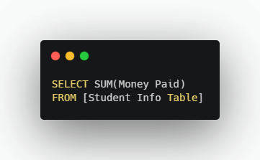
It is used for adding the values in a given field.
SUM FUNCTION
Student Info Table
ID
First
Name
Last
Name
Age
House
Money Paid
001
Jay
Chou
11
G
100
Query: Can you calculate for me how much in total these students have paid?
002
Jane
Watson
10
R
100
003
Will
Smith
13
B
200
004
Max
Verst
12
G
300
005
Anna
Maria
11
G
200
Answer: 900
(Try it out in Access!
For more help, please visit www.exampaperspractice.co.uk

Slide 53
USEFUL OPERATORS
OPERATOR
DESCRIPTION
=
EQUAL TO
>
GREATER THAN
<
LESS THAN
>=
GREATER THAN OR EQUAL TO
<=
LESS THAN OR EQUAL TO
<>
NOT EQUAL TO
BETWEEN
BETWEEN A RANGE OF TWO VALUES
LIKE
SEARCH FOR A PATTERN
IN
SPECIFY MULTIPLE VALUES
AND
SPECIFY MULTIPLE CONDITIONS THAT MUST ALL BE TRUE
OR
SPECIFY MULTIPLE CONDITIONS WHERE ON OR MORE CONDITIONS MUST BE TRUE
NOT
SPECIFY A CONDITION THAT MUST BE FALSE
For more help, please visit www.exampaperspractice.co.uk

Slide 54

Projects to practice SQL
Instagram
Followers
Sales
Reports
For more help, please visit www.exampaperspractice.co.uk

