Slide 1


Cambridge IGCSE Computer Science 0478/0984 - Revision Notes
Chapter 2 - Data Transmission
This study guide has been expertly compiled and edited by successful former teachers of Computer Science and highly experienced examiners and is suitable for students who are taking 0478 (9-1) IGCSE, the 0984 (A*-G) IGCSE, and the 2210 O Level for examination in 2023 onwards. It could be used as lesson starters, or supplied to students for independent use.
For more help, please visit www.exampaperspractice.co.uk

Slide 2

CHAPTER 2.1
Types and modes of Data Transmission
CHAPTER 2: DATA TRANSMISSION
IGCSE COMPUTER SCIENCE
For more help, please visit www.exampaperspractice.co.uk

Slide 3





Do your homework already?
YES (actually no)
For more help, please visit www.exampaperspractice.co.uk

Slide 4


HOW IS DATA (TEXT, IMAGE, AND SOUND) TRANSMITTED?
YES!
Computer Science
is Easy
For more help, please visit www.exampaperspractice.co.uk

Slide 5

LESSON OBJECTIVE
Packet
Structure
Packet
Switching
Types of Data Transmission
For more help, please visit www.exampaperspractice.co.uk

Slide 6
Packet Switching (Payload)
    Packet switching is a data transmission method where a message is divided into multiple packets.
    Each packet can be transmitted independently from the start point to the endpoint.
    Upon reaching the destination, the packets must be reassembled in the correct sequence.
    During transmission, nodes containing routers are encountered at various stages. Each router decides the route each packet should take to reach its destination, using the destination IP address as part of this routing process.
For more help, please visit www.exampaperspractice.co.uk

Slide 7

Each packet can be sent along a different route
P1
Any Route
Secret
Message
P2
Destination
P3
For more help, please visit www.exampaperspractice.co.uk

Slide 8
One disadvantage : Data needs to be reassembled when it reaches the destination.
P1
Secret
Message
P2
Destination
P3
For more help, please visit www.exampaperspractice.co.uk

Slide 9
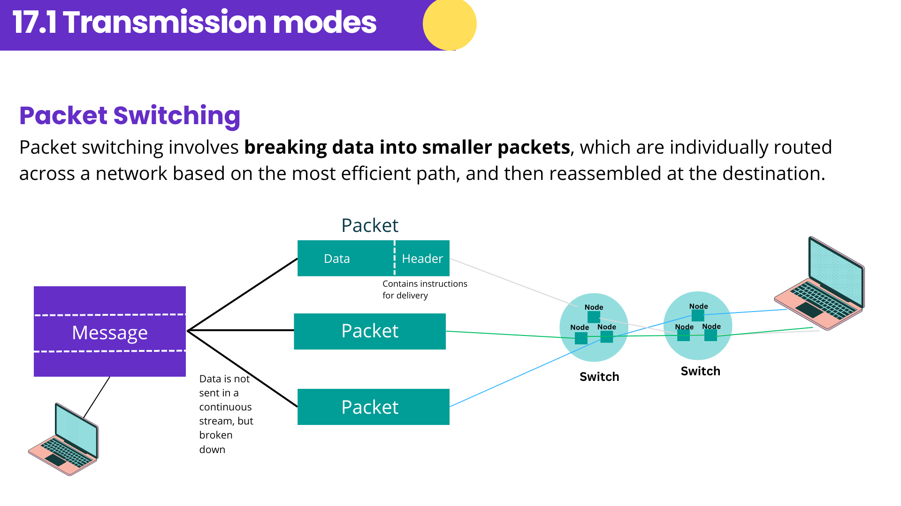
1. The router/switch will determine the route of each packet.
2. Routing Selection depends on the number of packets waiting to be processed at each node.
3. The shortest possible path available is always selected.
4. Packets can arrive in a different order compared to the way they were sent.
For more help, please visit www.exampaperspractice.co.uk

Slide 10
Benefits of packet switching
    There is no need to tie up a single communication line, enabling a high data transmission rate.
Drawbacks of packet switching
    Data may be lost and require re-transmission, causing a delay at the destination while the packets are being re-ordered.
For more help, please visit www.exampaperspractice.co.uk

Slide 11
Data Packets
    When data is transmitted over long distances, it is typically divided into data packets, also known as datagrams.
    These packets are approximately 64 KiB in size, which simplifies managing the data compared to sending it as one long, continuous stream.
    Each packet can travel via a different route to reach its destination.
For more help, please visit www.exampaperspractice.co.uk

Slide 12

Packet Structure
P1
A typical packet is split up into:
Header
Payload
Trailer
For more help, please visit www.exampaperspractice.co.uk

Slide 13
Packet Structure (Header)
    Sender IP Address
    Receiver IP Address
    Sequence number of the packet.
      This is to ensure that all the packets can be reassembled correctly once they reach the destination.
    Size of the packet
      This is to ensure that the receiving station can check if all of the packets have arrived.
Header
For more help, please visit www.exampaperspractice.co.uk

Slide 14
Packet Structure (Header)
    Sender IP Address
    Receiver IP Address
    Sequence number of the packet.
      This is to ensure that all the packets can be reassembled correctly once they reach the destination.
    Size of the packet
      This is to ensure that the receiving station can check if all of the packets have arrived.
Header
Remember SSSR
For more help, please visit www.exampaperspractice.co.uk

Slide 15
Packet Structure (Payload)
The actual data in the packet.
Payload
“Have you done your homework”
For more help, please visit www.exampaperspractice.co.uk

Slide 16
Packet Structure (Trailer)
    Some ways to identify the end of the packet. This is essential to allow each packet to be separated from each other as they travel from the sending to receiving station.
Trailer
For more help, please visit www.exampaperspractice.co.uk

Slide 17
Packet Structure (Trailer)
2. Some form of error checking to ensure packet arrives error free.
Trailer
For more help, please visit www.exampaperspractice.co.uk

Slide 18
Cyclic Redundancy Checks
    The sending computer will add up all the 1-bits in the payload and store it as a hex value in the trailer before it is sent.
Trailer
Eg. Payload
Number of 1 bit
Hexadecimal
Trailer
15
F
F
1110100110100
1111010010101
For more help, please visit www.exampaperspractice.co.uk

Slide 19
Cyclic Redundancy Checks
2. Once the packet arrives, the receiving computer recalculate the number of 1-bits in the payload.
Trailer
Trailer
F
Eg. Payload
Number of 1 bit
Hexadecimal
Compare
15
F
1110100110100
1111010010101
Does error occur?
For more help, please visit www.exampaperspractice.co.uk

Slide 20
Packet Structure
P1
A typical packet is split up into:
Header
Payload
Trailer
For more help, please visit www.exampaperspractice.co.uk

Slide 21
Data Transmission
    There are several different methods of transmitting data depending on the types of hardware and connections being used.
Transmission Mode
Types of data transmission
    Simplex
    Half-duplex
    Full-duplex
    Serial
    Parallel
For more help, please visit www.exampaperspractice.co.uk

Slide 22
Data Transmission
    There are several different methods of transmitting data depending on the types of hardware and connections being used.
Types of data transmission
    Serial
    Parallel
For more help, please visit www.exampaperspractice.co.uk

Slide 23
Types of data transmission - Serial
    Serial data transmission occurs when data is sent ONE BIT AT A TIME over a single wire/channel.
    Bits are sent one after the other as a single stream.
10111001
Sender
Receiver
Example : Computer is connected directly to the printer via a USB connection.
For more help, please visit www.exampaperspractice.co.uk

Slide 24
Types of data transmission - Parallel
    Parallel data transmission occurs when SEVERAL BITS OF DATA are sent down SEVERAL CHANNELS/WIRES all at the same time.
    Each channel/wire transmits one bit
1
Sender
1
Receiver
1
Example : Internal circuits in a computer.
For more help, please visit www.exampaperspractice.co.uk

Slide 25
Advantage
Disadvantage
    Reliable for transmitting data over long distance
    Fewer Errors
    Slow data transmission as only one channel is used
Serial
    Faster data transmission as multiple channels are used
    Parallel data transmission works well over short distances.
    Expensive
    Synchronisation errors can happen due to the separation of data across different channels.
    Data can be skewed
Parallel
For more help, please visit www.exampaperspractice.co.uk

Slide 26
Data Transmission
    There are several different methods of transmitting data depending on the types of hardware and connections being used.
Transmission Mode
    Simplex
    Half-duplex
    Full-duplex
For more help, please visit www.exampaperspractice.co.uk

Slide 27
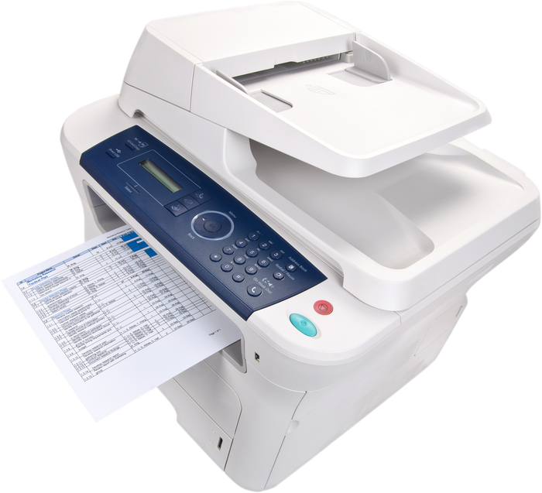

Transmission mode - Simplex
    Simplex mode occurs when data can be sent in ONE DIRECTION ONLY (for example, from sender to receiver).
LAPTOP TO PRINTER
Print this page
for me
For more help, please visit www.exampaperspractice.co.uk

Slide 28
Transmission mode - Half-duplex
    Half-duplex mode occurs when data is sent in BOTH DIRECTIONS but NOT AT THE SAME TIME (for example, data can be sent from ‘A’ to ‘B’ and from ‘B’ to ‘A’ along the same transmission line, but they can’t both be done at the same time).
"OVER OVER"
WALKIE
TALKIE
"YES?"
For more help, please visit www.exampaperspractice.co.uk

Slide 29
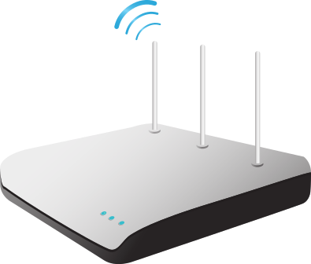
Transmission mode - Full-duplex
    Full-duplex mode occurs when data can be sent in BOTH DIRECTIONS AT THE SAME TIME (for example, data can be sent from ‘A’ to ‘B’ and from ‘B’ to ‘A’ along the same transmission line simultaneously).
BROADBAND
INTERNET CONNECTION
For more help, please visit www.exampaperspractice.co.uk

Slide 30
Advantage
Disadvantage
    The process can use full bandwidth for the channel
    Two way communication is not possible
Simplex
    Enable two-way transmission using full bandwidth
    Delay in the communication
Half-Duplex
    Fastest duplex transmission method due to each communication using its own simplex channel. No delay
    Some networks are not able to utilise the technology.
Full-Duplex
For more help, please visit www.exampaperspractice.co.uk

Slide 31
DIY
Which types of data transmission are being described:
data is sent one bit at a time in one direction only
Transmission Mode
Types of data transmission
Simplex
Serial
Parallel
Half-duplex
Full-duplex
For more help, please visit www.exampaperspractice.co.uk
Notes:
🍐 This is a Pear Deck Drawing Slide
🍐 To edit the type of question, go back to the "Ask Students a Question" in the Pear Deck sidebar.

Slide 32
DIY
Which types of data transmission are being described:
data is being sent 8 bits at a time in one direction only
Transmission Mode
Types of data transmission
Simplex
Serial
Parallel
Half-duplex
Full-duplex
For more help, please visit www.exampaperspractice.co.uk
Notes:
🍐 This is a Pear Deck Drawing Slide
🍐 To edit the type of question, go back to the "Ask Students a Question" in the Pear Deck sidebar.

Slide 33
DIY
Which types of data transmission are being described:
data is being sent 16 bits at a time in both directions simultaneously
Transmission Mode
Types of data transmission
Simplex
Serial
Parallel
Half-duplex
Full-duplex
For more help, please visit www.exampaperspractice.co.uk
Notes:
🍐 This is a Pear Deck Drawing Slide
🍐 To edit the type of question, go back to the "Ask Students a Question" in the Pear Deck sidebar.

Slide 34
DIY
Which types of data transmission are being described:
data is sent one bit at a time in both directions simultaneously
Transmission Mode
Types of data transmission
Simplex
Serial
Parallel
Half-duplex
Full-duplex
For more help, please visit www.exampaperspractice.co.uk
Notes:
🍐 This is a Pear Deck Drawing Slide
🍐 To edit the type of question, go back to the "Ask Students a Question" in the Pear Deck sidebar.

Slide 35


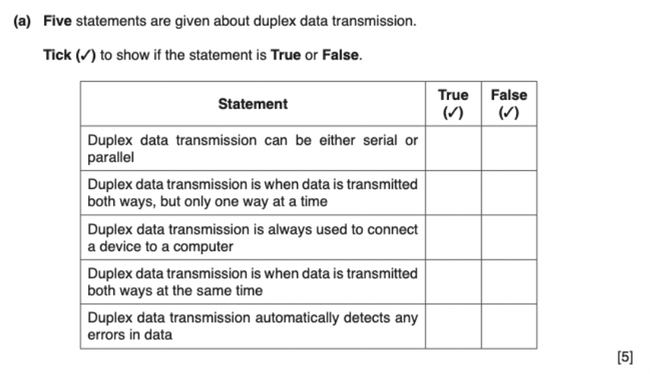
PAST YEAR QUESTIONS
For more help, please visit www.exampaperspractice.co.uk

Slide 36
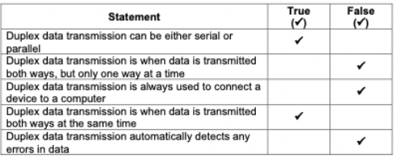
PAST YEAR QUESTIONS
For more help, please visit www.exampaperspractice.co.uk

Slide 37
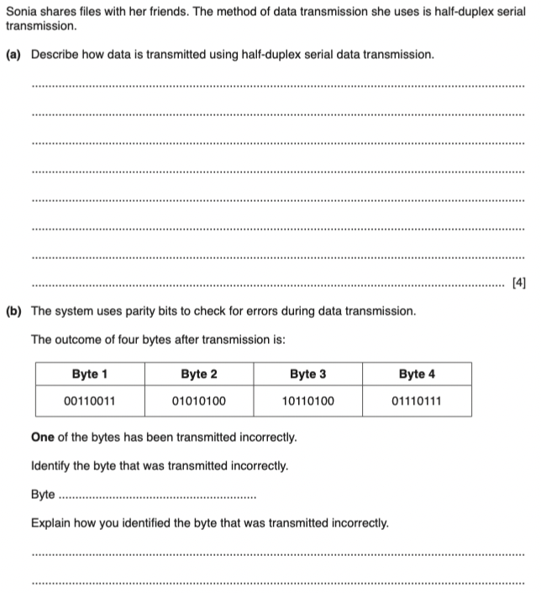
PAST YEAR QUESTIONS
For more help, please visit www.exampaperspractice.co.uk

Slide 38
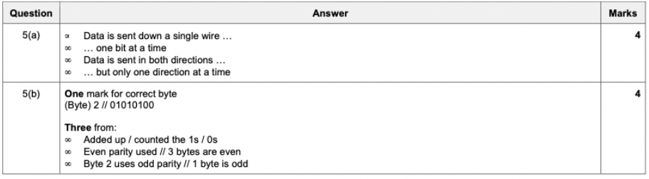
PAST YEAR QUESTIONS
For more help, please visit www.exampaperspractice.co.uk

Slide 39




Chapter 2.2
Universal Serial Bus (USB)
For more help, please visit www.exampaperspractice.co.uk

Slide 40



Universal Serial Bus (USB)
    Universal Serial Bus (USB) is a type of serial data transmission.
    Designed to replace older port types, USB has become the most common input/output port on computers.
    It has standardized data transfer between devices and computers, supporting both half-duplex and full-duplex data transmission.
For more help, please visit www.exampaperspractice.co.uk

Slide 41
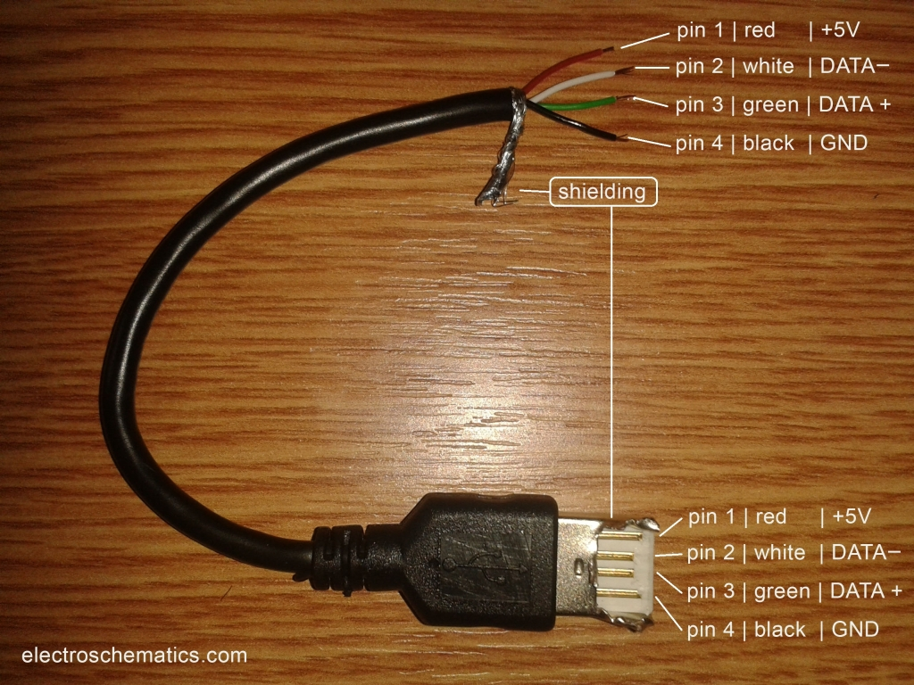
USB Cable
    The USB cable consists of a four-wired shielded cable, with
      two wires for power (red and black)
      two wires (white and green) are for data transmission.
For more help, please visit www.exampaperspractice.co.uk

Slide 42
When a device is plugged into a computer using one of the
USB ports:
    A computer automatically detects the presence of a device through a small change in voltage on the USB cable's data signal wires.
    The device is then recognized, and the appropriate driver software is loaded to facilitate communication between the computer and the device.
    If the necessary driver software is not available, the user is prompted to download it.
For more help, please visit www.exampaperspractice.co.uk

Slide 43
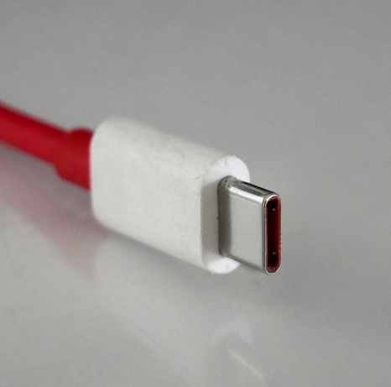
USB-C
    A new type of USB connector, known as USB-C, is increasingly common in laptops, tablets, and phones. This 24-pin symmetrical connector can be inserted either way into a USB-C port.
    Smaller and thinner than older USB connectors, USB-C provides 100-watt (20-volt) power connectivity, allowing full-sized devices to be charged. It also supports data transfer speeds of 10 gigabits per second (10 Gbps), enabling 4K video delivery.
For more help, please visit www.exampaperspractice.co.uk

Slide 44
Advantages and disadvantages of USB
    Ubiquitous and widely available.
    Supplies both power and data, eliminating the need for an external power source.
    Backward compatible when using appropriate adapters.
    Data transmission speed remains relatively slow.
    Transmission quality degrades with cable lengths over 5 meters.
For more help, please visit www.exampaperspractice.co.uk

Slide 45
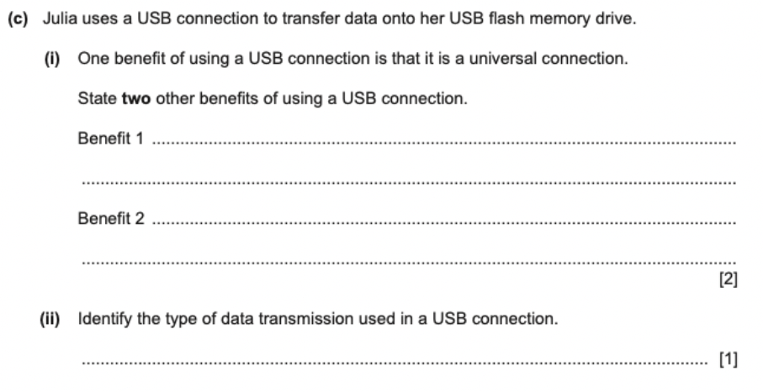
PAST YEAR QUESTIONS
For more help, please visit www.exampaperspractice.co.uk

Slide 46
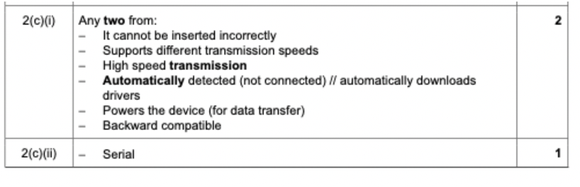
PAST YEAR QUESTIONS
For more help, please visit www.exampaperspractice.co.uk

Slide 47

Chapter 2.3
Methods of error detection
IGCSE Computer Science
For more help, please visit www.exampaperspractice.co.uk

Slide 48


HELP!
For more help, please visit www.exampaperspractice.co.uk

Slide 49

The need to check for errors.
    When data is transmitted, there is always a risk that it may be corrupted, lost or even gained.
    Errors can occur during data transmission due to:
      Interference: All types of cables can experience electrical interference, leading to data corruption or loss.
      Problems during packet switching: Data loss or unauthorized data access can occur during packet switching.
      Skewing of data: During parallel data transmission, bits can arrive out of synchronization, causing data corruption.
For more help, please visit www.exampaperspractice.co.uk

Slide 50
Five error detection methods
Parity Checks
Echo
Check
Check
Digit
Automatic
Repeat
Request
Checksum
For more help, please visit www.exampaperspractice.co.uk

Slide 51

How do we know that bits are being transmitted correctly?
0
1
1
0
1
1
0
0
0
1
1
0
1
0
0
0
For more help, please visit www.exampaperspractice.co.uk

Slide 52
Parity Checks
    Parity checking is a method used to detect data alterations or corruption during transmission.
    It involves counting the number of 1-bits in a data byte.
    Parity checks are divided into EVEN and ODD categories.
    One bit in the byte, typically the most significant or left-most bit, is assigned as the parity bit.
For more help, please visit www.exampaperspractice.co.uk

Slide 53
SETTING UP THE PARITY BIT - EVEN PARITY
The parity bit is set according to whether the parity being used is even or odd. For example, consider the byte:
What should I put here if I want an EVEN number of 1s?
0
1
1
0
1
1
0
0
0, awesome!
For more help, please visit www.exampaperspractice.co.uk

Slide 54
SETTING UP THE PARITY BIT - ODD PARITY
The parity bit is set according to whether the parity being used is even or odd. For example, consider the byte:
What should I put here if I want an ODD number of 1s?
1
1
1
0
1
1
0
0
1, awesome!
For more help, please visit www.exampaperspractice.co.uk

Slide 55
Steps to set up a parity bit:
1
1
0
1
1
0
0
    Count the number of 1s
    Ask a question:
      Even parity: What digit should I put in the empty box if I want an EVEN number of 1s?
      Odd parity: What digit should I put in the empty box if I want an ODD number of 1s?
      Decide yourself based on the question!
For more help, please visit www.exampaperspractice.co.uk

Slide 56

How does parity check helps detect errors?
Message
0
1
1
0
1
1
0
0
Let’s say that even parity
is used
For more help, please visit www.exampaperspractice.co.uk

Slide 57

Let's say the message is corrupted...
0
1
1
0
0
1
0
0
Let’s say that even parity
is used
Something is not right ... the byte should contain even number of 1
The computer will detect that an error has occurred during the transmission of the byte. The error is detected by the recipient’s computer
re-calculating the parity of the byte sent.
For more help, please visit www.exampaperspractice.co.uk

Slide 58
Do it yourself - does any error occur?
1)
Message (even parity is used)
1
1
1
0
1
1
0
1
2)
Message (odd parity is used)
1
1
1
1
1
1
1
1
For more help, please visit www.exampaperspractice.co.uk

Slide 59
Opps, there is a problem with parity check ...
Message
0
1
0
1
1
1
0
0
Even parity
is used
For more help, please visit www.exampaperspractice.co.uk

Slide 60
Parity check will not work if two bits are corrupted!
Message
0
1
1
1
1
1
0
1
Even parity
is used
In these scenarios, the byte is clearly corrupted, but the number of '1' bits remains even. Thus, no error would be detected despite the evident transmission errors.
Note: Parity check fails to detect errors when an even number of bits are corrupted.
For more help, please visit www.exampaperspractice.co.uk

Slide 61



Parity Block Check
Parity block check is more robust than simple parity check as it not only detects errors but also allows for their correction.
Let’s say we are transmitting the following seven bytes using even parity:
Parity bit
0
1
1
0
1
0
1
1
0
0
0
0
0
1
0
0
0
1
0
0
1
0
0
1
0
1
1
1
1
0
1
0
0
0
1
1
0
0
1
0
0
1
0
0
1
0
1
1
0
For more help, please visit www.exampaperspractice.co.uk

Slide 62
Parity Block Check
Steps
Set the parity bit.
Parity bit
0
0
1
1
0
1
0
1
0
1
0
0
0
0
0
1
0
0
0
0
1
0
0
1
0
0
0
1
0
1
1
1
1
1
0
1
0
0
0
1
1
1
0
0
1
0
0
1
1
0
0
1
0
1
1
0
For more help, please visit www.exampaperspractice.co.uk

Slide 63

Parity Block Check
Steps
Set the parity byte. It is set in a way that ensures each column has an even number of 1.
0
0
1
1
0
1
0
1
0
1
0
0
0
0
0
1
0
0
0
0
1
0
0
1
0
0
0
1
0
1
1
1
1
1
0
1
0
0
0
1
1
1
0
0
1
0
0
1
1
0
0
1
0
1
1
0
Parity byte
1
1
1
0
0
1
0
0
For more help, please visit www.exampaperspractice.co.uk

Slide 64




Parity Block Check
Steps
Let’s say an error has occurred. Unlike normal parity check, it can detect where exactly the error has occurred.
0
0
1
1
0
1
0
1
0
1
0
0
0
0
0
1
This row does not have an even number of 1!
0
0
0
0
1
0
0
1
0
0
0
0
0
1
1
1
1
1
0
1
0
0
0
1
1
1
0
0
1
0
0
1
1
0
0
1
0
1
1
0
1
1
1
0
0
1
0
0
This column does not have an even number of 1!
For more help, please visit www.exampaperspractice.co.uk

Slide 65
Checksum
Checksum
When a block of data is transmitted, a checksum is computed from that data block. Both the sender and receiver use a predetermined algorithm to perform this calculation.
0
0
1
1
0
1
0
1
= 53
Checksum that will be transmitted along with the data
0
1
0
0
0
0
0
1
= 65
150
0
0
0
0
1
0
0
1
= 9
0
0
0
1
0
1
1
1
= 23
For more help, please visit www.exampaperspractice.co.uk

Slide 66
Checksum
Checksum
Comparing the checksum before and after transmission will help to identify whether an error has occurred.
0
0
1
1
0
1
0
1
= 53
86 != 150, this shows that an error has occurred.
0
0
0
0
0
0
0
1
= 1
86
0
0
0
0
1
0
0
1
= 9
0
0
0
1
0
1
1
1
= 23
For more help, please visit www.exampaperspractice.co.uk

Slide 67
Echo Check
    Upon receiving a message, the receiver immediately sends a copy back to the sender.
    A comparison is then performed.
    If no differences are found between the two data sets during the echo check, it indicates no error has occurred.
    If differences are detected, an error has occurred, and the data will be retransmitted.
As you might have deduced, this method isn't very reliable. If the two data sets differ, it's unclear whether the error occurred during the initial data transmission or when sending the data back for checking.
For more help, please visit www.exampaperspractice.co.uk

Slide 68



Automatic Repeat Requests
    The receiving device gets an error detection code with the data transmission.
    If no error is detected, a positive acknowledgment is sent back to the sending device.
    If an error is detected, the receiving device sends a negative acknowledgment and requests a data retransmission.
    The sending device uses a time-out, waiting a predetermined time for an acknowledgment.
    If no acknowledgment is received within this time, the sending device automatically retransmits the data until it receives a positive acknowledgment or reaches a set number of retransmissions.
DATA
A
B
Timeout = Resend if no acknowledgement received after a certain time
No error = Positive Acknowledgement
Error = Negative Acknowledgement
For more help, please visit www.exampaperspractice.co.uk

Slide 69
Check Digits
A check digit is a single digit added to a string of numbers to verify the accuracy and integrity of the data during transmission or input.
Types of errors:
    an incorrect digit entered, for example 5327 entered instead of 5307
    Transposition errors where two numbers have changed order, for example 5037 instead of 5307
    Omitted or extra digits, for example 537 instead of 5307 or 53107 instead of 5307
    Phonetic errors, for example 13 (thirteen), instead of 30 (thirty).
For more help, please visit www.exampaperspractice.co.uk

Slide 70

Check Digits - ISBN 13 methods
International Standard Book Numbers
  The check digit in ISBN 13 is the thirteenth digit in the number.
2 . The thirteenth digit is generated using the other 12 digits in a number. Different methods are used for different system when calculating the thirteenth digit.
3. The thirteenth digit will help to identify whether an error has occurred or not.
For more help, please visit www.exampaperspractice.co.uk

Slide 71
Check Digits - ISBN 13 methods
International Standard Book Numbers
    Add all the odd numbered digits together (Not the 13rd number)
    Add all the even numbered digits together and multiply the result by 3
    Add the results from 1 and 2 together and divide by 10
    Take the remainder, if it is zero then use this value, otherwise subtract the remainder from 10 to find the check digit.
For more help, please visit www.exampaperspractice.co.uk

Slide 72

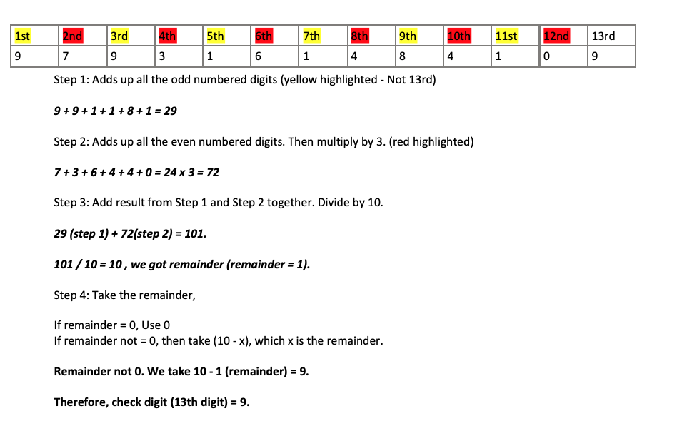
EXAMPLES – CHECK DIGIT IN ACTION
For more help, please visit www.exampaperspractice.co.uk

Slide 73
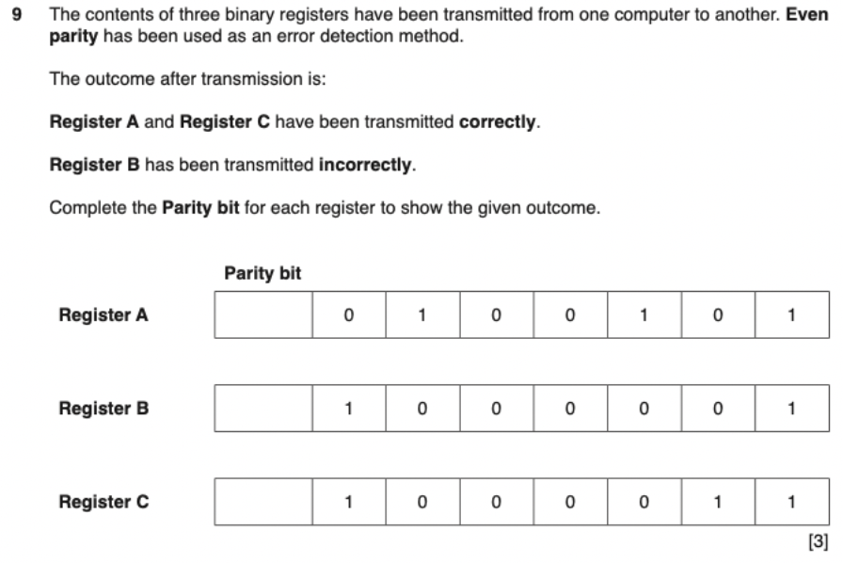
PAST YEAR QUESTIONS
For more help, please visit www.exampaperspractice.co.uk

Slide 74
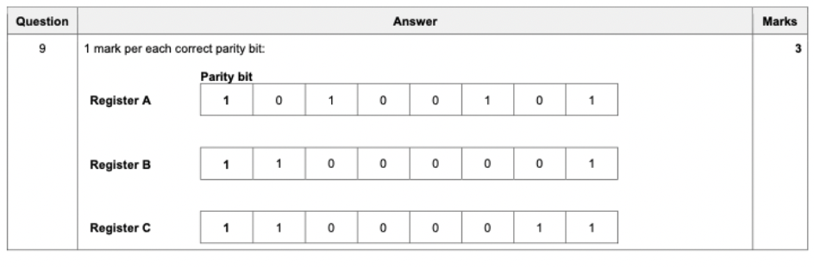
PAST YEAR QUESTIONS
For more help, please visit www.exampaperspractice.co.uk

Slide 75
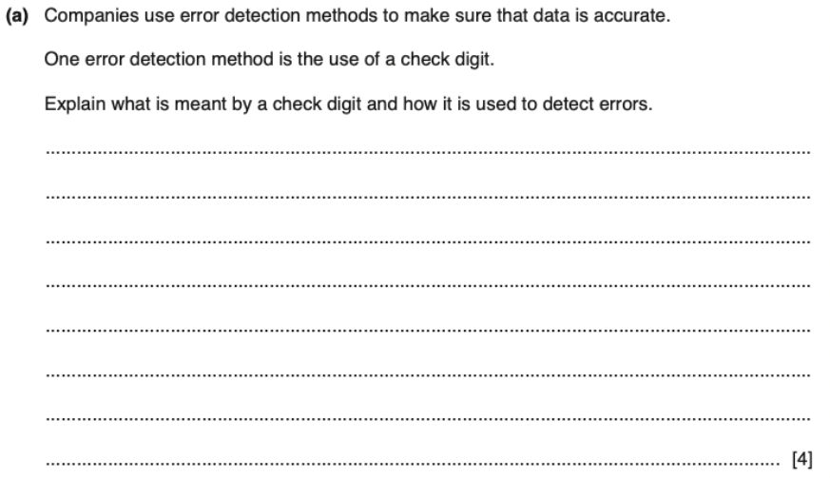
PAST YEAR QUESTIONS
For more help, please visit www.exampaperspractice.co.uk

Slide 76
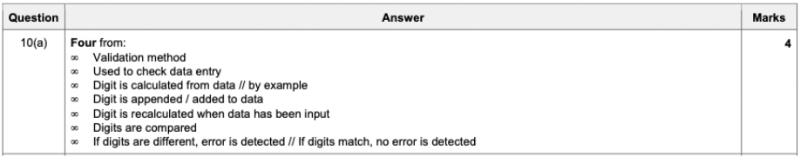
PAST YEAR QUESTIONS
For more help, please visit www.exampaperspractice.co.uk

Slide 77
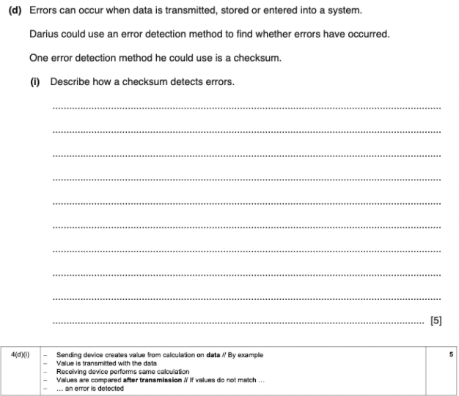
PAST YEAR QUESTIONS
For more help, please visit www.exampaperspractice.co.uk

Slide 78
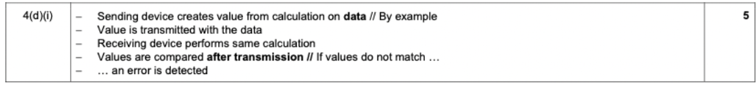
PAST YEAR QUESTIONS
For more help, please visit www.exampaperspractice.co.uk

Slide 79
PAST YEAR QUESTIONS
For more help, please visit www.exampaperspractice.co.uk

Slide 80
PAST YEAR QUESTIONS
For more help, please visit www.exampaperspractice.co.uk

Slide 81



Symmetric and Asymmetric Encryption

Slide 82

The purpose of encryption
Message could be intercepted by a hacker
For more help, please visit www.exampaperspractice.co.uk

Slide 83
Encryption cannot prevent a message from being intercepted, but it stops it from making sense to the hacker.
Wait, I don't get it....
For more help, please visit www.exampaperspractice.co.uk

Slide 84
Encryption cannot prevent a message from being intercepted, but it stops it from making sense to the hacker.
Wait, I don't get it....
For more help, please visit www.exampaperspractice.co.uk

Slide 85
Plaintext and Ciphertext
Encryption
Algorithm
Plaintext
Ciphertext
For more help, please visit www.exampaperspractice.co.uk

Slide 86
Plaintext and Ciphertext
Encryption
Algorithm
Plaintext
Ciphertext
Decryption
Algorithm
For more help, please visit www.exampaperspractice.co.uk

Slide 87
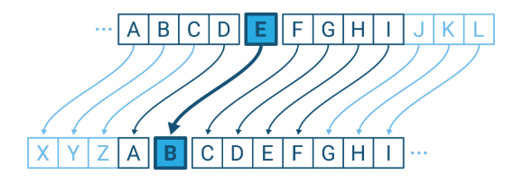
Symmetric Encryption
    Symmetric encryption uses an encryption key.
    The same key is used to encrypt and decrypt the encoded message.
    One method is called the Caesar Cipher.
For more help, please visit www.exampaperspractice.co.uk

Slide 88
Symmetric Encryption
Original message: I have covid
Key: 4578
i
h
a
v
e
c
o
v
i
d
For more help, please visit www.exampaperspractice.co.uk

Slide 89
Symmetric Encryption - Encrypt
Original message: I have covid
Key: 4578
i
h
a
v
e
c
o
v
i
d
8
4
5
7
8
4
5
4
5
7
For more help, please visit www.exampaperspractice.co.uk

Slide 90

Symmetric Encryption - Encrypt
i
h
a
v
e
c
o
v
i
d
INCREASE
8
4
5
7
8
4
5
4
5
7
For more help, please visit www.exampaperspractice.co.uk

Slide 91
Symmetric Encryption - Encrypt
i
h
a
v
e
c
o
v
i
d
8
4
5
7
8
4
5
4
5
7
m
m
h
d
i
h
v
d
m
i
mmhdihvdmi
For more help, please visit www.exampaperspractice.co.uk

Slide 92
Symmetric Encryption - Decrypt
m
m
h
d
i
h
v
d
m
i
8
4
5
7
8
4
5
4
5
7
For more help, please visit www.exampaperspractice.co.uk

Slide 93
Symmetric Encryption - Decrypt
m
m
h
d
i
h
v
d
m
i
DECREASE
8
4
5
7
8
4
5
4
5
7
For more help, please visit www.exampaperspractice.co.uk

Slide 94
Symmetric Encryption - Decrypt
m
m
h
d
i
h
v
d
m
i
DECREASE
8
4
5
7
8
4
5
4
5
7
i
h
a
v
e
c
o
v
i
d
For more help, please visit www.exampaperspractice.co.uk

Slide 95
Why symmetric?
Encrypt
Decrypt
+4
-4
+4
-4
i
h
a
v
e
c
o
v
i
d
m
m
h
d
i
h
v
d
m
i
8
4
5
7
8
4
5
4
5
7
8
4
5
7
8
4
5
4
5
7
m
m
h
d
i
h
v
d
m
i
i
h
a
v
e
c
o
v
i
d
For more help, please visit www.exampaperspractice.co.uk

Slide 96
Drawbacks of symmetric encryption
    The primary challenge lies in maintaining the confidentiality of the encryption key.
    Security remains the central concern with symmetric encryption, given that a lone encryption key serves both the sender and the recipient, presenting a vulnerability.
For more help, please visit www.exampaperspractice.co.uk

Slide 97
Encryption key is required for both sender and recipient.
For more help, please visit www.exampaperspractice.co.uk

Slide 98
Asymmetric Encryption
    Asymmetric encryption was created to address the security issues inherent in symmetric encryption.
    It makes use of two keys called the public key and the private key:
      public key (made available to everybody)
      private key (only known to the computer user).
For more help, please visit www.exampaperspractice.co.uk

Slide 99
Asymmetric Encryption
    When a sender encrypts a message for transmission, the receiver generates a pair of keys: a public key and a private key.
    The public key is disseminated to any device that may need to send a message to the receiver. Using the receiver's public key, the sender encrypts the message.
    Upon receiving the message, the recipient uses their private key to decrypt it.
For more help, please visit www.exampaperspractice.co.uk

Slide 100
Asymmetric Encryption
Public key:
Private key:
For more help, please visit www.exampaperspractice.co.uk

Slide 101
Asymmetric Encryption
Public key:
Private key:
For more help, please visit www.exampaperspractice.co.uk

Slide 102
Important notes
Public key cannot be used to decrypt a message.
Private key is never shared
As a result, asymmetric encryption is more secure than symmetric encryptioon
For more help, please visit www.exampaperspractice.co.uk

Slide 103
To enable two-way communication among five workers, each generates their own public and private keys. They then exchange public keys to securely send encrypted messages. Each worker decrypts incoming information using their private key.
For more help, please visit www.exampaperspractice.co.uk

Slide 104

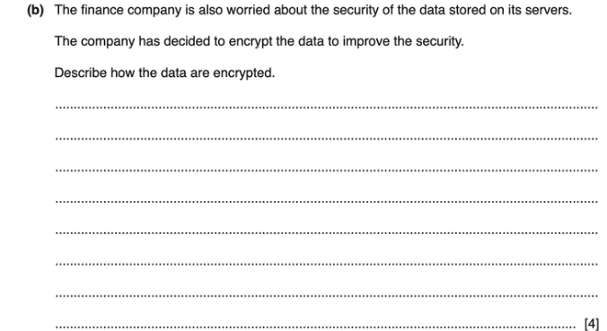
For more help, please visit www.exampaperspractice.co.uk

Slide 105
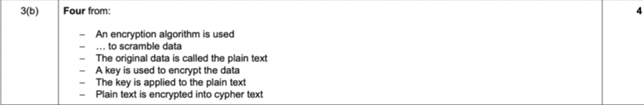
ANSWER
For more help, please visit www.exampaperspractice.co.uk

Slide 106
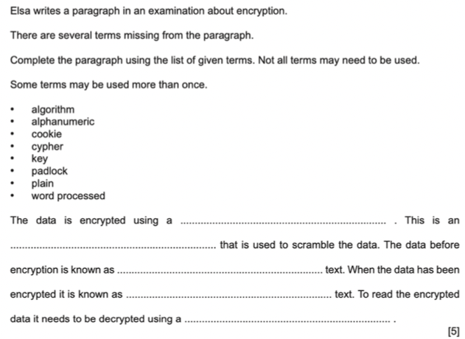
For more help, please visit www.exampaperspractice.co.uk

Slide 107
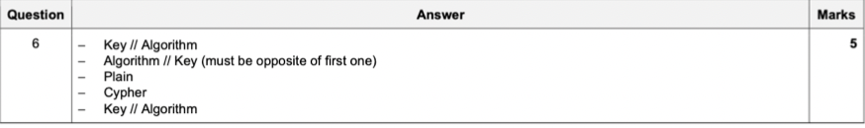
ANSWER
For more help, please visit www.exampaperspractice.co.uk

Slide 108
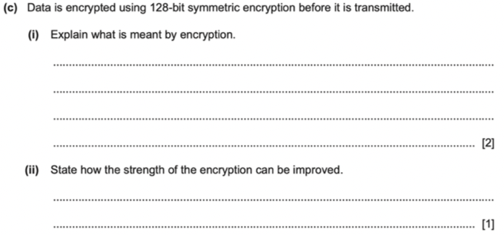
For more help, please visit www.exampaperspractice.co.uk

Slide 109
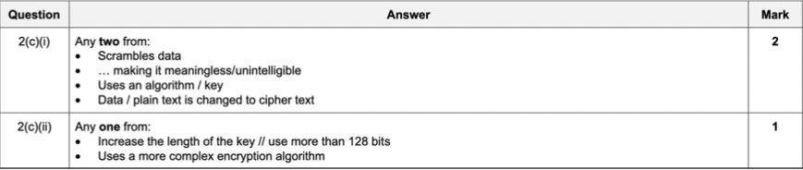
ANSWER
For more help, please visit www.exampaperspractice.co.uk

