Slide 1


Cambridge IGCSE Computer Science 0478/0984 - Revision Notes
Chapter 1 - Data Representation
This study guide has been expertly compiled and edited by successful former teachers of Computer Science and highly experienced examiners and is suitable for students who are taking 0478 (9-1) IGCSE, the 0984 (A*-G) IGCSE, and the 2210 O Level for examination in 2023 onwards. It could be used as lesson starters, or supplied to students for independent use.
For more help, please visit www.exampaperspractice.co.uk

Slide 2



CHAPTER 1.1
0101110?
AE73F9?
Number System
For more help, please visit www.exampaperspractice.co.uk

Slide 3
Binary System
For more help, please visit www.exampaperspractice.co.uk

Slide 4
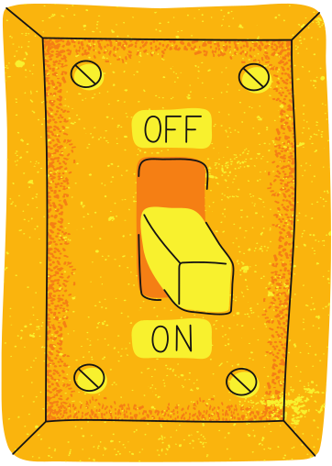
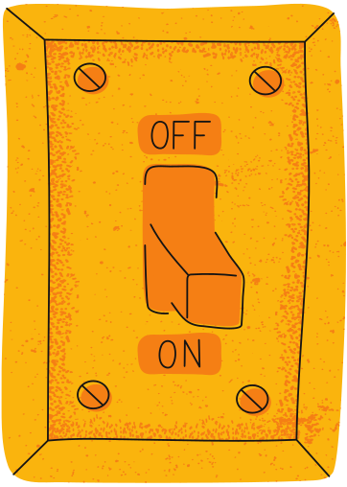
Why Binary System
Motivation
    Computers consist of millions of tiny switches that can be either on or off.
    All information must be transformed into binary format to be processed by a computer.
    Therefore, the binary system is selected as the method for computers to represent any type of data.
On = 1
Off = 0
For more help, please visit www.exampaperspractice.co.uk

Slide 5

Explanation
Denary System
Eg. 365
10² =100
10¹ =10
10⁰ =1
3
6
5
Explanation: Multiply the digit value (eg.3) by the place value (eg. 100)
(3x100) + (6x10) + (5x1) = 365
For more help, please visit www.exampaperspractice.co.uk

Slide 6



Explanation
Binary
Denary
Denary
Binary
For more help, please visit www.exampaperspractice.co.uk

Slide 7
Binary
Denary
Explanation
2² =4
2¹ =2
2⁰ =1
1
1
1
(1x4)
+ (1x2)
+ (1x1)
= 7 in denary
For more help, please visit www.exampaperspractice.co.uk

Slide 8
Binary
Denary
Explanation
Eg. "1011"
2³ =8
2² =4
2¹ =2
2⁰ =1
1
0
1
1
Explanation: Multiply the digit value (eg.1) by the place value (eg. 8). Then sum it all up!
(1x8)
+ (0x4)
+ (1x2)
+ (1x1)
= 11 in denary
For more help, please visit www.exampaperspractice.co.uk

Slide 9

Denary
Binary
(Method 1)
Explanation
Convert 5 to binary:
1
4
2
1
1
0
0
For more help, please visit www.exampaperspractice.co.uk

Slide 10
Denary
Binary
(Method 1)
Explanation
Convert 5 to binary:
1
4
2
1
- 1 = 1
1
0
1
For more help, please visit www.exampaperspractice.co.uk

Slide 11
Denary
Binary
DIY
What is the binary form of 15?
For more help, please visit www.exampaperspractice.co.uk

Slide 12
Denary
Binary
DIY
ANSWER
2³ =8
2² =4
2¹ =2
2⁰ =1
1
1
1
1

Slide 13

Denary
Binary
Explanation
Convert 5 to binary:
5
5
2
2
1
remainder
2
1
0
Read the remainder
from bottom to top
remainder
2
0
1
remainder
Answer: 101
For more help, please visit www.exampaperspractice.co.uk

Slide 14
Denary
Binary
Explanation
Convert 39 to binary:
39
39
2
19
1
remainder
2
9
1
remainder
2
4
1
Read the remainder
from bottom to top
remainder
2
2
0
remainder
2
1
0
remainder
2
0
1
remainder
Answer: 100111
For more help, please visit www.exampaperspractice.co.uk

Slide 15
Denary
Binary
DIY
What is the binary form of 42?
2⁵ =32
2⁴ =16
2³ =8
2² =4
2¹ =2
2⁰ =1
For more help, please visit www.exampaperspractice.co.uk
Notes:
🍐 This is a Pear Deck Number Slide
🍐 To edit the type of question, go back to the "Ask Students a Question" in the Pear Deck sidebar.

Slide 16
Denary
Binary
DIY
ANSWER
Convert 42 to binary:
42
42
2
21
0
remainder
2
10
1
remainder
2
5
0
Read the remainder
from bottom to top
remainder
2
2
1
remainder
2
1
0
remainder
2
0
1
remainder
Answer: 101010
For more help, please visit www.exampaperspractice.co.uk

Slide 17

Denary System
RECAP
10²
10¹
10⁰
(7x100) + (6x10)
+ (5x1) = 765
7
6
5
Hundredth
Tenth
Ones
For more help, please visit www.exampaperspractice.co.uk

Slide 18
Denary System
RECAP
10²
10¹
10⁰
(7x100) + (6x10)
+ (5x1) = 765
7
6
5
Binary System
2²
2¹
2⁰
(1x4) + (1x2)
+ (1x1) = 7
1
1
1
For more help, please visit www.exampaperspractice.co.uk

Slide 19
Binary
Denary
DIY
What is the denary form of "1010"?
2³ =8
2² =4
2¹ =2
2⁰ =1
1
0
1
0
For more help, please visit www.exampaperspractice.co.uk
Notes:
🍐 This is a Pear Deck Number Slide
🍐 To edit the type of question, go back to the "Ask Students a Question" in the Pear Deck sidebar.

Slide 20
Binary
Denary
DIY
ANSWER
2³ =8
2² =4
2¹ =2
2⁰ =1
1
0
1
0
(1x8)
+ (1x2)
= 10 in denary
For more help, please visit www.exampaperspractice.co.uk

Slide 21
Denary
Binary
DIY
What is the binary form of 38?
2⁵ =32
2⁴ =16
2³ =8
2² =4
2¹ =2
2⁰ =1
For more help, please visit www.exampaperspractice.co.uk
Notes:
🍐 This is a Pear Deck Number Slide
🍐 To edit the type of question, go back to the "Ask Students a Question" in the Pear Deck sidebar.

Slide 22
Denary
Binary
(Method 2)
DIY
ANSWER
Convert 38 to binary:
38
38
2
19
0
remainder
2
9
1
remainder
2
4
1
Read the remainder
from bottom to top
remainder
2
2
0
remainder
2
1
0
remainder
2
0
1
remainder
Answer: 100110
For more help, please visit www.exampaperspractice.co.uk

Slide 23


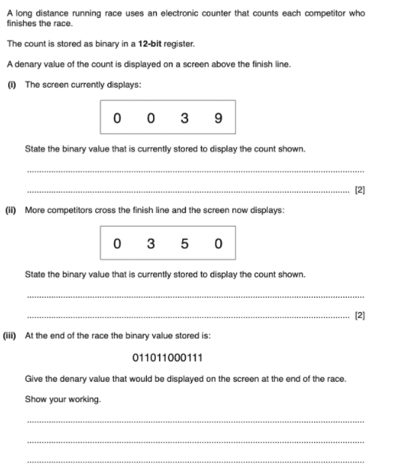
PAST YEAR QUESTION
For more help, please visit www.exampaperspractice.co.uk

Slide 24
ANSWER
For more help, please visit www.exampaperspractice.co.uk

Slide 25
Hexadecimal System
For more help, please visit www.exampaperspractice.co.uk

Slide 26
Hexadecimal System
Motivation
    It is a base 16 system.
    It uses 16 digits to represent each value
Number System
Digits used to represent each value
Denary
0, 1, 2, 3, 4, 5, 6, 7, 8, 9
Binary
0, 1
Hexadecimal
0, 1, 2, 3, 4, 5, 6, 7, 8, 9
, A, B, C, D, E, F
For more help, please visit www.exampaperspractice.co.uk

Slide 27


Hexadecimal System
Explanation
Denary System
Binary System
10¹ =10
2² =4
2¹ =2
2⁰ =1
10² =100
10⁰ =1
3
6
5
1
0
1
(3x100) + (6x10) + (5x1) = 365
(1x4) + (0x2) + (1x1) = 5
Hexadecimal System
?¹ =?
?² =?
?⁰ =?
3
E
5
For more help, please visit www.exampaperspractice.co.uk

Slide 28
Hexadecimal System
Explanation
Denary System
Binary System
10¹ =10
2² =4
2¹ =2
2⁰ =1
10² =100
10⁰ =1
3
6
5
1
0
1
(3x100) + (6x10) + (5x1) = 365
(1x4) + (0x2) + (1x1) = 5
Hexadecimal System
16² =256
16¹ =16
16⁰ =1
3
E
5
For more help, please visit www.exampaperspractice.co.uk

Slide 29



Conversion
Binary
Hexadecimal
Binary
Hexadecimal
For more help, please visit www.exampaperspractice.co.uk

Slide 30


Binary
Hexadecimal
Explanation
4
Since 16 = 2 this means that FOUR binary digits
are equivalent to each hexadecimal digit.
Binary
Hexadecimal
Binary
Hexadecimal
0
0
0
0
0
1
0
0
0
8
0
0
0
1
1
1
0
0
1
9
0
0
1
0
2
1
0
1
0
A
0
0
1
1
3
1
0
1
1
B
0
1
0
0
4
1
1
0
0
C
0
1
0
1
5
1
1
0
1
D
0
1
1
0
6
1
1
1
0
E
0
1
1
1
7
1
1
1
1
F
For more help, please visit www.exampaperspractice.co.uk

Slide 31


Binary
Hexadecimal
Explanation
1 0 1 1 1 1 1 0 0 0 0 1
Binary to Hexadecimal Conversion Table
0
0
0
0
0
1
0
0
0
8
1
0
1
1
1
1
1
0
0
0
0
1
0
0
0
1
1
1
0
0
1
9
0
0
1
0
2
1
0
1
0
A
0
0
1
1
3
1
0
1
1
B
0
1
0
0
4
1
1
0
0
C
B
E
1
0
1
0
1
5
1
1
0
1
D
0
1
1
0
6
1
1
1
0
E
0
1
1
1
7
1
1
1
1
F
ANSWER : BE1
For more help, please visit www.exampaperspractice.co.uk

Slide 32
Binary
Hexadecimal
Explanation
1 0 0 0 0 1 1 1 1 1 1 1 0 1
Binary to Hexadecimal Conversion Table
0
0
0
0
0
1
0
0
0
8
00
10
0001
1111
1101
0
0
0
1
1
1
0
0
1
9
0
0
1
0
2
1
0
1
0
A
0
0
1
1
3
1
0
1
1
B
0
1
0
0
4
1
1
0
0
C
2
1
F
D
0
1
0
1
5
1
1
0
1
D
0
1
1
0
6
1
1
1
0
E
0
1
1
1
7
1
1
1
1
F
ANSWER : 21FD
For more help, please visit www.exampaperspractice.co.uk

Slide 33

Binary
DIY
Hexadecimal
DIY
Binary to Hexadecimal Conversion Table
What is the hexadecimal form of
0111010011100?
0
0
0
0
0
1
0
0
0
8
0
0
0
1
1
1
0
0
1
9
0
0
1
0
2
1
0
1
0
A
0
0
1
1
3
1
0
1
1
B
0
1
0
0
4
1
1
0
0
C
0
1
0
1
5
1
1
0
1
D
0
1
1
0
6
1
1
1
0
E
0
1
1
1
7
1
1
1
1
F
For more help, please visit www.exampaperspractice.co.uk
Notes:
🍐 This is a Pear Deck Text Slide
🍐 To edit the type of question, go back to the "Ask Students a Question" in the Pear Deck sidebar.

Slide 34
Binary
DIY
Hexadecimal
DIY
ANSWER
0111010011100
Binary to Hexadecimal Conversion Table
0
0
0
0
0
1
0
0
0
8
0000
1110
1001
1100
0
0
0
1
1
1
0
0
1
9
0
0
1
0
2
1
0
1
0
A
0
0
1
1
3
1
0
1
1
B
0
1
0
0
4
1
1
0
0
C
0
1
0
1
5
1
1
0
1
D
0
1
1
0
6
1
1
1
0
E
0
E
9
C
0
1
1
1
7
1
1
1
1
F
For more help, please visit www.exampaperspractice.co.uk

Slide 35
Hexadecimal
Binary
Explanation
F 9 3 5
Binary to Hexadecimal Conversion Table
0
0
0
0
0
1
0
0
0
8
1111
0011
0101
0
0
0
1
1
1
0
0
1
9
1001
0
0
1
0
2
1
0
1
0
A
0
0
1
1
3
1
0
1
1
B
0
1
0
0
4
1
1
0
0
C
0
1
0
1
5
1
1
0
1
D
0
1
1
0
6
1
1
1
0
E
Answer:
1111
1001
0011
0101
0
1
1
1
7
1
1
1
1
F
For more help, please visit www.exampaperspractice.co.uk

Slide 36
DIY
Hexadecimal
Binary
DIY
Binary to Hexadecimal Conversion Table
What is the binary form of
BF08?
0
0
0
0
0
1
0
0
0
8
0
0
0
1
1
1
0
0
1
9
0
0
1
0
2
1
0
1
0
A
0
0
1
1
3
1
0
1
1
B
0
1
0
0
4
1
1
0
0
C
0
1
0
1
5
1
1
0
1
D
0
1
1
0
6
1
1
1
0
E
0
1
1
1
7
1
1
1
1
F
For more help, please visit www.exampaperspractice.co.uk
Notes:
🍐 This is a Pear Deck Number Slide
🍐 To edit the type of question, go back to the "Ask Students a Question" in the Pear Deck sidebar.

Slide 37
Binary
DIY
Hexadecimal
DIY
B F 0 8
Binary to Hexadecimal Conversion Table
0
0
0
0
0
1
0
0
0
8
1011
0000
1000
0
0
0
1
1
1
0
0
1
9
1111
0
0
1
0
2
1
0
1
0
A
0
0
1
1
3
1
0
1
1
B
0
1
0
0
4
1
1
0
0
C
0
1
0
1
5
1
1
0
1
D
0
1
1
0
6
1
1
1
0
E
Answer:
1011
1111
0000
1000
0
1
1
1
7
1
1
1
1
F
For more help, please visit www.exampaperspractice.co.uk

Slide 38
Conversion
Denary
Hexadecimal
Denary
Hexadecimal
For more help, please visit www.exampaperspractice.co.uk

Slide 39
Binary
Denary
RECAP
Eg. "111"
2² =4
2¹ =2
2⁰ =1
1
1
1
(1x4) + (1x2) + (1x1) = 7 in denary
For more help, please visit www.exampaperspractice.co.uk

Slide 40
Hexadecimal
Denary
Explanation
Eg. "45A"
16² =256
16¹ =16
16⁰ =1
4
5
A
Note: A=10
(4x256) + (5x16) + (10x1) = 1114 in denary
For more help, please visit www.exampaperspractice.co.uk

Slide 41
Hexadecimal
Denary
Explanation
Eg. "C8F"
16² =256
16¹ =16
16⁰ =1
C
8
F
Note: C=12, F=15
(12x256) + (8x16) + (15x1) = 3215 in denary
For more help, please visit www.exampaperspractice.co.uk

Slide 42
DIY
Hexadecimal
Denary
DIY
What is the denary form of BF08?
16³ =4096
16² =256
16¹ =16
16⁰ =1
B
F
0
8
For more help, please visit www.exampaperspractice.co.uk
Notes:
🍐 This is a Pear Deck Number Slide
🍐 To edit the type of question, go back to the "Ask Students a Question" in the Pear Deck sidebar.

Slide 43
DIY
Hexadecimal
Denary
DIY
ANSWER
16³ =4096
16² =256
16¹ =16
16⁰ =1
B
F
0
8
(11x4096) + (15x256) + (0x16) + (8x1) = 48904 in denary
For more help, please visit www.exampaperspractice.co.uk

Slide 44
Denary
Binary
(Method 2)
RECAP
Convert 5 to binary:
5
5
2
2
1
remainder
2
1
0
Read the remainder
from bottom to top
remainder
2
0
1
remainder
Answer: 101
For more help, please visit www.exampaperspractice.co.uk

Slide 45


Denary
Hexadecimal
Explanation
Eg. "2004"
2004/16 =
125
remainder = 4
2004
16
125
4
remainder
16
7
13
125/16 =
7
remainder = 13
remainder
16
0
7
remainder
Note: 13=D
Answer: 7D4
For more help, please visit www.exampaperspractice.co.uk

Slide 46
Denary
DIY
Hexadecimal
DIY
What is the hexadecimal form of 3179?
3179/16 = ?
3179
16
198
?
remainder
16
?
?
remainder
16
?
?
remainder
For more help, please visit www.exampaperspractice.co.uk
Notes:
🍐 This is a Pear Deck Text Slide
🍐 To edit the type of question, go back to the "Ask Students a Question" in the Pear Deck sidebar.

Slide 47
Denary
DIY
Hexadecimal
DIY
What is the hexadecimal form of 3179?
3179/16
= 198
remainder = 11
3179
16
198
11
remainder
198/16
16
12
6
= 12
remainder = 6
remainder
16
0
12
remainder
Answer: C6B
For more help, please visit www.exampaperspractice.co.uk

Slide 48
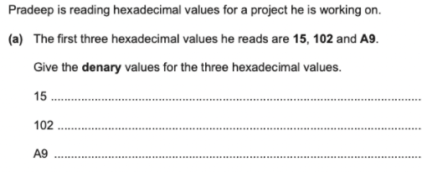
PAST YEAR QUESTION
For more help, please visit www.exampaperspractice.co.uk

Slide 49

ANSWER
For more help, please visit www.exampaperspractice.co.uk

Slide 50
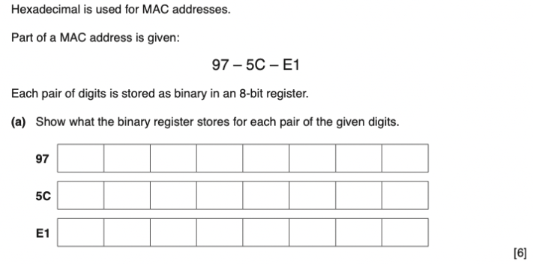
PAST YEAR QUESTION
For more help, please visit www.exampaperspractice.co.uk

Slide 51
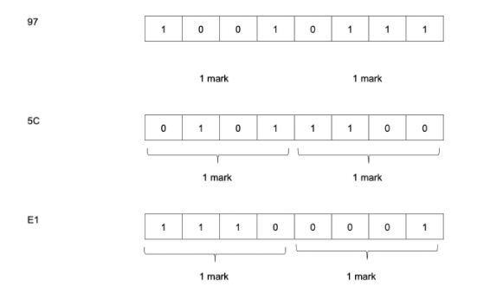
ANSWER
For more help, please visit www.exampaperspractice.co.uk

Slide 52



Use of hexadecimal system
For more help, please visit www.exampaperspractice.co.uk

Slide 53

Discussion Time
Use of hexadecimal system
Binary
Hexadecimal
110101111110100111001
1AFD39
Why is Hexadecimal used?
For more help, please visit www.exampaperspractice.co.uk

Slide 54
Discussion Time
Use of hexadecimal system
Binary
Hexadecimal
110101111110100111001
1AFD39
Why is Hexadecimal used?
Answer:
    Easier to read/write
    Use fewer characters
    Less likely to make mistakes.
For more help, please visit www.exampaperspractice.co.uk

Slide 55
Explanation
Use of hexadecimal system
    One hex digit represents four binary digits.
    The hex number is far easier for humans to remember, copy and work with.
For more help, please visit www.exampaperspractice.co.uk

Slide 56
Explanation
Usage 1: Error Code
    Error codes are often shown as hexadecimal values.
    These numbers refer to the memory location of the error.
    They are generated by the computer.
    The programmer needs to know how to interpret the hexadecimal error codes.
For more help, please visit www.exampaperspractice.co.uk

Slide 57
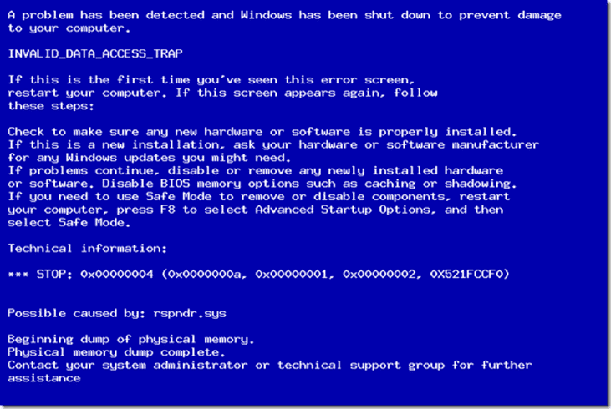
Explanation
Usage 1: Error Code
For more help, please visit www.exampaperspractice.co.uk

Slide 58
Explanation
Usage 2: MAC address
    A Media Access Control (MAC) address is a unique identifier assigned to a device on a network.
    It is linked to the network interface card (NIC) within the device.
    The MAC address is seldom altered, allowing the device to be consistently recognized regardless of its location.
For more help, please visit www.exampaperspractice.co.uk

Slide 59


Explanation
Usage 2: MAC address
00_1C_B3_4F_25_FE
00_1C_C3_4F_23_AE
For more help, please visit www.exampaperspractice.co.uk

Slide 60
Explanation
Usage 2: MAC address
Form 1
NN-NN-NN-DD-DD-DD
00-1C-B3-4F-25-FE
Form 2
NN:NN:NN:DD:DD:DD
00:1C:B3:4F:25:FE
For more help, please visit www.exampaperspractice.co.uk

Slide 61

Explanation
Usage 2: MAC address
00-1C-B3
4F-25-FE
Identity number of the manufacturer
Identity number of the manufacturer
00 – 14 – 22 which identifies devices made by Dell
00 – a0 – c9 which identifies devices made by Intel
For more help, please visit www.exampaperspractice.co.uk

Slide 62
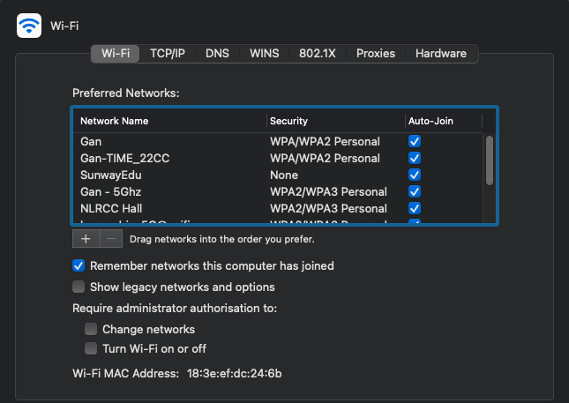
Explanation
Usage 2: MAC address
For more help, please visit www.exampaperspractice.co.uk

Slide 63
Usage 3: Internet Protocol Addresses
Explanation
    Every device connected to a network is assigned an Internet Protocol (IP) address.
    An IPv4 address is a 32-bit number, typically written in decimal or hexadecimal format, such as 128.65.152.11 (or 80.41.98.0b in hexadecimal).
    Recently, IPv4 has been enhanced with the introduction of IPv6, which uses a 128-bit number divided into 16-bit segments and represented in hexadecimal format.
    a8f b:7a88:fff0:0fff:3d21:2085:66f b:f0fa
For more help, please visit www.exampaperspractice.co.uk

Slide 64
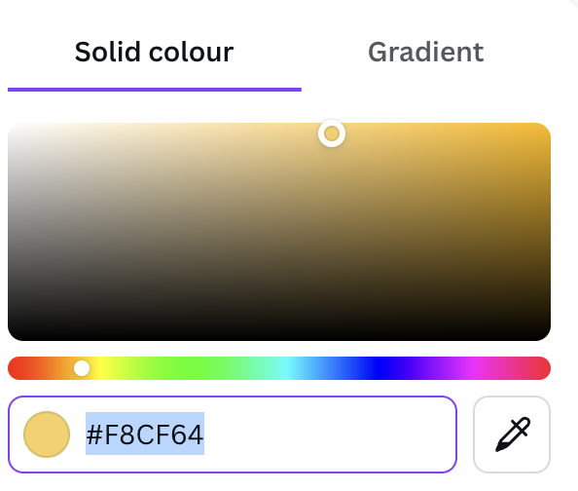
Usage 3: HyperText Markup Language (HTML) colour code
Explanation
    HyperText Mark-up Language (HTML) is used when writing and developing web pages.
    It is not a programming language, but a markup language.
    A mark-up language is used in the processing, definition and presentation of text.
For more help, please visit www.exampaperspractice.co.uk

Slide 65
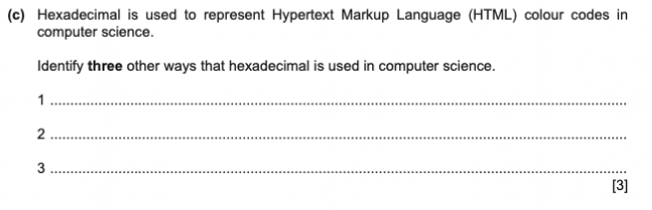
PAST YEAR QUESTION
For more help, please visit www.exampaperspractice.co.uk

Slide 66
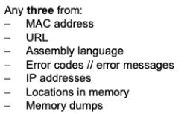
ANSWER
For more help, please visit www.exampaperspractice.co.uk

Slide 67
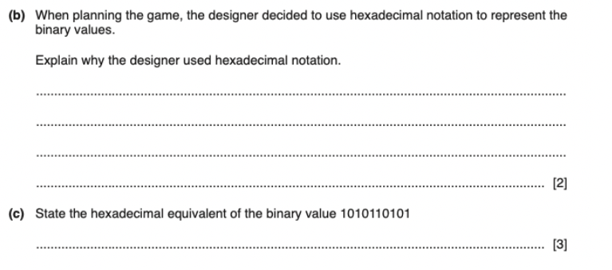
PAST YEAR QUESTION
For more help, please visit www.exampaperspractice.co.uk

Slide 68
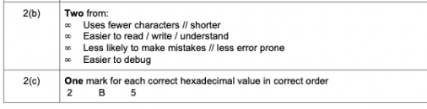
ANSWER
For more help, please visit www.exampaperspractice.co.uk

Slide 69
Chapter 1.3
Addition of
binary number
For more help, please visit www.exampaperspractice.co.uk

Slide 70
Explanation
Addition of binary number
How do we perform add and carry in denary?
0 + 0 = 0
9
+1
1
0 + 9 = 9
9 + 0 = 9
1
0
9 + 1 = 10
For more help, please visit www.exampaperspractice.co.uk

Slide 71
Explanation
Addition of binary number
How do we perform add and carry in denary?
1
1
6+9 = 15 (>9)
56
+79
1+5+7 = 13 (>9)
1
3
5
For more help, please visit www.exampaperspractice.co.uk

Slide 72
Explanation
Addition of binary number
How do we perform add and carry in binary?
0 + 0 = 0
0 + 1 = 1
1 + 0 = 1
1 + 1 = 10
For more help, please visit www.exampaperspractice.co.uk

Slide 73
Explanation
Addition of binary number
How do we perform add and carry in binary?
1
1
00100111
+01001010
1
0
1
1
1
0
0
0
1
For more help, please visit www.exampaperspractice.co.uk

Slide 74
DIY
Addition of binary number
How do we perform add and carry in binary?
Perform
01111110 + 00111110
For more help, please visit www.exampaperspractice.co.uk

Slide 75
Explanation
Addition of binary number
The overflow condition
1
1
1
1
1
1
01101110
+11011110
1
0
1
0
0
1
1
0
0
For more help, please visit www.exampaperspractice.co.uk

Slide 76
Explanation
Addition of binary number
1
1
1
1
1
1
01101110
+11011110
The overflow condition
1
0
1
0
0
1
1
0
0
    The maximum denary of an 8-bit binary number (11111111) is (2⁸ - 1 ) = 255
    The generation of a 9th bit is a clear indication that the sum has exceeded this value.
    This is known as an overflow error. The sum is too big to be stored using 8 bits.
For more help, please visit www.exampaperspractice.co.uk

Slide 77
Explanation
Addition of binary number
1
1
1
1
1
1
The overflow condition
01101110
+11011110
01101110 = 110
\11011110 = 222
110 + 222 = 322
322 > 255 (overflow)
The sum is too big to be stored in a 8 bit binary.
1
0
1
0
0
1
1
0
0
For more help, please visit www.exampaperspractice.co.uk

Slide 78




Lesson Objectives
Chapter 1.4: Binary Shifting
Last lesson on the binary system
BINARY SHIFTING
TWO COMPLEMENTS
Represent negative number in binary
Multiplication and division of binary numbers
For more help, please visit www.exampaperspractice.co.uk

Slide 79

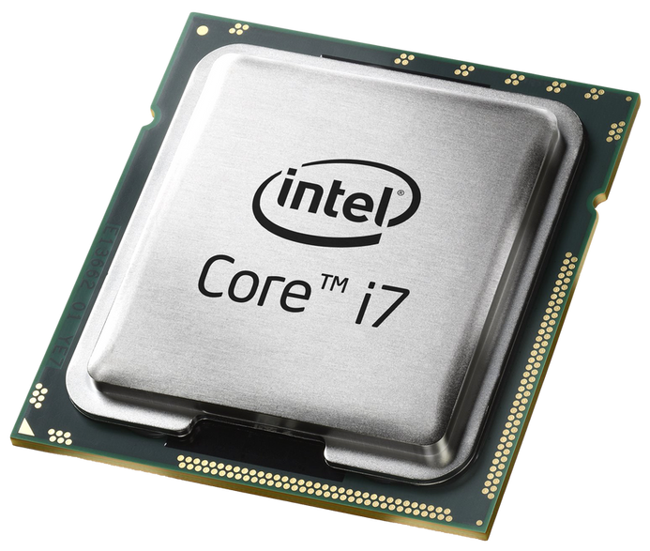
BINARY SHIFTING
    Binary shift is a process that a CPU uses to perform multiplication and division.
For more help, please visit www.exampaperspractice.co.uk

Slide 80

BINARY SHIFTING - MULTIPLICATION
    To multiply a binary number, a CPU shifts the number to the left, filling any remaining spaces with zeros.
For more help, please visit www.exampaperspractice.co.uk

Slide 81


BINARY SHIFTING - MULTIPLICATION
Examples: 111 (Binary)
64
32
16
8
4
2
1
0
0
0
0
1
1
1
Examples: 1110 (Binary)
64
32
16
8
4
2
1
0
0
0
1
1
1
0
Examples: 11100 (Binary)
64
32
16
8
4
2
1
0
0
1
1
1
0
0
For more help, please visit www.exampaperspractice.co.uk

Slide 82
BINARY SHIFTING - MULTIPLICATION
Examples: 111 (Binary)
64
32
16
8
4
2
1
0
0
0
0
1
1
1
1110
Multiply by 2, shift 1 place to the left
11100
Multiply by 4, shift 2 place to the left
111000
Multiply by 8, shift 3 place to the left
Multiply by 2^n, shift n place to the left
For more help, please visit www.exampaperspractice.co.uk

Slide 83
BINARY SHIFTING - DIVISION
    For a CPU to multiply a binary number, the number needs to be shifted to the right.
For more help, please visit www.exampaperspractice.co.uk

Slide 84
BINARY SHIFTING - DIVISION
Examples: 101100 (Binary)
32
16
8
4
2
1
1
0
1
1
0
0
Examples: 10110 (Binary)
32
16
8
4
2
1
0
1
0
1
1
0
Examples: 1011 (Binary)
32
16
8
4
2
1
0
0
1
0
1
1
For more help, please visit www.exampaperspractice.co.uk

Slide 85
BINARY SHIFTING - DIVISION
Examples: 101100 (Binary)
32
16
8
4
2
1
1
0
1
1
0
0
10110
Divide by 2, shift 1 place to the right
1011
Divide by 4, shift 2 place to the right
101
Divide by 8, shift 3 place to the right
Divide by 2^n, shift n place to the right
For more help, please visit www.exampaperspractice.co.uk

Slide 86
BINARY SHIFTING WITH 8-BIT BINARY NUMBERS
    Registers within a CPU typically have an 8-bit limit on the data they can store at once.
    During the multiplication shifting process, bits can be lost from one end of the register while zeros are added to the opposite end.
    This phenomenon is referred to as losing the most significant bit.
For more help, please visit www.exampaperspractice.co.uk

Slide 87
BINARY SHIFTING WITH 8-BIT BINARY NUMBERS
Examples: 10110101 (181 in denary)
128
64
32
16
8
4
2
1
1
0
1
1
0
1
0
1
10110101 -> 01101010
106 in denary
The bit lost is called the most significant bit, and when it is shifted beyond the furthest-column the binary data that is stored loses precision due to overflow.
For more help, please visit www.exampaperspractice.co.uk

Slide 88

BINARY SHIFTING WITH 8-BIT BINARY NUMBERS
The same process can happen when dividing an 8-bit binary number.
Example: 10111101 (189 in denary)
128
64
32
16
8
4
2
1
1
0
1
1
1
1
0
1
Divide this number by 32 (move 5 places to the right)
128
64
32
16
8
4
2
1
0
0
0
0
0
1
0
1
11101
The division shift produces the binary number 101 = 5, not 5.9 that arithmetic suggests.
Least
Significant bit
For more help, please visit www.exampaperspractice.co.uk

Slide 89





Text, Sound and Image
TEXT REPRESENTATION
SOUND REPRESENTATION
IMAGE REPRESENTATION
Usage of the ASCII Code and Unicode
Sampling Resolution and Sample Rate
Colour Depths and Image Resolution
For more help, please visit www.exampaperspractice.co.uk

Slide 90

TEXT REPRESENTATION
    Every character entered into a computer must be represented by binary code, including spaces and punctuation marks.
    A character set is a list of characters defined by computer hardware and software, enabling the computer to understand human characters.
    Examples of character sets include:
      ASCII (American Standard Code for Information Interchange)
      Extended ASCII
      Unicode
For more help, please visit www.exampaperspractice.co.uk

Slide 91
ASCII
    ASCII CODE USES SEVEN BINARY BITS TO REPRESENT ALL THE COMMONLY USED CHARACTERS.
    THIS PROVIDES A CHARACTER SET THAT HAS 128 DIFFERENT CHARACTERS, MADE UP OF
      26 UPPER CASE LETTERS
      26 LOWER CASE LETTERS
      DIGIT
      PUNCTUATION MARKS
For more help, please visit www.exampaperspractice.co.uk

Slide 92
EXTENDED ASCII
    Extended ASCII was created to allow 256 characters to be represented. This gives another 128 codes to allow for characters in non-English alphabets and for some graphical characters to be included.
For more help, please visit www.exampaperspractice.co.uk

Slide 93
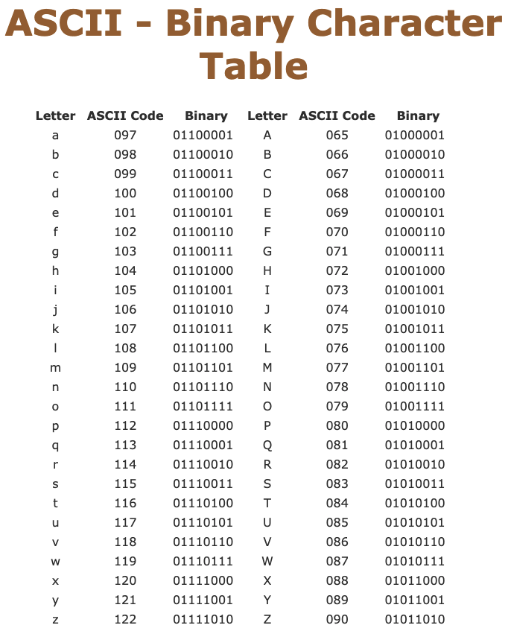
Using the ASCII table,
help me to decode this
(00100000 = SPACE)
01001001 00100000 01101100 01101001 01101011 01100101 00100000 01001101 01100011 01000100
For more help, please visit www.exampaperspractice.co.uk

Slide 94
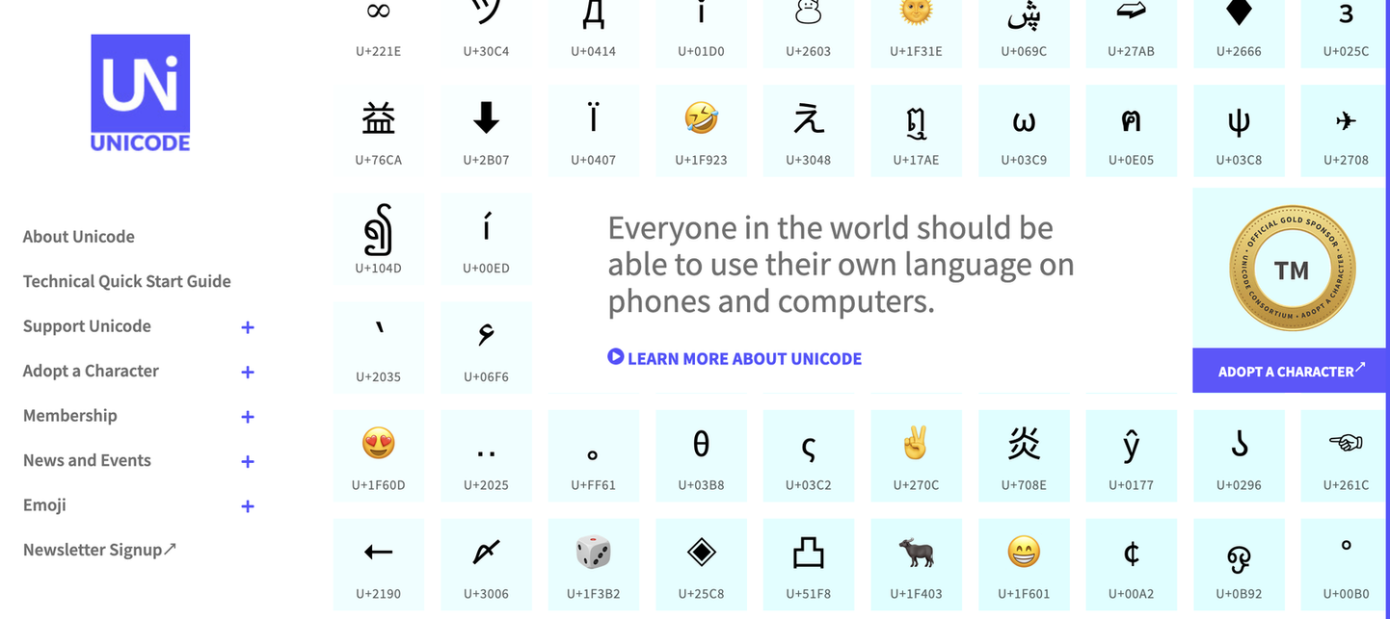
UNICODE
    COMPUTERS BEGAN TO BE PROGRAMMED USING UNICODE TO REPRESENT TEXT.
    UNICODE USES 16-BITS TO REPRESENT THE CHARACTERS IN ITS SET, WHICH ENABLES OVER 65000 CHARACTERS.
For more help, please visit www.exampaperspractice.co.uk

Slide 95

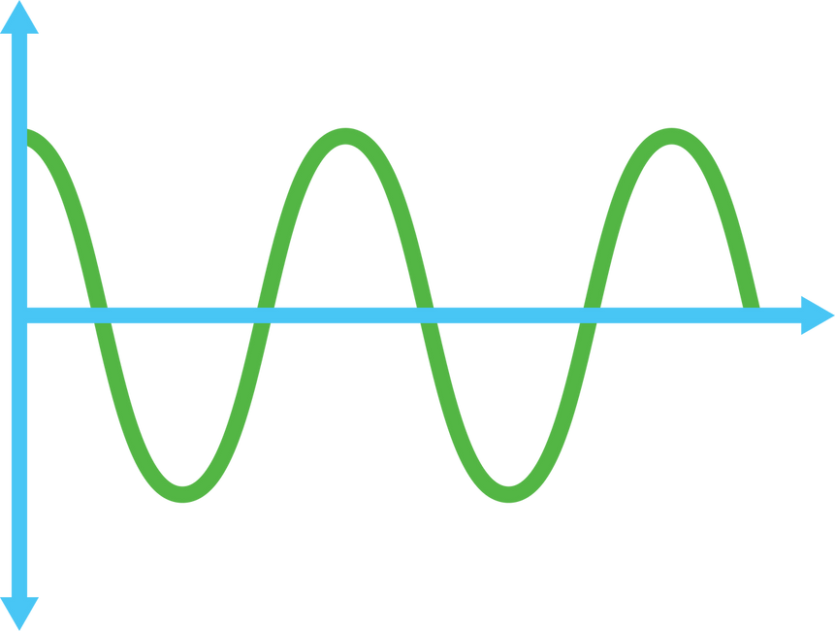
SOUND REPRESENTATION
    Sound can also be represented by binary.
    For a computer to process sound, the analog signal input must be converted into a digital format.
    A microphone captures the sound, and software converts the analog signal to digital.
    This digital recording is called a sample.
For more help, please visit www.exampaperspractice.co.uk

Slide 96




SOUND REPRESENTATION
HOW IS SAMPLING USED TO RECORD A SOUND CLIP
    The amplitude of the sound wave is measured at specific time intervals, providing an approximate representation of the sound wave.
    Each sample is then encoded as a series of binary digits.
Low Frequency Wave
High Frequency Wave
For more help, please visit www.exampaperspractice.co.uk

Slide 97

SOUND REPRESENTATION
Sampling resolution = 4
Sampling resolution = 3
16
8
15
14
7
13
12
6
11
10
amplitude
5
amplitude
9
8
4
7
3
6
5
2
4
3
1
2
1
1
2
3
4
5
6
7
8
9
10
1
2
3
4
5
6
7
8
9
10
time
time
DEFINITION:
SAMPLING RESOLUTION: THE NUMBER OF BITS USED TO REPRESENT SOUND AMPLITUDE IN DIGITAL SOUND RECORDING, ALSO KNOWN AS BIT DEPTH
For more help, please visit www.exampaperspractice.co.uk

Slide 98
SOUND REPRESENTATION
    Recording software can take multiple samples every second. This is measured in Hertz (Hz), where 1 Hz equals one sample per second.
DEFINITION:
SAMPLE RATE: THE NUMBER OF SOUND SAMPLES TAKEN PER SECOND.
For more help, please visit www.exampaperspractice.co.uk

Slide 99
SOUND REPRESENTATION
What are the Pros and Cons of using a higher sampling
rate or larger resolution
Benefits
Drawbacks
Enhanced sound quality
Bigger file size
Less sound distortion
Need more time to download / upload music
Greater dynamic range
For more help, please visit www.exampaperspractice.co.uk

Slide 100
IMAGE REPRESENTATION
    A bitmap essentially represents a collection of bits that, when displayed on a monitor, forms a specific image.
    An image consists of a grid of pixels arranged in two dimensions.
    Each pixel is stored in a computer as a sequence of binary numbers.
For more help, please visit www.exampaperspractice.co.uk

Slide 101

IMAGE REPRESENTATION
    A BLACK AND WHITE IMAGE ONLY REQUIRES 1 BIT PER PIXEL, THIS MEANS THAT EACH PIXEL CAN BE ONE OF TWO COLOURS, CORRESPONDING TO EITHER 1 OR 0.
0
0
1
1
For more help, please visit www.exampaperspractice.co.uk

Slide 102
IMAGE REPRESENTATION
    IF EACH PIXEL IS REPRESENTED BY TWO BITS, THEN EACH PIXEL CAN BE ONE OF FOUR COLOURS (00,01,10,11)
00
01
10
11
For more help, please visit www.exampaperspractice.co.uk

Slide 103
IMAGE REPRESENTATION
    IF EACH PIXEL IS REPRESENTED BY THREE BITS, THEN EACH PIXEL CAN BE ONE OF EIGHT COLOURS (000,001,010,011,100,101,110,111)
000
001
010
011
100
101
110
111
DEFINITION:
COLOUR DEPTH: THE NUMBER OF BITS USED TO REPRESENT EACH COLOUR
IS CALLED THE COLOUR DEPTH.
For more help, please visit www.exampaperspractice.co.uk

Slide 104
IMAGE REPRESENTATION
ONE BIT - 2 COLOUR (0,1)
TWO BIT - 4 COLOUR (00,01,10,11)
THREE BIT - 8 COLOUR (000,001,010,011,100,101,110,111)
EIGHT BIT - ?
TOTAL NUMBER OF COLOURS: 2 ^(NUMBER OF BITS)
MOST MODERN COMPUTERS HAVE A 24 BIT COLOUR DEPTHS,
WHICH MEANS OVER 16MILLION DIFFERENT COLOURS CAN BE USED.
For more help, please visit www.exampaperspractice.co.uk

Slide 105
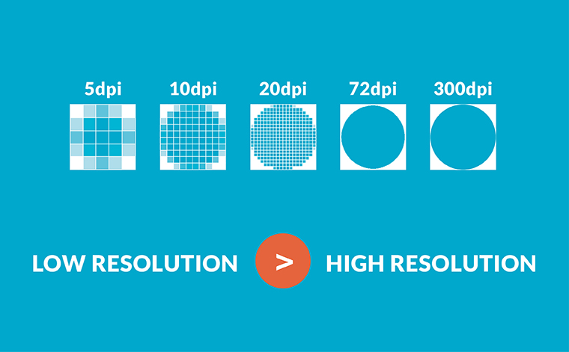
IMAGE REPRESENTATION
DEFINITION:
IMAGE RESOLUTION: THE NUMBER OF PIXELS THAT MAKE UP AN IMAGE/
PHOTOGRAPHS WITH A LOWER RESOLUTION HAVE LESS DETAIL THAN THOSE
WITH A HIGHER RESOLUTION.
For more help, please visit www.exampaperspractice.co.uk

Slide 106


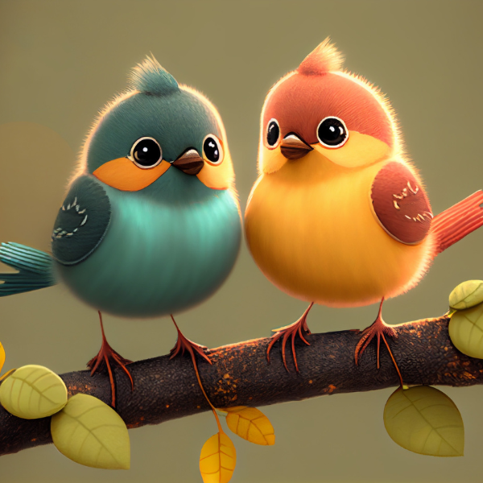
IMAGE REPRESENTATION
100x100
600x600
For more help, please visit www.exampaperspractice.co.uk

Slide 107
IMAGE REPRESENTATION
What are the Cons of using a higher resolution image
    Increase in file size (this occurs when the number of pixel increases.
    Greater the size, the longer it is needed to download the image.
    A certain amount of reduction in resolution of an image is possible before the loss of quality become noticeable/
For more help, please visit www.exampaperspractice.co.uk

Slide 108










Chapter 1.7
Measurement of Data Storage and Calculation of file size
For more help, please visit www.exampaperspractice.co.uk

Slide 109
Measurement of Data Storage
    A bit is the basic unit of all computing memory storage terms and is either 1 or 0.
    The byte is the smallest unit of memory in a computer.
    8 bits = 1 byte
    4 bits = 1 nibble
For more help, please visit www.exampaperspractice.co.uk

Slide 110
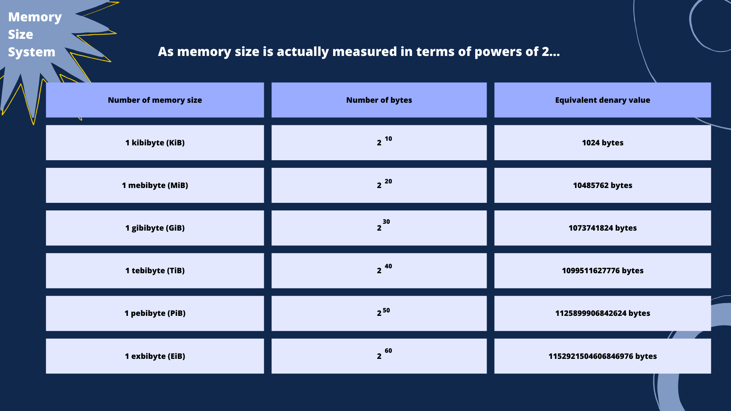
For more help, please visit www.exampaperspractice.co.uk

Slide 111

Memory
Size
System
Converting Bytes into KiB, MiB and GiB
68719476736 Bytes
=
68719476736 Bytes / 1024
= 67108864 KiB
=
67108864 KiB / 1024
= 65536 MiB
=
65536 MiB / 1024
= 64 GiB
For more help, please visit www.exampaperspractice.co.uk

Slide 112
Memory
Size
System
Converting Gib, Mib, Kib into bytes
64 GiB
=
64 x 1024
= 65536 MiB
=
65536 x 1024
= 67108864 KiB
=
67108864 x 1024
= 68719476736 Bytes
For more help, please visit www.exampaperspractice.co.uk

Slide 113
DIY
Convert the size of GTA-V to bytes
72 GiB
=
72 x 1024
= 73728 MiB
=
65536 x 1024
= 75497472 KiB
=
75497472 x 1024
= 77309411328 Bytes
For more help, please visit www.exampaperspractice.co.uk

Slide 114
Calculation
of file
size
Image
Audio
For more help, please visit www.exampaperspractice.co.uk

Slide 115
Calculation
of file
size - Image
Image Resolution - The number of pixels that make up an image.
The higher the image resolution, the higher the quality of the image.
For more help, please visit www.exampaperspractice.co.uk

Slide 116
Calculation
of file
size - Image
Formula
image resolution (pixels) x colour depths (bits)
For more help, please visit www.exampaperspractice.co.uk

Slide 117
Example 1
Calculation
of file
size - Image
2px
00
01
2px
10
11
Total pixels = 2 x 2 = 4
Colour depth = 2
Calculation = (2x2) x 2
= 8 bits = 1 byte
For more help, please visit www.exampaperspractice.co.uk

Slide 118
Example 2
Calculation
of file
size - Image
Formula : image resolution (pixels) x colour depths (bits)
Question:
Image Resolution = 1024 x 1080
Colour depth = 32
Calculate the size of this image in Bytes.
Workings:
1024 x 1080 = 1105920 pixels
1105920 x 32 = 35389440 bits
Answer in byte: 35389440/8 = 4423680 bytes
For more help, please visit www.exampaperspractice.co.uk

Slide 119

Example 2
Calculation
of file
size - Image
Question:
Image Resolution = 1024 x 1080
Colour depth = 32
Calculate the size of this image in Bytes. How many photograph of this size would fit onto a memory stick of 64Gib.
Each image = 4423680 bytes
First convert 64 Gib into bytes:
64 x 1024 = 65536 MiB
65536 x 1024 = 67108864 KiB
67108864 x 1024 = 68719476736 bytes
For more help, please visit www.exampaperspractice.co.uk

Slide 120
Example 2
Calculation
of file
size - Image
Question:
Image Resolution = 1024 x 1080
Colour depth = 32
Calculate the size of this image in Bytes. How many photograph of this size would fit onto a memory stick of 64Gib.
Each image = 4423680 bytes
First convert 64 Gib into bytes = 68719476736 bytes
68719476736/4423680 = 15534 photos.
For more help, please visit www.exampaperspractice.co.uk

Slide 121





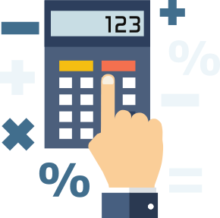



DIY
Question:
Image Resolution = 2048 x 2048
Colour depth = 16
Calculate the size of this image in Bytes.
For more help, please visit www.exampaperspractice.co.uk

Slide 122
DANSWER
Question:
Image Resolution = 2048 x 2048
Colour depth = 16
Calculate the size of this image in Bytes.
Answer:
2048 x 2048 x 16 = 67108864 bits
= 67108864/8
= 8388608 bytes
For more help, please visit www.exampaperspractice.co.uk

Slide 123
DIY
Question:
Image Resolution = 2048 x 2048
Colour depth = 16
Calculate the size of this image in Bytes (Answer: 8388608 bytes).
What is the size of the image in MiB.

Slide 124
ANSWER
Question:
Image Resolution = 2048 x 2048
Colour depth = 16
Calculate the size of this image in Bytes (Answer: 8388608 bytes).
What is the size of the image in MiB.
8388608 / 1024 = 8192 KiB
8192 / 1024 = 8 MiB
For more help, please visit www.exampaperspractice.co.uk

Slide 125
Formula
Calculation
of file
size - Sound
Sample Rate (in Hz) x Sample Resolution (in bits) x length of sample (in seconds)
For more help, please visit www.exampaperspractice.co.uk

Slide 126
Calculation
of file
size - Sound
Mono Sound vs Stereo Sound
Comparison
For more help, please visit www.exampaperspractice.co.uk

Slide 127
Example 1 - Mono Sound
Calculation
of file
size - Sound
Question:
Sample Rate: 44100
Sample Resolution: 8 bits
Length of the music: 20 seconds
Calculate the size of the audio in KiB.
44100 x 8 x 20 = 7056000 bits
7056000/8 = 882000 bytes
882000 / 1024 = 861.328 KiB

Slide 128
Example 1 - Stereo Sound
Calculation
of file
size - Sound
An audio CD has a sample rate of 44100 and a sample resolution of 16 bits. The music being sampled uses two channels to allow for stereo recording. Calculate the file size for a 60-minute recording.
44100 x 16 x 3600 = 2540160000 bits
2540160000 x 2 = 5080320000 bits
5080320000 / 8 = 635040000 bytes
635040000 / 1024 = 620156.25 KiB
620156.25 / 1024 = 605.62 MiB
For more help, please visit www.exampaperspractice.co.uk

Slide 129
DIY
An audio CD has a sample rate of 44100 and a sample resolution of 8 bits. The music being sampled uses two channels to allow for stereo recording. Calculate the file size for a 25-minute recording.
For more help, please visit www.exampaperspractice.co.uk

Slide 130
DIY
An audio CD has a sample rate of 44100 and a sample resolution of 8 bits. The music being sampled uses two channels to allow for stereo recording. Calculate the file size for a 25-minute recording in MiB.
44100 x 8 x 1500 = 529200000 bits
529200000 x 2 = 1058400000 bits
1058400000 / 8 = 132300000 bytes
132300000 / 1024 = 129199.218 KiB
129199.218 / 1024 = 126.17 MiB
For more help, please visit www.exampaperspractice.co.uk

Slide 131
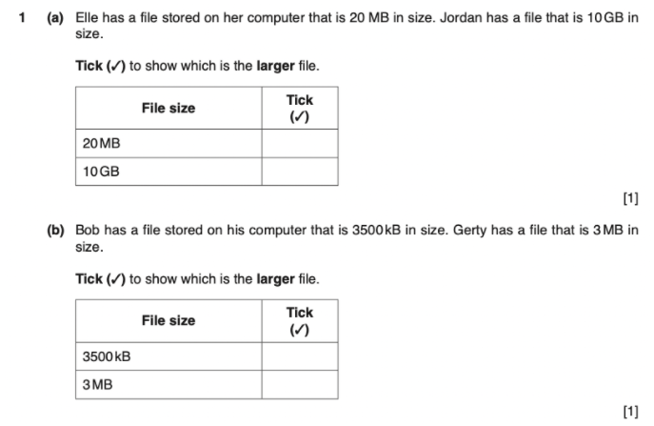
PAST YEAR QUESTION
For more help, please visit www.exampaperspractice.co.uk

Slide 132
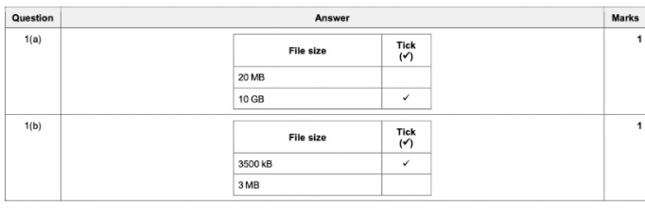
ANSWER
For more help, please visit www.exampaperspractice.co.uk

Slide 133




DATA
COMPRESSION
For more help, please visit www.exampaperspractice.co.uk

Slide 134


DATA COMPRESSION
For more help, please visit www.exampaperspractice.co.uk

Slide 135
DATA COMPRESSION
For more help, please visit www.exampaperspractice.co.uk

Slide 136
    FILE SIZE OF IMAGES AND SOUND CAN BE VERY LARGE.
    THEREFORE, DATA COMPRESSION IS NEEDED TO REDUCE THE SIZE OF A FILE.
For more help, please visit www.exampaperspractice.co.uk

Slide 137
WHAT ARE SOME BENEFITS OF
REDUCING THE FILE SIZE?
For more help, please visit www.exampaperspractice.co.uk

Slide 138
REDUCE
STREAMING TIME
REDUCE
COST
SAVE STORAGE SPACE
REDUCE
TIME TAKEN TO UPLOAD AND DOWNLOAD MEDIA
For more help, please visit www.exampaperspractice.co.uk

Slide 139
LOSSY
FILE
COMPRESSION
LOSSLESS
FILE
COMPRESSION
For more help, please visit www.exampaperspractice.co.uk

Slide 140
LOSSY FILE
COMPRESSION
    FILE COMPRESSION ALGORITHM ELIMINATES UNNECESSARY DATAS FROM THE FILE.
    ORIGINAL FILE CANNOT BE RECONSTRUCTED ONCE IT HAS BEEN COMPRESSED.
    IMAGE - REDUCE THE RESOLUTION // COLOUR DEPTH
    SOUND - REDUCE THE SAMPLING RATE // SAMPLING RESOLUTION
    SOME LOSSY FILE COMPRESSION ALGORITHMS ARE:
MPEG-3
MPEG-4
JPEG
For more help, please visit www.exampaperspractice.co.uk

Slide 141
LOSSY FILE
COMPRESSION
A COMPRESSION TECHNOLOGY THAT REDUCES THE SIZE OF A NORMAL MUSIC FILE BY ABOUT 90%.
MPEG-3
    REMOVE SOUNDS OUTSIDE THE HUMAN EAR RANGE
    ELIMINATE THE SOFTER SOUND - PERCEPTUAL MUSIC SHAPING
For more help, please visit www.exampaperspractice.co.uk

Slide 142
LOSSY FILE
COMPRESSION
ALLOWS STORAGE OF MULTIMEDIA FILES RATHER THAN JUST SOUND.
MPEG-4
MOVIES CAN BE STREAMED USING THE MP4 FORMAT WITHOUT LOSING ANY REAL DISCERNIBLE QUALITY
For more help, please visit www.exampaperspractice.co.uk

Slide 143
LOSSY FILE
COMPRESSION
A LOSSY COMPRESSION ALGORITHM USED FOR BITMAP IMAGES. ORIGINAL FILE CAN NO LONGER BE CONSTRUCTED.
JPEG
REMOVE COLOUR SHADES (HUMAN CAN'T NOTICE THEM)
For more help, please visit www.exampaperspractice.co.uk

Slide 144
DATA
COMPRESSION
    ALL THE DATA FROM THE ORIGINAL UNCOMPRESSED FILE CAN BE RECONSTRUCTED
    THIS IS IMPORTANT FOR FILES WHERE LOSS OF DATA WOULD BE DISASTROUS (COMPLEX SPREADSHEET).
    LOSSLESS FILE COMPRESSION IS DESIGNED SO THAT NONE OF THE ORIGNAL DETAIL FROM THE FILE IS LOST.
LOSSLESS
FILE
COMPRESSION
For more help, please visit www.exampaperspractice.co.uk

Slide 145
LOSSLESS FILE
COMPRESSION
    CAN BE USED FOR LOSSLESS COMPRESSION OF A NUMBER OF DIFFERENT FILE FORMATS.
RUN-LENGTH
ENCODING
2. IT REDUCES THE SIZE OF A STRING OF ADJACENT, IDENTICAL DATA.
3. A REPEATED STRING IS ENCODED INTO TWO VALUES.
NUMBER OF IDENTICAL DATA
DATA ITEM
For more help, please visit www.exampaperspractice.co.uk

Slide 146
LOSSLESS FILE
COMPRESSION
RUN-LENGTH
ENCODING
IN
ACTION
s | s | s | s | r | r | r | r | k | k | k | j | j | j | j | j
16 bytes
For more help, please visit www.exampaperspractice.co.uk

Slide 147
LOSSLESS FILE
COMPRESSION
Does not work well when there is
no repeated data!
RUN-LENGTH
ENCODING
IN
ACTION
s | s | s | s | r | r | r | r | k | k | k | j | j | j | j | j
4 | S | 4 | R | 3 | k | 5 | j
Each digit - 1 byte
Total size = 8 bytes (50% reduction in size)
For more help, please visit www.exampaperspractice.co.uk

Slide 148


LOSSLESS FILE
COMPRESSION
A compression method that encodes repeated byte values by specifying their count and value. Eg. It works well with a bitmap file.
Before RLE
10101101 10101101 10101101 10101101
10111101 10111101 10111101 10111101
10101101 | 10101101 | 10101101 | 10101101
10111101 | 10111101 | 10111101 | 10111101
10101100 | 10101100 | 10101100 | 10101100
10101100 10101100 10101100 10101100
After RLE
10101101 00000100 (4)
10111101 00000100 (4)
10101100 00000100 (4)
For more help, please visit www.exampaperspractice.co.uk

Slide 149
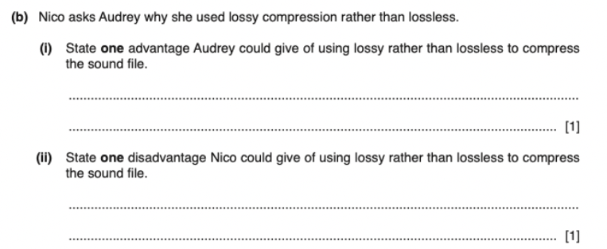
PAST YEAR QUESTION
For more help, please visit www.exampaperspractice.co.uk

Slide 150
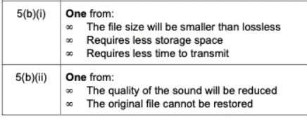
ANSWER
For more help, please visit www.exampaperspractice.co.uk

Slide 151
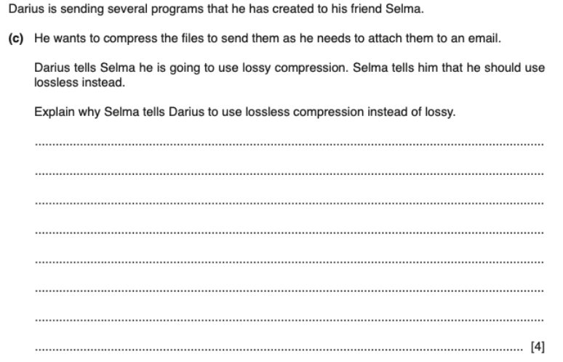
PAST YEAR QUESTION
For more help, please visit www.exampaperspractice.co.uk

Slide 152

ANSWER
For more help, please visit www.exampaperspractice.co.uk

