Slide 1


Cambridge IGCSE Computer Science 0478/0984 - Revision Notes
Chapter 6 - Automated System (A.I.)
This study guide has been expertly compiled and edited by successful former teachers of Computer Science and highly experienced examiners and is suitable for students who are taking 0478 (9-1) IGCSE, the 0984 (A*-G) IGCSE, and the 2210 O Level for examination in 2023 onwards. It could be used as lesson starters, or supplied to students for independent use.
For more help, please visit www.exampaperspractice.co.uk

Slide 2
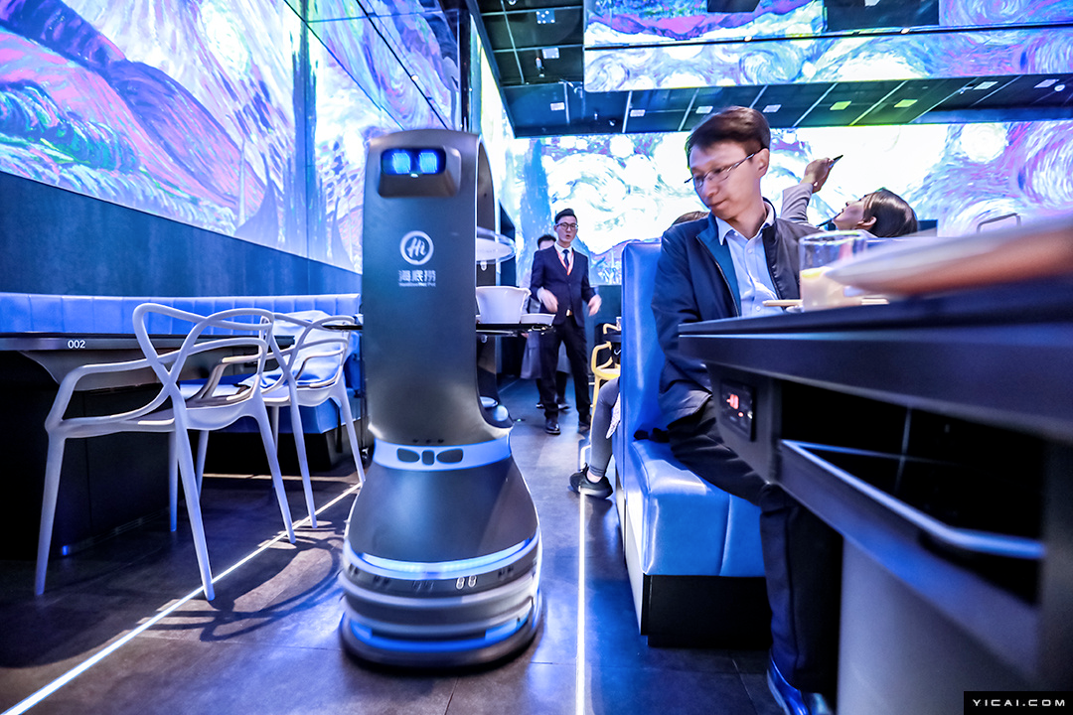
Automated
System

Slide 3
Definition
An automated system comprising both software and hardware that operates autonomously without human intervention.
For more help, please visit www.exampaperspractice.co.uk

Slide 4



The hardware that are need in an automated system are ...
For more help, please visit www.exampaperspractice.co.uk

Slide 5
The hardware that are need in an automated system are ...
A sensor is an input device that gathers data from its surroundings and transmits this information to a microprocessor or computer. If the data is in analogue form, it is initially converted into digital format using an analogue-to-digital converter (ADC).
For more help, please visit www.exampaperspractice.co.uk

Slide 6
The hardware that are need in an automated system are ...
A sensor is an input device that gathers data from its surroundings and transmits this information to a microprocessor or computer. If the data is in analogue form, it is initially converted into digital format using an analogue-to-digital converter (ADC).
A Microprocessor - The microprocessor processes inputs received from sensors (e.g., checking if input values exceed preset thresholds). It may send instructions to other components such as actuators as needed.
For more help, please visit www.exampaperspractice.co.uk

Slide 7
The hardware that are need in an automated system are ...
A sensor is an input device that gathers data from its surroundings and transmits this information to a microprocessor or computer. If the data is in analogue form, it is initially converted into digital format using an analogue-to-digital converter (ADC).
A Microprocessor - The microprocessor processes inputs received from sensors (e.g., checking if input values exceed preset thresholds). It may send instructions to other components such as actuators as needed.
Actuator - Converts electrical signals, typically sent by a microprocessor, into physical outputs such as movements
(e.g., activating a valve, rotating a steering wheel).
For more help, please visit www.exampaperspractice.co.uk

Slide 8
Agriculture
Weather
transport
Gaming
Application of automated system in the real world
Industry
lighting
Science
For more help, please visit www.exampaperspractice.co.uk

Slide 9

transport
Descriptions:
Autonomous cars utilize sensors, cameras, actuators, and microprocessors, along with sophisticated algorithms, to safely perform actions.
Sensors like radar and ultrasonics, along with cameras, enable the vehicle's control systems to sense road conditions dynamically, acting as the car's sensory systems.
Microprocessors analyze data from these sensors and cameras, then send commands to actuators to execute physical actions such as changing gears, applying brakes, and steering the vehicle.
For more help, please visit www.exampaperspractice.co.uk

Slide 10
transport
Advantages
disAdvantages
    Enhanced safety as human errors are minimized, leading to fewer accidents.
    Improved environmental impact with vehicles operating more efficiently.
    Initial setup costs are prohibitively high.
    Persistent concerns about potential hacking into the vehicle's control systems.
For more help, please visit www.exampaperspractice.co.uk

Slide 11


agriculture
Descriptions:
Automated harvesting of crops involves sensors detecting optimal harvesting times based on factors like weather conditions.
Microprocessors determine precise harvesting locations, and actuators are employed to extract goods from the ground.
For more help, please visit www.exampaperspractice.co.uk

Slide 12
agriculture
Advantage
DisAdvantage
Accurate delivery of chemicals (pesticides and fertilizers) is crucial for the success of farming and crop yield optimization.
Automation can lead to reduced job opportunities as machines replace human labor, and the initial investment in robots can be costly.
For more help, please visit www.exampaperspractice.co.uk

Slide 13

weather
Automated weather monitoring at airports involves sensors detecting adverse conditions like wind, rain, fog, or snow. Microprocessors analyze this data to issue appropriate warnings, while actuators can trigger emergency systems such as lighting as needed.
For more help, please visit www.exampaperspractice.co.uk

Slide 14
weather
advantages
disadvantages
Information about
the overhead
weather conditions
is fed constantly to
air traffic controllers.
Predictions can
sometimes be incorrect, for example if snow
is forecast and does
not arrive.
For more help, please visit www.exampaperspractice.co.uk

Slide 15


gaming
Artificial intelligence is integrated into computer games as adversaries. Sensors within gaming environments allow characters to interact with human players, microprocessors decide game outcomes and choices, and actuators in controllers provide haptic feedback, such as vibrations.
For more help, please visit www.exampaperspractice.co.uk

Slide 16
gaming
advantages
disadvantages
Computer-generated opponents enhance gaming challenges by simulating human-like behavior.
Reduces real-world social interactions and can lead to an isolated or fictionalized existence.
For more help, please visit www.exampaperspractice.co.uk

Slide 17


lighting
Automated lighting control systems in homes adjust based on detected behaviors: sensors monitor ambient light levels, microprocessors execute routines tailored to human preferences, and actuators operate household devices accordingly.
For more help, please visit www.exampaperspractice.co.uk

Slide 18
lighting
advantage
disadvantage
Implementing such systems can lead to complexity compared to traditional switches, and the technology involved, including light bulbs, can be costly to maintain over time.
The system can learn to respond to environmental cues, such as activating lights based on specific conditions being met.
For more help, please visit www.exampaperspractice.co.uk

Slide 19


science
Automated laboratory experiments can run continuously for many days. Sensors monitor environmental conditions, microprocessors adjust experimental settings accordingly, and actuators activate heaters, coolers, or water supplies as needed.
For more help, please visit www.exampaperspractice.co.uk

Slide 20
science
advantage
disadvantage
The automated setup allows for significantly more repetitions of experiments and readings of data compared to manual testing by humans.
If a malfunction occurs, it may take several hours before it is discovered, potentially compromising the integrity of the collected results.
For more help, please visit www.exampaperspractice.co.uk

Slide 21
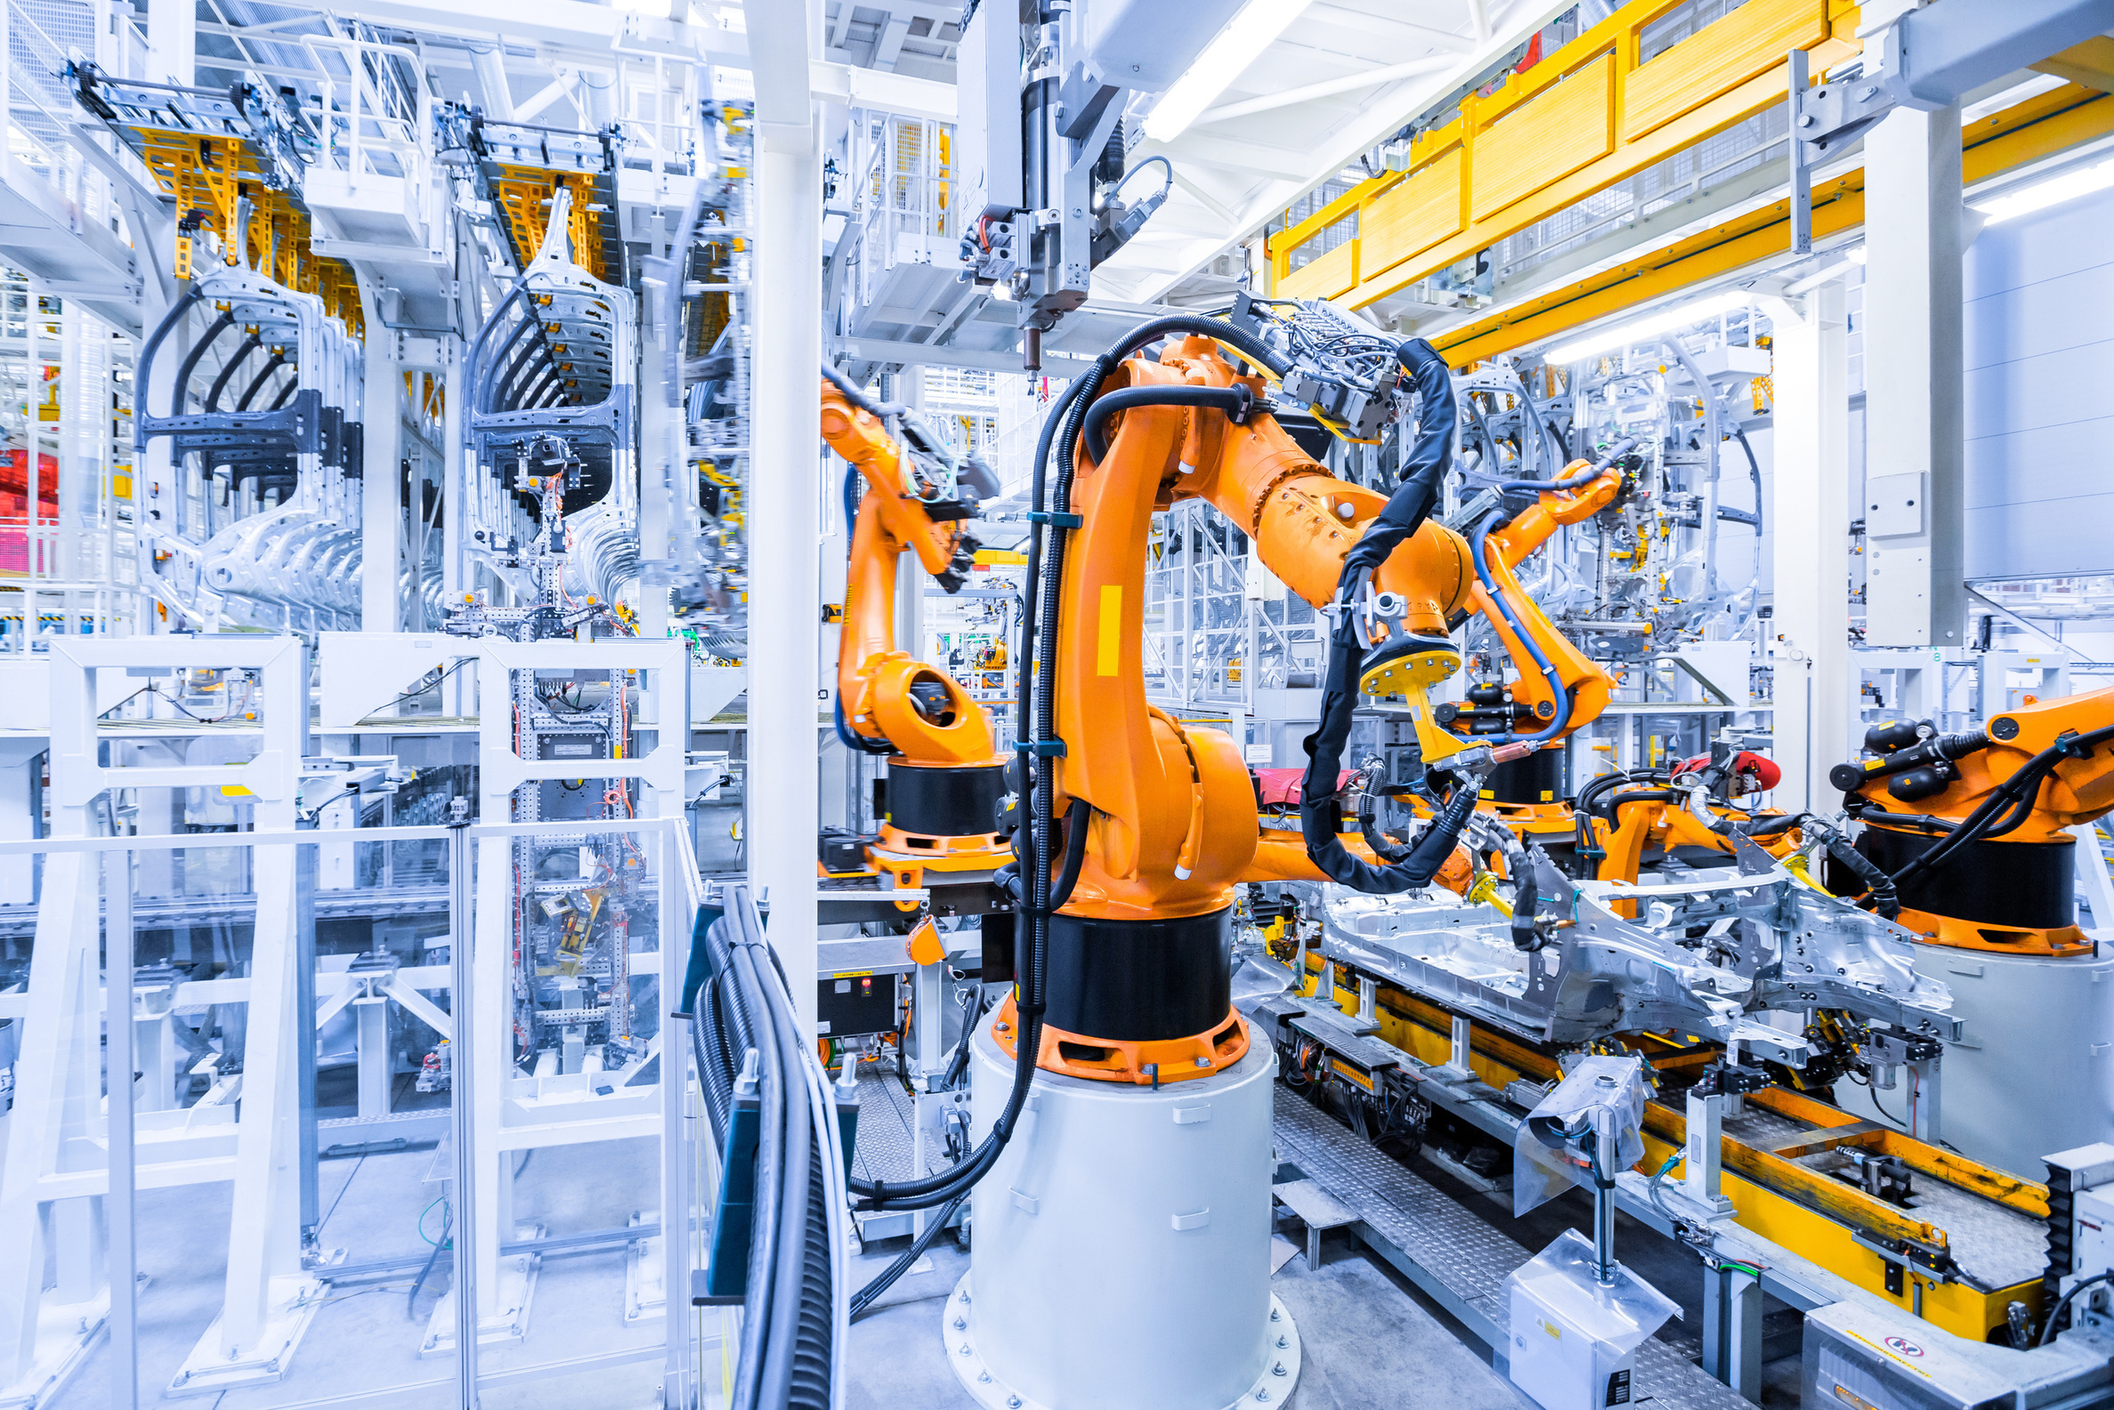
6.2
Robotics

Slide 22

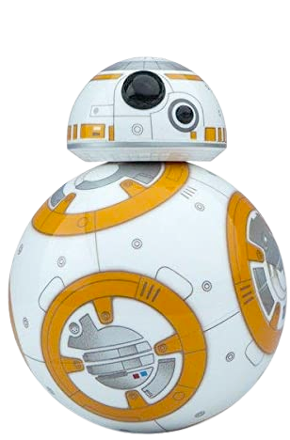
Robot
"Robota" in Czech
meaning: Forced labour
For more help, please visit www.exampaperspractice.co.uk

Slide 23
Definition
The term "robotic" refers to the field involving the design, construction, and operation of robots aimed at enhancing both our professional and personal lives.
For more help, please visit www.exampaperspractice.co.uk

Slide 24
Characteristics of a robot
    It has electrical components
  A robot should integrate sensors, a microprocessor, and actuators.
  Sensors are responsible for detecting the surroundings.
  The microprocessor processes the input data received from sensors.
  Actuators execute physical actions based on the processed data.
For more help, please visit www.exampaperspractice.co.uk

Slide 25
Characteristics of a robot
2. It has mechanical structures
  It should be a machine equipped with movable parts.
  For instance, robots can utilize components like wheels, cogs, pistons, gears, etc.
  These parts enable robots to perform various functions such as turning, twisting, moving backward/forward, gripping, or lifting.
For more help, please visit www.exampaperspractice.co.uk

Slide 26
Characteristics of a robot
3. It is programmable
  Robots are equipped with a brain known as a controller, which dictates actions to perform specific tasks.
  Controllers rely on input data provided by sensors.
  They are programmable, enabling robots to execute predefined tasks efficiently.
For more help, please visit www.exampaperspractice.co.uk

Slide 27

    It has electrical components
Based on the definition of a robot, is chat-bot a robot?
2. It has mechanical structures
3. It is programmable
For more help, please visit www.exampaperspractice.co.uk

Slide 28
    It has electrical components
No, because chat-bot does not have mechanical structure.
2. It has mechanical structures
3. It is programmable
For more help, please visit www.exampaperspractice.co.uk

Slide 29

Knowledge
Software robots, strictly speaking, do not possess physical components like sensors, actuators, or controllers, which are characteristic of hardware robots. Therefore, they differ significantly in their fundamental design and functionality.
For more help, please visit www.exampaperspractice.co.uk

Slide 30
Knowledge
    Independent robots operate autonomously, relying on internal programming and sensors. Examples include autonomous vehicles.
    Dependent robots require human operators to directly control them through interfaces like computers or control panels. Examples include remote-controlled drones.
For more help, please visit www.exampaperspractice.co.uk

Slide 31
Robotics are used in the following fields:
Agriculture
medicine
transport
domestic
industry
Entertainment
For more help, please visit www.exampaperspractice.co.uk

Slide 32

industry
Advantage(s):
Descriptions:
    Robots can operate in hazardous conditions that might endanger humans.
    Robots can work continuously, 24/7, without requiring breaks.
Robots are equipped with sensors to gather crucial environmental data and prevent errors. For instance, they can stop paint spraying if no car is present or halt operations when paint supplies are depleted.
Examples of tasks performed by robots include:
- Painting car bodies
- Welding car bodywork
- Manufacturing microchips
- Manufacturing electrical goods
- Automated warehouse operations
disAdvantage(s):
    Robots can contribute to higher unemployment in manual labor sectors.
    There is a risk of skill reduction when robots replace certain tasks.
For more help, please visit www.exampaperspractice.co.uk

Slide 33
transport
Descriptions:
Autonomous cars utilize sensors, cameras, actuators, and microprocessors, along with sophisticated algorithms, to safely perform their operations. Sensors like radar and ultrasonics, along with cameras, enable the car's control systems to monitor dynamic road conditions, serving as the car's sensory inputs.
Microprocessors analyze data from cameras and sensors, then send commands to actuators for physical actions such as changing gears, applying brakes, and steering the vehicle.
For more help, please visit www.exampaperspractice.co.uk

Slide 34
transport
Advantages
disAdvantages
    Enhanced safety as human errors are minimized, leading to fewer accidents.
    Improved environmental impact with vehicles operating more efficiently.
    Initial setup costs are prohibitively high.
    Persistent concerns about potential hacking into the vehicle's control systems.
For more help, please visit www.exampaperspractice.co.uk

Slide 35

agriculture
Descriptions:
Robotics can replace slow, repetitive tasks, allowing farmers to focus on improving production yields.
Areas where robotics can significantly contribute include:
1. Harvesting and picking: Robots can accurately and quickly harvest crops, ensuring only ripe fruits are picked.
2. Weed management: AI-powered robots can distinguish between weeds and crops, aiding in precise and targeted weed control.
3. Phenotyping: Robots observe plant physical characteristics to assess health and growth, aiding in crop management decisions.
4. Seed planting and fertilizer distribution: Drones and robots can autonomously plant seeds and distribute fertilizers efficiently.
5. Autonomous agricultural devices: Robots like grass mowers, weeding robots, seeding robots, and fertilizer sprayers operate autonomously, enhancing farm efficiency.
For more help, please visit www.exampaperspractice.co.uk

Slide 36
agriculture
Advantage
DisAdvantage
Accurate delivery of chemicals (pesticides and fertilizers) is crucial for the success of farming and crop yield optimization.
Automation can lead to reduced job opportunities as machines replace human labor, and the initial investment in robots can be costly.
For more help, please visit www.exampaperspractice.co.uk

Slide 37

medicine
Descriptions:
1. Surgical Precision: Robots enhance surgical procedures with greater precision, flexibility, and control.
2. Monitoring and Data Collection: They monitor vital life data and assist in research, including tissue engineering.
3. Prosthetics and Limb Replacement: Robots aid in the development and implementation of bionic prosthetics.
4. Training Simulations: They simulate medical environments and tasks for training healthcare professionals.
5. Blood Sample Collection: Robots can safely take blood samples:
- Less painful for patients by accurately finding suitable veins.
- Safer for medical staff, particularly when dealing with infectious diseases.
For more help, please visit www.exampaperspractice.co.uk

Slide 38
medicine
Advantage
DisAdvantage
surgery can take less time, which improves the chances of recovery for the patient
this technology is expensive and has to be tested extensively in research before it is used on humans
For more help, please visit www.exampaperspractice.co.uk

Slide 39

domestic
Descriptions:
Traditional household appliances such as vacuum cleaners and lawnmowers are being replaced by robotic counterparts.
Examples:
    Autonomous vacuum cleaner
    Autonomous grass cutter
    Personal assistant (eg. Alexa)
For more help, please visit www.exampaperspractice.co.uk

Slide 40
domestic
Advantage
DisAdvantage
robots can quickly learn the environment. they can be programmed to work at convenient times
this can encourage a more sedentary lifestyle.
For more help, please visit www.exampaperspractice.co.uk

Slide 41
entertainment
Descriptions:
In the entertainment industry, robots are increasingly employed in various capacities:
1. Entertainment Parks and Arenas/Venues: Theme parks utilize autonomous robots, often in costumes of cartoon characters, to interact with visitors. These robots enhance the theme park experience by safely engaging visitors with attractions and creating a more immersive environment.
2. Film and TV Industry: Robots play crucial roles in film and television production, particularly in camera control. They help maintain steady shots and automate focusing during dynamic scenes. For instance, in the movie "Gravity," robots were extensively used to operate cameras, props, and even simulate human movements in space to create realistic and captivating visuals.
For more help, please visit www.exampaperspractice.co.uk

Slide 42
entertainment
Advantage
disAdvantage
film can be presented in ways that a human would not be able to normally see due to robotic technology.
fewer job opportunities as humans are increasingly replace by machinery.
For more help, please visit www.exampaperspractice.co.uk

Slide 43


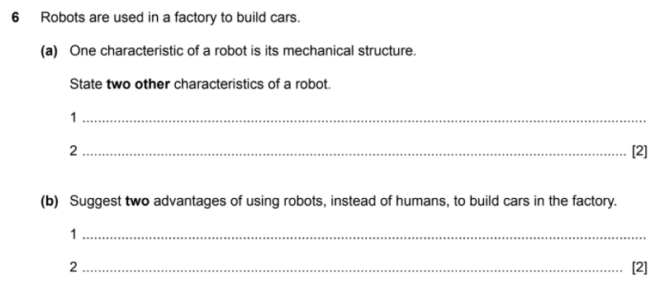
EXAM QUESTION
For more help, please visit www.exampaperspractice.co.uk

Slide 44
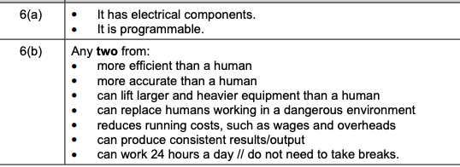
EXAM QUESTION
For more help, please visit www.exampaperspractice.co.uk

Slide 45

Chapter 6.3
Artificial
Intelligence
For more help, please visit www.exampaperspractice.co.uk

Slide 46


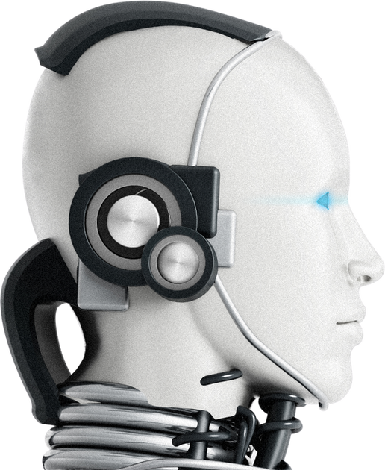
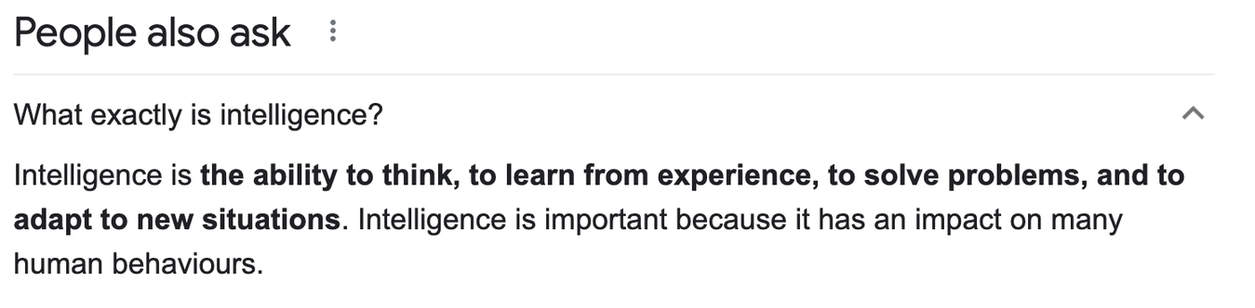
AI DEFINITION
A branch of computer science dealing with the simulation of INTELLIGENT human behaviour (reasoning, speech, sight) by a computer.
WHAT IS INTELLIGENCE?
For more help, please visit www.exampaperspractice.co.uk

Slide 47
ACTIVITY (5 MINUTES)
Work in pair, write down the thought process of how would you plan your class outing.
For more help, please visit www.exampaperspractice.co.uk

Slide 48


Okay, who is going with us.?
Okay, what's their hobbies?
Okay, what's their hobbies?
Where?..
to be continue
The thought process that you might have ...
For more help, please visit www.exampaperspractice.co.uk

Slide 49


Okay, who is going with us.?
Okay, what's their hobbies?
Okay, what's their hobbies?
Where?..
to be continue
When we are designing an ai system, we are essentially instilling our thought process onto a machine
For more help, please visit www.exampaperspractice.co.uk

Slide 50




How does AI reason?
For more help, please visit www.exampaperspractice.co.uk

Slide 51
Method 1: Draw a reasoned conclusion
based on given data
price (k$)
500
300
sqrt feet (M)
800
example: Predicting the price of a house using the sqrt metre attribute
For more help, please visit www.exampaperspractice.co.uk

Slide 52
Method 1: Draw a reasoned conclusion
based on given data
price (k$)
around here
500
300
sqrt feet (M)
800
We can predict the house price using insight from data points
For more help, please visit www.exampaperspractice.co.uk

Slide 53
Method 1: Draw a reasoned conclusion
based on given data
price (k$)
around here
500
300
sqrt feet (M)
800
out of syllabus: this method is known as linear regression in machine learning
For more help, please visit www.exampaperspractice.co.uk

Slide 54

Method 2: By carrying out a sequence of steps (asking some questions), the AI machine can learn, and next time it will know how to do the task more effectively and even apply it to a novel/new situation
conclusion:
Covid positive
does he cough?
close contact?
fever?
For more help, please visit www.exampaperspractice.co.uk

Slide 55
method 3: AI can quickly discern patterns and then make predictions by adapting to the new data
$50000
suspicious...
$500
example: fraud detection system based on spending habit
For more help, please visit www.exampaperspractice.co.uk

Slide 56
ARTIFICIAL
INTELLIGENCE
CATEGORY 2:
MACHINE LEARNING
CATEGORY 1:
EXPERT
SYSTEM
For more help, please visit www.exampaperspractice.co.uk

Slide 57
ARTIFICIAL
INTELLIGENCE
CATEGORY 2:
MACHINE LEARNING
CATEGORY 1:
EXPERT
SYSTEM
For more help, please visit www.exampaperspractice.co.uk

Slide 58



EXPERT SYSTEM
An expert system is an artificial intelligence application that utilizes knowledge and inference rules to solve complex problems or provide advice in a specific domain, mimicking the decision-making ability of a human expert.
For more help, please visit www.exampaperspractice.co.uk

Slide 59
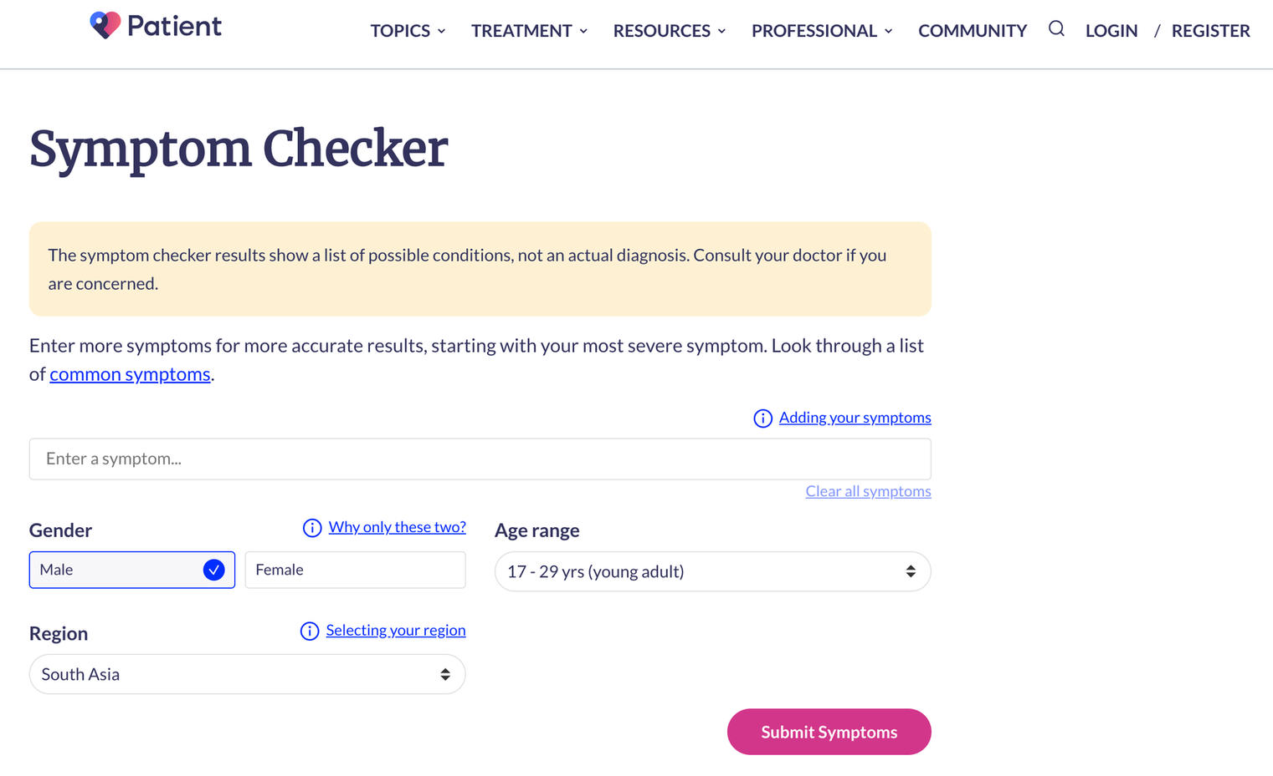
EXPERT SYSTEM
let us try out an expert system
For more help, please visit www.exampaperspractice.co.uk

Slide 60


STRUCTURE OF AN EXPERT SYSTEM
USER INTERFACE
USER INTERFACE
The user interface is the point of interaction between a human user and a computer system, facilitating input and output operations.
INTERACT
For more help, please visit www.exampaperspractice.co.uk

Slide 61
STRUCTURE OF AN EXPERT SYSTEM
USER INTERFACE
KNOWLEDGE BASE
The knowledge base stores the information, rules, and facts relevant to a specific domain that an expert system utilizes for problem-solving or decision-making.
INTERACT
For more help, please visit www.exampaperspractice.co.uk

Slide 62
STRUCTURE OF AN EXPERT SYSTEM
USER INTERFACE
KNOWLEDGE BASE
INTERACT
The rule base consists of a collection of rules, typically in the form of if-then statements, that define the behavior, decision-making process, or reasoning of an expert system.
RULE BASE
For more help, please visit www.exampaperspractice.co.uk

Slide 63
STRUCTURE OF AN EXPERT SYSTEM
USER INTERFACE
KNOWLEDGE BASE
INTERACT
INFERENCE BASE
For more help, please visit www.exampaperspractice.co.uk

Slide 64
STRUCTURE OF AN EXPERT SYSTEM
USER INTERFACE
KNOWLEDGE BASE
The inference engine is the component of an expert system that applies logical rules and algorithms to draw conclusions, make recommendations, or solve problems based on the knowledge in the system's knowledge base.
INTERACT
INFERENCE ENGINE
RULE BASE
For more help, please visit www.exampaperspractice.co.uk

Slide 65
STRUCTURE OF AN EXPERT SYSTEM
USER INTERFACE
EXPLANATION
SYSTEM
KNOWLEDGE BASE
types of conclusion given:
    suggested action to take
    accuracy of its prediction
INTERACT
INFERENCE ENGINE
RULE BASE
For more help, please visit www.exampaperspractice.co.uk

Slide 66
STRUCTURE OF AN EXPERT SYSTEM
USER INTERFACE
EXPLANATION
SYSTEM
KNOWLEDGE BASE
INTERACT
INFERENCE ENGINE
RULE BASE
For more help, please visit www.exampaperspractice.co.uk

Slide 67
EXAMPLE(1) OF AN EXPERT SYSTEM
MEDICAL DIAGNOSIS
USER INTERFACE
EXPLANATION
SYSTEM
KNOWLEDGE BASE
SUGGEST POSSIBLE DISEASE AND ACTION STEPS
LIBRARY OF SYMPTOM RELATIONS TO DISEASE
INTERACT
IF USER HAS MULTIPLE SYMPTOMS, SUGGEST DISEASE
INFERENCE ENGINE
RULE BASE
For more help, please visit www.exampaperspractice.co.uk

Slide 68
EXAMPLE(2) OF AN EXPERT SYSTEM
ROUTE SCHEDULING FOR DELIVERY SERVICE
USER INTERFACE
EXPLANATION
SYSTEM
KNOWLEDGE BASE
SUGGEST THE BEST ROUTE TO BE TAKEN
NUMBER OF ROUTES, PARCELS AND DELIVERY POINTS
INTERACT
IF TRAFFIC JAM, DON'T PICK THAT ROUTE
INFERENCE ENGINE
RULE BASE
For more help, please visit www.exampaperspractice.co.uk

Slide 69
EXAMPLE(3) OF AN EXPERT SYSTEM
DIAGNOSIS OF BREAST CANCER
USER INTERFACE
EXPLANATION
SYSTEM
KNOWLEDGE BASE
PREDICT PROBABILITY OF A PERSON GETTING BREAST CANCER
MAMMOGRAPHYS WITH ALL TYPES OF CANCERS / NORMAL MAMMOGRAPHY
INTERACT
IF HUGEWHITE SPOTS ARE OBSERVED, CATEGORISE AS CANCEL
INFERENCE ENGINE
RULE BASE
For more help, please visit www.exampaperspractice.co.uk

Slide 70
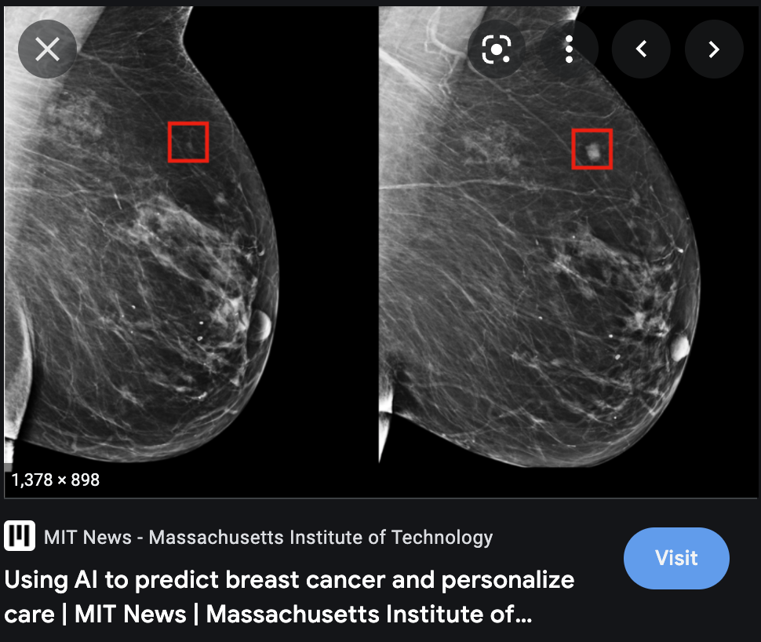
EXAMPLE(3) OF AN EXPERT SYSTEM
DIAGNOSIS OF BREAST CANCER
KNOWLEDGE BASE
MAMMOGRAPHYS WITH ALL TYPES OF CANCERS / NORMAL MAMMOGRAPHY
For more help, please visit www.exampaperspractice.co.uk

Slide 71
OTHER EXAMPLES OF AN EXPERT SYSTEM
    MINERAL PROSPECTING
    PLANT AND ANIMAL IDENTIFICATION
    FINANCIAL PLANNING
    CAR ENGINE FAULT SYSTEMS
    BANK LOAN APPROVAL SYSTEM
For more help, please visit www.exampaperspractice.co.uk

Slide 72
EXPERT SYSTEM
Advantages
1. HIGH LEVEL OF EXPERTISE
2. HIGH ACCURACY
3. CONSISTENT RESULT
4. HAVE THE ABILITY TO STORE VAST AMOUNTS OF IDEAS AND FACTS
5. THEY HAVE VERY FAST RESPONSE TIME
Disadvantages
1. SET UP AND MAINTENANCE COSTS ARE VERY HIGH
2. THEY ARE ONLY AS GOOD AS THE INFORMATION ENTERED INTO THE SYSTEM
For more help, please visit www.exampaperspractice.co.uk

Slide 73
ARTIFICIAL
INTELLIGENCE
CATEGORY 2:
MACHINE LEARNING
CATEGORY 1:
EXPERT
SYSTEM
For more help, please visit www.exampaperspractice.co.uk

Slide 74

MACHINE LEARNING
Machine learning is a branch of artificial intelligence that enables systems to automatically learn and improve from experience without being explicitly programmed.
For more help, please visit www.exampaperspractice.co.uk

Slide 75
MACHINE LEARNING
Algorithms undergo training and learn from previous experiences and examples, operating without the need for explicit programming, enabling them to predict outcomes for new, unseen data.
For more help, please visit www.exampaperspractice.co.uk

Slide 76

EXAMPLE (1)
SPAM FILTER
"CONGRATULATION, YOU HAVE WON 2 MILLIONS DOLLAR $$$ IN THE NATIONAL LOTTERY. SIGN UP AS OUR MEMBER NOW TO REDEEM YOUR PRIZE"
"HOW DO WE TEACH THE MACHINE THAT THIS EMAIL IS INDEED A SPAM EMAIL?"
For more help, please visit www.exampaperspractice.co.uk

Slide 77
PROCESS
A MACHINE LEARNING ALGORITHM COLLECTS DATA ABOUT EMAILS
For more help, please visit www.exampaperspractice.co.uk

Slide 78
PROCESS
"CONGRATULATION, YOU HAVE WON 2 MILLIONS DOLLAR $$$ IN THE NATIONAL LOTTERY. SIGN UP AS OUR MEMBER NOW TO REDEEM YOUR PRIZE"
A MACHINE LEARNING ALGORITHM COLLECTS DATA ABOUT EMAILS
CARRIES OUT A CLEANING PROCESS TO REMOVE STOP WORDS (THE, AN, A)
"CONGRATULATION, WON 2 MILLIONS DOLLAR $$$ NATIONAL LOTTERY SIGN UP OUR MEMBER NOW REDEEM PRIZE"
For more help, please visit www.exampaperspractice.co.uk

Slide 79
PROCESS
A MACHINE LEARNING ALGORITHM COLLECTS DATA ABOUT EMAILS
CARRIES OUT A CLEANING PROCESS TO REMOVE STOP WORDS (THE, AN, A)
CERTAIN WORDS/ PHRASES ARE FREQUENTLY USED IN EMAIL THAT COULD INDICATE THAT THE INCOMING EMAIL IS VERY LIKELY TO BE SPAM
(LOTTERY, EARN, FULL-REFUND).
For more help, please visit www.exampaperspractice.co.uk

Slide 80
PROCESS
THE MACHINE LEARNING MODEL IS BUILT AND A TRAINING DATA SET IS USED TO TRAIN THE MODEL AND MAKE IT USING PAST EMAILS KNOWN THE BE SPAM. ONCE IT IS EVALUATED, THE MODEL IS FINE-TUNED AND TESTED LIVE
A MACHINE LEARNING ALGORITHM COLLECTS DATA ABOUT EMAILS
CARRIES OUT A CLEANING PROCESS TO REMOVE STOP WORDS (THE, AN, A)
CERTAIN WORDS/ PHRASES ARE FREQUENTLY USED IN EMAIL THAT COULD INDICATE THAT THE INCOMING EMAIL IS VERY LIKELY TO BE SPAM
(LOTTERY, EARN, FULL-REFUND).
For more help, please visit www.exampaperspractice.co.uk

Slide 81

EXAMPLE (2)
AUTO TAG - PHOTOGRAPH
For more help, please visit www.exampaperspractice.co.uk

Slide 82
DIFFERENCE BETWEEN THE EXPERT SYSTEM AND MACHINE LEARNING
CATEGORY 1:
EXPERT
SYSTEM
CATEGORY 2:
MACHINE LEARNING
The primary distinction lies in the fact that expert systems rely on rule-based approaches, whereas modern machine learning (ML) employs statistical modeling of data. Expert systems utilize IF-THEN statements for inference, whereas ML systems map inputs to a model space.
For more help, please visit www.exampaperspractice.co.uk

